Slide 1
Computing as a utility?
SLA as Big Data?
András Pataricza with contributions of
Imre Kocsis¹, Ágnes Salánki¹,
Zsolt Kocsis²
¹Dept. of Measurement and Information Systems, BME
²IBM Hungary

Slide 2
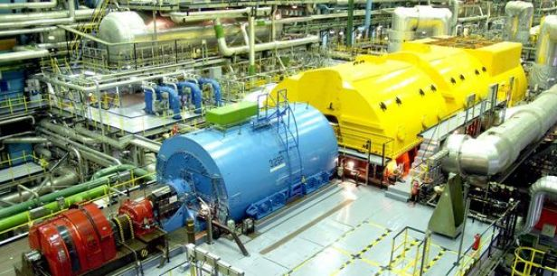
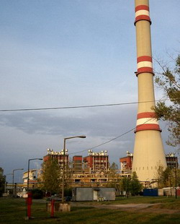
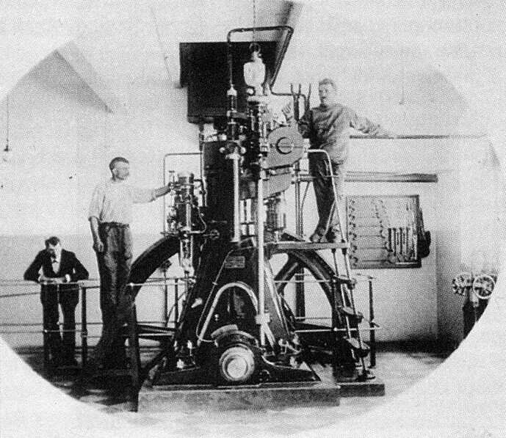
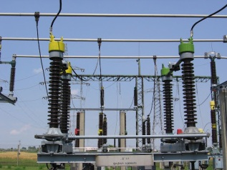




Cloud computing vs. electricity
Origins: do it yourself
Utility
Individual production
Capacity=Peak workload
Low utilization
Efficient production
Peak power station
Redundancy, control
Worlkloaqd mgmt,
Monitoring
Control
Cloud computing
Electric power → computing power
Power station → Server
Power line → Internet
Power distribution, control, protection, measurement
Interconnection
SLA

Slide 3
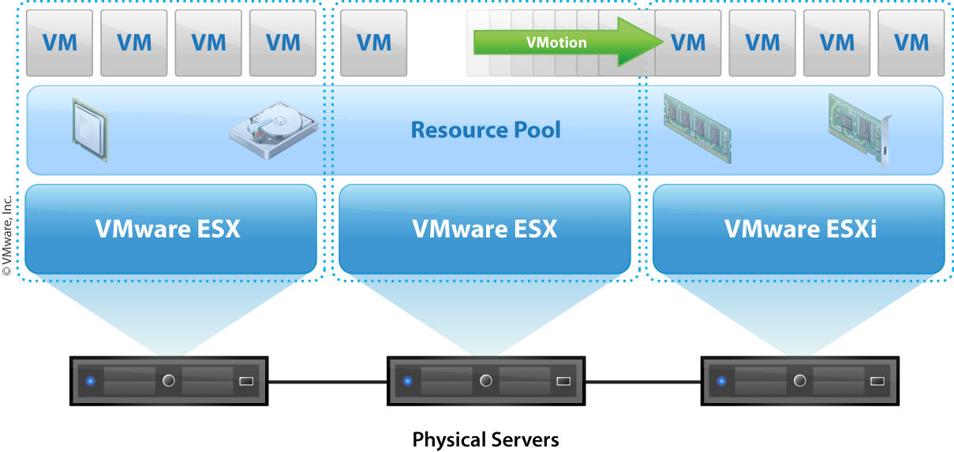
Virtualization

Slide 4
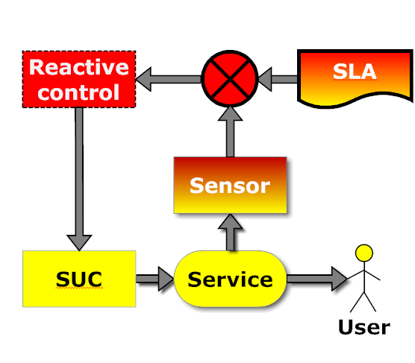
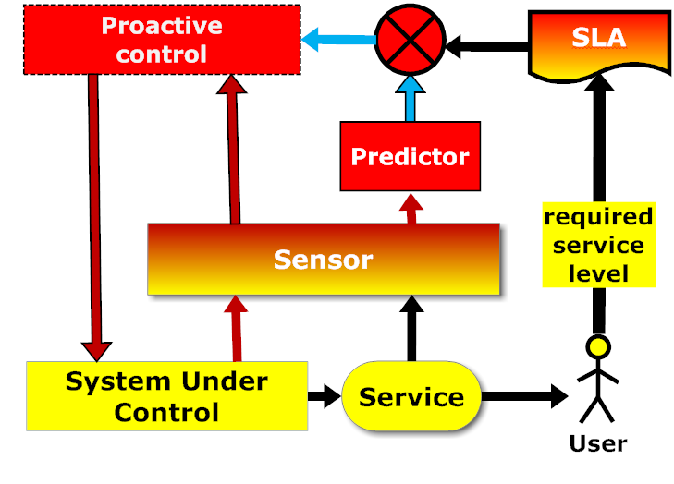

Reactivity vs. proactivity
Reactive control
  „acting in response to a situation rather than creating or controlling it:”
Proactive control
  „controlling a situation rather than just responding to it after it has happened:”

Slide 5
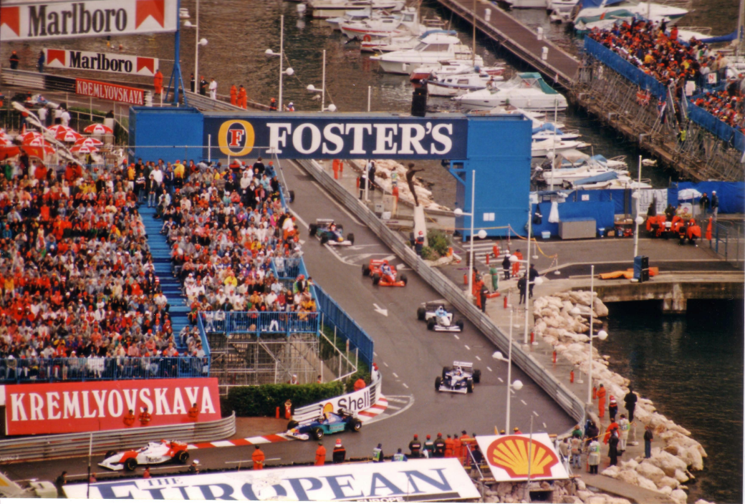

Standard infrastructure for demanding applications?
Power supply to an ER
COTS energy source replicated
→ economic efficiency
Warm backup
(diesel generator)
→ HA for critical processes
Monaco Grand Prix
COTS infrastructure
→ economic efficiency
Isolated + monitored high SLA
(barriers, road quality)
→ dependability

Slide 6
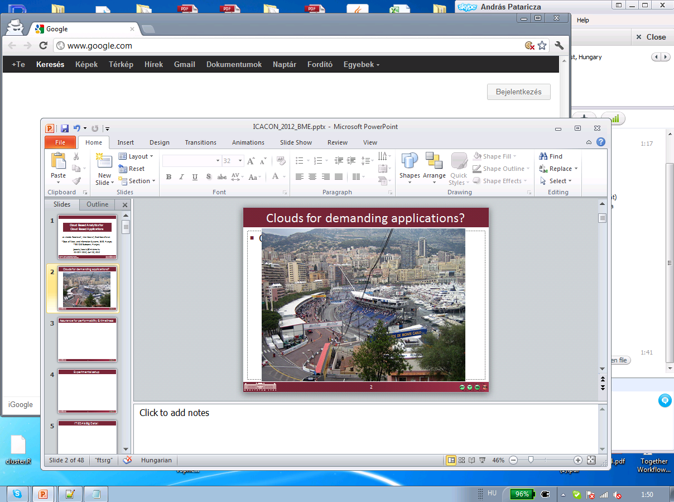
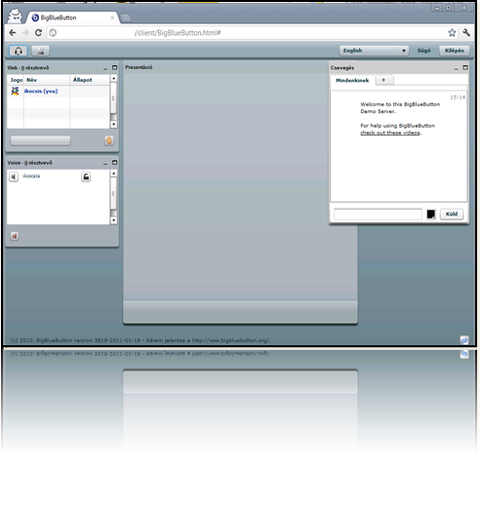
Clouds for demanding applications?
Extra-functional reqs:
throughput, timeliness, availability
„Small problems” → high impact ?
Virtual Desktop
Infrastructure
Telecommunications

Slide 7
Dangers in a standard cloud for demanding apps?
What are the impacts of factors not covered by an SLA
Example: performability attacks

Slide 8
Impact of platform faults (perfomability domain)
Protected
I’ am
well-protected
soft real-time
Protected?

Slide 9
Experimental setup

Slide 10

Exploratory data analysis (EDA)
Approach to analyzing data sets
  Summary of their main characteristics in
    Easy-to-understand, often: visual graphs
    without using statistical model or having formulated a hypothesis.
Dynamic visualization capabilities
  Identification of outliers, trends and patterns
Two developments in statistics to reduce the sensitivity of inferences to errors :
  Robust statistics - low sensitivity to outliers
  Nonparametric statistics – no a priori assumptions

Slide 11
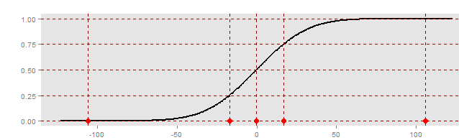
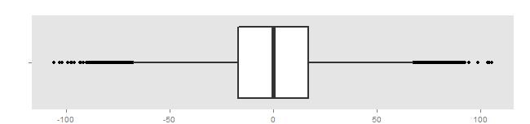
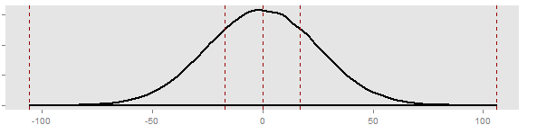
Five number summary of numerical data
100 %
75 %
50 %
Q1
Q3
25 %
Min.
Median
Max.
0 %
Extr. small
Small
Normal
Large
Extr. large
Qualitative domains
Q1 – 1.5 IQR
Normal
Quantitative domains
Small
Large
Extr. small
Extr. large

Slide 12
Example: Robust and non-paramteric measures
Sample set
  1000 points
  U(1, 5) unif. Distribution
    mean = median = 3 ms
1 sample of 20 sec
3ms ± 2 ms
Response time
New median: sort(resp. times)[501] = 3.02 ms
Resp. t. median
✓Robust
Resp. t. mean
✗Non-robust
New mean: (2 * 10^4 + 3 * 10^3 )/ 1001 = 25 ms!

Slide 13
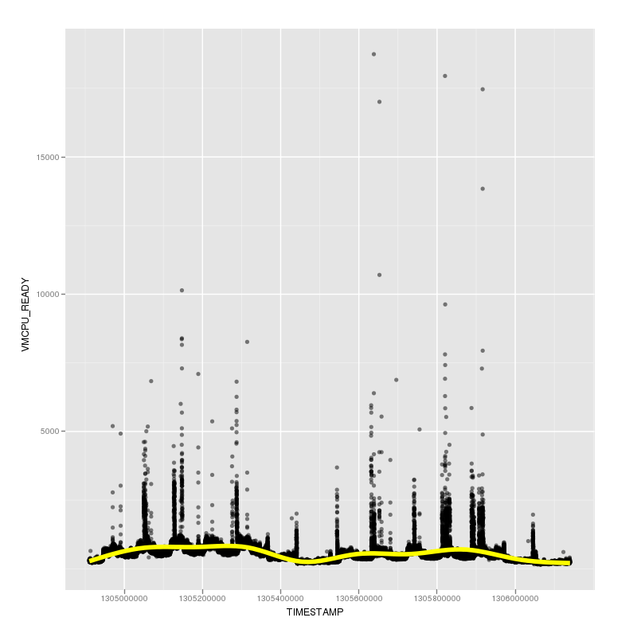

Measurement of output QoS
High availabilty, rare faults
Big data?
Rare events: $\frac{6.000}{180.000.000}$
Platform SL
Time

Slide 14
The noisy neighbour problem
Logic „fence”
Tenant
Neighbor
Hypervisor

Slide 15

Same, but different?
Overload
Normal
workload
Denial of Service
attack
Noisy neighbour

Slide 16
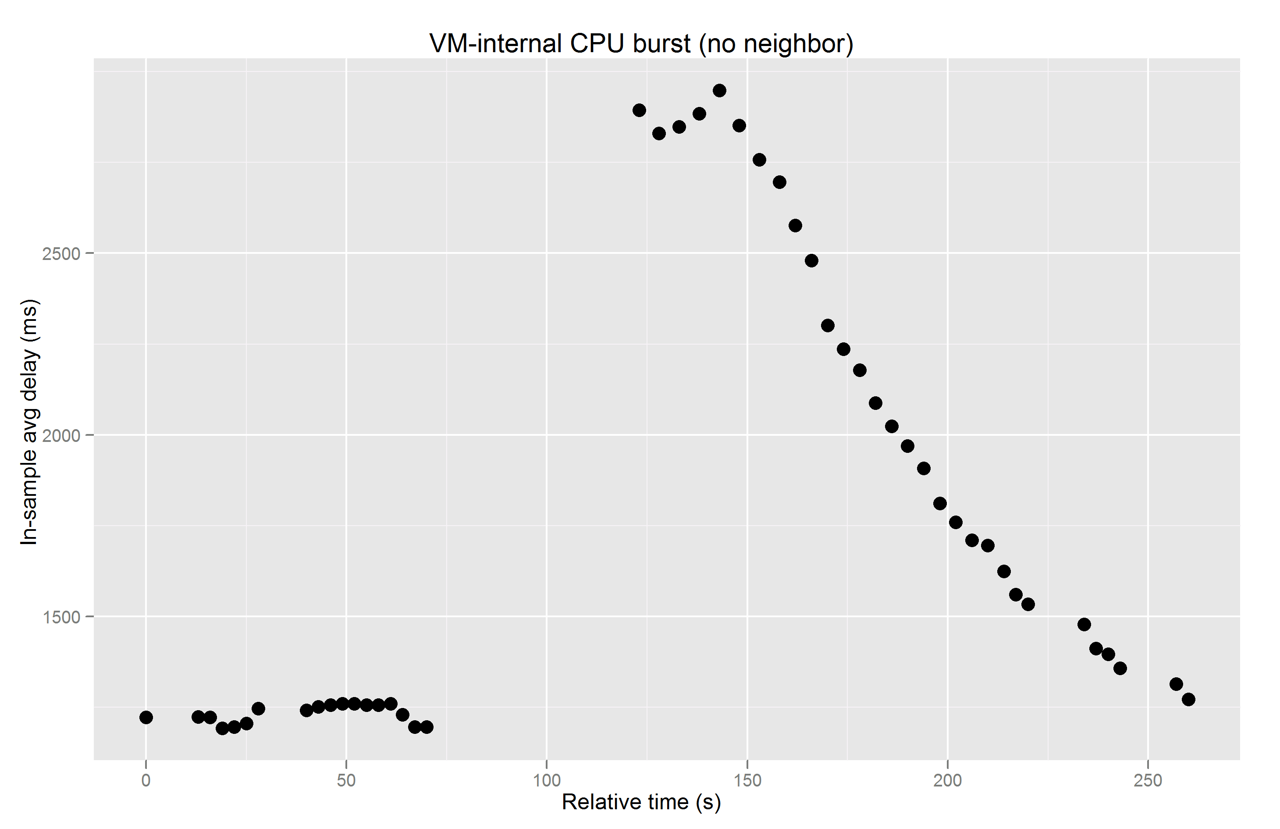
Short transient faults – long recovery
As if you unplug your desktop for a second...
30 sec
service
outage
120 sec SLA violation
8 sec platform overload

Slide 17
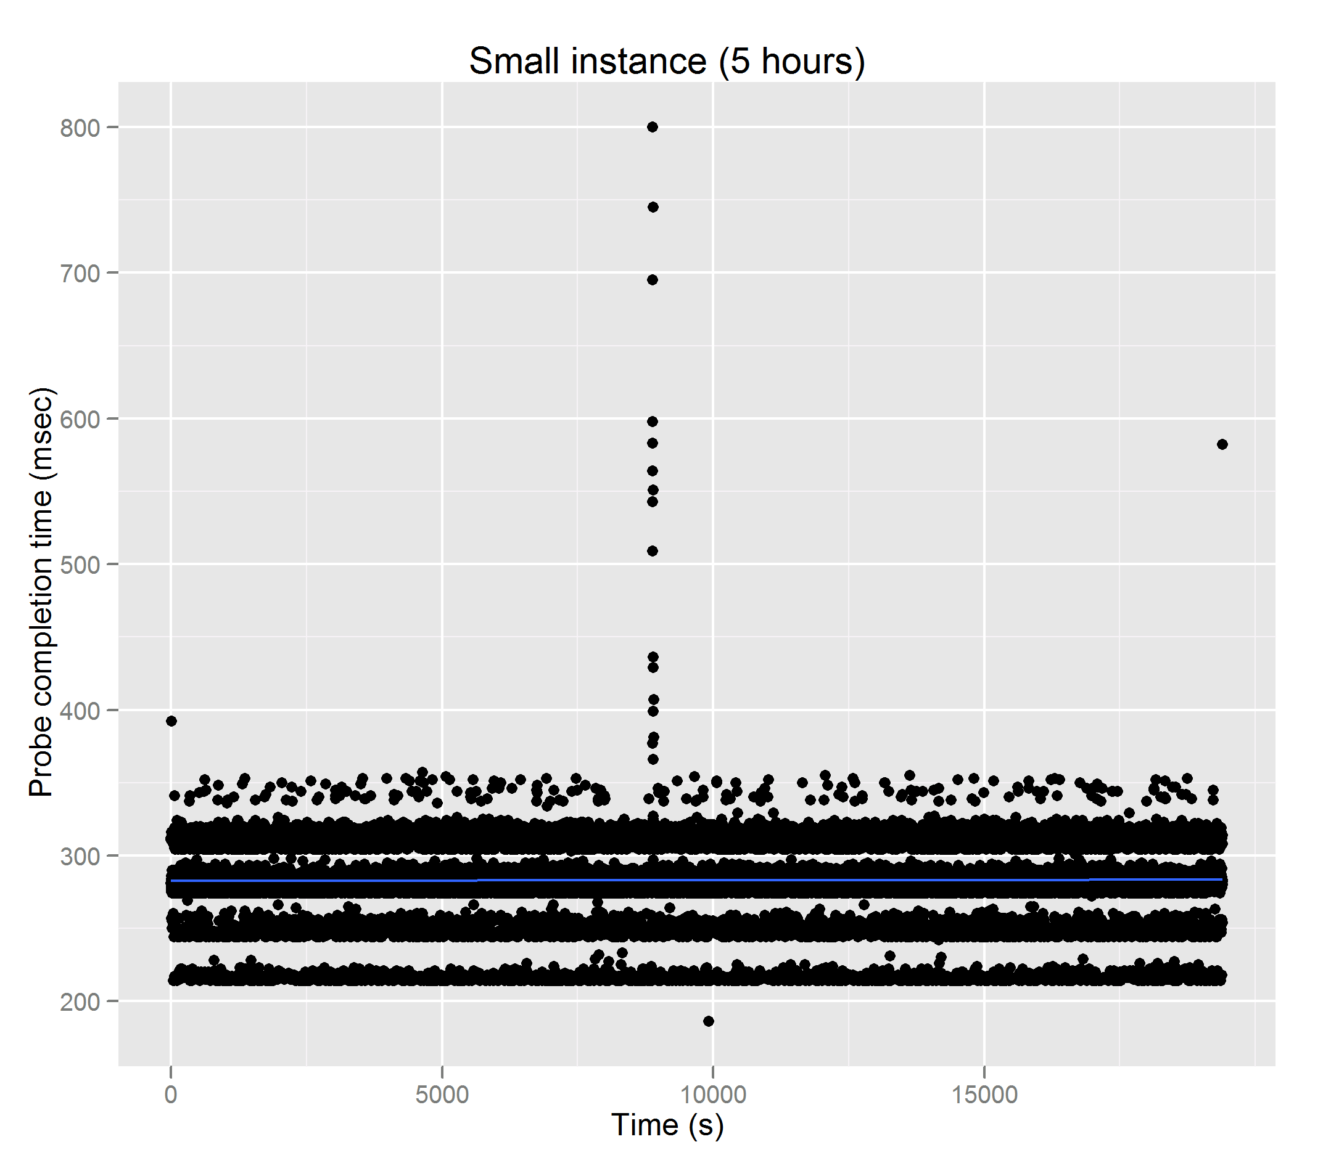
You don’t need enemies:
Deterministic (?!) run-time in the public cloud...
Performance outage intolerable by overcapacity
Variance tolerable by overcapacity

Slide 18
Let’s try it at user level
Poor observability of the platform necessitates self-*

Slide 19
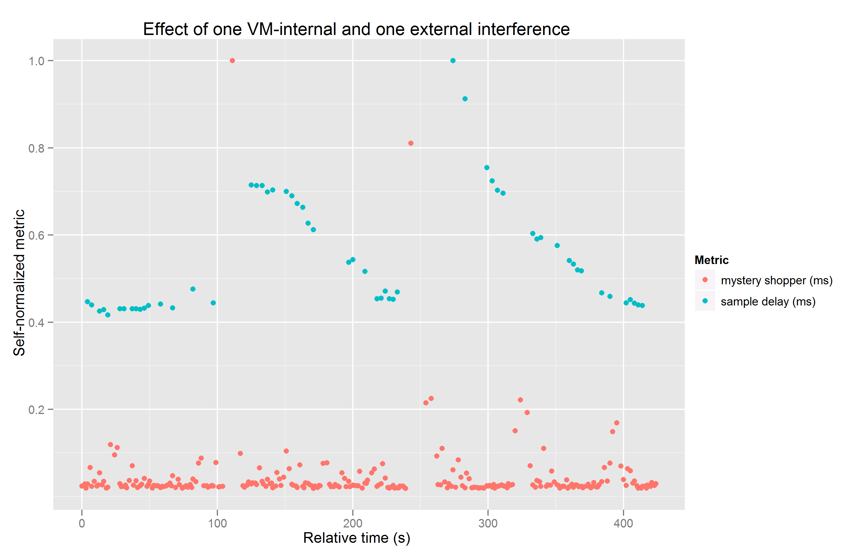
Mystery shopper & service QoS
Application failure
Main application
Fast detection
Reaction time
window
Reaction time
window
VM internal fault
Noisy neighbour fault
Mystery shopper

Slide 20
Summary
Technical
  SLA coverage:
    missing aspects
  Can be (somewhat) compensated
    Cheap computing power -> redundancy
    „Double” autonomic computing
      Cloud level – provider
      Application level – user
Methodology
  Visual exploratory data analysis for insight
  Algorithmic analysis for proofs and evaluation
Fault-tolerance design patterns revisited
  Cheap redundancy in the cloud
I. Kocsis, A. Pataricza et al.: Analytics of Resource Transients in Cloud Based Applications Int. Journal of Cloud Computing

