Slide 1
Choosing the right key for your data
(Using Cassandra for application performance monitoring)
BigData Club
Rudolf Rakos, Akos Nagy-Zambo
2012 September 12th

Slide 2
Agenda
Introduction
Metrics
Possible solutions
Our choice

Slide 3
Introduction
Our main goal is to increase our productivity when supporting applications.
Our team is responsible for several applications running on multiple hosts and executing critical operations on financial data.
In case of issues we need to trace messages across various log files on different hosts.
Analyzing our logs could help us finding patterns and outliers.
We would like to be able to find or predict performance bottlenecks in the system.
  Alerts (proactive)
  Charts (reactive)
For this reason we aim to store our log messages in a centralized location.
Having it indexed will also help us to retrieve exactly what we are looking for.

Slide 4
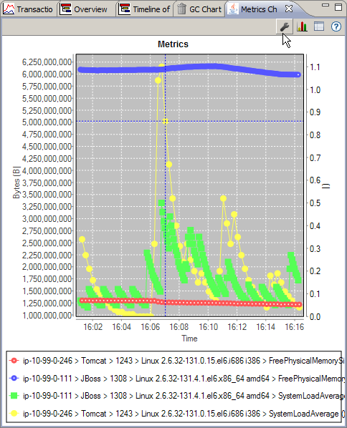
Metrics
For performance monitoring we need measurements.
If we are able to measure and track certain attributes in our system it can be used to improve the performance over time.
What makes metrics different?
  Aggregatable (average, min, max)
  Correlatable
  Immutable
Example metrics are:
  Message size
  Processing duration
    Calculations
    Database operations
    IO (disk, network)

Slide 5
Possible solutions
There are various ways to store time series but here I compare 2 common solutions.
RDBMS
Pros
  Wide range of query options
  Easy integration with existing systems (relations, joins)
  ACID transactions
  Known performance tuning practices
  Good random IO performance
Cons
  Limited storage
  Limited distribution to nodes
Wide column stores
Pros
  Distributed
  Linear scalability
  Flexible consistency models (CAP theorem)
  Efficient IO
    Compression
    Sorting
    Sequential reads
Cons
  Limited querying (by key, by key range)
  Limited transactions (only atomicity)
  Performance tuning at schema design time

Slide 6
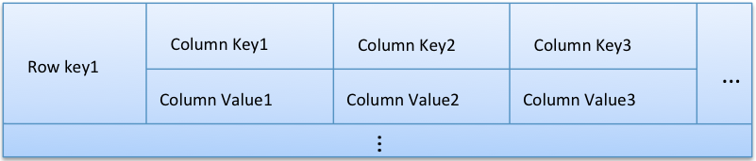
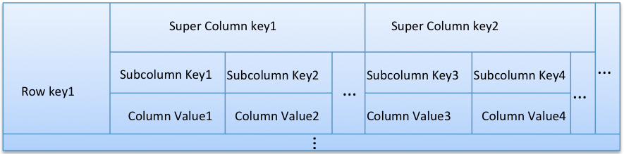
Possible solutions
We believe columns stores would serve us better in this case.
Well known wide column stores
Amazon DynamoDB
Amazon SimpleDB
Apache Cassandra
Apache Hbase (Hadoop)
Google BigTable
Think of it like:
Map<RowKey, SortedMap<ColumnKey, ColumnValue>>

Slide 7

Our choice
Physical organization of the data
Keys
  Determines the physical location of the data (which node)
  Meaningful data (not just a name)
Super columns
  Collection of columns
  Similar to columns with composite keys
  Sorted by key
Rows
  Collection of (super) columns
  Partitioned by key (token ring)
  Not sorted by key (usually)
Columns
  Key/value pair
  Sorted by key

Slide 8
Our choice
Choosing the right key
Use cases
  Chart metrics by date, tags, aggregation
  Chart multiple metrics by date, tags, aggregation
  Chart multiple metrics aggregated on the fly
  Aggregate metrics by minutes or hours
  Aggregate metrics older than a month by minutes or hours
  Delete metrics older than a year
  Delete metrics aggregated by seconds older than a month
Things to consider
  Ease of use
  Efficiency
Operations
  Insertion
  Querying
    By date (range)
    By date, tags, aggregation
    By date, tags, aggregation, time range
  Deletion
    By date (range)
    By date, tags, aggregation

Slide 9
Our choice
Schema ideas
“Tags, date, metric type, aggregation”
  Row key: Host, Service, Metric Name, Date
  Super column key: Metric Type, Aggregate Function
  Column key: Time Stamp
“Tags, date, aggregation”
  Row key: Host, Service, Metric Name, Metric Type, Date
  Super column key: Aggregation Interval
  Column key: Aggregate Function, Time Stamp
“Date, tags, aggregation”
  Row key: Date, Service, Host, Metric Name, Metric Type
  Super column key: Aggregation Interval
  Column key: Aggregate Function, Time Stamp
“Date, tags, aggregation, no super column “
  Row key: Date, Service, Host, Metric Name, Metric Type
  Column key: Aggregation Interval, Aggregate Function, Time Stamp
Secondary indexes (to support querying)

