Slide 1

The Artificial Intelligence National Lab
András Benczúr
SZTAKI “Big Data – Momentum” Group
Hungarian AI Coalition Data Industry WG leader
Mathematical Foundations of AI Excellence Program
benczur@sztaki.hu

Slide 2

National labs – a new funding scheme
Predecessors
  Hungarian Brain Research Program (NAP)
  ELI-ALPS Szeged Laser Research Center
A few more National Labs in plan
Coordination with external entities is key
  Other labs, Zalazone autonomous driving test bed, University excellence programs, Health programs
  Industry key players (AIMotive, Audi, Bosch, Continental, Ericsson, GE, IBM, Micorsoft, Telekom, Vodafone, …)
The Artificial Intelligence Lab
Announced October 15 by the Minister of Innovation and Technology
Planned to start next year and expand from 2021
First year will be key to impress stakeholders
Demonstrations, Events for both Industry and research collaboration

Slide 3

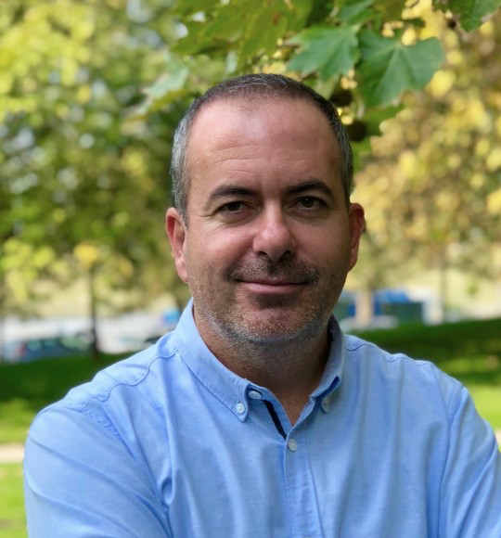

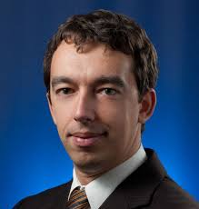
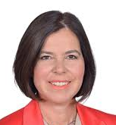
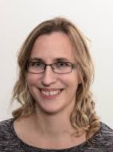


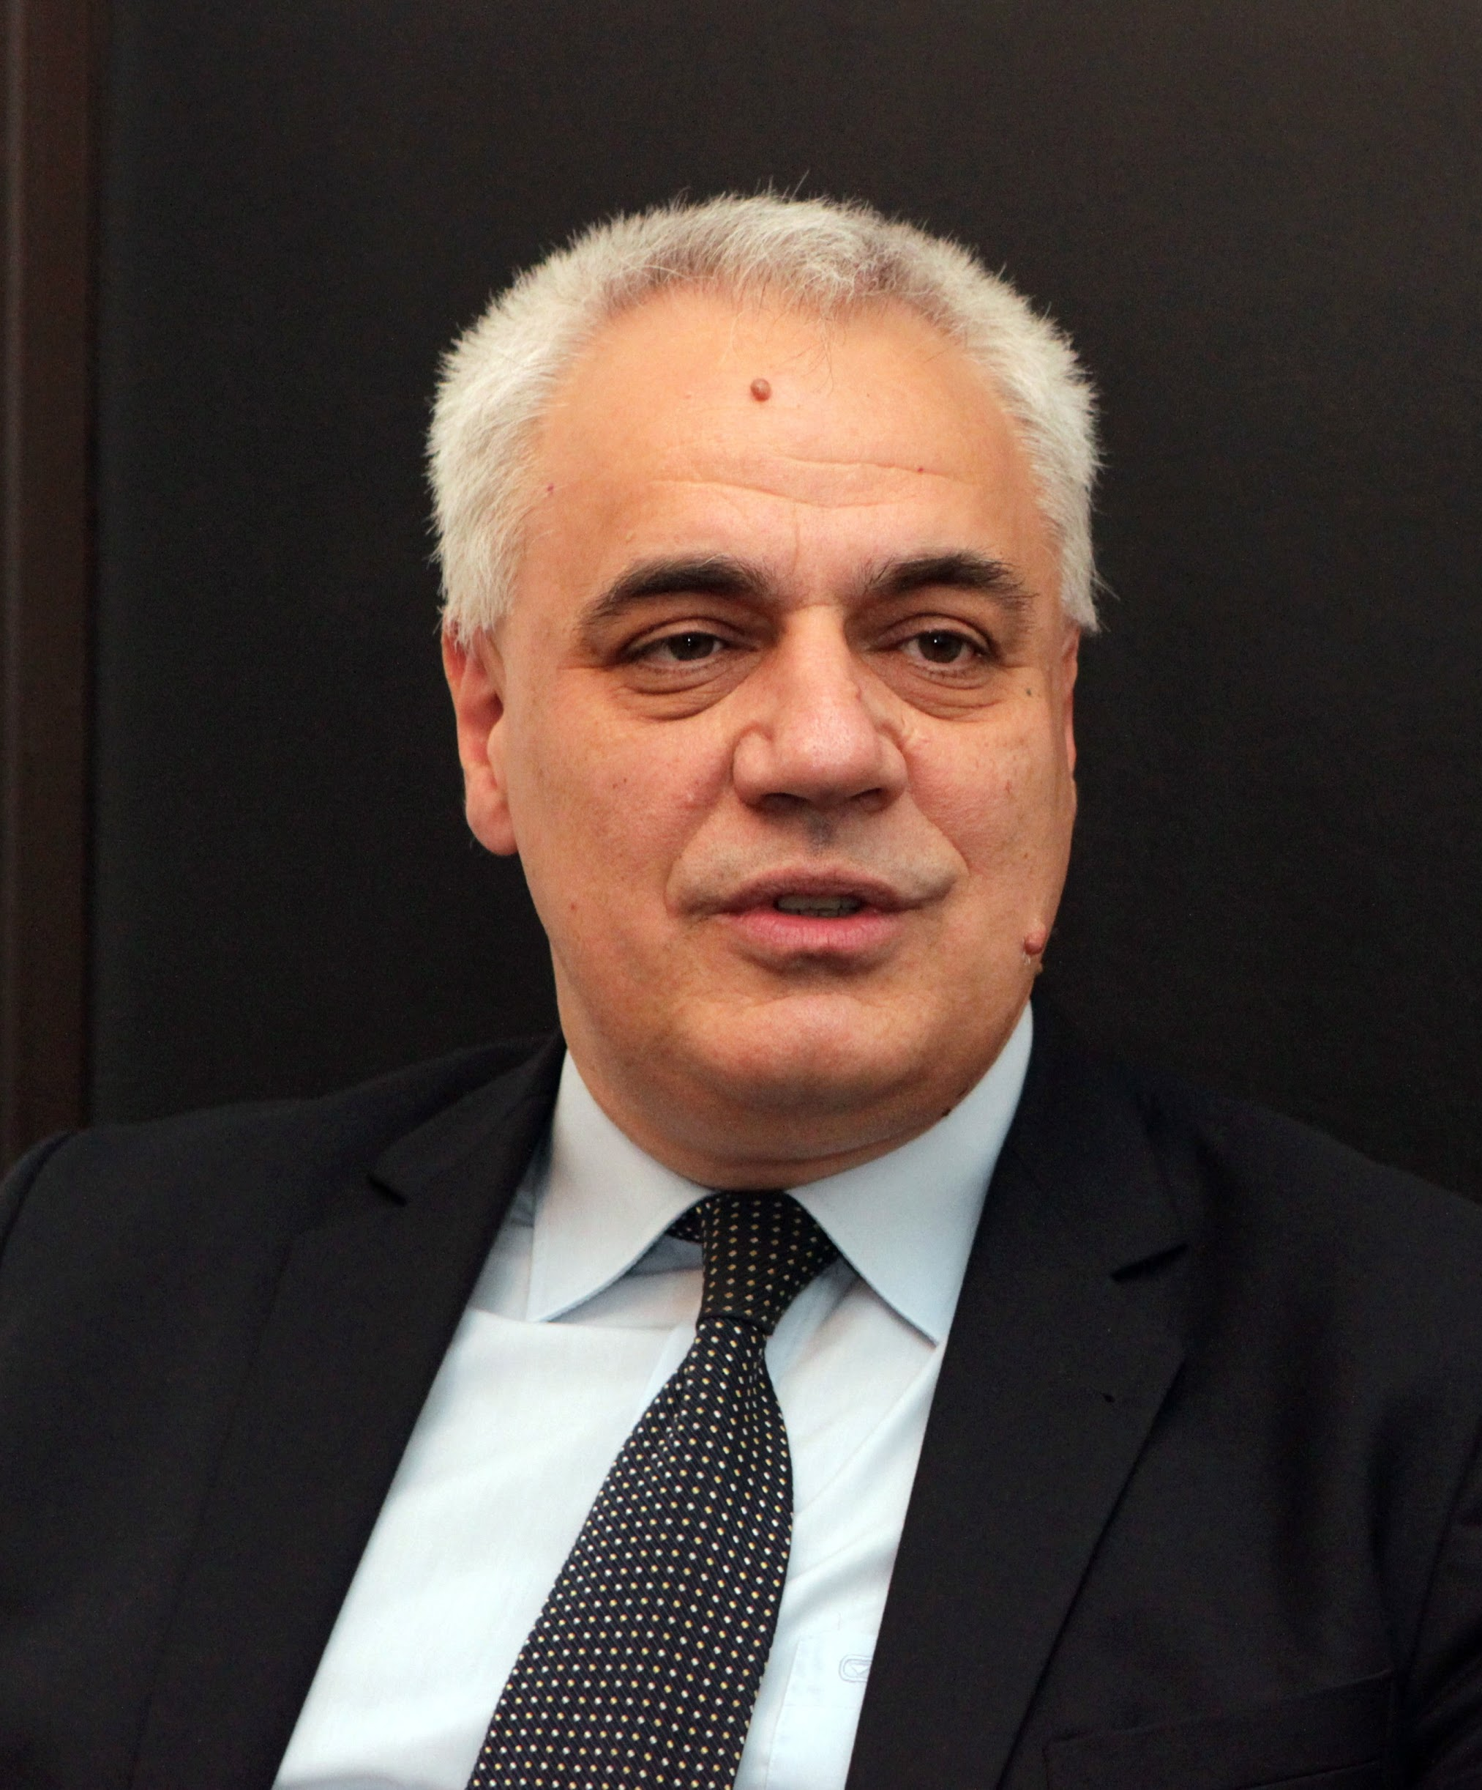
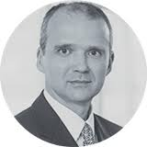
Build on a strong team of the Artificial Intelligence Coalition WGs
András Benczúr
SZTAKI
Data Industry
Ferenc Dietz
BGE
Education
László Boa
Applications
Zoltán Hans
Clementine
Data Industry
Edina Németh
NKFIH
International Relations
Dóra Petrányi
CMS Law
Policy and ethics
Gábor Érdi-Krausz
T-Systems
Technology
Géza Németh
BME
International Relations
Lénárd Darázs
ELTE
Policy and ethics
Zsolt Marosvári
Nokia
Technology

Slide 4
Apologies
Project and partnership under construction
In this talk, mostly SZTAKI references

Slide 5
Part I
Technology

Slide 6
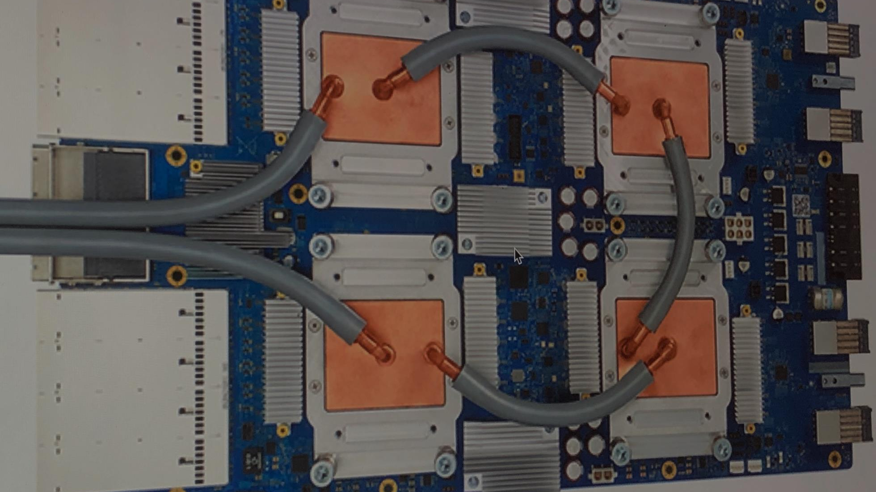
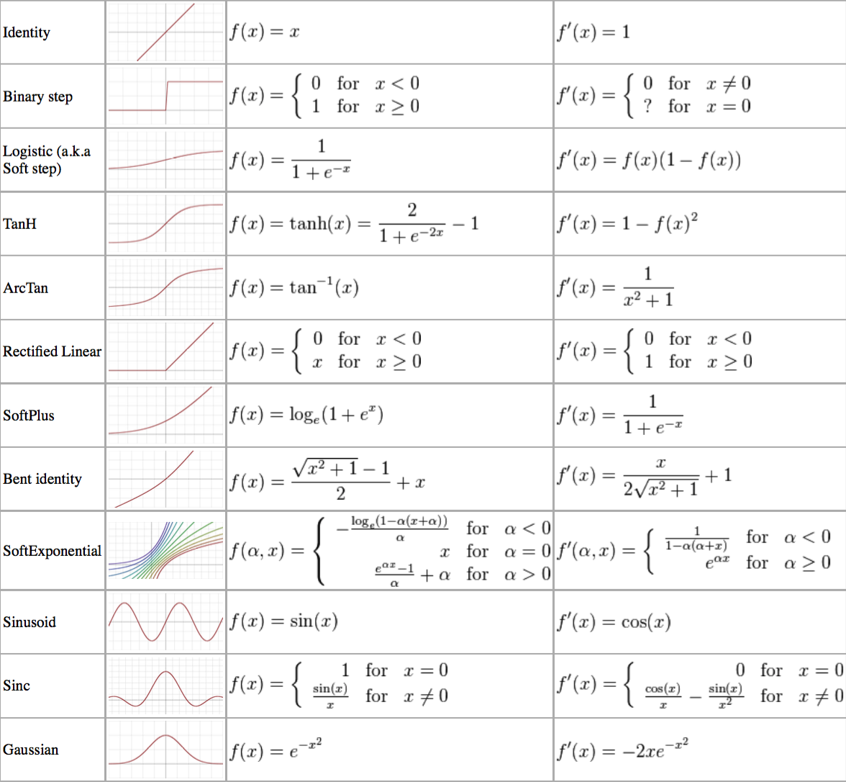
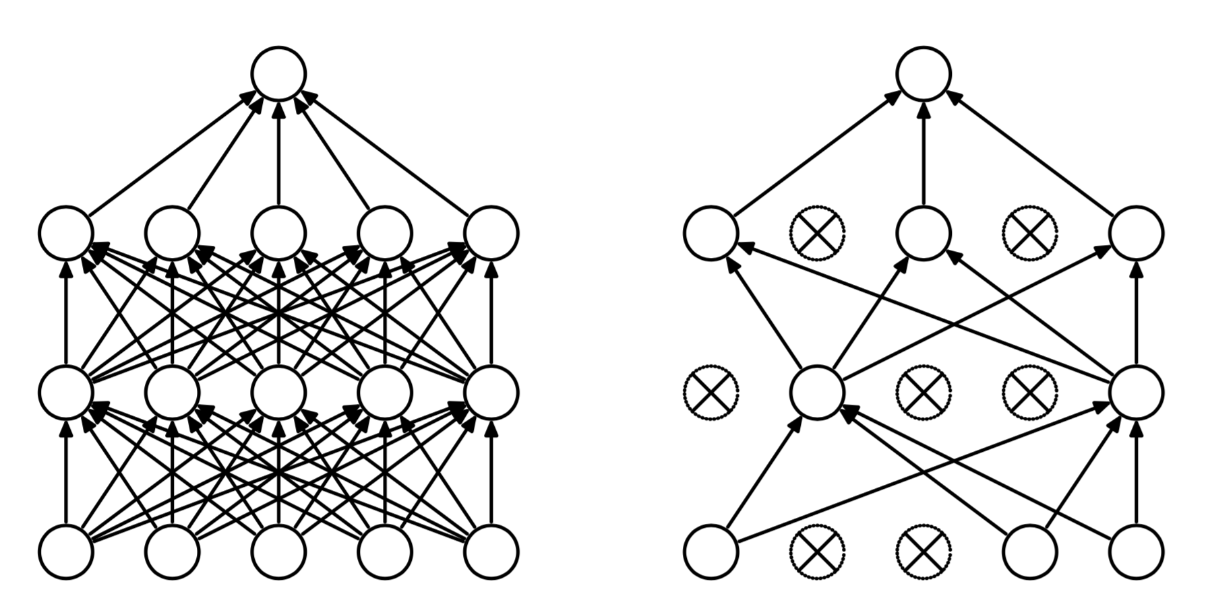
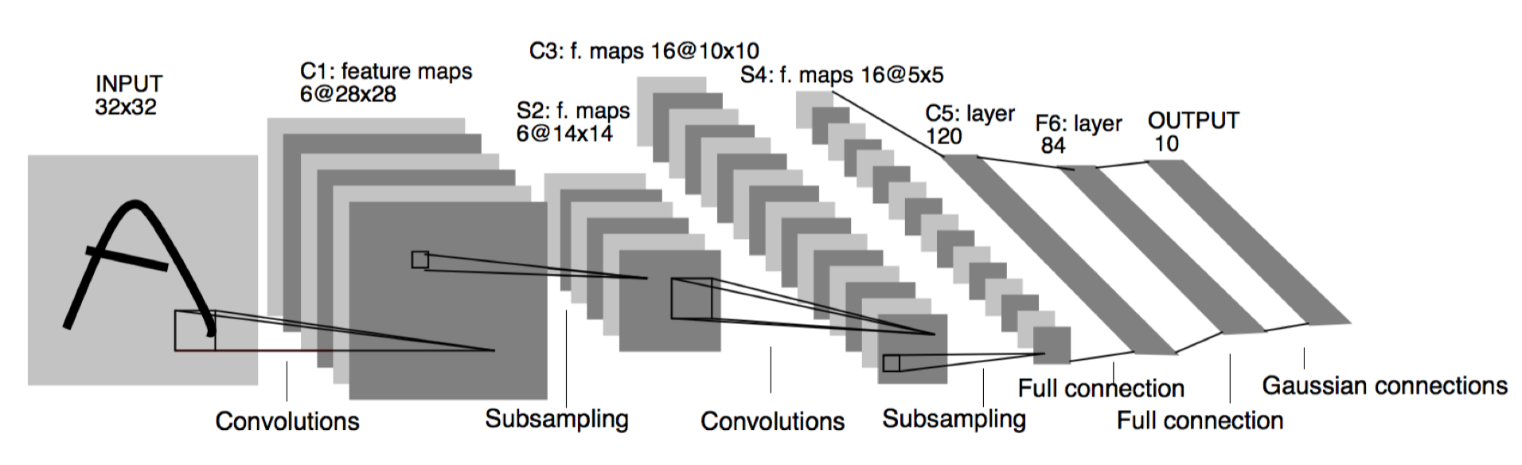
Artificial Intelligence from a Model Developer’s perspective
Scientific and technological breakthrough:
Tricks for traning, optimization (ReLU activation, dropout, …)
GPU
Distributed processing, e.g. Google MapReduce
Smart tricks, better hw-sw solutions but theory existed back at least 20 years
Main ingredient
Huge training data
Billion-user systems (Google, Facebook, …)
USA and China without exception

Slide 7
Data may be more important than models
https://www.nytimes.com/2018/06/20/technology/deep-learning-artificial-intelligence.html
“But now some scientists are asking whether deep learning is really so deep after all.”
“a growing number of A.I. experts are warning that the infatuation with deep learning may well breed myopia and overinvestment now — and disillusionment later.”
“There is no real intelligence there,” said Michael I. Jordan,
“And I think that trusting these brute force algorithms too much is a faith misplaced.”

Slide 8
Big Data: Why now?
Hardware is keep getting better
Data should be much less a problem now than 50 years back

Slide 9
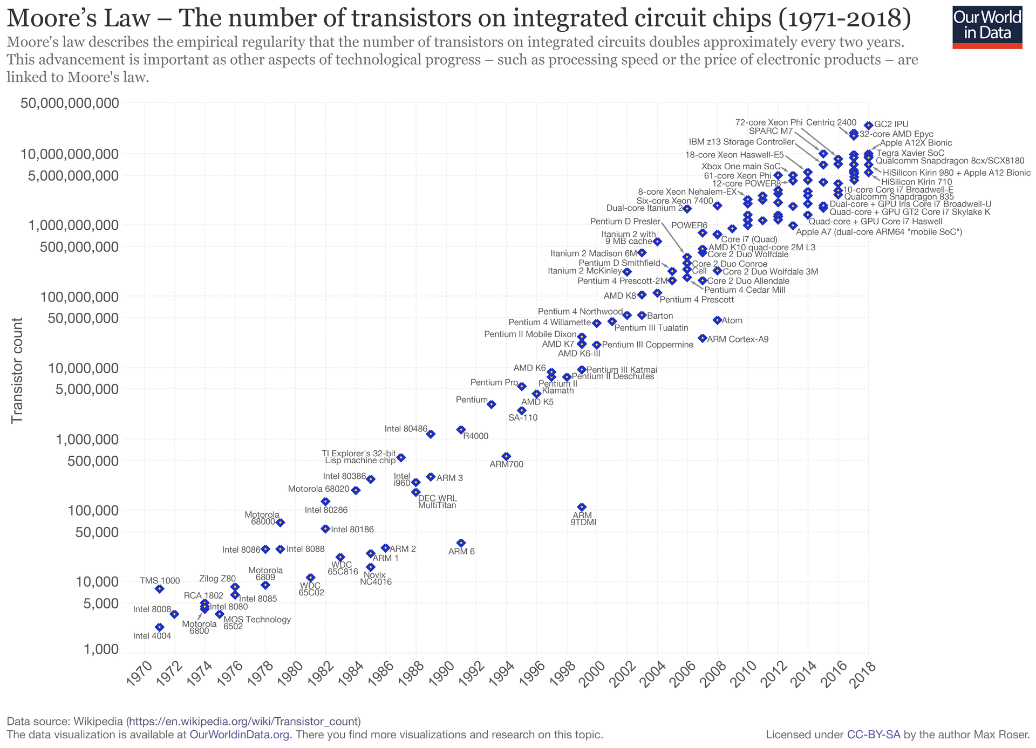
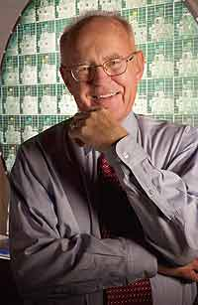
Moore’s Law and Big Data
By Max Roser - https://ourworldindata.org/uploads/2019/05/Transistor-Count-over-time-to-2018.png CC BY-SA 4.0, https://commons.wikimedia.org/w/index.php?curid=79751151

Slide 10
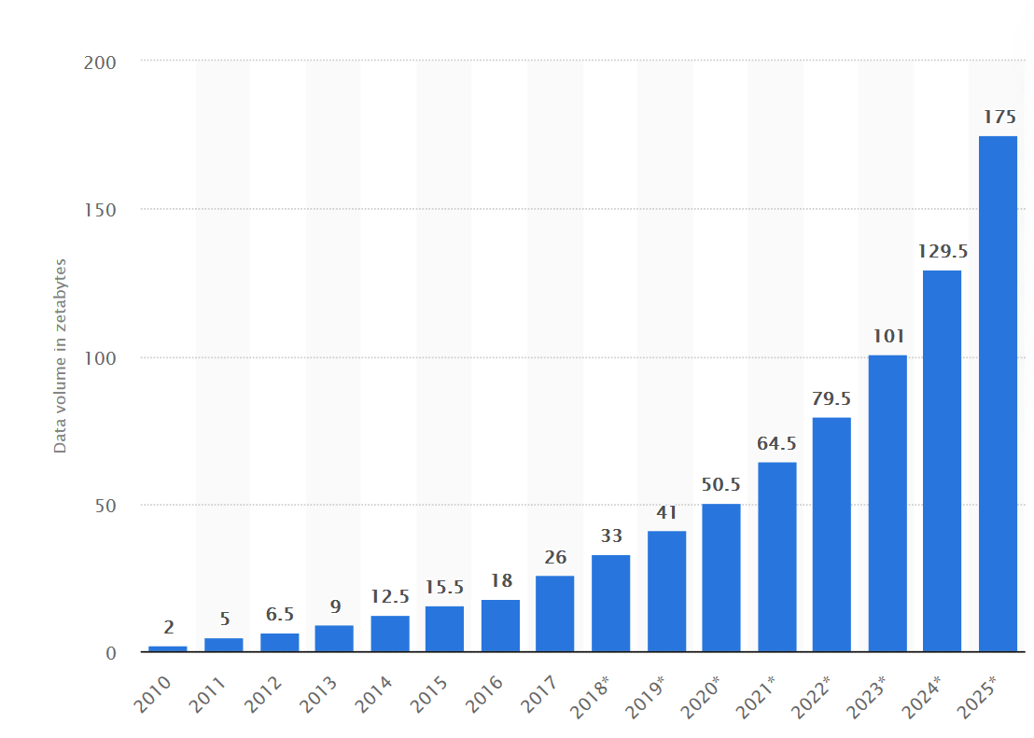
Moore’s Law and Big Data: Worldwide Data (Zetabytes)
https://www.statista.com/statistics/871513/worldwide-data-created/ Published by Arne Holst, Sep 27, 2019

Slide 11
Big Data: Why Now?
“Computational Capabilities” double every two years
(“Capability” is very imprecise, and increase slowed down a bit)
Approx 5-10-fold increase 2010-2017
Data volume approx increase 2010-2017 13-fold
Most algorithms scale slower than linear
Simplest and most common is sorting
BTW Faster scaling: search once sorted

Slide 12
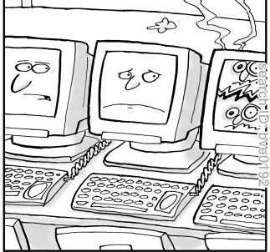
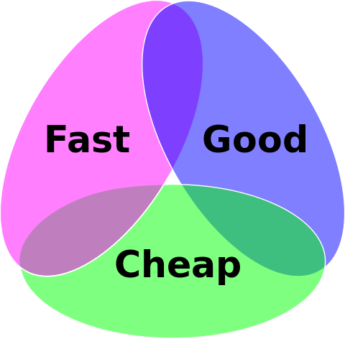
Limitations of Distributed Systems
Fox-Brewer Theorem:
You may choose two of C-A-P
1000 servers with 3 years of warranty: average 1 failure/day
Most everyday systems (Web, telecom) only provide eventual consistency
C
Consistency
(Good)
CA: big expensive supercomputers
CP: no response if disagreement with replicas
Availability
(Fast)
A
P
AP: some replicas may give erroneous answer
Partition-resilience (Cheap)

Slide 13
We can’t compete with data
Google, Facebook, Apple, Alibaba, … technology achievements cannot be replicated with just smart researchers and developers

Slide 14
Can we improve the models?
Our opportunity is our smart mathematicians
Graph Limits
Information Geometry
… ?

Slide 15
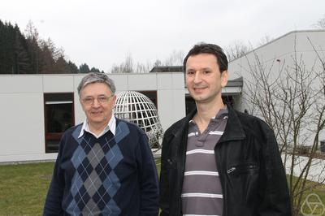
Graph limit theory and Deep Learning
Lovász-Szegedy 2006: “Limits of dense graph sequences” - ﬁrst paper in a rapidly growing area called graph limit theory
A key ingredient in limit theories is the decomposition of large systems into structure and noise.
Noise is a relative concept. It depends on the subjective notion of "interesting" measurements:
  Principal Component Analysis (PCA), Fourier analysis,…
  Szemerédi’s regularity lemma
  Autoencoders generalize most of the previous concepts
As we go to the limit, we ignore the noise and keep the structure. Example: ﬂuid dynamics: we only keep certain averaged quantities.
Knowledge without ignorance is useless
Too much information - we have to ignore most of it in a smart way - abstraction.
Is there a mathematical theory of abstraction itself? We can’t say that yet....
Interesting directions: Structural decomposition and limit theories + dimension reduction in deep learning.

Slide 16
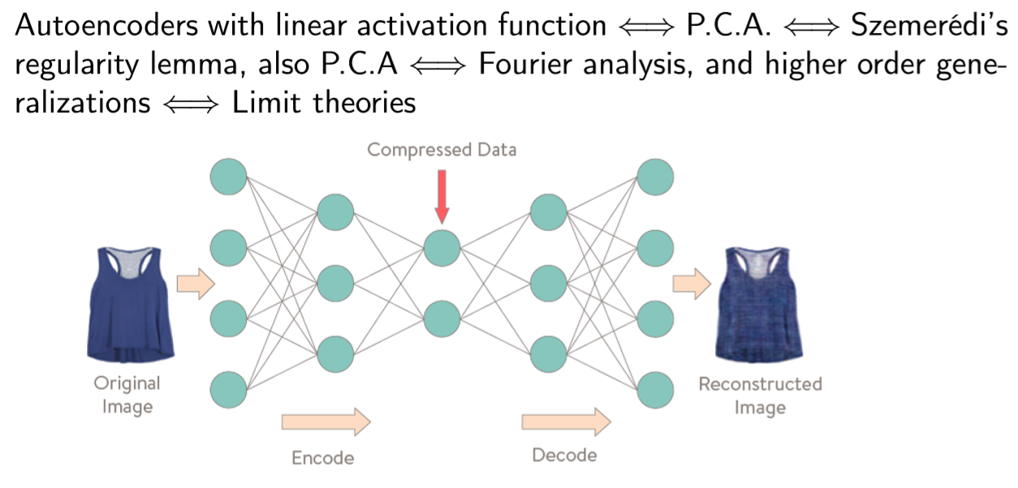
The Promising Correspondence

Slide 17
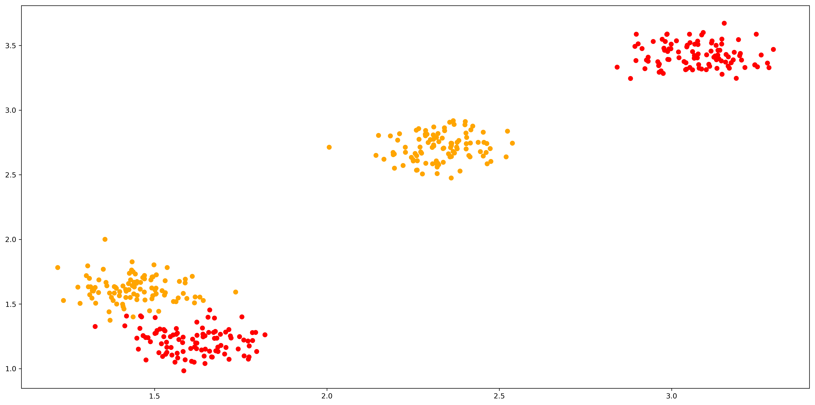
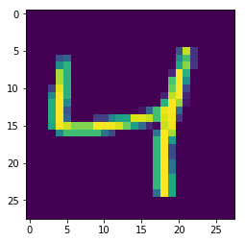
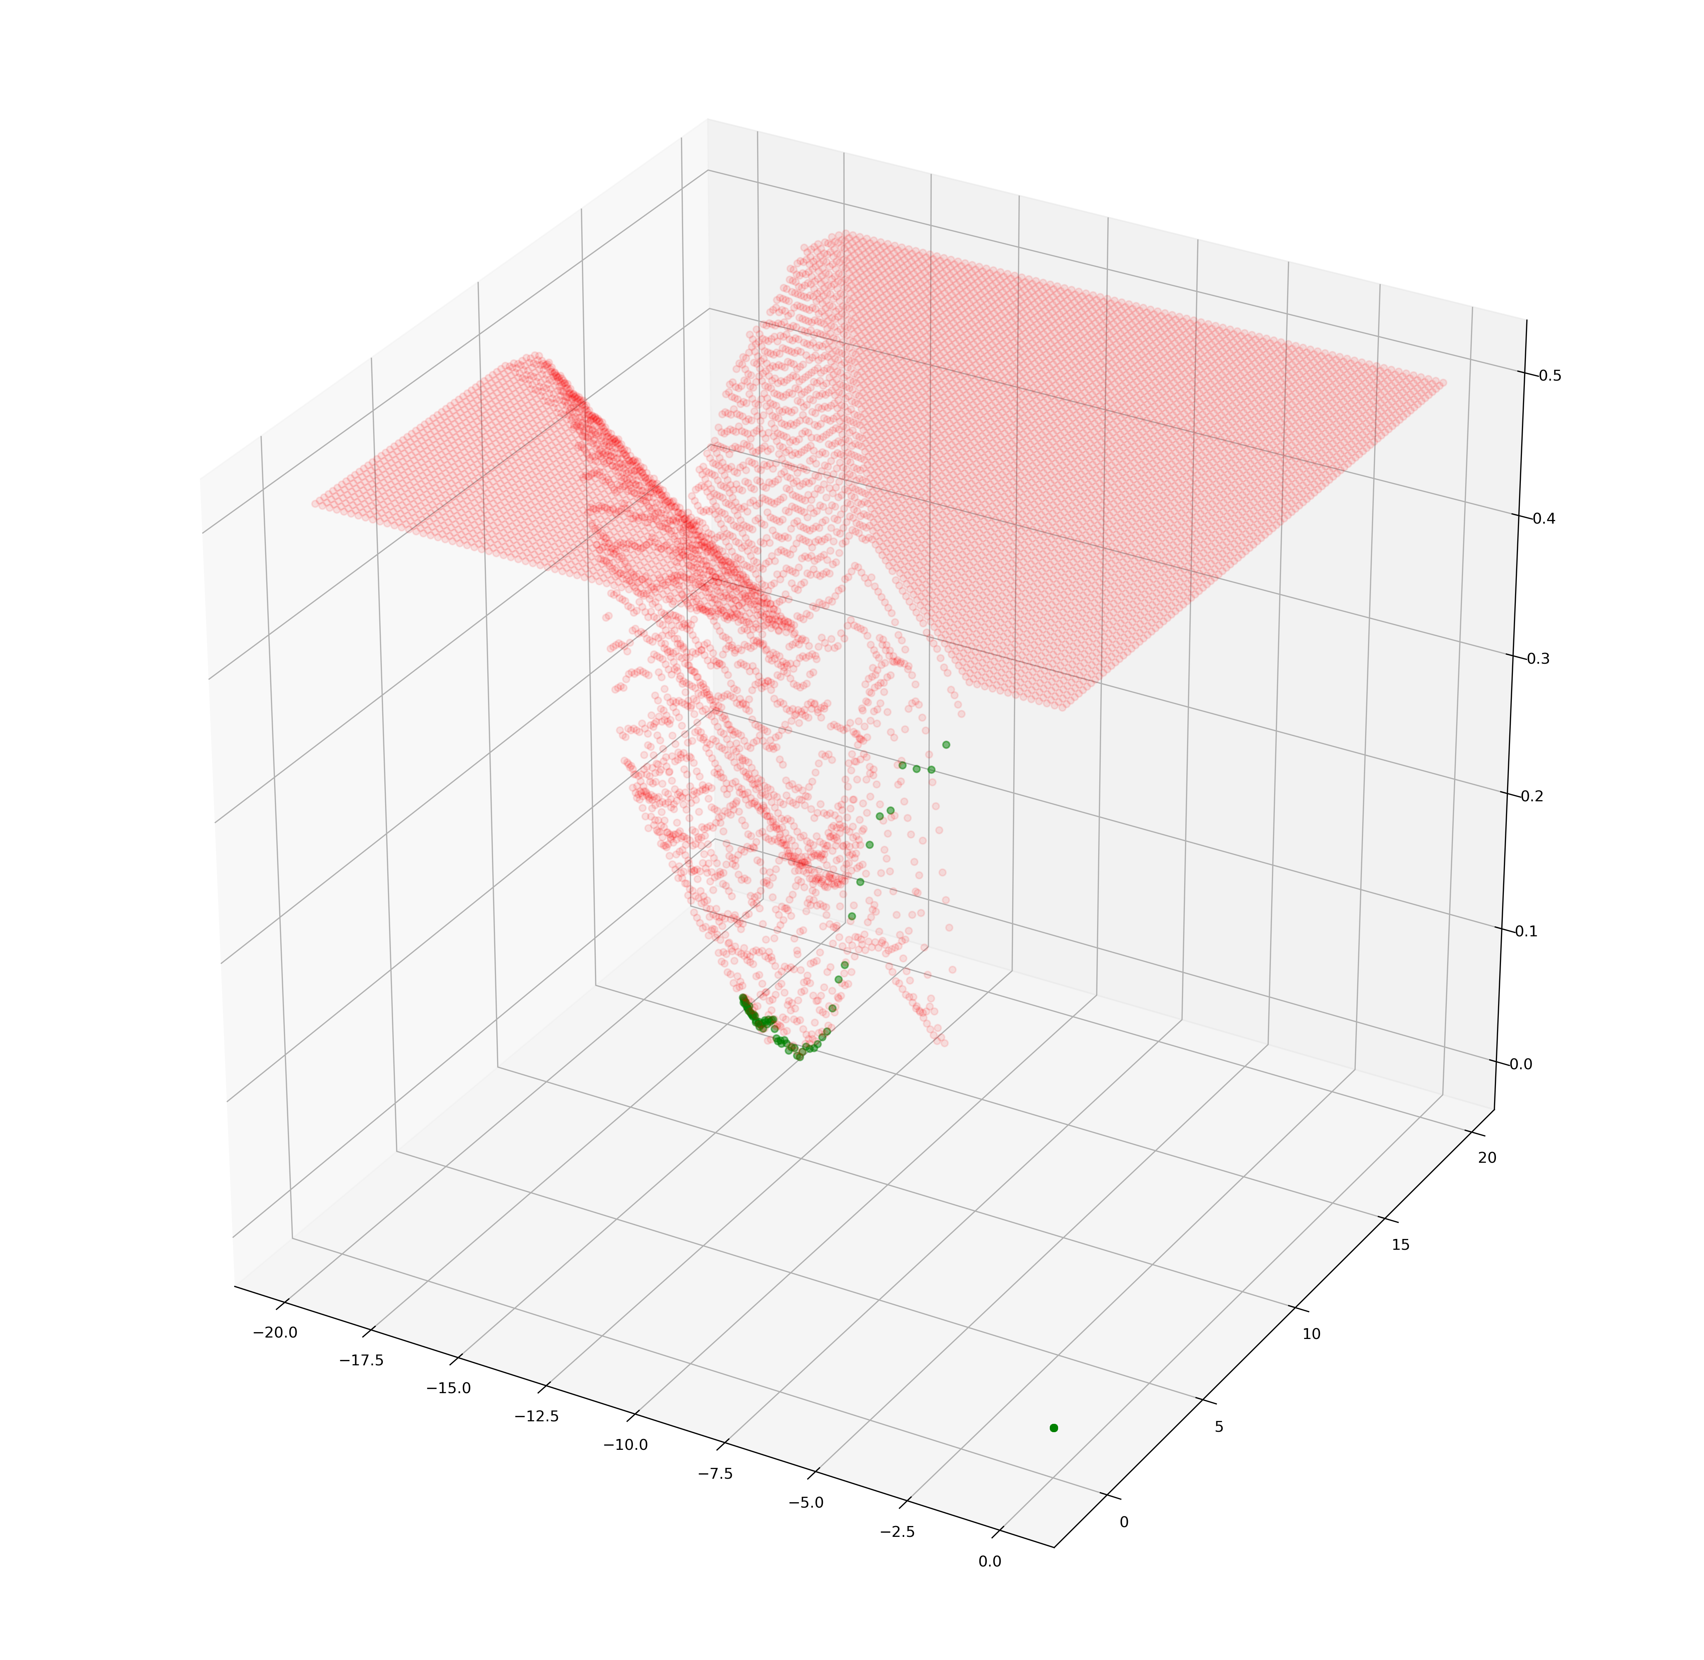
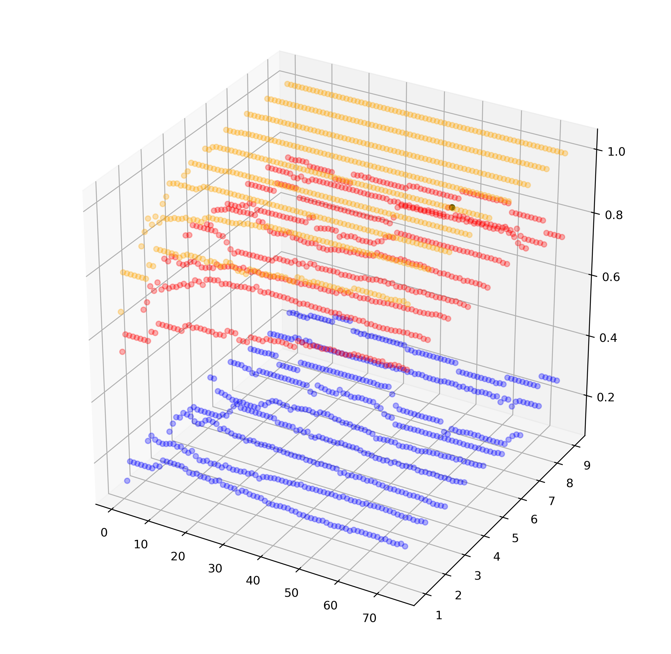
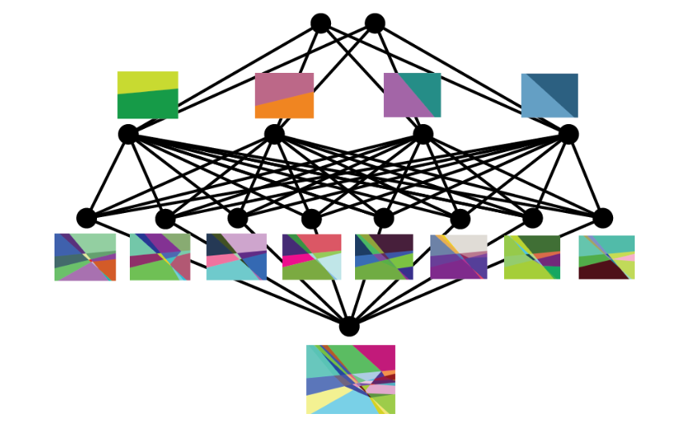
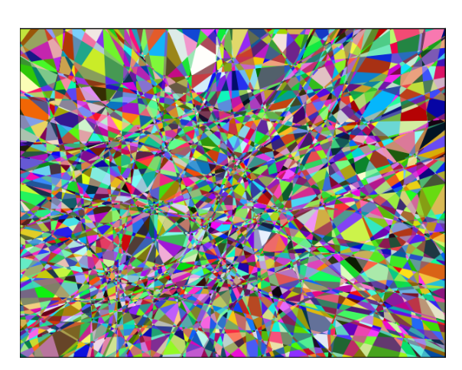
Information geometry
Data
Measure the performance of the approximation
  Predict how the model will generalize for unseen data
Choose the function class
  Find a particular element in the function class
Neural net w/ piecewise linear activation
Loss
Hyperparameter surface

Slide 18
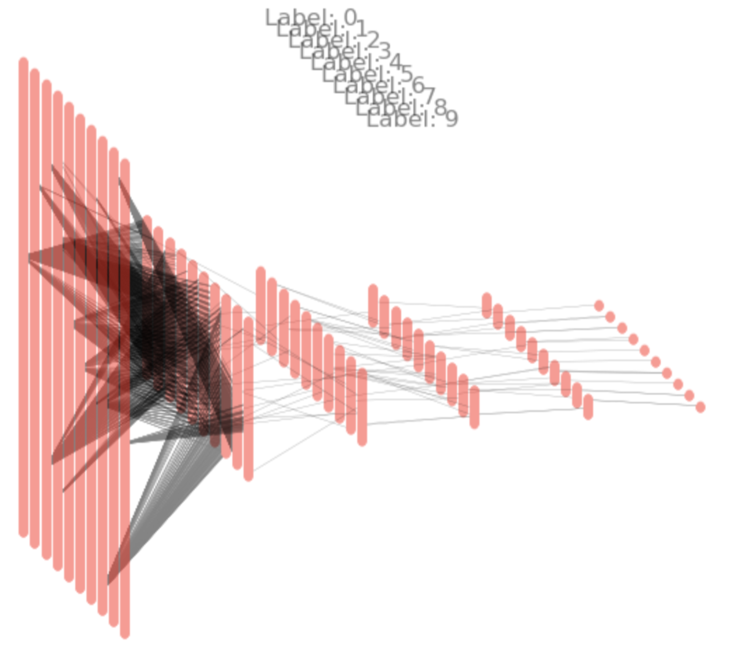
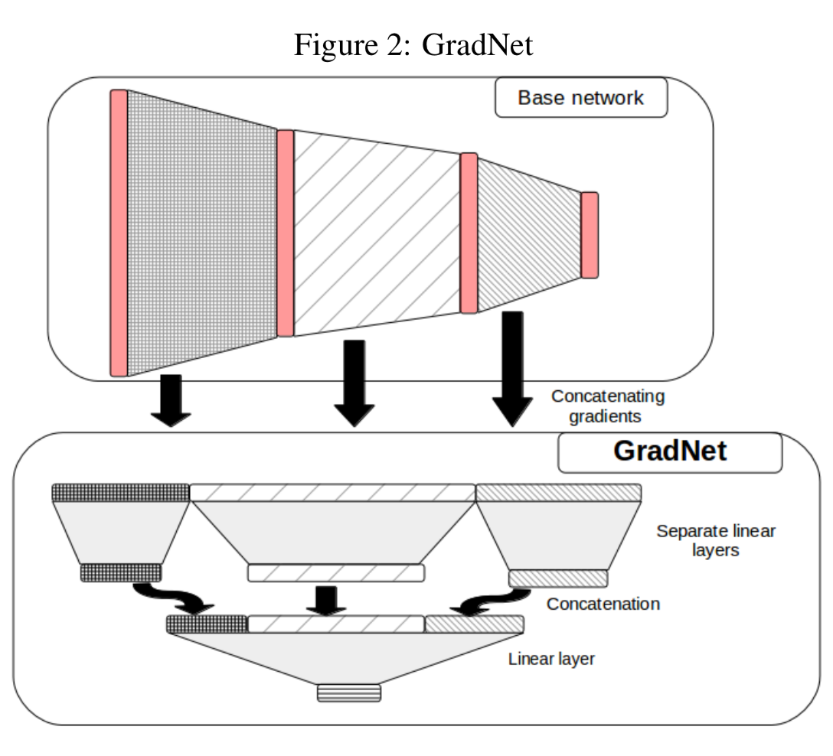
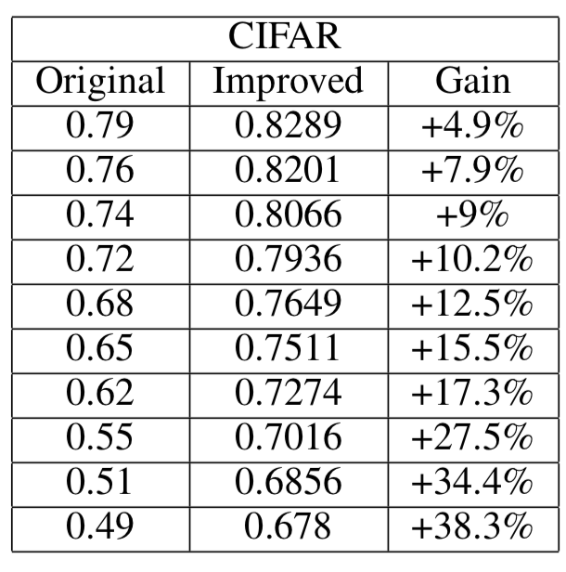
Model training in gradient space
The gradient network
Experiments
MNIST (10 handwritten digits) sparsified gradient net shows relationship of class and gradient of a partially trained net
CIFAR experiments: very fast results by using gradient of weakly trained networks
Loss , where θ are network weights
Gradient space:
Riemann metric:
    Inner product can be defined and approximated
    Flat network learns the gradient

Slide 19
Regulation is key issue
GDPR – Is Europe becoming a compliance nightmare?

Slide 20
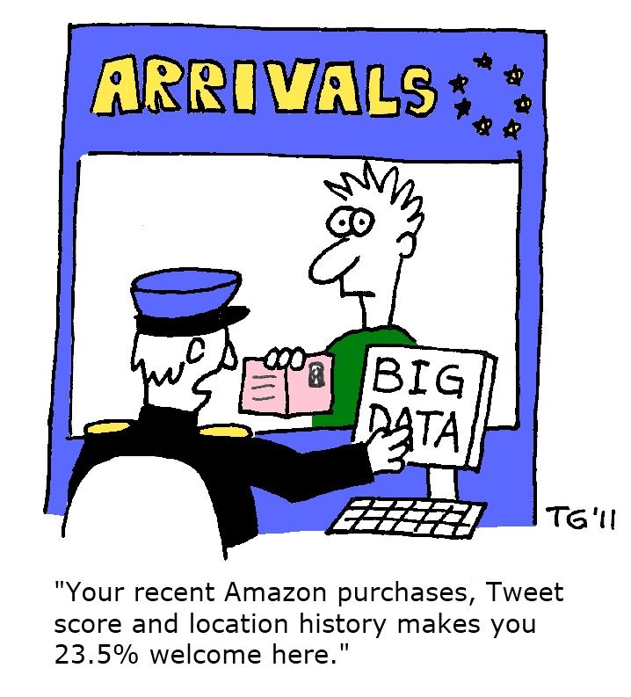
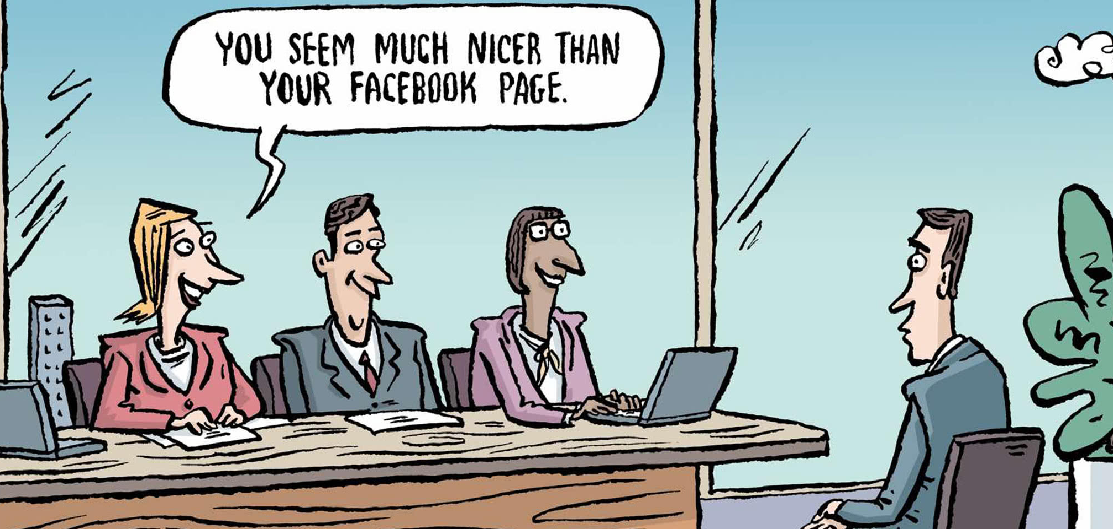

Slide 21
Regulation is key issue
Rules and common sense
  Limiting automated decision making
  Limiting profiling
  Right to transfer, erase, correct
  Consent required
Europe is not (yet) China
Can we guarantee anonymity without sacrificing usability?
Risk of deanonymization: not a (purely) regulatory question!
  Even in aggregates, we can infer to individuals, e.g. constants, salient values
  Data remains personal as long as there is a reasonable chance to directly or indirectly identify the person
  For example, pseudonyms are insufficient in GDPR as the person can be identified
Need to provide strong evidence to convince lawyers!
New collaboration of law and computer science …

Slide 22
Deanonymization attacks
Attacks
  Connect public data with observed typical commute route from home to work
  Learn characteristic complex patterns, e.g. terms, punctuation, source code style, traffic volume and direction, …
Privacy guarantees
  K-anonymity: every combination of IDs (e.g. place, birthdate, …) appears at least k times
  L-diversity: the frequency of sensitive values (e.g. positive medical diagnosis) should be at most 1/L
  Differential privacy: result of anonymization is independent of the value of any single record – a property that will also hold when we join data tables
  …

Slide 23
Part II
Applications

Slide 24
Data sources
Images, videos, laser scans, …
  Autonomous vehicles
  Medical imaging (X-ray, CT, MRI, ultrasound, …)
  Social media
  …
Text and speech (+ interactions, networks)
  Traditional and social media, Web
  Automated customer relations
  Medical diagnosis
  …
Sensors
  Motion (accelerometer, gyroscope, …)
  GPS and other positioning
  Network packets, radio signals
  Temperature, pressure, humidity
  And a wide variety more in a factory

Slide 25
Bio – Medical – Health applications
Other references:
InnoHealth Datalake Project
E-Group and U Pécs https://innohealth.eu/en/datalake/
Department of Physics of Complex Systems, ELTE
Success at Dream Challenges: Digital mammography, Preterm birth prediction
And more …

Slide 26
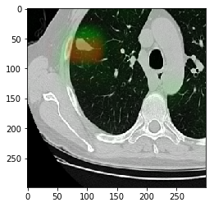
AI for Lung Cancer Diagnosis based on CT GINOP-2.2.1-18
(Ulyssys – SOTE – SZTAKI)
Green: machine learning
Red: annotation
X-Ray is insufficient for early detection
CT reading (300-500 slices) is cumbersome and exhaustive
National Lung Screening Trial had 450 false negative out of 45,000
Traditional CAD (Computer Assisted Diagnostic) systems need lots of manual parameter tuning, low accuracy
Goal for AI to reach the accuracy of an average radiologist to serve as second reader

Slide 27

Not only deep learning: interpretable modeling
Kerepesi, C., Daróczy, B., Sturm, Á., Vellai, T., & Benczúr, A. (2018). Prediction and characterization of human ageing-related proteins by using machine learning. Scientific reports, 8(1), 4094.
Ageing related protein and gene research
Gradient Boosted Tree has not just best accuracy, but also interpretable
New, previously unclassified but relevant proteins revealed, e.g. Werner syndrome ATP-dependent helicase
Number of interactions with other known ageing-related proteins
0
1
2
3-4
>4
+0.6
+1.7
+2.1
+0.2
regulation of insulin-like growth factor receptor signaling pathway
N
Y
+1.3
response to oxidative stress
N
Y
+0.9
…

Slide 28

Not just deep learning: information extraction from partly unstructured medical text
Paragh, G., Harangi, M., Karányi, Z., Daróczy, B., Németh, Á., & Fülöp, P. (2018). Identifying patients with familial hypercholesterolemia using data mining methods in the Northern Great Plain region of Hungary. Atherosclerosis, 277, 262-266.
Text processing task
  Anonymization before processing (data also includes reports as pdf scans!)
  Data cleaning, missing and erroneous values
  Bag-of-words models, Word2Vec neural embedding representation
  Hand crafted rules, regexp patterns for processing the diagnosis text
1.3M patients
Dutch Lipid Clinic Network (DLCN) score can be computed after processing all reports
Over 10,000 potentially affected patients identified

Slide 29
Data sources
“traditional” deep learning, e.g. convolutional nets
Images, videos, laser scans, …
  Autonomous vehicles
  Medical imaging (X-ray, CT, MRI, ultrasound, …)
  Social media
  …
Text and speech
  Traditional/social media, Web
  Automated customer relations
  Medical diagnosis
  …
Sensors
  Motion (accelerometer, gyroscope, …)
  GPS and other positioning
  Network packets, radio signals
  Temperature, pressure, humidity
  And a wide variety more in a factory
?
“traditional” deep learning, e.g. recurrent networks

Slide 30
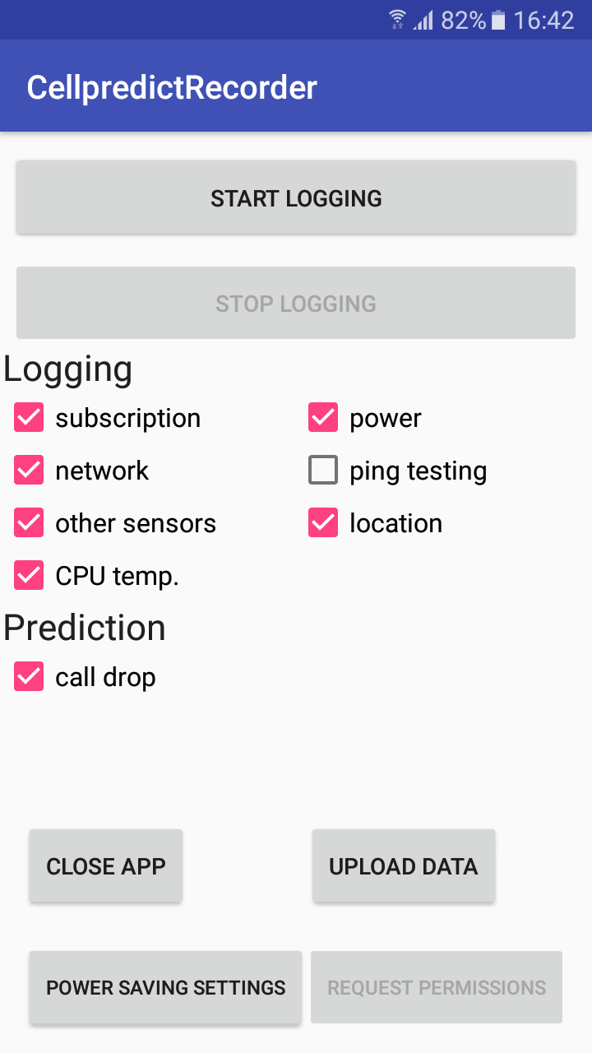
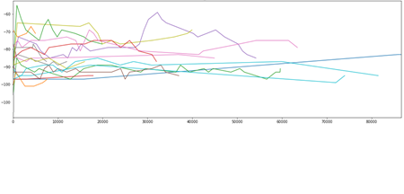
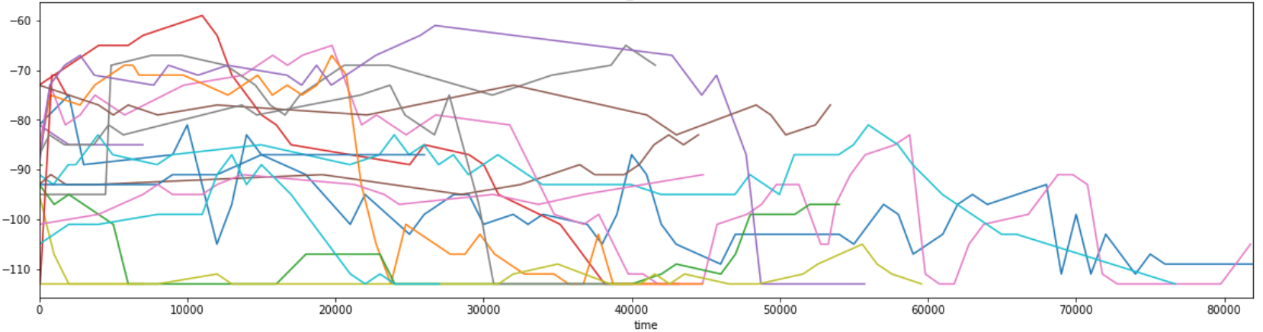
Data example: Smartphone – by a logging app
Logged whenever they change:
Cell info, signal strength
Network and Wi-Fi connectivity
Telephony call and data activity
Sensors: accelerometer, magnetic, gyroscope, light, pressure, proximity, gravity, humidity, temperature, battery, CPU and battery temperature
GPS and network based location
Network quality: ping test results, time and loss; data packet counts, Facebook net quality API etc.
Normal
dBm
Dropped
dBm

Slide 31

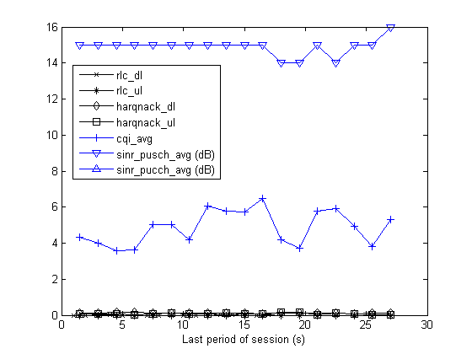
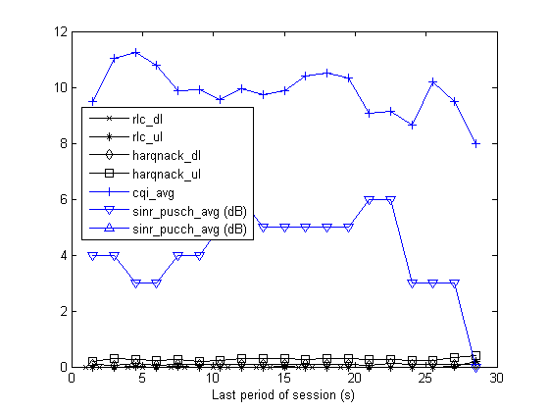
Radio Session Drop Prediction
Multiple time series (uplink, donwlink radio, no acknowledgement count, etc)
Predict network failures few seconds before they happen to reorganize and prioritize traffic, e.g. reduce Internet bandwith to keep voice session alive, prioritize for premium customers, …
High quality
RRC connection setup /
Successful handover into the cell
UE context release/
Successful handover out of the cell
START
END
Low quality
Per UE measurement reports
(RSRP, neighbor cell RSRP list)
Configurable period
Not available in this analysis
Per UE traffic report
(traffic volumes, protocol events (HARQ, RLC))
Per radio UE measurement
(CQI, SINR)
Period: 1.28s
Daróczy, Vaderna, Benczúr. "Machine learning based session drop prediction in LTE networks and its SON aspects." Vehicular Technology Conference (VTC Spring), 2015 IEEE 81st. IEEE, 2015.

Slide 32

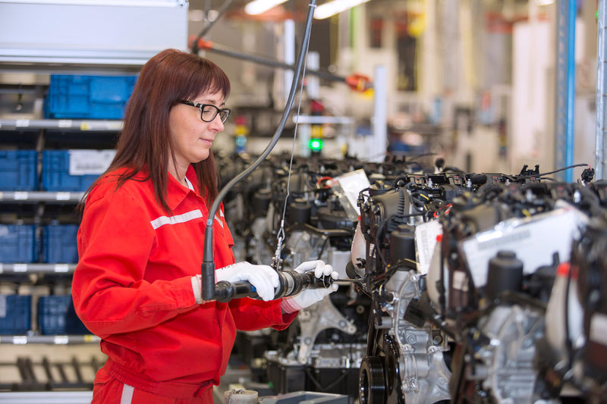
Data from (cyber-)physical systems
Largest Audi engine factory in Győr
Assembly process records all components, the operator and the force of every screwdriver, etc.
They want to learn how to make use of their data
Glass coating by various metals
Several products in a chamber, each in a different compartment; no gas isolation between compartments
Physics is very complex
We need to teach data science and train operators

Slide 33

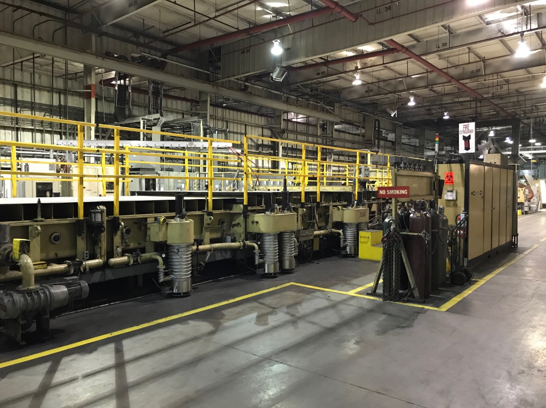
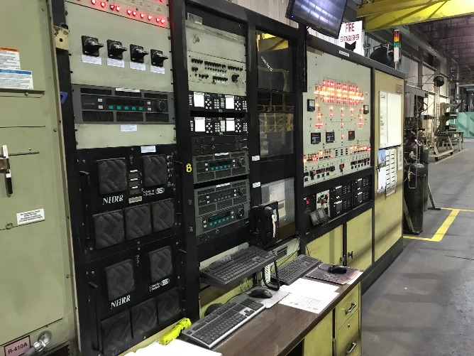
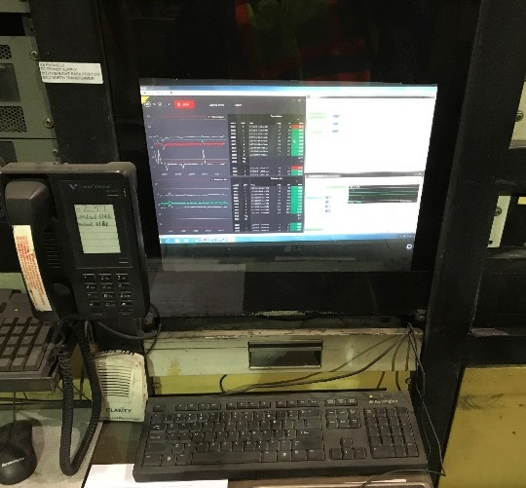
Glass Coating line
Power generators located across coating line from control console
Control console
Networking and Data collection HW inside of rear doors
Front of control console
Control PC
Ethernet cable

Slide 34

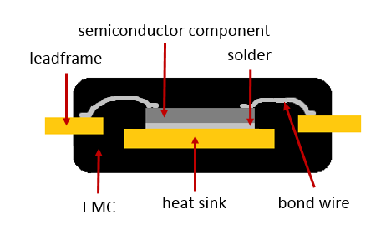
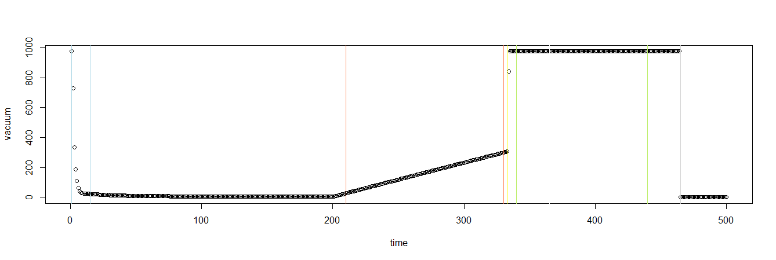
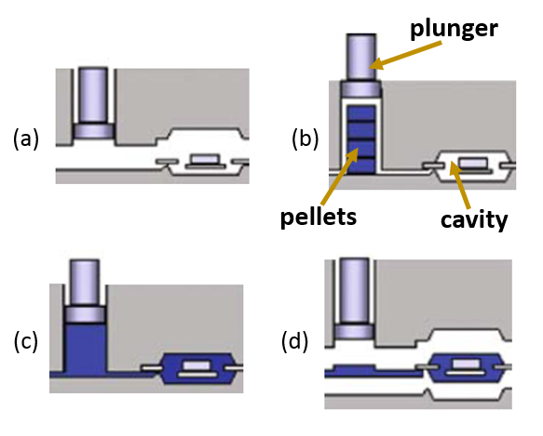
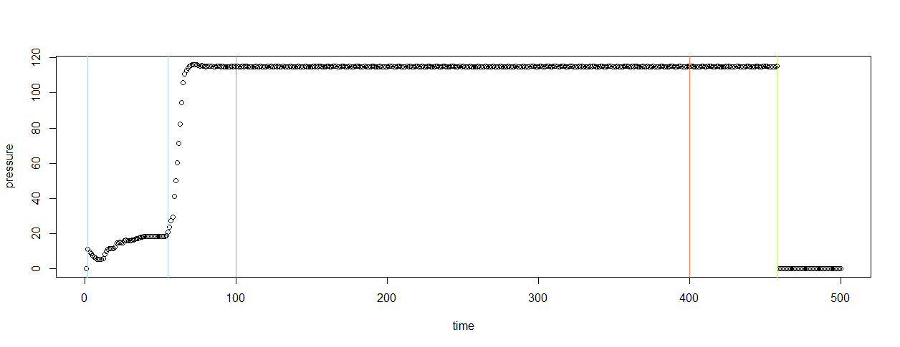
Molding electronic components
Multiple time series, 500+ measurements in each: many, many data points
Features of transfer graph measurement series
In the end, ~50 features in the final classification data
Vacuum Pressure
Filling pressure
Transfer Pressure
Mándli, Anna, Róbert Pálovics, Mátyás Susits, and András A. Benczúr. "Time Series Classification for Scrap Rate Prediction in Transfer Molding.”
3rd SIGKDD Workshop on Mining and Learning from Time Series Held in conjunction with KDD'17 Aug 14, 2017 - Halifax, Nova Scotia, Canada

Slide 35
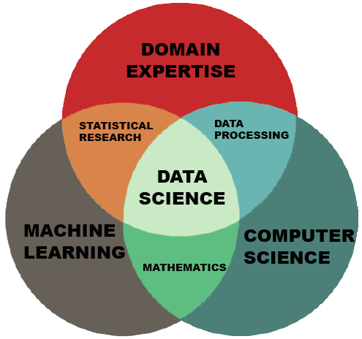
Summary
Not just deep learning
Must be application driven
Data is key
Consider regulations, policies, ethics
Use our Human Capital
  Theoretical mathematics, networks, …
  Attract and train young talents
Outreach and impact
  Events, demos and coordination key in especially in the first year

Slide 36
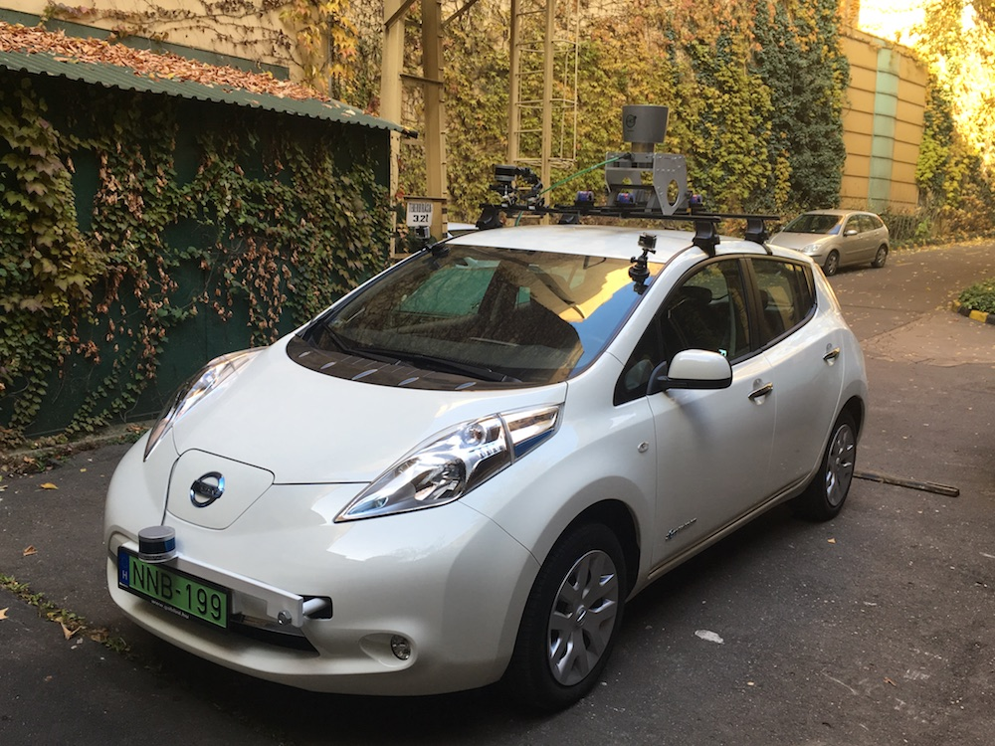
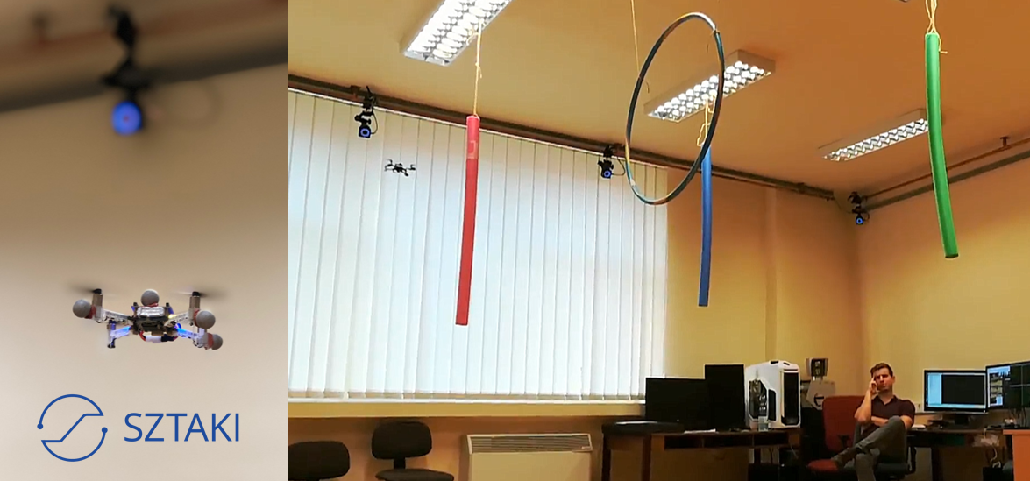
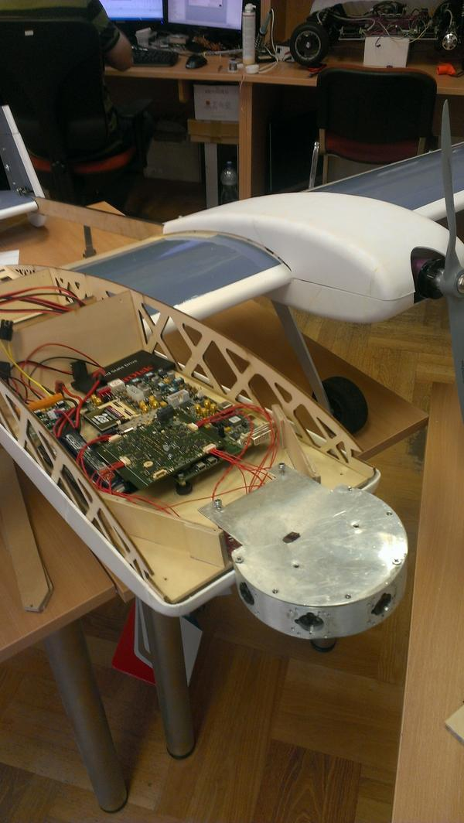
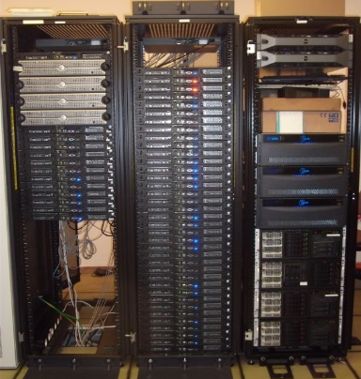
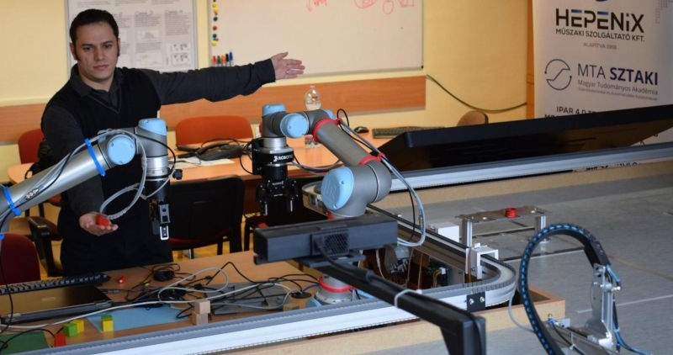
SZTAKI Test beds

Slide 37
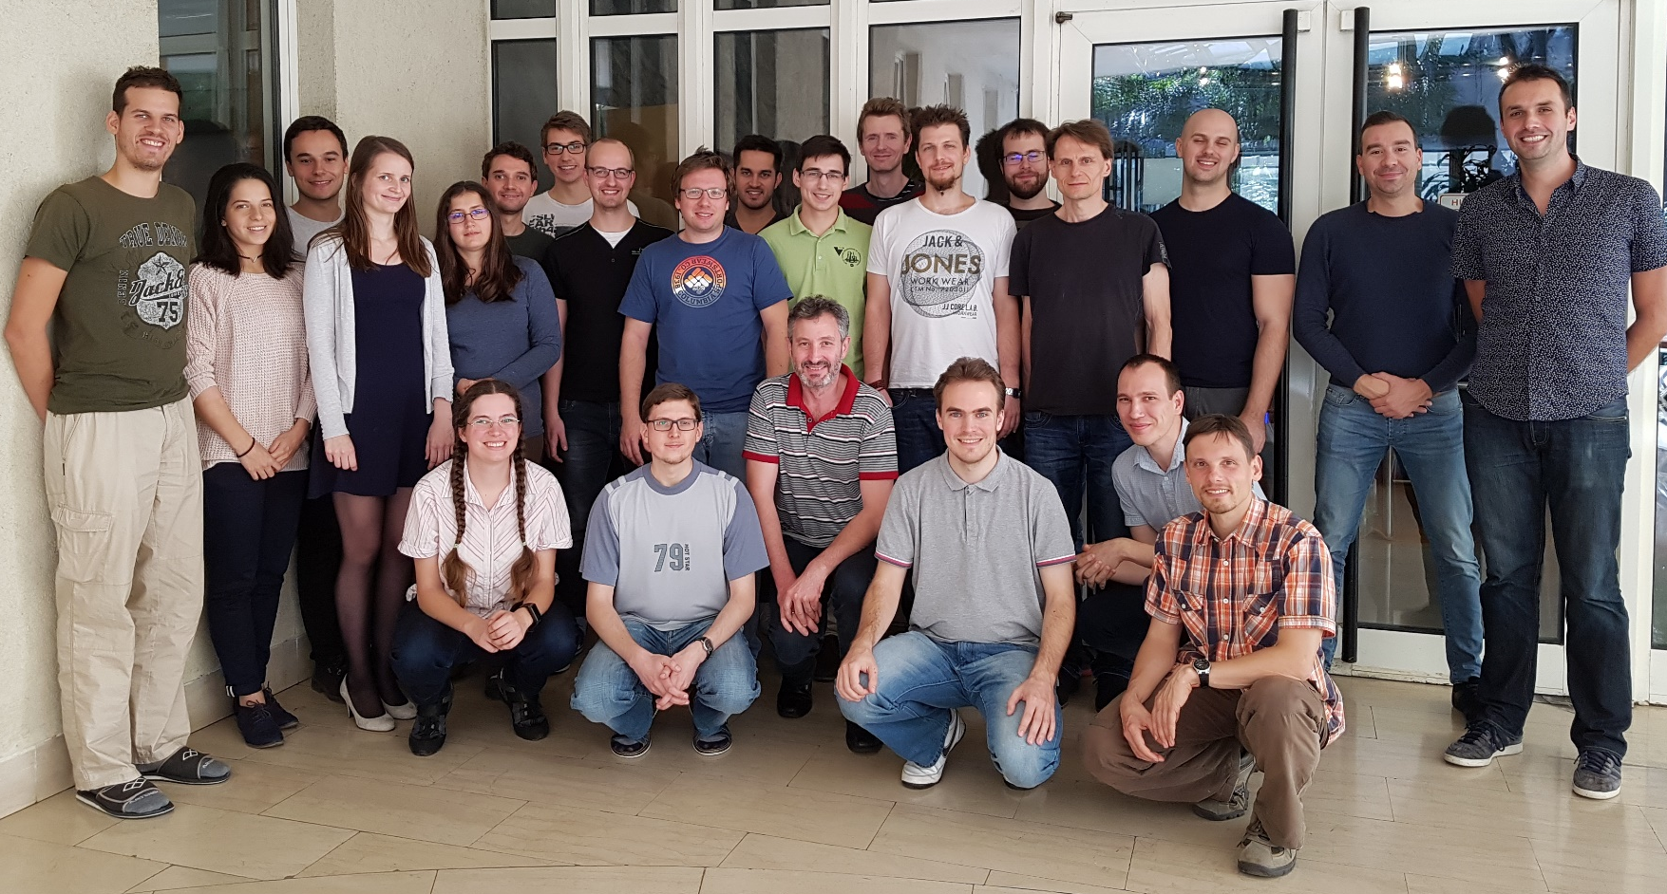
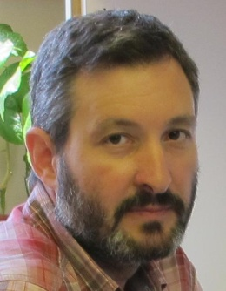
Questions?
András Benczúr
SZTAKI
Big Data – Momentum Group

