Slide 1


Adding artificial intelligence into process control systems – implementation and integration by open source tools
Tamás Ruppert^{1,2}, Gyula Dörgő^{1,2}, Dr. János Abonyi²
^{1 - Rabbit Miner Kft.}
2 - Pannon Egyetem, MTA-PE Lendület Komplex Rendszerek Megfigyelő Kutató csoport
^{ruppert@rabbitminerlab.com}
www.rabbitminerlab.com
www.abonyilab.com

Slide 2
Data-driven business development
MONEY FLOW
Business management
Buying, selling, cash management, asset management, product management
Decision
support
system
KPIs - dynamical targeting
Smart monitoring
(operator performances … business processes)
Level 5
Improvement opportunities
Performance model
Business planning & logistics
planning & scheduling, production/logistic management
Level 4
INFORMATION FLOW
Operations management
Detailed scheduling, reliability & availability assurance
Level 3
Machine learning
Procedure & Control execution
Automated Control / Monitoring
Level 2
Level 1
Sensing & Manipulating
„Touch and feel of the process”
MATERIAL FLOW
Raw data
Level 0
Production execution
The actual production process

Slide 3
Alarm management
We have expertise in building data-driven models to:
detect the correlated alarm tags
develop predictive models to make an event prediction
make assumptions on the past and carry out a root cause analysis.
PAST
FUTURE
Deep learning
Event (failure) prediction
Hierarchy of the process
Sequence mining
Discrete events and states
Root cause analysis
Alarm suppression / automation
Discrete events
Deep learning
Hierarchy of the process
State of the process
Frequent sequence mining for prediction
Alarm – operator interactions
Root cause analysis
Event prediction
Visualisation for interpretability
Structural process models
Helps the freq. seq. mining
Monitoring the spillover of malfunctions

Slide 4
The alarm management lifecycle
Which alarms are necessary?
Measuring performance, KPIs
ANSI/ISA – 18.2
Management of Alarm Systems
for the Process Industries
Notes:
The operator is in the focus ..
Provide exactly the right amount information
I recognised most people in this room know much more about …
For those who are less familiar with alarm management than me …
What is important on this slide is that … it shows our ambition that we want to develop tools …
To deterime the important, informative set of alarms
Reduce any redundancy .. Show the operators contectualised information
(so this means we would like to group … , supress ..

Slide 5


Self-driving car/operator
Lane keeping
Cruise control
Smart routing
Computer vision
Predictive decision making
Predictive maintenance
Safety
Lane keeping – line keeping
Cruise control – Pressure control
Smart routing – Smart workinstruction
Computer vision
Predictive decision making
Predictive maintenance
Safety

Slide 6
Big data and ML can support the alarm management?
From | To | Production Unit | Unit | Tag | Event Type | Description
10/24/2018 16:02 | 10/24/2018 16:04 | Distillation | Main column | Head temp. | Alarm | High alarm
10/24/2018 16:02 | 10/24/2018 16:04 | Distillation | Main column | Cond. cooling | Operator action | Open
…
Millions of data points
Data (process) mining, machine (deep) learning…
Something useful ?
Notes:
To solve these ambitious problems we have to answer to the most important question, ….
Does BD and ML can …?
We started this work three years ago … we developed … and we have received strong support from MOL
The log file has a similar structure …
Start and end of an event that can be alarm, warning, operator action …
…

Slide 7

Knowledge Discovery can support alarm management
05
Integration
04
Evaluation
Utilisation of the knowlege
monitoring of alarm
rationalisation projects
grouping alarms
suggest alarm supression rules
fault detection and diagnosis
support and monitor of
the operators
Data
-mining
03
Patterns
and
Rules
Transforma-tion
02
Transformed
Data
Selection &
cleaning
01
Target Data
DATA
Warehouse

Slide 8
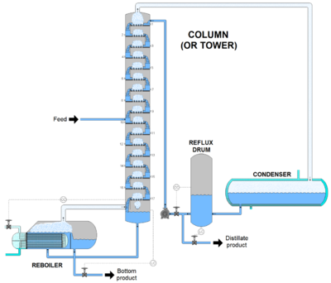


Illustration of the frequent pattern-based concept
ALARMS
Root cause analysis:
60 % confidence
Grouping:
Parent-children
Prediction:
80 % of the cases
$$Fouling\underset{⇒}{}$$
$$F_{reflux}^{L}\underset{⇒}{}p_{condenser}^{H}\underset{⇒}{}T_{column top}^{H}\underset{⇒}{}T_{condenser}^{H}\underset{⇒}{}A_{product}^{L}$$
Automation
Recommendation
OPERATOR ACTIONS
$${Flow}_{pump}^{H}\underset{⇒}{}Q_{cooling}^{H}\underset{⇒}{}{Flow}_{inflow}^{L}\underset{⇒}{} Bypass$$
Notes:
So what is the potential of frequent sequence mining in alarm management?
Let’s have a simple and hopefully, didactic example. Assume a distillation column and a small fouling after the condenser of the column.
In the simplest case, if two alarms frequently occur together, they can be grouped in order to reduce the operator workload and define more informative process alarms.
Observing a frequent outcome of a sequence, we can make a prediction of the next occurring event and assign an appropriate probability measure as well.
If we have a historic database of the malfunctions, we can realise that the fouling is followed by the recorded sequence, hence we can make a root cause analysis.
On the other hand, we cannot just analyse alarm messages, as the operators constantly interact in the process and change the ongoing processes. In the case of the fouling, they can increase the pump or the cooling efficiency at the condenser. If these solutions does not work, they can reduce the inflow of the whole column, or in the worst case scenario they need to put the appropriate part on a bypass.
So the concept is …
F – flow, p – pressure, T – temperature, Q – heat, A – analysis (prod. quality)
H – high, L - low

Slide 9



The method and the framework
Open source machine learning tools are applicable in the process industry
00
Online data
Offline data
03
Online applications
Trained model
Data
warehouse
Root cause analysis
Seq2seq
Event prediction
Anomaly detection
Deep learning
Keras, TensorFlow
01
02
Extracted knowledge
Visualisation
Sequence mining
Matplotlib, plotly, bokeh
spmf toolbox
Notes:
We developed these tools as part of our research work with the hope as the concept will work
But know we are just turing it into product, namely to plugins of a SCADA system developed for
water production, treatment and distribution companies.
The main takeaway is that ML can be implemented …
The main prolem is how you can turn the bussiness problem into data analyis task,
how you transform your data …
How you find the good algorithm and most importantly, how the resulted data-driven models
are utilised and MAINTANED.

Slide 10
The process flow of development
Filtered Database
DCS
1
Business problem
2
Proof of Concept
3
Define requirements
4
Use-cases
5
GUI and integration
6
Test
json
Data processing
EXE
packages
AI
Framework

Slide 11
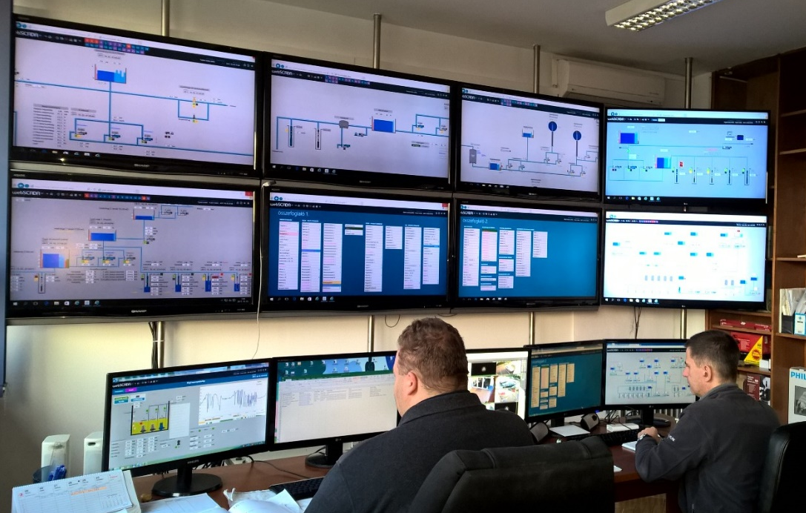
Water production & distribution
134 station object
35611 variables
7165 trend variables
4 909 701 events
2 531 019 daily archive data
(since 2017 january)
http://www.controlsoft.hu/hu

Slide 12
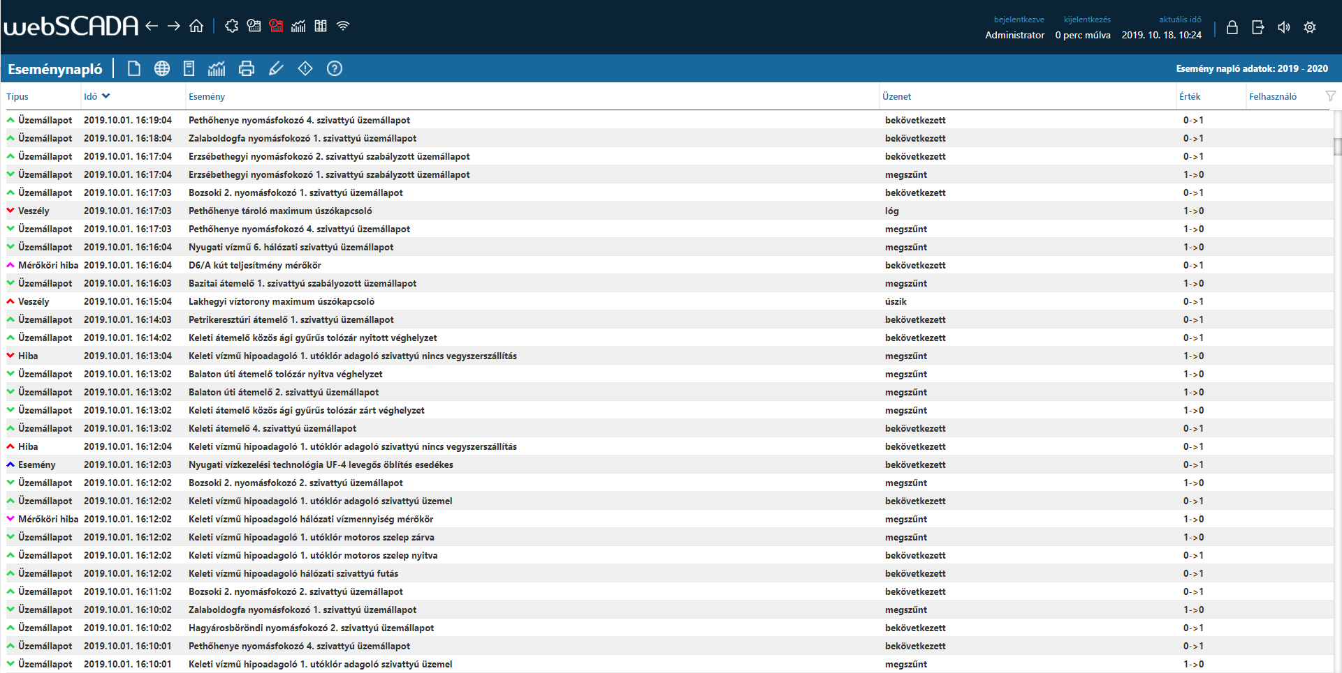
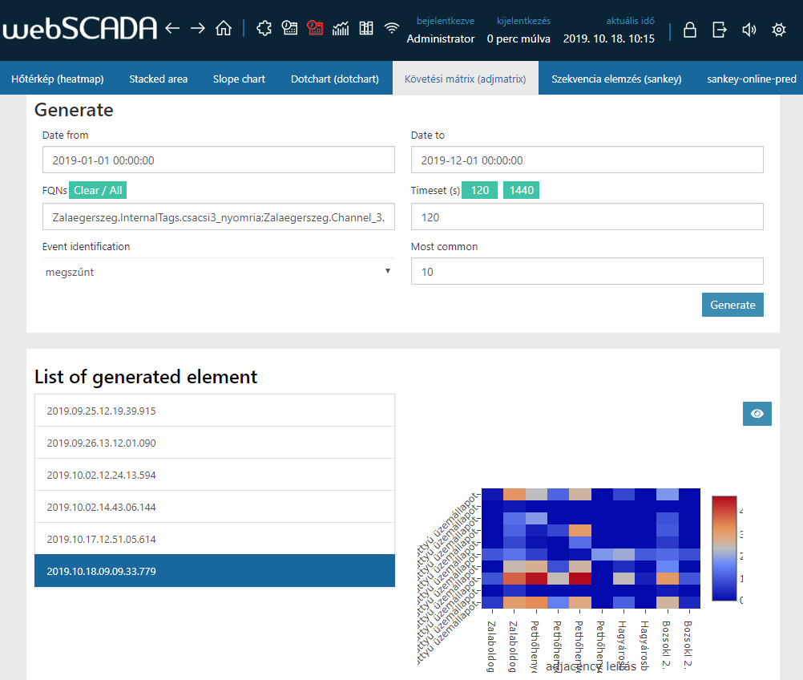
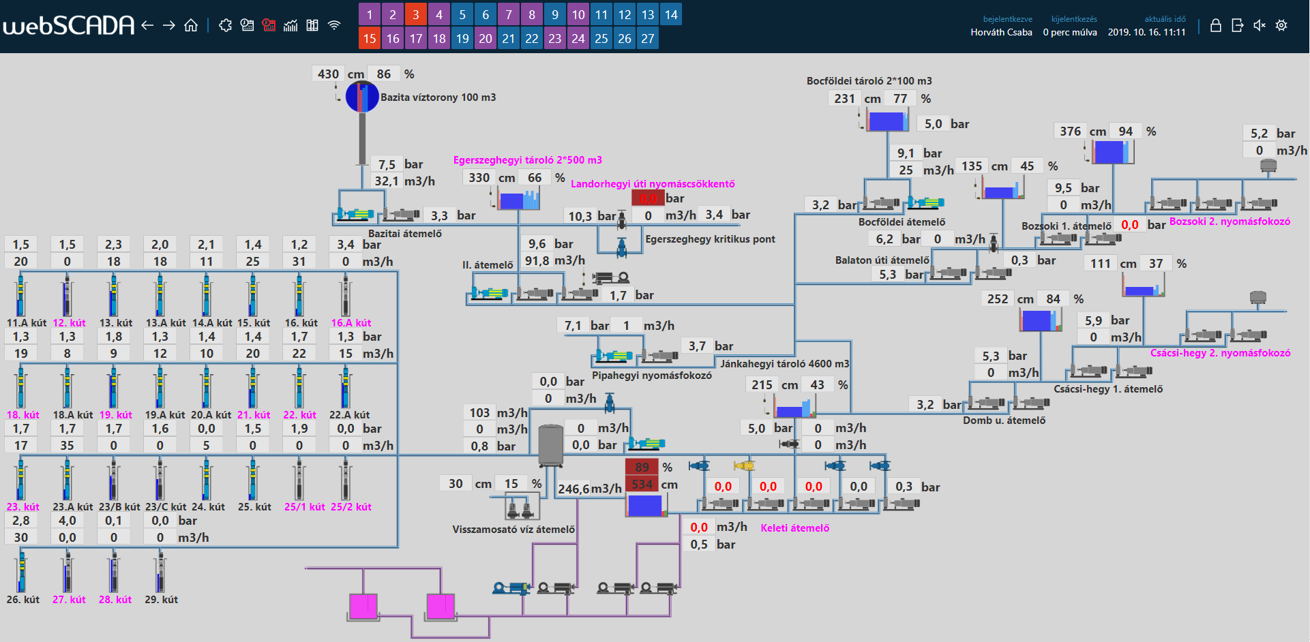
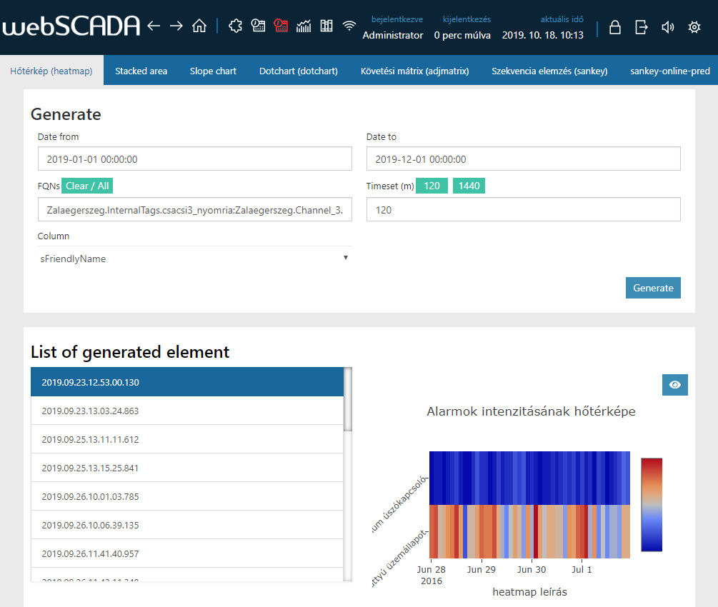
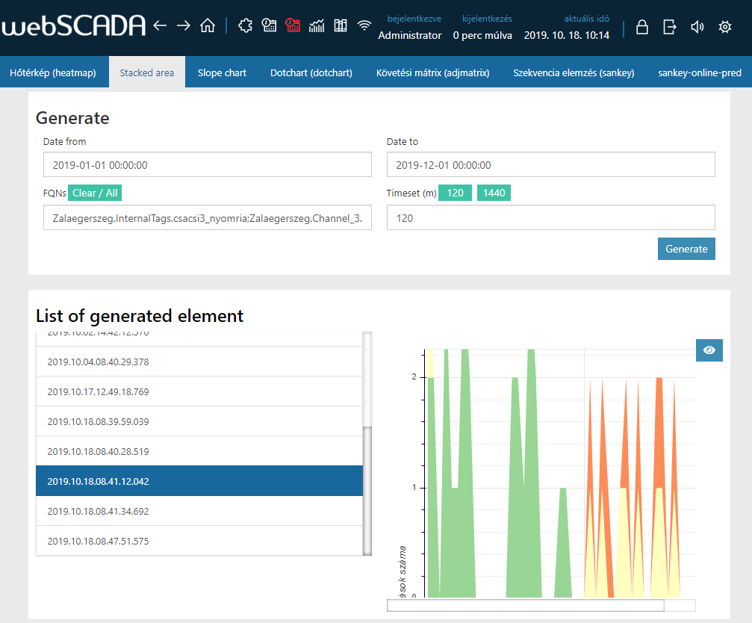
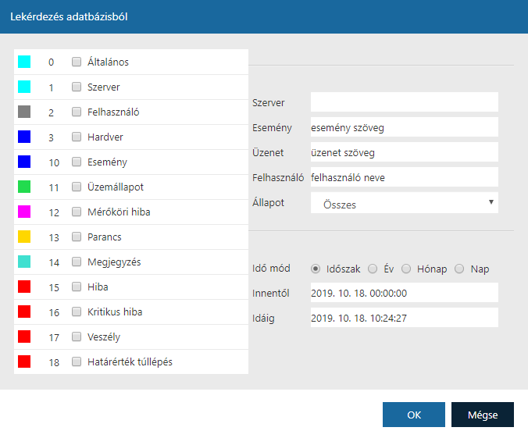
webSCADA before/after

Slide 13
Conclusion
The related ML task
Realization
Future
Sequence mining
Event prediction
Prediction
Visualisation
Advanced techniques
Fully integrated
Open source
KPIs of operation actions
Rare events?
Recommendation system
Problem
Solution
Improvement
The python script-based solutions are well integrable

Slide 14



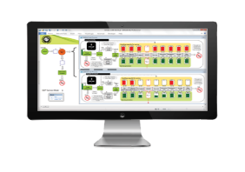
Rabbit Miner –
The process systems engineers
Rabbit Miner Ltd. offers comprehensive data mining and process systems engineering services. We are specialized in process optimization, data science applications, supply chain management, and Industry 4.0 solutions. Our potential partners and customers are the industrial companies open to new data-driven optimization techniques. Our experience in data science as well as in process systems engineering makes us the ideal innovation and R&D service partner to solve your process optimization problems.
Data-driven
process development
Smart monitoring
system
Root cause
analyses
Decision support
based on process simulation

