Slide 1
Hindrances to adaptation of Machine Learning in Healthcare
Richard Nagyfi
richard@cursorinsight.com

Slide 2
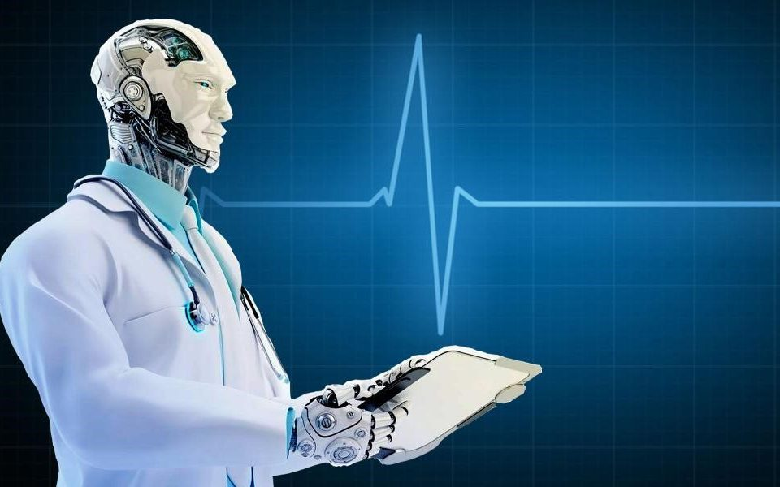
OVER-HYPING AI
Notes:
Conflicting interestes

Slide 3
The limitations of Machine Learning models should be made clear
Machine Learning may be re-branded as a diagnostic tool based on patient data
Notes:
IF WE WANT TO SEE THE FRUITS OF OUR RESEARCH APPLIED, there are 2 things we should consider: 1 2
The solution is to educate people and to present our findings as clearly as possible.
I will show examples from popular media that are counterproductive
2 – at least for now!

Slide 4
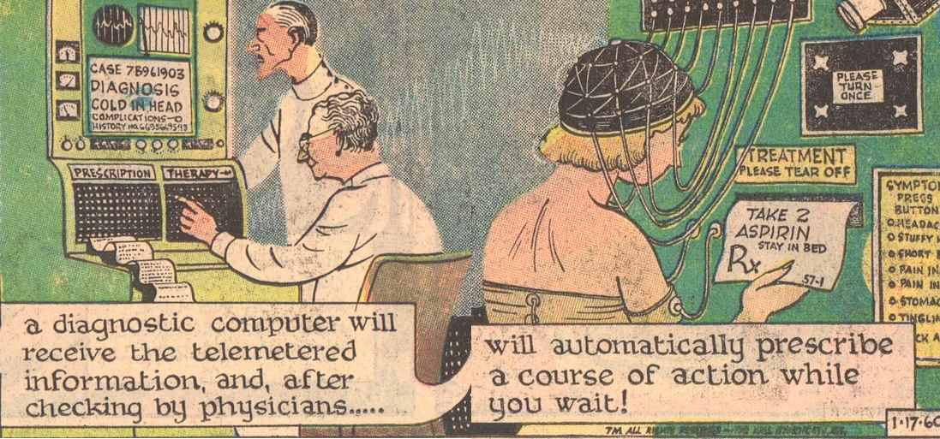
The Expert Systems of the 60s
Notes:
This isn’t new: First AI winter: the unfulfilled promises of the perceptron (limits of its representational power)
AI was rebranded as Expert Systems, that needed all the information of domain experts – doctors were told they will soon be replaced
Problems: strange outputs for strange inputs, needed all the info, and had to be constantly updated

Slide 5
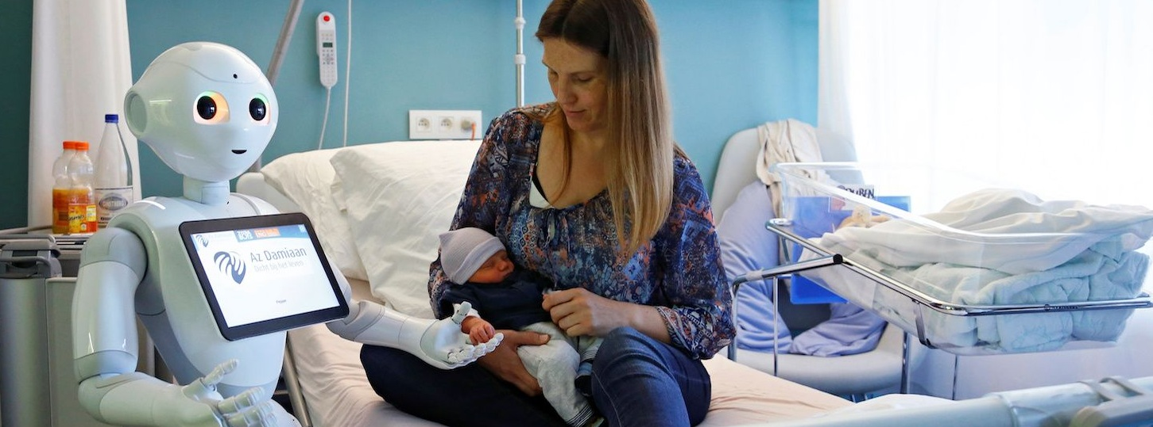
The Hype is back
Notes:
Infallable AI doctors who are better at screening any cancer related image than most experts

Slide 6
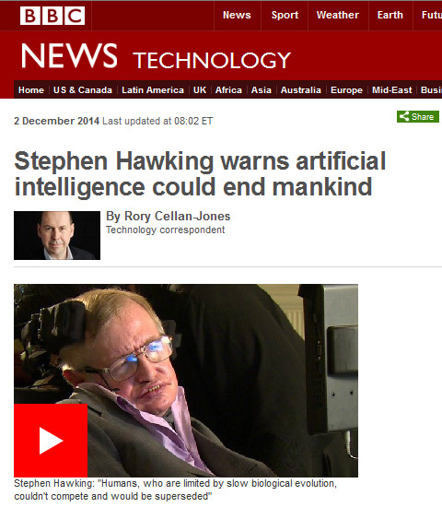
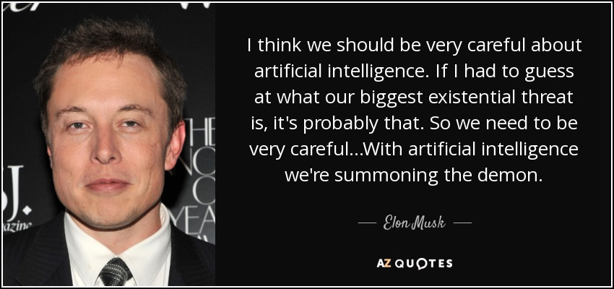
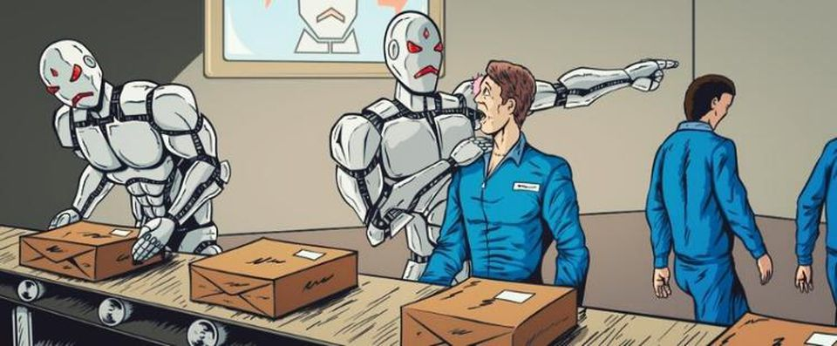
And so are the fears
Notes:
Fearmongering and antropomorphising
Attracts clicks and views online, but makes it harder for the technology to spread if we don’t educate people
Looking back in history, each and every technological revolution always had similar patterns: worries, excitement and the transformation of jobs

Slide 7
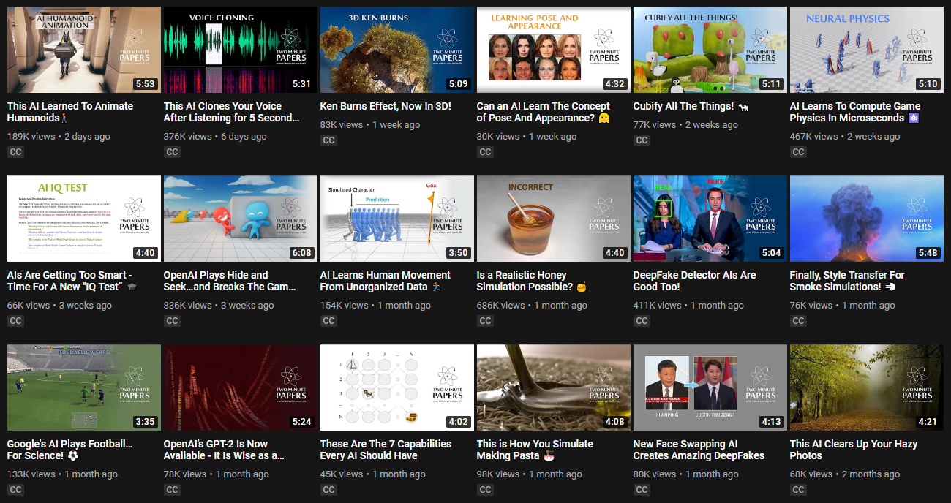
Notes:
The progress is real, there is a lot of value generated by machine learning
It is really hard to imagine that Google or Facebook would stop using AI
But lay people will only get a false impression of the technology
The way we present findings can either help or hinder adaptation in the long run

Slide 8
The limitations of Machine Learning models should be made clear
Antropomorphism
„AI has developed its own language, etc.”
Notes:
Great for headlines, terrible for discussion

Slide 9
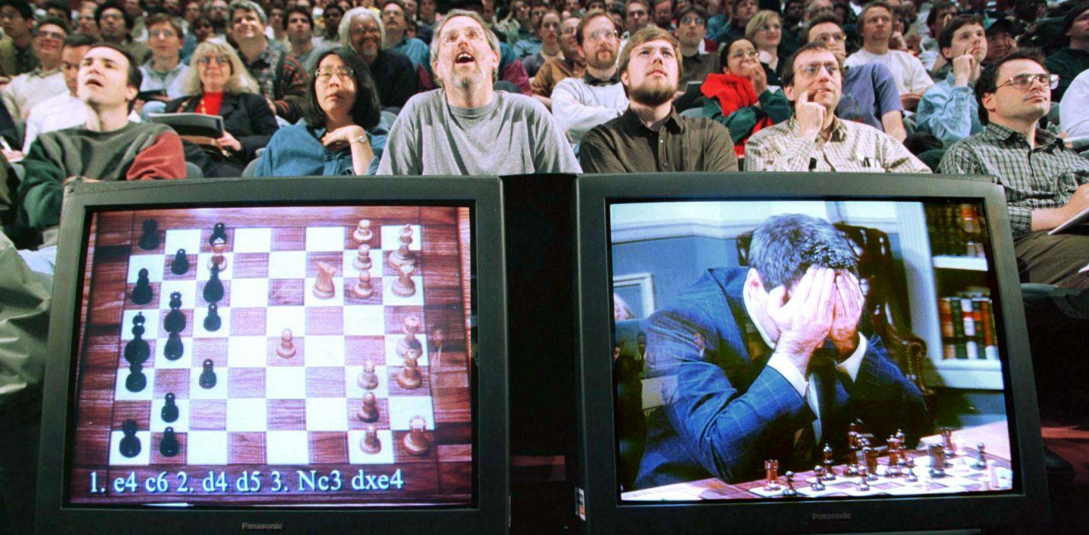
False impressions of AGI
Notes:
Kasparov was beaten after 50+ years of research by the joint effort of IBM’s brightest engineers and exponential computational growth.
He could have beaten Deep Blue in any other game,
He could learn chess from different representations. – again: narrow domain
We can make systems that beat Kasparov in chess, but can’t do things a 1 year old baby can do.
„Buliding trust” – people forgive humans but not AI for wrong decisions (thermometer, x-ray)

Slide 10
The limitations of Machine Learning models should be made clear
Medicine is not a classification problem
„AI will take most jobs”
Notes:
Simplify & Frame a physicians job as an image classificaiton

Slide 11
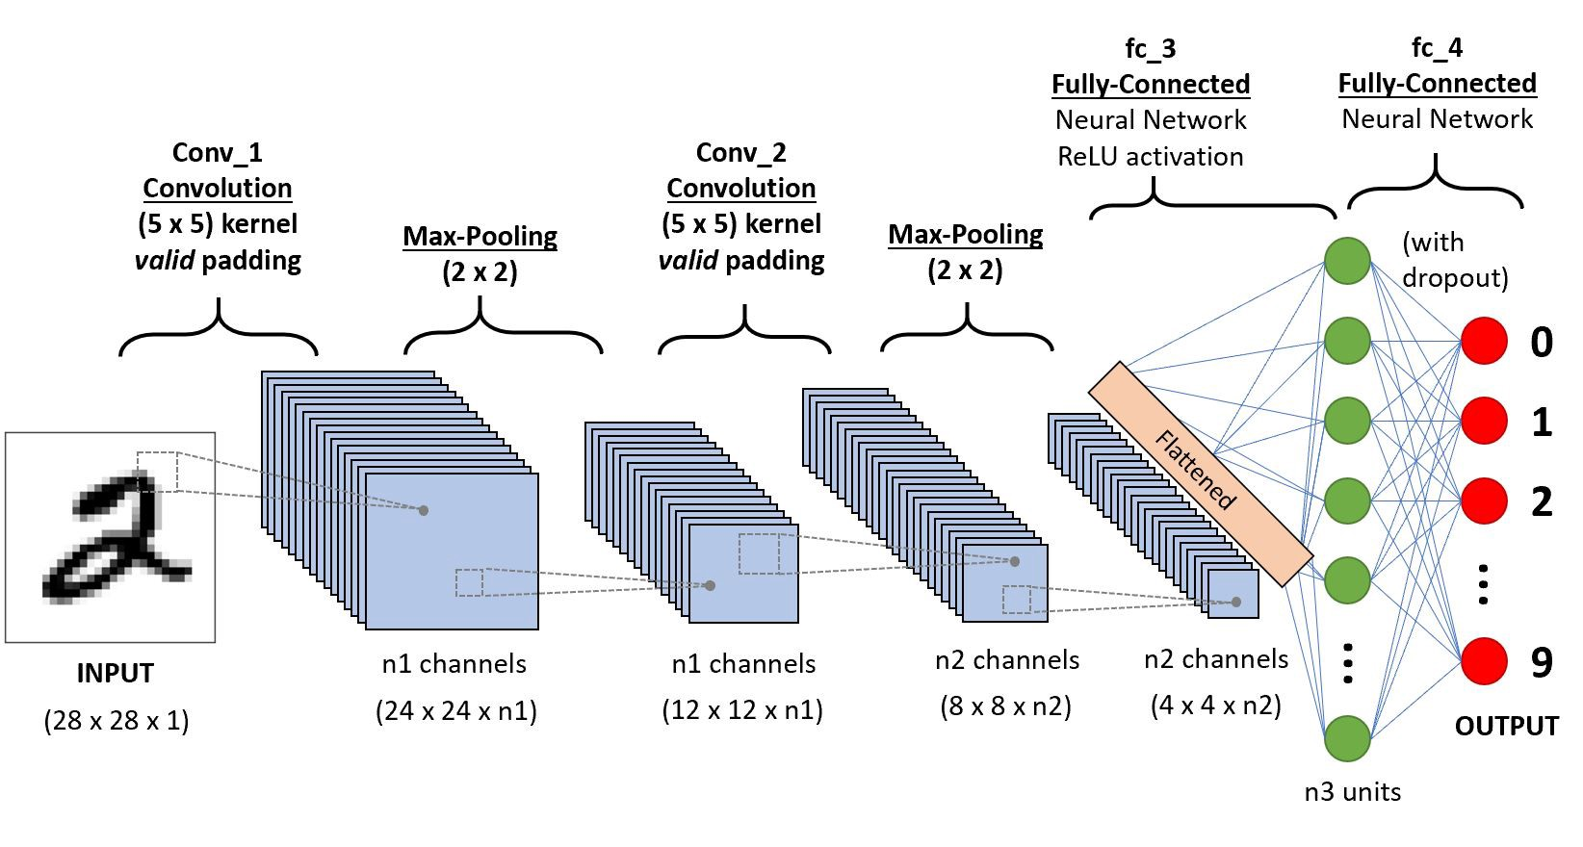
Classificaiton within a narrow domain
Notes:
Doctors do more then diagnosis → loss function means losses in human lives?
The problem isn’t physicians inability to classify most diseases, but rare cases and multiple cases at once.
It implies the doctor already knows what the problem might be: what if we used scans from different imaging device for the same ML solution?
What if the inputs can’t encode and the outputs do not represent the actual problem?

Slide 12
The limitations of Machine Learning models should be made clear
Misleading evaluation metrics
„AI has outcompeted humans with 99% accuracy”

Slide 13
Single score for accuracy
Notes:
Inbalanced datasets with inbalanced costs
Having high scores on a holdout set does not equate to real life usefulness (sensitive to scaling and movement).
Andrej Karpathy – scrolling for 5 minutes to select from 120 breeds of dogs

Slide 14
The limitations of Machine Learning models should be made clear
Not enough data
„Unlimited BigData is the new oil”

Slide 15
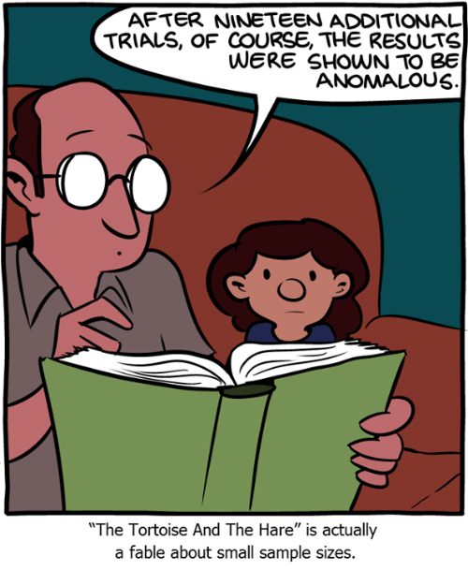
Sample sizes are often too small for Machine Learning
Sample sizes are often too small for Machine Learning models
Data cleaning and preprocessing take time, and involve domain knowledge
Not enough examples for rare diseases
Notes:
It is acceptable to do hypothesis testing on n=12 and above, however ML will only overfit
DataScientists have to juggle to find optimal bias and variance
Data is never clean enough – administration might have different kinds of data that does not reflect reality
Data hygene – have you ever seen clean data that is clean on its own?

Slide 16
The limitations of Machine Learning models should be made clear
Lack of transparency
„Even scientists can’t explain AI’s decisions”

Slide 17
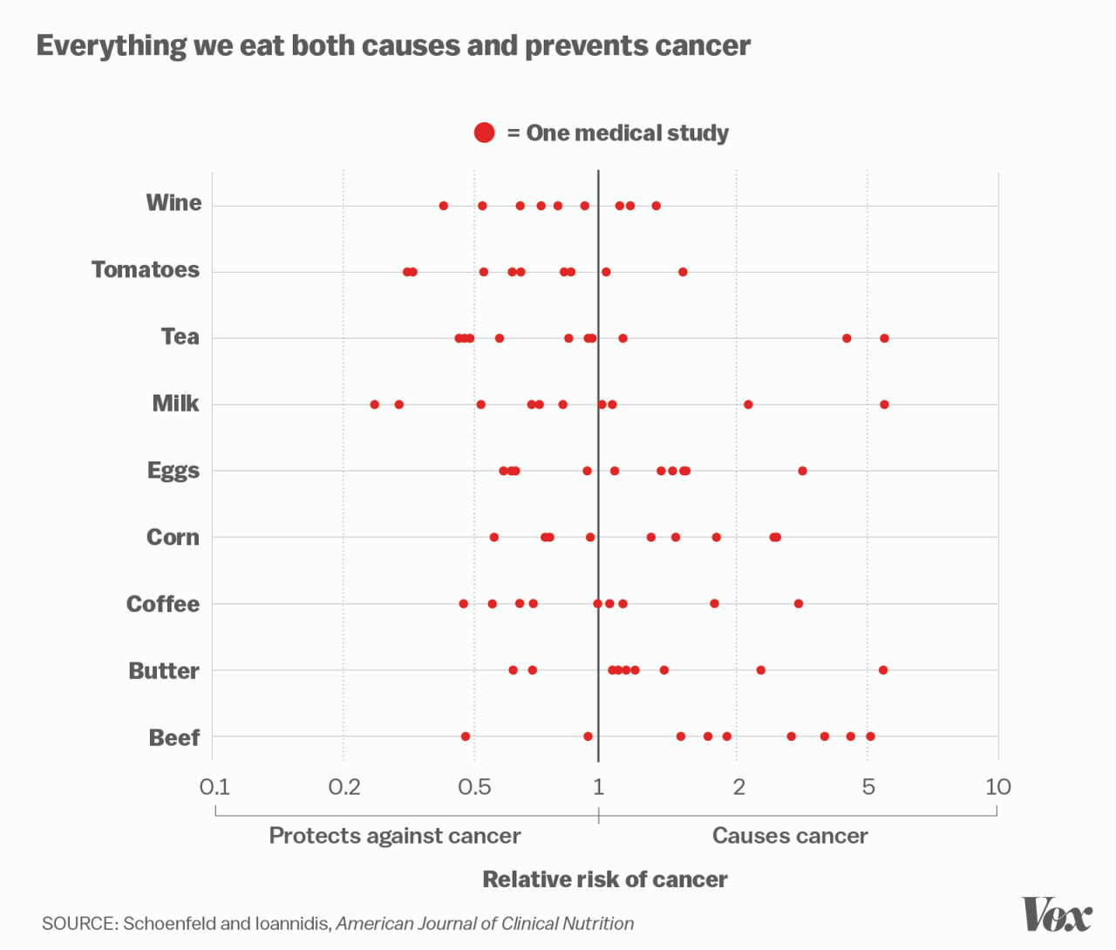
Black Box Systems
Lack of interpretability
Randomization
Bias in datasets
Notes:
Biology is full of black box systems – we have SOME understanding of how cells work
If it’s interpretable chances are it’s useless
Bias is also hidden antropomorphism

Slide 18
Machine Learning may be re-branded as a diagnostic tool based on patient data
Notes:
The problem’s are based on the unrealistic expectations towards AI

Slide 19
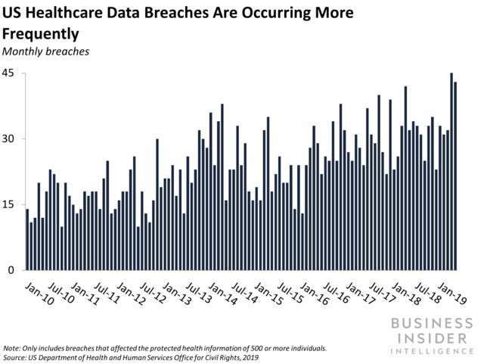
Create the groundwork for AI first
Notes:
2019 healthcare databreaches are setting records
Doctors will use other software for communication if they don’t have the proper tools

Slide 20
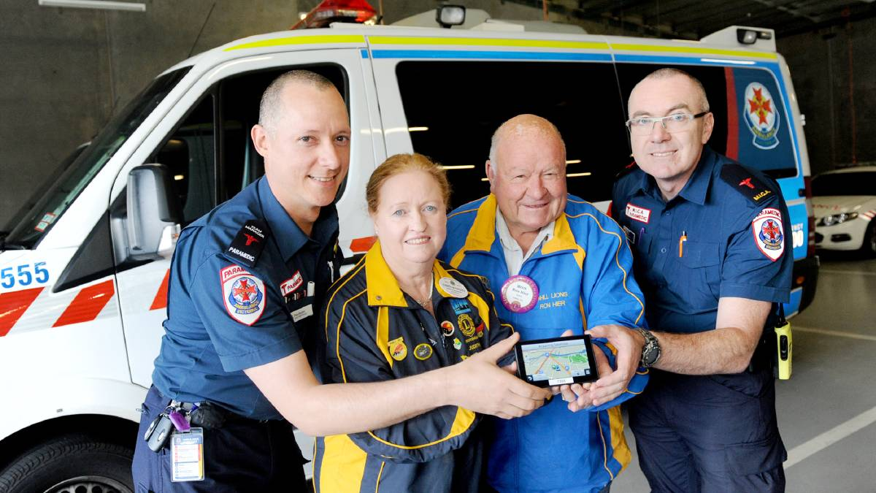
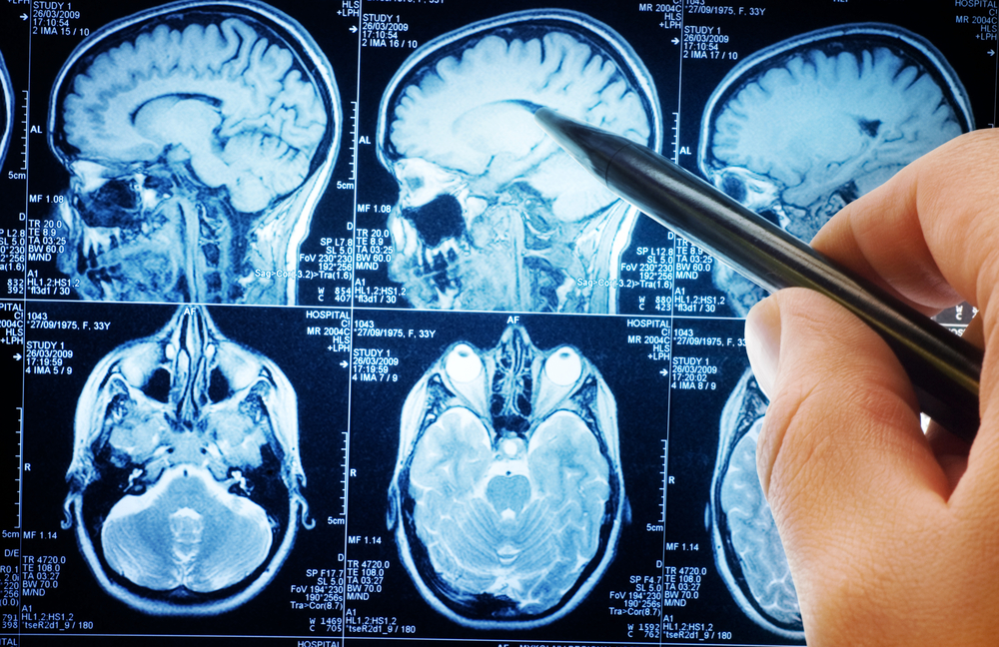
Explaining that „AI” is already part of Healthcare
Notes:
Google and Facebook in social psychology.

Slide 21
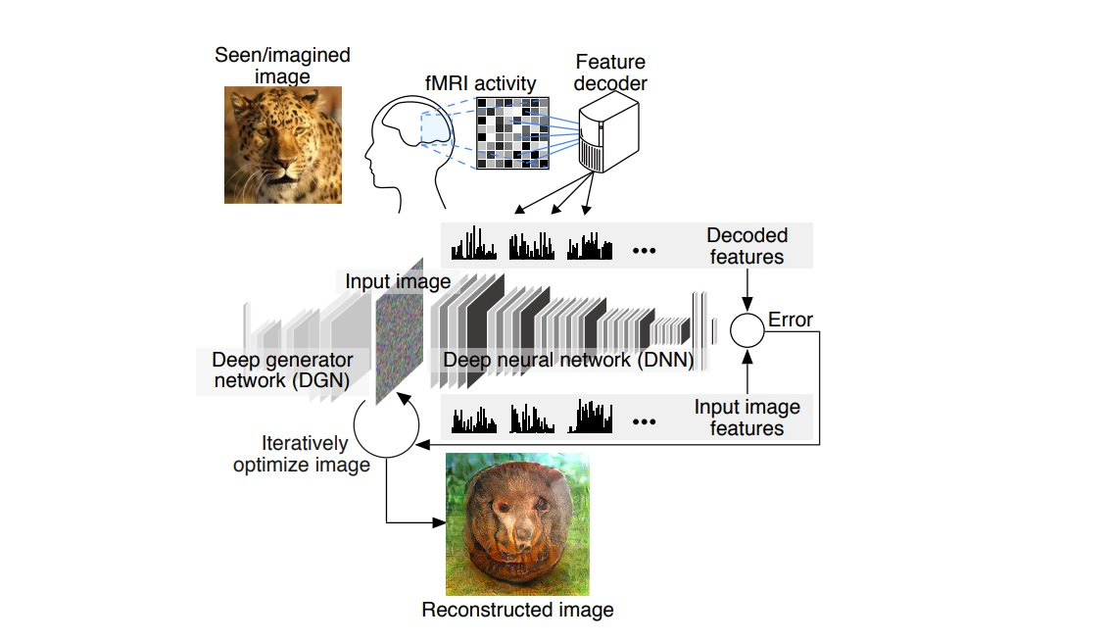
Notes:
The more data is generated the bigger the need for making sense of that data.
Machine Learning is inevitable. High number of features and non-linearity can only be tackled with ML.

Slide 22
Even if lab results are sometimes incorrect, they can still help physicians to make better decisions.
Machine Learning models are another set of diagnostic tools that give results based on the patient’s data, instead of their bodily functions.
Notes:
Every model has its own limitations. Every drug has its side effects. But we still prescribe antibiotics even if some people are allergic to them.

Slide 23
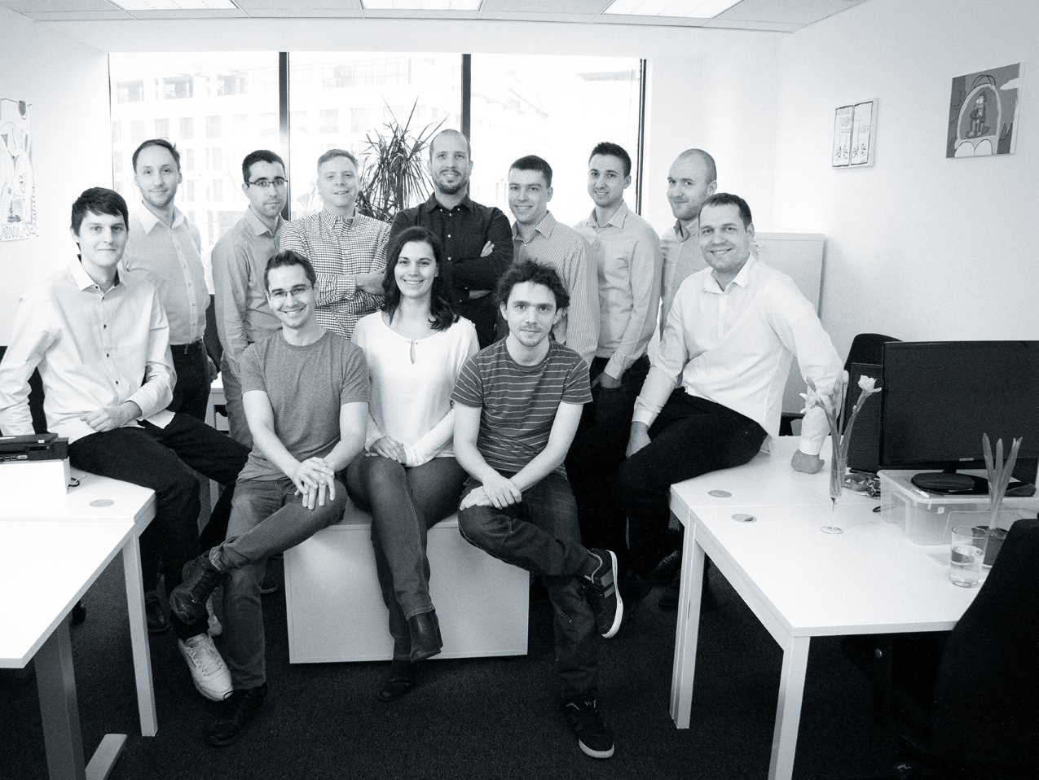
Notes:
We are agumenting images for doctors, in collaboration with a Hungarian Medical University
Early next year, medical device research with relal patient will start

Slide 24
Thank you for your attention
Any questions?
richard@cursorinsight.com

