Slide 1


NAPLIFE Collaboration
Nanoparticle doping of fusion targets
Dr. Attila Bonyár
bonyar@ett.bme.hu
Budapest, 2022.05.18.

Slide 2

Speaker Introduction
Attila Bonyár is an associate professor at the Department of Electronics Technology at Budapest University of Technology and Economics.
He has two M.Sc. degrees in electrical engineering and biomedical engineering and Ph.D + habilitation in electrical engineering.
His research activities are focused on the development of optical, affinity type biosensors, utilizing low-dimensional nanomaterials, plasmonics and nanometrology (AFM).
Chair of the IEEE Hungary&Romania EPS&NTC (Electronics Packaging Society and Nanotechnology Council) joint chapter since 2019.
IEEE EPS/NTC Nanotechnology/Nanopackaging Technical Committee chair since 2022, co-chair since 2019.
IEEE NTC Region 8 Chapters Coordinator.

Slide 3
Agenda
Introduction of the NAPLIFE Collaboration and our work group
Considerations for target fabrication
Nanocomposite target preparation – results
  Tuning of plasmonic properties
  Controlling the layer thickness
Conclusions

Slide 4
1. Introduction of the NAPLIFE project
Nano-Plasmonic Laser Inertial Fusion Experiment Collaboration
Theoretical group (modelling, simulations)
Material properties
Target properties
Target fabrication group (nanocomposite preparation, measurements)
Target
Laser group
(Target irradiation)
Target performance
Irradiated target
Analytical group
(Effect detection)

Slide 5


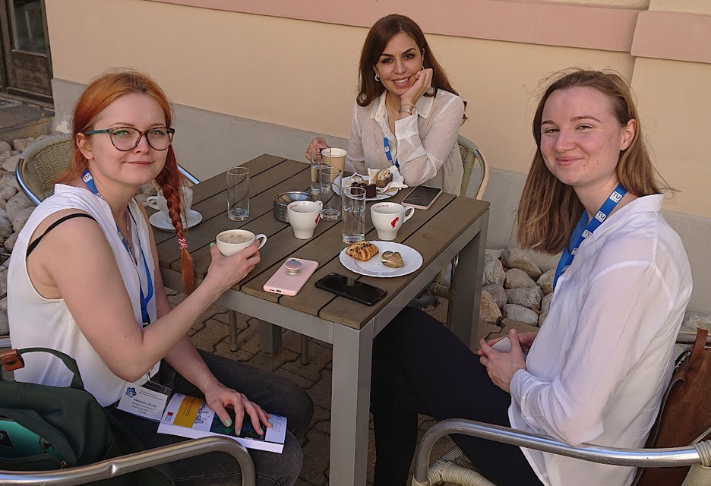
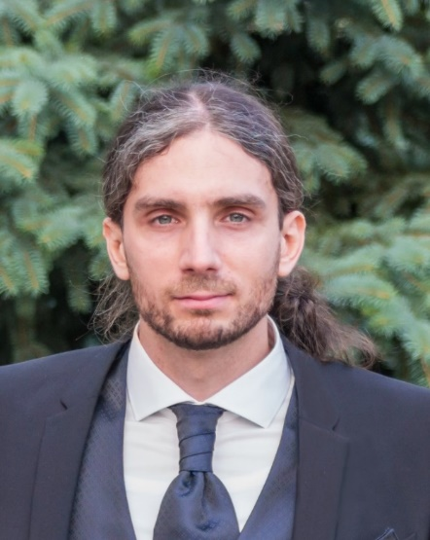




1. Introduction of the Target Fabrication Group
Dr. Szalóki Melinda
Assistant Professor
Polymer chemistry, doping of nanomaterials, nanocomposite preparation
Dr. Petrik Péter
Senior Research Fellow, Head of Laboratory
Dr. Bonyár Attila
Associate Professor
Alexandra Borók, Shereen Zangana, Rebeka Kovács
PhD Students
Coordination, target fabrication from nanocomposite, optical measurements, etc.
Optical measurements (ellipsometry), transmission electron microscopy (Dr. Zsolt Fogarassy)

Slide 6
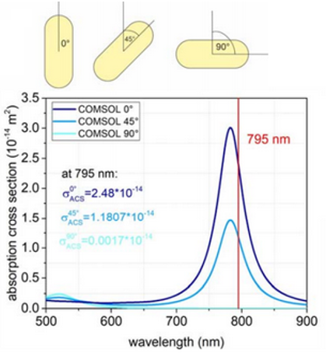
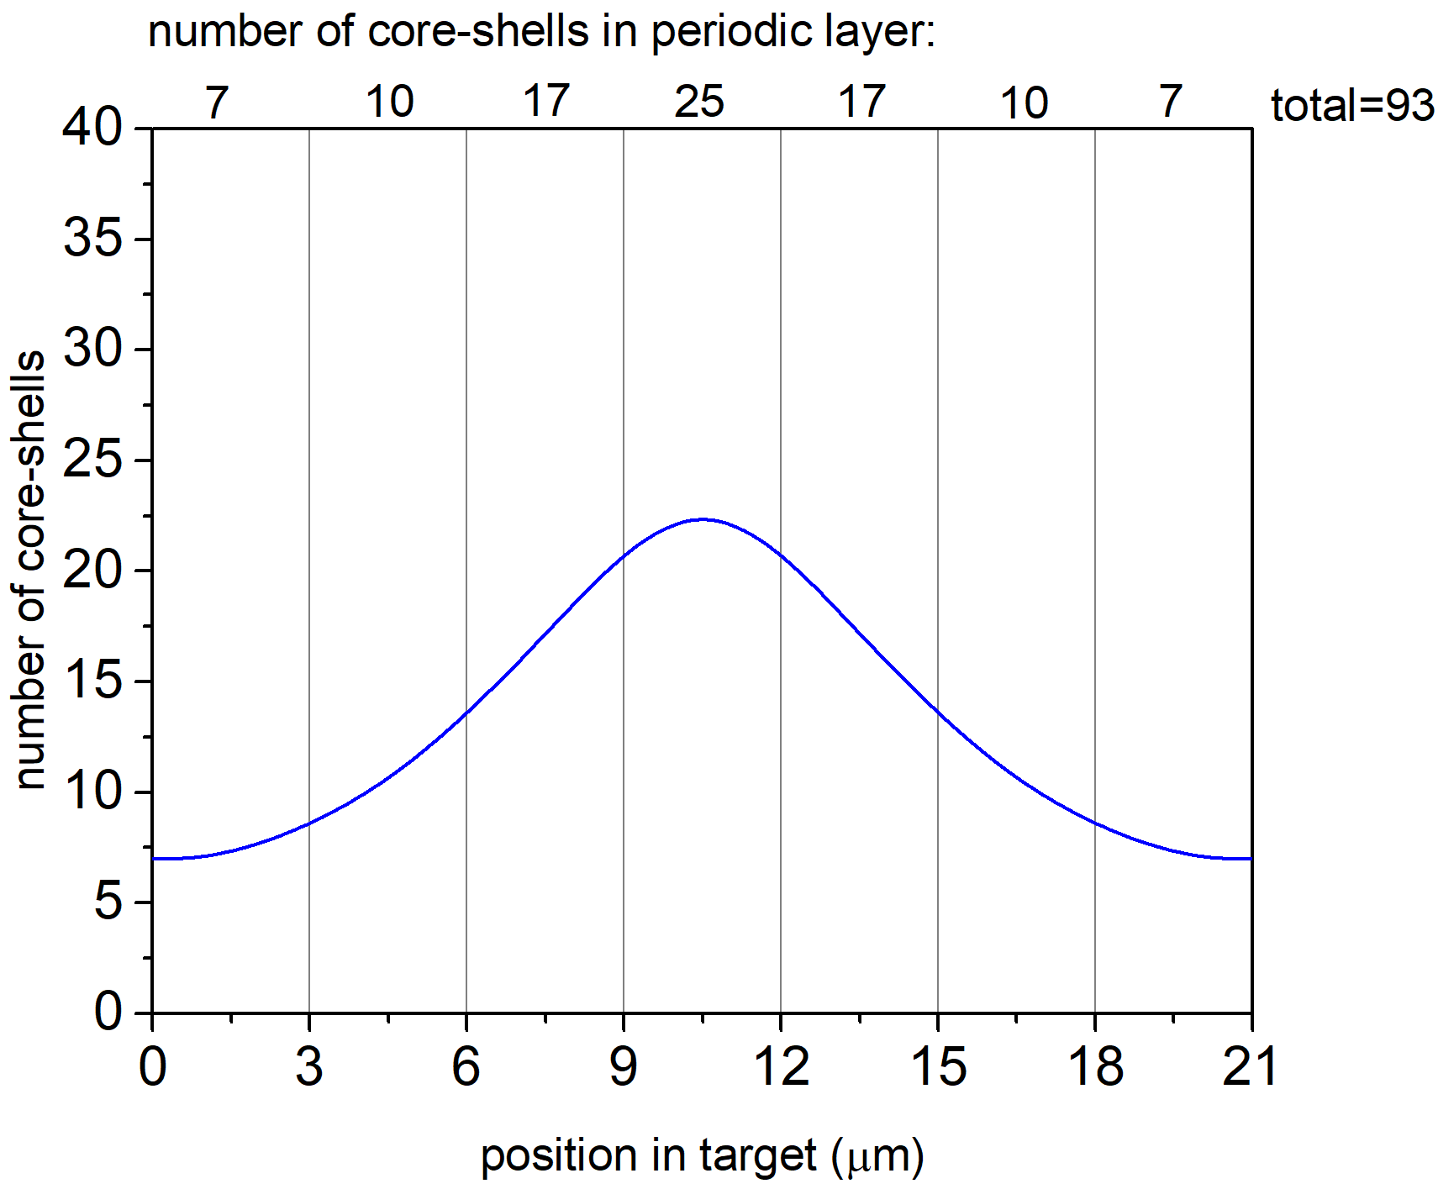
2. Considerations for the target
Laser beam
The planned target is a model material, where the density of the nanoparticles (and thus the absorption) in controlled in layers.
Absorption cross-section [10⁻¹⁴ m²]
d_{n}, ρ_{n}
Wavelength [nm]
Calculations from the Theory Group
Number of nanoparticles [-]
.
.
.
.
.
.
.
.
.
20 µm
Target schematics considering two-sided irradiation
d₃, ρ₃
d₂, ρ₂
d₁, ρ₁
Number of layers: n=10
d₁=d₂=…=d_{n}= 2 μm
D = sum(d) = 20 μm
ρ_{n}: concentration of the nanoparticles in the layers.
Target thickness [µm]
Calculations from the Theory Group
Laser beam

Slide 7
2. Considerations for the target
Boundary conditions (requirements):
The continuous nanoparticle distribution will be approximated with layers of constant nanoparticle densities.
The layer thickness needs to be controlled (approx. 2 µm).
The absorption peak should be at 795 nm.
The nanoparticle density should be controlled, aggregation should be avoided.
Multiple particle types should be tested (e.g. nanorods, nanoprisms, core-shells…)
Questions to be answered:
What matrix material should we use?
How to control the layer thickness and build layers on top of each other?
How to synthetize nanoparticles with various shape and size?
How can we control the plasmon absorption peak of the final target material?

Slide 8
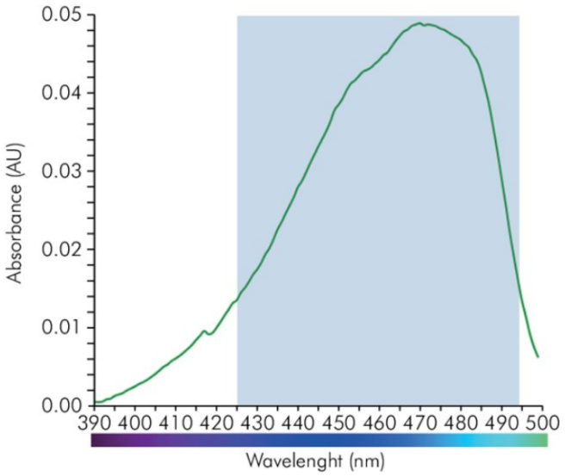
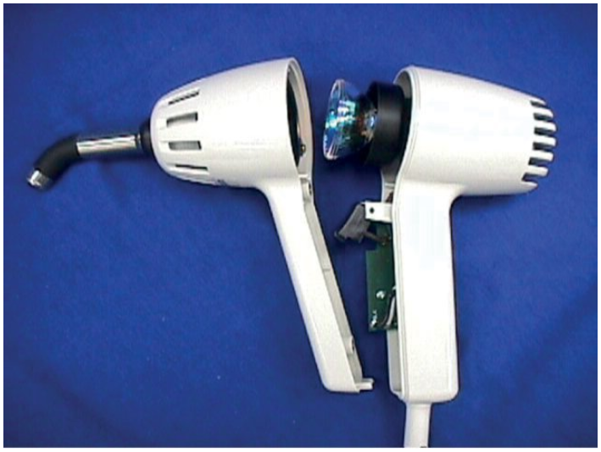
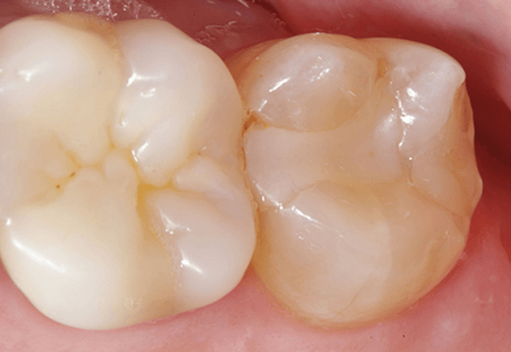
2. Considerations for the target
The selected polymerization method is photopolymerization:
Works with thin layers (see microtechnology resists e.g. SU-8).
Fast polymerization (a couple of minutes).
Polymerized layers are stable in organic solvents.
Layers can be built on each other.
The selected polymer is UDMA (urethane dimethacrylate) with TEGDMA (Triethylene Glycol Dimethacrylate) dilution monomer, CQ (Camphorquinone) photoinitiator and EDAB (ethyl 4-dimethylaminobenzoate) co-initiator, which is a well-known mixture in dentistry.
Emission [-]
Wavelength [nm]
Emission spectrum of a standard blue-light lamp
Acrylate resin in cavity

Slide 9
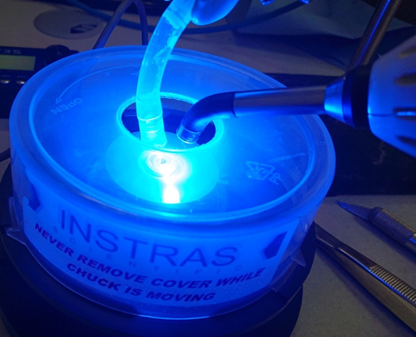
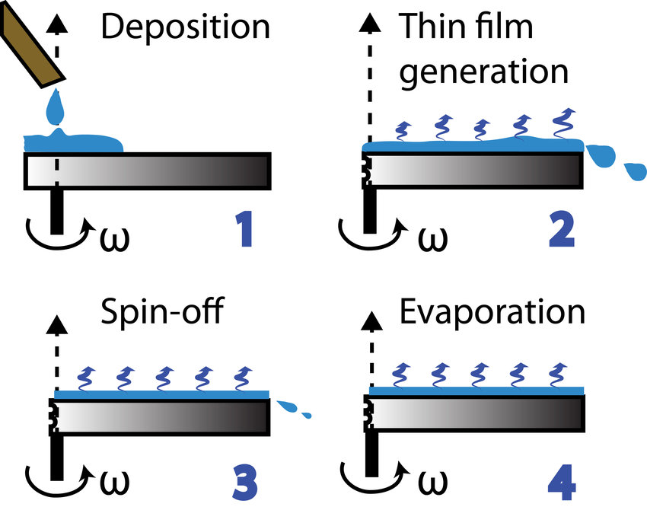
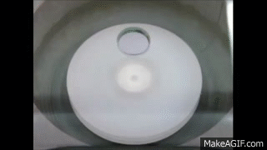
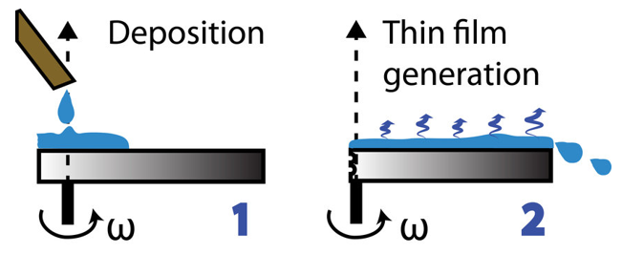
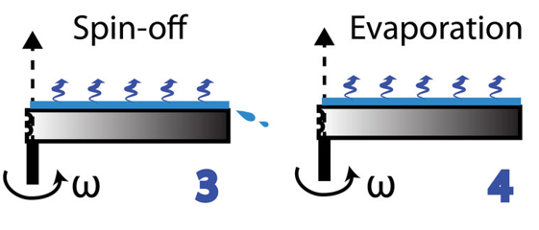
3. Target preparation – layering technologies
felcseppentés
réteg
képzése
Nitrogen flow
szárítás, polimerizáció
elvékonyítás
Blue light lamp
Sample
Advantages / Disadvantages:
+ Precise control over layer thickness.
Viscosity has to be controlled.
The polymerisation is sensitive to oxygen.
(Source: Rodrigo Perez Gartia)

Slide 10
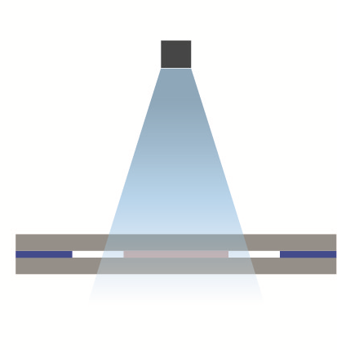
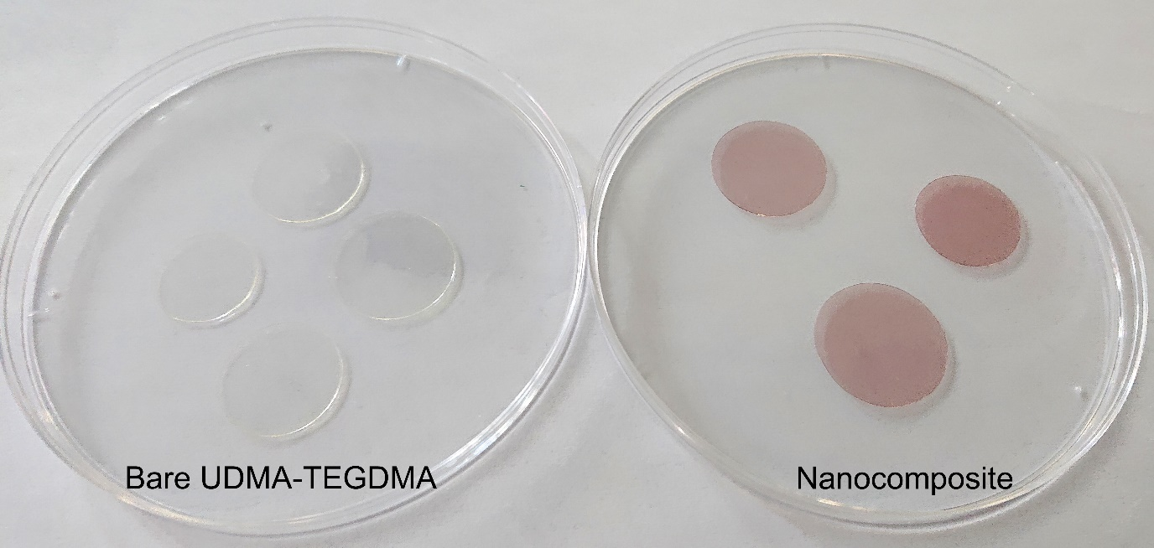
3. Target preparation – layering technologies
Polymerization during mechanical shaping between glass slides
Light source
1
2
3
Glass slide
Spacer
Glass slide
Polymer
Advantages / Disadvantages:
+ Oxygen is not an issue.
+ Optically perfect, smooth layer.
Viscosity has to be controlled.
The thickness is hard to be controlled in the µm range.
Future improvement:
Multi-levelled frame created with thin film technology.

Slide 11
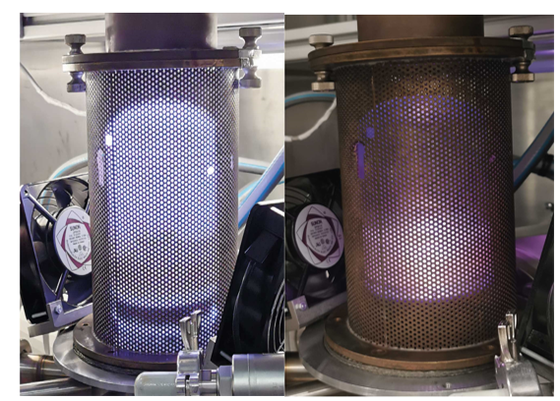
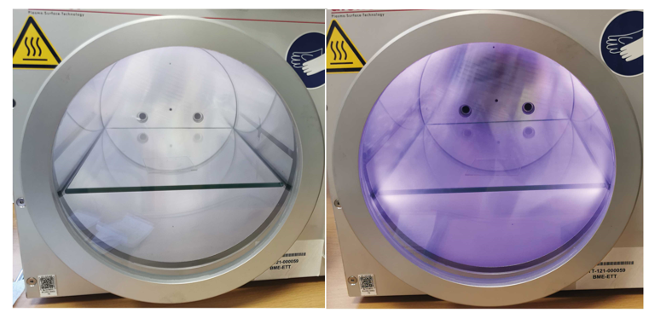
3. Target preparation – controlling the layer thickness
Plasma etching of the UDMA-TEGDMA material
High-power plasma reactor using focused H plasma (left) and defocused Ar plasma (right).
A reproducible etching rate of 80 nm/min was found in O₂ plasma at 300 W power, 0.3 mbar pressure.
Low-pressure plasma chamber using O₂ (left) and Ar+Hr (right) as process gases for plasma generation.

Slide 12
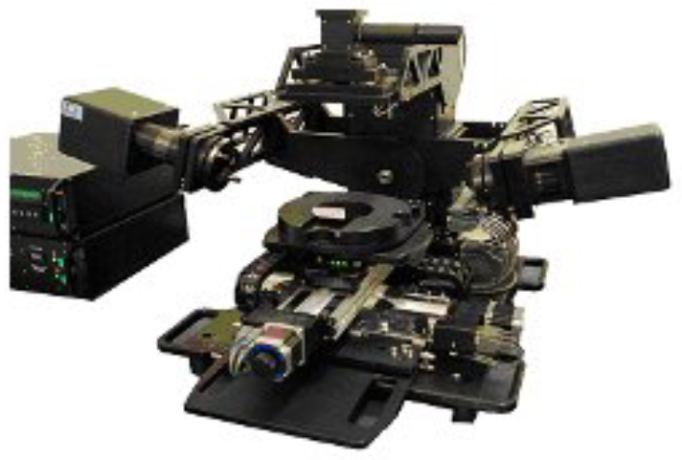
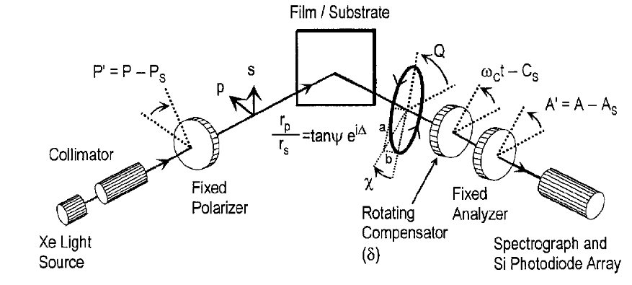
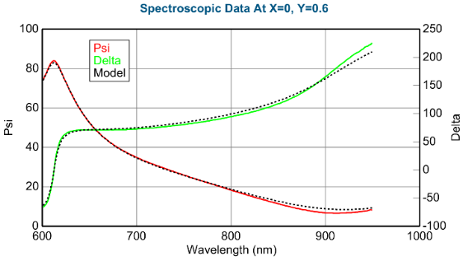
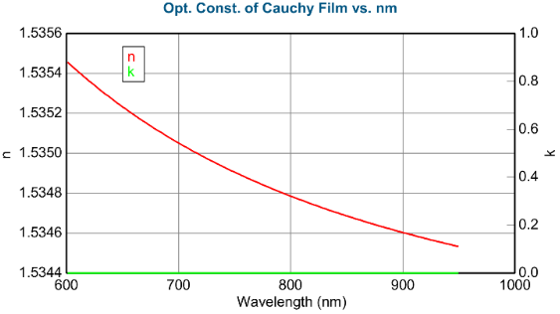
3. Target preparation – layering technologies
Ellipsometry
Woollam M-2000DI
The measured Psi-Delta and the fitted model
The complex refractive index (1 µm layer)
Psi
n
k
Delta
Wavelength [nm]
Wavelength [nm]

Slide 13
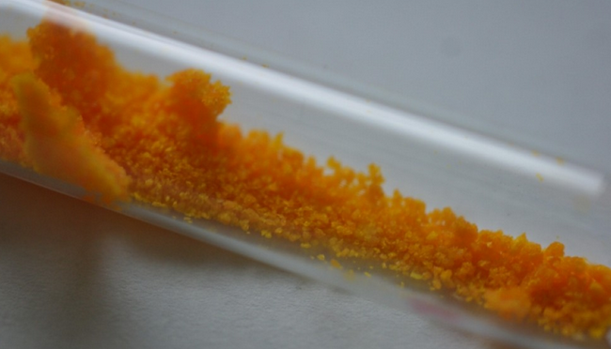
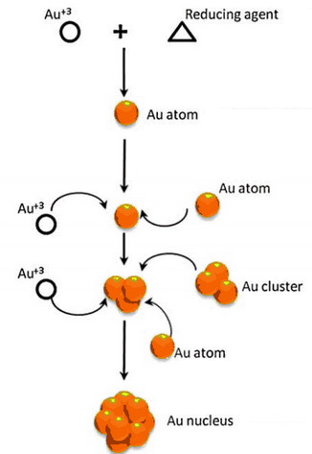
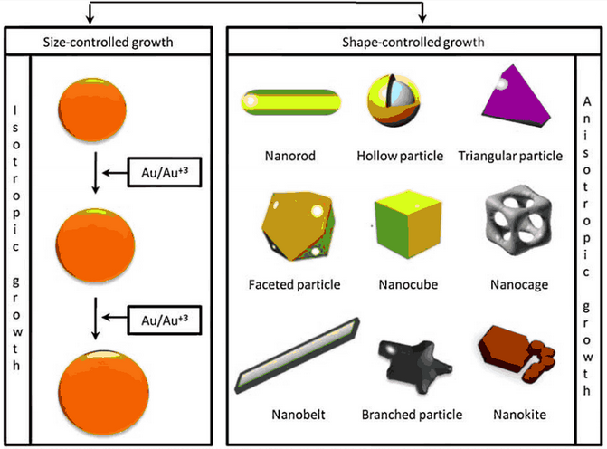

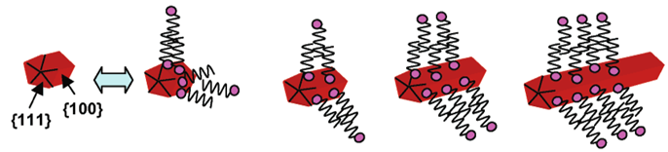
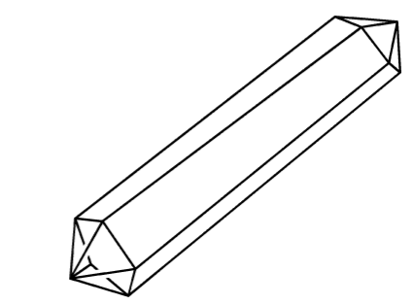

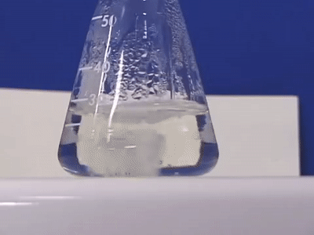

3. Target preparation – nanoparticle synthesis
Gold nanoparticles from HAuCl₄ solutions
Size- (left) and size-controlled (right) growth
Reduction
HAuCl₄ salt crystals
Nanoparticle synthesis
Growth direction
(Source: Nguen et al, 2011)

Slide 14
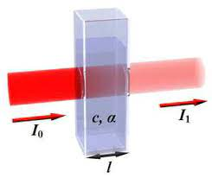
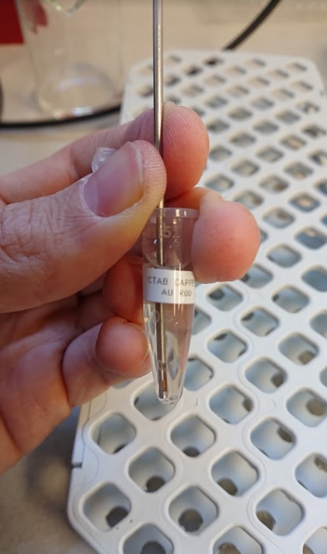
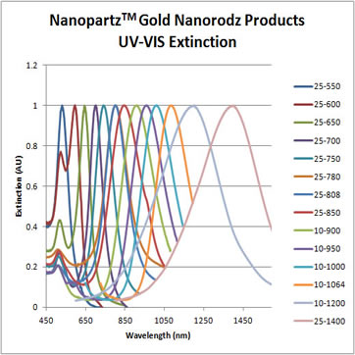
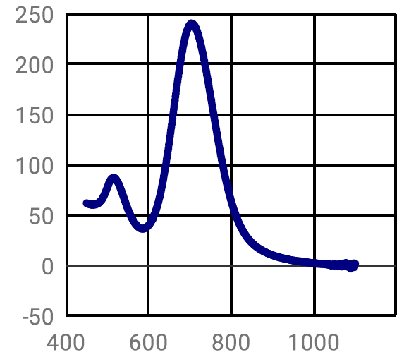
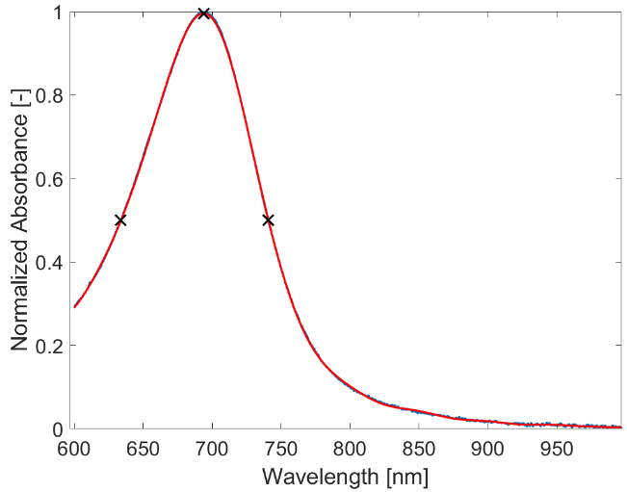
3. Target preparation
Absorbance measurements with optical spectroscopy
Illustration of the optical (dip) probe measurement setup (right)
Absorption spectra of 25 × 75 nm gold nanorods. Left: manufacturer. Right: own measurement
NanopartzTM
Own measurement
Peak (water): 695 nm
FWHM: 105 nm
Normalized extinction [-]
Absorption [O.D.]
Normalized absorption [-]
FWHM
Wavelength [nm]
Wavelength [nm]
Wavelength [nm]

Slide 15
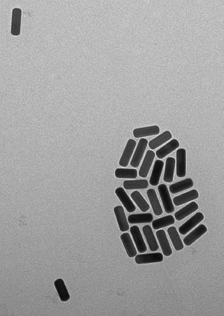
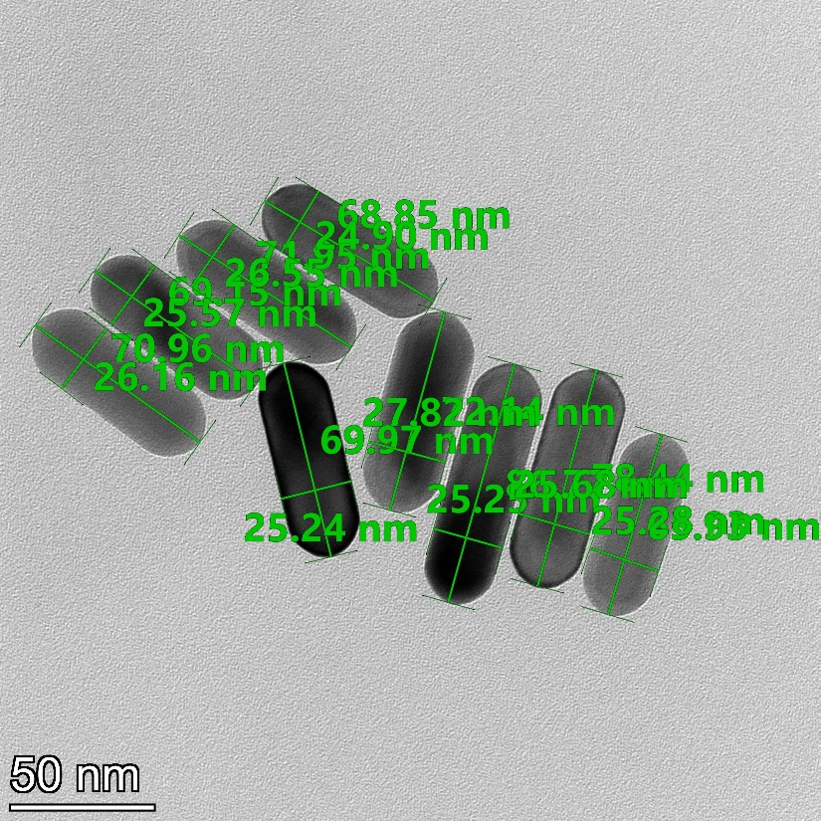
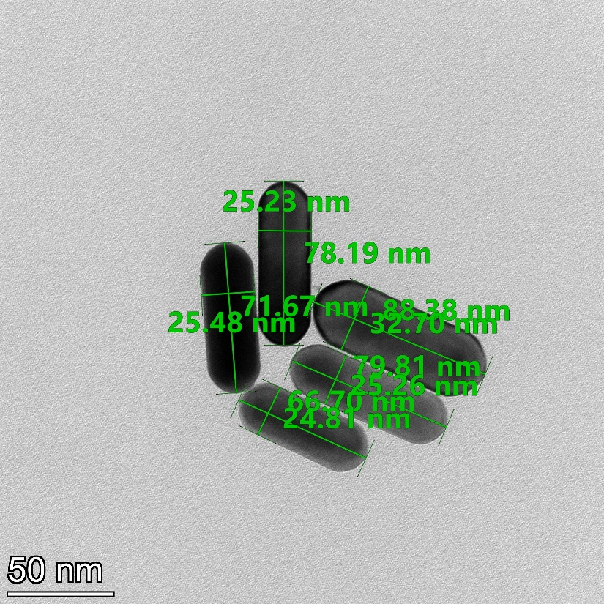
3. Target preparation – nanoparticle size control
Transmission electron microscopy (TEM)
NanopartzTM datasheet
Own measurements (Fogarassy Zsolt, ELKH-EK-MFA)
Nominal values from the manufacturer: 25 × 75 nm (±10 %)
Own measurements:
Average (deviation) for 28 nanoparticles: 26 (1.65) × 76 (7.97) nm
100 nm

Slide 16

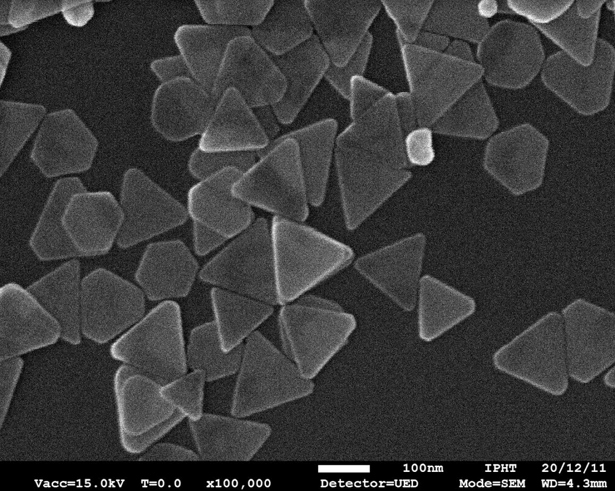
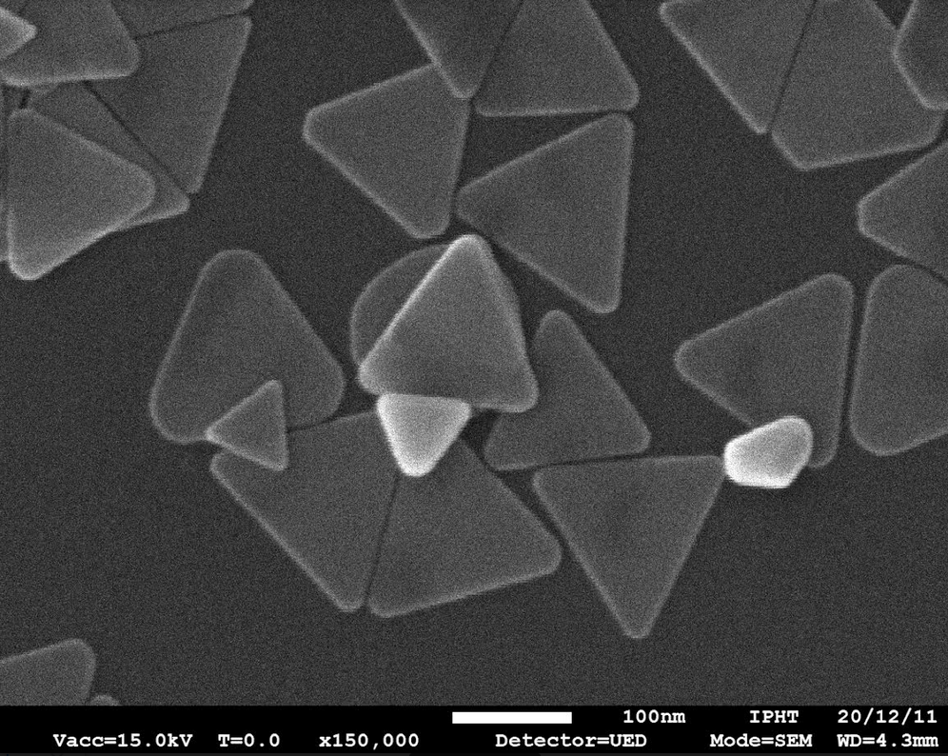
3. Target preparation – nanoparticle size control
Transmission electron microscopy (TEM)
A new direction: gold and silver nanoprisms, synthetized in Jena (Germany).

Slide 17
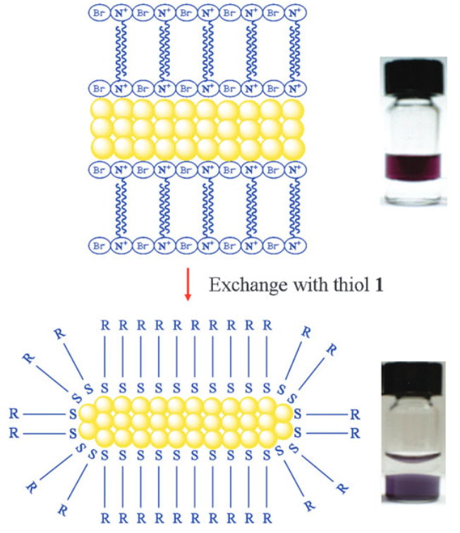
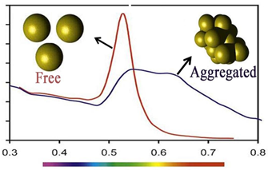
3. Target preparation – nanoparticle phase transfer
Importance of the molecular layer covering the nanoparticles (capping)
It is important to make the nanoparticles soluble in the polymer matrix, to avoid aggregation and to ensure uniform distribution.
Solubility is defined by the molecular capping.
Water + nanoparticles (top)
Organic solvent (bottom)
Illustration of particle aggregation
Phase transfer: changing CTAB to alkanethiol
Extinction [-]
Water (top)
Organic solvent + nanoparticles (bottom)
Wavelength [nm]

Slide 18
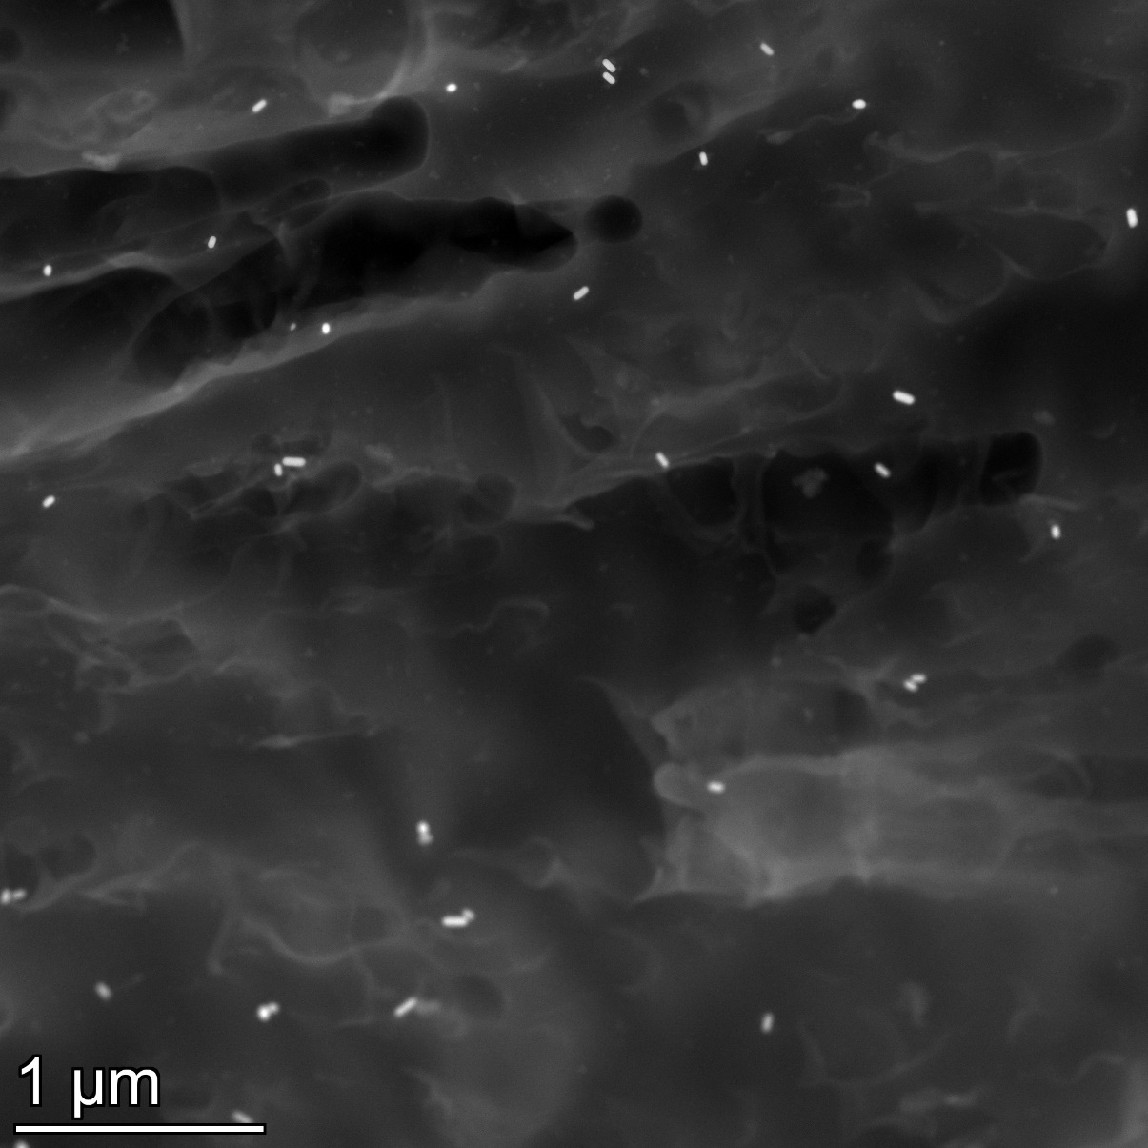
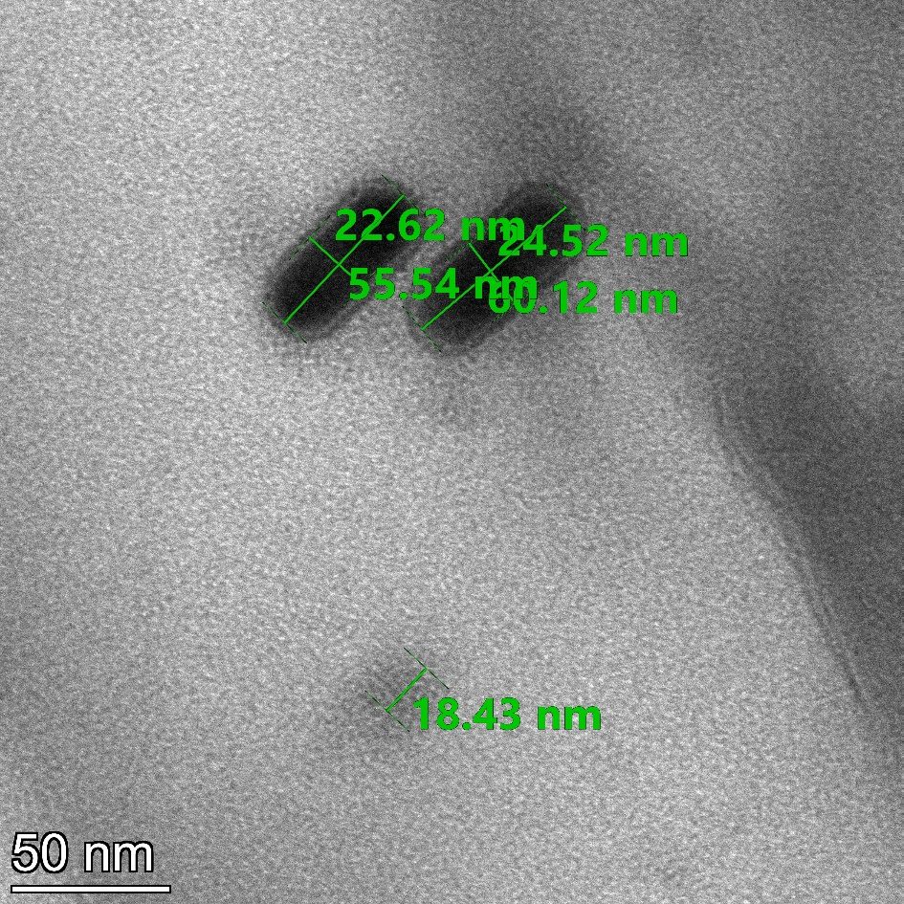
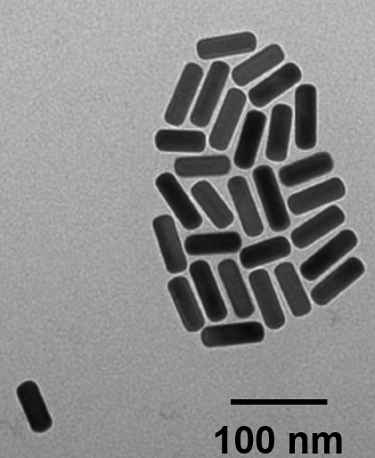
3. Target preparation – particle distribution control
Investigation of the embedded particles with TEM
Density of nanorods: 9-20 db μm⁻³
Calculated from stock solution: 2 db μm⁻³
Sn NP !

Slide 19
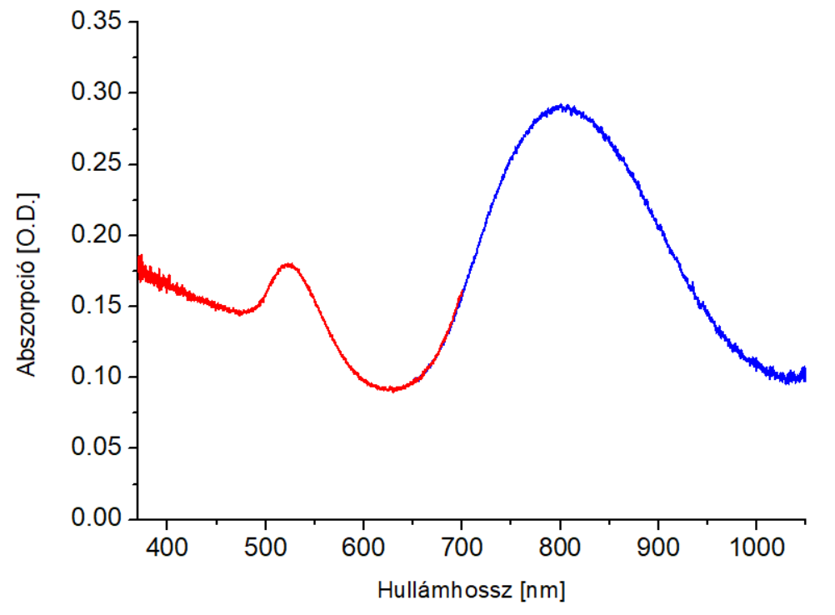
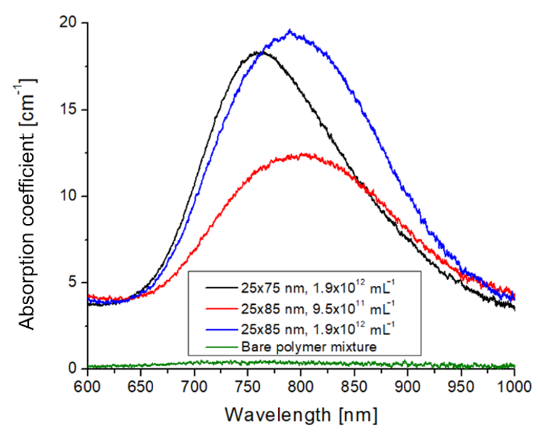
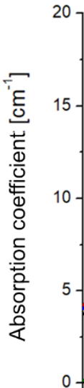
3. Target preparation – particle distribution control
Investigation of the absorbance with optical spectroscopy
Full spectrum of the nanocomposite (25x85 nm rods)
Nanoparticle aggregation starts at 3.8x10¹² mL⁻¹
NIR spectrometer
VIS spectrometer
Wavelength [nm]

Slide 20

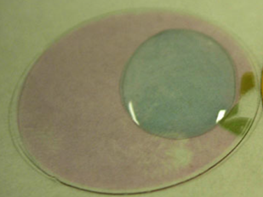
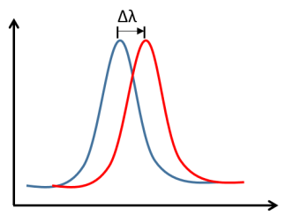

3. Target preparation – fine tuning the absorption band
Refractive index sensing with nanoparticles
Illustration: gold nanodiscs on glass in water and in air
n₁
n₂
n₂ = 1.33
Bulk refractive index sensitivity (RIS):
Absorption [A.U.]
$$RIS=\frac{Δλ}{Δn}$$
n₁ = 1
Wavelength [nm]
Source: Springer, Nanoplasmonic Sensors (2012)

Slide 21
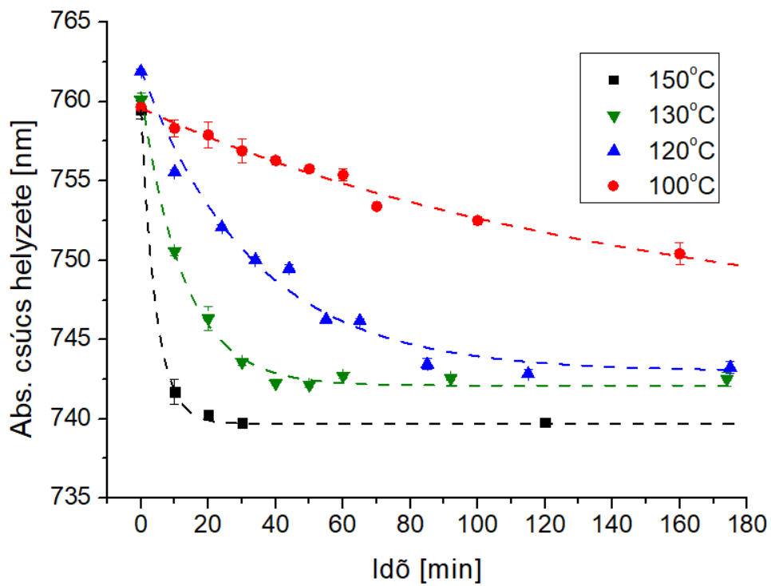
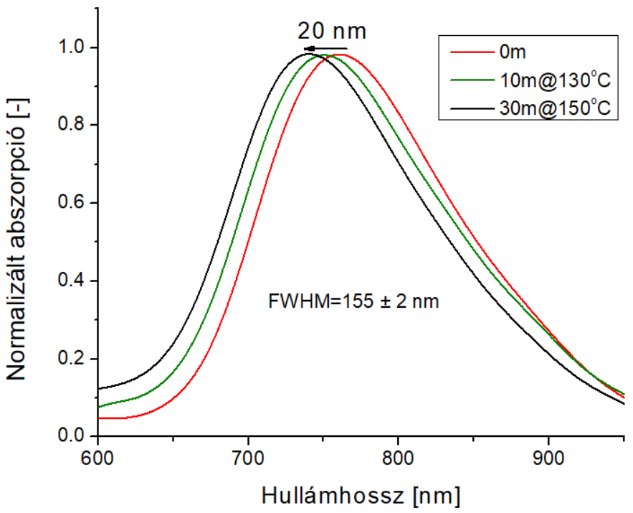
3. Target preparation – fine tuning the absorption band
Heat treatment was used to shift the absorption band – control with time and temperature
25x75 nm nanorods
Absorption peak position [nm]
Normalized absorption [-]
Time [min]
Wavelength [nm]

Slide 22
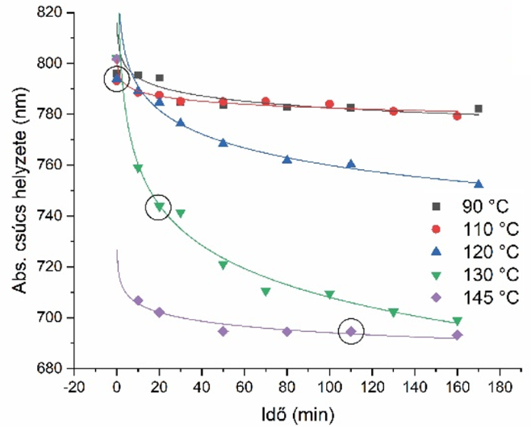
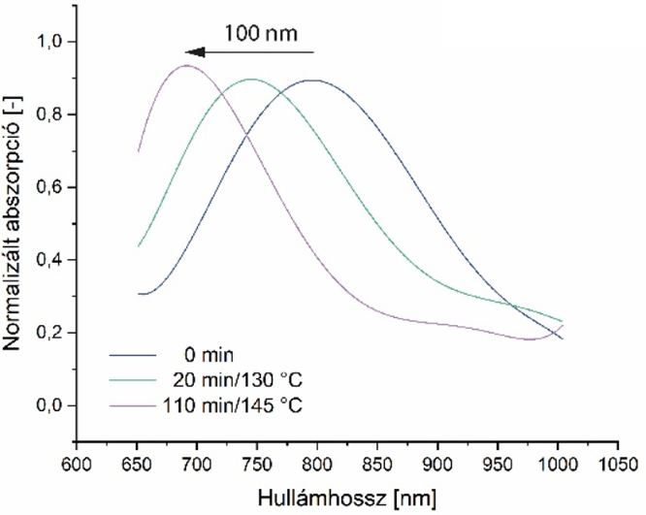

3. Target preparation – fine tuning the absorption band
The charts can be used to control the absorption in a wide range
25x85 nm nanorods
$$RIS=\frac{Δλ}{Δn}$$
Absorption peak position [nm]
Normalized absorption [-]
Time [min]
Wavelength [nm]

Slide 23
Conclusions
“Take-home messages”
Our current target is a model material made of a nanocomposite (doped polymer).
Layering technologies are used to realize pre-defined nanoparticle distributions along the target’s thickness.
Nanoparticle synthesis and doping are controlled with optical spectroscopy and TEM.
A method based on thermal treatment was developed to fine tune the plasmon absorption band of the nanocomposite.

Slide 24




Acknowledgements
For the colleagues in the sample preparation group (Dr. Szalóki Melinda, Dr. Petrik Péter, Borók Alexandra, Kovács Rebeka, Shereen Zangana).
Whole NAPLIFE collaboration.
NKFIH, ELKH for financial support.

Slide 25
Acknowledgements
This work was partially supported by Nanoplasmonic Laser Fusion Research Laboratory project financed by the National Research and Innovation Office (NKFIH-468-3/2021) and by the Eötvös Lóránd Research Network (ELKH), Hungary. The research reported in this paper and carried out at the Budapest University of Technology and Economics has been supported by the NRDI Fund (TKP2020 IES, Grant No. BME-IE-BIO) based on the charter of bolster issued by the NRDI Office under the auspices of the Ministry for Innovation and Technology.

