Slide 1




Comparison of Very Deep Learning performance on GPU and CPU
Olena Linnyk^{1,2}
J. Pawlowski¹, Manjunath O.K. ¹, J. Steinheimer¹, K. Zhou¹, H. Stöcker¹, K. Schmidt³, T. L. Weber², I. Teetz²
¹Frankfurt Institute for Advanced Studies (FIAS), Frankfurt am Main, Germany
²„milch & zucker“ Talent Acquisition & Talent Management Company, Giessen, Germany
³Institute of Physics, University of Silesia, Poland
seriously creative
21.10.2020
creatively serious

Slide 2
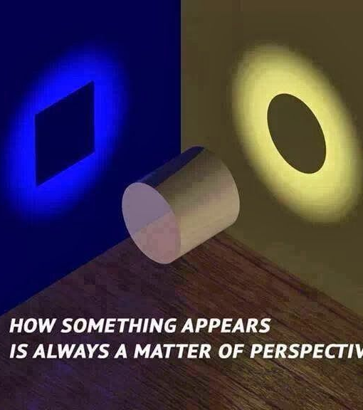
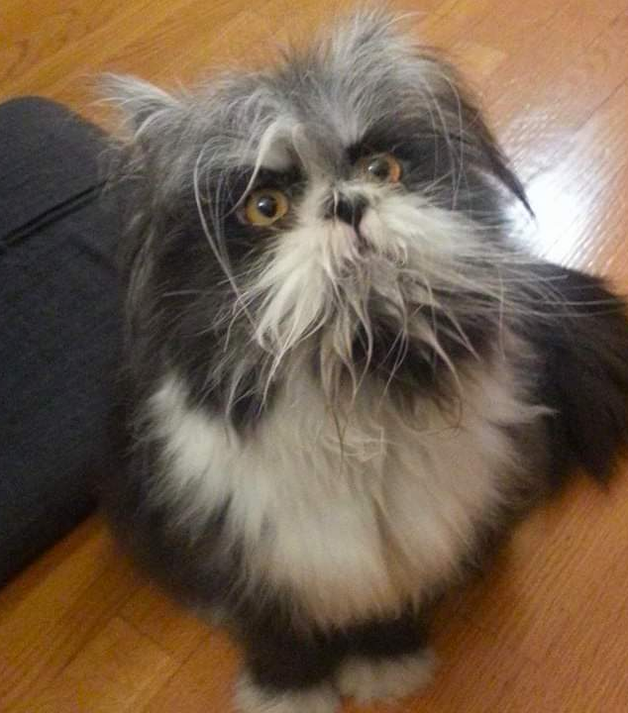

Classification = understanding

Slide 3
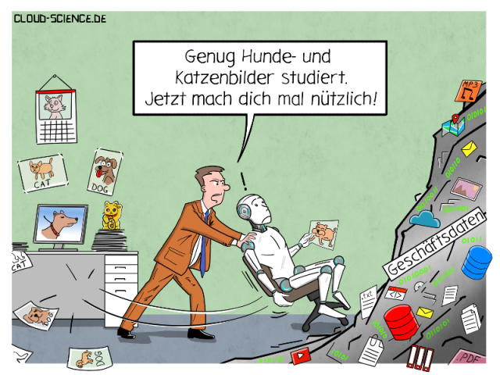
Enough playing with cat and dog pictures, now do something useful!
CERN Data, Texts

Slide 4
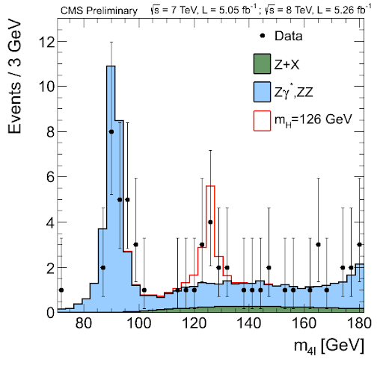
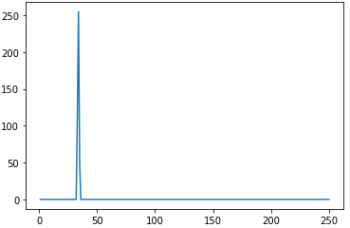

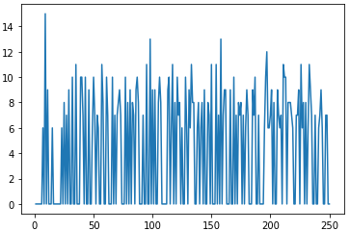
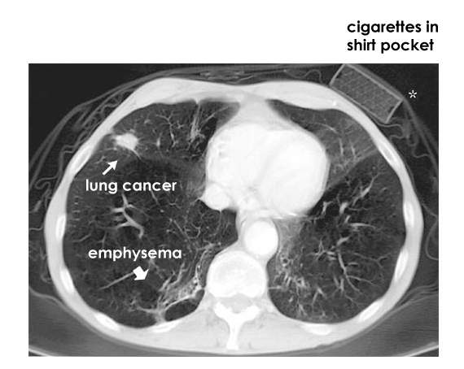
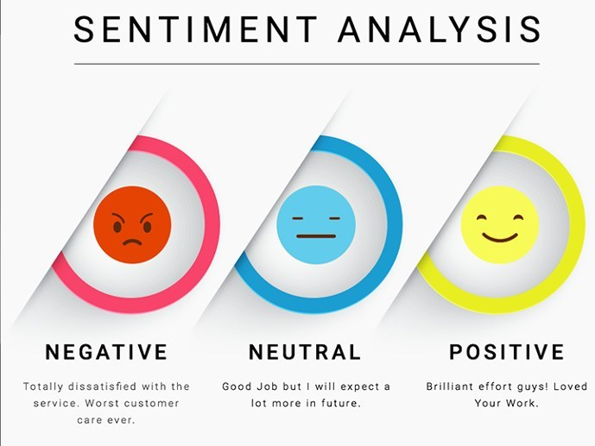
Some useful tasks

Slide 5
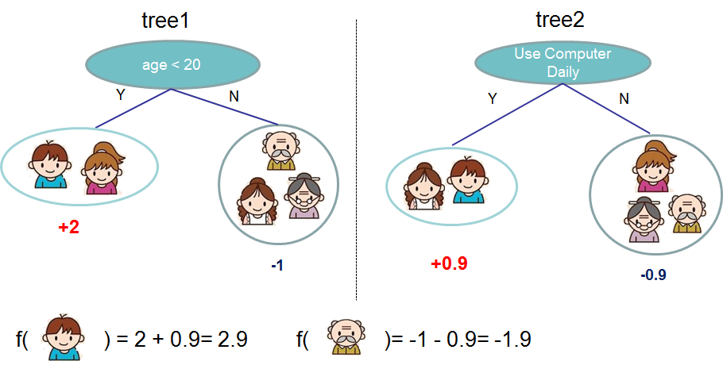
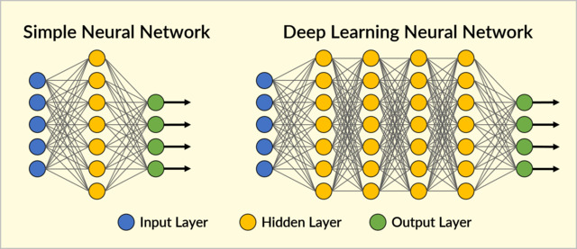
XGBoost model
We tested machine learning approaches ranging from desicion trees to deep neural networks
Image: https://xgboost.readthedocs.io

Slide 6
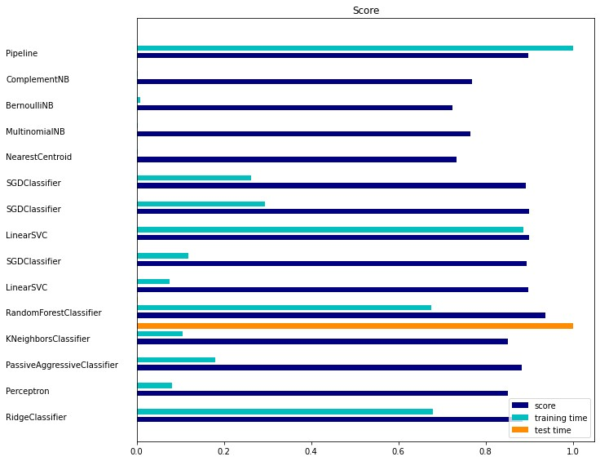
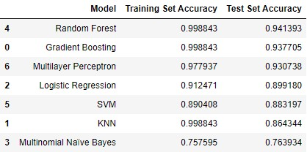
Best accuracy is achieved by the deep convolutional neural networks
… … …
Convolutional Neural Net 97.8% on Test
Example: Text classification on real life data from the web portal jobstairs.de © milch&zucker

Slide 7
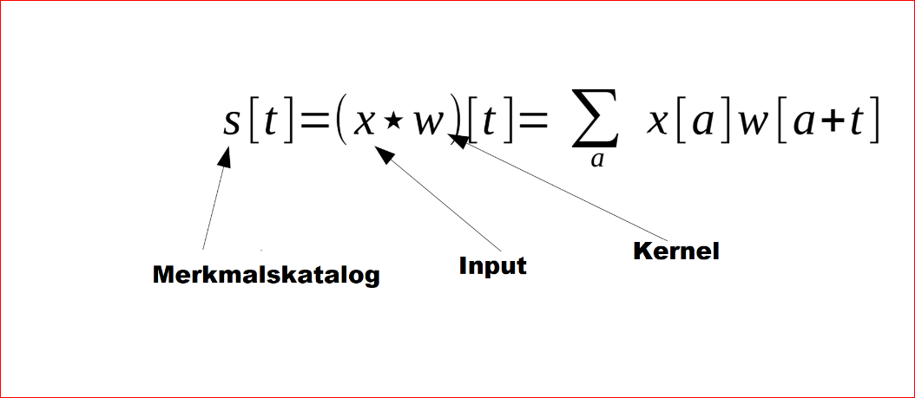
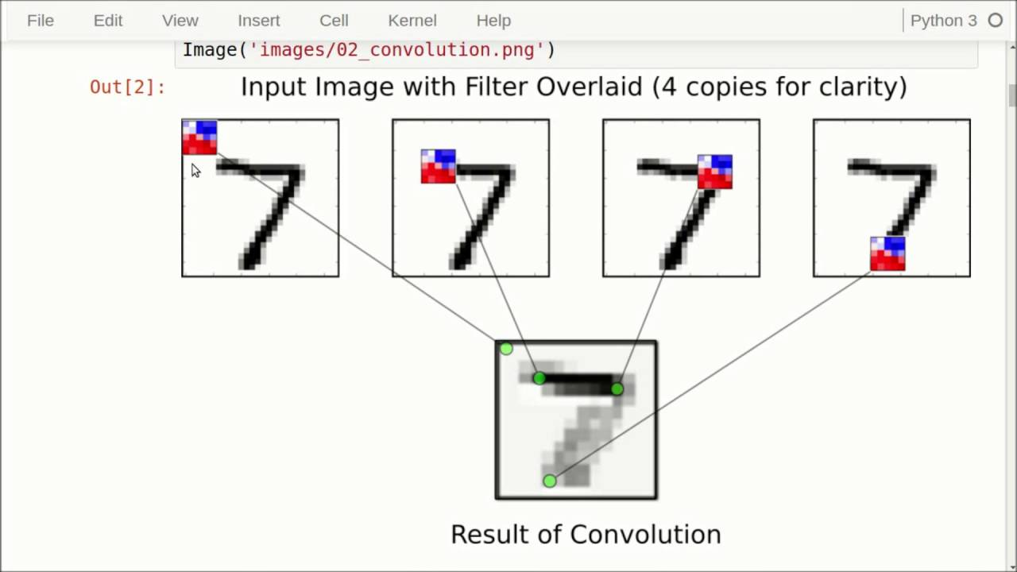
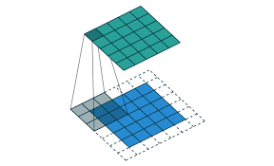
Convolutional neural networks
Krizhevsky won the ImageNet Large Scale Visual Recognition Challenge (ILSVRC) 2012 competition with the brilliant deep convolutional neural networks. This was the first time this architecture was more successful that traditional, hand-crafted feature learning.
Alex Krizhevsky, Ilya Sutskever, Geoffrey E. Hinton. ImageNet Classification with Deep Convolutional Neural Networks. 2012.

Slide 8

Very deep convolutional networks suggested
“Previous very deep convolutional neural networks were trained on the giant ImageNet datasets. Small datasets like CIFAR-10 has rarely taken advantage of the power of depth since deep models are easy to overfit. By adding stronger regularizer and using Batch Normalization, very deep CNN can be used to fit small datasets with simple and proper modifications and don't need to re-design specific small networks.
Karen Simonyan, Andrew Zisserman. Very Deep Convolutional Networks for Large-Scale Image Recognition. 2014.
Better understanding -> More layers, more dimentions, more filters?

Slide 9
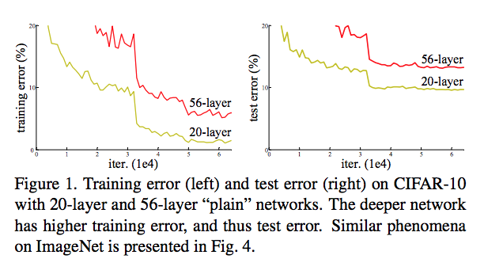
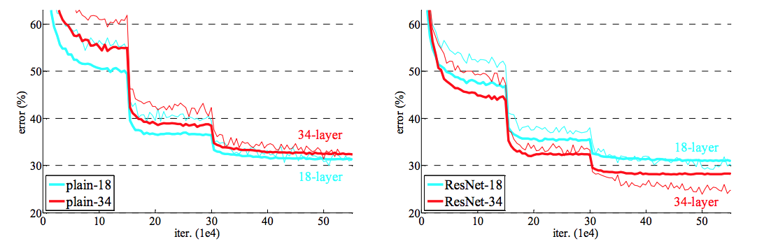
Vanishing gradients preventing the benefit of the depth
This Deeper networks do not lead to better accuracy on the test data sent, because when the network is too deep, the gradients from where the loss function is calculated easily shrink to zero after several applications of the chain rule. This result on the weights never updating its values and therefore, no learning is being performed.
Solution: ResNet
Kaiming He, Xiangyu Zhang, Shaoqing Ren,
Jian Sun. Deep Residual Learning for Image
Recognition. 2015.

Slide 10
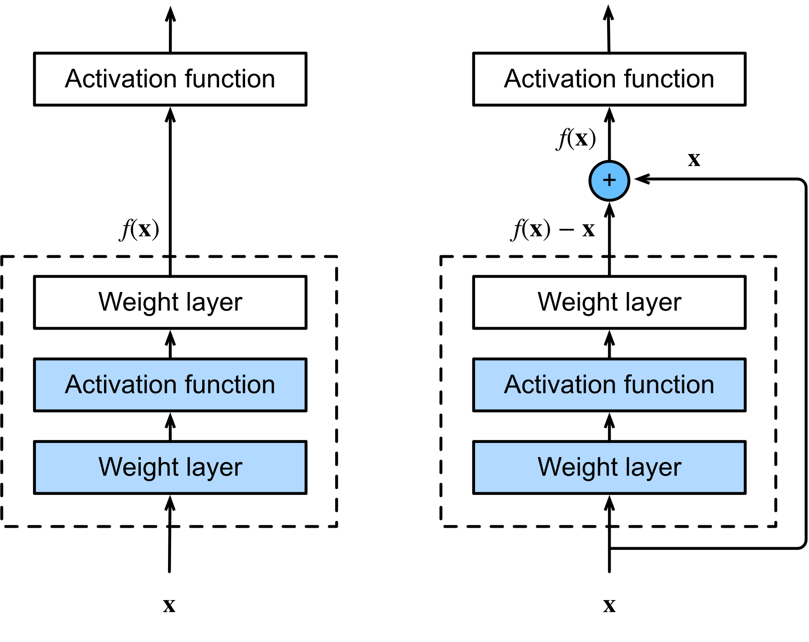
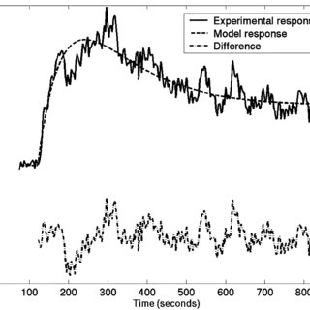
ResNet
Effectively it means fitting f(x)-x in stead of f(x).
By adding several blocks, we fit first the main feature,
then more detailes by fitting the residue of the function
and the approximation in the second block etc.
The iterative approach prevents „jumping over“ the global optimum.

Slide 11
ResNet also applicable to the understanding of texts

Slide 12
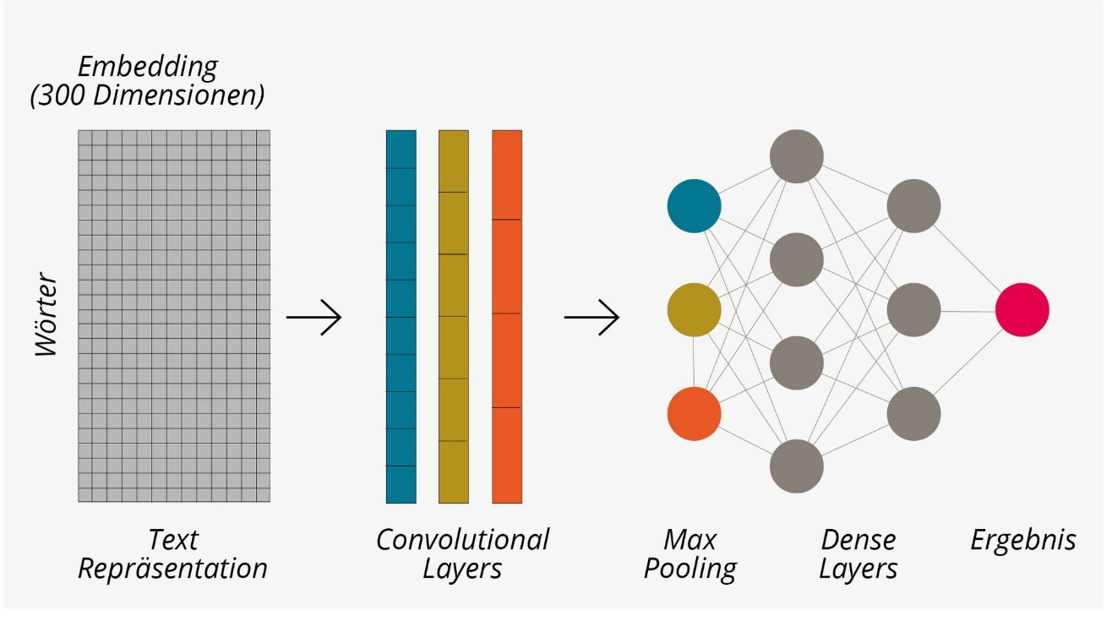
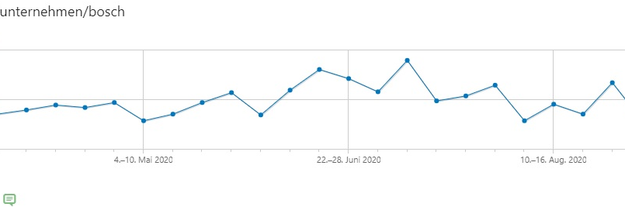
Example:
Prediction OF cLICK RATES
Milch & zucker / 2020
Optimization for JOBAD TITLES
Stellentitel Score
Web-Marketing Controller (m/w/d) 0.217
Web-Marketing ControllerIn (m/w/d) 0.616
Online-Marketing ControllerIn (m/w/d) 0.680
ControllerIn Online-Marketing (m/w/d) 0.680
Marketing-ControllerIn (m/w/d) Online 0.777
ControllerIn (m/w/d) Online-Marketing 0.872
ControllerIn (m/w/x) Online-Marketing 0.960
Web sites indeed perform better after the optimization
Stand: 04.09.2020
Notes:
Die Titelanalyse von BeeSite Better Ads ist so einfach, dass sie gut zum Probieren einlädt. Wir haben von Kunden gehört, dass es durch den Score fast zu einem kleinen Sport geworden ist, wer einen noch besseren Titel für diese Stelle findet. Auch als Benchmark- Tool lässt sich BetterAds nutzen: Testen Sie im Handumdrehen die Titel Ihres Wettbewerbs, um zu sehen, wo Sie im Vergleich stehen. Finden Sie dabei bessere Formulierungen, können Sie diese auch für sich übernehmen. Der kinderleichte Umgang mit BetterAds erlaubt Ihnen die Simulation einer Anzeige bzw. Opti-mierung in kürzester Zeit. Statt wie bisher nach einer Änderung die Anzeige für teures Geld 14 Tage zu schalten und dann zu sehen, ob die Änderung funktioniert hat.
Hinweis: Der Score reicht von 0–1, wobei ein höherer Score mehr Reichweite bedeutet. Der Score für eine Formulierung kann sich im Laufe der Zeit ändern. Die KI lernt daher kontinuierlich, welche Stellentitel häufiger geklickt werden und passt den Score entsprechend an.

Slide 13

Milch & zucker, 2020
AI in hr
Example 3: GENDER „sentiment“
Hidden Bias
Sertain key words were defined in job ads to influence the text in the direction of the gender typical description, which decreases the chance of especially female job seakers to apply for the job.

Slide 14

Milch & zucker, 2019
KI in hr
Experiement:
Randomized Single-Blind A/B-Test
Clicks on “apply now”
per 100 visitors
Originaltext vs. Better-Ad Text
Plattform: JobStairs.de
More than 50 Job ads from various entry levels and industries
ca. 1000 visitors
Analyse: Web Tracking
35,0
30,0
25,0
20,0
15,0
10,0
Original
Optimized

Slide 15

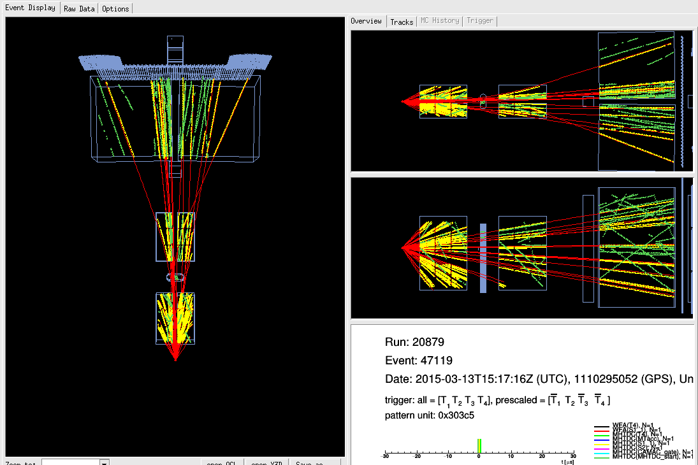
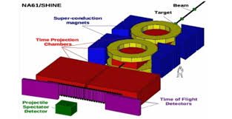
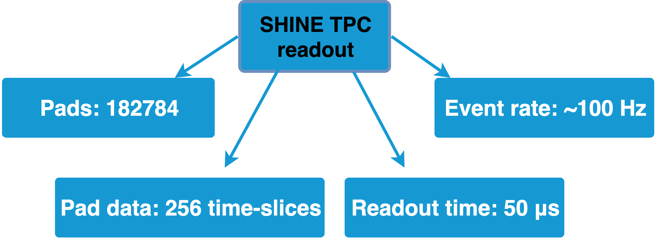
Performance critical application: Experiment NA61/SHINE at CERN
Noisy clusters: Up to 70%
decision has to be done in real time (online): faster than 1 millisecond/event
maximum 3 sec / node / event
CPU?
GPU?
Work in progress: O. Linnyk, W. Bryliński, M. Gaździcki, N. Davis, A. Rybicki

Slide 16
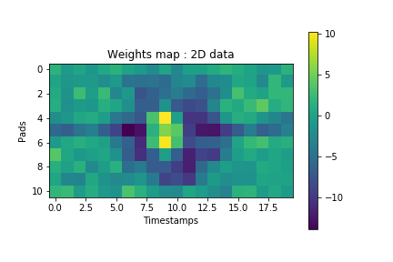
Machine learning for cluster classification
Notes:
As the name suggests, machine learning is the process of imparting the decision making ability to the machine without human interference. In our case, we need the machine to decide whether the given cluster contributes to a track or not. This is clearly a supervised learning problem where the machine is trained on some sample of data to enable it with the capability to make decisions. How this is done can be easily understood using the following analogy. First, we choose a type of the brain which can learn to solve our problem. Then we train the brain with relevant data and at regular intervals we test if the brain has learned to make decisions by asking it to make decisions on unseen data. Once we reach required accuracy, this configuration of the brain so that it can be used when ever required. Based on the structure of this brain and the training method, there exists a variety of algorithms. However, we have tried two techniques to classify the clusters. The first one is a tree based algorithm called xgboost and the second one is a convolutional neural network based algorithm called ResNet. However, the cnn based algorithms were found to be more accurate than the decision trees. So we’ll restrict ourself to the CNN based architecture for cluster classification.

Slide 17
Tracking algorithm (offline) to label. Convusion matrix as a result

Slide 18
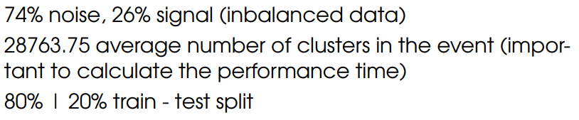
Which machine learning method to chose?
Test dataset: 16000 samples
train dataset: 4000 samples
GPU: GeForce RTX2080 Ti Noise reduction Params FalseNegative
?? Seconds / Event XX%? NN YY%?
CPU: Intel Xeon X5550, 2.67 GHz
?? Seconds / Event

Slide 19
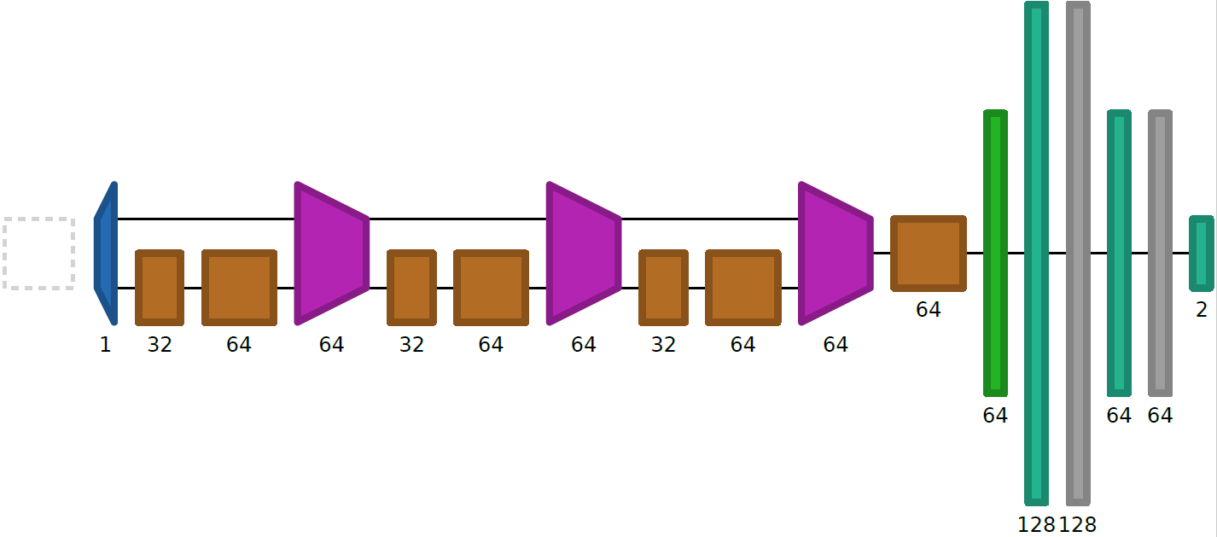
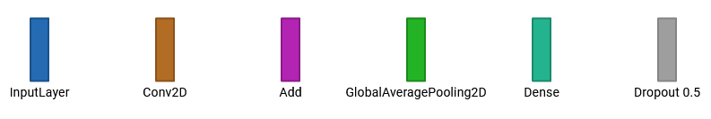
Network Performance
ResNet
Input fed into 3 blocks of convolutional layers with shortcuts between blocks
Feature maps are then averaged to a single value (Global Average Pooling)
Values fed into Dense network
2 Outputs
(corresponding to „good“ and „bad“ classes)
Trainable Parameters: 95.170
Validation Accuracy:
(trained and validated on the same dataset)
92,0 % on MTPCL
92,6 % on VTPC2
*Visualization with Net2Vis

Slide 20
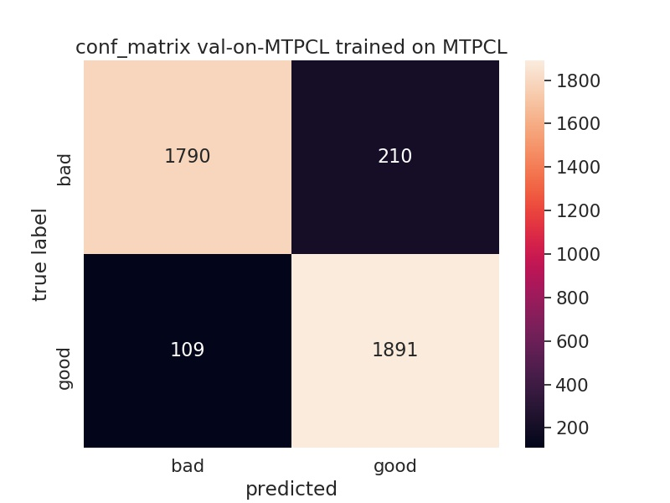
3. Network Performance
3.2 ResNet
Trained on MTPCL 2d dataset
Input data
89.5%
10.5%
92,0% overall accuracy
90 % of noise is removed
5,5% of „good“ clusters are wrongly predicted as „bad
Improvement of 2D over the 1D input.
Questions:
Speed?
Generalisation?
5.5%
94.5%

Slide 21
3. Network Performance
3.2 ResNet
Generalisation from one TPC to the other:
90,4 % accuracy trained on VTPC2 validated on MTPCL
→ - 2,2 % to validation on VTPC2
91,0 % accuracy trained on MTPCL validated on VTPC2
→ - 1,0 % to validation on MTPCL
Where does this difference to learning on MTPCL data come from?
→ Overfitted on VTPC2 dataset!

Slide 22
Simple network
Understand therefore trust
Can we understand the reasons behind the decision of the network?

Slide 23
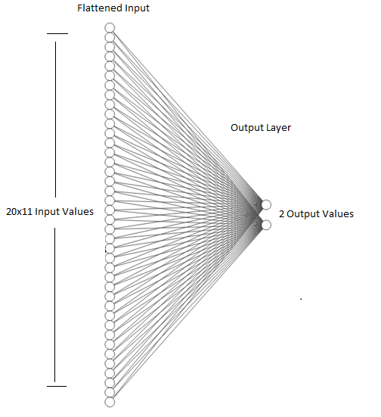
Simple network
Two-Neuron perceptron
Strategy
Input flattened and fed directly into 2 output neurons (Perceptron)
Softmax Activation Function Output example: (0.2|0.8)
Both outputs combined always add up to 1
can be interpreted as propability for the corresponding class label
Trainable Parameters: 442
Validation Accuracy:
(trained and validated on same dataset)
89,3 % on MTPCL
89,4 % on VTPC2
Cross Validation:
89,1 % trained on MTPCL validated on VTPC2
89,0 % trained on VTPC2 validated on MTPCL

Slide 24
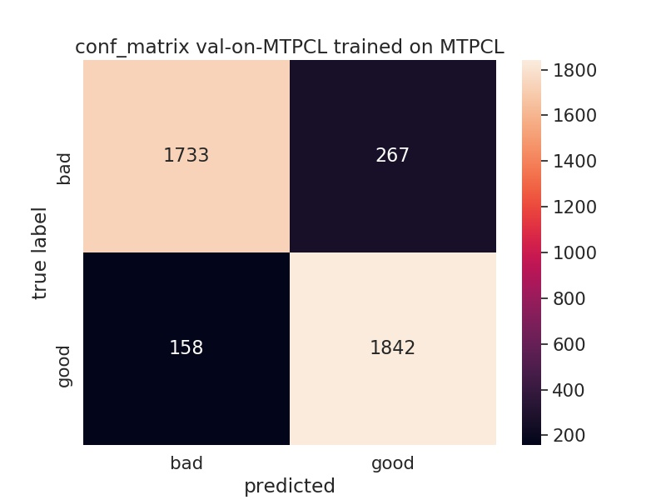
Simple nettwork performance
Confusion matrix
87% of noise removed
8% of „good“ clusters are wrongly predicted as „bad“
Question:
Why is the number of False Negatives btw. False Positives not symmetrical?
(Tracking algorithm not perfect ?)
87%
13%
7.9%
92.1%

Slide 25
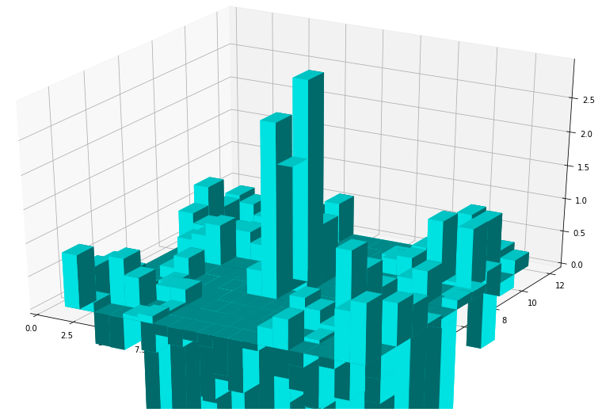
Weights of the simple perseptron
Understanding the desicion of the network
What do the Weights look like?
„inner“ pixel values are weighted heavily (up to x2.5)
Outer pixel values are mostly low or negatively weighted
„Output is simplified the outer values substracted by the values in the center.“
one „peak“ in the center predicted as „good“
The weights „on the cross“ are negative
Question: Why? → Causality!
-> let‘s use this!!
Abbildung 1: 3D Plot of the network weights for the second neuron (if output > 0.5 → „good“ cluster)
*Trained and validated on MTPCL 2D data

Slide 26
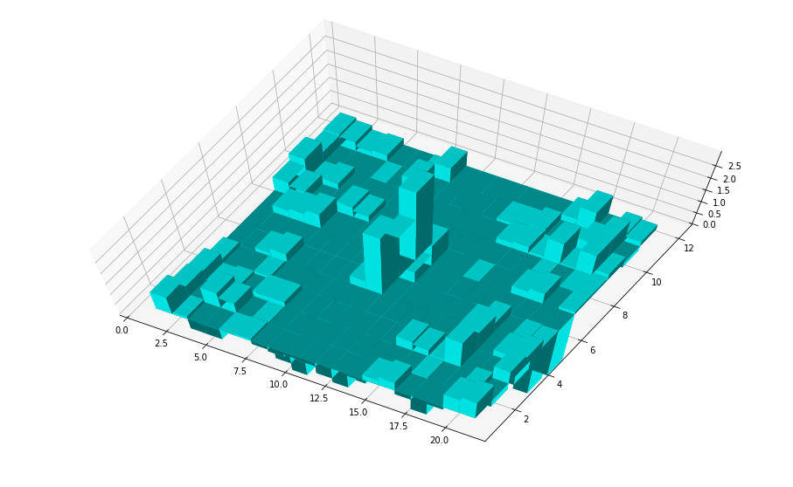
Weights of the simple perseptron
Understanding the desicion of the network
What do the Weights look like?
„inner“ pixel values are weighted heavily (up to x2.5)
Outer pixel values are mostly low or negatively weighted
„Output is simplified the outer values substracted by the values in the center.“
one „peak“ in the center predicted as „good“
The weights „on the cross“ are negative
Question: Why? → Causality!
-> let‘s use this!!
Abbildung 1: 3D Plot of the network weights for the second neuron (if output > 0.5 → „good“ cluster)
*Trained and validated on MTPCL 2D data

Slide 27
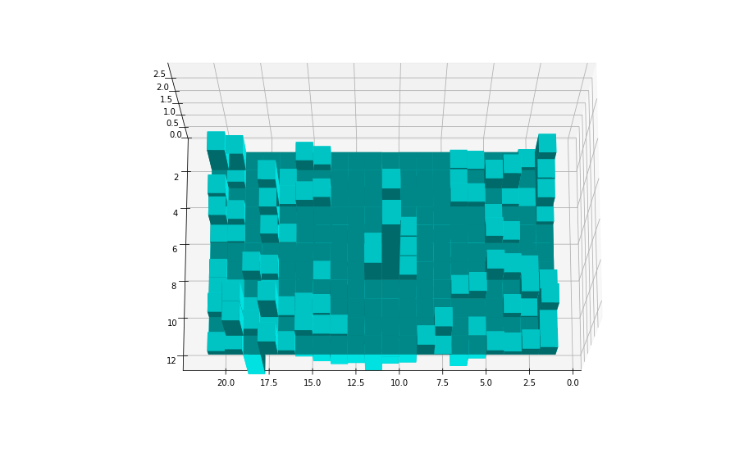
Weights of the simple perseptron
Understanding the desicion of the network
What do the Weights look like?
„inner“ pixel values are weighted heavily (up to x2.5)
Outer pixel values are mostly low or negatively weighted
„Output is simplified the outer values substracted by the values in the center.“
one „peak“ in the center predicted as „good“
The weights „on the cross“ are negative
Question: Why? → Causality!
-> let‘s use this!!
Abbildung 1: 3D Plot of the network weights for the second neuron (if output > 0.5 → „good“ cluster)
*Trained and validated on MTPCL 2D data

Slide 28
Physics based network
Splitted convolution
Network architecture based on physics

Slide 29
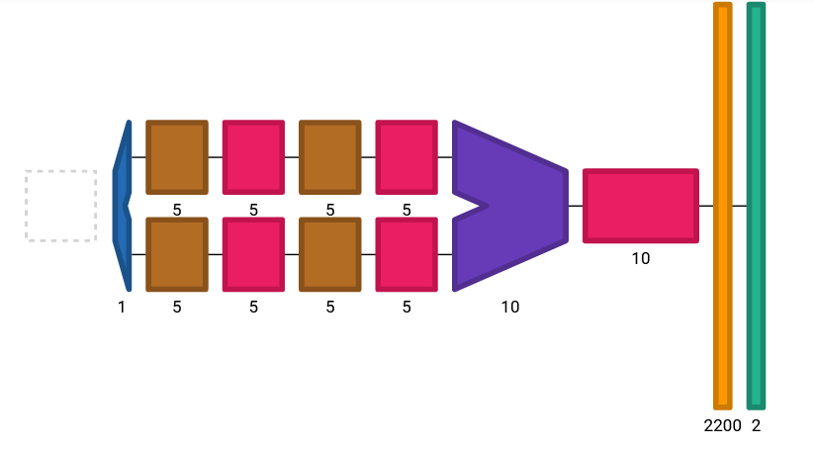
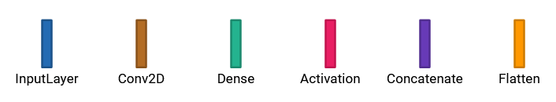
Network Performance
Splitted Convolution
  Strategy:
Input fed into 2 seperate blocks of convolutional layers
Feature maps are then concatenated and flattened
Values fed into 2 output nodes
(corresponding to „good“ and „bad“ classes)
Trainable Parameters: 4.612 (≈ 1/20 of ResNet)
Accuracy:
91,1 % on MTPCL
91,9 % on VTPC2
*Visualization with Net2Vis

Slide 30
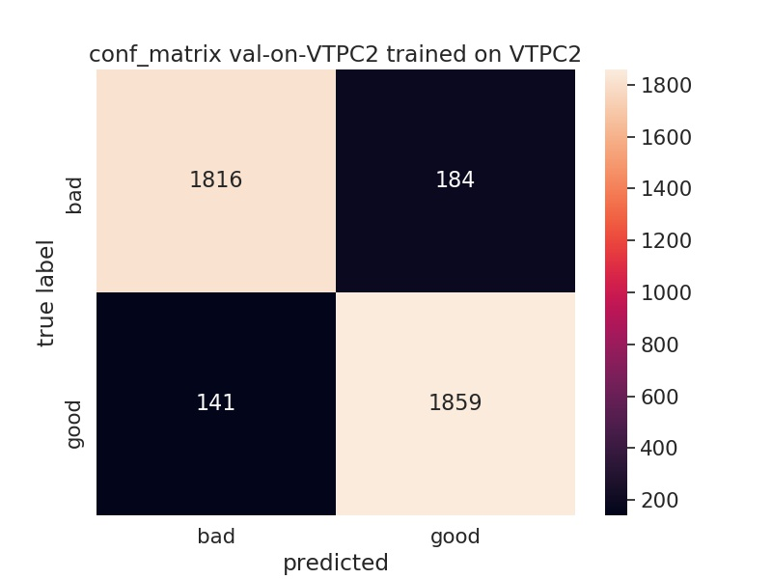
Network Performance
Splitted Convolution
91 % of noise is removed
7 % of „good“ clusters are wrongly predicted as „bad
Overall Accuracy: 91,9 %
___________________________________________
Cross-Validation on a different TPC: 89,4 %
90.8.5%
9.2%
7.05%
92.95%

Slide 31
Computational Time
Test dataset: 16000 samples
train dataset: 4000 samples
GPU: GeForce RTX2080 Ti Noise reduction Params FalseNegatives
network: split_input7
0.33 s/Event 91% 4 000 6-8%
network: res2_final
0.78 s/Event 90% 100 000 4-5%
network: simple_final
0.01 s/Event 87% 400 8-10%
CPU: Intel Xeon X5550, 2.67 GHz
network: split_input7
2.6 s/Event
network: res2_final
20.4 s/Event
network: simple_final
0.1 s/Event

Slide 32
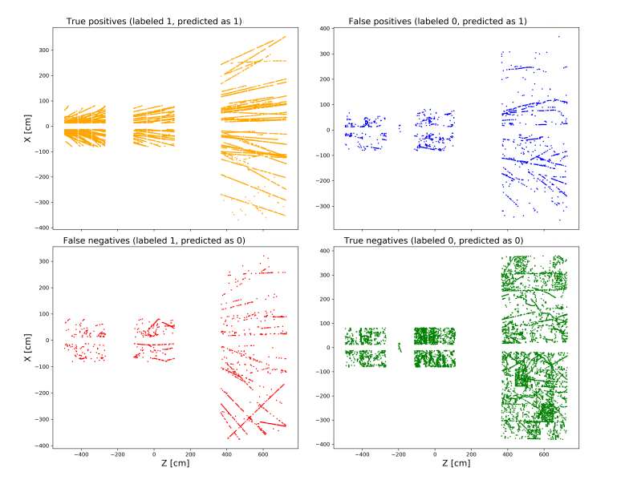

Conclusions and Outlook
Check-list
Improvements:
over 90% noise reduction
~67% of hits can be removed from the tracking
Speed:
<1 s/Event/Node possible on one GPU
Generalisation:
TPCV to TPCL works,
30 AGeV to … 158 AGeV – to be checked
collision systems – to be cheked
Efficiency:
~4% of signal is lost,
Lost signal vs p_T, mass, PID – to be checked
…
…
…
GPUs allow the benefit of the depth in the cases where performance is key

Slide 33

GPU DAY 2020, (C) Milch & zucker, FIAS, NA61/SHINE
Olena Linnyk
THANK YOU FOR YOUR ATTENTION

