Slide 1


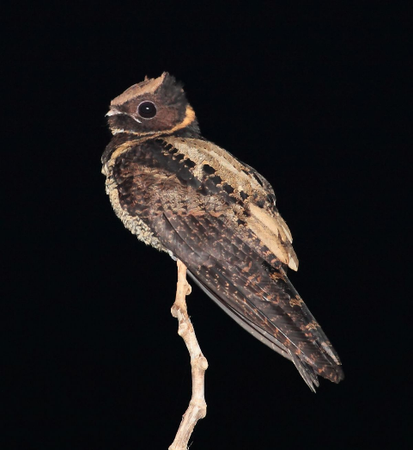
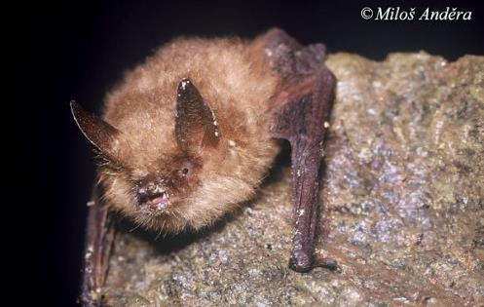
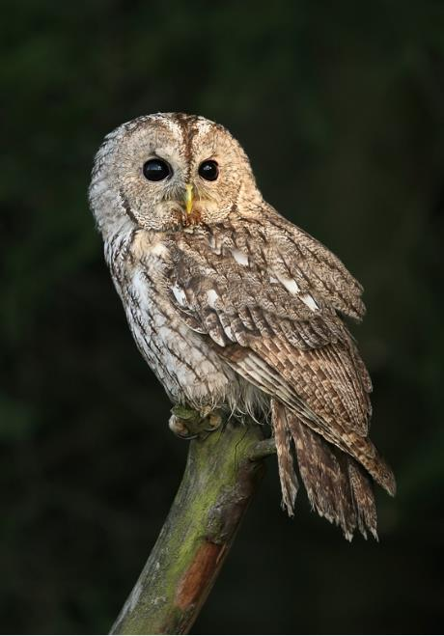
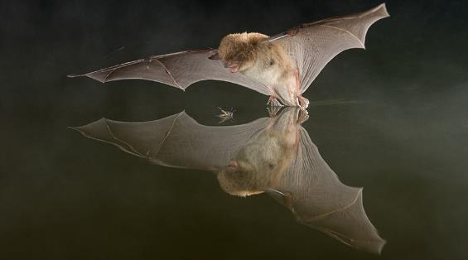
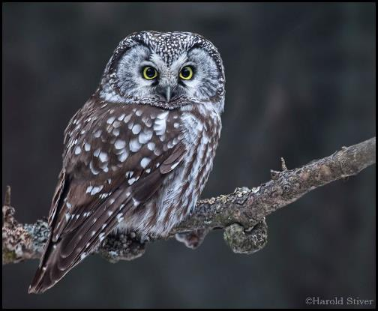
Image classification for biodiversity assessment and
nature conservation based on acoustic recordings
Sándor Zsebők
© Paul van Hoof

Slide 4
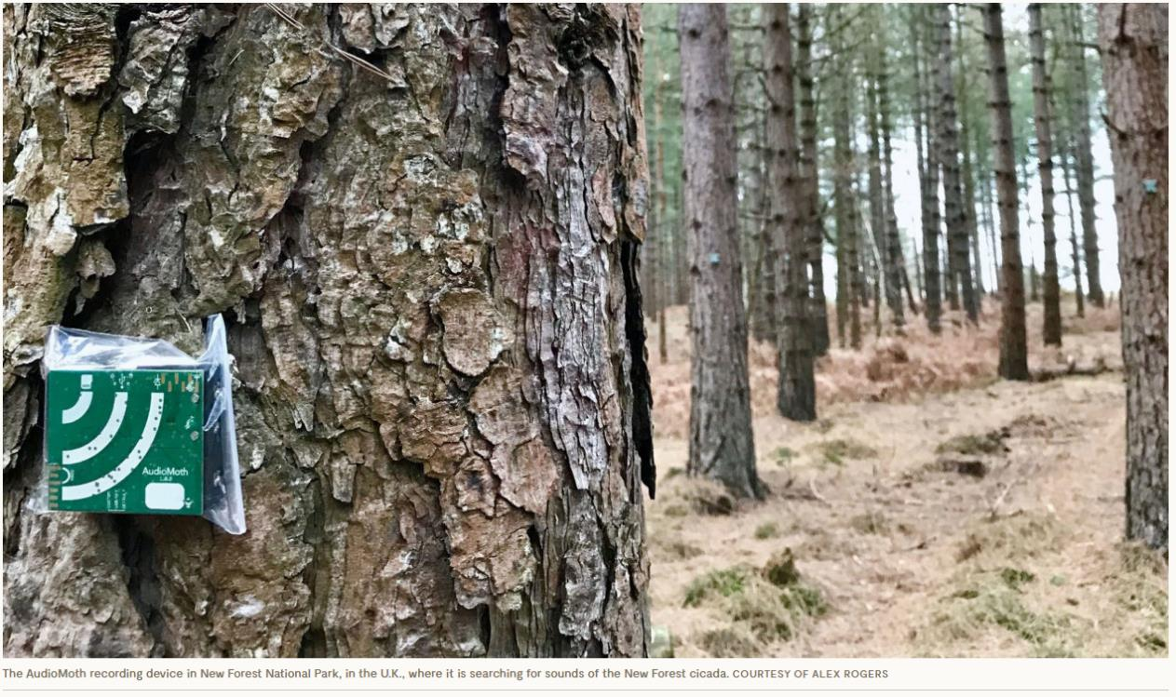
Passive acoustic methods
https://www.wwf.org.uk/project/conservationtechnology/acoustic-monitoring

Slide 5
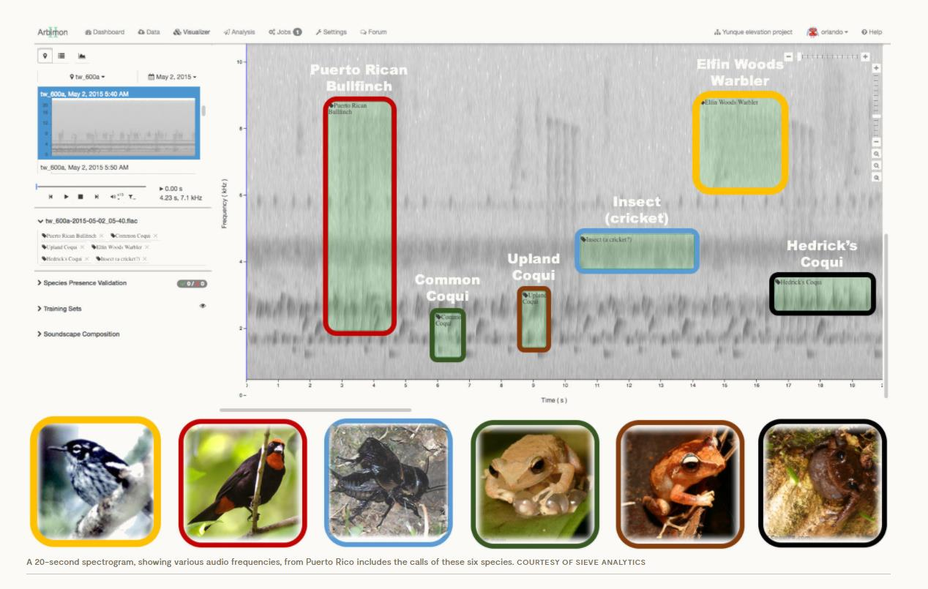
Passive acoustic methods
https://e360.yale.edu/features/listening-to-nature-the-emerging-field-of-bioacoustics

Slide 8


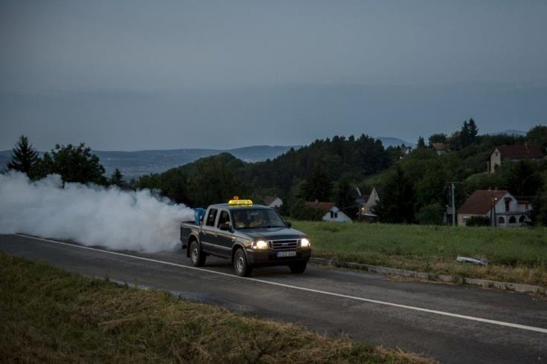
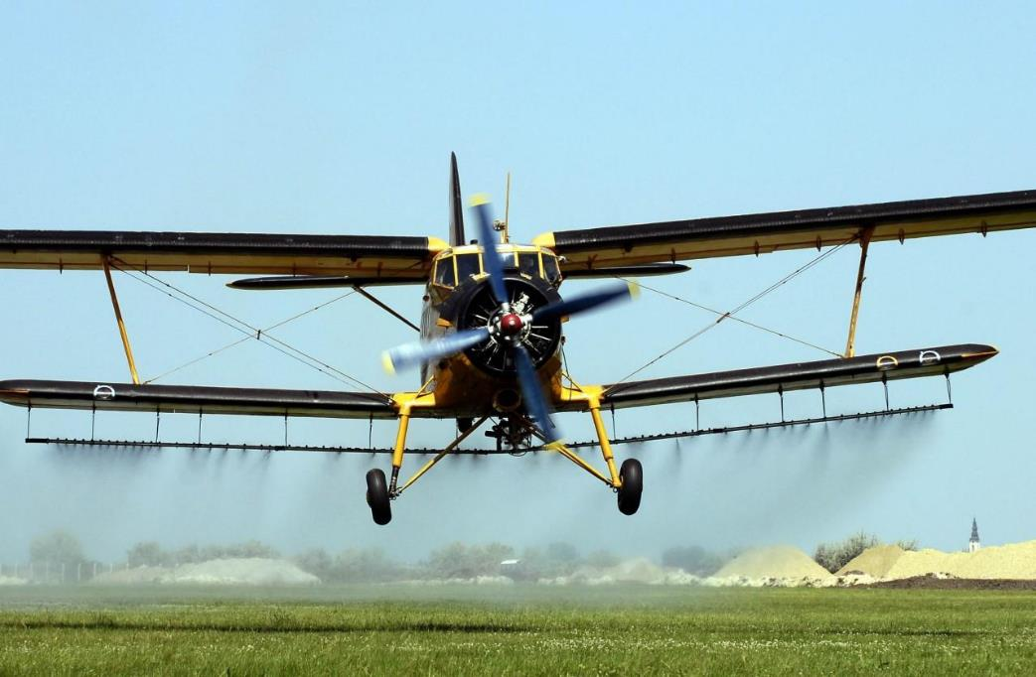
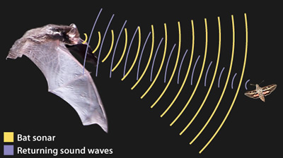
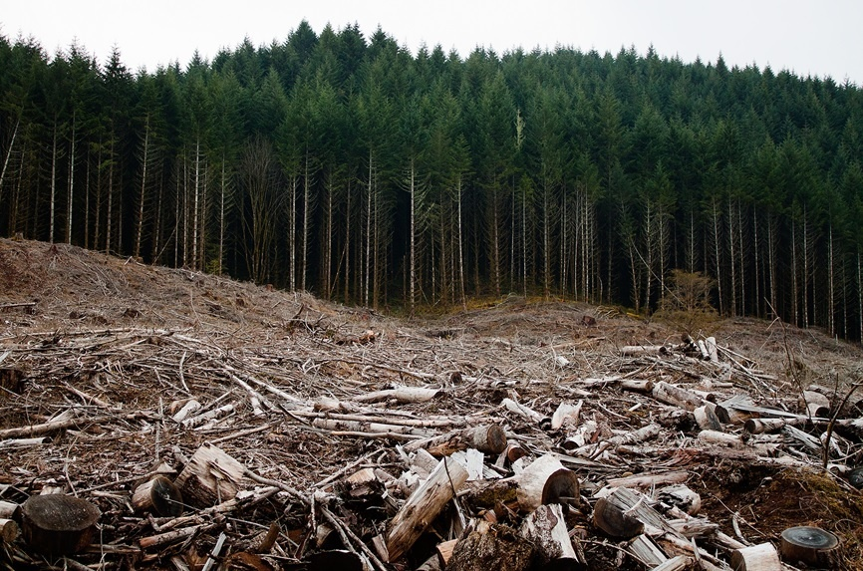

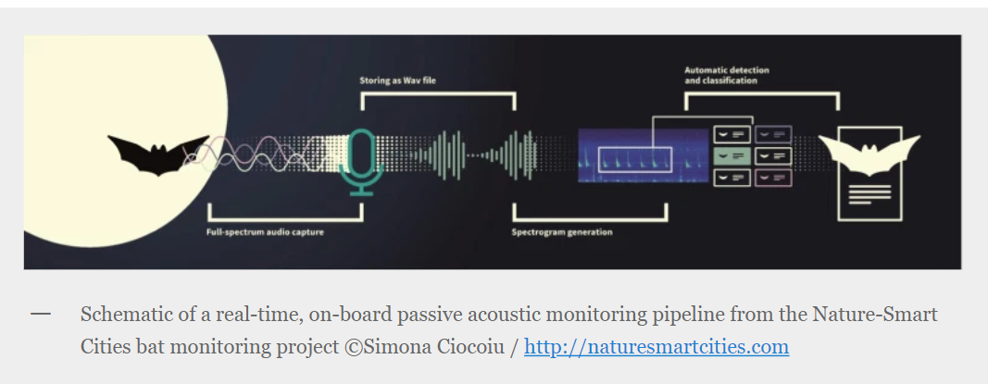
Bats
https://askabiologist.asu.edu/echolocation

Slide 9
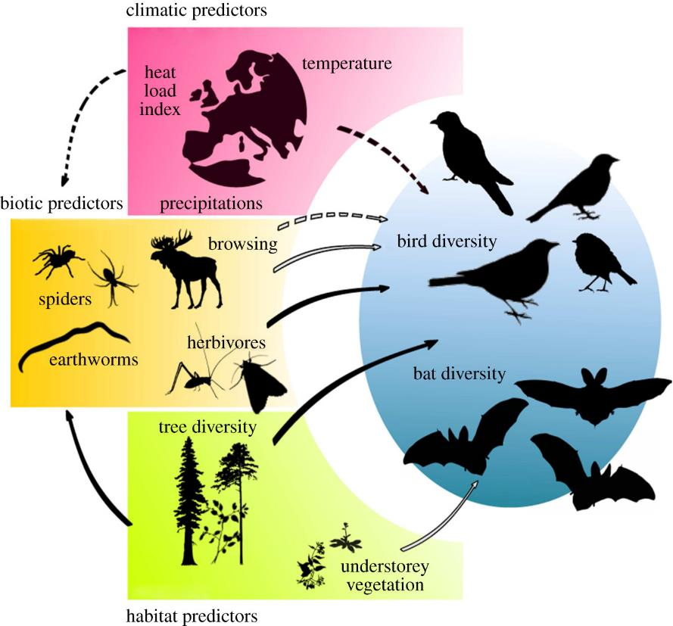
Bats as indicators species

Slide 10
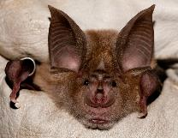
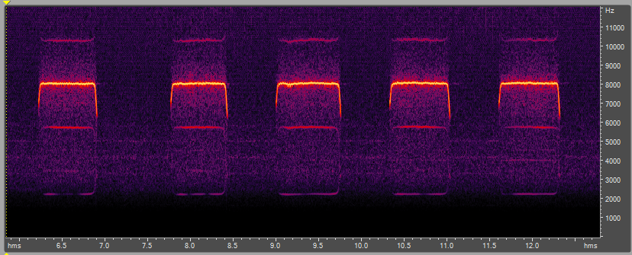
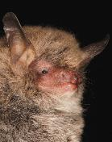
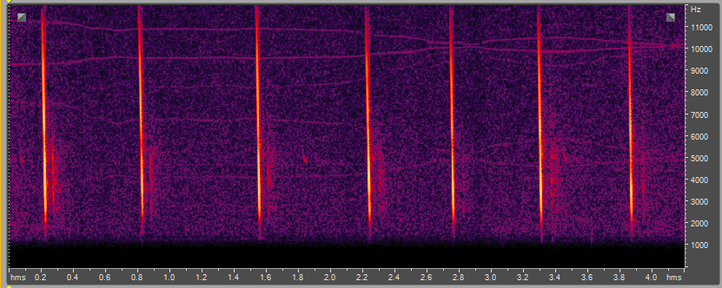

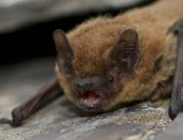
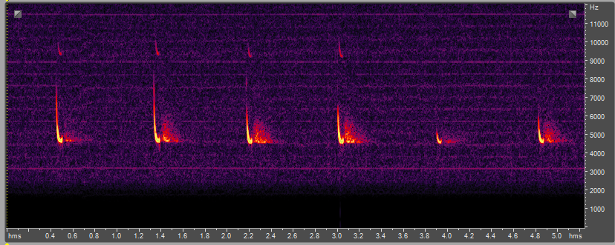
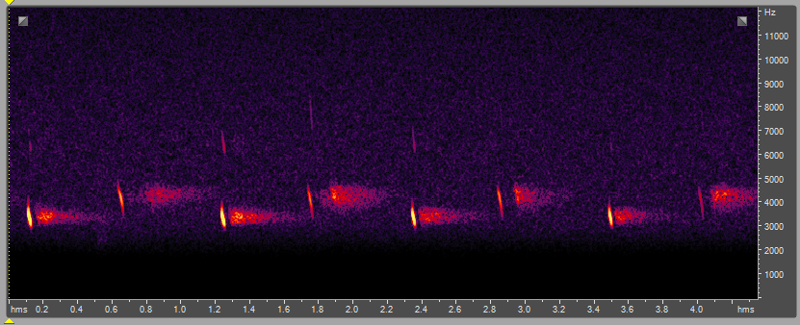
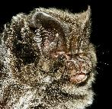
Type of bat sounds
Greater horseshoe bat (Rhinolophus ferrumequinum)
Natterer's bat (Myotis nattereri)
Common pipistrelle (Pipistrellus pipistrellus)
Western barbastelle (Barbastella barbastellus)

Slide 11

Many species with similar sounds
Daubenton’s bat
abs high signal in open areas
Geoffroy’s bat
abs high signal in open areas
© Paul van Hoof

Slide 12
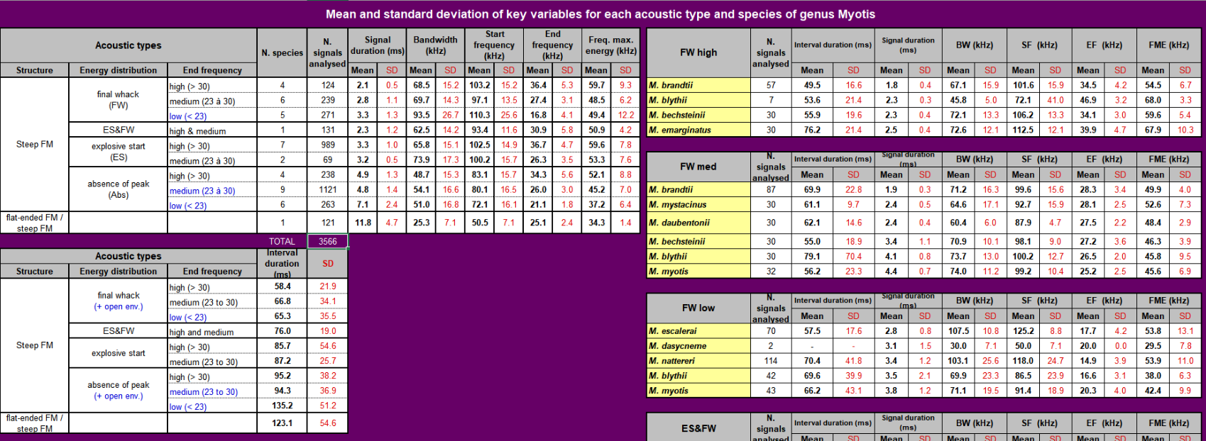
Identification based on acoustic measurements

Slide 13
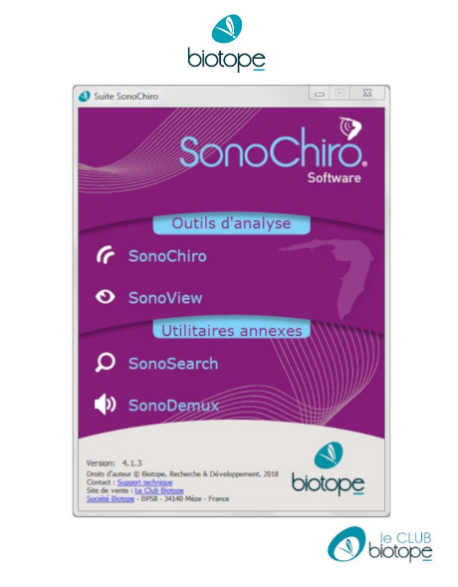

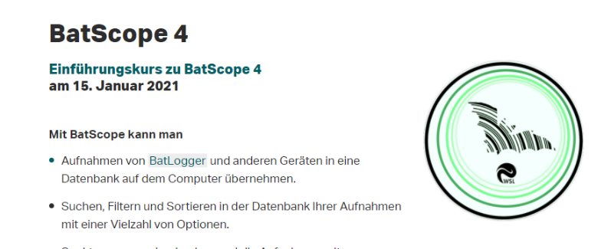

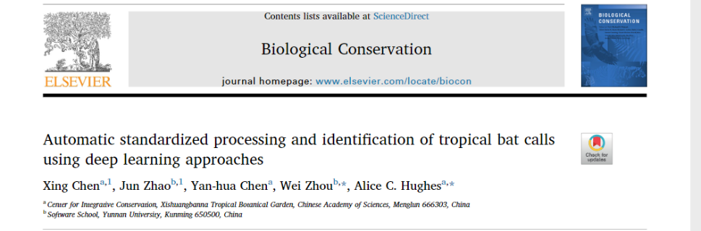
Automatic bat species identification

Slide 14

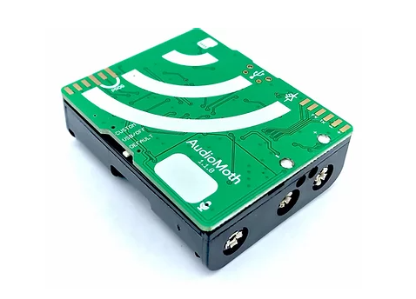
The Project: Acoustic sampling in Vas county, Hungary
1200 sampling points
4800 hours of recordings

Slide 15
Building automatic species identification model
- bat sound library
12 species:
  Barbastella barbastellus
  Myotis bechsteinii
  Myotis emarginatus
  Myotis myotis
  Myotis daubentonii
  Eptesicus serotinus
  Nyctalus leisleri
  Nyctalus noctula
  Pipistrellus kuhlii
  Pipistrellus nathusii
  Pipistrellus pipistrellus
  Pipistrellus pygmaeus
Manually identified sounds based on measurements
Recordings from identified individuals
Σ: ~ 65.000 samples (0.1 sec)

Slide 16
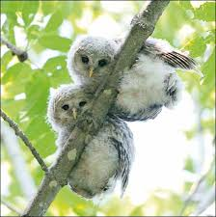
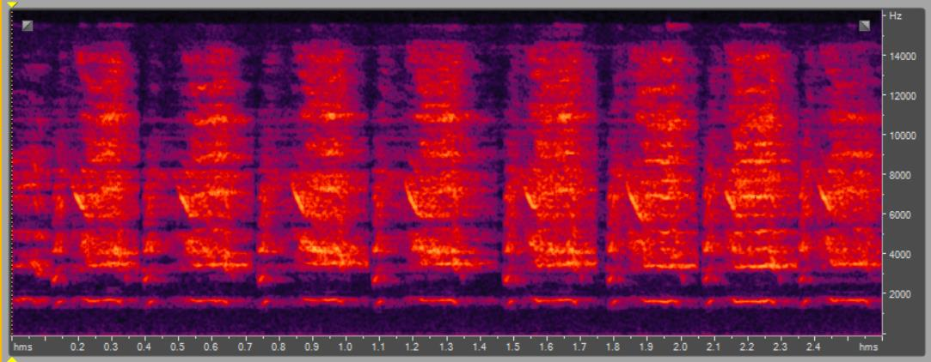
What else on the recordings?
tawny owl chicks

Slide 17

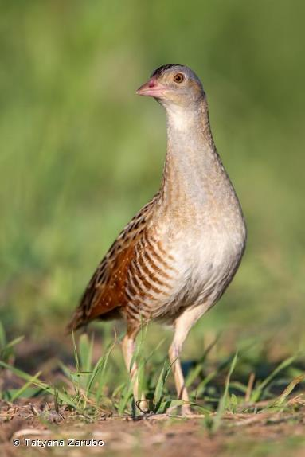
Nocturnal birds
Aegolius funereus – 292 recordings
Asio flammeus – 102 recordings
Asio otus – 616 recordings
Athene noctua – 752 recordings
Bubo bubo – 335 recordings
Caprimulgus europaeus – 640 recordings
Crex crex – 455 recordings
Glaucidium passerinum – 343 recordings
Otus scops – 356 recordings
Strix aluco – 414 recordings
Strix uralensis – 180 recordings
Tyto alba – 374 recordings
Σ: ~ 107.000 samples (3 sec)

Slide 18
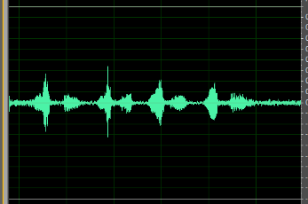
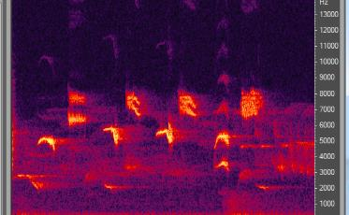
Common approach – image classification
soundfile
spectrogram
using “Darknet YOLO” program
Freeware, open source
C and Python
OpenCV / CUDA
CPU and GPU supported
Changeble input dimensions
image classification
results

Slide 19
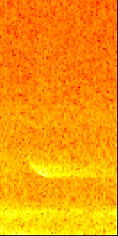
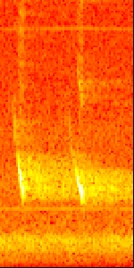
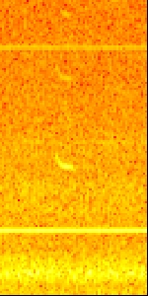
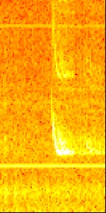
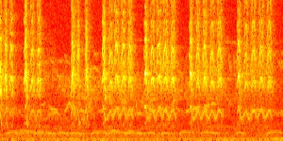
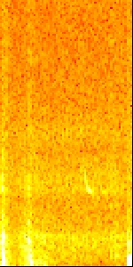
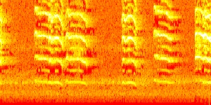
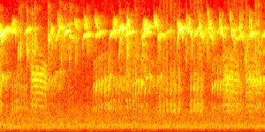
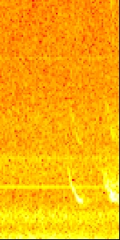
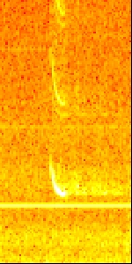
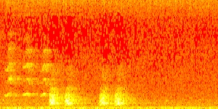
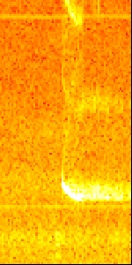
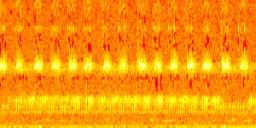
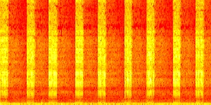
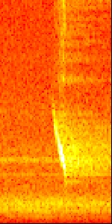
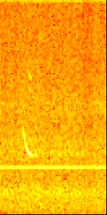
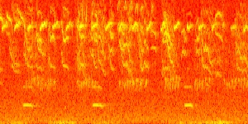
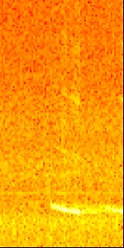
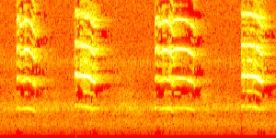






Bat pictures
Bird pictures

Slide 20

Bat model
Bird model
64 x 64 input layer
10 convolutional layers
GPU: 4 × Nvidia GeForce GTX 1080 Ti
11.2 GB RAM
~ 90% accuracy
~ 85% accuracy

Slide 21
Directions of improvement
Exploring other network architectures
Pre-processing of recordings
Data augmentation
Including more species

Slide 22



Usage of the method in our project

Slide 23



Acknowledgements
Varró Karolina
Kurali Anikó
Jandó Benedek

