Slide 2
The CERN
Quantum Technology Initiative
Alberto Di Meglio, Sofia Vallecorsa - CERN openlab, IT Department
Michael Doser – EP Department
Dorota Grabowska – TH Department
20/10/2020

Slide 3
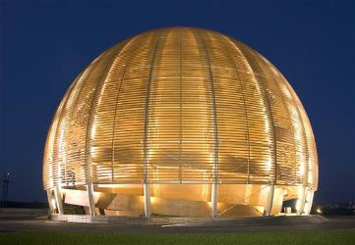
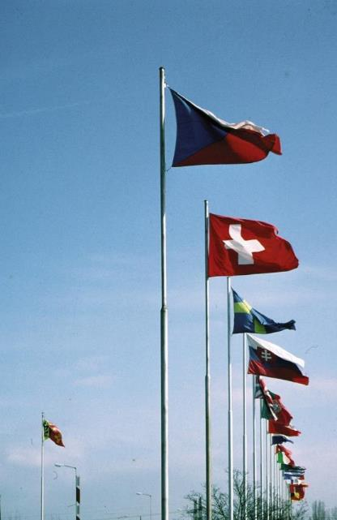
CERN
“Science for peace”
1954: 12 Member States
International organisation close to Geneva, straddling Swiss-French border, founded 1954
Facilities for fundamental research in particle physics
23 member states,
1.1 B CHF budget
~3’200 staff, fellows, trainees, …
>13’000 associates
Members: Austria, Belgium, Bulgaria, Czech republic, Denmark, Finland, France, Germany, Greece, Hungary, Israel, Italy, Netherlands, Norway, Poland, Portugal, Slovak Republic, Slovenia, Spain, Sweden, Switzerland, United Kingdom
Candidate for membership: Cyprus, Slovenia
Associate members: Croatia, India, Lithuania, Pakistan, Turkey, Ukraine
Observers: EC, Japan, JINR, Russia, UNESCO, United States of America
Numerous non-member states with collaboration agreements
>2’500 staff members, 645 fellows, 21 trainees
7’000 member states, 1’800 USA, 900 Russia, 270 Japan, …

Slide 4
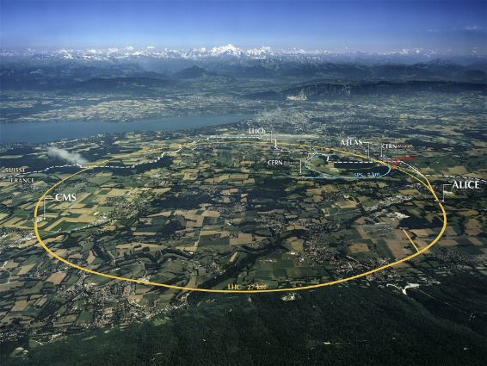
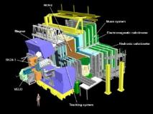
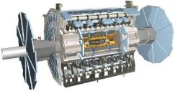
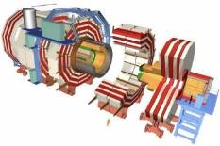
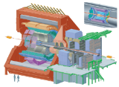
The Large Hadron Collider (LHC)

Slide 5
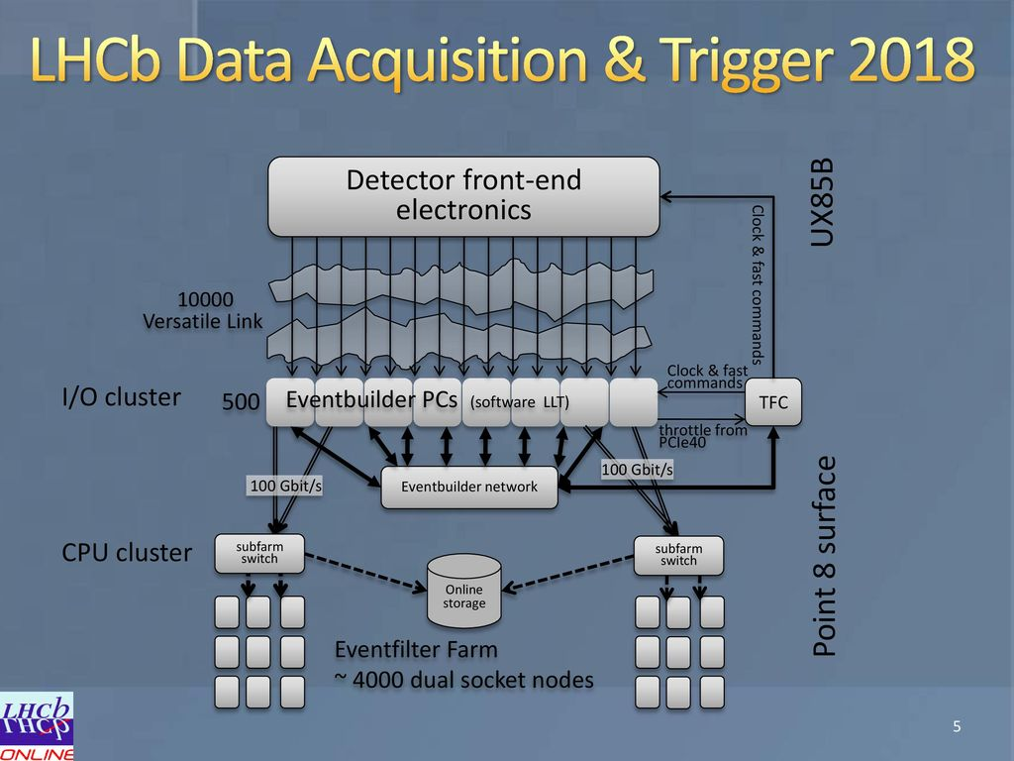
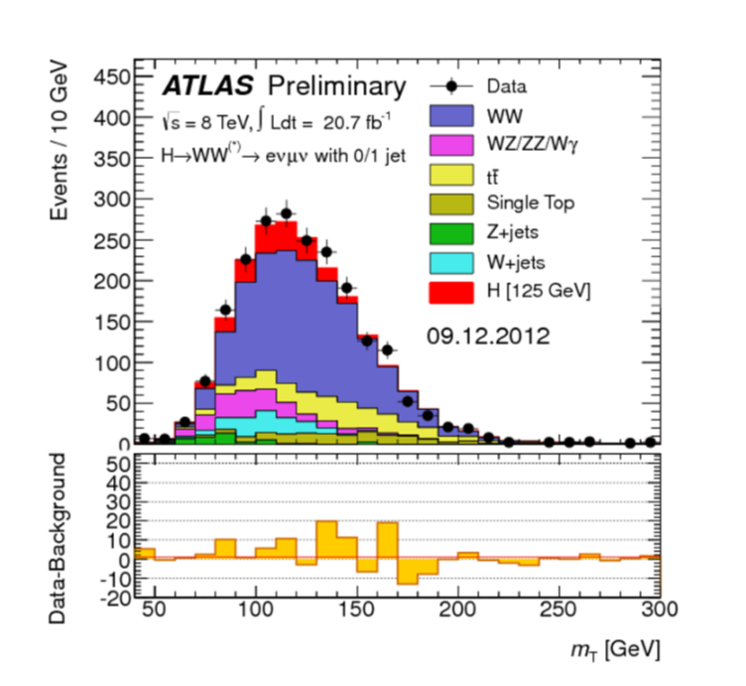
Typical LHC Experiments Workloads
© Niko Neufeld - LHCb
Data Acquisition
Track Reconstruction
Simulation
Data Analysis

Slide 6
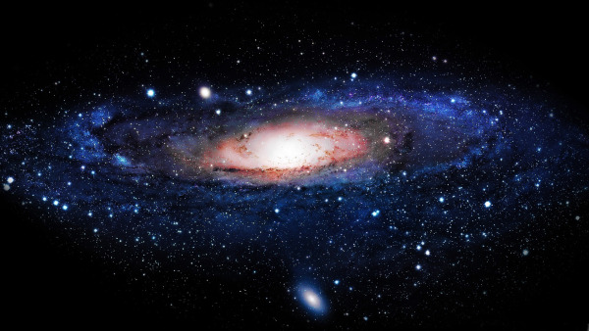
The Higgs Boson completes the Standard Model,
but the Model explains only about 5% of our Universe
What is the other 95% of the Universe made of?
How does gravity really works?
Why there is no antimatter in nature?

Slide 7
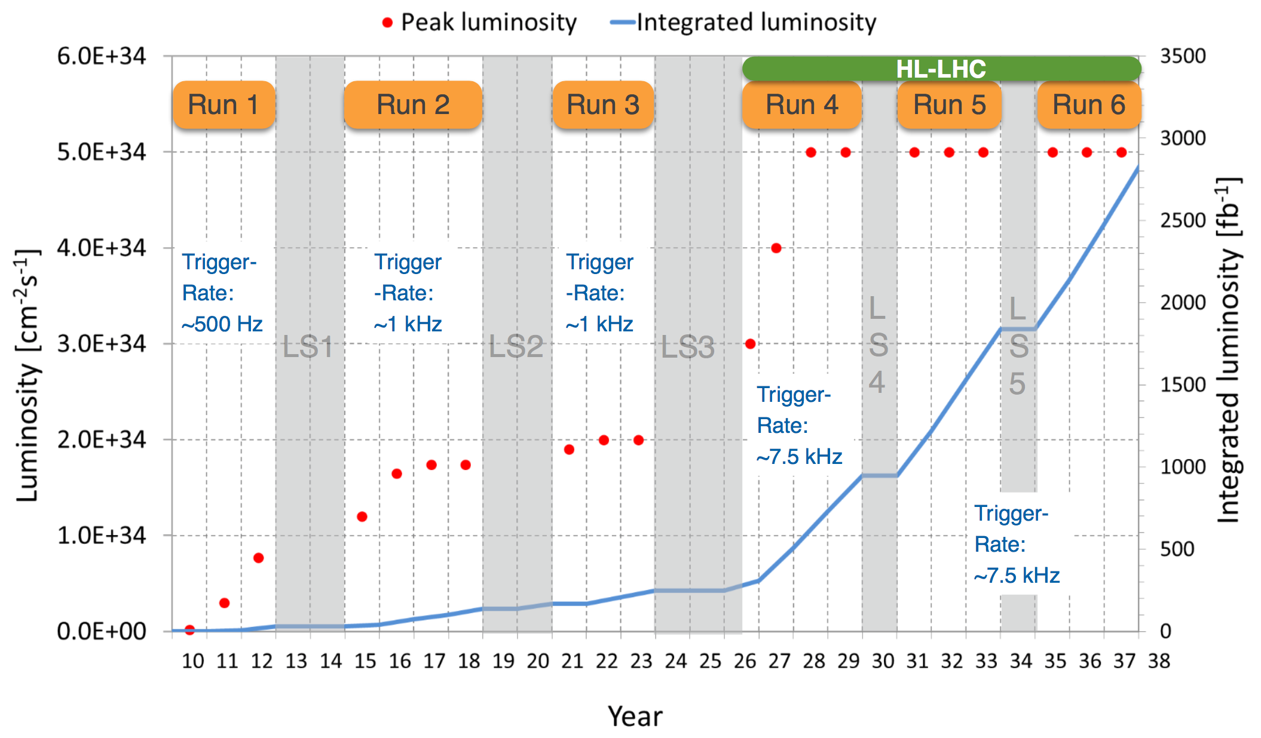
LHC Schedule
Schedule
being revised

Slide 8
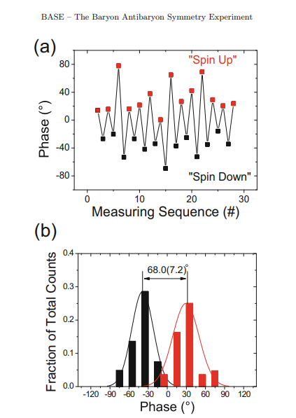
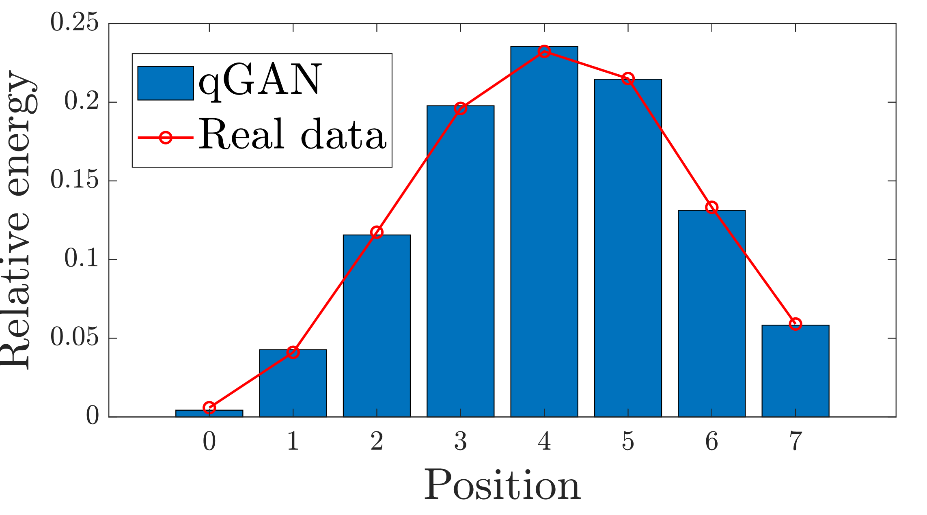
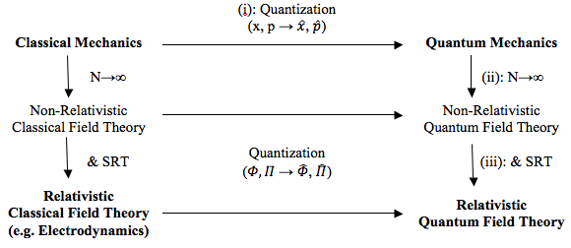
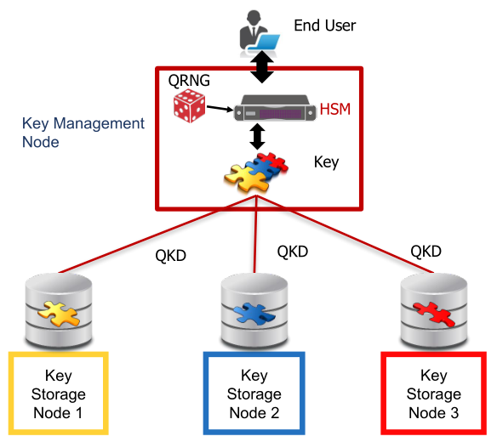
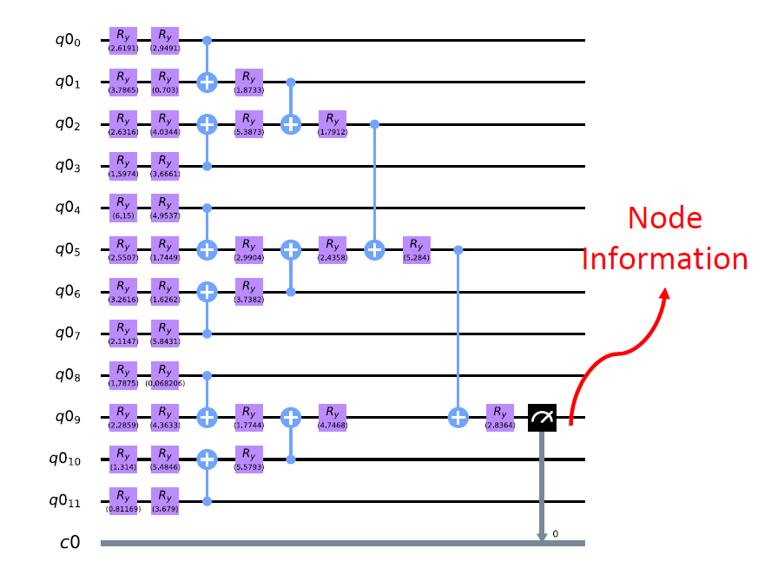
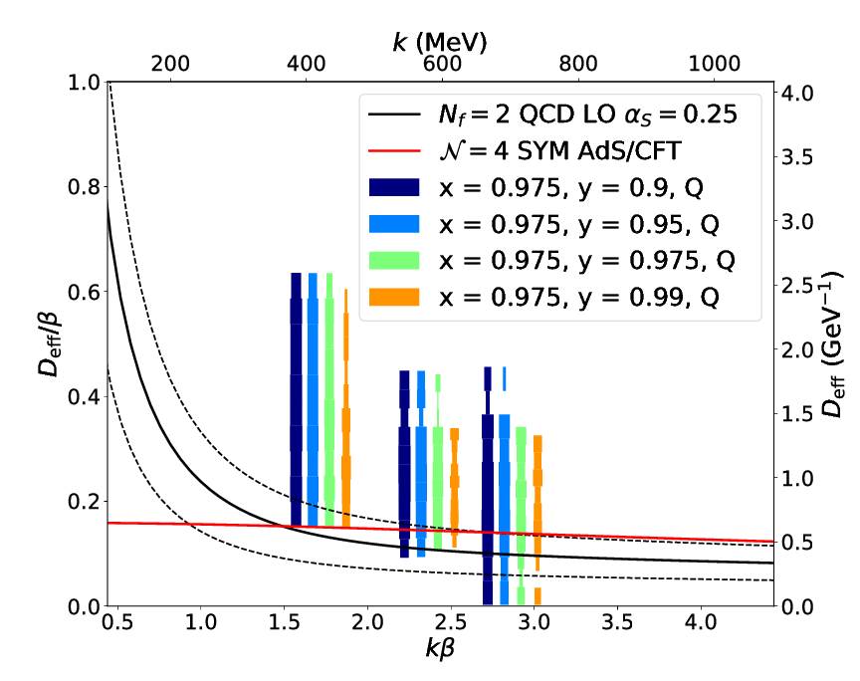
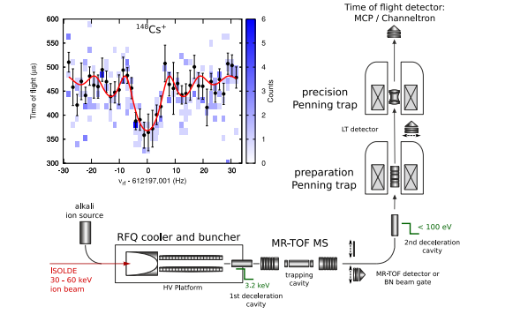
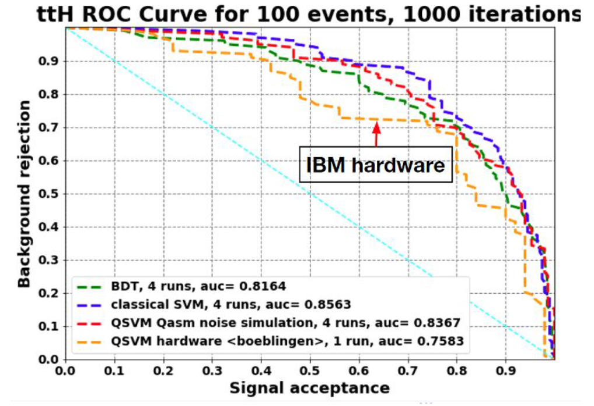
CERN Unique Expertise and Activities
Computing
Sensing
Communications
Theory
Simulation
https://doi.org/10.1140/epjst/e2015-02607-4
Quantum Field Theory
BASE phase-sensitive measurement of spin allowing very precise magnetic field drift measurements
Reconstruction
QKD node
Secure Data
Classification
https://cds.cern.ch/record/2703396
https://doi.org/10.1088/1361-6471/aa5a20
Lattice QCD
ISOLTRAP Mass-Spec
Many pilot projects already started as part of the CERN openlab quantum programme (https://openlab.cern/quantum)

Slide 9
1st CERN Quantum HEP Workshop
CERN openlab has organized a kick-off event of its Quantum Computing initiative on November 5th-6th , 2018
  https://indico.cern.ch/event/719844/
  > 400 registered participants from the HEP physics community, companies and worldwide research laboratories and beyond
Create a database of QC projects to foster collaborations between interested user groups, CERN openlab and industry
Continue to seek opportunities to support QC projects
CERN is now investigating ways of scaling up the QC activities in 2020

Slide 10
CERN Quantum Technology Initiative
CERN Management
Sensing,
Detectors R&D
Communication
Joint HEP R&D Programme
QT Advisory Board
(Member States)
QT Initiative Management
Computing & Engineering
Simulation,
Information Processing
Strategy
Coordination
R&D
Capacity building
Academic Programmes / Industrial Collaborations / Knowledge Transfer

Slide 11


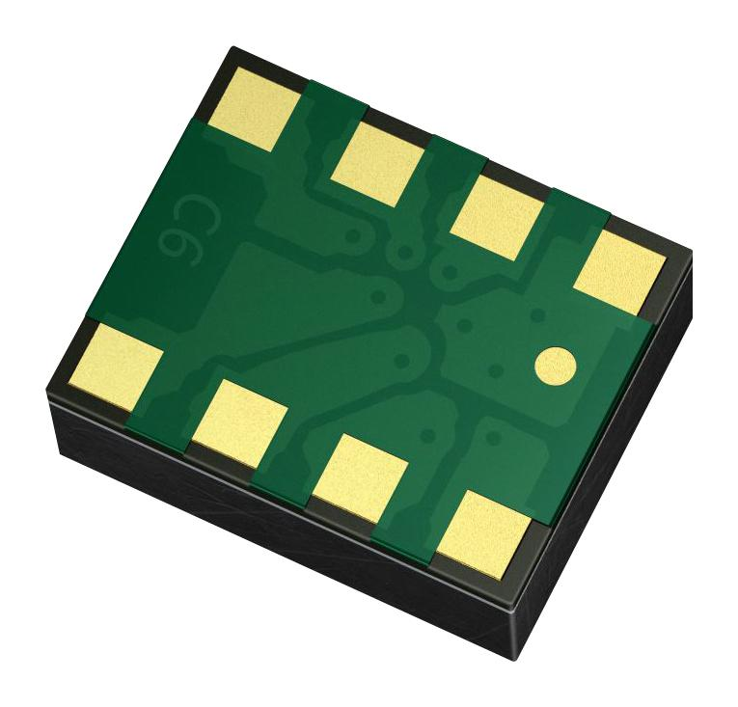
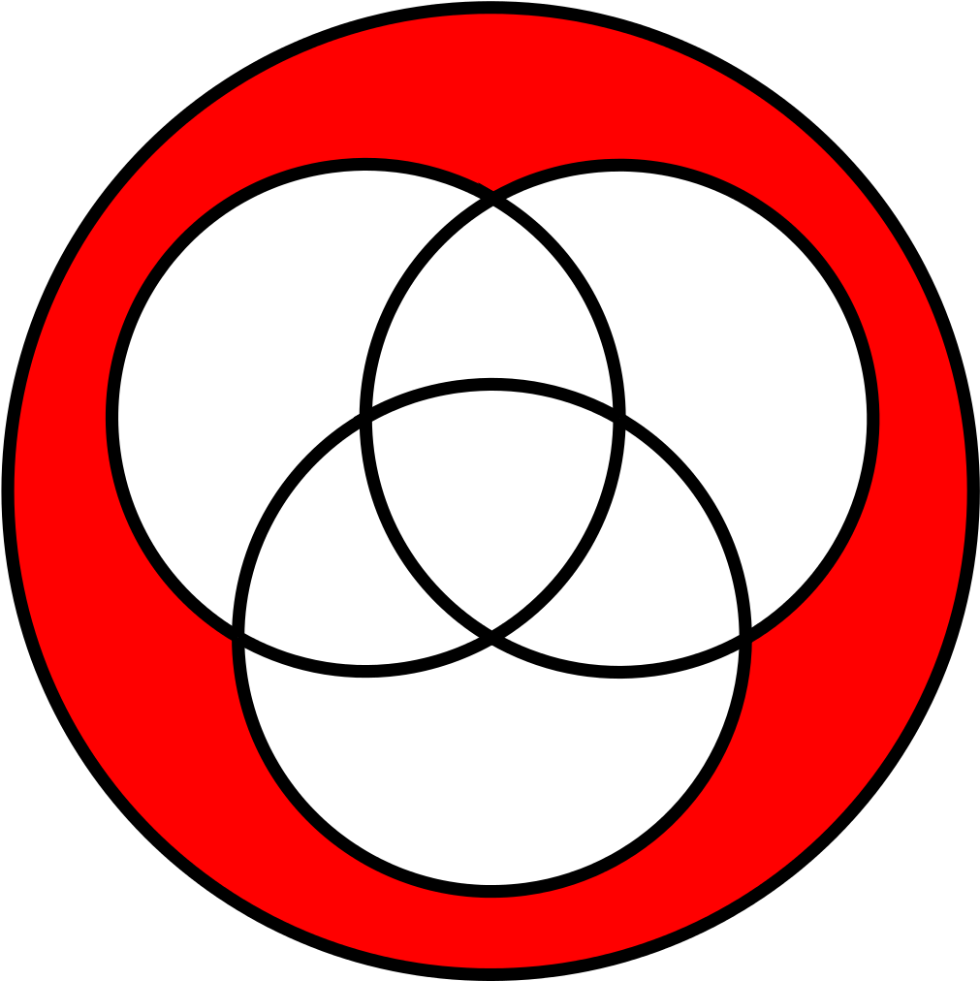
High-Level Objectives
Assess the potential and role of QML in HEP workloads, work on optimization and more robust mathematical formulations
Build expertise in the state-of-the-art of the software stack (simulators, compilers, programming models/languages/tools)
Work on quantum systems simulators (FPGA?)
Set up a distributed QCS platform
Explore possible applications of QKD
Comms+sensing for detectors?
European Quantum Network/Internet
Computing
Communications
Ion/particle traps as computing/sensing devices
Mass/charge/gravity sensors
Quantum clocks
Nanowires/nanodots for particle tracking/calorimetry
Rydberg calorimetry
Simulation of quantum systems
Quantum gravity
Information processing, error mitigation/correction strategies
Sensing
Theory

Slide 12

High-Level Objectives
Assess the potential and role of QML in HEP workloads, work on optimization and more robust mathematical formulations
Build expertise in the state-of-the-art of the software stack (simulators, compilers, programming models/languages/tools)
Work on quantum systems simulators (FPGA?)
Set up a distributed QCS platform
Explore possible applications of QKD
Comms+sensing for detectors?
European Quantum Network/Internet
Knowledge sharing
Education
Training
Computing
Communications
Ion/particle traps as computing/sensing devices
Mass/charge/gravity sensors
Quantum clocks
Nanowires/nanodots for particle tracking/calorimetry
Rydberg calorimetry
Simulation of quantum systems
Quantum gravity
Information processing, error mitigation/correction strategies
Sensing
Theory

Slide 13
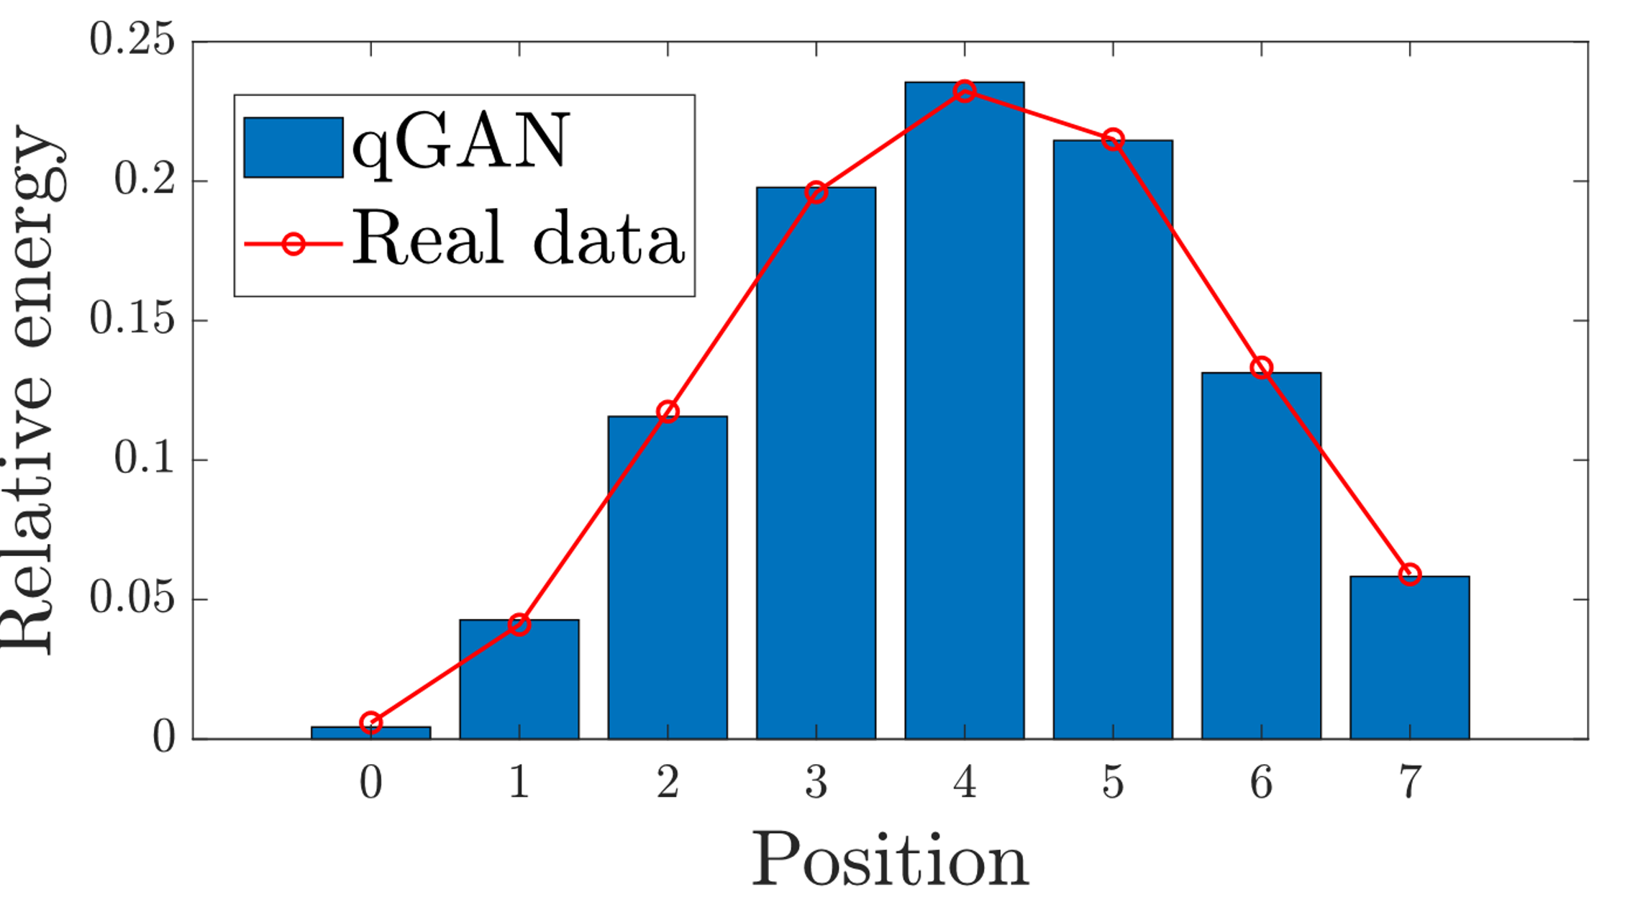
Quantum Computing Projects
Simulation
Quantum Generative Adversarial Networks for detector simulation
Quantum Graph Neural Networks for particle trajectory reconstruction
Quantum Support Vector Machines for signal/background classification (Higgs, SUSY,..)
Workload optimization via quantum Reinforcement Learning
Quantum Random Number Generators tests and integration
Quantum Homomorphic Encryption
Reconstruction
Classification
Collaborations with institutes (DESY, U. Aachen, INFN, U.Tokyo, U. Wisconsin, METU, P. U. Bucharest, U. Oviedo, …) and companies (IBM, Google, Intel, CQC, ...)​

Slide 14


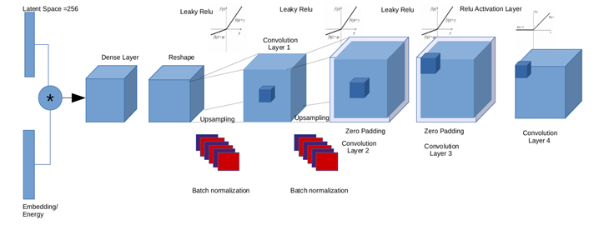
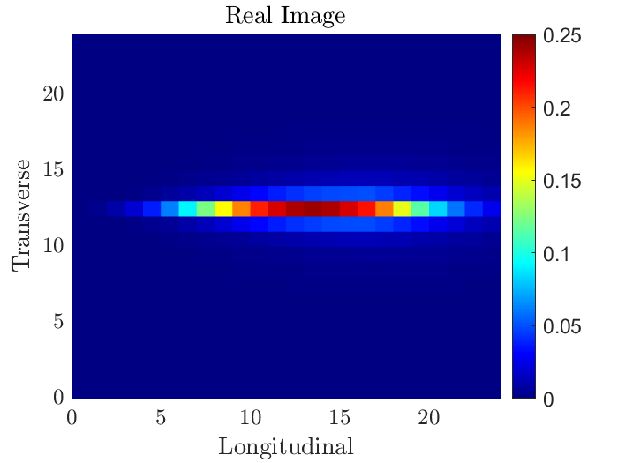
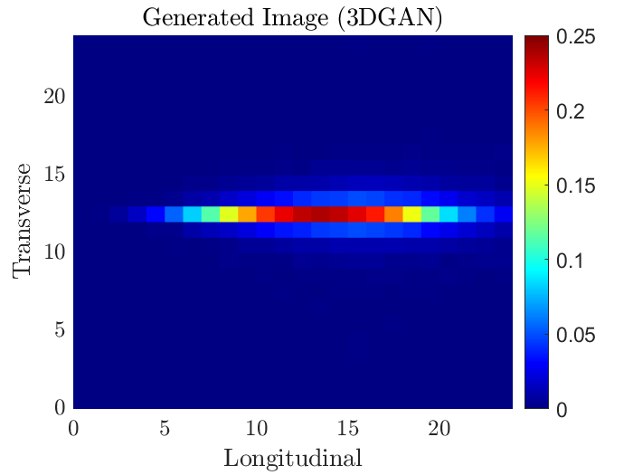
Quantum Generative Models
3DGAN generator
https://doi.org/10.1051/epjconf/201921402010
Classical Generative Models can replace Monte Carlo simulation
  3DGAN: Generative Adversarial Networks for calorimeter simulation
  Detector output interpreted as a 3D image.
Quantum Generative Models might have larger representational power
Quantum GAN investigations:
  Down sample 3DGAN use case to manageable number of pixels
  Compressed data representation in quantum states.
    Qubits or Continuous Variables
  Different hybrid classical-quantum combinations
Real image
3DGAN output
Calorimeter Depth
Calorimeter Depth
Notes:
One possible strategy to accelerate the computationally expensive simulations of particle collisions in the experiments detectors is to use Generative Adversarial Networks. We use the technique to generate very realistic images of what happens inside a particle detector by training the model on real images. It has also many applications in different simulation scenarios, for example for financial analysis. We have very interesting results in the classic computing world and have started exploring the potential of quantum GANs.
We have started by simplifying the model to a manageable number of pixels and using a compressed data form that can be represented as quantum states.

Slide 15
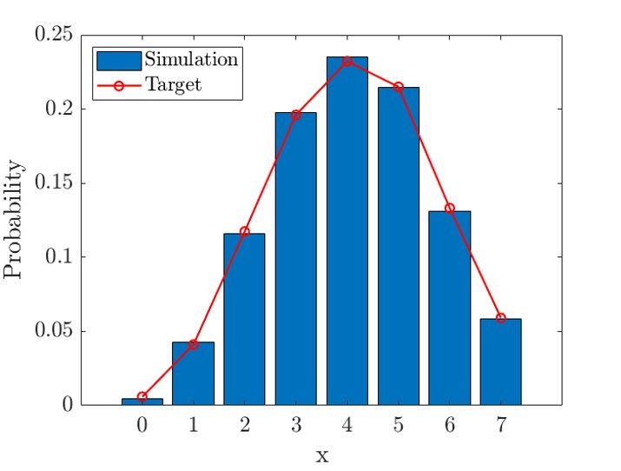
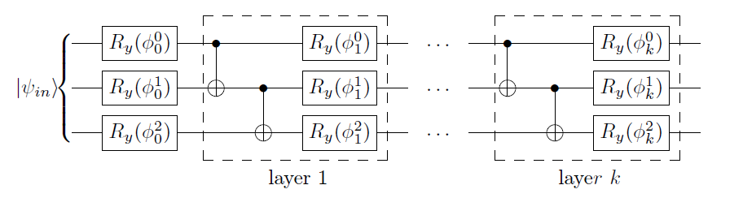
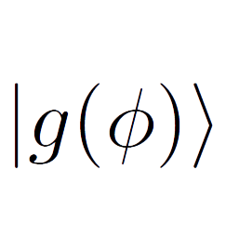
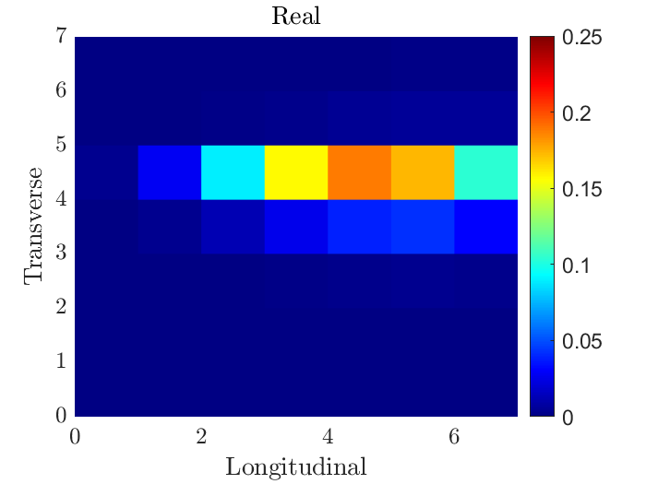
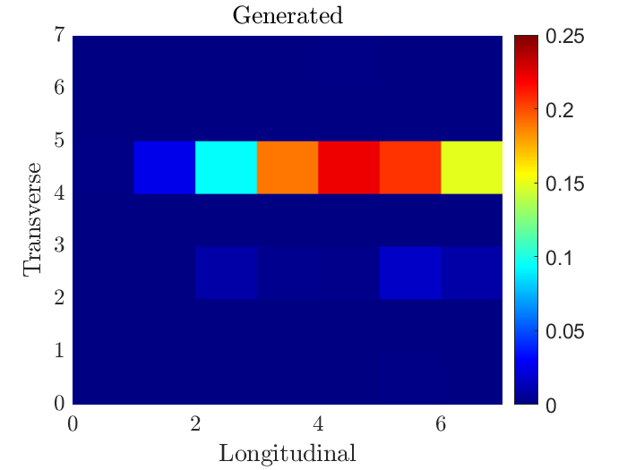
Hybrid Classical-Quantum GAN
IBM qGAN can load probability distributions in quantum states
3 qubits
1D & 2D energy profiles from 3DGAN images
  2^{n} classical pixels expressed by n qubits
Train a hybrid classical-quantum GAN to generate average image
Relative Energy Profile
  Quantum Generator: 3 R_{y} layers
Calorimeter Depth
Real image
6 qubits
qGAN image
https://doi.org/10.1038/s41534-019-0223-2
Need a way to sample single images
Calorimeter Depth
Calorimeter Depth
Notes:
An initial 1D model has shown good potential in generating the correct energy distribution of a particle crossing a calorimeter. We have used a combination of a classic discriminator to analyse the images and a 3-layer quantum generator from Qiskit.

Slide 16

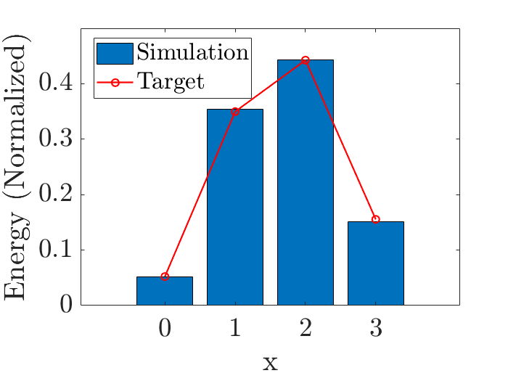
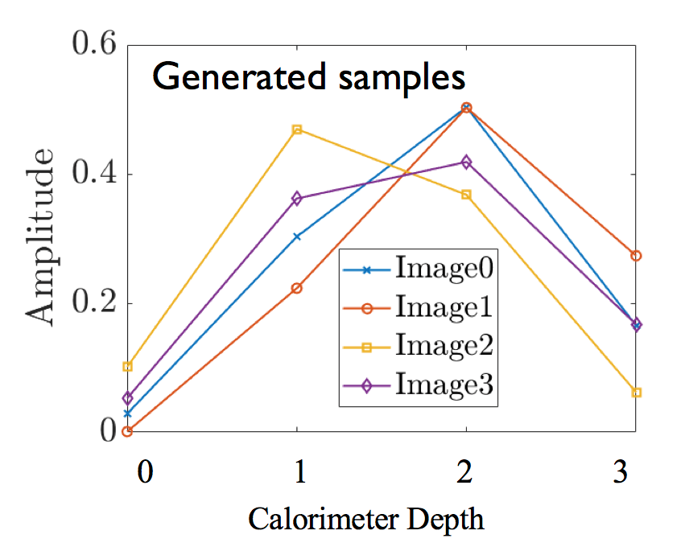
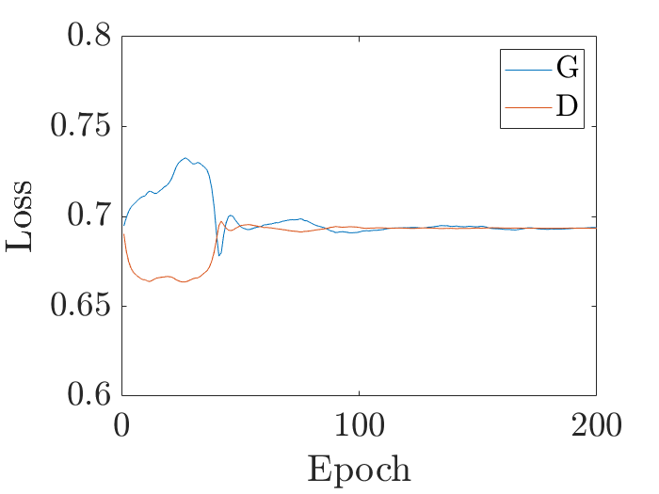
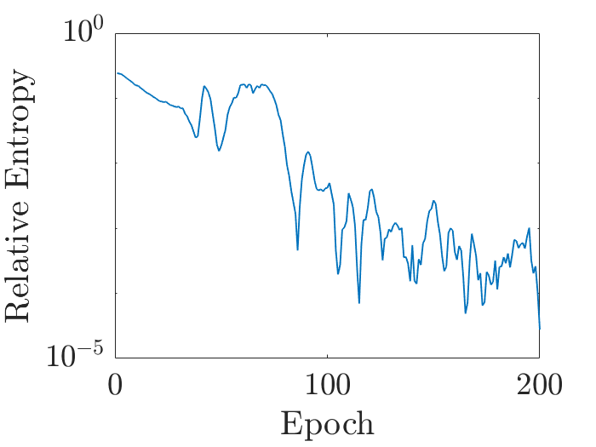
Extending the qGAN model
Collaboration with Cambridge Quantum Computing
Two-steps quantum generator to learn the average distribution and sample images from it
  Ry variational form implemented using qiskit & t|ket
Classical discriminator (pyTorch) 4 nodes → 512 nodes → 256 nodes → 1 node
WORK IN PROGRESS
Mean Image
Calorimeter Depth
Notes:
So, we have teamed up with Cambridge Quantum Computing, which we have met thanks to the IBM Q-Net, and we have extended the qGAN model with a two-step approach that both learns the average distribution and allows to sample images from it. As you can see we still get a nice loss function and the relative entropy (the distance between real and simulated images) converges to low values. The model has been implemented both in Qiskit and in CQC own t|ket compiler. And in time we hope it will provide a nice contribution to extend the Qiskit qGAN library for the whole community.

Slide 17


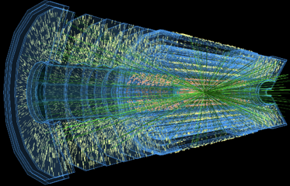
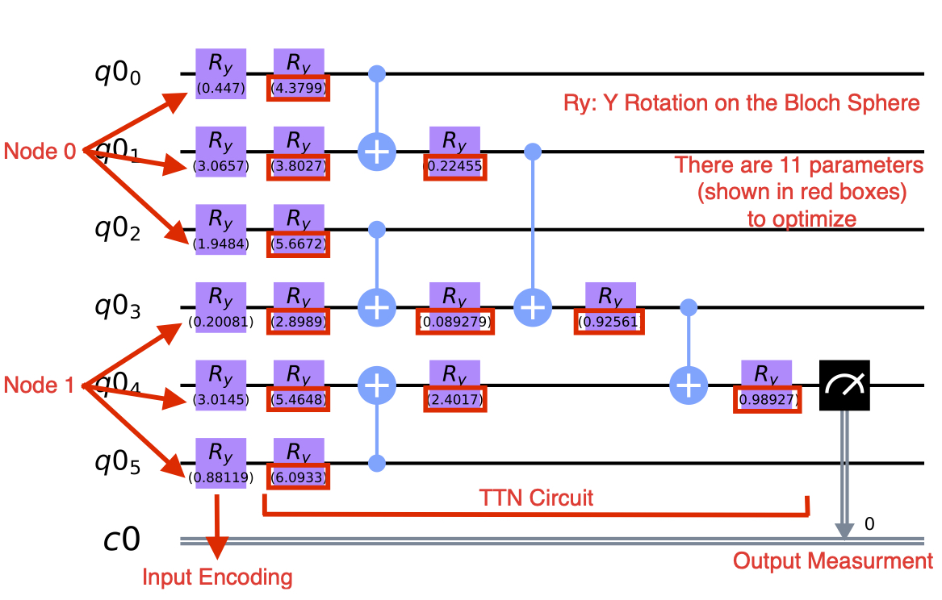


Quantum TTN for tracking
arxiv:2003.08126
Q-TrKx project designs a cascade of TTN to perform trajectory reconstruction from detector digital hits
  Mimics classical GNN based approach (HEPTrk)
  Realistic dataset used for TrackML challenge
Comparison to simple classical networks shows quantum potential
Node 1 (r₁,$∅1$,z₁)
Increasing N_{hid.dim.} , improves the performance
Node 0 (r₀,$∅0$,z₀)

Slide 18


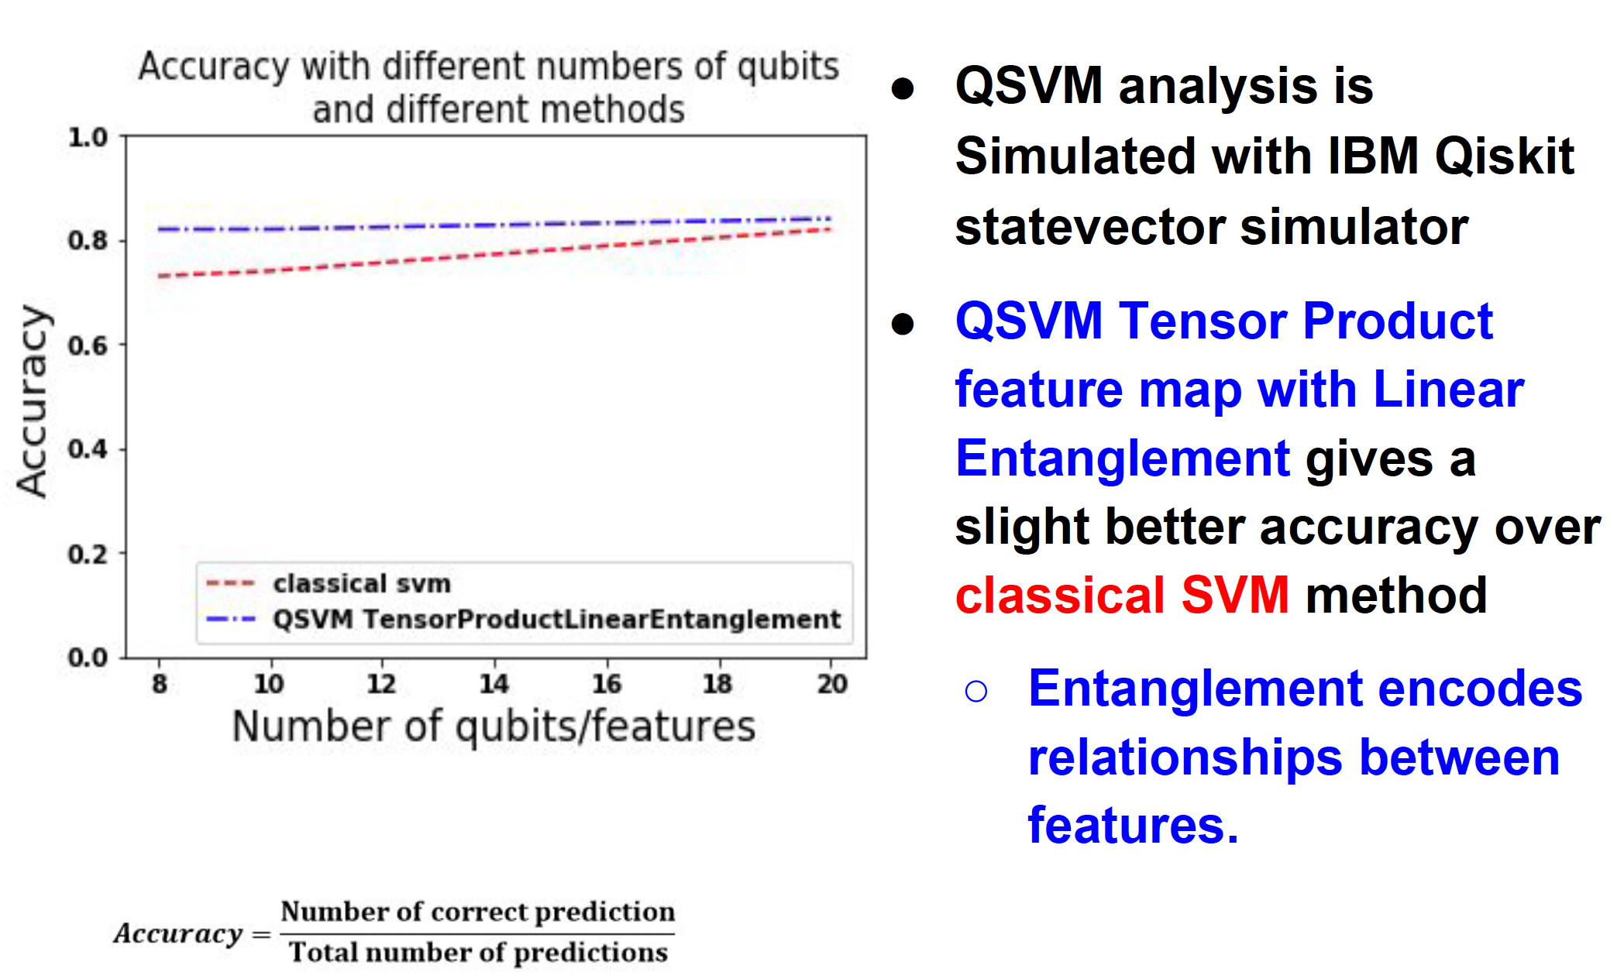
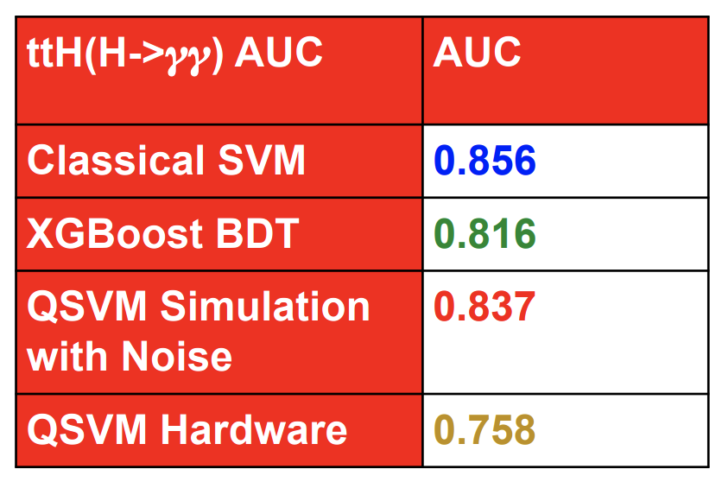
Quantum SVM
Chan et al PoS, LeptonPhoton2019 49 (2019)
Prof. Saun Lan Wu and her team
A quantum classifier for Higgs boson identification: ttH(H → γγ)
45 signal/background classical distinctive features
  Reduce number using PCA (5 qubits)
Implement a Support Vector Machine as Variational circuit in Qiskit
Comparison to classical BDT and SVM
  1000 iteration on IBM boeblingen
Quantum simulation requires large computing resources
  Memory increases with qubit, training events and complexity

Slide 19

QC Simulation Platform
1
Enable building skills and starting R&D work, both as a preparation to real H/W and to explore “quantum-inspired” computational models
“Standardized” access to different simulators, hardware, tools, libraries (e.g. pre-packaged containers, Jupyter notebooks, GitHub, etc.)
Multiple participating sites, capitalizing on CERN world-level expertise in operating distributed infrastructures
2
3

Slide 20
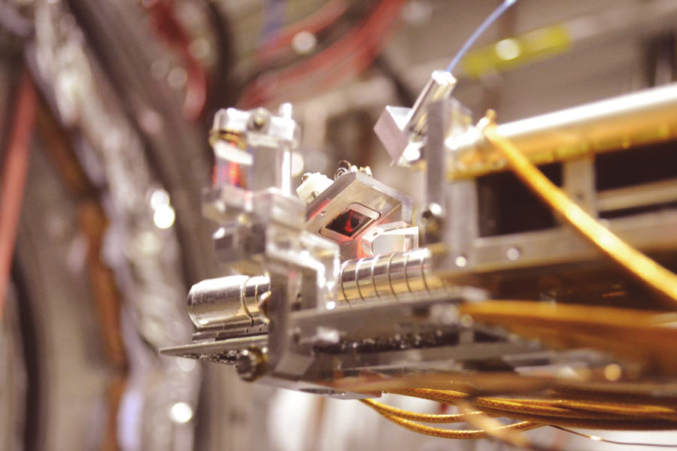
Quantum Sensing and Low-Energy Physics
Scope
Low-Energy Physics: antimatter, dark matter searches, symmetries, EDM’s (AD, AeGIS,
ISOLDE, etc.)
Strategy
Discrete processes, changes of quantum states
Novel devices: nanowires, photon upconverters,
microwaves, magnetic junctions, SQUIDs, TES
Measurements of properties of trapped, atoms, ions, molecules, Rydberg atoms,
neutral systems
Correlations of entangled systems: e.g. e⁺ e⁻ 3γ decay: simultaneous measurement
of E, polarization and direction
Applications

Slide 21
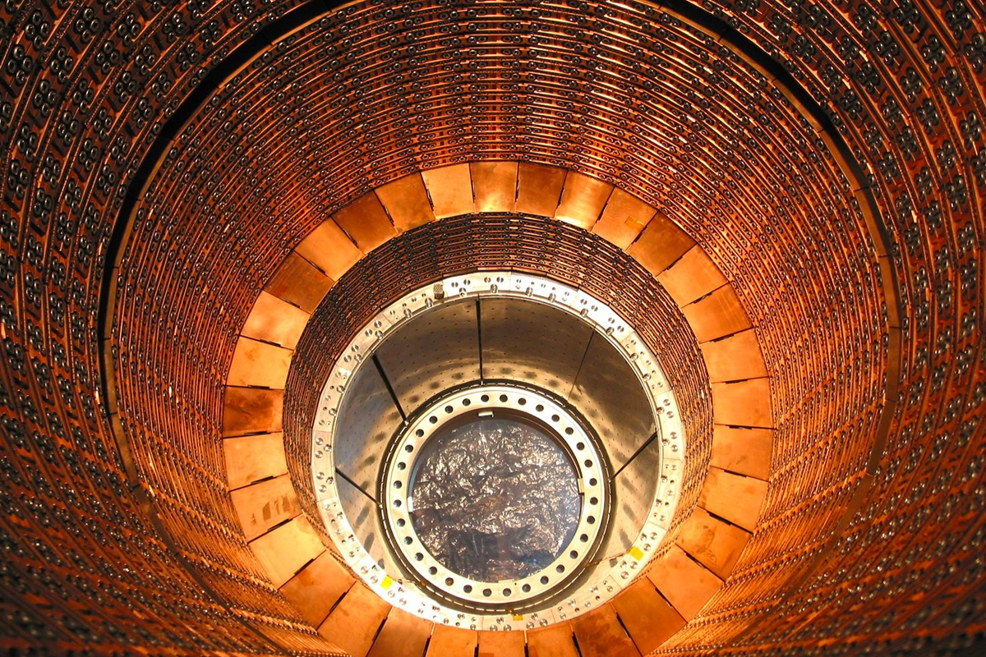
Quantum Sensing for High-Energy Physics
Scope
High-Energy Physics, particle tracking, calorimetry, identification in HEP detectors
Quantum “priming” of detectors before measurement, signal enhancement
by laser excitation, quantum effects due to size, cryogenics
Strategy
Applications
Chromatic particle trackers composed of arrays of nanodots of varying size,
Calorimeters and low-energy single-particle (photons, mip’s, ions,...) detectors
made of arrays of nanowires (SNSPD)
“Rydberg-amplified” calorimeters with high dE/dx

Slide 22
Quantum Internet
1
CERN started the Web; we have some expertise it’s in our DNA ☺
CERN was part of early quantum networks experiments already 10+ years ago
Interested in taking part in EU and international network deployment initiatives
Quantum memory/storage would be necessary for our typical “big data” models
2
3

Slide 23


Data in transit
Data Analysis
Auditing and monitoring
Data at rest
QUANTUM-based privacy and self-determination
Funded as an openQKD open call funds
End-to-end use of QKD to secure distributed data analysis over cloud infrastructures
Data analysis: quantum homomorphic encryption
Auditing: quantum block chains
Medical use cases: image classification and segmentation for neurological diseases research

Slide 24
Numerical Methods and Simulations
in Particle Theory
Modern day HEP requires high performance computing, relying on Monte Carlo simulations
But not every physics problem is amenable to Monte Carlo simulation
Mass Spectrum and Scattering in Low Energy Nuclear Physics
Hadronic contributions to BSM Experimental Searches
Event generation for Particle Collisions
Nuclear Physics at Finite Density (sign problem)
Interference effects in Parton Showers (must work at amplitude level)
Transfer Phenomena (must work in real time)
Baryonic Physics (signal to noise problem)
Main focus is developing methodologies and algorithms that would allow us to address these questions using quantum computers, without relying on importance sampling
CERN QTI - 19/10/2020
24

Slide 25
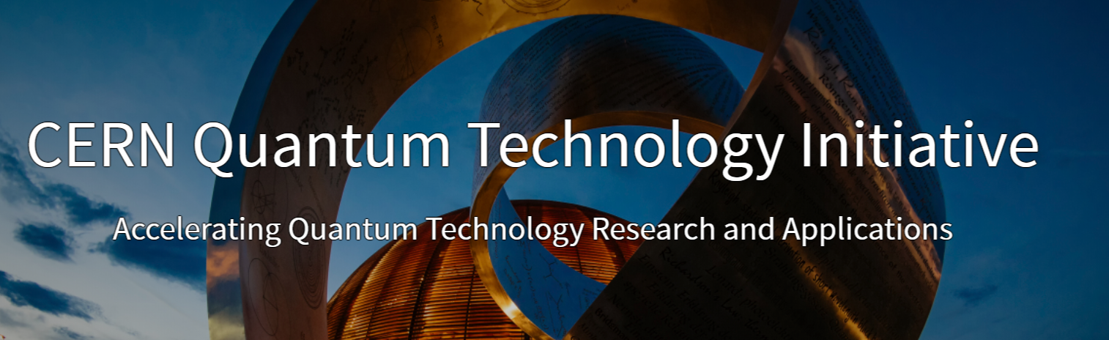
Thanks!
https://quantum.cern/
alberto.di.meglio@cern.ch
@AlbertoDiMeglio

