Slide 1
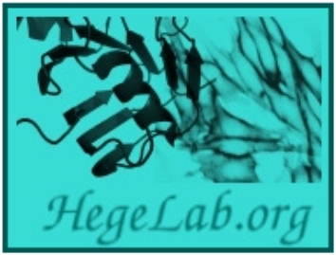
AlphaFold2 transmembrane protein structure prediction shines
Tamás Hegedűs
tamas.hegedus@hegelab.org
Dept. of Biophysics and Radiation Biology
Semmelweis University

Slide 2
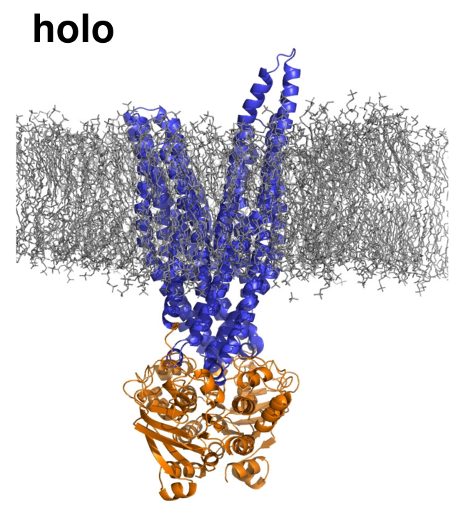
Multidrug transport – membrane ABC proteins
drog
drog
drog
drog
MDR fehérje
ATP
sejtmag DNS
ADP+P_{i}
célfehérje

Slide 3
Structure prediction from sequence
Christian B. Anfinsen, Nobel prize in 1972
>MDR1_HUMAN | P08183
MDLEGDRNGGAKKKNFFKLNNKSEKDKKEKKPTVSVFSMFRYSNWLDKLYMVVGTLAAII
HGAGLPLMMLVFGEMTDIFANAGNLEDLMSNITNRSDINDTGFFMNLEEDMTRYAYYYSG
IGAGVLVAAYIQVSFWCLAAGRQIHKIRKQFFHAIMRQEIGWFDVHDVGELNTRLTDDVS
KINEGIGDKIGMFFQSMATFFTGFIVGFTRGWKLTLVILAISPVLGLSAAVWAKILSSFT
DKELLAYAKAGAVAEEVLAAIRTVIAFGGQKKELERYNKNLEEAKRIGIKKAITANISIG
AAFLLIYASYALAFWYGTTLVLSGEYSIGQVLTVFFSVLIGAFSVGQASPSIEAFANARG
AAYEIFKIIDNKPSIDSYSKSGHKPDNIKGNLEFRNVHFSYPSRKEVKILKGLNLKVQSG
QTVALVGNSGCGKSTTVQLMQRLYDPTEGMVSVDGQDIRTINVRFLREIIGVVSQEPVLF
ATTIAENIRYGRENVTMDEIEKAVKEANAYDFIMKLPHKFDTLVGERGAQLSGGQKQRIA
IARALVRNPKILLLDEATSALDTESEAVVQVALDKARKGRTTIVIAHRLSTVRNADVIAG
FDDGVIVEKGNHDELMKEKGIYFKLVTMQTAGNEVELENAADESKSEIDALEMSSNDSRS
SLIRKRSTRRSVRGSQAQDRKLSTKEALDESIPPVSFWRIMKLNLTEWPYFVVGVFCAII
NGGLQPAFAIIFSKIIGVFTRIDDPETKRQNSNLFSLLFLALGIISFITFFLQGFTFGKA
GEILTKRLRYMVFRSMLRQDVSWFDDPKNTTGALTTRLANDAAQVKGAIGSRLAVITQNI
ANLGTGIIISFIYGWQLTLLLLAIVPIIAIAGVVEMKMLSGQALKDKKELEGSGKIATEA
IENFRTVVSLTQEQKFEHMYAQSLQVPYRNSLRKAHIFGITFSFTQAMMYFSYAGCFRFG
AYLVAHKLMSFEDVLLVFSAVVFGAMAVGQVSSFAPDYAKAKISAAHIIMIIEKTPLIDS
YSTEGLMPNTLEGNVTFGEVVFNYPTRPDIPVLQGLSLEVKKGQTLALVGSSGCGKSTVV
QLLERFYDPLAGKVLLDGKEIKRLNVQWLRAHLGIVSQEPILFDCSIAENIAYGDNSRVV
SQEEIVRAAKEANIHAFIESLPNKYSTKVGDKGTQLSGGQKQRIAIARALVRQPHILLLD
EATSALDTESEKVVQEALDKAREGRTCIVIAHRLSTIQNADLIVVFQNGRVKEHGTHQQL
LAQKGIYFSMVSVQAGTKRQ

Slide 4
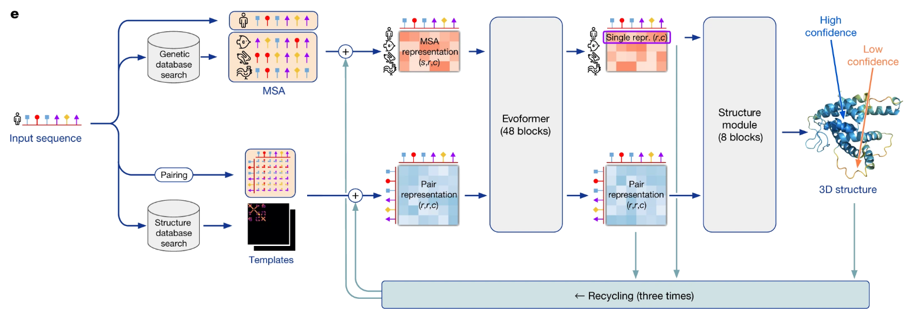
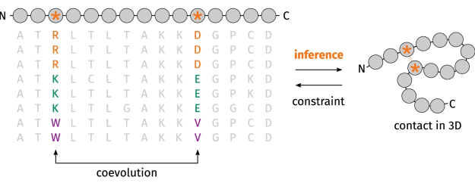
AlphaFold2
machine learning, deep learning, AI
Jumper et al. Nat 2021

Slide 5
AF2 – IT parts
sequence searches
2.3 TB disk space for sequence database
I/O limited, SSD
shrinking to 550 GB and keeping in RAM
RAM: at least 90 GB
Parsing the output in RAM
it may be over ~100 GB
open(filename).read()

Slide 6
AF2 – IT parts
DL models’ running and structure building
GPU
1,500 amino acid long / 24 GB GPU RAM
multi-GPU
max. 2 GB limit for a TensorFlow data struct bug solved with 2 lines of code

Slide 7
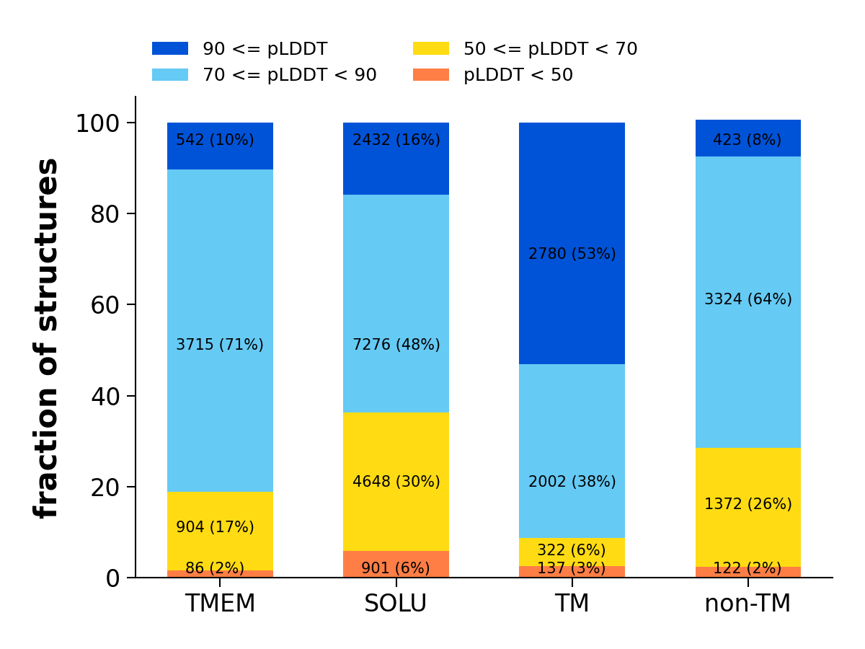
TM protein structure prediction by AF2

Slide 8
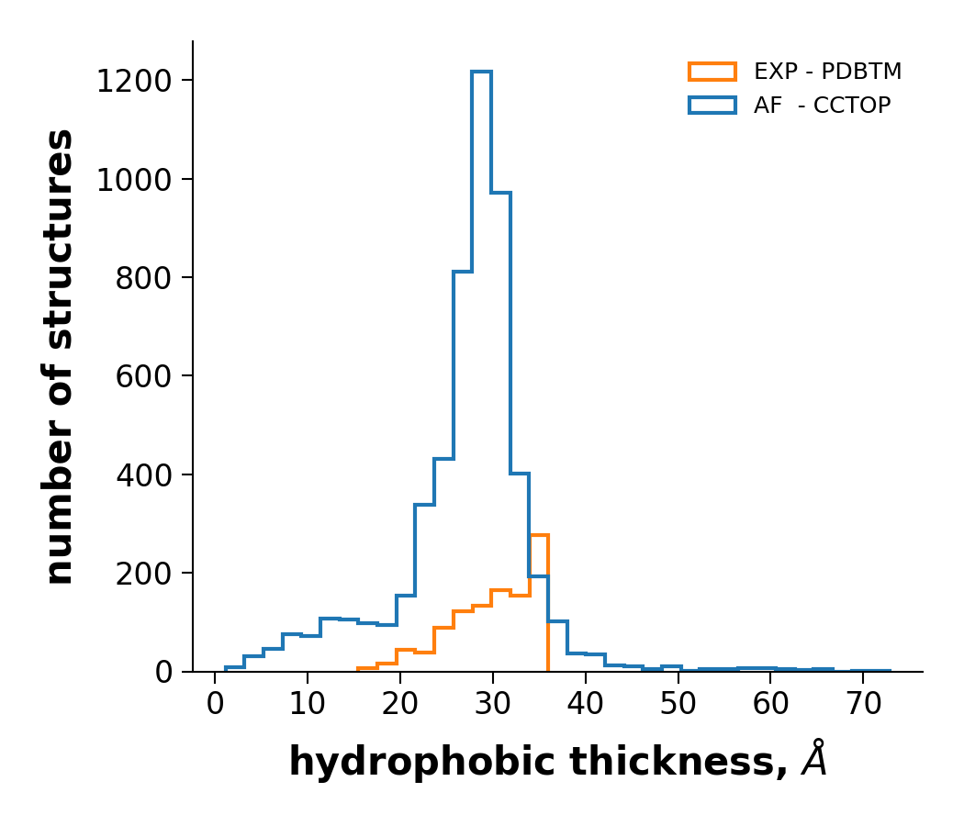
TM protein structure prediction by AF2
enzim.hu
(Tusnády et al.)
s1
s2
s1
s1
s2
s2
s2
s1

Slide 9
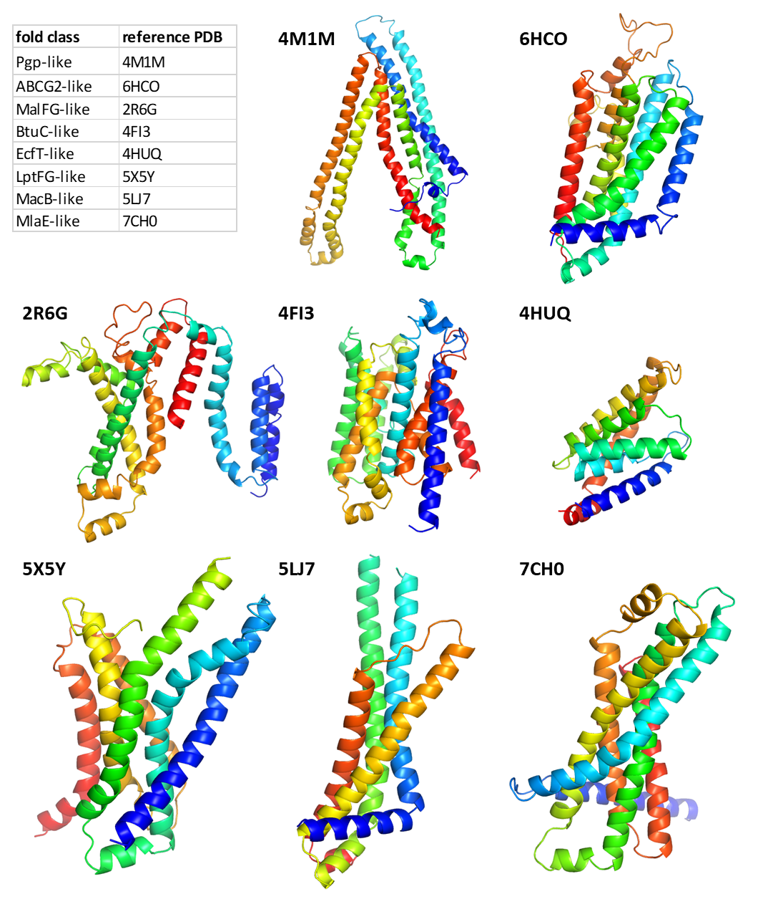
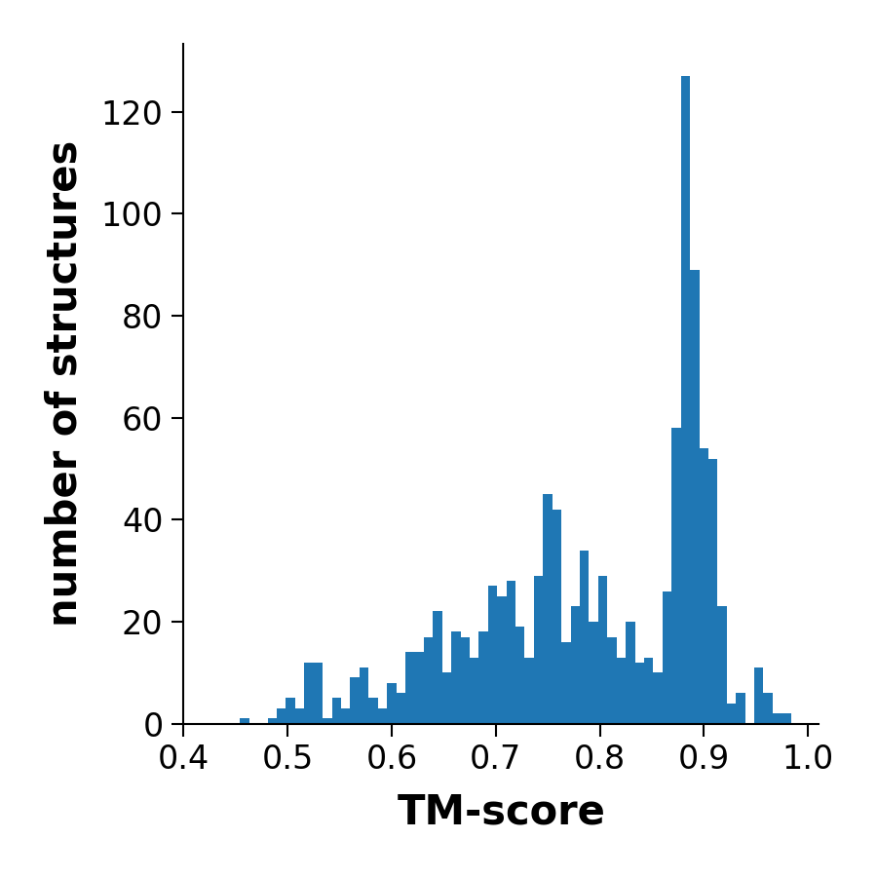
ABC protein folds

Slide 10
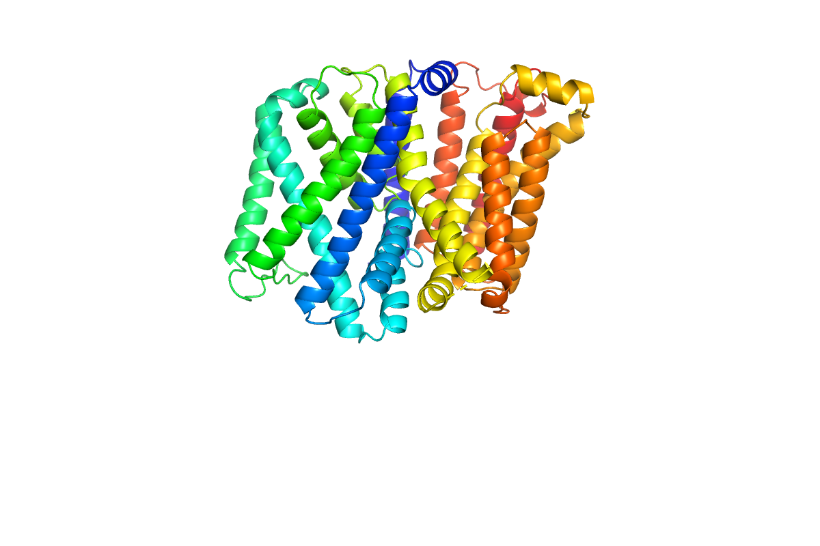
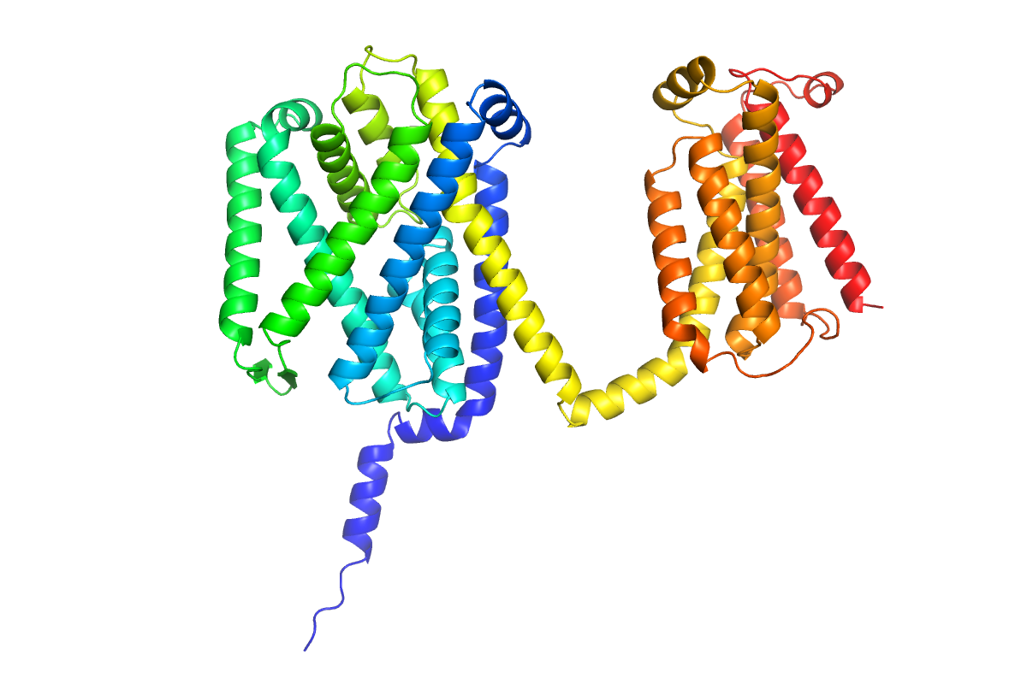
Prediction of new TM folds
MprF (PDBID: 7DUW)
AF2

Slide 11
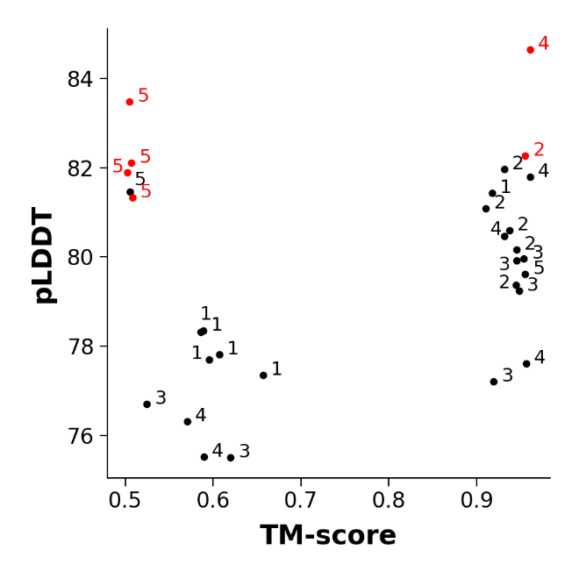
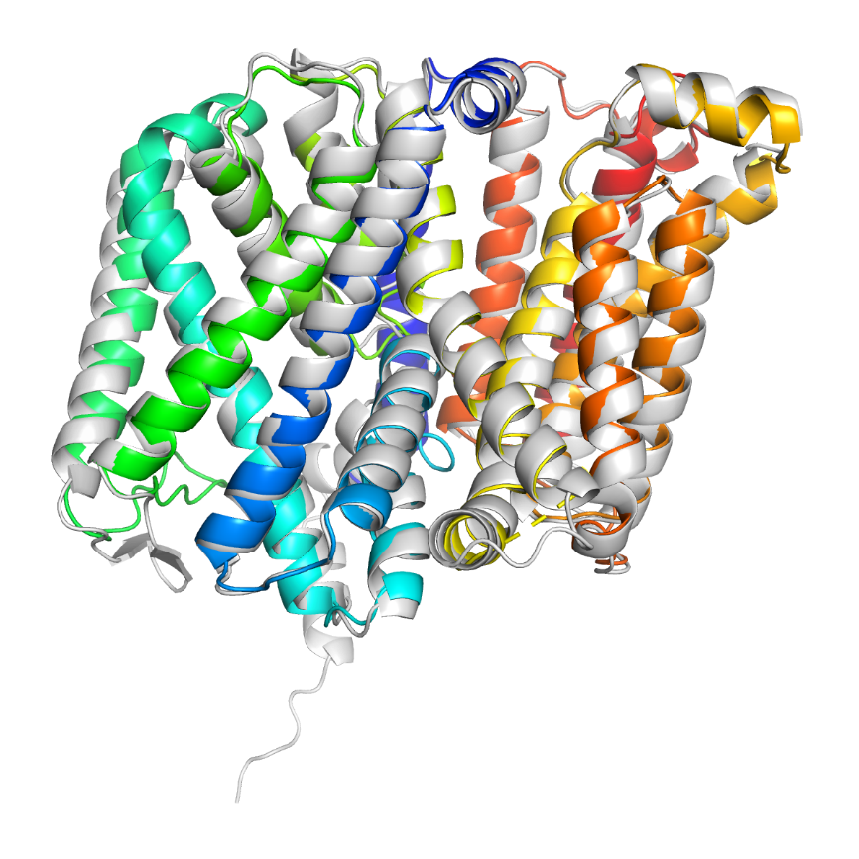
Prediction of new TM folds

Slide 12
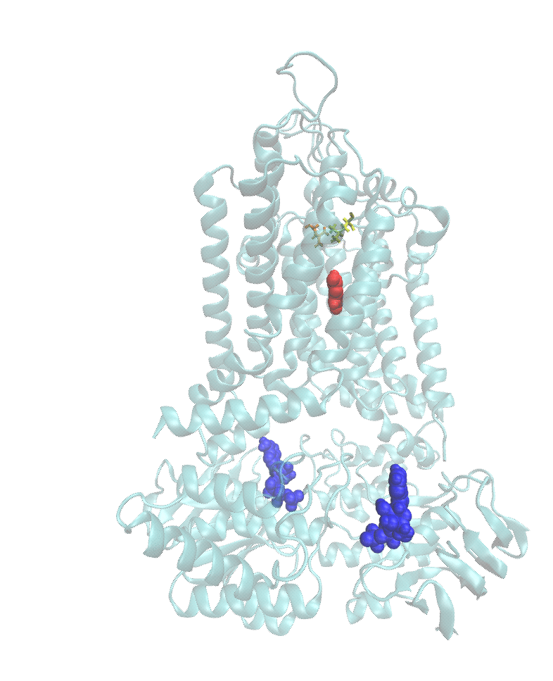
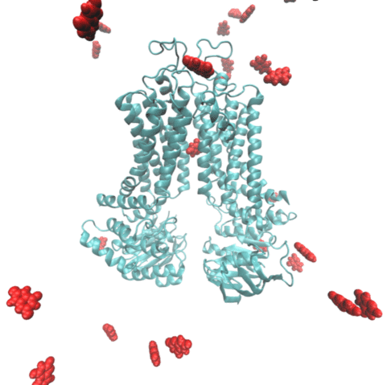
Describing the transport process
Equilibrium MD and Metadynamics; substrate: uric acid
Nagy et al. CMLS 2021

Slide 13
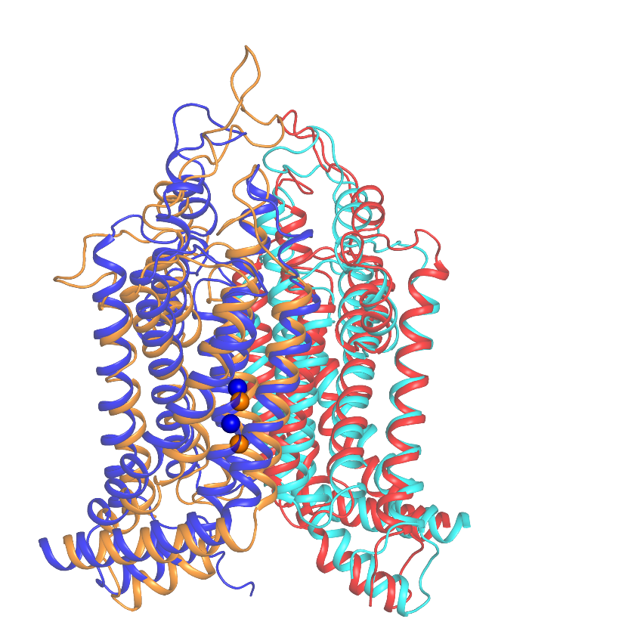
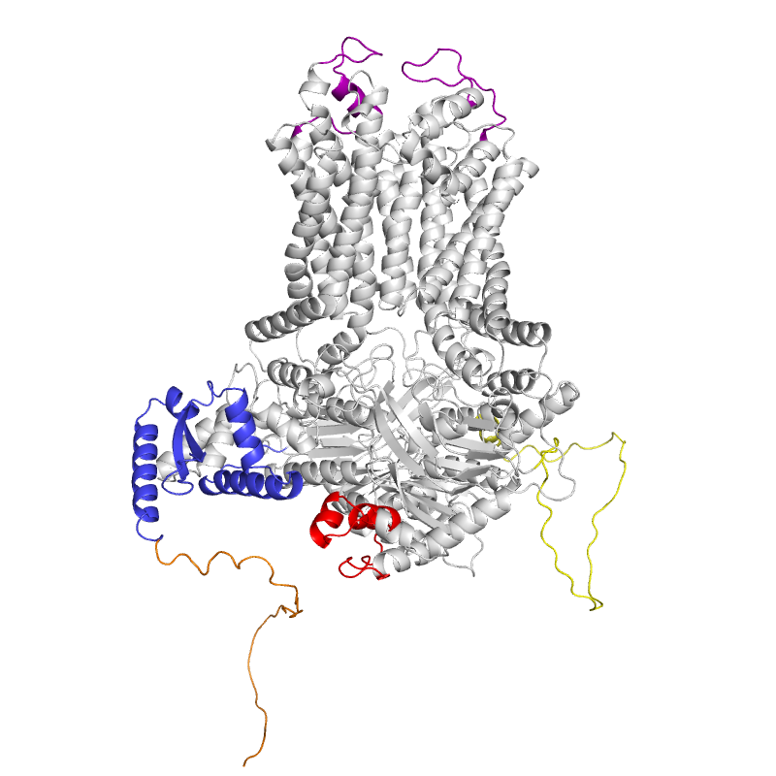
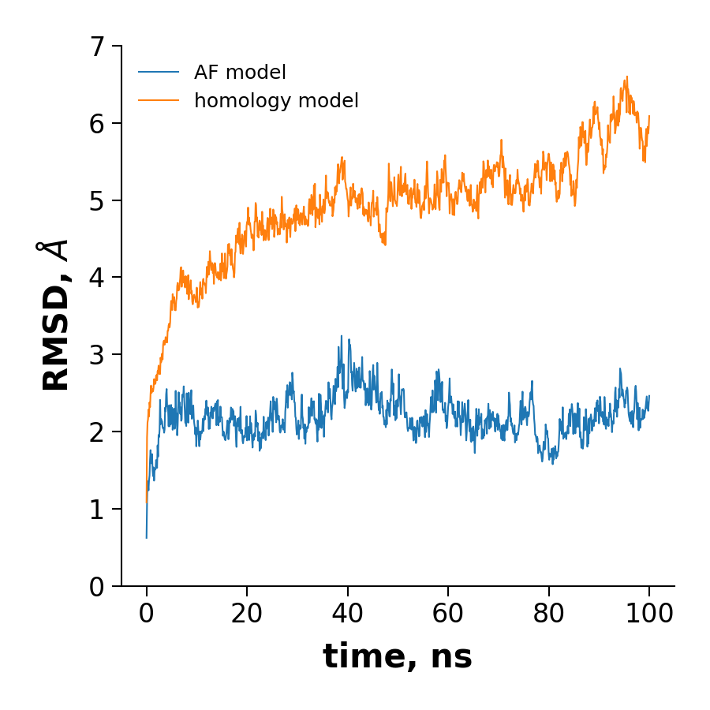
AF2 AtABCG36 is stable in MD simulations

Slide 14
Summary
AF2 performance is great in the case of TM proteins
AF2-Multimer (released this Tuesday)
The conformation of the output is „random”
AF2 code needs some tuning (kód foldozgatás)
The folding problem is not solved
Find our preprint and code at
http://alphafold.hegelab.org

Slide 15
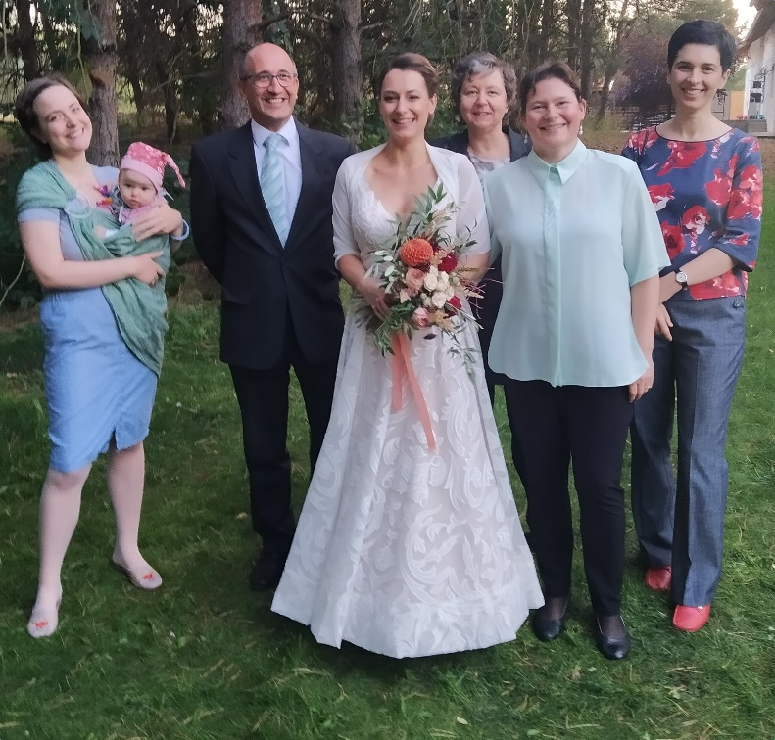
Acknowledgements
hegelab.org
Gergely L. Lukács, McGill, Montreál
Markus Geisler, University of Fribourg
Grubmüller laboratory, MPI, Göttingen
MTA Wigner, GPU Laboratórium
Boblem Kft
NIIF/KIFÜ HPC
Csizmadia Gina+ReGina
Farkas Bianka
Tordai Hedvig
Lór Krisztina
Padányi Rita
Erzsébet Suhajda
Támogatások:
CFF HEGEDU20I0
NKFI-127961 (2018-2022)

Slide 16
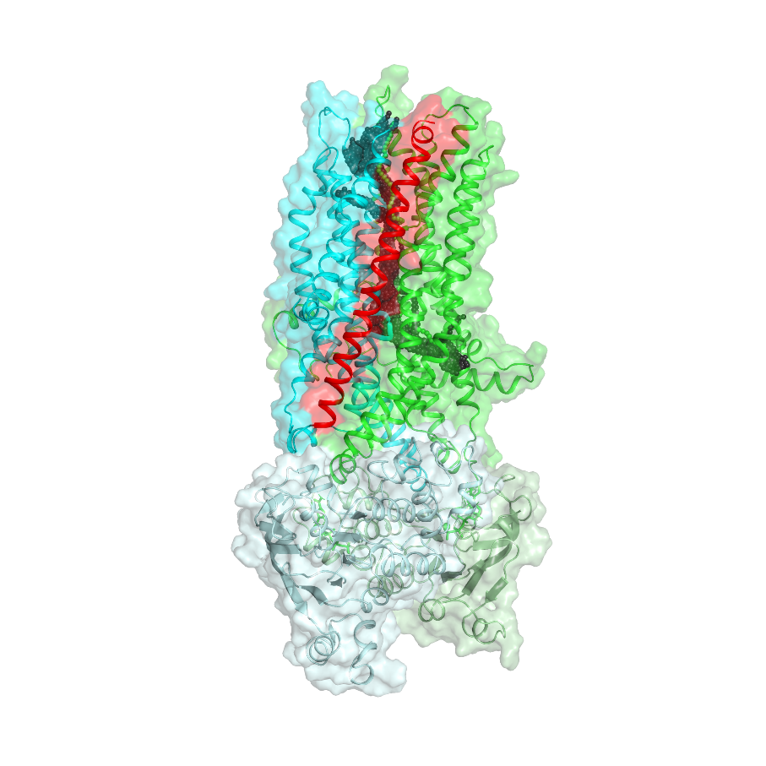
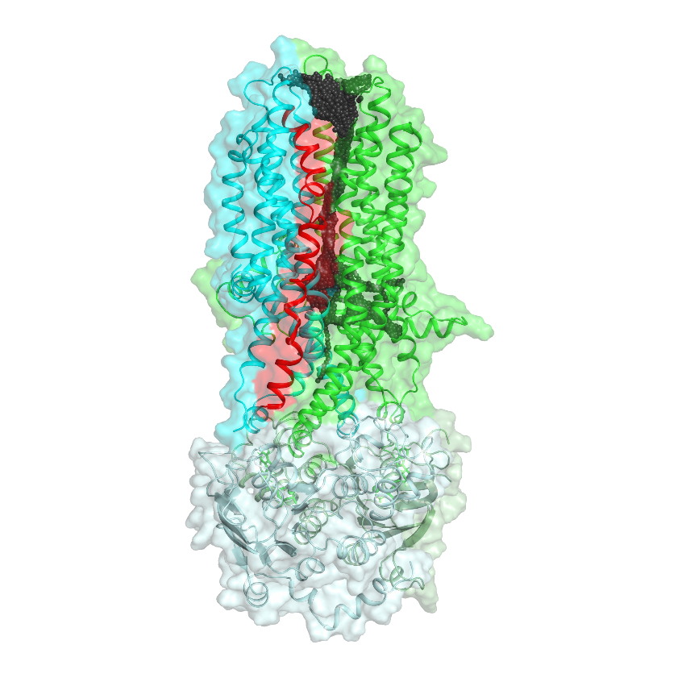
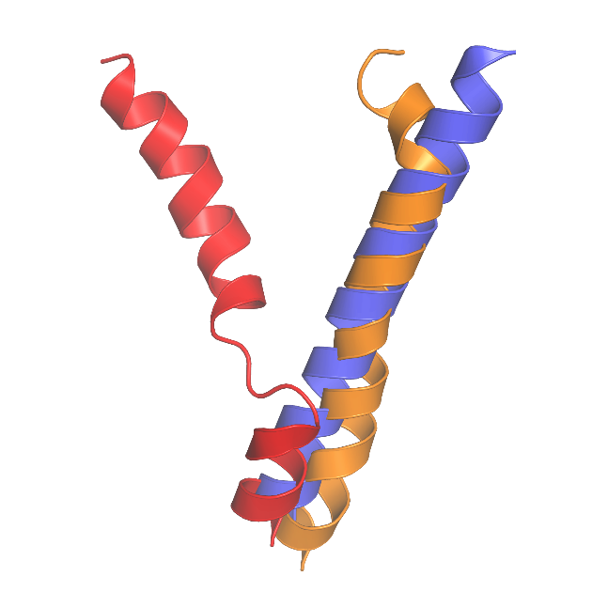
CFTR TM8
MRP1-based
Cryo-EM
AF2

Slide 17
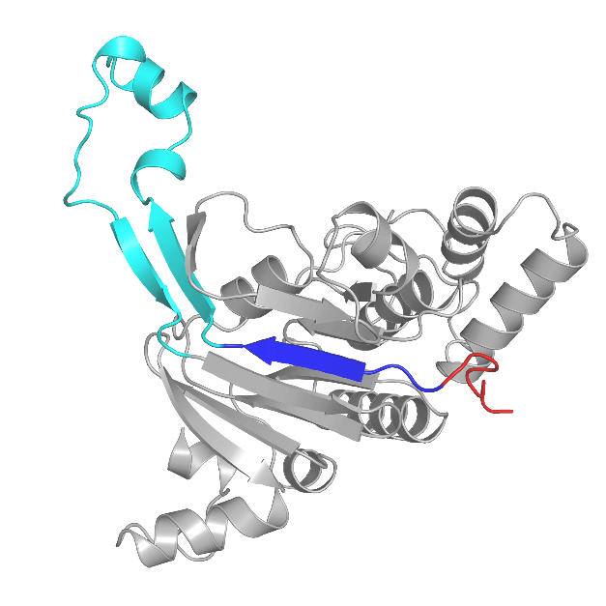
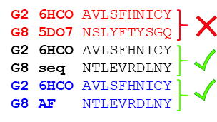
Az ABCG8 regiszter korrekciója

