Slide 1
Exploring SARS-CoV-2 receptor binding domain variants
Ákos Gellért, Oz Kilim, Anikó Mentes, Balázs Pál, István Csabai
Notes:
VEO satellite project

Slide 2
Project Team members introduction
Oz Kilim – Machine learning specialist
Anikó Mentes – Bioinformatics, big data handling
Balázs Pál – IT problem solving
István Csabai – Team leader, scientific think tank
Ákos Gellért – AlphaFold running, data analysis
Notes:
VEO

Slide 3
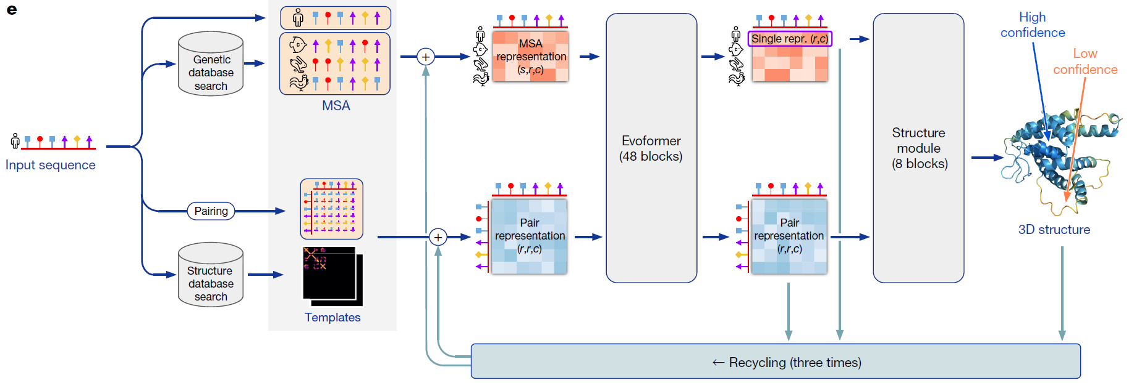
AlphaFold model architecture
CPU GPU
J. Jumper et al., “Highly accurate protein structure prediction with AlphaFold,” Nat. 2021 5967873, vol. 596, no. 7873, pp. 583–589, Jul. 2021, doi: 10.1038/s41586-021-03819-2.
Notes:
protein structures as a graph inference problem in 3D space in which the edges of the graph are defined by residues in proximity.

Slide 4
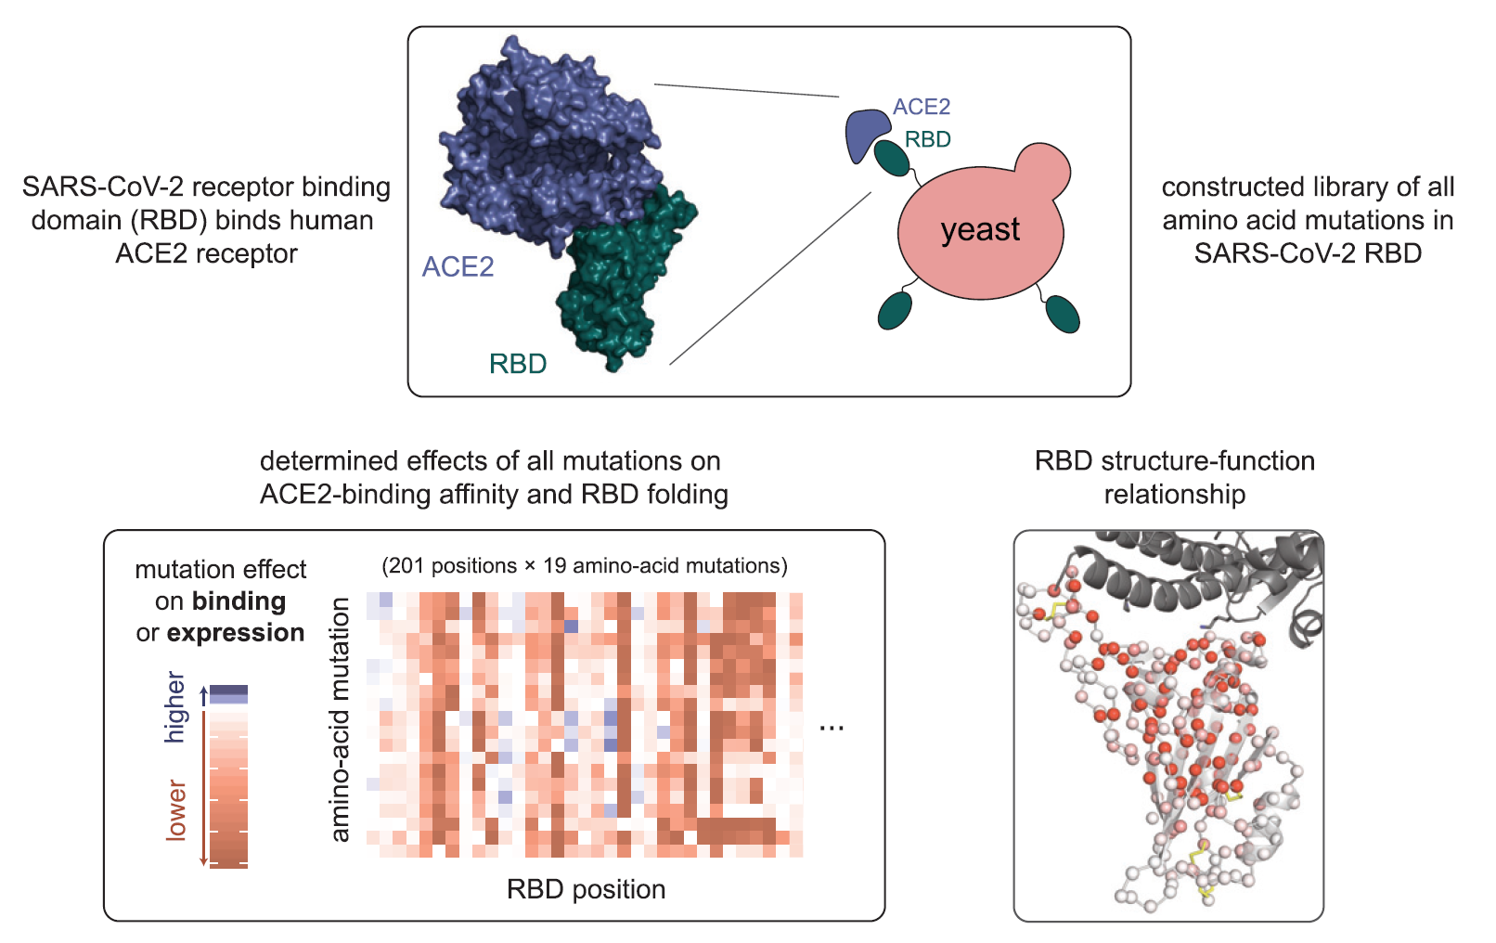
Deep Mutational Scanning
T. N. Starr et al., “Deep Mutational Scanning of SARS-CoV-2 Receptor Binding Domain Reveals Constraints on Folding and ACE2 Binding,” Cell, vol. 182, no. 5, pp. 1295-1310.e20, Sep. 2020, doi: 10.1016/J.CELL.2020.08.012.

Slide 5
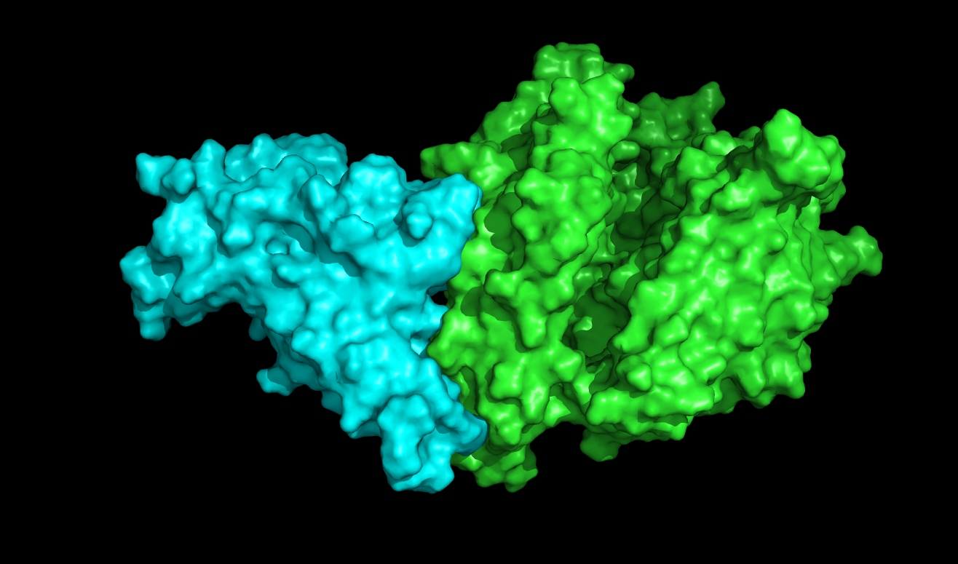
RBD
ACE2

Slide 6
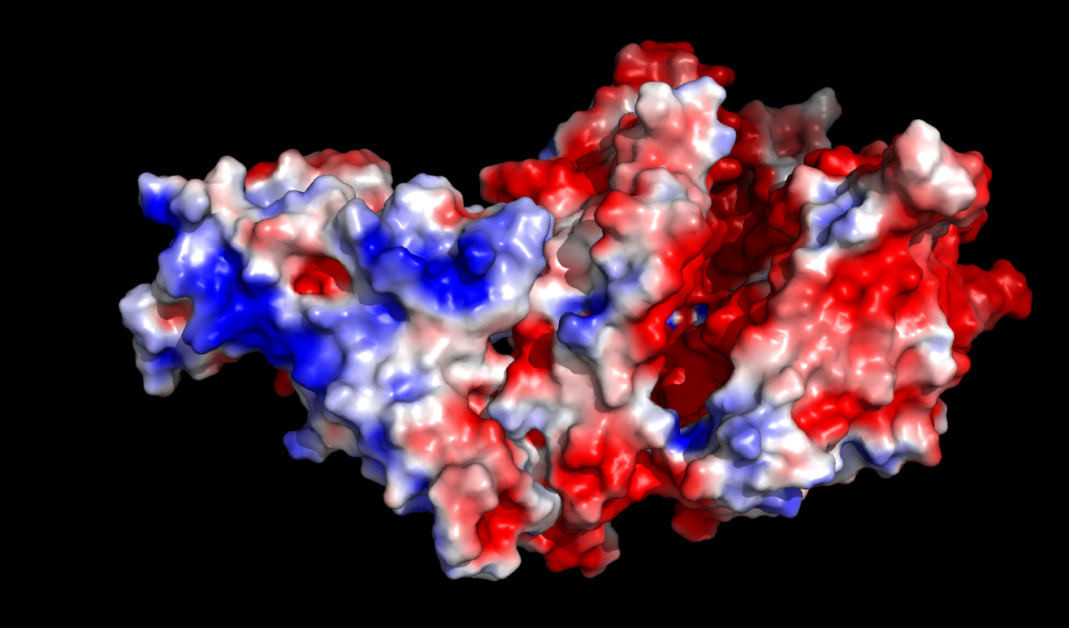
RBD
ACE2

Slide 7
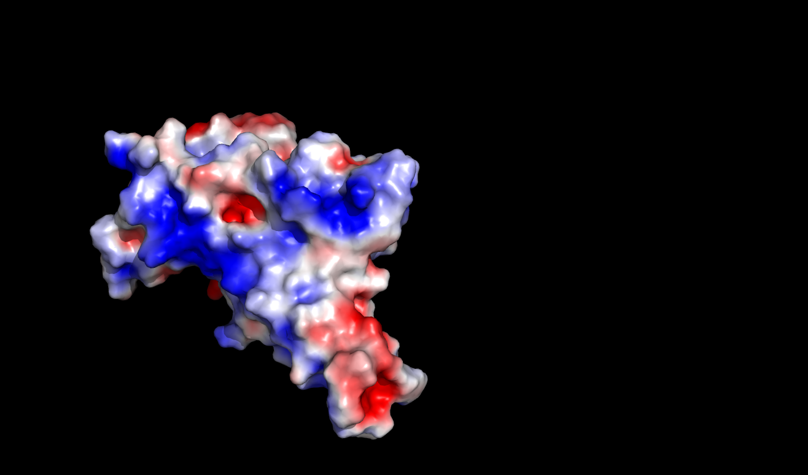
RBD

Slide 8
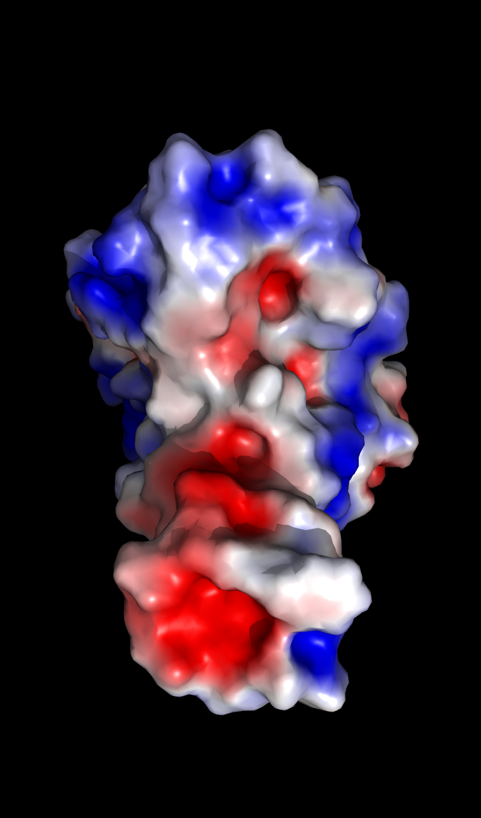
Binding interface

Slide 9
Change in ACE2 binding
-3.55
-2.83
-0.98
-0.30
-3.73
-3.54
RBD_Wuh_IF
RBD_Y489E_IF
RBD_Y489R_IF
RBD_Q493E_IF
RBD_Q493R_IF
RBD_Y505E_IF
RBD_Y505R_IF

Slide 10
Expected results
Structure database
Single mutant structural database generated with AlphaFold2 for
RBD variants: Wuhan, alpha, beta, delta, eta and omicrons
already done
Develop machine learning methods
Using electrostatic and shape descriptors from RBD structures
correlated with experimental ACE2 binding affinity
The previous method combined with protein-protein docking calculations

Slide 11
The main goal is to try to develop a machine learning based method that can produce deep mutational scanning experimental data in-silico.
So there should be no need to perform expensive molecular biology experiments. ☺ But for now, it is still a dream.

Slide 12
Technical details
Ampere01 @ Wigner Research Centre for Physics
256 CPUs - AMD EPYC 7742 64-Core Processor
8 nVIDIA A100 80GB GPU cards
For AlphaFold database access time acceleration an 5 TB SSD is used.
Running time for one RBD model is about 15 to 20 minutes.
10 parallel run per GPU card.
Notes:
Before I finish my presentation I’d like to talk a few words about the technical details

Slide 13
Thanks for my colleagues and for the GPU Team at Wigner

