Slide 1
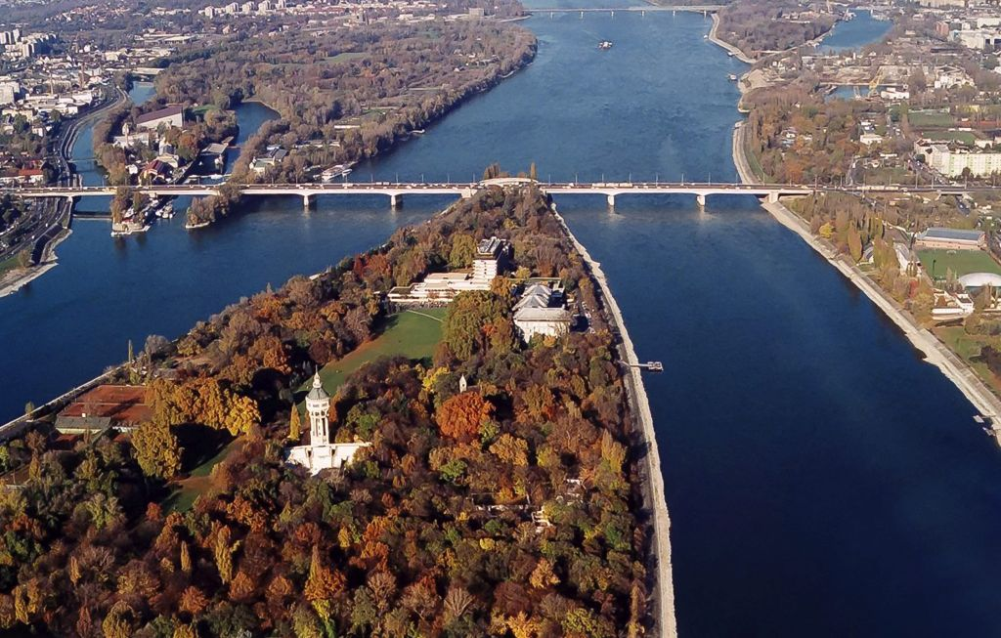
High intensity laser-particle interactions in Flying Focus regime
Martin Formanek
martin.formanek@eli-beams.eu
Margaret Island Symposium 2023 on Vacuum Structure, Particles, and Plasmas
This project is supported by EU Marie Sklodowska-Curie grant
No. 101105246-STEFF

Slide 2
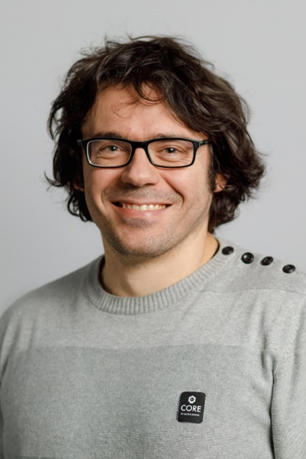
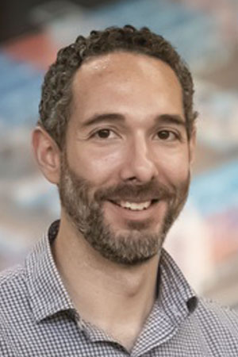
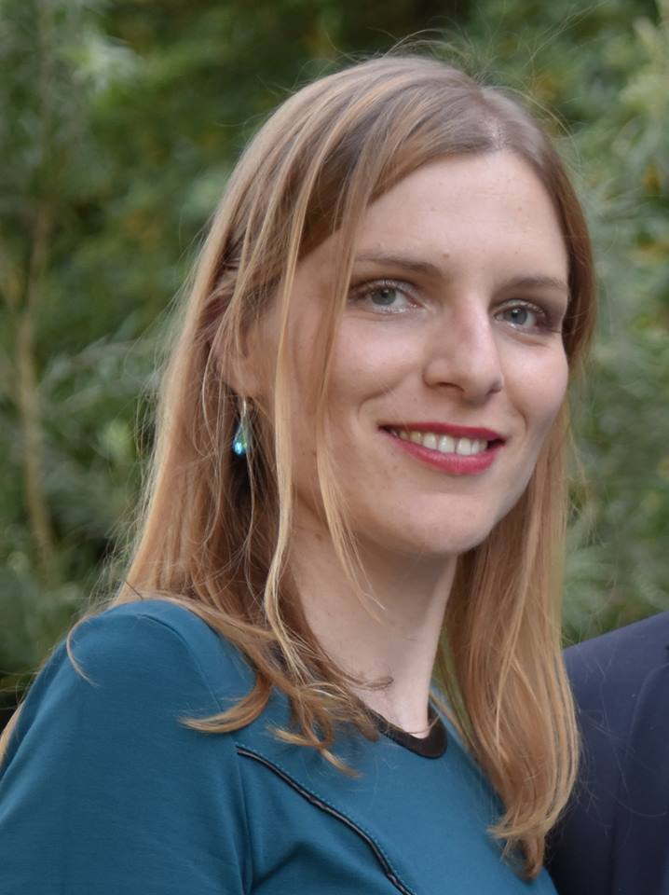
Outline of the talk:
and other people working on Flying Focus fields at LLE, IST, and UCLA
Introduction: What are Flying Focus (FF) pulses and how are they generated?
Analytical description
FF beams and pulses with arbit. focus velocity (Ramsey et al., PRA 107 (2022) 013513)
Illustration of the behavior
Nonlinear Thomson scattering (Ramsey et al., PRE 105 (2022) 065201)
Radiation reaction accumulation in FF pulses (MF et al., PRA 105 (2022) L020203)
Flying focus beams and strong field QED (Di Piazza, PRA 103 (2021) 012215)
Charged particle beam control with FF pulses with OAM (MF et al., PRE 107 (2023) 055213)
Manfred Virgil Ambat
Philip Franke
Dustin Froula
Bernardo Malaca
Warren Mori
Miguel Pardal
Jacob Pierce
Jeremy Pigeon
Hans Rinderknecht
Jessical Shaw
Tanner Simpson
David Turnbull
Jorge Vieira
Kathleen Weichman
Collaboration:
Antonino Di Piazza
MPIK, Heidelberg
John Palastro
Dillon Ramsey
Marija Vranic
IST, Lisbon
LLE, Rochester

Slide 3
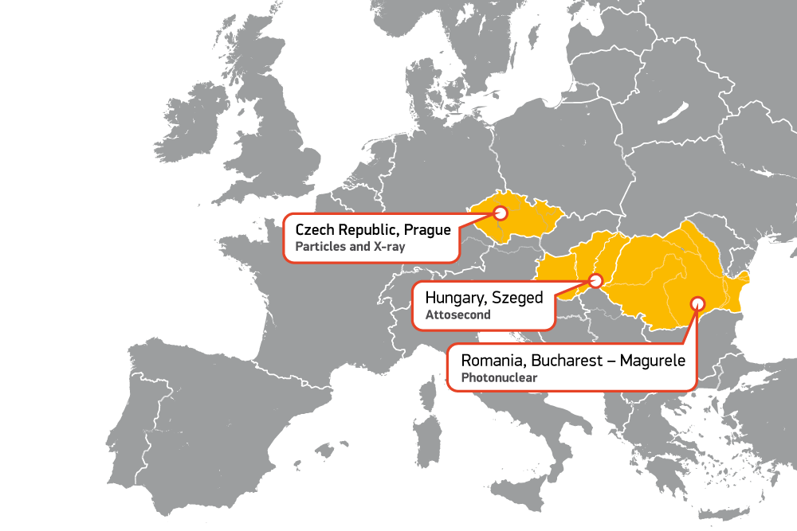
Extreme Light Infrastructure
International project – 3 pillars
ELI Beamlines
(Dolni Brezany, Czech republic)
ELI Attosecond
(Szeged, Hungary)
ELI Nuclear Physics
(Magurele, Romania)

Slide 4
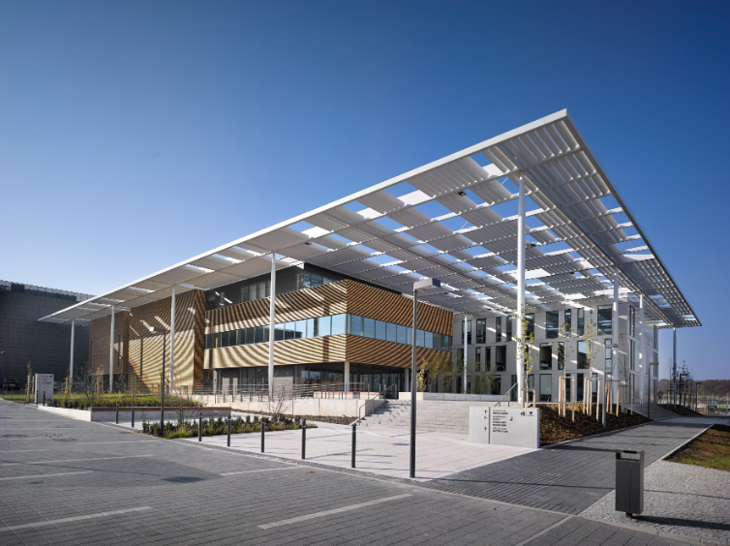
ELI Beamlines (Extreme Light Infrastructure)
 | L1 (2019) | L2 (2024/26) | L3 (2021/23) | L4(2024)
Pulse energy | 30 mJ | 2 / 3 J | 13.3 / 30 J | 1.5 KJ
Peak power | 2 TW | 80 / 120 TW | 490 TW / 1 PW | up to 10 PW
Pulse duration | 15 fs | 25 fs | 27 fs | 150 fs
Repetition rate | 1 kHz | 20 / 50 Hz | 3.3 / 10 Hz | 1 shot / min
Wavelength | 750-920 nm | 820 nm | 810 nm | 1050 nm
Dolni Brezany (Prague), Czechia
L4 – Aton up to ${10}^{24}$ W/c$m^{2}$

Slide 5
What are Flying Focus pulses? Spatiotemporal control of laser peak intensity!
a) Chromatic flying focus:
Images (top, right) from Froula et al., Nat. Photonics 12 (2018) 262.
Image from Sainte-Marie et al., Optica 4 (2017) 1298.

Slide 6
What are Flying Focus pulses?
a) Chromatic flying focus:
Animations from Froula et al., Nat. Photonics 12 (2018) 262.

Slide 7
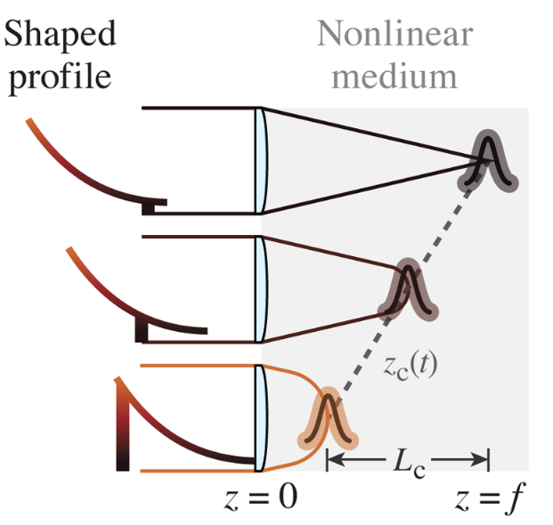
What are Flying Focus pulses?
b) Axiparabola-echelon setup:
Stepped mirror “Echelon”
Introduces time delay
Focusing mirror
Image adapted from Palastro et al., PRL 124 (2020) 134802.
c) Use of nonlinear media:
Image from Simpson et al., Opt. Expr. 28 (2020) 38516.
Or a setup involving a Kerr lens with high intensity pilot beam.

Slide 8
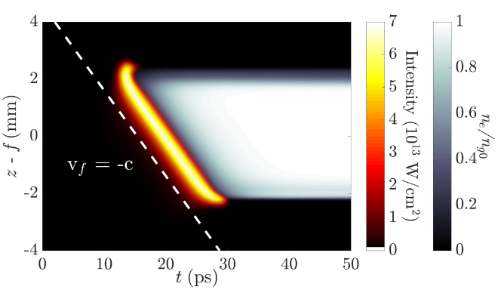
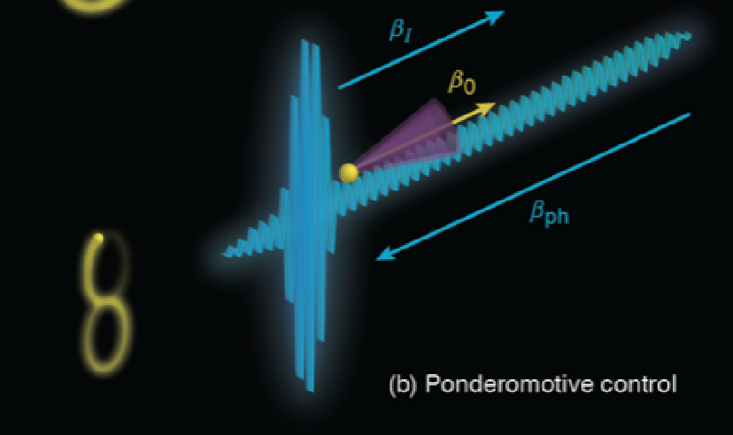
Use of flying focus pulses
Generating plasma ionization waves of arbitrary velocity Turnbull et al., PRL 120 (2018) 225001; Palastro et al., PRA 97 (2018) 033835.
Frequency upshifting of witness pulse photons by the plasma ionization front (photon acceleration) Howard et al., PRL 123 (2019) 124801.
Laser wakefield acceleration Palastro et al., PRL 124 (2020) 134802.
Ponderomotive acceleration of electrons Ramsey et al., PRE 102 (2020) 043207; Ramsey et al., PRE 105 (2022) 065201

Slide 9
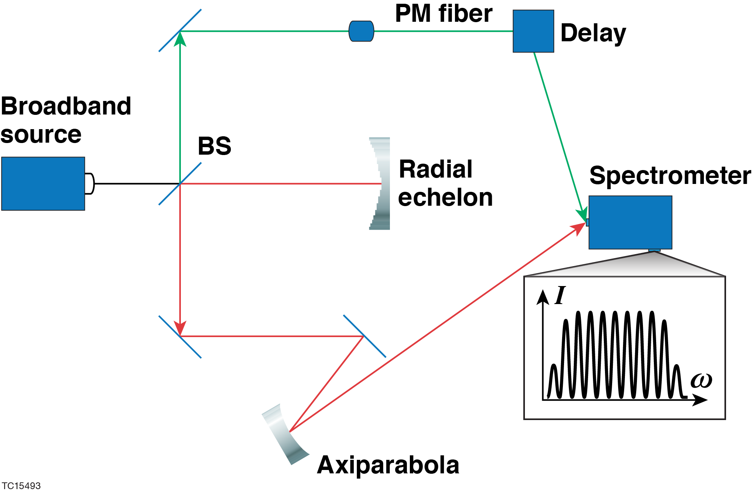
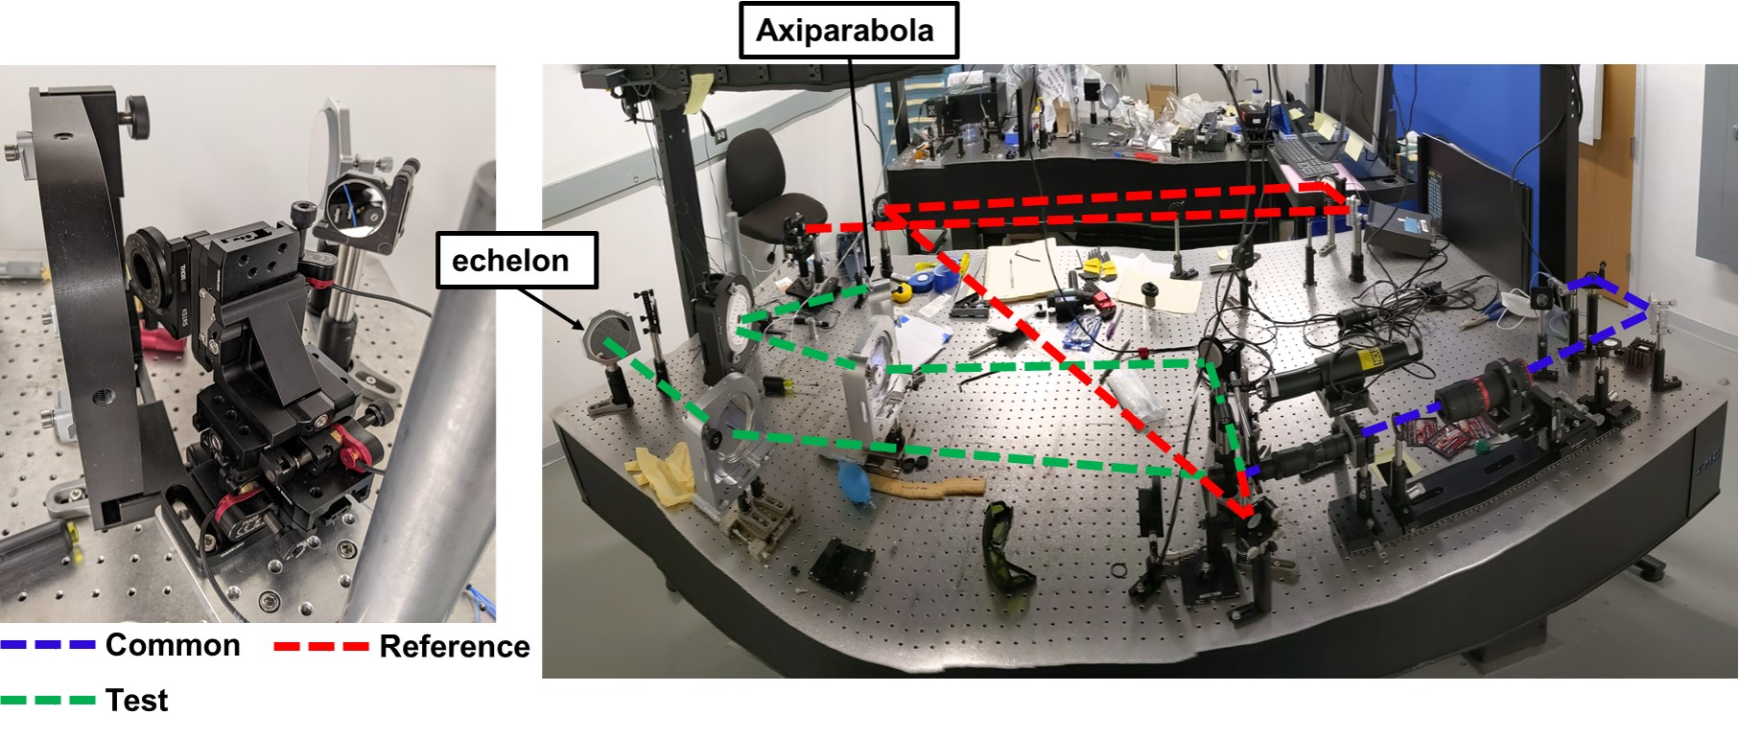
Experimental demonstrations of the “achromatic” flying focus (axiparabola + echelon) are underway
Spectral interference of a reference pulse with the imaged far-field of the axiparabola-echelon provides the relative delay and velocity
Pigeon et al., to be submitted (2023)
Slide courtesy of John Palastro
LLE has developed an in-house capability to fabricate radial echelons

Slide 10
Analytical solution
Esarey et al., J. Opt. Soc. Am. B 12 (1995) 1695;
Longhi, Opt. Expr. 12 (2004) 935;
Di Piazza, PRA 103 (2021) 012215.
Fourier transformation in $φ$
Generalized light cone coordinates:
$φ=t−z$ (phase oscillations)
$η=\left(1+ε\right)t+z$ (focus coordinate)
$$A_{−}=A^{0}−A^{z}$$
$$β_{f}=−1−ε$$
$$A_{+}={(1+ε)A}^{0}+A^{z}$$
We demand Lorenz condition $∂⋅A=0$ and additionally $A_{+}=0$ two degrees of freedom remaining. Lorenz condition:
$$∂_{φ}A_{−}+∇_{⊥}⋅A_{⊥}+∂_{η}A_{+}=0$$
Which allows us to evaluate $A_{−}$ as
$$A_{−}\left(η,x_{⊥}φ\right)=−\int{dφ}∇_{⊥}⋅A_{⊥}(η,x_{⊥},φ)$$
The wave equation $∂^{2}A^{μ}=0:$
$$\left(4∂_{φ}∂_{η}−∇_{⊥}^{2}+2ε∂_{η}∂_{φ}+\left(2ε+ε^{2}\right)∂_{η}^{2}\right)A^{μ}=0$$

Slide 11
Analytical solution
$φ=t−z$
$η=\left(1+ε\right)t+z$
$β_{f}=−1−ε$
Fourier transformation for the perpendicular component:
$$\left(−2i\left(2+ε\right)k∂_{η}−∇_{⊥}^{2}+\left(2ε+ε^{2}\right)∂_{η}^{2}\right){\tilde{A}}_{⊥}=0$$
Special cases:
$ε=−2:$ In this case $η=−φ,$ linearly dependent, $β_{f}=1$ and solution are usual plane waves
$ε=0:$ In this case we have ordinary light-cone coordinates, $β_{f}=−1$ and the wave equation reads
$$\left(−4ik∂_{η}−∇_{⊥}^{2}\right){\tilde{A}}_{⊥}=0$$
Which has exactly form of the paraxial wave equation.
General case: If either $\left|ε\right|≪1$ or $∂_{η}^{2}$ negligible (paraxial approximation):
($−2i(2+ε)k∂_{η}−∇_{⊥}^{2}){\tilde{A}}_{⊥}=0$
In cylindrical coordinates ($r,θ,η)$:
$$\left(∂_{r}^{2}+\frac{1}{r}∂_{r}+\frac{1}{r^{2}}∂_{θ}^{2}+2i(2+ε)k∂_{η}\right){\tilde{A}}_{⊥}=0$$

Slide 12
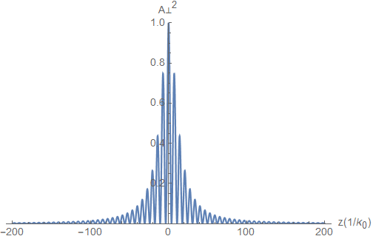
Analytical steady state beam solution
Esarey et al., J. Opt. Soc. Am. B 12 (1995) 1695; Longhi, Opt. Expr. 12 (2004) 935
Di Piazza, PRA 103 (2021) 012215; Ramsey et al., PRE 105 (2022) 065201.
$$A_{n,ℓ,⊥}\left(η,r,θ,φ\right)=A_{0,⊥}\frac{σ_{0}}{σ(η)}{\left(\frac{\sqrt{2}r}{σ\left(η\right)}\right)}^{ℓ}L_{n}^{ℓ}\left(\frac{2r^{2}}{σ^{2}\left(η\right)}\right)e^{−r^{2}/σ^{2}(η)}$$
$×cos⁡\left(k_{0}φ−\frac{r^{2}}{σ^{2}\left(η\right)}\frac{η}{η_{0}}+ℓθ+\left(2n+ℓ+1\right)\text{arctan}\frac{η}{η_{0}}\right)$
Generalized light cone coordinates:
$φ=t−z$ (phase oscillations)
$η=\left(1+ε\right)t+z$ (focus coordinate)
Oscillations: $φ$
Focal velocity:
$$β_{F}=−1−ε$$
Distance from focus: $η$
Analytic $ε=0$
Paraxial approx. $ε≠0$
Cylindrical coord.
“Rayleigh range”
“Spot size”
$$r, θ, η_{0}=\left(2+ε\right)k_{0}σ_{0}^{2}/2, σ\left(η\right)=σ_{0}\sqrt{1+η^{2}/η_{0}^{2}}$$
For $ε=−1$ we have $φ=t−z$, $η=z$ and $β_{F}=0$this solution reduces to standard gaussian beam solution in paraxial approximation with Rayleigh range $η_{0}=k_{0}σ_{0}^{2}/2$.

Slide 13
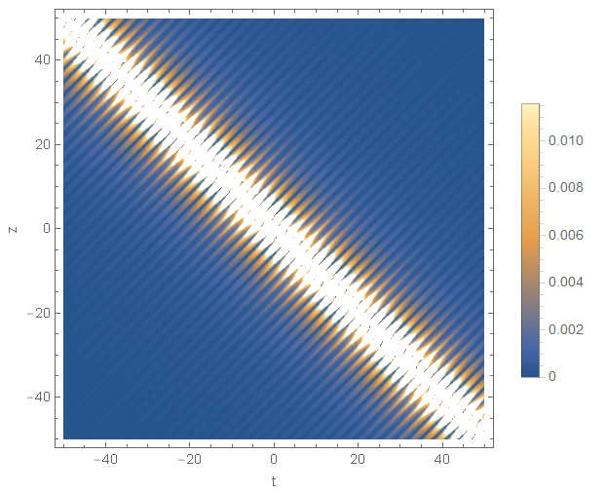
Illustration of the behavior (${n=0, ε=0, β}_{f}=−1)$
$$A_{ℓ=0,⊥}\left(η,r=0,φ\right)=A_{0}\frac{σ_{0}}{σ(η)}\cos\left(k_{0}φ+\text{arctan}\frac{η}{η_{0}}\right)$$
On the axis and $ℓ=0$
Intensity envelope:
Plane-wave-like oscillations
$$A_{⊥}^{2}$$
$$\frac{σ_{0}}{σ(η)}=\frac{1}{\sqrt{1+{\left(t+z\right)}^{2}/η_{0}^{2}}}$$
$$cos⁡(k_{0}\left(t−z\right))$$
$$φ$$
$$η$$
$$z(1/{k_{0}})$$
The remaining components of the vector 4-potential can be calculated from the Lorenz gauge condition $∂_{μ}A^{μ}=0$ and additional constraint – we use:
$$A_{+}={(1+ε)A}^{0}+A^{z}=A^{0}+A^{z}=0$$
$$η=0$$
$$t(1/{k_{0}c})$$

Slide 14
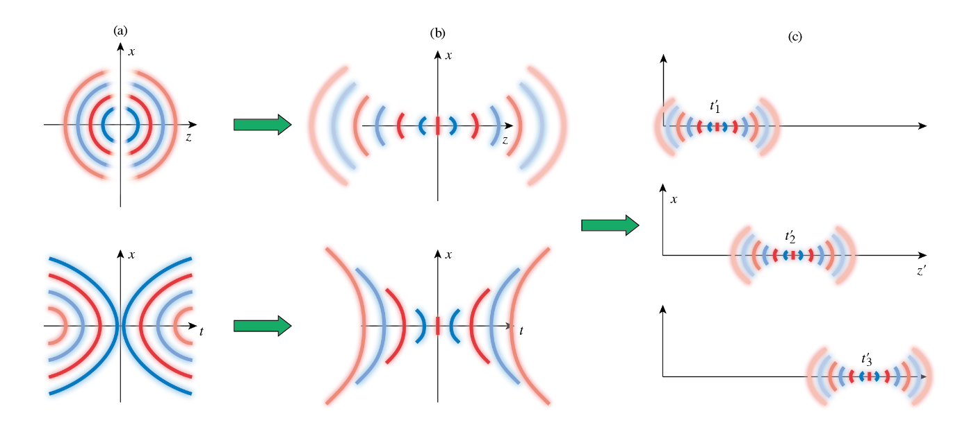
Exact solution for arbitrary focus velocities
(Ramsey et al., PRA 107 (2022) 013513)
Subluminal Flying focus
$$β_{F}$$
Displ. of $t$ or $z$ coord. to complex plane
Lorentz transformation
Superluminal
Flying Focus
$$β_{F}^{−1}$$
Multipole spherical/hyperbolic solution
Beam solution with stationary focus
Flying focus solution
Luminal focus - limit $β_{F}→−1$ of either case matches the previous exact analytical solution

Slide 15
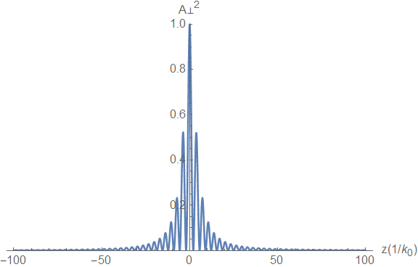
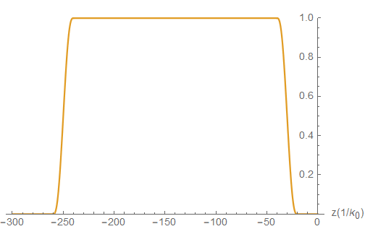
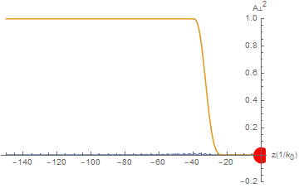
Electron interacting with Flying focus pulse (on the axis, $β_{f}=−1$)
Vector potential
Envelope $g(t−z)$
$$A_{⊥}^{2}∝\frac{1}{1+\frac{{\left(t+z\right)}^{2}}{η_{0}}}$$
-$c$
$$c$$
Phase oscillations
Focus velocity
$$∝cos⁡(k_{0}\left(t−z\right))$$
$$e^{−}$$
$$−c$$
Electron at $η≈0$ (at focus) sees approximately field:
$$A_{⊥}≈A_{0}e^{−r^{2}/2σ_{0}^{2}}cos⁡(2k_{0}z)$$
Which is on the axis $r=0$
$$A_{⊥}≈A_{0}cos⁡(2k_{0}z)$$
just plane wave field!

Slide 16
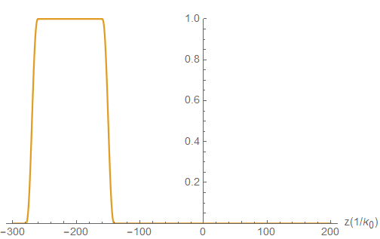
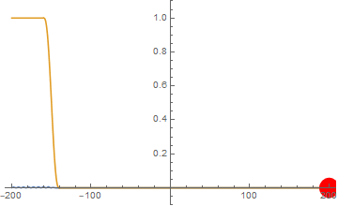
Electron interacting with Gaussian pulse – stationary focus (on the axis)
Vector potential
Envelope $g(t−z)$
$$A_{⊥}^{2}∝\frac{1}{1+\frac{z^{2}}{z_{0}}}$$
$$c$$
Phase oscillations
$$∝cos⁡(k_{0}\left(t−z\right))$$
$$e^{−}$$
$$−c$$
Electron on the axis interacts approximately with a field
$$A_{⊥}≈\frac{A_{0}}{\sqrt{1+z^{2}/z_{0}^{2}}}cos⁡(2k_{0}z)$$
$ρ$ – Interaction length / 2 (in units of Rayleigh range)
$$−ρz_{0}$$
$$ρz_{0}$$
$$z(1/{k_{0})}$$

Slide 17
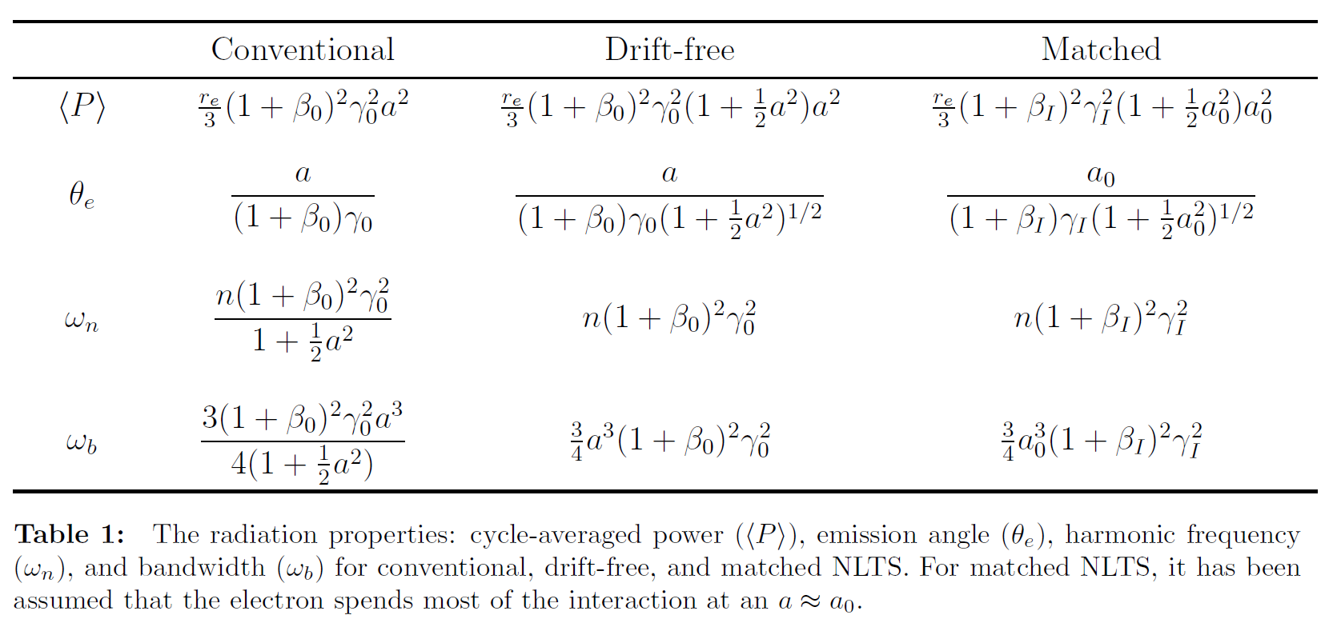
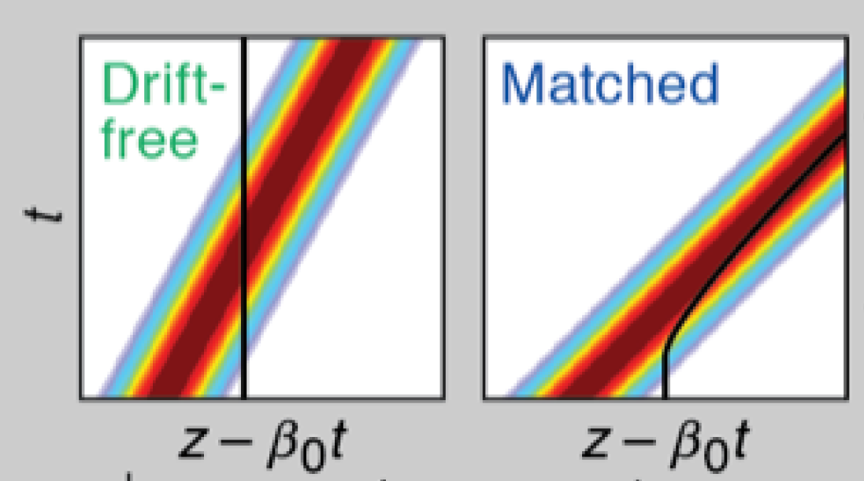
Nonlinear Thomson Scattering with ponderomotive control
(Ramsey, D. et al., PRE 105 (2022) 065201)
Drift-free: superluminal focus compensating the ponderomotive deceleration $β_{F}=β_{0}^{−1}$ so that $\left\langle β\right\rangle =β_{0}$
Matched: subluminal focus accelerating the electrons so that they stay trapped in the pulse: $γ_{I}=\sqrt{2}γ_{0}a_{0}$

Slide 18
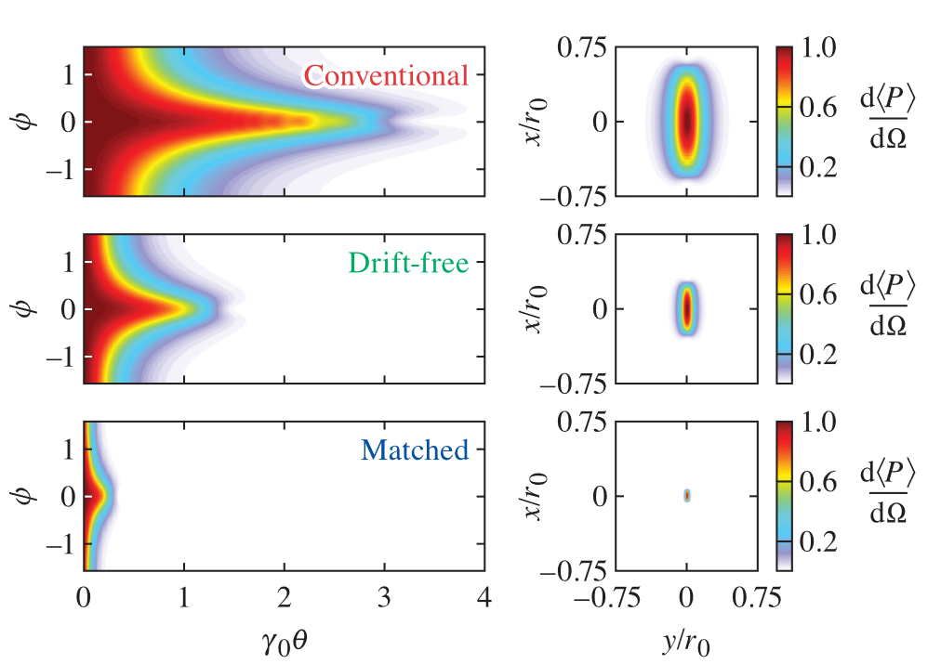
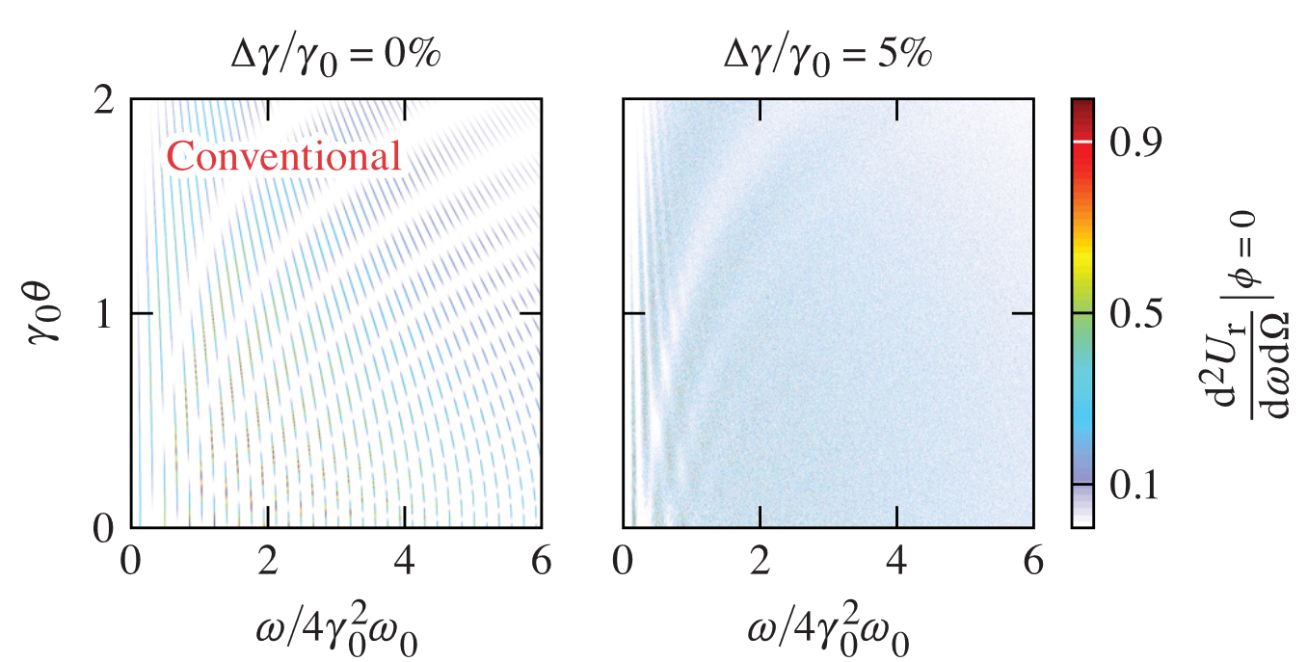
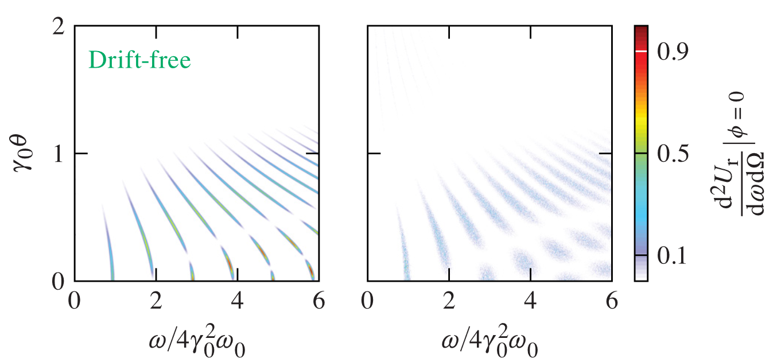
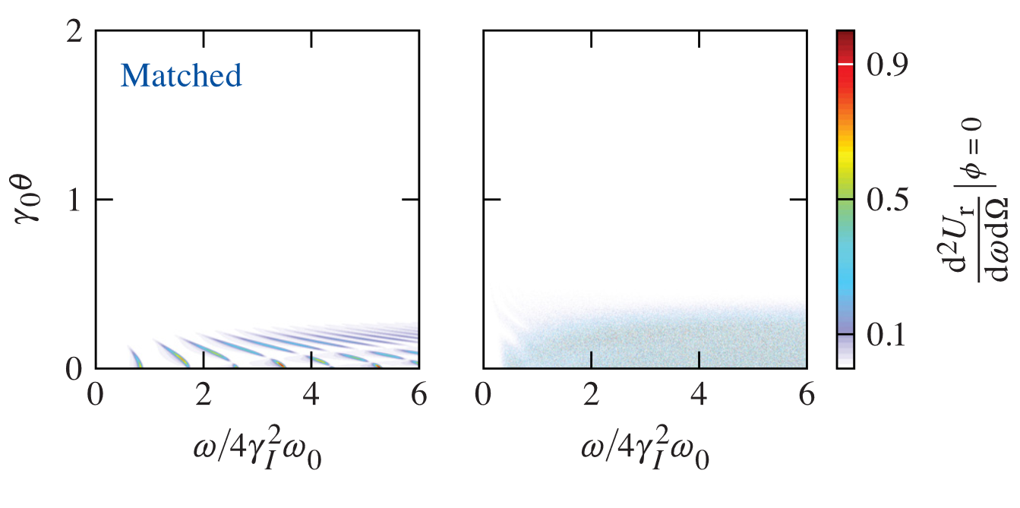
Nonlinear Thomson Scattering with ponderomotive control
(Ramsey, D. et al., PRE 105 (2022) 065201)
Radiated power normalized to the maximal value in each case 0.016, 0.50, 204 MeV ${sr}^{−1}\text{p}{\text{s}}^{−1}$ respectively, $φ$ – angle from the laser polarization direction. $θ$ – angle from the axis beam axis

Slide 19
Electron motion with Radiation Reaction
From Lorentz-Abraham-Dirac:
$$\frac{du^{μ}}{dτ}=\frac{q}{m}F^{μν}u_{ν}+τ_{0}\left(\frac{d^{2}u^{μ}}{dτ^{2}}+{\frac{du^{ν}}{dτ}\frac{du_{ν}}{dτ}u}^{μ}\right)$$
To Landau-Lifshitz:
$${\dot{u}}^{μ}=\frac{e}{m}F^{μν}u_{ν}+τ_{0}\frac{e}{m}\left(u⋅∂\left(F^{μν}\right)u_{ν}+\frac{e}{m} F^{μν}F_{να}u^{α}−\frac{e}{m}\left(u⋅F⋅F⋅u\right)u^{μ} \right)$$
Lorentz force
Landau-Lifshitz Radiation reaction $ℱ_{LL}^{μ}$
Exact solution for plane wave fields: Di Piazza, Lett. Math. Phys. 83 (2008) 305.
If we assume that the electron interacts with approximately plane wave modulated by the intensity envelope $ξ\left(t\right)$ and pulse envelope $g\left(t\right)$ then for ultrarelativistic electron
$$γ\left(t\right)≈\frac{γ_{0}}{1+2γ_{0}τ_{0}ω_{0}^{2}\int_{0}^{t}{g^{2}\left(t^{′}\right)ξ^{2}\left(t^{′}\right)dt^{′}}}$$
$$=\frac{γ_{0}}{1+κ(t)}$$

Slide 20
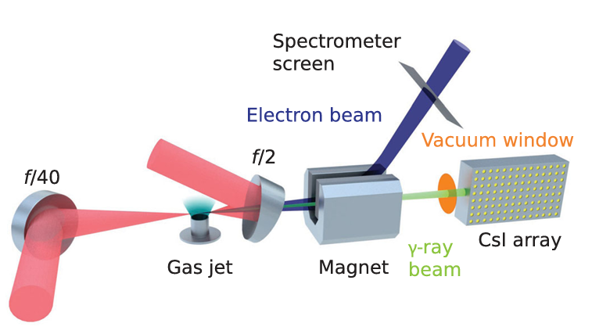
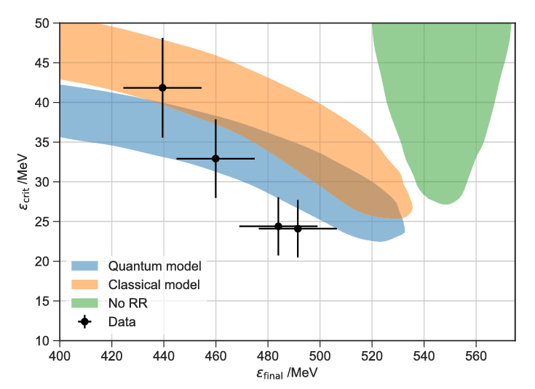
Use of high-intensity lasers for RR measurements
Cole et al., PRX 8 (2018) 011020; Poder et al., PRX 8 (2018) 031004 Astra-Gemini
Laser parameters: $E_{\text{tot}}∼10 \text{J}\text{, }ξ_{0}∼10, P_{\text{ave}}∼$ $0.25$ PW, $t_{\text{int}}∼40 \text{fs}$
Deceleration formula
$$γ\left(t\right)=\frac{γ_{0}}{1+κ(t)}$$
Where the deceleration factor $κ(t)$ is for both ultrashort Gaussian pulses and FF pulses
Images (top, bottom) from Cole et al., PRX 8 (2018) 011020
$$κ_{\text{FFP}}\left(t_{\text{int}}\right)=2.03\frac{E_{tot}\left[\text{J}\right]ℰ_{0}[\text{GeV}]}{σ_{0}^{2}[μ\text{m}]}$$
Long flying focus pulses (tens of ps) reach the same RR deceleration as ultrashort gaussian pulses (tens of fs) of the same energy
(MF et al., PRA 105 (2022) L020203)

Slide 21
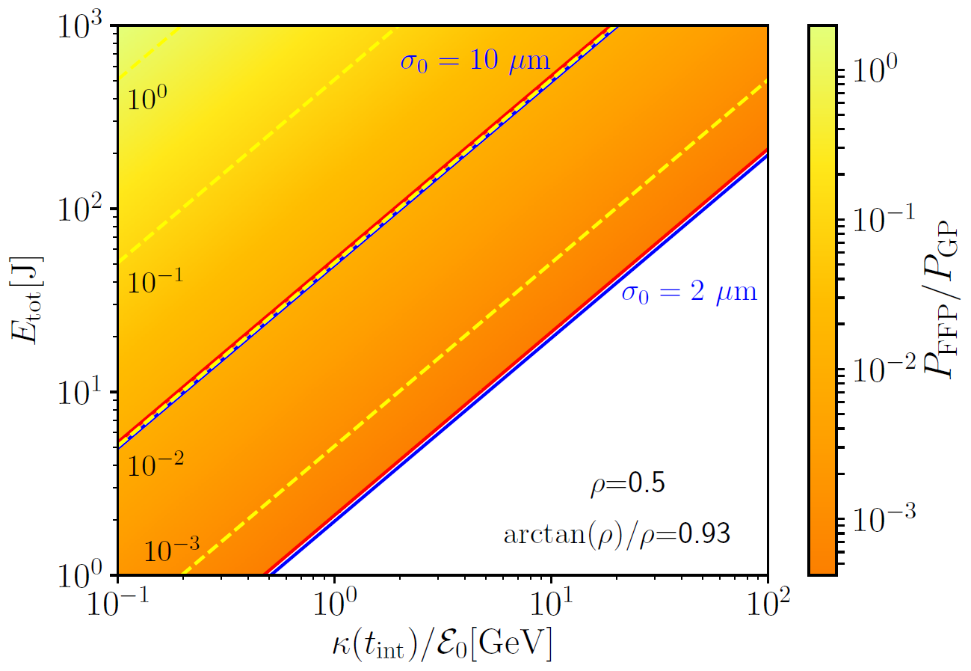
Comparison with short Gaussian pulses
If we keep $E_{tot}$ fixed we can increase the interaction time $t_{\text{int}}$ and decrease the power and $ξ_{0}$ as
$$P_{ave}∝ξ_{0}^{2}∝1/t_{int}$$
The necessary power is up to ${10}^{3}$ times lower and $ξ_{0}$ is up to ~ $30$ times lower
This allows us to reach significant decelerations at lower powered laser systems.
At high intensities it is difficult to determine the pulse parameters precisely.
It is possible to use pulses with higher overall total energy since high intensities are not necessary
$t_{\text{int}}=100 \text{ps}$($60$k osc.)
(MF et al., PRA 105 (2022) L020203)

Slide 22
FF beams and strong-field QED (Di Piazza, PRA 103, (2021) 012215)
The longitudinal formation length (LFL) is a classical concept (Jackson 1975)
An ultrarelativistic electron with energy $ε≫mc^{2}$radiates along its instantaneous velocity within a cone of aperture $θ_{r}=mc^{2}/ε$and the LFL is given by the curvature radius $ρ$ of the trajectory times $θ$
$$ℓ_{∥}$$
$$θ_{r}$$
Courtesy
A. Di Piazza
The LFL is found to be comparable with the laser wavelength if $ξ_{0}∼1$ (Ritus, J. Laser Res., 6 (1985)) and if $ξ_{0}≫1$ for sufficiently low emitted frequencies (Di Piazza et al., PRA 98 (2018) 012134, Ilderton et al., PRD 100 (2019) 076002)
The transverse formation length (TFL) is a quantum concept and its typical size is of the order of the Compton wavelength $λ_{C}=ℏ/mc≈3.9×{10}^{−11}\text{cm}$
In a conventional laser beam, TFL effects can be safely ignored
The TFL effects accumulate as the electron propagates inside the field and they may become sizable in a FF beam, with the focus co-propagating with the electron (Di Piazza, PRA 103, (2021) 012215)
At $ε≫mc^{2}$ and $a_{0}∼1$, the emission probability is substantially modified by TFL effects if ($τ$ is the pulse duration and $σ$ is the spot radius)
$$ρ=\frac{1}{2}\frac{cτ}{σ_{0}}\frac{mc^{2}ξ_{0}}{ε}≳1$$
For $τ=100 \text{ps}$, $σ_{0}=2 μ\text{m}$, $ξ_{0}=1$, and $ε=8 \text{GeV}$, one obtains $ρ =0.5$

Slide 23
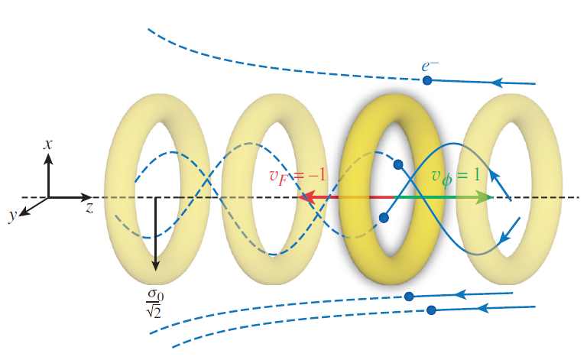
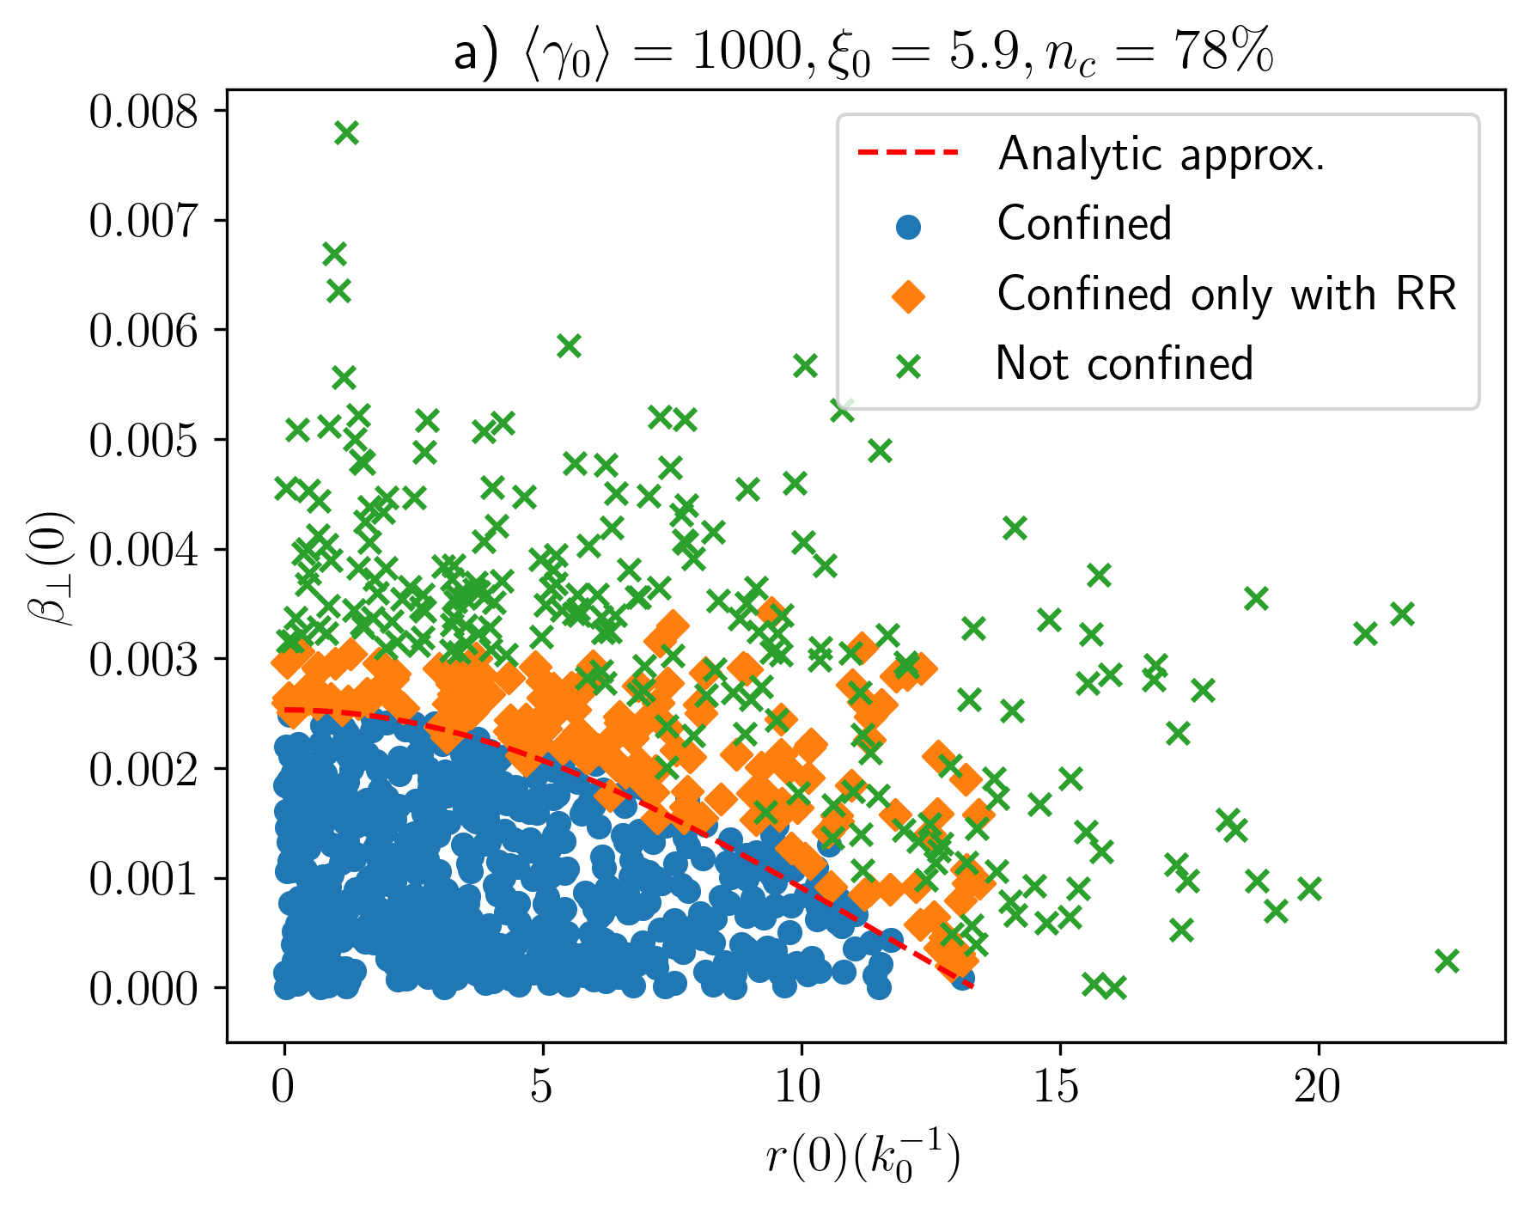
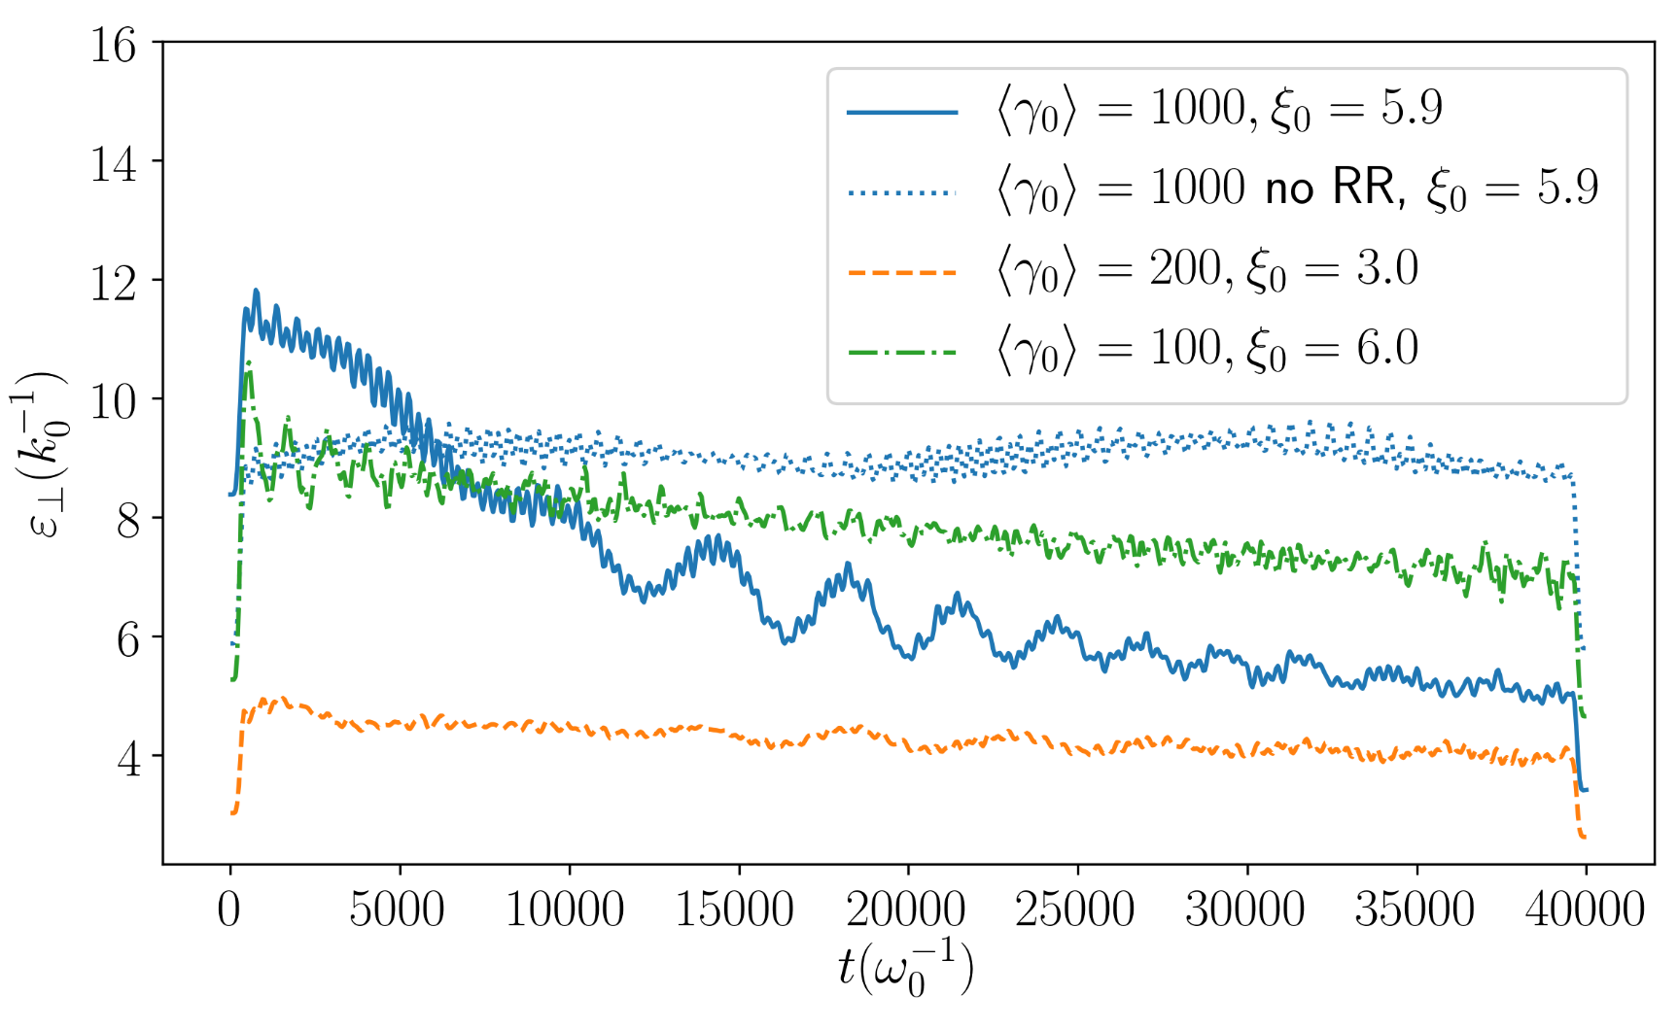
Charged particle beam control (MF et al., PRE 107 (2023) 055213)
Ponderomotive potential barrier in $ℓ=1$ OAM FF pulse:
which travels with the electron bunch!
Initial transverse phase space
Normalized transverse emittance of the bunch

Slide 24
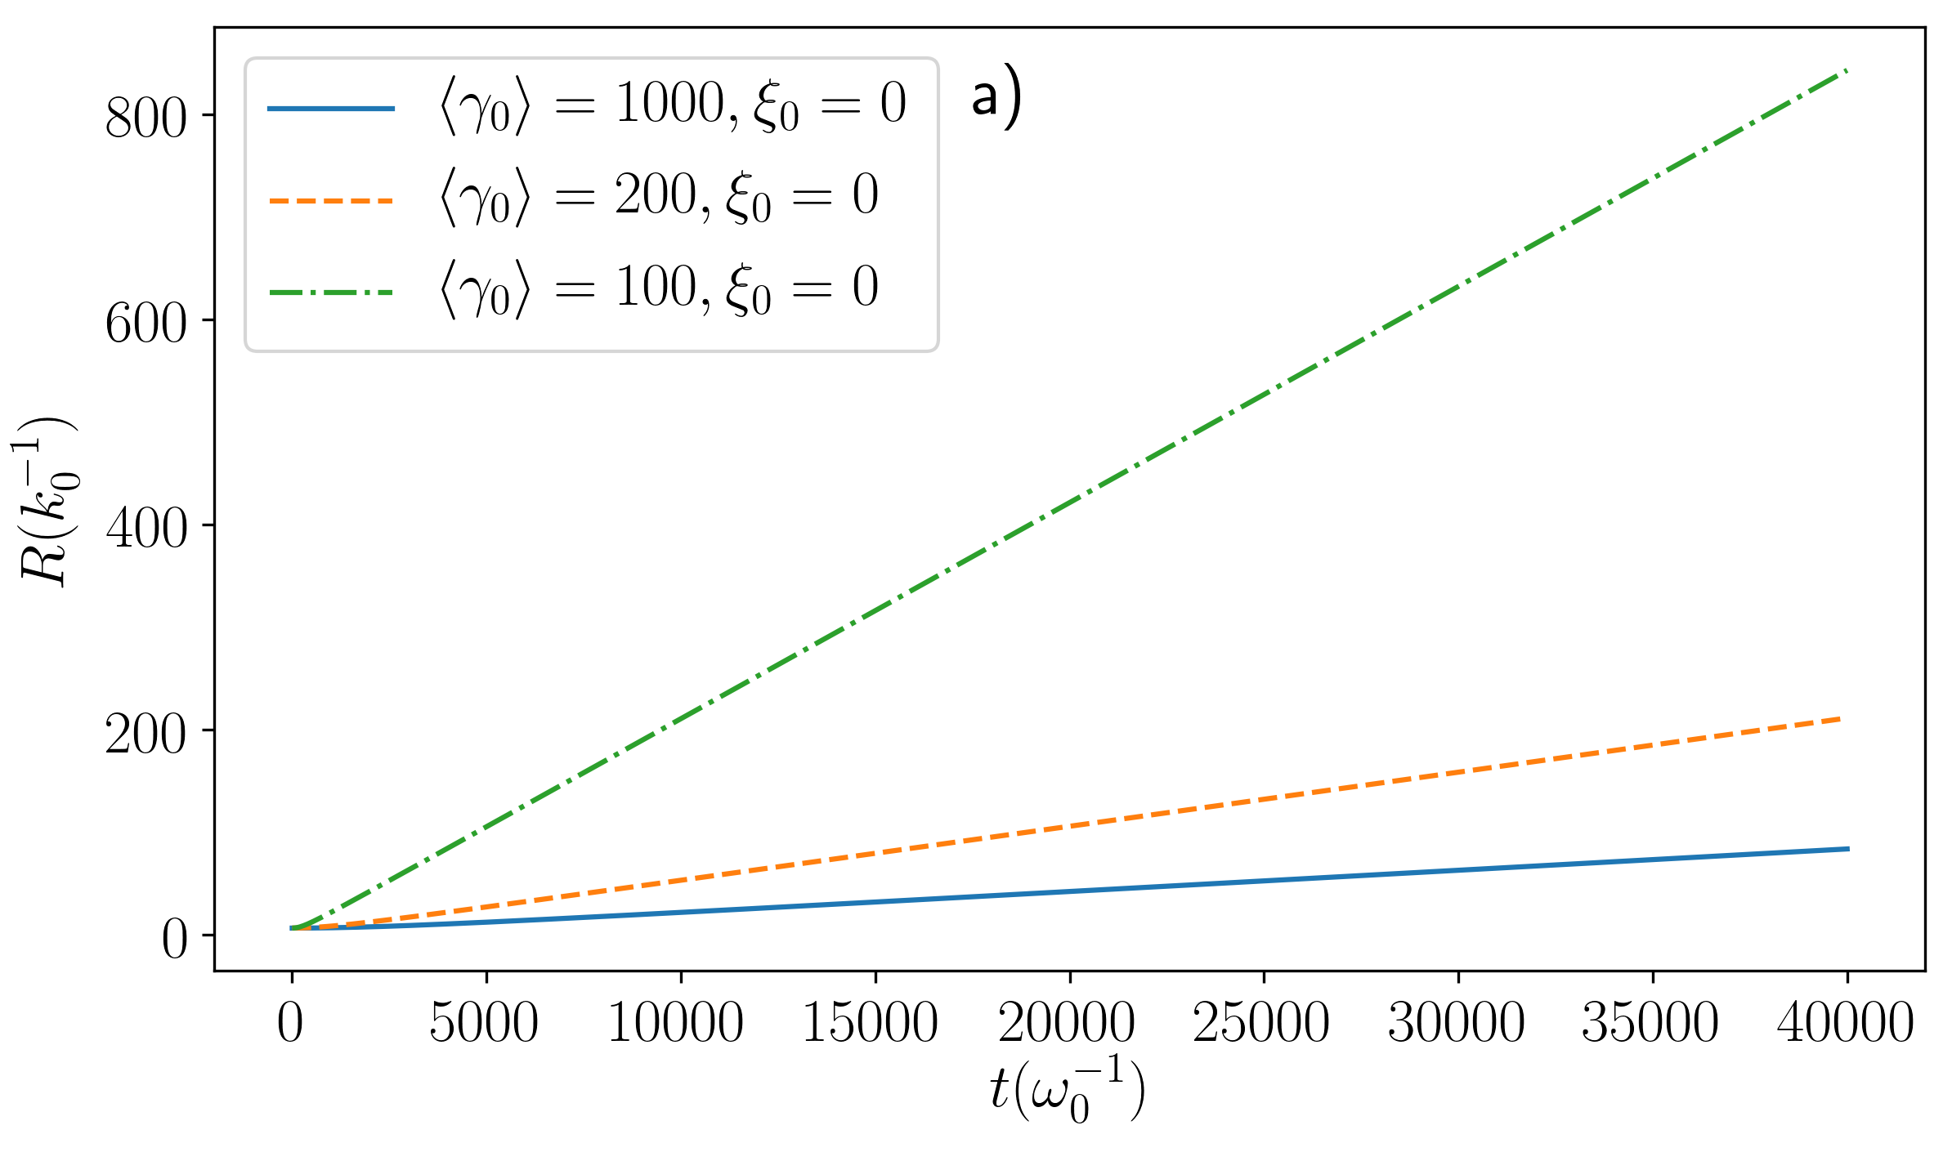
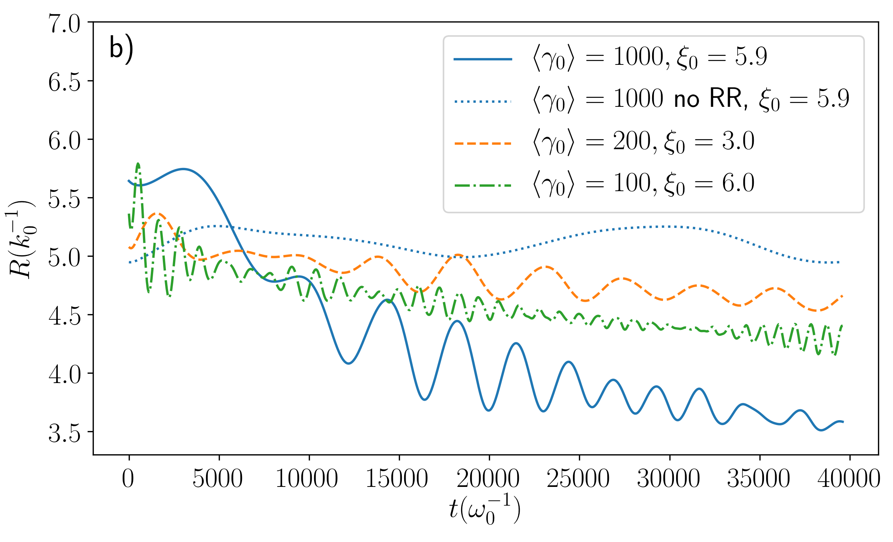
Charged particle beam control (MF et al., PRE 107 (2023) 055213)
Evolution of the RMS radius $R\left(t\right)$ during the same interaction time
No external fields
$ℓ=1$ OAM FF pulse
$$R\left(t\right){\left.​\right|}_{ξ_{0}=0}≈σ_{β_{⊥}}\left(0\right)t$$
$$T=2π\frac{γσ_{0}}{ξ_{0}}$$

Slide 25
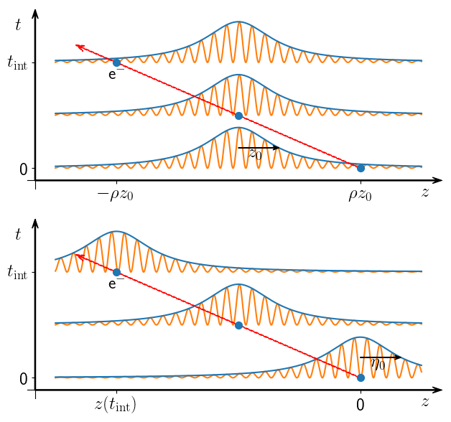
Summary:
Flying Focus pulses are useful in the situations when the long laser-particle interaction time is beneficial
For example this can be exploited in cumulative effects such as radiation energy and momentum loss (radiation reaction)
Promising tool for charge particle beam control over macroscopic distances while maintaining good focus properties.
Gaussian
Flying focus
Thank you for your attention!

