Slide 1

Margaret Island Symposium 20223 on Particles and Plasmas
Theoretical advances in the
NAPLIFE
project
Ensana
Margaret
Island Thermal
Hotel,
Margaret Island,
1007 Budapest,
Hungary
Laszlo P. Csernai, for the
NAPLIFE Collaboration
Univ. of Bergen, Norway
Budapest, June 9, 2023

Slide 2
NAPLIFE Collaboration – Participants - ELKH, National Res. Lab.
Laszlo P. Csernai, Tamás S. Biró, Norbert Kroó, Peter J. Lévai, Márk Aladi, Roman Holomb, Miklós Kedves, Archana Kumari, István Papp, Péter Petrik, Béla Ráczkevi, István Rigó, Miklós Veres, Anett Szeledi, Ágnes Nagyné Szokol; Gábor Galbács, Balázs Bánhelyi, Mária Csete, Attila Czirják, Olivér Antal Fekete, Péter Földi, Emese Tóth, András Szenes, Dávid Vass; Attila Bonyár, Nour Jalal Abdulameer, Judit Kámán, Alexandra Borók; Zsolt Fogarassy, Kolos Molnár, Roman Holomb, Péter Dombi, Melinda Szalóki, Laura Juhász; Horst Stoecker, Leonid Satarov, Johann Rafelski, Anton Motornenko; Larissa Bravina, Evgeny E. Zabrodin; Igor N. Mishustin, Daniel D. Strottman, Csaba Tóth, Shereen Zangana, Konstantin Zhukovsky (~> 40)

Slide 3
Rayleigh-Taylor Instability

Slide 4
[Clark et al., Phys. Plasmas,
22, 022703 (2015).]
Snapshots of 3D simulation
22.53ns: peak impl. Velocity
23.83ns: bang, max compr.
22.96ns: jet out, up left
Green surface: Ablator/DT-f.
Peaks: Ablator defects
Colours:
Left: fluid speed
Right: matter density
~adiabatic compression
➔ 80 μm
& heating

Slide 5
NIF – RT instability
The target is compressed to density
~ 700 g/cm³.
But, although an ablator layer is used, only ~ 10%-of the target is ignited.
Elsewhere
the surface protruded as “potato from the potato press”:
RT- instability.

Slide 6
How can we prevent it
Idea - #1

Slide 7
[ L. P. Csernai, Zh. Eksp. Teor. Fiz. 92, 379-386 (1987) &
Sov. Phys. JETP 65, 216-220 (1987) ]
corrected the work of
[ A. Taub, Phys. Rev. 74, 328 (1948) ]
λ_{α} λ^{α} = ± 1
+1
-1

Slide 8
@ CERN in High energy heavy ion collisions
Light cone
[ Stefan Floerchinger, and Urs Achim Wiedemann,
Phys. Rev. C 89, 034914 (2014) ]

Slide 9
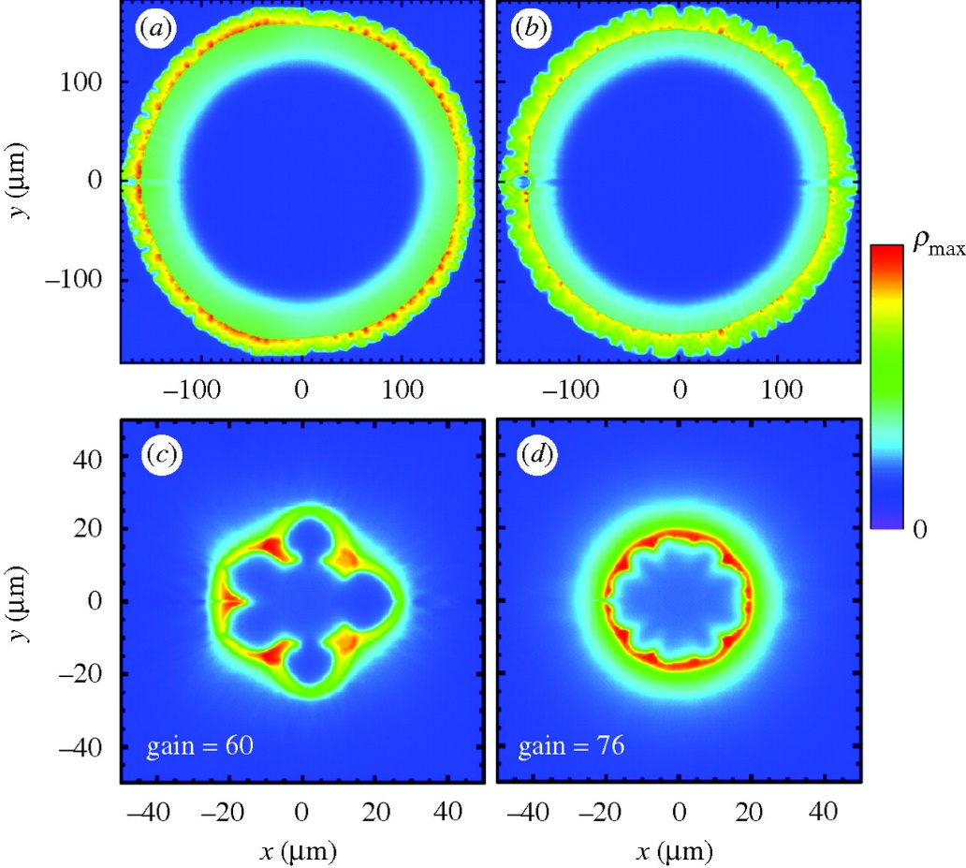
Fusion reaction:
D + T ➔ n(14.1 MeV) + 4He (3.5 MeV)
Constant absorptivity,
Spherical irradiation
Ignition temperature = T1 ➔
Simultaneous, volume ignition up to
0.5 R (i.e. 12% of the volume).
Not too good, but better than:
[ L.P. Csernai & D.D. Strottman,
Laser and Particle Beams 33, 279 (2015).]

Slide 10
How can we realize it
Idea - #2

Slide 11
LPB, 36(2), (2018) 171-178.
… and 35th Hirschegg Int. Workshop on High Energy Density Physics, Jan. 25‐30, 2015

Slide 12
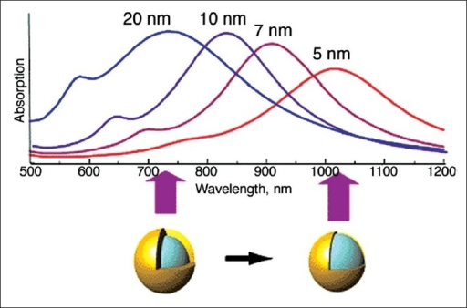
Golden Nano-Shells – Resonant Light Absorption

Slide 13
L.P. Csernai, N. Kroo, I. Papp [ Patent # P1700278/3 ]
The absorption coefficient is linearly changing with the radius: In the center, r = 0, α_{K} = 30 cm⁻¹ while at the outside edge α_{K} = 8 cm⁻¹.
The temperature is measured in units of T₁ = 272 keV, and T_{n} = n T₁.
Simultaneous, volume ignition is up to 0.9 R, so 73% of the fuel target!
T (MeV)

Slide 14
How can we realize it
simpler and with less expense

Slide 15
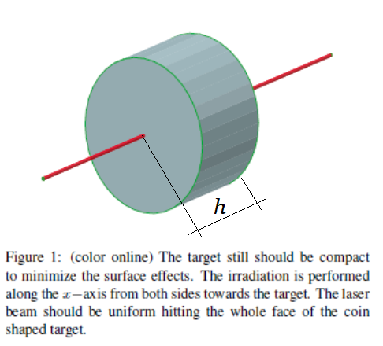
Thick coin like flat target & Two beams only
Thickness of the target is: h …
.
h depends on pulse energy, ignition energy, target mass, …
X
[ Csernai et al., (NAPLIFE
Collaboration) Phys. of Wave Phenomena, 28 (3), 187-199 (2020). ]

Slide 16
However,
- no simultaneous ignition, and
- no nano-antennas up to now !

Slide 17
Without nano
antennas
The deposited energy from laser irradiation from one side only. The absorption is constant, this leads to an exponentially decreasing energy deposition, and only a negligibly small energy reaches the opposite end of the target.

Slide 18
With nano
antennas
The absorptivity is increased towards the center, due to the implanted nano antennas.
The deposited energy from laser irradiation from one side only. The absorption is modified by nano antennas so that the absorptivity is increasing towards the middle, so that the deposited energy is constant up to the middle. Then the absorptivity is decreasing, but hardly any energy is left in the irradiation front. Thus again only a negligibly small energy reaches the opposite end of the target.

Slide 19
With nano
antennas
Irradiation from both sides.
Ignition energy is: Q_{i} /m
e.g. for DT target: Q_{i} /m = 27 kJ/g
➔ if we have Q = 100 J , then
we can have a target mass:
m_{DT} = Q / Q_{i} g = 3.703 mg.
Then with m_{DT} and ρ_{DT} given
we get the DT-target’s volume, V_{DT} and h_{DT} = 2.67 mm .

Slide 20
With nano
antennas
Ignition is reached at contour line Q = 1.
[ Csernai et al., (NAPLIFE
Collaboration) Phys. of Wave Phenomena, 28 (3), 187-199 (2020). ]
Simultaneous ignition in the whole target volume ➔
Short Pulse:
ELI - ALPS

Slide 21
Validation tests at lower energies
idea #2 increased absorption via
nano-antennas

Slide 22
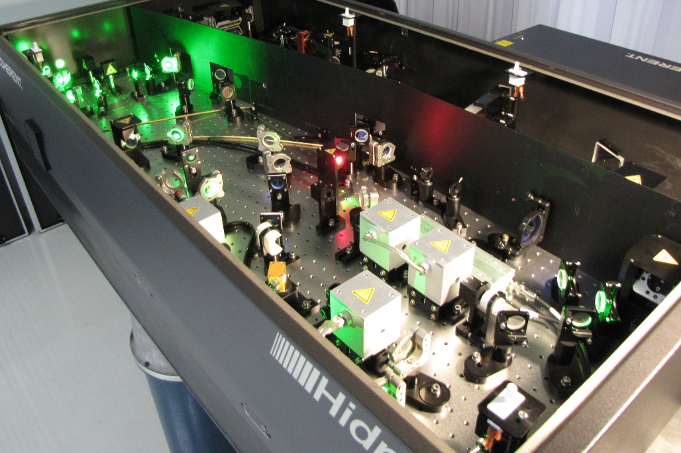
Wigner RCP, Budapest
Ti:Sa Hidra Laser: 30mJ, 10Hz, 40fs [P. Racz et al., Wigner RCP]

Slide 23
Target Modeling and Manufacturing
➔ Attila Bonyár’s talk

Slide 24
Transmission Electron-microscopy photos of 75x25 nm gold nano-rod antennas
[Judit Kámán, A. Bonyár et al. (NAPLIFE Collab.)., Gold nanorods …, 10th ICNFP 2021, Kolymbari]

Slide 25
TEM Photo of ~uniformly implanted nanorod antennas in UDMA target polymer. The density is
9-20 / μm³
[Judit Kámán, A. Bonyár et al. (NAPLIFE Collab.)., Gold nanorods …, 10th ICNFP 2021, Kolymbari, Crete, Greece, 30 August 2021.]

Slide 26
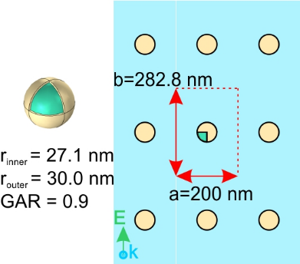
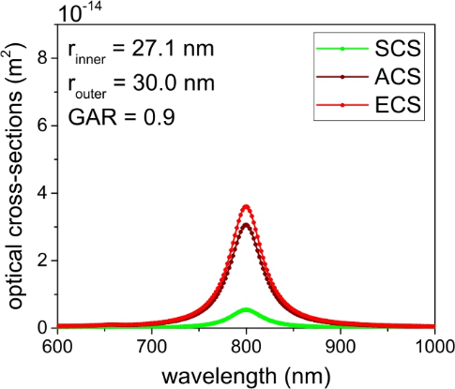
Nano-particle absorption
The target absorptivity is increased via core-shell type plasmonic nano-shells. Calculations via solving the Maxwell equations, and evaluating the ohmic heating were performed using the COMSOL simulation package.
1 ps laser pulse length, λ = 800 nm, one-sided & two-sided irradiation tested,
85-100 % absorption in the target length h.
Nano-antenna shapes, layer configurations, layer distribution varied & analyzed.
[M. Csete, et al., U. Szeged, HU https://doi.org/10.1007/s11468-021-01571-x 10.3103/S1541308X20030048 ]

Slide 27
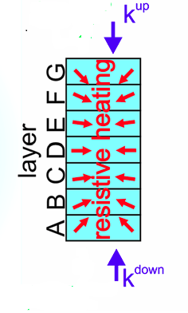
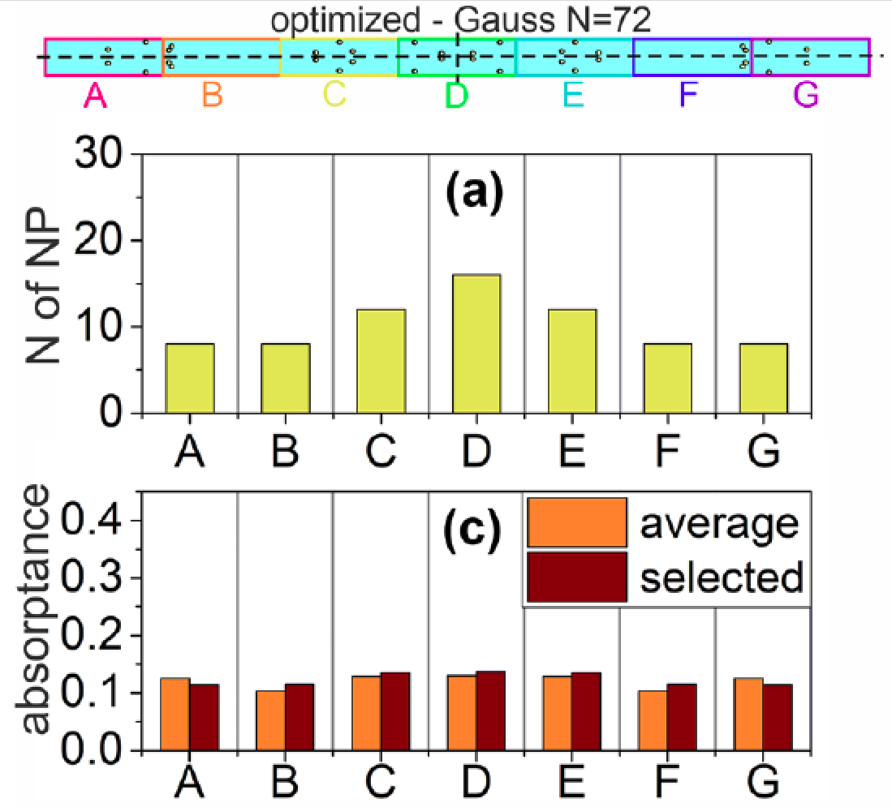
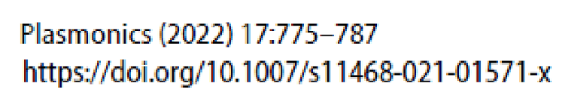
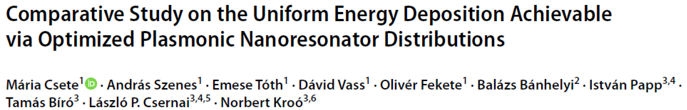
Layered target with variable light absorption
Representative uniform & Gaussian
number density distributions of (d) 70 oriented nanorods, in a 1 × 1 × 21 µm3 supercell of UDMA polymer target, with random location distribution.
[ M. Csete, A. Szenes, E. Tóth, D. Vass, O. Fekete, B. Bánhelyi, T. S. Bíró, L. P. Csernai, N. Kroó:
„Comparative study on the uniform energy deposition achievable
via optimized plasmonic nanoresonator distributions“,
Plasmonics (2022), 17: 775-787; https://doi.org/10.1007/s11468-021-01571-x. ]

Slide 28
Validation tests at lower energies
idea #1 Simultaneous (time-like)
transition (ignition)
➔
Two opposing beams

Slide 29
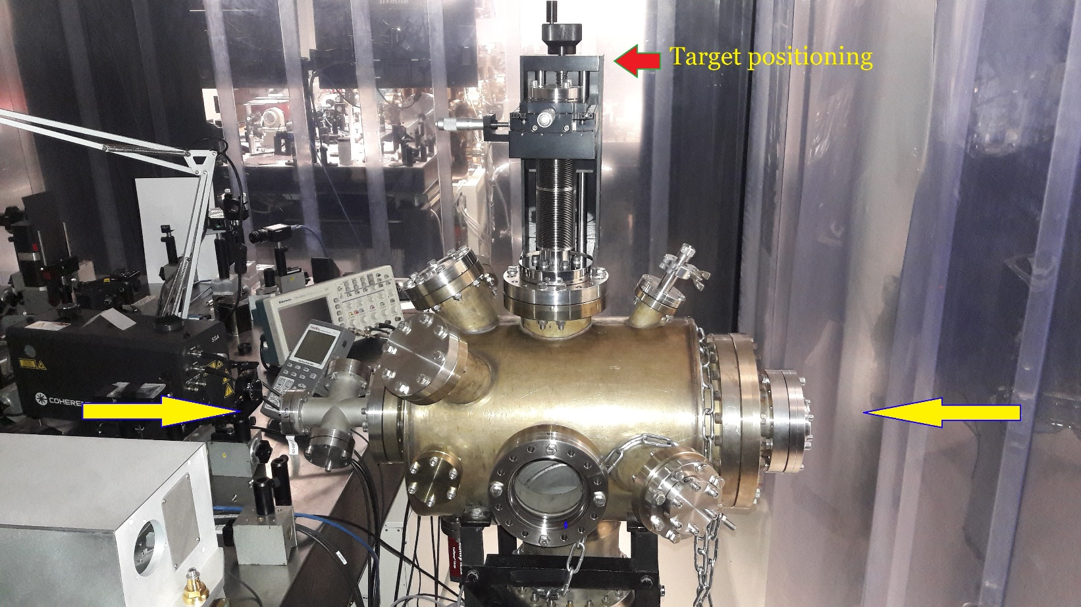
Validation tests – Target manufacturing
Two basic principles are tested on non-fusion material targets at low energies
Implanted with nano-antennas ➔ Amplified absorption √
Multilayer targets ➔ Simultaneous Ignition (in progress)
[M. Csete,
A. Bonyár,
I. Papp,
P. Rácz,
et al.]
In preparation

Slide 30
Multilayered fuel target

Slide 31
Laser Wake Field Collider
Ǝ Pre-compression/acceleration, before ignition
Ion (e.g. p) Energy E_{p} ≈ 50 MeV (or more)
Initial beam densities assumed: n_{H} ≈ γ n₀ = 2·10⁻¹⁹/cm³ and 2·10⁻²¹/cm³
≈ n_{liquid-H} , ≈ n_{NIF} /1000 ^{(/wo precompression!)}
Target density after interpenetration: n_{t} ≥ 2 n_{H}
The ionization of the H atoms at ignition in a Laser Wake Field (LWF)
wave due to the irradiation from both the +/- x directions
[ Papp, I., et al., NAPLIFE, Phys. Lett. A 396, 12724 (2021). ]

Slide 32
Validation tests ➔
Laser Induced Fusion
with Nanoantennas

Slide 33
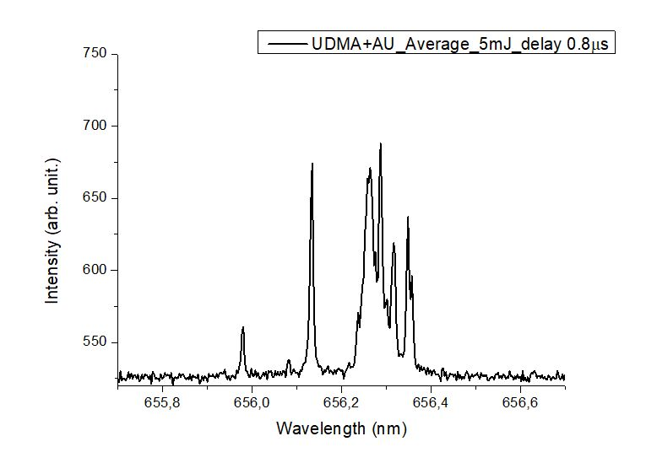
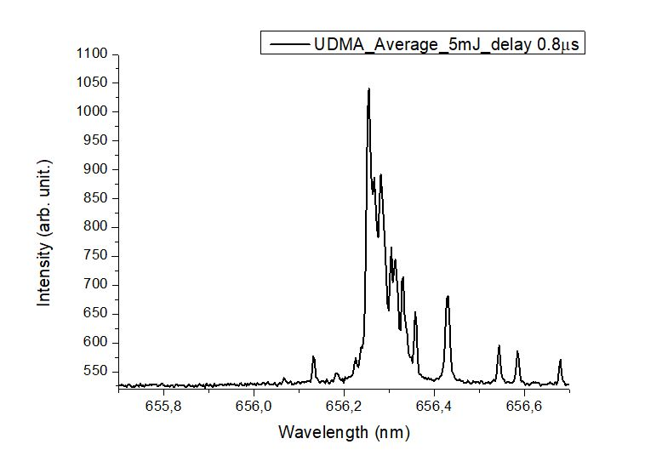
(N.K.*)
Deuterium production ( PRELIMINARY ! )
D
H
H
5-12% D + 88-95% H 100% H
~ 10¹⁷ D / pulse (10Hz) Balmer-α line
Two step process (average of 20 shots):
p + e* → n + ν \ electron capture (-1.24 MeV)
n + p → d + γ \ neutron capture (+2.22 MeV)
Electron capture may happen spontaneously in heavy nuclei,
here laser light and resonant nanorods act similarly, high e density
UDMA (470: H38, C23, O8, N2)

Slide 34
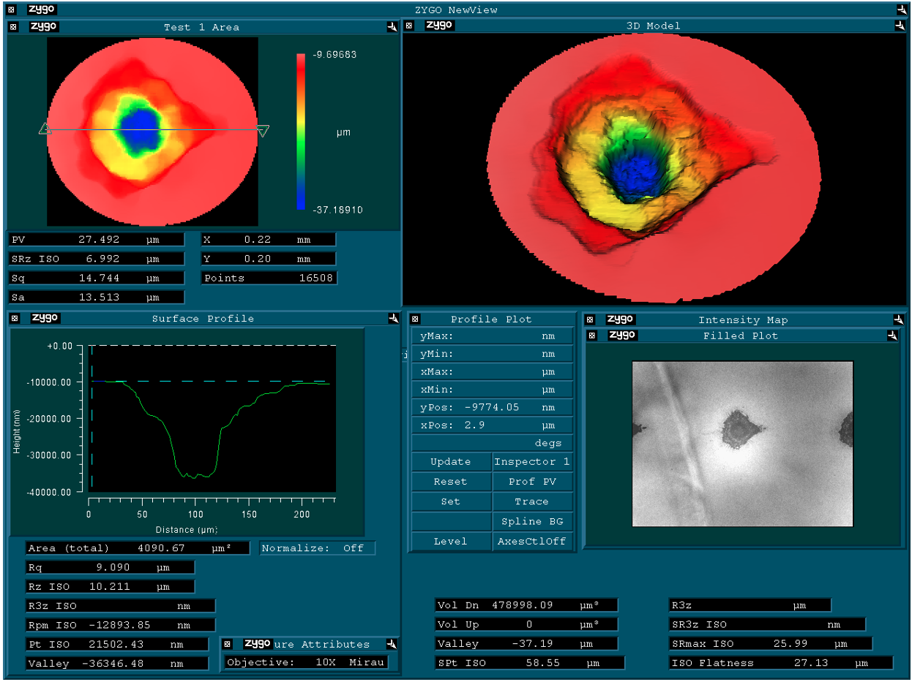
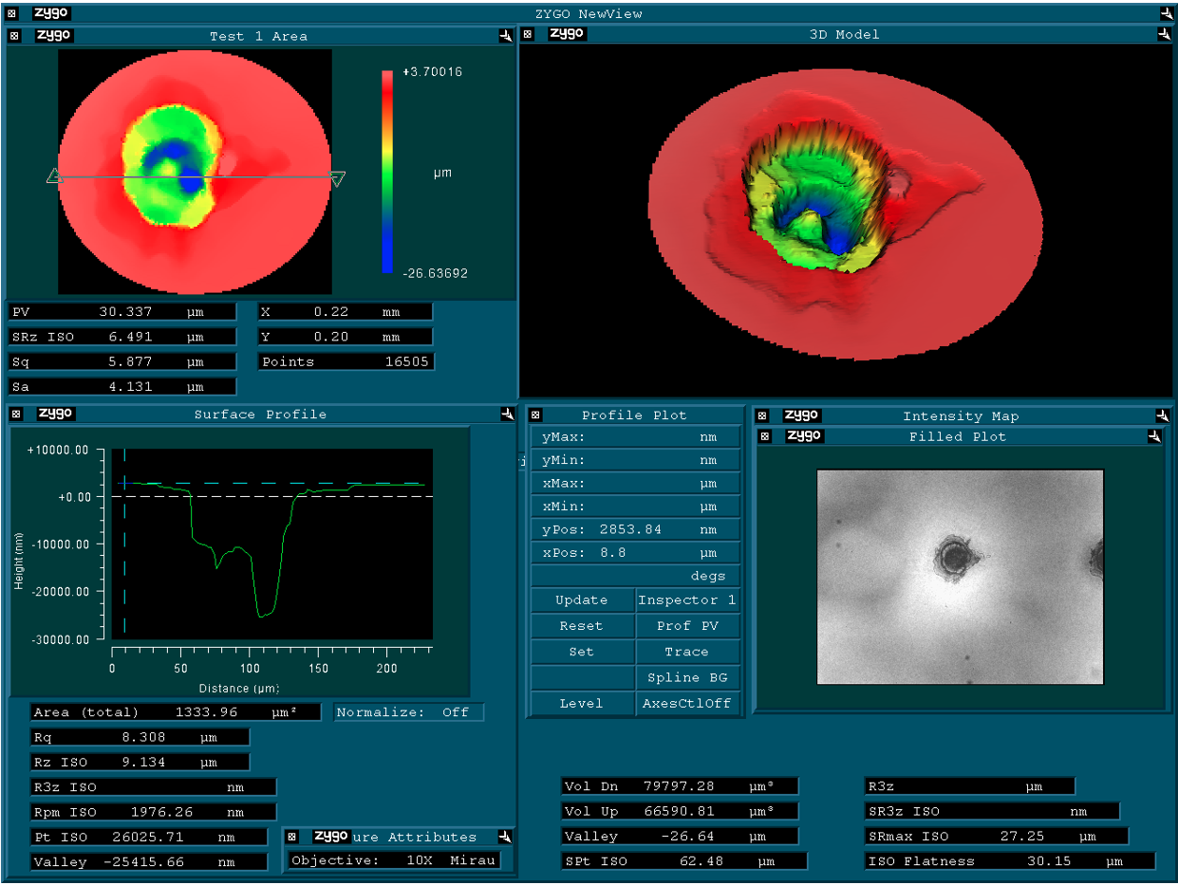
(N.K.*)
Deuterium production w
ith 795nm 40fs Ti:Sa laser 10¹⁶-10¹⁷ W/cm² intensity
UDMA-TEGDMA target 20-100 μm thick, \w & \wo Au nanorods 25x85nm.
➔ 5 mJ pulse -> crater of 4.55-1.07·10¹⁴ μm³ \w &\wo Au ~ 15/ μm³
➔ From the crater the emitted matter was analysed by Raman spectroscopy & Laser Induced Breakdown Spectroscopy (LIBS).

Slide 35
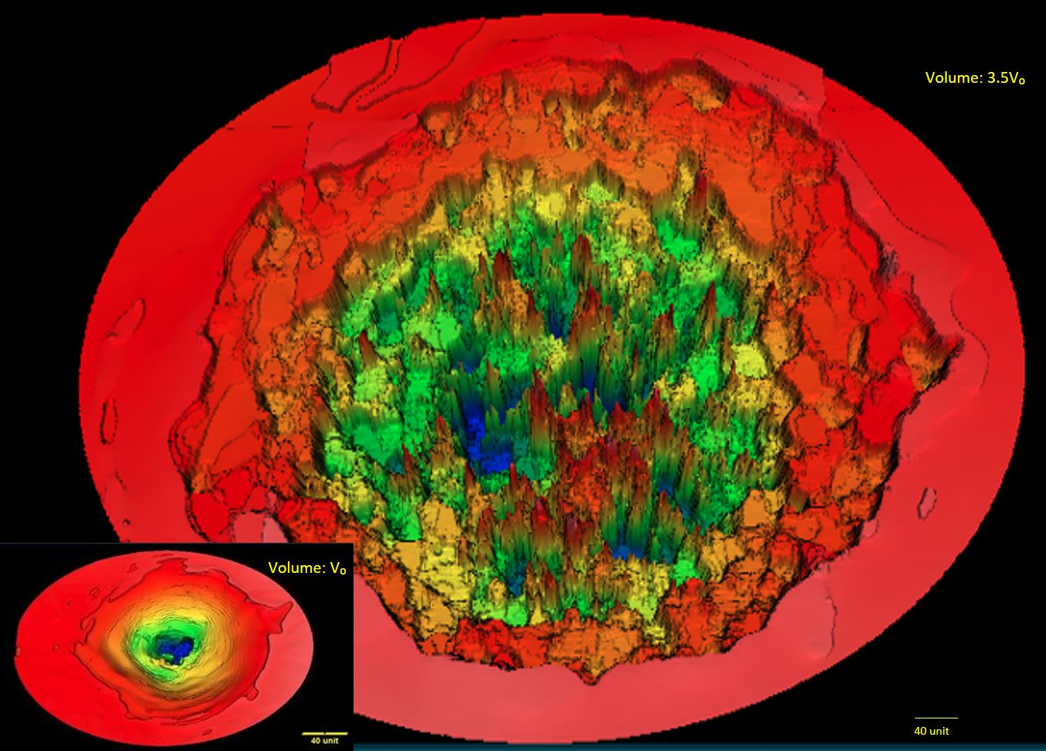

Slide 36
( 2022 )

Slide 37
With Nanorods (Au2) at 25 mJ laser pulse
~4 times increased D production, compared to 1 mJ pulse

Slide 38
( 2022 )

Slide 39
25x130 nm antennas, resonant for λ=795 nm
Initial 2 ord. magn.
[L. Novotny (2007)]
“Final.

Slide 41
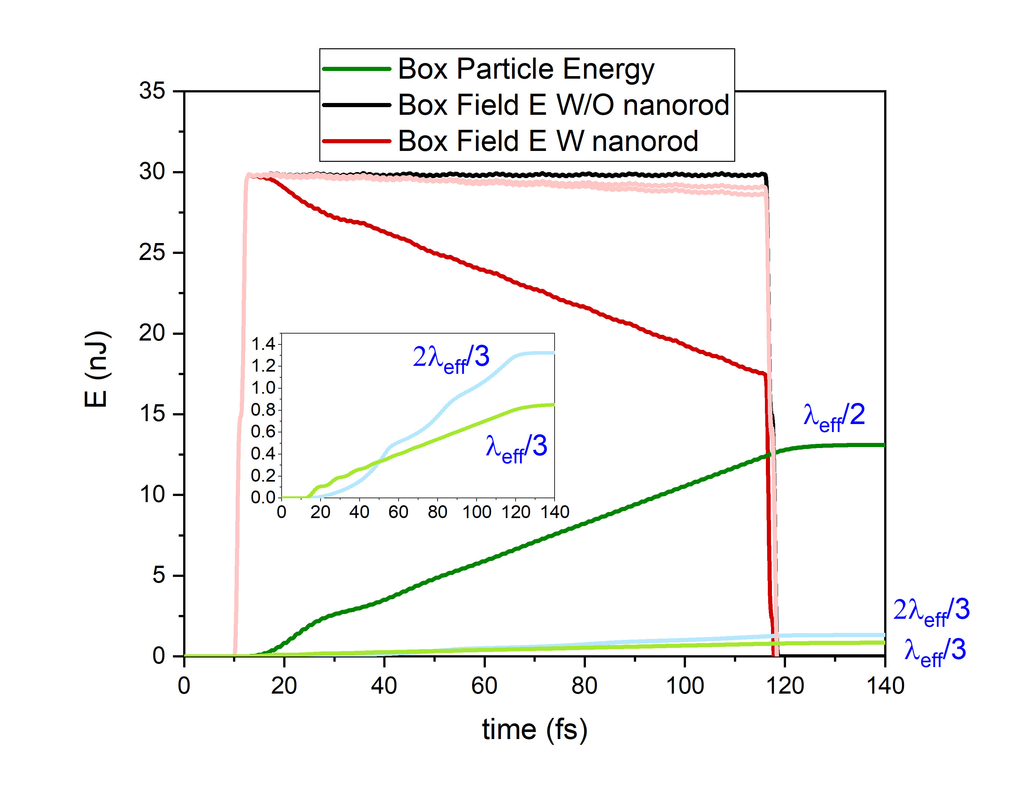
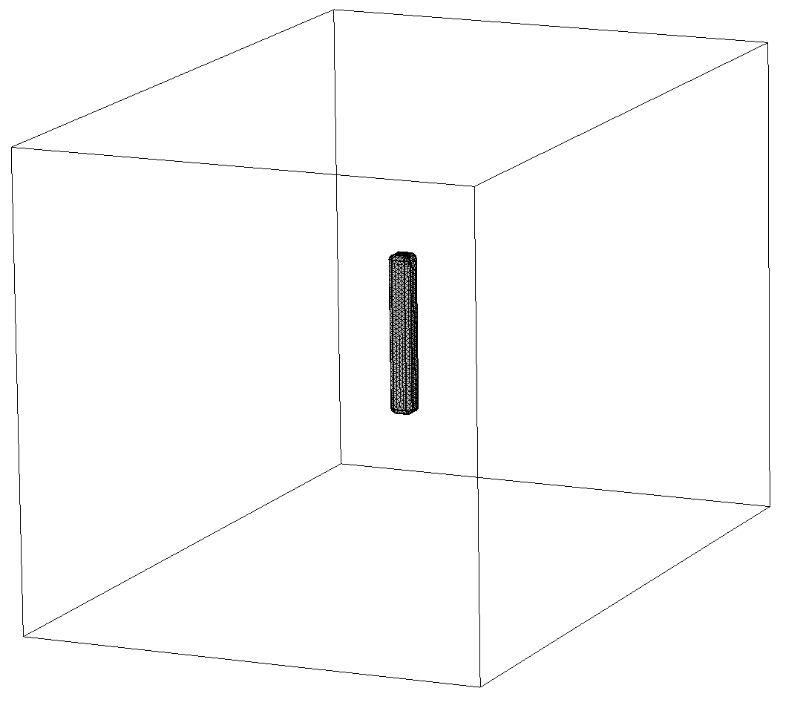
Resilience of Nanorod Antenna with COMSOL
FEM computations with the same model parameters
[M.Csete et al.]
Good qualitative agreement between FEM and EPOCH/PIC methods Quantitative difference:
the hydrodynamic model of the electron plasma (FEM) predicts a sharper resonance than the kinetic model (EPOCH/PIC)

Slide 42
( 2023 )

Slide 43
25x85 nm antennas, resonant for λ=795 nm in
UDMA polymer
[L. Novotny (2007)]
Accumulated momentum of conduction electrons in vacuum (blue) and in UDMA (black)

Slide 44
( 2022 )

Slide 45
Puzzle ?

Slide 47
Theoretical studies in progress =>
Idea #3
We pursue kinetic model (EPOCH) studies in the same Calculational Box, where the nano-rod antenna is surrounded be hydrogen target.
W assume that the hydrogen is relatively dense and ionized, in order to study what effect will have the nano-rod antennas on the surrounding protons.

Slide 48
Laser
I = 4 ∙ 10¹⁷ W/cm² V ~ 7.1 ∙ 10¹² V/m
I = 4 ∙ 10¹⁵ W/cm² V ~ 2.6 ∙ 10¹² V/m

Slide 49
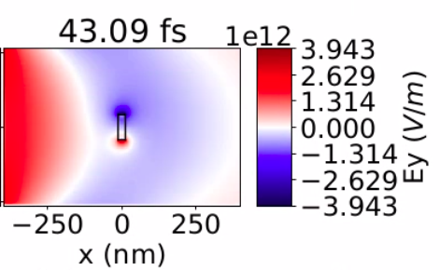
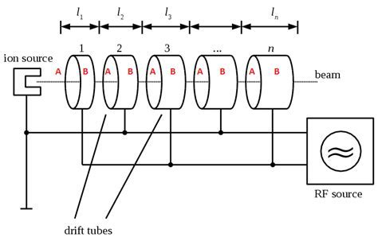
Neighboring
protons are
accelerated
(100-200 nm)
Dipole L = 85 nm
I = 4 ∙ 10¹⁷ W/cm² dV ~ 8 ∙ 10¹² V/m
LHC dV ~ 1 ∙ 10⁶ V/m
Dipole L ~ 16 cm

Slide 50
Laser wake field acceleration mechanism =>
BUT
Proton
amplitudes
& speeds are smaller

Slide 51
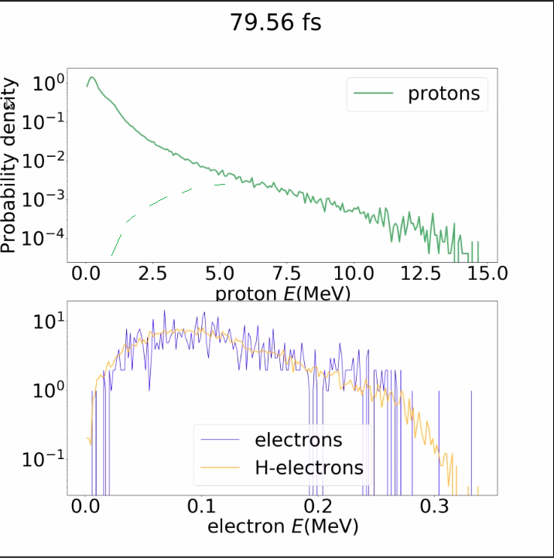
Number of
1-2 MeV protons is about 1-100
=>
About 3 ordrs of magnitude less than electrons
=>
small number
of Deuterium

Slide 52
➔ IDEA # 3: New fusion mechanism
Traditionally (NIF) after ignition, DT burning is spreading by alpha particle self heating. This turns out to be slower than expansion after extreme compression and extreme pressure.
HINT:
Here after simultaneous (time-like) ignition attraction of large number of electrons collectively accelerate protons, which can induce nuclear reaction (e.g. transmutation).
We try to verify this mechanism and evaluate if the rate that can be achieved this way is sufficient for massive energy production

Slide 53
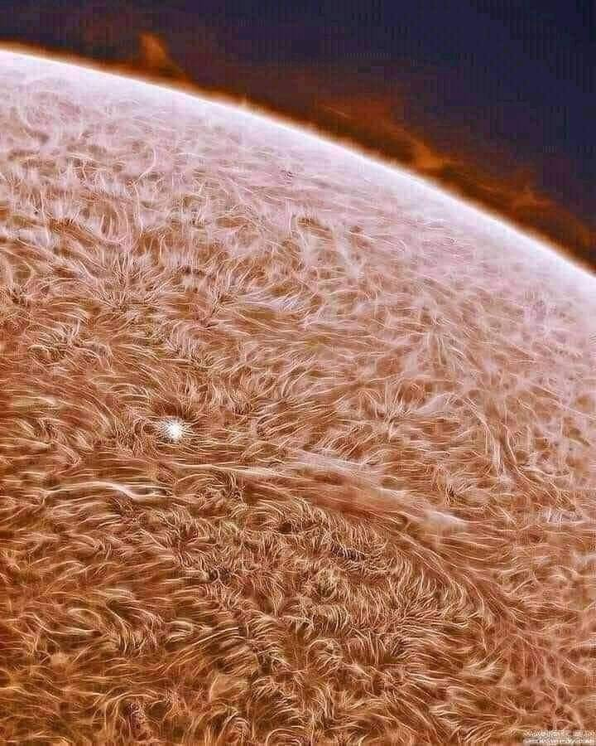
Thanks for your attention

