Slide 1


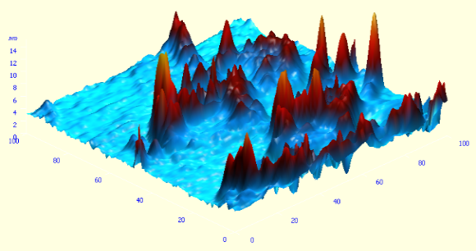
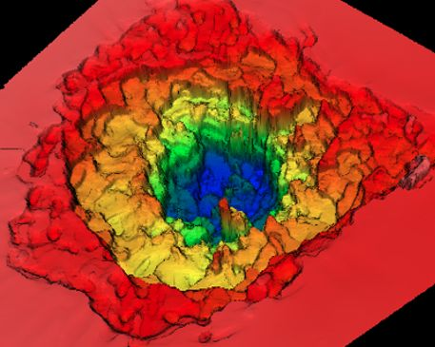
HIGH FIELD PLASMONICS AND SOME APPLICATIONS
NORBERT KROO
(on behalf of the NAPLIFE Programme)
WIGNER PHYSICS RESEARCH CENTER and
HUNGARIAN ACADEMY OF SCIENCES
PP2023, 06.09.2023

Slide 2

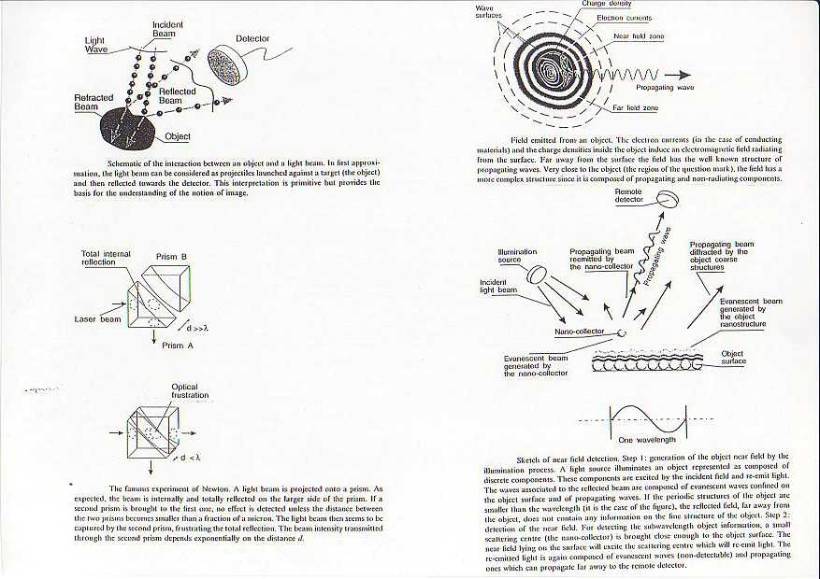
THE OPTICAL NEAR FIELD

Slide 3
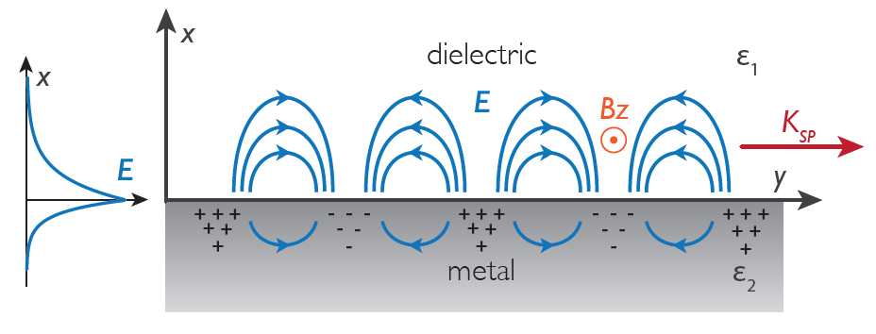
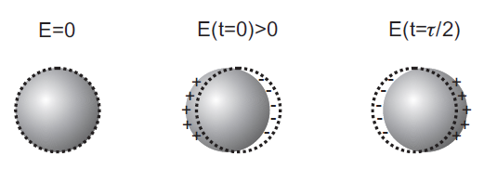
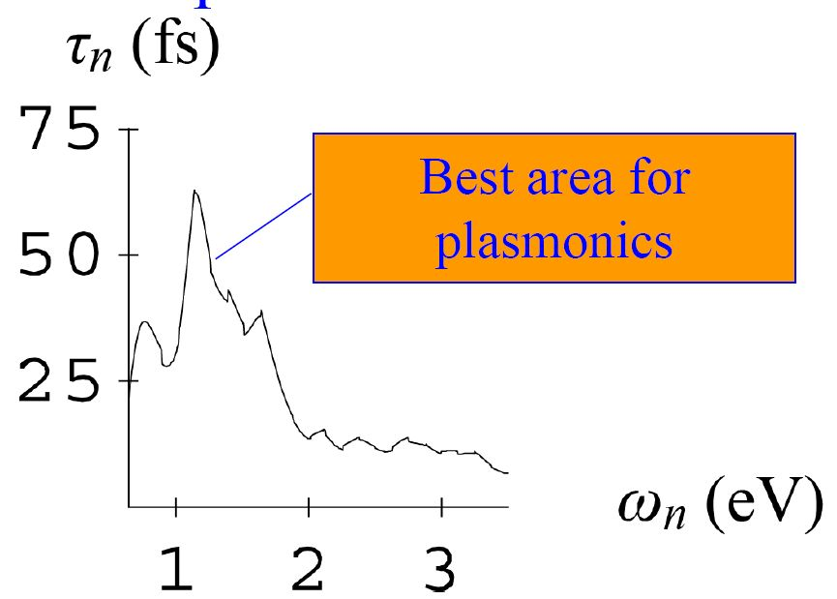
PLASMONICS AND HIGH FIELDS APPLICATIONS
Special type of the optical near field. No diffraction limit.
SPP
LSPP
Ti:Sa laser: ʎ=800nm (~1.55eV) ; t(SPP)~30fs
ω(eV)

Slide 4
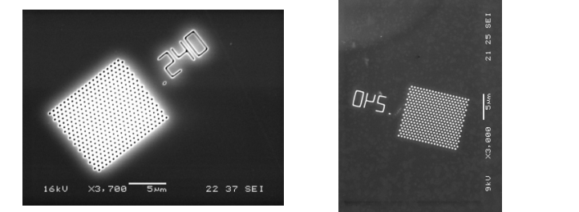
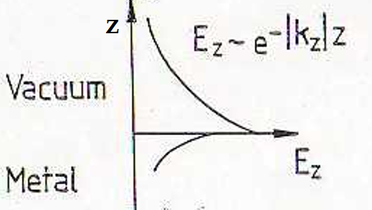
Light gets through the holes much smaller, than the wavelength of applied light.
VACUUM
MOST OF THE ENERGY IS CONCENTRATED AT THE SURFACE: GIANT FIELD ENHANCEMENT!
METAL

Slide 5
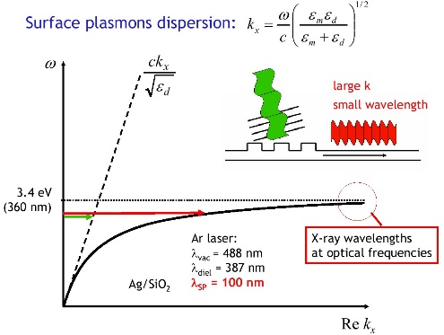
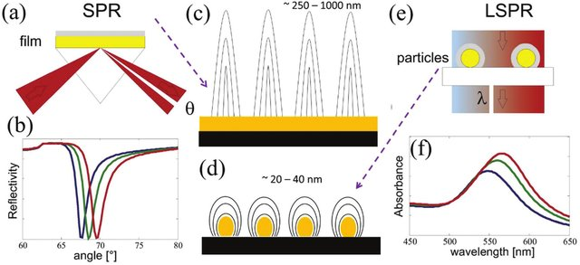
LOCALIZED PLASMONS (SPP andLSPP) UP TO 10²⁰ W/cm²)
(The basic difference between SPP-s and LSPP-s)
LSPP: - NO EM FIELD PENETRATION INTO THE PLASMONIC MATERIAL (e.g. metal)
- SMALLER PENETRATION INTO THE DIELECTRIC /VACUUM
-NO DISPERSION
-BROADER RESONANCE

Slide 6
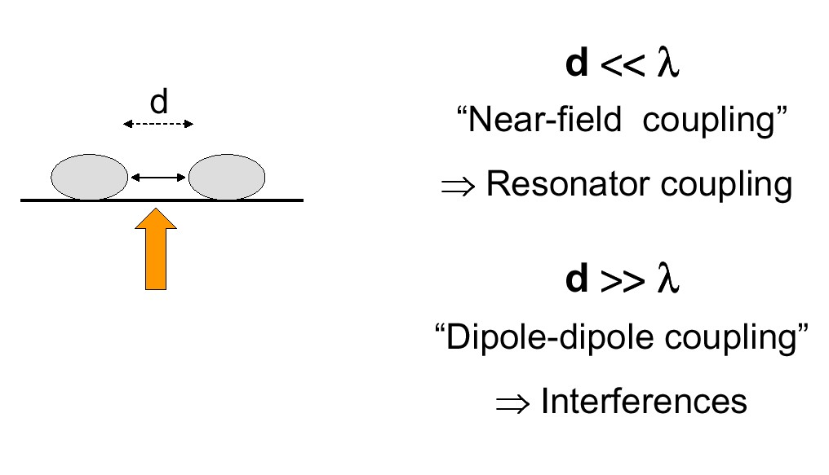
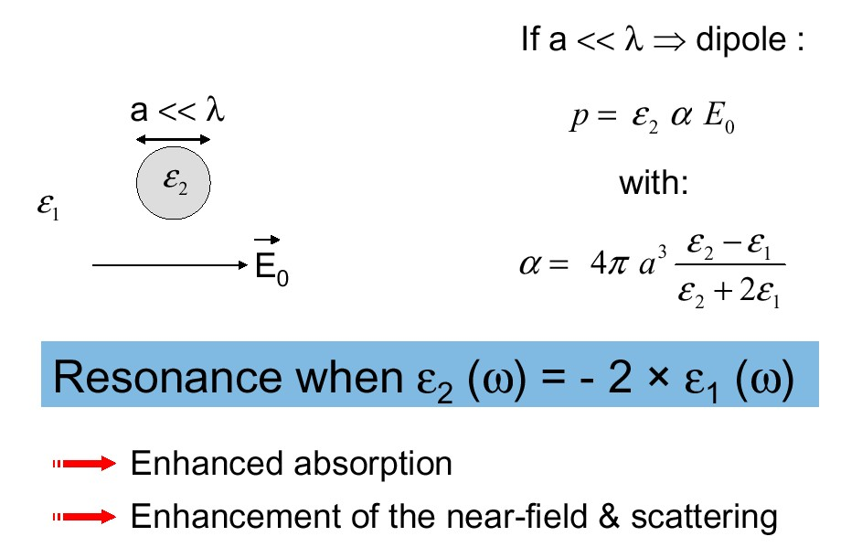
LSPP

Slide 7
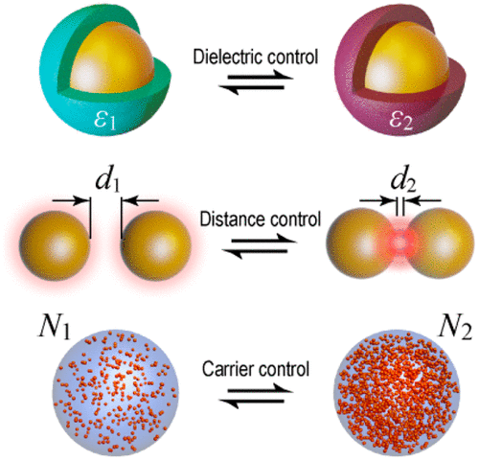
PLASMON RESONANCE OF NANOPARTICLES SHAPE AND SIZE DEPENDENT!
Nanoshell:
Bulk
a
b
Surface
Nanoshell plasmon resonance depends on the x ratio .
Sphere
Hole

Slide 8

SPP and LSPP are a „NEW TYPE OF LIGHT”, they are
1. BOUND TO THE (METAL) SURFACE (SPP and LSPP)
2. HAVE SPECIFIC DISPERSION PROPERTIES (LSPP no dispersion)
3.THE DIFFRACTION LIMIT DOES NOT APPLY,
4.CAN BE SQUEEZED TO NANOSIZED VOLUMES
5. COULD REPRESENT VERY HIGH ELECTRIC FIELDS (hot spots)
6. SCREEN POSITIVE (e.g.proton) PARTICLE CHARGES
7. IS CORRELATED MOTION OF A HIGH NUMBER OF CONDUCTION
ELECTRONS
8. MAY BE THE SOURCE OF DIFFERENT NONLINEAR PROCESSES
9.SHOW NON-CLASSICAL PROPERTIES

Slide 9
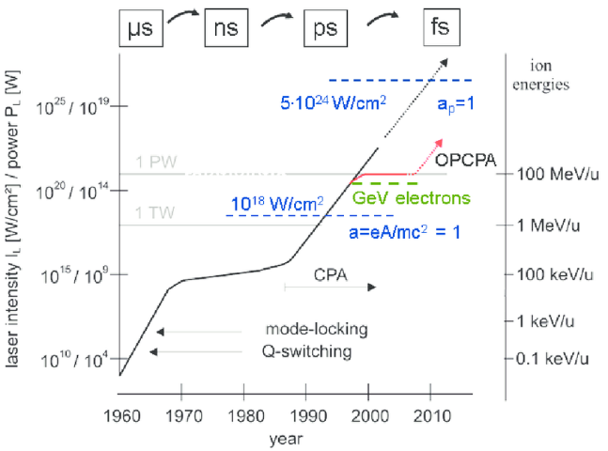
DEVELOPMENT OF HIGH INTENSITY SHORT PULSE LASERS IN TIME

Slide 10
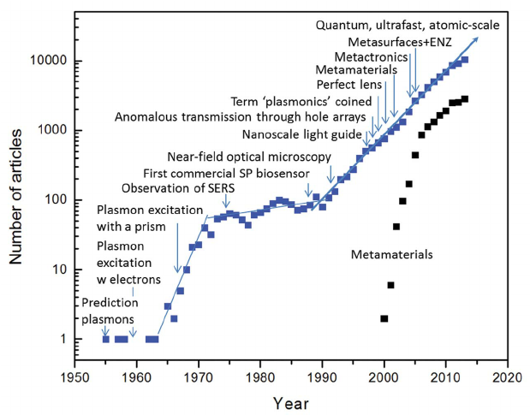

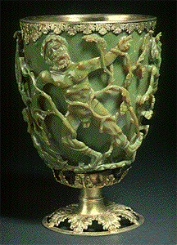
we

Slide 11
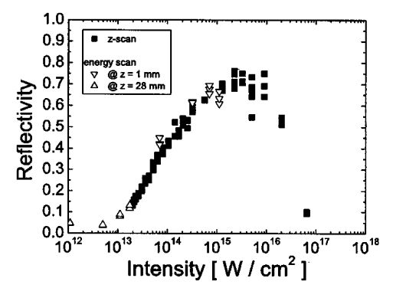
PLASMA MIRROR REFLECTIVITY
Ch.Ziener at al : J.Appl.Phys. 93,768 (2013)

Slide 12
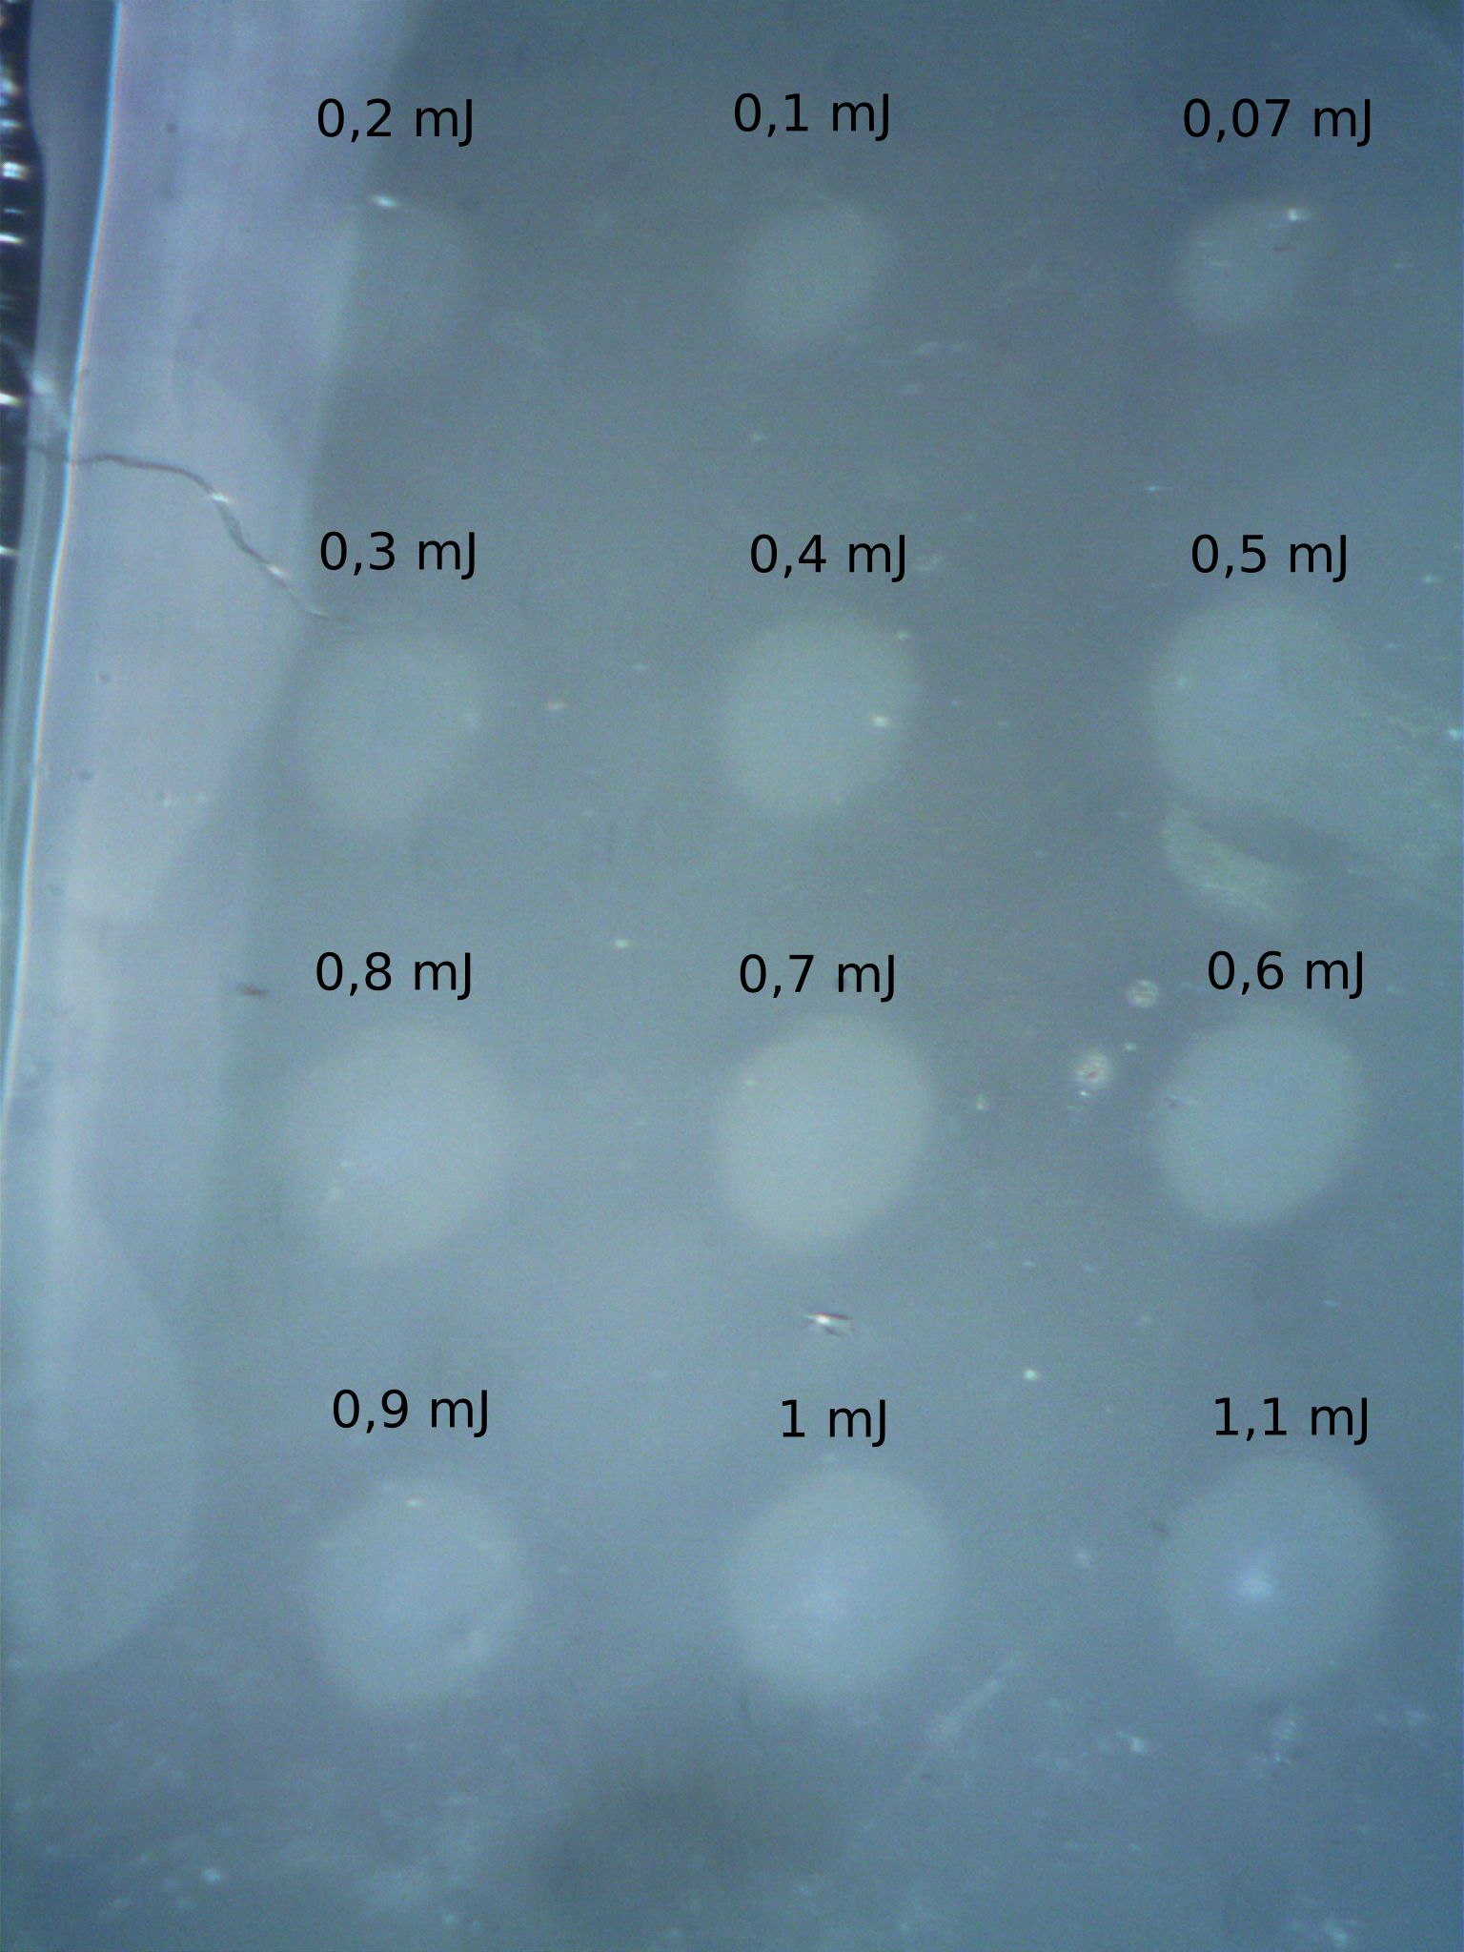
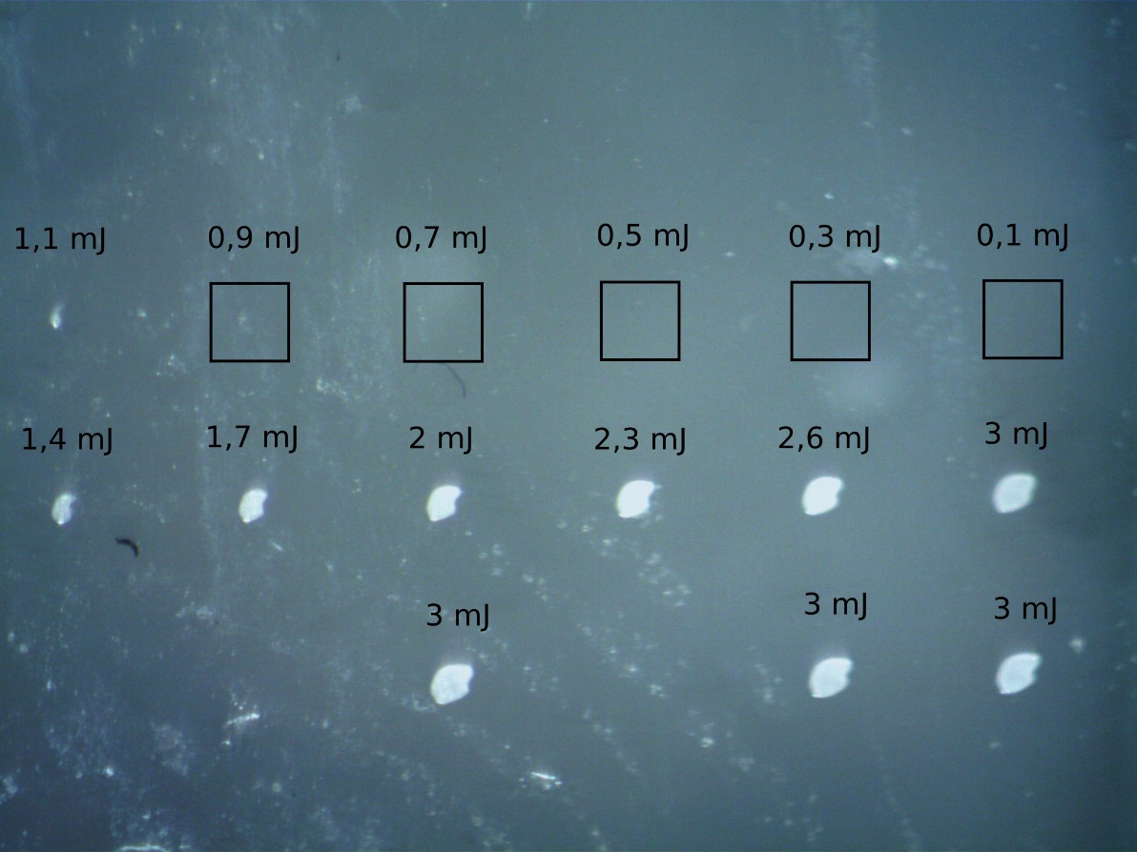
LIGHT NOT REFLECTED, GOLD NANOPARTICLES REACHED!
Doped (amplification: 40x)
Non doped (amplification: 30x)
Focus: 20μ diameter
Pulse length: ~40fs
Intensity: max. ~4.10¹⁷W/cm²
Laser
Thickness: ~30μ or 160μ
~10¹¹/cmᶾ gold nanoparticles

Slide 13
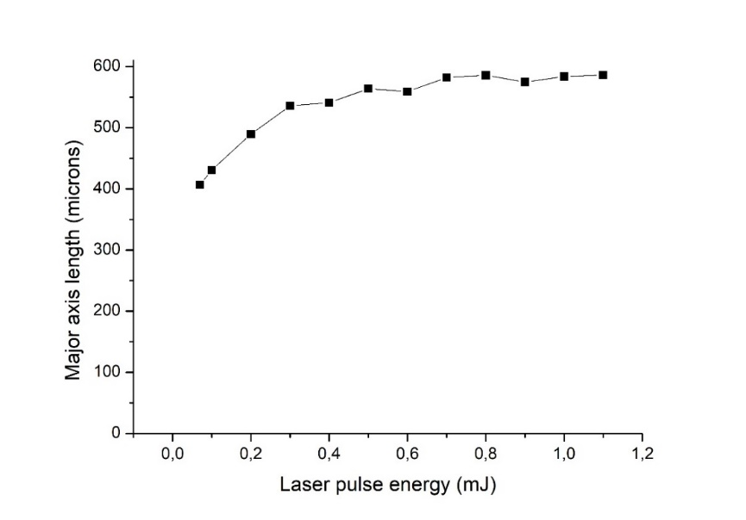
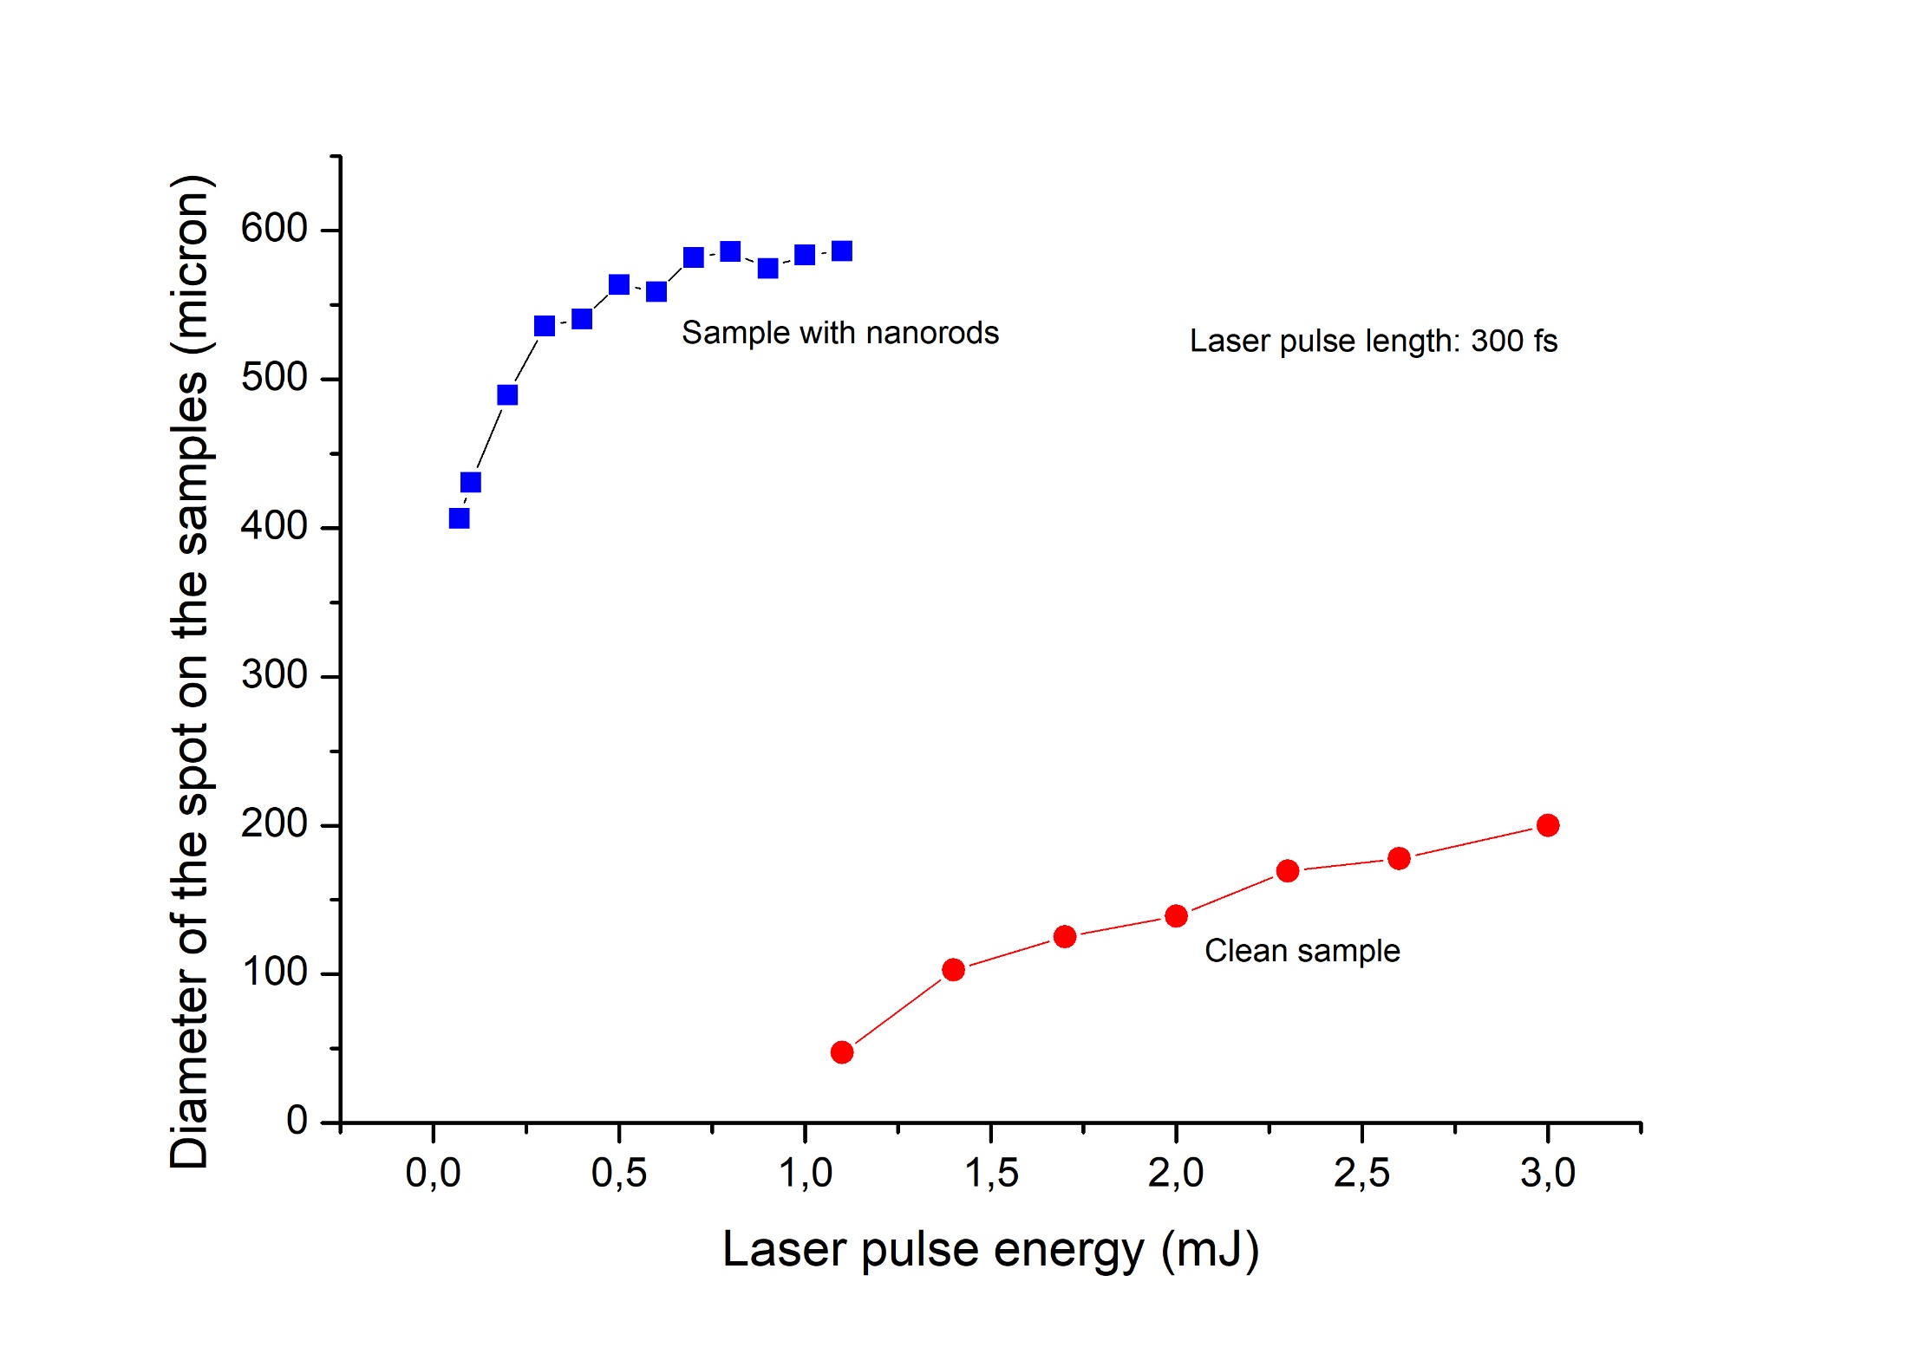

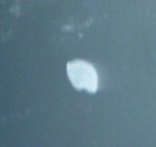

Laser pulse length: 300 fs
Ti:Sa laser: ʎ=800nm, ~1.55eV
Spot size nearly constant
30μ
40μ
~10¹⁴ W.cm ̄²
Giant plasmonic amplification; the laserlight reaches the nanoantennas;

Slide 14
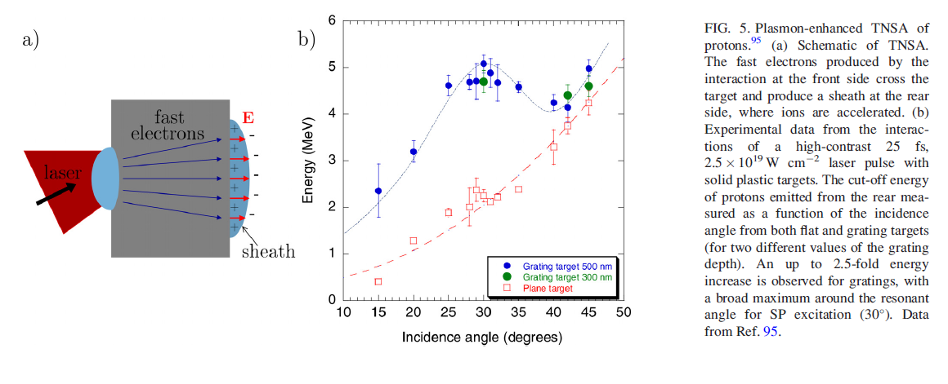
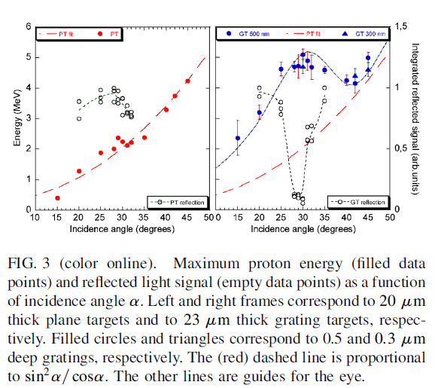
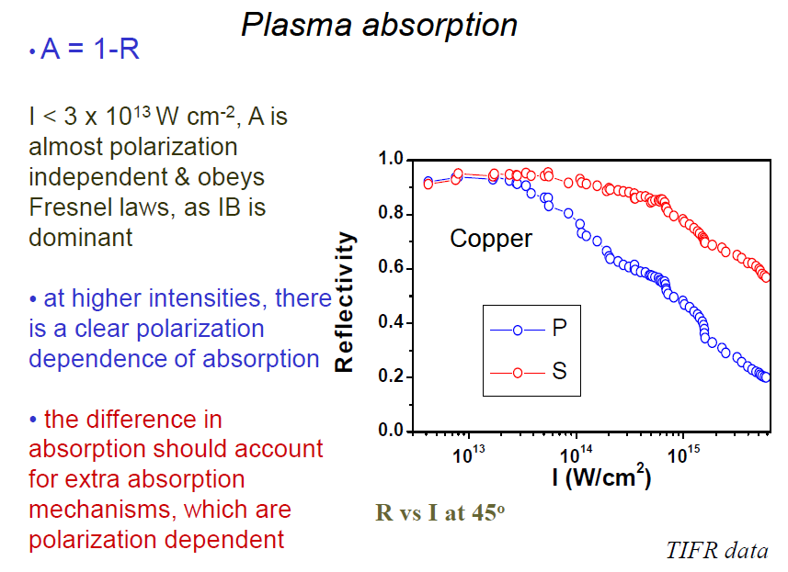
Checcotti

Slide 15
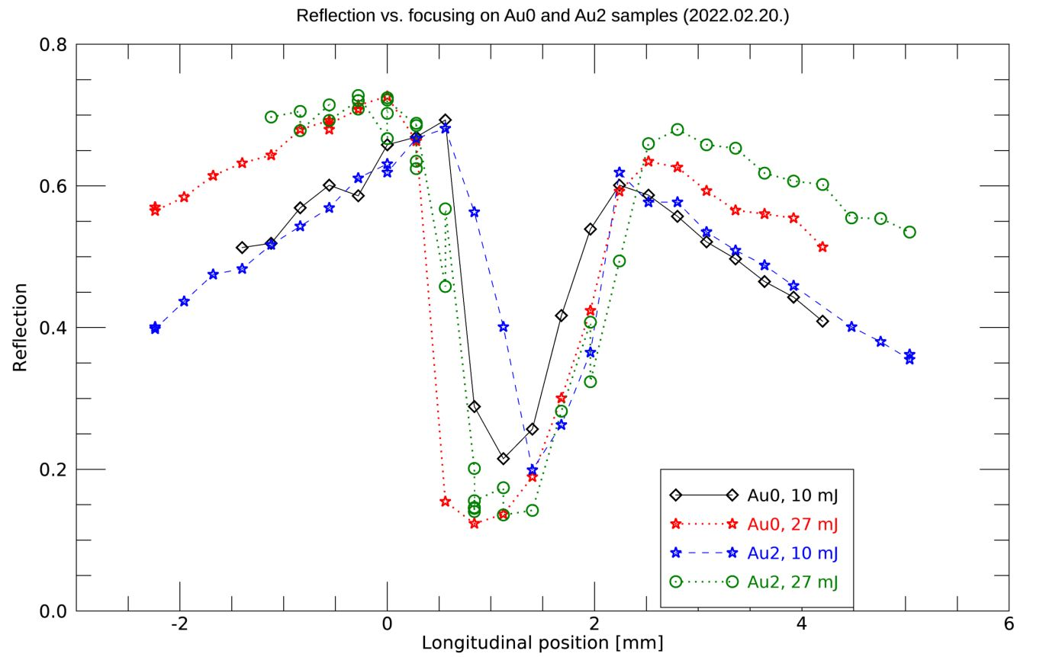
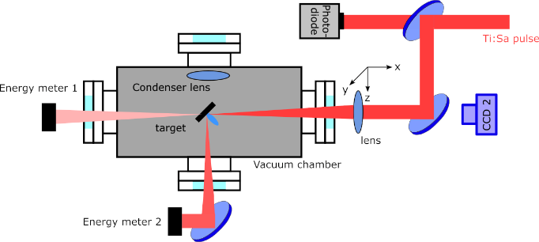
REFLECTIVITY OF A POLYMER FILM WITH AND WITHOUT RESONANT GOLD NANORODS
PLASMAMIRROR
PENETRATION
3.10¹⁷W/cm²

Slide 16
CRATER VOLUMES
3,2.10¹⁷W/cm²
2,2.10¹⁷W/cm²
1,2.10¹⁷W/cm²
HIGH FIELD PLASMONICS WORKS!
0,5.10¹⁷W/cm²

Slide 17
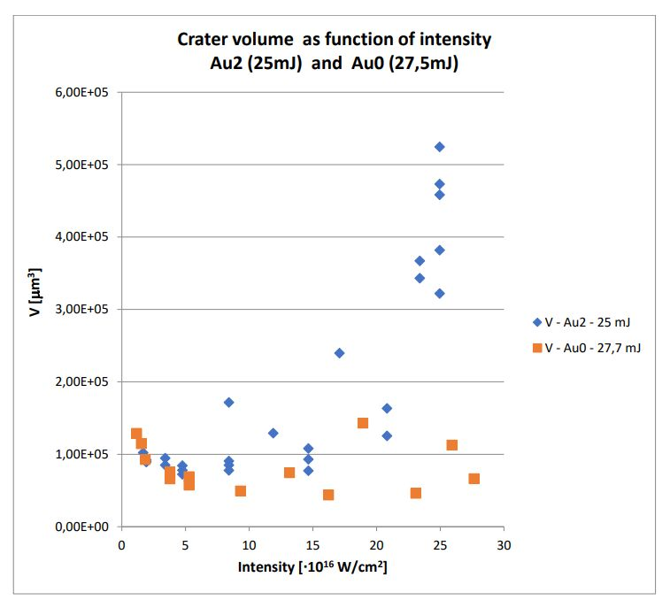
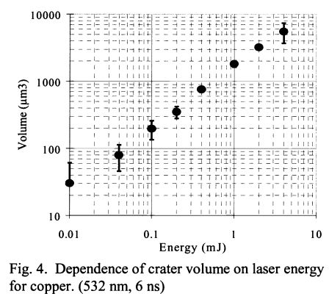
LINEAR

Slide 18
No1 appl.
Matter under extreme conditions
(extremely high intensities)
single
atom
I = 10¹⁶ W cm⁻²
E ~ 10⁹ V/cm
High intensity
Photoeletric Effect
+
Rapid ionization of valence electrons
Tunnelling
10¹⁴ - 10¹⁵ W cm⁻²
Over the barrier
> 10¹⁵ W cm⁻²
Each atom loses at least one electron. Some can lose as many as 6 !

Slide 19
MULTIPHOTON ELECTRON EMISSION FROM GOLD
Multiphoton tunneling
transition at
~4x10¹⁰ W/cm² incident
intensity,
~5.5x10⁸ V/m field
Keldysh-gamma γ=31
→ indication of well-known
field enhancement of surface
plasmonic fields
slope: 0.89 ± 0.03
Tunneling from ~4x10¹⁰ W/cm²
slope: 4.3 ± 0.4
PLASMONIC ENHANCEMENT!
W: work function, E_{l}: laser field strength

Slide 20
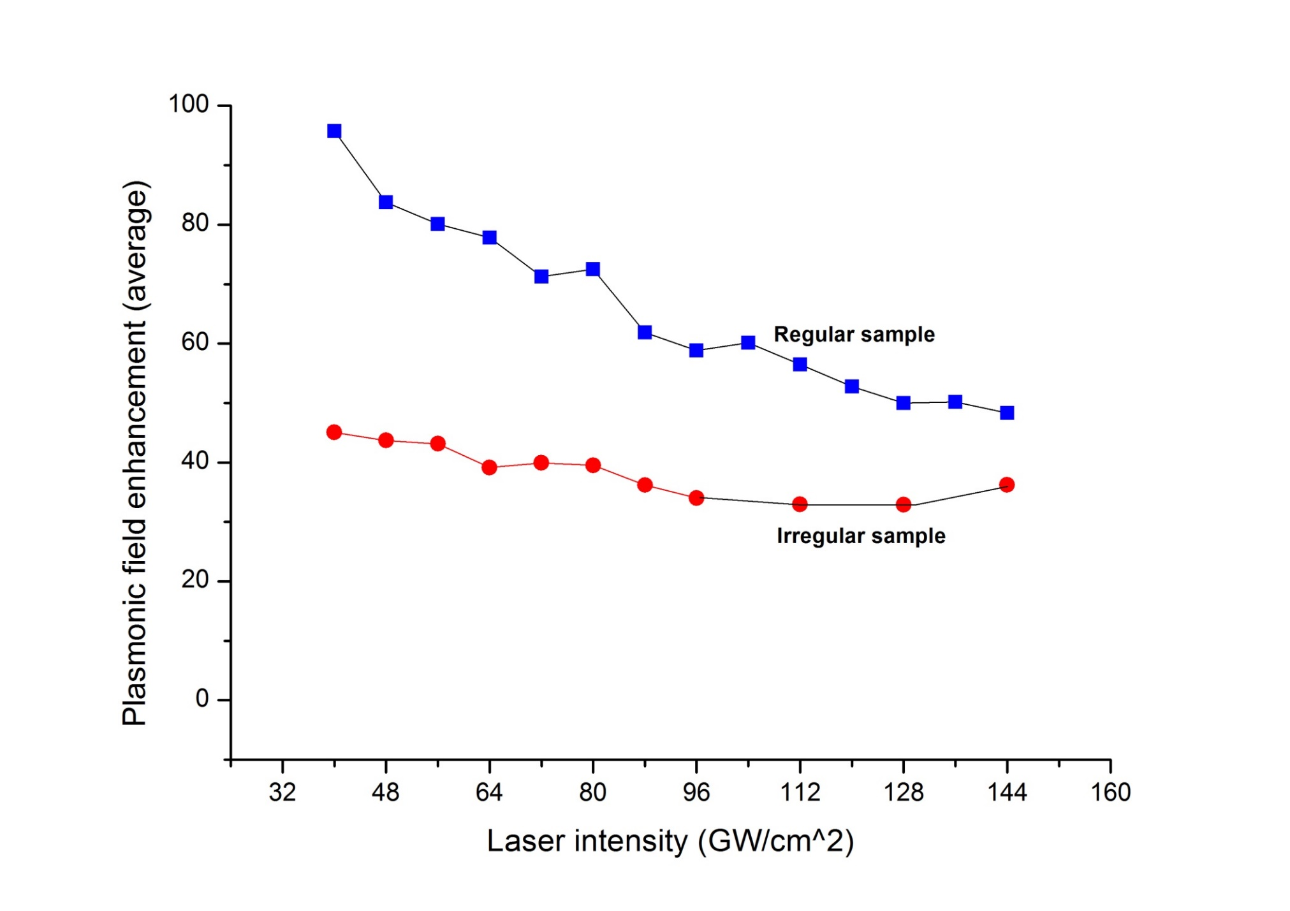
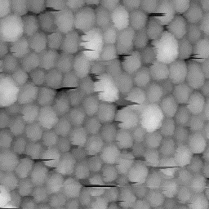
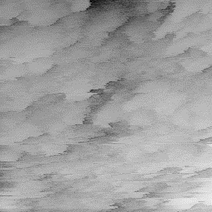
From multi plasmon electron emission
Kisérleti tapasztalat ~10¹² W/cm²-ig
Born-Openheimer?: >10¹⁵ W/cm²; Relativistic phenomena: >10¹⁸W/cm²
MAY PLASMONS EXIST IN THESE LASER INTENSITY REGION?

Slide 21
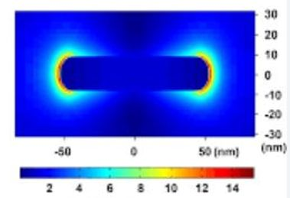
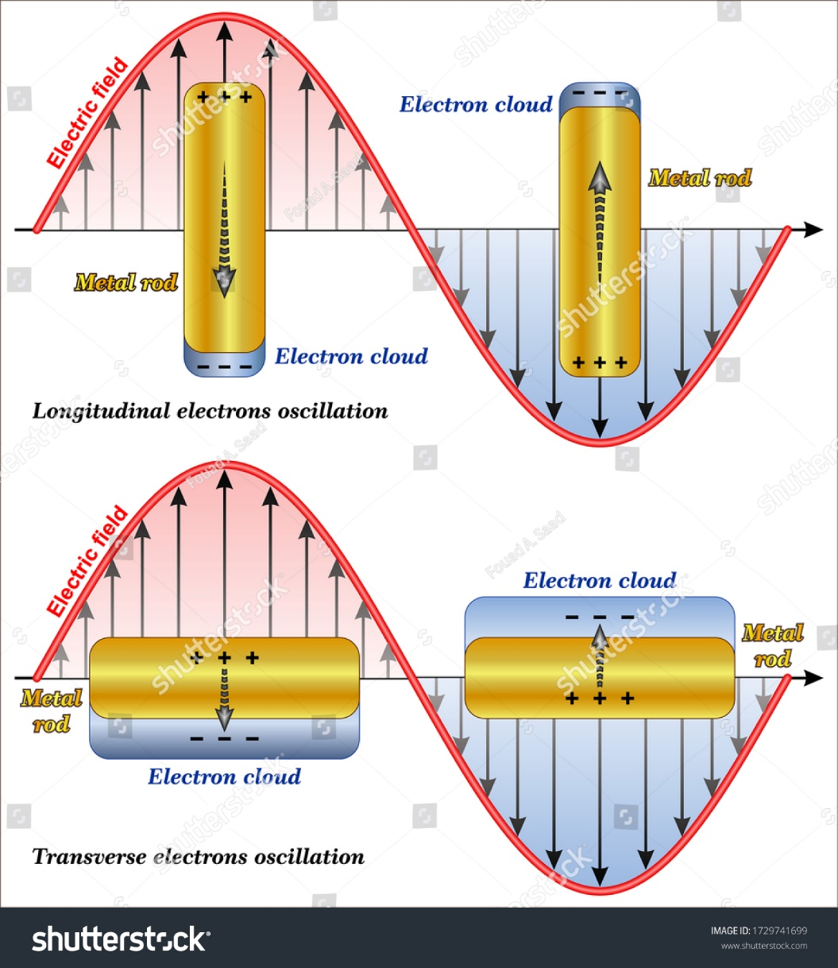
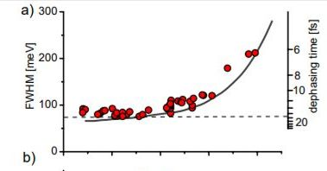
Transverse and longitudinal modes!

Slide 22
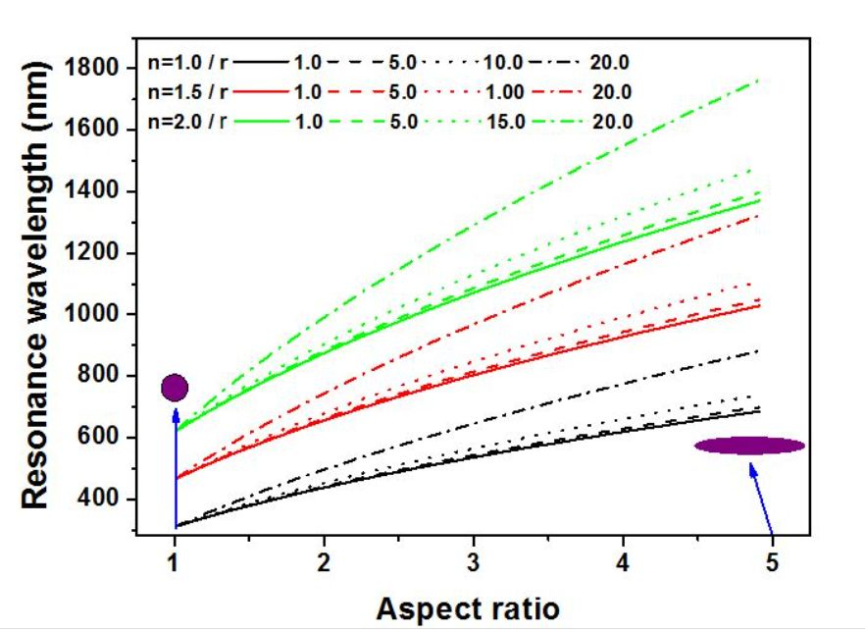
Ti:Sa laser

Slide 23
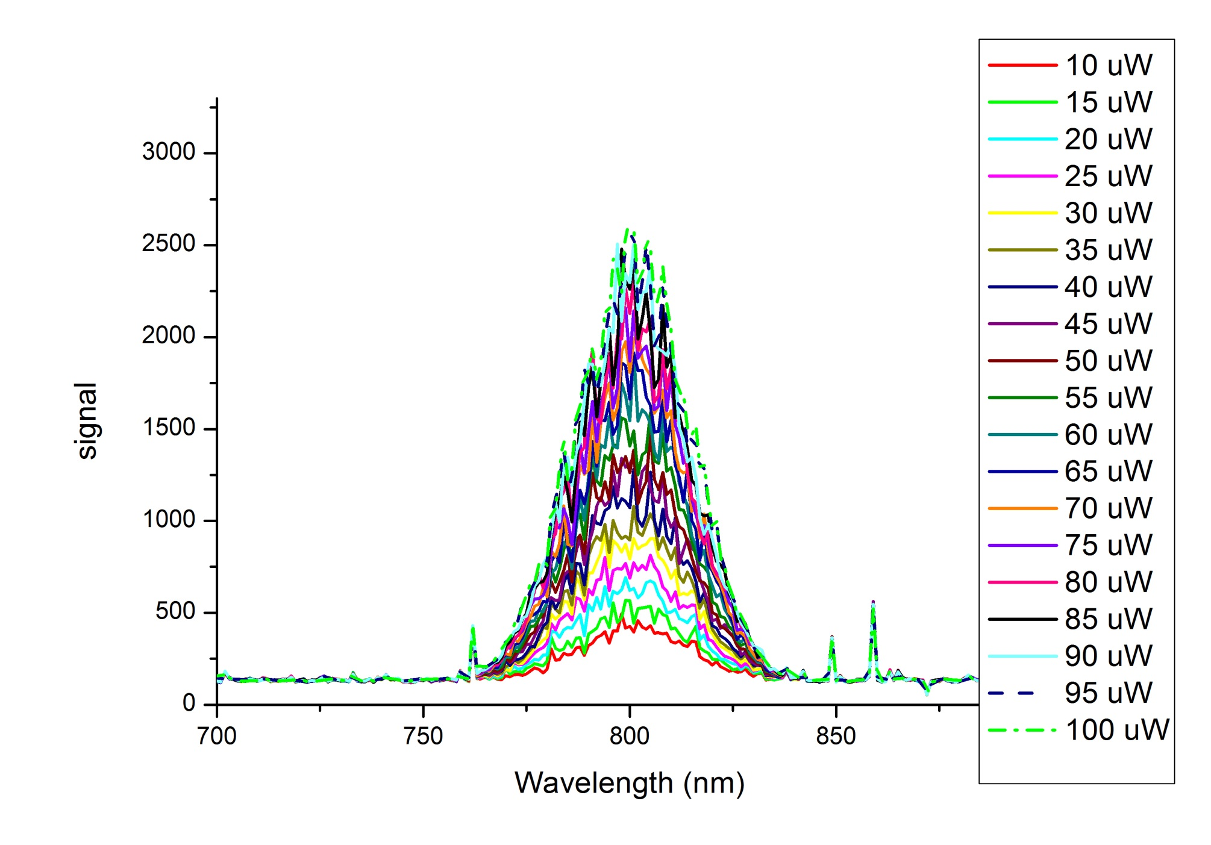
Ti:Sa LASER SPECTRA AT DIFFERENT PULSE ENERGIES

Slide 24
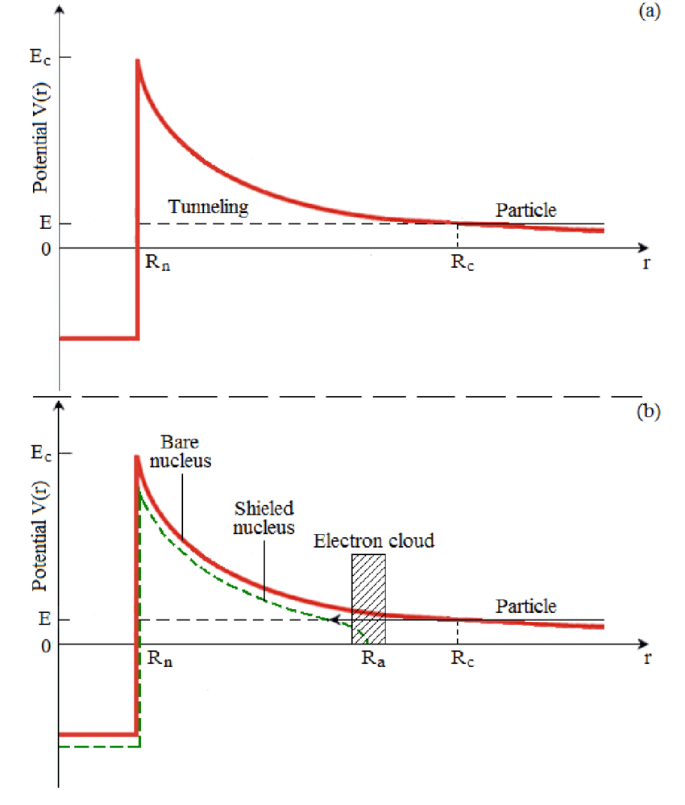
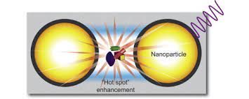
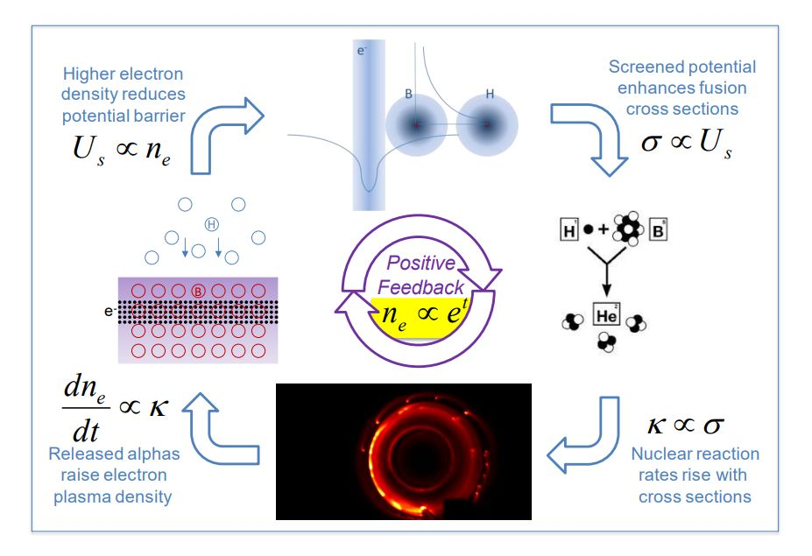
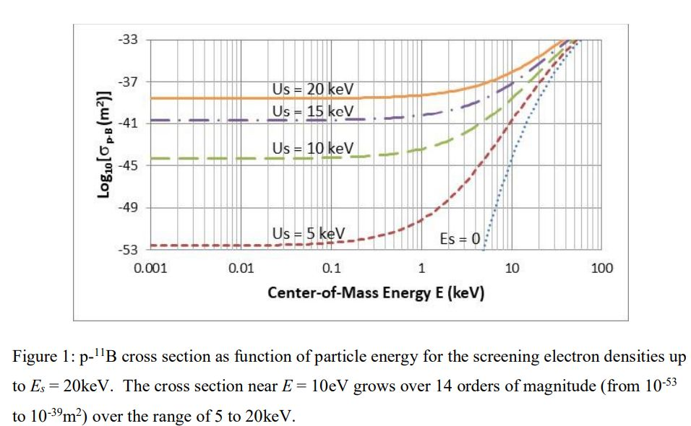
ILLUSTRATION OF THE RESULT OF THE SCREENING EFFECT
Ponderomotive screening Fᵨ = (e²/4mₑꙍ²).grad (E²)
Illustration with the H+B
3He reaction
A.Y.Wong and C-C.Shinh:UCLA 2019

Slide 25
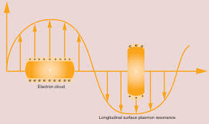
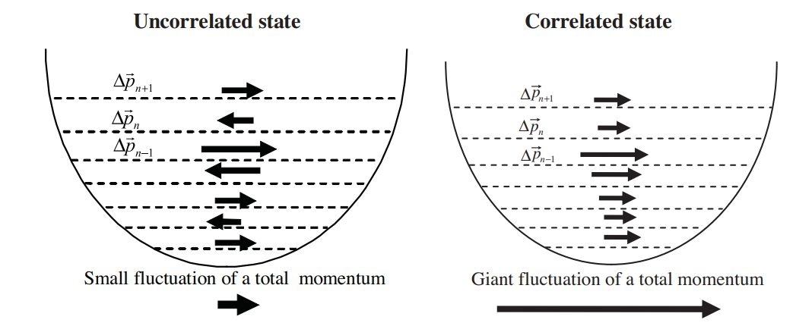
Demonstration of the correlated state

Slide 26
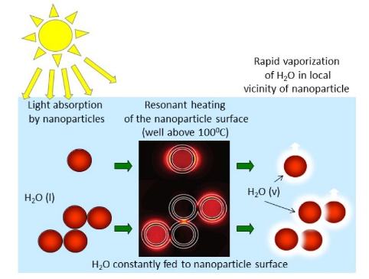
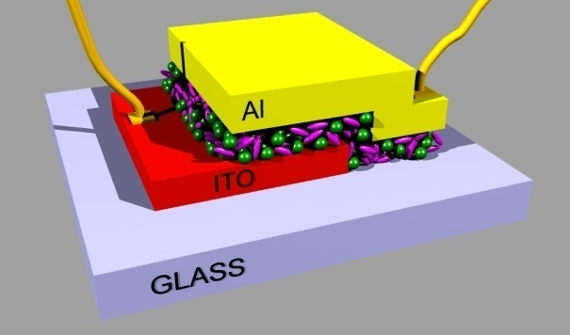
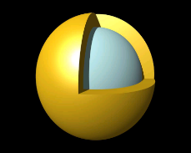
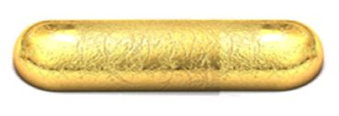
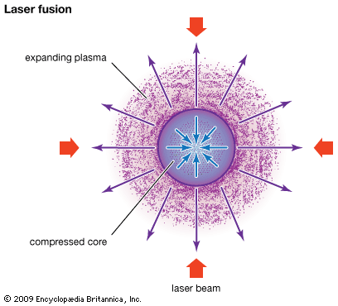
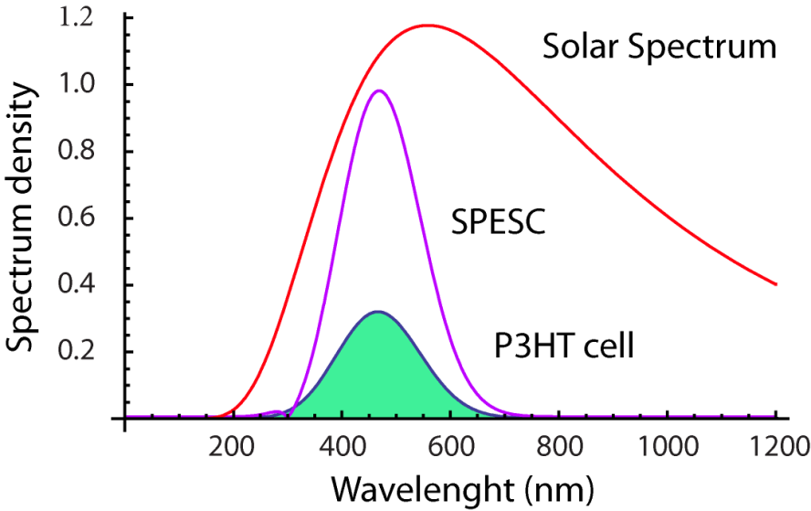
Some potential new energy technologies
(involving nanotechnologies)
P3HT Cell efficiency = 6%
SPESC (P3HT) efficiency = 17.5%
?
Toward our proposal

Slide 27
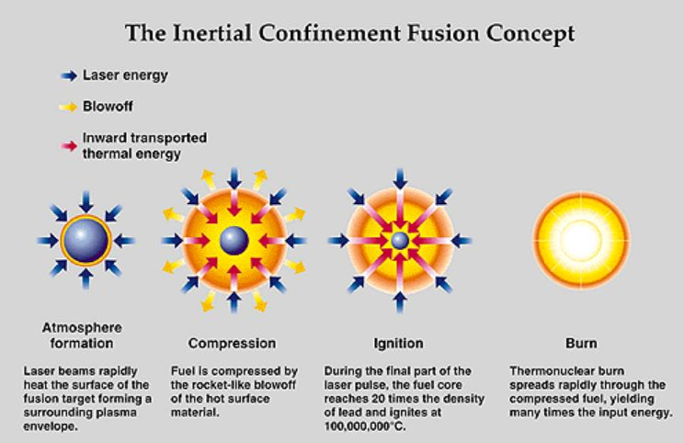


No2 application (LSPP)
The most succesful technologies imitate nature
E = mc²
Laserbeams

Slide 28





10⁵USD
1sho
Long laser pulses (~50ns)
Raileigh-Taylor instability
Complicated target construction
Enormous laser energy (400/1.8MJ)
TO COMBINE 2 DIFFERENT (e.g. fusion and nano-) TECHNOLOGIES TO REACH FUSION AT THESE ULTRAHIGH EM FIELDS?

Slide 29
OUR PROPOSAL: COMBINE PLASMONICS WITH NUCLEAR FUSION TECHNOLOGY
SOME POTENTIAL EXPLOITABLE HIGH FIELD PLASMONIC PROCESSES:
1.Go for localized surface plasmon polaritons (LSPP)
2.Lifetime of LSPP-s is in the few ten femtosecond timerange. We may get high
intensity laser pulses in this timediapazon and the plasma instabilities disappear.
3.High electron densities and EM fields can be obtained in small (nanosized) volumes on
resonant plasmonic nanoparticles (hot spots).
4.The near field of plasmons screen the repulsive field of positively charged (e.g. protons)
particles and they may fuse more easily.
5.The large number of conduction electrons move in plasmonic excitations in correlated
way and their momentum may be transfered in high exciting fields to positive particles
moving together with them, further increasing the probability of nuclear fusion.
6.With these short pulses we do not need many beams, like in the NIF, the target can be a
thin film, illuminated only by 2 beams from opposite directions, reaching the same
energy density in the whole thicknes of the target sample, and this may lead to
timelike fusion.

Slide 30

OUR GOAL IS:
To explore these properties of LSPP-s with the intention to
-drive for nanoplasmonic aneutronic fusion reactions,
-and this way scale down the size and costs of laser based nuclear fusion
facilities;
-find solutions at lower optimal laser intensities;
When the winds of changes are blowing some build shelters, but some others build wind turbines

Slide 31




Resonant
ʎ = 800nm
NANOSHELLS
(nx10nm)
NANOROD (~85x25nm)
d ~ n.10μ
n.10μ
FEMTOSECOND LASER PULSES
HIGH REPETITION FREQUENCY
LIGHT SPEED: NO TIME FOR INSTABILITIES,ONLY TWO BEAMS,
VOLUME IGNITION
NANOPARTICLES IN THE FUSION MATERIAL
Here only indications. Details in other talks, both in theory and experiments.

Slide 32


Two-sided irradiation

Slide 33


1. DIAGNOZIS (crater volume)
Volume max. 3.5V₀
Volume:V₀
40μ
Laser shots from one side of a thick (~160μ) foil

Slide 34


Slide 35



SEM IMAGE OF UDMA WITH AU NANORODS SEM IMAGE OF UDMA WITHOUT AU NANORODS
and Zygo images of the same craters
b
a
Images at 17.5mJ laser energy, 1,16.10¹⁷ W/cm² laser intensity.The volume of the crater of the sample with nanorods (b) is 1.98 times that of the sample without rods (a).

Slide 36



Au1
Au2
AuX

Slide 37
3,2.10¹⁷W/cm²
2,2.10¹⁷W/cm²
1,2.10¹⁷W/cm²
0,5.10¹⁷W/cm²

Slide 38


2.Diagnozis :Raman scattering from the crater surface
arXiv2210.00619(2022),submitted to Advanced Optical Materials
Ilaser > 10¹⁶ W/cm²
a
Au2
Au1
b
Au0

Slide 39




IN WORK BUT NOT YET CONCLUDING TECHNIQUES:
1.Atomic optical spectroscopy,
2. Mass spectrometry.
3.Nuclear detection techniques.
1
3: CR39 film, 1 laser shot
2

Slide 40


THE ADVICE OF ALBERT EINSTEIN FOR THE FUTURE:
THE PROBLEMS WE ARE FACING TODAY CAN NOT BE SOLVED WITH THE SAME WAY OF THINKING BY WHICH WE CREATED THEM.
THIS IS WHY CREATIVE SCIENTIFIC THINKING IS THE KEY TO OUR FUTURE
THANKS FOR YOUR ATTENTION

