Slide 1
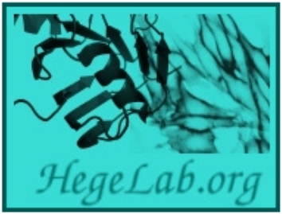
Exploring the complex structures of the
disordered region of CFTR using AlphaFold
Erzsébet Suhajda, Tamás Hegedűs
Dept. Biophysics and Radiation Biology, Semmelweis University
Fac. of Electrical Engineering and Informatics, Budapest Technical University

Slide 2
Cystic fibrosis
Most common hereditary genetic disease in Caucasians
Malfunction of an ion transporter in the cell membrane
Short life expectancy and frequent medical complications
Most common mutation: ΔF508 – therapy available
Numerous rare mutations – impossible to develop individual therapies for all
General molecular approach

Slide 3
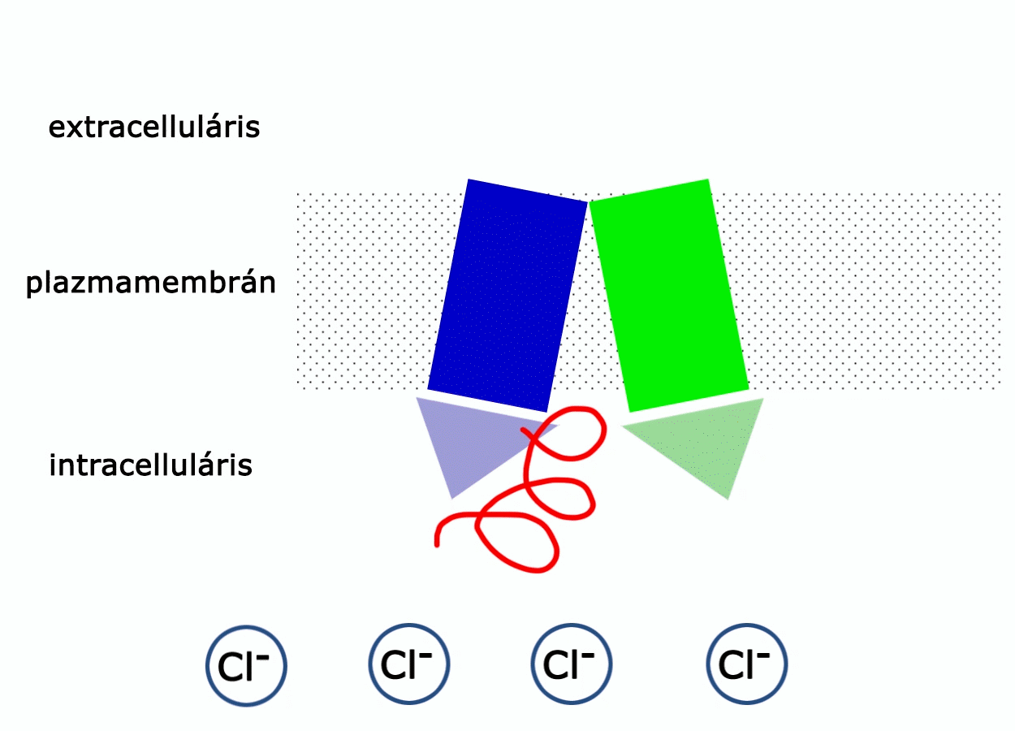
CFTR protein, the molecular protagonist of CF
extracellular
intracellular
PDB ID: 5UAK
TMD1
NBD1
R domain
TMD2
NDB2
Liu et al., Molecular Structure of the Human CFTR Ion Channel, Cell, 2017, https://doi.org/10.1016/j.cell.2017.02.024
Notes:
Olyan komplex kiválasztása, amelynek a rendezett részét áttervezve olyan minipeptidet kapunk, ami az R-doménhez köt és olyan pozícióban fixálja, amely lehetővé teszi a csatorna aktivitását - hiperaktiváció

Slide 4
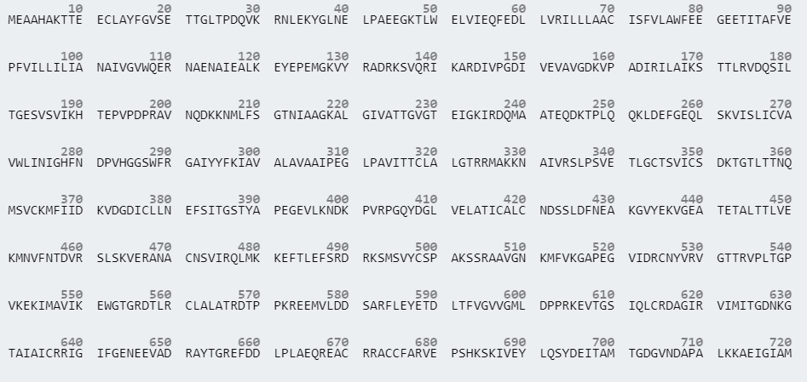
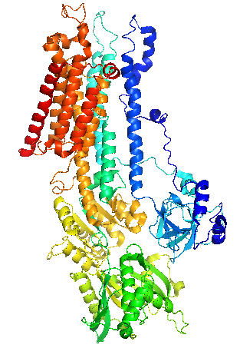
Structure prediction from sequence
Sequence
Structure
Function

Slide 5
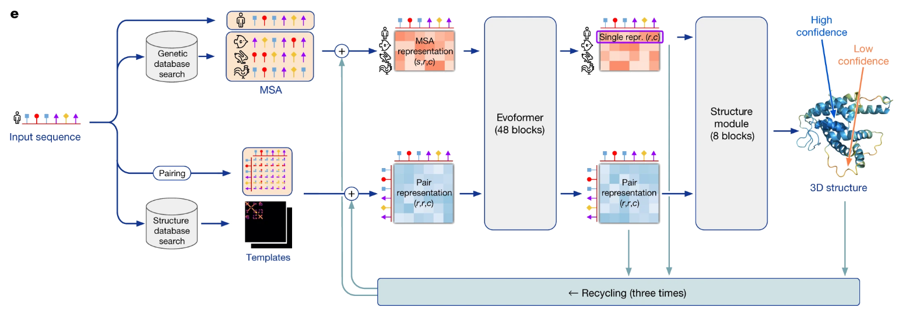
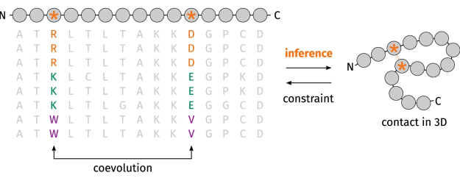
AlphaFold2
machine learning, deep learning, AI
Jumper, Evans,, Pritzel, et al. Highly accurate protein structure prediction with AlphaFold. Nature 596, 583–589 (2021).
https://doi.org/10.1038/s41586-021-03819-2

Slide 6
AlphaFold Multimer
tailored to protein complex structures
Input
amino acid sequence
Output
x*5 structures
Modified model confidence score to include information from interfaces
0.8* ipTM + 0.2 * pTM
Evans et al. Protein complex prediction with AlphaFold-Multimer https://www.biorxiv.org/content/10.1101/2021.10.04.463034v2
Notes:
AlphaFold2 – Deepmind fejlesztette, rendelkezésre álló kísérletes szerkezeteken lett betanítva, majd olyan szerkezeteken letesztelve amiket nem látott az algoritmus: kísérletes pontosságot megközelítő eredmények
AlphaFold Multimer – fehérjekomplexek szerkezetének predikciója
pTM: predicted template modeling score
ipTM: interface predicted template modeling score
DIBS – rendezett + rendezetlen fehérjeláncok, egymással komplexet alkotnak
Templát keresése R-domén minipeptid újratervezéséhez

Slide 7
Objectives
Complex structures predicted between NBD1 and R domain peptides (11 a.a. length)
S737
S753
S786
S795
Explore complex structures of human ABC dimers
Collect, categorize and publish available ABC protein structures

Slide 8
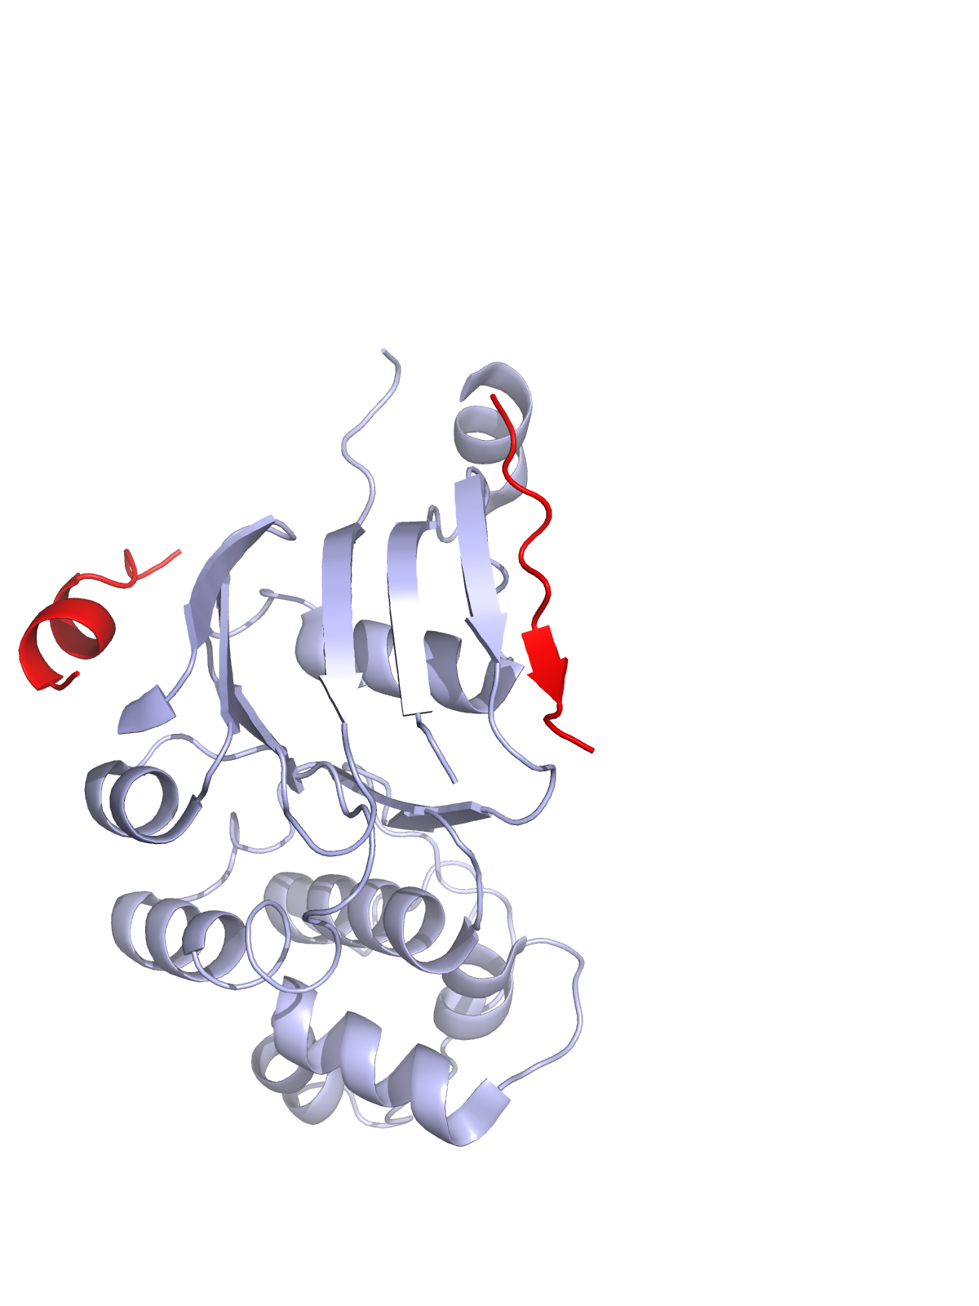
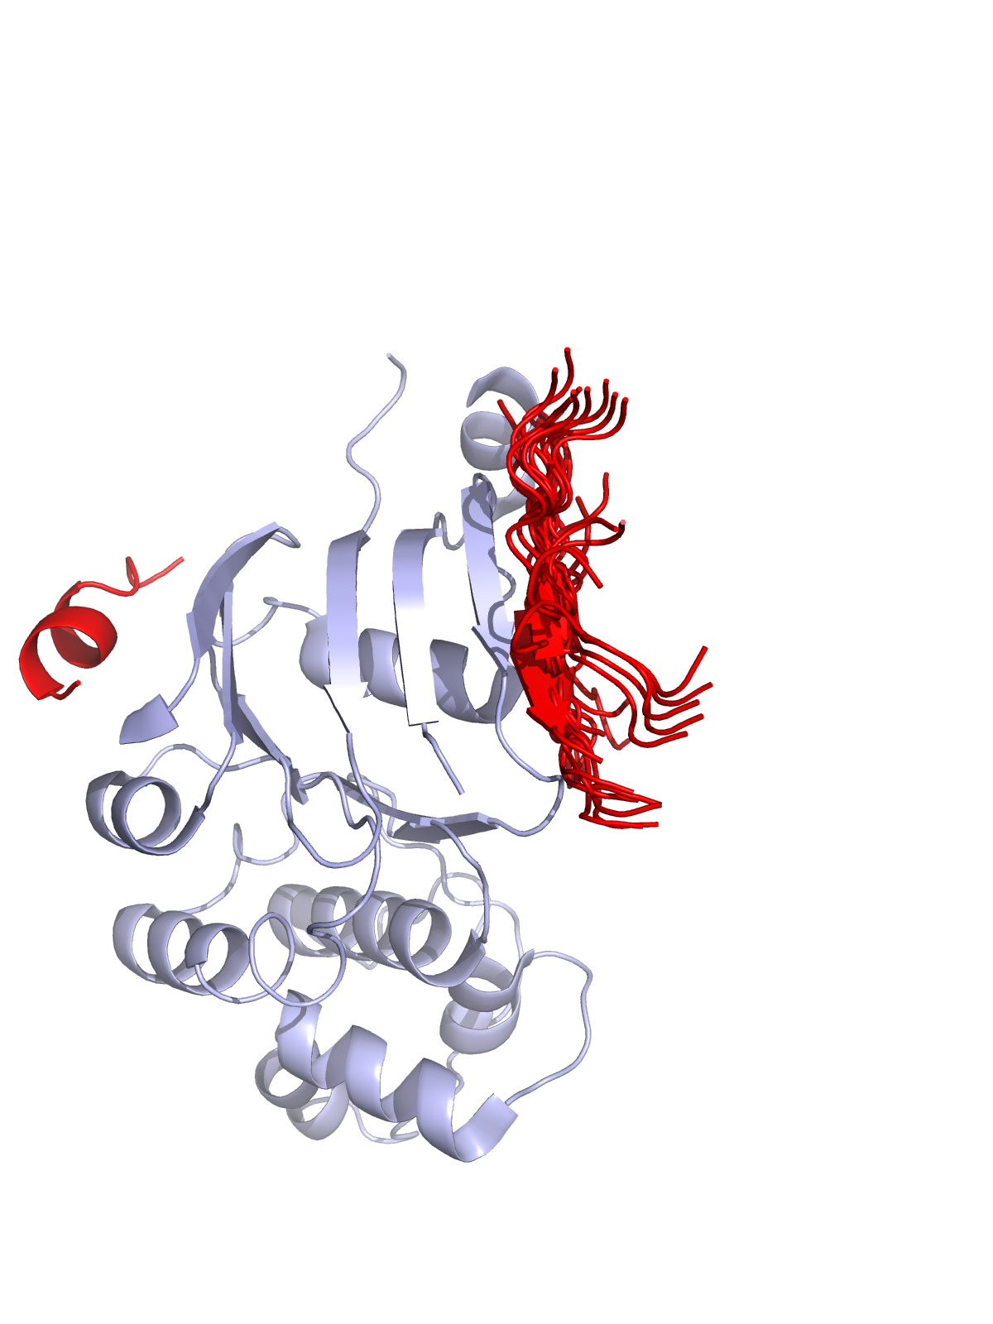
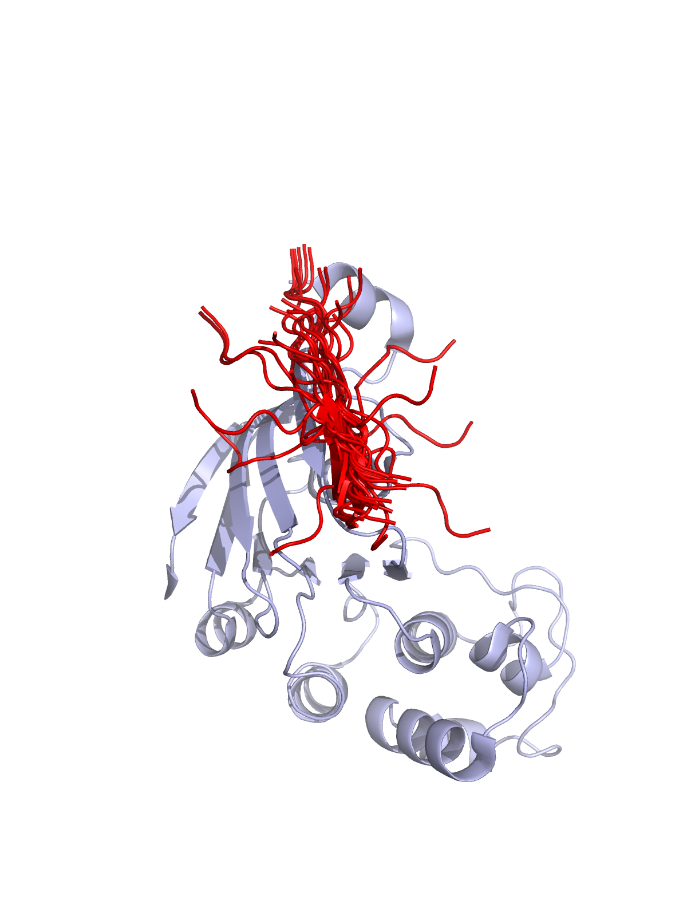
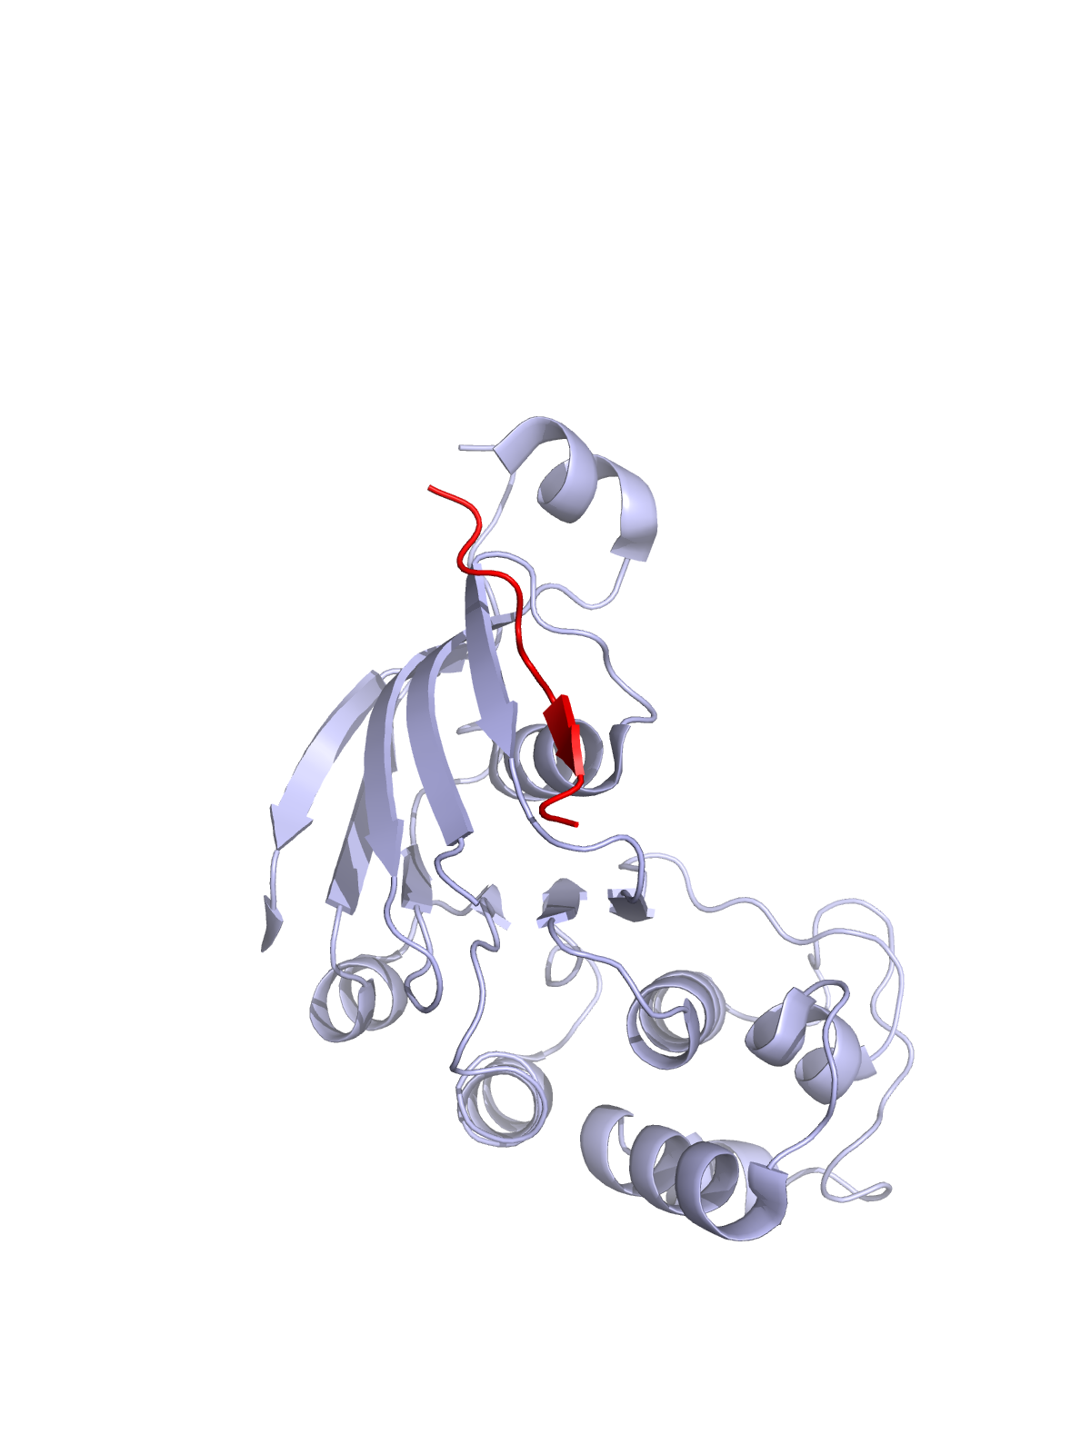
S737 and S795 peptides mostly show unstructured form
S795
Flexible structure and occasional β-barrel
Best confidence score 0.45
S737
1 model with a confidence score higher than 0.5
α-helical properties
NBD1
S737
S795
S795
Notes:
Nbd1-et odaírni

Slide 9
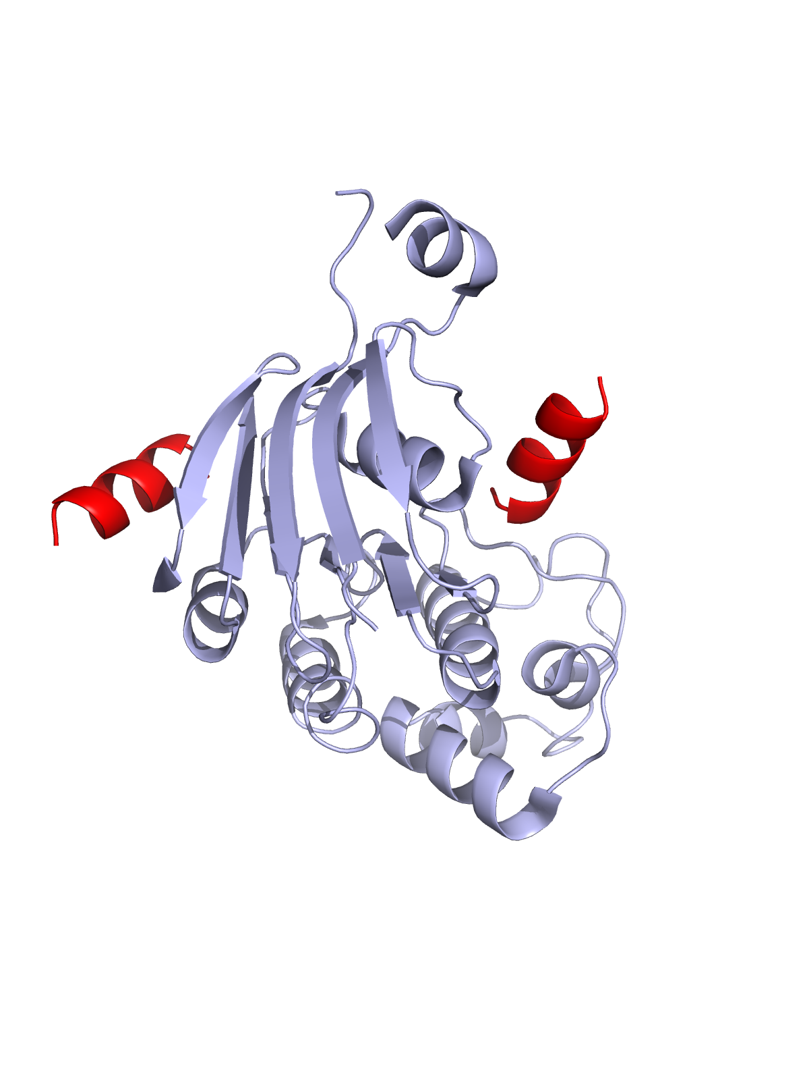
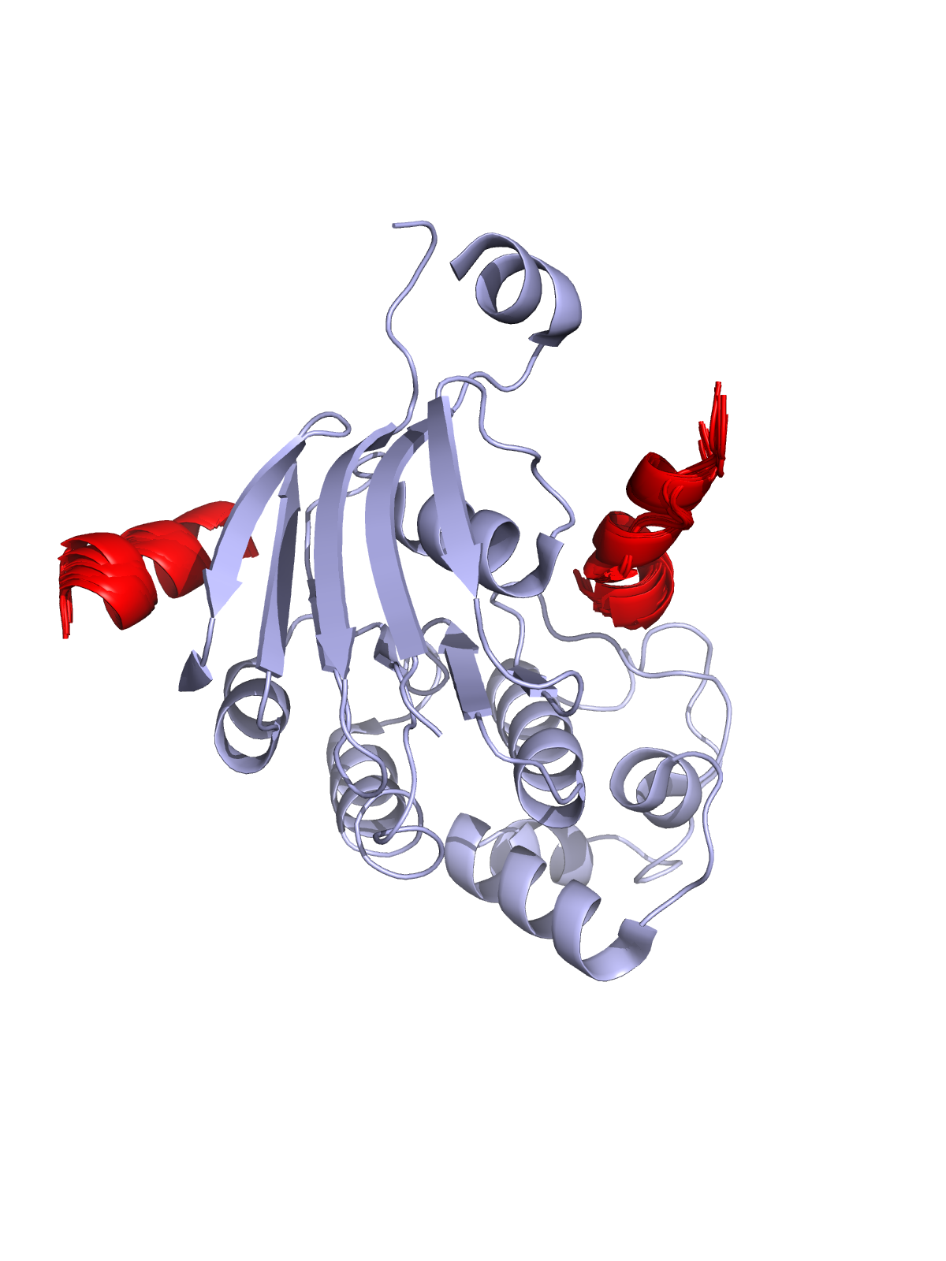
S768 peptide shows 2 characteristic binding sites
and α-helical secondary structure
NBD1
More than half of the models show high confidence (13/25 structures > 0.5)
α-helical and flexible structures
Notes:
5*5 db szerkezet
pTM+ipTM értékek alapján – láncon belüli és láncok közötti pontosságot is vizsgálja
0,5 feletti értékeknél megbízható szerkezeteket épít
S737
S768-ról több szerkezetet (min. 2)
S795-ról

Slide 10
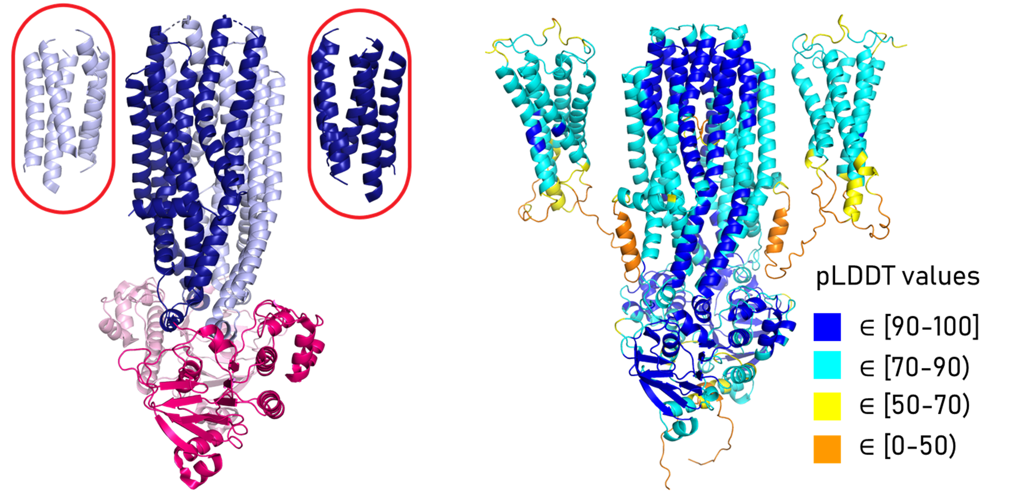
abc3d
Prediction of human ABC dimer structures
with AlphaFold
PDB ID: 7D7N

Slide 11
3dbeacon.hegelab.org

Slide 12
3D-Beacon network
central
databases
servers
users
json
3D-Beacon
Registry & Hub
@EBI
PDBe-KB
UniProt
InterPro
e!Ensembl
mmCIF
browser
download
analysis
visualization
coordinates
xdata
json
3D-Beacon
Client
http://3dbeacon.hegelab.org
html (model_page_url)
mmCIF, pdb, xdata

Slide 13
Structural ABC protein families

Slide 14
abc3d.hegelab.org

Slide 15
Summary
AF greatly covers the structural space of proteins supplementing experimental findings
3dbeacon.hegelab.org
abc3d.hegelab.org
Please also find our publications:
Tordai, Suhajda et al. Comprehensive Collection and Prediction of ABC Transmembrane Protein Structures in the AI Era of Structural Biology. Int. J. Mol. Sci. 2022, 23, 8877. https://doi.org/10.3390/ijms23168877
Varadi et al. 3D-Beacons: Decreasing the gap between protein sequences and structures through a federated network of protein structure data resources, GigaScience, Volume 11, 2022 https://doi.org/10.1093/gigascience/giac118

Slide 16
Acknowledgements
Tamás Hegedűs
Hedvig Tordai
Mihály Váradi
Nair Sreenath
Sameer Velankar
Ian Sillitoe
CFF HEGEDU20I0
NKFI-127961
NKFI-137610
MTA Wigner GPU Laboratory
NIIF/KIFÜ HPC
ÚNKP-22-2-III-BME-239
Animation: Eszter Kajlik

