Slide 1
Parallel EEG processing on GPULab, a GPU-enabled container-based distributed system in the SLICES EU research infrastructure
May 2023
Zeyu Wang, Iffah Syafiqah binti Suhaili, Zoltan Juhasz
University of Pannonia
Veszprem, Hungary
Notes:
Parallel Implementation of Multivariate Empirical Mode Decomposition on GPU

Slide 2
Content outline
1. Background
1.1 About the GPULab
1.2 About EEG processing
1.3 HPC requirements for EEG processing
2. The usage of GPULab
2.1 Hardware infrastructure
2.2 Access modes
2.3 Our workflow on GPULab
3. Multi-GPU access test
3.1 Unified Memory
3.2 Unified Virtual Address
3.3 Peer-to-peer access
4. Future works
Notes:
nvShmem

Slide 3
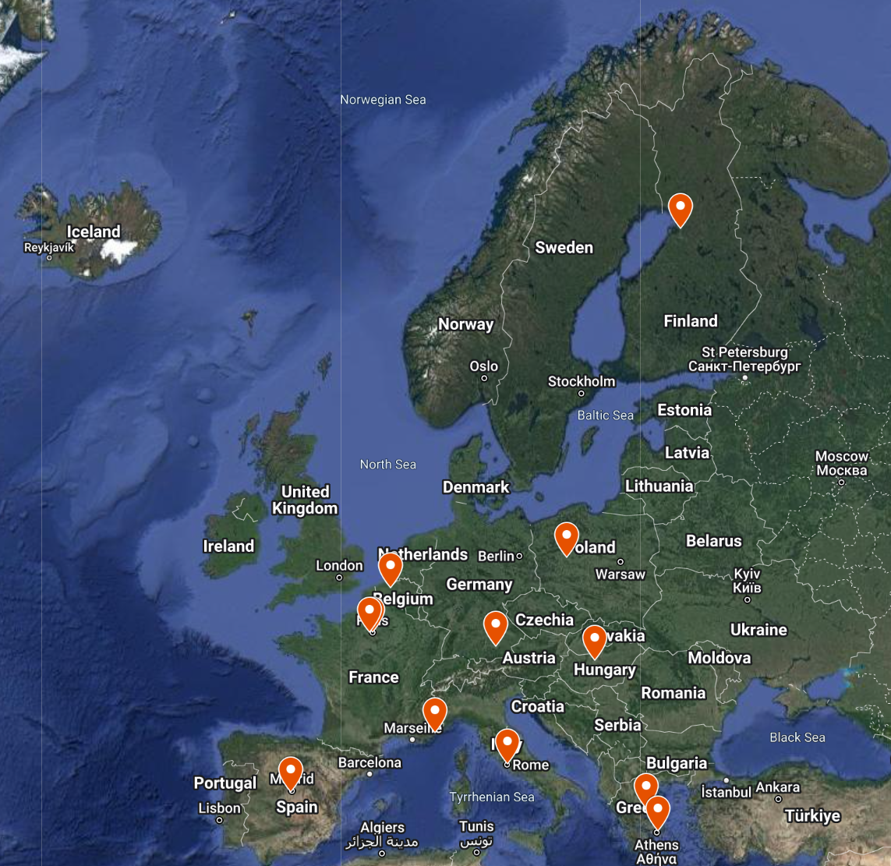
1.1 About the SLICES
Scientific Large-scale Infrastructure for Computing/Communication Experimental Studies (SLICES)
SLICES-RI (Research Infrastructure)
SLICES-DS (Design Study)
SLICES-SC (Starting Community)
SLICES-PP (Preparatory Phase)
SLICES-SC (Starting Community)
1. Consiglio Nazionale Delle Ricerche (IT)
2. SZTAKI (HU)
3. Imec (BE)
4. University of Thessaly (GR)
5. Sorbonne Universite (FR)
6. French Institute for Research in Computer Science (FR)
7. Eurecom (FR)
8. University of Oulu (FI)
9. Poznan Supercomputing and Networking Center (PL)
10. IMDEA Networks Institute (ES)
11. Cosmote (GR)
12. Technische Universitat Munchen (DE)
Notes:
Interuniversitair Micro-Electronica Centrum

Slide 4
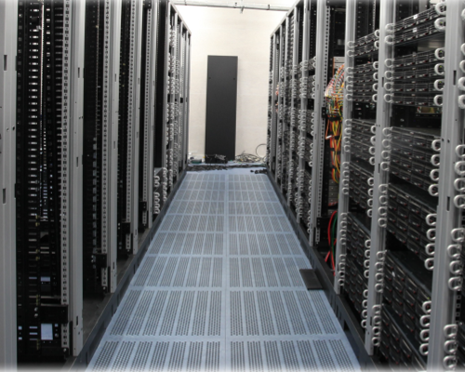
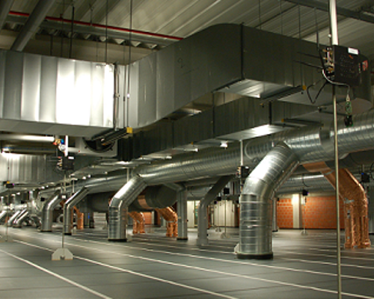
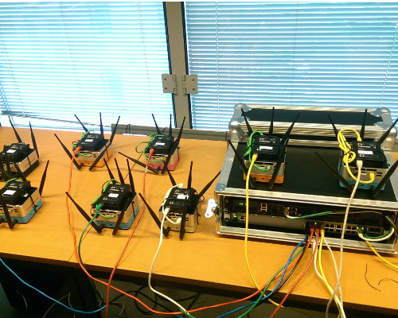
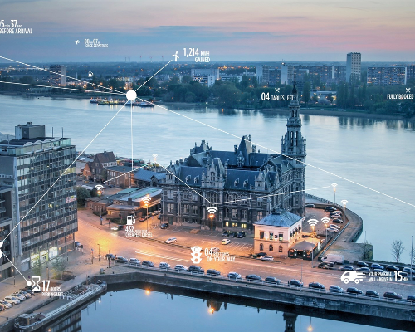
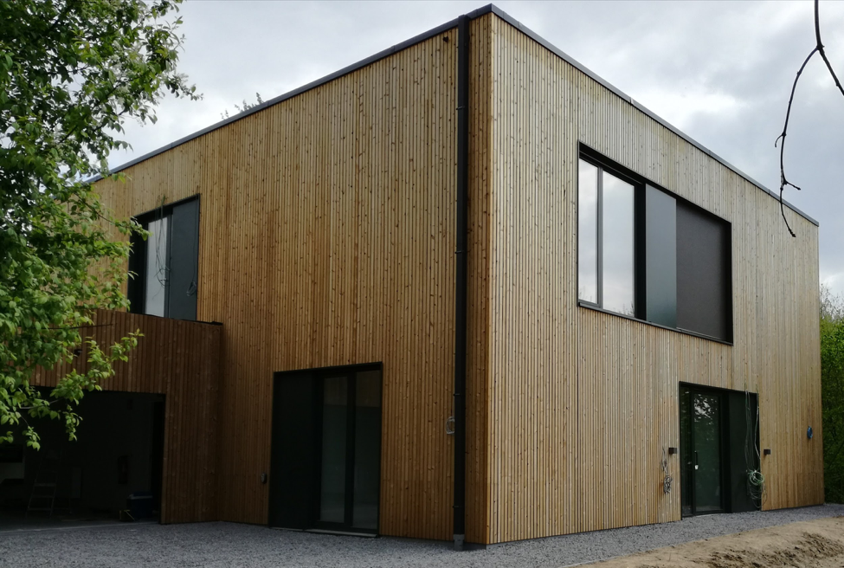
imec iLab.t testbed
Virtual Wall
W-iLab.t testbeds
GPULab
Perform large networking and cloud experiments
Wireless Testbed and Officelab
Batch system for GPU-enabled docker containers
Portable testbed
CityLab testbed
HomeLab
A testbed which can be deployed in the wild
City of Things smart cities FIRE testbed
HomeLab test environment

Slide 5
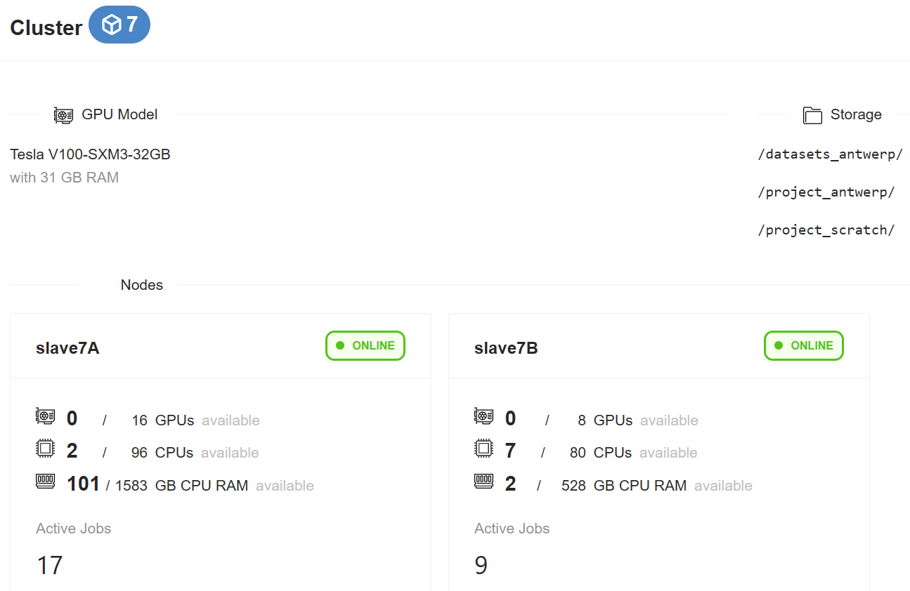
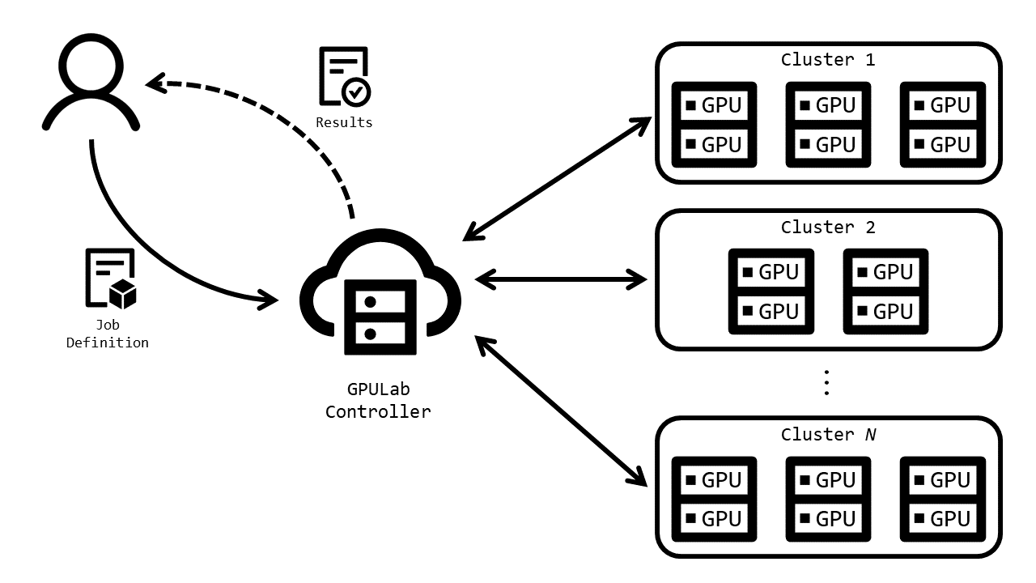
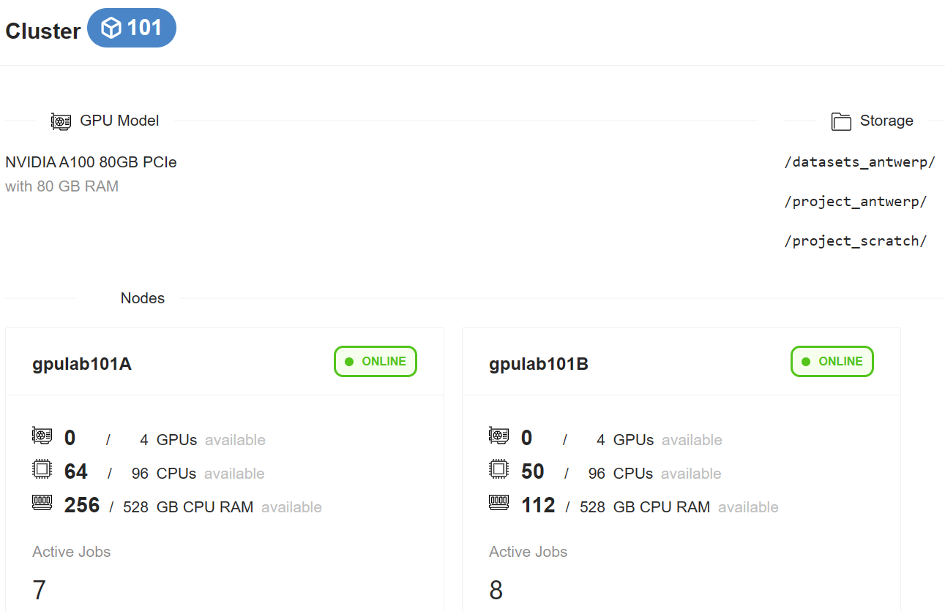
GPULab architecture
GPULab is a distributed system for running jobs in GPU-enabled Docker-containers.
Notes:
GPULab consists out of a set of clusters, each with their own characteristics (GPU model, CPU speed, memory, bus speed, …), allowing users to select the most appropriate hardware.
Each job runs isolated within a Docker containers with dedicated CPUs, GPUs and memory for maximum performance.
The cluster 7 and cluster 101, V-100 DGX system
A-100

Slide 6
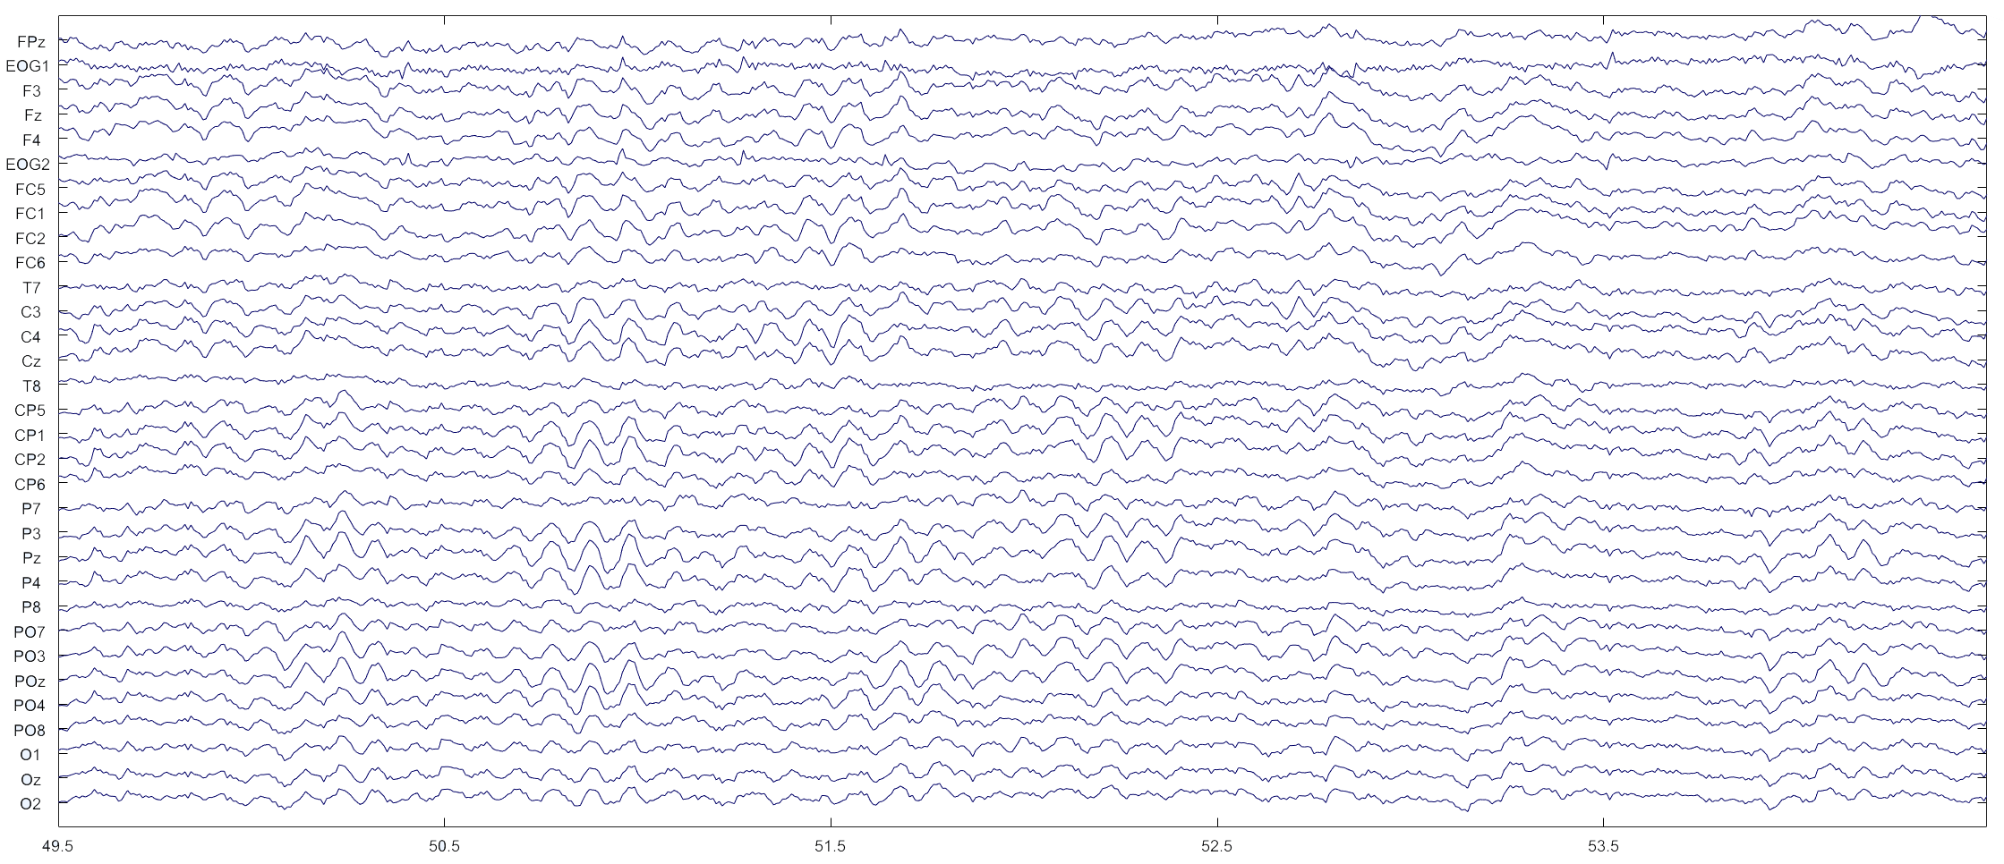
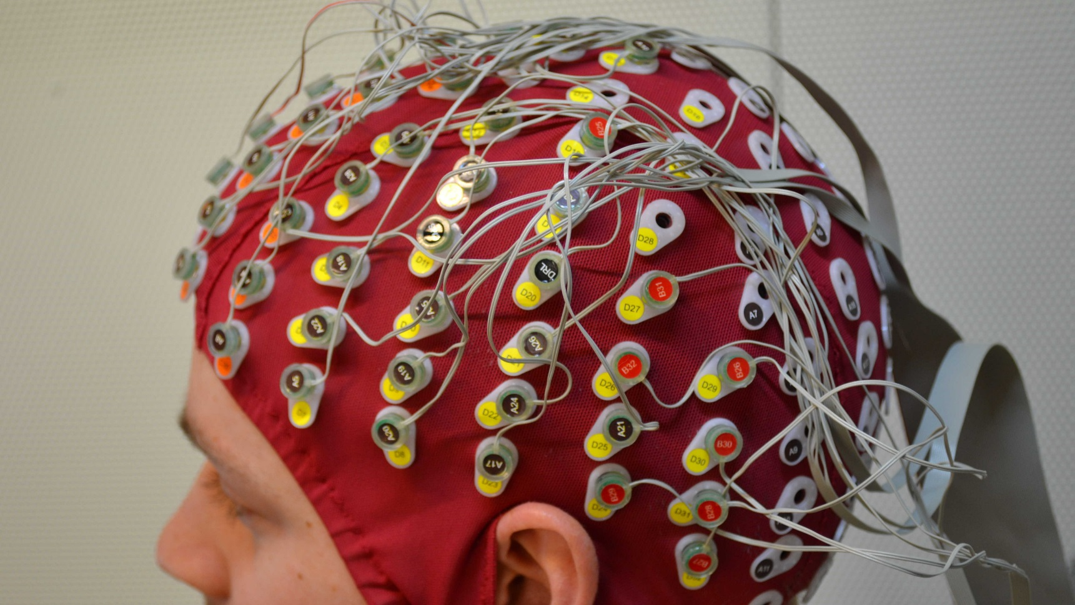
1.2 About EEG processing
The brain is the most complex system known to human
EEG contains physiological and pathological information of brain activity.
Channel
Time
Time-frequency analysis
Connectivity analysis
Source localization analysis
Signal decomposition analysis
Resting state and task-related analysis
……
Notes:
Extract useful information to understand how our brain work and treat the patients

Slide 7
1.3 HPC requirements for EEG processing
High computational workload factors:
Compromise solutions:
High temporal resolution
1024Hz, 2048Hz
High electrode density
128, 256 channels
Long record
Minutes to half hour
Large number of subject
Start from 20 subjects usually
MATLAB based processing script
Low execution efficiency
Complex processing algorithms
ICA EMD
Down sampling
1024Hz, 2048Hz → 256Hz, 128Hz
Reduce spatial resolution
128, 256 → 32, 16 channels
Segmentation
Minutes → epoch in seconds
Limited number of subjects
20 → less than 10
C based processing program
Low → high efficiency
Algorithm optimization
Time/space complexity: high → low
Notes:
The disadvantages of the compromise solutions
The penalization is the ideal solution for acceleration.
How we use GPU to accelerate EEG processing?
It is a good way to improve the execution efficiency, but it’s far away enough.
The optimization direction should be set to the parallelization.

Slide 8
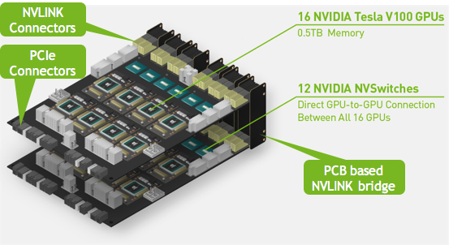
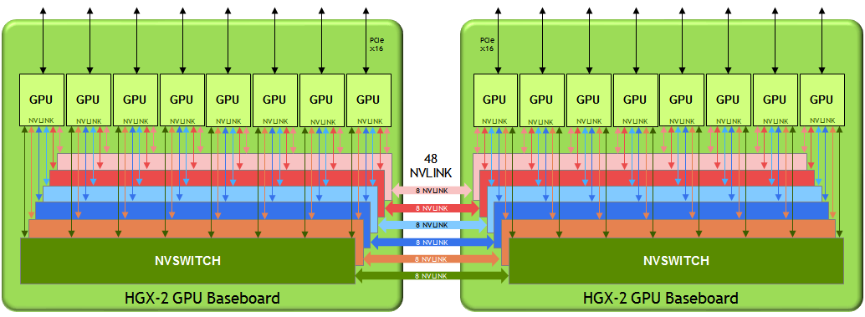
2.1 Hardware infrastructure of GPULab
Several GPU clusters with different types of GPU cards
We take Cluster 6 as an example:
NVIDIA HGX-2 with 16 Tesla V100 GPUs, 96 2.7Ghz vCPU cores with 1.5TB RAM
NVLink switch connection fabric
Notes:
The GPULab provides an opportunity to solver these problems in a parallelization way.
As we mentioned before, GPULab contains several GPU clusters with differen types of GPUs, let’s take the cluster 6 as an example
The cluster 6 is a Nvidia HGX-2 system with 16 Tesla V100 Cards, and these 16 GPUs are connected by the Nvlink
In this way, different GPUs can access the data stored on
More flixable

Slide 9
2.2 Access modes of GPULab
Default container images:
Interactive mode
Everything runs in
containers
CLI batch mode
Notes:
Now, we know the hardware configuration, The access of the hardware is docker-container based, so everything runs in containers.
Container images

Slide 10
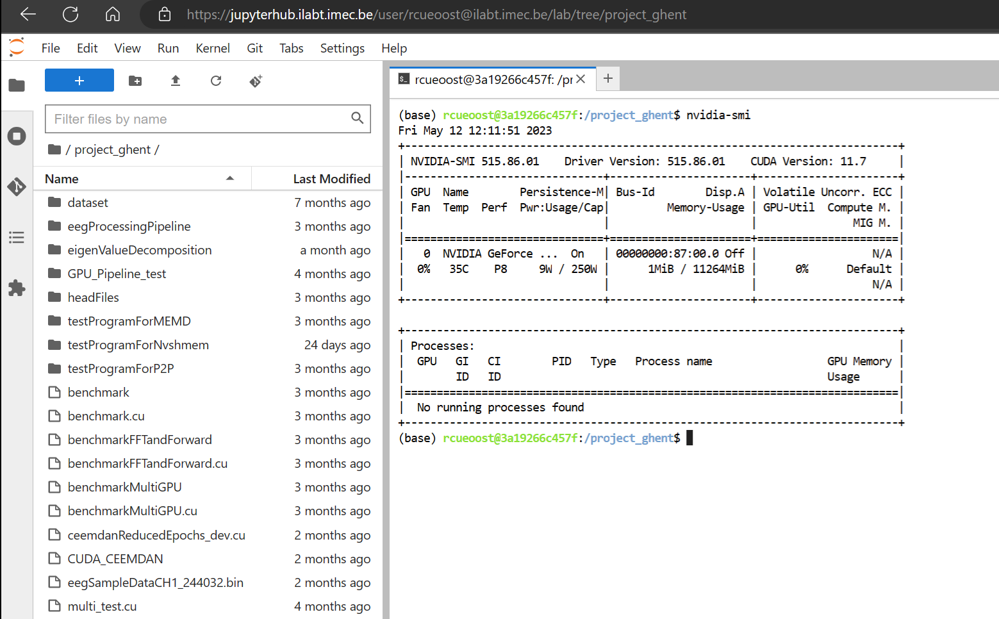
JupyterHub based interactive mode
Storage space
Interactive shell

Slide 11
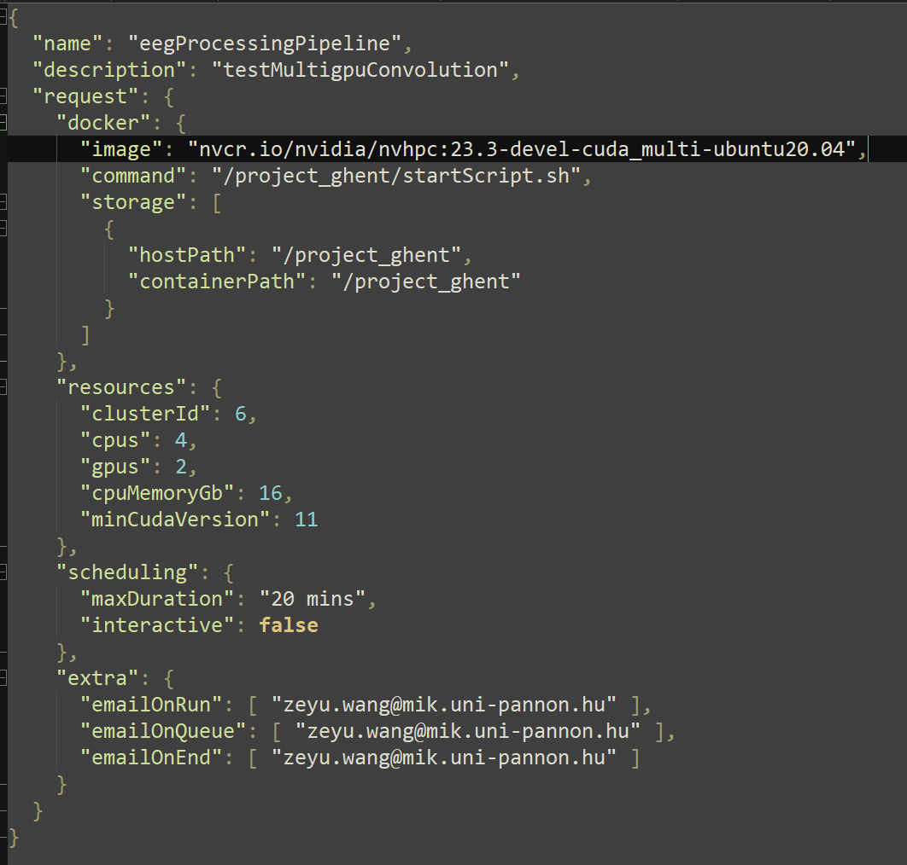
CLI batch mode
Job definition file
Customized containers are available
Container image files
Batch script
Storage path specification
Hardware resource specification
Scheduling info
Notification config
“gpulab-cli submit jobDefinition.json”
Notes:
The job definition file is for the

Slide 12
2.3 Our workflow with GPULab
Local development environment
Program design
Debugging
Local compilation
Local performance testing
Source code
EEG data
Job definition file
CLI mode
Interactive mode
Performance testing
Batch script design
Profiling result
Processing result
Compilation
Execution
GPULab clusters
Notes:
When we use the GPULab for EEG processing, we design the program on the local side, and the compilation, performance testing, and code debugging are performed in the local development environment.
Then we use the interactive mode to upload the EEG data and the source code, also, in the interactive mode, we need to design the batch script, to make sure the source code could be compiled and the EEG data could be processed.
and next step is sending the job definition file in the CLI mode to execute the bathc script design, by executing the batch script, the code compilation, execution, and performance testing can be performed.
After this, we usually switch back to the iteractive mode to fetch the processing result and the performance profiling result back to the local development environment.

Slide 13
3 Multi-GPU access test
Case 1
Case 2 & 3
CPU
CPU
h_input_GPU0
h_output_GPU0
h_input_GPU1
h_output_GPU1
h_input
h_output
GPU0
GPU1
GPU0
GPU1
d_input_GPU0
d_output_GPU0
d_input_GPU1
d_output_GPU1
Naïve pattern
Unified Memory & Unified Virtual Address
Notes:
There are 4 cased

Slide 14
3 Multi-GPU access test
Case 4
Input signal is processed by 2 GPUs
Different lengths with same SR (2048 Hz)
Kernel: multiplication and addition
Hardware: HGX-2
50 repetitions
CPU
h_input_GPU0
h_output_GPU0
h_input_GPU1
h_output_GPU1
GPU0
GPU1
 | 512s | 1024s
Case1 | 4.28 | 69.99
Case2 | 7.47 | 43.14
Case3 | 0.93 | 6.41
Case4 | 0.79 | 5.79
d_input_GPU0
d_output_GPU0
d_input_GPU1
d_output_GPU1
Execution time in microseconds
Peer-to-Peer access pattern

Slide 15
4 Future works
Several single-GPU EEG processing algorithms have bee developed
Empirical Mode Decomposition (EMD) and its several variants
Independent Component Analysis (ICA)
Source localization
……
Single-GPU algorithm optimization
Multi-GPU-based EEG processing algorithm development
Extend the EEG pre-processing pipeline to multi-GPU system
filtering, mean removal, averaging, artifacts removal, statistical analysis ……
Research on the scalability of multi-GPU signal processing algorithm

