Slide 1
Iterated nth order nonlinear quantum dynamics
Notes:
- 25 perc → 10 dia (elméletileg diánkként 5 perc, gyakorlatban inkább 2-3)
11 valódi dia (33 helyett)
Introduction of the topic (self introduction)

Slide 2
Nonlinear quantum protocol
Notes:
main idea behind nonlinear protocols
divide the system to subsystems
then measure a part of the subsystems to gain information
the quantum state of the unmeasured part can evolve nonlinearly
- 2 qubits example:
same initial state
CX gate
entangled state of the two qubits
measurement and post selection → “select” certain elements of density operator
nonlinear map between one qubit states
cost: one ancilla qubit

Slide 3
Nonlinear quantum protocol
Notes:
main idea behind nonlinear protocols
split the system two subsystems
then measure a part of the subsystems to gain information
the quantum state of the unmeasured part can evolve nonlinearly
- 2 qubits example:
same initial state
CX gate
entangled state of the two qubits
measurement and post selection → “select” certain elements of density operator
nonlinear map between one qubit states
cost: one ancilla qubit

Slide 4
Nonlinear quantum protocol
00
01
10
11
00
01
10
11
Notes:
main idea behind nonlinear protocols
split the system two subsystems
then measure a part of the subsystems to gain information
the quantum state of the unmeasured part can evolve nonlinearly
- 2 qubits example:
same initial state
CX gate
entangled state of the two qubits
measurement and post selection → “select” certain elements of density operator
nonlinear map between one qubit states
cost: one ancilla qubit

Slide 5
Nonlinear quantum protocol

Slide 6
Nonlinear quantum protocol
Notes:
simple nonlinear transformation
adding a unitary quantum logic gate → more diverse protocols
Hadamard

Slide 7
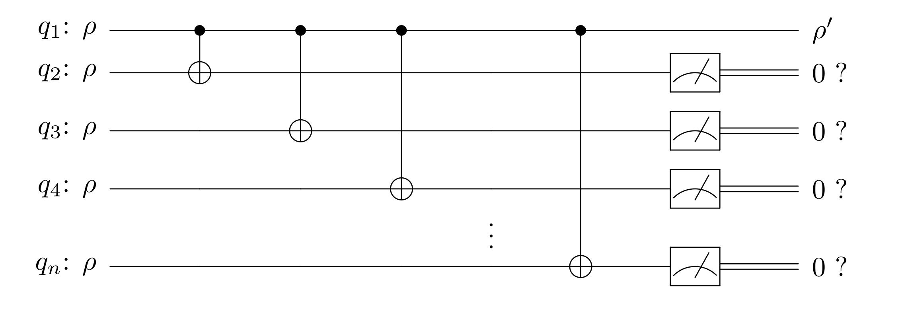
The nth order nonlinear quantum protocol
Notes:
2 qubits → quadratic nonlinearity
N qubits → nth order

Slide 8
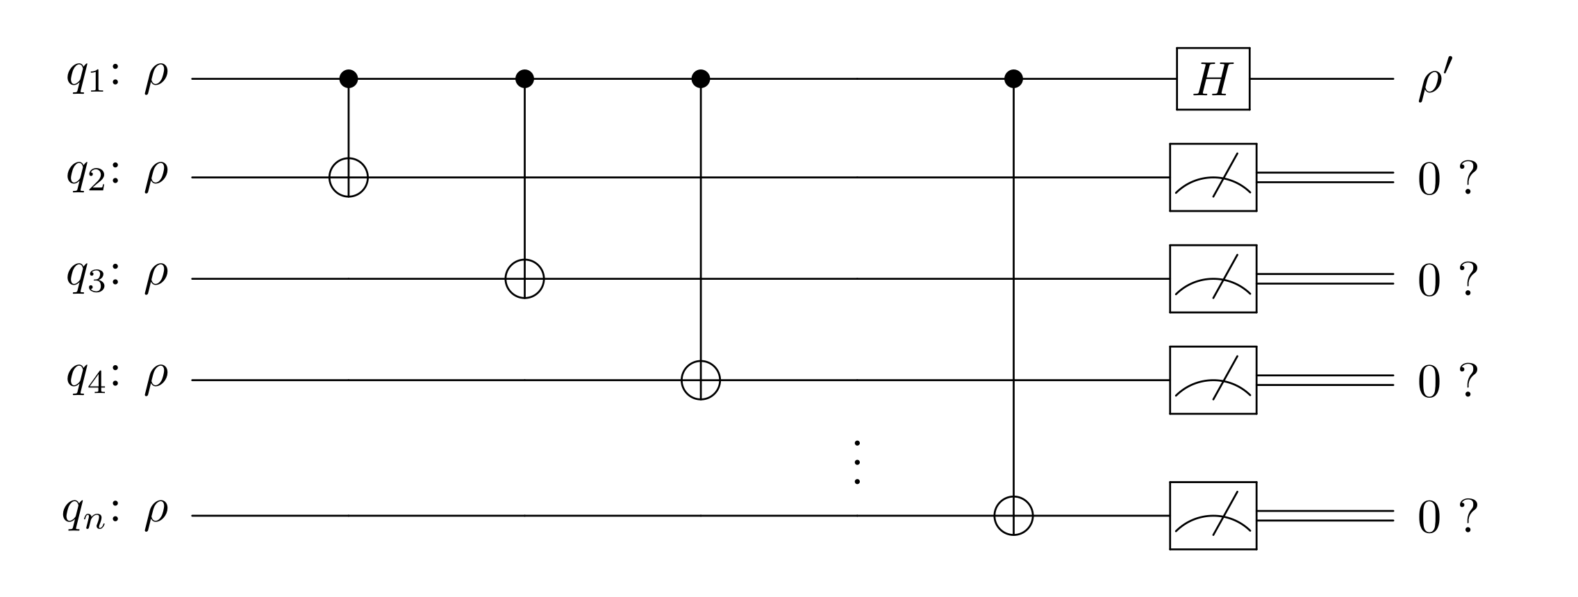
The nth order nonlinear quantum protocol
Notes:
- Hadamard

Slide 9
Bloch coordinates
Notes:
Bloch coordinates
Relation of the density operators → system of difference equations
Quadratic rational functions
Nth order rational functions

Slide 10
Bloch coordinates
second order protocol
Notes:
Bloch coordinates
Relation of the density operators → system of (difference) equations
Quadratic rational functions
Nth order rational functions

Slide 11
Bloch coordinates
nth order protocol
Notes:
Bloch coordinates
Relation of the density operators → system of difference equations
Quadratic rational functions
Nth order rational functions

Slide 12
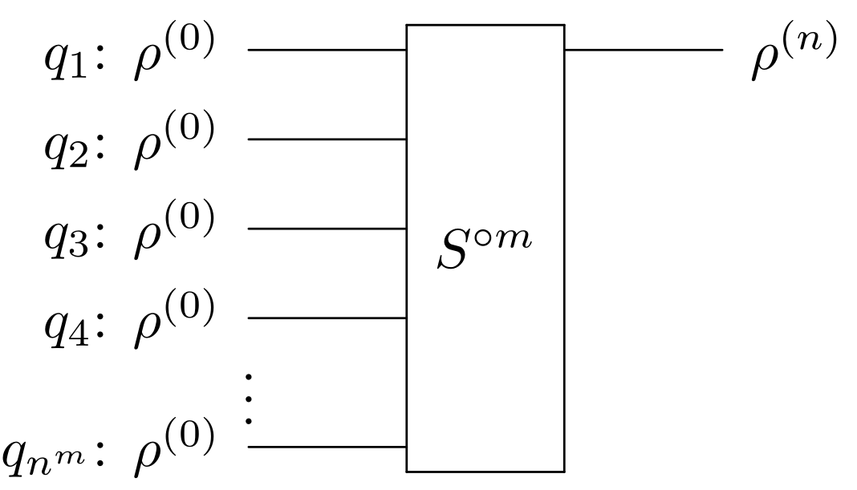
Iterated quantum protocol
m
Notes:
Basic nth nonlinear time evolution step
Iterative manner
multiple copies of the qubits in the same quantum state

Slide 13
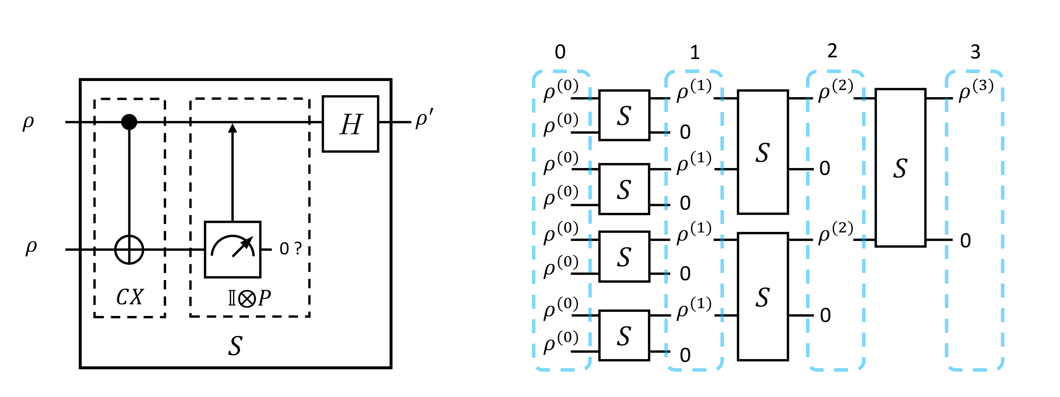
Iterated quantum protocol
second order protocol
Notes:
Second order protocol: illustrate the iterative structure

Slide 14
Iterated quantum protocol
Second order protocol
1.
2.
3.
n.
Notes:
Second order protocol: illustrate the iterative structure
Basic nth nonlinear time evolution step
Iterative manner
multiple copies of the qubits in the same quantum state

Slide 15
Difference equation for the Bloch coordinates
characteristics of dynamics
properties of the quantum protocol
Notes:
- difference equation for the Bloch coordinates
- simulate the quantum protocol by these equations

Slide 16
Invariant sets of the dynamics
The invariant plane (u, v = 0, w)
2 independent variables
Notes:
Invariant sets → any order of nonlinearity

Slide 17
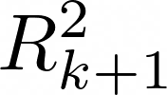
Invariant sets of the dynamics
Pure states – The surface of the Bloch sphere
Notes:
- The set of the Pure states
- Can not create mixed states from pure states

Slide 18
Invariant sets of the dynamics
Pure states – The surface of the Bloch sphere
2 independent variables
Time evolution of the pure states
Notes:
reduce the number of parameters
Theory of iterated complex functions

Slide 19
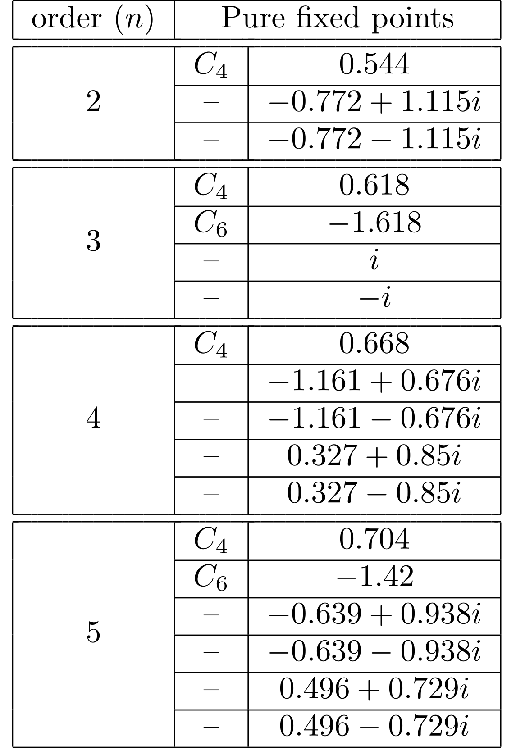
Fixed points
Pure fixed points
Notes:
“invariant” points
Stable under the time evolution
- attractive or repelling

Slide 20
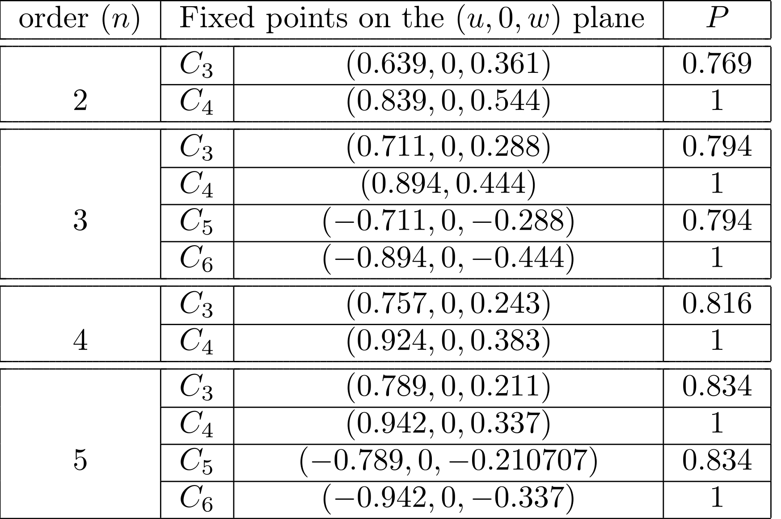
Fixed points
Fixed points on the invariant plane
Notes:
- Special internal repelling fixed point

Slide 21
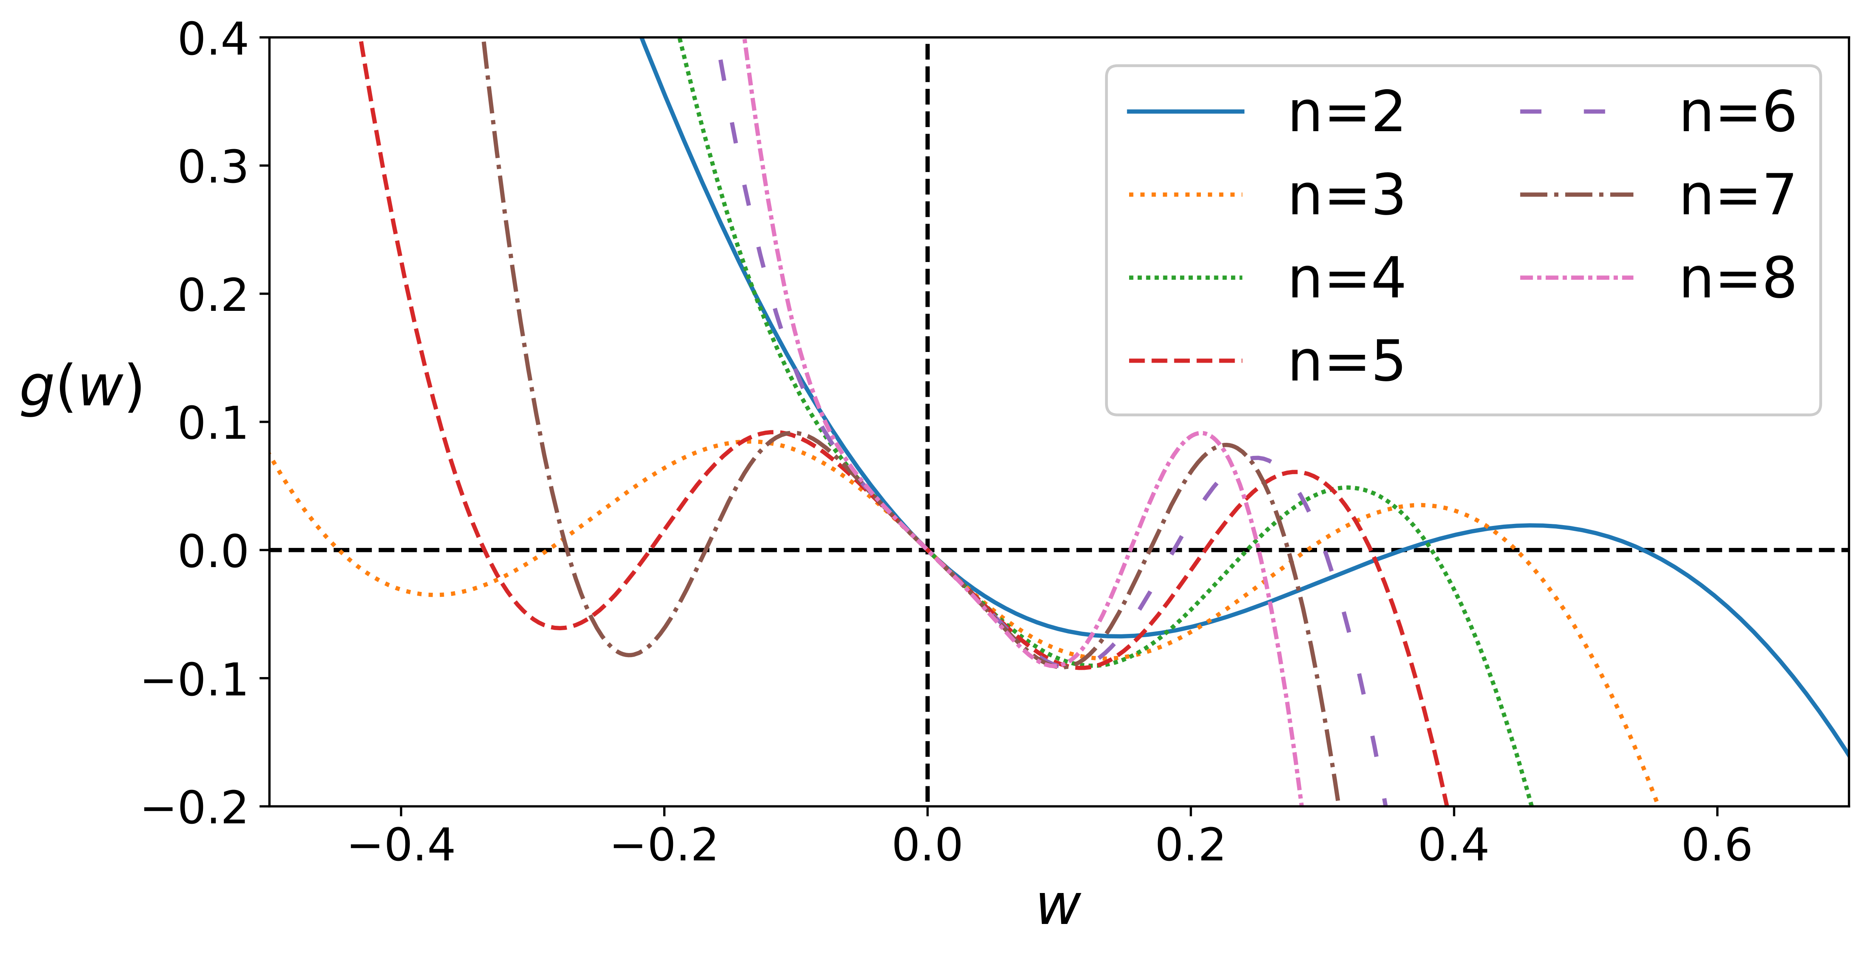
Fixed points
Fixed points on the invariant plane

Slide 22
Limit cycles
numerical
simulations
super attractive cycles
Notes:
All the fixed points are repelling

Slide 23
Limit cycles
Super attractive cycles
for even values of n
for odd values of n
and
Critical points
at most two different pure limit cycles
Notes:
- have we found all the limit cycles?

Slide 24
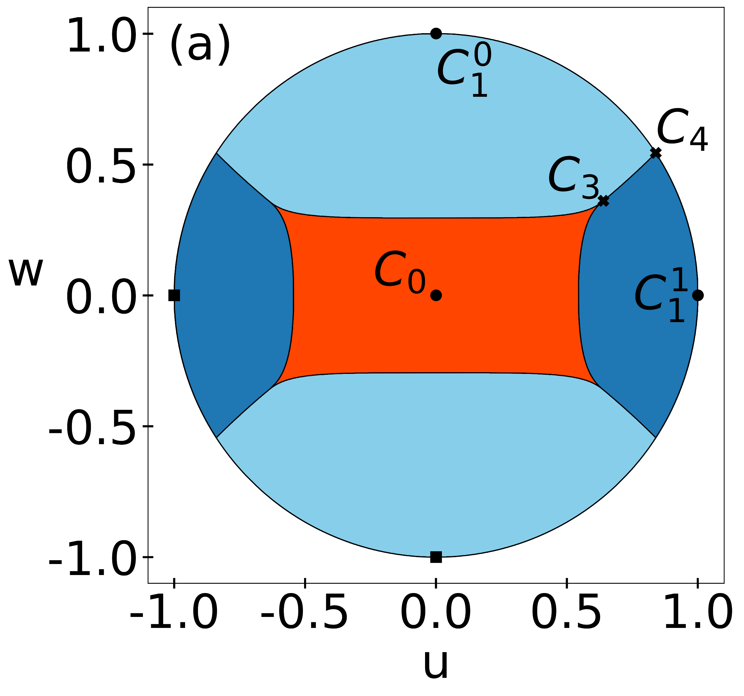
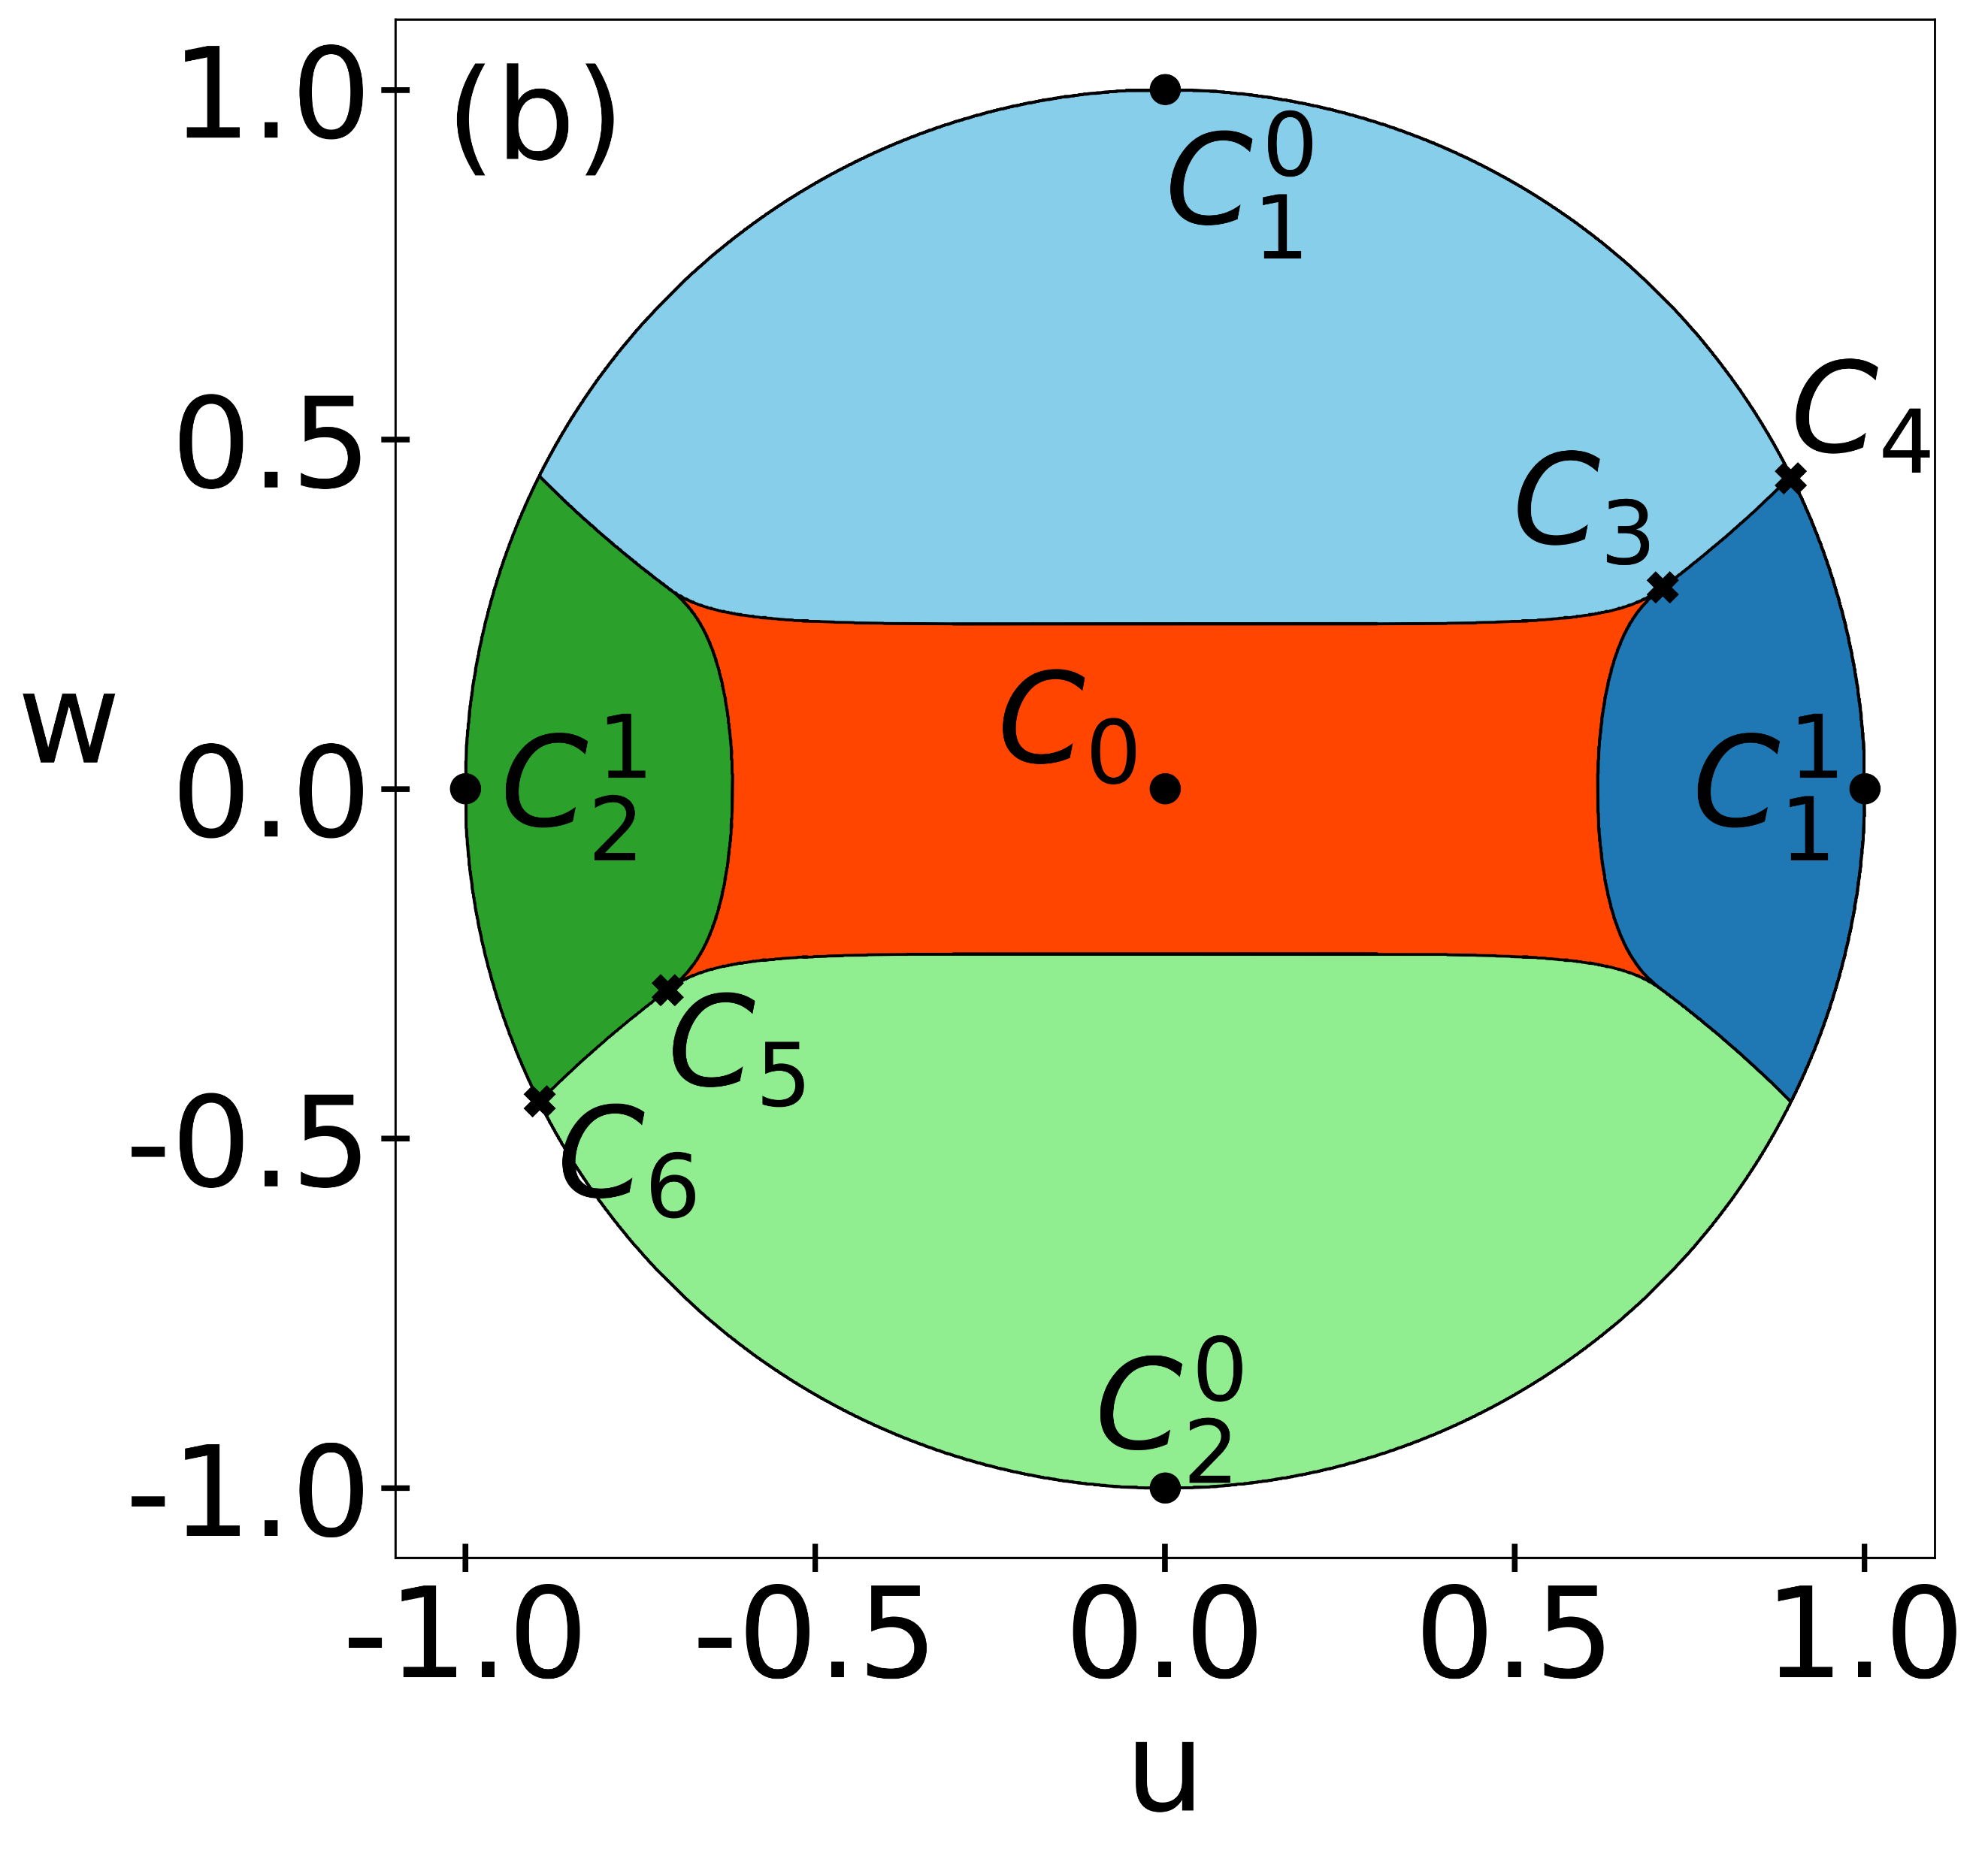
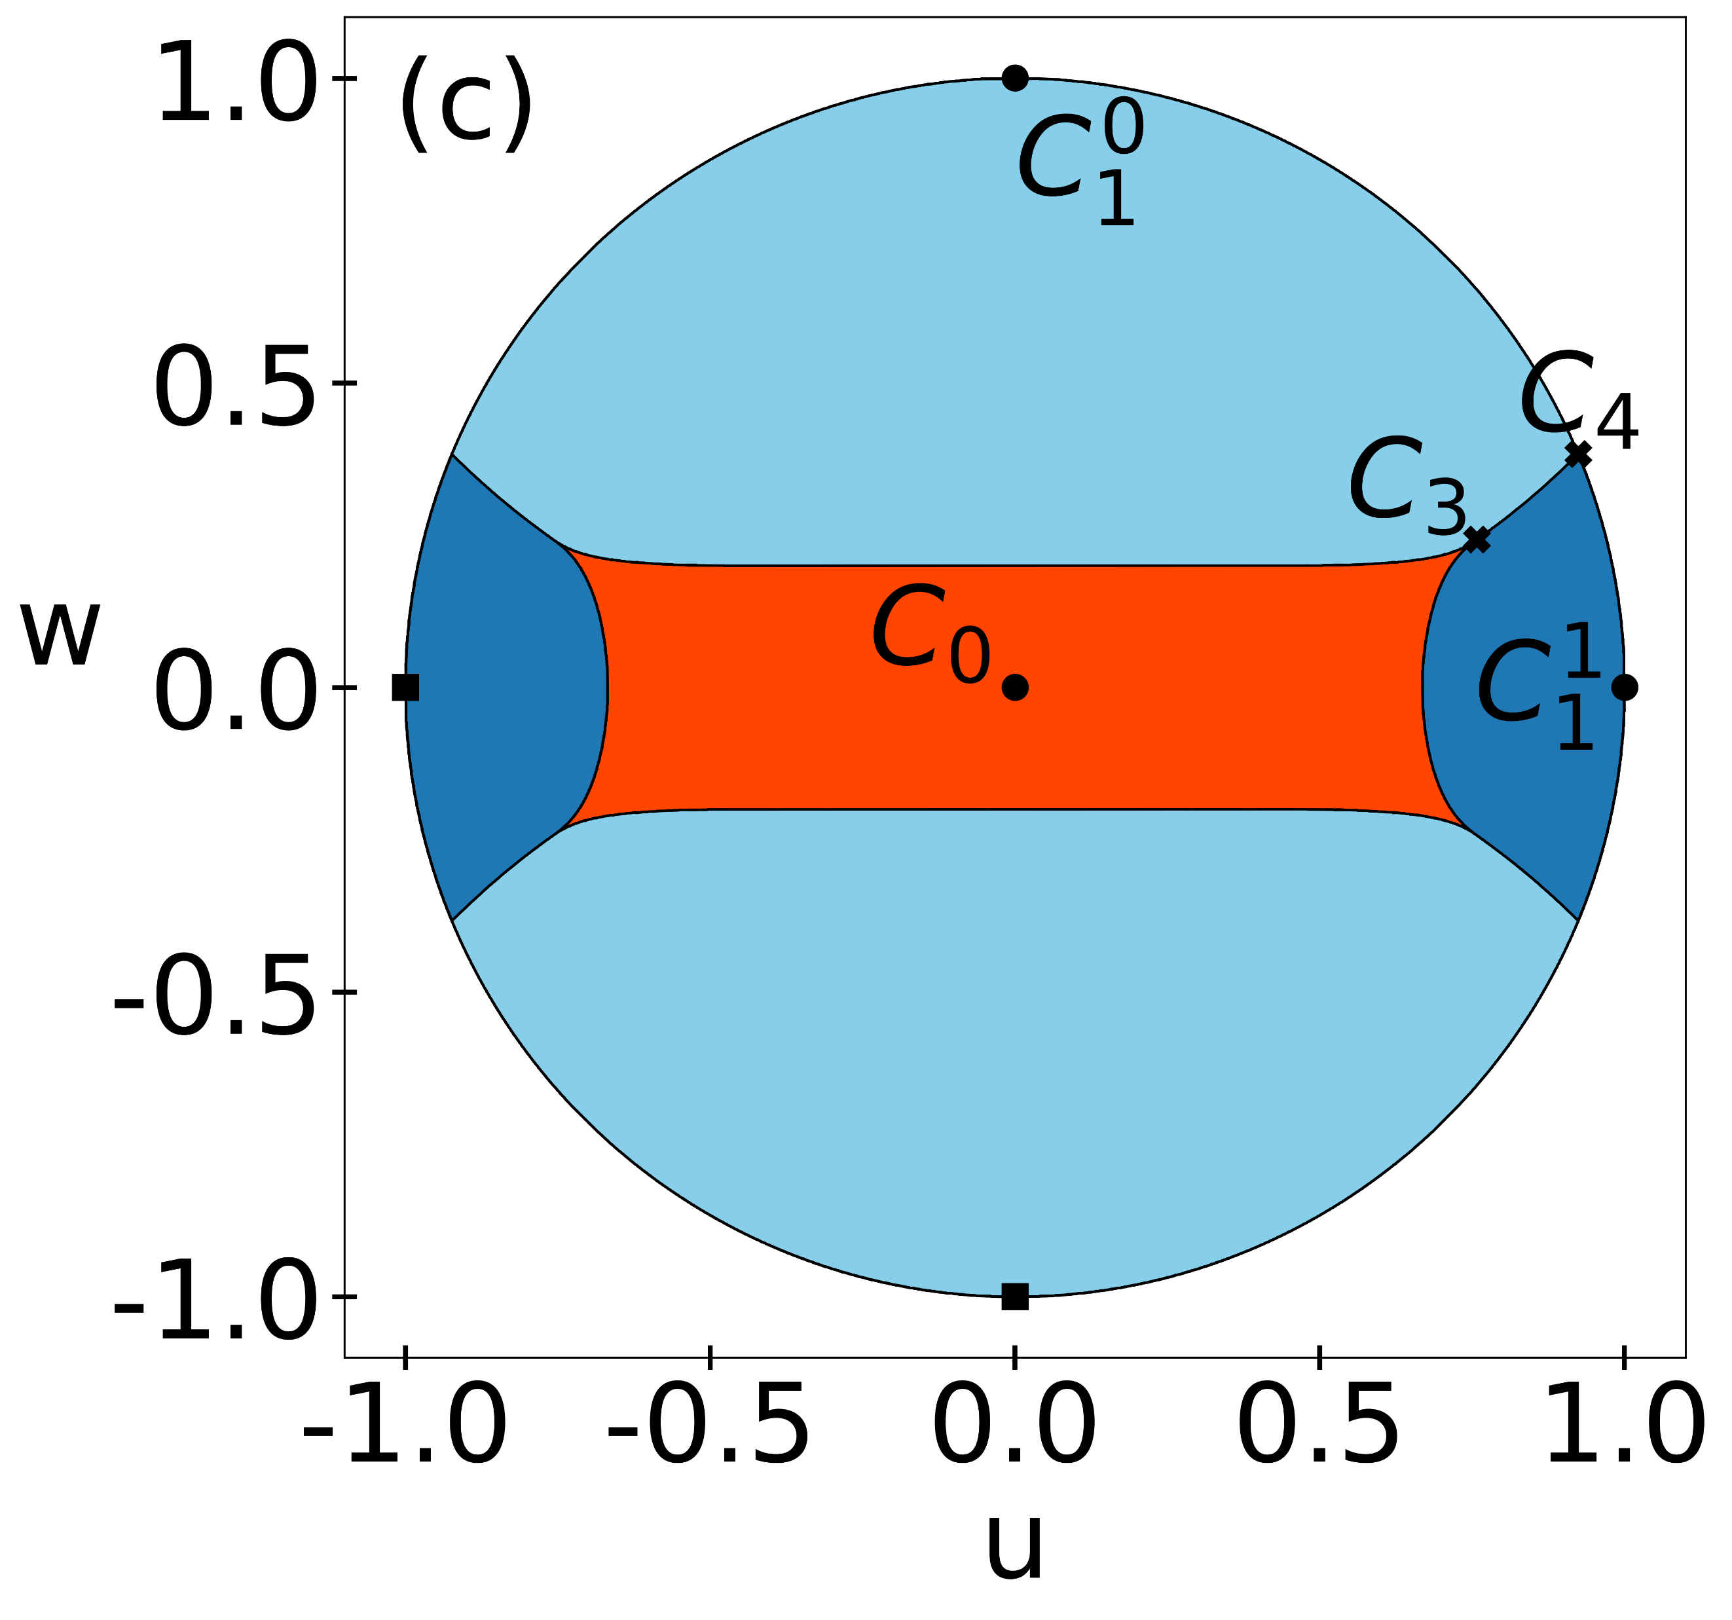
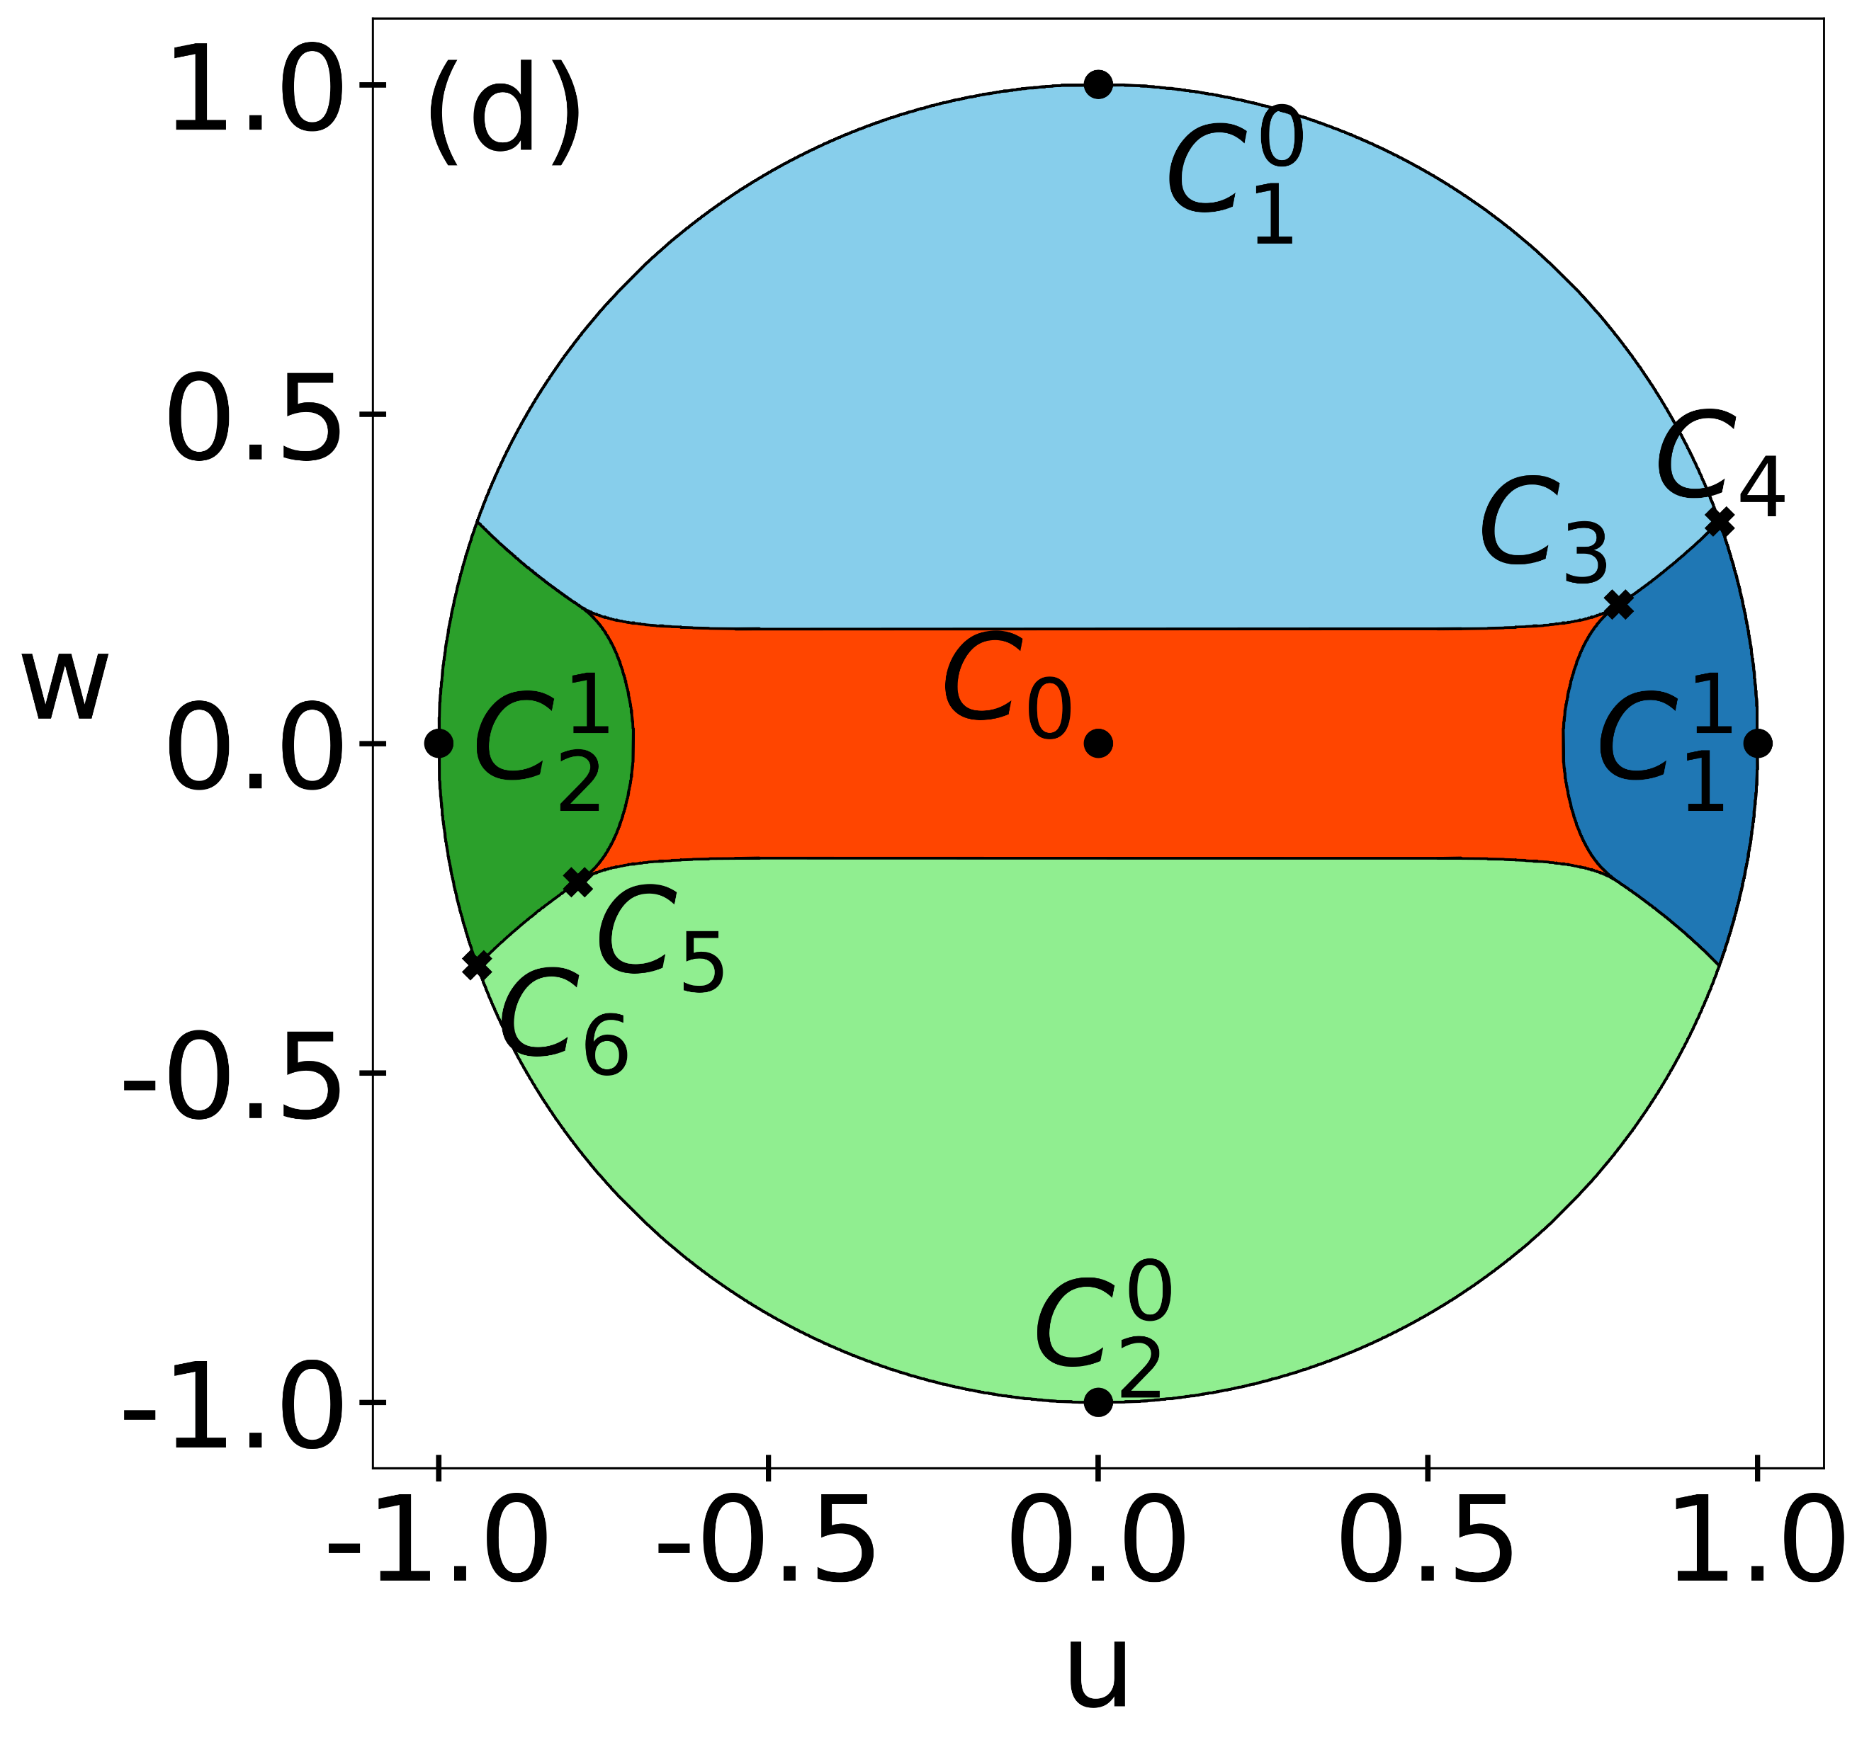
The convergence regions invariant plane
n=2
n=3
n=4
n=5
maximally mixed state; attractive fixed point
superattractive cycles
repelling fixed point
Notes:
- Convergence regions

Slide 25
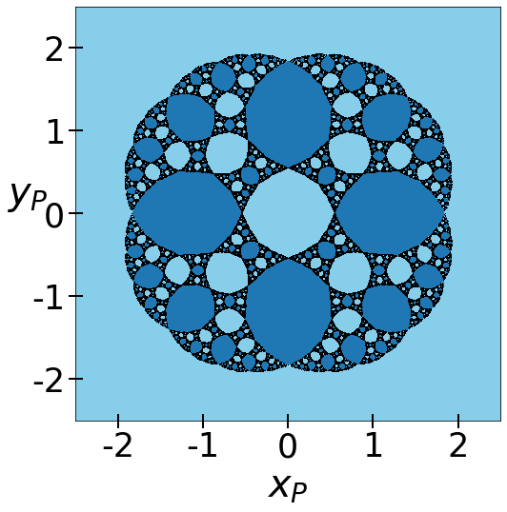
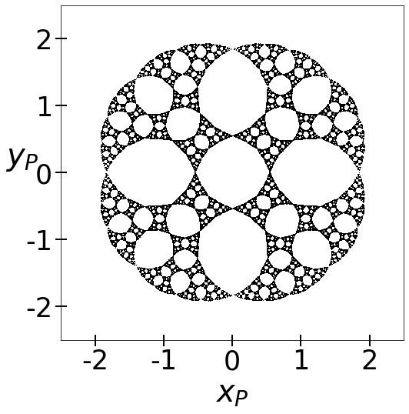
Julia set and Quasi-Julia set
pure convergence regions
Julia set: border of pure basins of attraction
Notes:
Complicated structure
Large connected regions
Boundary is complex → Julia set = fractal

Slide 26
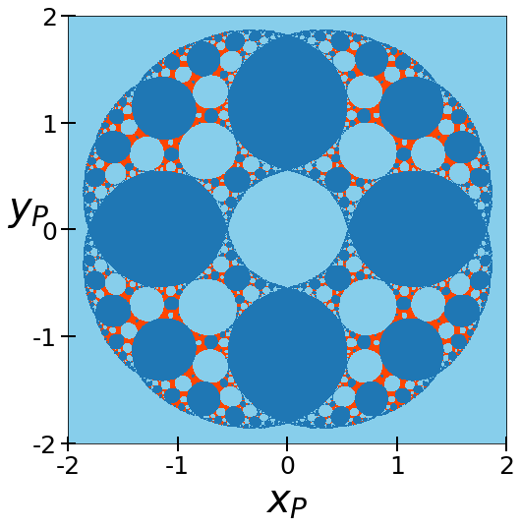
Julia set and Quasi-Julia set
pure convergence regions
Julia set: border of pure basins of attraction
Quasi-Julia set: all mixed points situated at the boundary of the pure attraction regions
P=0.95
Notes:
Iterated complex function theory
the Julia set is the set of limit points of the full backwards orbit

Slide 27
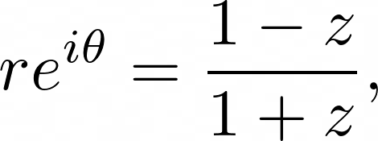
Julia set and Quasi-Julia set
pure convergence regions
Julia set: border of pure basins of attraction
backwards iteration inverse function
Notes:
Iterated complex function theory
the Julia set is the set of limit points of the full backwards orbit

Slide 28
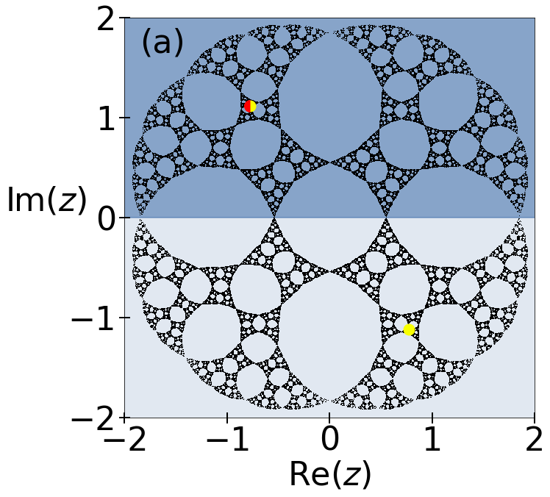
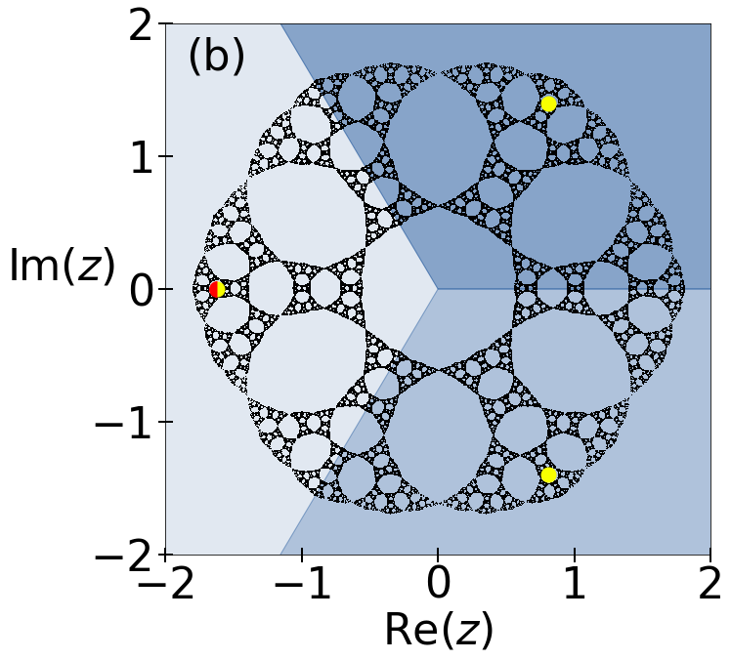
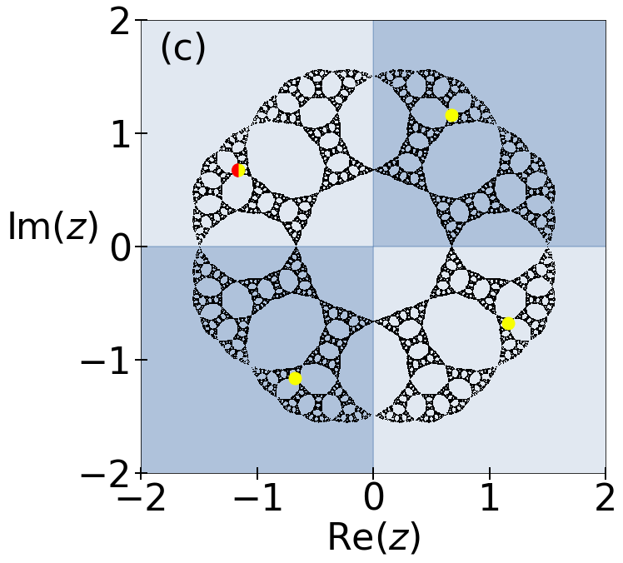
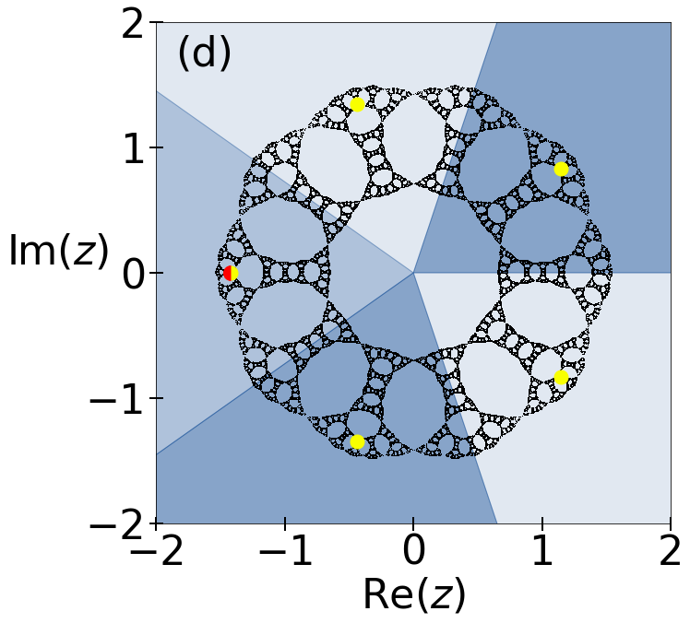
Julia set and Quasi-Julia set
pure convergence regions
Julia set: border of pure basins of attraction
backwards iteration inverse function
Notes:
- a given n there are n symmetric sectors

Slide 29
Julia set and Quasi-Julia set
pure convergence regions
Julia set: border of pure basins of attraction
backwards iteration inverse function
Quasi-Julia set: all mixed points situated at the boundary of the pure attraction regions
P=0.95
Notes:
The border of the convergence regions → similar to the Julia set → Quasi-Julia set
we believe that, similarly to the pure case, we can calculate the points of the Quasi-Julia set by iterating the inverse function starting from arbitrary mixed points

Slide 30
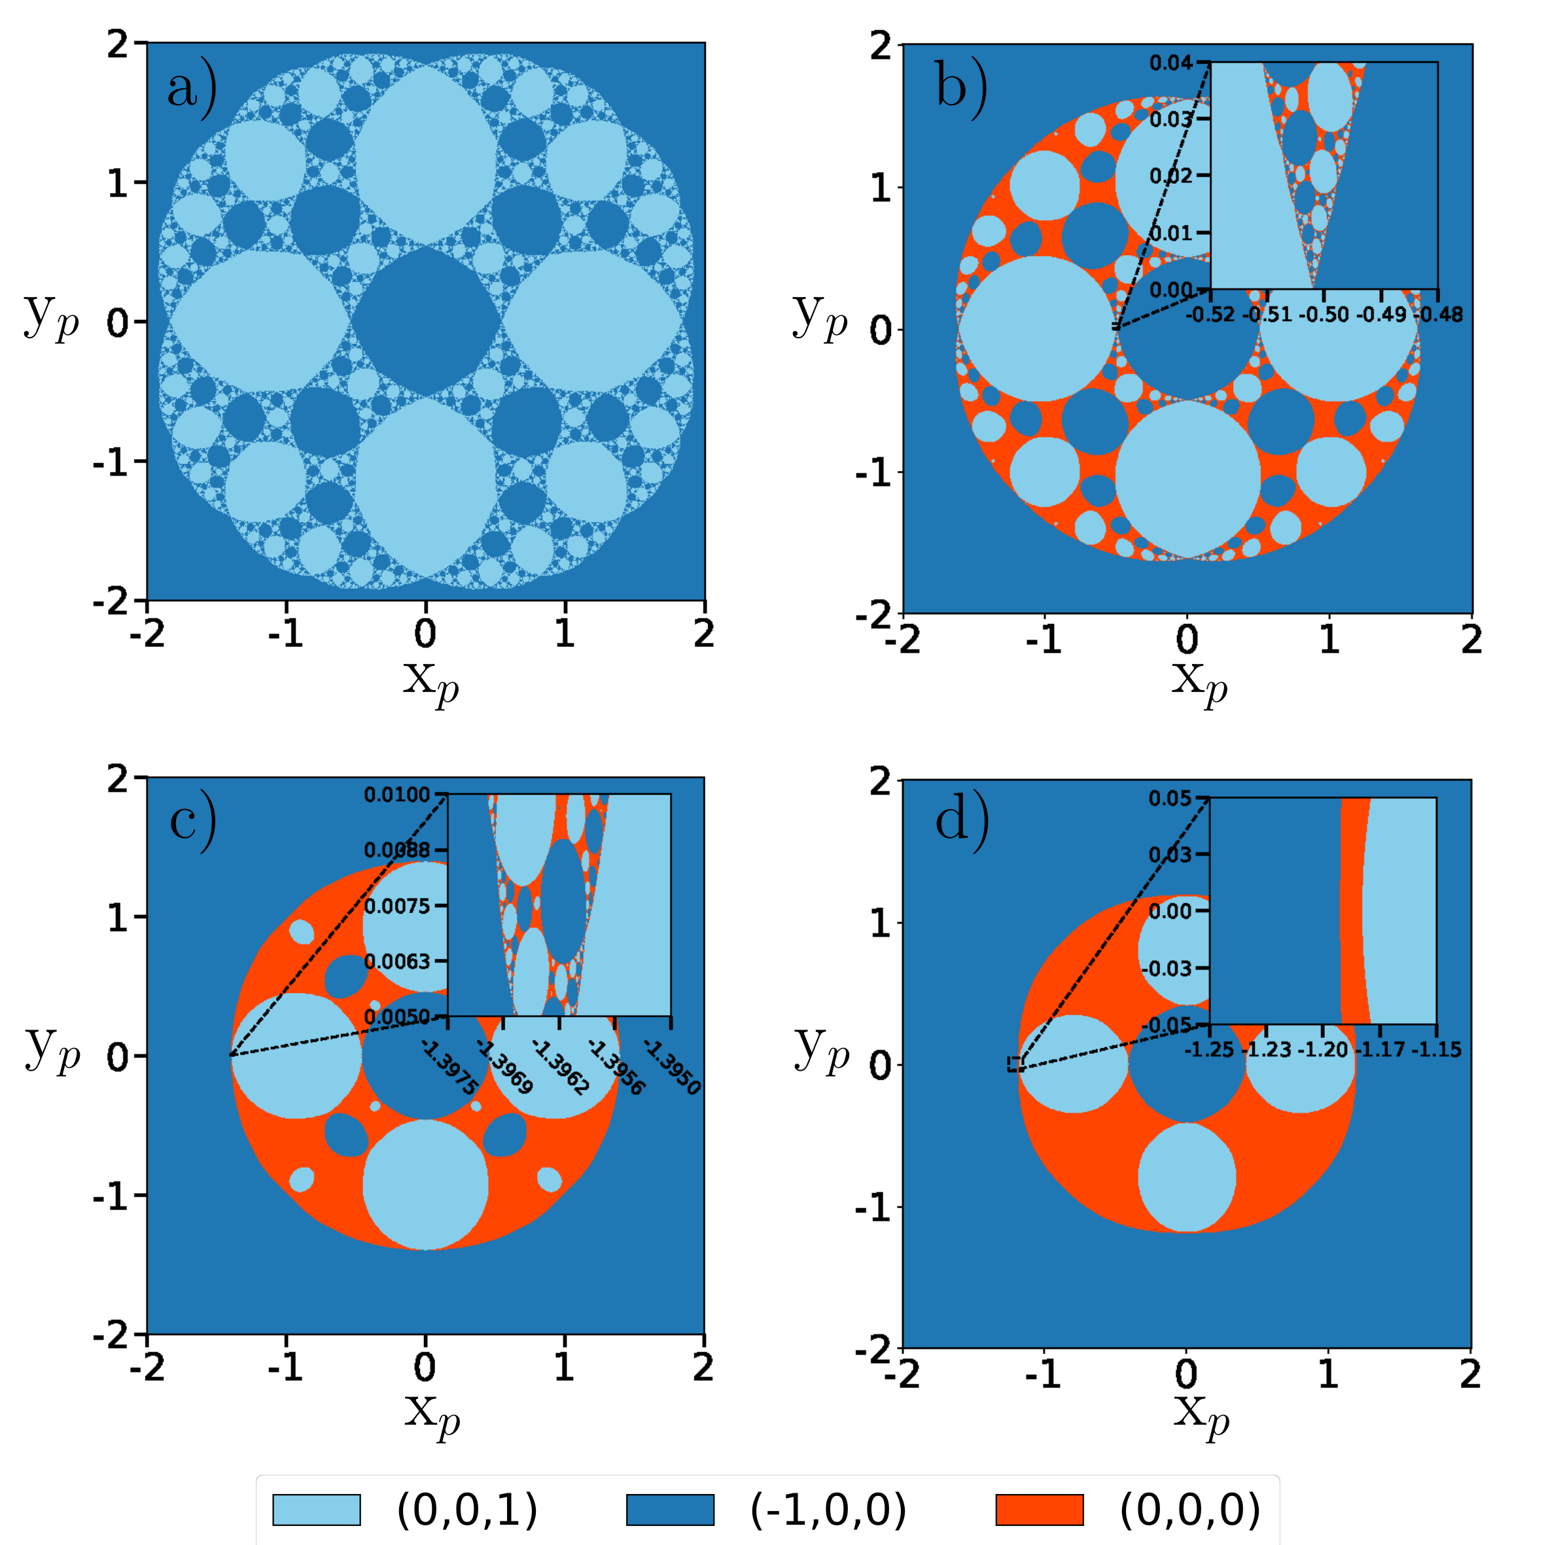
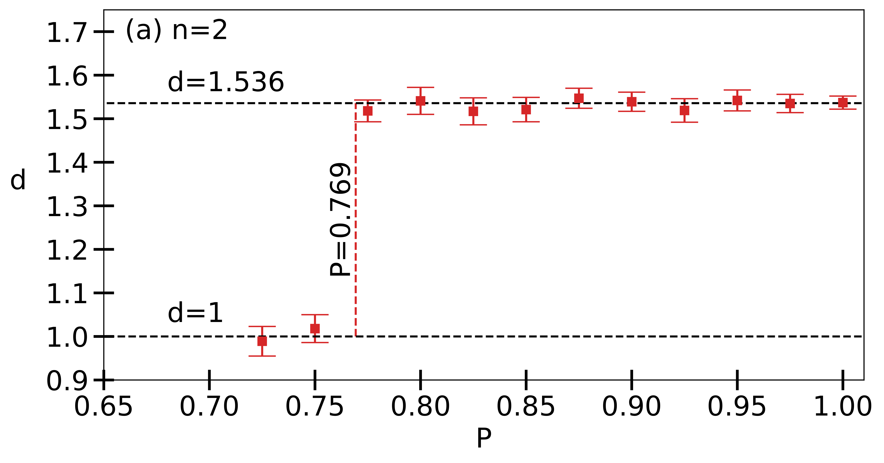
Phase transition
the fractal dimension of the border is constant as a function of the purity of the initial state
below a critical purity value, the fractal disappears
Notes:
The similarity can quantified
Fractal dimension – Box-counting dimension

Slide 31
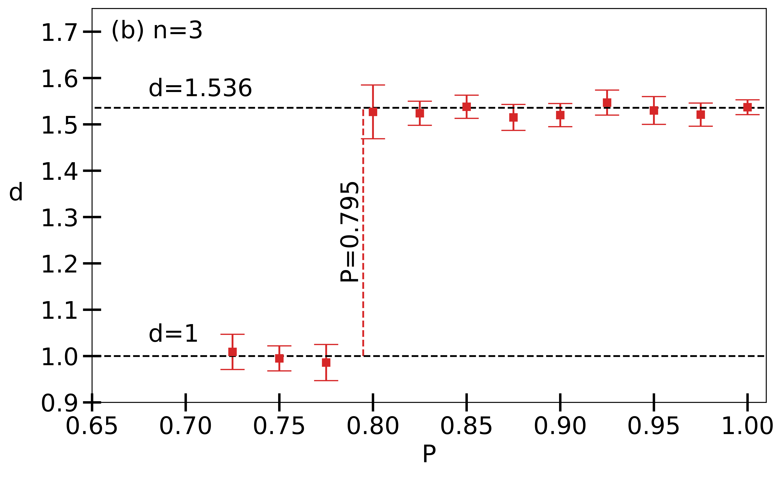
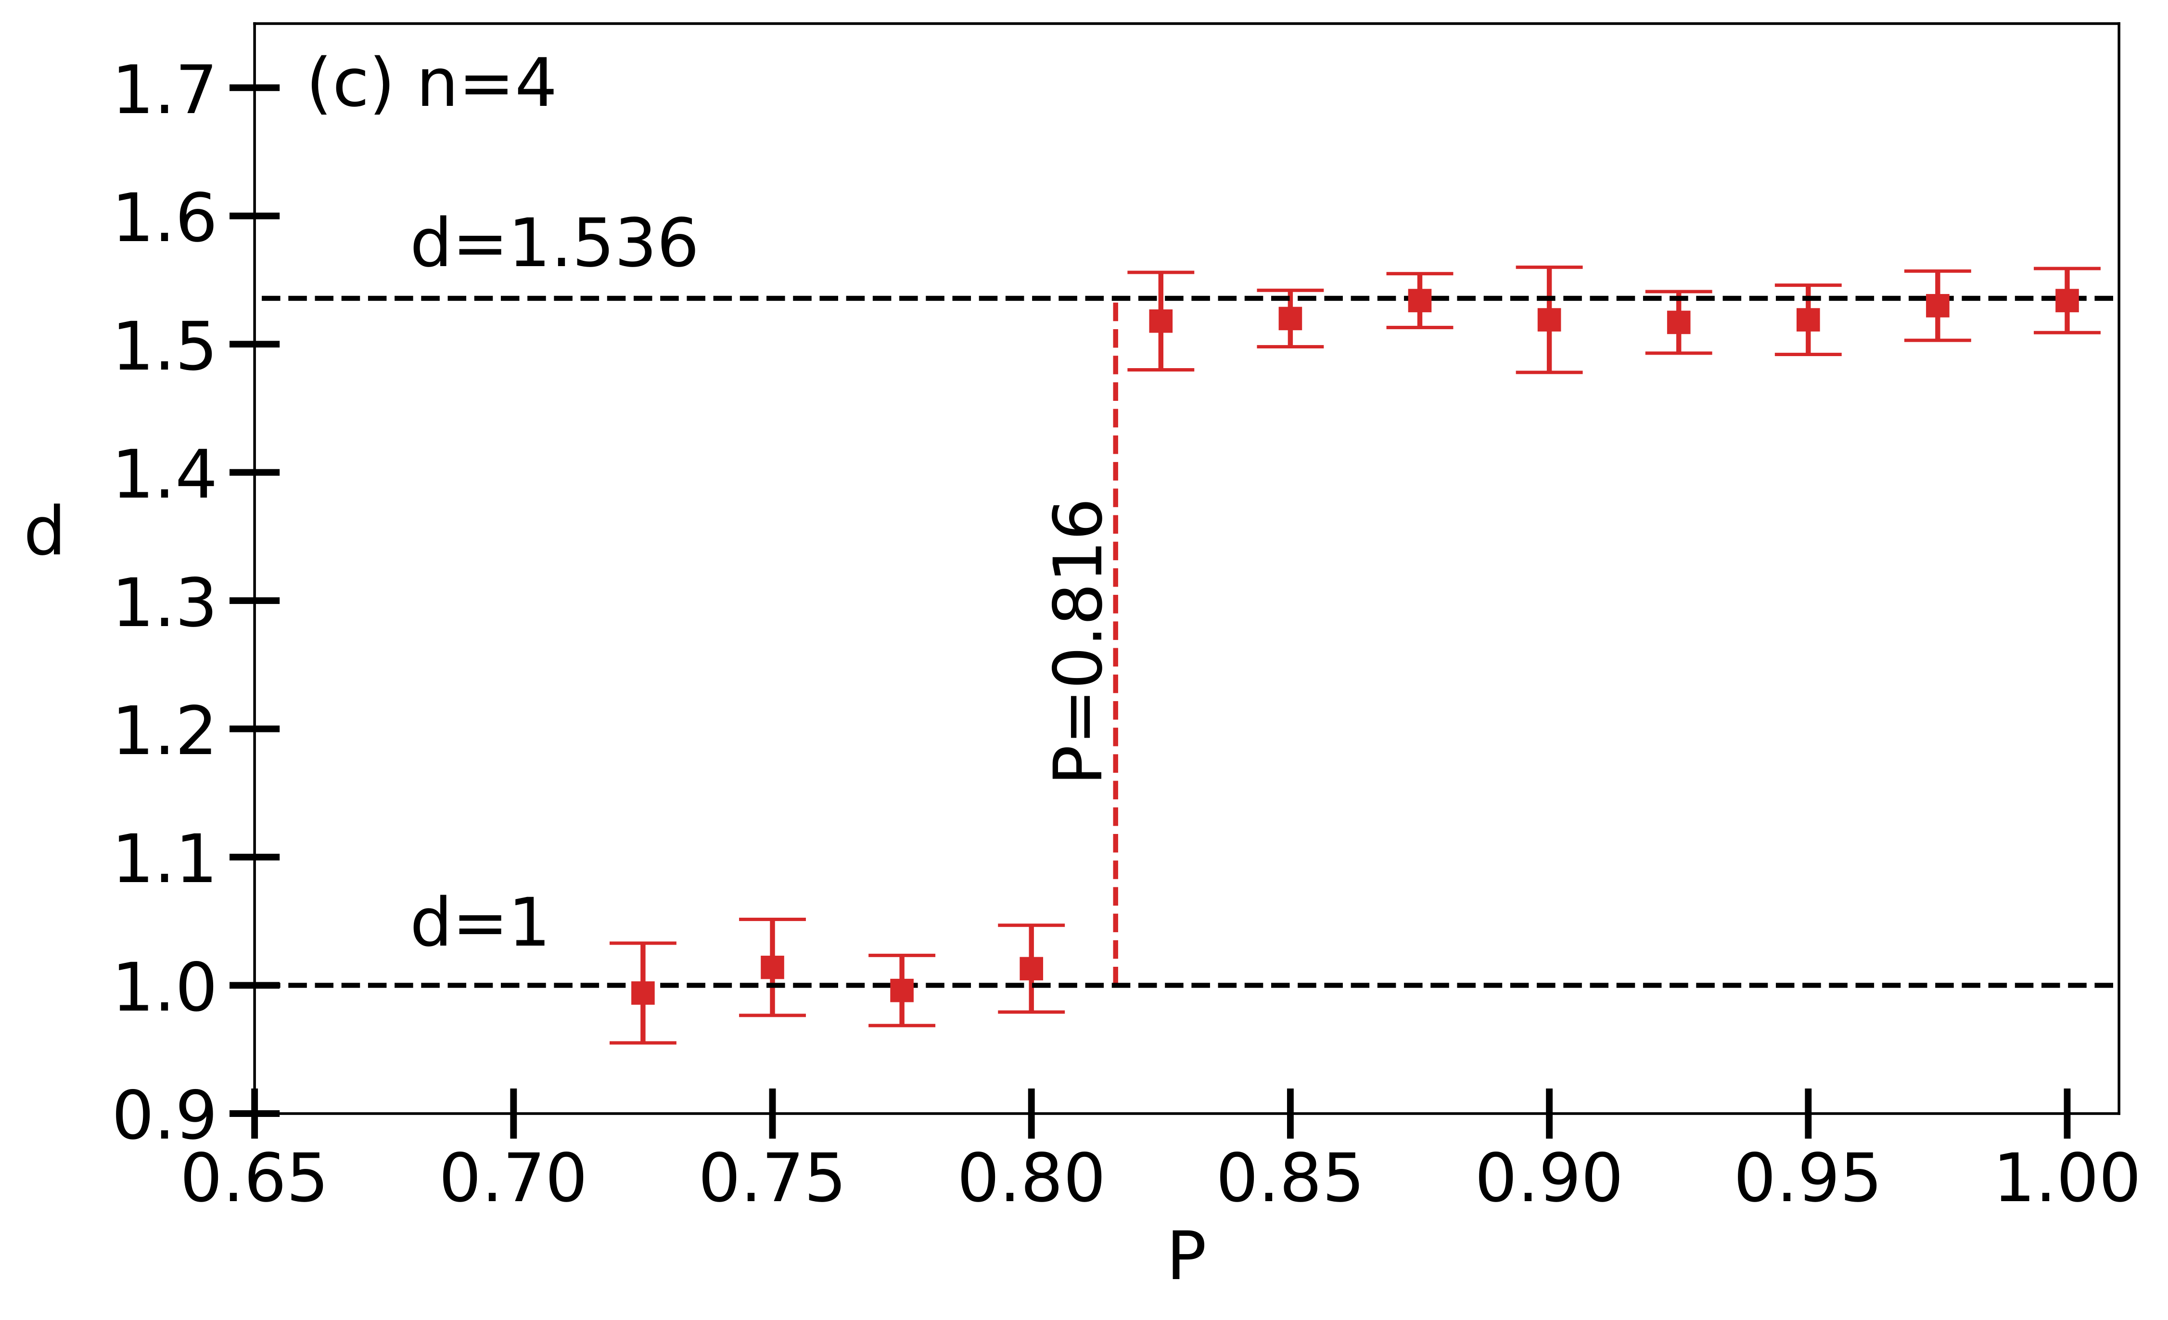
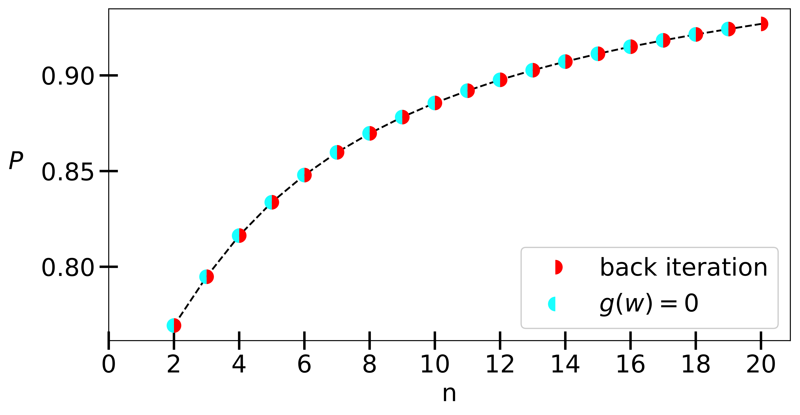
Critical purity
the point of transition between the regions depends on the degree of the nonlinearity
the critical purity is equal to the purity of the repelling fixed point located on the invariant plane
Notes:
critical purity depends on the order of the nonlinearity
last shared boundary point
numerically prove: estimation, back iteration and repelling point

Slide 32
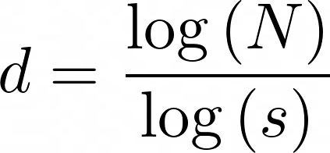
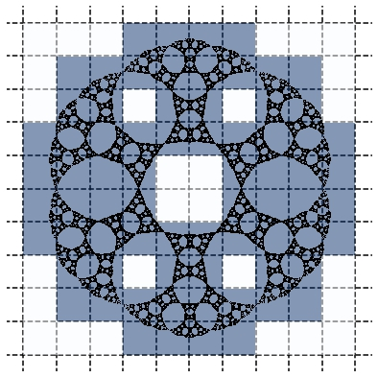
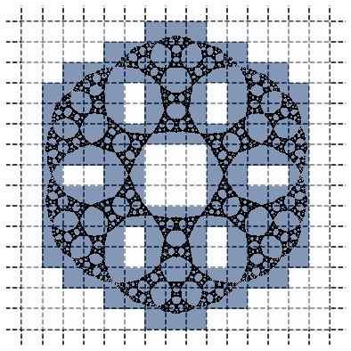
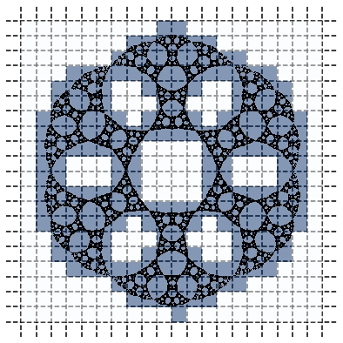
Box-counting dimension
N = 72
s = 1
N = 138
s = 2
N = 217
s = 4
Notes:
-

Slide 33
Thank you!
Portik, A., Kálmán, O., Jex, I., Kiss, T., 2022. Iterated nth order nonlinear quantum dynamics with mixed initial states. Physics Letters A 431, 127999. https://doi.org/10.1016/j.physleta.2022.127999
Wu, J., Jin, X., Mi, S., Tang, J., 2020. An effective method to compute the box-counting dimension based on the mathematical definition and intervals. Results in Engineering 6, 100106. https://doi.org/10.1016/j.rineng.2020.100106

