Slide 1
The Importance of Research Infrastructures for Hungary
István Szabó PhD
Director, ELTE Research and Industrial Relations Center
Márk Végh
University of Pannonia

Slide 2
system of rdi programmes of nrdio

Slide 3
renewed financing scheme of nrdi fund 2021
Horizontal programmes
Horizontal programmes
Individual excellence
Thematic programmes
Business innovation
National security
and defense
Total spending in 2022 for RI memberships:
~30 M€
Health
National challenges: Secure society and environment, Industry and digitization, Culture and family
NRDI Fund Research sub-fund: HUF 105.762 billion
NRDI Fund Innovation sub-fund: 76.53 billion
Research data management plan
Dedicated OA budget

Slide 4
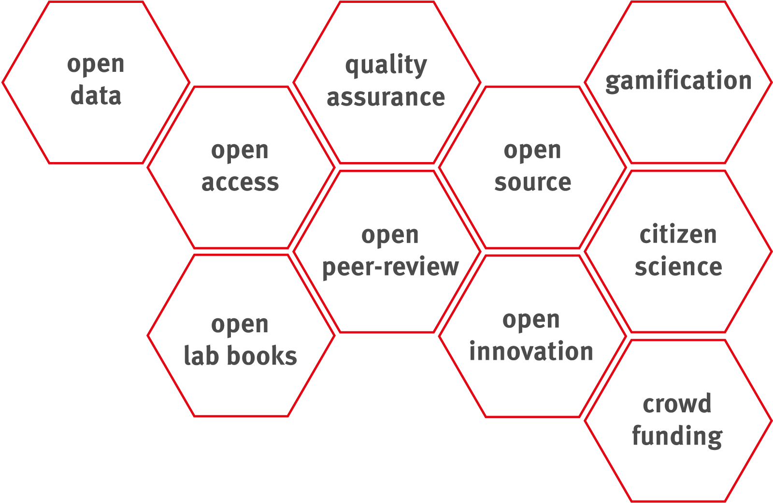

Slide 5
challenges and answers new programmes and institutions - i
Global megatrends, social, economic, technological challenges
Institutional approach
Sustainable institutional system beyond project based calls
Cooperation- oriented framework
Universities as centres of innovation ecosystem
Science Parks
Regional Innovation Platforms
National Laboratories
Challenge based RDI

Slide 6
challenges and answers new programmes and institutions - ii
Knowledge utilization
Focusing of resources and projects
HR capacities of research
RDI capacities and stakeholder demand
Concentration of resources
Flexible carrier path and applied R&D topics
University Innovation Ecosystem
Thematic Excellence Programme
Cooperative Doctoral Programme

Slide 7
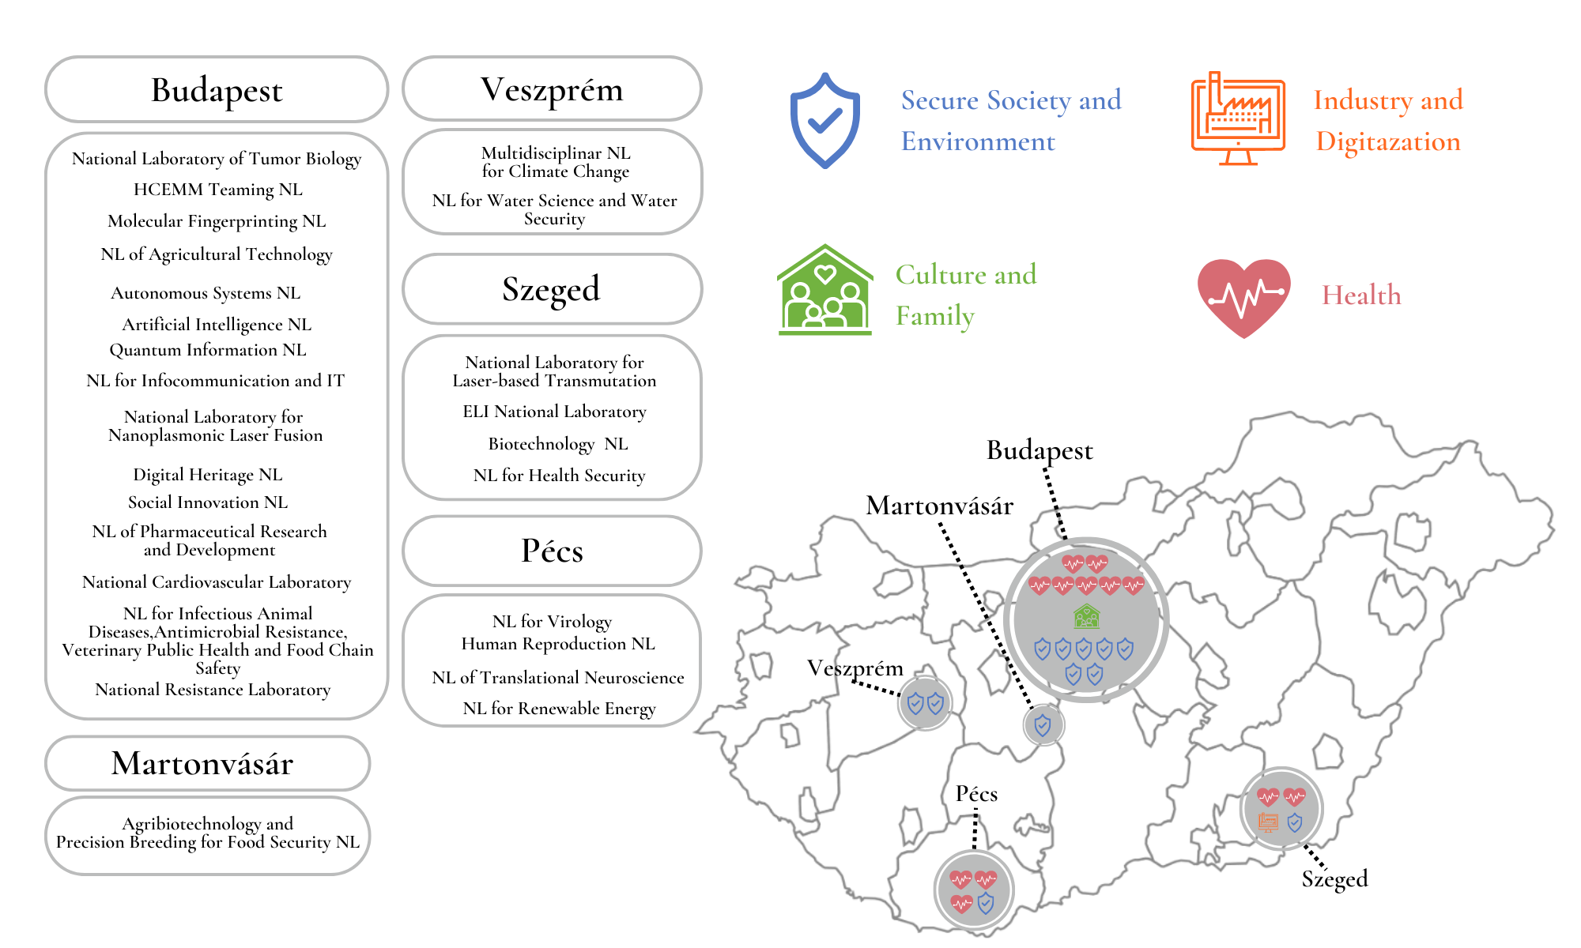
national laboratories

Slide 8
The National Research Infrastructure Committee (NRIC)
Chair: Zsolt Fülöp, Atomki
Vice-chair: István Szabó
Members: 6 scientific advisors – according to the ESFRI thematic areas
Tasks
Makes proposals for:
joining new international research infrastructures
the development of domestic research infrastructures
Makes recommendations for:
the evidence based design of funding schemes supporting research infrastructures
the establishment of a monitoring and evaluation system of RIs and monitoring of our international memberships
all matters concerning the domestic research infrastructures

Slide 9
ESFRI Roadmap 2021 – mechanism of joining to RIs – new Hungarian RI memberships –
1) November 2019 - National questionnaire assessing the intention of joining
to ESFRI Projects and Landmarks
listed on the
ESFRI Roadmap 2018
to projects to be included in the ESFRI Roadmap 2021
2) January 2020 – Detailed questionnaire
14 July 2020 – Oral presentation for NRIC
July 2020 – proposal for decision by NRIC
July-October 2020 – Discussion with ELKH
Nov 2020 & Feb 2021 – Decision by the Minister
Q2 2021 – 2 supporting letters of joining issued by NRDIO
18 Feb 2020 - proposal for decision by NRIC
March 2020 – decision by the Minister
April 2020 – 5 EoS issued by NKFIH to support joining
Similar mechanism is envisaged for the next ESFRI Roadmap update.

Slide 10
hungary’s membership in esfri projects & landmarks
Total spending in 2022:
~30 M€
Σ 4 (+1) Projects
Σ 16 Landmarks
 | Energy | Environment | Health & Food | Physical Sciences & Engineering | Social & Cultural Innovation | Data, Computing & Digital RIs
Projects |  |  |  | EuPRAXIA | E-RIHS GGP GUIDE | (SLICES)
Landmarks |  | ICOS | BBMRI ERIC ECRIN ERIC ELIXIR ERINHA EuBI ERIC | CERN HL-LHC ELI ERIC ESRF EBS ESS ERIC European XFEL | CESSDA ERIC CLARIN ERIC ESS ERIC SHARE ERIC | PRACE

Slide 11
Distribution of Hungary’s ESFRI memberships
E-infrastructures
Social & cultural innovation
Physical sciences & engineering
Health & food
Environment
Energy

Slide 12
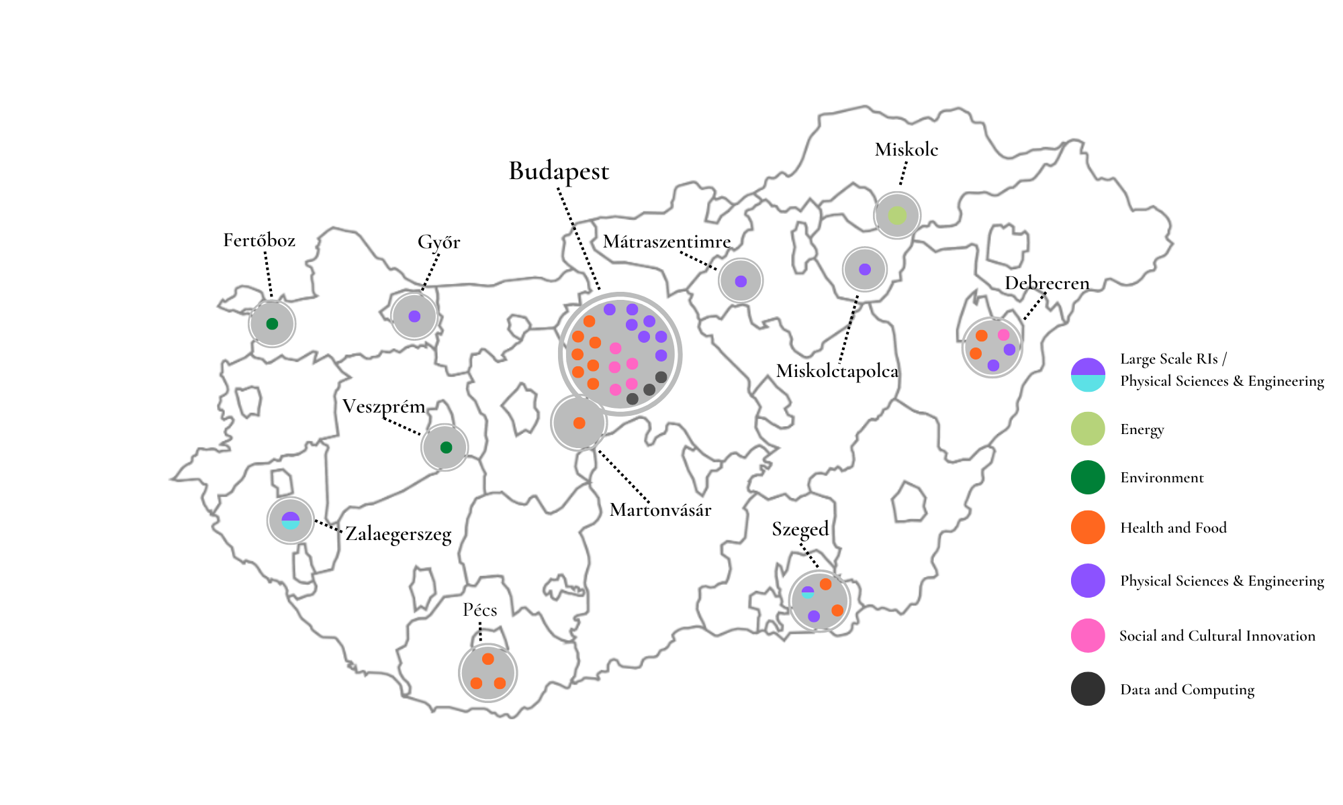
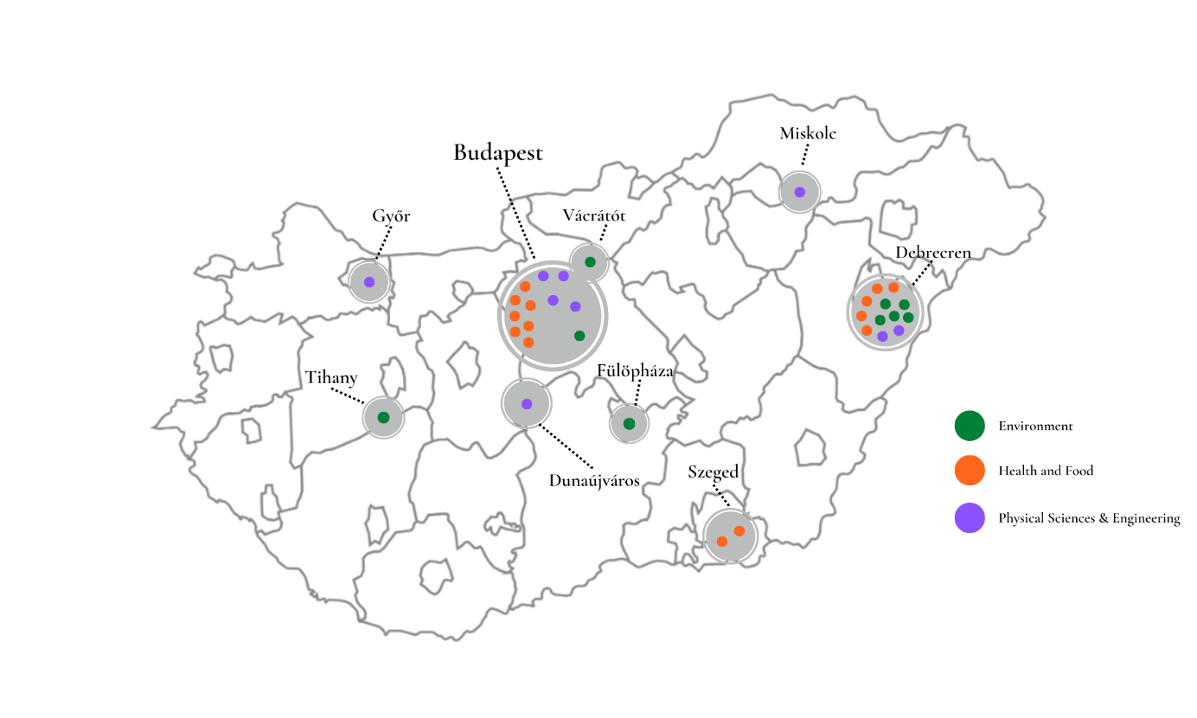
TOP RESEARCH INFRASTRUCTURES AND CLUSTERS IN HUNGARY
nearly 60 excellent and
newly developing
research infrastructures
and clusters
newly developing
research infrastructure clusters
top research infrastructures
and clusters
researchinfrastructures.hu launched in December 2022

Slide 13
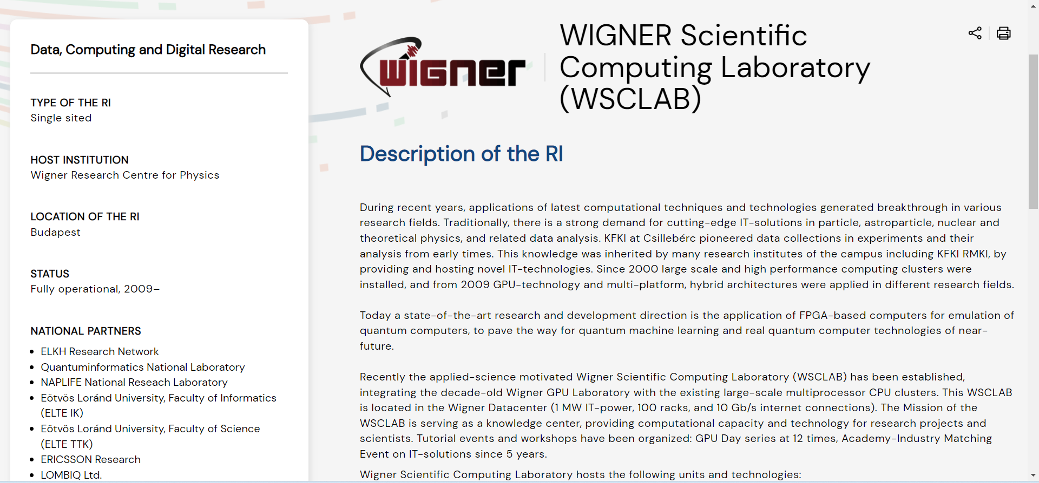

Slide 14
Thank you for your attention!
istvan.szabo@elte.ttk.hu

