Slide 1
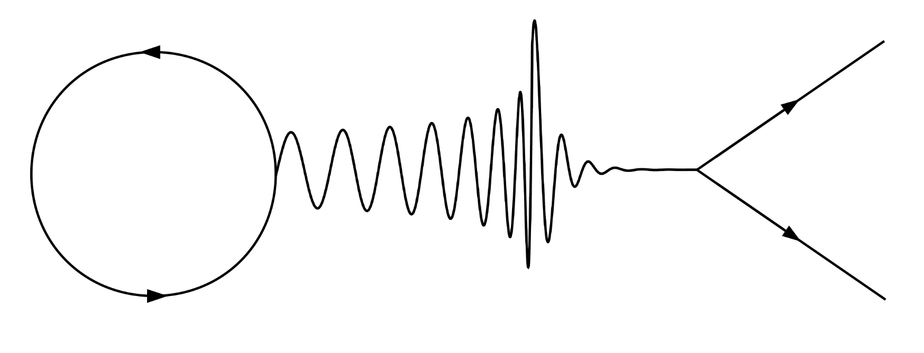
Testing General Relativity with Gravitational Waves
Vítor Cardoso
[Niels Bohr Institute & Técnico Lisbon]
Image: Cardoso & Pani
CERN Courier (2016)
Notes:
Einstein is still imaculate

Slide 2
Dark matter
Dark energy
Inflation
Quantum Gravity
Information Paradox
Spacetime singularities
Gravity

Slide 3
Singularities & Cosmic Censorship
Theorem (Penrose 1965; 1969):
For “reasonable” matter, trapped surface formation results in “singularity,” where at least one of the following holds:
a. Negative local energy occurs.
b. Einstein's equations are violated.
c. The space-time manifold is incomplete.
d. The concept of space-time loses its meaning at very high curvatures – possibly because of quantum phenomena.
Conjecture (Penrose 1969):
No singularity is visible from future null infinity (weak CCC)
General Relativity is deterministic (strong CCC)
Notes:
Nobel 1983

Slide 4
Uniqueness: the Kerr solution
Theorem (Carter 1971; Robinson 1975; Chrusciel, Costa & Heusler 2012):
A stationary, asymptotically flat, vacuum BH solution must be Kerr
Describes a rotating BH with mass M and angular momentum J=aM, iff a<M
“In my entire scientific life, extending over forty-five years, the most shattering experience has been the realization that an exact solution of Einstein’s equations of general relativity provides the absolutely exact representation of untold numbers of black holes that populate the universe.”
S. Chandrasekhar, The Nora and Edward Ryerson lecture, Chicago April 22 1975
Notes:
Nobel 1983

Slide 5
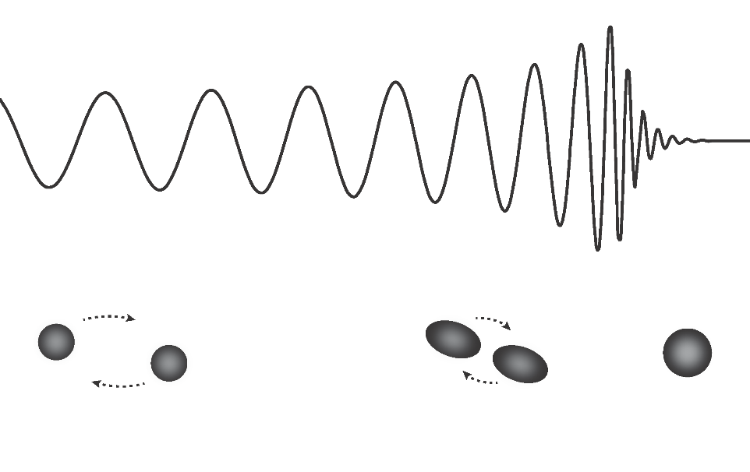
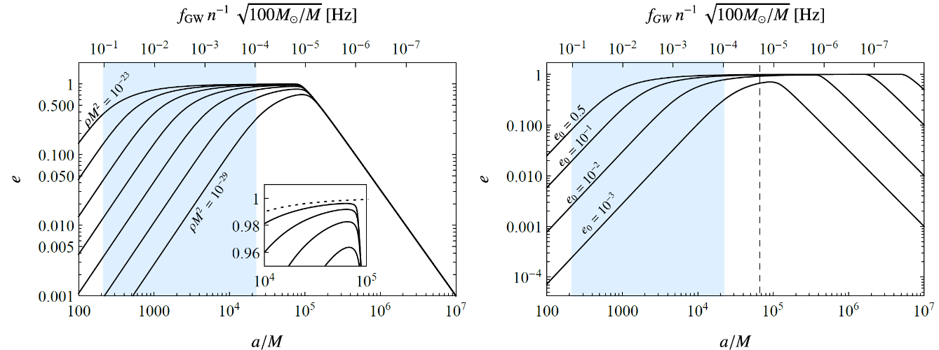
Black holes as perfect laboratories
Simple spin-induced multipoles (uniqueness)
Tidal heating
Tidal Love number
(BHs don’t polarize)
Simple relaxation of final state (uniqueness)
Peters PR136: B1224 (1964); Cardoso & Pani, Nature Astronomy 1: 586 (2017); Living Reviews in Relativity 22: 1 (2019)
Cardoso, Macedo & Vicente PRD103: 023015 (2021)
Notes:
A is semi-major axis

Slide 6
The next decimal place
“New realms will become visible by improving the accuracy of the numerical measurement of quantities with which one has long been familiar.“ [Maxwell, Scientific papers]
Test black hole & Kerr paradigm with precision & understand environments
Cardoso, Nature Reviews Physics (2019) Cardoso and Pani, Living Reviews in Relativity 22: 1 (2019)

Slide 7
Fundamental questions
BH seeds, BH demography, galaxy co-evolution (how many, where, how?)
See review Barack+ CQG 36: 143001 (2019); arXiv:1806.05195
Is cosmic censorship preserved?
Sperhake+ PRL103:131102 (2009); Cardoso+ PRL120:031103 (2018)
Is it a Kerr black hole? Can we constrain alternatives?
Cardoso+ CQG33:174001 (2016); Barack+ CQG36:143001 (2019); Cotesta + PRL129:111102 (2022)
Are we really observing black holes?
Cardoso+ PRL116: 171101 (2016); Nature Astronomy 1: 586 (2017); Liv. Rev. Rel. 22 (2019)
Can we do galaxy tomography, or constrain dark matter?
Barausse+ PRD89:104059 (2014); Cardoso+ AA644:147 (2020); Cardoso+ PRL129:241103 (2022)
Can gravitational waves inform us on new fundamental fields?
Arvanitaki+ PRD95: 043001 (2016); Brito+ PRL119:131101 (2017); Annulli+PRD102:063022 (2020)
Answer requires understanding of theoretical framework, PDEs, precise modelling, challenging simulations & challenging data analysis techniques
Notes:
At level of theories, there are small corrections or smoking guns

Slide 8
Black hole spectroscopy
Ringdown
poles = QNMs
Leaver PRD34:384 (1986); Cardoso & Gualtieri CQG33: 174001 (2016); Baibhav + arXiv:2302.03050

Slide 9
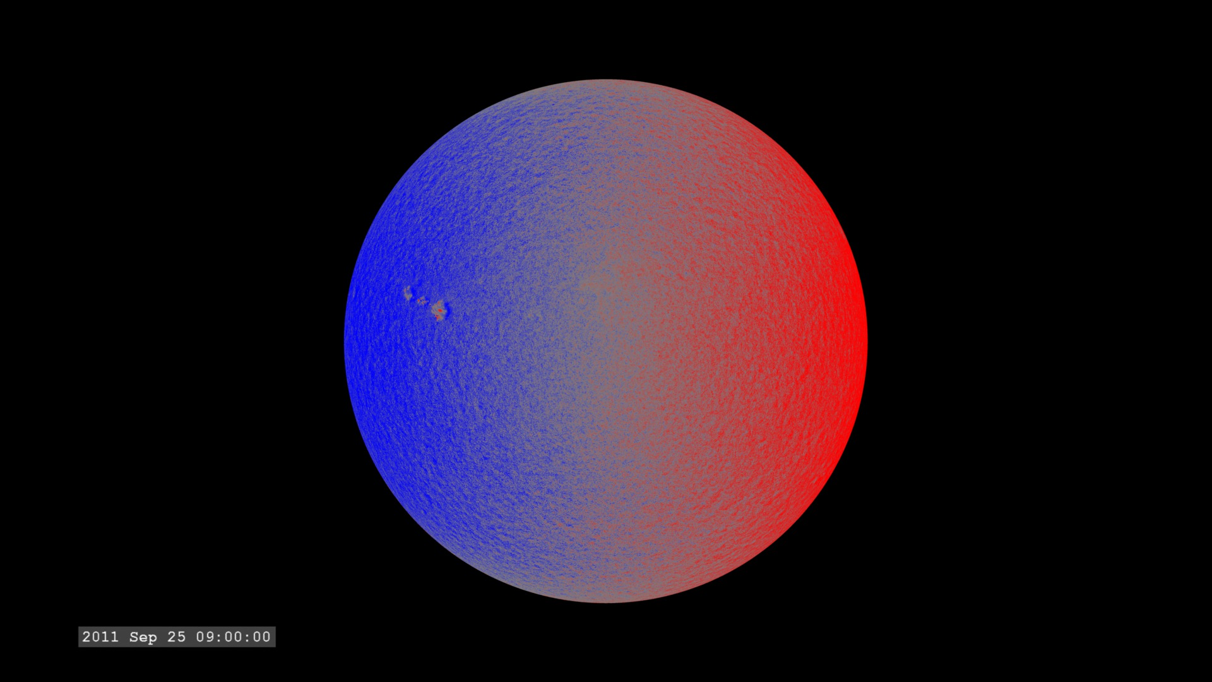
Helioseismology
Solar spectrum sensitive to radial structure, opacity, temperature…
More than ${10}^{6}$ modes with periods between 4 and 6 minutes
Quality factors of order ${10}^{6}−{10}^{9}$
Driven by turbulence
Notes:
Solar spectrum sensitive to radial structure, to opacitiy, sound speed, neutrino. More than a million modes with period between 4 and 6 minutes. Q factos of a billion or so

Slide 10
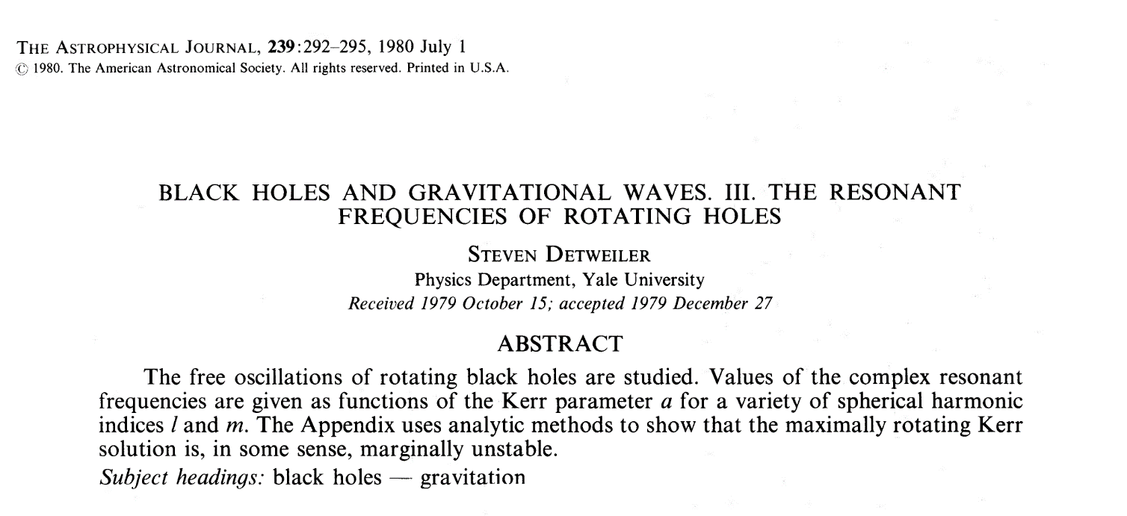
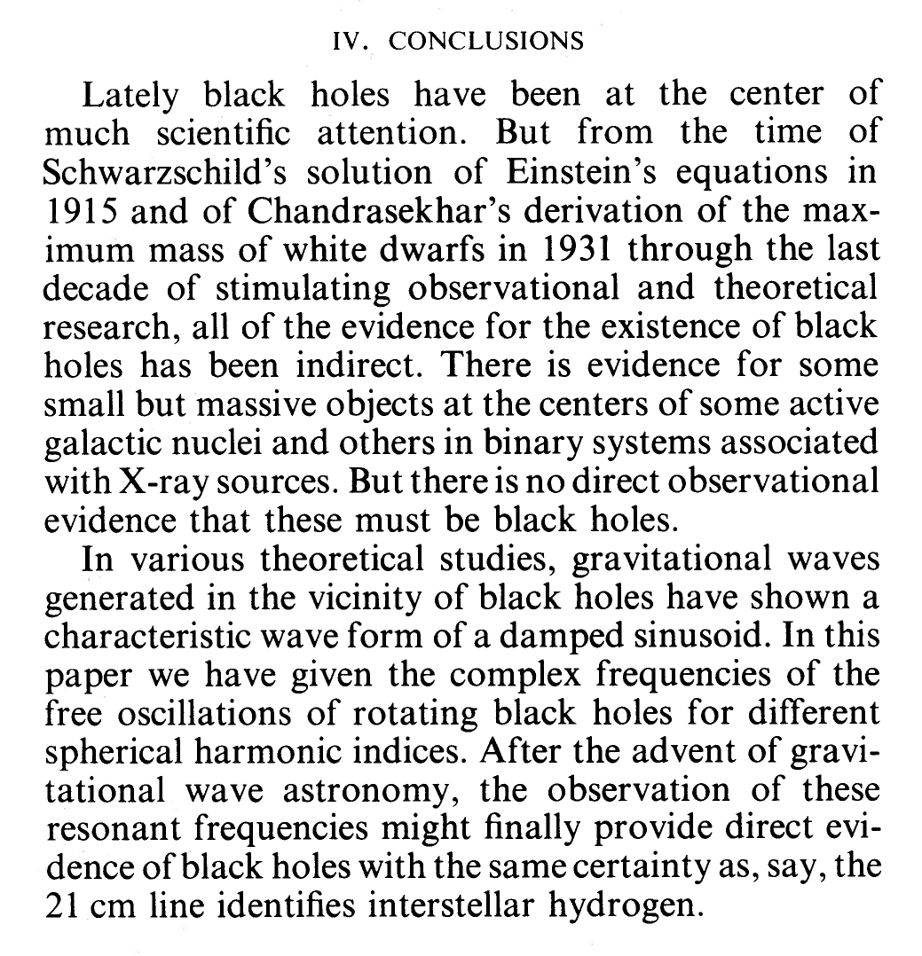
Holeseismology…
Notes:
So, this is my introduction. The reason why black hole spectroscopy or black hole seismology is exciting is due to uniqueness results:

Slide 11
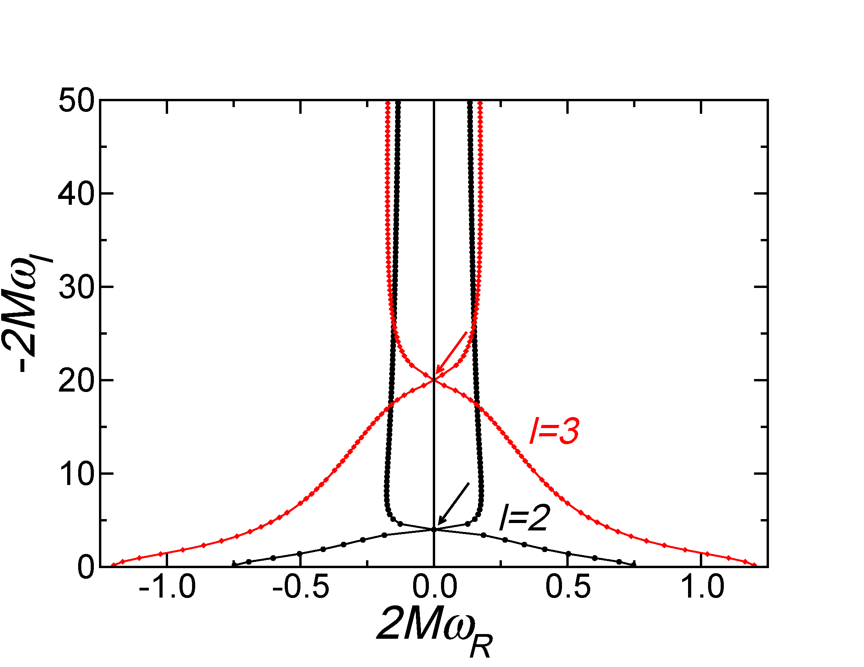
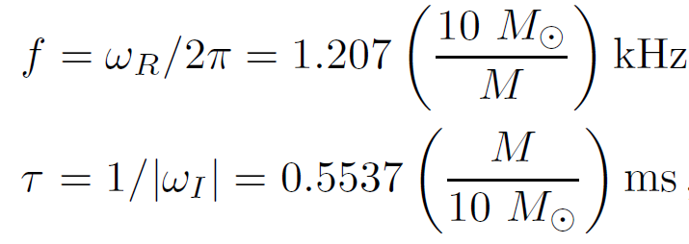
Quality factors of ~3. Black holes don’t ring, they relax with a thud.
Berti, Cardoso and Starinets CQG 26: 163001 (2009)
Notes:
Go to notes

Slide 12
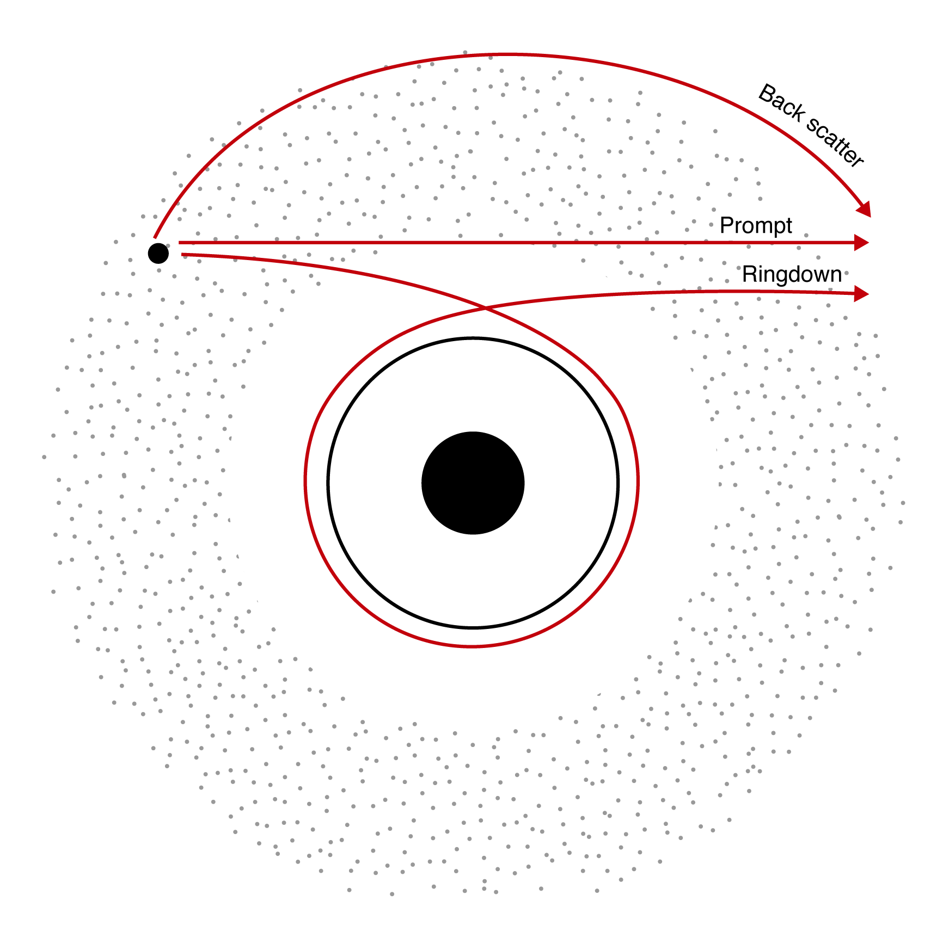
When is a linear ringdown description valid?
Light ring
Image: Ana Carvalho
Leaver PRD34:384 (1986); Baibhav + arXiv:2302.03050; Nee+ PRD108:044032 (2023)

Slide 13
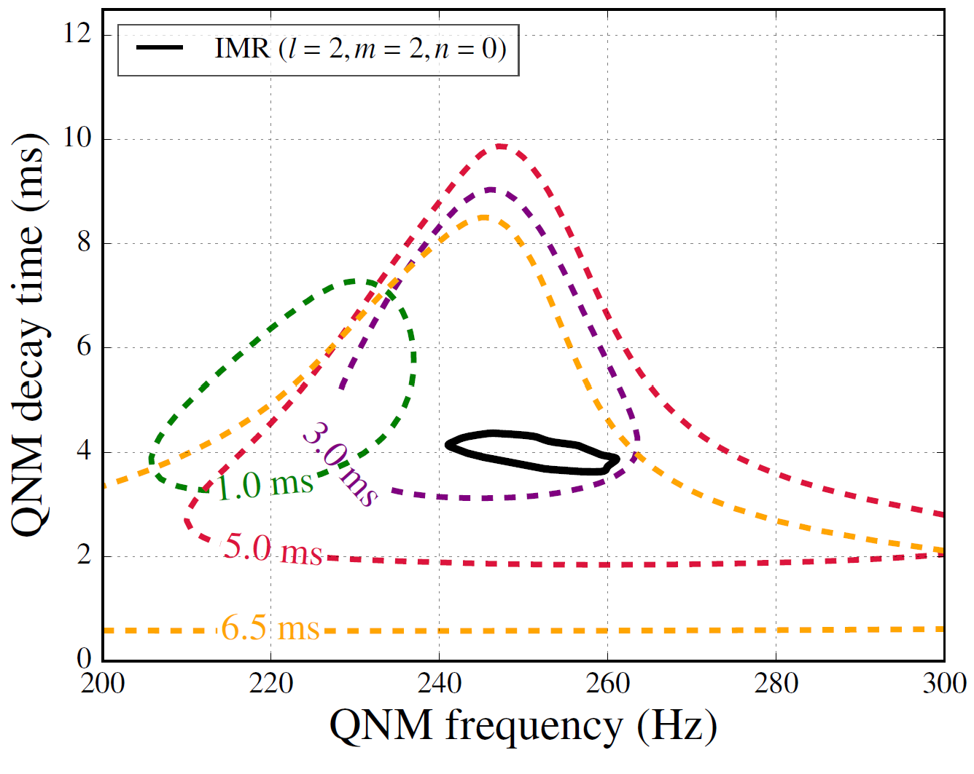
One and two-mode estimates: the start of spectroscopy
90% posterior distributions.
Black solid is 90% posterior of QNM as derived from the posterior mass and spin of remnant
LSC PRL116:221101 (2016); arXiv:2010.14529; For future detectors, Berti+ PRL117:10102 (2016)

Slide 14
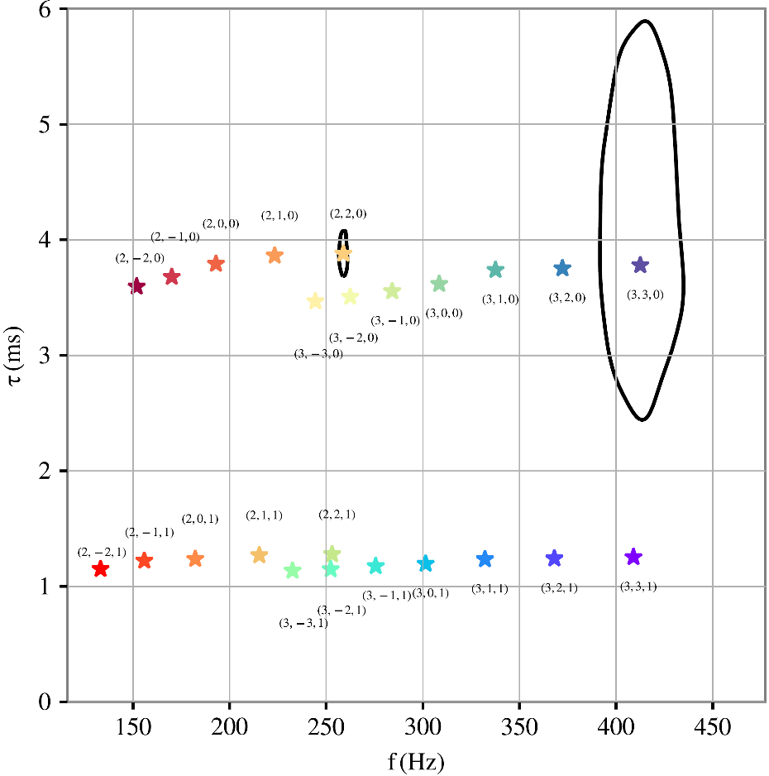
One and two-mode estimates: the start of spectroscopy
90% posterior distributions.
Black solid is 90% posterior of QNM from a future event with SNR=40 in ringdown.
LISA will see SNRs of thousands…
Courtesy of Gregorio Carullo
See also Berti+ PRL117:10102 (2016); Bhagwat+ arXiv:2304.02283

Slide 15
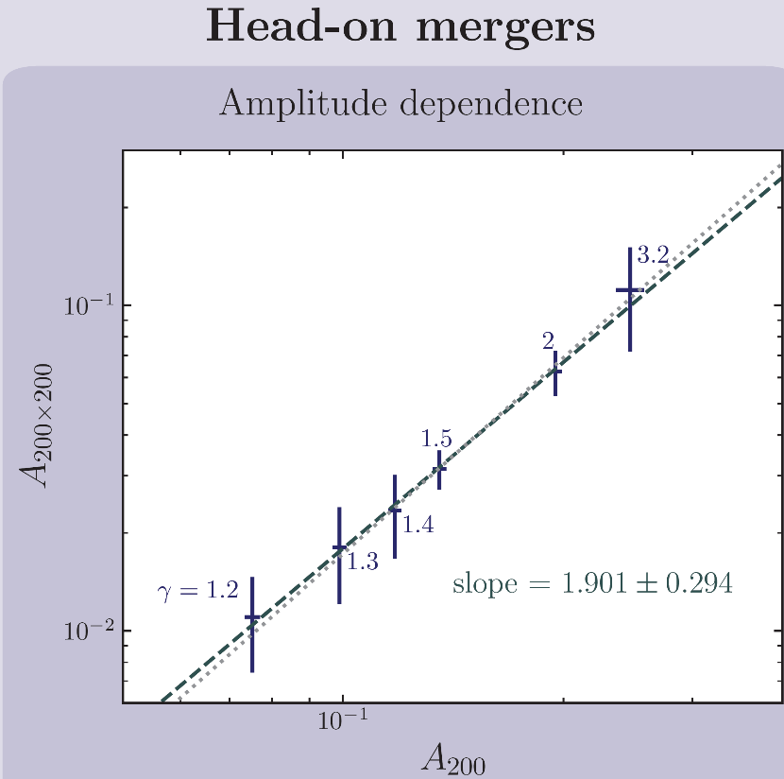
Nonlinearities in ringdown
Cheung + PRL130:8 (2023)

Slide 16
Nonlinearities in ringdown
$$R_{220×220}=\frac{A_{220×220}}{A_{220}^{2}}$$
For quasi-circular inspirals of non spinning binaries, from NR:
$$R_{220×220}=0.16$$
It is not hopelessly small!
Similar number recovered from near-horizon symmetries (“Kerr/CFT”)
Cheung+ PRL130:8 (2023); also Ma+ arXiv 2207.10870; Mitman+ arXiv 2208.07380; see Kehagias+ arXiv:2301.09345 for Kerr/CFT

Slide 17
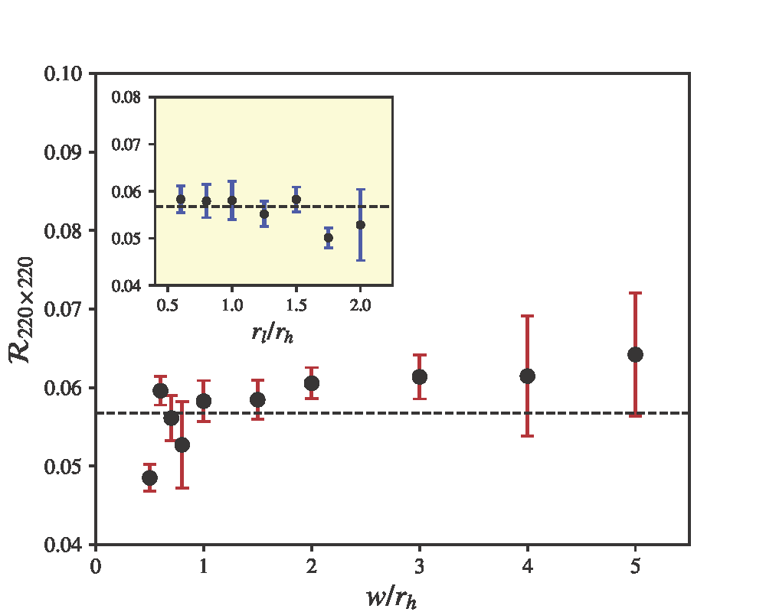
Nonlinearities in ringdown: second-order
Second order amplitude only weakly dependent on ID
Redondo-Yuste + arXiv:2308.14796

Slide 18
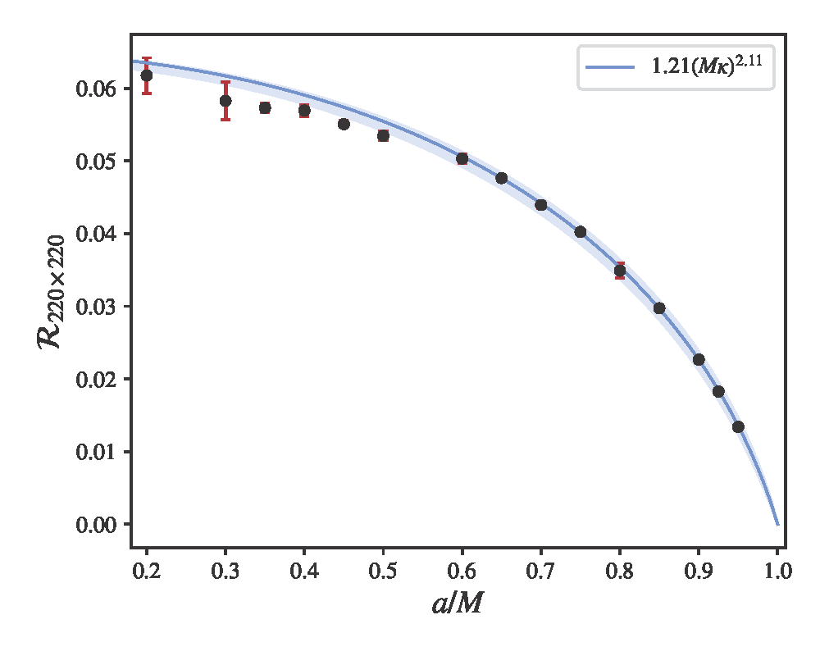
Nonlinearities in ringdown: second-order
But dependent on spin…raising doubts about Kerr/CFT applications
Redondo-Yuste + arXiv:2308.14796

Slide 19
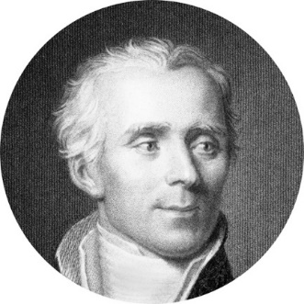
Testing black hole nature
BH exterior is pathology-free, interior is not.
Dark matter exists, and interacts gravitationally. Are there compact DM clumps?
Physics is experimental science. We can test exterior. Aim to quantify evidence for horizons. Similar to quantifying equivalence principle.
“Plus un fait est extraordinaire, plus il a besoin d'être appuyé de fortes preuves; car, ceux qui l'attestent pouvant ou tromper ou avoir été trompés, ces deux causes son d'autant plus probables que la réalité du fait l'est moins en elle-même.…” Laplace, Essai philosophique sur les probabilities 1812

Slide 20
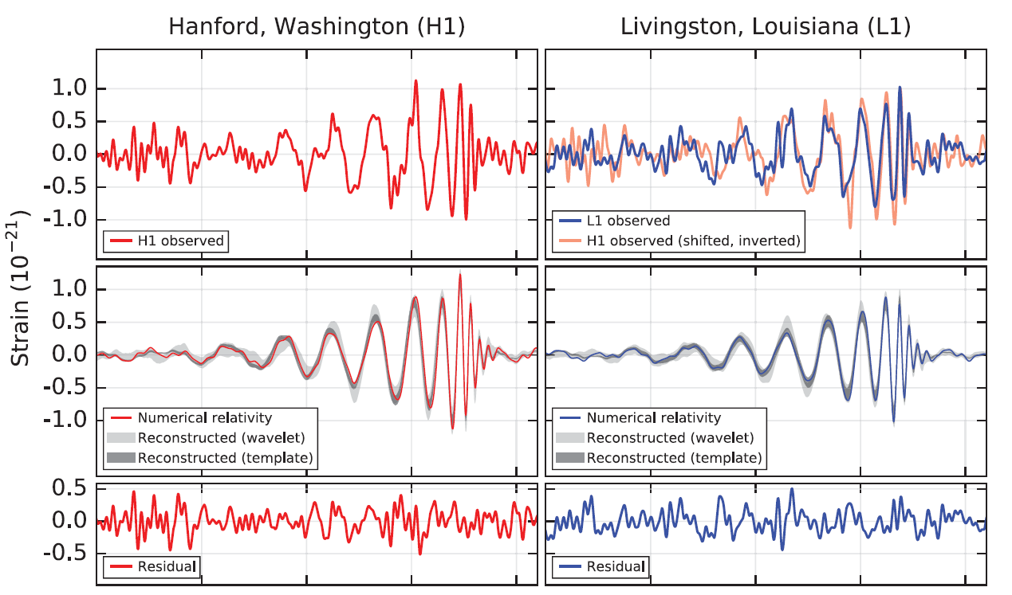
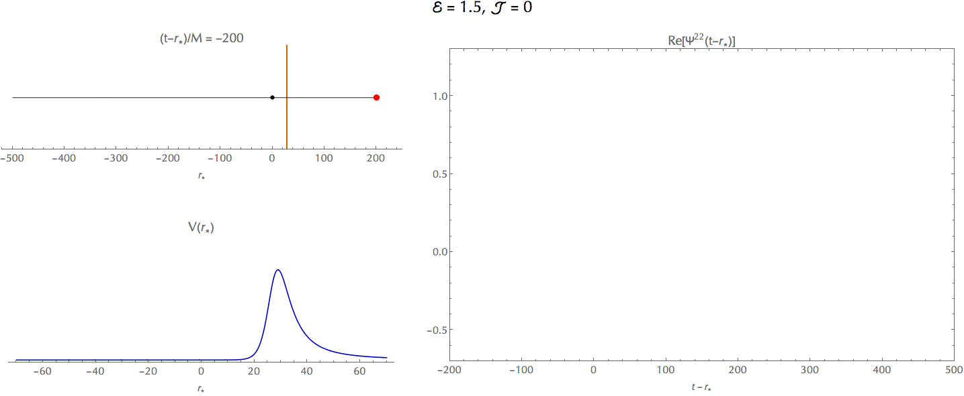
Post-merger

Slide 21
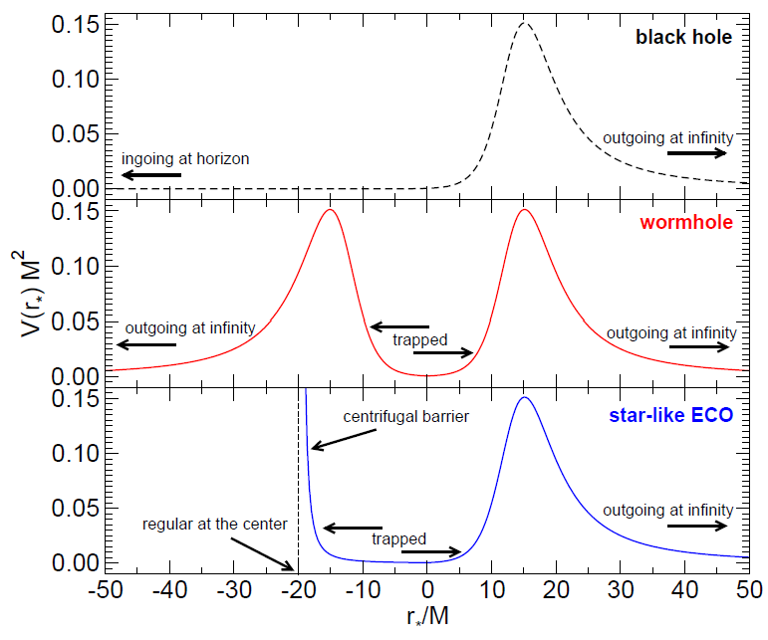
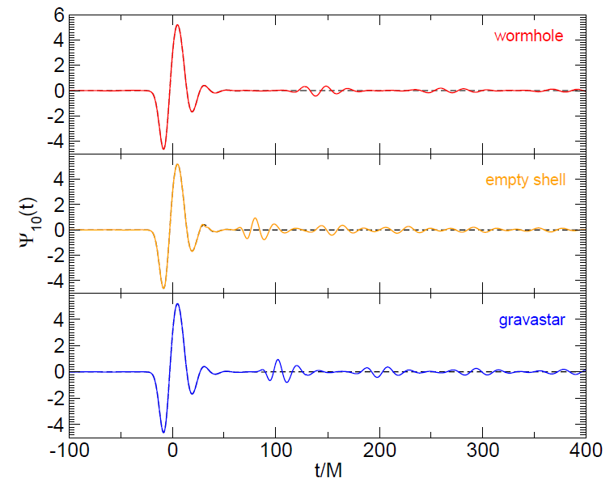
Echoes
Cardoso + PRL116:171101 (2016); Cardoso and Pani, Nature Astronomy 1: 2017
Cardoso and Pani, Living Reviews in Relativity 22:1 (2019) See also Abedi+ PRD96:082004 (2017); LIGO/Virgo Collaboration arXiv:2010:14529; arXiv:2112.06861

Slide 22
Gravitational waves & dark matter I
Inspiral occurs in DM-rich environment and may modify the way inspiral proceeds, given dense-enough media: accretion and gravitational drag play important role.
Eda + PRL110:221101 (2013); Macedo + ApJ774:48 (2013); Cardoso + AA644: A147 (2020) Kavanagh + arXiv 2002.12811; Annulli + PRD102: 063022 (2020)

Slide 23
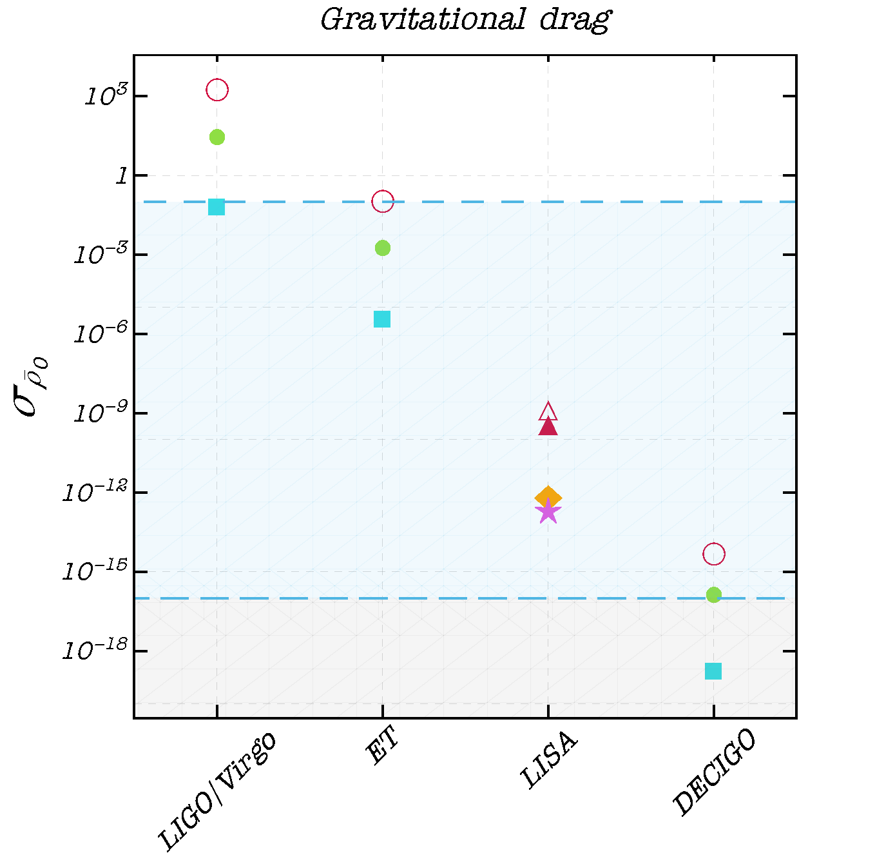
Small Compton wavelength: heavy DM
GW150914
GW170608
GW170817
IMRI
EMRI
MBBH high spin
IMBBH low spin
Effect is -5.5 PN on GW phase
Cardoso & Maselli AA644: A147 (2020) arXiv 1909.05870
Also Eda + PRL 110 (2013) 221101; Macedo+ApJ774 (2013) 48; Annulli+ PRD102;063022 (2020)

Slide 24
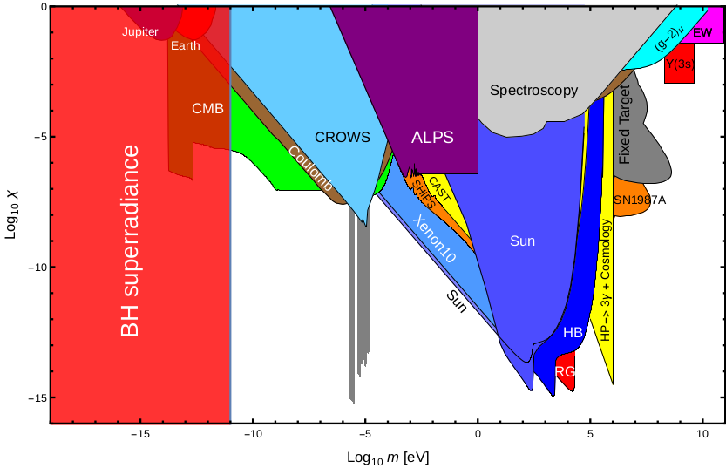
Particle detectors in the sky: dark matter II
Cardoso+ 2018, adapted from Sigl (2017) and Jaeckel arXiv:1303.1821
Interesting as effective description; proxy for more complex interactions;
arise as interesting extensions of GR* (BD or generic ST theories, f(R), etc)
Bosons do exist (Higgs) and lighter versions may as well
Peccei-Quinn (interesting because not invented to solve DM problem),
axiverse (moduli and coupling constants in string theory)
...and one or more could be a component of DM.
Notes:
Strong CP: smallness of neutron EDM

Slide 25
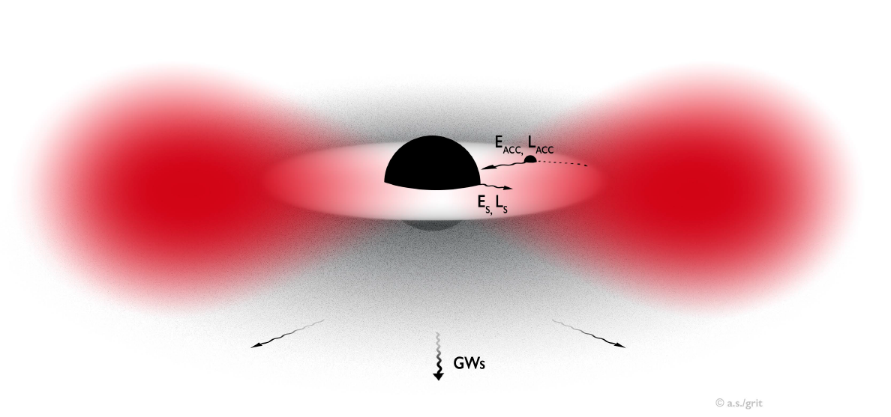
Fundamental fields: particle detectors in the sky
Wonderful sources of GWs
Brito, Cardoso, Pani, Lecture Notes Physics 971 (2020)
Notes:
M\mu*G/(ch)=7.5 (M/Modot)(mu/10^(-9)eV)

Slide 26
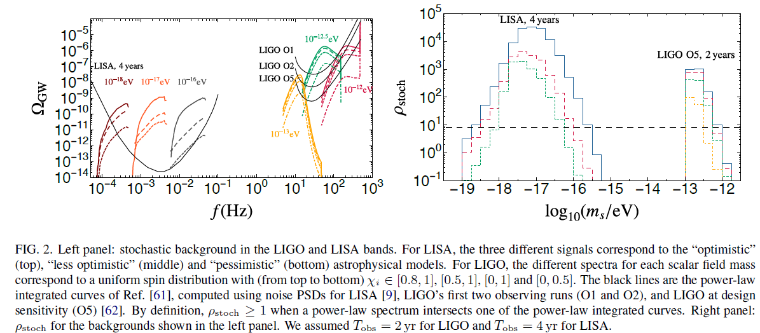
Wonderful sources for different detectors
Brito + PRL119: 131101 (2017); Tsukada + arXiv: 2011.06995; Yuan + arXiv:2106.00021

Slide 27
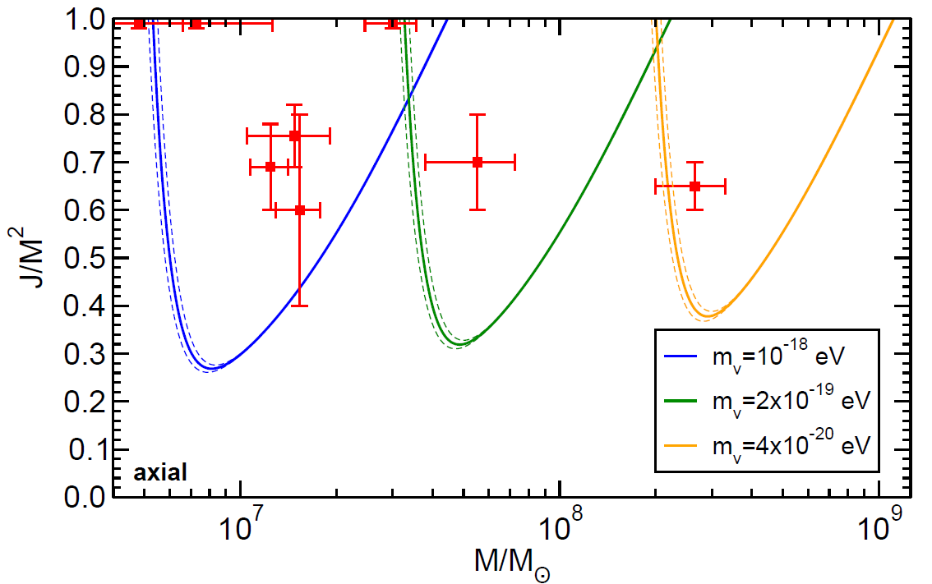
Bounding the boson mass with EM observations
Pani + PRL109, 131102 (2012)
Bound on photon mass is model-dependent: details of accretion disks or intergalactic matter are important... but gravitons interact very weakly!
Brito + PRD88:023514 (2013); Review of Particle Physics 2014

Slide 28
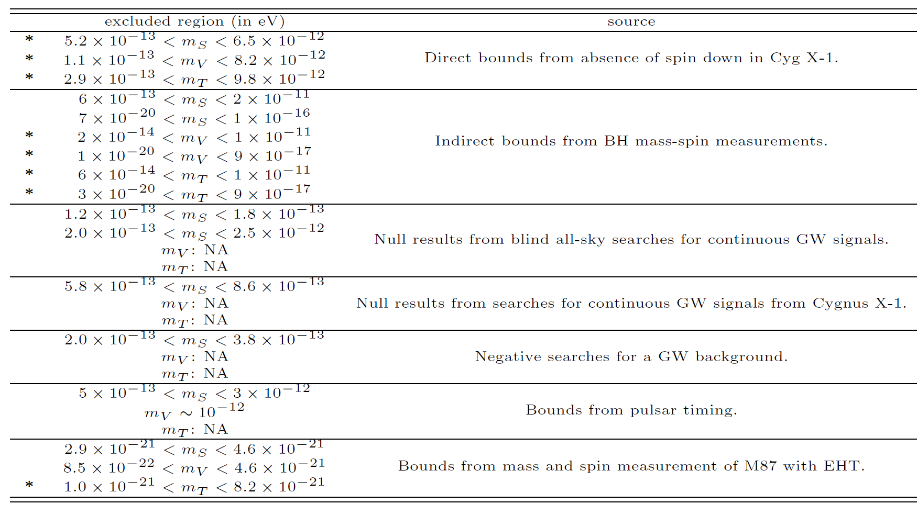
Constraints on fundamental fields via superradiance
Brito, Cardoso & Pani, Superradiance, Lecture Notes Physics 971 (2020)

Slide 29
Conclusions: exciting times!
Gravitational wave astronomy will become a precision discipline, mapping compact objects throughout the entire visible universe.
Strong field gravity is a fascinating topic. From precise maps of Universe to tests of Cosmic Censorship or constraints on dark matter, possibilities are endless & exciting. Black holes respond in simple way to external perturbations, and may serve as detectors for nontrivial environments.
Black holes remain the most outstanding object in the universe.
Spectroscopy will allow to test GR and provide strong evidence for the presence of horizons... improved sensitivity pushes putative surface closer to horizon, like probing short-distance structure with accelerators.

Slide 30
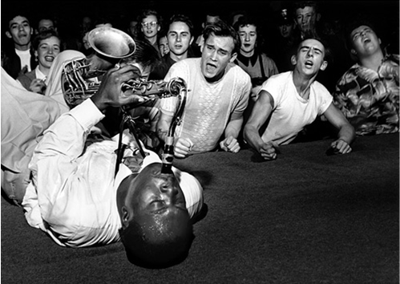
Big Jay Mc Neely, Photograph by Bob Willoughby
“Imagine being able to see the world but you are deaf, and then suddenly someone gives you the ability to hear things as well — you get an extra dimension of perception”
B. Schutz, BBC

Slide 31
Thank you

Slide 32
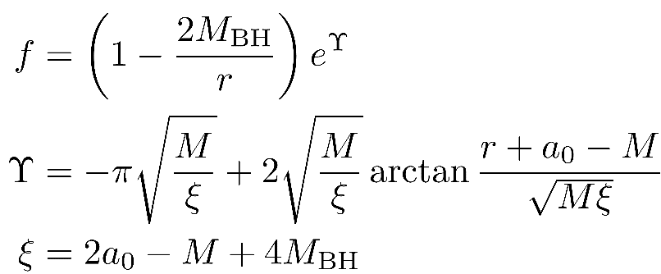
Vacuum is an illusion: galaxy tomography?
Cardoso + PRD105:L061501 (2022); PRL129:241103 (2022)
Black holes in galaxies: an Einstein Cluster prescription (Einstein 1939)
Assume averaged stress-tensor
Impose spherical symmetry
Assign mass function
Solve field equations
Hernquist ApJ356:359 (1990)
Generalization to other profiles is straightforward. see Figueiredo + arXiv:2303.08183

Slide 33
Environments: galaxy tomography?
Cardoso+ PRDL061501 (2022); PRL129:241103 (2022); Figueiredo + arXiv:2303.08183
Two ingredients play a role:
1. Compactness of distribution $\frac{M}{a_{0}}$, which dictates geometry & wave generation effects. For typical galaxies $\frac{M}{a_{0}}$=${10}^{−4}$- ${10}^{−6}.$For dark matter spikes one can pump up to ${10}^{−3}$.
2. Density ρ which governs matter effects (dynamical friction etc)

Slide 34
Environments: galaxy tomography?
Cardoso+ PRDL061501 (2022); PRL129:241103 (2022); Figueiredo + arXiv:2303.08183
Thus EHT physics affected to levels of ${10}^{−8}$ only, for expected parameters
(tests on nature of compact objects can be done to very good precision)

Slide 35
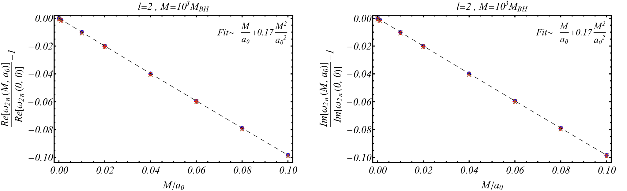
Light-ring corrections

Slide 36
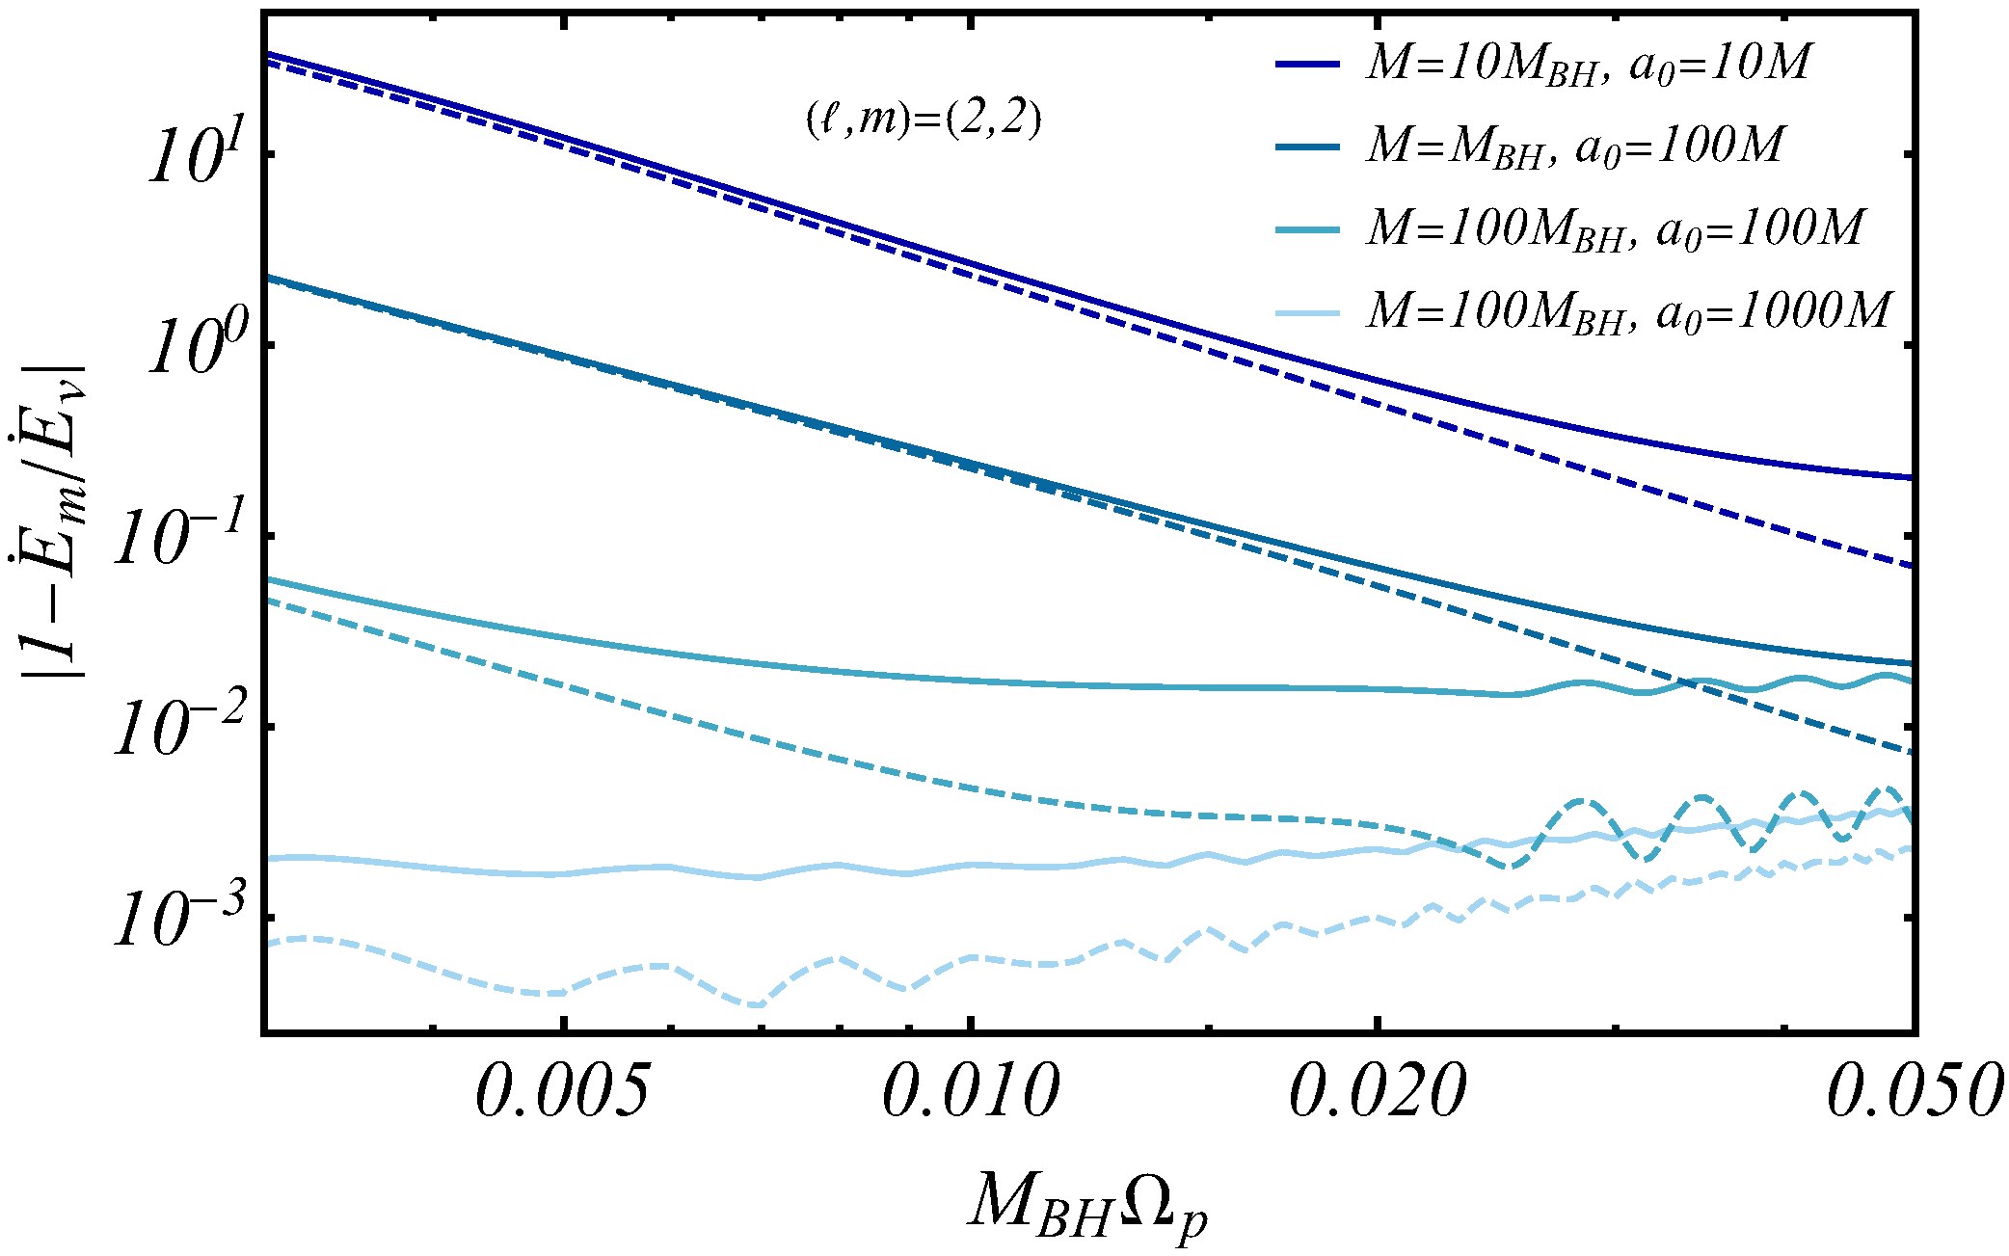
Environments: a fully relativistic analysis
Cardoso+ PRL129:241103 (2022); Figueiredo + arXiv:2303.08183

Slide 37
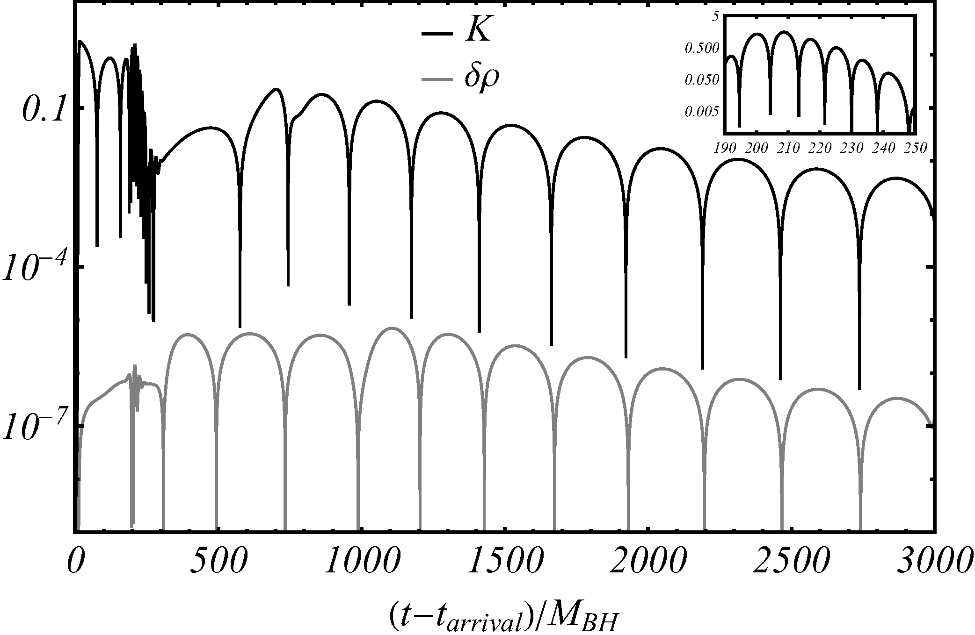
Spectral instability in action
Cardoso+ PRL129:241103 (2022)
Light ring modes (BH ringdown)
Fluid modes

Slide 38
Some questions
Spectral instability: prompt change to ringdown?
Requirements for detection?
Mode excitation by turbulent accretion disks?
Rotation, memory and tails in presence of environments
Nonlinearities and mass and spin evolution
Nonlinearities and gravitational turbulence
Are low-frequency detectors able to perform galaxy tomography?

