Slide 1

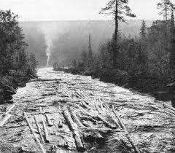

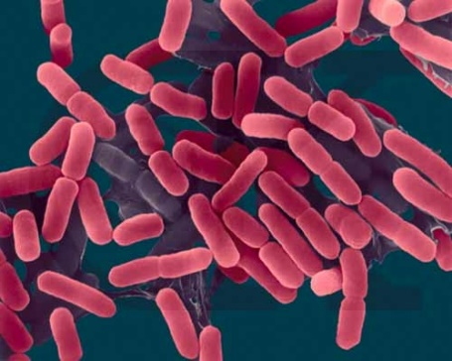
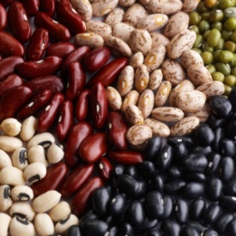
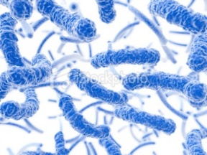
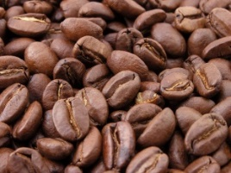
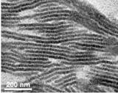
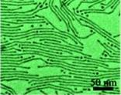
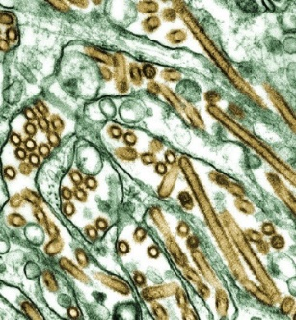
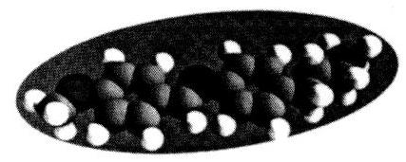
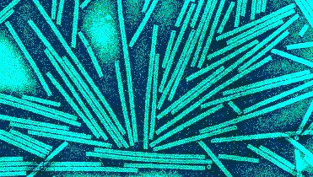
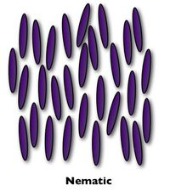
Flow of elongated particles
Tamás Börzsönyi, Wigner Research Centre for Physics, Budapest, Hungary
logs on a river
agriculture, foods
bacteria
nanorods, nanowires
nematic liquid crystals
viruses
MBBA molecule
Collaborators:
Tivadar Pongó, Bo Fan, Balázs Szabó, János Török, Ellák Somfai
Ralf Stannarius, Raul Cruz Hidalgo
www.szfki.hu/~btamas

Slide 2
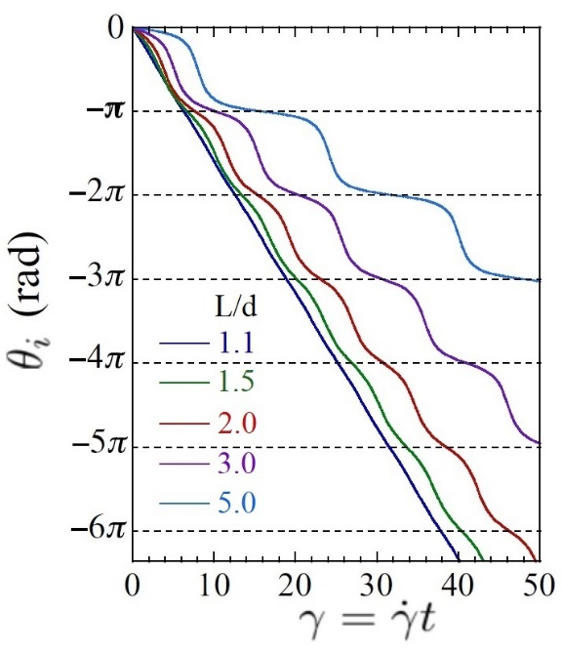
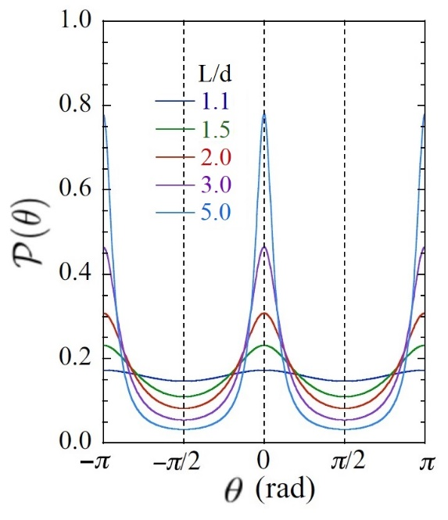
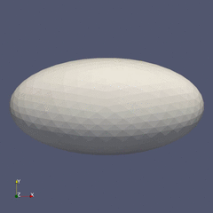
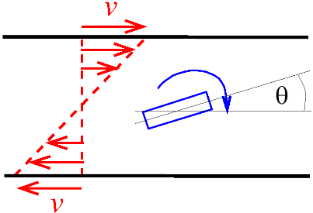
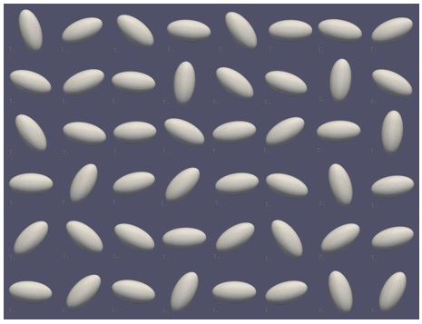
Particle orientation as a function of shear deformation
Probability distribution of particle orientation
Ellipsoid in a liquid in shear flow
particle elongation: L/d
Marschall, Teitel, PRE 2020
Jeffery,
1922
L/d=2
D. Das
Elongated grains in a shear flow: rotation.
The rotation velocity is not constant.
Fast rotation when the particle is perpendicular to the flow.
Slow rotation when the particle is parallel to the flow.

Slide 3
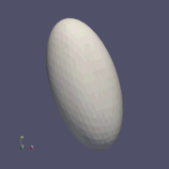
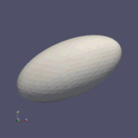
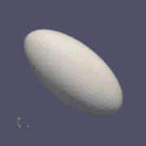
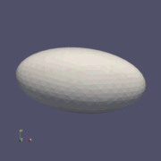
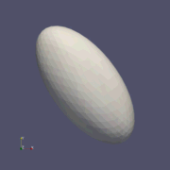
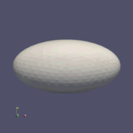
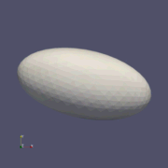
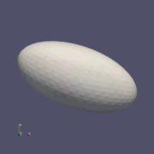
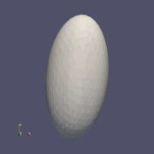
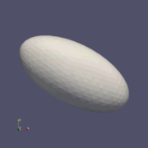
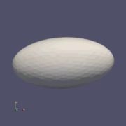
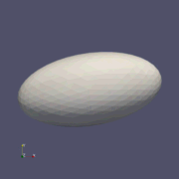
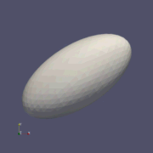
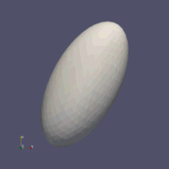
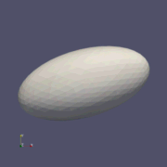
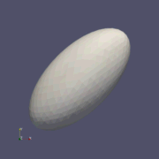
Particle orientation as a function of shear deformation
Probability distribution of particle orientation
Ellipsoid in a liquid in shear flow
particle elongation: L/d
Marschall, Teitel, PRE 2020
Jeffery,
1922
L/d=2
D. Das
Elongated grains in a shear flow: rotation.
The rotation velocity is not constant.
Fast rotation when the particle is perpendicular to the flow.
Slow rotation when the particle is parallel to the flow.
Tegze, et al. Soft Matter 2020

Slide 4
Particle orientation as a function of shear deformation
Probability distribution of particle orientation
Ellipsoid in a liquid in shear flow
particle elongation: L/d
Marschall, Teitel, PRE 2020
Jeffery,
1922
L/d=2
D. Das
Elongated grains in a shear flow: rotation.
The rotation velocity is not constant.
Fast rotation when the particle is perpendicular to the flow.
Slow rotation when the particle is parallel to the flow.

Slide 5
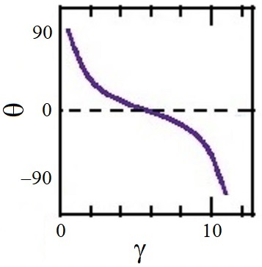
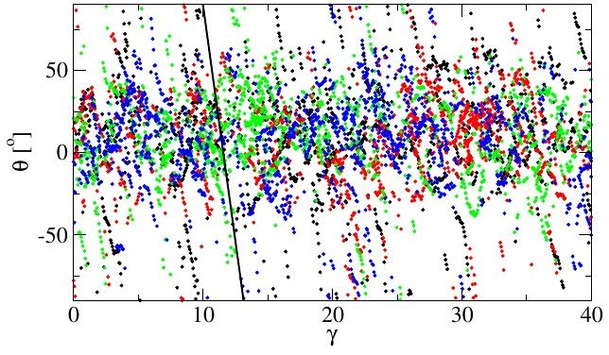
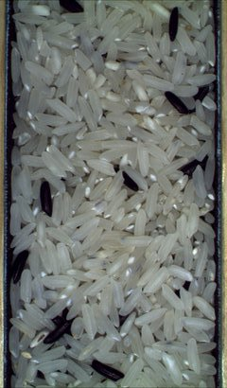
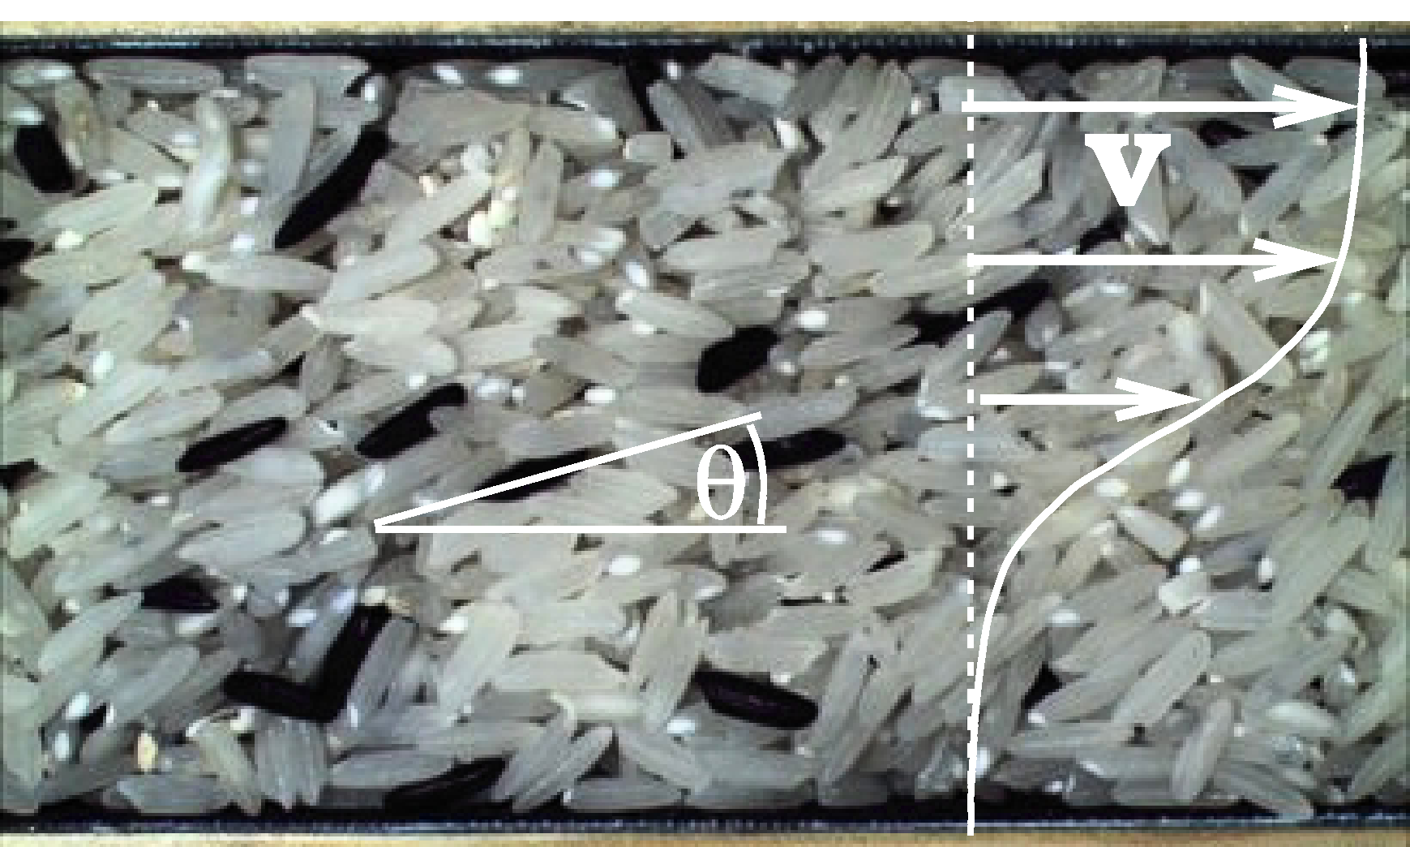

Ellipsoid in a liquid:
Experiments with a dry granular material:
Marschall, Teitel, PRE 2020
Börzsönyi et al., PRL 2012
Börzsönyi et al., PRE 2012
Instead of this
we get this
Glass rods (L/d=3.5)
L/d=3
www.szfki.hu/~btamas

Slide 6
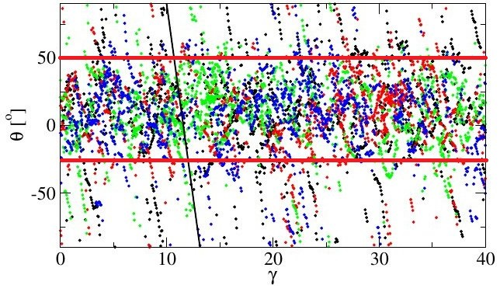
Ellipsoid in a liquid:
Experiments with a dry granular material:
Marschall, Teitel, PRE 2020
Börzsönyi et al., PRL 2012
Börzsönyi et al., PRE 2012
Instead of this
we get this
Glass rods (L/d=3.5)
L/d=3
www.szfki.hu/~btamas

Slide 7
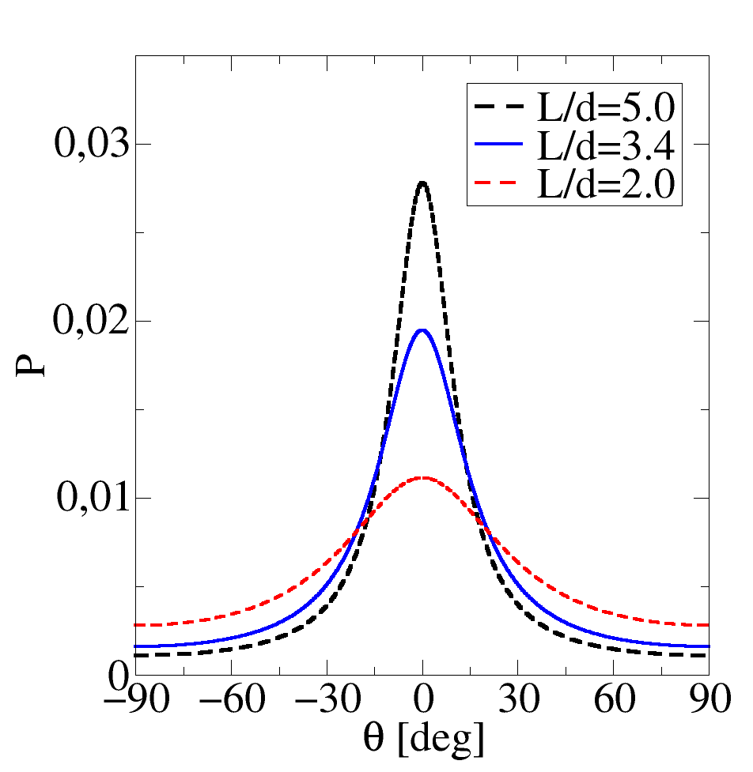
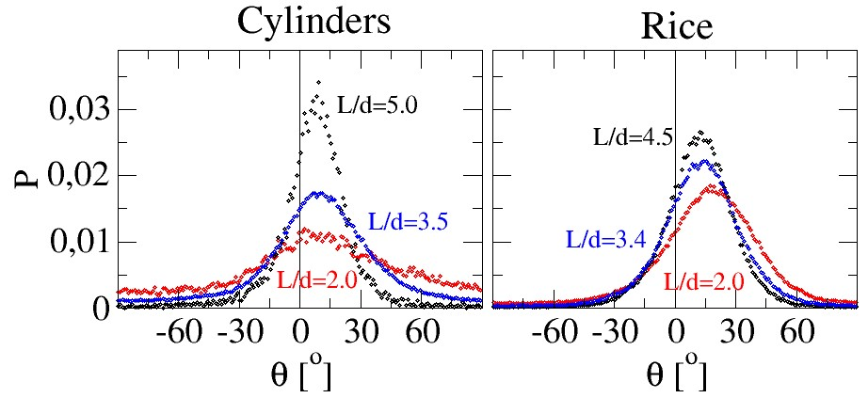
Ellipsoid in a liquid:
Experiments with a dry granular material:
Marschall, Teitel, PRE 2020
Börzsönyi et al., PRL 2012
Börzsönyi et al., PRE 2012
Instead of this
we get this
Glass rods (L/d=3.5)
L/d=3

Slide 8
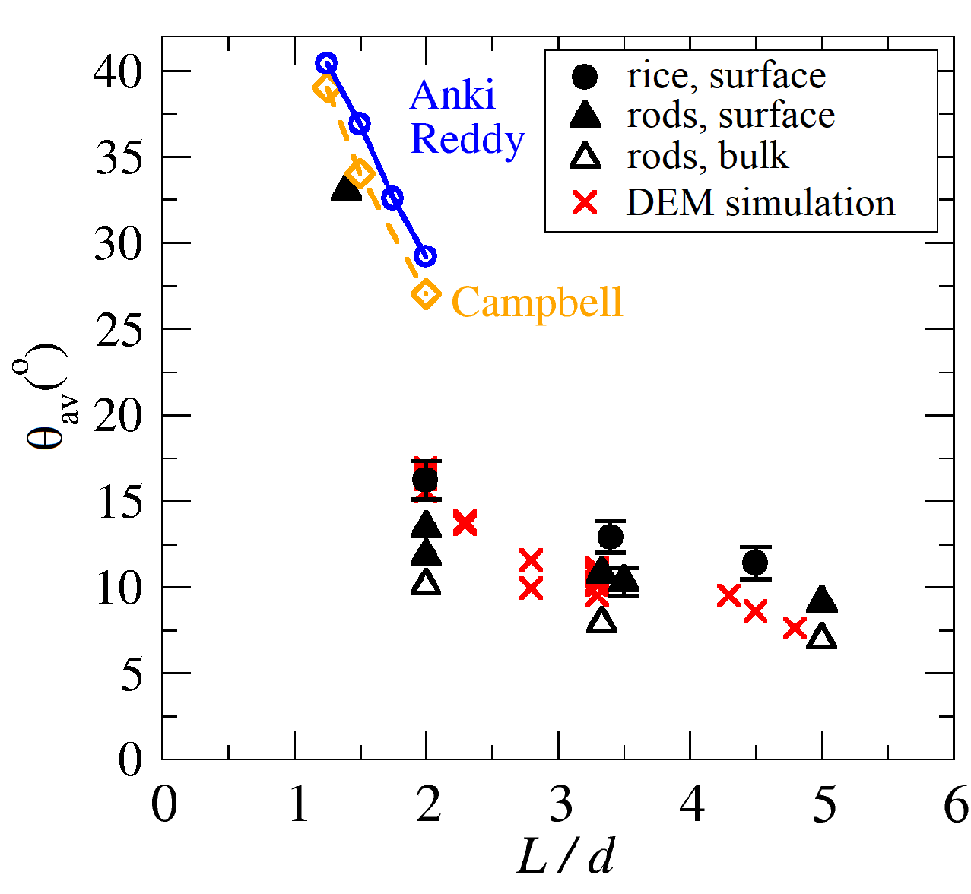
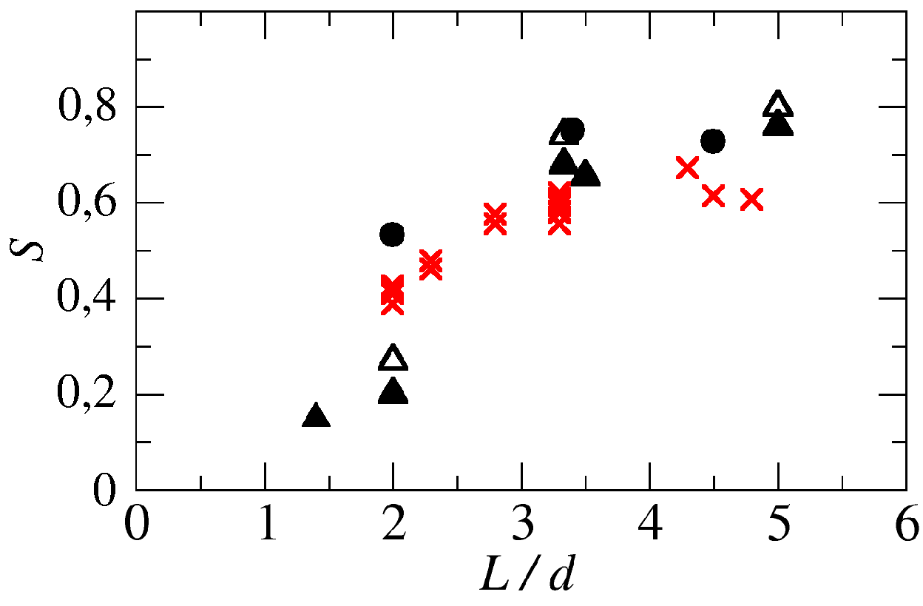
Average angle
Order parameter

Slide 9
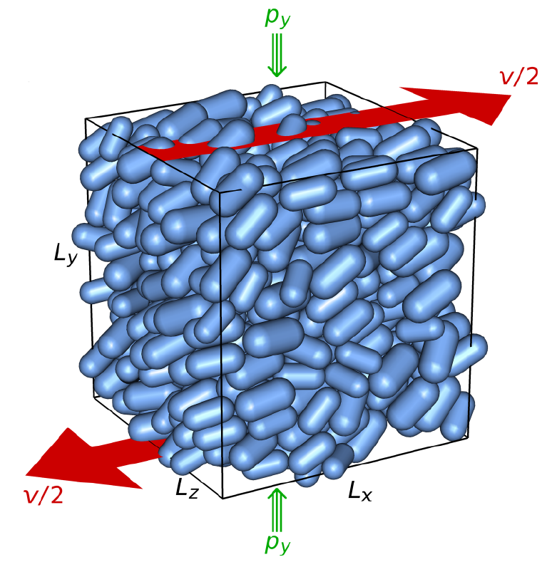
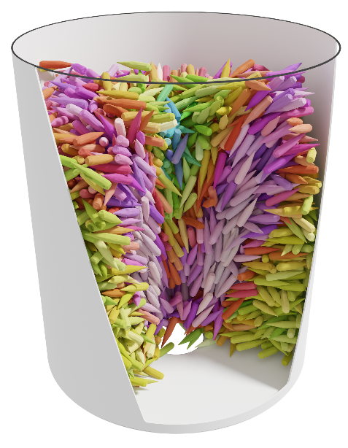
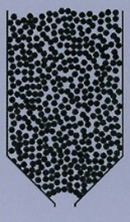
What flows easier, spheres or elongated grains?
Effective friction
Flow out of a silo
Clogging
Pongó, Fan, Delfin, Török,
Stannarius, Hidalgo, Börzsönyi
New J. Phys. 2022
Ashour, Wegner, Trittel,
Börzsönyi, Stannarius
Soft Matter 2017
Nagy, Claudin, Börzsönyi, Somfai
New J. Phys. 2020

Slide 10
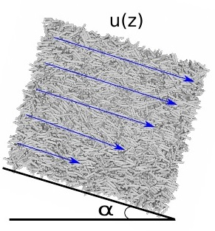
Effective friction (DEM simulations)
Simple shear
Inclined plane flow
Small Intertial Number, quasistatic limit
Larger Intertial Number
Nagy, Claudin, Börzsönyi, Somfai,
New J. Phys. 2020
Hidalgo, Szabó, Gillemot, Börzsönyi, Weinhart,
Phys. Rev. Fluids 2018

Slide 11
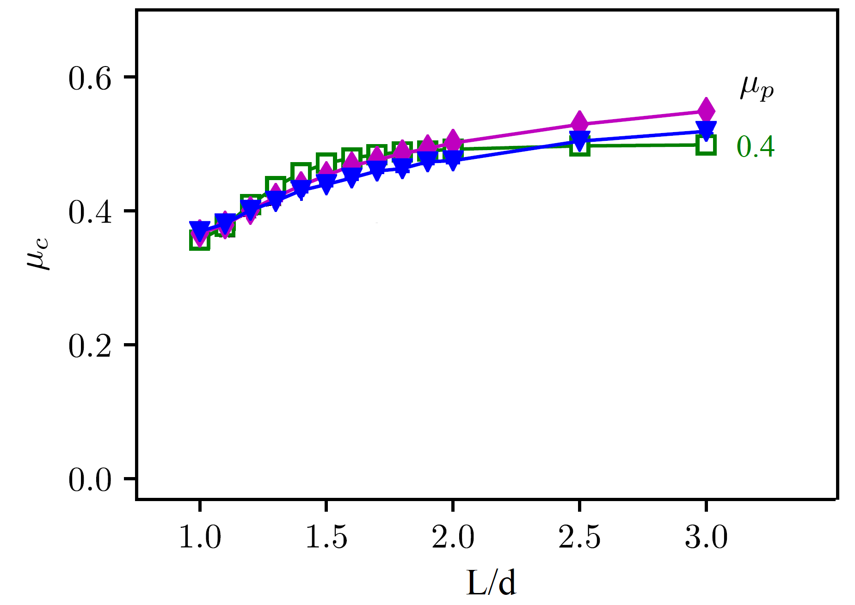
Spherocylinders exposed to shear (DEM simulations)
Nagy, Claudin, Börzsönyi, Somfai, New J. Phys. 2020
www.szfki.hu/~btamas

Slide 12
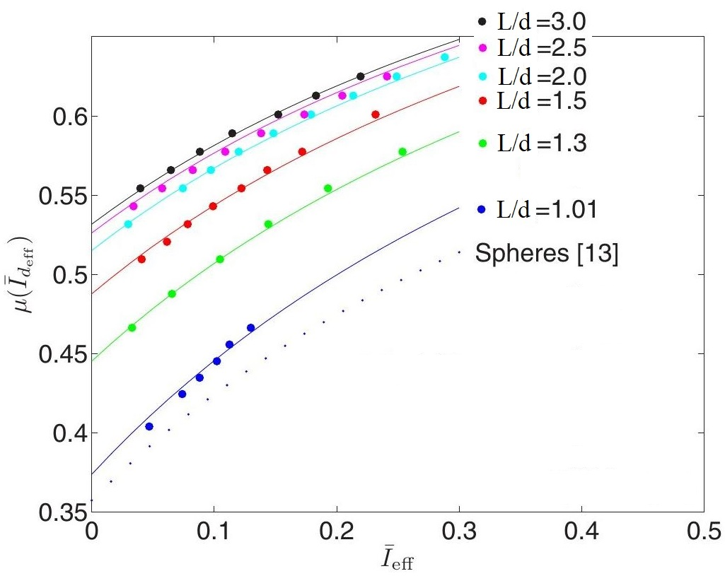
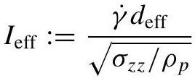
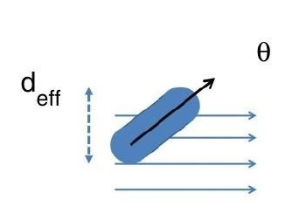
Frictional spherocylinders on an inclined plane
Hidalgo, Szabó, Gillemot, Börzsönyi, Weinhart,
Phys. Rev. Fluids 2018
(normalized shear rate)
www.szfki.hu/~btamas

Slide 13
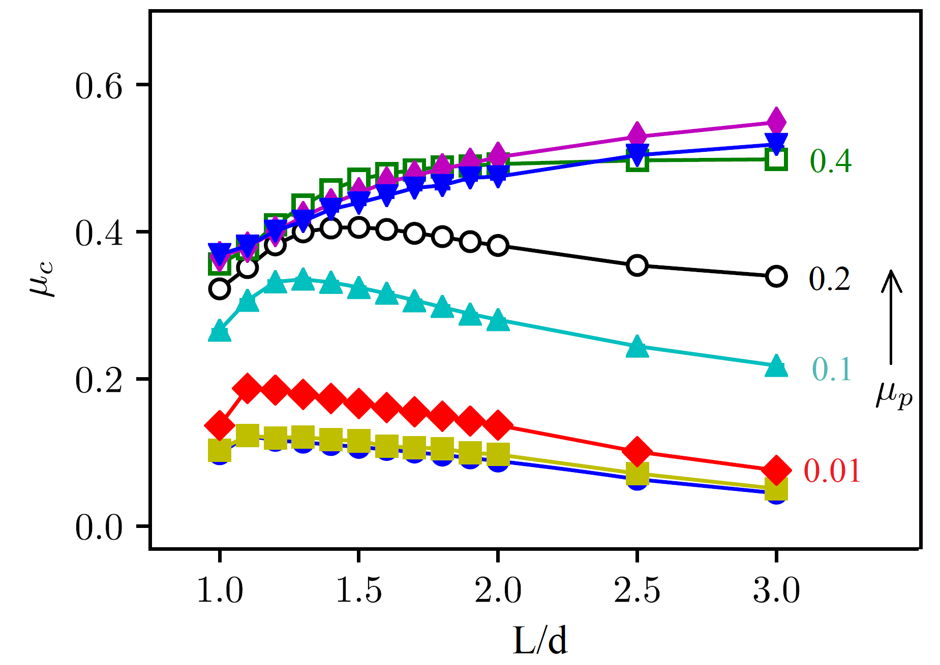
Effective friction
Nagy, Claudin, Börzsönyi, Somfai, New J. Phys. 2020
DEM simulations
www.szfki.hu/~btamas

Slide 14

Effective friction
Nagy, Claudin, Börzsönyi, Somfai, New J. Phys. 2020
DEM simulations
www.szfki.hu/~btamas

Slide 15


Effective friction
Nagy, Claudin, Börzsönyi, Somfai, New J. Phys. 2020
DEM simulations
bead
lentil
rice
experiments
www.szfki.hu/~btamas

Slide 16



Silo flow and clogging

Slide 17





Silo flow rate as a function of grain shape
Pongó et al.
New J. Phys. (2022)

Slide 18



Clogging statistics
Critical radius increases with grain elongation
Higher probability for clogging with increasing grain elongation
Ashour, Wegner, Trittel, Börzsönyi, Stannarius, Soft Matter 2017
www.szfki.hu/~btamas

Slide 19





Summary
orientation distribution
Elongated grains in shear flow:
average grain alignment nearly parallel to flow
Börzsönyi et al., PRL 2012, PRE 2012
average angle
Börzsönyi, Stannarius, Soft Matt. 2013
Effective friction increases with elongation
DEM simulation
Hidalgo et al. Phys. Rev. Fluids 2018
Nagy et al. New J. Phys 2020
experiment
Silo: flow rate and decreases,
clogging probability increases
with elongation
Ashour et al.
Soft Matter 2017
Pongó et al.
New J. Phys. (2022)
www.szfki.hu/~btamas

Slide 21


Silo flow rate as a function of grain shape
rotational ellipsoids

Slide 22


Evolution of angle distribution from a random initial configuration
www.szfki.hu/~btamas

Slide 23

Evolution of angle distribution from a random initial configuration
www.szfki.hu/~btamas

Slide 24

Average angle
Order parameter

Slide 25


Weak shear rate dependence
Order parameter
Average angle

Slide 26

Experimental characterization of the resistance of the material against shearing
rotational ellipsoids
Split bottom shear cell
quasistatic flow
bead
lentil
rice
www.szfki.hu/~btamas

Slide 27



Shear induced dilation vs. ordering
Orientational ordering only partially compensates Reynolds dilation
Lentils
Rods L/d=3.3
Plastic spheres
Rods L/d=2
Peas
www.szfki.hu/~btamas
Wegner, Stannarius, Bose, Rose, Szabó, Somfai, Börzsönyi, Soft Matter 2014

Slide 28


pegs, L/D = 5.0
chocolate lentils
beads
pegs, L/D = 3.3
airsoft balls
D = 2.5 cm
Φ = 50º
pegs, L/D = 2.0
peas
rods

Slide 29






Horizontal velocity profiles
profiles at h=60d
z
x
Elongated grains:
- flowing channel is narrower
- larger velocity fluctuations
Szabó, Kovács, Wegner, Ashour, Fischer, Stannarius, Börzsönyi, Phys. Rev. E 2018
www.szfki.hu/~btamas

Slide 30





Flow rate as a function of mass in the silo
D_{silo}/d* =32
D_{silo}/d* =31.7
D_{silo}/d* =31.7
Pongó, Fan, Hernández-Delfin, Török, Stannarius, Hidalgo, Börzsönyi, New J. Phys. 2022

Slide 32




Dry granular material exposed to shear – grain orientations
Alignment angle θ_{av} does not depend
on shear rate
θ_{av} decreases with L/d
www.szfki.hu/~btamas

Slide 33




Comparison with DEM simulations
János Török
(Budapest)
LIGGGHTS
www.szfki.hu/~btamas

Slide 34



Secondary flow and heaping
Flow perpendicular to the primary flow lines will develop in a complex geometry
Lentils
X-ray CT detection of secondary flow
Rods L/d=5
Plastic spheres
Rods L/d=3.3
Peas
Rods L/d=2
Wortel, Börzsönyi, Somfai, Wegner, Szabó, Stannarius, van Hecke Soft Matter 2015
Fischer, Börzsönyi, Nasato, Pöschel, Stannarius, New J. Phys. 2016
www.szfki.hu/~btamas

Slide 35

Secondary flow and heaping
Flow perpendicular to the primary flow lines will develop in a complex geometry
Lentils
X-ray CT detection of secondary flow
Rods L/d=5
Plastic spheres
Rods L/d=3.3
Peas
Rods L/d=2
Wortel, Börzsönyi, Somfai, Wegner, Szabó, Stannarius, van Hecke Soft Matter 2015
Fischer, Börzsönyi, Nasato, Pöschel, Stannarius, New J. Phys. 2016
www.szfki.hu/~btamas

Slide 36

Secondary flow and heaping
Flow perpendicular to the primary flow lines will develop in a complex geometry
Rod climbing:
Weissenberg effect
Lentils
X-ray CT detection of secondary flow
Rods L/d=5
Plastic spheres
Rods L/d=3.3
Peas
Rods L/d=2
Wortel, Börzsönyi, Somfai, Wegner, Szabó, Stannarius, van Hecke Soft Matter 2015
Fischer, Börzsönyi, Nasato, Pöschel, Stannarius, New J. Phys. 2016
www.szfki.hu/~btamas

Slide 37



d
effective diameter
d*
L
V_{rod} = V_{bead}
Investigate the effect of particle shape on the
- flow field in the silo

Slide 38

Flow rate as a function of mass in the silo
D_{silo}/d* =32
D_{silo}/d* =31.7
D_{silo}/d* =32
D_{silo}/d* =31.7
Pongó, Fan, Hernández-Delfin, Török, Stannarius, Hidalgo, Börzsönyi, New J. Phys. 2022

Slide 39

www.szfki.hu/~btamas
Nagy, Claudin, Börzsönyi, Somfai, New J. Phys. 2020

Slide 40


Phytoplankton
Dilute Brownian suspensions
Dhont,
2004

Slide 41





5CB
Flow of alignment in nematic liquid crystals
MBBA
temperature
Smectic
Nematic
Isotropic
Alignment angle θ is independent of shear rate
θ is decreasing with increasing order parameter:
Viscosity is reduced (~50%) due to flow alignment

Slide 42
5CB
Flow of alignment in nematic liquid crystals
MBBA
Alignment angle θ is independent of shear rate
Granular material
θ is decreasing with increasing order parameter:
Viscosity is reduced (~50%) due to flow alignment

