Slide 1
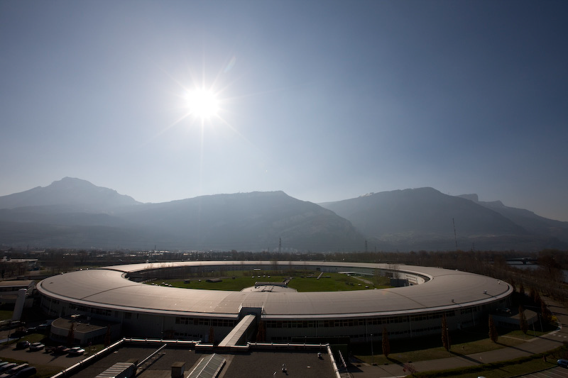

Hard x-ray spectrograph
and
anomalous soft modes
in α-iron
Aleksandr Chumakov
European Synchrotron Radiation Facility
Nuclear Resonance beamline ID14

Slide 2
Hungary at ESRF:
Many thanks to these people!
- for making ESRF better;
- for making ESRF famous.
ESRF upgrade
&
COVID time

Slide 3
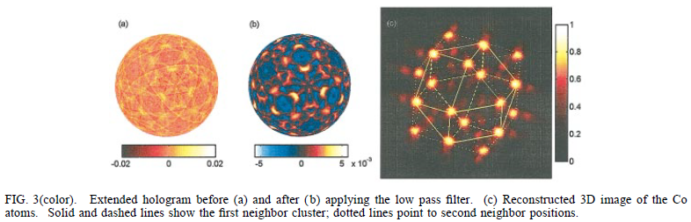
Thanks from Nuclear Resonance beamline ID18 (→ ID14)
Three dimensional imaging of atoms
with isotropic 0.5 Å resolution
PRL 82 (1999) 4847
Miklos Tegze
Gyula Faigel
Acquiring of holograms
requires
high beam stability
(no vibrations)
Upgrade of LN₂
cooling system
of
ID18 monochromator
excellent stability
of x-ray beam,
vibration amplitude:
< 0.1 μrad (rms)

Slide 4
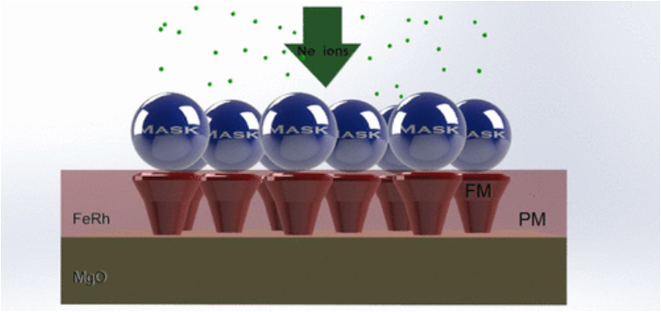
Thanks from Nuclear Resonance beamline ID18 (→ ID14)
A three-dimensional analysis
of magnetic nanopattern formation
in FeRh thin films on MgO Substrates:
implications for spintronic devices
Appl.Nano.Mater. 5 (2022) 5516
Dénes Nagy
Dániel Merkel
Request to study
singe
nano-particle
New instrument
“Nanoscope”:
focusing mirror
with short focal length
sub-micron
beam size:
380 nm × 650 nm
(H × V)

Slide 5

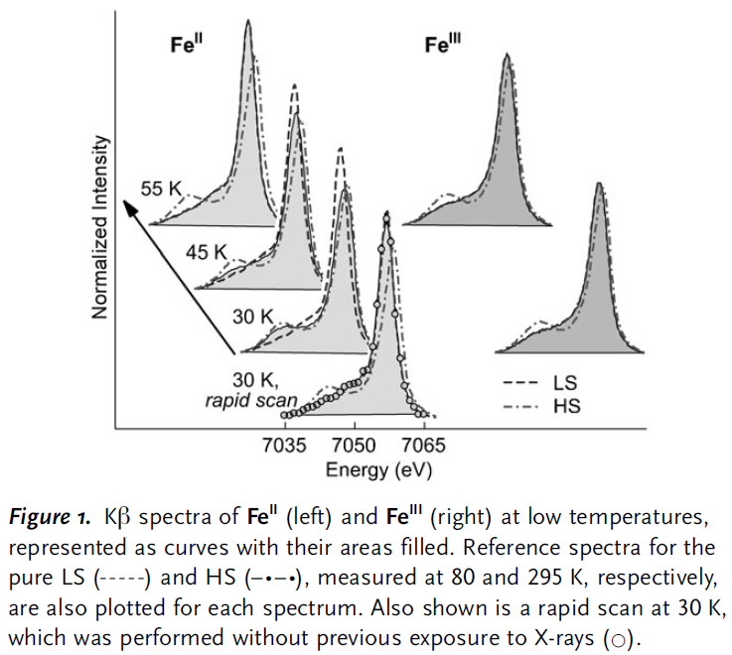
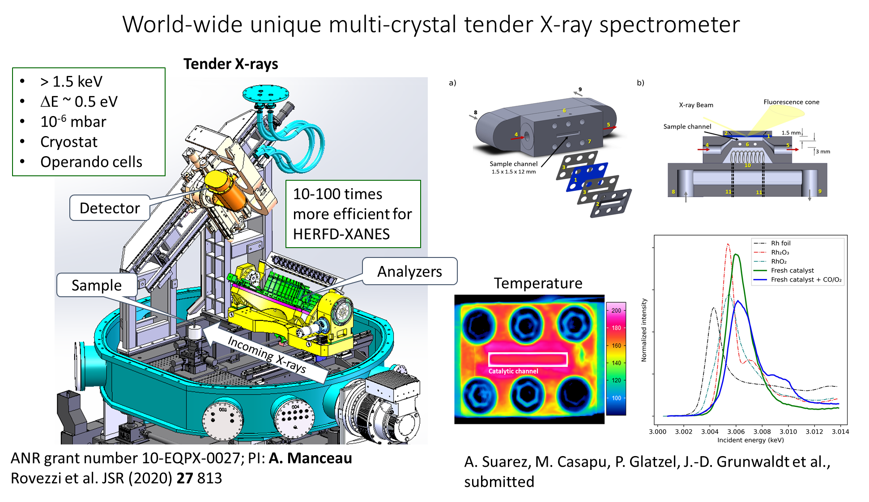
Thanks and news from X-ray absorption and emission spectroscopy beamline ID26
Hard-X-ray-Induced
Excited-Spin-State Trapping
Angew. Chem. 46 (2007) 5306
György Vankó
News from
Pieter Glatzel:
(ID26)
XANES:
X-ray Absorption
Near Edge Structure
HERFD-:
High Energy Resolution
Fluorescence Detected
techniques

Slide 6
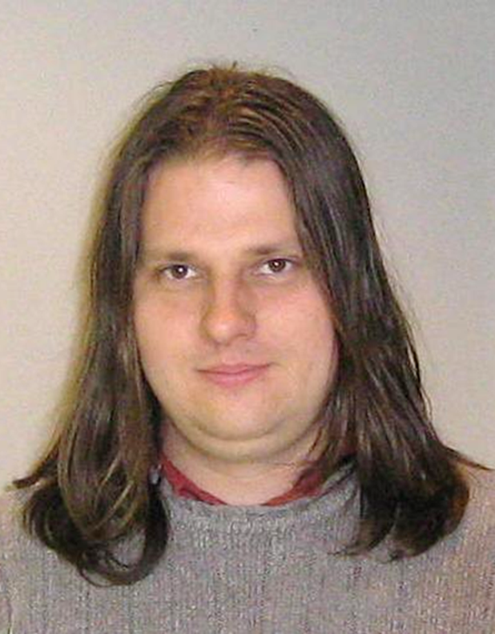
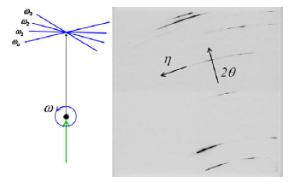

Thanks and news from material science beamline ID11
Burgers vector population,
dislocation types and dislocation densities
in single grains
extracted from a polycrystalline commercial-purity
Ti specimen by X-ray line-profile analysis
Scripta Materialia 63 (2010) 69
Gábor Ribárik
News from
Jonathan Wright:
(ID11)
Today at ESRF,
with Extremely Brilliant Source,
you can do similar studies
by an order of magnitude faster!

Slide 7
Beamtime use by Hungary in 2022 – % by scientific area

Slide 8
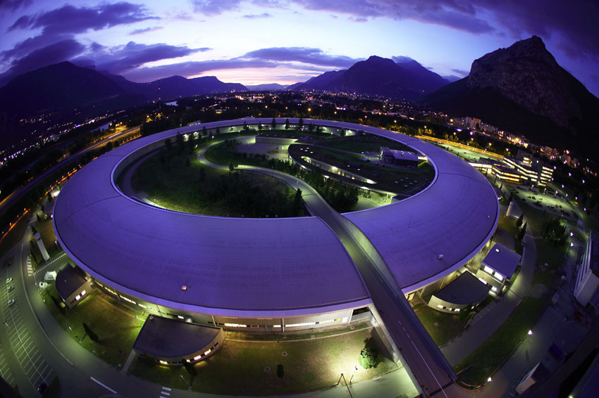
Many thanks, and we hope to see you again at ESRF!
Many thanks to you and to many others!
we hope to see you again at ESRF!

Slide 9
Hard x-ray spectrograph
and
anomalous soft modes
in α-iron

Slide 10
Outlook:
Motivation:
      - from monochromator to spectrograph
Hard x-ray spectrograph:
      - optical scheme
- short introduction to Nuclear Inelastic Scattering
Hard x-ray spectrograph:
      - experimental results
          - Anomalous atomic dynamics of alpha-iron.

Slide 11
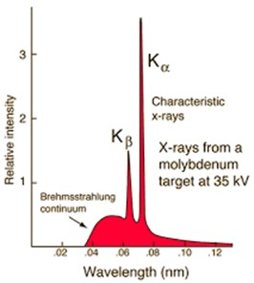


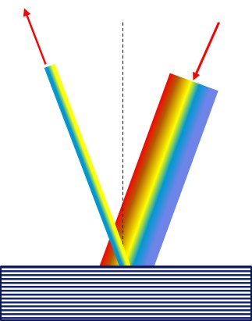

X-ray monochromator: for diffraction and for spectroscopy
Diffraction:
Spectroscopy:
fixed energy
energy scan
100 meV
2d$\sin{θ}=λ$
1 meV
we take good photons
we do not need others
we take some photons
but we also need others
fixed angle
angular scan

Slide 12
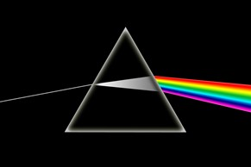
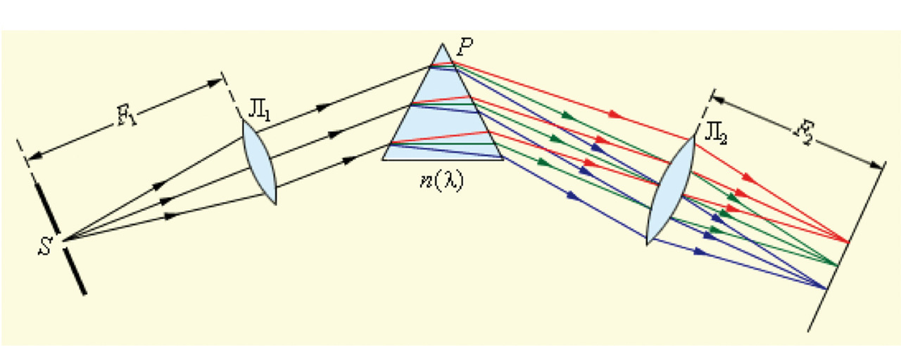

From monochromator to spectrograph
Dispersion:
Spectrograph: all energies at once
Isaac Newton, Opticks, 1704).
position-sensitive
detector
Does not work for x rays:
- too small refraction
- big absorption
There is a way out:
- asymmetric diffraction
- dispersion amplification

Slide 13
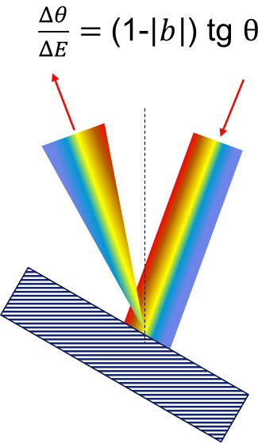
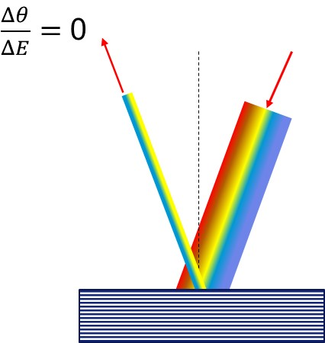
asymmetric reflection
symmetric reflection:
asymmetric reflection:
T. Matsushita and U. Kaminaga, J. Appl. Crystallogr. 13, 472 (1980).
bad for focusing …
Y. V. Shvyd’ko, M. Lerche, U. Kuetgens, H. D. Rüter, A. Alatas, and J. Zhao, Phys. Rev. Lett. 97, 235502 (2006).
good for dispersion!

Slide 14
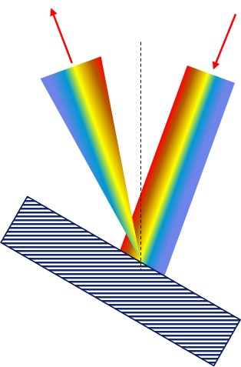


Hard x-ray spectrograph
Good news:
- big dispersion,
- i.e., good energy resolution
$$\frac{dθ}{dE}=314 \frac{μrad}{meV}$$
Hard-x-ray spectrographs:
Y. Shvyd’ko, S. Stoupin, K. Mundboth, and J. Kim, Phys. Rev. A 87, 043835 (2013).
Rainbow
$$\frac{dθ}{dE}=\frac{1.86°}{1.1 eV}=30 \frac{μrad}{meV}$$
Bad news:
- small angular range
- i.e., small energy bandwidth …

Slide 15
Hard x-ray spectrograph: optical scheme
ac et al, PRL 123, 097402 (2019)
Multiple asymmetric reflections create and enhance dispersion.
X rays of different energies are directed at different angles.
Lens system focuses x rays of different energies at different vertical positions.
Small slits provides high energy resolution, availability of all beams keeps flux.

Slide 16

Hard x-ray spectrograph: optical scheme
How to
measure:
$$\frac{dθ}{dE}=30 \frac{μrad}{meV}$$
resolution and
spectral window:
dispersion:
resolution:

Slide 17
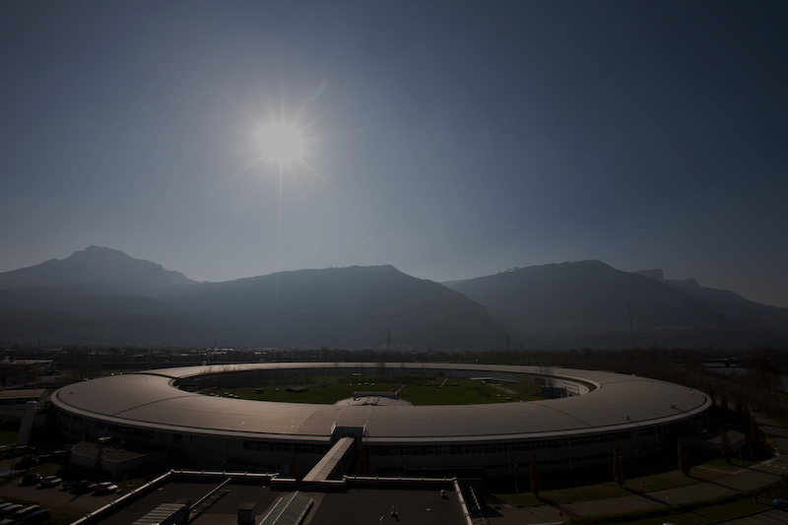
before coming to
experimental data:
short introduction to
Nuclear Inelastic Scattering
(nuclear inelastic absorption)

Slide 18

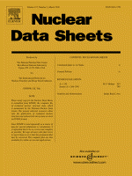
Nuclear resonance scattering
Electronic and nuclear levels:
57
Fe
26
706.4
366.8
136.5
14.412 keV
E = 7.112 keV
E = 14.412 keV
σ
e
=
26
⋅
10
-
20
cm
2
σ
n
= 256
⋅
10
-
20
cm
2
Γ ≈ 2 eV
τ₀ ≈ 0.33 fs
Γ = 4.7 ×10⁻⁹ eV
τ₀ = 141 ns

Slide 19
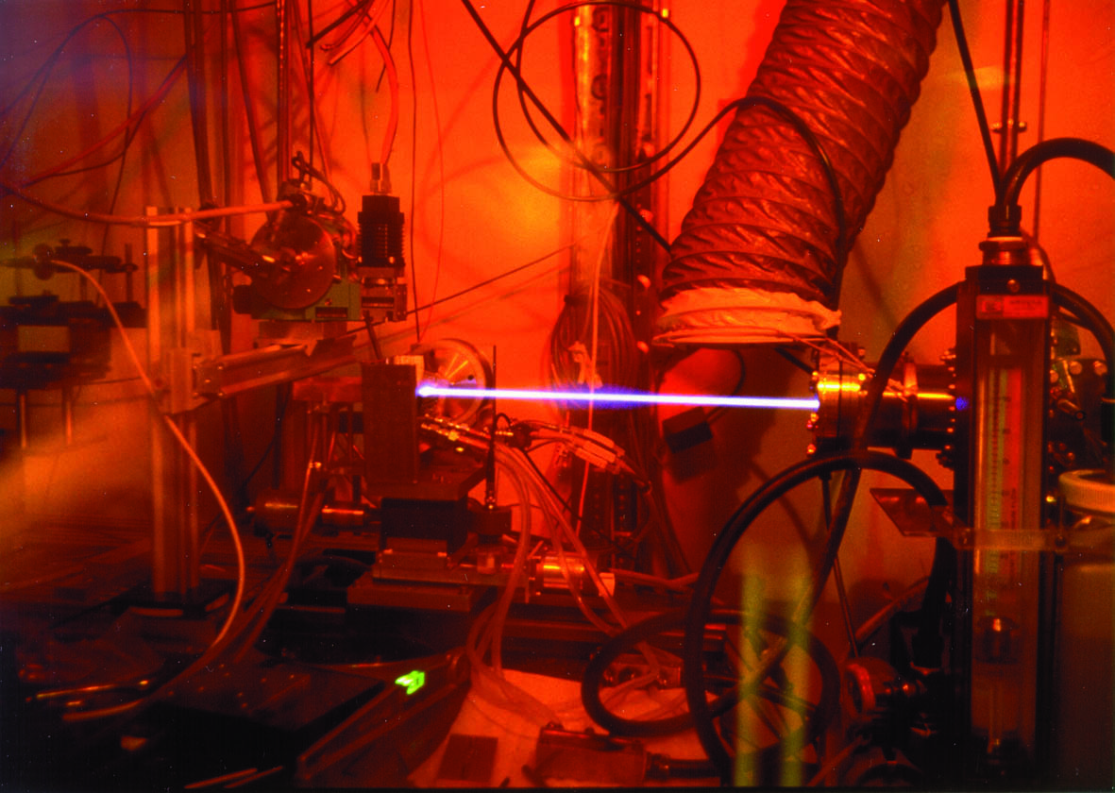
Nuclear inelastic scattering (absorption)
Absorption
monochromator
ΔE ~ 0.6 meV
Energy
6.4 keV
14.4 keV
pulsed structure of
synchrotron radiation:
detector
energy scan
0.1 ns
176 ns
~ few hours for sample with resonant isotope ( ⁵⁷Fe )
~ a day for other samples (SiO₂)
counts
time
time gate

Slide 20

Nuclear inelastic absorption
Very long time:
τ₀ = 141 ns
Very narrow level:
Γ = 4.7 neV
no need for analyzer
much easier to get very high energy resolution
Time of interaction:
~10⁵ phonon lifetimes.
Absorption:
ideal integration over all q-vectors
Scattering is impossible:
${\vec{k}}_{0} + \vec{q}=$ ${\vec{k}}_{1}$
well
defined
changes
with time
(averaging)
does not know
where to emit
dispersion
relations
not we, nature
DOS

Slide 21

Velocity distribution of vibrating atoms
Classical interpretation of Nuclear Inelastic Scattering:
monitoring velocity distribution of vibration atoms
Imagine ⁵⁷Fe nuclei
in cars running on a road
Measure velocity
by Doppler effect
v₋
v₊
⁵⁷Fe nuclei
E = E_{res} (1+v/c)

Slide 22
Hard x-ray spectrograph: experimental results
ac et al, PRL 123, 097402 (2019)
Spectrograph, energy resolution = 0.11 meV
Accurately study extremely small differences:
Four samples (S) and four detectors(D):
Instrumental function
ΔE = 1.5 meV
τ = 0.53 ns
δE = 254(19) μeV
difference in energy
of optical modes for
K₃MgFe(CN)₆ and
(NH₄)₂MgFe(CN)₆

Slide 23
Hard x-ray spectrograph: experimental results
ac et al, PRL 123, 097402 (2019)
Spectrograph, energy resolution = 0.11 meV
Sum all spectra,
use all radiation components,
Gain both:
high energy resolution
and high flux:
Four samples (S) and four detectors(D):
Four
identical
samples
of alpha-iron
Anomalous soft modes
in normal ambient α-iron

Slide 24
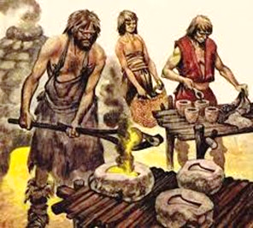
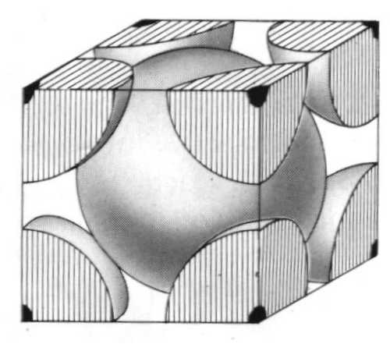
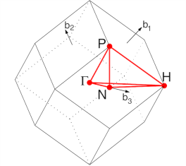
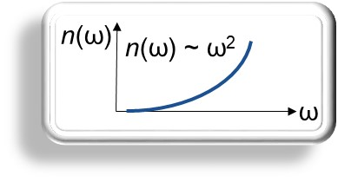
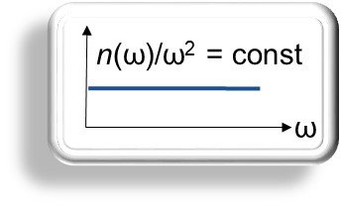
Alpha-iron: one of the most studied by mankind system
1200 B.C. – 600 B.C.
V_{L}
integrate number of states
in 3D:
ω(q)
sound velocity
q_{z}
n(q) ~ 4πq²
ω = v q
q_{x}
q
q_{y}
Simple BCC structure:
reduced density of states
(raw spectrum)
density of states
Lattice
dynamics:
V_{L}
V_{T1}
known sound velocity
measurements with low resolution:
V_{T2}
ω(q)
n(ω)/ω²
should be
a constant,
~ 1/<V³> !!!
Minkievicz et al., PR 162, 528 (1967)
Neuhaus et al., PRB 89, 184302 (2014)

Slide 25
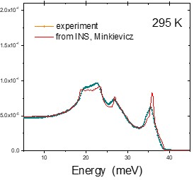
Alpha-iron: now with 0.1 meV energy resolution
Earlier data, measured with
the energy resolution of 0.7 meV
effect is seen in raw data
statistical uncertainty: error bars
uncertainty of subtraction of elastic peak: less than symbol size

Slide 26
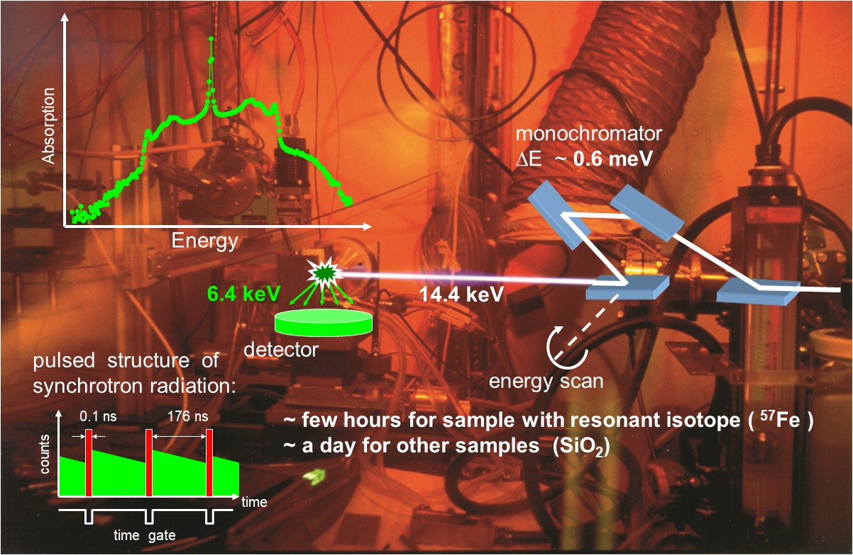
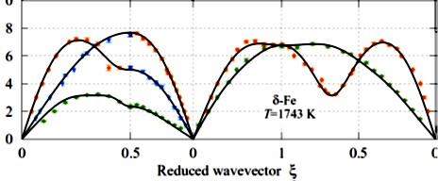
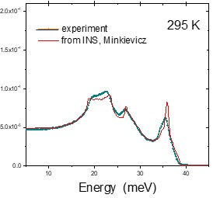
Density of states: measured by NIS and from dispersion relations
measurements with low resolution:
from dispersion relations
(red curves):
calculated DOS
using force constants
fitted to measured
eigen - friequences
in selected q-points
measured by NIS
(blue dots):
complete picture
of ALL atomic displacements,
no momentum resolution

Slide 27
Anomalous modes: temperature dependence
Neuhaus = J.Neuhaus et al., PRB 89, 184302 (2014)
Minkievicz = V.G.Minkievicz et al., PR 162, 528 (1967)
Temperature dependence of the excess?

Slide 28
Anomalous modes: temperature dependence
Excess of reduced DOS
Life-time broadening
T_{C}
anharmonism:
Excess of modes increases close to T²: anharmonism?
But it changes behavior at Curie temperature: magnons?

Slide 29
Possible origins:
1. Positive curvature
of T2 branch:
but: not seen by INS
harmonic
J. Scheipers and W. Schirmacher,
Z. Phys. B 103, 547 (1997).
anharmonic
2. Anharmonism:
spin displacements
3. Magneto-elastic
waves
(magnon-phonons):
spatial displacements of atoms

Slide 30
To take home:
Hard x-ray spectrograph is possible:
- ESRF: offered to users (phonon spectroscopy)
- LCLS: in technical design (RIXS)
Energy resolution is fine:
- 100 μeV
Energy band is small:
- 500 μeV: has to be developed
Alpha-iron anomalous vibrational modes:
- seen even at room temperature;
- increase with temperature;
- anharmonism? magnons?
Measuring DOS is NOT momentum-resolved.
But: it does ideal averaging on momentum, you CANNOT miss something.
Sometimes this makes the difference

Slide 31
Thank you
for your attention!

Slide 32
Who did the work:
ESRF:
Rudolf Rüffer
Dimitrios Bessas
Alexey Bosak
Wilson Crichton
Hugo Vitoux
PERTA-III:
Ilya Sergeev
APS:
Yuri Shvyd’ko

Slide 34
accessible isotopes:
Fe
Sn Sm Eu Dy Sb I Ni Te Xe Ge Os Ru
if required – K Kr Ba Tm

Slide 36
relevance to an ideal crystalline lattice
⁵⁷Fe and natural Fe (99.99+%)
foil and single crystal
with and without magnetic field
not from impurities
not from grain boundaries
not from magnetic walls

Slide 37
not an artefact
elastic peak subtraction
not the multi-phonons
⁵⁷Fe_{0.55}Ni_{0.20}Cr_{0.25}
⁵⁷FeBO₃
no effect in stainless steel
no effect in iron borate

Slide 39
Iron at RT with 0.25 meV resolution:
1/2 L [110]
2/3 L [111]
1/2 T₁ [110]
1/2 T₂ [110]
INS data (Neuhaus)
experiment vs theory
experiment vs convoluted theory
- normal trend: upper branches have higher damping;
- not feasible with ~0.6 meV resolution.
Neuhaus = J.Neuhaus et al., PRB 89, 184302 (2014)
Minkievicz = V.G.Minkievicz et al., PR 162, 528 (1967)

Slide 40
Iron at high temperatures with 0.6 meV resolution:
Neuhaus = J.Neuhaus et al., PRB 89, 184302 (2014)
Minkievicz = V.G.Minkievicz et al., PR 162, 528 (1967)

Slide 41
Iron at 1043 K (T_{C}) with 0.6 meV resolution:
1/2 L [110]
2/3 L [111]
1/2 T₁ [110]
1/2 T₂ [110]
INS data (Neuhaus)
experiment vs theory
experiment vs convoluted theory
- anomaly: lowest branch shows highest damping!
- to check an entire temperature dependence?
Neuhaus = J.Neuhaus et al., PRB 89, 184302 (2014)

Slide 42
Iron at high temperatures with 0.6 meV resolution:
1/2 L [110]
2/3 L [111]
1/2 T₁ [110]
1/2 T₂ [110]
INS data (Neuhaus)
life-time broadening
decrease of vibrational energy
Yes, anomaly: lowest T₂ branch has highest damping.
Furthermore, it’s frequency shows largest decrease!
Neuhaus = J.Neuhaus et al., PRB 89, 184302 (2014)

Slide 43
the same, but using not theory but LT exp. data for reference:
1/2 L [110]
2/3 L [111]
1/2 T₁ [110]
1/2 T₂ [110]
INS data (Neuhaus)
life-time broadening
decrease of vibrational energy
The anomaly persists: T₂ branch has highest damping
and it’s frequency shows largest decrease.
Neuhaus = J.Neuhaus et al., PRB 89, 184302 (2014)

