Slide 1


Advances in the Investigation of FeRh Thin Films
Dániel G. Merkel
Functional Nanostructures Research Group

Slide 2
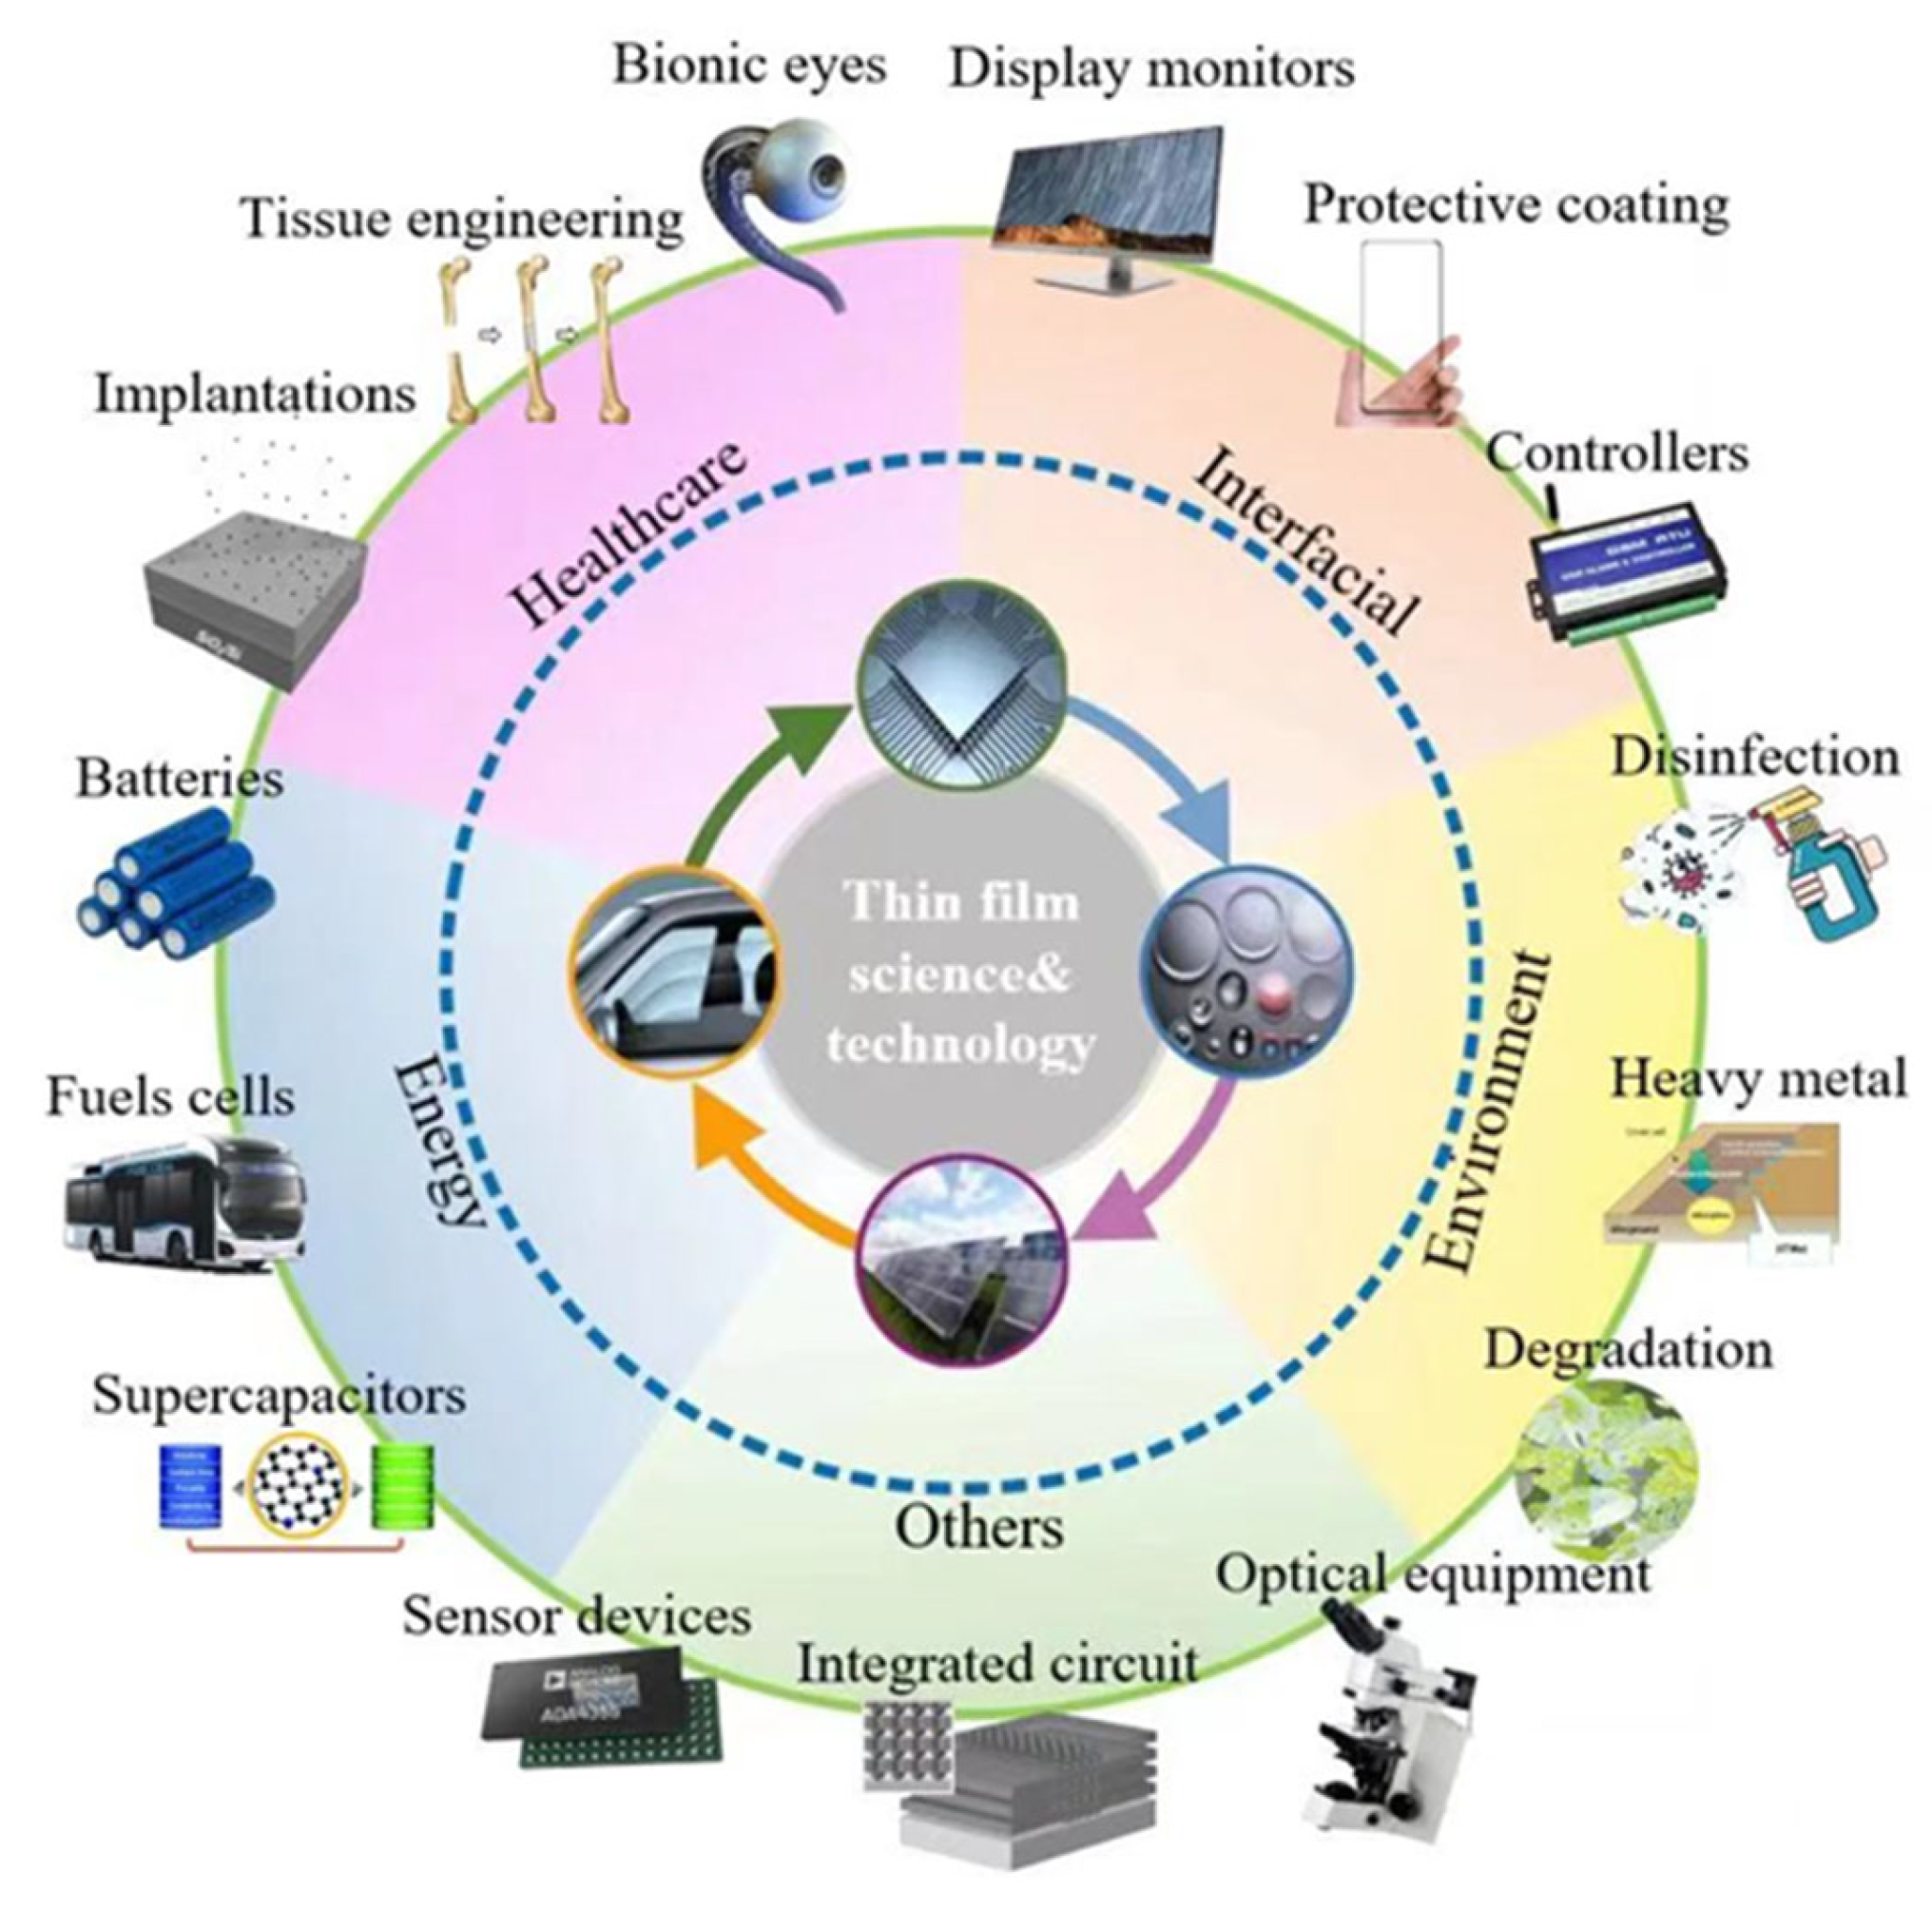
Thin film applications
X. Long et al. Coatings 12, 1768 (2022)

Slide 3
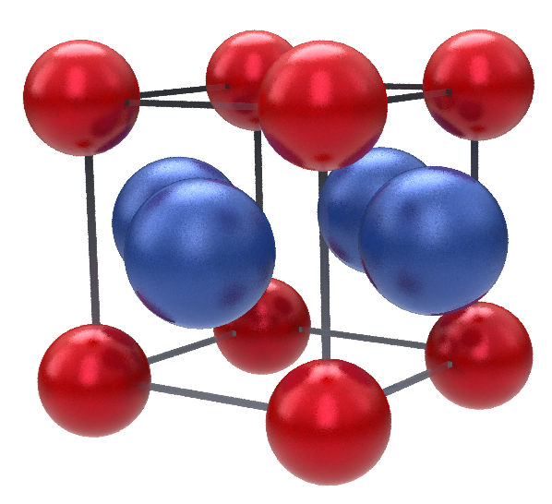
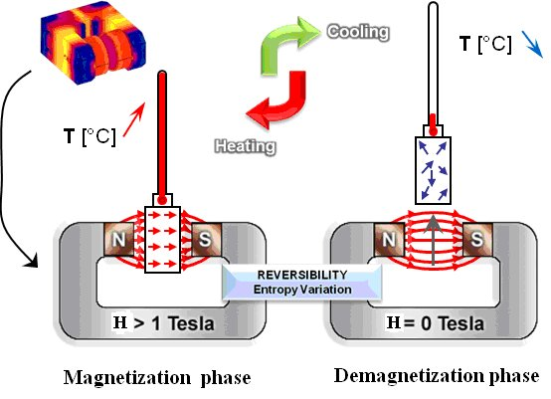
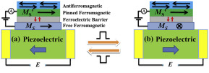
FeRh
Ferromagnetic
Antiferromagnetic
Paramagnetic
Magnetocaloric
Multiferroic
W. Huang et al. / J Materiomics 1 (2015) 263
C. Muller „NEW AIR-CONDITIONING AND REFRIGERATION MAGNETOCALORIC GAS FREE SYSTEM”, International Symposium on Next-generation Air Conditioning and Refrigeration Technology (2010)

Slide 4

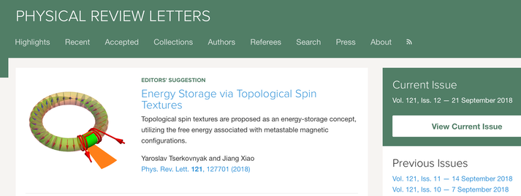
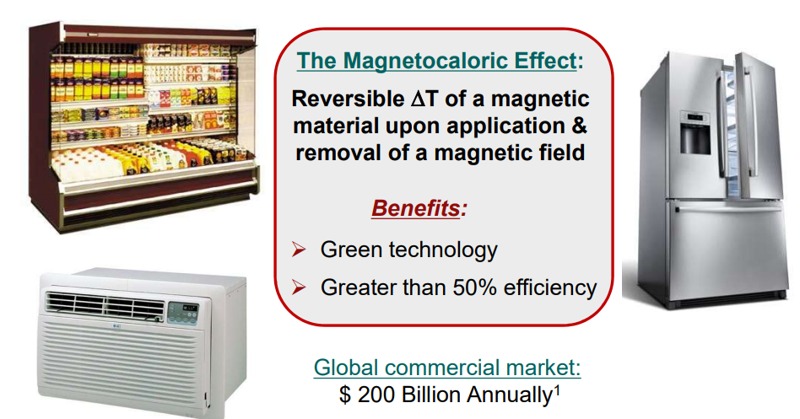
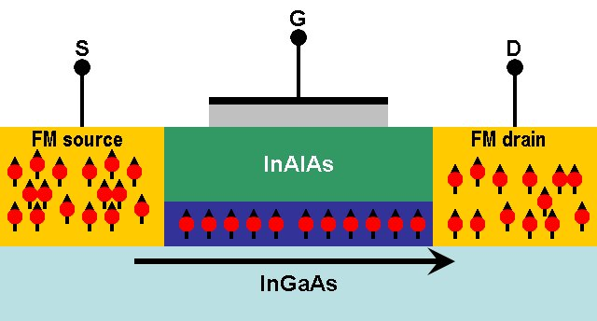
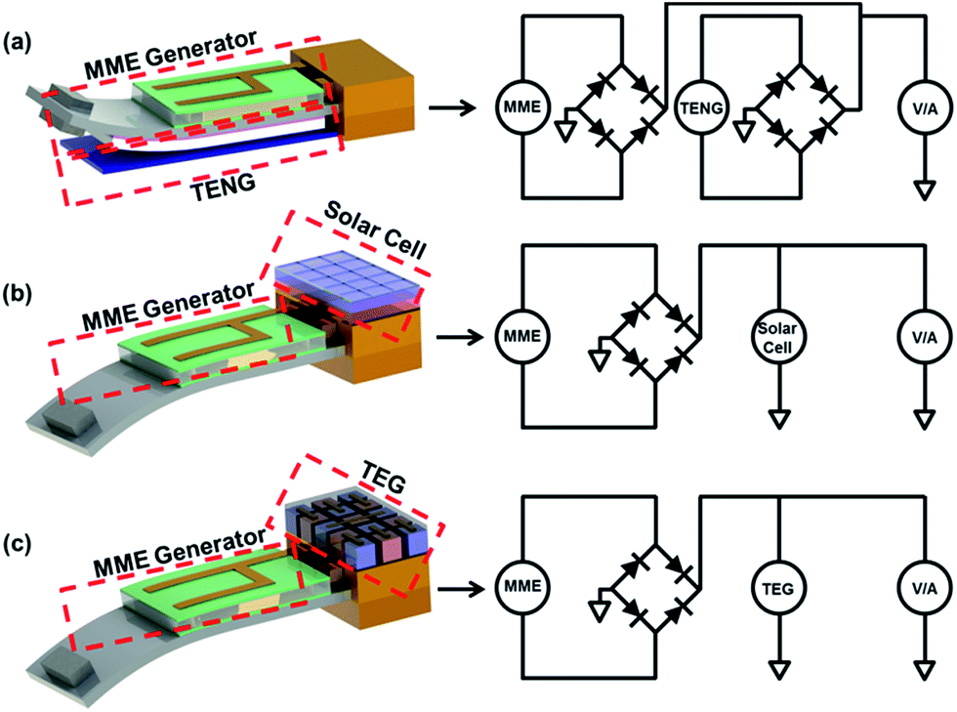
Introduction
Hazardous-gas-free, effective cooling
Energy storage
Y. Tserkovnyak et al. Phys. Rev Lett. 121, 127701 (2018)
http://www.sec.gov/Archives/; http://goo.gl/bwGr41; http://goo.gl/zhg29L; http://goo.gl/02x9kK
Enegry Production
Energy-efficient devices
K. Samanta „Synthesis and characterization of 3d-transition metal ions doped
zinc oxide based dilute magnetic semiconductor thin films”, PhD work (2014)
V. Annapureddy et al., Sustainable Energy Fuels, 1, 2039 (2017)
Notes:
The energy is stored in the metastable winding number, which can be injected electrically by an appropriately tailored spin torque

Slide 5
Recent works on FeRh
Creating magnetic pattern
Self-diffusion study
Multiferroic study
  Electric field effect
  Magnetic Field effect
  Temperature effect
  Synergy effect of temperature, electric and magnetic field

Slide 6
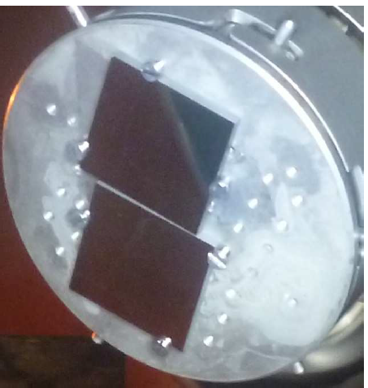
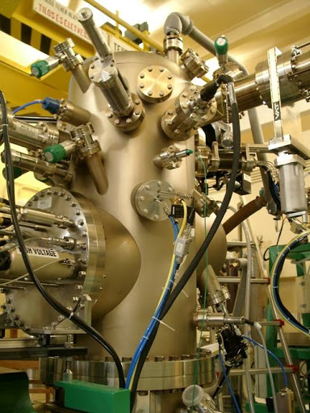
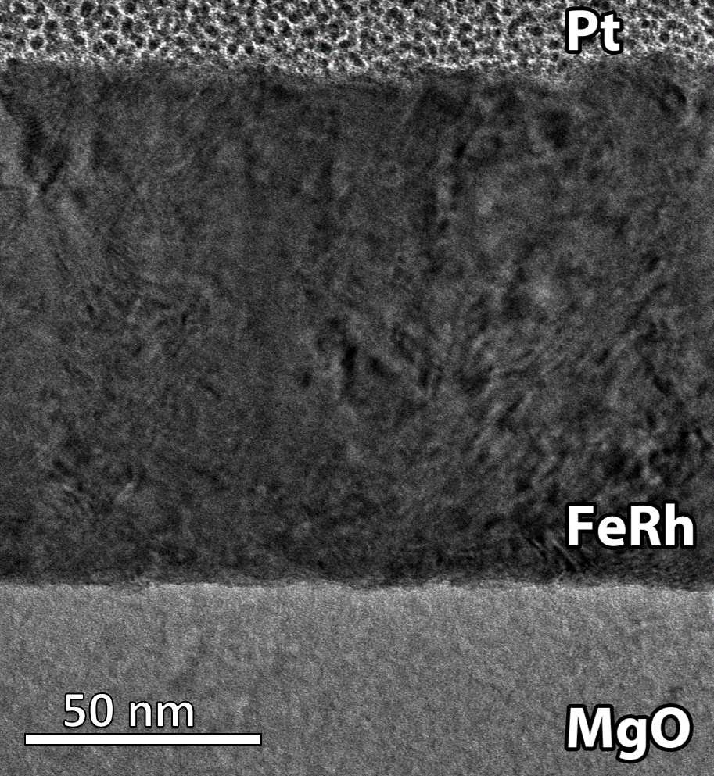
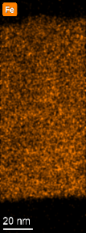
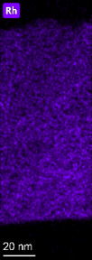
Sample praparation
Molecular beam epitaxy
T subs = 200 °C

Slide 7

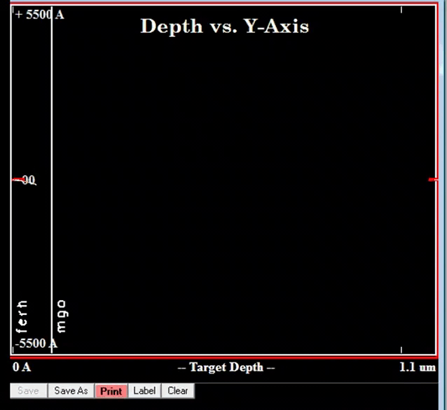
D. G. Merkel, A. Lengyel, D. L. Nagy, A. Németh, Zs. E. Horváth, Cs. Bogdán, M. A. Gracheva, G. Hegedűs, Sz. Sajti, Gy. Z. Radnóczi & E. Szilágyi Scientific Reports 10, 13923 (2020)

Slide 8
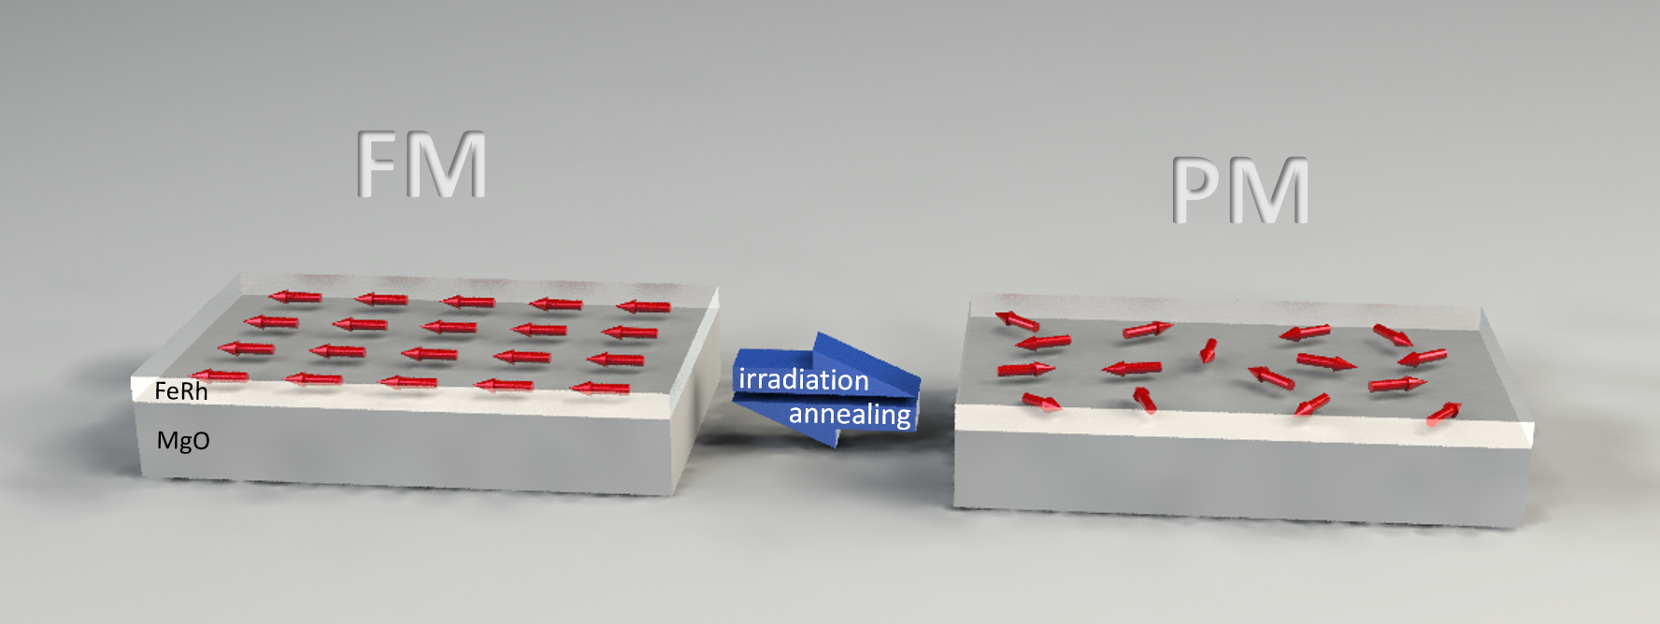

Slide 9
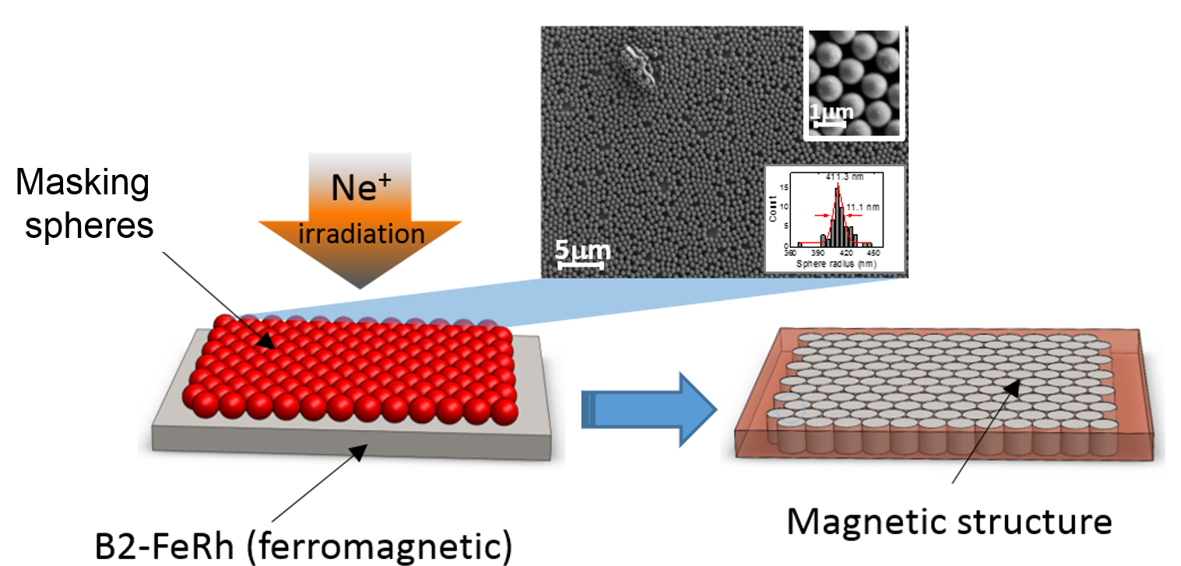

Slide 10
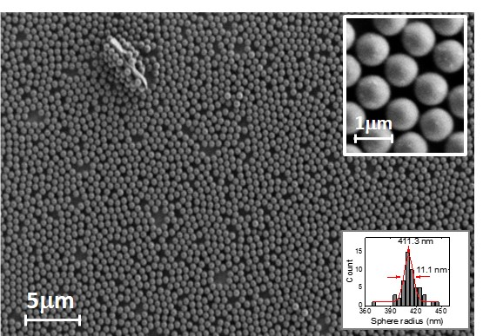
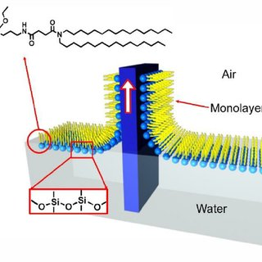
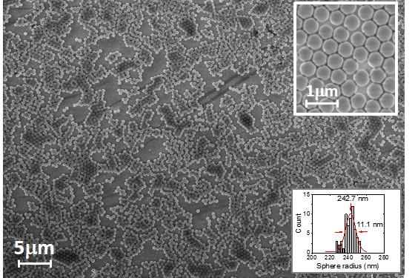
Langmuir-Blodgett filmtechnika
Monolayer
V. Malgras et al. Bulletin of the Chemical Society of Japan 88, 1171 (2015)

Slide 11
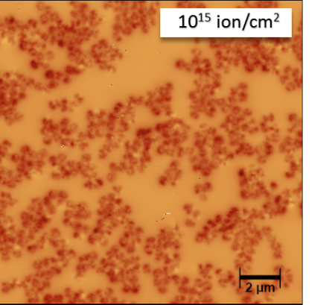
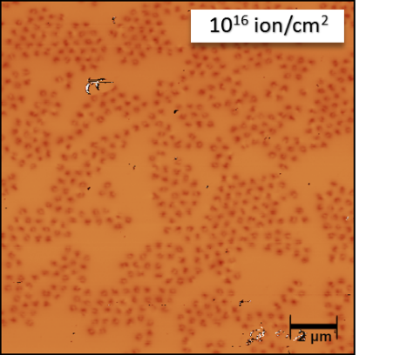
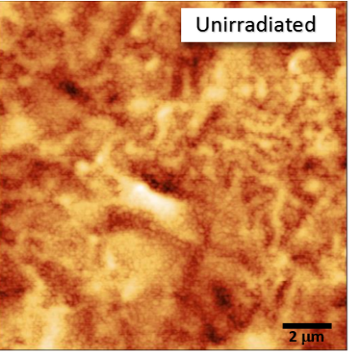
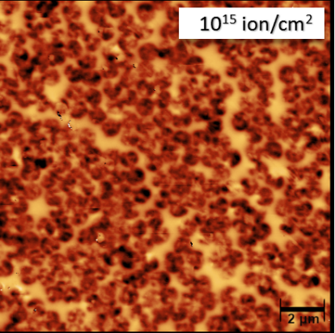
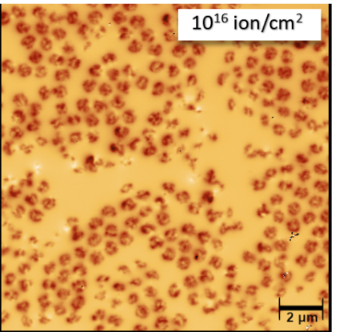
500 nm sphere mask
1000 nm sphere mask

Slide 12
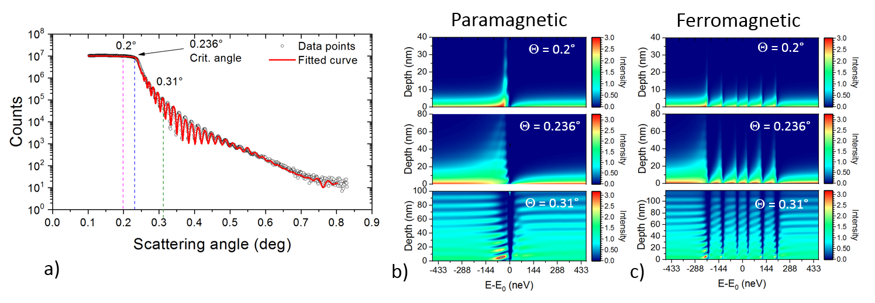
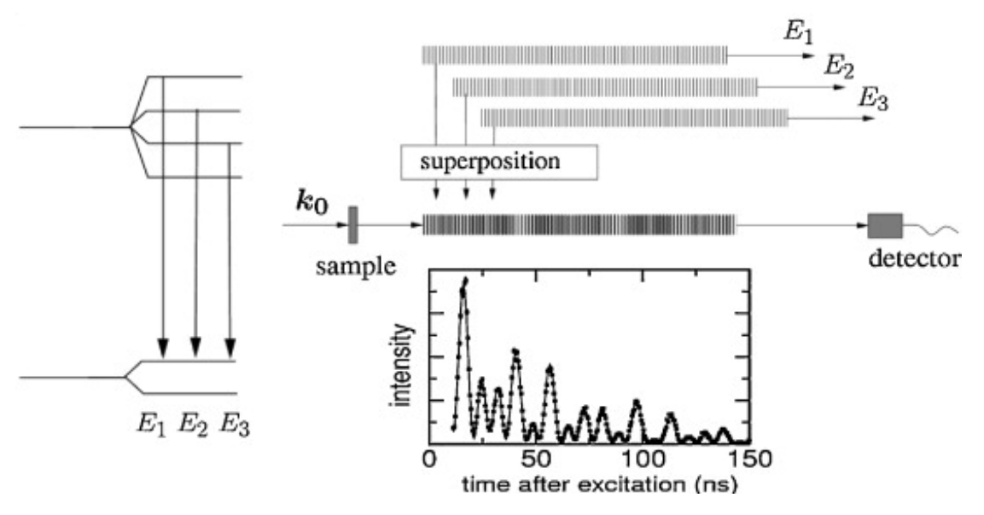
FM to PM
Grazing incidence nuclear resonance scattering

Slide 14
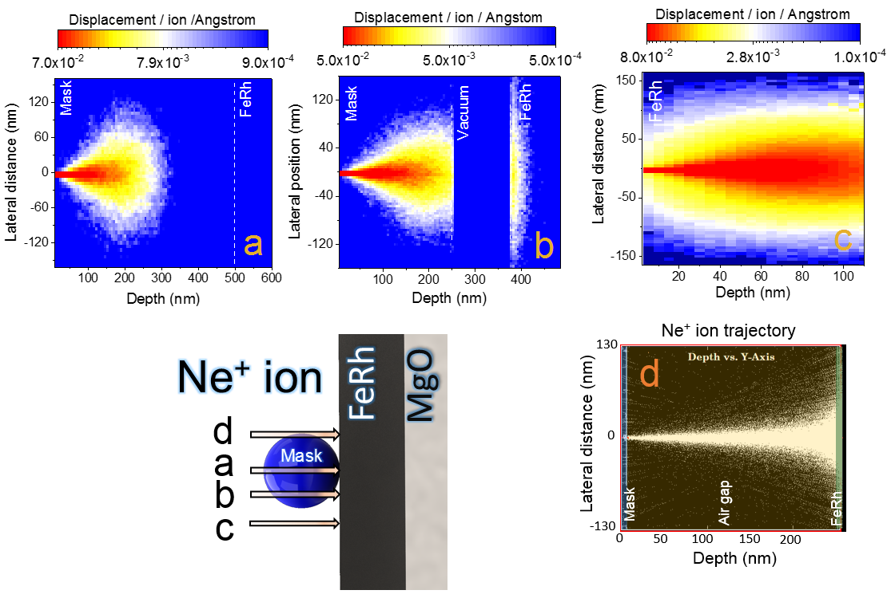
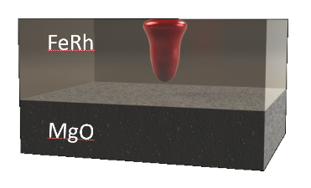
FM to PM
FM
PM

Slide 15
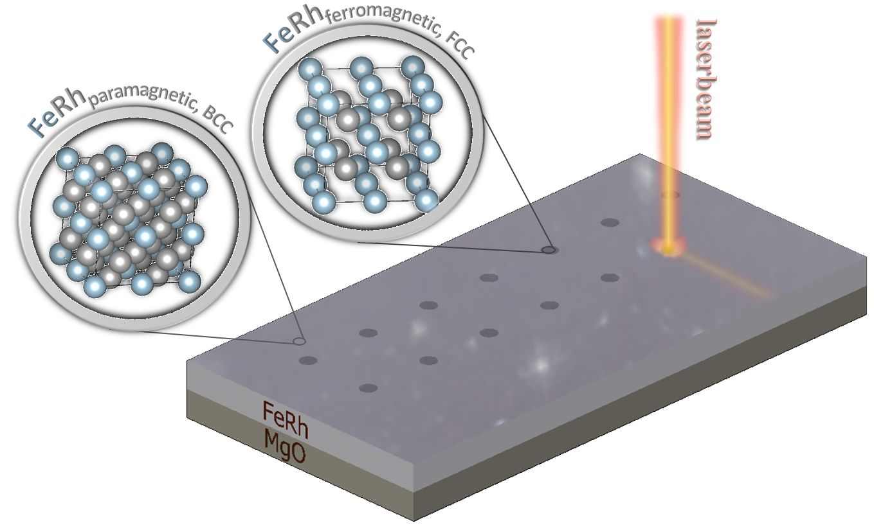
PM to FM

Slide 16
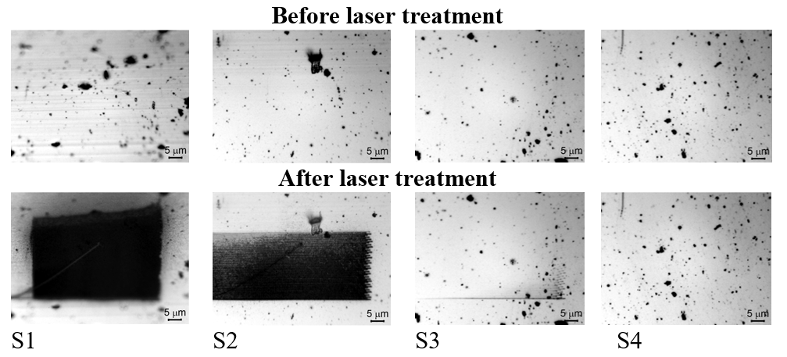
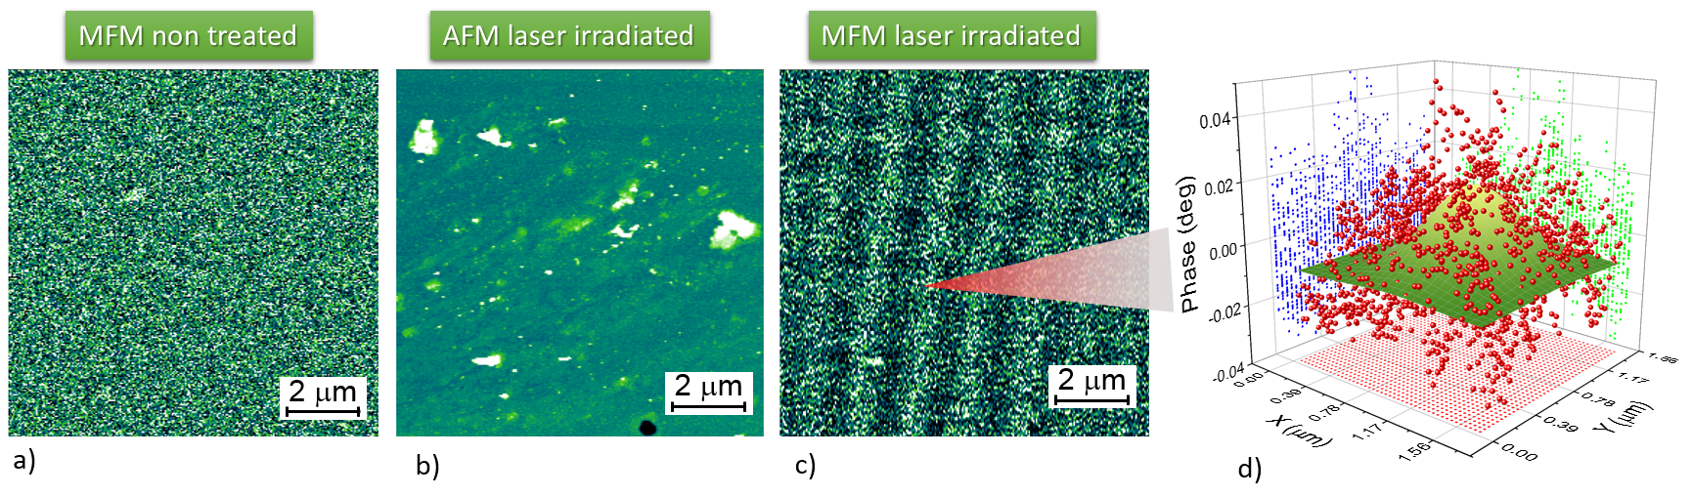
PM to FM
Sample notation | Laser power (mW) | Dwell time (ms/pixel) | Step size (mm/pixel) | Total fluence (J cm⁻²)
S1 | 200 | 1.16 | 0.2 | 16.2
S2 | 100 | 1.16 | 1 | 8.1
S3 | 60 | 1.16 | 1 | 4.8
S4 | 20 | 5.8 | 1.52 | 8.1

Slide 17
Summary
The magnetic ordering of the FeRh alloy film can be reversibly transformed through ion irradiation and heat treatment application.
Ferromagnetic nanopattern can be created by:
  Masked ion irradiation
  Laser irraditation

Slide 18






Thank you for your attention!
Klára Sájerman
Tamás Váczi
Sándor Lenk
Gergő Hegedűs
Szilárd Sajti
Péter Petrik
Márton Major
Zsolt Zolnai
Dimitrios Bessas
Alexander Chumakov
Attila Németh
Maria Gracheva
Zsolt Horváth
Attila Lengyel
Dénes Lajos Nagy
Edit Szilágyi
András Deák
Levente Illés
Maccari Fernando
Deshabrato Mukherjee

