Slide 1
19th of September, Wigner 121 Scientific Symposium
Symmetries in Quantum Information Science
Adrian Solymos
Wigner RCP
Computational Sciences Department,
Quantum Computing and Information Research Group

Slide 2
Quantum Computing and Information Research Group
Dr. Zoltán Zimborás
Ágoston Kaposi
Zoltán Kolarovszki
Dr. Dávid Jakab
(Now @ Duke Uni)
+ other group members...

Slide 3
Unitary t-designs

Slide 4
Unitary t-designs

Slide 5
Unitary t-designs
Unitary t-designs always exist for any t and dimension d!

Slide 6
Unitary t-designs - Uses
Derandomization of probabilistic constructions - Gross et al.
Channel fidelity estimation - Dunkert et al.
Randomized benchmarking - Wallman et al.
Shadow tomography - Helsen et al.

Slide 7
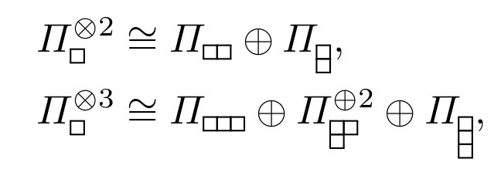
Unitary t-designs – Examples
Unitary 1-design: (Schur’s lemma)
Any (unitary) irrep of a finite group will do for V!
Unitary 2-design:
?

Slide 8
Unitary t-designs – What can we do?
Most important/elegant unitary designs: group designs
One particle Clifford groups over finite fields – 2-design in primepower dimensions
Multipartite Clifford groups over finite fields – 3-designs for qubit systems
Problems:
No 4-group-designs for d>2! (Bannai et al.)
No group design construction that gives 2-designs in every dimesion!
(There exists other constructions… → contrived and infeasible)

Slide 9
Unitary t-designs – New construction: generalised group designs
Example using GAP:
Standard irrep of A7
A 6D irrep of PSU(3,3)
2-design in 6 dimensions!

Slide 10
Unitary t-designs – Generalised Group Designs
Example using GAP:
Standard irrep of A13
Any of the two 12D irrep of 6-Suz
4-design in 12 dimensions!
BROKEN THE 3-DESIGN BARRIER!!!
(shadow tomography)

Slide 11
Unitary t-designs – 2-designs in arbitrary dimension
Alternating group on d elements:
Reducible:
Fusion for d>5:
What do we get?

Slide 12
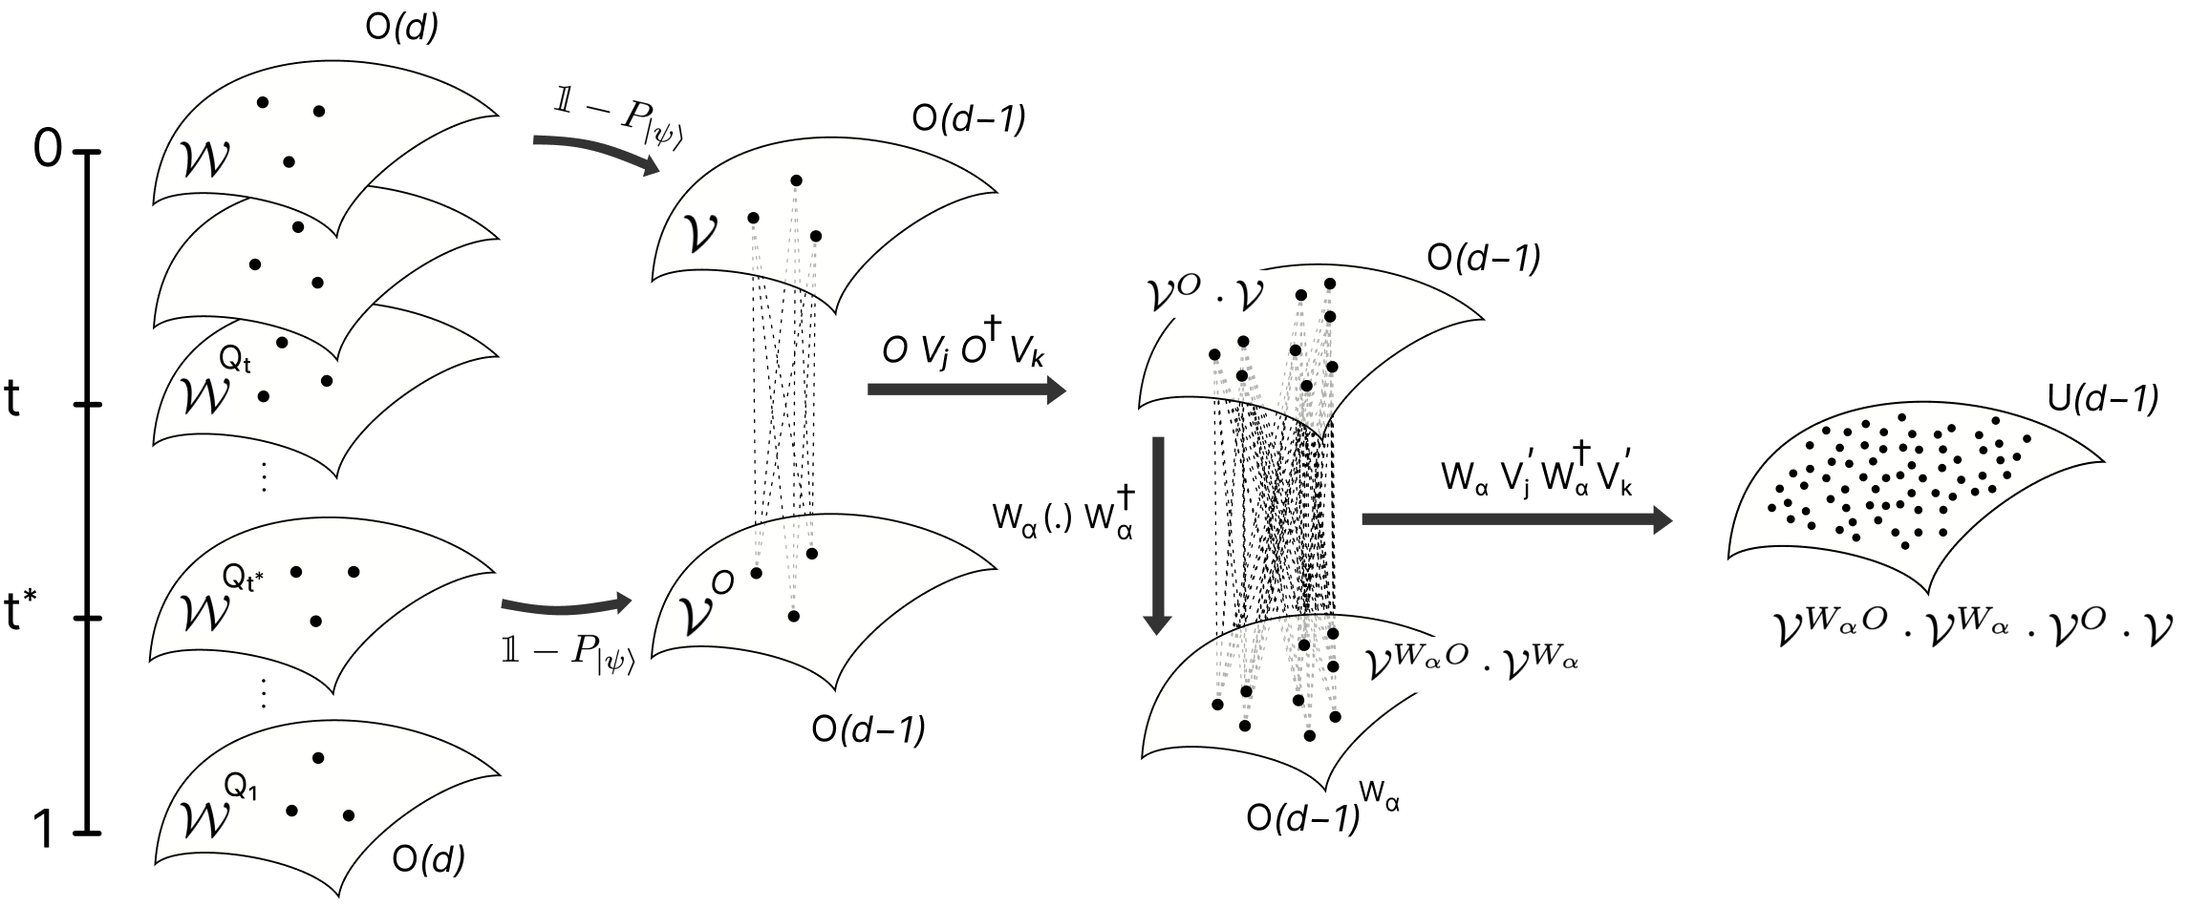
Unitary t-designs – 2-designs in arbitrary dimension

Slide 13
Symmetric State Extensions (shareability)

Slide 14
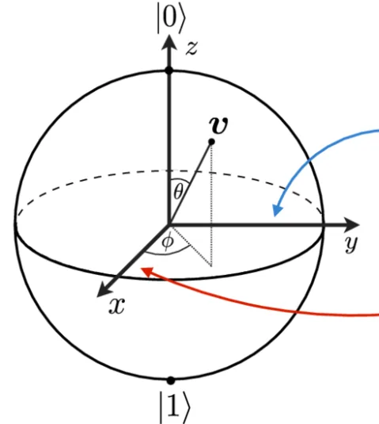
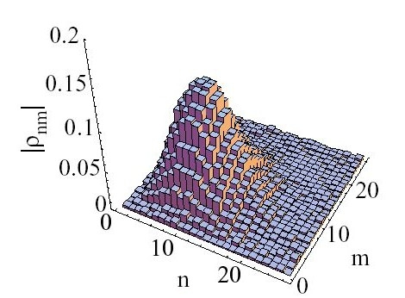
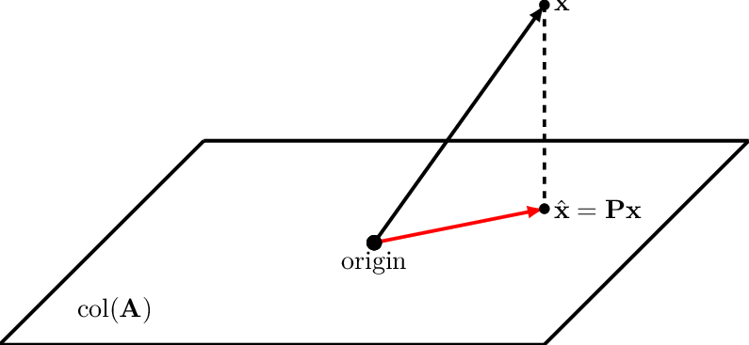
Symmetric State Extensions - States
Quantum state (dim < ∞)
1-Projection
Density matrix

Slide 15
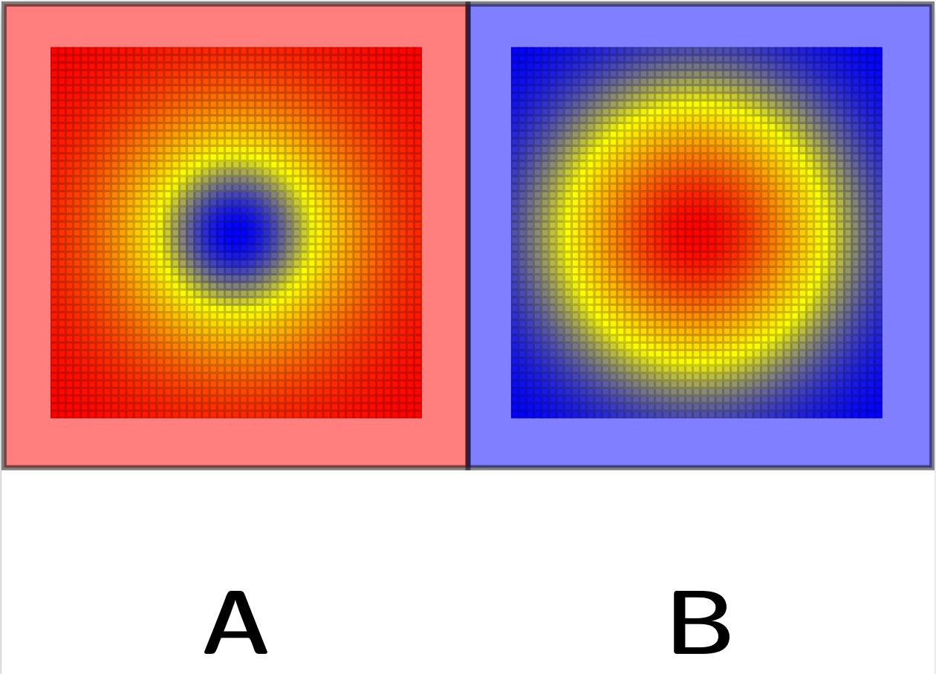
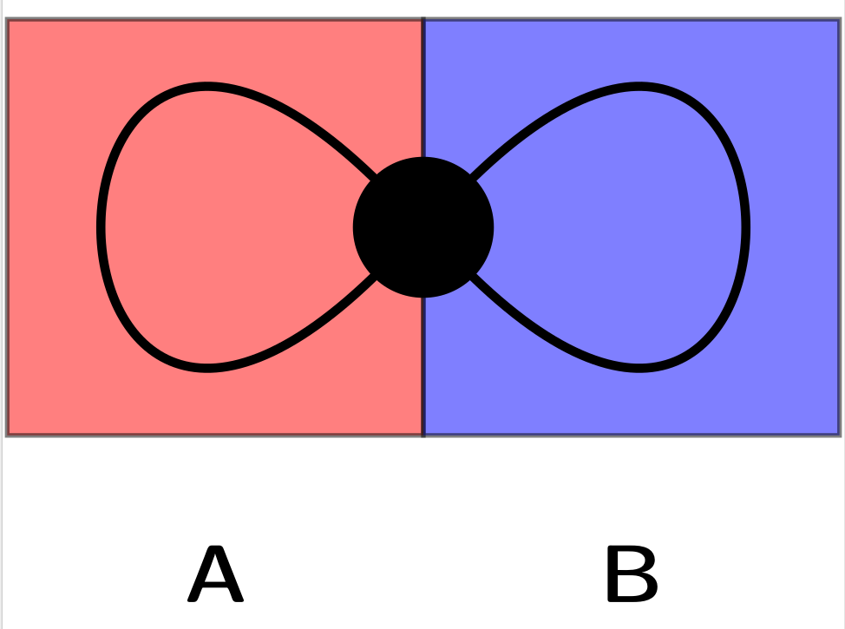
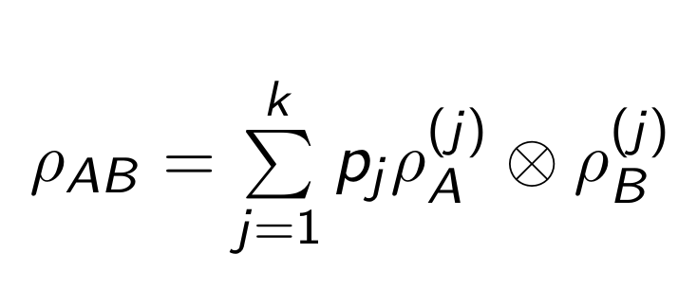
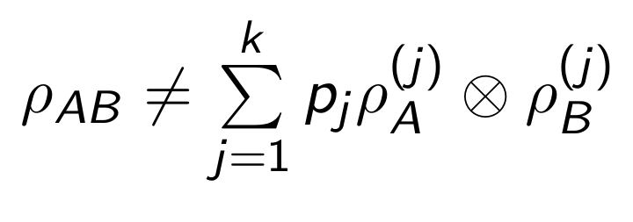
Symmetric State Extensions - Entanglement

Slide 16
Symmetric State Extensions – Monogamy of entanglement
“A bipartite system in a pure entangled quantum state cannot be correlated to any other system.”

Slide 17
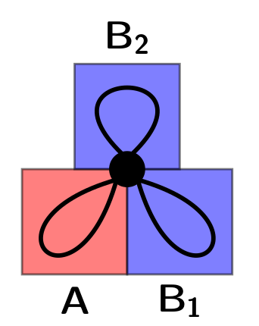
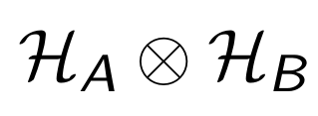
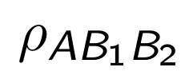
Symmetric State Extensions – Shareability
?
?

Slide 18
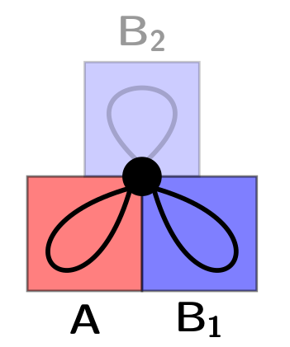
Symmetric State Extensions – Shareability
?

Slide 19
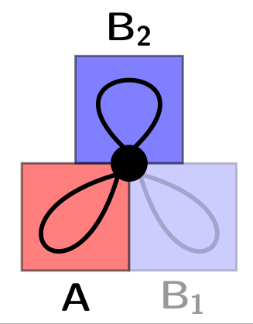
Symmetric State Extensions – Shareability
?

Slide 20
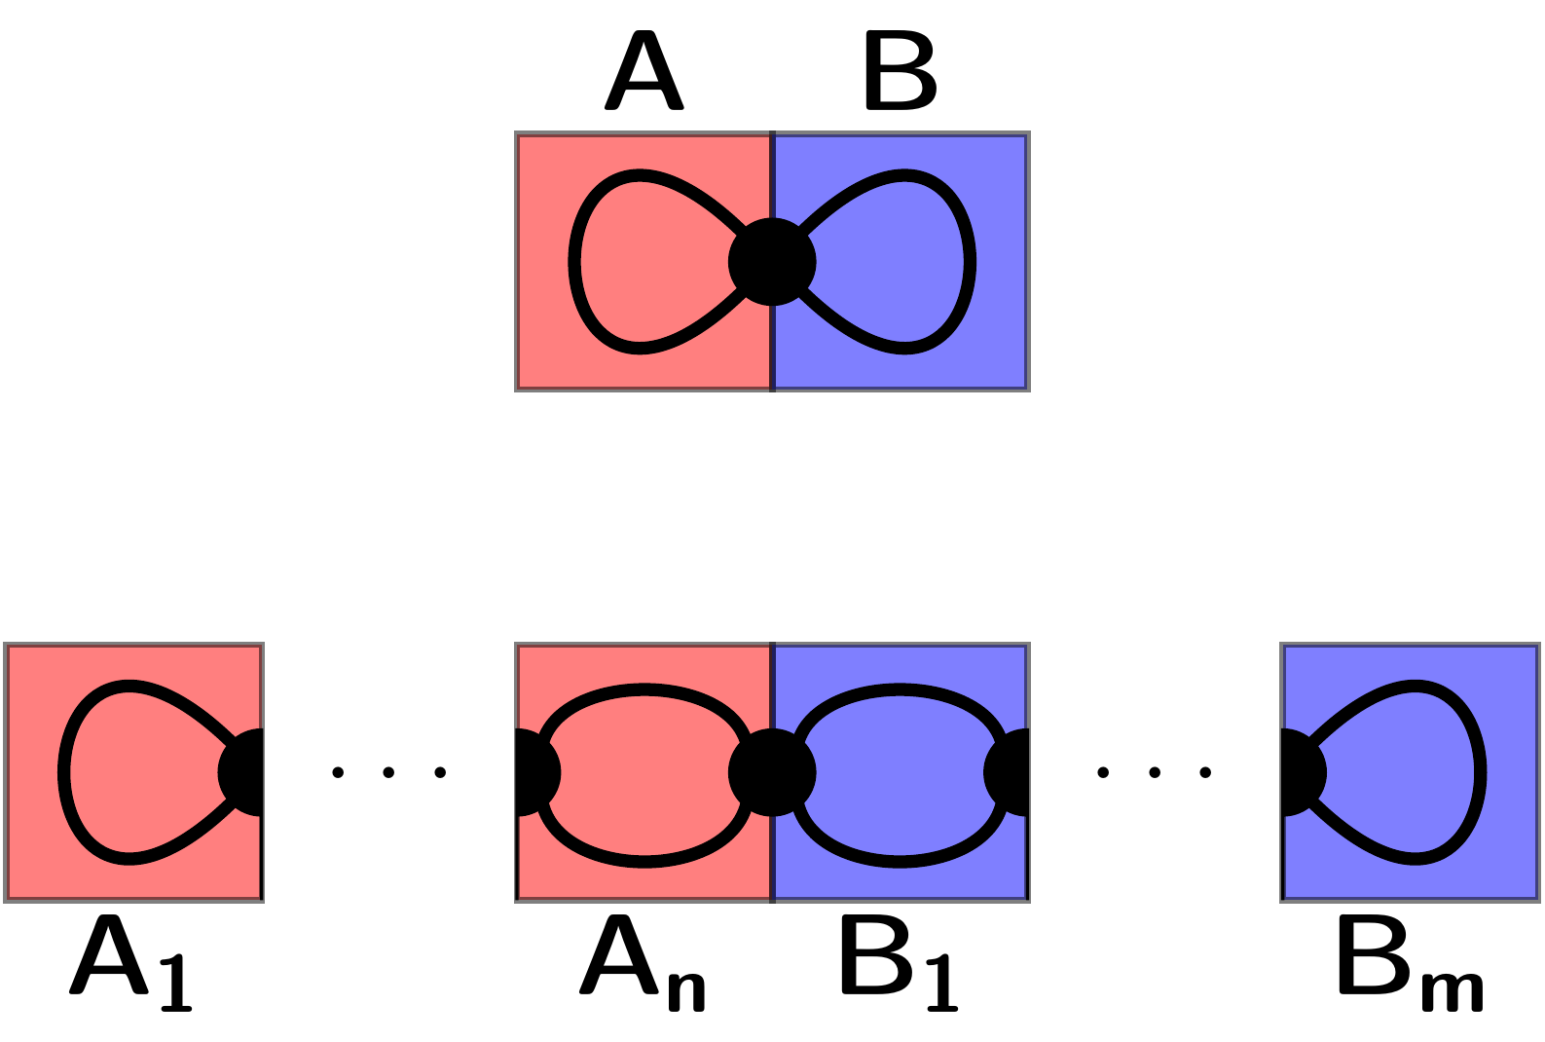
Symmetric State Extensions – Shareability

Slide 21
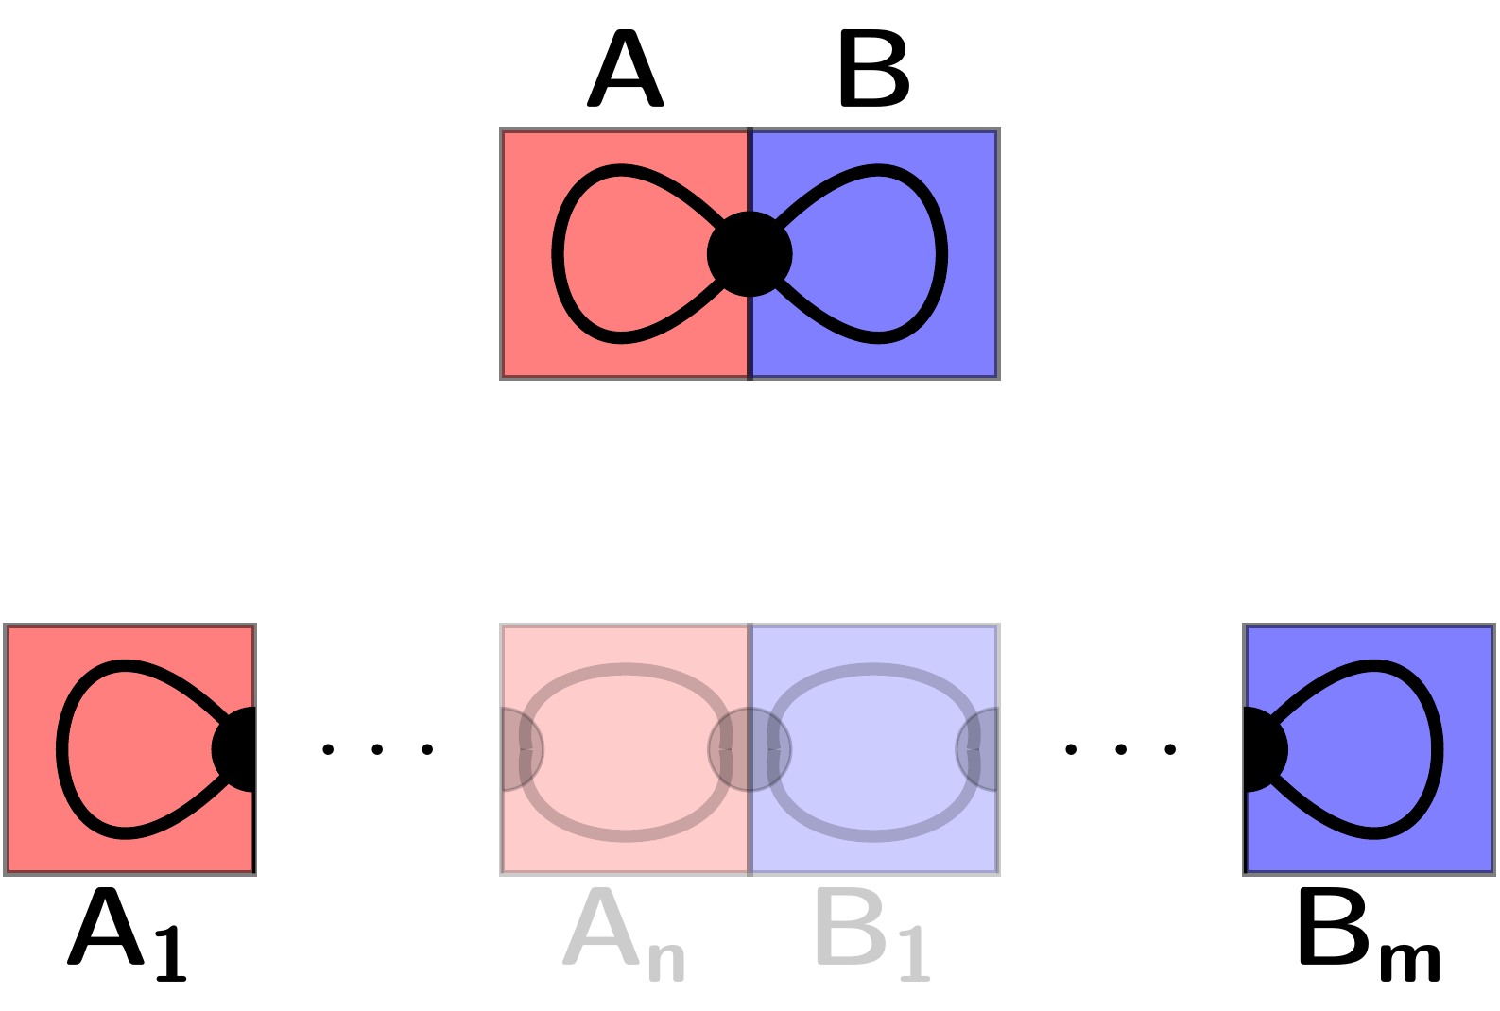
Symmetric State Extensions – Shareability

Slide 22
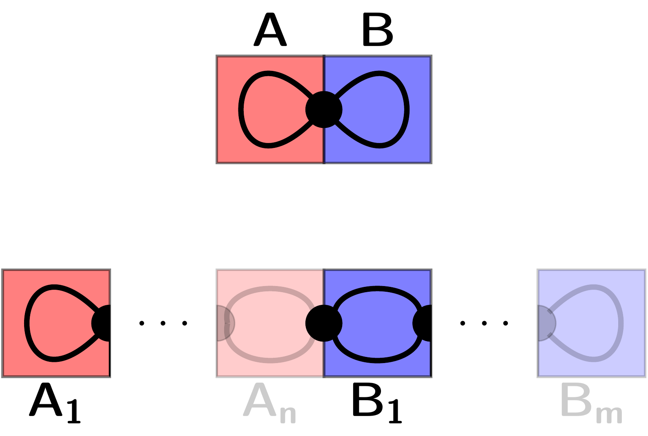
Symmetric State Extensions – Shareability

Slide 23
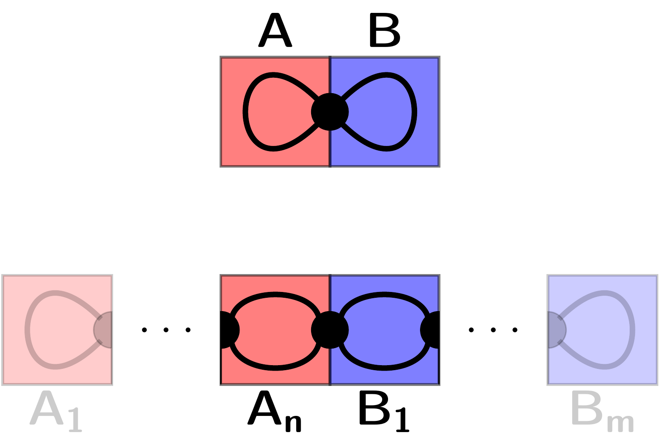
Symmetric State Extensions – Shareability

Slide 24
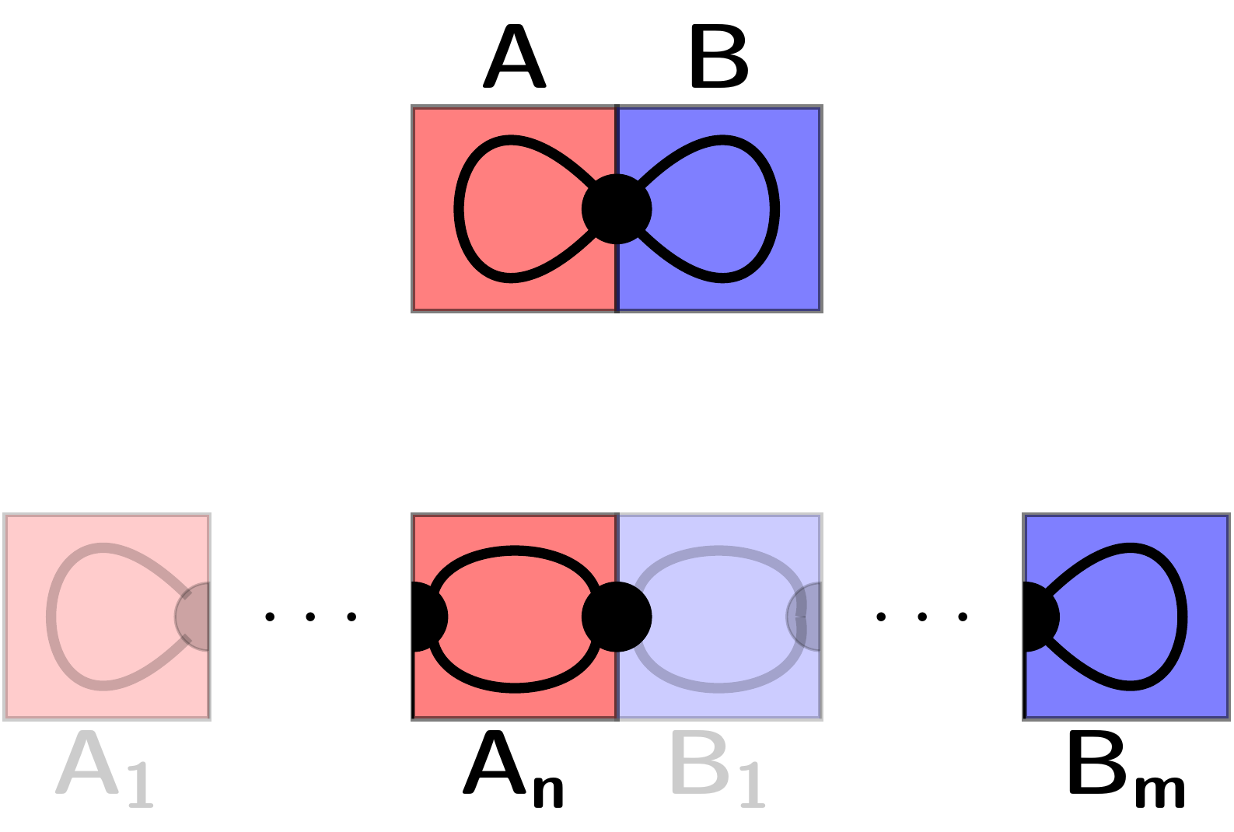
Symmetric State Extensions – Shareability

Slide 25
Symmetric State Extensions – Shareability
A state is (∞,∞)-shareable IFF it is separable!
(+ it is LOCC monotone…)
For entangled:
Maximal numbers.
It is an
Entanglement measure!

Slide 26
Symmetric State Extensions – Werner states

Slide 27
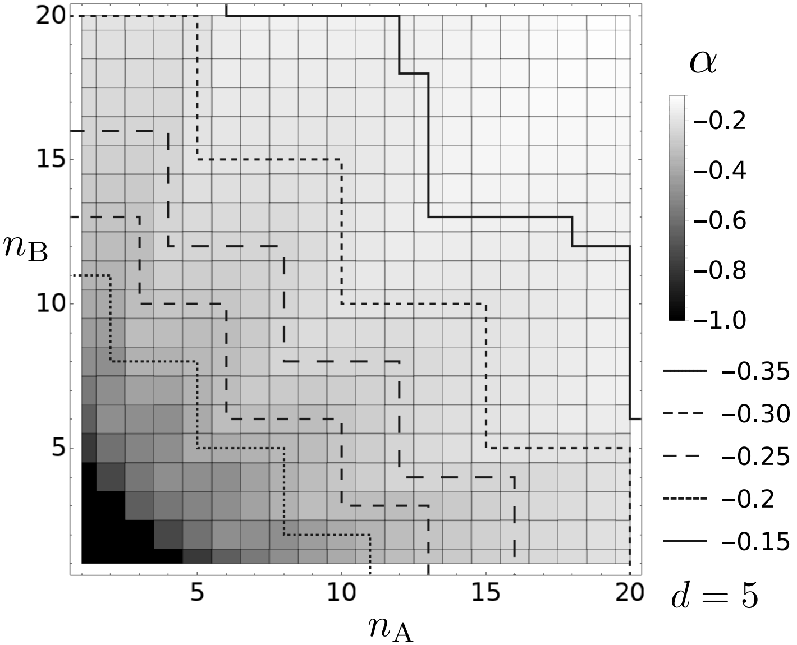
Symmetric State Extensions – Werner states, result
Non-trivial tradeoff between n_{A} and n_{B}!
(counterexample:
Isotropic states, only larger counts!)
arXiv:2208.13743

Slide 28
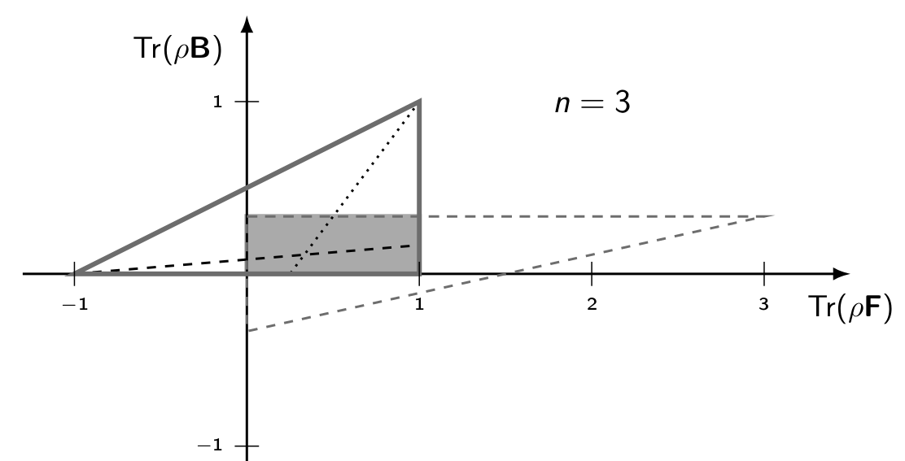
Symmetric State Extensions – OO-states

Slide 29
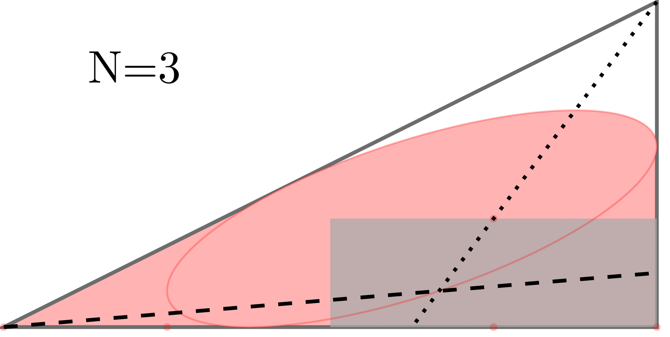
Symmetric State Extensions – OO-states, results

Slide 30
Thank you for your attention!
solymos.adrian@wigner.hu
“The unreasonable efficiency of mathematics in science is a gift we neither understand nor deserve.”
Questions?

Slide 31
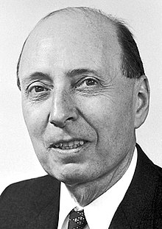
"for his contributions to the theory of the atomic nucleus and the elementary particles, particularly through the discovery and application of fundamental symmetry principles"

Slide 32
Unitary t-designs
Twirl property:
~
Schur-Weyl duality – Littlewood-Richardson rule:
Schur’s lemma:

Slide 33
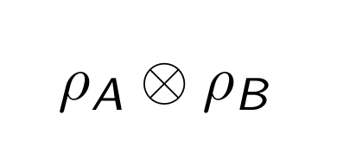
Symmetric State Extensions – Separable states

Slide 34
Symmetric State Extensions – Entangled states
?
→ Maximal (n,m) shareability numbers!

Slide 35
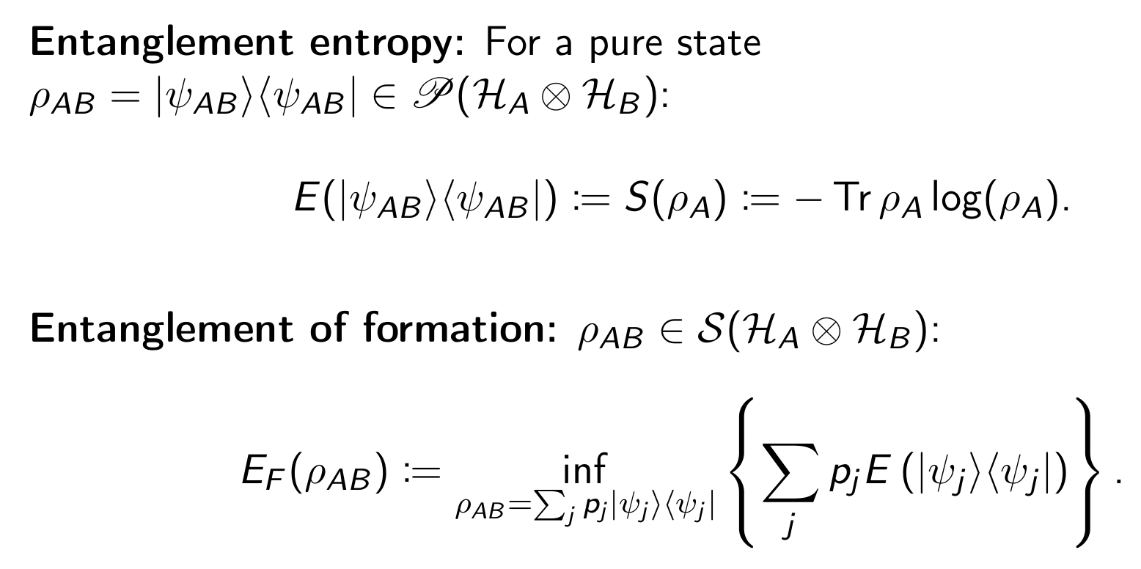
Symmetric State Extensions – Shareability
Is it easy to caculate? NO!
Behaves like an (is!)
Entanglement measure!

