Slide 1

Near-field infrared microscopy on carbon nanostructures
Katalin Kamarás
Institute for Solid State Physics and Optics,
Wigner Research Centre for Physics, Budapest
Institute of Technical Physics and Materials Science,
Centre for Energy Research, Budapest

Slide 2
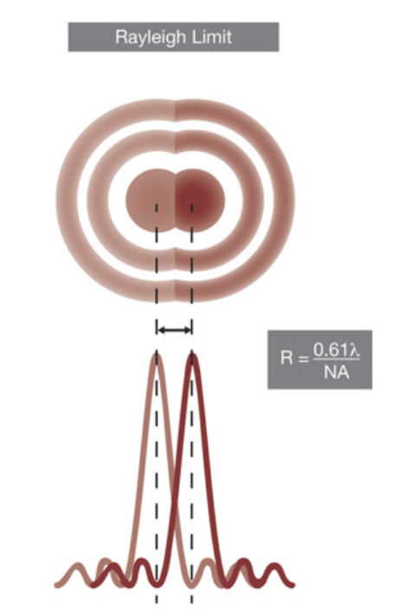
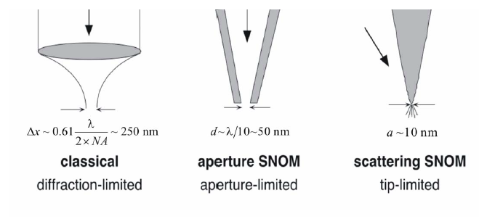
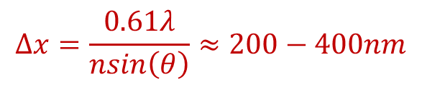
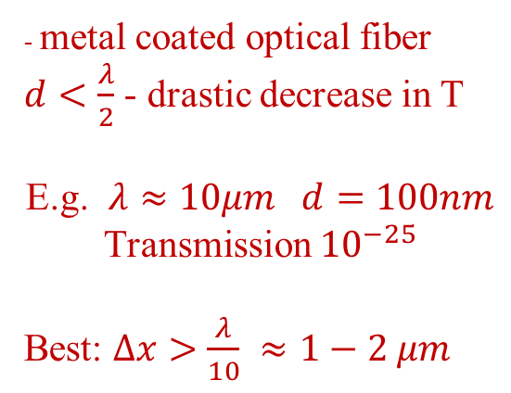
Resolution in classical microscopy and SNOM
(scanning near-field optical microscopy)
- metal coated optical fiber
$d<\frac{λ}{2}$ - drastic decrease in T
E.g. $λ≈10μm d=100nm$
Transmission ${10}^{−25}$
Best: $Δx>\frac{λ}{10} ≈1−2 μm$
$$Δx=\frac{0.61λ}{nsin\left(θ\right)}≈200−400nm$$

Slide 3
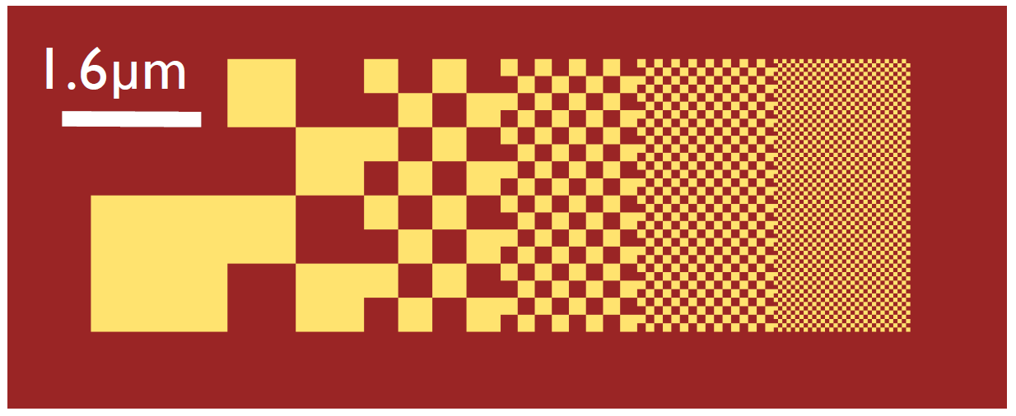
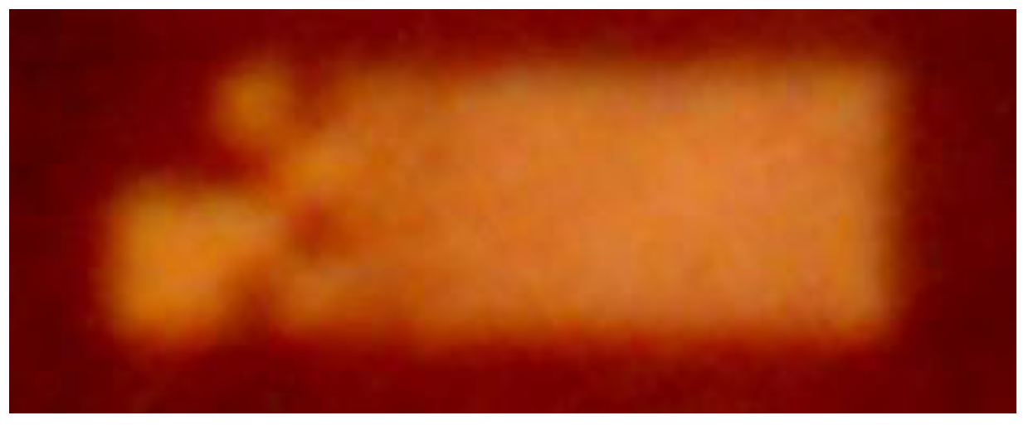


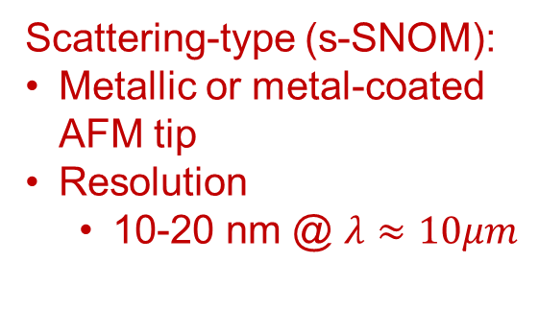

s-SNOM: Optical probe
Classical microscopy
Diffraction limited
Inhomogeneous sample
Scattering-type (s-SNOM):
Metallic or metal-coated
AFM tip
Resolution
  10-20 nm @ $λ≈10μm$
$λ=0.5 μm$ (VIS)
$λ=10 μm$ (IR)
N. Ocelic et al., Nature Mater 3, 606–609 (2004)

Slide 4
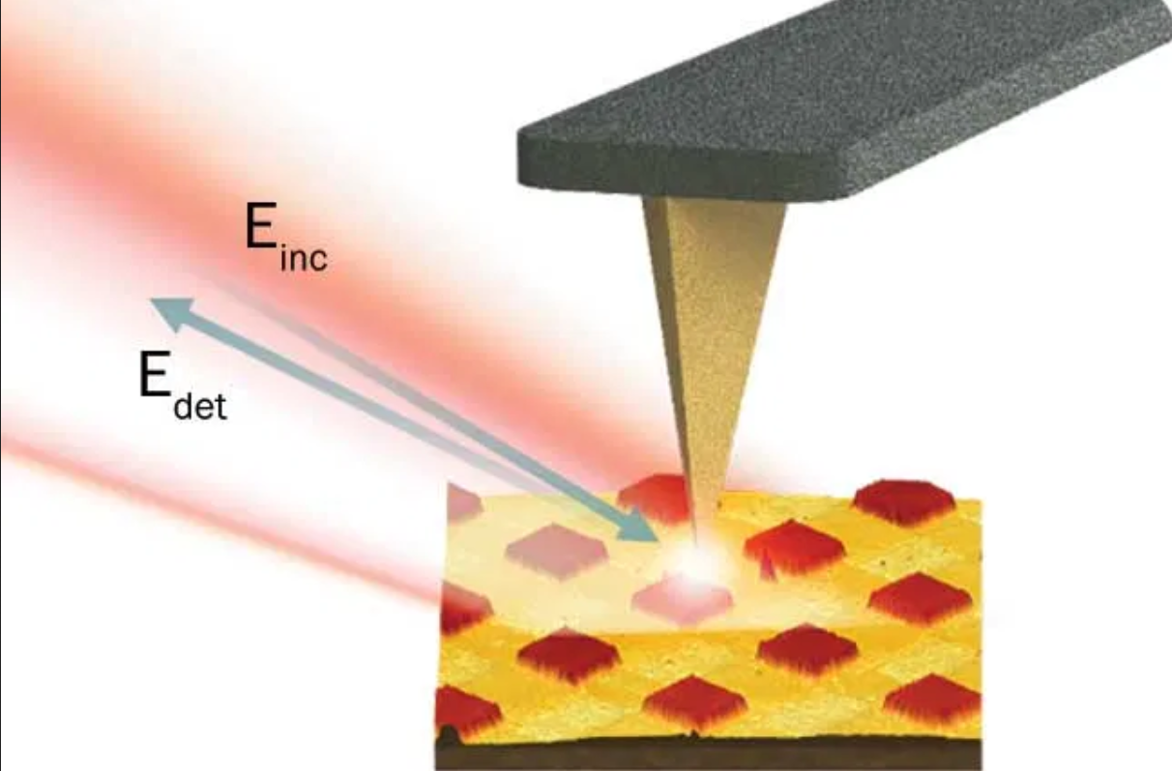

What is near field? How do we apply it for detection?
Non-radiating part of an optical field, decays faster than 1/r
Incoming light p-polarized
Directly not detected, still interacts with matter, if it is close enough
Interaction modifies scattered field under metallic probe antenna
Challenge: isolate the part of the field that corresponds to the near field spot
$$E_{S}=σE0$$
$$σ=seiφ$$
σ scattering coefficient
Notes:
The near field can have huge amplitude and huge momentum components
That modifies the scattered propagating field form the metal-coated AFM tip acting as a nano-antenna

Slide 5
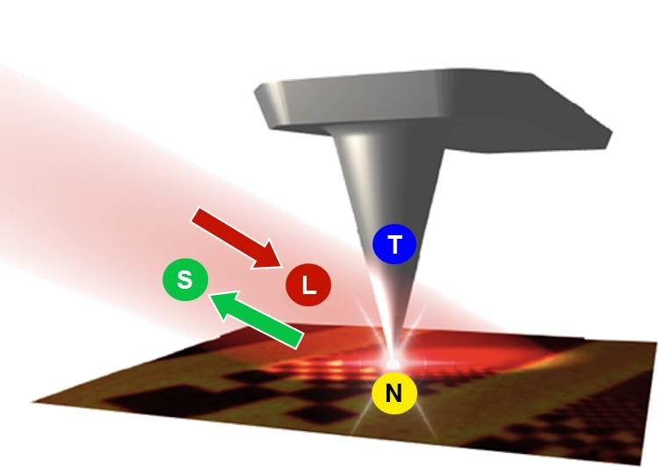
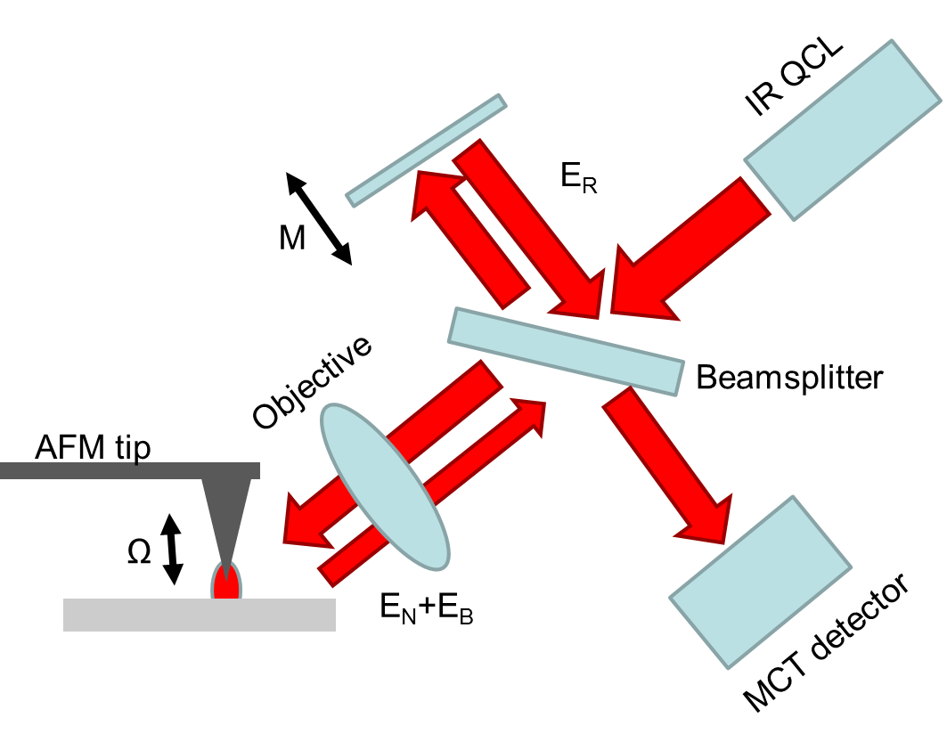


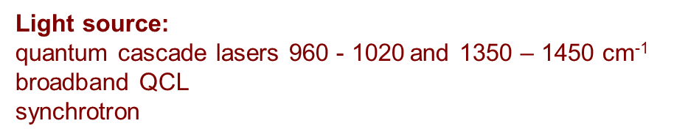
Scattering-type near-field optical microscopy (s-SNOM)
Ω = 30 kHz, Δz = 30 nm
M = 400 Hz, Δl = 2.2 μm
$$E_{s}=σE_{0} σ=s⋅e^{iφ}$$
Light source:
quantum cascade lasers 960 - 1020 and 1350 – 1450 cm⁻¹
broadband QCL
synchrotron
DAQ-PC
$$s_{n},φ_{n}$$
N. Ocelic, A. Huber, R. Hillenbrand: Appl. Phys. Lett. 89, 101124 (2006)
E_{N} – near-field scattering
E_{B} – background scattering
E_{R} – phase modulated reference beam

Slide 6
Applications of s-SNOM
Nano-identification
  individual molecules: oscillator strength of molecular modes too low
  collective modes (free electrons, phonons)
Quasiparticle mapping
Polariton imaging and interferometry

Slide 7
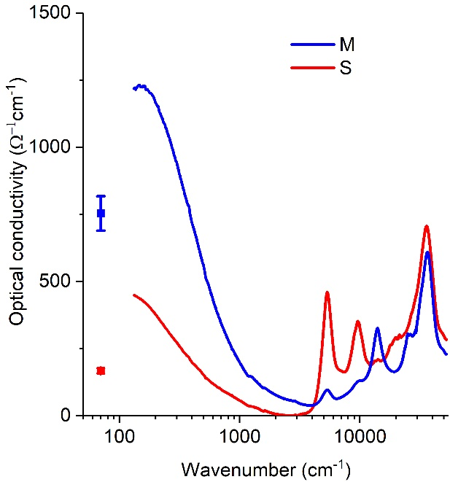
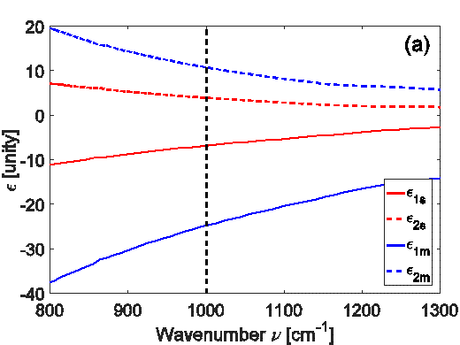
Carbon nanotubes
Properties defined by structure
Metallic or semiconducting
Separated fractions available
Different optical properties
H. M. Tóháti, Á . Pekker, B. Á. Pataki, Zs. Szekrényes, K. Kamarás: Eur. Phys. J. B 87, 126–1–6 (2014).

Slide 8
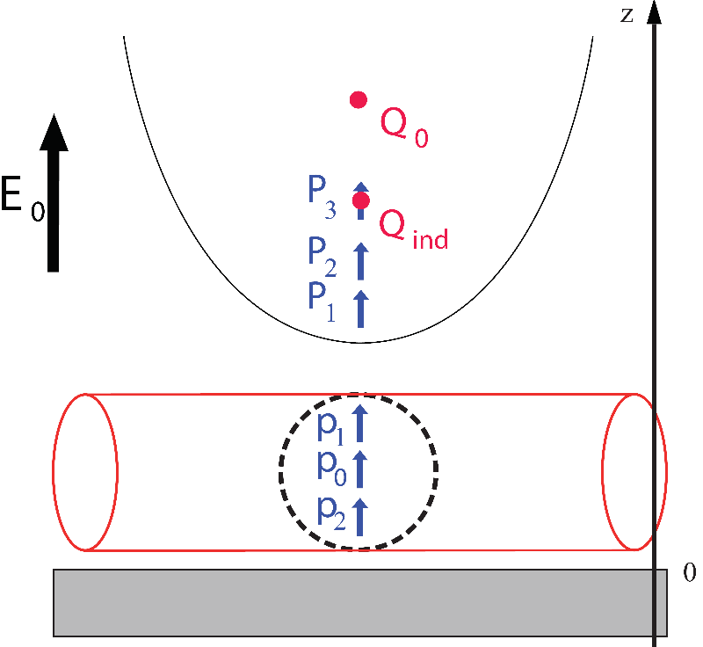

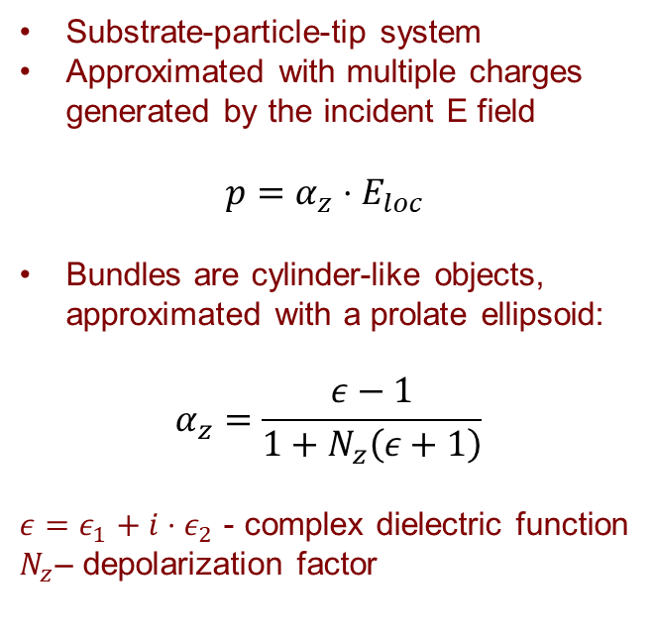
Analytical model
Based on extended finite dipole model (EFDM)
Substrate-particle-tip system
Approximated with multiple charges
generated by the incident E field
$$p=α_{z}⋅E_{loc}$$
Bundles are cylinder-like objects,
approximated with a prolate ellipsoid:
$$α_{z}=\frac{ε−1}{1+N_{z}\left(ε+1\right)}$$
$ε=ε_{1}+i⋅ε_{2}$ - complex dielectric function
$N_{z}$– depolarization factor
$$p_{eff}∝σ$$
$$p_{eff}=−2Q_{0}L−Q_{ind}L+P_{1}+P_{2}+P_{3}+p_{0}+p_{1}+p_{2}$$
Simulating the tapping mode: $z=(H+A(1−\cos\left(Ωt\right))$ → demodulation→$σ_{n}=s_{n}e^{iφ_{n}}$
A. Cvitkovic, Ph.D. thesis, Technische Universität München (2009).
J.Venermo and A. Sihvola, J. Electrostat. 63, 101–117 (2005).

Slide 9
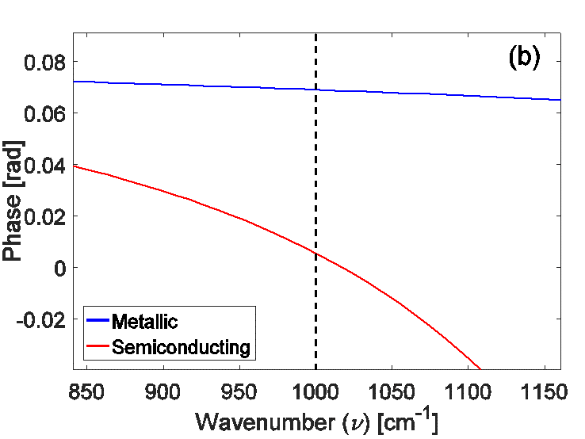
Analytical calculations
Complex dielectric function of separated
SWCNTs from transmission of self-supporting
films by Kramers-Kronig analysis
Third harmonic phase of d=4 nm bundles
relative to SiO₂ substrate

Slide 10
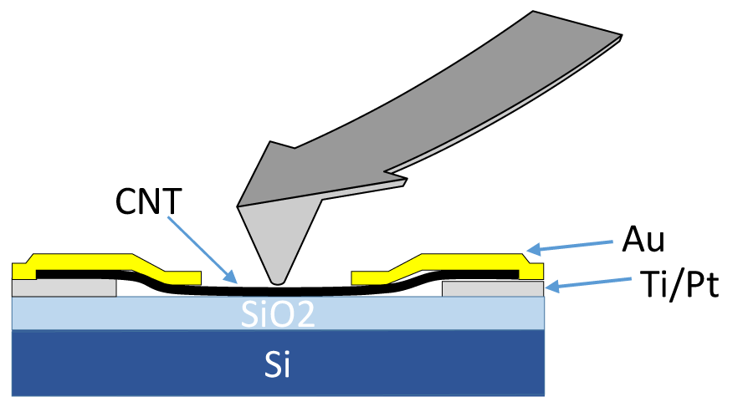
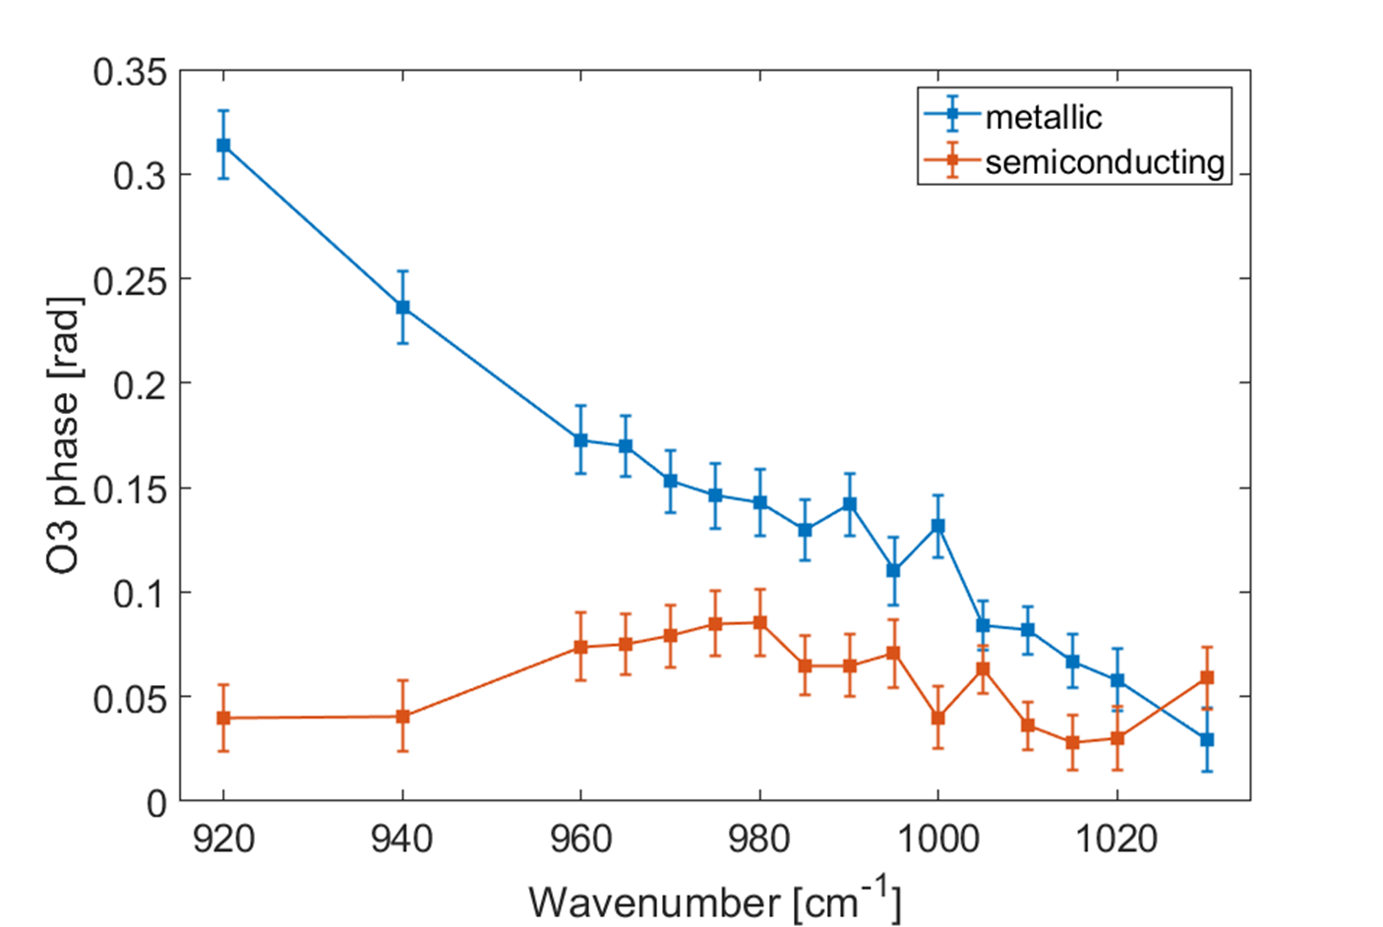
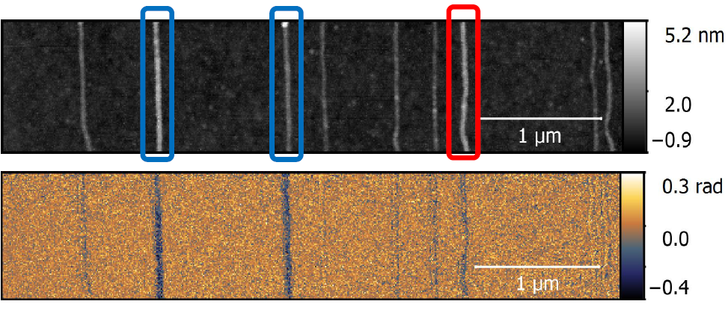
s-SNOM of metallic and semiconducting nanotubes
Characterizing CNT FETs – substrate SiO₂
Distinguish between metallic and semiconducting
Horizontally aligned nanotubes
G. Németh et al., Physica status solidi (b), 253, 2413-2416 (2016)
G. Németh et al., Physica status solidi (b), 254, 1700433 (2017)
Notes:
animation

Slide 11
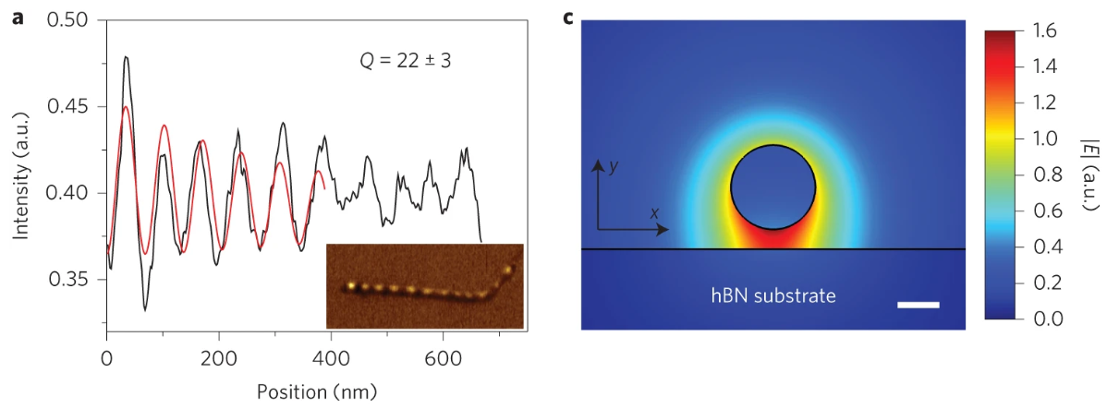
Carbon nanotube plasmons: single nanotube level
1D plasmons exist in single-walled carbon nanotubes:
1D nature: e-e interaction -> Luttinger-liquid plasmons
Long propagation length – long lifetime
High confinement ratio
High out-of-plane localization of EM field
Zhiwen Shi, Xiaoping Hong, Hans A. Bechtel, Bo Zeng, Michael C. Martin, Kenji Watanabe,
Takashi Taniguchi, Yuen-Ron Shen and Feng Wang, Nature Photon 9, 515–519 (2015)

Slide 12
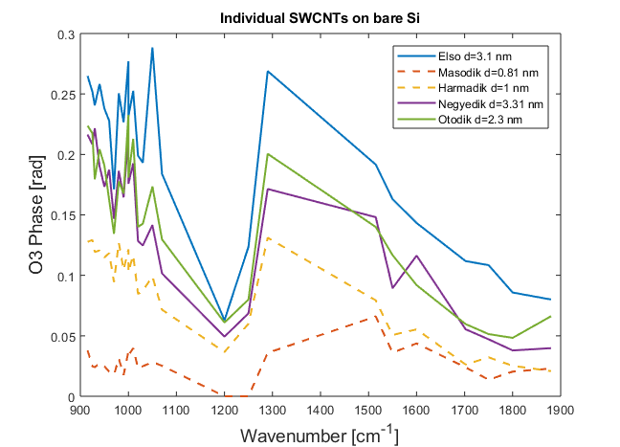
SNOM contrast of metallic and semiconducting nanotubes
Where are the plasmons?
  SNR is not enough, sample quality
Literature lacks the full midIR contrast spectrum
??? SiO₂ phonons ???
It should be a peak, not a dip
There is only native oxide
Strong coupling?
@ neaspec HQ

Slide 13
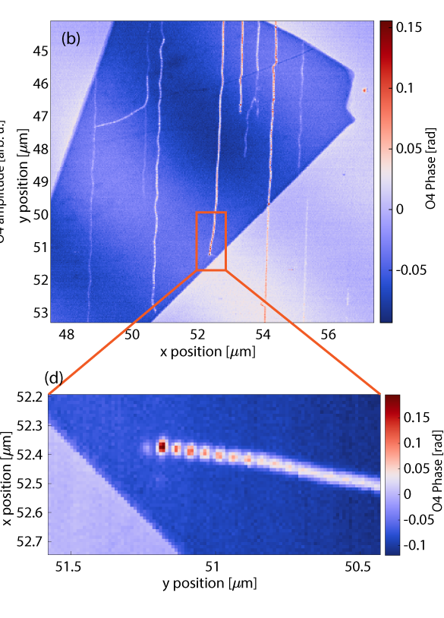
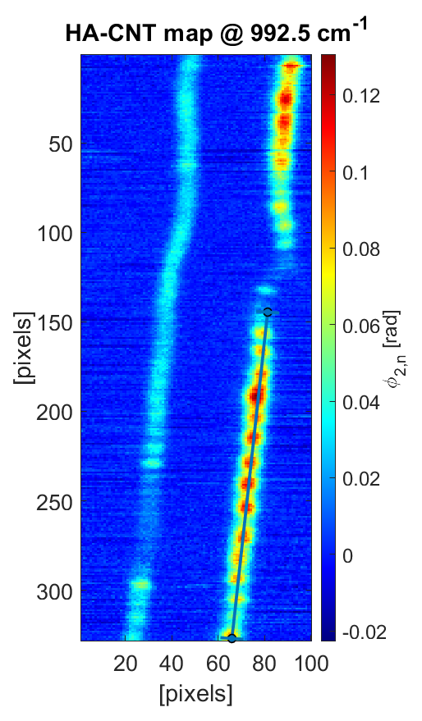
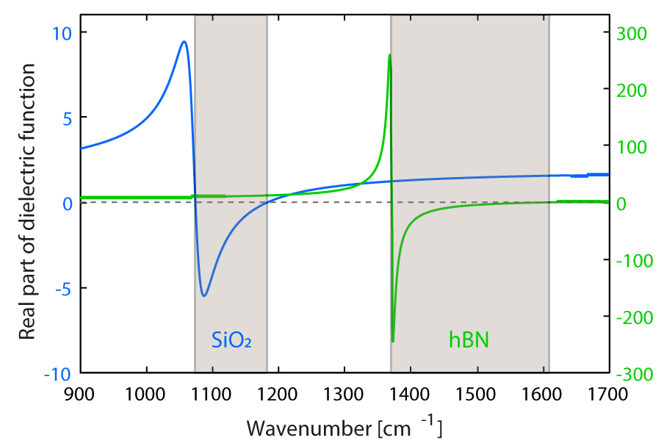
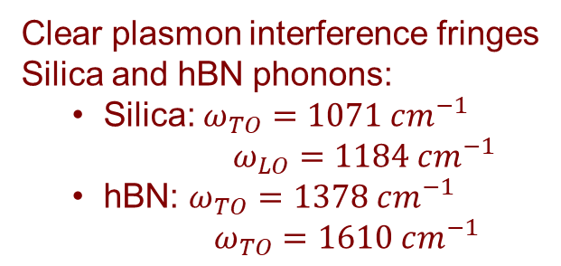
Interaction of plasmons with substrate phonons (Si, hBN)
Clear plasmon interference fringes
Silica and hBN phonons:
  Silica: $ω_{TO}=1071 cm^{−1}$
    $ω_{LO}=1184 cm^{−1}$
  hBN: $ω_{TO}=1378 cm^{−1}$
    $ω_{TO}=1610 cm^{−1}$

Slide 14
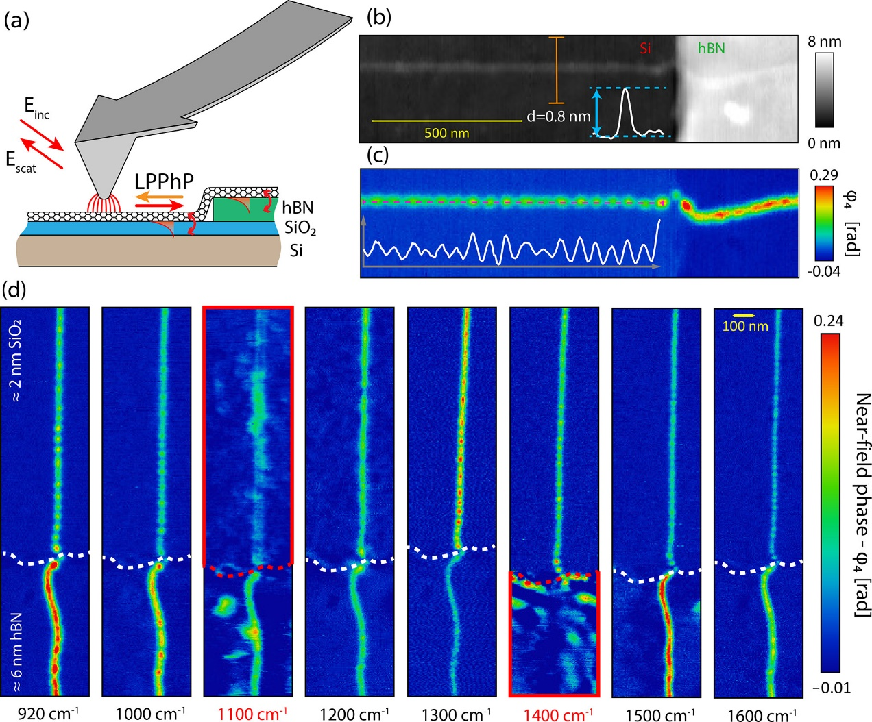
Wide-range measurement
Strong field confinement
Strong coupling
Enhanced sensitivity
(molecular detection)
Sequential spectral imaging 920-1720 cm⁻¹ with 20 cm⁻¹ steps
Plasmon wavelength changes
Fringe contrast dramatically changes
Nanotube becomes invisible in the respective Reststrahlen bands

Slide 15
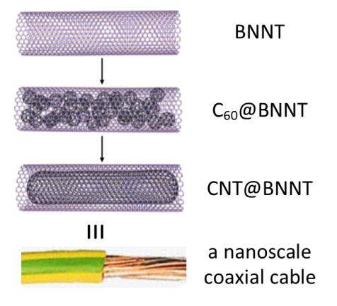
C₆₀@BNNT
Growth of Carbon Nanotubes inside Boron Nitride Nanotubes by Coalescence of Fullerenes: Toward the World’s Smallest Coaxial Cable
Kate E. Walker, Graham A. Rance,* Áron Pekker, Hajnalka M. Tóháti, Michael W. Fay, Rhys W. Lodge, Craig T. Stoppiello, Katalin Kamarás, and Andrei N. Khlobystov*
Small Methods 1, 1700184 (2017)

Slide 16
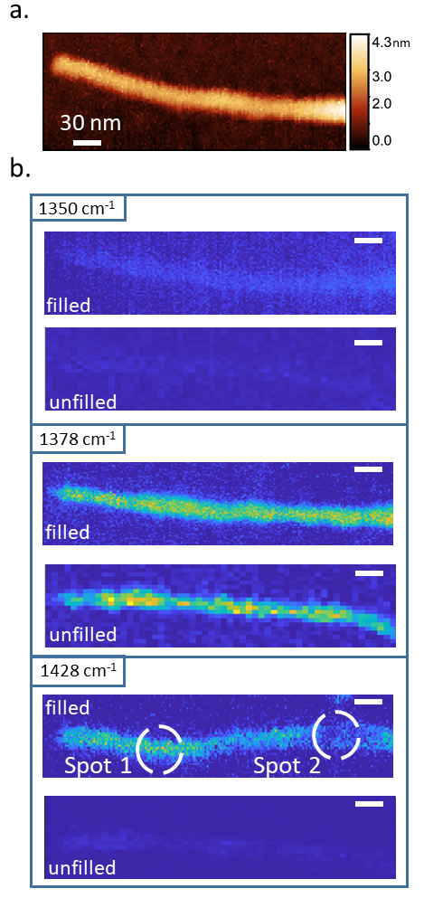
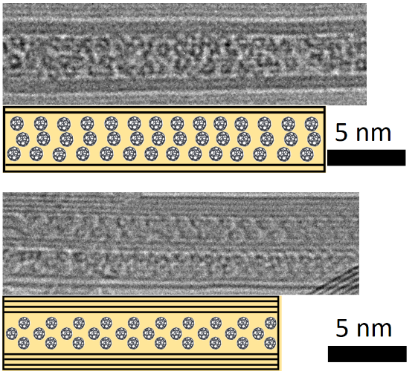
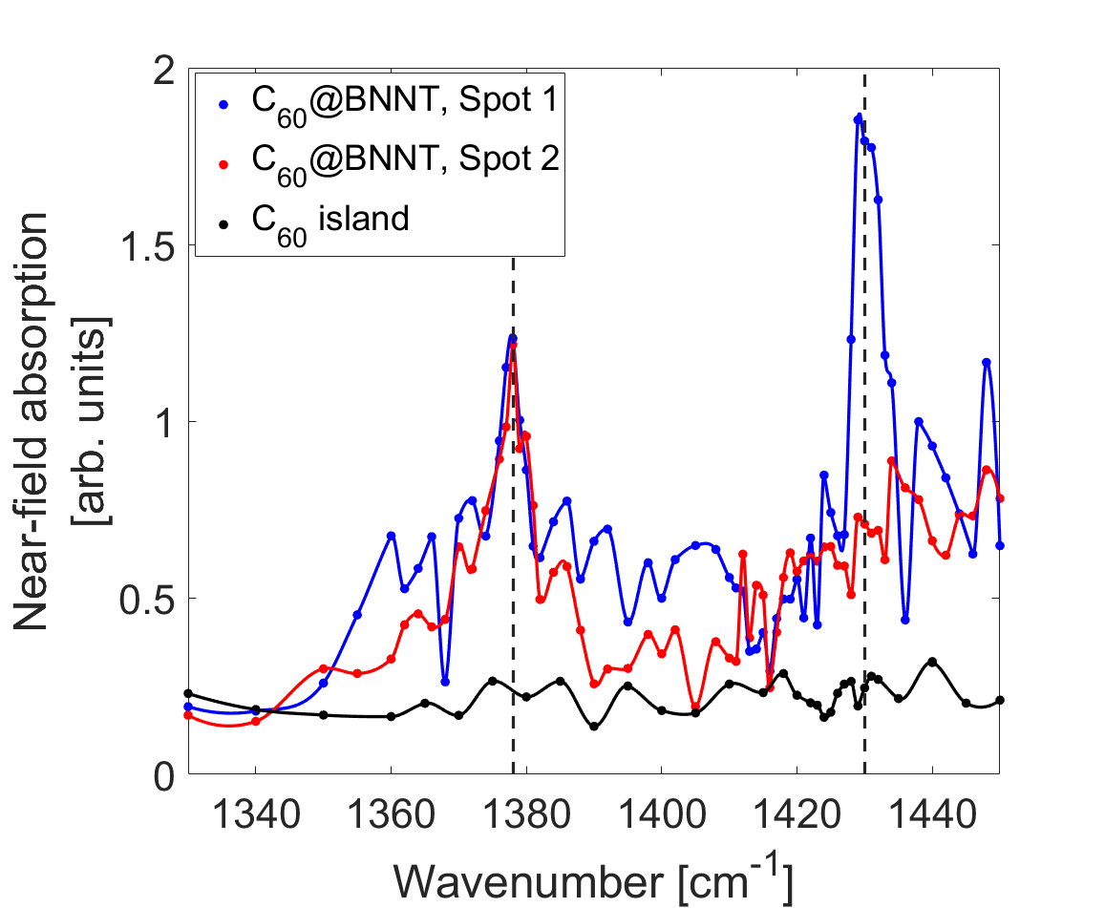
C₆₀ in BNNT – interaction with phonon-polaritons
Coupling of
phonon-polaritons to
molecular vibrations
Detection threshold:
~ 160 molecules
D. Datz, G. Németh, K.E. Walker et al. ACS Appl. Nano Mater. 4, 4335 (2021)

Slide 17
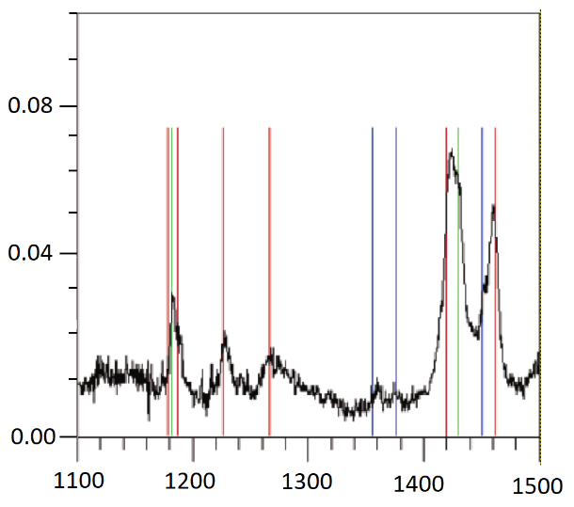
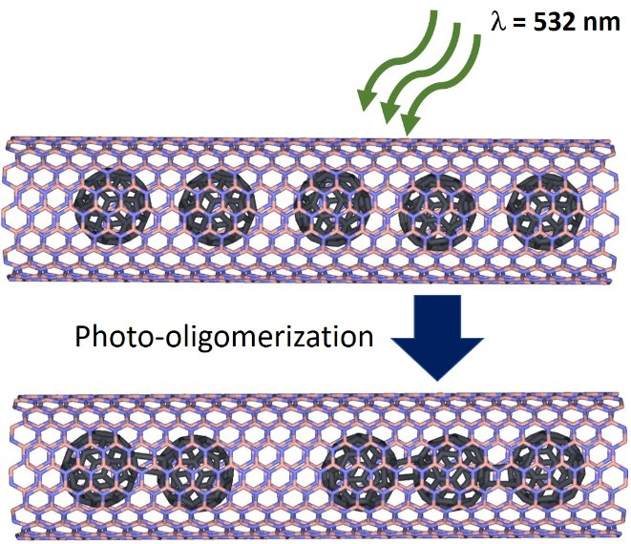
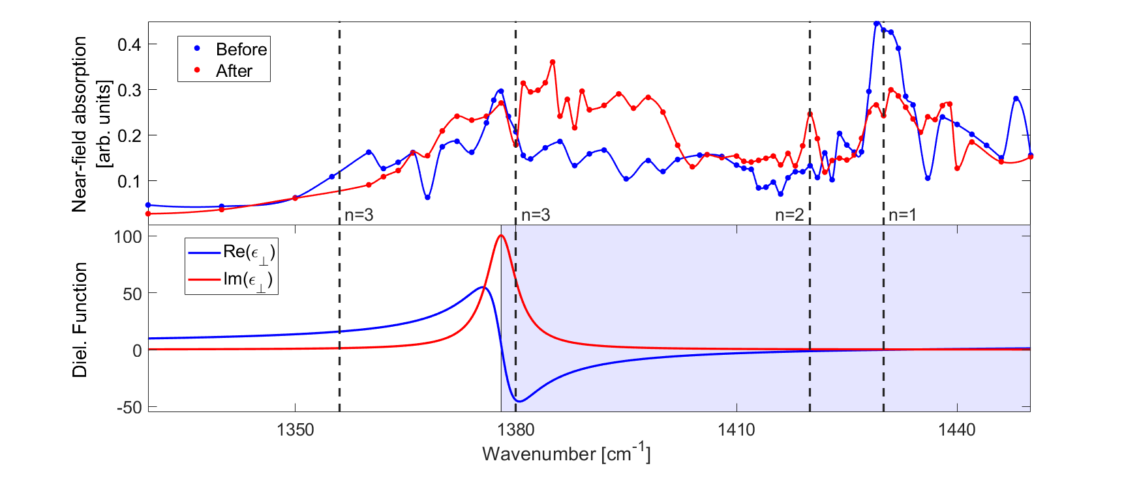
Photo-oligomerization
n = 3
n = 2
n = 3
n = 1
Far-field absorption
Wavenumber [cm⁻¹]
D. Datz, G. Németh, K.E. Walker et al. ACS Appl. Nano Mater. 4, 4335 (2021)

Slide 18
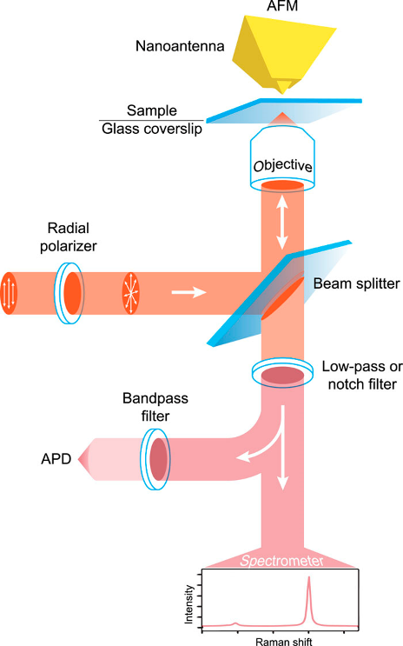
Tip-enhanced Raman Spectroscopy (TERS)
C.D. Tschannen, T.L. Vasconcelos, L. Novotny: J. Chem. Phys. 156, 044203 (2022)

Slide 19
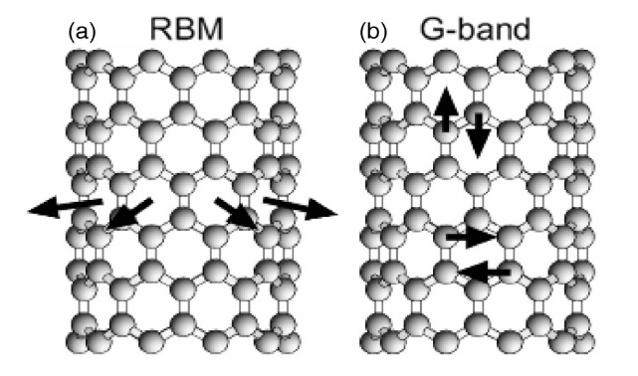
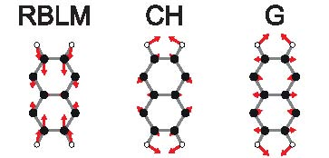
Graphene nanoribbons in carbon nanotubes
d_{vdW}
1
d_{CH}
2
3
d_{GNR}
4
5
6
d_{CH}
d_{vdW}
Nanotube
Nanoribbon

Slide 20
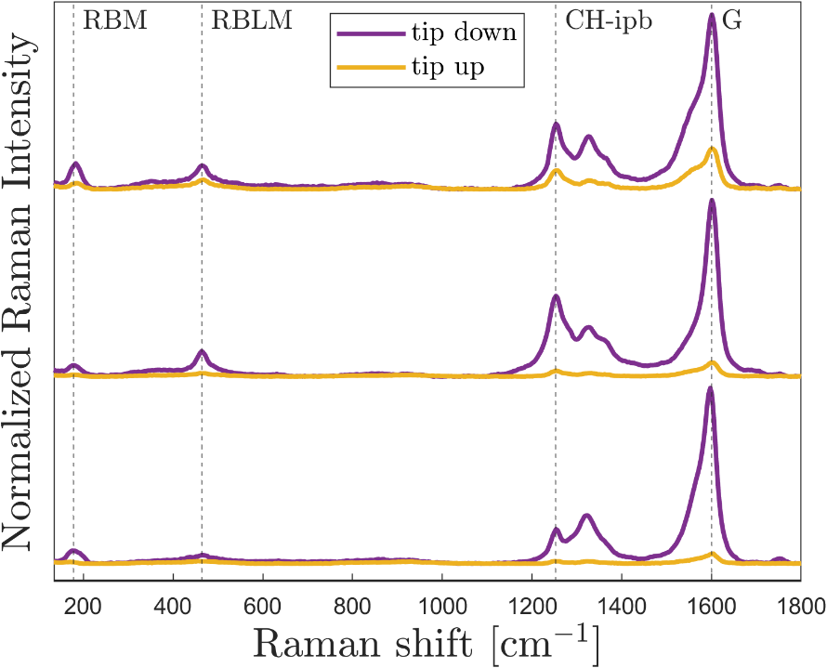
TERS on NR@NT
Topography
NT RBM
(Cla Duri Tschannen,
Lukas Novotny,
ETH Zürich)
NR RBLM
NT+NR G mode
A. Cadena, B. Botka, Á. Pekker, C.D. Tschannen, C. Lombardo, L. Novotny, A.N. Khlobystov, K. Kamarás: J. Phys. Chem. Lett. 13, 9752 (2022)

Slide 21
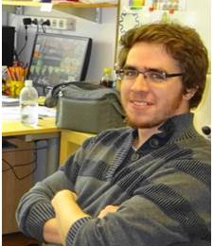
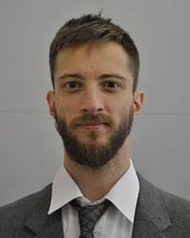
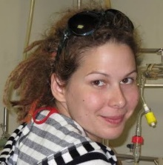
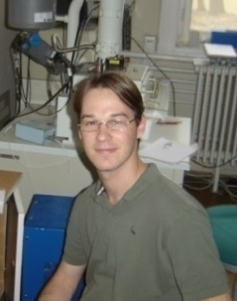
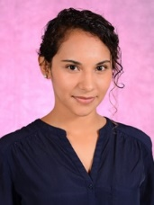
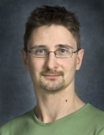
Collaborators
Dániel Datz
Gergely Németh
Bea Botka
Áron Pekker
Ana Cadena
Erzsébet Dodony, Zsolt Fogarassy, Béla PéczResearch Institute for Technical Physics and Materials Science
Cla Duri Tschannen, Chiara Lombardo, Lukas Novotny
ETH Zürich
Adrian Cernescu
Neaspec – Attocube GmbH, Munich
Keigo Otsuka, Taiki Inoue, Shigeo Maruyama
The University of Tokyo
Kate Walker, Graham A. Rance, Andrei N. Khlobystov
University of Nottingham
Hidetsugu Shiozawa
University of Vienna
Ferenc Borondics

Slide 22
Funding
OTKA FK 125063, K 143153 – operating costs
NeaSNOM original investment
2012, funded by MTA
SZFKI -> Wigner
Major upgrade
2019, funded by ELKH
MTA -> ELKH
????????
ELKH -> HUN-REN

