Slide 1
Installation of the first Hungarian magnetically shielded room in Nagycenk
Géza Erdős
&
Zoltán Németh, Nikolett Biró, Miklós Veres
(HUN-REN Wigner RCP)
Viktor Wesztergom, István Lemperger
(HUN-REN Institute of Geophysics and Space Science, Sopron)

Slide 2
The HUN-REN Institute of Earth Physics and Space Science and the HUN-REN Wigner Physics Research Centre have built jointly a zero magnetic field laboratory in the Széchenyi István Geophysical Observatory, near Nagycenk.
Finantial support: 0.5 billion HUF
GINOP-2.3.3-15-2016-00016
(Economic Development and Innovation Operational Programme)
Duration of project: 2016 – 2018 …… 2023 („Penelopé” project)

Slide 3
Motivation: development of magnetometers for use in space
Best magnetometers in terms of precision and low noise:
SQUID (superconducting magnetometers): liquid helium cooling
SERF (spin exchange relaxation free): works in ultralow magnetic field (<10nT)
Interplanetary space (outside the terrestrial magnetosphere):
Helium cooling is not possible, but
Magnetic field is in the order of 10 nT
Our goals are
To stablish an electro- magnetically clean room,
To build an environment which is similar to deep space
Developing, testing, calibrating equipment to be sent to space (in particular SERF magnetometers)
To perform magnetic cleanliness programs

Slide 4
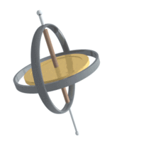
SERF magnetometers:
Atoms with magnetic moment make Larmor precession in magnetic field, the frequency of which depends on the product of the magnetic moment and the external field. By measuring the Larmor frequency:
We can determine the material inside a known field (NMR equipment in medicine)
We can determine the field, if we know the material in the field (atomic magnetometer)
Electrons orbiting around the nucleus make spin exchange collision with other electrons (orbiting around a neighbouring nucleus)
↓
the effective magnetic moment of atoms are fluctuating
↓
Larmor frequency broadens
SERF: during one Larmor period there are many spin collisions
Potassium atoms 200 C
Low magnetic field (<10nT)

Slide 5
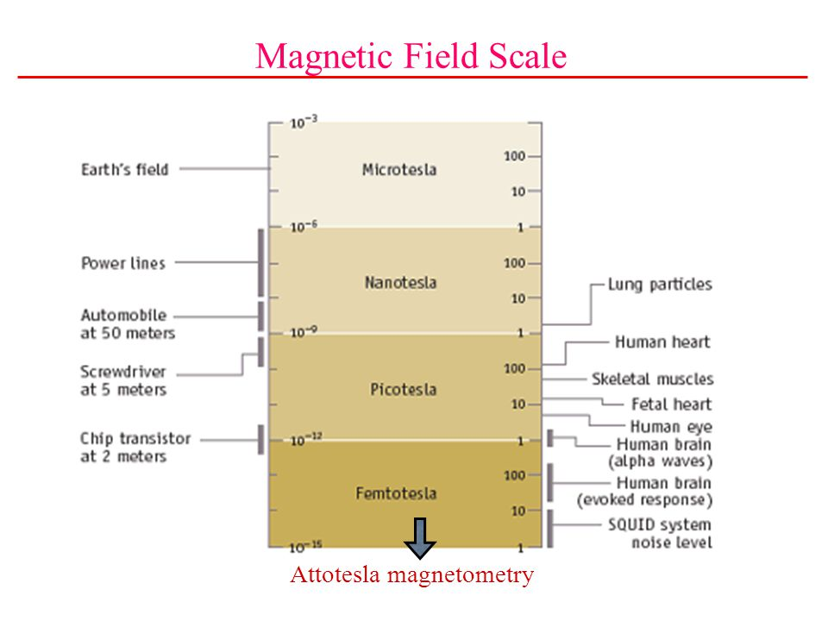
Magnetic storm
Interplanetary space
Our laboratory
SERF

Slide 6
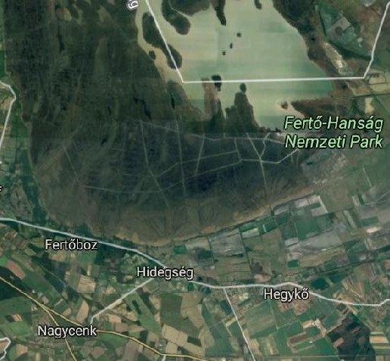
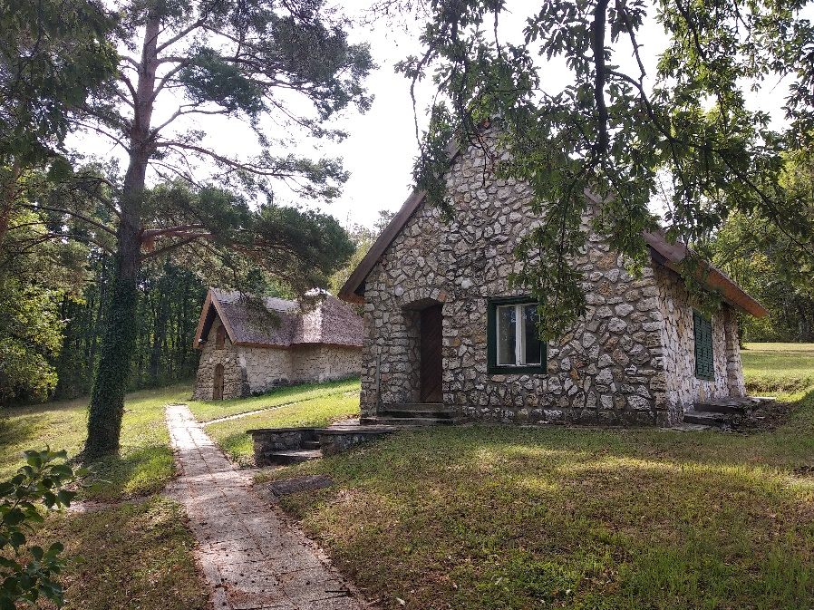
How to reduce the terrestrial magnetic field by 5 orders of magnitude?
„Hobbit houses”
Location:
Szécheny István Geophysical Observatory
Remote place for geomagnetic observations in a national park
2 km wide sedimentary soil
Continuous measurement of the terrestrial magnetic field

Slide 7
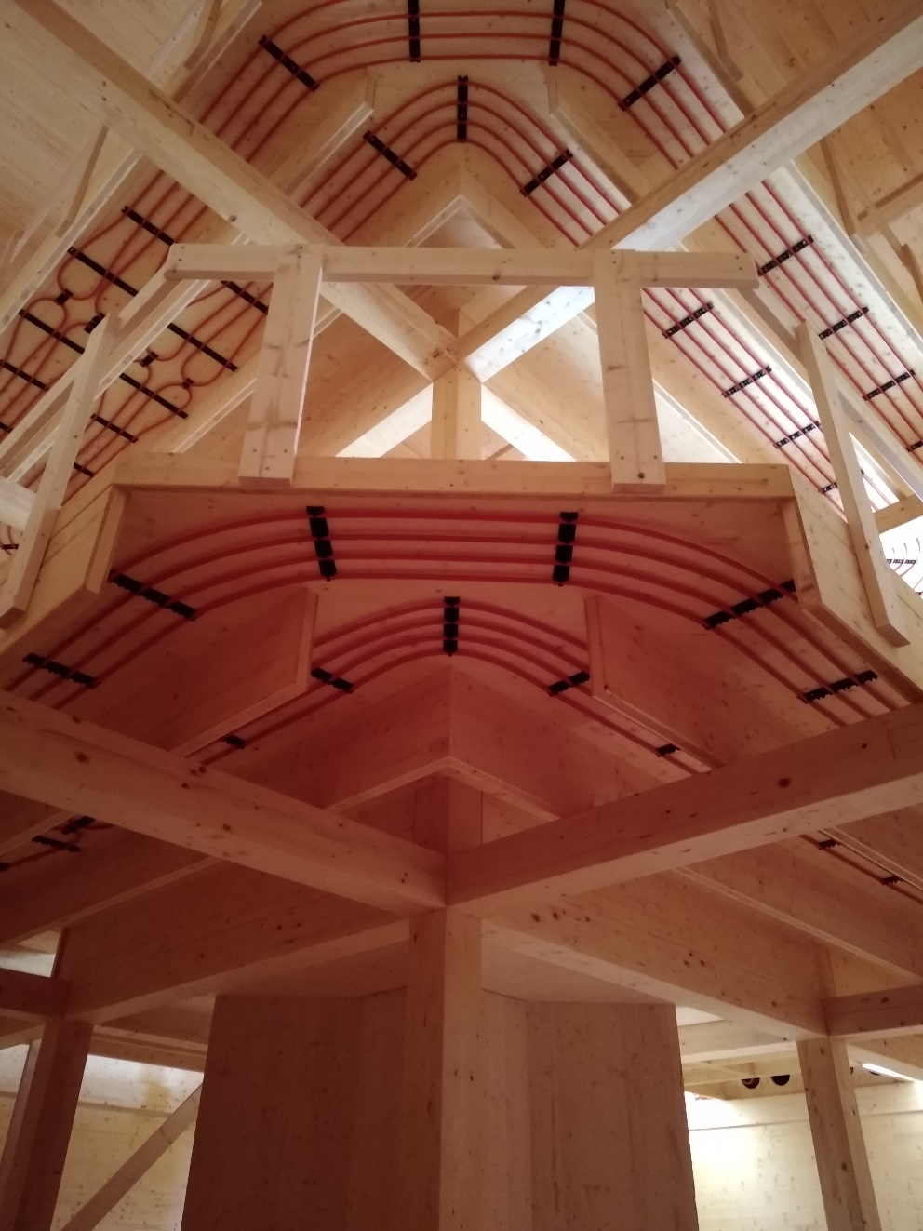
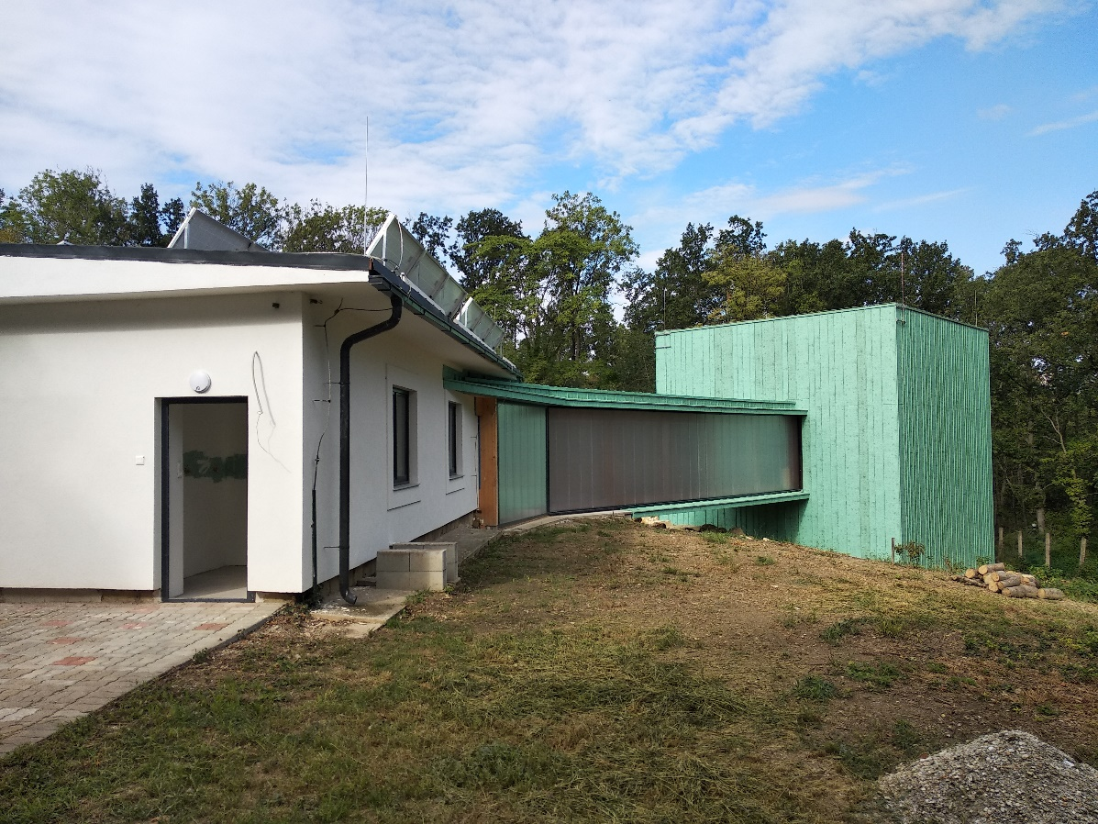
Hall
9 x 9 x 9 m hall, built by wood (no magnetic material)

Slide 8
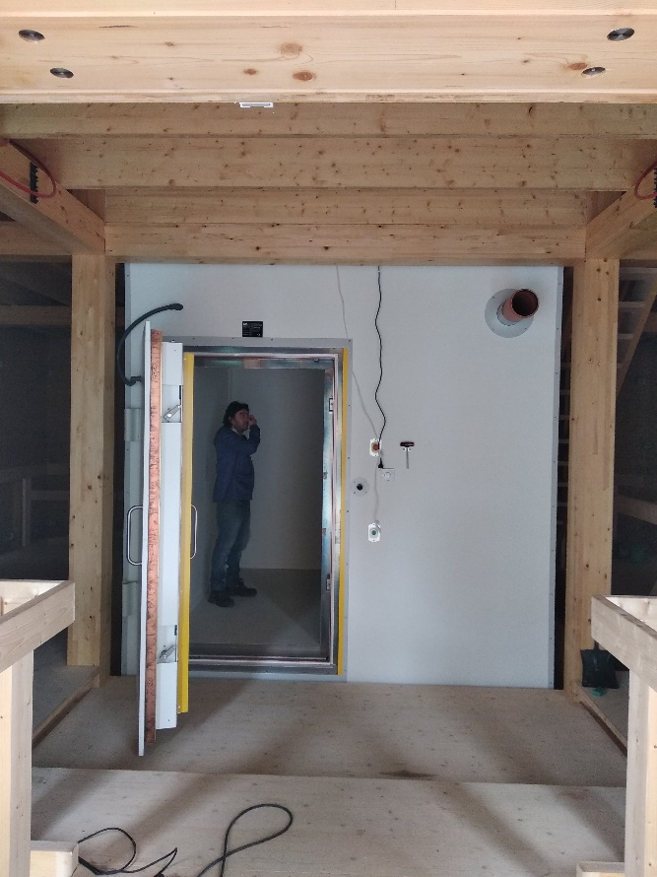
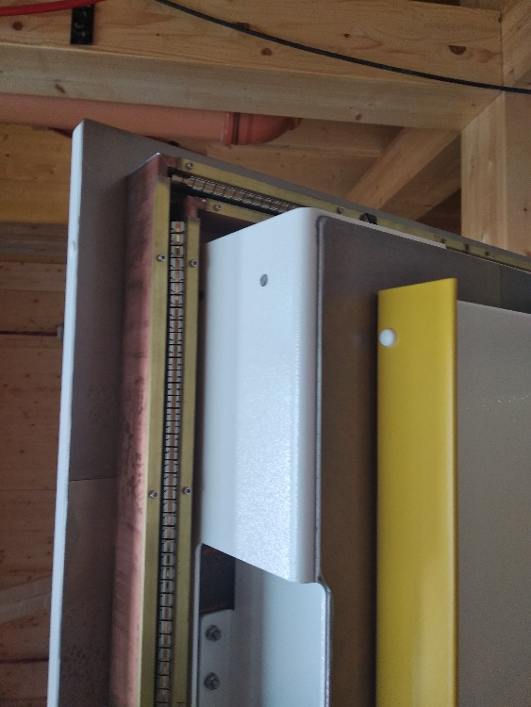
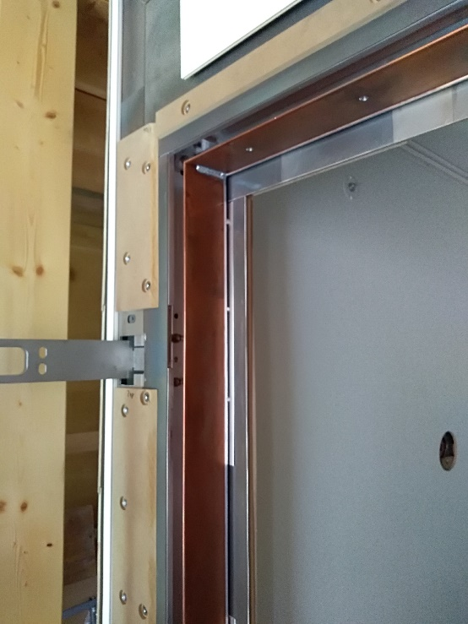
Magnetic shielding in two steps: passive and active
Passive shielding:
3 x 3 m room
2 mumetal layer (permeability = 100000): deflection of magnetic lines of force
1 cooper coated aluminium layer: Faraday-cage
Pneumaticaly assisted closing of the door
Feedthrough holes
Led light outside of the inner layer

Slide 9
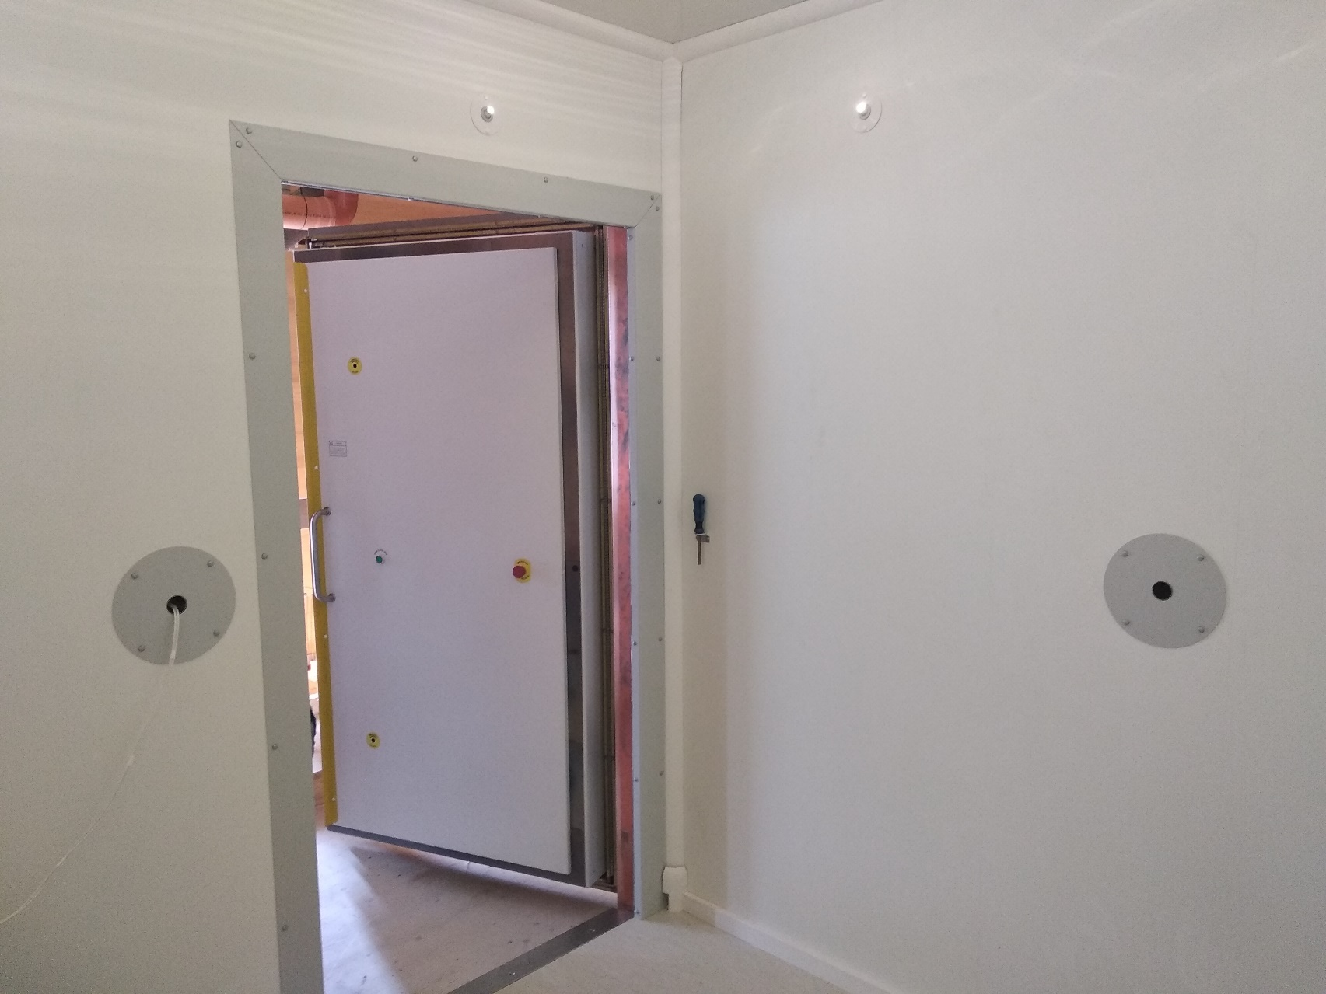
Lamps
Feedthrough holes

Slide 10
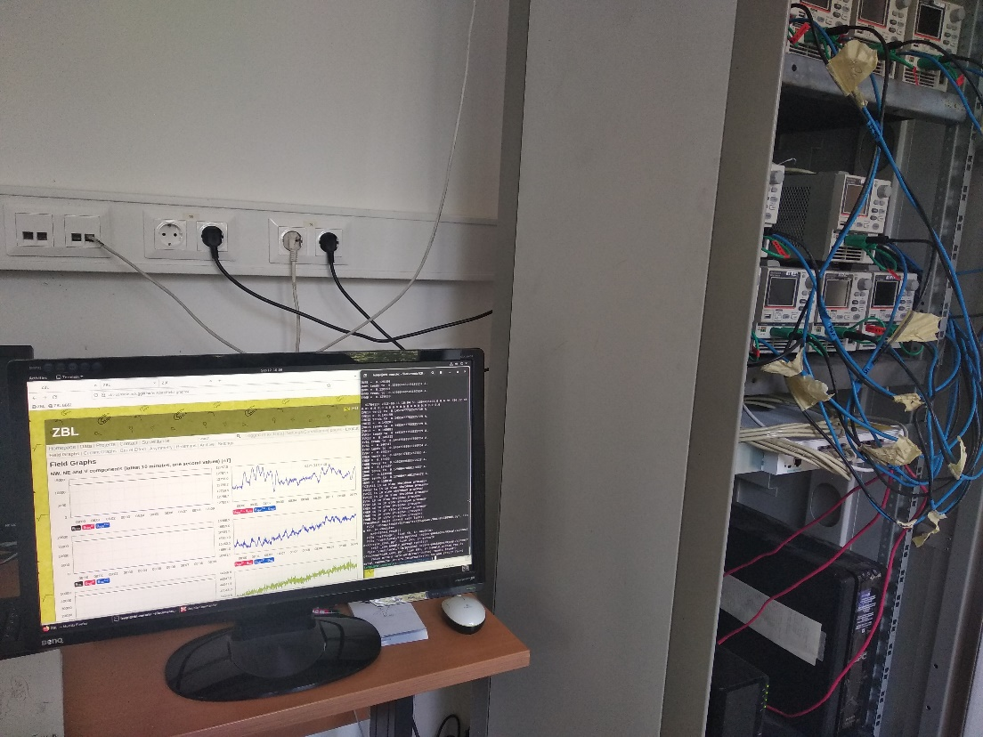
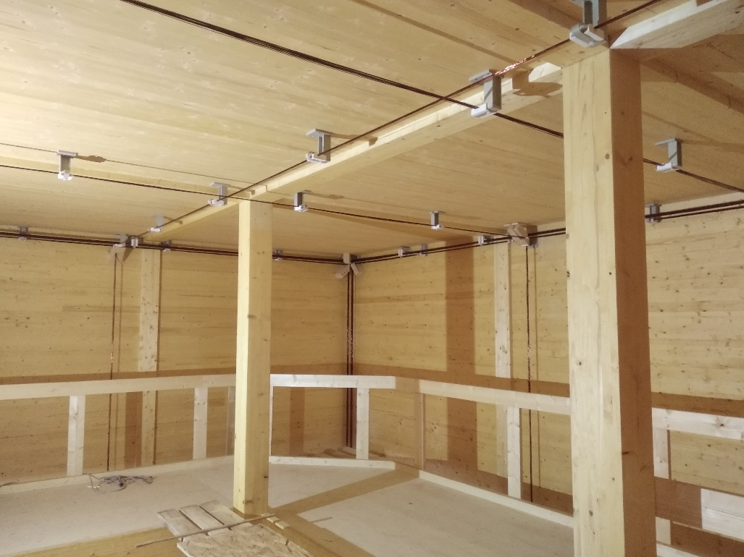
Active shielding
Coils on the wall of the hall, the magnetic field of which compensate the terrestrial field
Current in the coils are determined by the instant terrestrial field, measured by 1 Hz
12 coils in Merritt arrangement
12 single-loop wires for fine tuning

Slide 11
Applications of the magnetically shielded room
Space physics
Development, test, calibration of magnetometers
Magnetic cleanliness program
Technology
Study of interferences between electronic components
Material sciences
Heat treatment of magnetic materials in zero field
Geology
Paleomagnetism
Chemistry
Nuclear magnetic resonance in low field
Particle physics
Measurement of electric dipol moment of particles
Biology
Creatures navigating with magnetic field: study of receptors
Medicine
Magnetoencephalography
Magnetocardiography
Monitoring the position of magnetic contras materials in human body

Slide 12
Technology
Space technology and aviation industry:
Complex electronic systems
Subsystems of the instruments might interfere
High demand for safe operation
↓
Study of the interference needs electromagnetically quiet space
Material science
Magnetic alloys heated up to the Curie temperature.
When cooling down in zero magnetic field, the christallization of the magnetic moment of atoms are not affected by external magnetic field.
This can result in alloys without remnant field.
Geology
Ancient terrestrial magnetic fields are frozen into rocks. This should be studed in clean magnetic conditions.

Slide 13
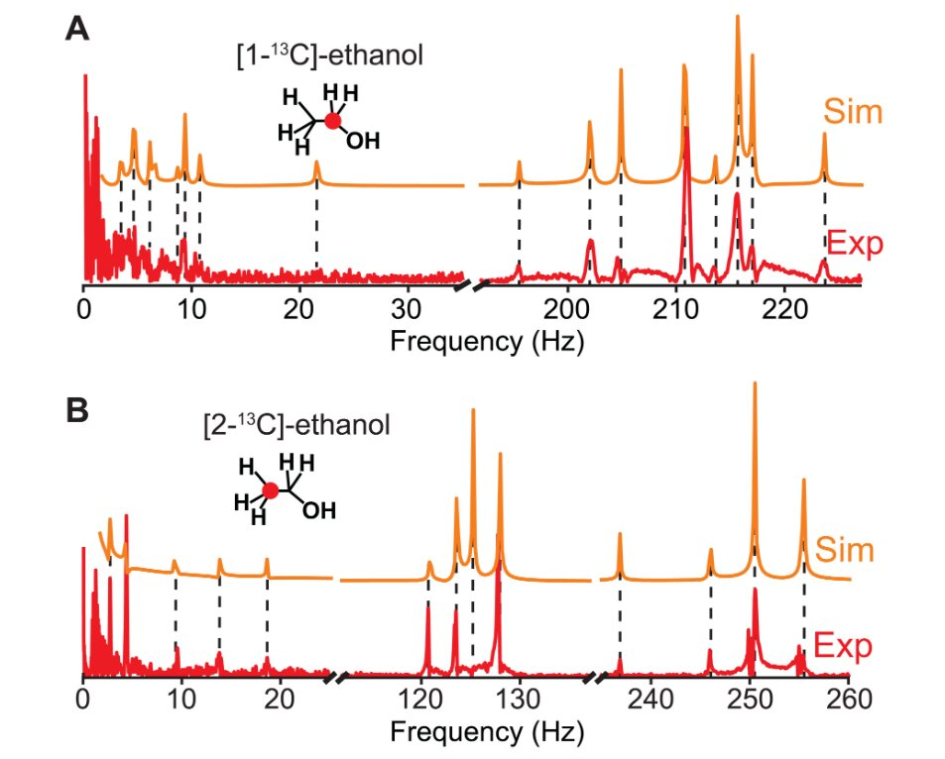
Chemistry
Zero to ultralow-field nuclear magnetic resonance (ZULF NMR)
Normal NMR:
Magnetic field ~Tesla
Signal: ~GigaHz
Detection: search coil
Gives information on magnetic moment of atoms
ZULF NMR:
Magnetic field ~nT
Signal: ~100Hz
Detection: SQUID, SERF
Spectral resolution by computer
Gives information on chemical bonds
„Chemical fingerprint” of molecules
Selection between isomers
Reaction dynamics

Slide 14
Magnetic storm
Interplanetary space
Our laboratory
SERF

Slide 15
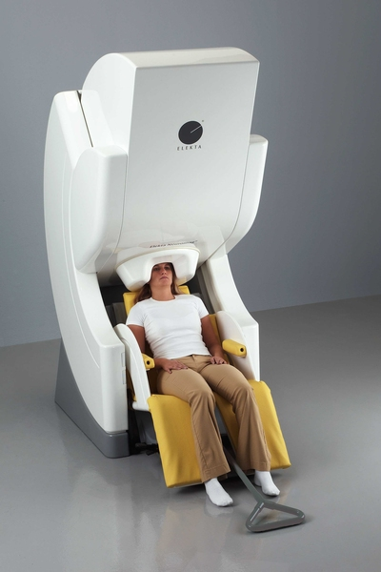
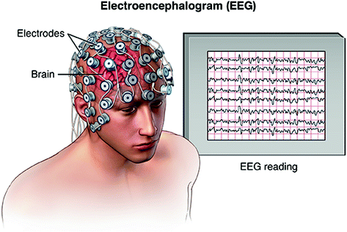
Medicine
Human brain emits electromagnetic waves. Commonly used technique for its detection is the electroencephalography (EEG), where electrodes are placed on the head of the patient. However, if the waves originate deep inside the brain, the electrodes should be poked into the brain, which is highly invasive medical examination. A solution for that problem is the magnetoencephalography (MEG), where the magnetic field of the currents in the brain is directly measured.
Magnetoencephalography (MEG)
306 SQUID detectors (MIT)
Replacement with SERF detectors?

Slide 16
Summary
Electromagnetic clean laboratory room was installed in a remote place, near Sopron
The terrestrial magnetic field is reduced by 5 orders of magnitude
The room provides electromagnetic conditions similar to the interplanetary space
The main goal of the installation is to develop a new generation of magnetometers for space missions
The near-zero magnetic field environment gives a lot of opportunity for interdisciplinary researches

