Slide 1
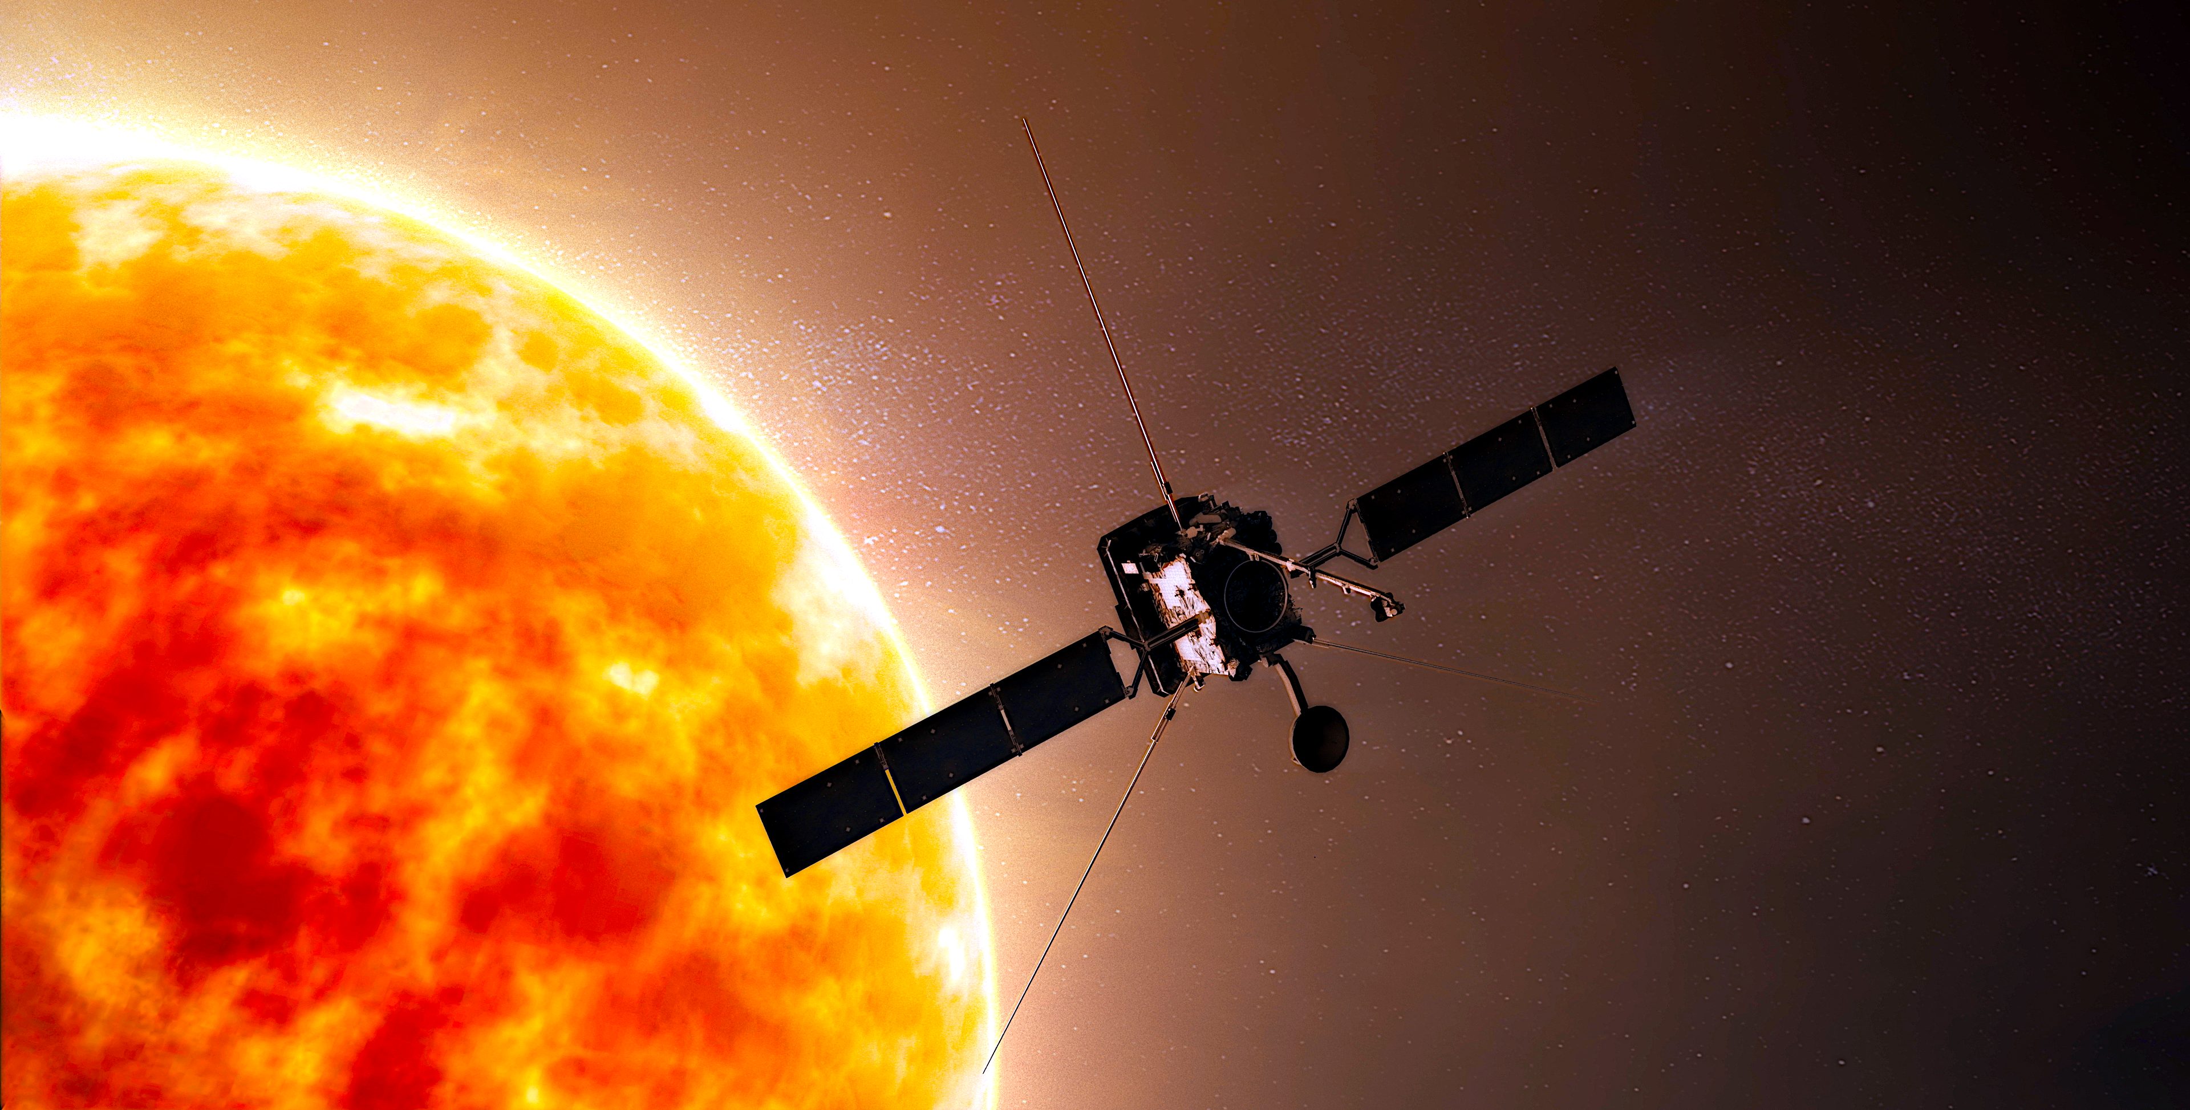
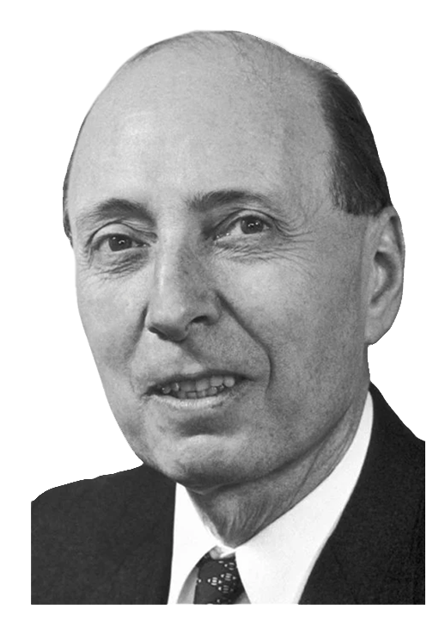
SOLAR SYSTEM RESEARCH WITH SPACE PROBES
WIGNER RCP
DEPARTMENT OF SPACE PHYSICS AND SPACE TECHNOLOGY
ZSÓFIA BEBESI
SENIOR RESEARCH FELLOW
WIGNER 121 SCIENTIFIC SYMPOSIUM - Heritage and Future

Slide 2
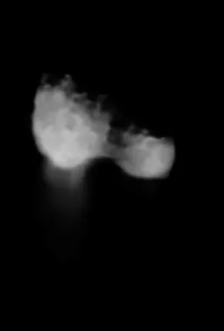
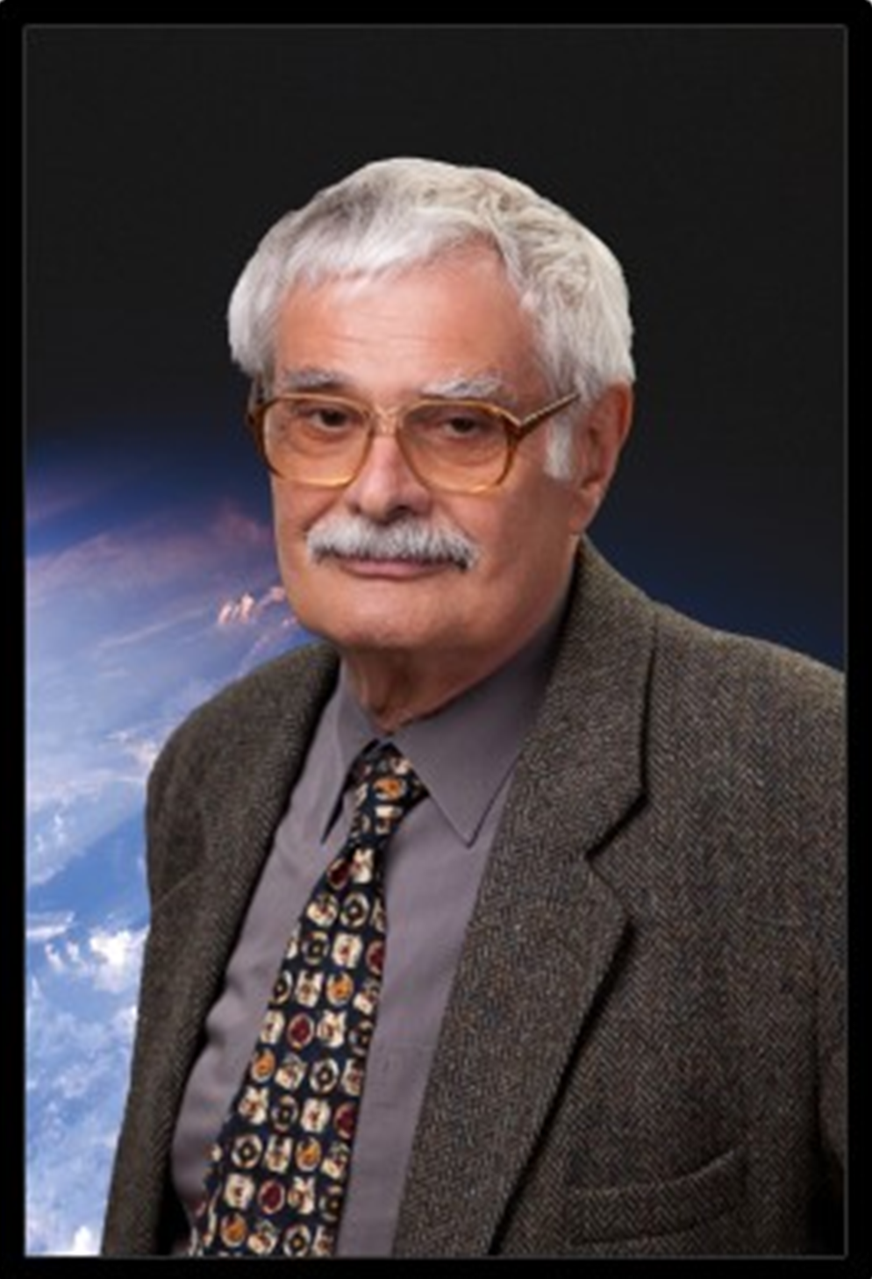
Our heritage - Hungary joined international space projects
In the 80's, physicists and engineers of the former KFKI-RMKI were already participating in the Vega-1 and 2 space missions to Venus and comet Halley.
During the assembly of the onboard instruments our scientists had the opportunity to work together with researchers of NASA and ESA.
By the 90's many valuable connections with international space agencies and teams had been established, hence our participation in major space projects began.
Comet Halley by Vega 2 (1986), RAS/Ted Stryk
Károly Szegő
(1943-2022)
WIGNER 121 SCIENTIFIC SYMPOSIUM - Heritage and Future

Slide 3
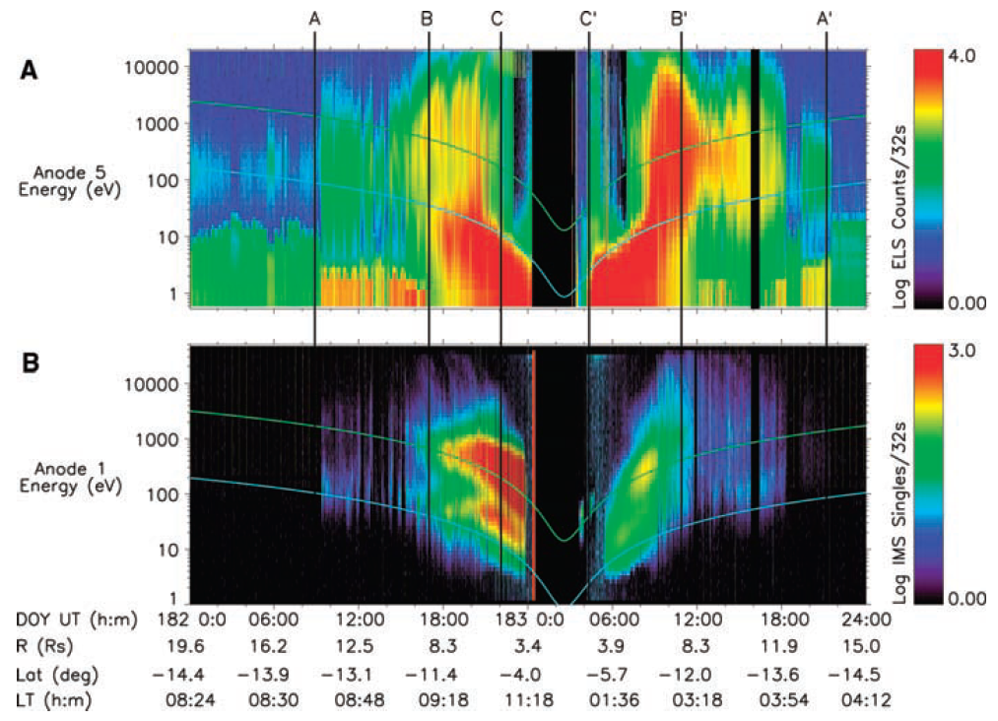
Our main fields of research
(Young et al., 2005)
We use in-situ measurements of spacecraft in the different regimes of the Solar System, and analyze the scientific data regarding the complex interactions between the energetic plasma particles of solar wind or planetary/cometary origin and the interplanetary magnetic field and the intrinsic magnetic fields of atmospheres of the planets and moons.
We conduct comparative studies between the plasma environments of planets to better understand how our cosmic environment affects our own planet; space weather.
We also study the solar interior, the origin of the solar wind, its transient features and their evolution throughout the solar system.
WIGNER 121 SCIENTIFIC SYMPOSIUM - Heritage and Future

Slide 4
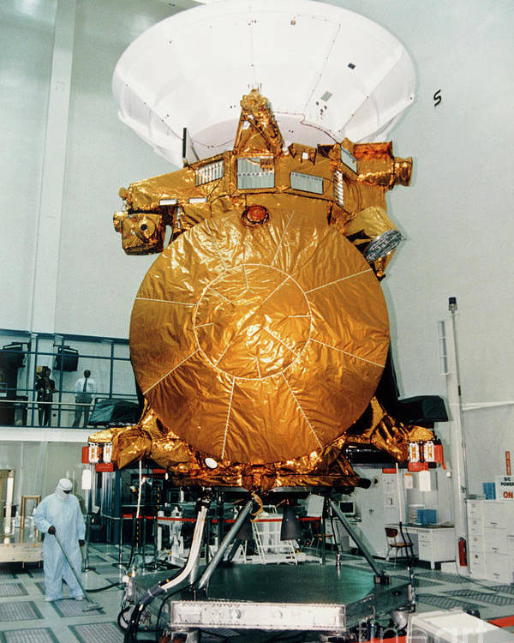
Our contributions to space missions
Our team has been involved in several major space missions from the earliest planning phases through the development, building and testing of onboard instruments and finally the evaluation of the measurements in space.
Planetology missions:
JUICE (ESA; 2023 - ), power supply units
BepiColombo (ESA/JAXA; 2018 - ), SERENA/PICAM
Cluster (ESA; 2000 - ), FGM magnetometer, RAPID and the Hungarian Data Centre
Cassini-Huygens (NASA/ESA; 2004 - 2017) CAPS, MAG
Rosetta-Philae (ESA; 2004 - 2016) Rosetta Plasma Consortium, Command and Data Management System (on Philae)
Heliospheric missions:
STEREO (NASA; 2006 - ): PLASTIC, IMPACT
Solar Orbiter (ESA/NASA; 2020 - ): MAG
SOHO (ESA/NASA; 1995 - ): COSTEP/LION
WIGNER 121 SCIENTIFIC SYMPOSIUM - Heritage and Future

Slide 5
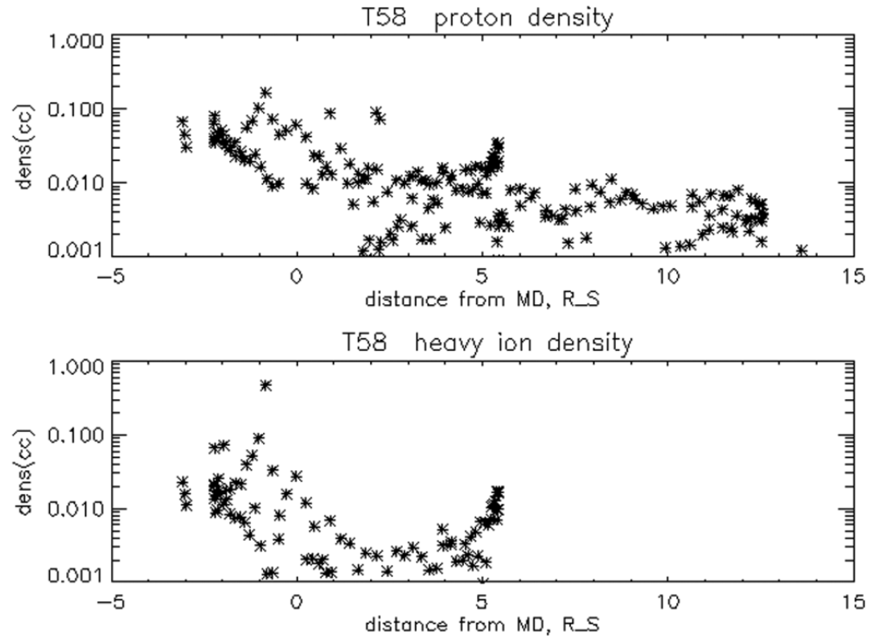
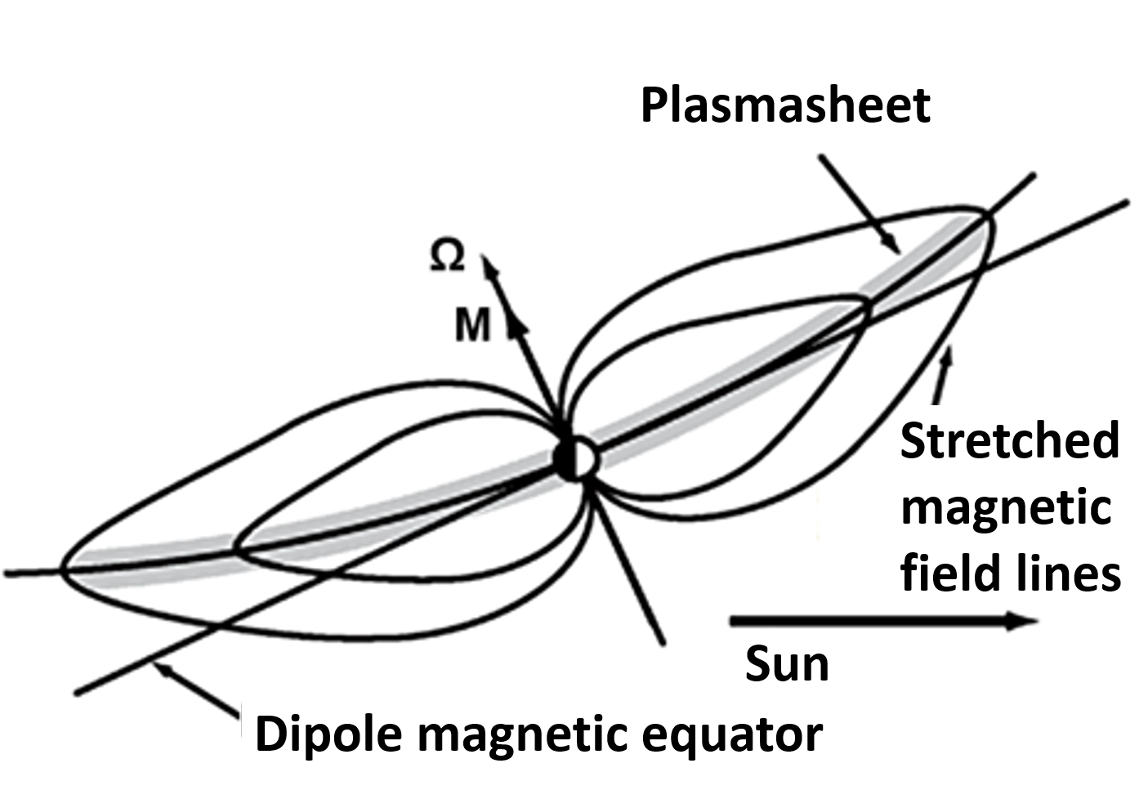
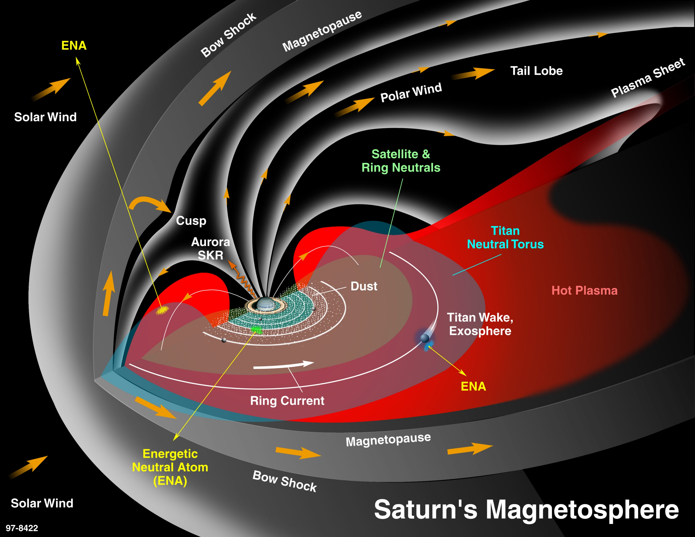
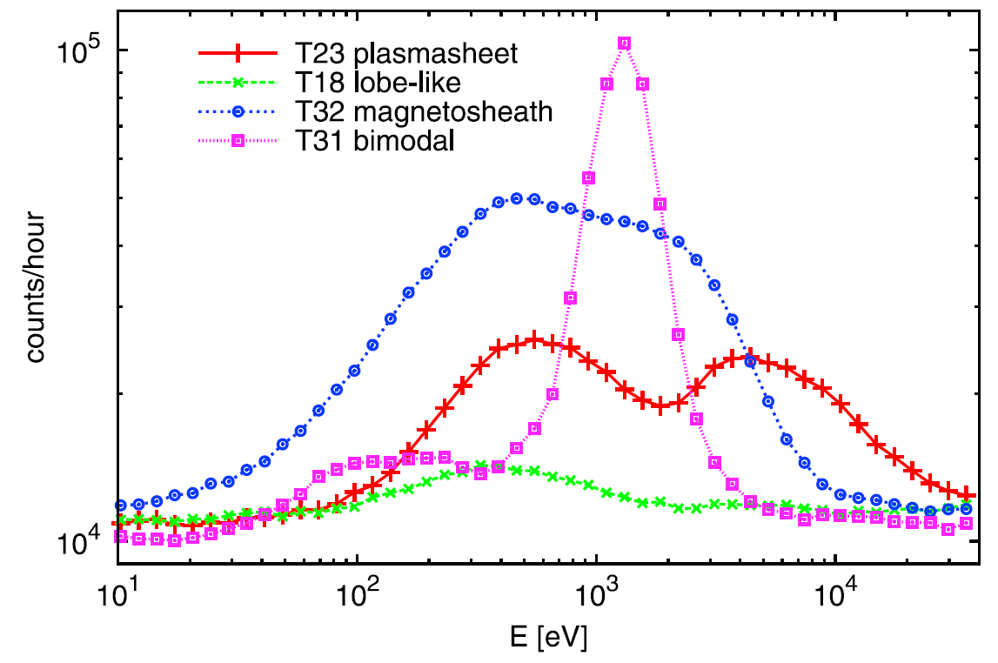
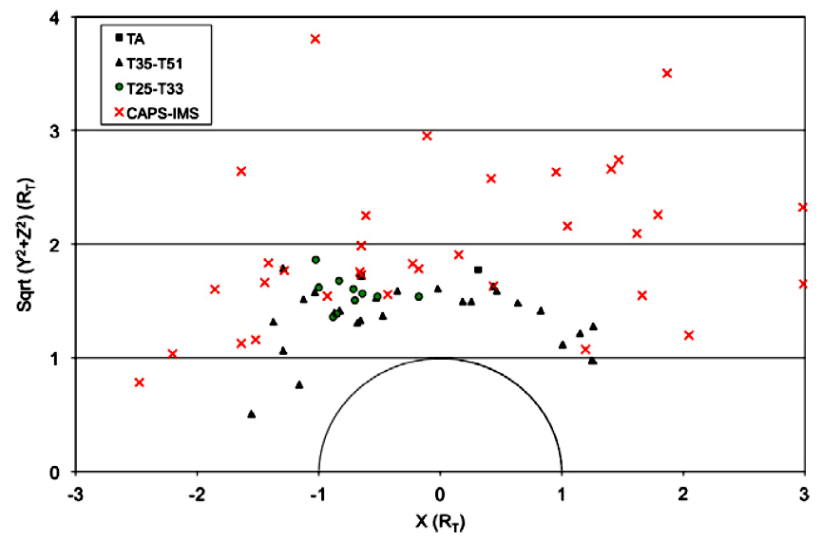
Magnetospheric dynamics of Saturn
Our scientific contributions to the Cassini-Huygens mission:
Study of the physical processes of Saturn's inner magnetosphere especially related to the magnetodisc.
Titan-magnetospheric plasma interaction.
Boundary layers and their dynamics around Saturn.
Upstream wave activity related to the solar wind's interaction with the magnetosphere.
(Szegő et al., 2012)
(Németh et al., 2011)
(Bebesi et al., 2012)
WIGNER 121 SCIENTIFIC SYMPOSIUM - Heritage and Future

Slide 6
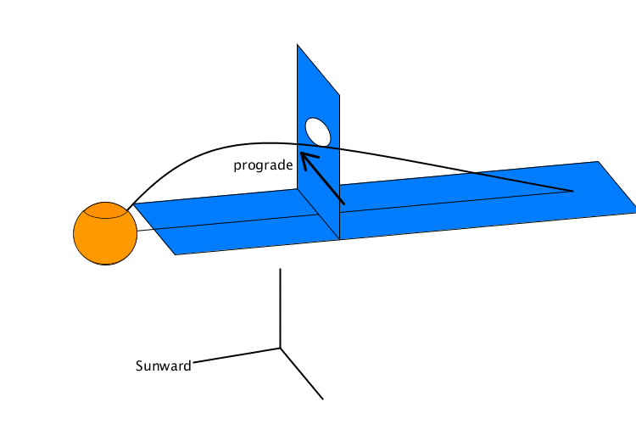
Magnetospheric dynamics of Saturn
In a rotation-dominated magnetosphere, there is a region where closed field lines rotate around the planet, and also a region where the open field lines stretch away from the planet, forming the lobes of the magnetotail.
Recently a new domain has been discovered (Nemeth, 2023), where the magnetic field lines are closed (attached to the planet with both ends) but do not rotate around the planet as expected, since the middle points of these field lines are anchored in the far magnetotail, in slowly moving plasma.
At the same time the footpoints of the field lines, where they are attached to the planetary surface, rotate together with the planet.
Closed field line vortices in planetary magnetospheres (Nemeth, 2023).
The field lines of this domain form huge vortices, and the magnetospheric plasma also conducts swirling motion (instead of co-rotation).
WIGNER 121 SCIENTIFIC SYMPOSIUM - Heritage and Future

Slide 7
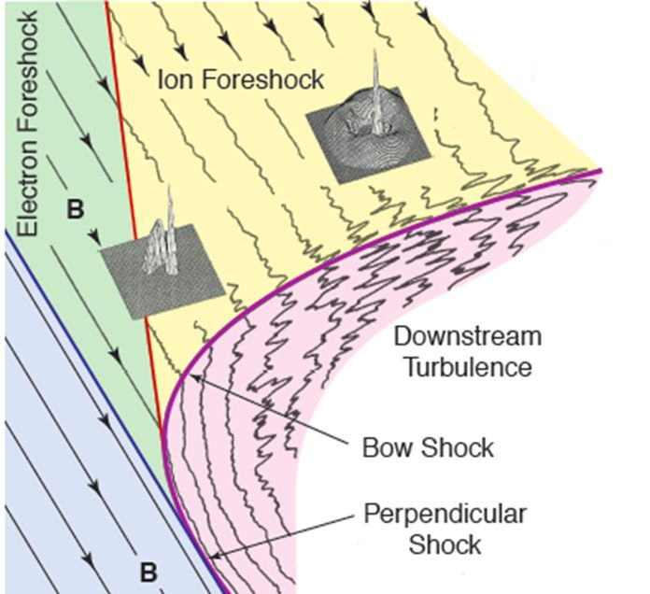
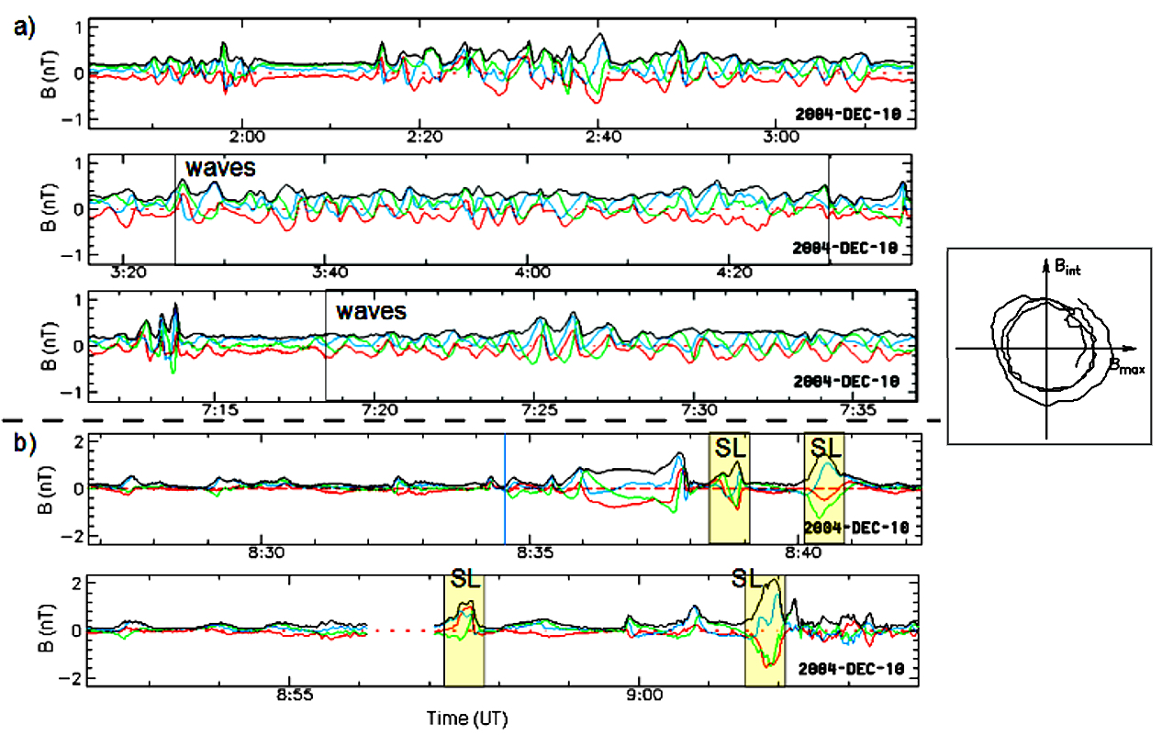
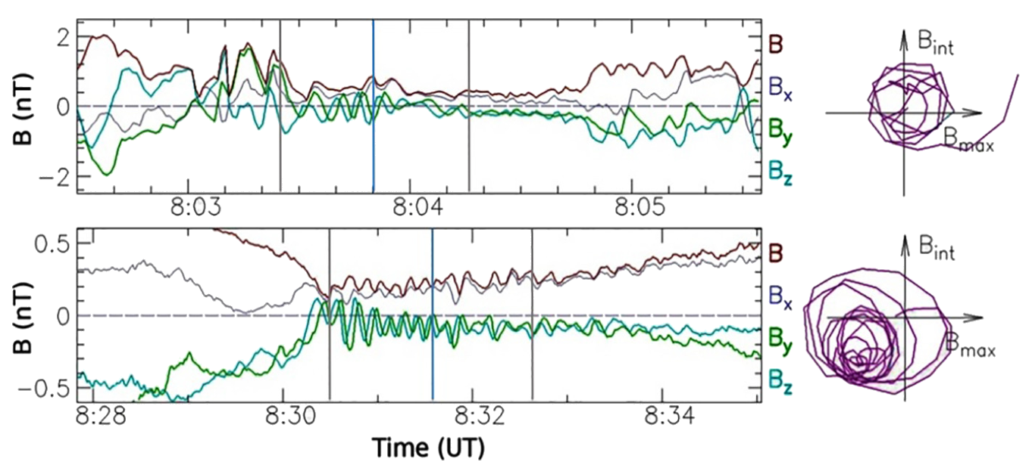
ULF wave activity in the planetary foreshocks I.
Backstreaming particles at the plantary bow shocks interact with the incoming solar wind, and the resulting instabilities give rise to ULF waves in the quasi-parallel upstream region.
The waves are gradually convected back to the bow shock, and are also steepening to eventually turn into shocks (SLAMS). The magnetic structures will then replace the former bow shock front (shock reformation).
It was found that formation of SLAMS is possible upstream of Saturn by the same mechanism, like at the Earth, however, the characteristic time scale for the events is longer due to the smaller upstream magnetic field values.
(Bebesi et al., 2019)
WIGNER 121 SCIENTIFIC SYMPOSIUM - Heritage and Future

Slide 8
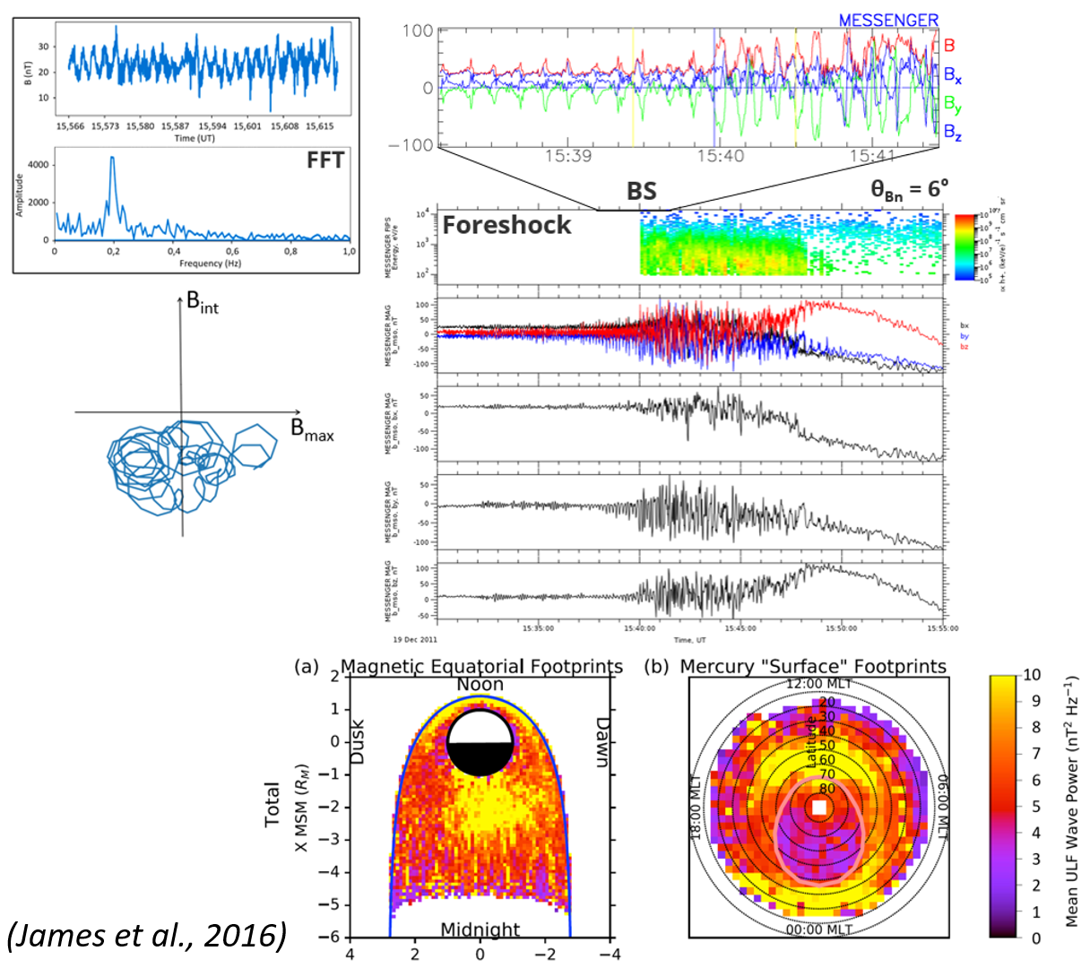
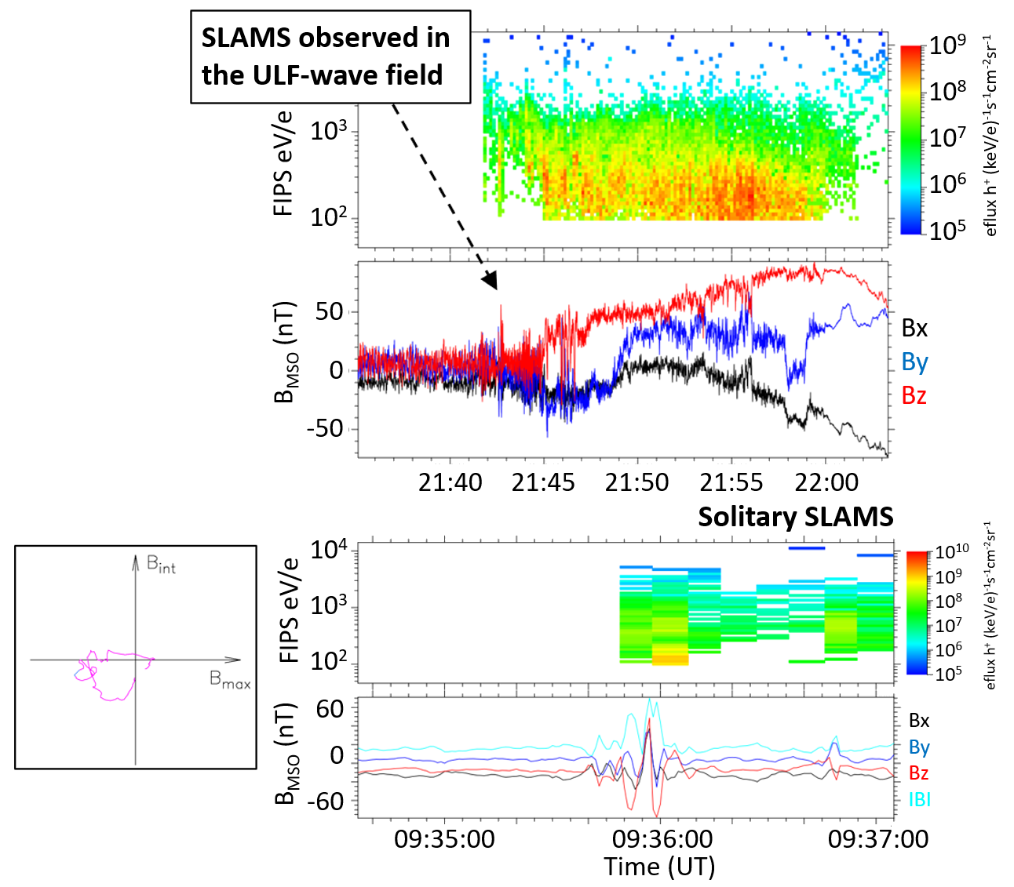
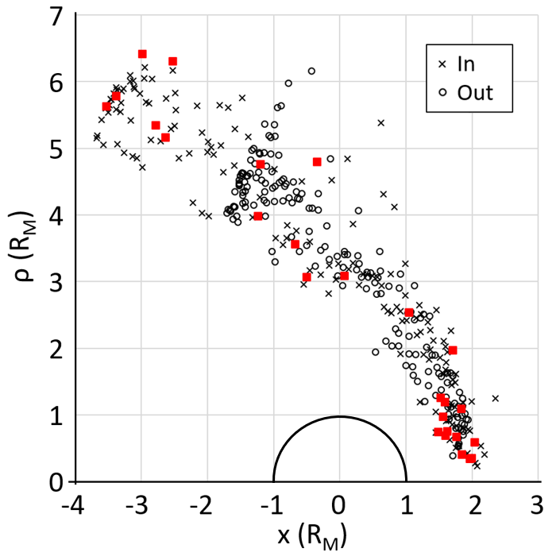
ULF wave activity in the planetary foreshocks II.
ULF wave activity and SLAMS in the foreshock of Mercury.
Small, more "rigid" magnetosphere, fast reconfiguration in response to solar events.
At Earth the typical period of these fast magnetosonic waves is ~30 s, and are observed upstream of the quasi-parallel BS. The frequency of ULF waves at Mercury is ~0,05-0,41 Hz.
SLAMS occurrence rate depends on M_{A}, and the cone angle.
Coupling between the upstream waves and and waves observed in the magnetosphere.
(Bebesi et al., in preparation)
WIGNER 121 SCIENTIFIC SYMPOSIUM - Heritage and Future

Slide 9
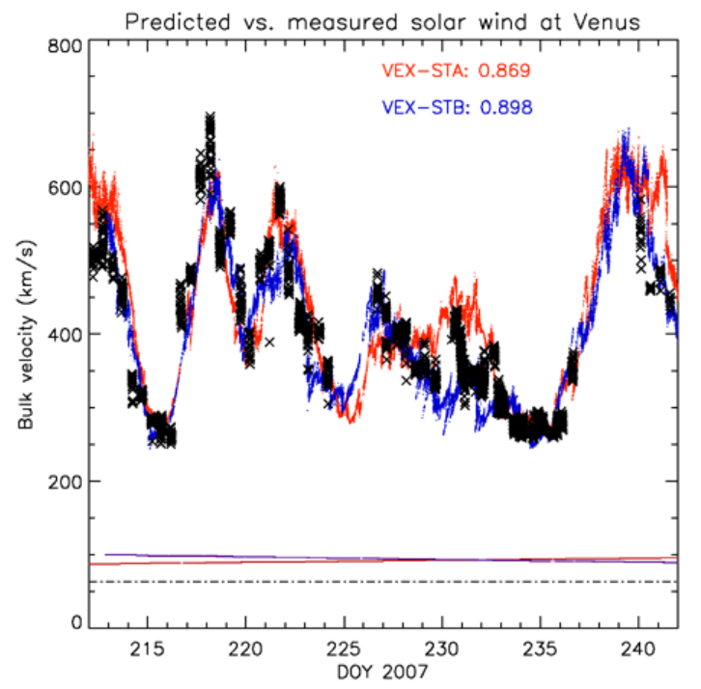
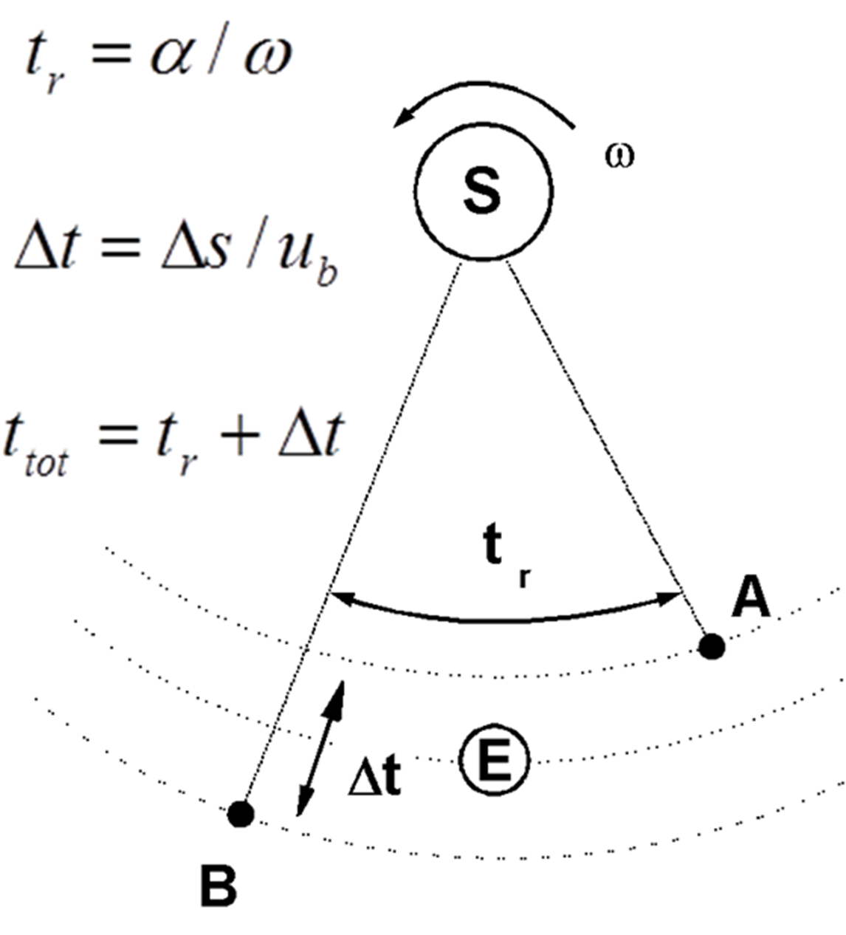
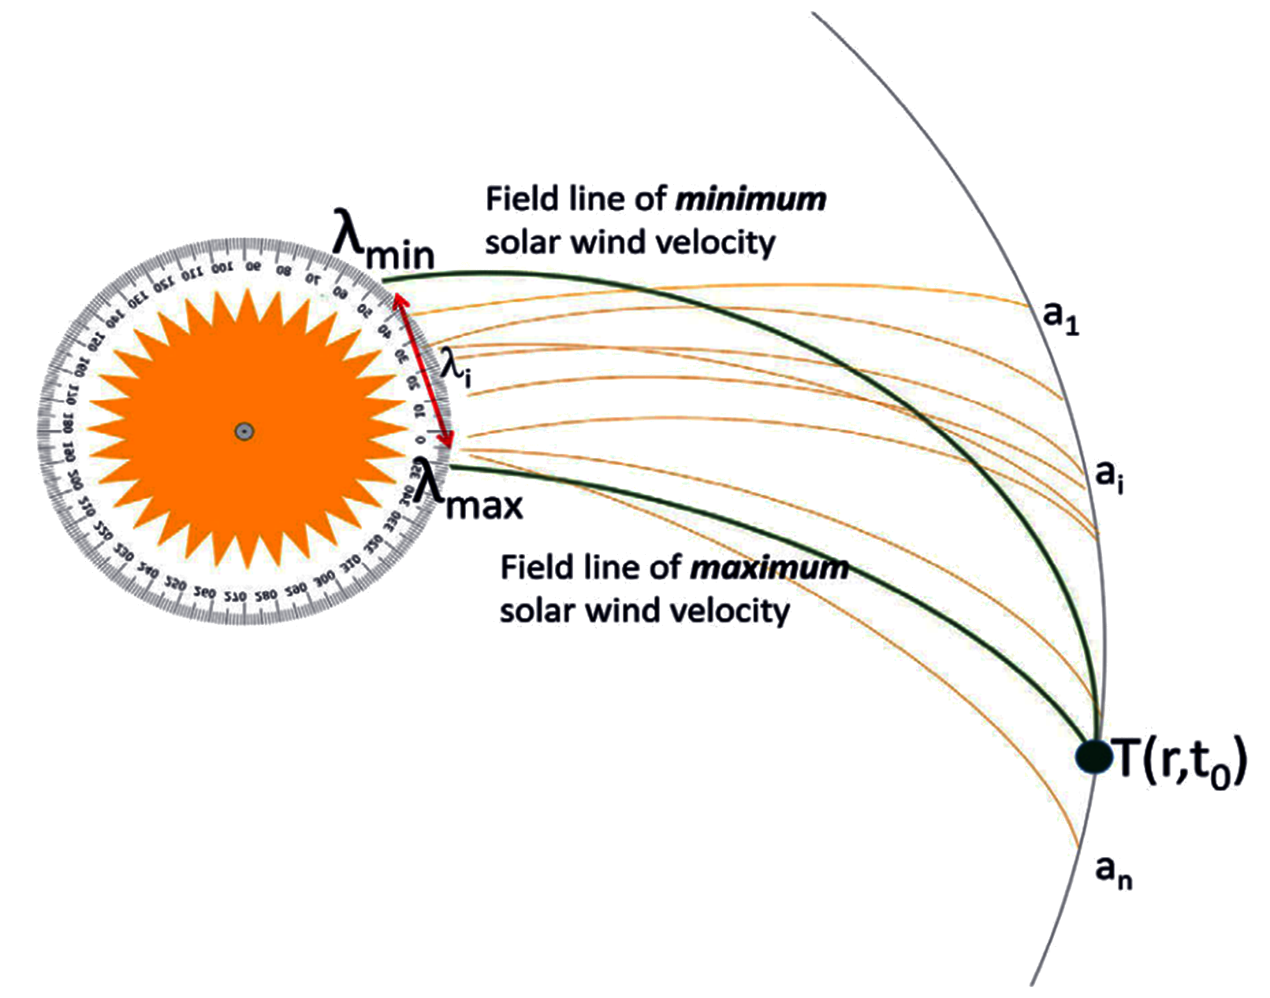
Solar wind propagation models
Ballistic model - radial propagation assuming constant solar wind velocity, it calculates the arrival times of "solar wind packages" at the target, using the time lag method (Opitz et al., 2009).
Magnetic lasso: A further developed version of the ballistic model, that considers a magnetic connection between a source point on the solar surface and the target object (Dósa et al., 2018). It evaluates the arrival times of "solar wind packages" but without the magnetic field lines ever crossing one another during the propagation.
OMNI: works with solar wind pressure data, 1D MHD model for radial propagation, with simple rotation to the target (Zieger and Hansen, 2008).
WIGNER 121 SCIENTIFIC SYMPOSIUM - Heritage and Future

Slide 10
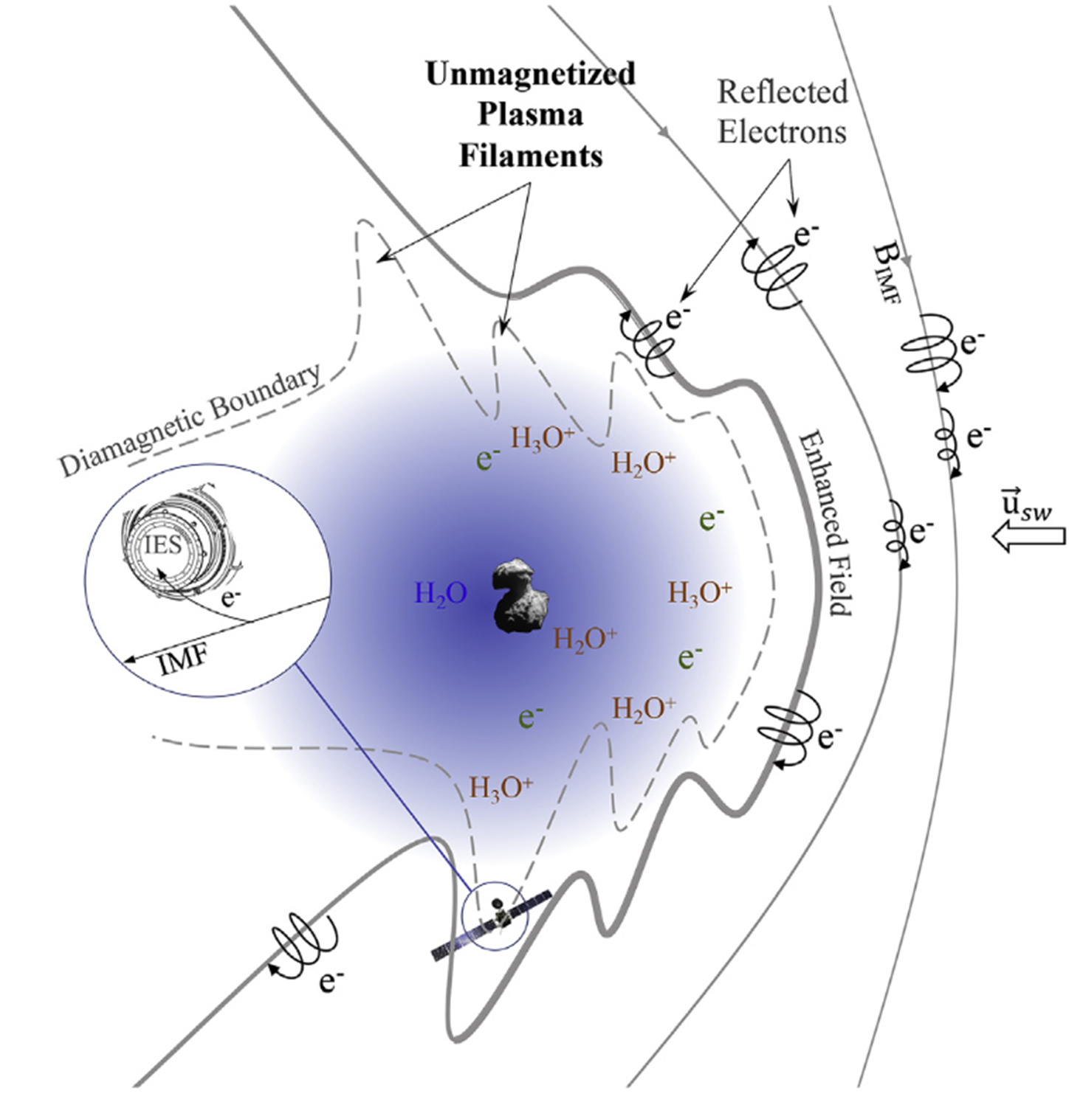
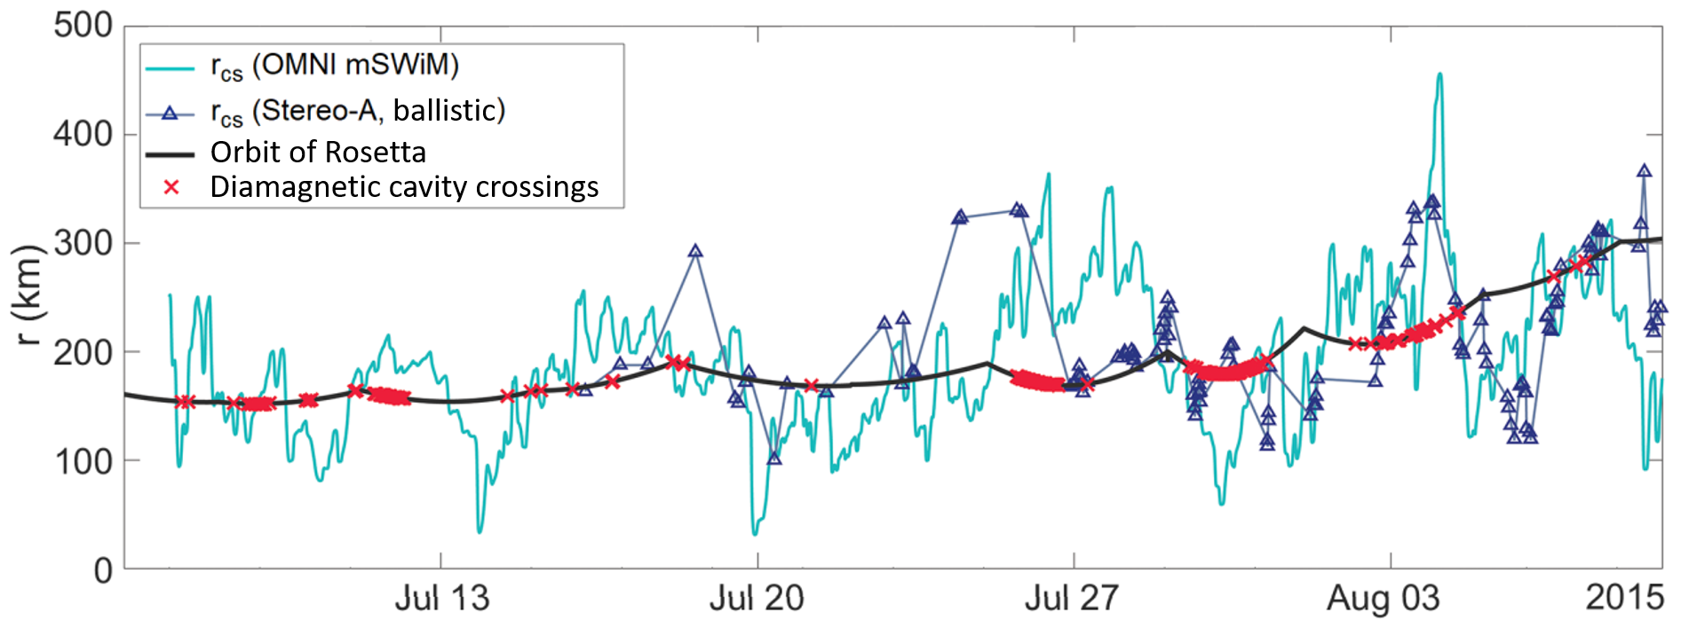
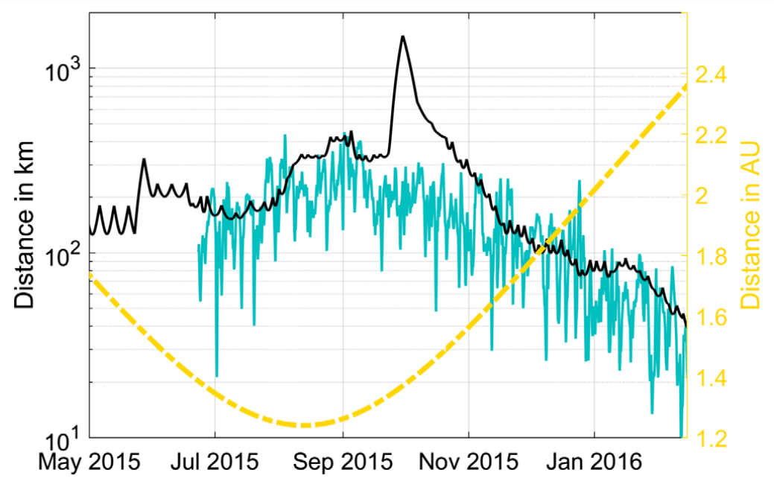
Observations of the diamagnetic cavity of a comet
(A. Timár et al., 2016, 2019)
The Rosetta spacecraft followed the comet 67P/Churyumov–Gerasimenko for almost 2.5 years, hence could observe the full cycle of its activity.
The diamagnetic cavity is the innermost region of the magnetosphere of an active comet from which the magnetic field is expelled by the outflowing matter.
Observing the changes in cavity size throughout the whole cometary activity cycle.
A simple (1+1)-dimensional analytic MHD model of the diamagnetic cavity was also presented, which for the first time explained the unexpected size and variability of the cavity (Nemeth, 2020).
WIGNER 121 SCIENTIFIC SYMPOSIUM - Heritage and Future

Slide 11
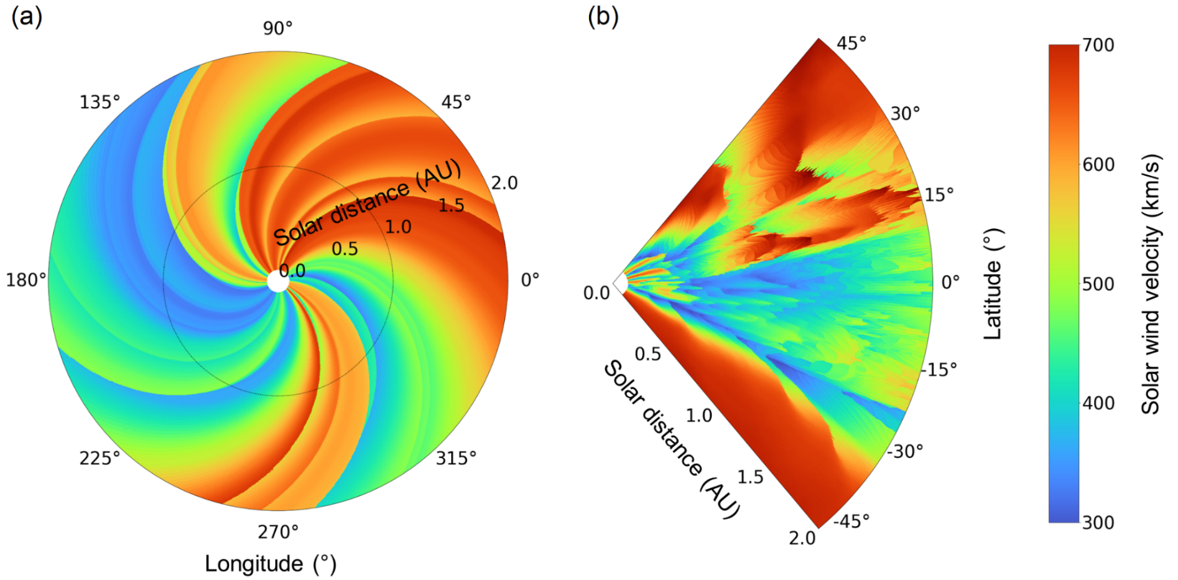
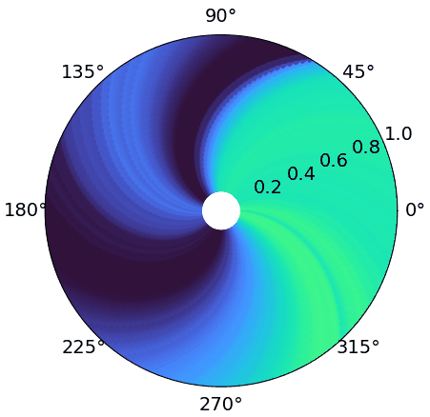
Studies of the inner heliosphere
3D pressure corrected ballistic extrapolation of solar wind parameters in the inner heliosphere
Extrapolation of solar wind parameters in 3D with an improved ballistic propagation method. The data of the BATS-R-US MHD solar corona model of the space weather modeling framework has been used as input.
The enhanced model considers the interaction of slow and fast solar wind by applying a pressure correction during propagation.
It also takes the solar differential rotation into account; more accurate prediction at higher heliospheric latitudes (Timar et al., Biró et al., papers submitted in 2023).
Extrapolated 3D ballistic solar wind velocity in the ecliptic (a) and at a Carrington longitude of 180° (b) in January 2017.
WIGNER 121 SCIENTIFIC SYMPOSIUM - Heritage and Future

Slide 12
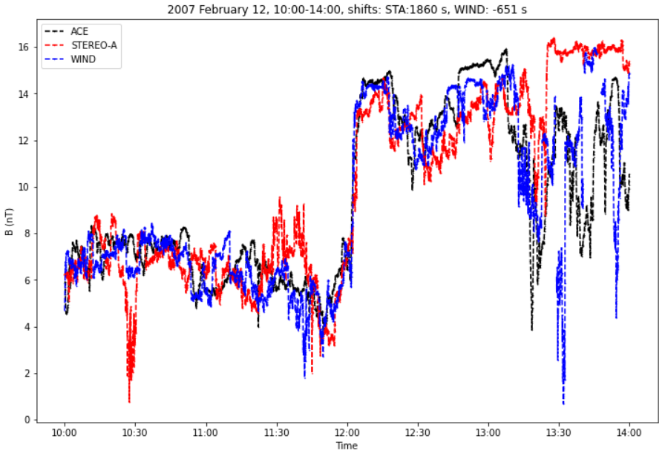
Studies of the inner heliosphere
Orientation of the stream interface in CIRs
Shifted time series of the total magnetic field measurements for ACE, STEREO-A, and WIND.
The interface between fast and slow solar wind is called the stream interface, which often has considerable north-south tilt.
A sliding window correlation method was applied on multi-spacecraft data to obtain the time delay between the spacecraft.
Using the time delays and in-situ solar wind velocity measurements, the positions of two spacecraft can be shifted, and, together with the position of the reference spacecraft, the spatial orientation of the stream interface can be reconstructed.
This method allows further studies about the interaction of fast and slow solar wind streams (Kobán et al. 2023).
WIGNER 121 SCIENTIFIC SYMPOSIUM - Heritage and Future

Slide 13
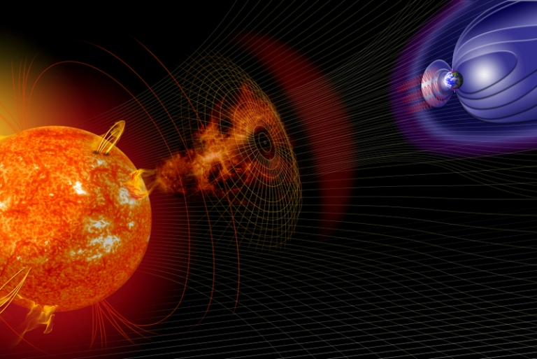
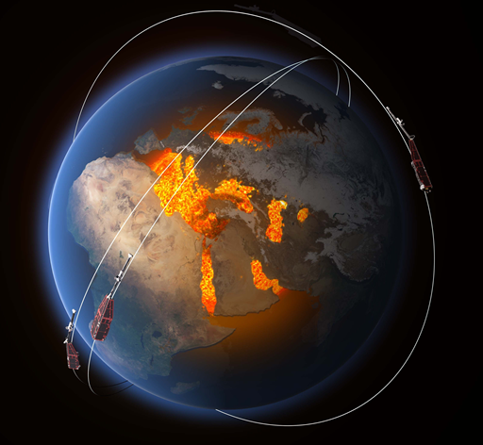
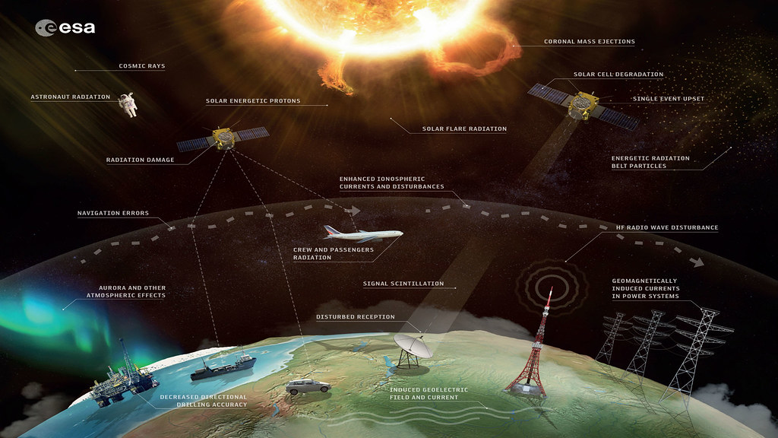
Terrestrial space weather related studies
Monitoring the solar surface, radiation, solar wind and the interplanetary magnetic field is very important for us to be able to prevent the destructive effects a more intense solar event can inflict on our technology.
We use the high resolution magnetic field data of the Swarm mission to monitor the irregularities in the F layer (at ~500 km altitude) of the ionosphere (P. Kovács).
It is argued that the irregularities evolve due to turbulent plasma phenomena exhibiting scale-dependent intermittent magnetic fluctuations.
WIGNER 121 SCIENTIFIC SYMPOSIUM - Heritage and Future

Slide 14
Plasma irregularities in the upper ionosphere
Spatial distribution of magnetic field irregularities in the polar
and mid-latitude region (northern hemisphere, magnetic latitude vs. magnetic local time - Sun is @12) (P. Kovács)
Quiescent
Moderate storm
Geomagnetic storm
Making use of the non-Gaussian behaviour of the intermittent variations, a so-called intermittency index has been developed (5s resolution, since the beginning of the mission.)
Showing the average intermittency index values on a map, we get a picture about the typical irregularity zones of the upper ionospheric plasma.
Near the poles and mid-latitudes the irregularities of the plasma and magnetic field tipically occur at the domain of the aurora (inner ring) and near the ionospheric footprint of the plasmapause (outer ring) (and are shifted towards the equator during geomagnetic storms).
14
WIGNER 121 SCIENTIFIC SYMPOSIUM - Heritage and Future

Slide 15
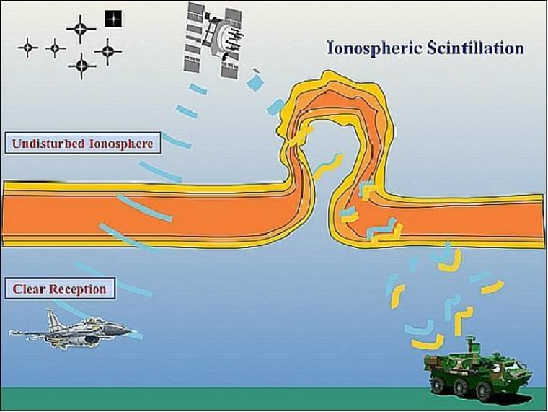
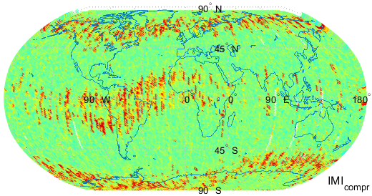
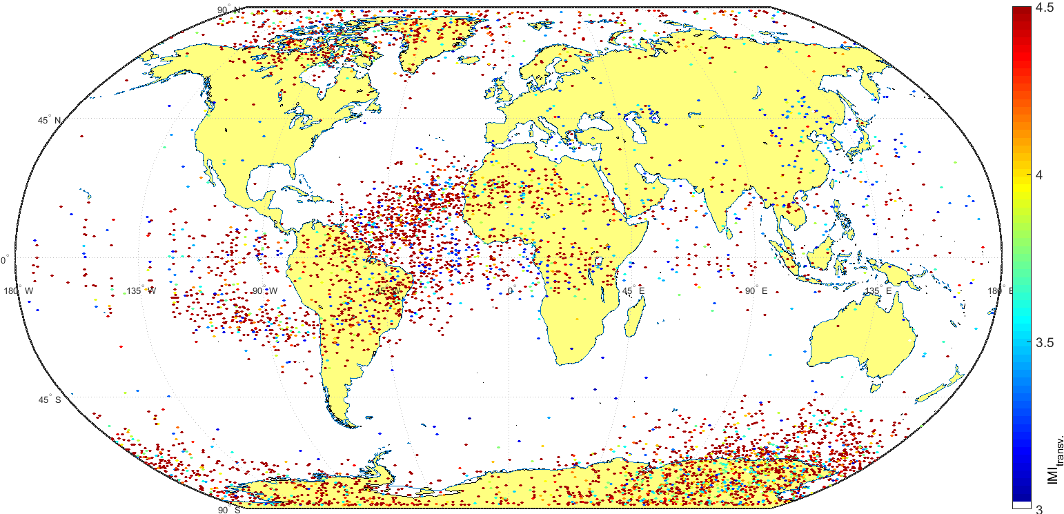
Plasma irregularities in the upper ionosphere
Space weather consequences of the observed irregularities; theit correlation with the propagation of GNSS radio signals was also investigated; loss of lock events and signal distortions (i.e. scintillations).
In the equatorial region most of the irregularities are caused by "plasma bubbles". These few 100 km wide structures occur along the equator due to the decrease of plasma density in the upper ionosphere, typically after sunset.
Their incidence varies depending on seasonal effects and those of the solar cycle.
They can significantly disturb the propagation of radio signals used in navigation and telecommunication; importance of modelling and forecasts. (P. Kovács, G. Kobán)
Magnetic field irregularities in post sunset observations.
Loss-of-lock events between the Swarm satellites and at least 2 GNSS satellites between 2014 and 2020.
WIGNER 121 SCIENTIFIC SYMPOSIUM - Heritage and Future

Slide 16
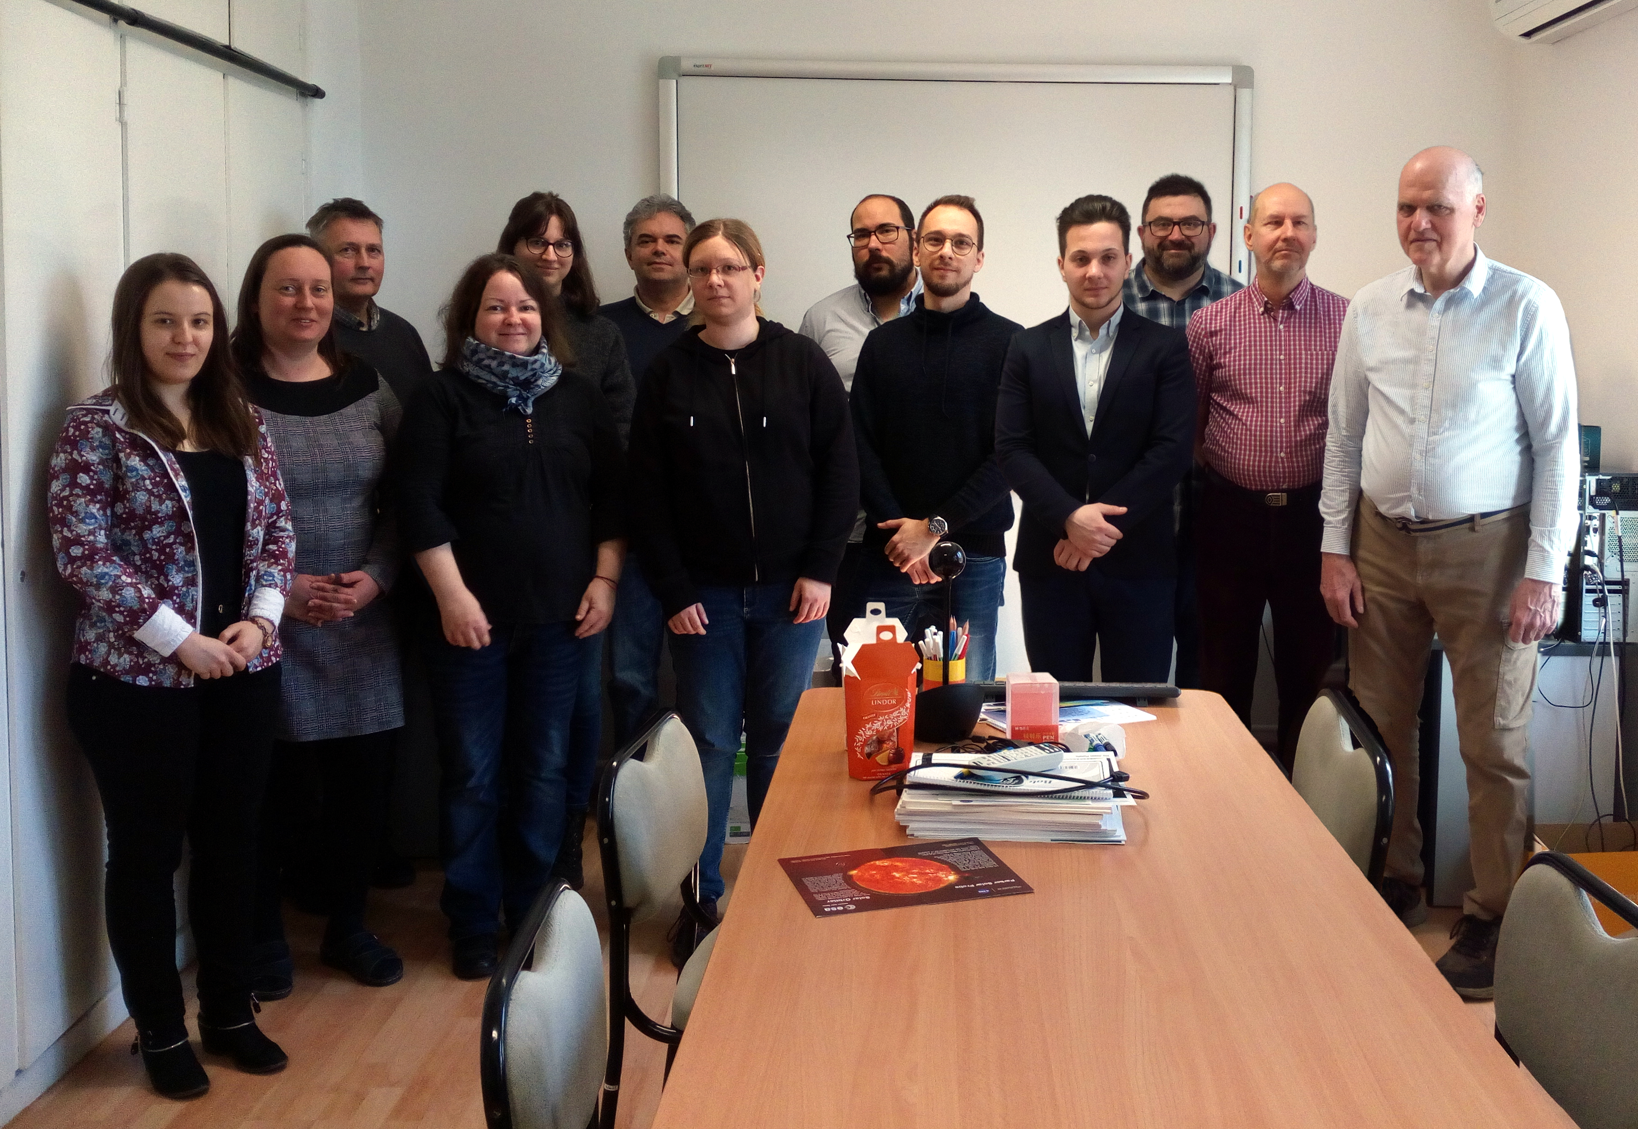
Our team
Zoltán Németh (head)
Andrea Opitz
Péter Kovács
Zsófia Bebesi
Gábor Facskó
Antal Juhász
Lajos Földy
Anikó Timár
Mohammed Talafha
Nikolett Biró
Gergely Kobán
Ákos Madár
Géza Erdős
Mariella Tátrallyay
https://wigner.hu/en/space-physics-and-space-technology
https://space.wigner.hu
WIGNER 121 SCIENTIFIC SYMPOSIUM - Heritage and Future

