Slide 1

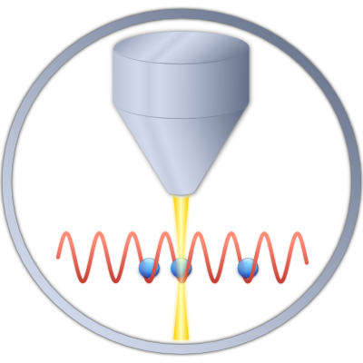
Ultracold Bose Gases in
Driven-Dissipative Environments
Herwig Ott
RPTU Kaiserslautern-Landau

Slide 2
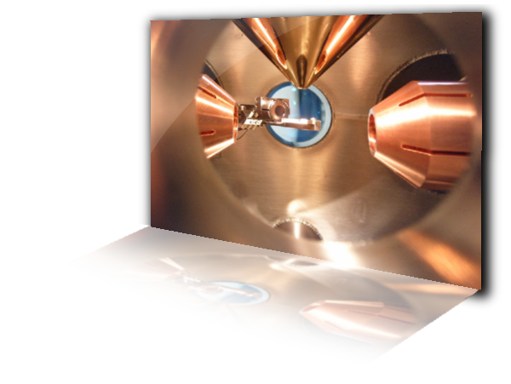
Outline
Lindblad master equation
Spectral theory of Liouvillians
Optical bistability
First order dissipative phase transition
in a quantum gas
Hysteresis scaling

Slide 3

Motivation
Floquet Systems
Transport in open systems
Effective Hamiltonians
Phase transitions in open systems
Preparation of quantum states
Non-Hermitian Hamiltonians
Attractor dynamics

Slide 4
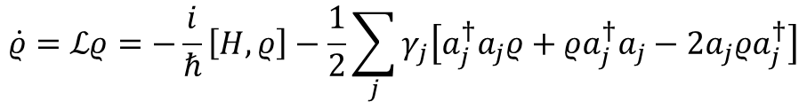
Particle loss as dissipation
A one dimensional system: leaky optical lattice
$$\dot{ρ}=ℒρ=−\frac{i}{ℏ}\left[H,ρ\right]−\frac{1}{2}\sum_{j}{γ_{j}\left[a_{j}^{†}a_{j}ρ+ρa_{j}^{†}a_{j}−2a_{j}ρa_{j}^{†}\right]}$$
Lindblad master equation
loss rate at each lattice site
anihilation and creation operators
at each lattice site
P. Barmettler and C. Kollath Phys. Rev. A 84, 041606 (2011)
D. Witthaut,…, S. Wimberger, Phys. Rev. A 83, 063608 (2011)
I. Vadanovic,…,W. Hofstetter, Phys. Rev. A 89, 053614 (2014)

Slide 5
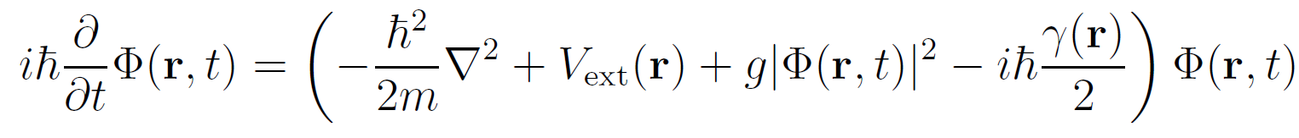

Mean-field approximation
$$n=0$$
Josephson model with lossy site
$$iℏ\frac{∂ψ_{n}}{∂t}=−J\left(ψ_{n−1}+ψ_{n+1}\right)+U{\left|ψ_{n}\right|}^{2}ψ_{n}−iℏ\frac{γ}{2}ψ_{n}δ_{n0}$$
Continuous system: Gross-Pitaevskii equation with imaginary potential
What about the fluctuations?

Slide 6
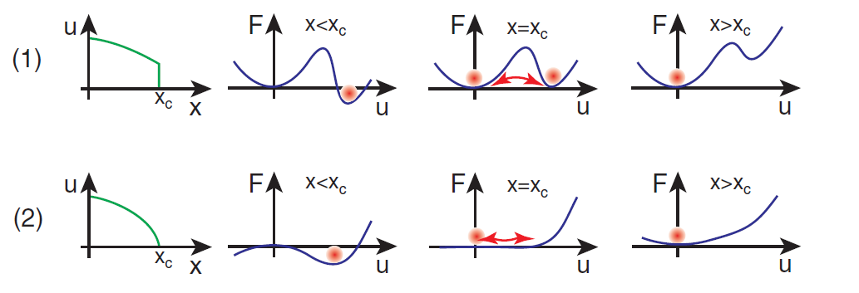
Phase Transitions
First and second order phase transitions: order parameter and free energy
First order
phase transition
Second order
phase transition
Pfleiderer: J. Phys.: Condens. Matter 17, S987 (2005)

Slide 7


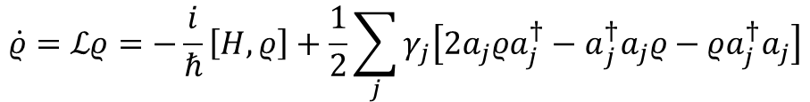
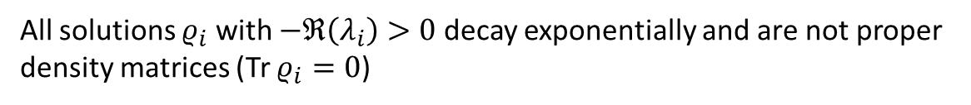
Dissipative Phase Transition
Spectral theory of Liouvillians
$$\dot{ρ}=ℒρ=−\frac{i}{ℏ}\left[H,ρ\right]+\frac{1}{2}\sum_{j}{γ_{j}\left[{2a_{j}ρa_{j}^{†}−a}_{j}^{†}a_{j}ρ−ρa_{j}^{†}a_{j}\right]}$$
$$ℒρ_{i}=λ_{i}ρ_{i}$$
There is at least one eigenvalue $λ_{0}=0$ with corresponding $ρ_{0}$ for which Tr $ρ_{0}=1$.
This is a steady-state because ${\dot{ρ}}_{0}=0$.
All solutions $ρ_{i}$ with $−ℜ\left(λ_{i}\right)>0$ decay exponentially and are not proper
density matrices (Tr $ρ_{i}=0$)
Every allowed $ρ$ has a contribution from $ρ_{0}$ ⬄ attractor dynamics
Liouvillian gap $λ$ = smallest$−ℜ\left(λ_{i}\right)$ for $λ_{i}≠0$
Kessler et al. Phys. Rev A 86, 012116 (2012)
Ciuti et al. Phys. Rev A 98, 042118 (2018)

Slide 8
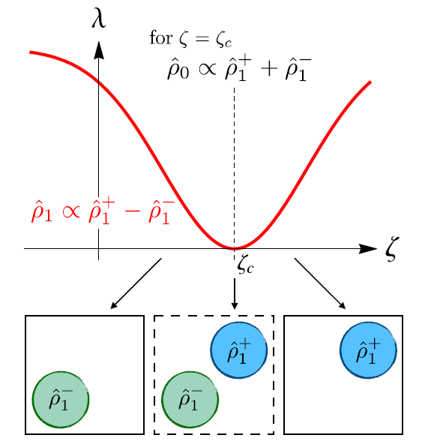
First order dissipative phase transition
Thermodynamic limit:
Liouvillian gap close at a critical point
At the critical point, the order parameter
changes discontinuously
At the critical point, there is bistability
The system shows hysteresis
Finite size systems:
Liouvillian gap remains finite
System shows metastability
Phase transition washes out
Ciuti et al. Phys. Rev A 98, 042118 (2018)

Slide 9


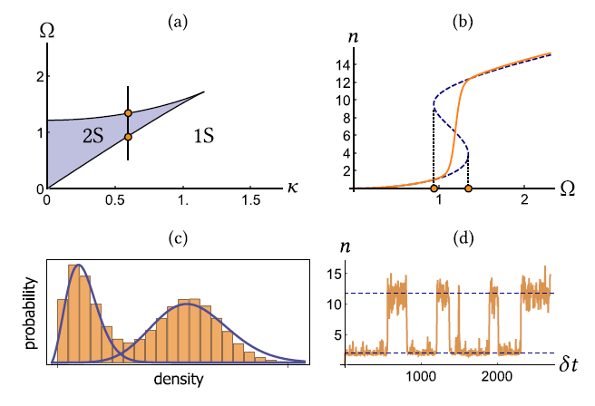
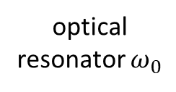
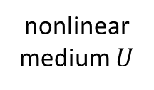
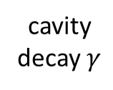
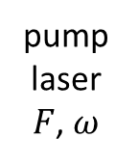
Optical bistability
Quantum theory of optical bistability: Drummond and Walls, J. Phys. A 13, 725 (1980)
Dissipative single mode Kerr resonator
pump laser $F$, $ω$
optical resonator $ω_{0}$
cavity decay $γ$
nonlinear medium $U$
Mean-field solution
versus quantum fluctuations
Foss-Feig et al. Phys. Rev. A 95,
043826 (2017)

Slide 10
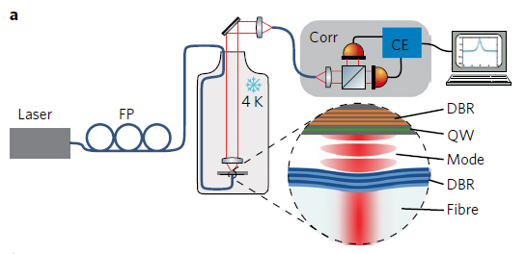
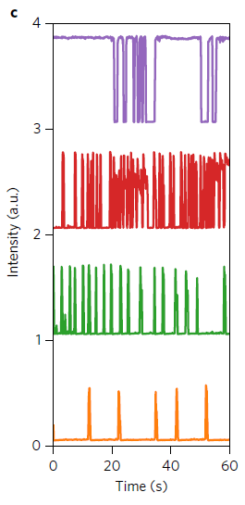
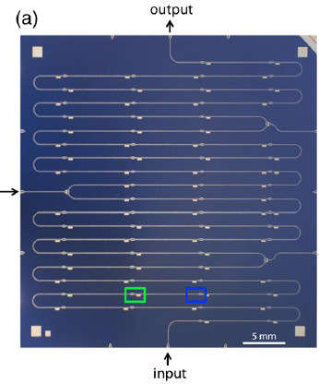
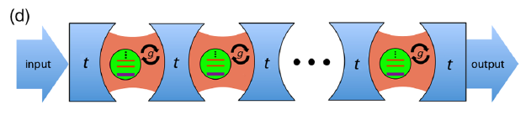
Experimental realizations
Exciton-polaritons:
Fink et al. Nat. Phys. 14, 365 (2018)
circuit-QED:
1 D chain of cavities
Fitzpatrick et al. Phys. Rev. X 7, 011016 (2017)

Slide 11
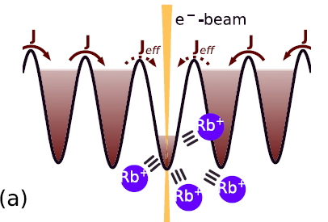
Our system: experimental approach
Array of Bose-Einstein condensates in a 1D optical lattice
one site is subject to dissipation
Neichboring sites are coherently coupling to the lossy site

Slide 12
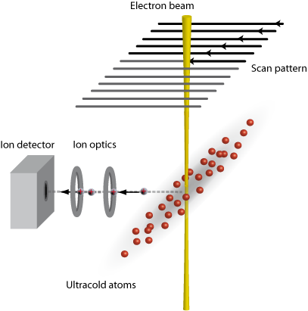
Realizing dissipation with an electron beam
Spatial resolution =
Beam diameter
> 100 nm
In situ technique
In vivo technique
Single atom
sensitivity
Manipulation and preparation tool
2D imaging
Gericke et al., Nat. Phys (2008)
Würtz et al., PRL (2009)

Slide 13
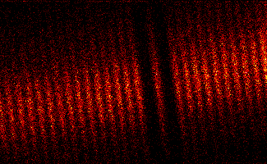
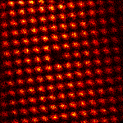
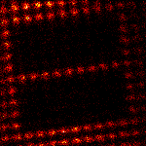
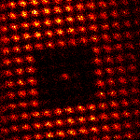
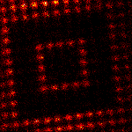
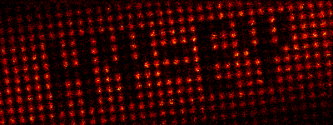
Image gallery

Slide 14
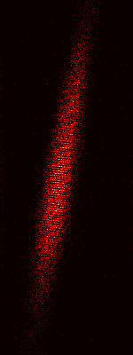
An array of Bose-Einstein condensates
Experimental settings:
Superimpose a one-dimensional optical lattice on an elongated BEC
Lattice constant 600 nm, 800 atoms per site, quasi 2D condensate in each site

Slide 15
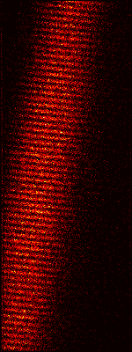
Adding drive and dissipation
local loss = dissipation
reservoir = drive
reservoir = drive

Slide 16
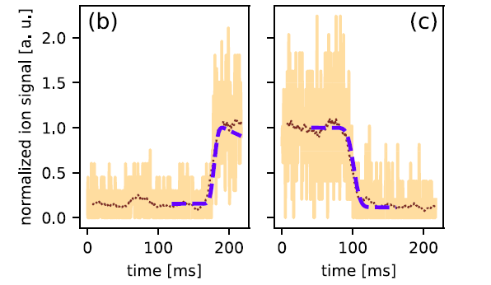
Single trajectories
Procedure:
Load BEC in 1D lattice
Freeze out tunneling
Remove atoms from one site
Do not remove any atoms
Switch on dissipation and allow for tunneling
„initially empty“
„up-rate“
„initially full“
„down rate“
large jumps in
atom number

Slide 17
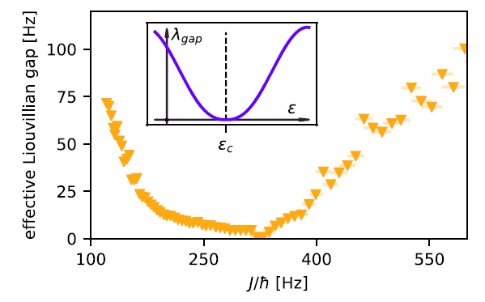


Liouvillian gap
Measurement protocoll: measure jump rate from normal to superfluid and vice versa
$$λ_{gap}=−(γ_{− +}+γ_{+ −})$$
$$γ_{diss}=250 s^{−1}$$
Closing of the Liouvillian gap
„critical slowing down“
Benary et al. New J. Phys. 24, 103034 (2022)

Slide 18
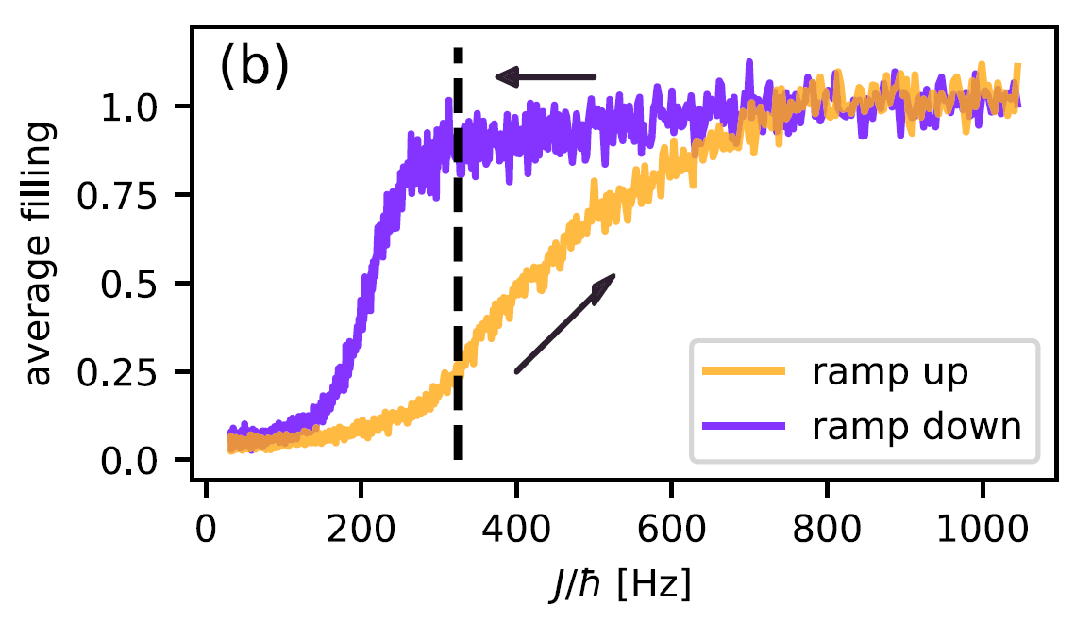
Metastability, hysteresis and fluctuations
Dynamically crossing the critical point
Corrected for atom loss
650 ms ramp duration
Average over 130 realizations
Change ramp duration and
measure hysteresis area as
well as fluctuations
hysteresis area

Slide 19
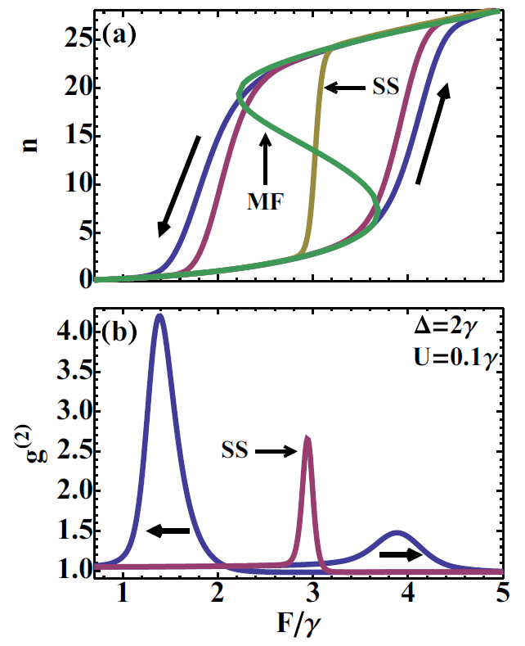
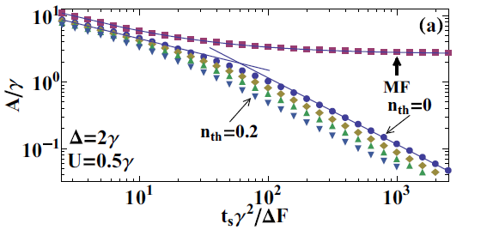


Theoretical prediction
Optical bistability, finite temperature
Mean-field prediction
$$A∝t^{−2/3}$$
photon number
Exact result
$$A∝t^{−1}$$
fluctuations
Casteels et al. Phys. Rev. A 93, 033824 (2016)

Slide 20
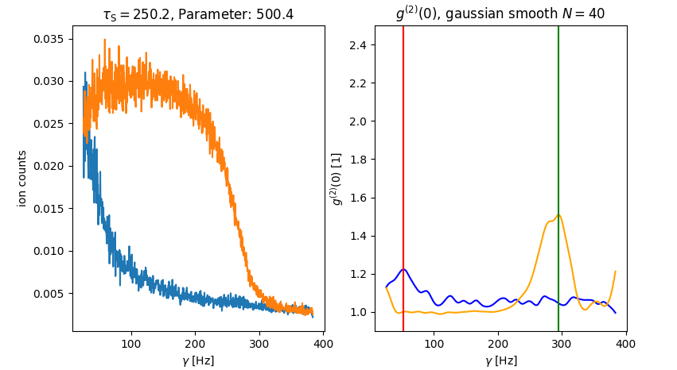
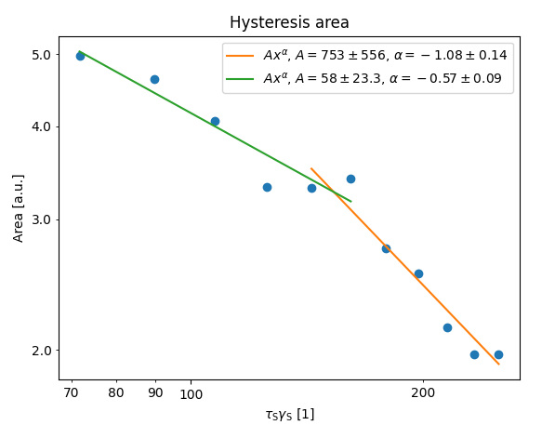
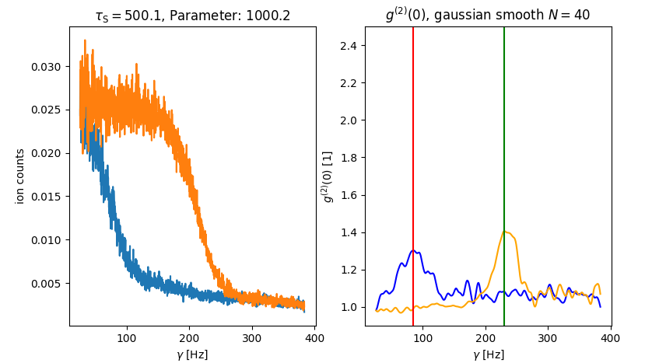
Experimental results
preliminary
scaling of the hysteresis area

Slide 21
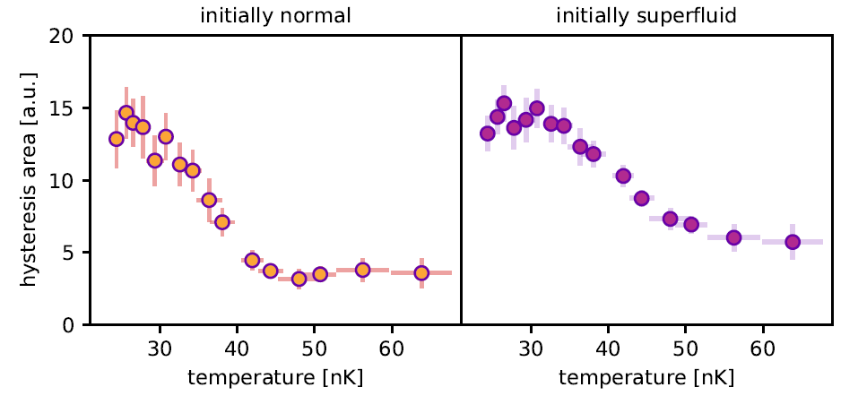
Finite temperature effects
preliminary
Increase temperature ⬄ reduce condensate fraction

Slide 22
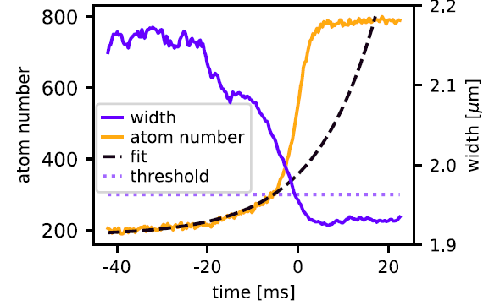
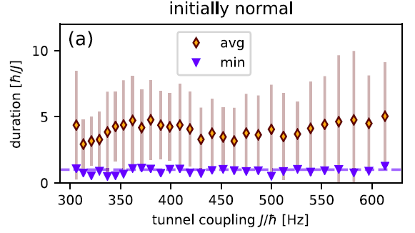
Microscopic system dynamics
How does the fluctuations look like?
average „jump“ from normal to superfluid
jump duration
Fastest jumps compatible with Josephson dynamics!

Slide 23


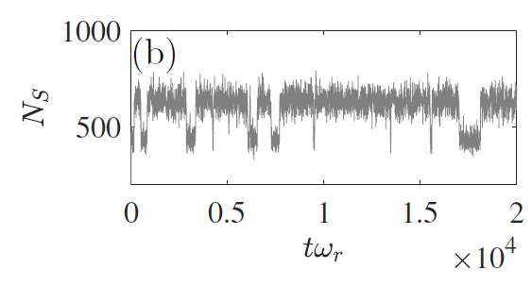
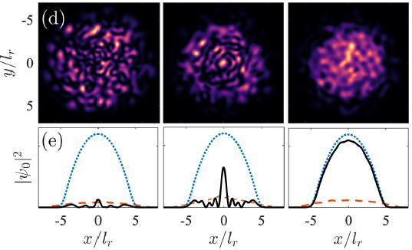
Theoretical treatment
C-field approach by M. Reeves and M. Davis, SciPost Phys. 15, 068 (2023)
Description via damped and driven stochastic projected Gross-Pitaevskii equation
switching behaviour
density in the tranverse direction
normal
superfluid

Slide 24
Summary
Realization of a dissipative phase transition in a quantum gas
Extension of previous work towards many modes, more particles
and stronger interactions
Characteristic closing of the Liouvillian gap
Appearance of hysteresis and metastability
Scaling of hysteresis signals presence of quantum fluctuations
(even though the number of atoms is very large)
Rich microscopic dynamics
Outlook
Scaling laws for different temperatures
Connection to BEC phase transition
Second order dissipative phase transition?

Slide 25
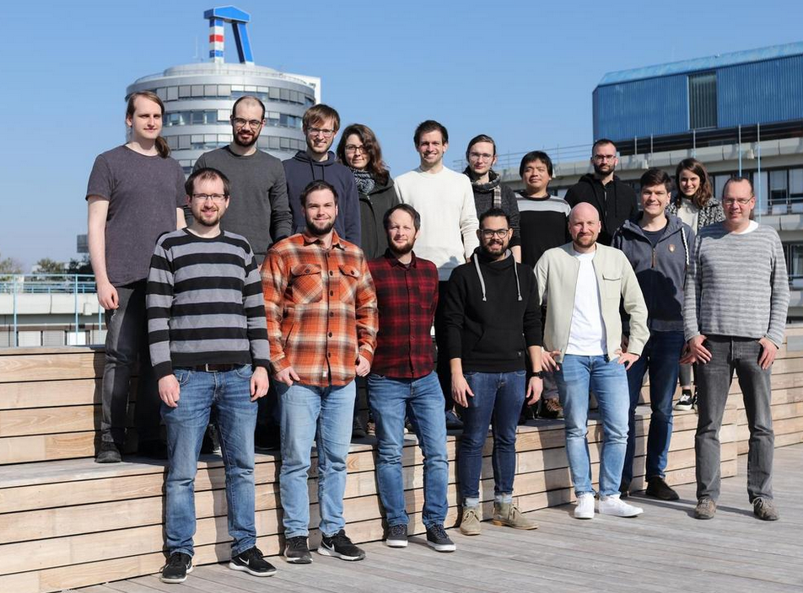
Thanks a lot to these people
Marvin Röhrle, Erik Bernhart, Jian Jiang, Jens Benary

Slide 26
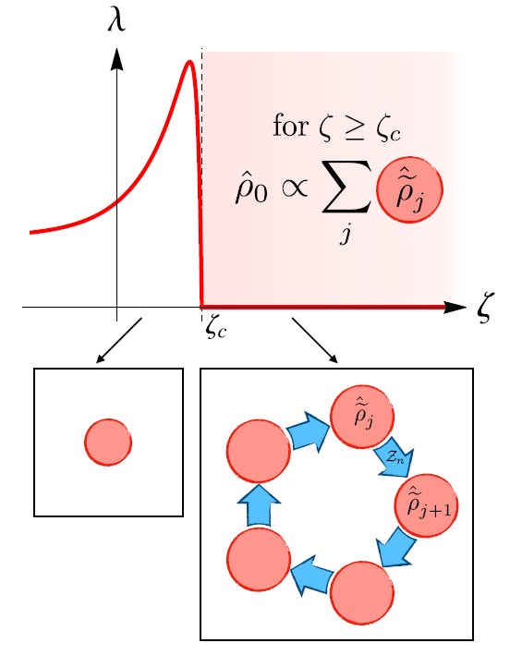

Second order dissipative phase transition
Liouvillian gap closes over a whole
parameter region
Steady-state is a statistical mixture of
different density matrices (at least 2)
Connected to symmetry breaking
Ciuti et al. Phys. Rev A 98, 042118 (2018)

Slide 27
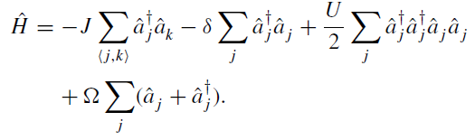
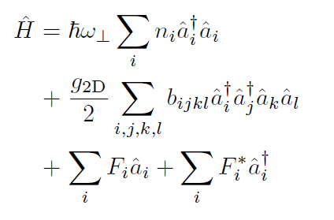
Many-body multi-mode extension
Many-body system in 2D array of coupled cavities
Our system: continuous 2D harmonic oscillator

Slide 28




Finite system size
For finite systems, the gap opens
and the steady-states wash out
over a certain range
System shows jump behaviour
Toy model for the system dynamics
$$ρ^{−}$$
„normal state“ (few atoms, no coherence)
$$ρ^{+}$$
„superfluid state“ (many atoms, phase coherence)
$$\frac{d}{dt}\left(\begin{matrix}p^{+} \\ p^{−}\end{matrix}\right)=\left(\begin{matrix}−γ_{+ −} & γ_{− +} \\ γ_{+ −} & −γ_{− + }\end{matrix}\right)\left(\begin{matrix}p^{+} \\ p^{−}\end{matrix}\right)$$
coupled equations for the probabilities
$γ_{+ −}$ , $γ_{− +}$ are the corresponding jump rates

Slide 29
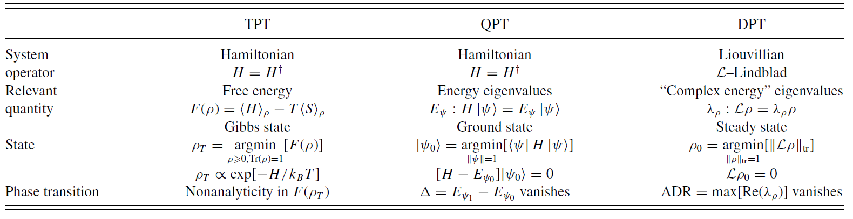
Dissipative Phase Transition
Thermal
phase
transition
Quantum
phase
transition
Dissipative
phase
transition
Phys. Rev. A 86, 012116 (2012)

Slide 30
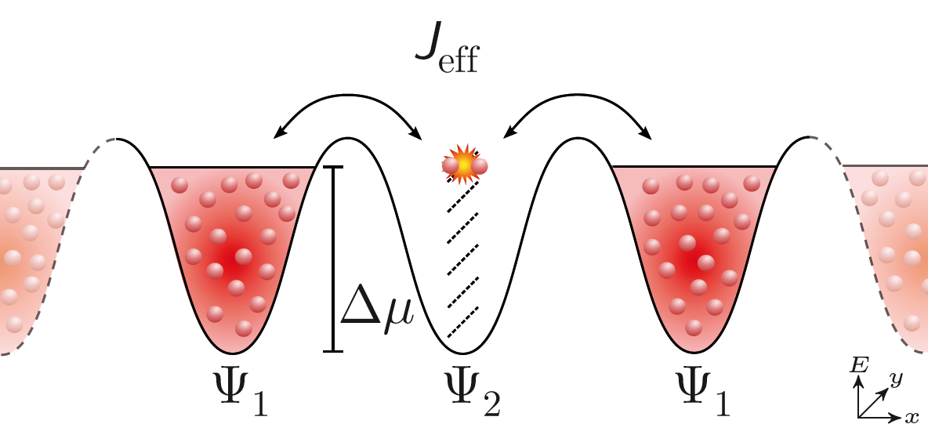
Microscopic level structure
radially excited single particle
states
mean field
~ 800 atoms
ν_{r} = 180 Hz
Δµ = h x 1500 Hz
Energy conservation requires tunneling into radially excited state!

Slide 31
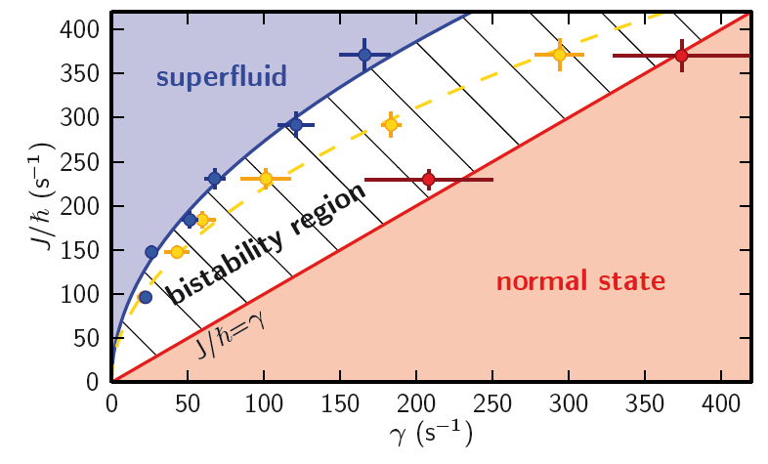
Phase diagram
Labouvie et al PRL 116, 235302 (2016)

Slide 32




Coherent perfect absorption
Bidirectional incoming radiation
$${a^{L}e}^{iq_{⋆}x}$$
$${a^{R}e}^{iq_{⋆}x}$$
absorber
$${b^{L}e}^{−iq_{⋆}x}$$
$${b^{R}e}^{−iq_{⋆}x}$$
Destructive interference of transmitted and reflected waves leads to perfect absorption
D. Stone Phys. Rev. Lett. 105, 053901 (2010)

Slide 33
Coherent perfect absorption
CPA needs matching parameters,
works only for one particular
wave vector and is phase sensitive
Science 331, 889 (2011)

Slide 34











Linear CPA and transfer matrix
$${a^{L}e}^{iq_{⋆}x}$$
$${a^{R}e}^{iq_{⋆}x}$$
absorber
$${b^{L}e}^{−iq_{⋆}x}$$
$${b^{R}e}^{−iq_{⋆}x}$$
Transfermatrix M
$$\left(\begin{matrix}a^{R} \\ b^{R}\end{matrix}\right)=\left(\begin{matrix}M_{11} & M_{12} \\ M_{21} & M_{22}\end{matrix}\right)\left(\begin{matrix}a^{L} \\ b^{L}\end{matrix}\right)$$
$$M_{11}=0$$
$$a^{L}=b^{R}$$
$$a^{R}=b^{L}=0$$
CPA
spectral singularity
$$M_{22}=0$$
$$a^{R}=b^{L}$$
$$a^{L}=b^{R}=0$$

Slide 35
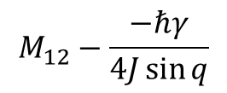
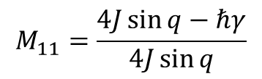

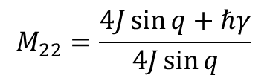

CPA for linear matter waves
$${a^{L}e}^{iq_{⋆}x}$$
$${a^{R}e}^{iq_{⋆}x}$$
absorber
$${b^{L}e}^{−iq_{⋆}x}$$
$${b^{R}e}^{−iq_{⋆}x}$$
$$iℏ\frac{∂ψ_{n}}{∂t}=−J\left(ψ_{n−1}+ψ_{n+1}\right)−iℏ\frac{γ}{2}ψ_{n}δ_{n0}$$
no interactions
$$M_{11}=\frac{4J\sin{q}−ℏγ}{4J\sin{q}}$$
$$M_{12}−\frac{−ℏγ}{4J\sin{q}}$$
Transfermatrix M =
$$M_{21}=\frac{ℏγ}{4J\sin{q}}$$
$$M_{22}=\frac{4J\sin{q}+ℏγ}{4J\sin{q}}$$

Slide 36



CPA for linear matter waves
$${a^{L}e}^{iq_{⋆}x}$$
$${a^{R}e}^{iq_{⋆}x}$$
absorber
$${b^{L}e}^{−iq_{⋆}x}$$
$${b^{R}e}^{−iq_{⋆}x}$$
$$M_{11}=\frac{4J\sin{q}−ℏγ}{4J\sin{q}}=0$$
$$4J\sin{q}−ℏγ=0$$
$$J,q,γ$$
have to match each other

Slide 37



CPA of nonlinear matter waves
$$iℏ\frac{∂ψ_{n}}{∂t}=−J\left(ψ_{n−1}+ψ_{n+1}\right)+U{\left|ψ_{n}\right|}^{2}ψ_{n}−iℏ\frac{γ}{2}ψ_{n}δ_{n0}$$
Same solution by explicit construction
$$4J\sin{q}−ℏγ=0$$
$$a^{L}=b^{R}$$
$$a^{R}=b^{L}=0$$
CPA is a solution

Slide 38


CPA of nonlinear matter waves
experimental results
numerical simulation
collaboration with
V. V. Konotop

Slide 39

Outlook
Characterize phase transition
scaling of slowing down
atom number fluctuations
correlation times

Slide 40


Outlook
Looking for dark states of the system
In case of a phase difference of π,
the steady-state solution is a dark soliton
How to measure a local phase
difference of π ?
Use Talbot interferometry!
Nat. Comm. 10, 1038 (2017)
collaboration with A. Pelster

Slide 41

First slide from Matt Davis and Matt Reeves
Stochatisc field equation
Tunnelling from neighbouring site
Ground state at neighbouring site
Dissipation from SEM
Noise correlations

Slide 42

Second slide from Matt Davis and Matt Reeves
Theory:
Experiment:

Slide 43


What is the generic effect of an imaginary potential?
Simple toy model in 1D: an imaginary potential barrier in one dimension
Increasing dissipation
inhibits losses

Slide 44
The extreme limit
Projection to a unitary time evolution in the subspace with no losses:
x

Slide 45

Phase noise as decoherence
V(t)
Fluctuating potential in a lattice site
or collisions, fluorescence
effective decoherence rate
number operator

