Slide 1
Photon-blockade breakdown as a first-order dissipative phase transition in zero dimension
András Vukics
Quantum Optics group, HUN-REN Wigner RCP
Wigner 121 Symposium
20/09/2023

Slide 2
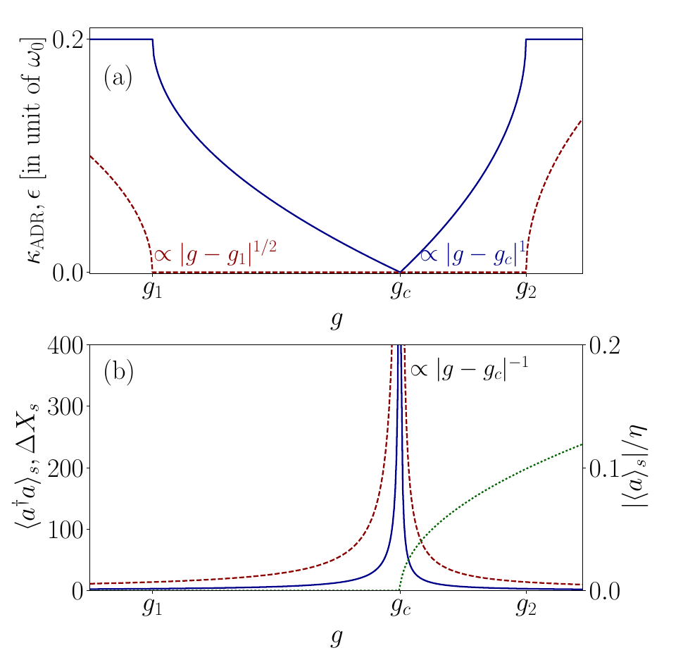
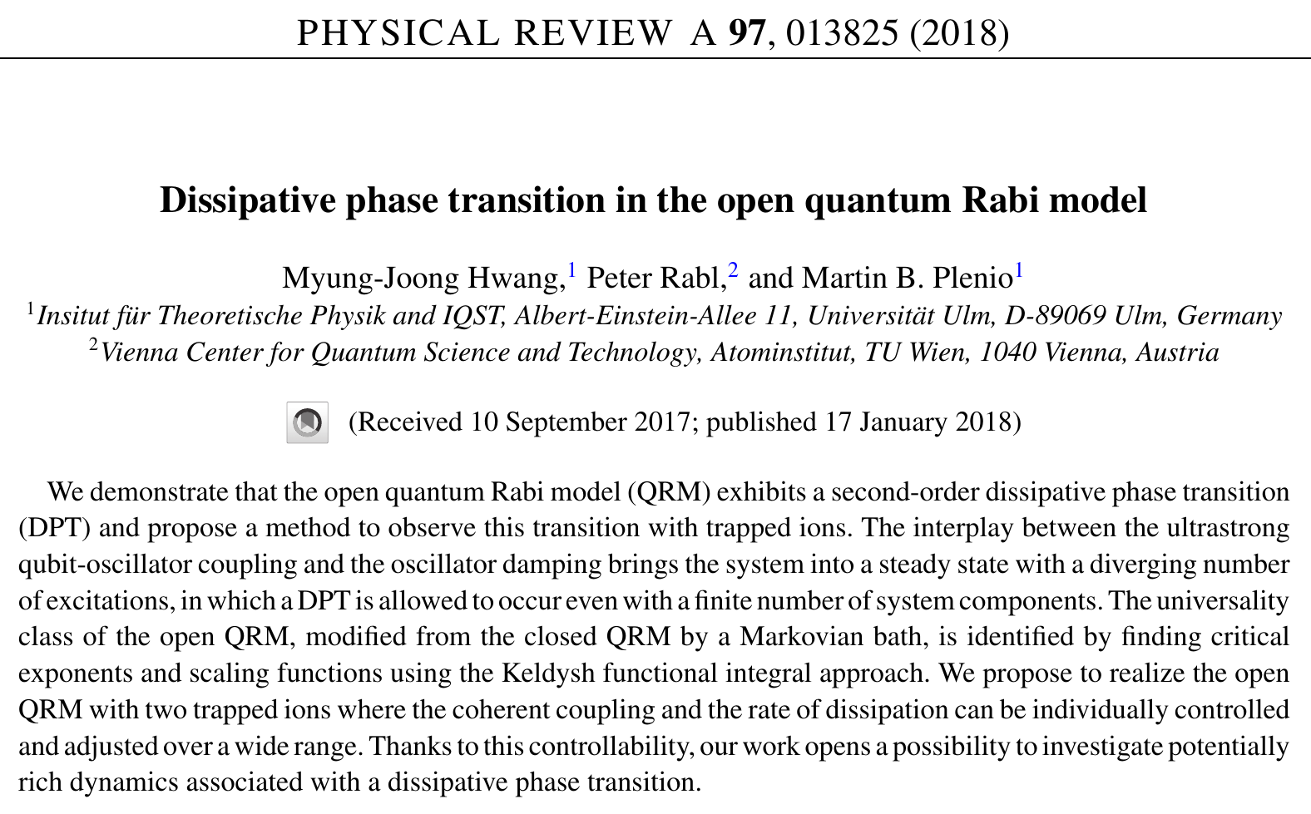
Dissipative phase transitions
Concept of (quantum) phase transitions: one of the greatest intellectual achievements of 20th century physics
appeals mostly to condensed matter physics
Dissipative (quantum) phase transitions (DPT):
can occur in meso- or even microscopic systems

Slide 3
1st order dissipative phase transitions

Slide 4
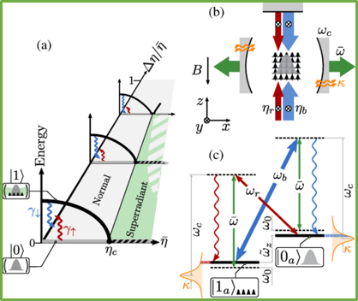
1st order dissipative phase transitions

Slide 5
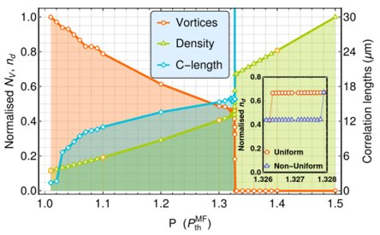
1st order dissipative phase transitions

Slide 6
1st order dissipative phase transitions
1st order – existence of bistability region
(cf. water @0°C in a certain range of free enthalpy)

Slide 7
How is a DPT different from a quantum phase transition?
QPT: closed quantum system
dynamical parameter of the system

Slide 8
How is a DPT different from a quantum phase transition?
QPT: closed quantum system
dynamical parameter of the system
Look for abrupt changes in an eigenstate (ground state) of the system as a function of η.

Slide 9
How is a DPT different from a quantum phase transition?
DPT: open quantum system
density operator
(GKSL) Master equation
Liouvillian superoperator
dynamical parameter of the system

Slide 10
How is a DPT different from a quantum phase transition?
Wigner-Weisskopf theory of spontaneous emission (cca. 1930)
DPT: open quantum system
dynamical parameter of the system
Look for abrupt changes in the steady state of the system as a function of η.

Slide 11
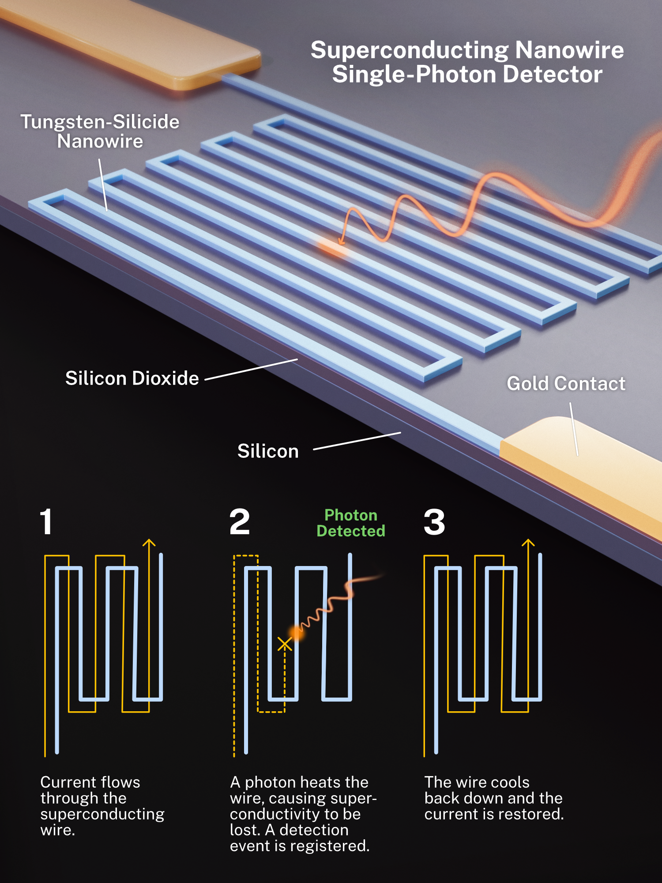
DPT as metrological resource single photon detection
Optical domain
Microwave domain
Thermal phase transition can be used
Much smaller energy/photon
=> thermal phase transition cannot be used
Clumsiness due to the need for thermodynamic parameters to cross the PT point
=> manifests e.g. in detection dead time

Slide 12
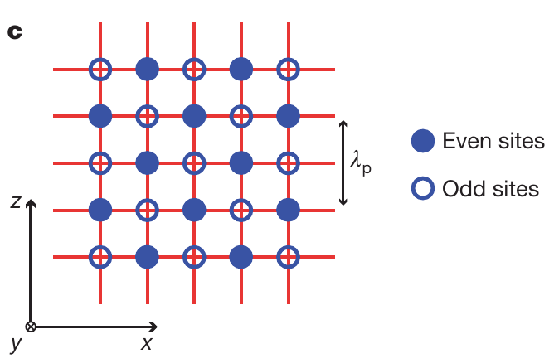
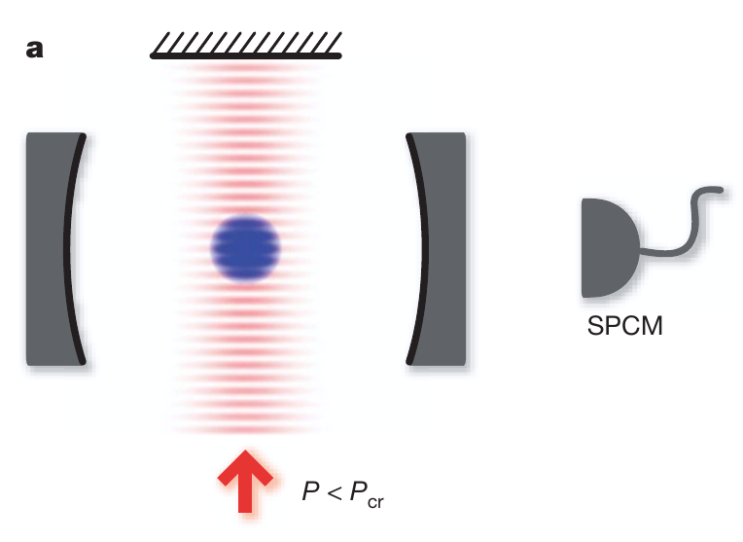
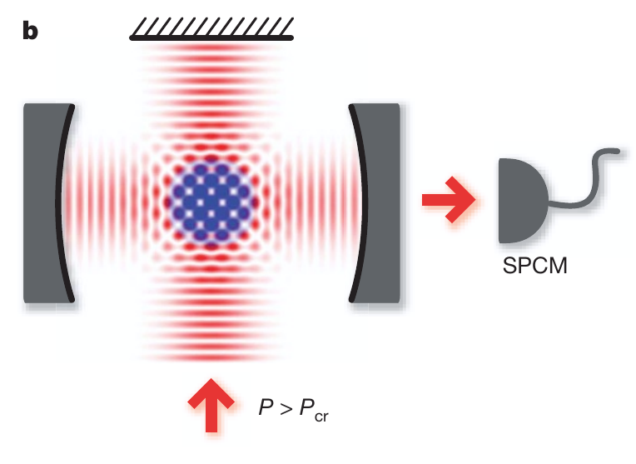
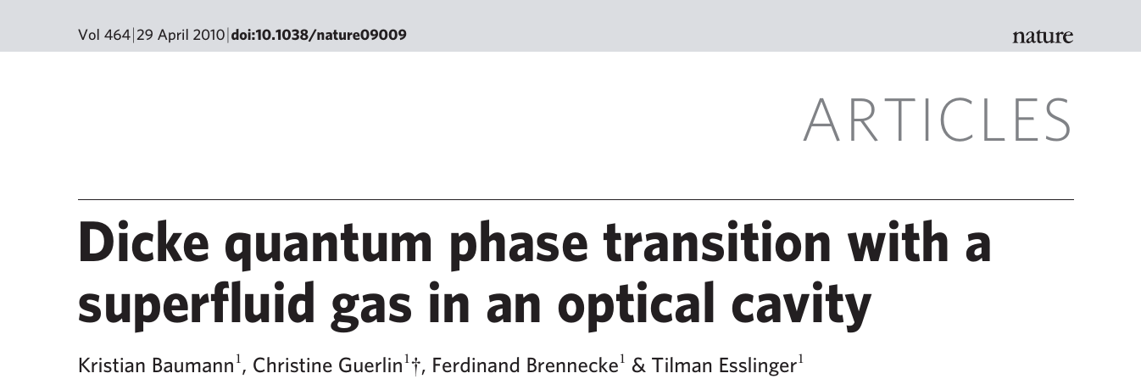
Self-organization of a Bose-Einstein condensate in a cavity field as a 2nd order DPT
Spontaneous symmetry breaking

Slide 13
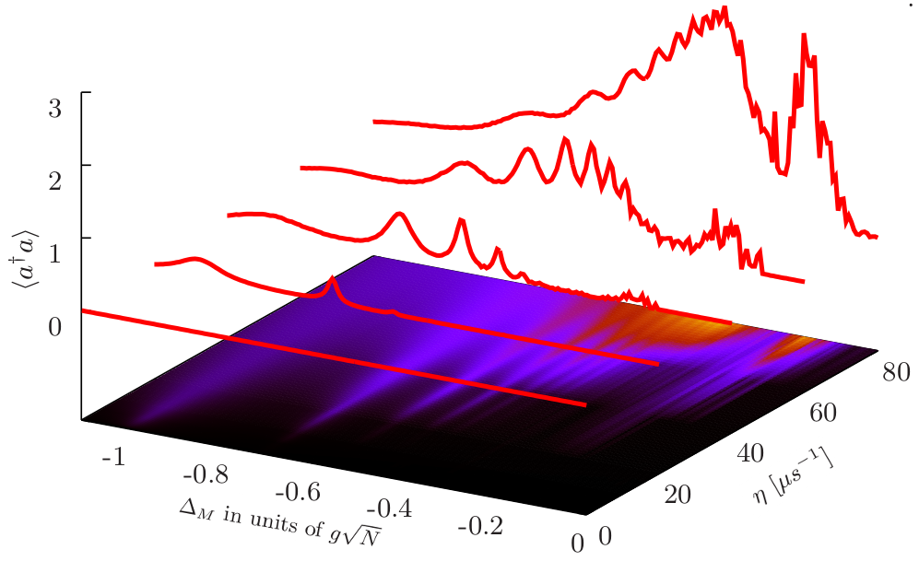
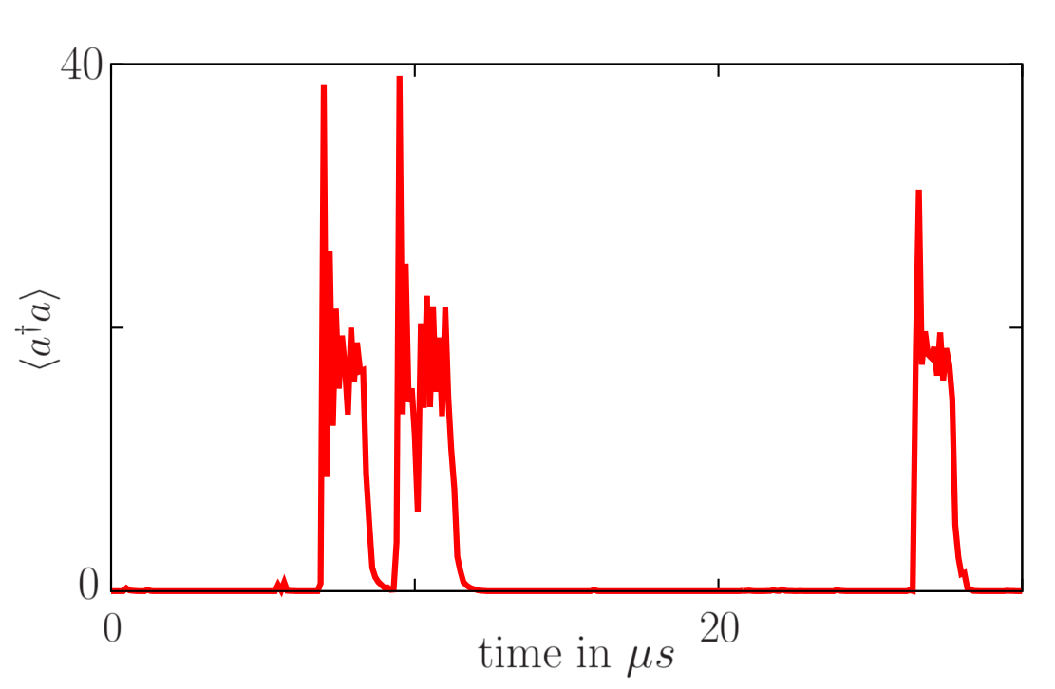
The photon-blockade breakdown effect
multi-photon resonances
“quantum bistability”
single-photon Rabi peak

Slide 14
Jaynes-Cummings model
Derived from a dipolar atom–field interaction:
In a rotating frame with rotating-wave approximation:
Master equation:

Slide 15
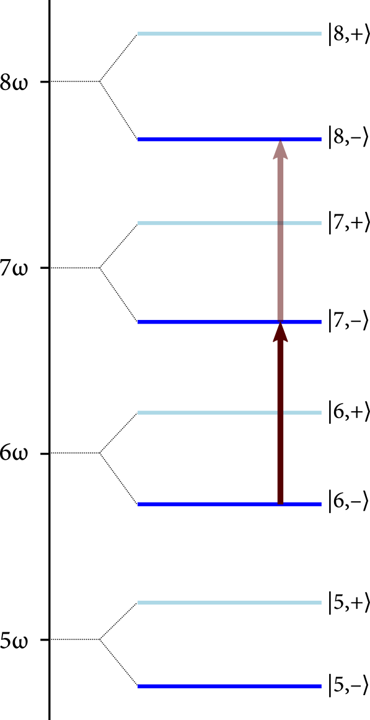
PBB microscopic mechanism
For small n: photon blockade if g≫κ,γ
Spectrum:
δ
difference in level-spacing for ‘–’ manifold decays as

Slide 16
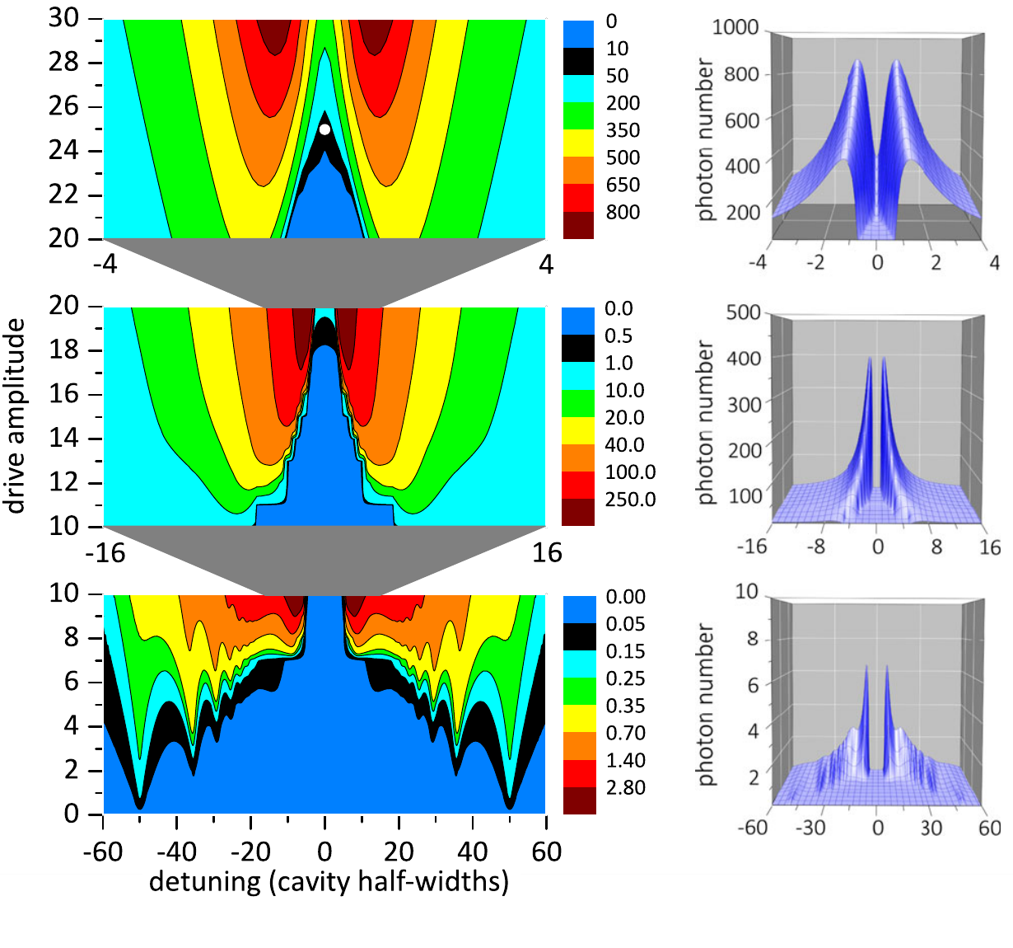
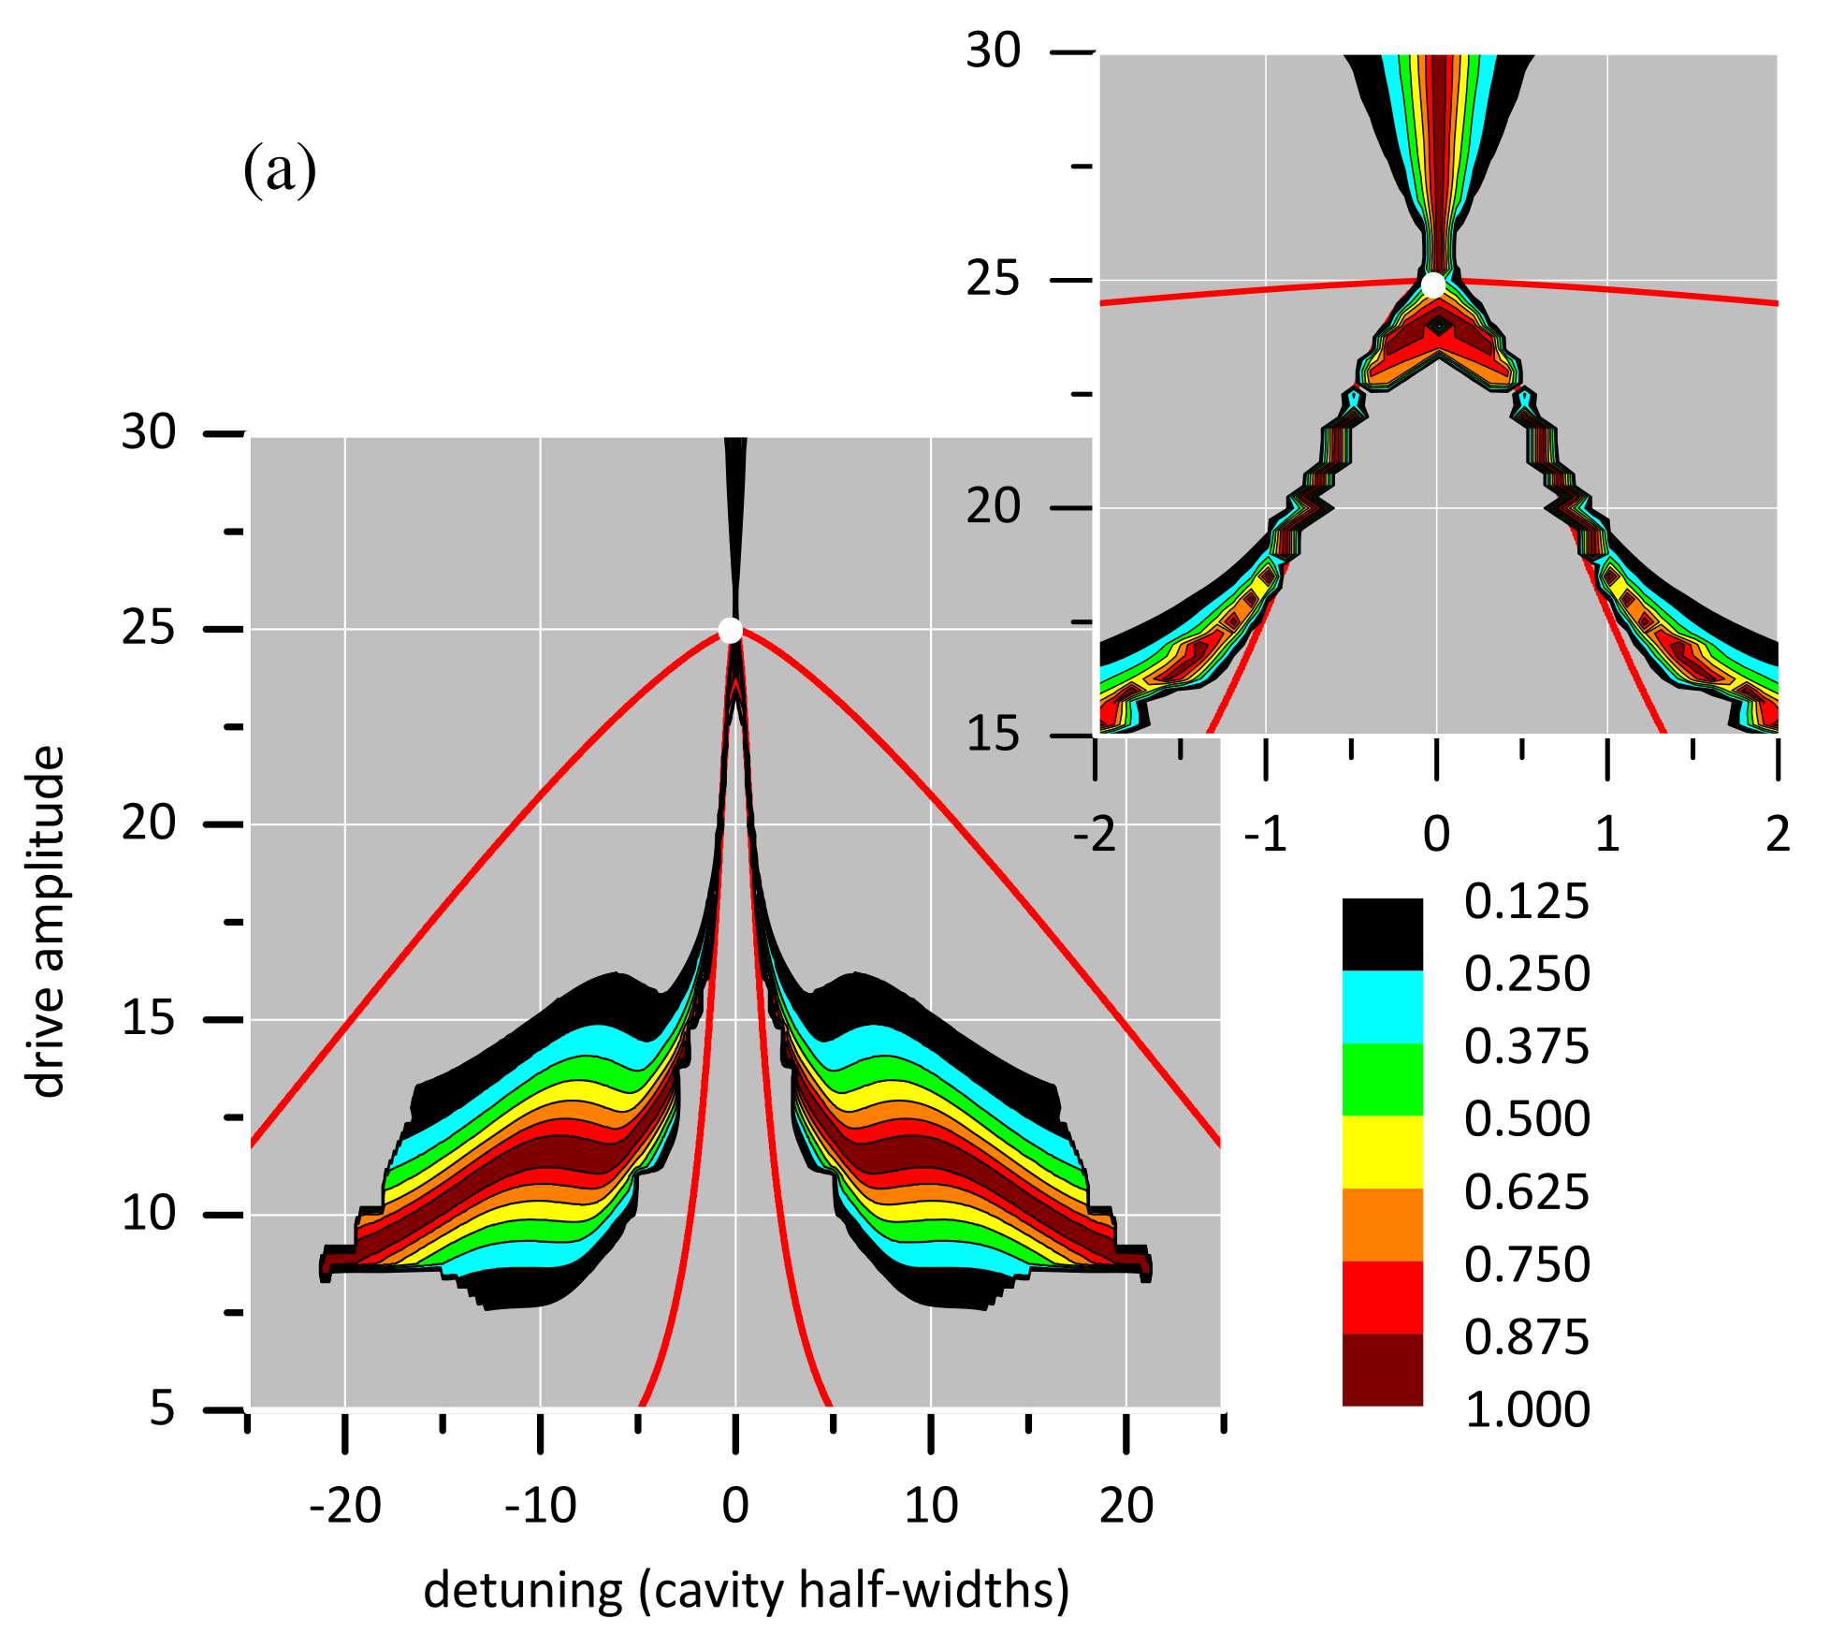

Slide 17
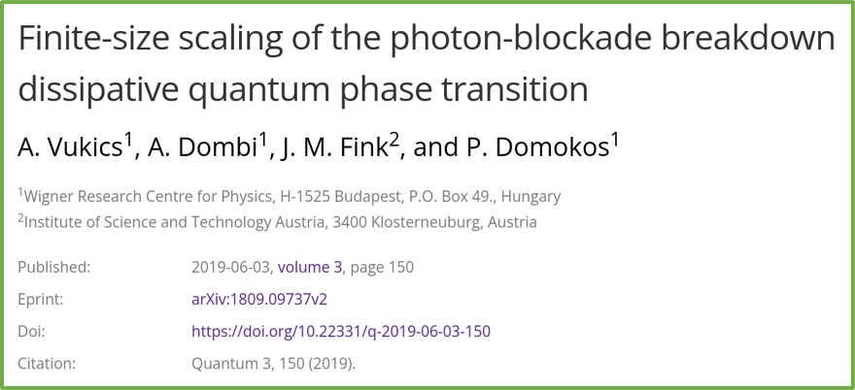
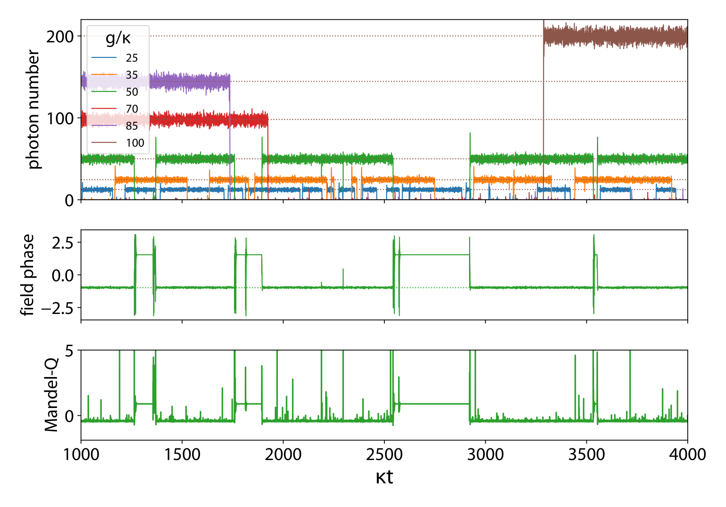
PBB thermodynamic limit
strong-coupling limit
Quantum-trajectory
(Quantum-jump Monte Carlo)
simulations
Thermodynamic limit:
bistable behaviour becomes macroscopic both in
timescale and
amplitude
⇒ bistability becomes hysteresis
Mscopically distinct states ⤳ phases

Slide 18
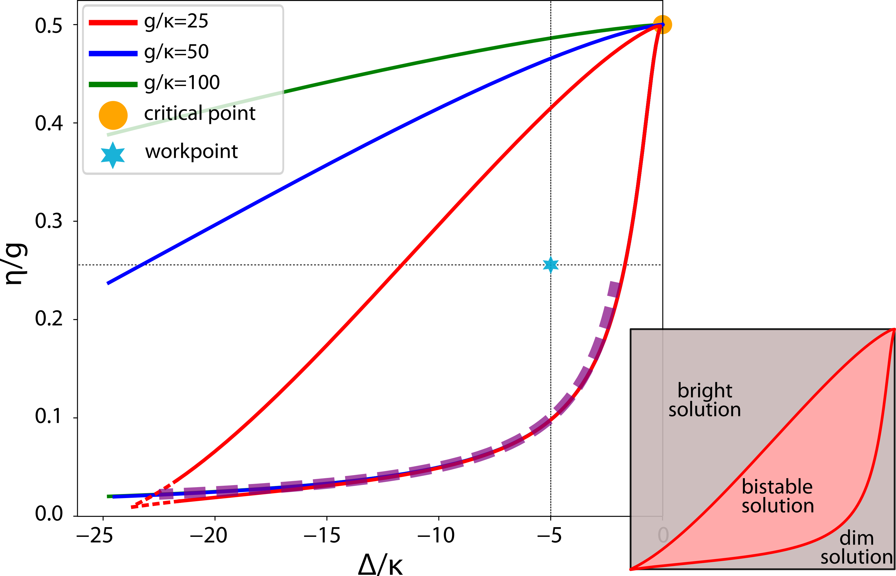
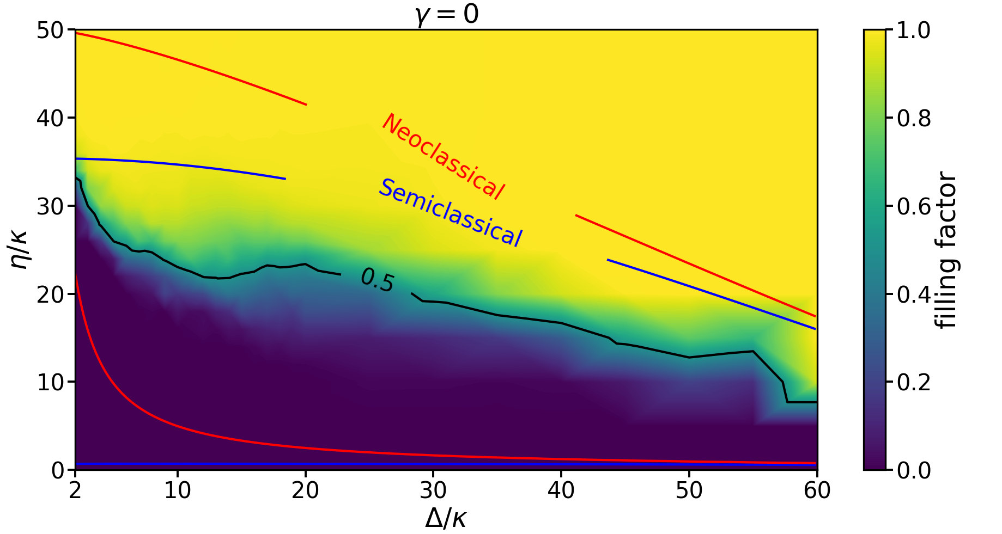
The neoclassical phase diagram
half-filling curve consistent with neoclassical boundaries

Slide 19
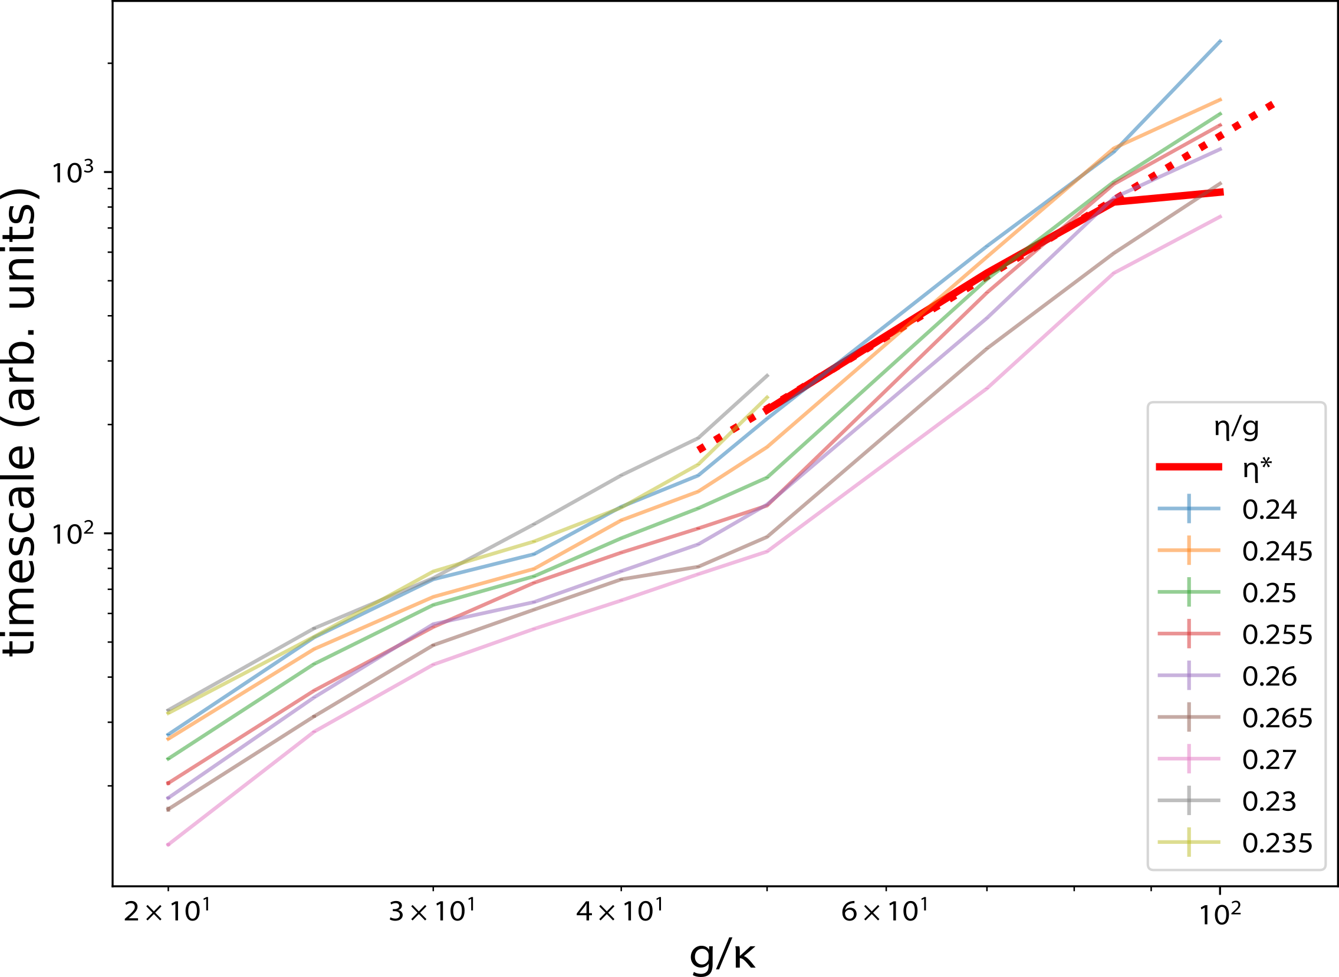
PBB thermodynamic limit
finite-size scaling of timescale with exponent 2.2

Slide 20
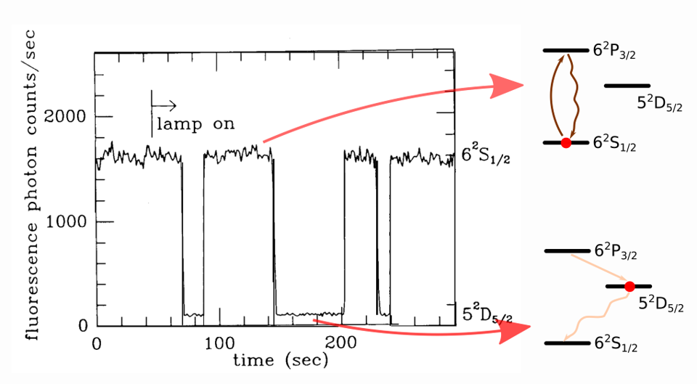
Comparison with electron shelving
Long-lived bistability not unknown in quantum optics
e.g. electron-shelving (Dehmelt, 1986) — single Ba+ ion
Timescale remains determined by (long) microscopic timescale

Slide 21
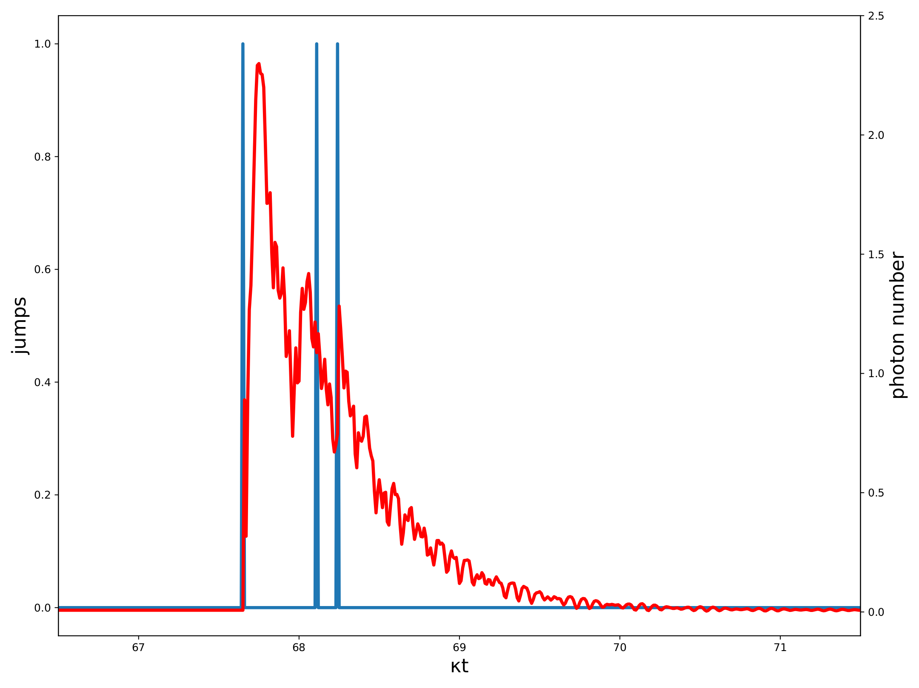
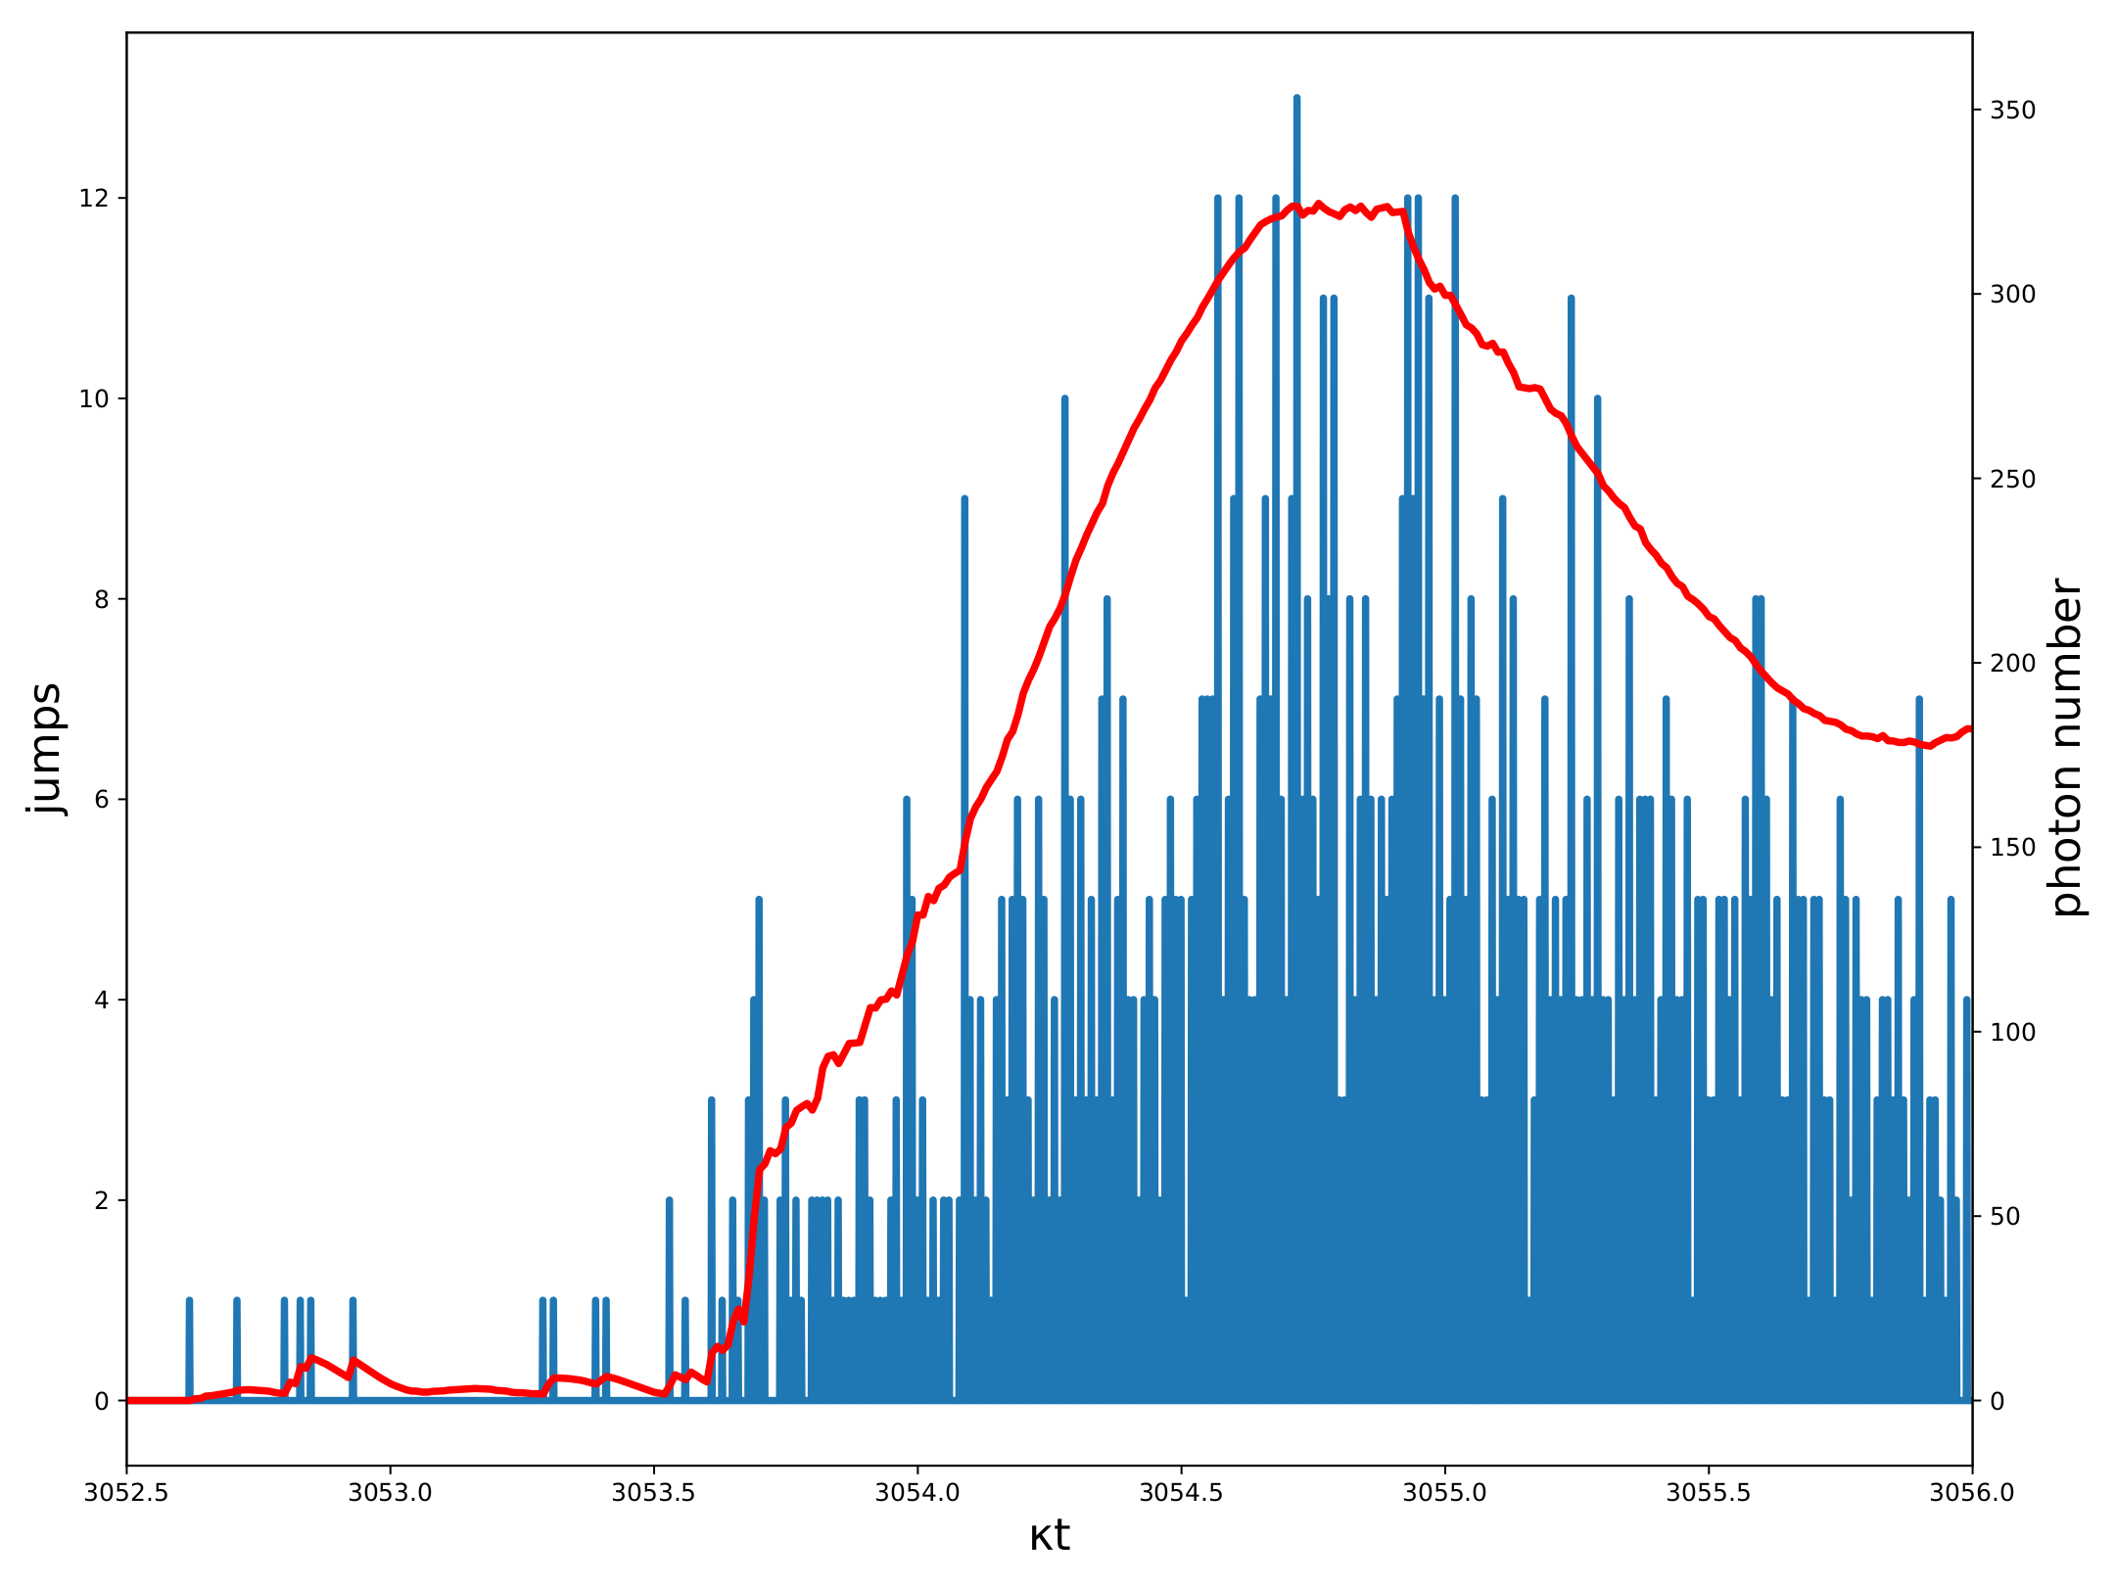
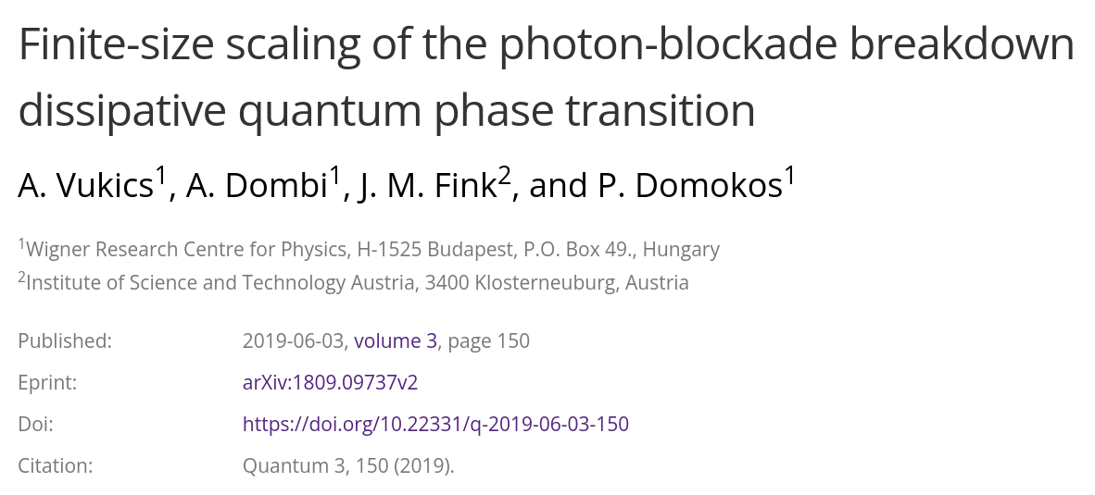
PBB quantum aspects
Jump-induced switch-ON events:
Unsuccessful switching
Successful switching

Slide 22
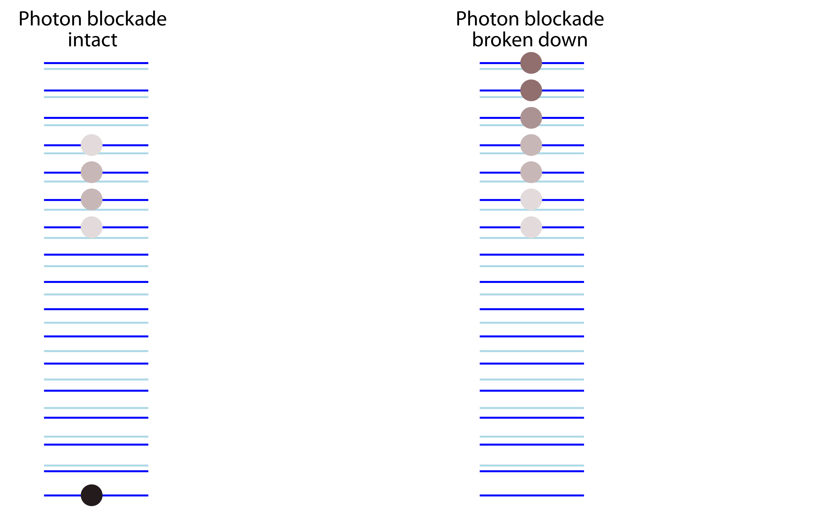
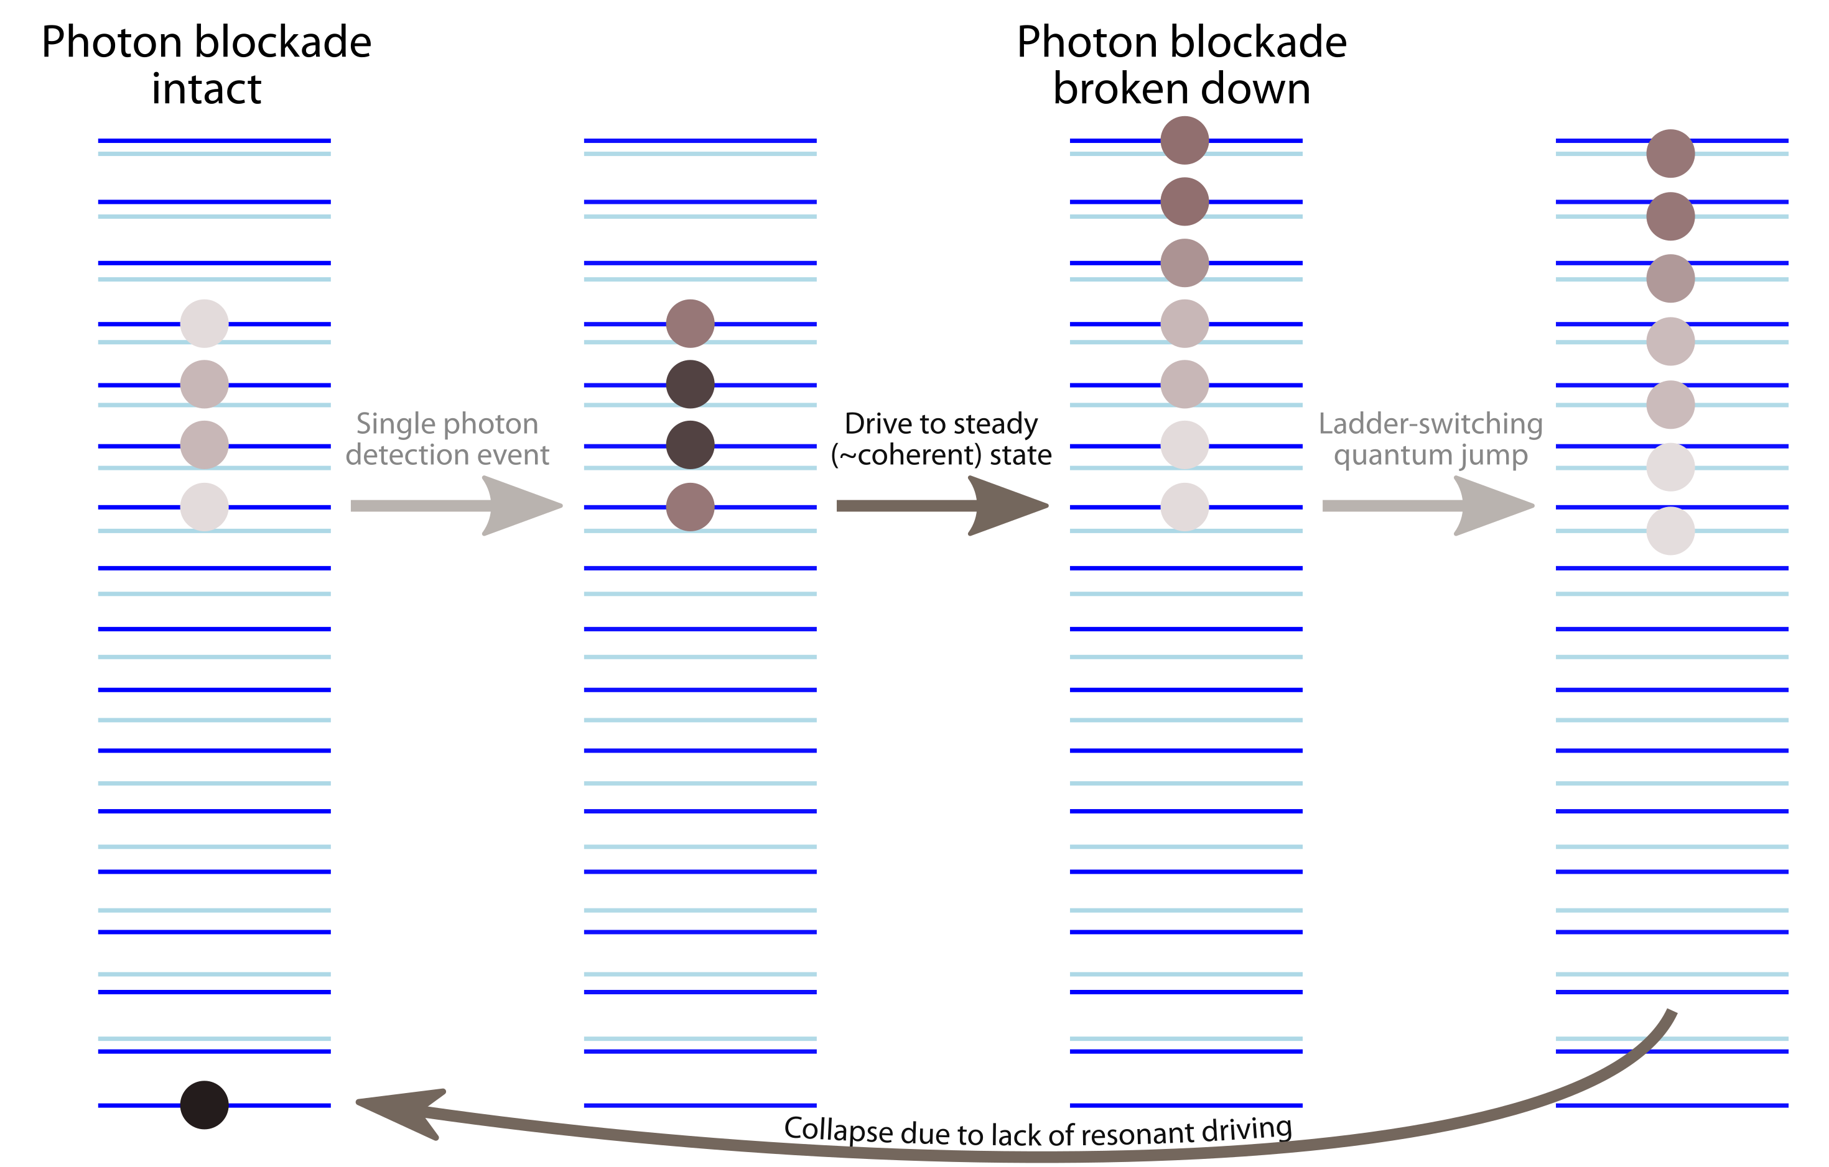
PBB quantum aspects
The full cycle:

Slide 23
PBB vs. optical bistability
Maxwell–Bloch (semiclassical) theory:

Slide 24
PBB vs. optical bistability
Maxwell-Bloch (semiclassical) theory (steady state):
Dispersion and/or absorption
is essential algebraically for
non-trivial solution
Nonlinearity due to saturation
=> multiple solutions for intensity in steady state possible

Slide 25
PBB vs. optical bistability
Neoclassical theory (γ=0)
Population equation becomes degenerate

Slide 26
PBB vs. optical bistability
Neoclassical theory (γ=0)
Classical OB is well described by MB theory.
Some aspects of PBB (phase diagram and thermodynamic limit) are reproduced by NC theory.
Gets replaced by conservation of pseudospin (≍ atom being in pure state)

Slide 27
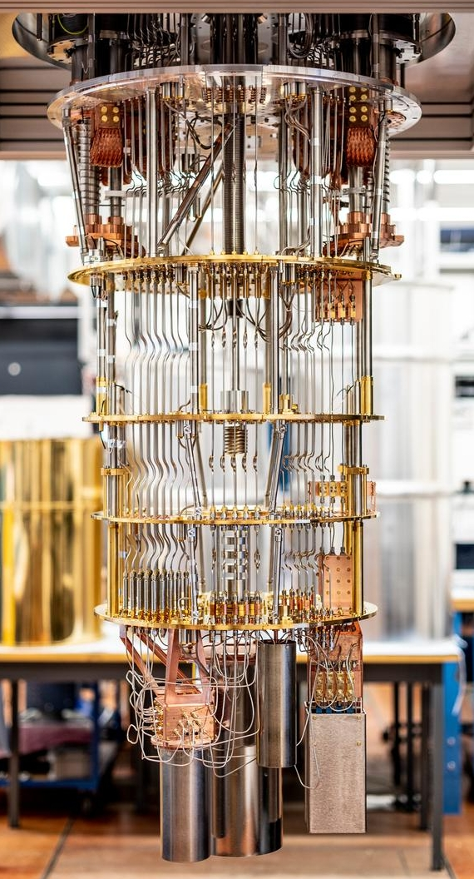
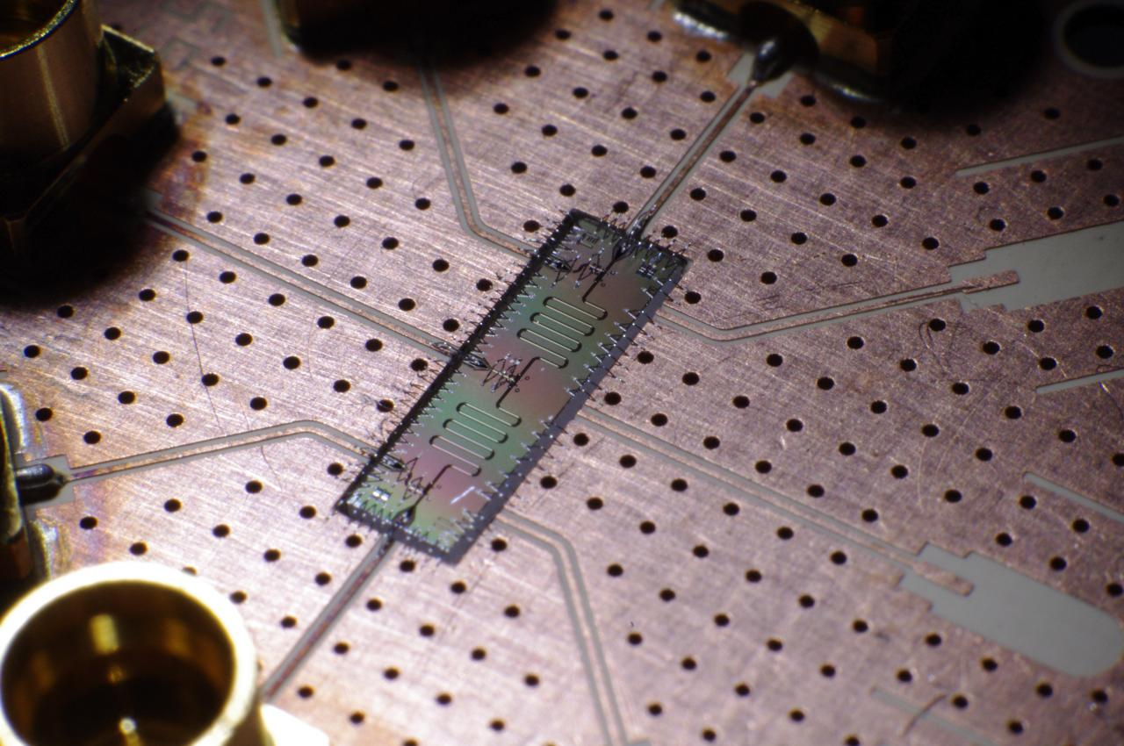
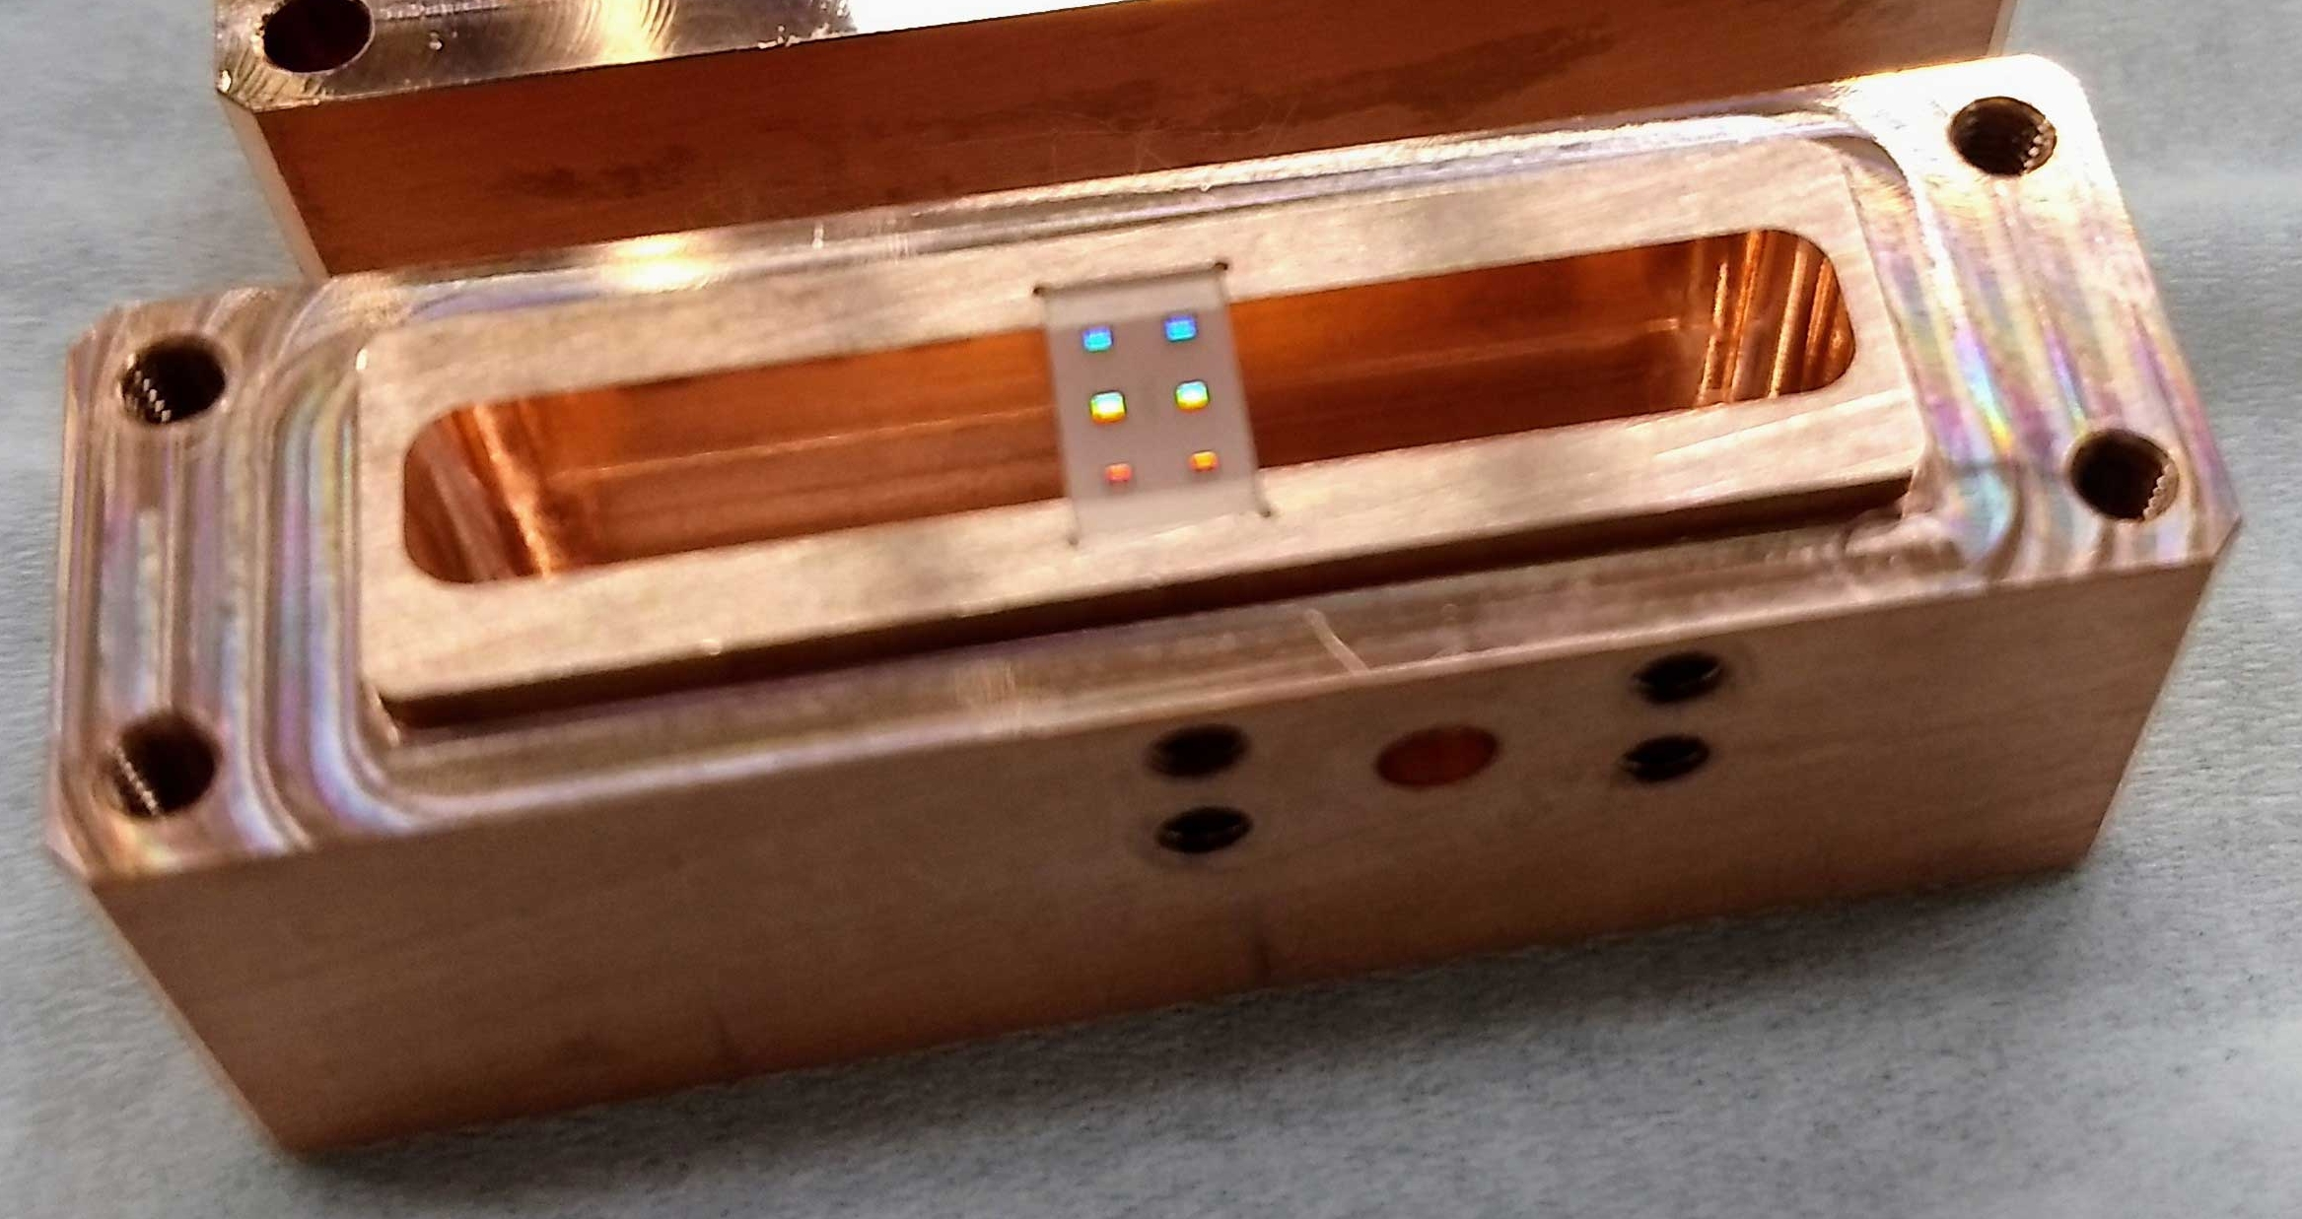
Experiments: circuit QED
Emerging microwave platform since the 1980’s
Josephson-junction ⇒ Cooper-pair box ⇒ transmon
non-linear inductance
qubit
Quantum behaviour due to
low-power (fW–aW)
lossless operation (@ T≲1mK)
Transmon specification: (E_{J}≫E_{C})
⇒ reduced sensitivity to charge noise
(but anharmonicity is also reduced)
Very strong coupling possible (ω∼10GHz, g∼300MHz)
Here: operated as an analog quantum computer

Slide 28
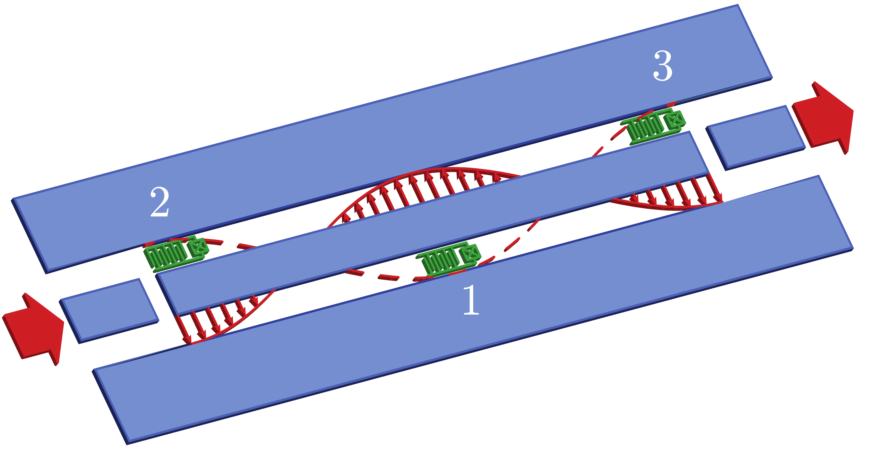
Experiments: circuit QED
Wallraff group @ Quantum Devices Lab, ETH

Slide 29
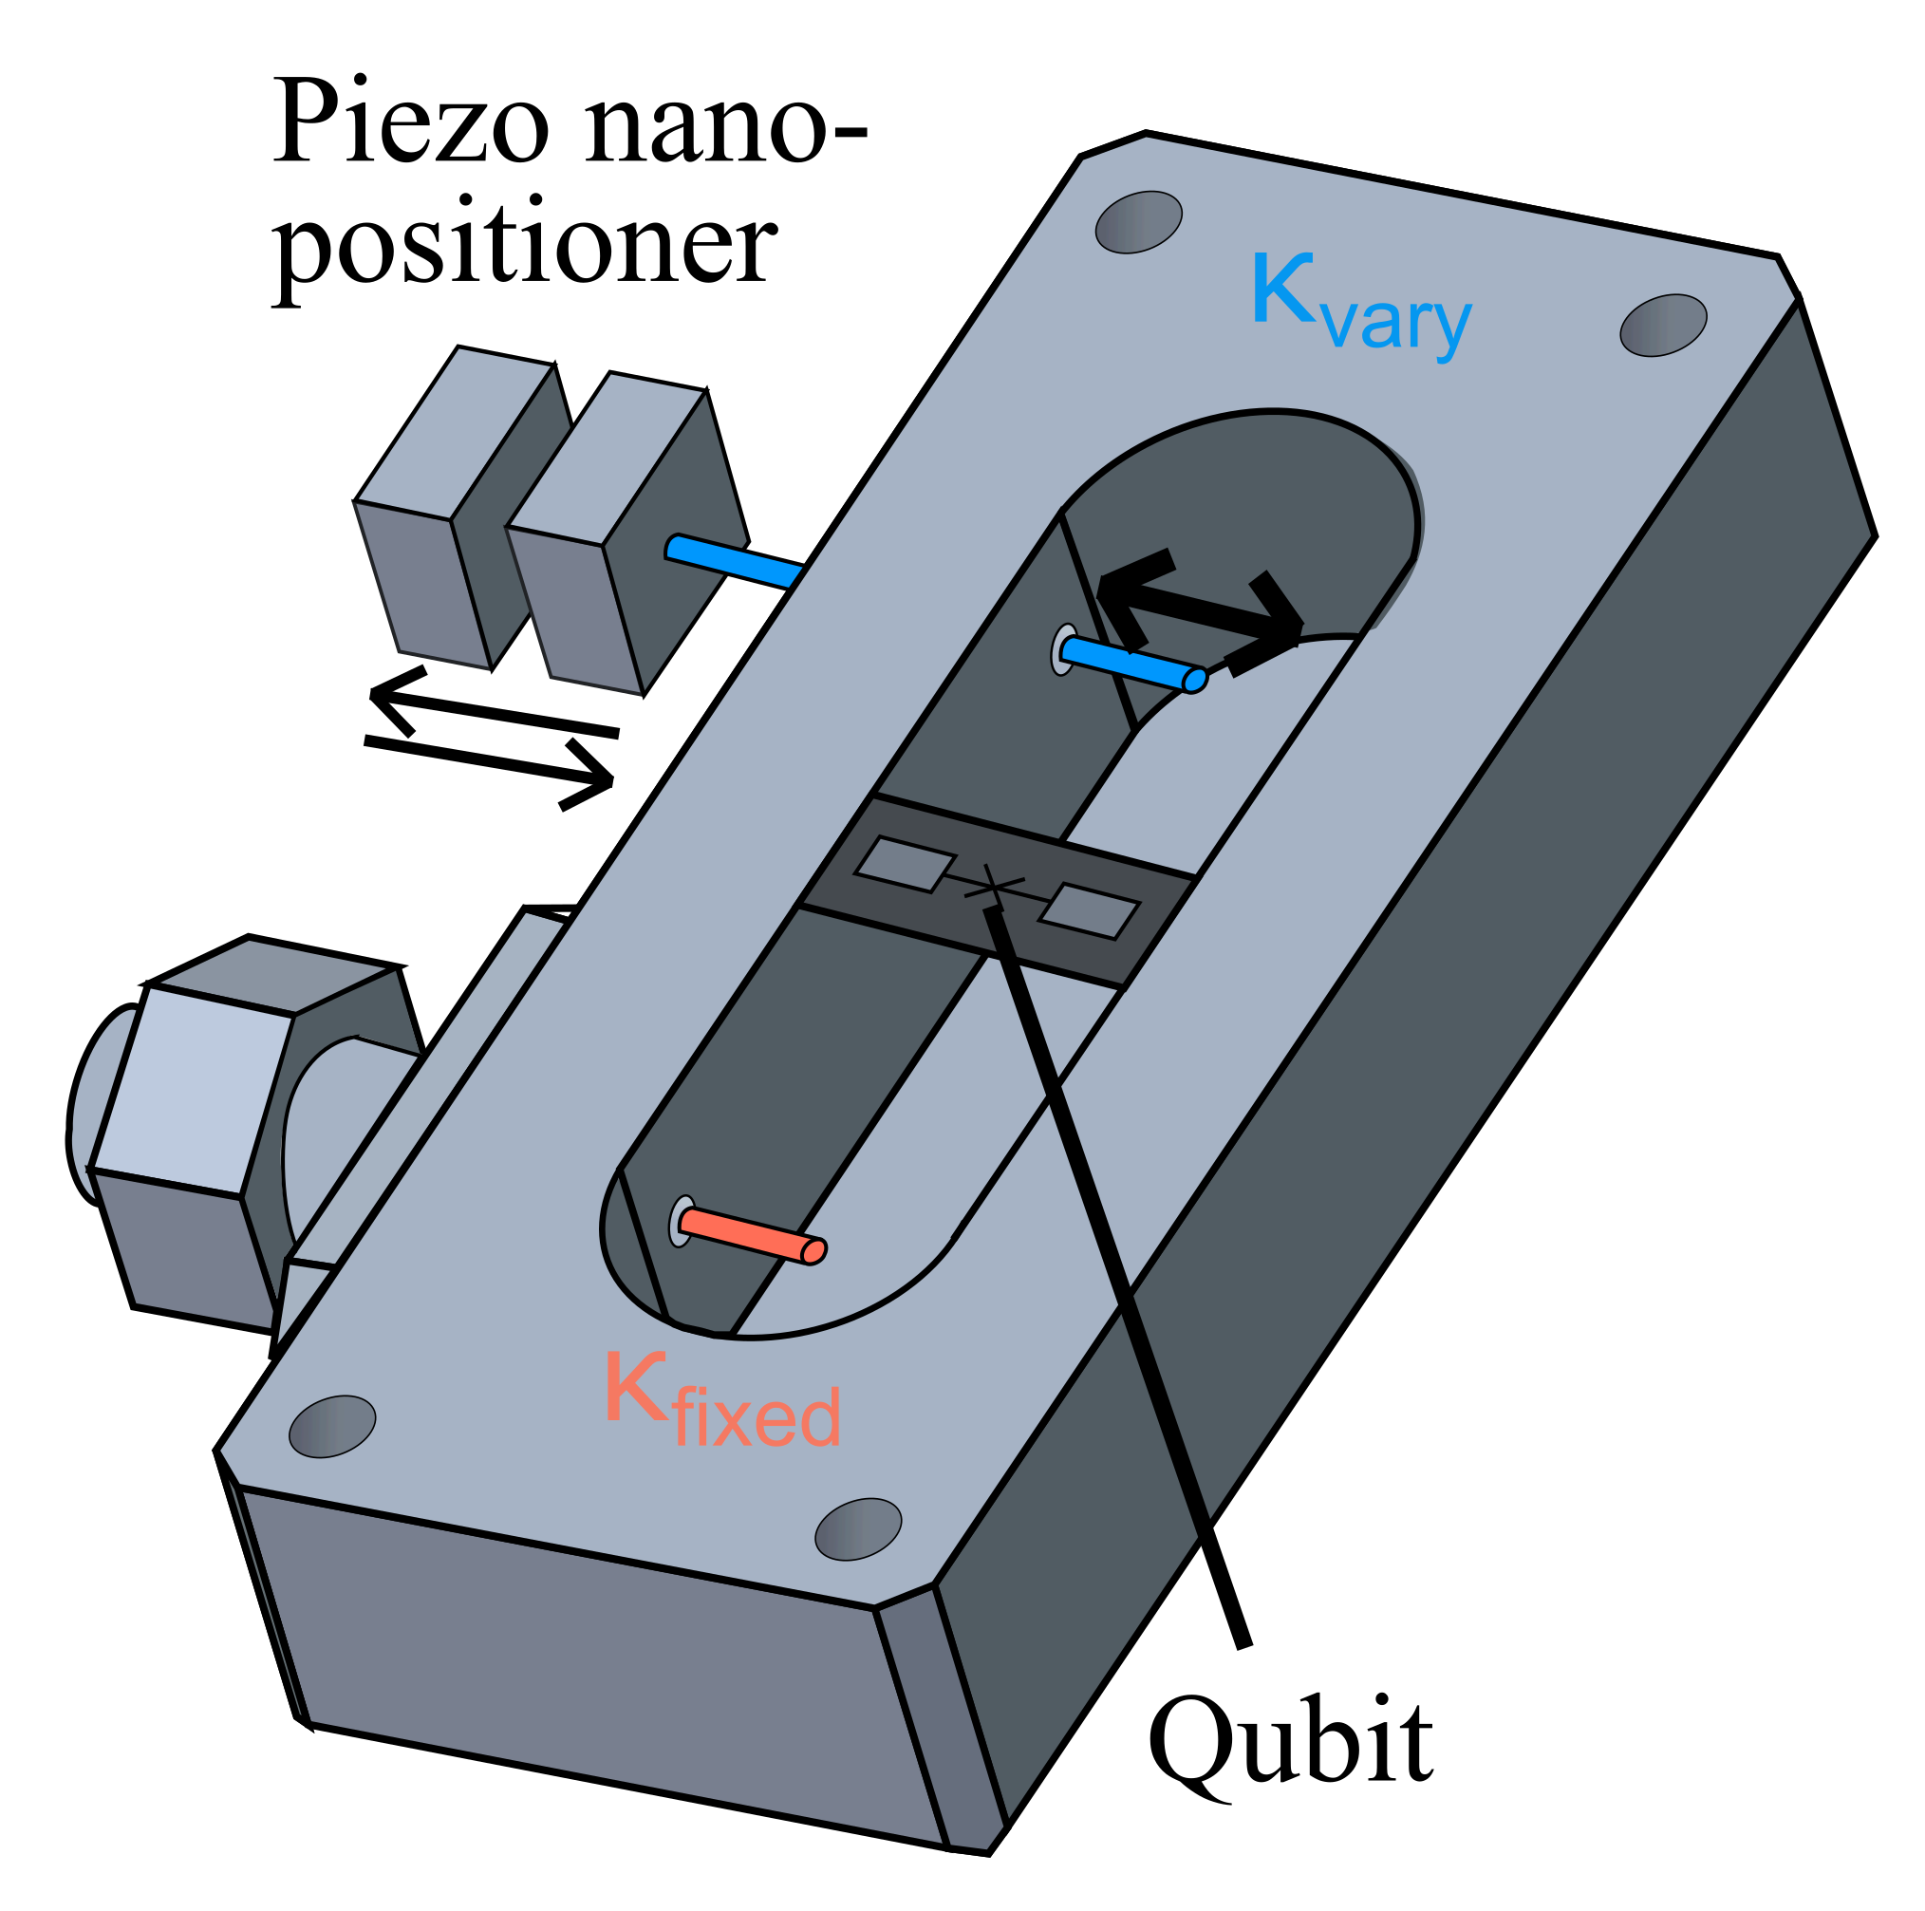
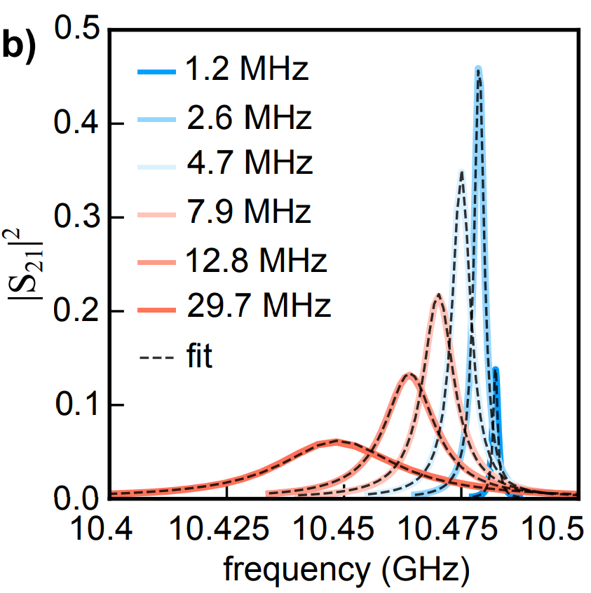
Experiments: circuit QED
Fink group @ Quantum IDs Lab, ISTAustria
Wallraff group @ Quantum Devices Lab, ETH
Idea of modelling
the thermodynamic limit:
not by increasing g, but by decreasing κ (1–30MHz)
Very strong coupling:

Slide 30
The transmon artificial atom (qubit)

Slide 31
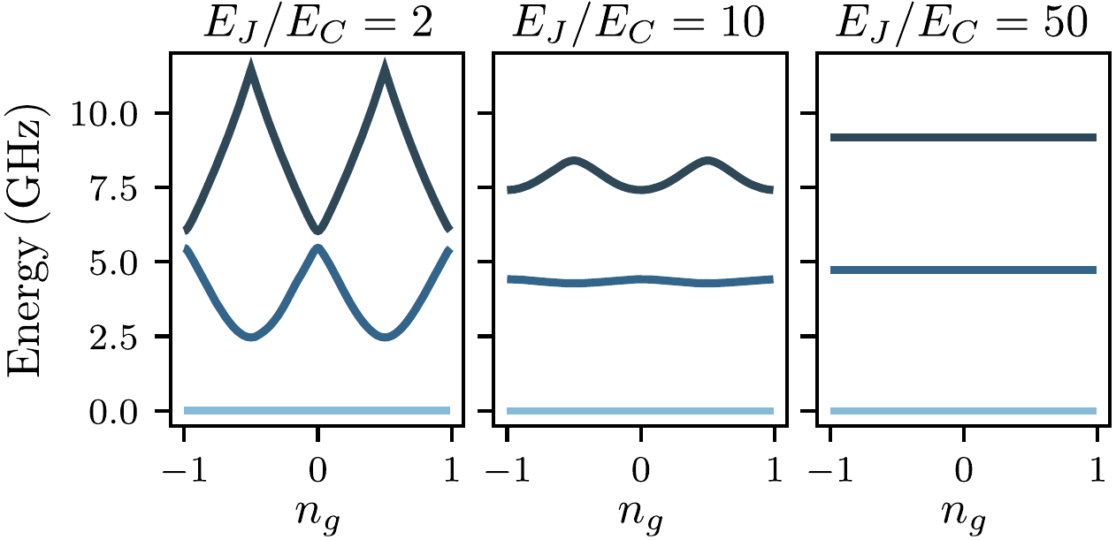
The transmon artificial atom (qubit)
The first 3 energy levels

Slide 32
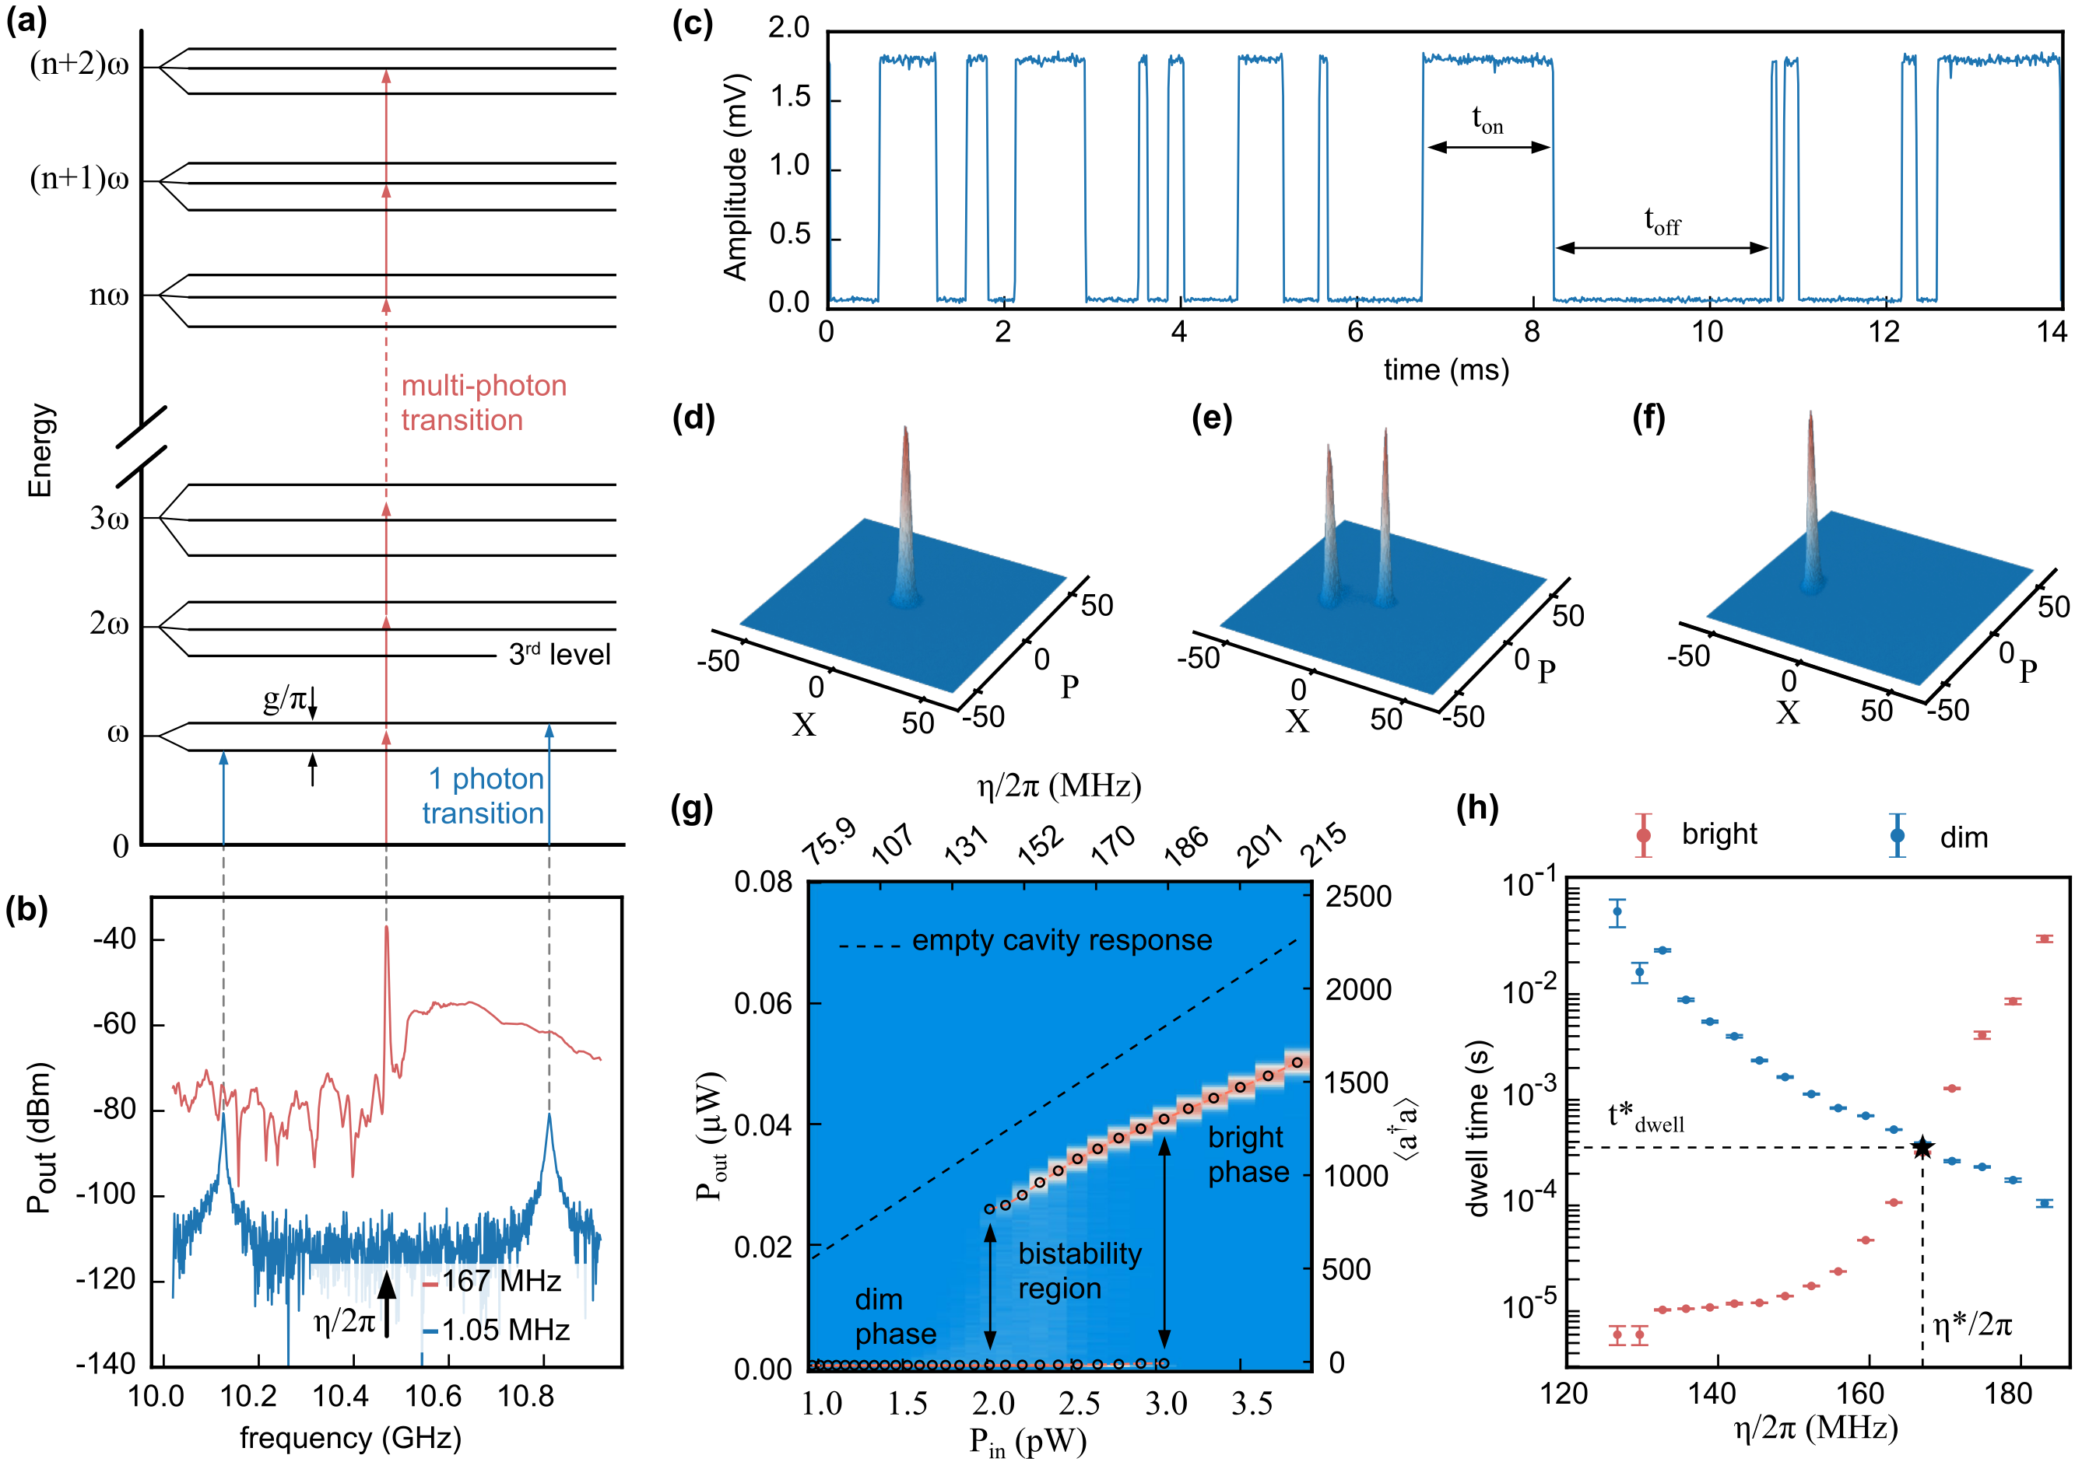
Experiments: circuit QED
With this kind of strong coupling, more transmon levels come into play

Slide 33
How is a 1st order DPT possible?
Inhomogeneous linear system of equations
=> multiple solutions not possible!
Solution: single accommodate mixture of phases, e.g.

Slide 34
How is a 1st order DPT possible?
Solution: single accommodate mixture of phases, e.g.

Slide 35
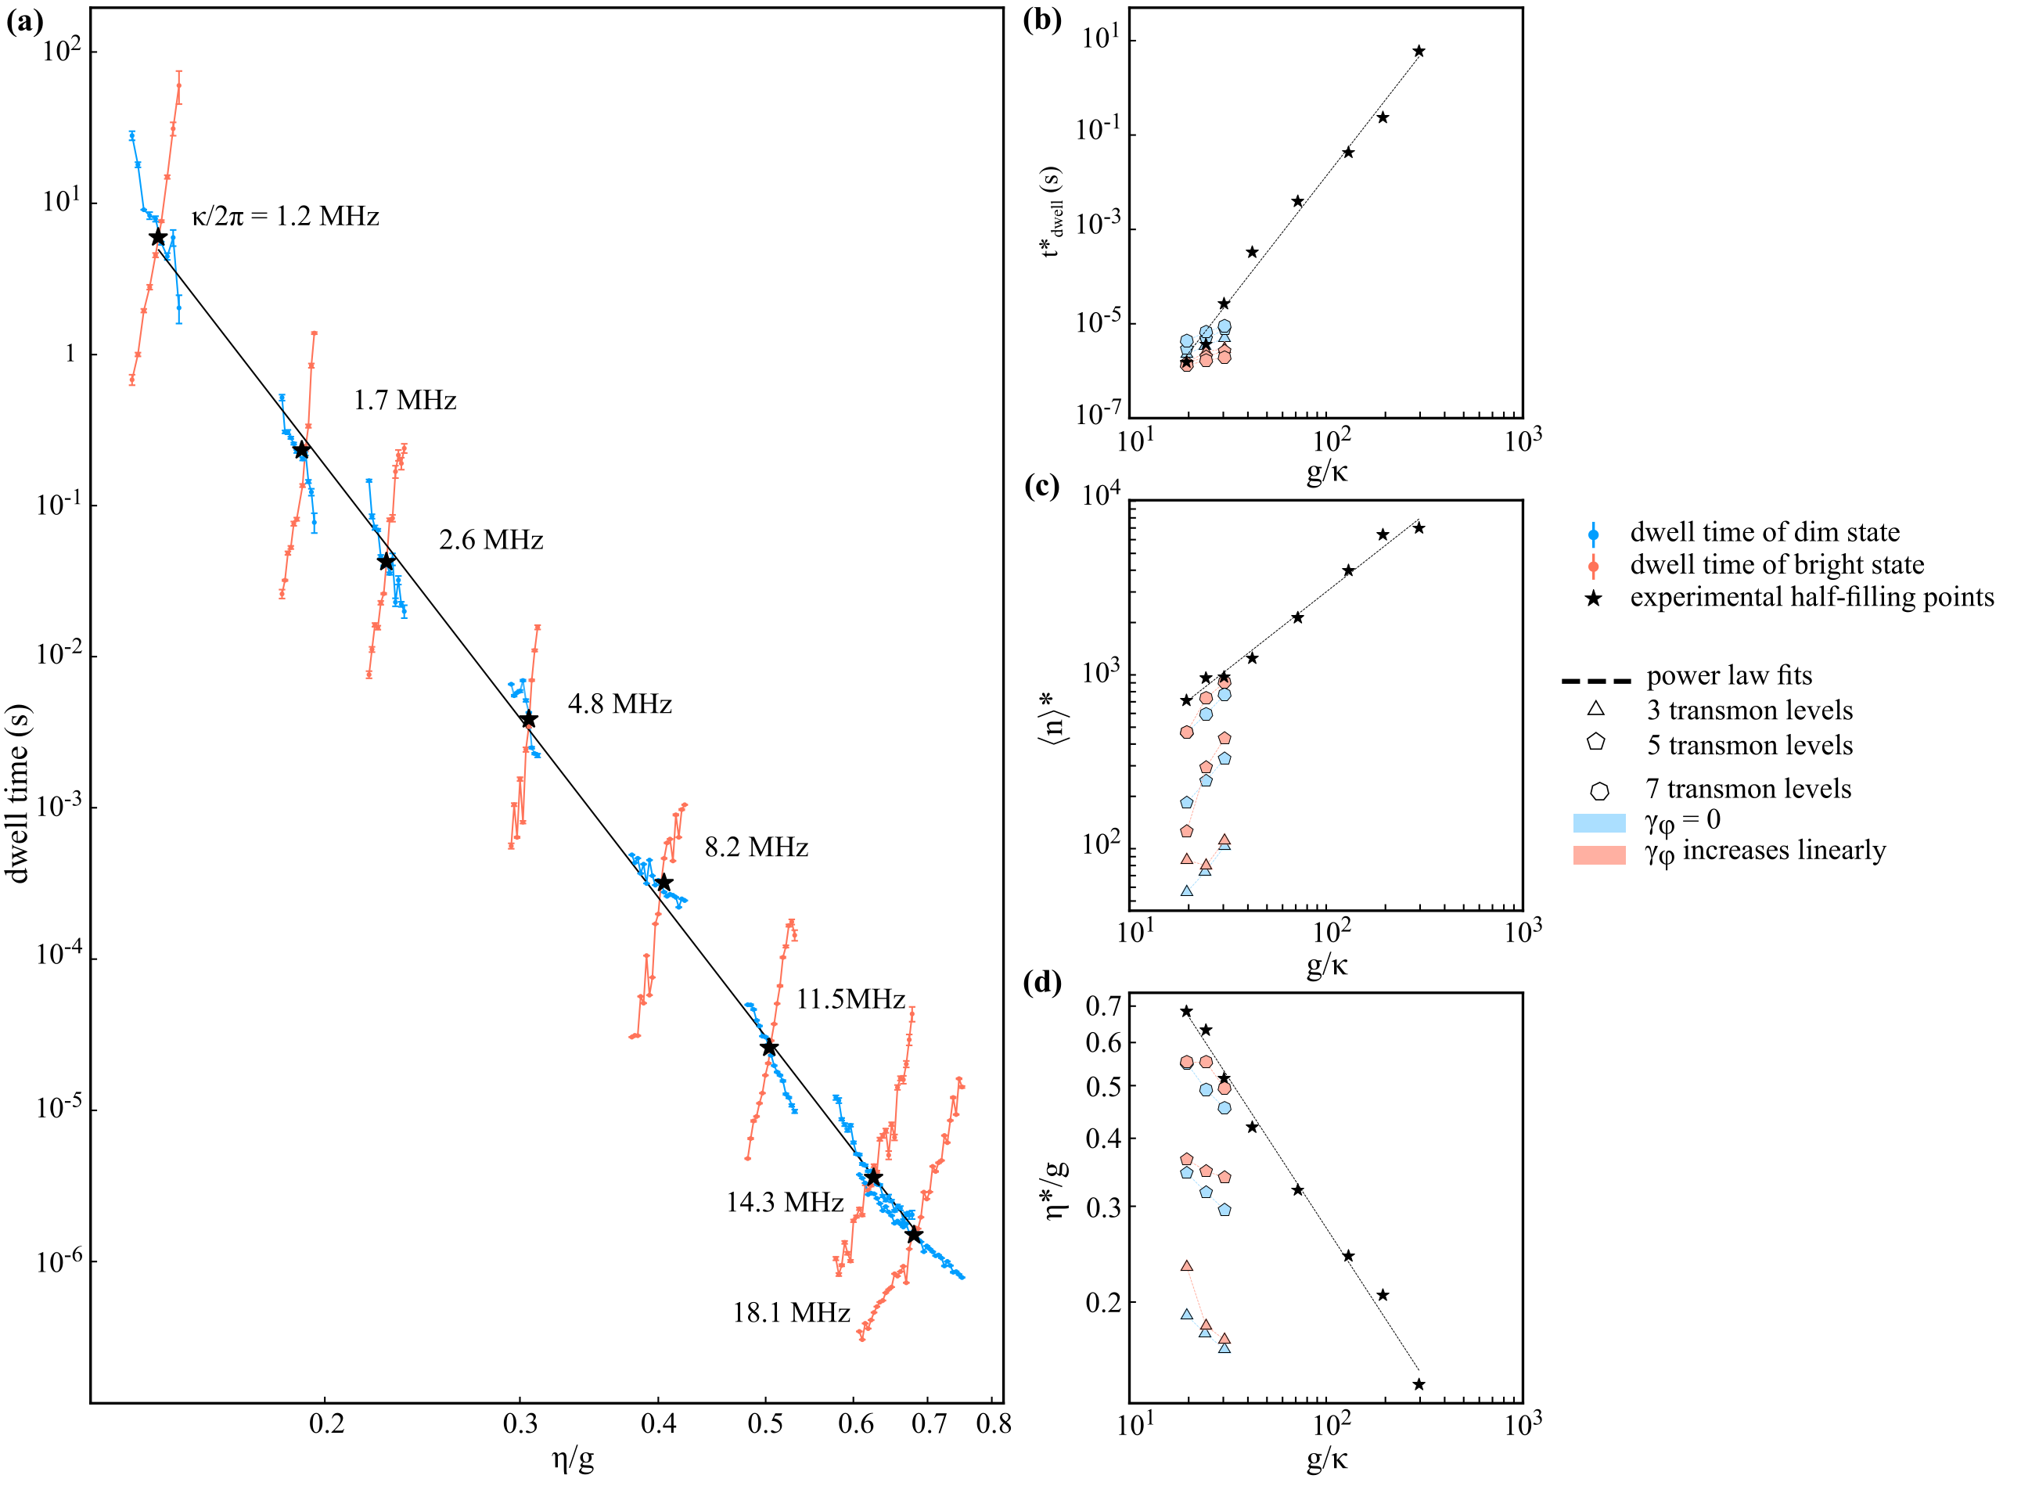
Modelling the thermodynamic limit
Finite-size scaling exponent of timescale: 5.4
dwell time surpassing the slowest characteristic system timescale by 4 orders of magnitude
quantum-trajectory simulations
7 orders of magnitude increase

Slide 36
The exponents

Slide 37
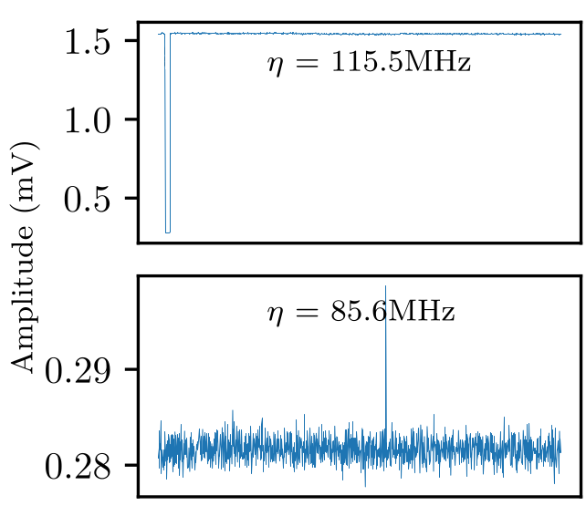
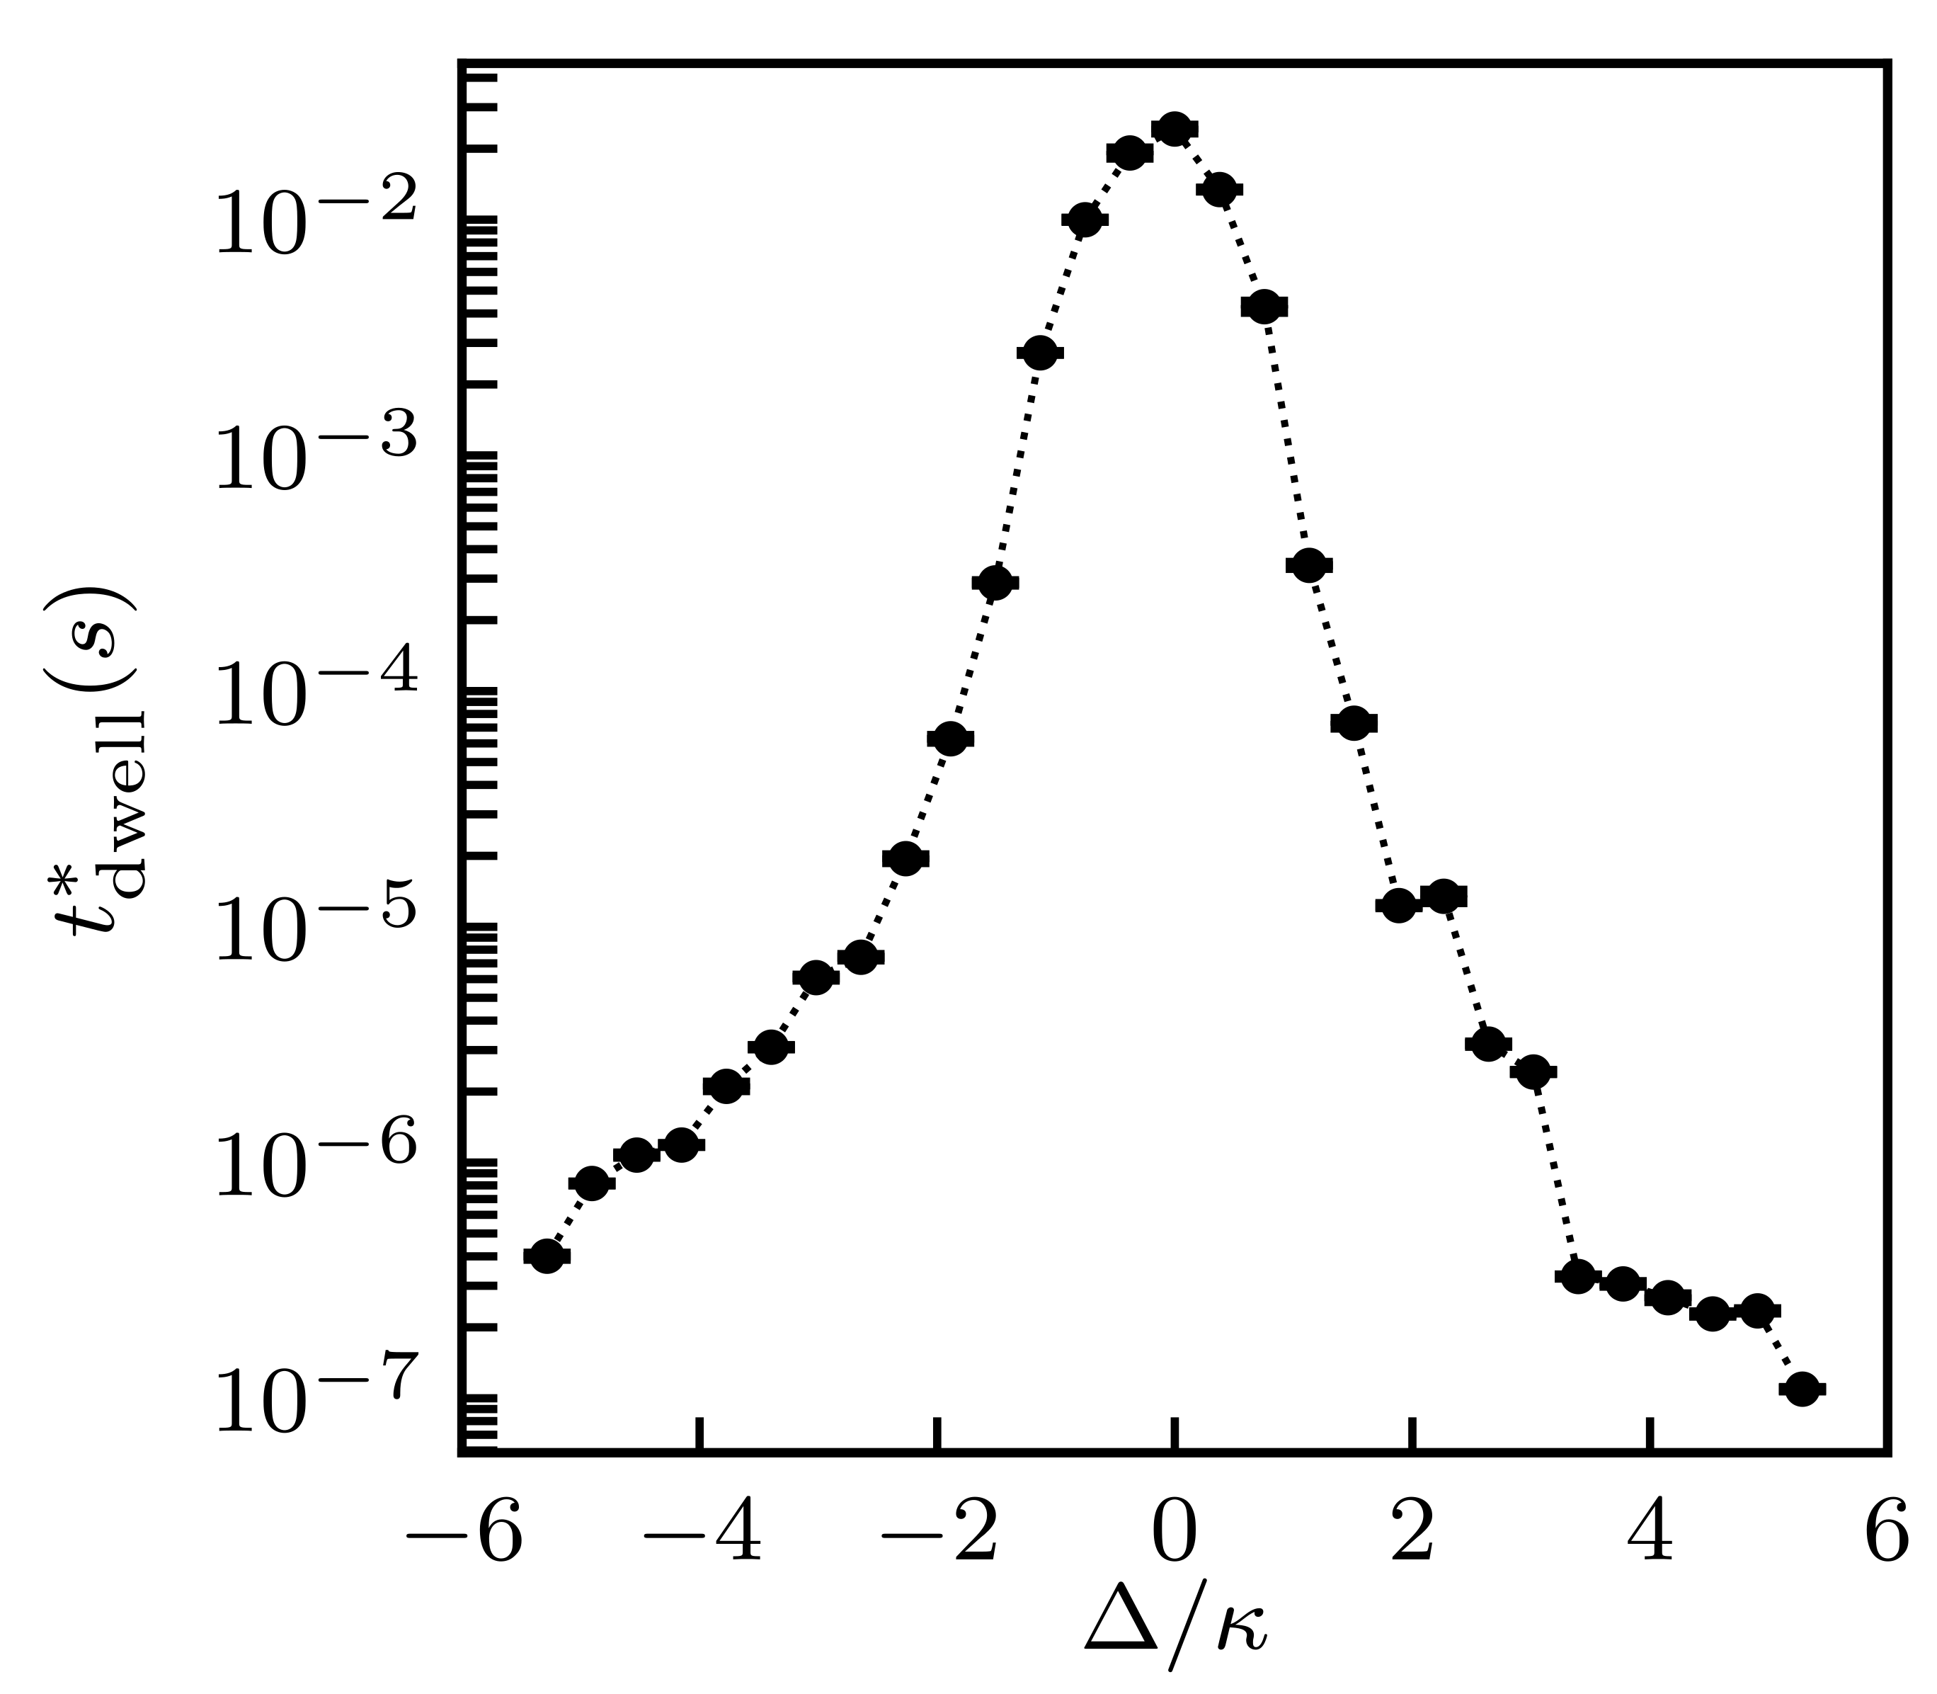
The experimental phase diagram

Slide 38
Computational technology
Software: C++QED
Developed since 2006
Free elements (TLS, mode, spin, motional DoF) + interactions to build complex (μscopic) systems
Tuned for supercomputing (HTC) environments
Set apart from QuTiP & QuantumOptics.jl
Open-source project: http://github.com/vukics/cppqed
Hardware: OpenStack cloud-based virtual cluster
ELKH Cloud: http://science-cloud.hu
Thermodynamic limit: half-a-year data-collection campaign on 64 VCPUs

Slide 39
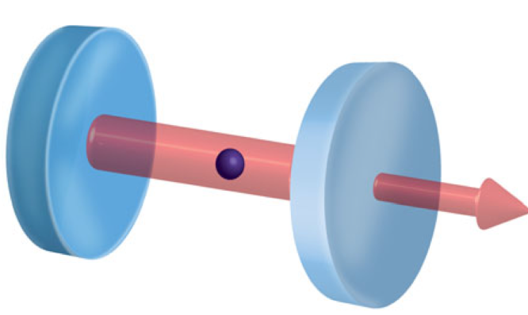
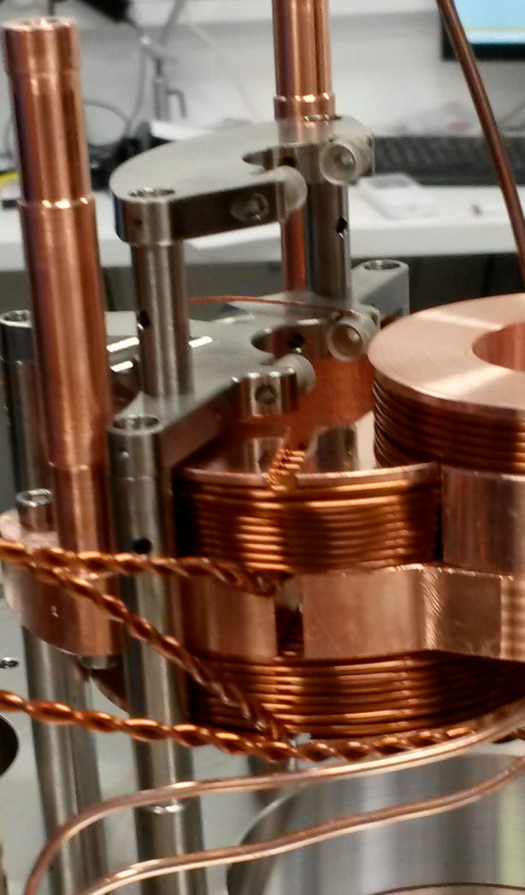
Experimental cold-atom physics @Wigner RCP
Theory -> experiment transition since 2016
Full-fledged setup with Rb MOT & magnetic trapping by early 2019
Locked cavity with atoms inside by early 2020
Intra-cavity optical dipole trapping in 2022

Slide 40
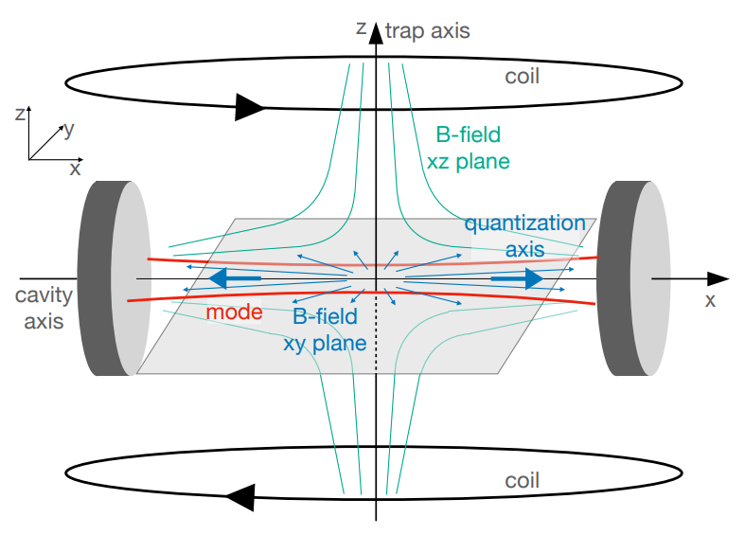
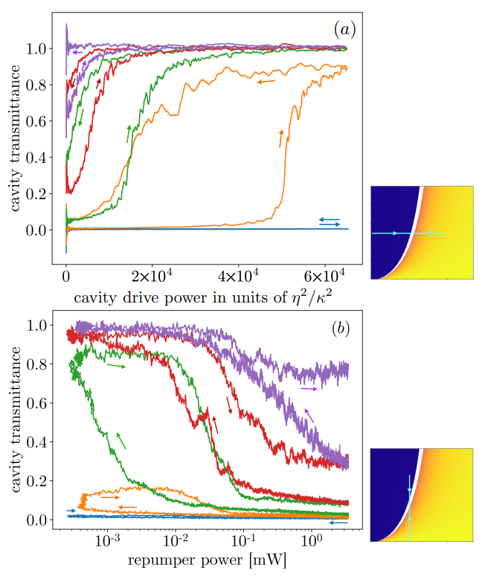
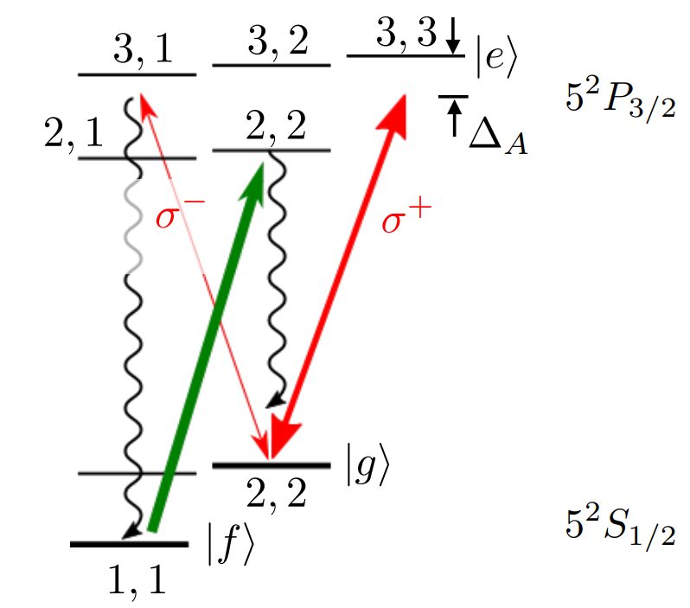
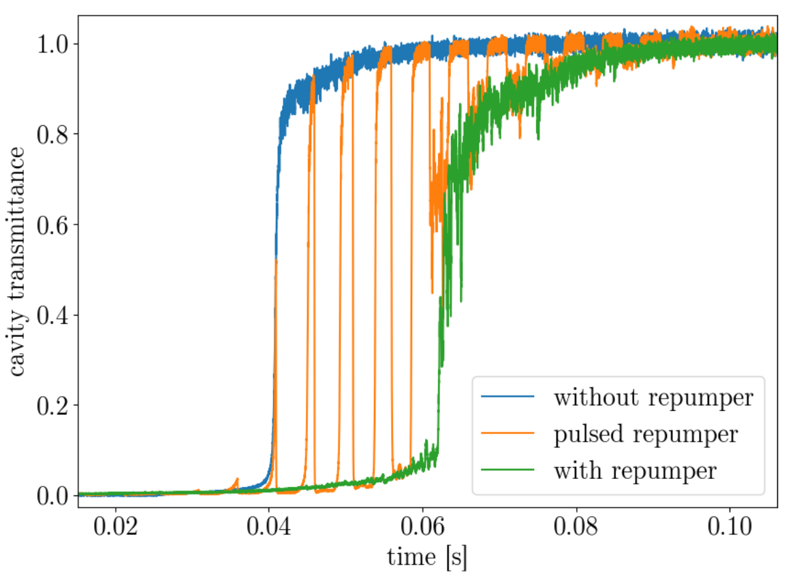
Ground state bistability of cold atoms in an optical cavity
D₂ line of ⁸⁷Rb
repumper
cavity
probe

Slide 41
Conclusions
The PBB bistability has been shown to turn into a 1st order DPT in a strong-coupling thermodynamic limit
The finite-size scaling could be followed numerically over several orders of magnitude
The Jaynes-Cummings neoclassical theory has been shown to reproduce several keys aspects of the PBB phenomenology
The thermodynamic limit has been modelled using a bespoke device on the circuit QED platform
The increase in characteristic time could be followed over 7 orders of magnitude
Quantum-trajectory simulations using different models for the transmon reproduce the trends of the experiment

Slide 42
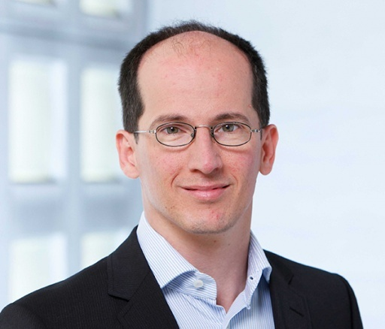
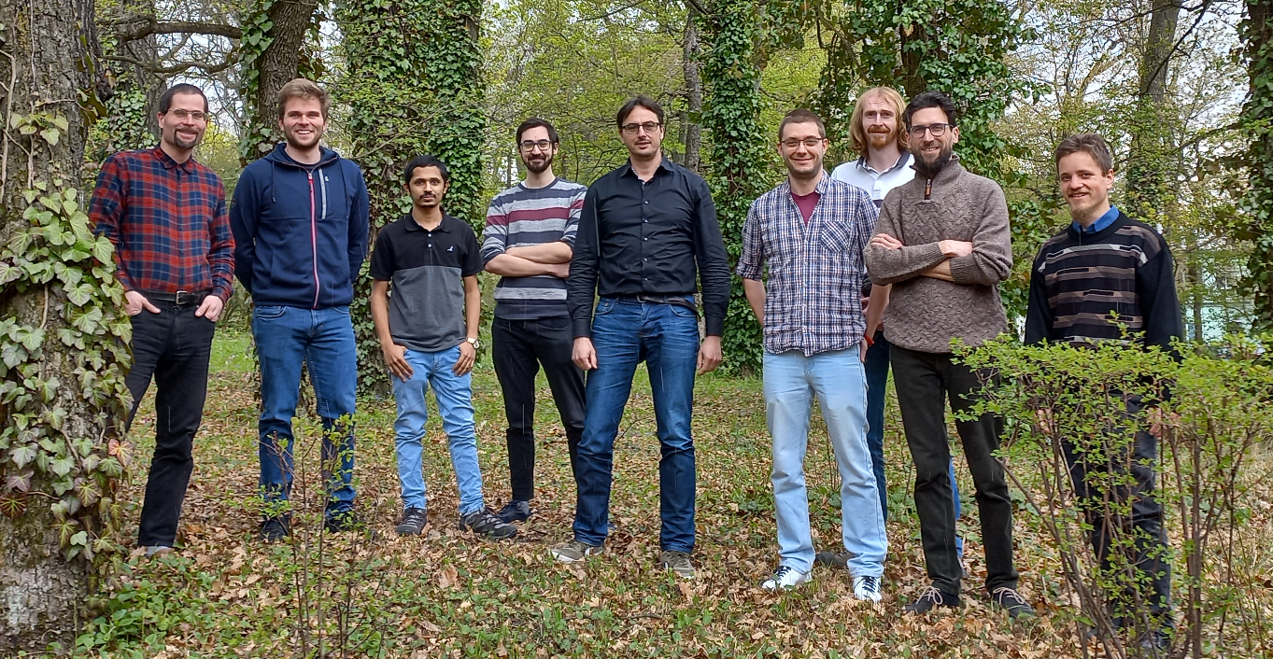
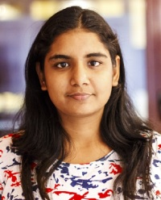
Thank you for your attention!
Fink@ISTAustria
Domokos@Wigner
Wallraff@ETH
Német, Nagy, Varga, Adwaith, Sárközi, Dombi, Clark, Gábor, Kurkó
Sett@ISTAustria

