Slide 1






New approaches for quantum sensing with nitrogen-vacancy centers in diamond
Anton Pershin, Péter Udvarhelyi, Vladimir Verkhovlyuk, Gergő Thiering, Adam Gali

Slide 2
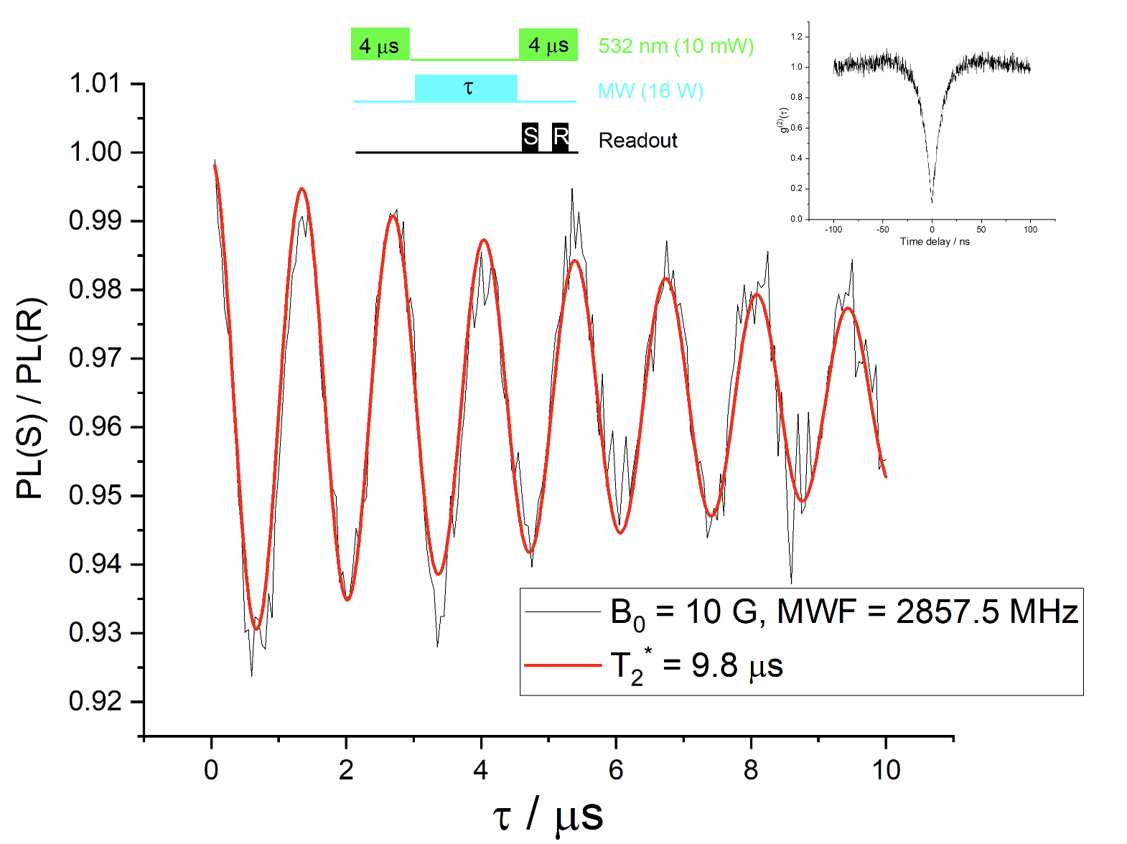
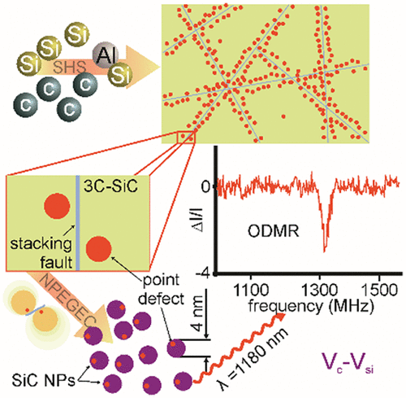
Semiconductor nanostructures group of A. Gali
Quantum optics lab
Quantum optics experiments (CW ODMR, Rabi, Ramsey…)
THEORY
QUANTUM OPTICS LAB
SYNTHESIS
JPC Lett 11 (5), 1675-1681, (2020)
Theory
Synthesis
Defect identification, calculation of defect properties, prediction of optical protocols…
Material preparation, defect generation, surface modification….
Full “in-house” characterisation of defect quantum bits

Slide 3
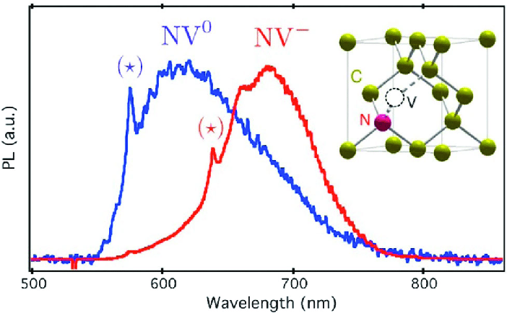
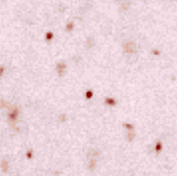
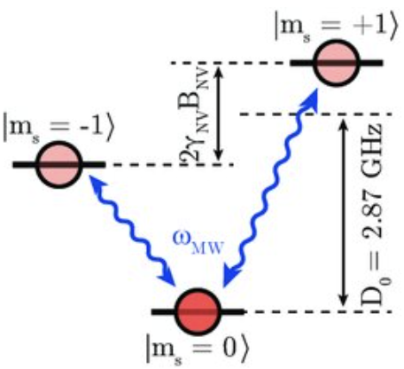
Nitrogen-vacancy in diamond
Nitrogen-vacancy (NV⁽⁻⁾) in diamond: “pseudo-molecule” with triplet ground state
confocal image
Negatively charged nitrogen-vacancy center is the most studied point defect qubit
NV can be generated on demand by irradiation/ion implantation at different depth
NV exist either as NV⁽⁰⁾ or NV⁽⁻⁾; NV⁽⁻⁾ is useful due to triplet ground state
Spin levels of NV can be used as qubit states

Slide 4
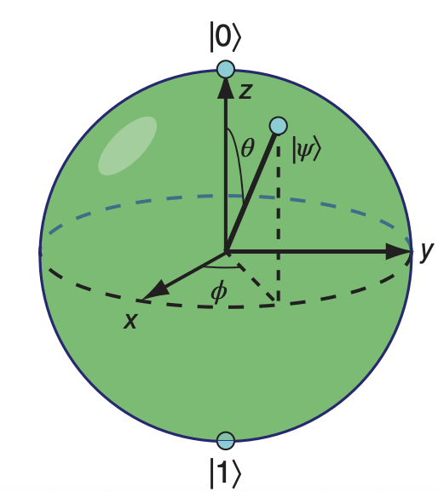
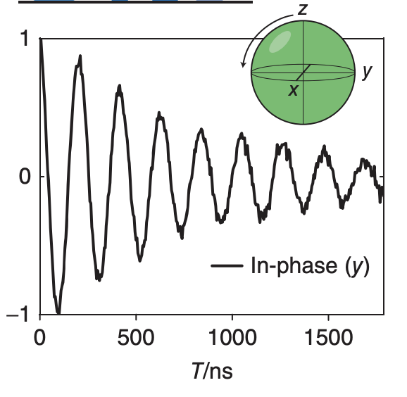
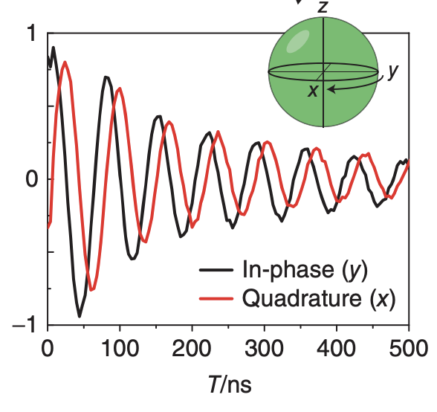
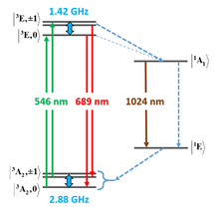
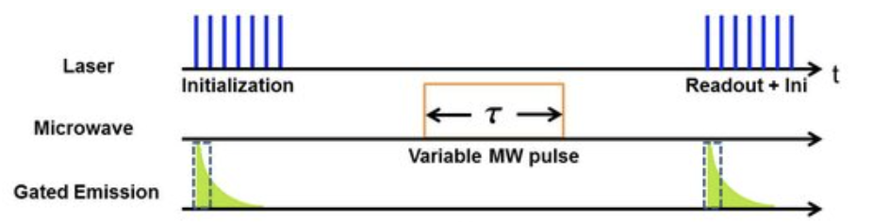
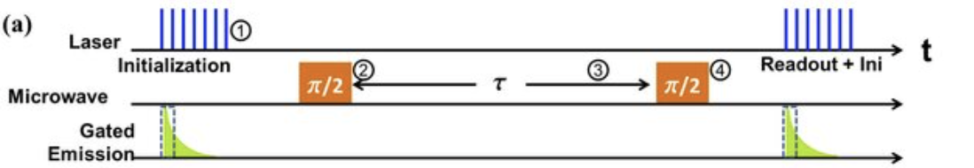
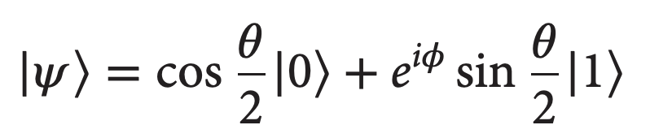
Qubit operations & Coherence time
Rabi Ramsey
Rabi oscillations: determination of pi-pulse
Ramsey interferometry: free induction decay (T2* time)
Quantum sensing is based on either changes in T2* or FFT of response
Spin-lattice relaxation sets an ultimate limit for T2 time (T1 time)

Slide 5
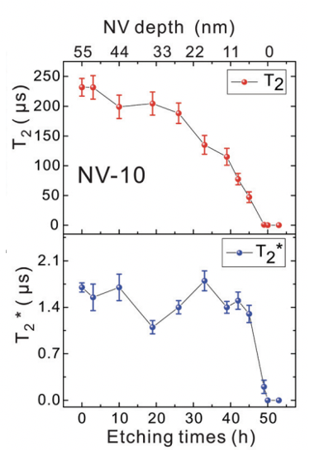
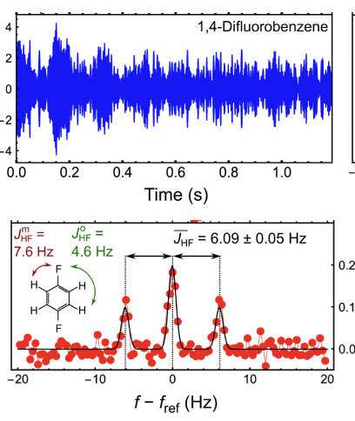
Sensing with NV center
STN scales as ~1/d⁶: NV⁻ should be close to surface
Complications:
ODMR signal is gone at cryogenic temperatures: no optical readout
T2 time is shortened by electric noises (fluctuating charges) and magnetic noises (nuclear flip-flops)

Slide 6
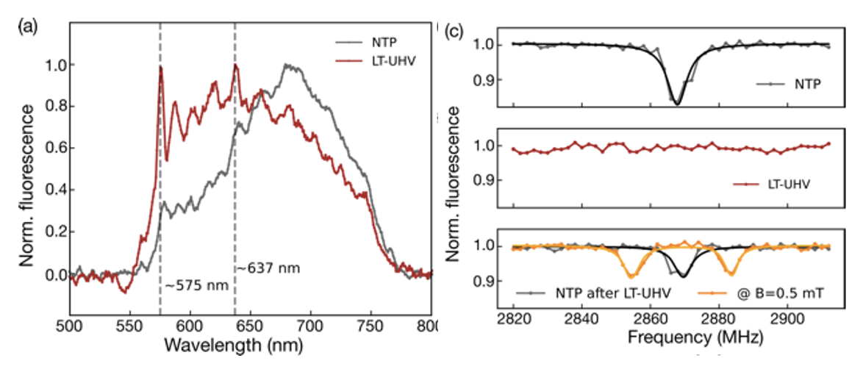
Revival of NV ODMR at low temperature
ODMR signal of single NVs disapers at ~4 K, so that the antibunching feature
From the PL, NV⁽⁻⁾ gets oxidised to NV⁽⁰⁾
Spraying water (1-2 nm layer) leads to the revival of the ODMR signal
Important: T=4 K is achieved at UHV
together with A. Singha @ MPI in Stuttgart

Slide 7
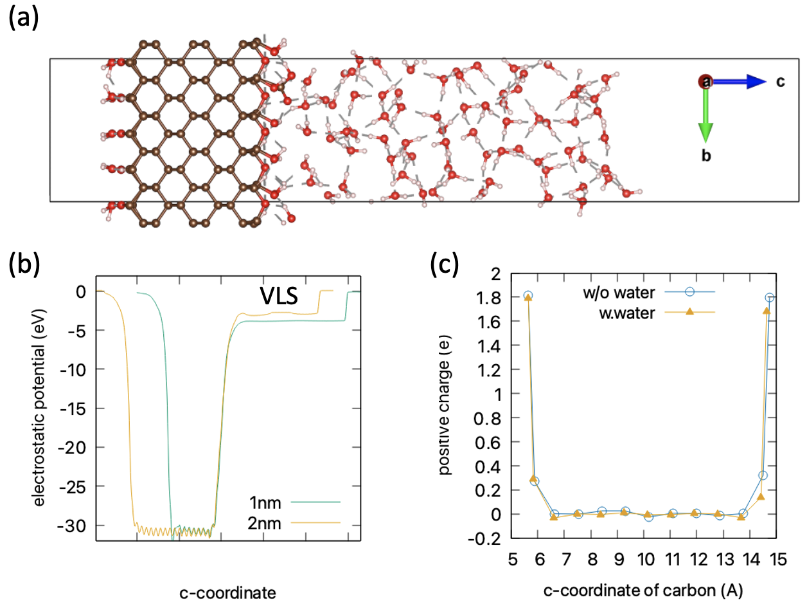
Interaction of O-diamond surface with water
O-related groups intoduce large VLS: hole accumulation
AIMD of water on top of diamond
Water donates electrons to accepotor defects to compensate the hole accumulation

Slide 8
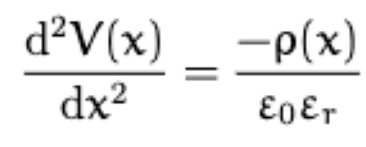
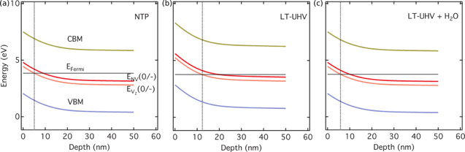
Interfacial band bending
NOT
STABLE
water+high temperature no water water+low temperature
Large band bending causes the instability of deep defects’ charge state (V₂⁽⁻⁾ → V₂⁽⁰⁾)
V₂⁽⁰⁾ emmits a hole (V₂⁽⁰⁾ → V₂⁽⁻⁾ + h⁽⁺⁾), which is captured by the NV (NV⁽⁻⁾ + h⁽⁺⁾→ NV⁽⁰⁾)
Water, reducing the band bending, extends the stability region towards the surface
The effect originates from the low pressure rather than low temperature
Key players:
deep acceptors (V₂..)

Slide 9
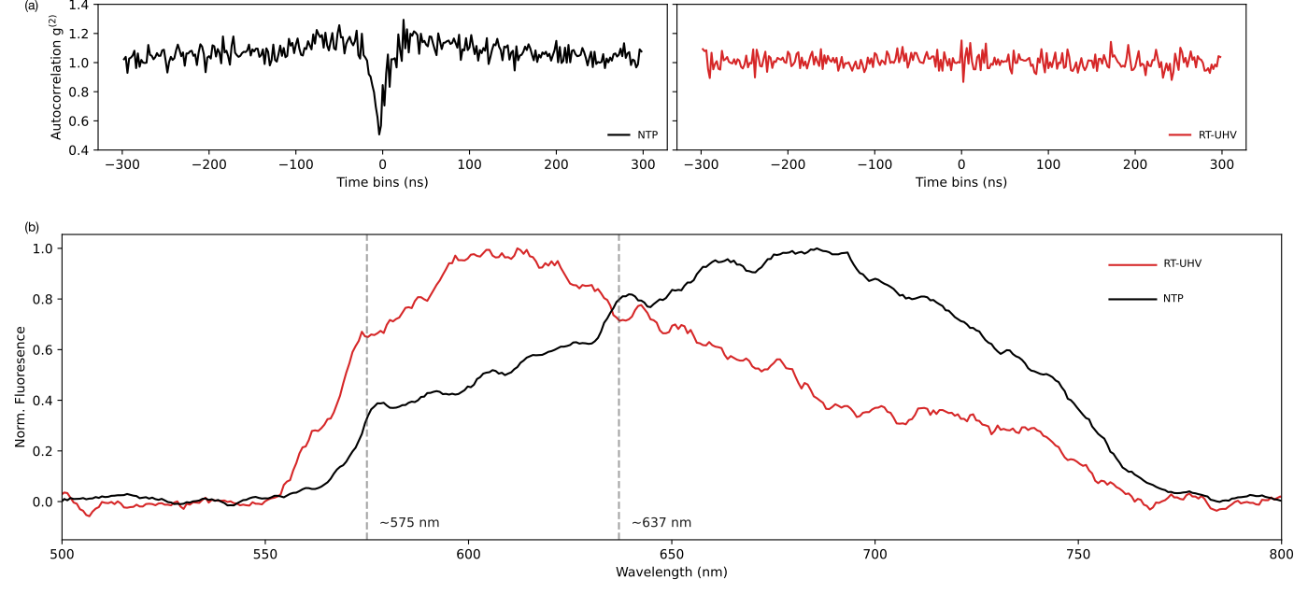
Experimental confirmation
The same effect as at low T is observed experimentaly at room temperature under low pressure
Neethi Neethirajan et al. Nano Lett. 2023 (accepted)

Slide 10
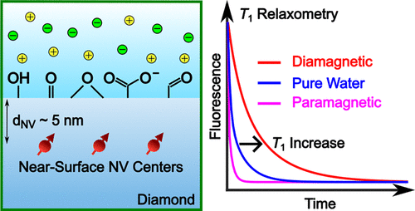
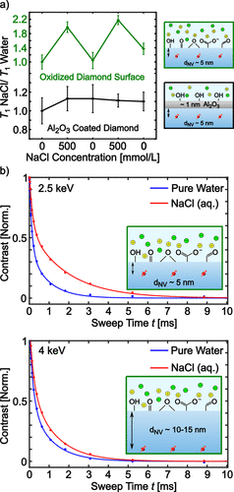
Coference time & band bending
Experiments show that NaCl increases T1 time
The effect is reversable and is more pronounced for shallower NV centers
together with D. Bucher @ TU Munich

Slide 11
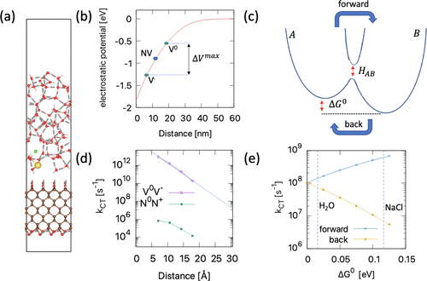
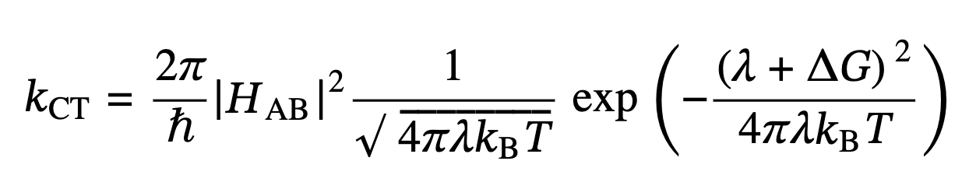
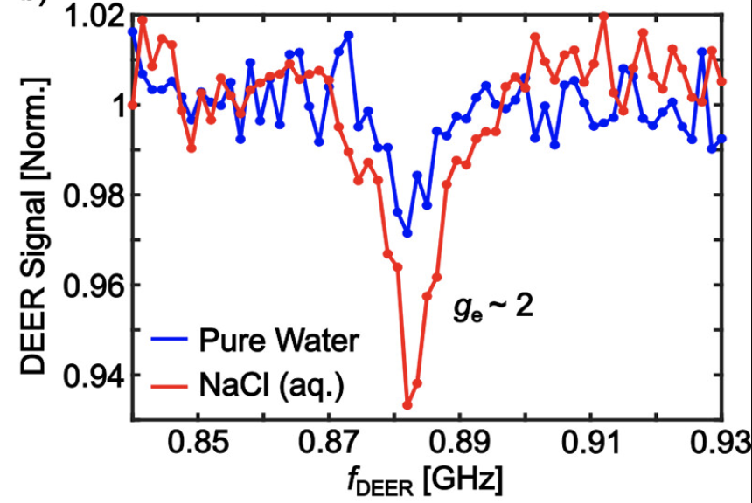
Electric noises
Rate equation:
Potential gradient lead to stabilisation of charge fluctuations: reduced electric noises
ACS Nano 2023, 17, 11

Slide 12
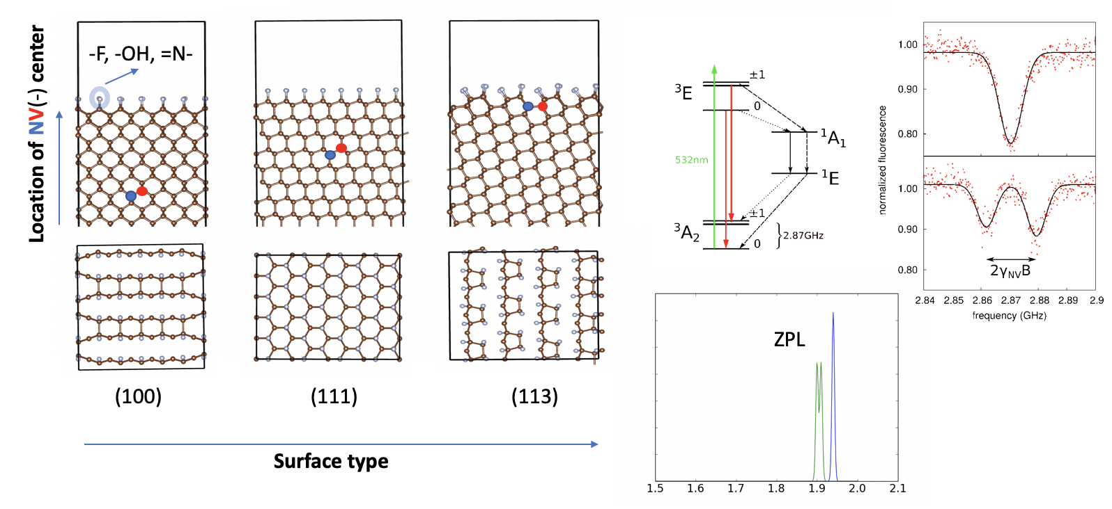
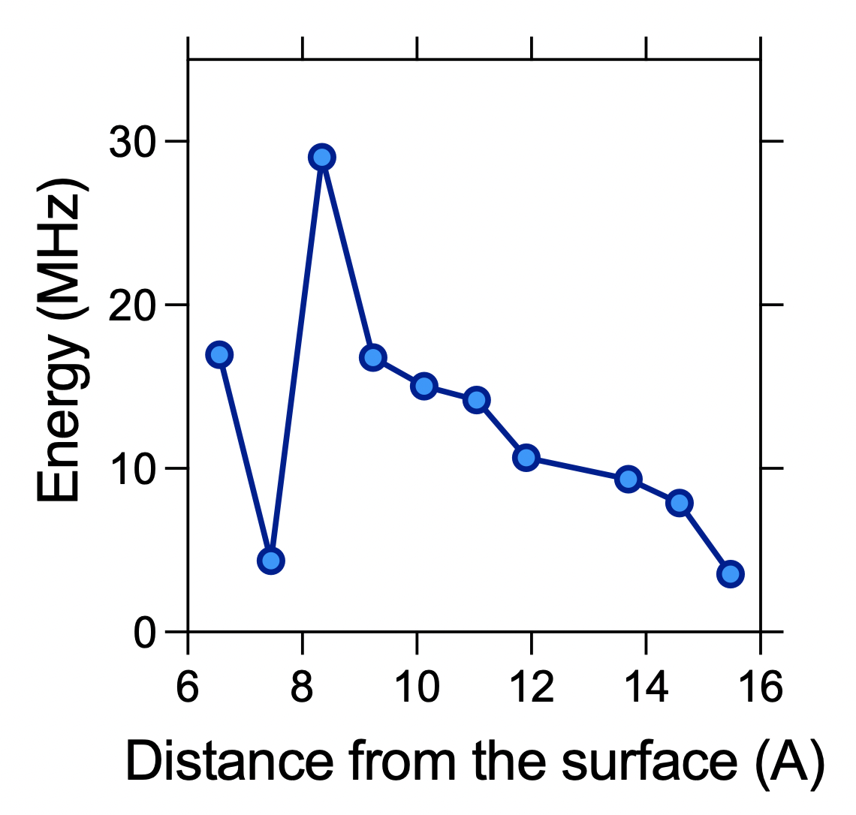
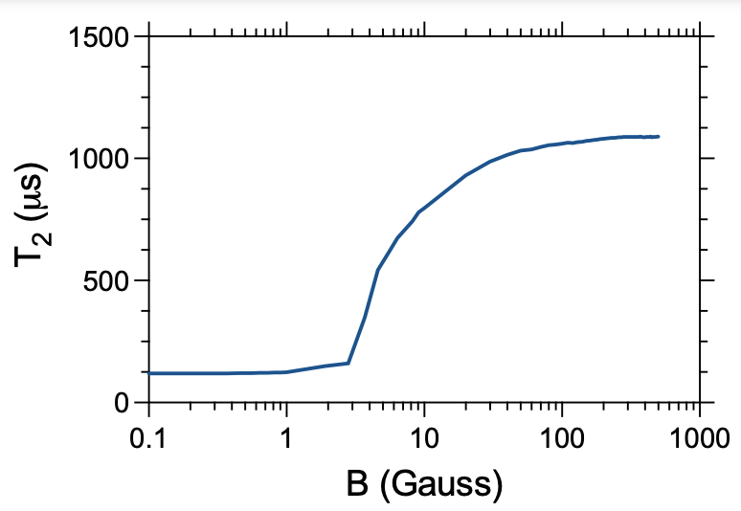

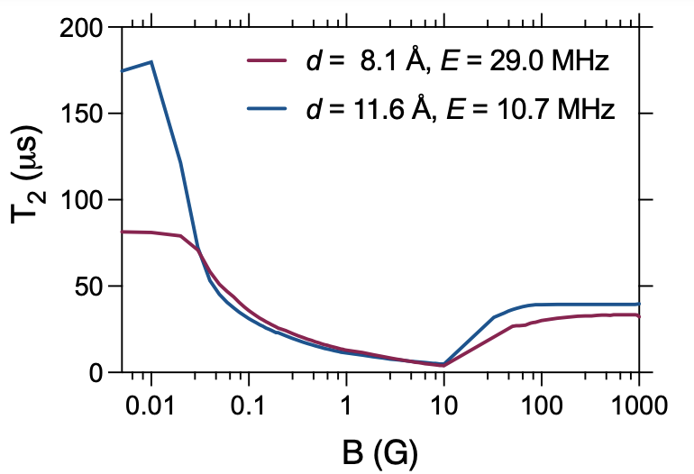
Shallow NV centers: magnetic noises
Spin dynamics
Bulk
Avoided crossing at zero field where the levels are protected from magnetic noises
New feature allows to maintain high coherence time at special magnetic fields
Surface

Slide 13
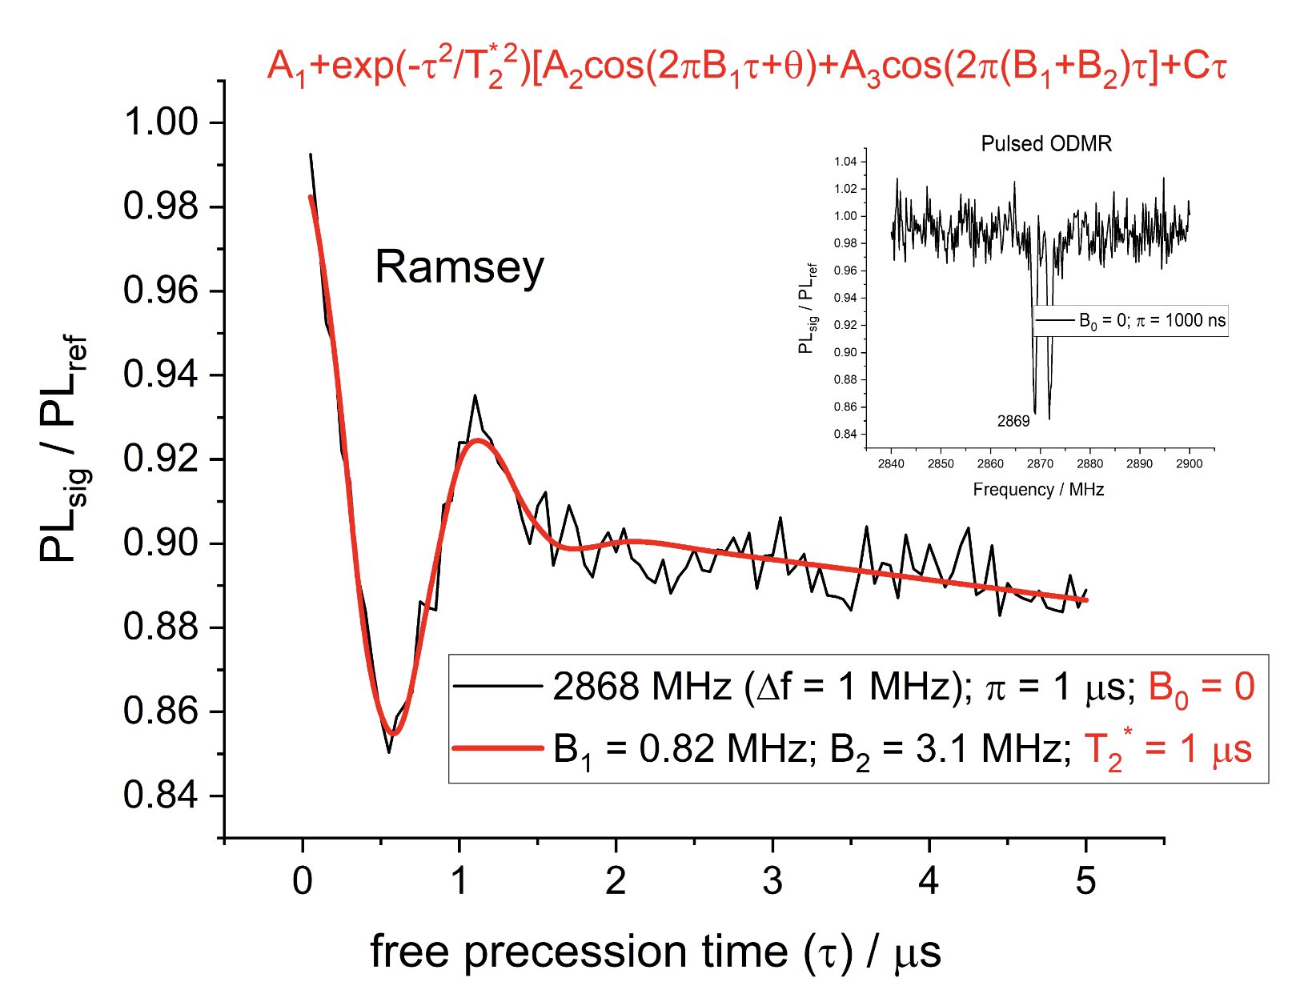
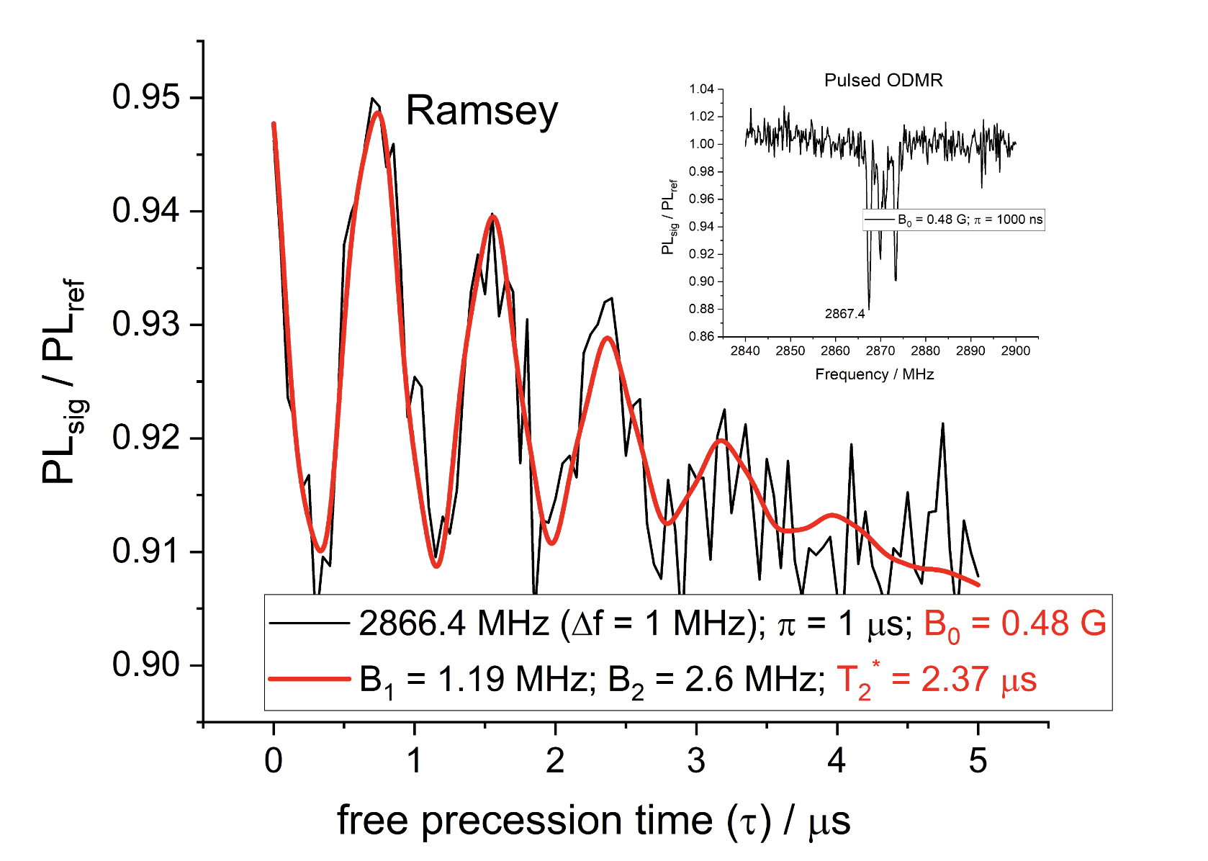
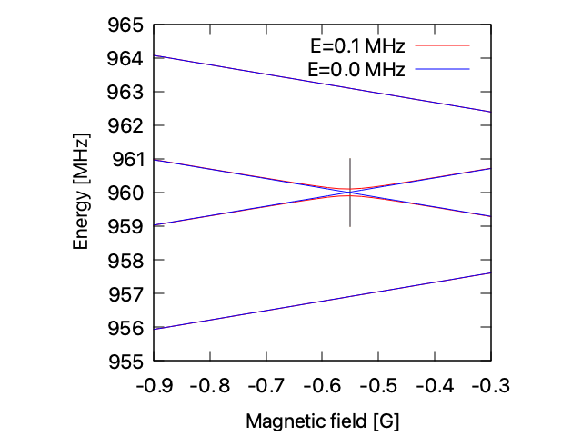
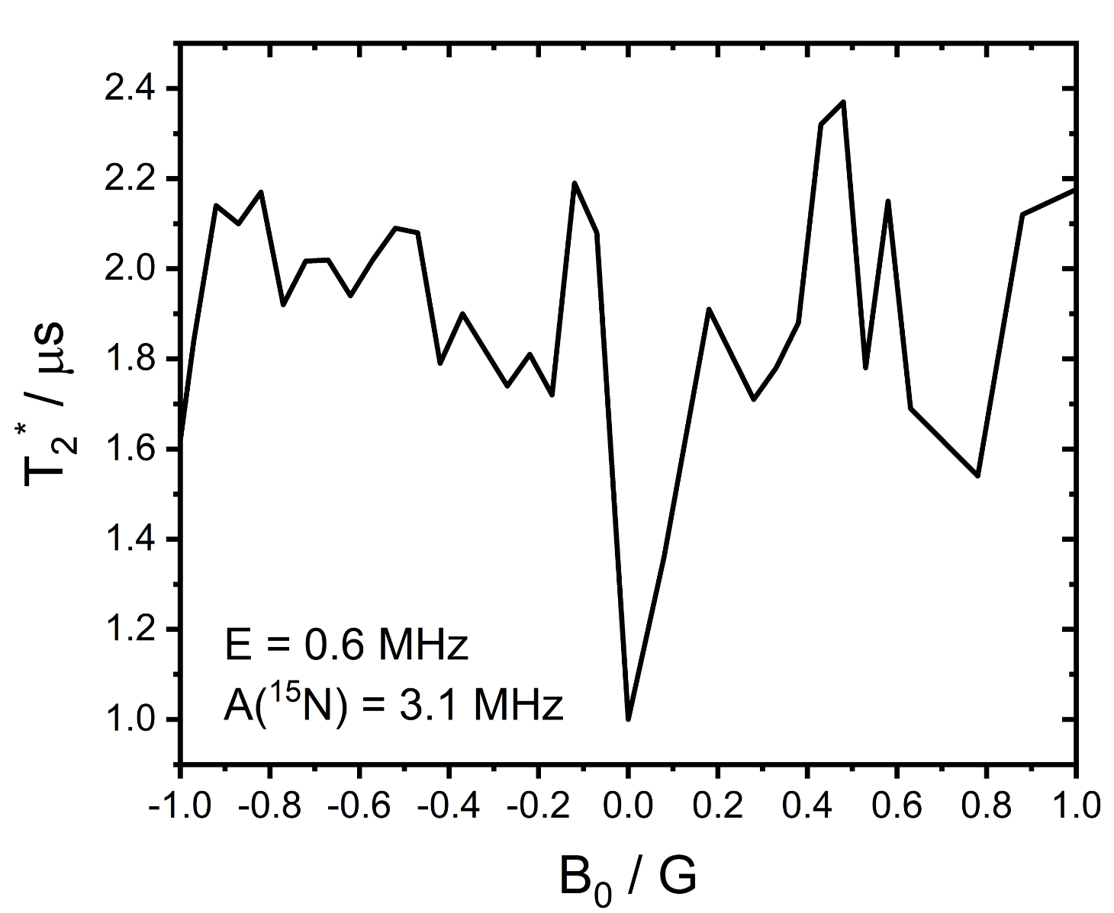
Experimental confirmation @ Wigner RCP
8nm-deep single NV center
T2* changes by a factor of 2.4 from 0 G to 0.48 G
The complex shape of the curve is due to the nuclear spins
Detection of HFI (~300 kHz) below resolution of ODMR (~1 MHz)
The precision is only limited by the electrical setup

Slide 14
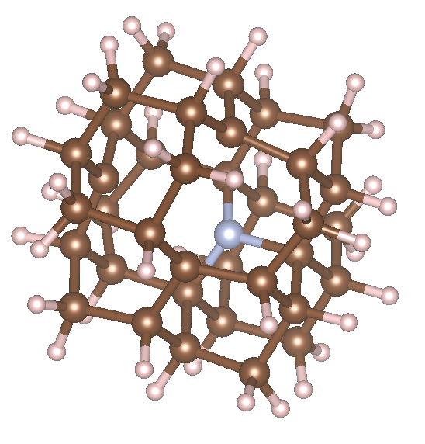
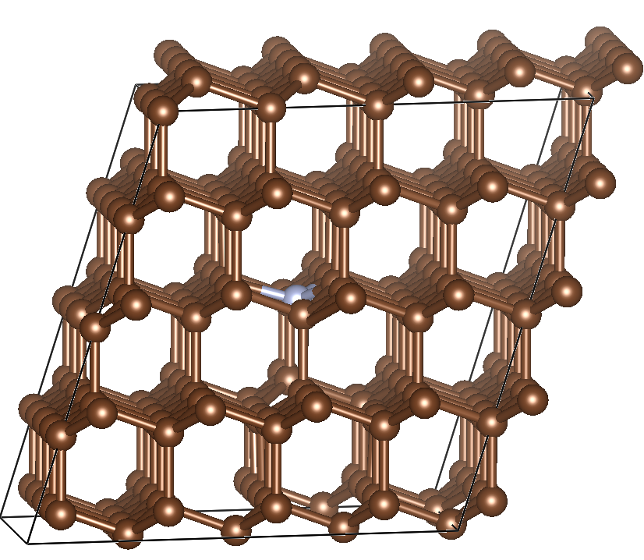
Method development: excitons in solids using plane waves
Excitation energies and properties are widely available for molecules, but not for solids
Cluster model Periodic model
Post HF methods (e.g. multireference methods and coupled cluster theory) are very accurate for finite systems
Idea: to extend their applicability for solids to compute the excited states

Slide 15
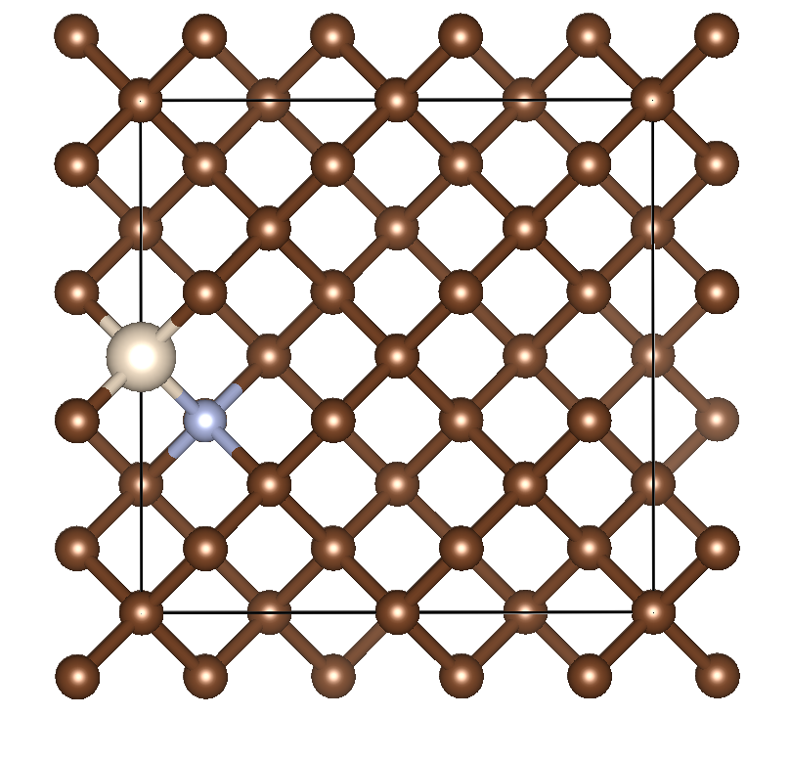
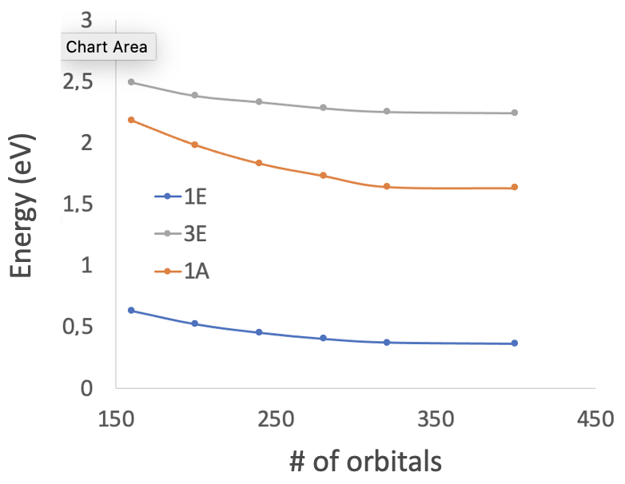
NEVPT2 calculations for NV center
transition | NEVPT2 | EXP (eV)
³A - ³E | 2.24 | 2.22
¹E - ¹A | 1.26 | 1.28
Excitation spectrum of NV center from theory and experiment
NV center in 64C diamond
Post HF methods are extended to solids to compute the excited state properties using plane waves
We are able to converge the excitation energies to the basis set limit
The fully ab initio excitation energies for the NV center are in excellent agreement with experiment

Slide 16
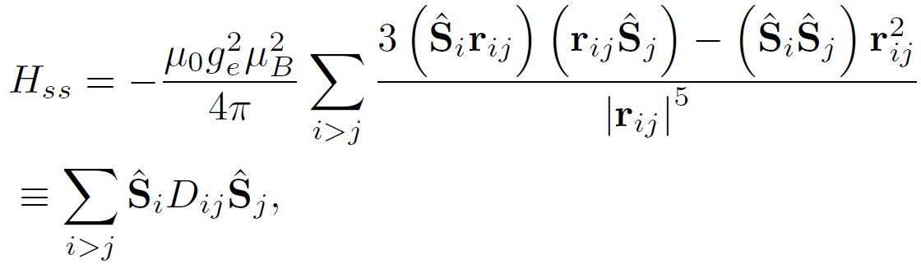
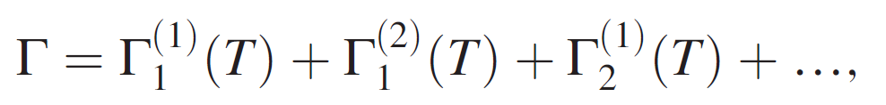
Method development: T1 time calculations
Phys. Rev. Lett. 130, 256903 (2023)

Slide 17
Conclusions
Band bending can improve the stability and coherence time of shallow NV centers
Special magnetic fields for shallow NV centers for an improved T2 time
New tools for ab initio characterization of qubits

Slide 18



Thank you for your attention!
Theory:
Gali, Ádám. "Recent advances in the ab initio theory of solid-state defect qubits”, Nanophotonics, vol. 12, no. 3, 2023, pp. 359-397
Gali, Ádám. "Ab initio theory of the nitrogen-vacancy center in diamond" Nanophotonics, vol. 8, no. 11, 2019, pp. 1907-1943.

Slide 19
