Slide 1

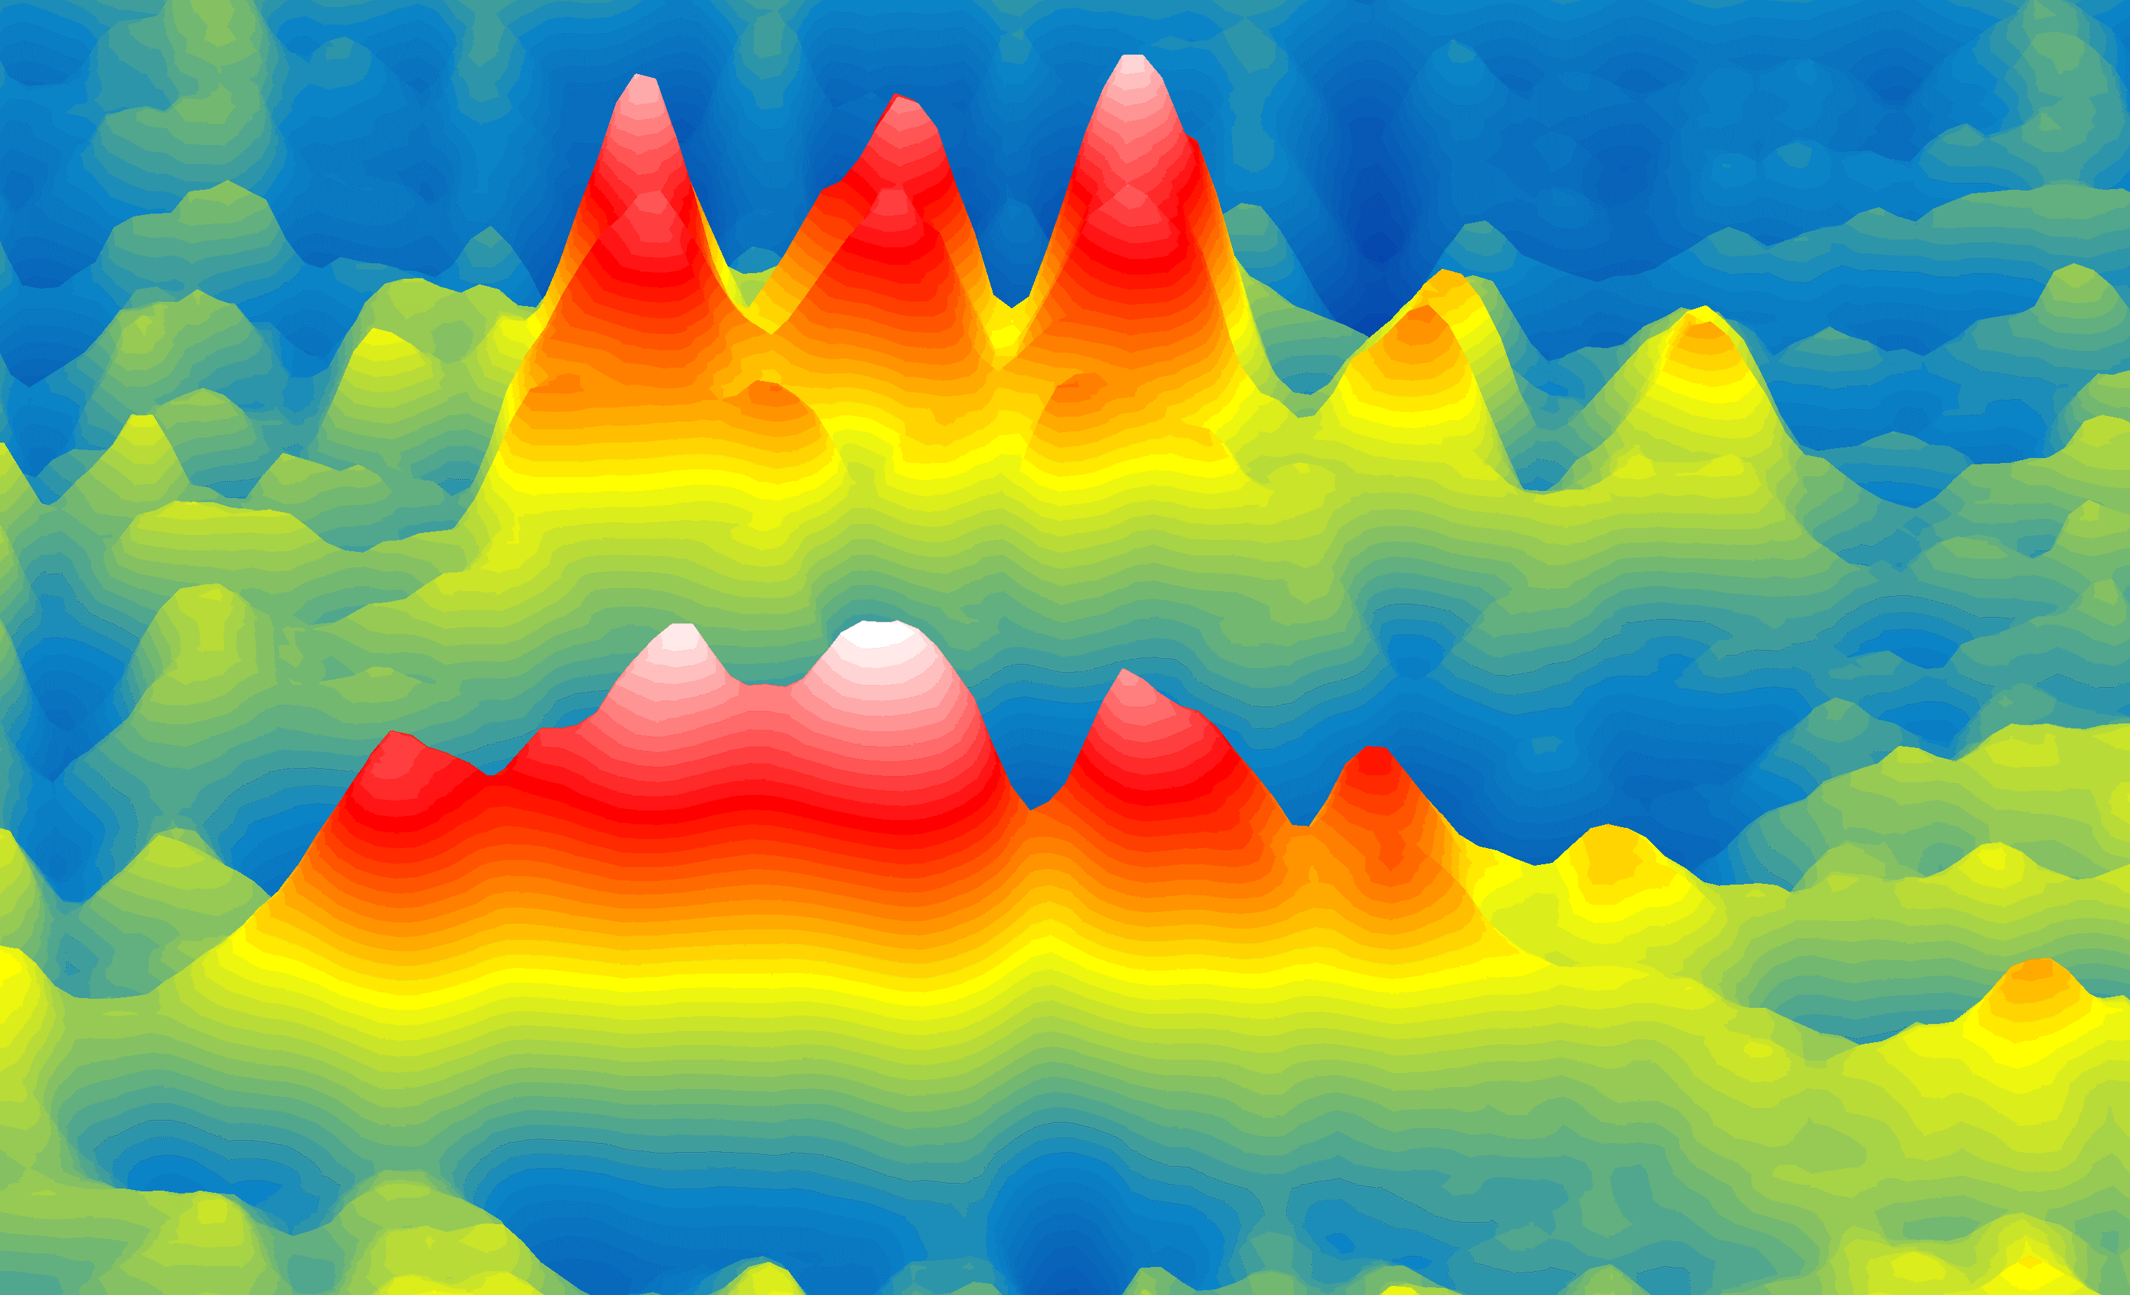

WIGNER 121
Scientific Symposium – Heritage and Future
September 18-20, 2023
Budapest, Italy
Martin Schultze
www.tugraz.at/institute/iep
Wigner time delays &
controlling electrons and spins

Slide 2



Lots of Hungarian Physics inside
WIGNER 121
Scientific Symposium – Heritage and Future
September 18-20, 2023
Budapest, Italy
Ultrafast
Light
Martin Schultze
www.tugraz.at/institute/iep
Charge &
Spin

Slide 3
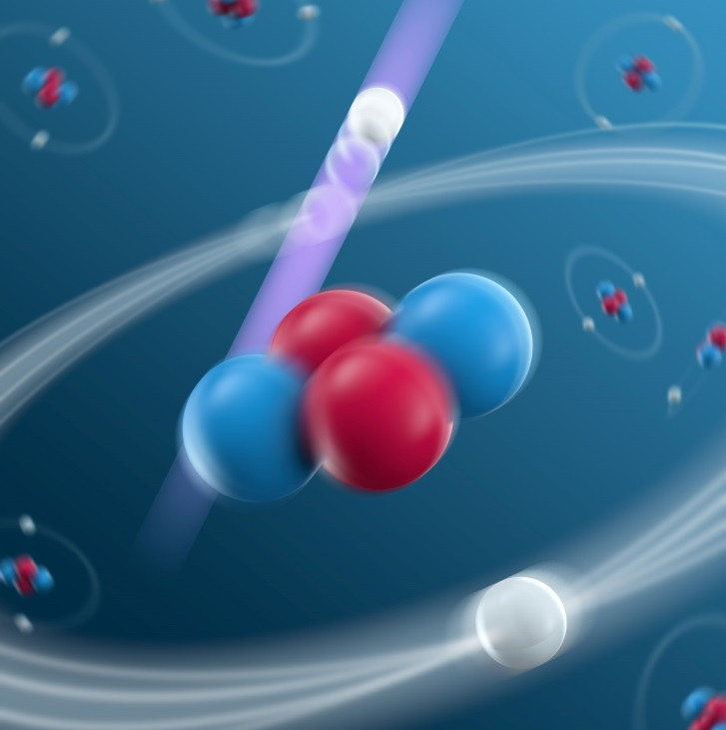
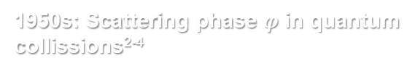
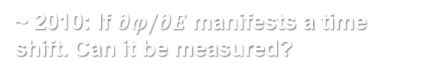
How fast is quantum mechanics?
1905: The photo-electric effect¹
1950s: Scattering phase $φ$ in quantum collissions²⁻⁴
~ 2010: If $∂φ/∂E$ manifests a time shift. Can it be measured?
¹A. Einstein, Ann. Phys. 322, 132–148 (1905).
²E. P. Wigner and L. Eisenbud, Phys. Rev. 72 (1947)
³E. P. Wigner Phys. Rev. 98 (1955)
⁴F. T. Smith Phys. Rev. 118 (1960)

Slide 4
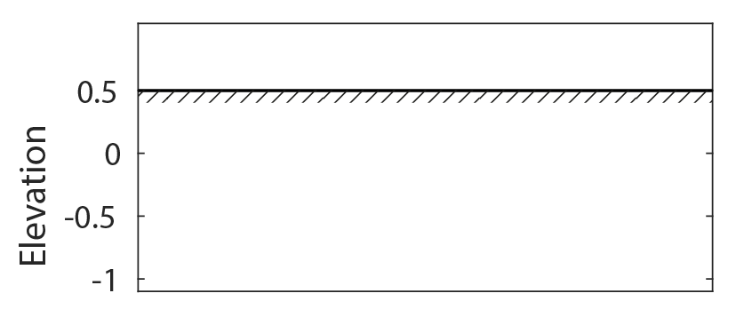
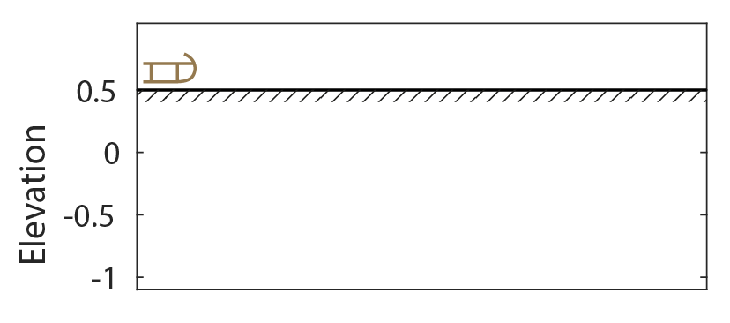
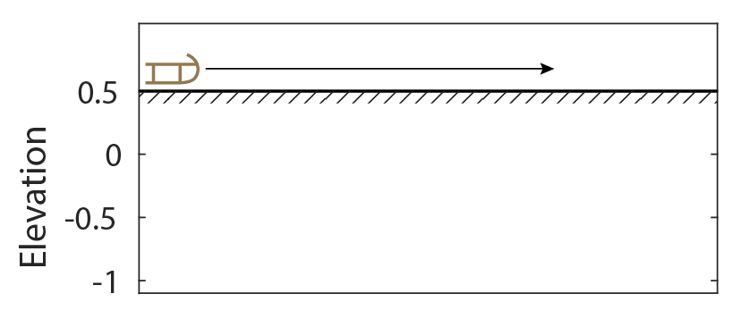
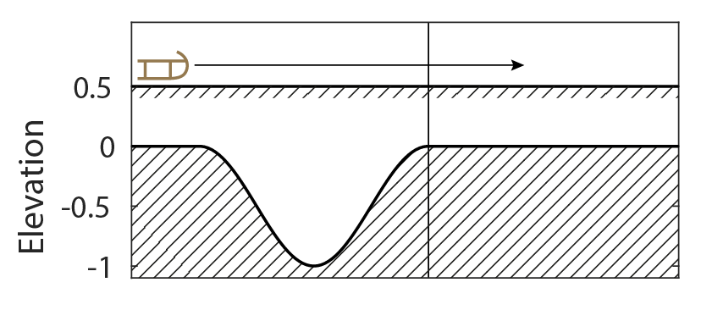
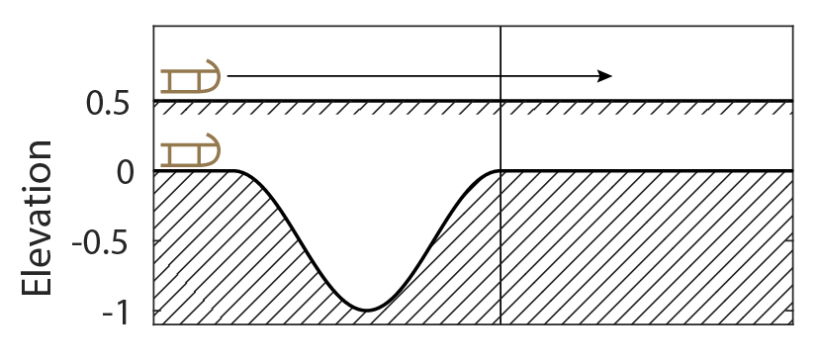
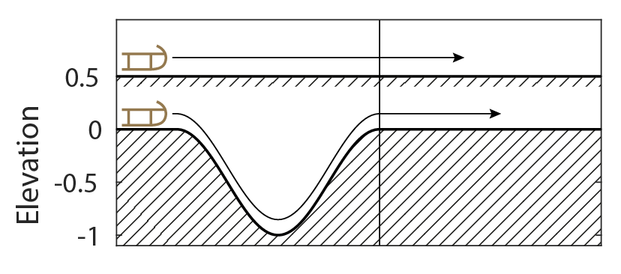
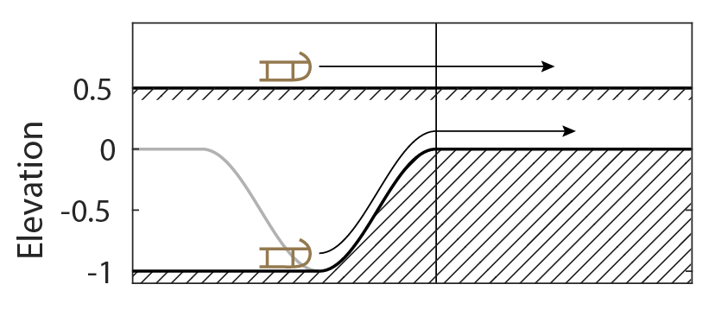
Photoionization: time & phase I

Slide 5
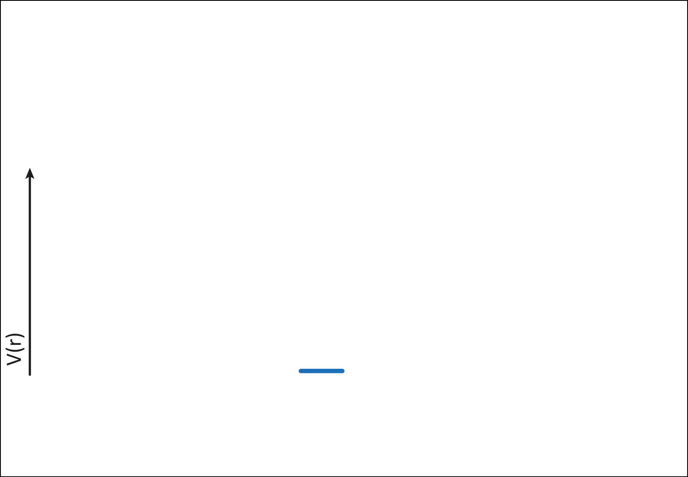
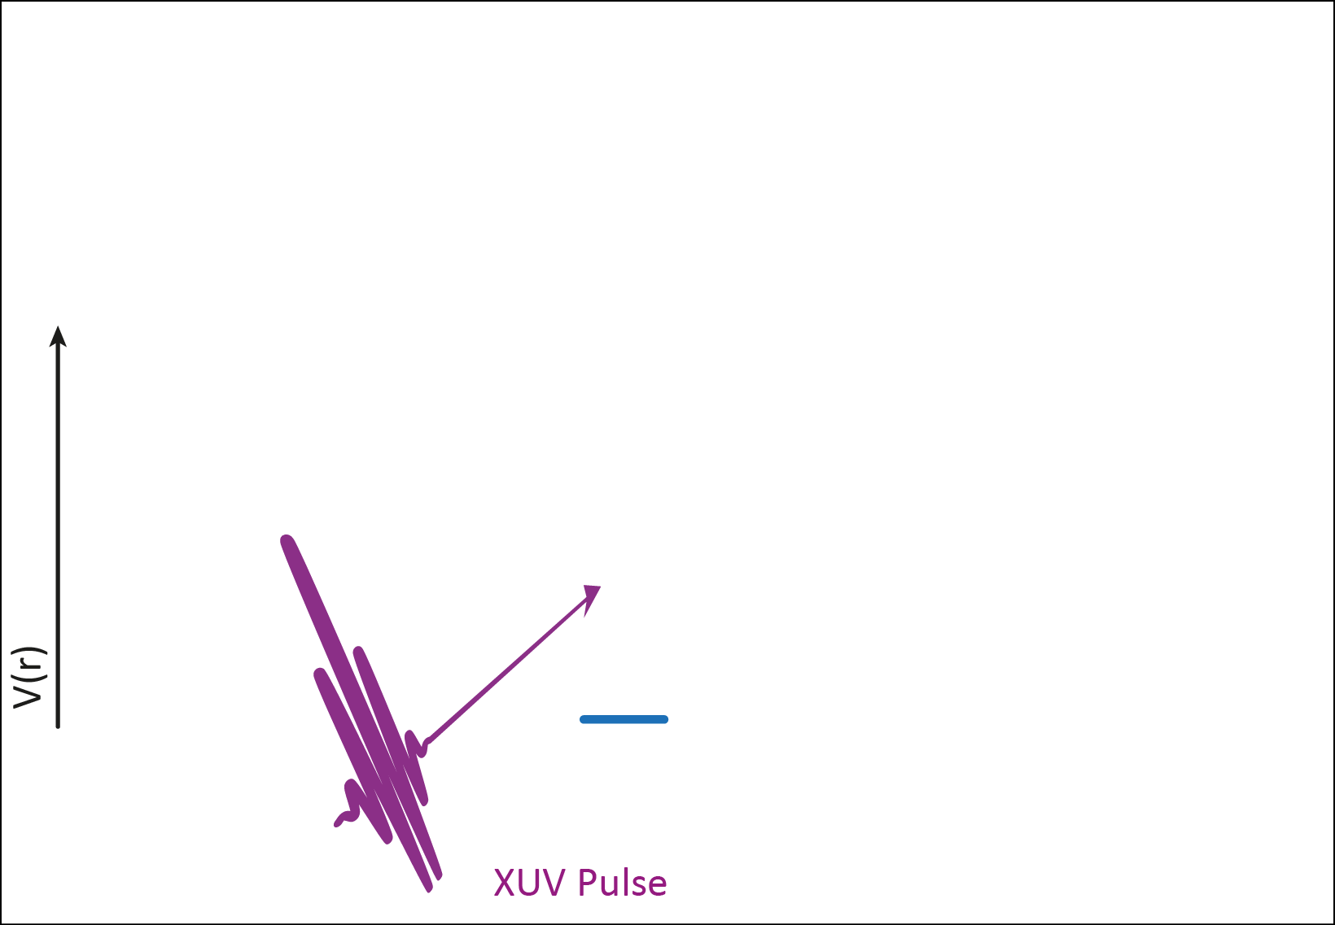
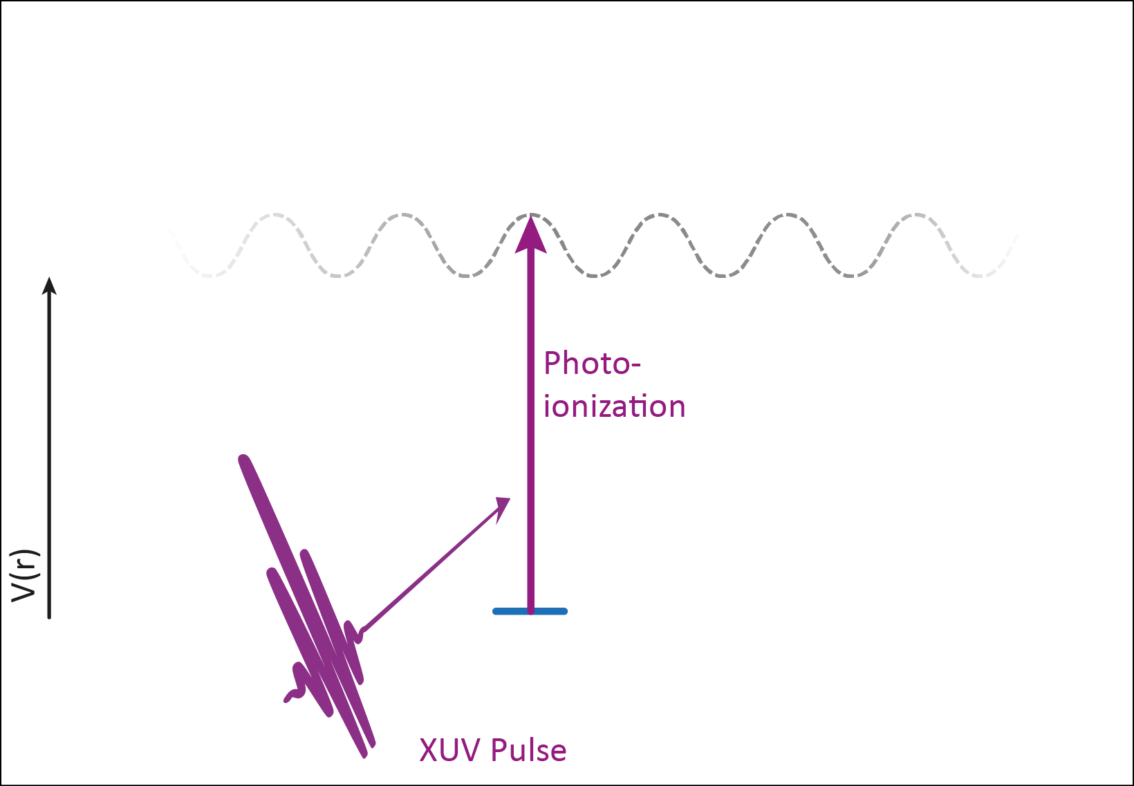
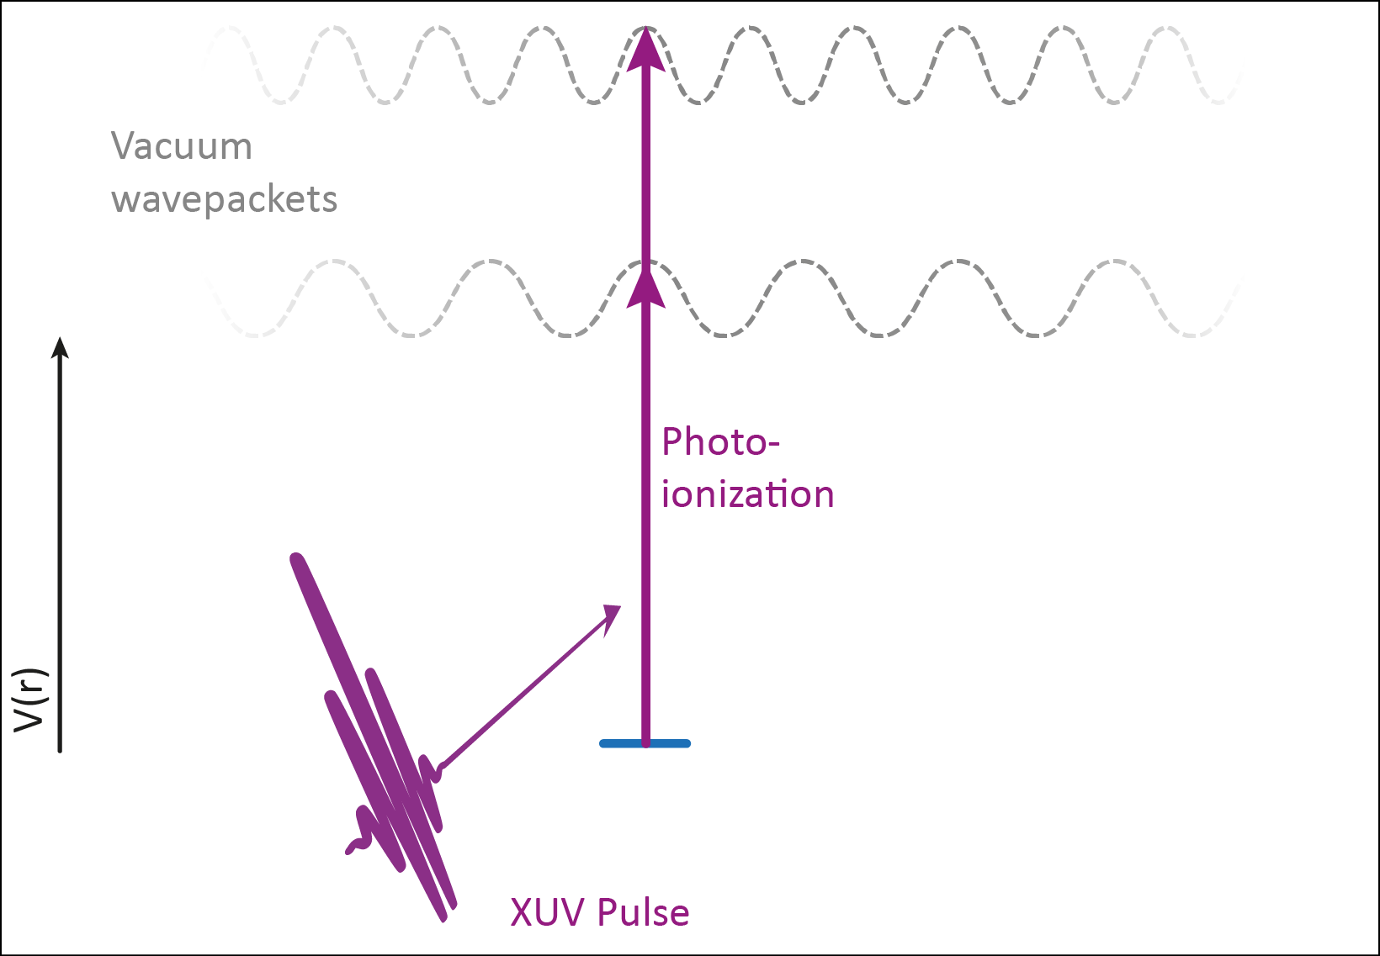
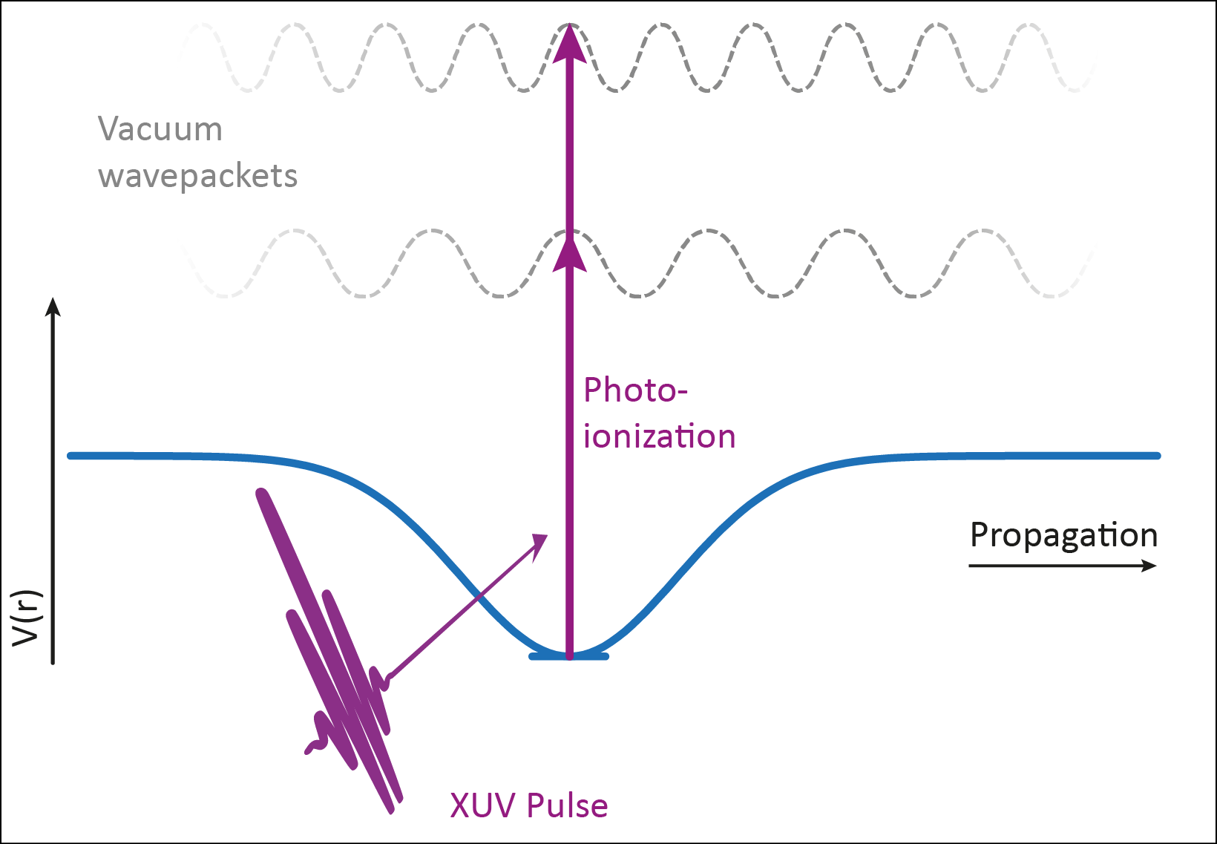
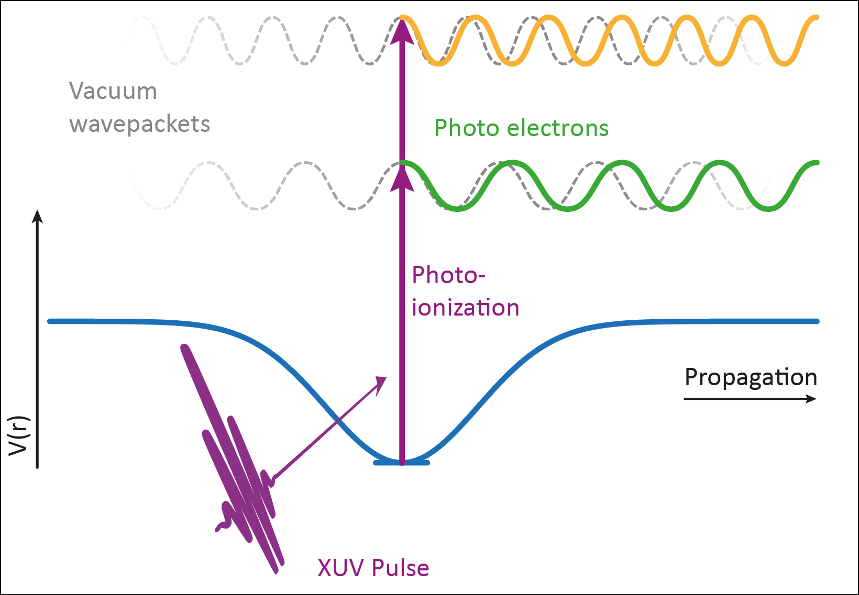
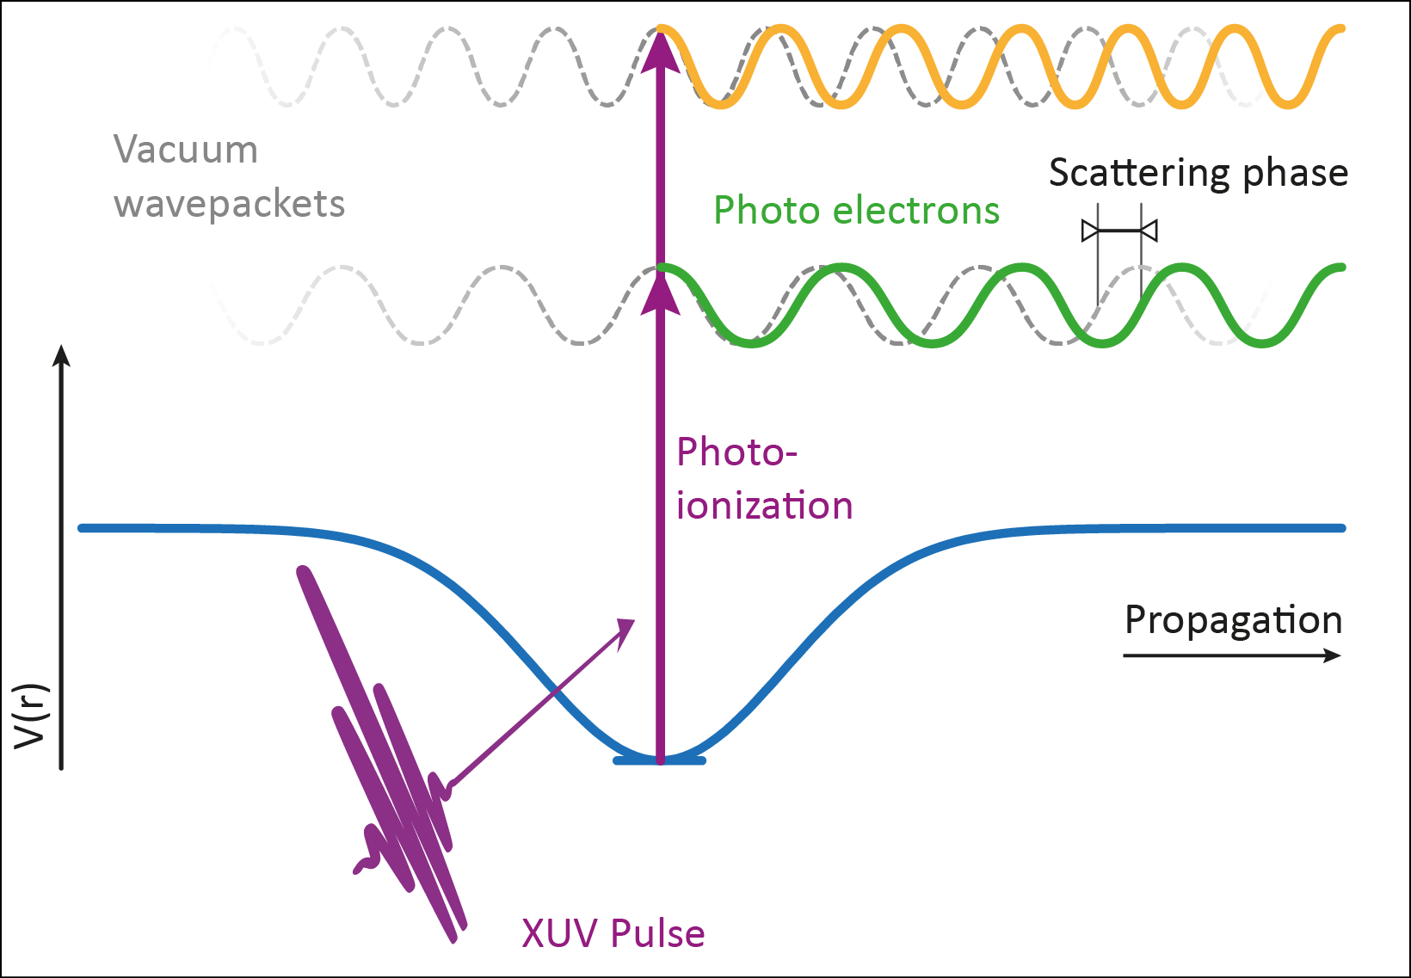
Photoionization: time & phase II
Energy derivative of phase shift
time delay in photoemission

Slide 6
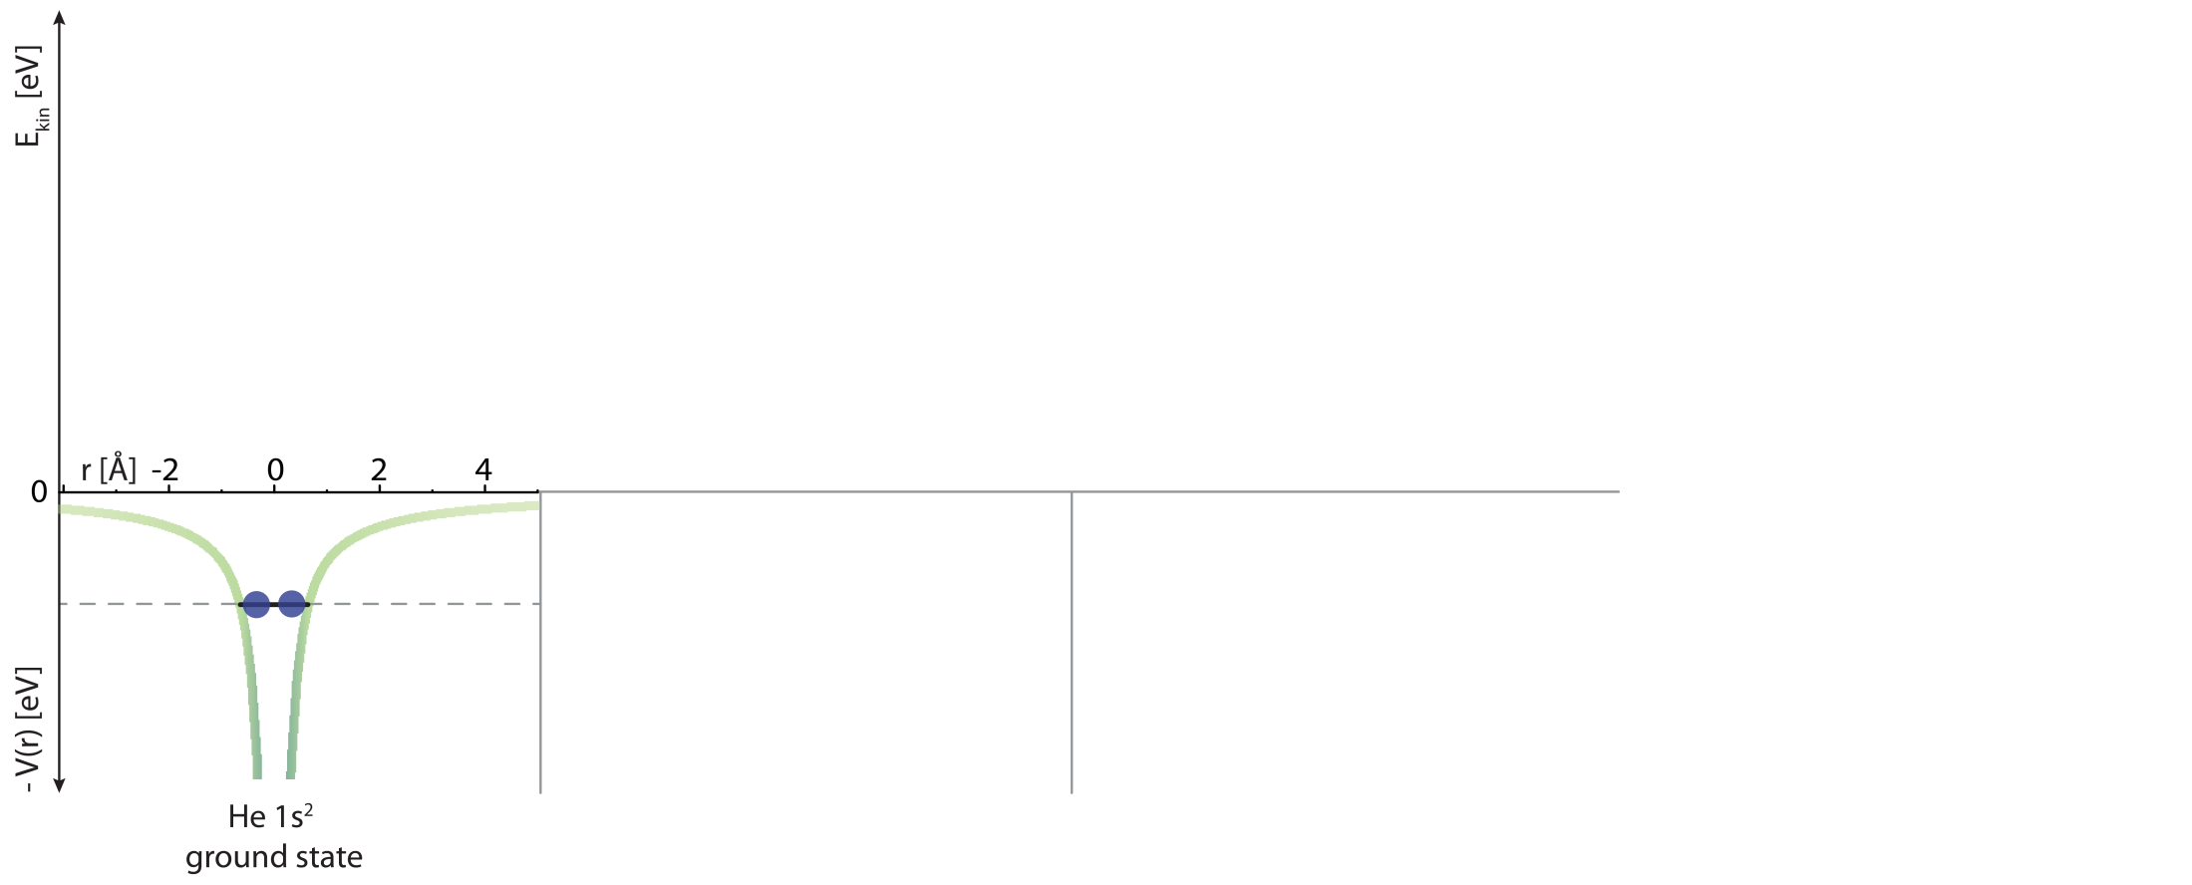
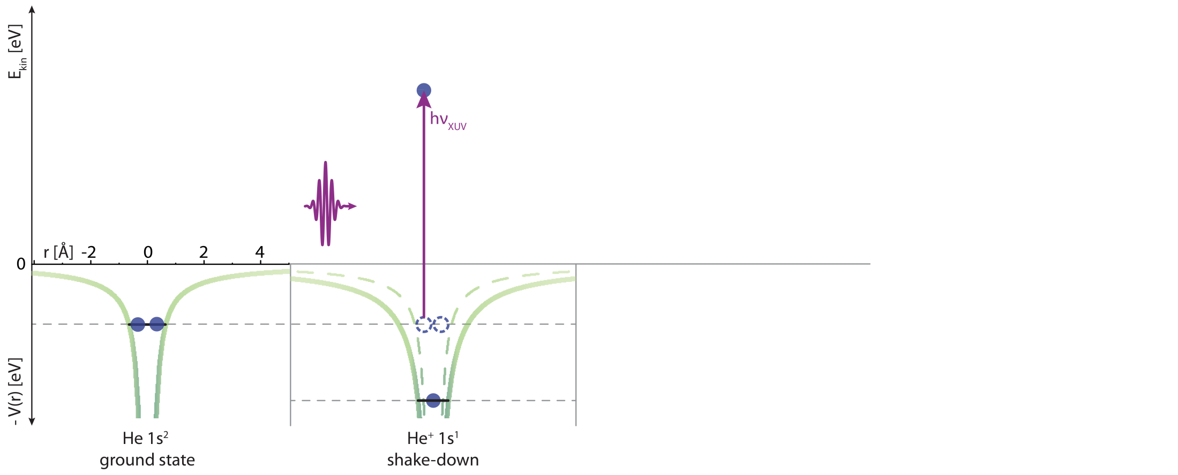
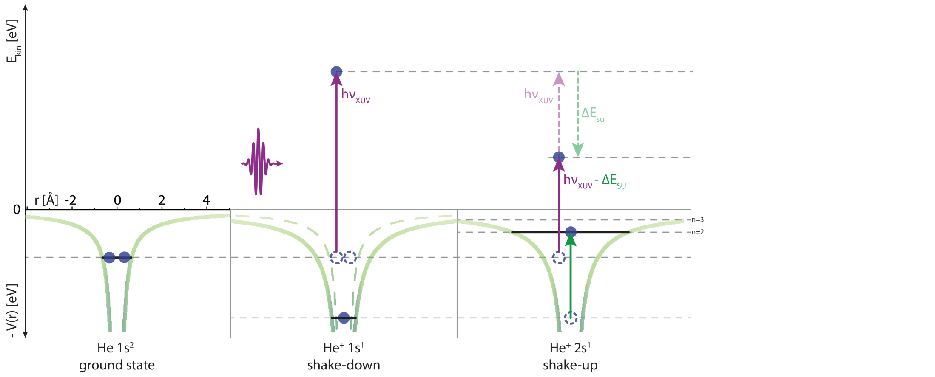
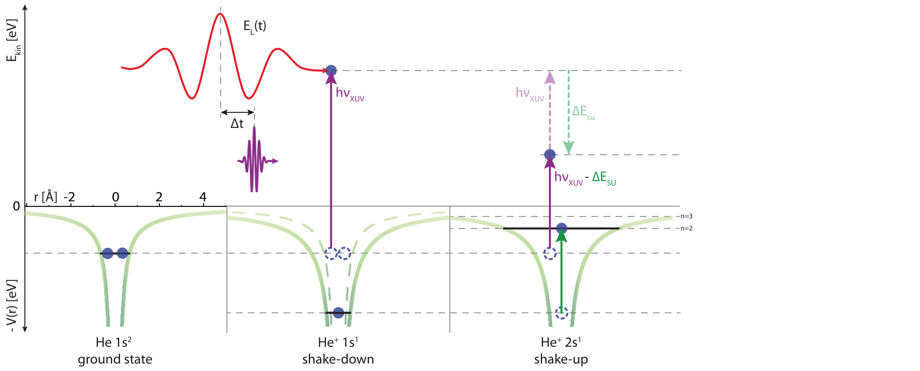
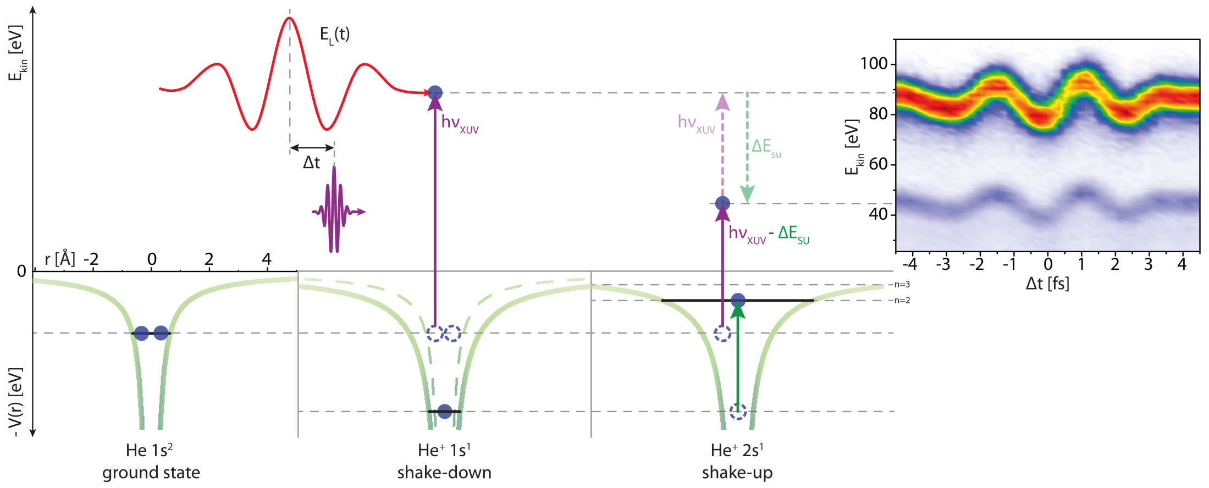
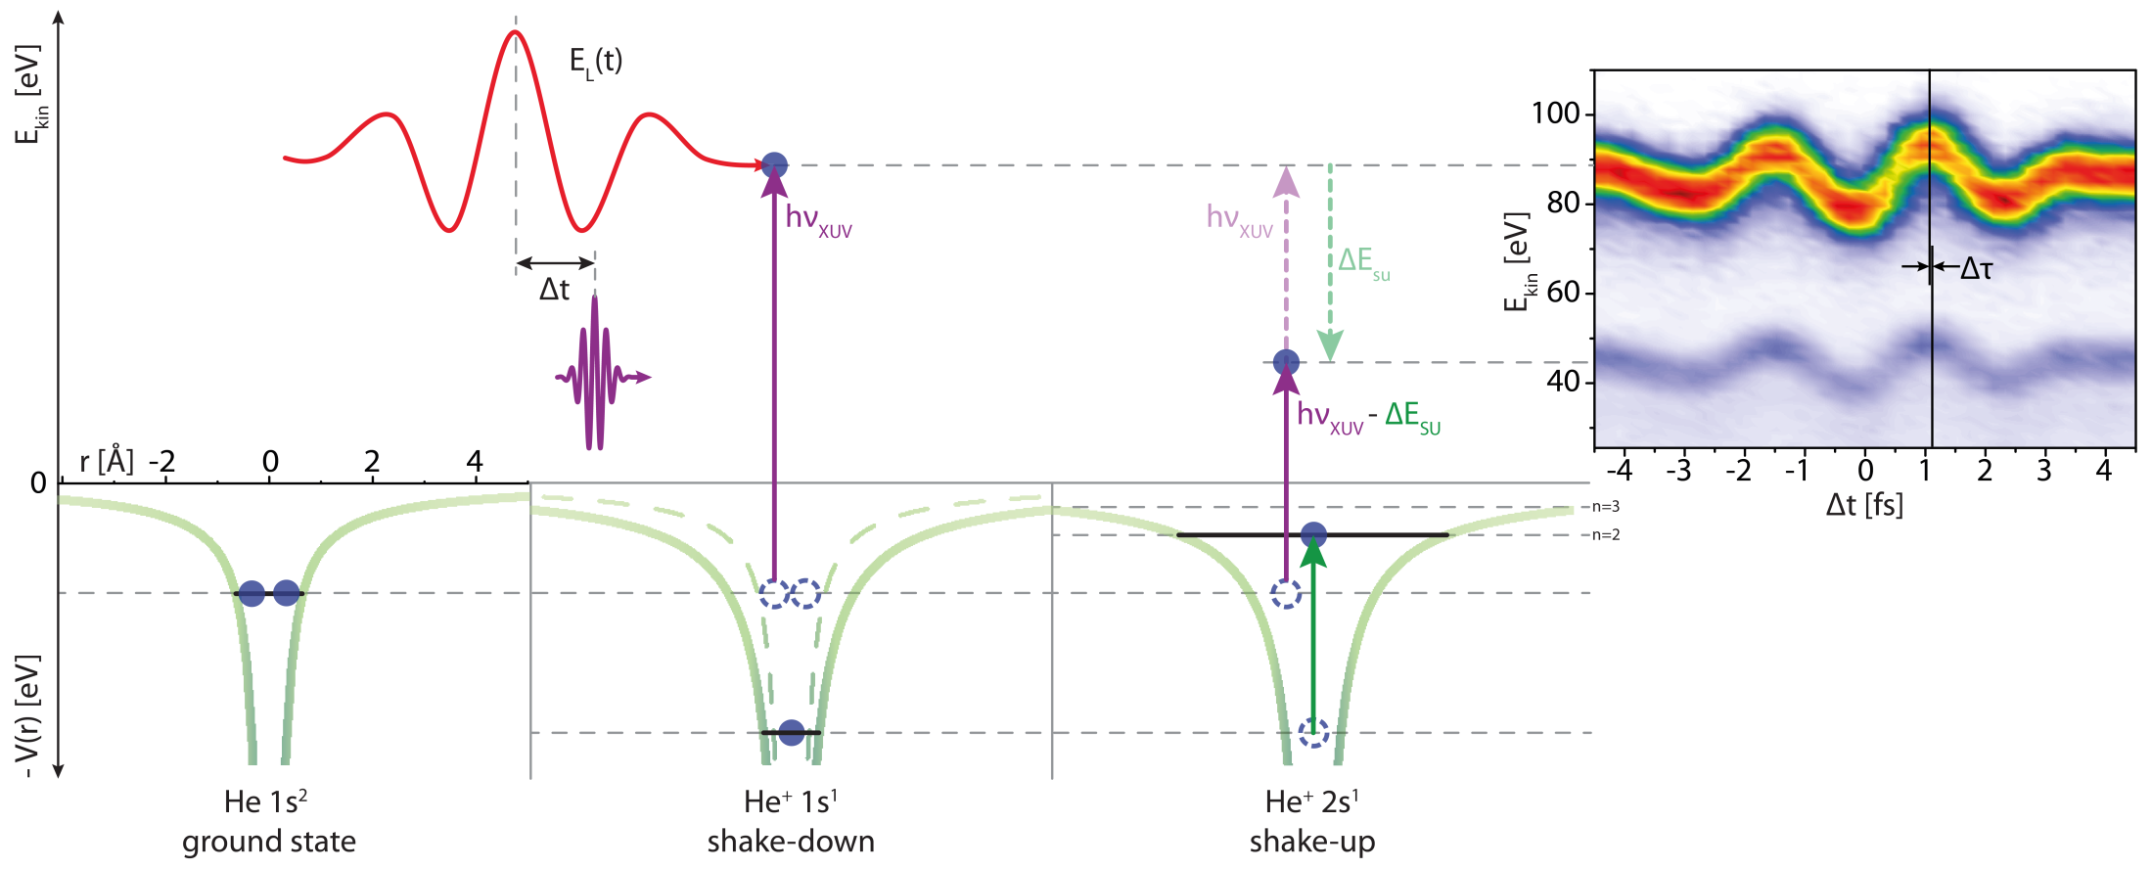
Clocking electronic correlations
Helium
ground state
Photoelectric effect
Photoelectric effect
& electronic excitation
Eisenbud–Wigner–Smith time delay in photoemission

Slide 7
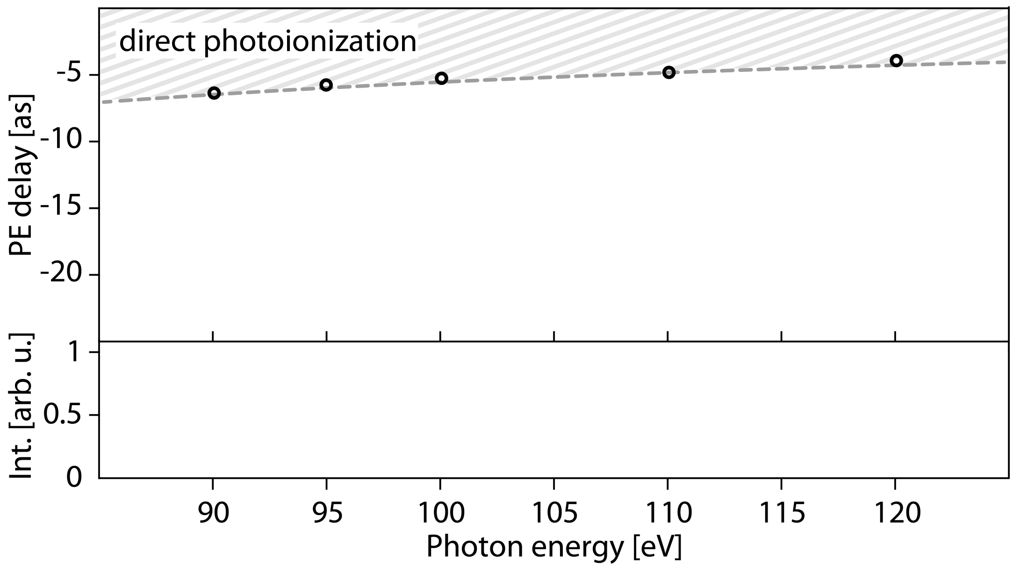
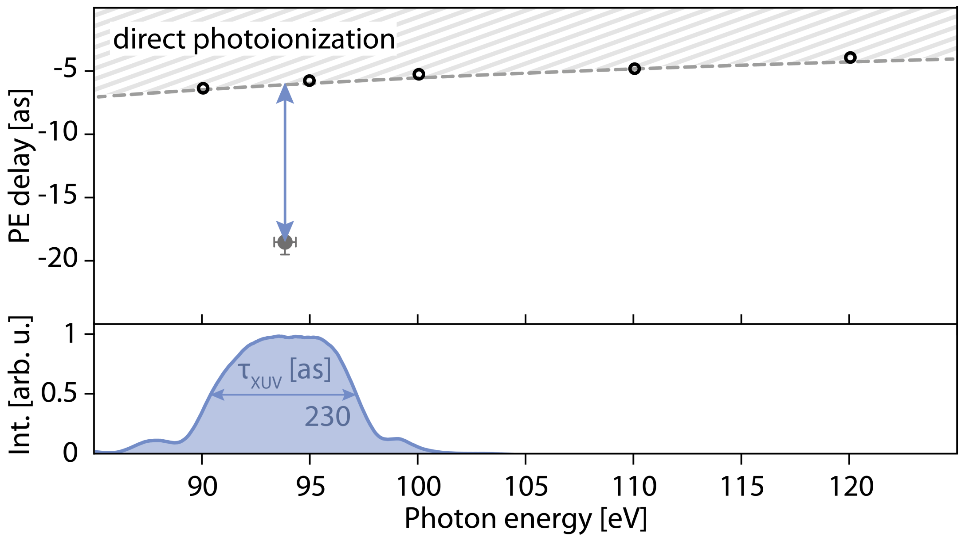
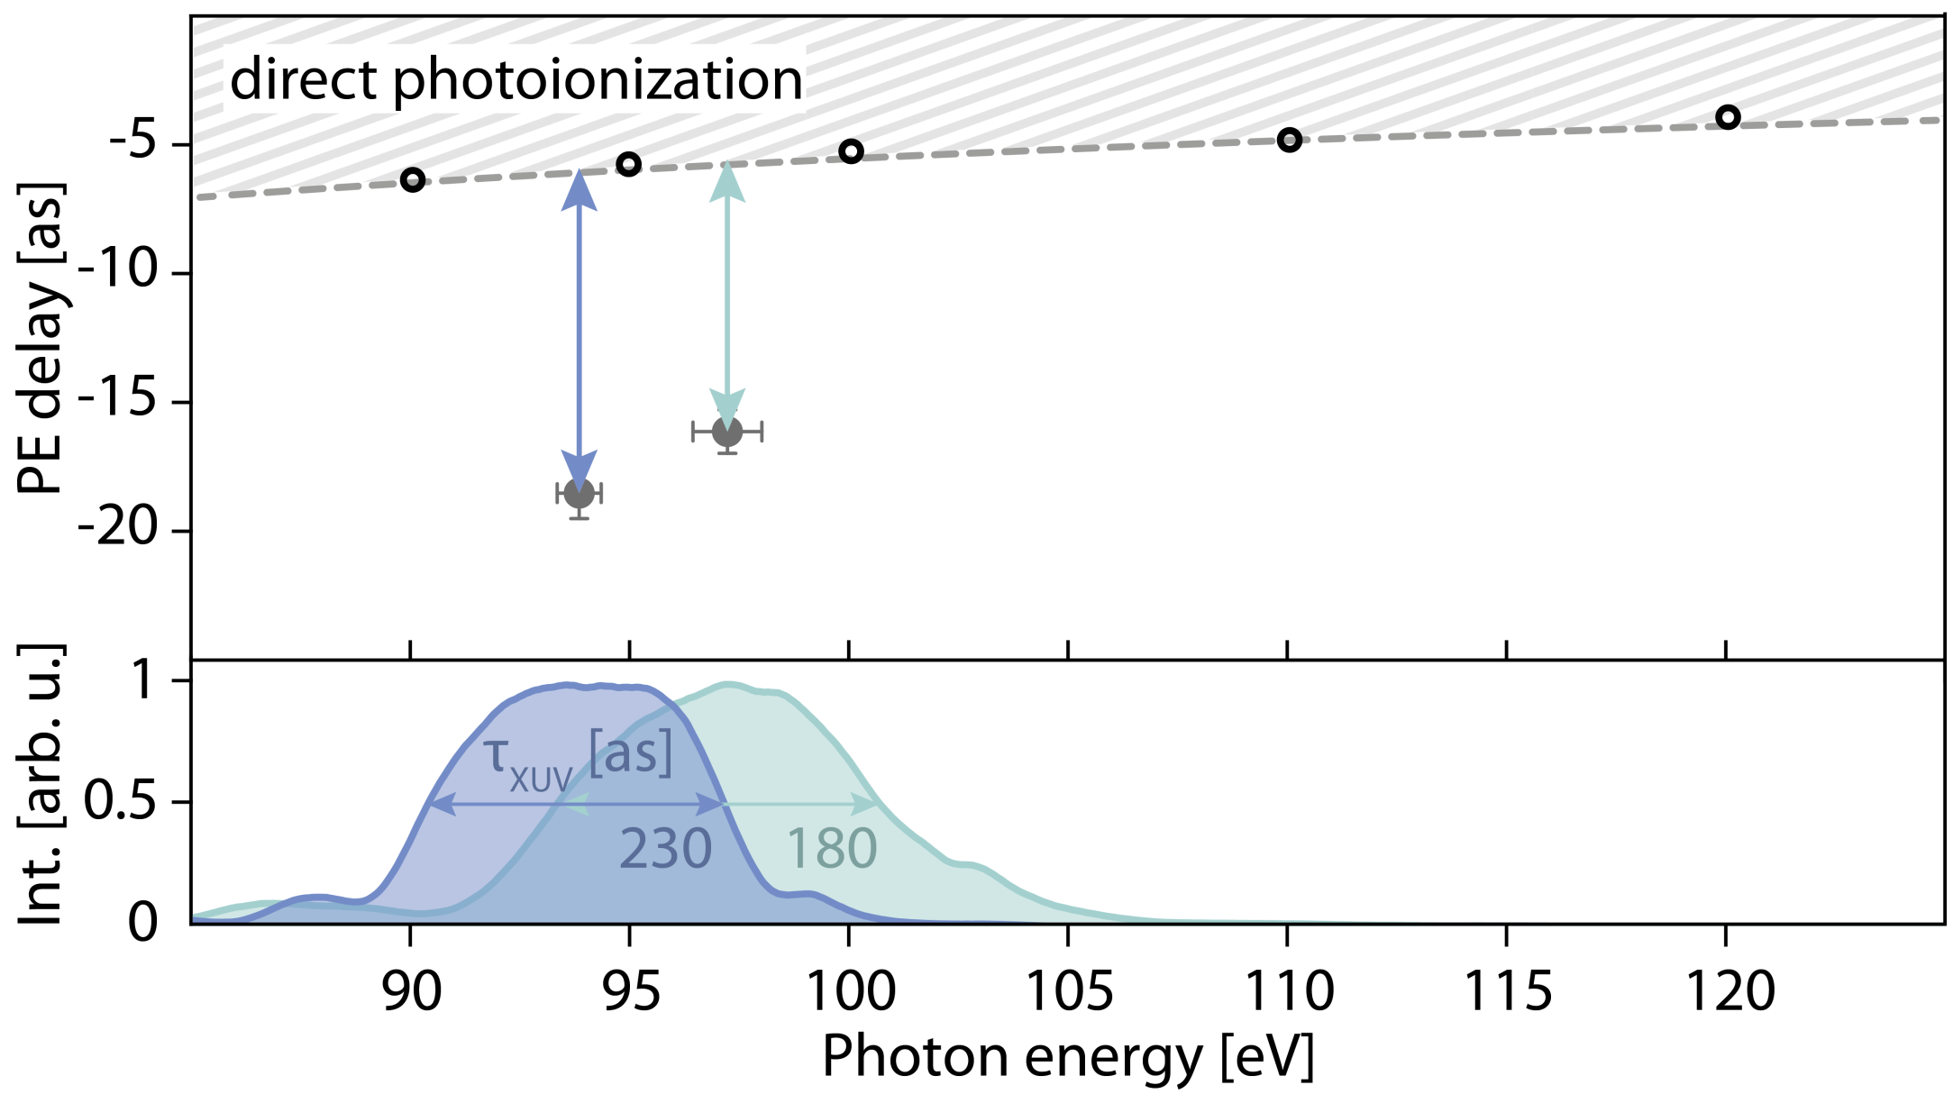
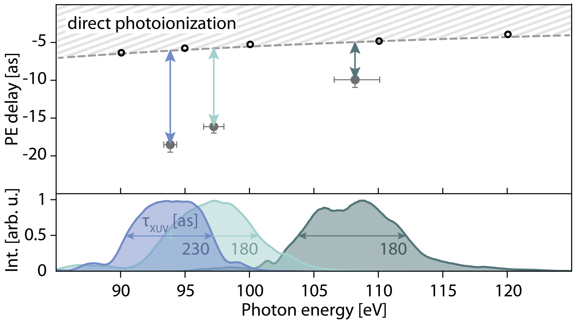
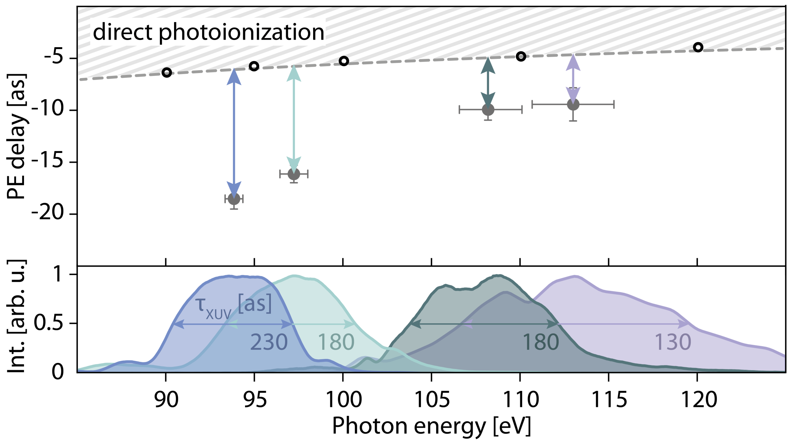
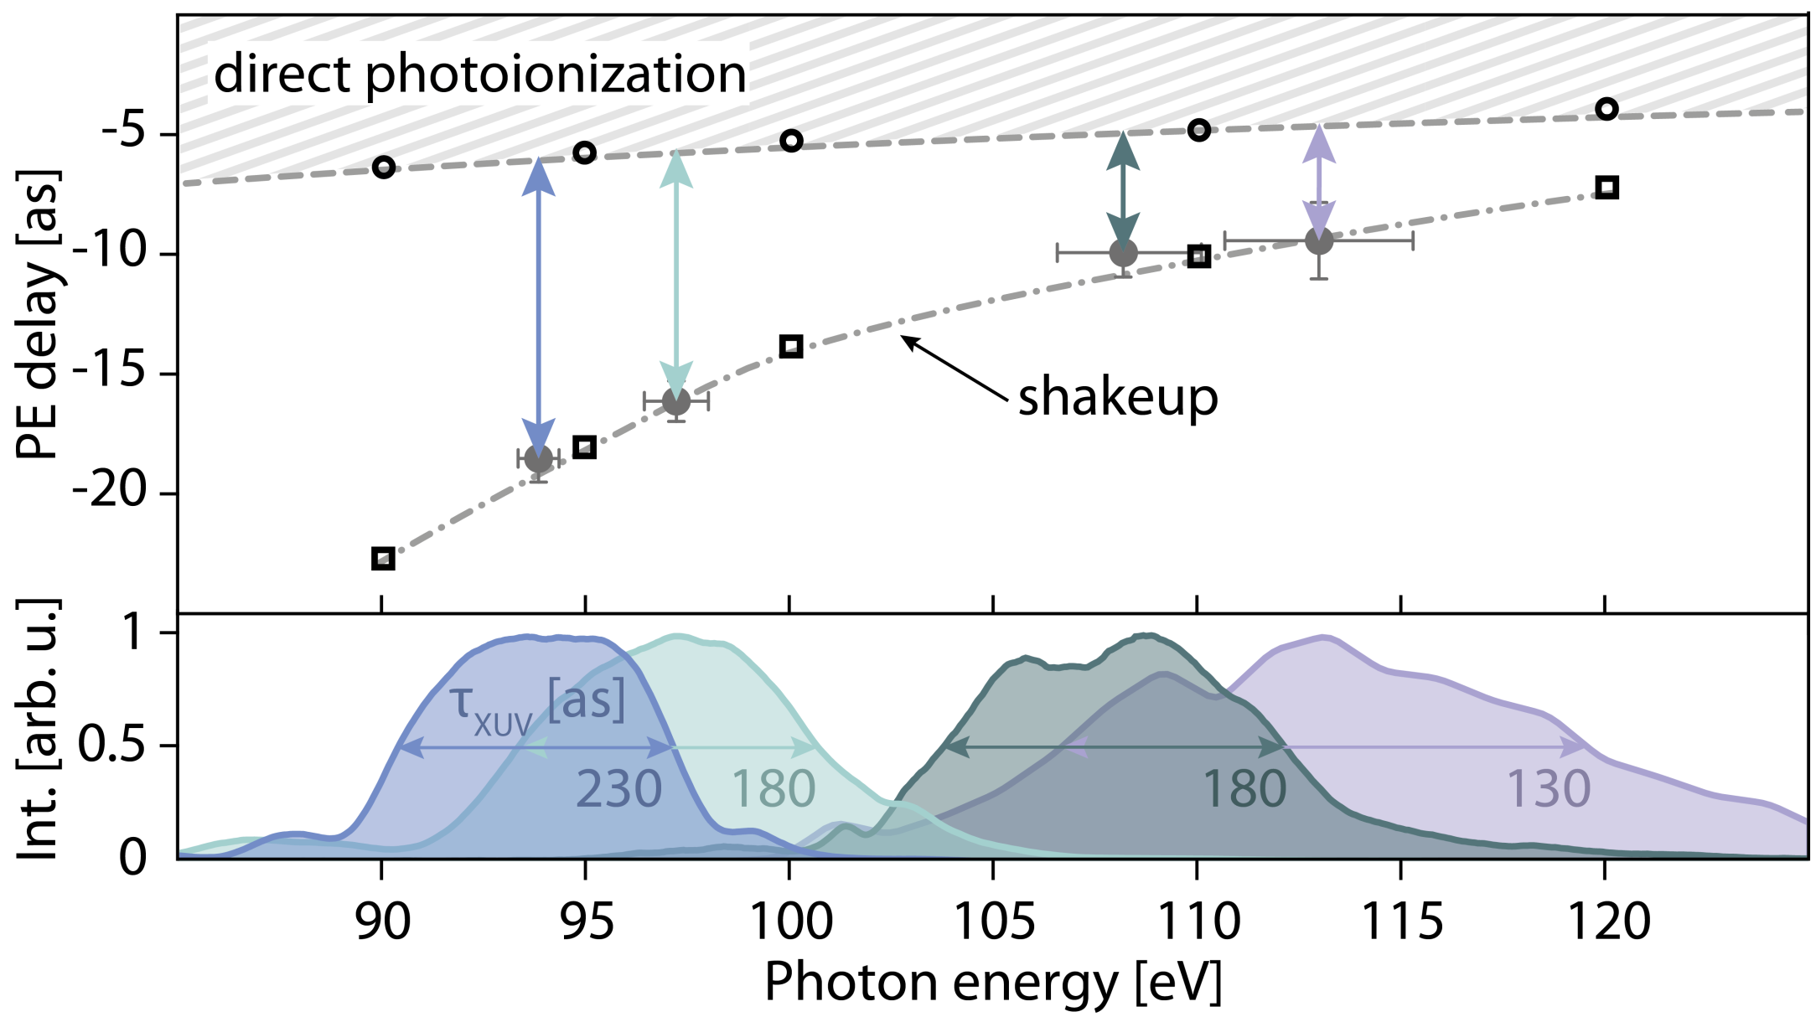
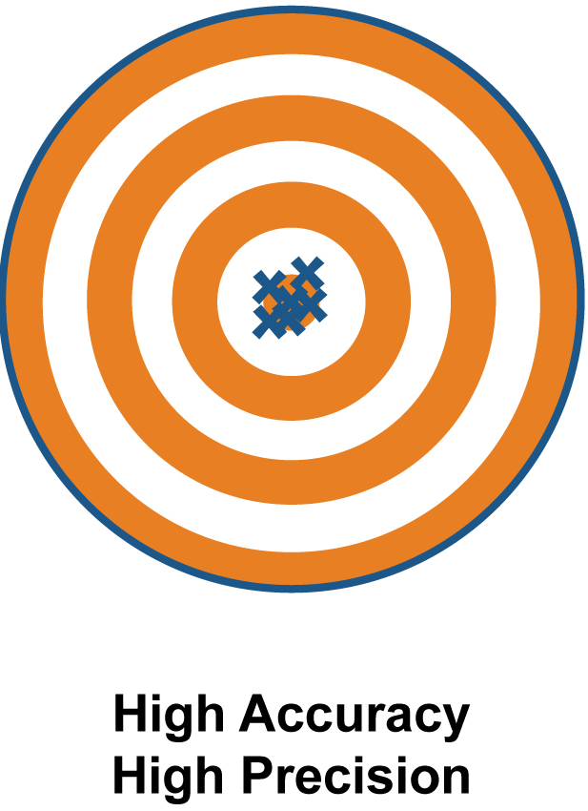
Clocking electronic correlations
Nat. Phys. 13, 280 (2017)
Science 328, 5986 (2010)
Atomic units accuracy in detecting electronic motion
- and controlling?

Slide 8
Quantum
Classical
e⁻
e⁻
e⁻
State-of-the-art
PHOTONICS
State-of-the-art
ELECTRONICS
e⁻
e⁻
e⁻
CB
e⁻
e⁻
e⁻
ph
Coherent
interaction
Electron cascades
Spin dynamics
Electron-phonon interaction
h⁺
VB
h⁺
Fig. adapted from B. Ziaja, Sci. Rep., 5, 18068 (2015)
e⁻
e⁻
h⁺
h⁺
Processes
Electron-hole recombination
h⁺
h⁺
h⁺
h⁺
Hole
scattering
Electron-hole interaction
10⁻¹⁶ 10⁻¹⁵ 10⁻¹⁴ 10⁻¹³ 10⁻¹² 10⁻¹¹ 10⁻¹⁰ 10⁻⁹ t (sec)
Loss of Coherence
Electron / Hole thermalization
Demagnetization
Electron-lattice equilibration
Electron-hole equilibration
Excitation
Polarization
Consequences
Cooling and relaxation

Slide 9
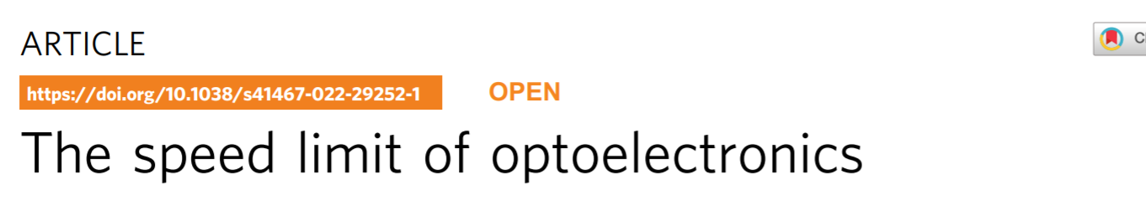
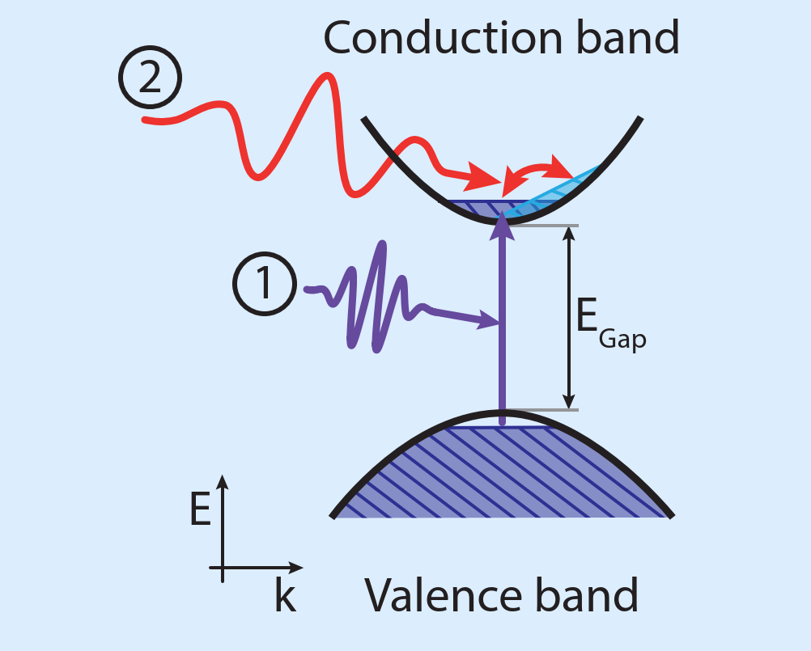
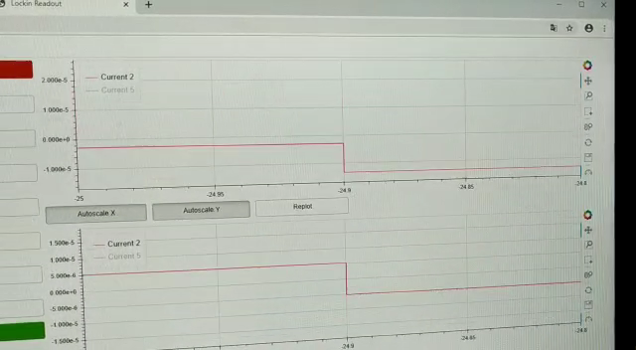
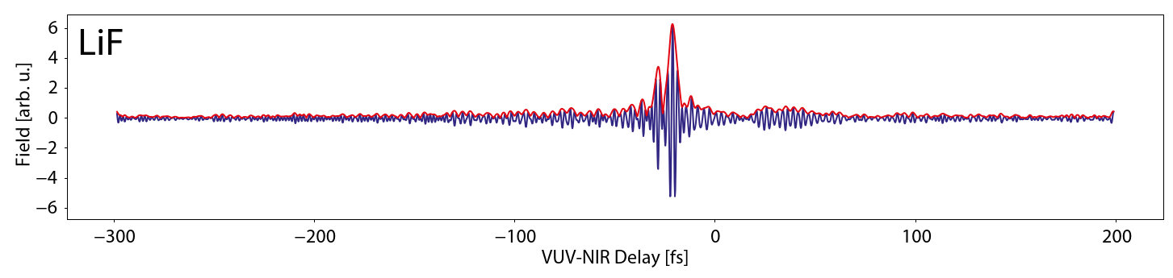
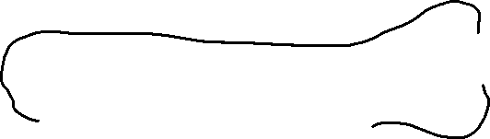
Optical Antenna – ultrafast?
Attosecond one-photon injection–
Optical gate field

Slide 10
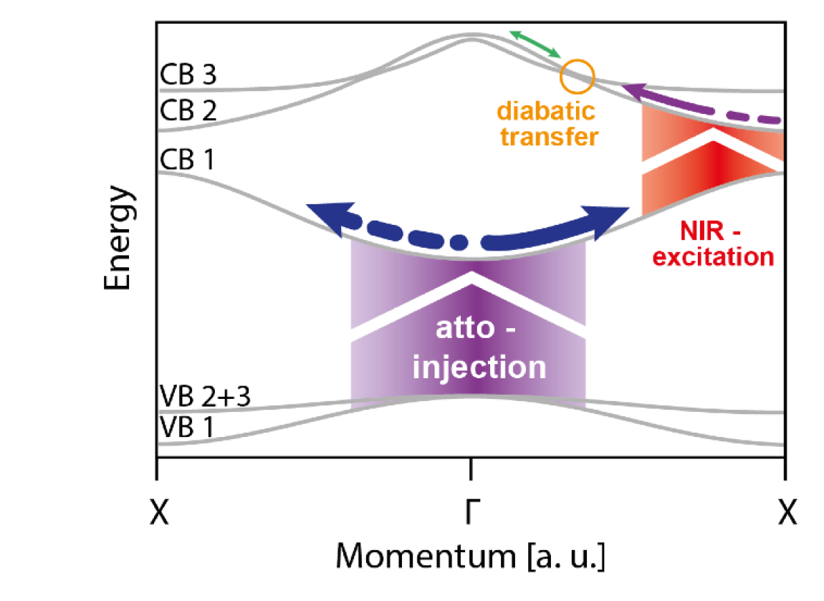
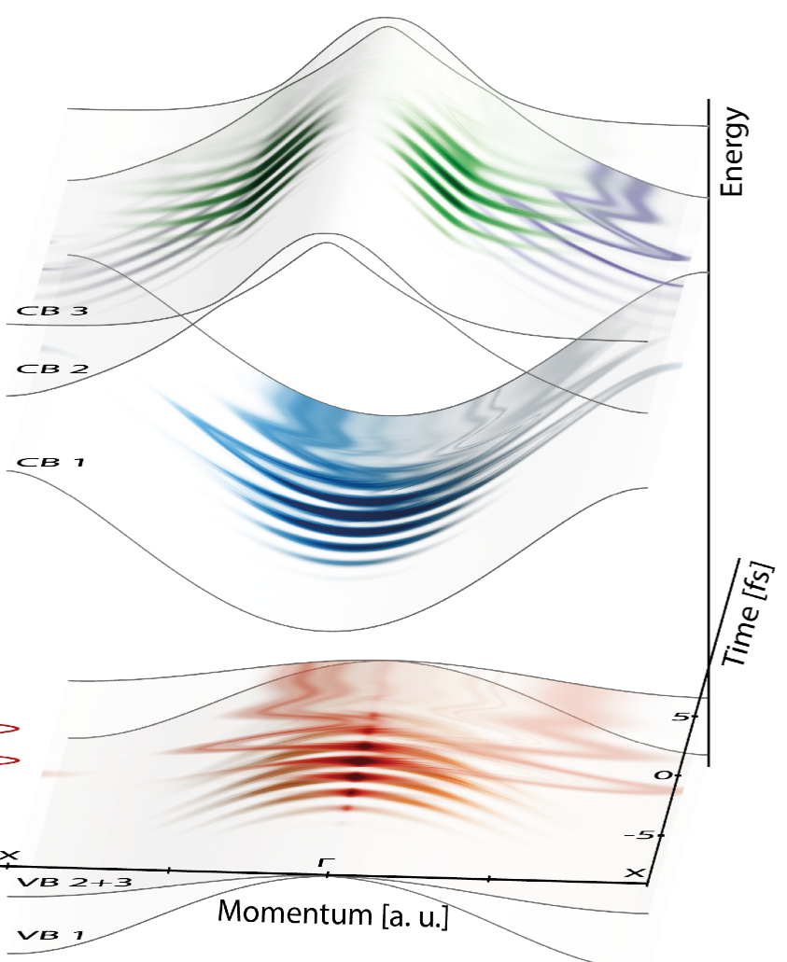
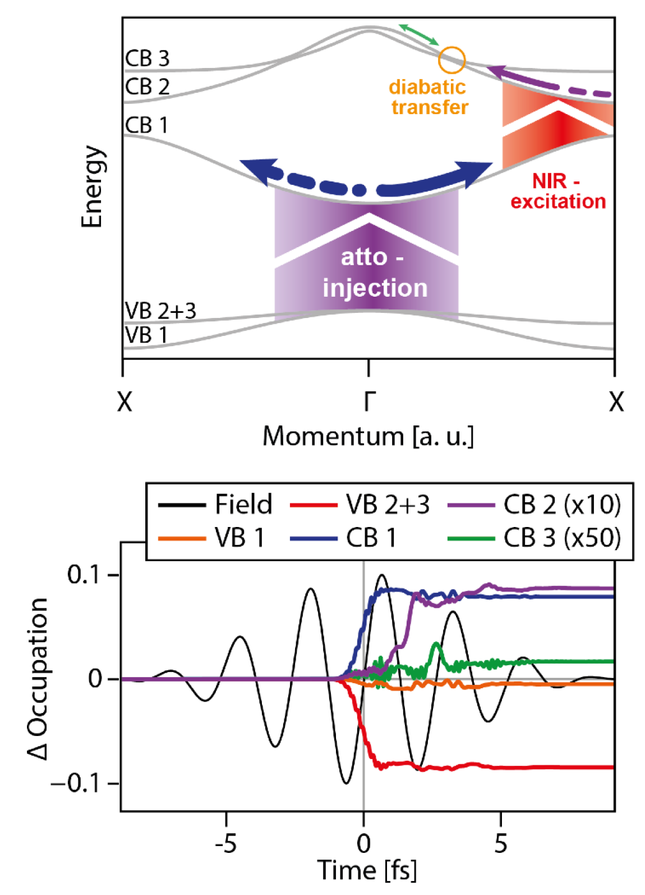

Momentum Transfer - Theory
Nat. Comm. 13, 1620 (2022)
- time & band-resolved occupations
- time-domain absorption spectroscopy

Slide 11
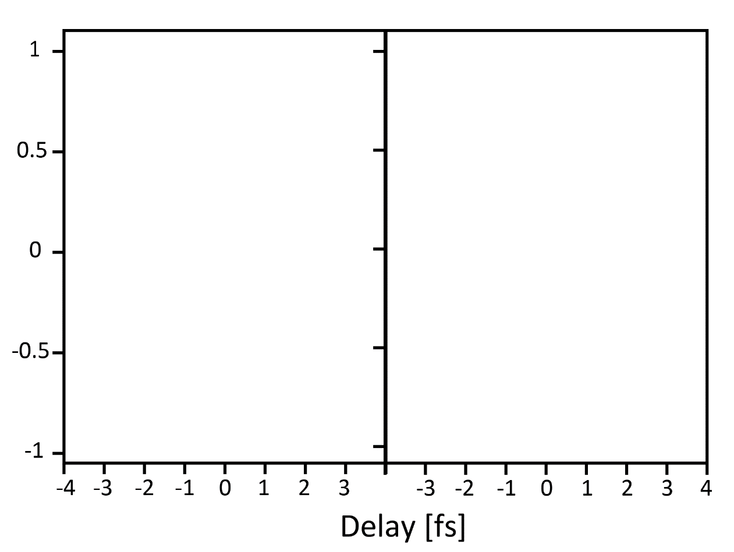
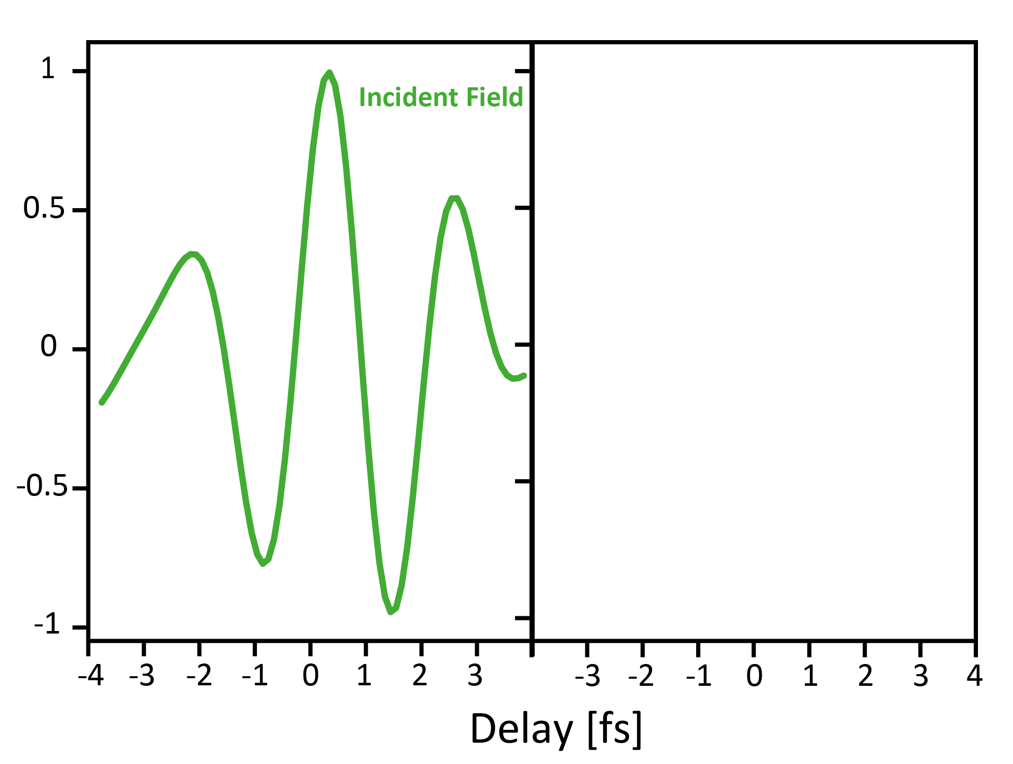
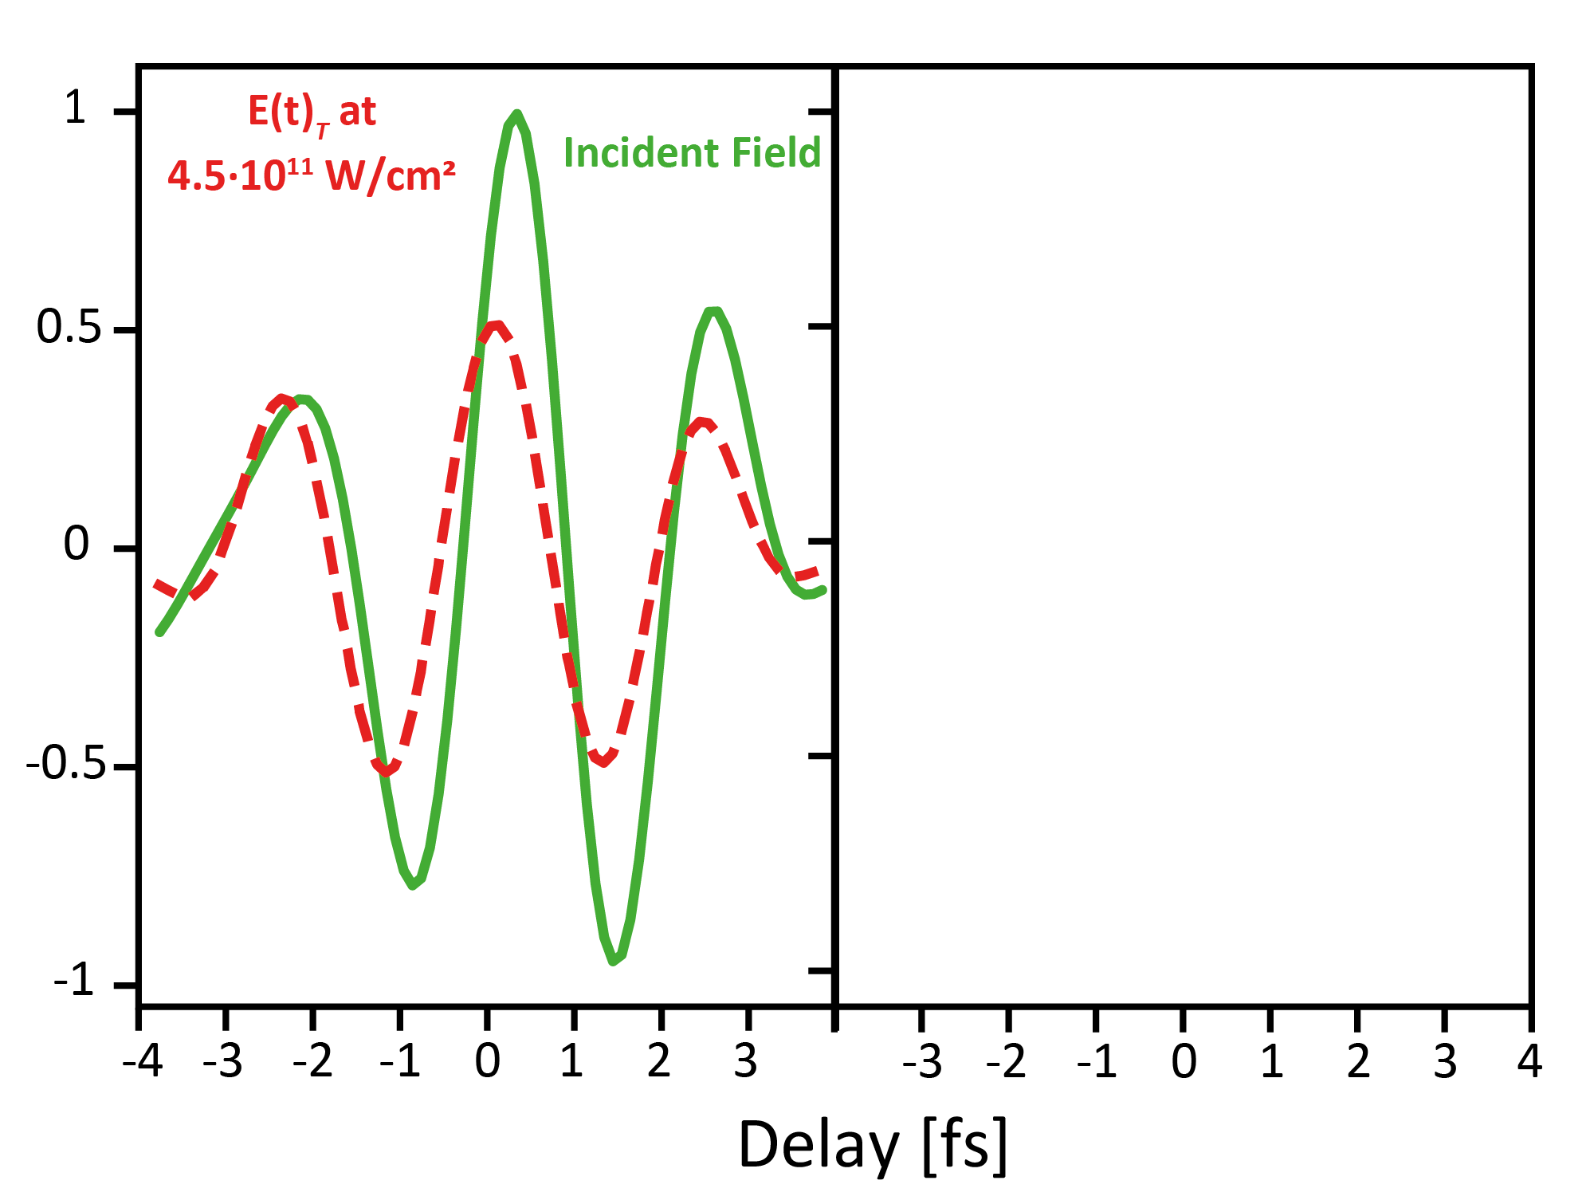
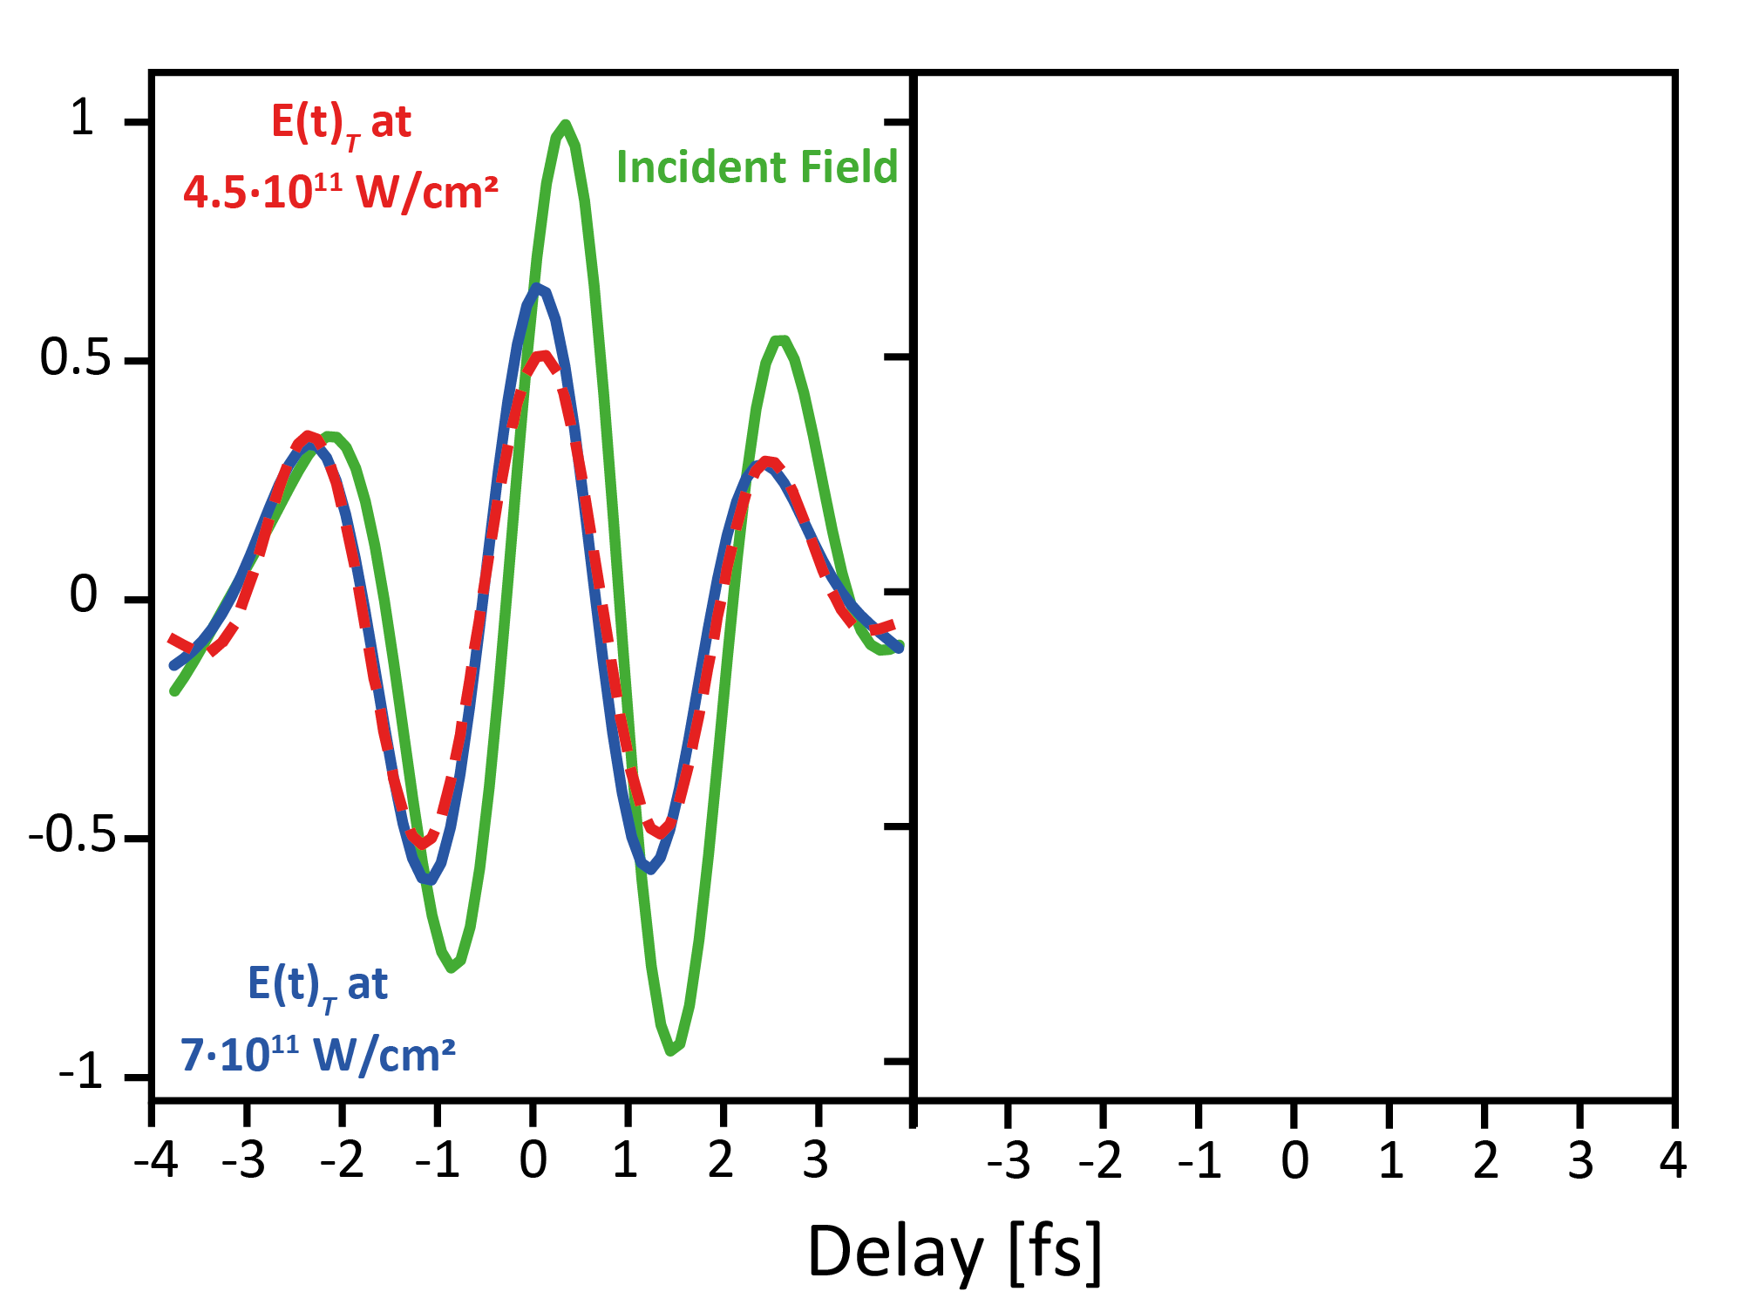
Nonlinear optics in dressed systems
high intensity ->
nonlinear optics
Same pulse energy – different intensity
Nickel
metallic bandstructure
transmission through
nanofilm
Saturable absorption

Slide 12
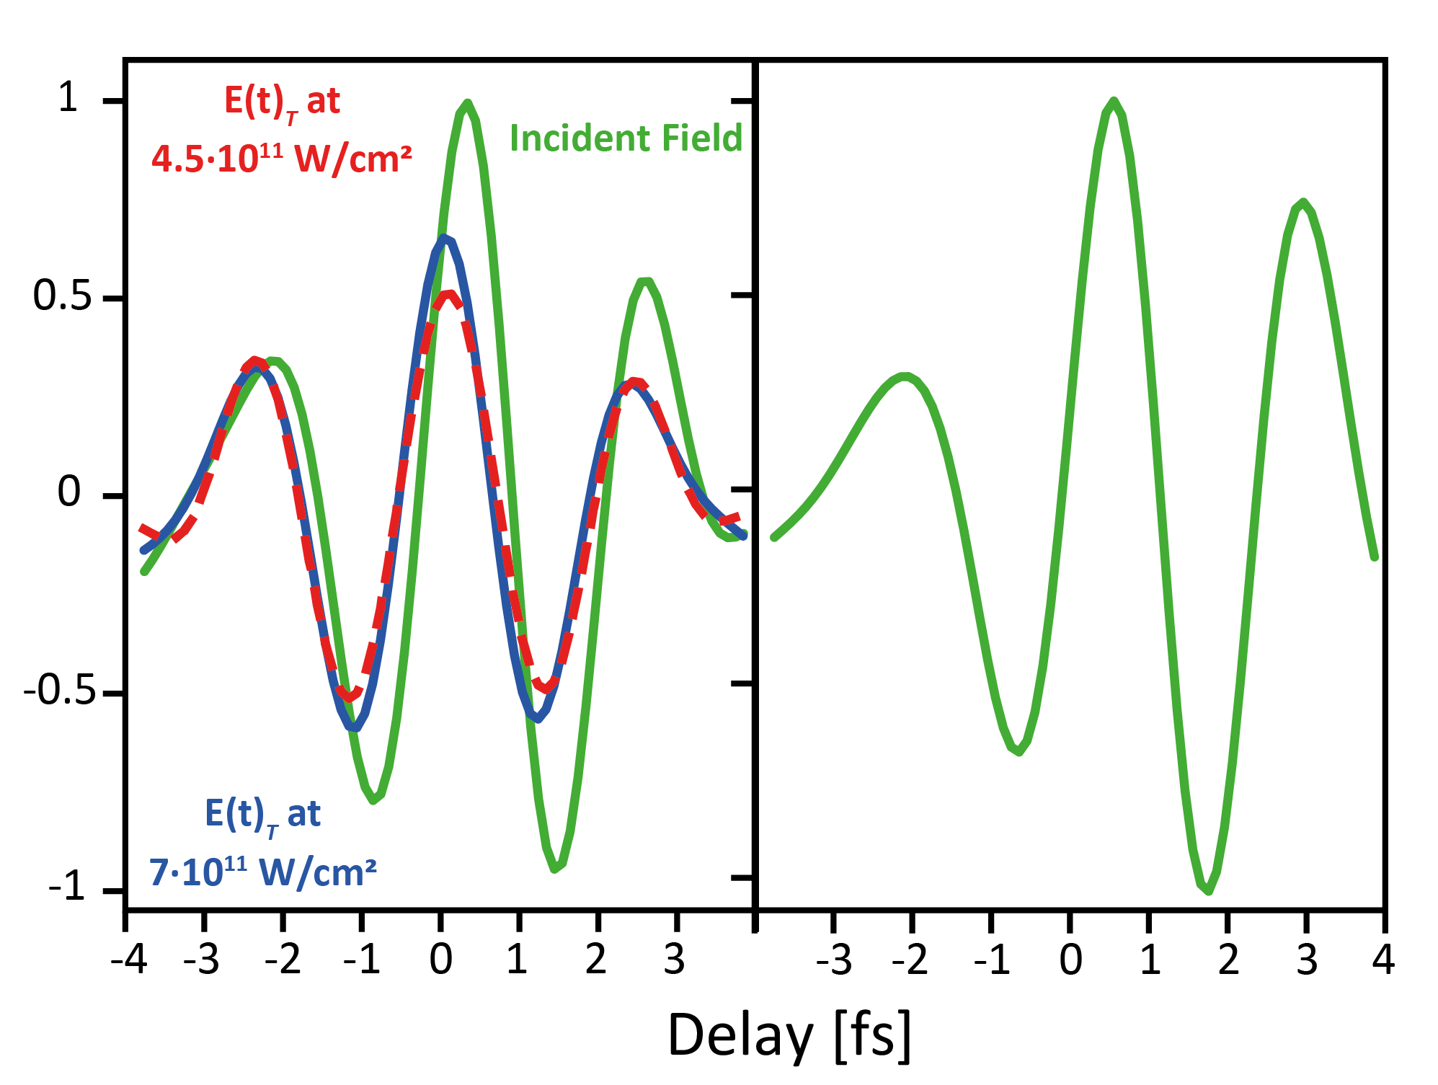
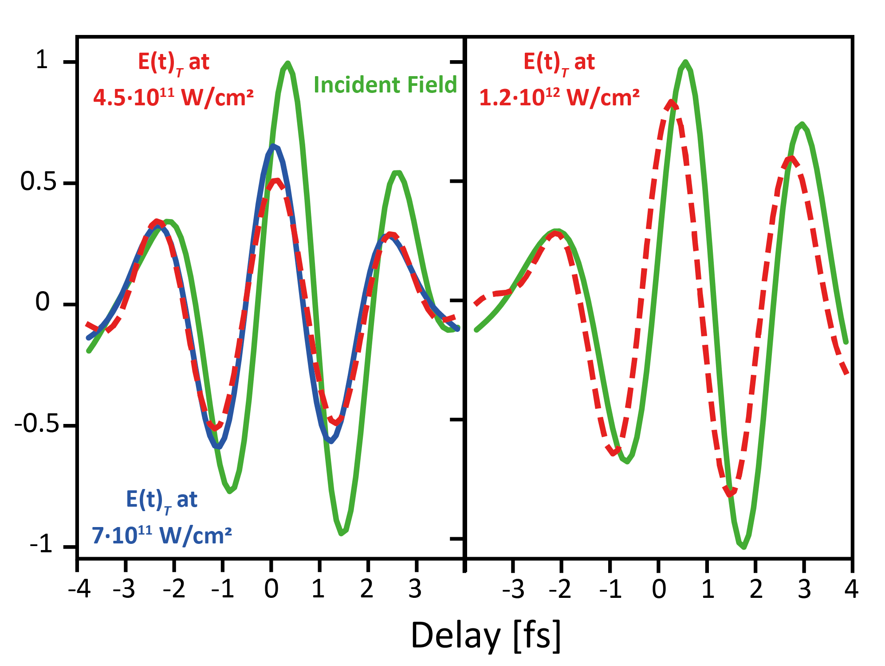
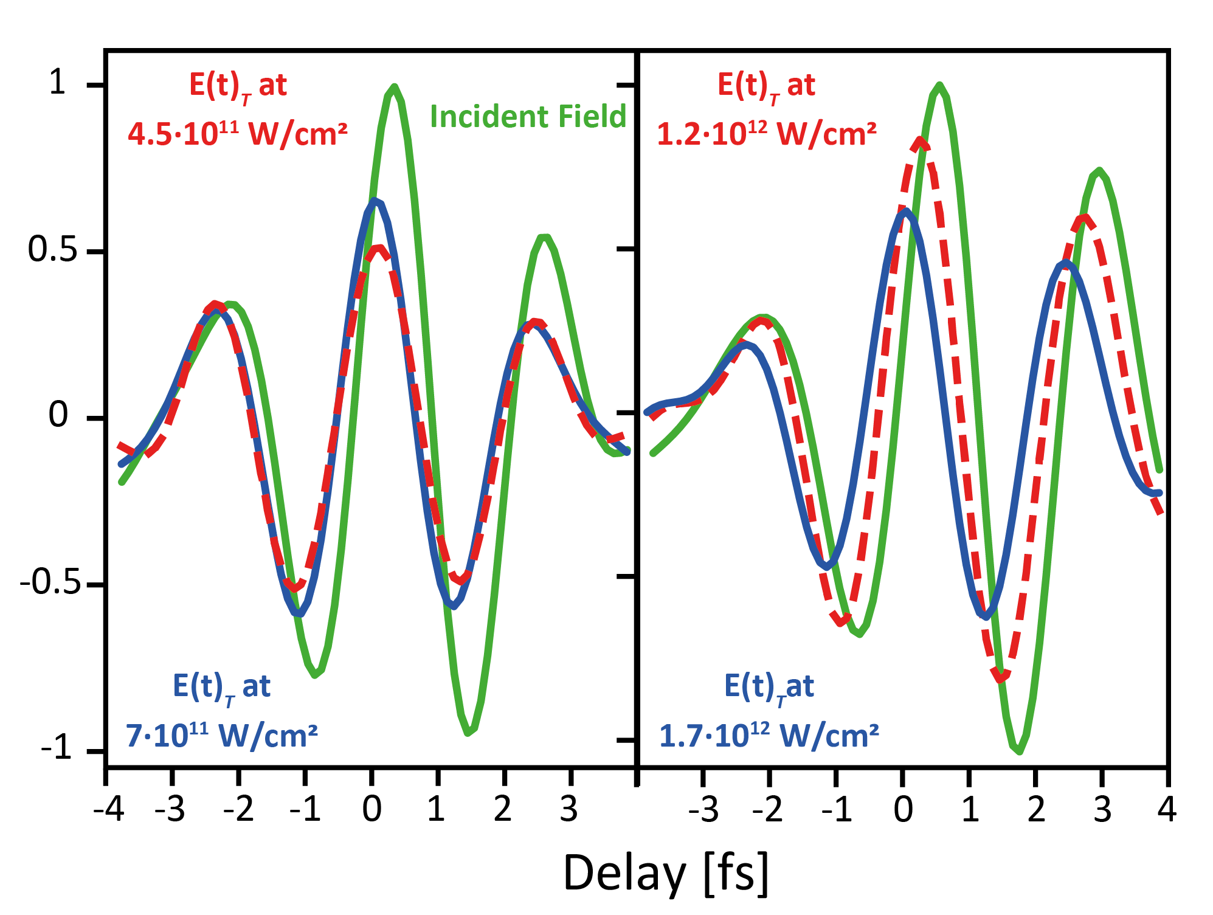
Nonlinear optics in dressed systems
high intensity ->
nonlinear optics
huge intensity ->
super-nonlinear optics
Same pulse energy – different intensity
Nickel
metallic bandstructure
transmission through
nanofilm
Saturation of saturable
absorption
Saturable absorption
Sudden phase
acceleration!

Slide 13
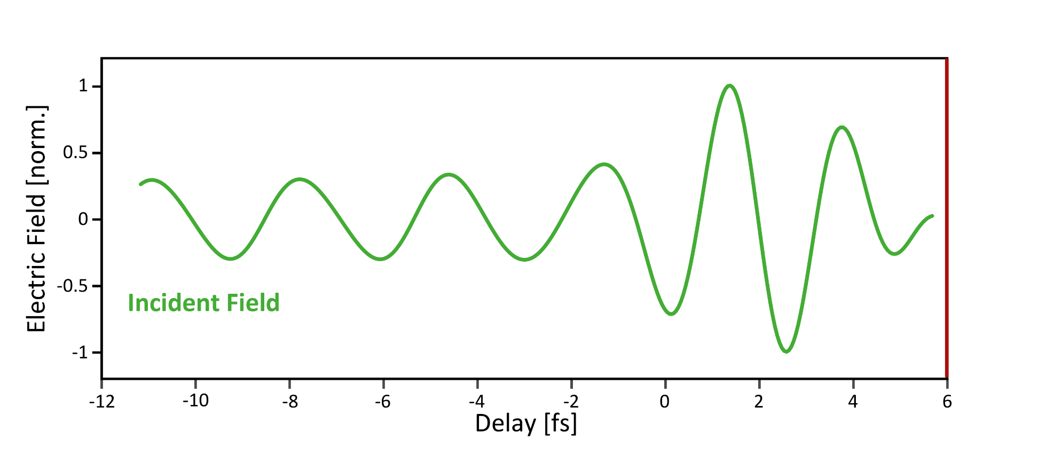
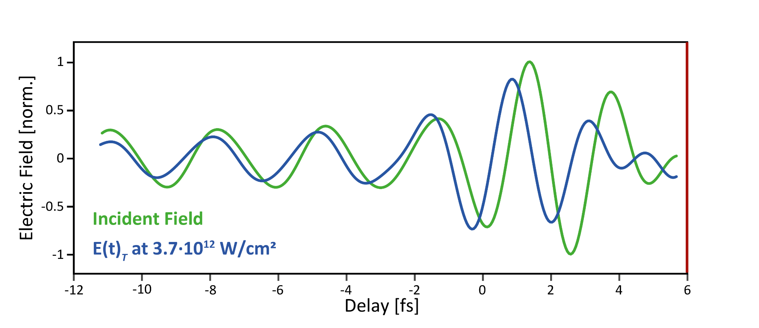
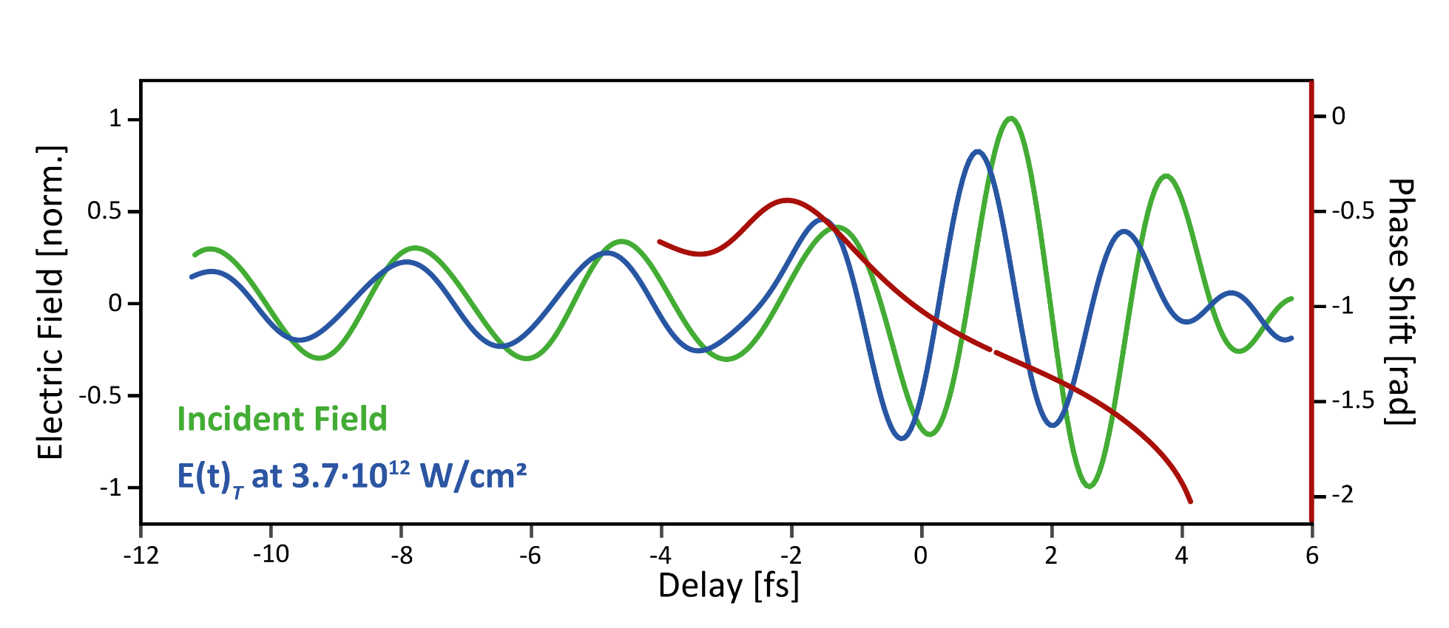
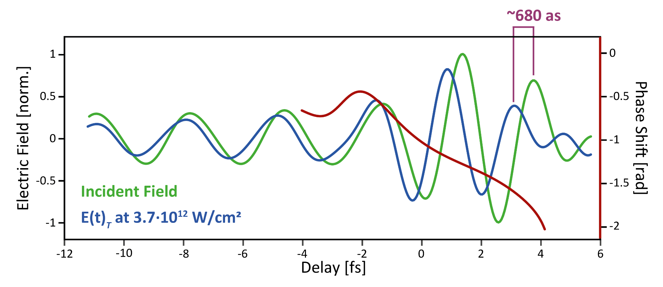
Nonlinear optics in dressed systems
Nickel
huge intensity ->
super-nonlinear optics
metallic bandstructure
Nickel nanofilm, cooled
Negative refractive index!
Re(n) = -20
Superluminal group velocity,
bi-directional phase shifter
Phase shift π/4
50 x layer thickness
Sudden phase
acceleration!

Slide 14

Charge control → Magentism
hook up spin system to optical carrier control ?
ultrafast

Slide 15






Optically Induced Spin Transfer
F. Siegrist et al., Light-wave dynamic control of magnetism, Nature 571, 240–244 (2019)
Light excitation in heterostructure
-> spin transport
-> directional flow of charge

Slide 16





Optically Induced Spin Transfer
F. Siegrist et al., Light-wave dynamic control of magnetism, Nature 571, 240–244 (2019)
Light excitation in heterostructure
-> spin transport
-> directional flow of charge

Slide 17



Boost magnetic moment by light?
Light excitation in heterostructure
-> spin transport
-> directional flow of charge

Slide 18
Boost magnetic moment by light?

Slide 19
Boost magnetic moment by light?

Slide 20

Boost magnetic moment by light?

Slide 21





Tracking charge and spin dynamics
-> in devices & circuits?
Carbon nanotube transistors
Plasmonic wavpackets
THz optoelectronic modulator
Needed:
Attosecond spectroscopy with spatial resolution

Slide 22




4 - D Microscopy?
needs:
short pulses
needs:
small foci
Fourier Limit:
Abbe Limit:
$$τ_{FWHM}∗{∆f}_{FWHM}>0.44$$
to achieve τFWHM ≈ 1 fs
to achieve d ≈ 350 nm ?
ΔfFWHM ≈ 0.44 PHz
ΔEFWHM ≈ 1.8 eV
λ ≈ 500 nm -> NA ≈ 0.7
(i.e. θ = 45°)
independent of
the wavelength
λ ≈ 50 nm -> NA ≈ 0.07
(i.e. θ = 4°)
-> XUV light for microscopy with sub-optical resolution in space & time

Slide 23


Outlook: Attosecond Microscopy
Marcus Ossiander
Hana Hampel
Maryna Meretska
Daniel Lim
Nico Knefz
Thomas Jauk
Federico Capasso
Vacuum guiding enables
XUV Metalenses

Slide 24



Outlook: Attosecond Microscopy
Vacuum guiding enables
XUV Metalenses
“Extreme ultraviolet metalens by vacuum guiding”
Science 380, 59-63 (2023)
-> sub-wavelength microscopy in time & space

Slide 25
Strong light waves controlling charge & spin dynamics
Ultrafast laser fields can manipulate
electronic states&magnetic moments
… possibly faster than the decoherence
recombination
coherent
electronics /
spintronics
optical phonon decay
e-phonon scattering
e-h creation
e-e scattering
seconds

Slide 26



Outlook: Photophysics
Collaboration: R. Baker, H. Gajapathy
Ohio NEXUS
Yttrium Iron Garnet Photoanodes
Spin Selective Photocatalysis
Linear Pump
(Visible)
Switching Magnet
S
N
Circular Probe (XUV)
YIG
B
Substrate
Gajapathy et al., ChemRxiv, DOI: 10.26434/chemrxiv-2023-4dzxg.
-> chemical state & spin-resolved
investigations of photocatalytic processes

Slide 27



Vacuum Guiding EUV Metalens
How good can it get
Fresnel Zone Plate
Metasurface

Slide 28

XUV Material Properties
Vacuum guiding:
Loss-less phase shift?
n_{material} < nvacuum
→ vacuum behaves like
a high-refractive-index pillar
kmaterial > 0
→ thin / no substrate
n, k
Trans.
A.
R.
Transmission

Slide 29




XUV Optics
Challenges:
Absorption & Aberration
Fresnel Zone Plates
multiple foci
small efficiency
Reflective Optics
grazing incidence
small NA & aberrations
Source: Wikipedia
Thin Film Devices
reflection
small efficiency
Source: Sagittal focusing inducing energy structure in medium to high-energy resolution X-ray monochromators
Marcelo G Hönnicke et al. Proc SPIE 8848(884809):1-7

Slide 30




Spin-sensitive attosecond probing
Attosecond time resolved XMCD

Slide 31

Clocking electronic correlations
Science 328, 5986 (2010)
Helium
ground state
Photoelectric effect
Photoelectric effect
& electronic excitation
Eisenbud–Wigner–Smith time delay in photoemission

Slide 32


Meta: Optics Revolution
Focus:
Phase shift via refractive index
the phase counts, not the shape:
distance from optical axis
wavelength
focal length
Wikipedia, LeoDE, CC BY-SA 4.0
-> Needs a high-refractive index / low absorbing material

Slide 33
EUV Metalens
Vacuum guiding:
Nanoscale holes in Silicon
-> Needs a high-refractive index / low absorbing material

Slide 34


EUV Metalens
In 19 easy steps:
Fabrication
Fabrication:
Marcus Ossiander, Maryna Meretska, Daniel Lim, Federico Capasso

Slide 35
EUV Metalens
Imaging non-imageable wavelength?
incoming beam
with metasurface
with metasurface
- unfocussed light

Slide 36



EUV Metalens
Outlook: Attosecond Microscopy
Imaging non-imageable wavelength?
Knife-edge scan
z
focus
x
f =1 cm, NA= 0.05, 1.6 x diffraction limit

Slide 37




Outlook: Attosecond Microscopy
Imaging non-imageable wavelength?
Knife-edge scan
Marcus Ossiander
Hana Hampel
Maryna Meretska
Daniel Lim
Thomas Jauk
Federico Capasso
z
focus
“Extreme ultraviolet metalens by vacuum guiding”
Science 380, 59-63 (2023)
x
-> 4-D microscopy of charge carrier dynamics
in time & space

Slide 38

Boost magnetic moment by light?

