Slide 1

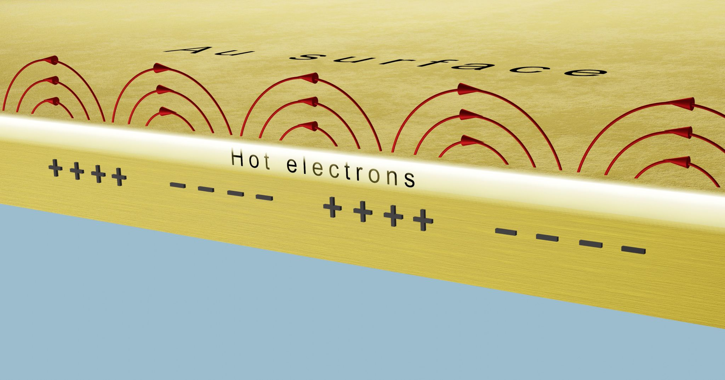
Ultrafast electron processes in solids
Dombi Péter

Slide 2
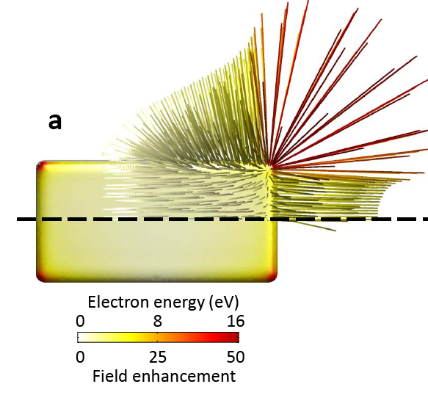
1. Ultrafast electron processes in plasmonic systems
Plasmonic hot electron generation and decay
(1-1000 fs)
Photoemission (even in attoseconds if tunneling)

Slide 3
approach for measuring field enhancement
fs near-field stimulates photoemission
spectra of photoelectrons can be measured
photoelectrons rescattered at the surface have the highest kinetic energy
4. Q_{max} = 10,007 e²λ²E_{loc}² / (16 π²mc²)
5. rescattering takes place in nanometric volumes
Near field maximum can be measured with photoelectrons
P. Rácz… P. Dombi, Nano Lett. 17, 1181 (2017)
Notes:
…Well-known it atomic physics as ATI, however, its counterpart with the photoemission from solids has not been exploited so far for any practical application

Slide 4
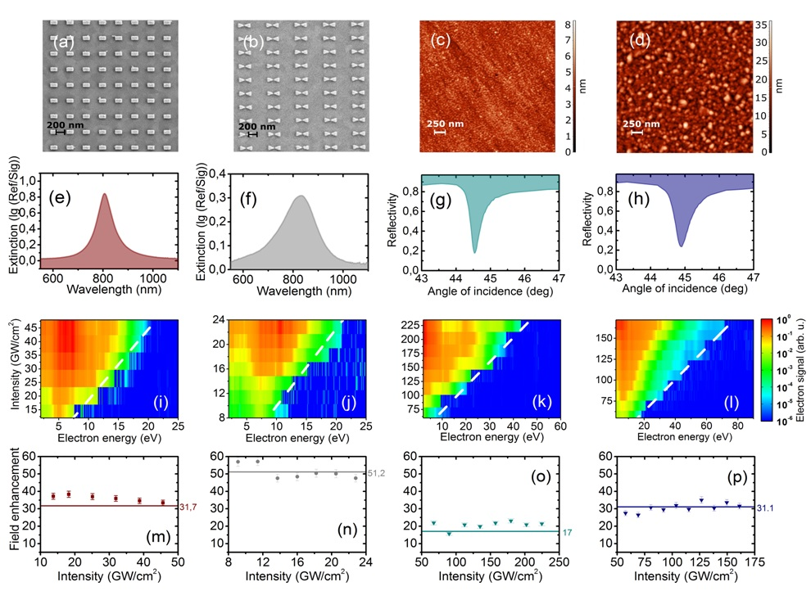
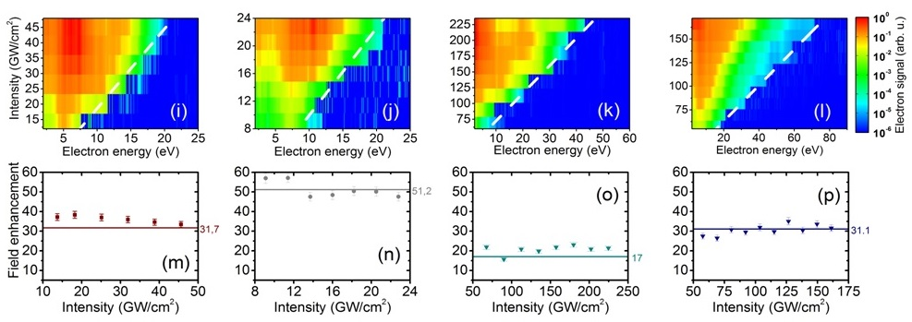
Validation
← experiment vs.
simulation
36.1 vs. 31.7
51.2 vs.50.5
P. Rácz…P. Dombi, Nano Lett. 17, 1181 (2017)

Slide 5
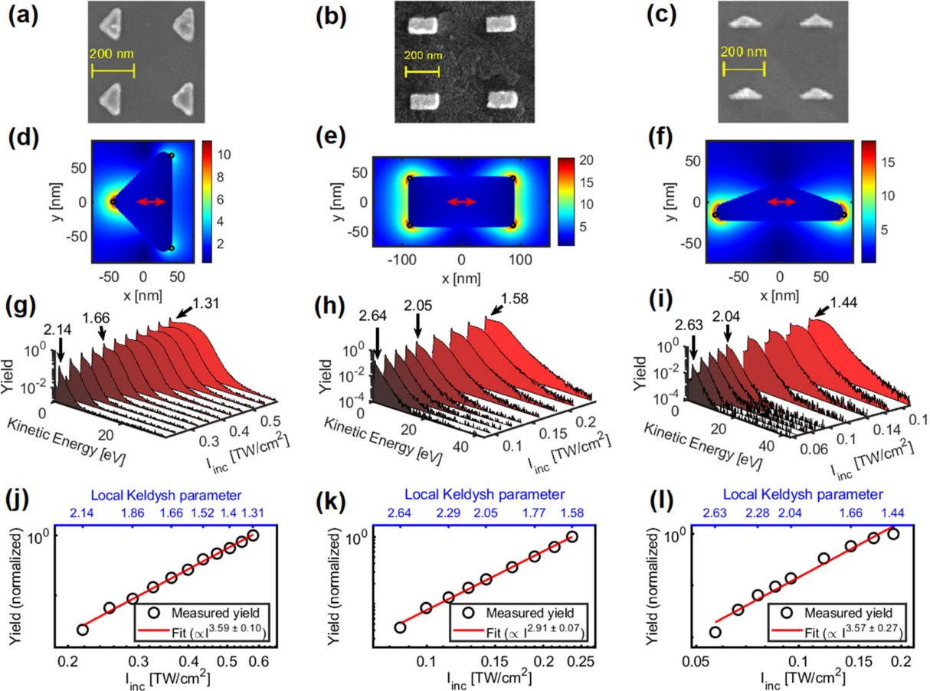
Nonadiabatic nanooptical tunneling of photoelectrons
B. Lovász…P. Dombi,
Nano Lett. 22, 2303 (2022)

Slide 6
Ultrafast electron processes in plasmonic systems
Plasmonic hot electron generation and decay
(1-1000 fs)
Photoemission (even in attoseconds if tunneling)

Slide 7
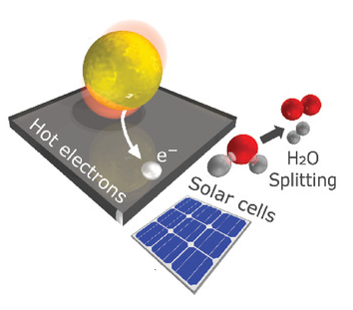
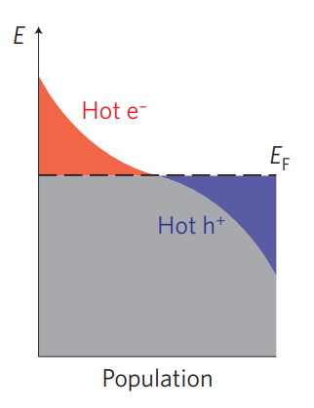
Hot electrons and their plasmon mediated excitation
Hot electrons: electrons with energy levels differing significantly from the Fermi-Dirac distribution at the given temperature
N.Nanotechnology 10, 25 (2015)
Adv.OpticalMater. 2020, 8, 1901166

Slide 8
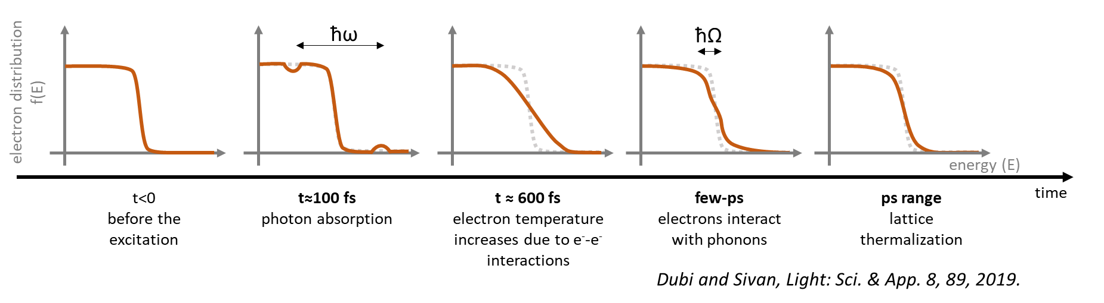
Typical timescales of electron excitation
Processes following SPP excitation // each process has its own f(E):
photon absorption drives the electron distribution out of equilibrium
electron-electron scattering: high temperature Fermi–Dirac distribution
electron–phonon interactions: reduction of this electron temperature on a picosecond time scale

Slide 9
What can ε₂ tell us about the excitation/decay of SPPs?
where
ε_{2,intra} is the contribution from intraband transitions
D is the energy distribution of the joint density of states
f(E) is the electron energy distribution
→ by measuring ε_{2,} we can extract information on f(E), therefore on hot electrons!
Budai, Pápa, Petrik & Dombi, Nature Comm. 13, 6695 (2022)

Slide 10
A very sensitive way to measure ε₂ is ellipsometry
Hot electron measurement concept:
to generate difference data with and without plasmon excitation

Slide 11
Ellipsometry model to reproduce measured data
Au with hot electrons: ε_{2,top}
variable thickness in model
Au without hot electrons: ε_{2,bottom}
substrate: ε_{2,substrate}

Slide 12
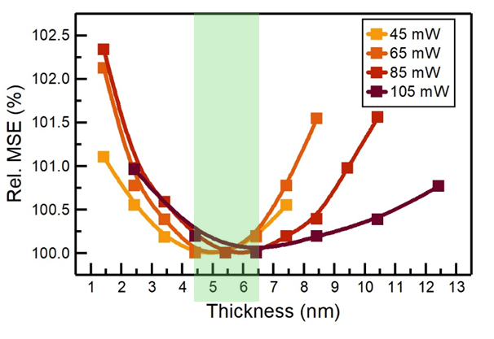
CW excitation – retrieving ε₂
The measured difference curves are perfectly reproduced
What is the thickness of the upper hot electron layer?
Changes with laser power between 4.5-6.5 nm
Budai, Pápa, Petrik & Dombi, Nature Comm. 13, 6695 (2022)

Slide 13
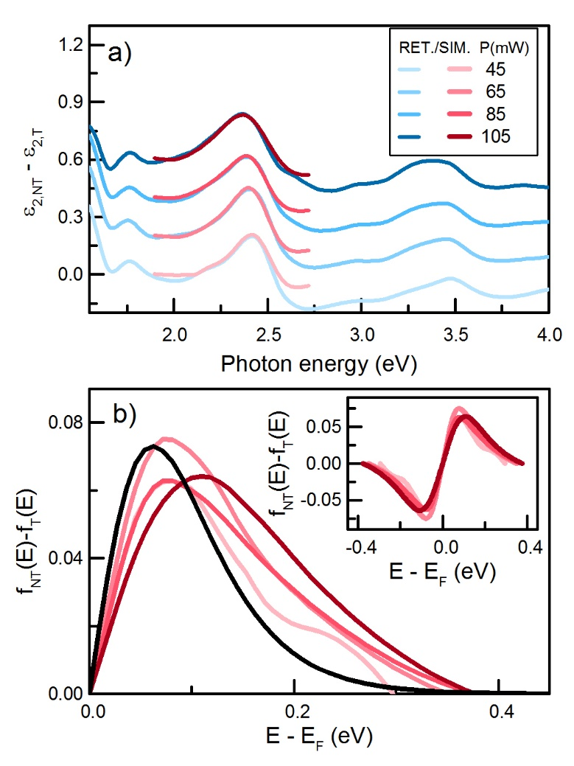
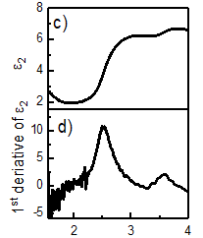
CW excitation – retrieving ε₂
How much do the dielectric function of the upper and the lower layer differ?
0.2 eV shift of interband bandedge due to hot electrons (2.5 eV vs. 2.3 eV)

Slide 14


Conclusion
4.5-6.5 nm
50 nm
…performed with novel ellipsometric probing
Budai, Pápa, Petrik & Dombi, Nature Comm. 13, 6695 (2022)

Slide 15
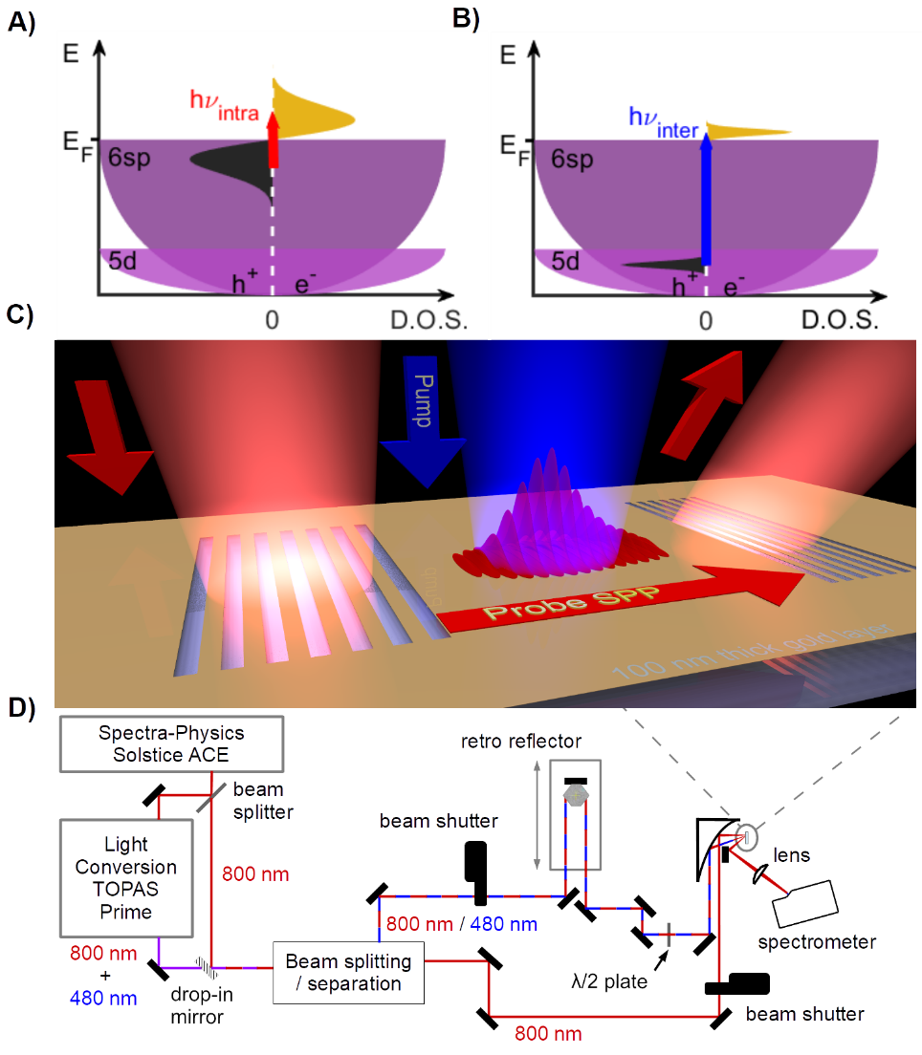
Time-resolved pump-probe experiment
Compare ultrafast intraband (800 nm pump) and interband (480 nm pump) excitations of gold at the nanoscale
New pump-probe method developed @Wigner: plasmon wavepacket as a probe for nonthermal electrons

Slide 16
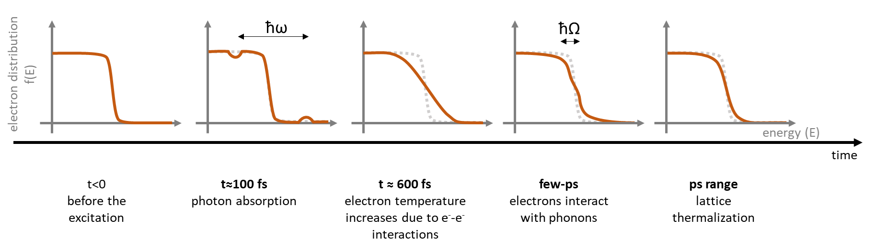
Ultrafast dynamics after photoexcitation

Slide 17
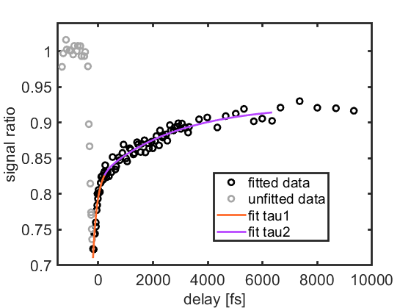
We measured a 2-component ultrafast decay of hot electron populations

Slide 18
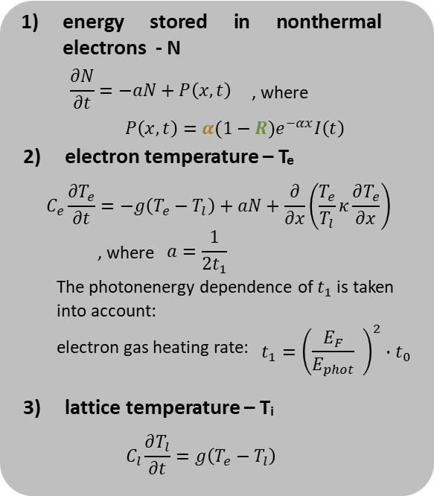
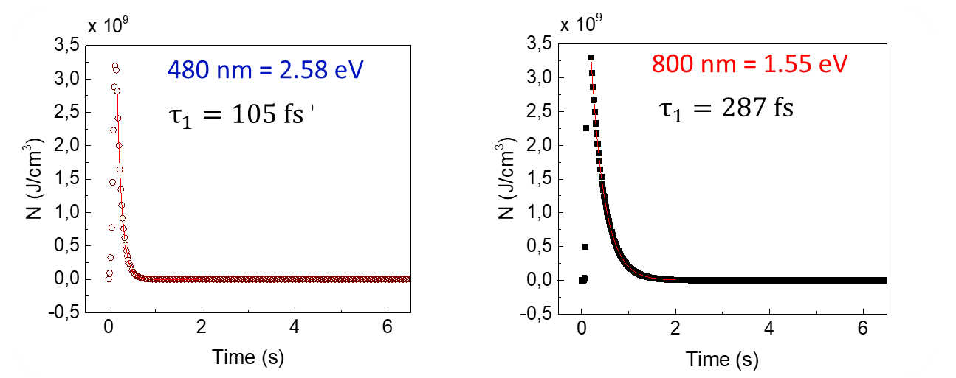
Three-temeprature model to reproduce measurement
THREE-TEMPERATURE-MODEL (3tm) to explain 2-comp. Decay
Pump affects optical properties of gold layer -> three-temperature model (3TM)
absorption coefficient (a) and reflection (R: 35% vs. 97%) different for 480 nm and 800 nm
Largest modulation ~ when energy stored in nonthermal electrons (N) is maximal in 3TM

Slide 19
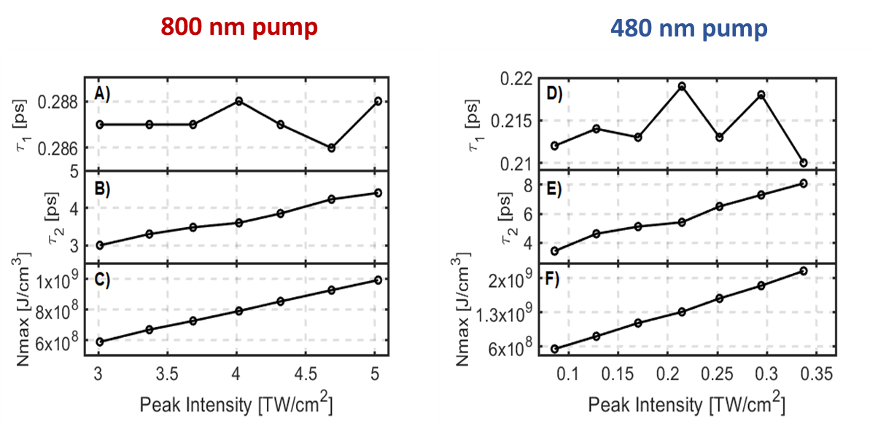
Three-temeprature model results
Lovász et al., submitted (2023)

Slide 20
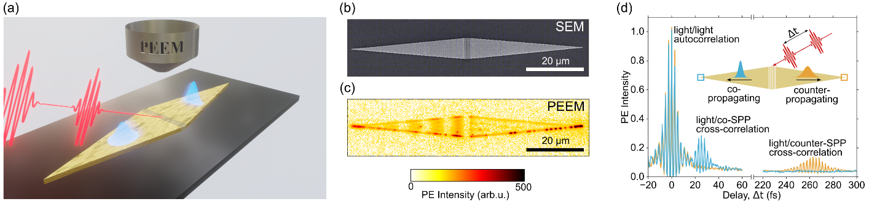
Collaboration with TU Graz (Martin Schultze): ultrahigh resolution plasmon nanoscopy

Slide 21
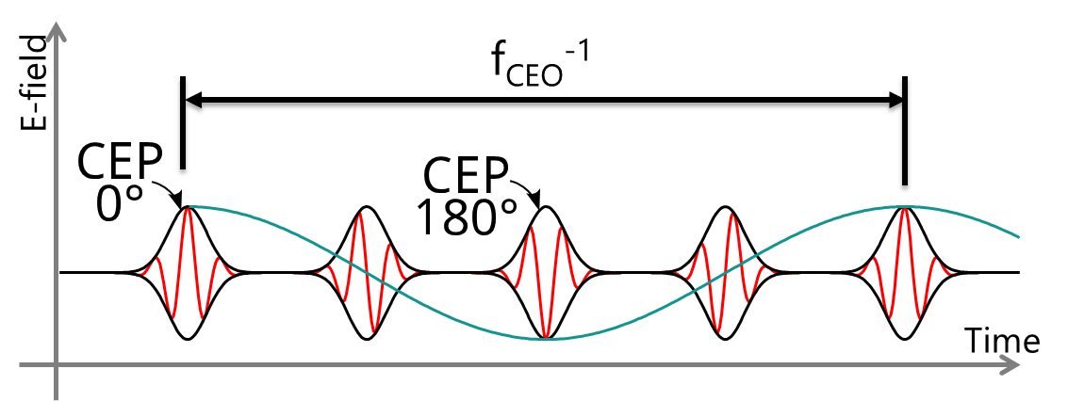
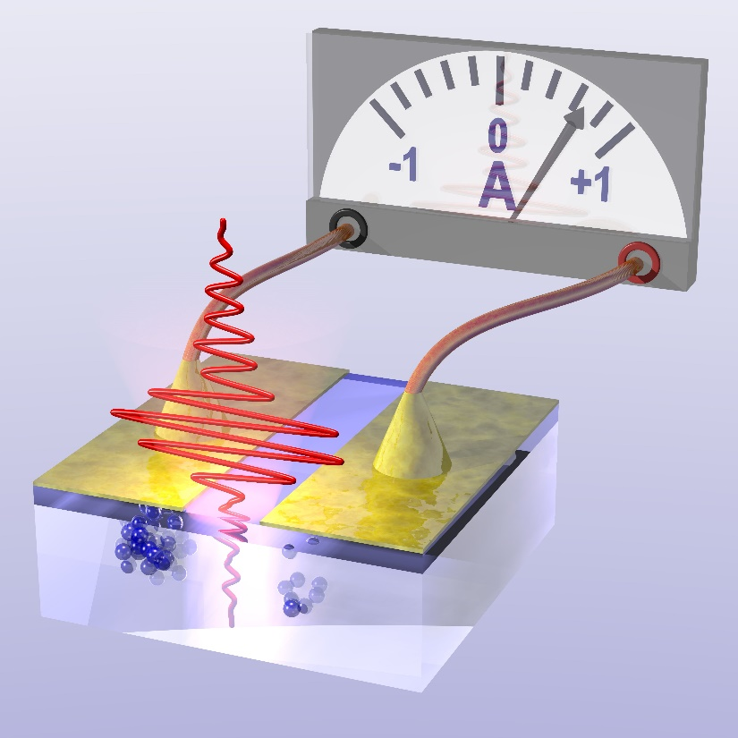
Carrier-envelope phase detector based on transient metallization of dielectrics
V. Hanus…P. Dombi, Optica, 8, 570 (2021)
V. Hanus…P. Dombi, Nature Commun., 14, 5068 (2023)

Slide 22
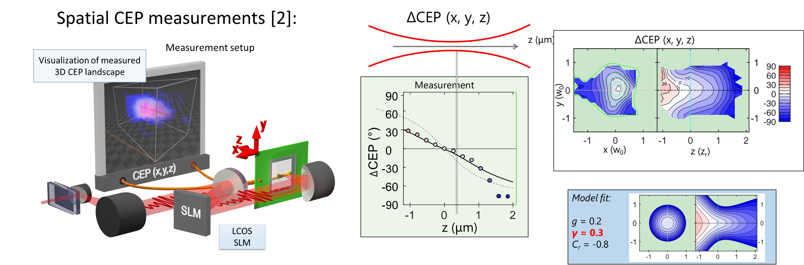
3D phase scanning and scuplting
V. Hanus…P. Dombi, Optica, 8, 570 (2021)
V. Hanus…P. Dombi, Nature Commun., 14, 5068 (2023)

Slide 23
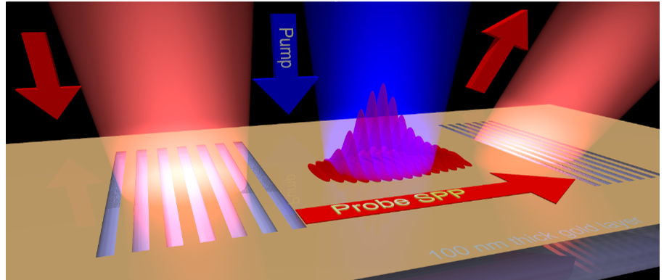
Conclusions
Nonadiabatic tunneling from nanoparticles
(Lovász, Nano Lett. 2022)
Ultrasensitive hot electron detection
(Budai et al. Nature Comm. 2022)
Plasmon probing of hot electron decay
(Lovász et al., 2023)
Optical chip for phase scanning and sculpting of laser beams
(Hanus et al., Nature Comm. 2023)

Slide 24

Thank you - lab members
P. Rácz, P. Sándor, V. Hanus, K. Vereb, Z. Pápa, V. Csajbók,
B. Fehér, B. Lovász, B. Bánhegyi, G. Ligeti, G. Z. Kiss
Open positions:
dombi.peter@wigner.hu
www.femtolab.hu

Slide 26
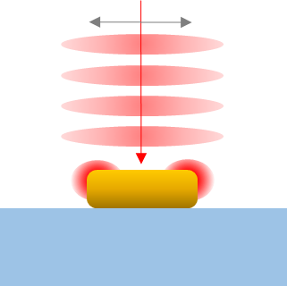
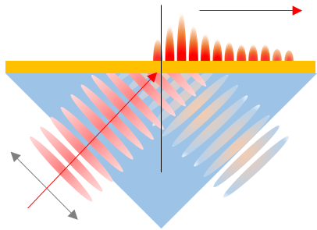
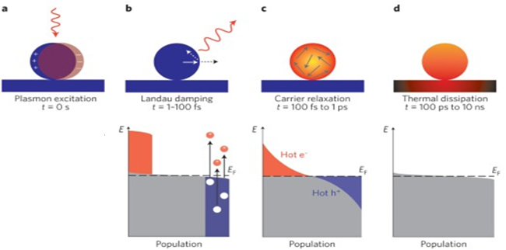
Surface plasmon polaritons (SPP) - collective charge-density oscillations and the coupled EM wave
~100 nm
After the excitation of SPP their energy is transfered to the electron subsystem and afterwards to the lattice
1st step of this process: hot electron generation
N.Nanotechnology 10, 25 (2015)

Slide 27
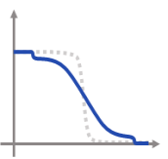
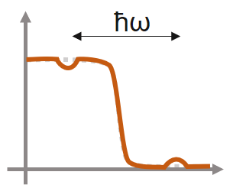
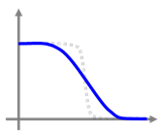
Understanding ε₂
generation of SPP
energy transferred to the electron subsystem
energy distributed via e⁻ - e⁻ and e⁻ - phonon scattering
CW excitation:
all sc. process are present and
the electron excitation is continued => a region with different e- distribution
Why do we observe hot electrons with energies only up to 0,4 eV?
Based on the 1.55 eV excitation photon energy one would expect higher photon energies
e⁻-e⁻scattering energy dependent => only less energetic electrons can be observed

Slide 28
What can ε₂ tell us about the excitation/decay of SPPs?
The different time-delays can be attributed to different process following SPP excitation
Each process have its own f(E):
photon absorption drives the electron distribution out of equilibrium
electron-electron scattering: high temperature Fermi–Dirac distribution
electron–phonon interactions: reduction of this electronic temperature on a picosecond time scale
t<0
before the excitation
t≈100 fs
photon absorption
t ≈ 600 fs
electron temperature increases due to e⁻-e⁻ interactions
few-ps
electrons interact with phonons
ps range
lattice thermalization
Dubi and Sivan, Light: Sci. & App. 8, 89, 2019.

Slide 29
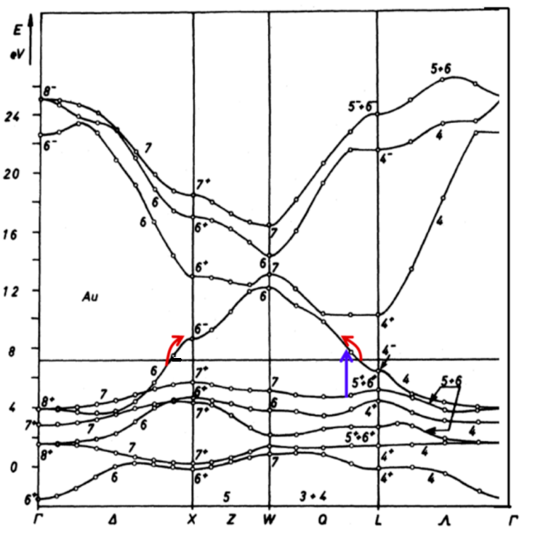
Interband and intraband excitation pathways with 480 nm and 800 nm pumps
Govorov et al. J. Phys. Chem. C 2013 117, 32
Notes:
So here you can see the band structure of gold, and there are pathway for 800 nm intraband exitations, and 480 nm interband exitations

