Slide 1
Self-Consistent Strong Screening Applied to Thermonuclear Reactions
Electron-Positron plasma in the during the BBN Epoch
Chris Grayson – Particles & Plasmas Symposium 2024
“C. Grayson, C.T. Yang, M. Formanek, J. Rafelski - Publication forthcoming”

Slide 2
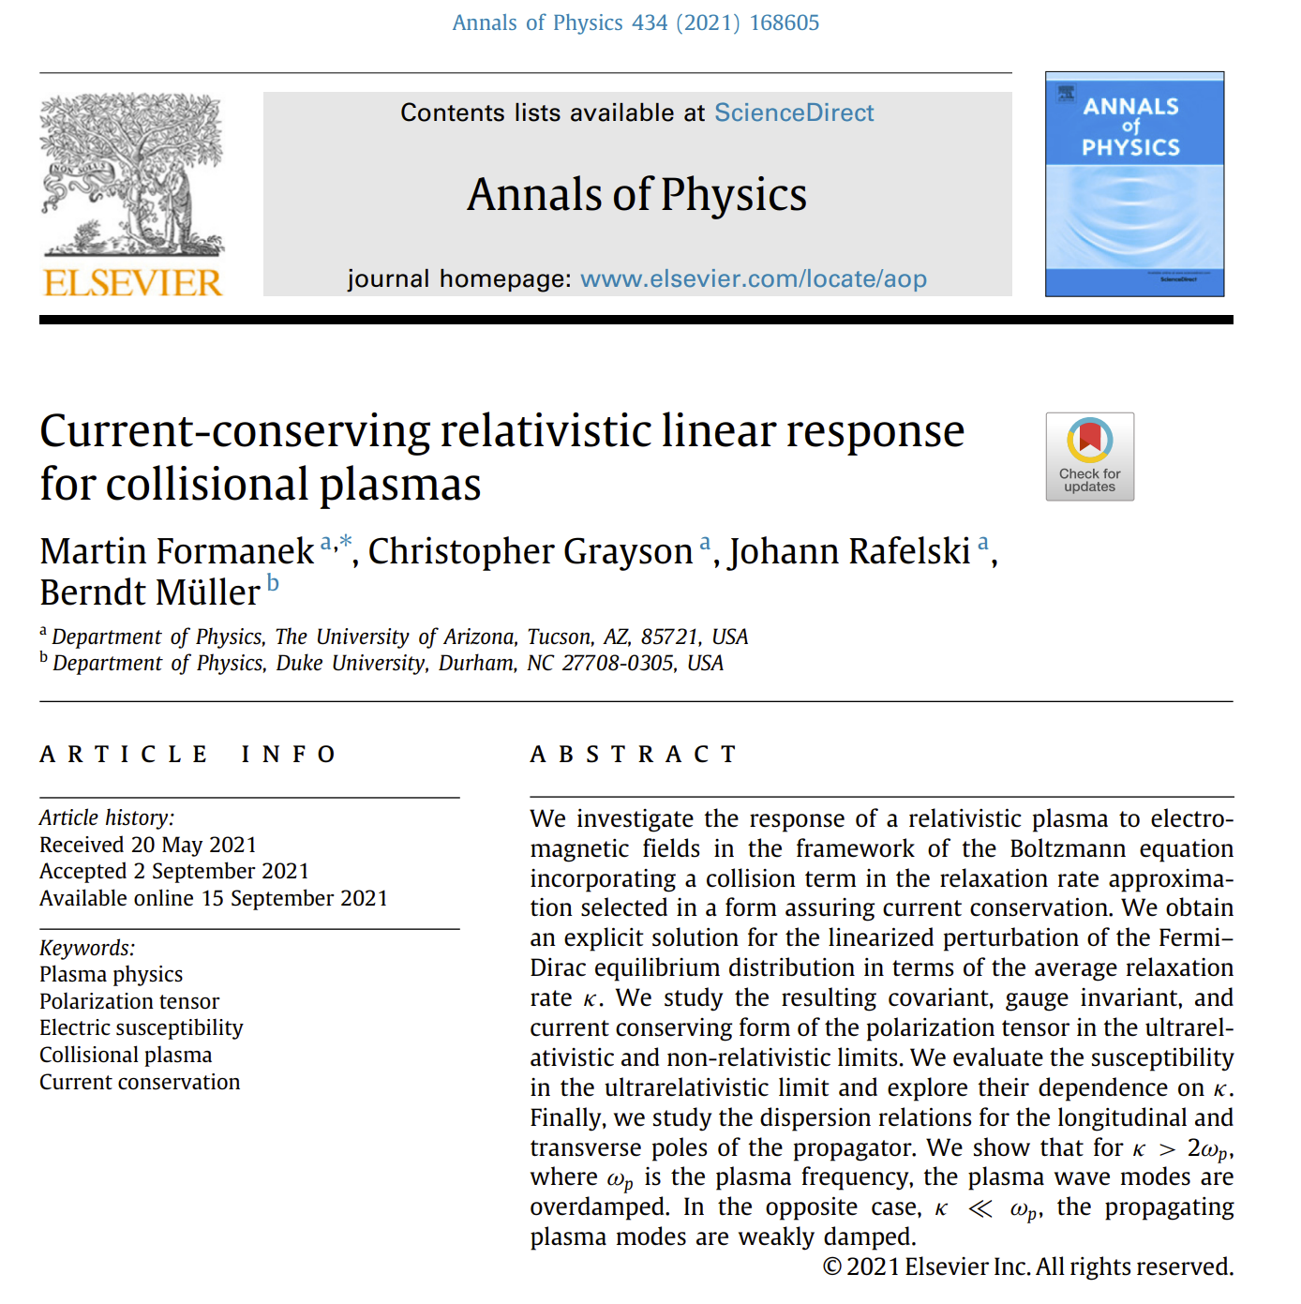
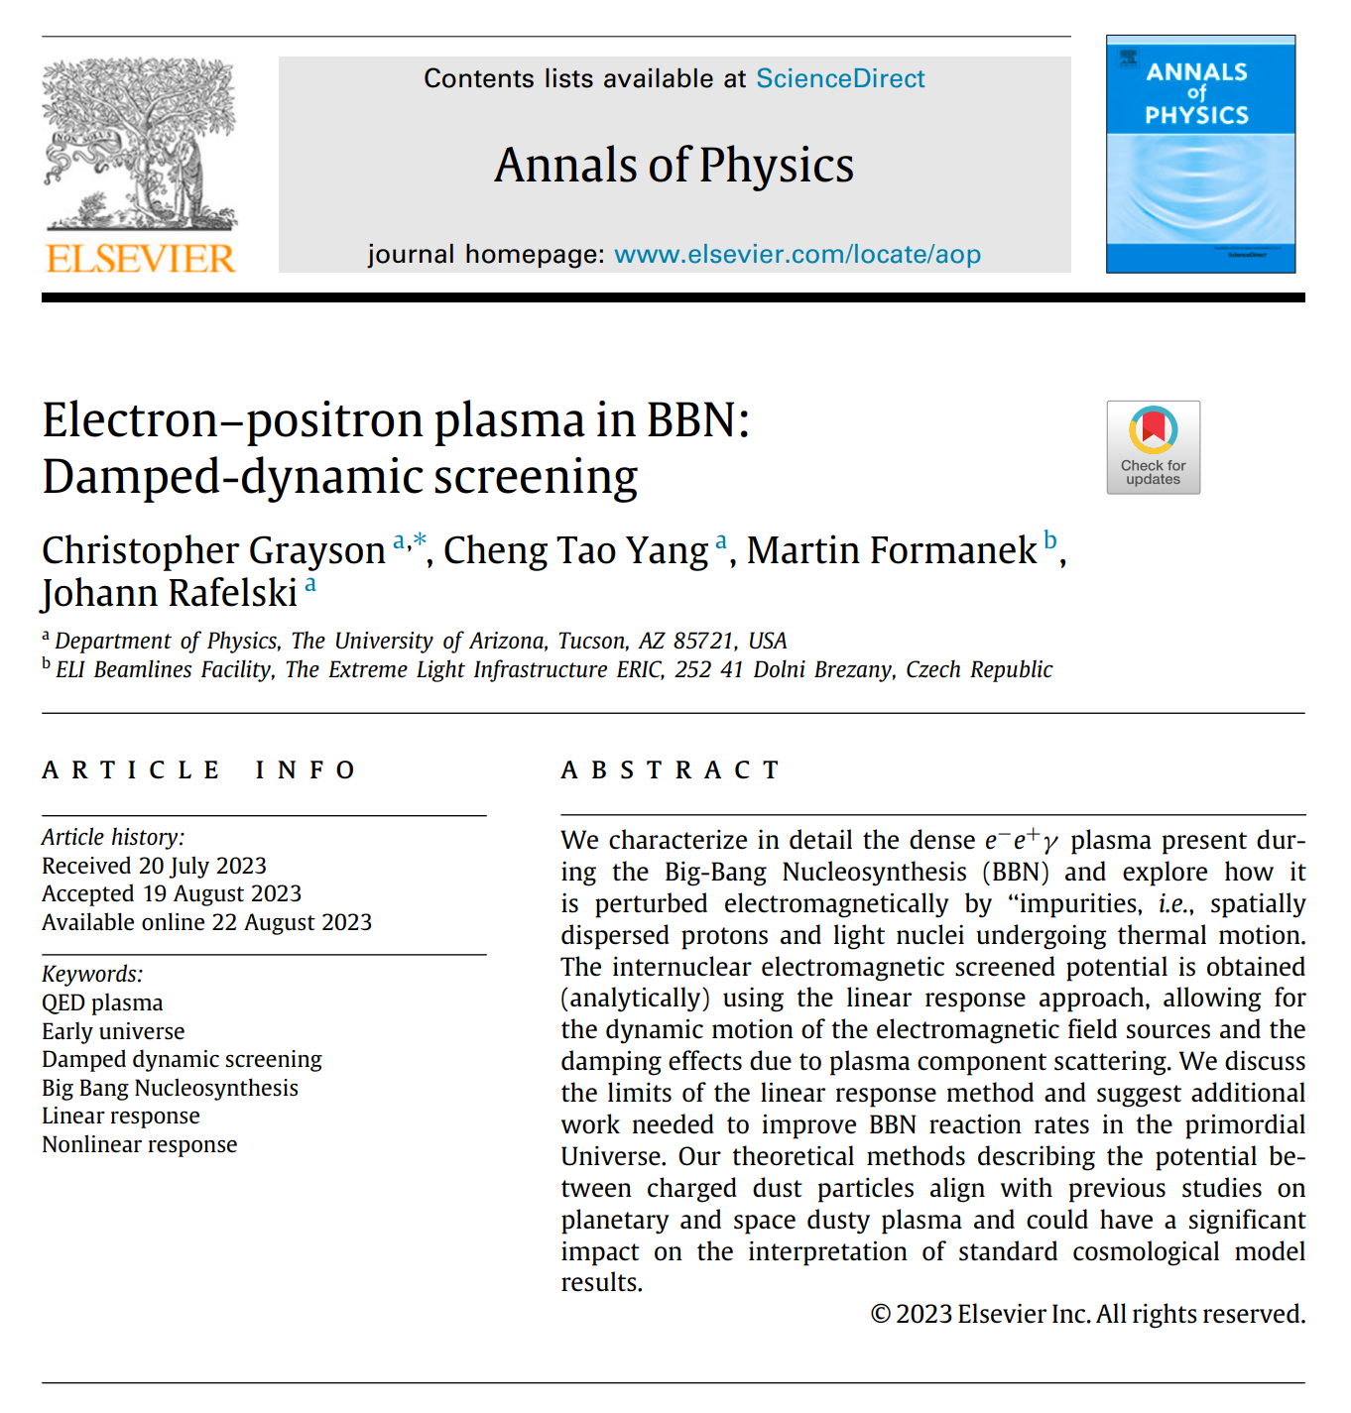
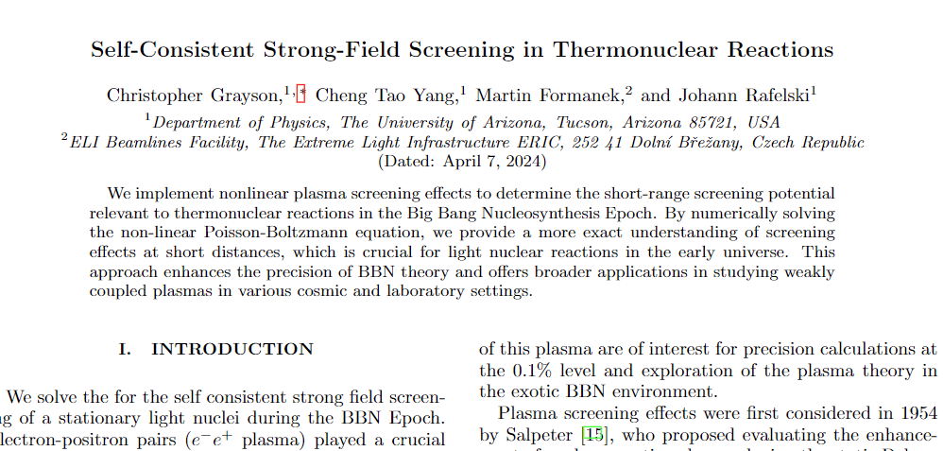
My Research
My current research interest is to model electromagnetic fields of heavy particles in extremely dense matter-antimatter plasmas studied in our research group in A rizona.
We developed covariant kinetic theory used to calculate electromagnetic fields using in space and time dependent plasmas with damping from collisions (2021). This allows for a finite conductivity $σ$ which can respond to dynamic EM fields.
With these methods, we obtain new results for electromagnetic fields in quark-gluon plasma in heavy ion collisions (2023) and in electron-positron plasma during Big Bang Nucleosynthesis (2023-2024).
Being finalized

Slide 3
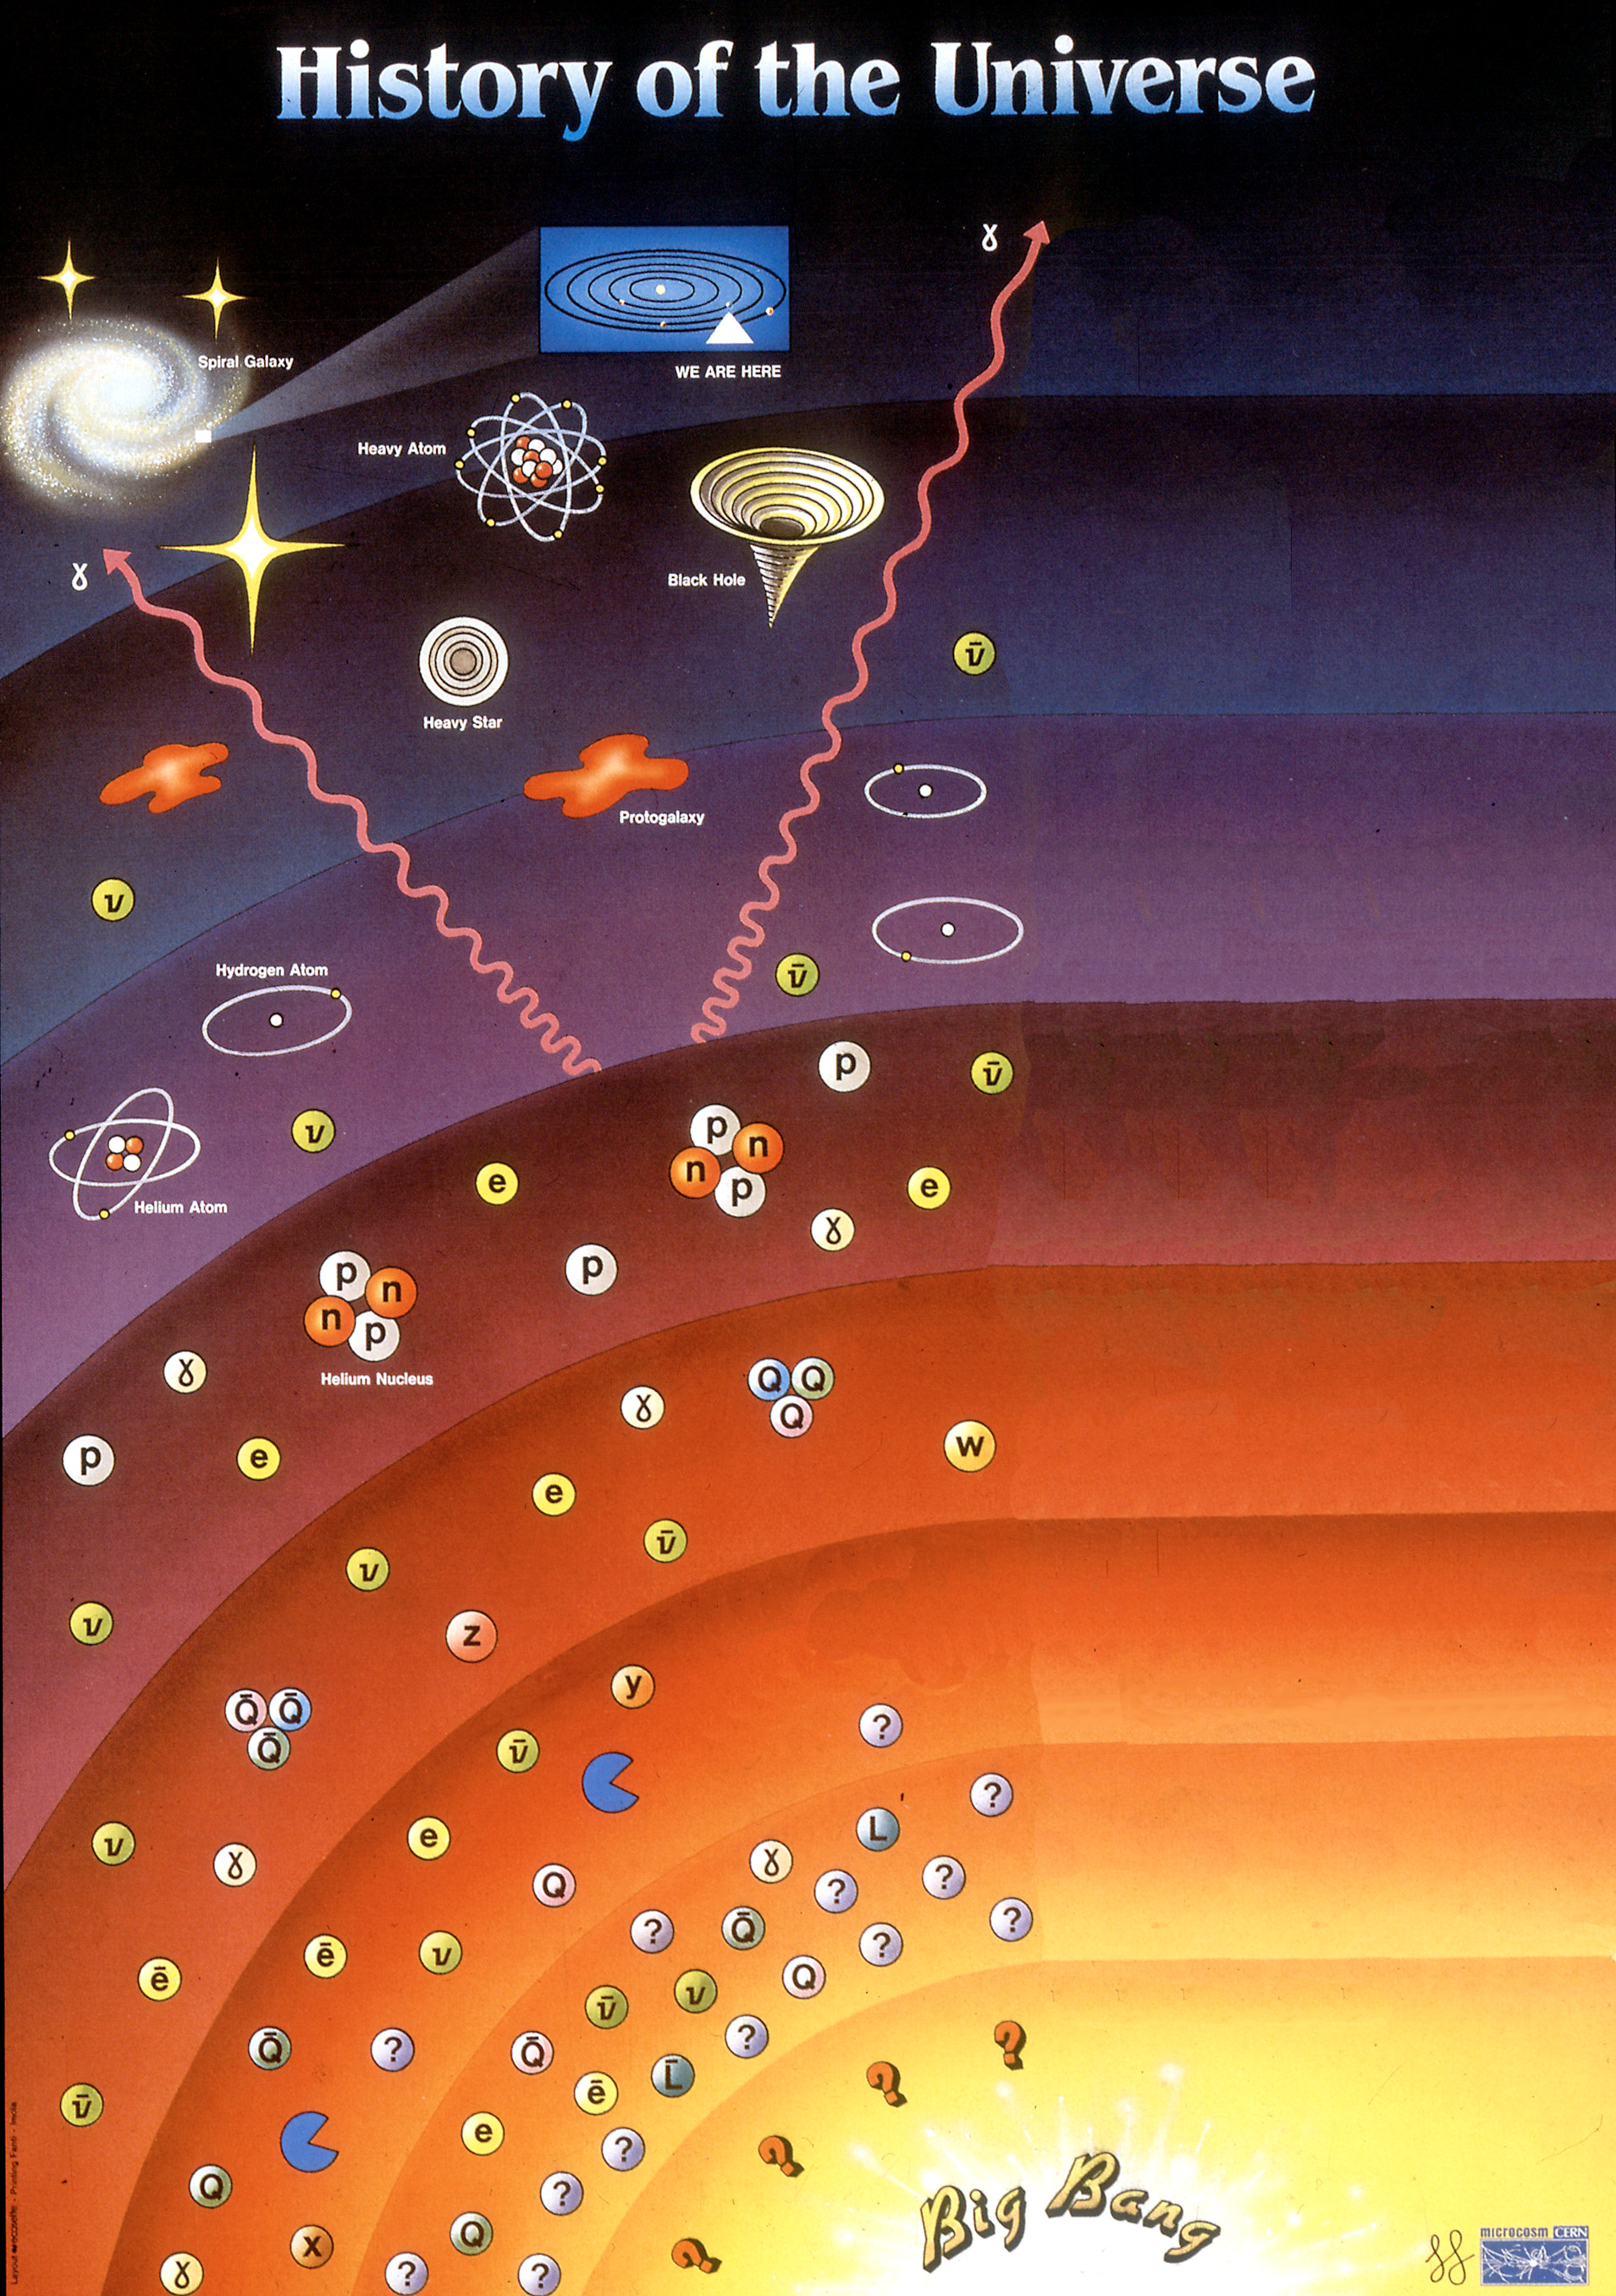
13.7 billion
years
The Big Bang Nucleosynthesis Epoch
Time
Temp.
The early universe was filled with hot dense plasma whose composition evolved over time as the universe cooled.
The Big Bang nucleosynthesis Epoch (BBN), began when the universe cooled enough for dueterium to form. During this time many of the universe’s light elements (H, He, Be, Li, B, C) were produced in fusion reactions.
The abundances of these primordial light elements allow us to study the universe before recombination.
We will focus on a smaller time scale $∼2−20$minutes ($T=86−50$ keV) after the Big Bang since after this period most fusion reactions had already taken place.
300,000
years
3000℃
Big Bang Nucleosynthesis Epoch (BBN)
100 s
10⁹ ℃
The Universe is filled with dense plasma
Pitrou, C., A. Coc, J.-P. Uzan, and E. Vangioni (2018). Phys. Rept., 754, pp. 1–66.

Slide 4
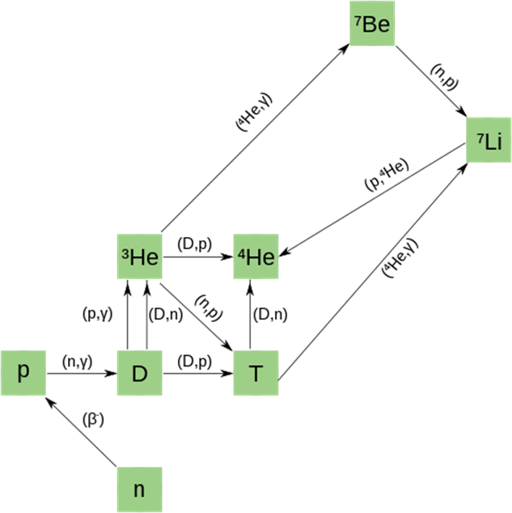
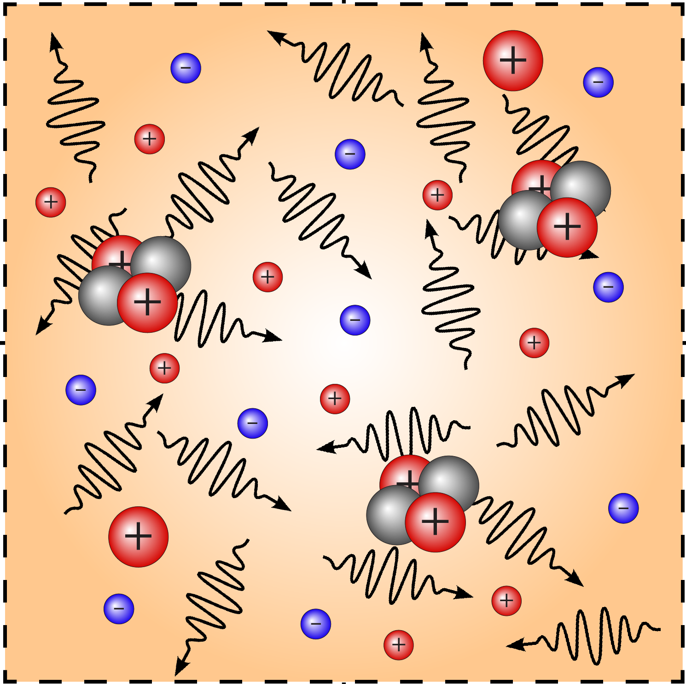
Big Bang Nucleosynthesis (BBN)
During BBN, numerous fusion reactions occur, producing primordial light element distributions.
Open questions and tensions between measurement and theory remain about light element distributions in the universe.
It is becoming more widely recognized that the universe was filled with a hot dense electron-positron plasma interspersed with light nuclei during BBN.
Carraro et al. (1988), Famiano et al. (2016), X. Yao et al (2017), B. Wang et al. (2021), Sasankan et al. (2020), Kedia et al. (2021), C. Grayson et al. (2023)
BBN fusion reaction network is normally imagined in vacuum
BBN fusion reaction network re-imagined in a plasma.

Slide 5
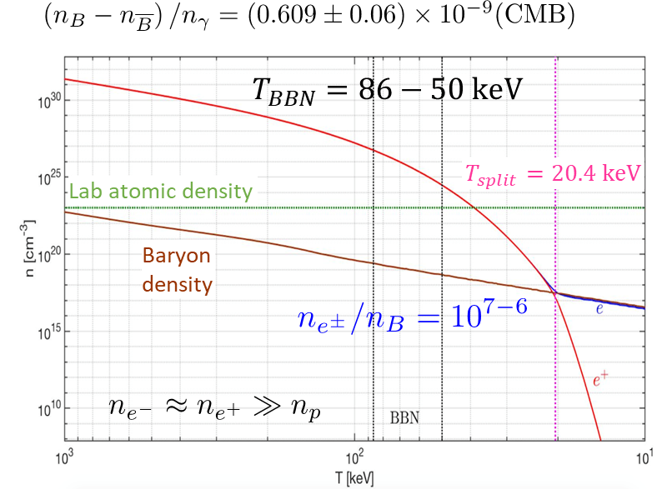
BBN $e^{+}e^{−}$Plasma: Early Universe Contents
BBN nuclear reactions occurred in the presence of a hot dense electron-positron plasma.
Solar Core Density
C. Grayson, C. T. Yang, M. Formanek, and J. Rafelski (2023). Annals Phys., 458, p. 169453.
Figure by Cheng Tao Yang, University of Arizona

Slide 6
BBN $e^{+}e^{−}$Plasma: Early Universe Contents
BBN nuclear reactions occurred in the presence of a hot dense electron-positron plasma
Solar Core Density
Since the baryon density is very small, we describe them as spatially dispersed heavy ‘impurities’ in the plasma.
C. Grayson, C. T. Yang, M. Formanek, and J. Rafelski (2023). Annals Phys., 458, p. 169453.
Figure by Cheng Tao Yang, University of Arizona

Slide 7
BBN $e^{+}e^{−}$Plasma: Early Universe Contents
BBN nuclear reactions occurred in the presence of a hot dense electron-positron plasma.
Solar Core Density
Since the baryon density is very small, we describe them as spatially dispersed heavy ‘impurities’ in the plasma.
Before T=20 keV, the electron-positron chemical potential is zero. Thus the plasma contains effectively equal parts electrons and positrons.
C. Grayson, C. T. Yang, M. Formanek, and J. Rafelski (2023). Annals Phys., 458, p. 169453.
Figure by Cheng Tao Yang, University of Arizona
Notes:
use

Slide 8
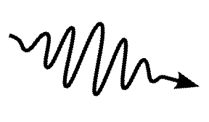
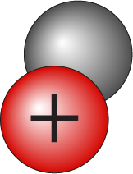
BBN $e^{+}e^{−}$Plasma: Early Universe Contents
The early universe plasma is filled with incredibly dense electron-positron plasma interspersed with ionized light elements.
proton
Helium-4
photon
electron
Hydrogen-2
positron
Relatively dispersed with some heavier elements
Li, Be, B, C
$100−1000$times greater density
Electrons travel 100 times faster than the slower ionized light elements.
$$v_{i}≈ \sqrt{{2T}/{m_{i}}}$$
Low density slow moving “impurities” in a high-density medium of fast-moving light particles.
“Plasma is purely electromagnetic during BBN”

Slide 9
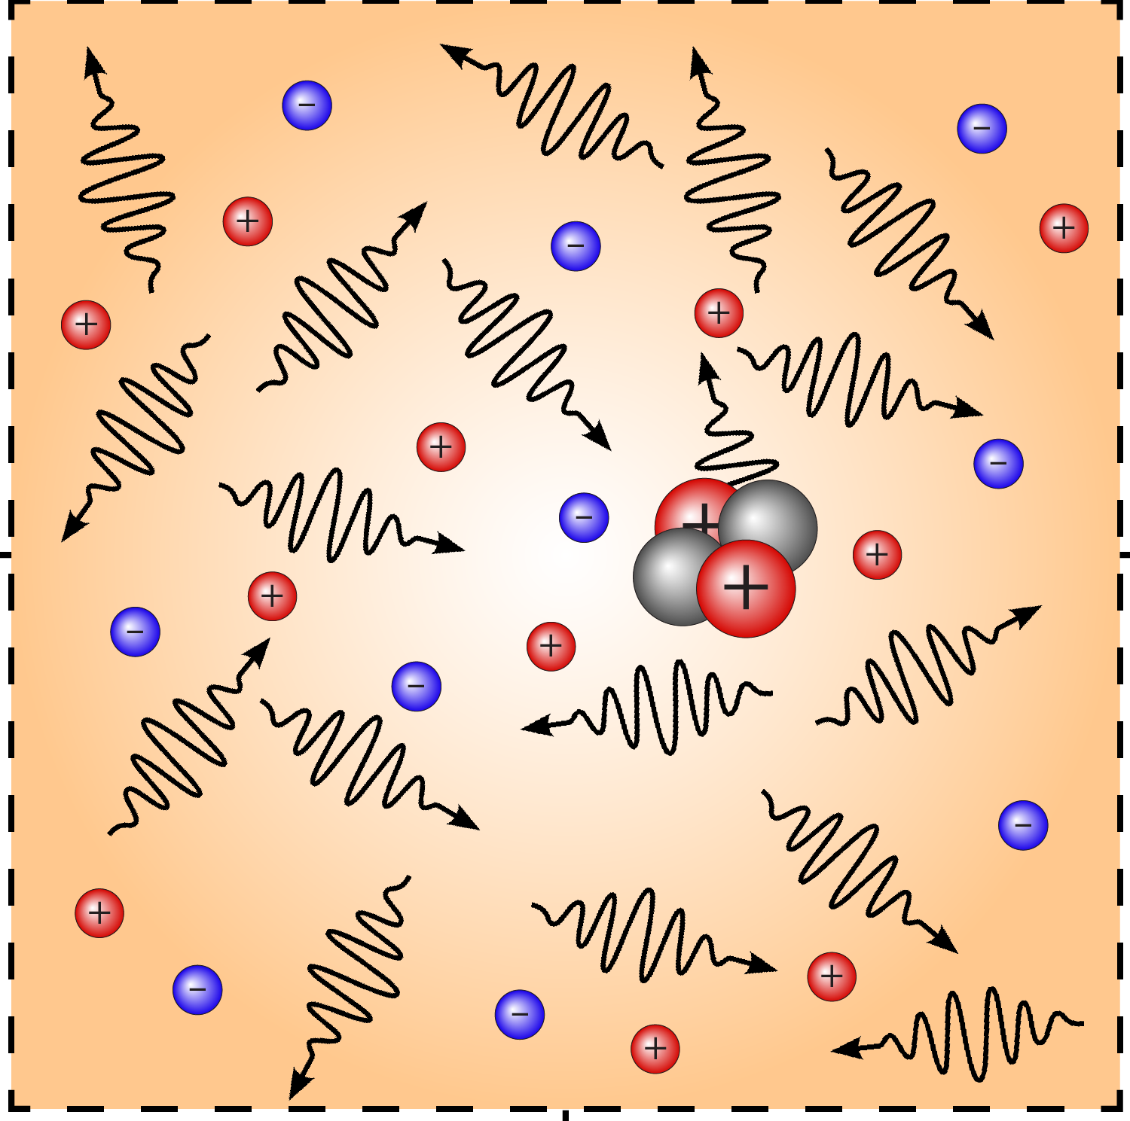
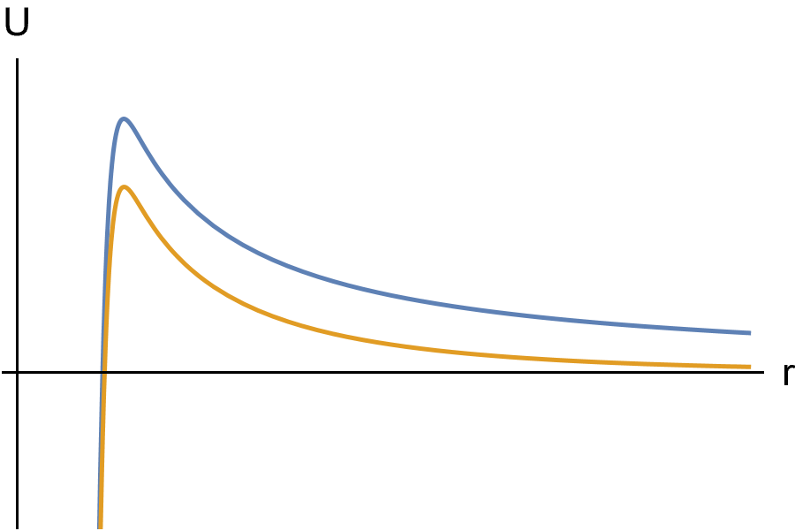
How Does a Plasma Alter Fusion Reactions?
Ion acts as an external perturbation in the plasma.
$$λ_{D}$$
$$φ_{stat}\left(r\right)= \frac{Ze}{4π ε_{0} r} e^{−r/{λ_{D}}}$$
$$φ_{stat}\left(r\right)= \frac{Ze}{4π ε_{0} r}$$
Polarization reduces electrostatic repulsion.
Ions generate an electromagnetic potential around them.
Reduction of the coulomb barrier enhances reactions rates.
Enhancement of reactions rates changes primordial light element distributions.
Strong Nuclear Attraction
Electromagnetic repulsion
E. E. Salpeter, “Electron screening and thermonuclear reactions,” Austral. J. Phys. 7 (1954), 373-388 doi:10.1071/PH540373

Slide 10
BBN Plasma is Globally Weakly Coupled
A plasma is weakly coupled if the coulomb energy is much less than the thermal energy
$$λ_{D}$$
$$a$$
$$R$$
$$\frac{eφ(a)}{T}≪1$$
$a=n_{B}^{−1/3}$- internuclear spacing
$R$ – nuclear radius
$λ_{D}=$ Debye screening length
$$k_{B}=1$$
Then the plasma is dominated by thermal fluctuations rather than coulomb polarization attraction
$\frac{eφ(a)}{T}≈{10}^{−2}$ with
$a≈{10}^{4}$ fm
Globally the BBN plasma is weakly coupled.
Notes:
use

Slide 11
BBN $e^{+}e^{−}$Plasma: Screening Models
Static Screening - nuclei sit at rest in the global frame of the plasma and have a standard Debye-Hückel potential.
E. E. Salpeter (1954), Salpeter & van Horn (1969), Famiano et al. (2016)
Dynamic Screening - due to the temperature of the BBN plasma nuclei have a nonrelativistic thermal distribution of velocities.
Carraro et al. (1988), X. Yao et al. (2017), B. Hwang et al. (2021)
Static screening potential has corrections due to the motion of nuclei.
Damped-Dynamic Screening – collisions between plasma particles cause damping in the dynamic screened potential.
$$β_{N}={v_{N}}/c≈ \sqrt{\frac{2T}{m_{N}c^{2}}}$$
(Most probable velocity Boltzmann Distribution)
Usually, models assume the weak field limit ${eφ}/T≪1$
C. Grayson, C. T. Yang, M. Formanek, J. Rafelski, Annals Phys. 458 (2023)
The short-distance potential does not satisfy the weak screening condition.
Notes:
use

Slide 12
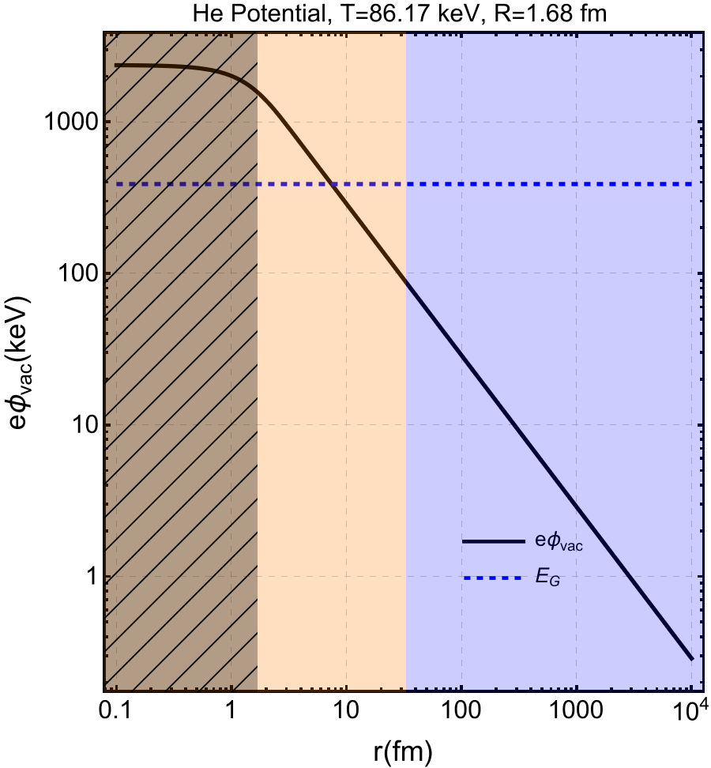
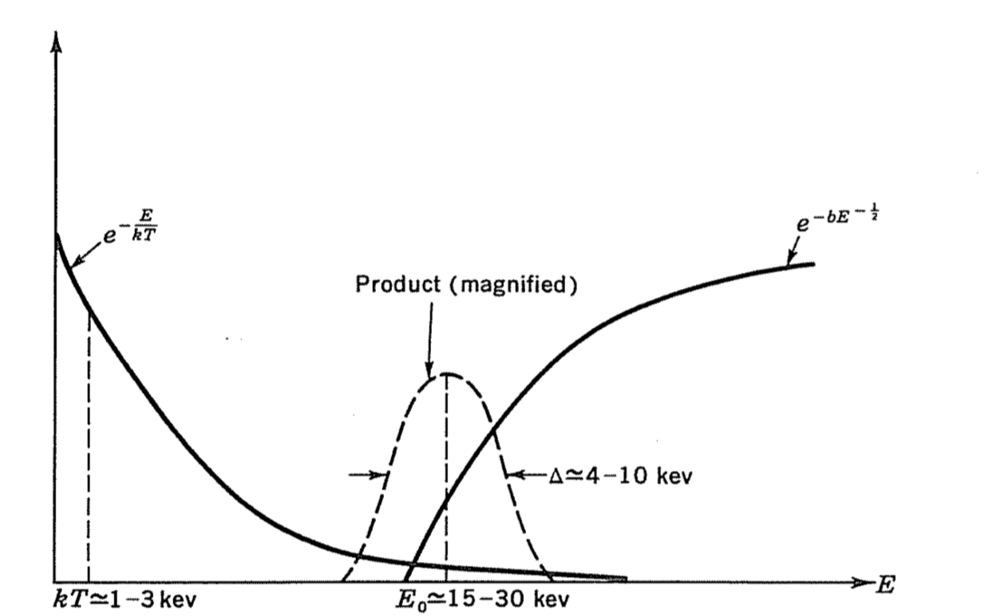
Strong Screening
Although the BBN is weakly coupled at large distances $a,$ this is not true for the short-range potential in relevant for quantum tunneling.
$$E_{G}$$
$$\frac{eφ}{T}>1$$
$$\frac{eφ}{T}<1$$
Nuclear interior
Strong Screening
Weak Screening
Energy
Distribution
Tunneling
Probability
“Tunneling occurs at the Gamow energy $E_{G}$”
$$E_{G}$$
Clayton, Donald. Principles of Stellar Evolution and Nucleosynthesis. University of Chicago Press, 1983, p. 302.
$μ_{r}$ - reduced mass
Notes:
use

Slide 13
Strong Screening
Although the BBN is weakly coupled at large distances $a,$ this is not true for the short-range potential in relevant for quantum tunneling.
$$E_{G}$$
$$\frac{eφ}{T}>1$$
$$\frac{eφ}{T}<1$$
Nuclear interior
Strong Screening
Weak Screening
Energy
Distribution
Tunneling
Probability
The short-range potential requires strong screening.
“Tunneling occurs at the Gamow energy $E_{G}$”
$$E_{G}$$
Clayton, Donald. Principles of Stellar Evolution and Nucleosynthesis. University of Chicago Press, 1983, p. 302.
$μ_{r}$ - reduced mass
Notes:
use

Slide 14
What is Strong Screening? Example Boltzmann case
The full non-relativistic equilibrium distribution includes a potential term that accounts for the energy change due to the rest frame potential (or equivalently uses the kinetic vs canonical momentum) to describe the rest energy[2, 3]
Where $u_{μ}=(1, 0, 0, 0)$ is the reference frame velocity of the plasma. The density according to this distribution is the normal expression but altered by the exponential factor in potential
For and electron $q=−e$ and a potential generated by a positive charge, the equilibrium density is exponentially enhanced
Using Boltzmann statistics, a huge strong screening effect is expected $\frac{eφ\left(0\right)}{T}≈20$
[2] R. Hakim ”Relativistic Perfect Gas in an External Force Field,”Phys. Rev. 162, 128 (1967) doi:10.1103/PhysRev.162.128 [3] S. R. De Groot, W. A. Van Leeuwen and C. G. Van Weert, Relativistic Kinetic Theory. Principles and Applications, North-Holland Publishing Company (1980)

Slide 15
Strong Screening to Self Consistent Screening
“Strong” Screening $\left({eφ}/T≫1\right)$ - relevant for strongly coupled plasmas and assumes a uniform density of electrons that can completely screen nuclei.
Relevant for white dwarf $^{12}$C plasma.
E. E. Salpeter (1954), H. E. Dewitt et al. (1973),N. Itoh et al. (1977 & 1979), S. Ichimaru (1982), P. A. Kravchuk & D. G. Yakovlev (2014)
Self-Consistent Strong Screening (intermediate screening) - Solving the Poisson equation including energy change due to potential $φ.$ Valid for all ${eφ}/T$.
A. V. Gruzinov & J. N. Bahcall, (1998), D. Elsing & A. Palffy (2022) – Boltzmann Statistics
R. D. Cowan & J. G. Kirkwood (1958), M. Bruggen & D. O. Gough (2000), Liolios (2004) – Fermi-Dirac statistics
Notes:
use

Slide 16
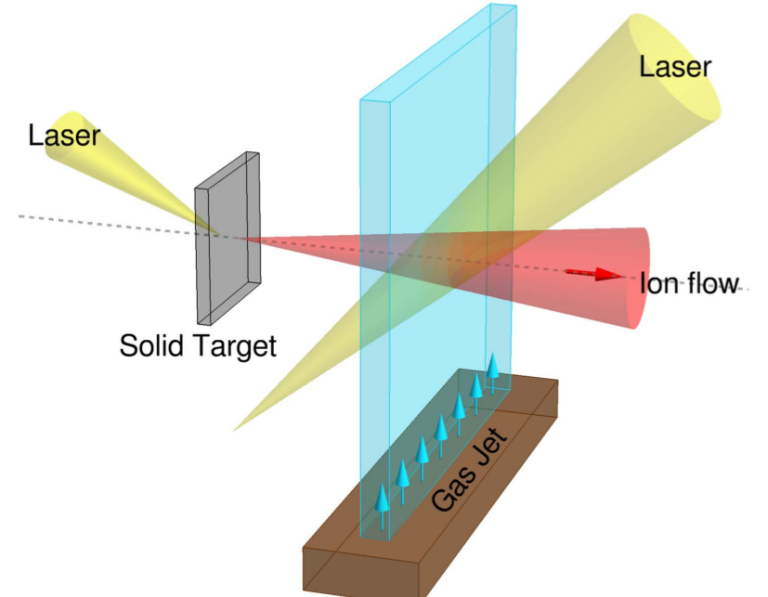
Strong Screening to Self Consistent Screening
“Strong” Screening $\left({eφ}/T≫1\right)$ - relevant for strongly coupled plasmas and assumes a uniform density of electrons that can completely screen nuclei.
Relevant for white dwarf $^{12}$C plasma.
E. E. Salpeter (1954), H. E. Dewitt et al. (1973),N. Itoh et al. (1977 & 1979), S. Ichimaru (1982), P. A. Kravchuk & D. G. Yakovlev (2014)
Self-Consistent Strong Screening (intermediate screening) - Solving the Poisson equation including energy change due to potential $φ.$ Valid for all ${eφ}/T$.
A. V. Gruzinov & J. N. Bahcall, (1998), D. Elsing & A. Palffy (2022) – Boltzmann Statistics
R. D. Cowan & J. G. Kirkwood (1958), M. Bruggen & D. O. Gough (2000), Liolios (2004) – Fermi-Dirac statistics
Historically an anonymously large screening effect is measured at low temperature (high $eφ/T)$ as compared to Debye-Hückel Theory. Shoppa et al. (1993), Zhang et al. (2020).
Strong Screening has recently become of interest in the context of reaction rate enhancement in laser fusion, Elsing et al. (2022).
Wu & Palffy (2017)
Notes:
use

Slide 17
Strong Screening to Self Consistent Screening
“Strong” Screening $\left({eφ}/T≫1\right)$ - relevant for strongly coupled plasmas and assumes a uniform density of electrons that can completely screen nuclei.
Relevant for white dwarf $^{12}$C plasma.
E. E. Salpeter (1954), H. E. Dewitt et al. (1973),N. Itoh et al. (1977 & 1979), S. Ichimaru (1982), P. A. Kravchuk & D. G. Yakovlev (2014)
Self-Consistent Strong Screening (intermediate screening) - Solving the Poisson equation including energy change due to potential $φ.$ Valid for all ${eφ}/T$.
A. V. Gruzinov & J. N. Bahcall, (1998), D. Elsing & A. Palffy (2022) – Boltzmann Statistics
R. D. Cowan & J. G. Kirkwood (1958), M. Bruggen & D. O. Gough (2000), Liolios (2004) – Fermi-Dirac statistics
Strong screening has not yet been applied to BBN.
We solve the Poisson equation without approximation using finite sized nuclei. (Using point charges leads to singular behavior near the origin.)
Notes:
use

Slide 18
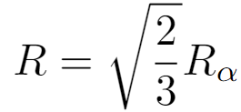
Finding the Short-range Potential
$R_{α}=1.67824$ fm
$$\text{Krauth}\text{,} \text{et} \text{al}\text{., }\text{Nature}\text{ 589 (2021).}$$
We would like to find how the strong screening polarization cloud around light nuclei screens the electromagnetic potential during BBN. This can be done by solving the Poisson equation for the induced polarization charge and the external charge of the light nuclei
“Gaussian Charge Distribution”
where
The equilibrium-induced charge density is the difference between the charge density of electrons and positrons
Boltzmann statistics
The induced charge density $ρ_{ind}$ will be a nonlinear function of the total potential $φ$ given by the equilibrium phase space distribution $f_{eq}$.
Fermi-Dirac statistics

Slide 19
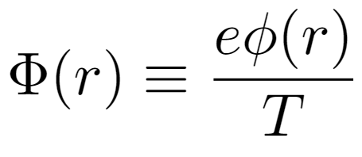
Finding the Short-range Potential
$R_{α}=1.67824$ fm
$$\text{Krauth}\text{,} \text{et} \text{al}\text{., }\text{Nature}\text{ 589 (2021).}$$
We calculate the strong screening polarization cloud around light nuclei by finding the electromagnetic potential during BBN. This can be done by solving the Poisson equation for the induced polarization charge and the external charge of the light nuclei
____Re-definitions:____
Generalized Screening mass
The screening mass $m_{s}^{2}\left(Φ\right)$ can be used to compare weak screening, and strong screening using Fermi-Dirac and Boltzmann statistics.
-Weak Screening

Slide 20
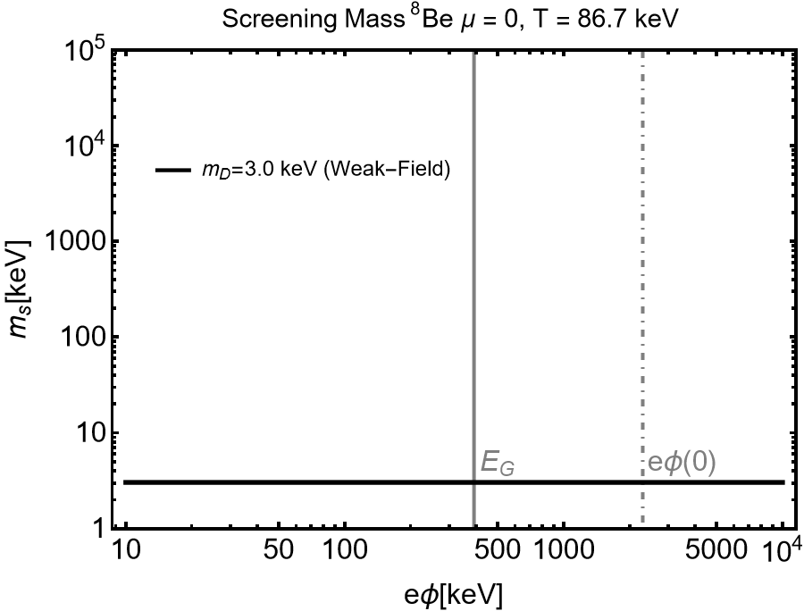
Generalized Screening Mass: $m_{s}(Φ)$
We show us the strength of the screening mass as a function of potential $eφ$.
Weak screening _
The BBN plasma asymptotically satisfies Boltzmann statistics
Weak screening is doesn’t depend on the external potential and describes the screening properties of the plasma at large distances $\frac{φ}{T}≪1$
“Gamow
Energy”
“Potential
at origin”
$E_{G}≈390$ keV
$eφ\left(0\right)≈2300$ keV

Slide 21
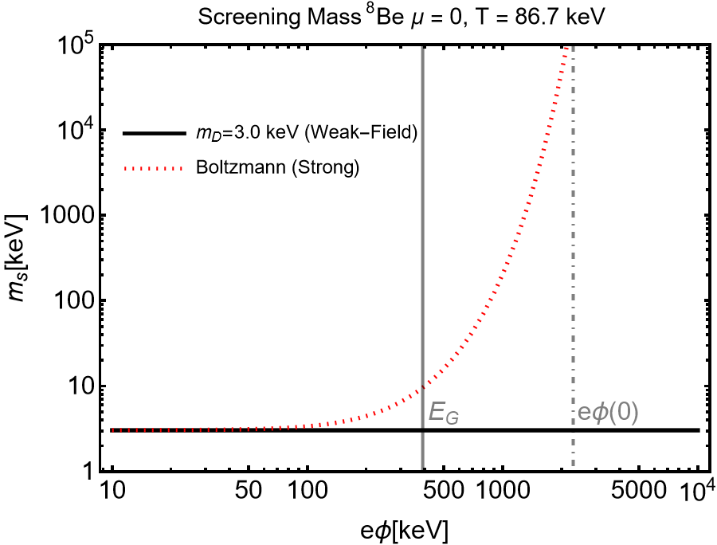
Generalized Screening Mass: $m_{s}(Φ)$
We show us the strength of the screening mass as a function of potential $eφ$.
Weak screening _
Large distance behavior
Boltzmann screening _
The screening mass using Boltzmann statistics over predicts the amount of screening due to the large local density in the polarization cloud around the nucleus
$E_{G}≈390$ keV
$eφ\left(0\right)≈2300$ keV

Slide 22
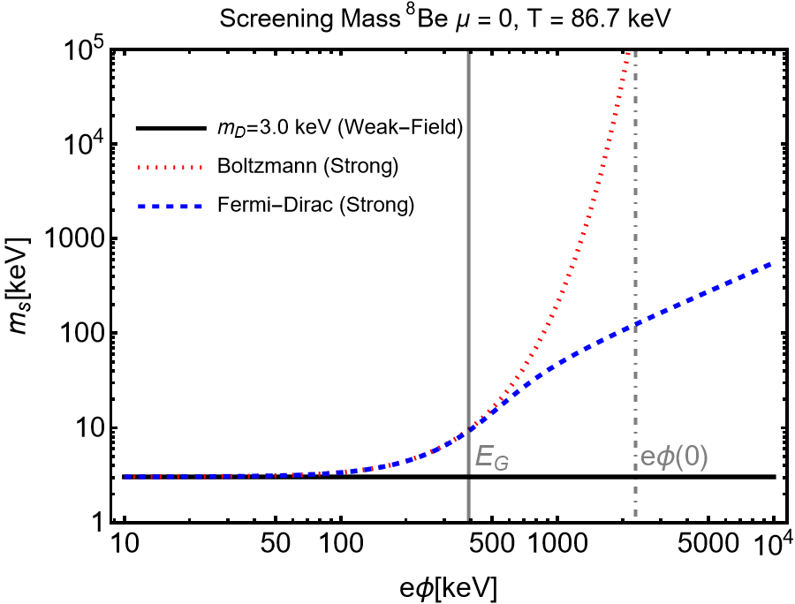
Generalized Screening Mass: $m_{s}(Φ)$
We show us the strength of the screening mass as a function of potential $eφ$.
Weak screening _
Large distance behavior
Stacking of fermion states
Boltzmann screening _
We use Fermi-Dirac statistics to describe the polarization cloud
Overpredicts screening
Fermi-Dirac screening _
$E_{G}≈390$ keV
$eφ\left(0\right)≈2300$ keV

Slide 23
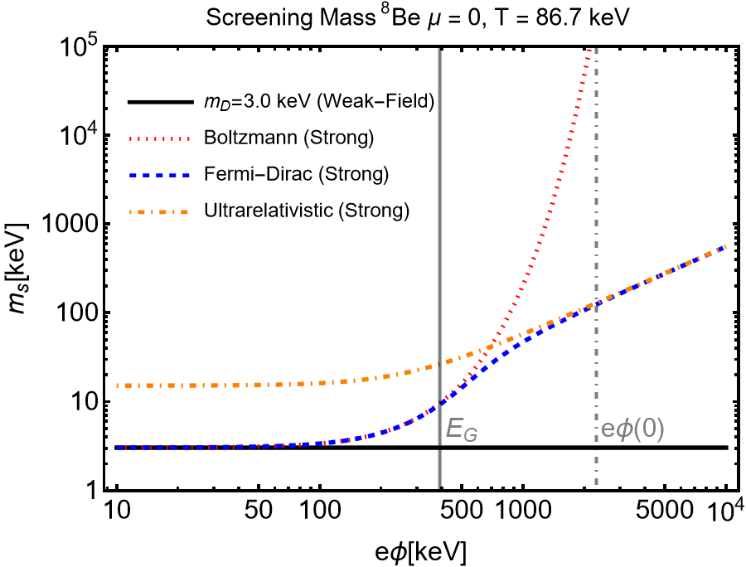
Ultra-relativistic Screening Mass: $m_{s}(Φ)$
An analytic solution for the screening mass valid to all orders in Φ(r) exists in the ultra-relativistic limit
$$p_{0}=\sqrt{m^{2}+p^{2}}≈|p|$$
is then integrated analytically into the known form
H. T. Elze, W. Greiner, J. Rafelski, The relativistic ideal fermi gas revisited, J. Phys. G 6 (1980) L149–L153
$E_{G}≈390$ keV
$eφ\left(0\right)≈2300$ keV

Slide 24
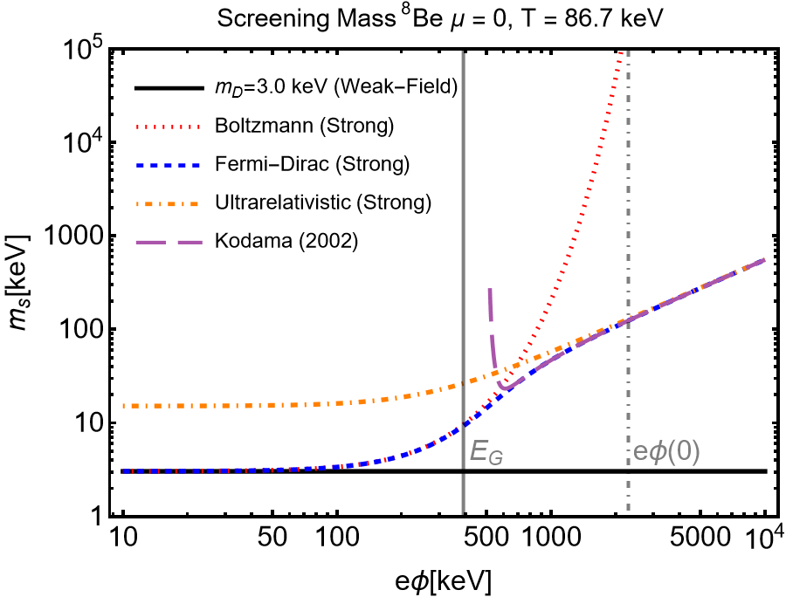
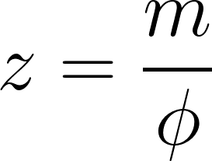
Ultra-relativistic Screening Mass: $m_{s}(Φ)$
An analytic solution for the screening mass valid to all orders in Φ(r) exists in the ultra-relativistic limit
$$p_{0}=\sqrt{m^{2}+p^{2}}≈|p|$$
is then integrated analytically into the known form
H. T. Elze, W. Greiner, J. Rafelski,, J. Phys. G 6 (1980) L149–L153
T. Kodama, AIP Conference Proceedings, Vol. 631, AIP, 2002, pp. 3–26
$E_{G}≈390$ keV
$eφ\left(0\right)≈2300$ keV
Small density expansion

Slide 25
Ultra-relativistic Screening Mass: $m_{s}(Φ)$
An analytic solution for the screening mass valid to all orders in Φ(r) exists in the ultra-relativistic limit
$$p_{0}=\sqrt{m^{2}+p^{2}}≈|p|$$
is then integrated analytically into the known form
H. T. Elze, W. Greiner, J. Rafelski,, J. Phys. G 6 (1980) L149–L153
This solution stops the polarization charge density from diverging at large $eφ/T$.
Simple analytic form could be helpful in developing a strong-dynamic theory of screening.
$E_{G}≈390$ keV
$eφ\left(0\right)≈2300$ keV

Slide 26
Solving the Nonlinear Poisson Equation
We numerically solve the nonlinear Poisson equation using Fermi-Dirac statistics for the strong screening potential $Φ.$
At large distances $r≫λ_{D}$ we know the weak field condition is satisfied $\frac{eφ(a)}{T}≪1$.
This can be solved analytically giving us a boundary conditions at large distances
for $r≫λ_{D}$
$λ_{D}∼1 Å$
C. Grayson, C. T. Yang, M. Formanek, J. Rafelski, Annals Phys. 458 (2023)

Slide 27
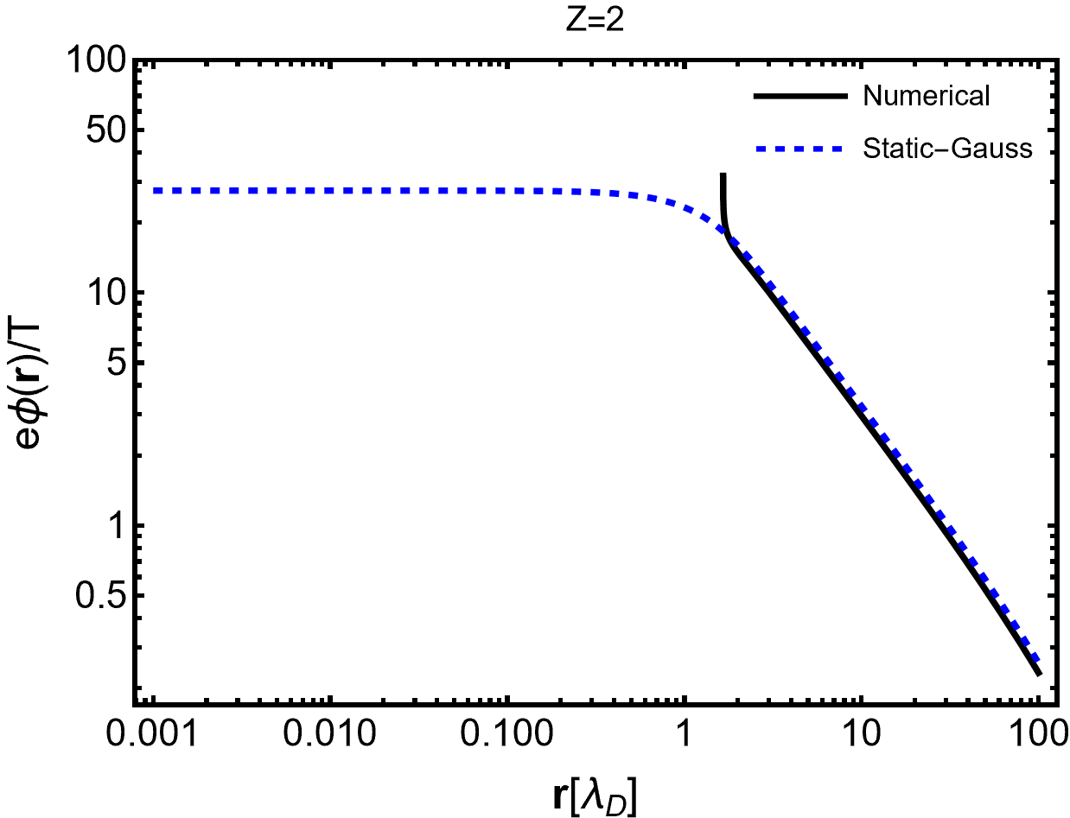
Solving the Nonlinear Poisson Equation
Starting integration at large values of r where the weak field condition applies
We then using a shooting method, integrating inwards towards small values of r with the solution, either diverging to positive or negative infinity based on whether an effective charge normalization has been chosen to be too large or too small.
$$T=86 keV$$
$$φ_{r≫λ_{D}}\left(r\right)≈\frac{Q_{eff}e^{{−λ}_{D}r}}{r}$$
$Q_{eff}$ too large
$$φ_{r≫λ_{D}}$$

Slide 28
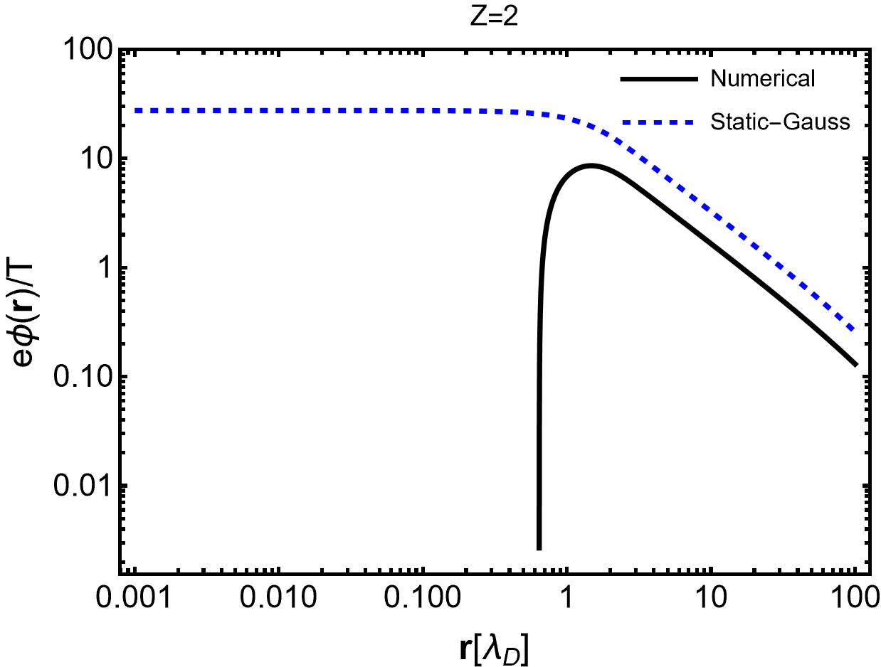
Solving the Nonlinear Poisson Equation
Starting integration at large values of r where the weak field condition applies
We then using a shooting method, integrating inwards towards small values of r with the solution, either diverging to positive or negative infinity based on whether an effective charge normalization has been chosen to be too large or too small.
$$φ_{r≫λ_{D}}\left(r\right)≈\frac{Q_{eff}e^{{−λ}_{D}r}}{r}$$
$Q_{eff}$ too small
$$φ_{r≫λ_{D}}$$

Slide 29
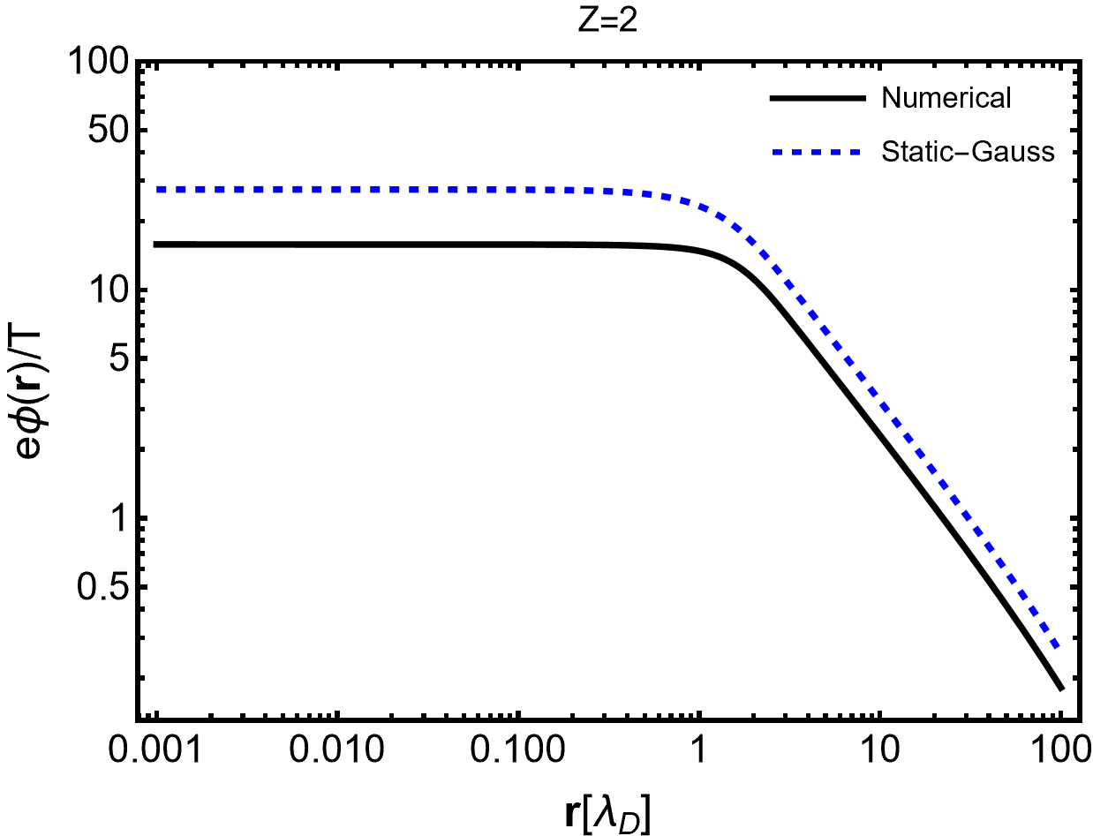
Solving the Nonlinear Poisson Equation
Starting integration at large values of r where the weak field condition applies
We then using a shooting method, integrating inwards towards small values of r with the solution, either diverging to positive or negative infinity based on whether an effective charge normalization has been chosen to be too large or too small.
$$T=86 keV$$
$$E\left(0\right)=−∇φ(0)=0$$
$$φ_{r≫λ_{D}}\left(r\right)≈\frac{Q_{eff}e^{{−λ}_{D}r}}{r}$$
$Q_{eff}$ converges after shooting
$$φ_{r≫λ_{D}}$$

Slide 30
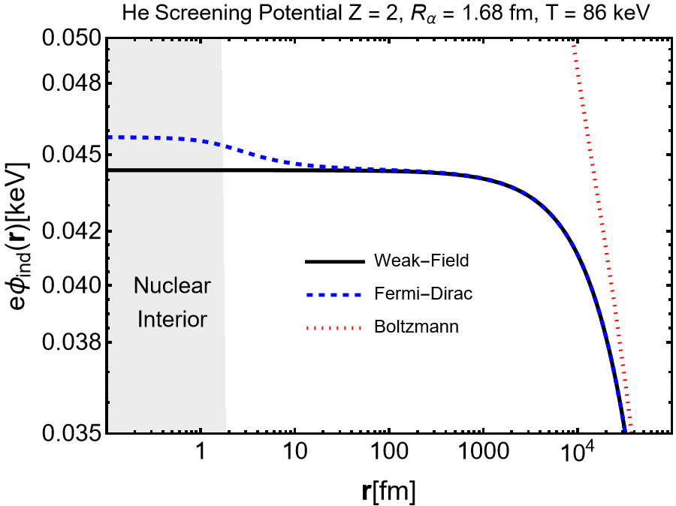
$^{4}$He Strong Screening Potential
The screening potential $φ_{ind}$has a stepped shape near the nuclear surface due to Fermi-Dirac statistics. The potential behaves like a position depended chemical potential $μ\left(r\right).$
1.3 eV

Slide 31
$^{4}$He Strong Screening Potential
The screening potential $φ_{ind}$has a stepped shape near the nuclear surface due to Fermi-Dirac statistics. The potential behaves like a position depended chemical potential $μ\left(r\right).$
Strong screening using Fermi-Dirac statistics predicts a very small change in the screening potential due to the small value of $m_{D}$ and $Z$. This is expected since theoretical He abundances match expectation Pitrou, (2018).
1.3 eV
Pitrou, C., A. Coc, J.-P. Uzan, and E. Vangioni (2018). Phys. Rept., 754, pp. 1–66.

Slide 32
$^{4}$He Strong Screening Potential
The screening potential $φ_{ind}$has a stepped shape near the nuclear surface due to Fermi-Dirac statistics. The potential behaves like a position depended chemical potential $μ\left(r\right).$
Strong screening using Fermi-Dirac statistics predicts a very small change in the screening potential due to the small value of $m_{D}$ and $Z$. This is expected since theoretical He abundances match expectation Pitrou, (2018).
1.3 eV
Boltzmann statistics vastly overpredicts the screening potential since it doesn’t account for the stacking of fermion states. At large distances however the plasma obeys Boltzmann statistics.
Pitrou, C., A. Coc, J.-P. Uzan, and E. Vangioni (2018). Phys. Rept., 754, pp. 1–66.

Slide 33
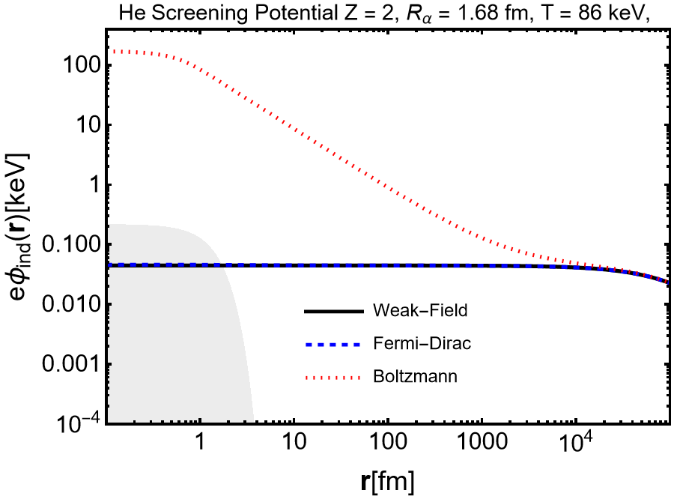
$^{4}$He Strong Screening Potential
The screening potential $φ_{ind}$has a stepped shape near the nuclear surface due to Fermi-Dirac statistics. The potential behaves like a position depended chemical potential $μ\left(r\right).$
Strong screening using Fermi-Dirac statistics predicts a very small change in the screening potential due to the small value of $m_{D}$ and $Z$. This is expected since theoretical He abundances match expectation Pitrou, (2018).
170 keV
Boltzmann statistics vastly overpredicts the screening potential since it doesn’t account for the stacking of fermion states. At large distances however the plasma obeys Boltzmann statistics.

Slide 34
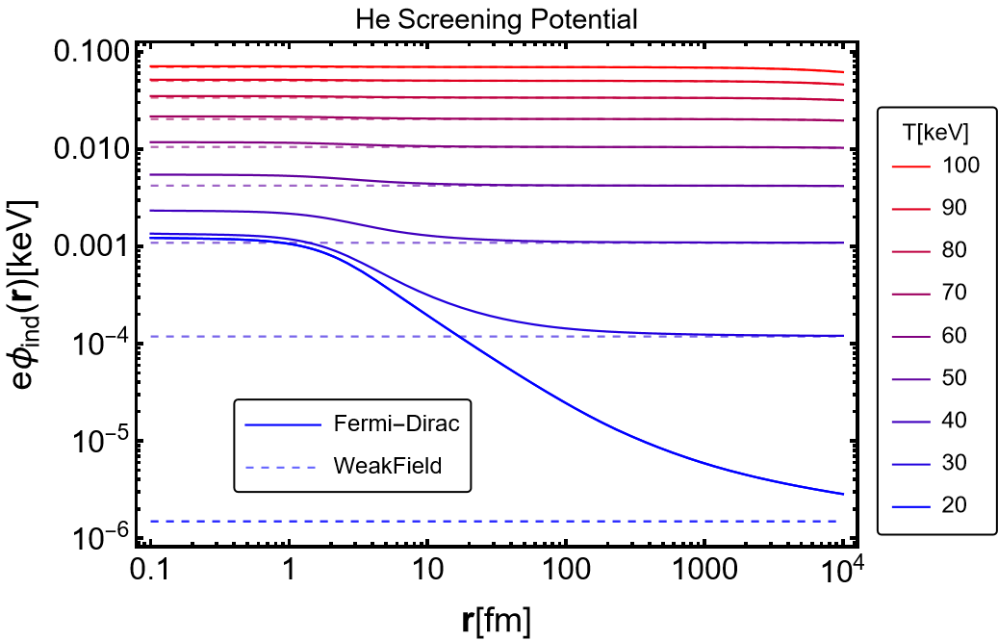
$^{4}$He Strong Screening Potential
Screening increases with temperature overall since the Debye screening mass $m_{D}$ increases with $T$.

Slide 35
$^{4}$He Strong Screening Potential
Screening increases with temperature overall since the Debye screening mass $m_{D}$ increases with $T$.
The effect of strong screening increases with decreasing temperature since $\frac{φ}{T}$ becomes larger.

Slide 36
Thermonuclear reaction rate Enhancement
To calculate the enhancement of thermonuclear reactions we compare the screened reaction rate in plasma to the reaction rate in vacuum
“Relative energy of collision”
“Thermonuclear Reaction Rate”
“Reduced Mass”
“Reaction Threshold”
“Boltzmann distribution”
W. K. Rose, Advanced Stellar Astrophysics, Cambridge University Press, 1998
Normally the $\frac{1}{E}$ energy dependence and the WKB tunneling integral are removed from the cross-section to define an S-factor $S(E)$.
Coulomb Penetration Factor
Potential in Plasma
Integral runs from the classical turning point $r_{c}$ to the nuclear radius $R$.
Notes:
Add citation

Slide 37
Salpeter Enhancement Factor (1954)
$$φ_{stat}\left(r\right)= \frac{Ze}{4π ε_{0} r} e^{−r/{λ_{D}}}$$
$$φ_{stat}\left(r\right)= \frac{Ze}{4π ε_{0} r}$$
The enhancement of a nuclear reaction process by screening
is related to the WKB probability of tunneling through the
Coulomb barrier.
In the weak screening limit, the screening charge density is almost constant on scales less than $λ_{D}$, we can then approximate the screening potential energy $U\left(r\right)−U_{vac}\left(r\right)=U_{ind}(r)$ as a constant, with its value at the origin $U_{ind}(0)$ .
$$U\left(r\right)−Internuclear$$
$$Screenined potetnial$$
Salpeter, E. E. (1954) Austral. J. Phys., 7, pp. 373–388.
Turning point
$$R$$
$$r_{c}$$
$$E$$
$${−U}_{vac}$$
$${−U}_{tot}$$
Reduced mass
Nuclear radius
$${−U}_{ind}$$
“Screening length”
“Classical turning point”
Static Screening
$$λ_{D}≫r_{C}$$
$$Å$$
fm
The Salpeter enhancement factor only depends on the screening potential at the origin.

Slide 38
Salpeter Enhancement Factor (1954)
The enhancement of a nuclear reaction process by screening
is related to the WKB probability of tunneling through the
Coulomb barrier.
In the weak screening limit, the screening charge density is almost constant on scales less than $λ_{D}$, we can then approximate the screening potential energy $U\left(r\right)−U_{vac}\left(r\right)=U_{ind}(r)$ as a constant, with its value at the origin $U_{ind}(0)$ .
$$U\left(r\right)−Internuclear$$
$$Screenined potetnial$$
Salpeter, E. E. (1954) Austral. J. Phys., 7, pp. 373–388.
Turning point
$$R$$
$$r_{c}$$
$$E$$
$${−U}_{vac}$$
$${−U}_{tot}$$
Reduced mass
Nuclear radius
$${−U}_{ind}$$
“Screening length”
“Classical turning point”
Damped-dynamic Screening
$$λ_{D}≫r_{C}$$
$$Å$$
fm
Due to the large damping rate $κ$ compared to the Debye mass and the small velocities of nuclei during BBN $β_{N}$, the correction due to damped-dynamic screening is small ${10}^{−5}$.
Our Contribution for weak damping $ω_{p}>κ$
C. Grayson, C. T. Yang, M. Formanek, and J. Rafelski (2023). Annals Phys., 458, p. 169453.

Slide 39
Salpeter Enhancement Factor (1954)
The enhancement of a nuclear reaction process by screening
is related to the WKB probability of tunneling through the
Coulomb barrier.
In the weak screening limit, the screening charge density is almost constant on scales less than $λ_{D}$, we can then approximate the screening potential energy $U\left(r\right)−U_{vac}\left(r\right)=U_{ind}(r)$ as a constant, with its value at the origin $U_{ind}(0)$ .
$$U\left(r\right)−Internuclear$$
$$Screenined potetnial$$
Salpeter, E. E. (1954) Austral. J. Phys., 7, pp. 373–388.
Turning point
$$R$$
$$r_{c}$$
$$E$$
$${−U}_{vac}$$
$${−U}_{tot}$$
Reduced mass
Nuclear radius
$${−U}_{ind}$$
Damped-dynamic Screening
$σ_{BBN} −$Conductivity of the early universe
$200−2$ eV
weak damping $ω_{p}>κ$
Due to the large damping rate $κ$ compared to the Debye mass and the small velocities of nuclei during BBN $β_{N}$, the correction due to damped-dynamic screening is small ${10}^{−5}$.
Could be relevant for solar and laboratory fusion

Slide 40
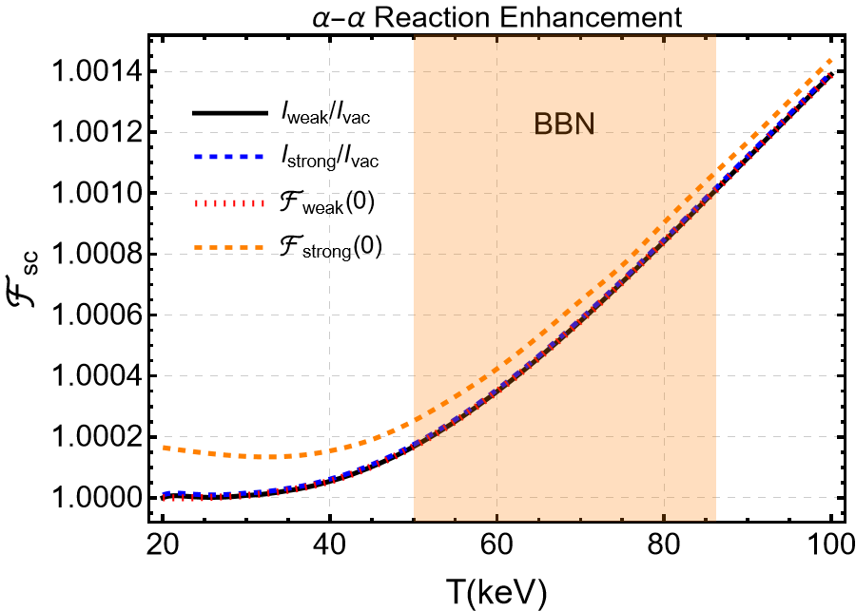
Enhancement Factor: $^{4}$He -$^{4}$He
Strong screening using Fermi-Dirac statistics predicts a very small change in the screening potential due to the small value of $m_{D}$ and $Z$. This is expected since theoretical He abundances match expectation Pitrou, (2018).
“Salpeter
Factors”
$$\frac{ℱ_{strong}}{F_{weak}}−1≈{10}^{−6}$$

Slide 41
Enhancement Factor: $^{4}$He -$^{4}$He
Strong screening using Fermi-Dirac statistics predicts a very small change in the screening potential due to the small value of $m_{D}$ and $Z$. This is expected since theoretical He abundances match expectation Pitrou, (2018).
“Salpeter
Factors”
Using the strong screening potential at the origin $φ_{Strong}(0)$ to find an enhancement factor over-predicts the screening effect due to its “stepped shape”
$$\frac{ℱ_{strong}}{F_{weak}}−1≈{10}^{−6}$$

Slide 42
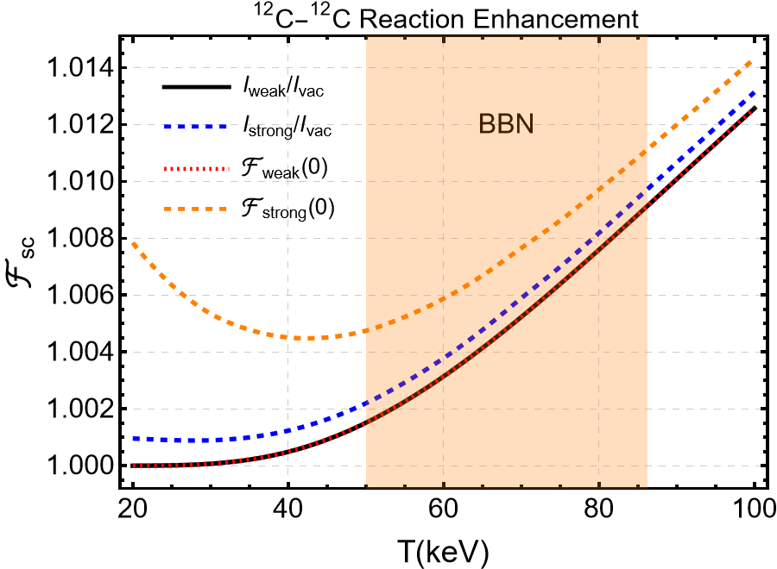
Enhancement Factor: $^{12}$C -$^{12}$C Example
Carbon is not significantly present during BBN.
Strong screening enhancement has a nonlinear increase in $Z$
$$Z^{2}: 4→36$$
$$\left(\frac{ℱ_{strong}}{F_{weak}}−1\right): {10}^{−6}→{10}^{−3}$$
Factor of 1000
“Salpeter
Factors”
Over-prediction is larger.
$$\frac{ℱ_{strong}}{F_{weak}}−1≈6×{10}^{−4}$$
Carbon burning begins around $50$keV

Slide 43
Enhancement Factor: $^{12}$C -$^{12}$C Example
Carbon is not significantly present during BBN.
Strong screening enhancement has a nonlinear increase in $Z$
$$Z^{2}: 4→36$$
$$\left(\frac{ℱ_{strong}}{F_{weak}}−1\right): {10}^{−6}→{10}^{−3}$$
Factor of 1000
“Salpeter
Factors”
The strong screening effect compared to weak screening is larger at low temperatures due to larger $φ/T$.
Over-prediction is larger.
$$\frac{ℱ_{strong}}{F_{weak}}−1≈6×{10}^{−4}$$
$$T$$
Carbon burning begins around $50$keV

Slide 44
Enhancement Factor: $^{12}$C -$^{12}$C Example
Carbon is not significantly present during BBN.
Strong screening enhancement has a nonlinear increase in $Z$
$$Z^{2}: 4→36$$
$$\left(\frac{ℱ_{strong}}{F_{weak}}−1\right): {10}^{−6}→{10}^{−3}$$
Factor of 1000
“Salpeter
Factors”
The strong screening effect compared to weak screening is larger at low temperatures due to larger $φ/T$.
Over-prediction is larger.
$$\frac{ℱ_{strong}}{F_{weak}}−1≈6×{10}^{−4}$$
Strong screening in BBN may affect heavier element abundances while leaving light element abundances unaffected.
Carbon burning begins around $50$keV

Slide 45
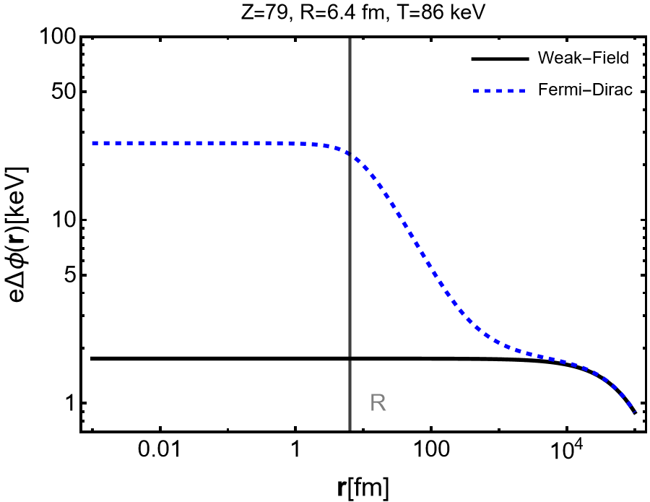
Heavy Nuclear Catalysts - Preliminary
Since screening increases nonlinearly with $Z$ the screening cloud around a high $Z$ nucleus should be enormous. As an example, we look at a gold nucleus $Z=79$at BBN temperatures and densities.
26 keV
Light nuclei colliding in the electron cloud of a heavy nucleolus could lead to significant enhancement.

Slide 46
Conclusion and Outlook
We implemented strong screening in the $e^{+}e^{−}$ during BBN:
Determined the short-range screening potential relevant to quantum tunneling thermonuclear reactions.
Analytic form of the screening mass in the Ultra-relativistic limit
Fermi-Dirac Statistics is necessary to accurately describe the strong screening polarization cloud during BBN:
Boltzmann statistics overestimates the screening effect.
“Stepped shape” of the potential, indicates that relying solely on screening energy near the origin can overestimate reaction rate enhancement.
Strong screening enhancement of fusion is nonlinear in $Z$:
High-Z elements can be enhanced while leaving lower-z elements relatively unaffected
Potential relevance to the observed lithium under-abundance.
Strong screening of heavy nuclei could be of interest in the context of laser fusion.

Slide 47
Thank You

Slide 48
Method of Numerical Solution - Check
We then check the numerical result by integrating it to find $Q_{eff}$ and comparing it to the large distance fall-off
$φ\left(r\right)=\frac{Q_{eff}e^{{−m}_{D}r}}{r}$ where $Q_{eff}="shooting coefficient"$
$which gives$ $Q_{eff}=23.6396 \text{vs}\text{ 23.6392}$

Slide 49
What do we mean by Hot and Dense?
$$1 cm$$
Material | Number Density (normalized to water) | Temperature (°C) | Energy ($T k_{B}$)
Air (dry) | 0.00076 | 20-60 | 0.03 ev
Water | 1 | --
Diamond | 5.27 | --
Solar Core^{[1]} | 134.4 | $$\sim 1.5×{10}^{6}$$ | 1.4 keV
$e^{+}e^{−}$ Early Universe Plasma | $$\sim {10}^{4}$$ | $$\sim 7×{10}^{8}$$ | 86-50 keV
Quark-Gluon Plasma | $${>10}^{15}$$ | >$6×{10}^{11}$ | >150 MeV
electron
$$1 cm$$
positron
$$1 cm$$
Grayson, C., C. T. Yang, M. Formanek, and J. Rafelski (2023). Annals Phys., 458, p. 169453.
Grayson, C., M. Formanek, J. Rafelski, and B. Müller (2022). Phys. Rev. D, 106(1), p. 014011.
($n_{water}=33.4×{10}^{21} particles per {cm}^{3}$)
Natural units
[1] J.N. Bahcall et al.. Astrophys. J. 2001, 555, 990–1012, [astro-ph/0010346]. doi:10.1086/321493.

Slide 50
Strong Screening Electron-Positron Plasma during BBN Epoch:
Focus on $α−α$ scattering and plasma stabilization of ⁸Be
Chris Grayson, Cheng Tao Yang, Martin Formanek, Johann Rafelski
In preparation

Slide 51
III) BBN $e^{+}e^{−}$Plasma: Screened Potential
We then expand the potential in the limit of large damping and small velocity of the source due to the comparatively large mass of nuclei.
$$β_{N}={v_{N}}/c≈ \sqrt{\frac{2T}{m_{N}c^{2}}}$$
Zeroth order term is simply static screening
contribution due to damped-dynamic screening
This can then be Fourier transformed back into position space for a point charge ($R=0$)
“Small distance behavior”
L. Stenflo, M. Y. Yu, and P. K. Shukla ”Shielding of a slow test charge in a collisional plasma” Phys. Fluids 16 (1973)
$ψ$is the angle between $\left(x−β_{N}t\right)$ and $β_{N}$
C. Grayson, C. T. Yang, M. Formanek, and J. Rafelski (2023). Annals Phys., 458, p. 169453.

Slide 52
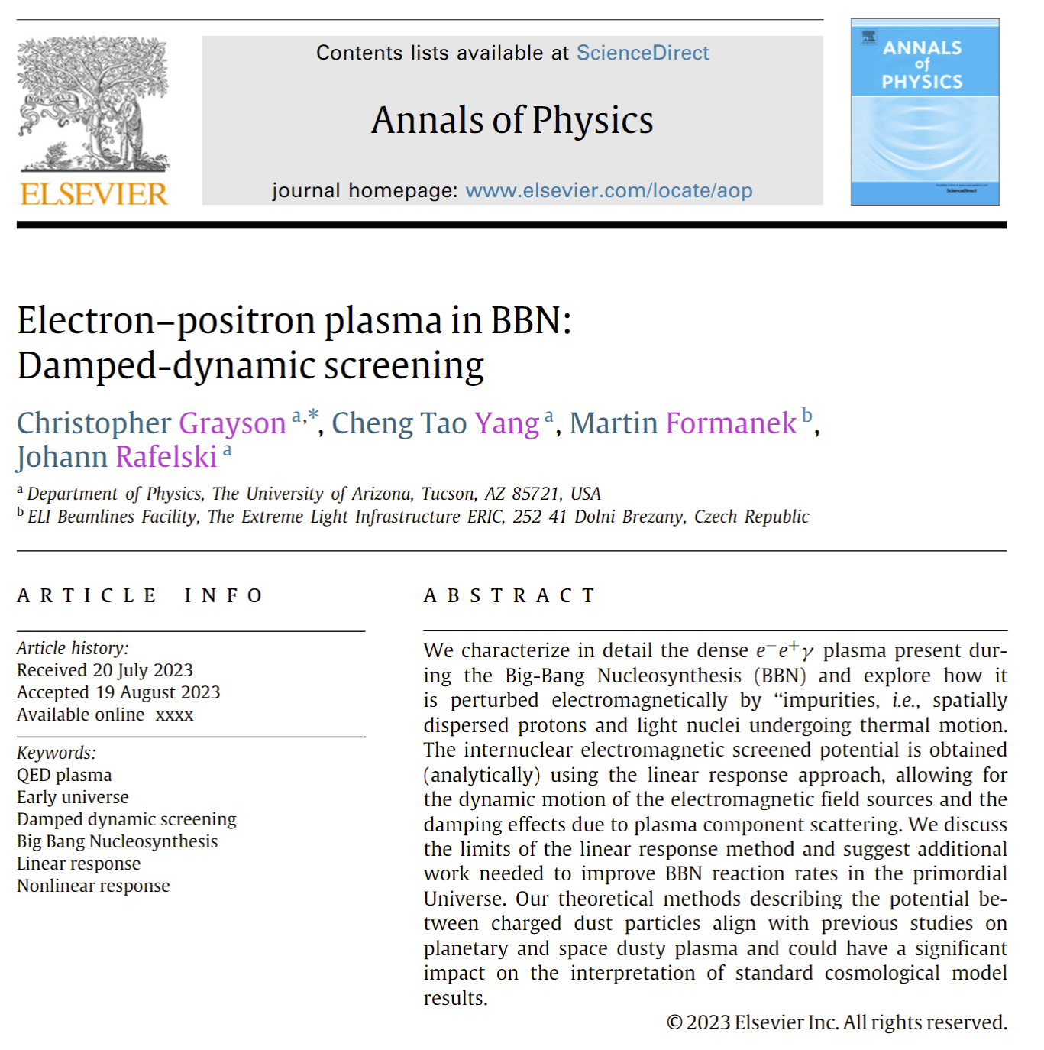
Strong Screening During BBN
Our most recent publication studies damped-dynamic screening of light nuclei during Big Bang Nucleosynthesis (BBN), with an interest in how the screening affects thermonuclear reactions by reducing Coulomb repulsion.
In this article, we note that this study and previous studies in this field assume the screening potential can be calculated in the weak field limit
$$\frac{eφ(a)}{T}≪1$$
$$λ_{d}$$
$$λ_{d}$$
The Coulomb energy is much smaller than the thermal energy.
‘Plasma is weakly coupled’
$$a$$
$T_{BBN }=50−86$ keV
$$r_{d}$$

Slide 53
Why ⁸Be?
Beryllium 8 is a state of two quasi-bound alpha particles that is partially stable. It is unbound by only 91.8 keV^{[1]}.
$t_{1/2}=$(8.19±0.37)×10⁻¹⁷ s
⁸Be
⁴He
⁴He
[1] L. Kumar, S. Awasthi, A. Khachi and O. S. K. S. Sastri, [arXiv:2209.00951 [nucl-th]].

Slide 54
Why ⁸Be?
Beryllium 8 is a state of two quasi-bound alpha particles that is partially stable. It is unbound by only 91.8 keV^{[1]}.
If the polarization cloud in the BBN plasma could stabilize the ⁸Be state, it could alter the BBN thermonuclear reaction network by allowing for more beryllium burning.
⁸Be
⁴He
⁸Be
⁴He
⁴He
¹²C
[1] L. Kumar, S. Awasthi, A. Khachi and O. S. K. S. Sastri, [arXiv:2209.00951 [nucl-th]].

Slide 55
Why ⁸Be?
Could address tensions between predicted and measured primordial light element abundances for Z>2 .
Beryllium 8 is a state of two quasi-bound alpha particles that is partially stable. It is unbound by only 91.8 keV^{[1]}.
If the polarization cloud in the BBN plasma could stabilize the ⁸Be state, it could alter the BBN thermonuclear reaction network by allowing for more beryllium burning.
⁸Be
⁴He
⁸Be
⁴He
⁴He
¹²C
[1] L. Kumar, S. Awasthi, A. Khachi and O. S. K. S. Sastri, [arXiv:2209.00951 [nucl-th]].

Slide 56
Strong Field Equilibrium Distribution
The full non-relativistic equilibrium distribution includes a potential term that accounts for the energy change due to the rest frame potential (or equivalently uses the kinetic vs canonical momentum) to describe the rest energy [2, 3].
The one particle distrubution function $f^{eq}(x,p)$ Solves the Vlasov-Boltzmann equation
[2] R. Hakim ”Relativistic Perfect Gas in an External Force Field,”Phys. Rev. 162, 128 (1967) doi:10.1103/PhysRev.162.128 [3] S. R. De Groot, W. A. Van Leeuwen and C. G. Van Weert, Relativistic Kinetic Theory. Principles and Applications, North-Holland Publishing Company (1980)

Slide 57
The Poisson Boltzmann Equation
We would like to find how the induced equilibrium charge density around light nuclei screens the electromagnetic potential during BBN. This can be done by solving the Poisson equation for the induced polarization charge and the external charge of the light nuclei
Where
Nonlinear Poisson Boltzmann equation
Needs to be solved numerically
Positive feedback between induced charge and the potential

Slide 58
Method of Numerical Solution – First Step
Start integration at large values of r where the weak field condition applies and we know the analytic solution.
The linear Poisson-Boltzmann equation can be solved analytically for a Gaussian charge distribution
$≈−2e^{2}n_{eq} φ(x)/T$ For $\frac{eφ\left(x\right)}{T}≪1$
where $m_{d}^{2}=2e^{2}\frac{n_{eq}}{T}$
C. Grayson, C.T. Yang, M. Formanek, J. Rafelski, Electron–positron plasma in BBN: Damped-dynamic screening, Annals of Physics 458, 1 (2023)

Slide 59
Method of Numerical Solution – First Step
Start integration at large values of r where the weak field condition applies and we know the analytic solution.
We then integrate inwards to small values of r with the solution, either diverging to positive or negative infinity based on whether the effective charge normalization has been chosen to be too large or too small.

Slide 60
Method of Numerical Solution - Boltzmann
We then integrate inwards to small values of r with the solution diverging to positive or negative infinity based on whether the effective charge normalization has been chosen to be too large or too small. Thus, one can create a shooting algorithm that increases or decreases the effective charge seen at large distances based on whether the previous guess diverges to positive or negative values, decreasing the divergence point until it reaches r = 0.
$$T=86 keV$$
Boltzmann
$$_$$
$Q_{eff}$ too large
$$φ\left(r\right)=\frac{Q_{eff}e^{{−m}_{D}r}}{r}$$
$r$[fm]

Slide 61
Method of Numerical Solution - Boltzmann
We then integrate inwards to small values of r with the solution diverging to positive or negative infinity based on whether the effective charge (normalization) has been chosen to be too large or too small. Thus, one can create a shooting algorithm that increases or decreases the effective charge seen at large distances based on whether the previous guess diverges to positive or negative values, decreasing the divergence point until it reaches r = 0.
$$T=86 keV$$
Boltzmann
$$_$$
$Q_{eff}$ too small
$$φ\left(r\right)=\frac{Q_{eff}e^{{−m}_{D}r}}{r}$$
$r$[fm]

Slide 62
Method of Numerical Solution - Boltzmann
We then integrate inwards to small values of r with the solution diverging to positive or negative infinity based on whether the effective charge has been chosen to be too large or too small. Thus one can create a shooting algorithm that increases or decreases the effective charge seen at large distances based on whether the previous guess diverges to positive or negative values, decreasing the divergence point until it reaches r = 0.
$$T=86 keV$$
Boltzmann
$$_$$
$Q_{eff}$ converges after shooting
$$φ\left(r\right)=\frac{Q_{eff}e^{{−m}_{D}r}}{r}$$
$r$[fm]

Slide 63
Method of Numerical Solution - Check
We then check the numerical result by integrating it to find $Q_{eff}$ and comparing it to the large distance fall-off
$φ\left(r\right)=\frac{Q_{eff}e^{{−m}_{D}r}}{r}$ where $Q_{eff}="shooting coefficient"$
$which gives$ $Q_{eff}=23.6396 \text{vs}\text{ 23.6392}$

Slide 64
Poisson-Fermi-Dirac Equation – Realistic Case
At small distances, we need to account for Pauli-blocking of the electrons and positrons in the polarization cloud. We need to model the equilibrium density with the relativistic Fermi-Dirac distribution to do this.
The dependence on the potential is trivial one can simply parameterize a numerical solution for various values of potential Φ and then use the resulting parameterization in the differential equation.
Poisson-Fermi-Equation
$$Φ=e\frac{φ}{T} , P=ρ/T$$

Slide 65
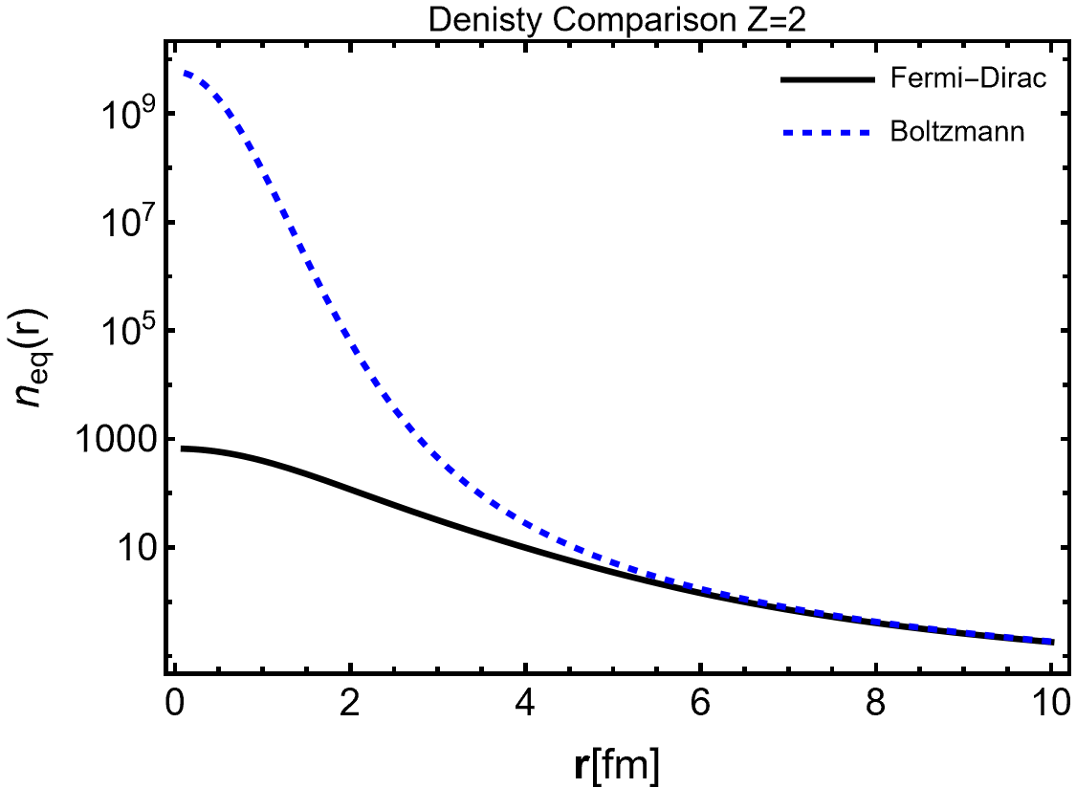
Fermi-Dirac Vs Boltzmann Density
First-order induced charge density calculated using the vacuum Gaussian solution.
Pauli-Blocking decreases the density.
$$T=86 keV$$
$α$ Radius
$$[MeV^{3}]$$
Pauli
Blocking
Boltzmann
Fermi-Dirac

Slide 66
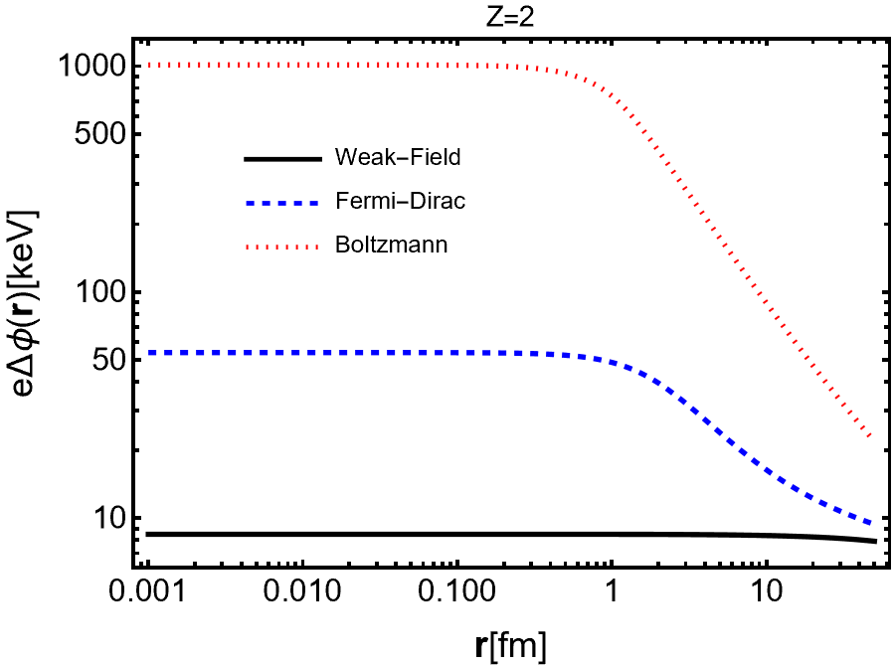
Strong field Screening – Decrease in Coulomb Repulsion
Here, we show the decrease in Coulomb repulsion by showing the difference between the vacuum field and the screened potential
$∆φ=φ_{vac}−φ_{tot}$
Strong screening predicts 6.35 times more screening than Debye-Hückel theory
Could enhance stabilization of ⁸Be in a dense plasma environment
54 keV
8.5 keV

Slide 67
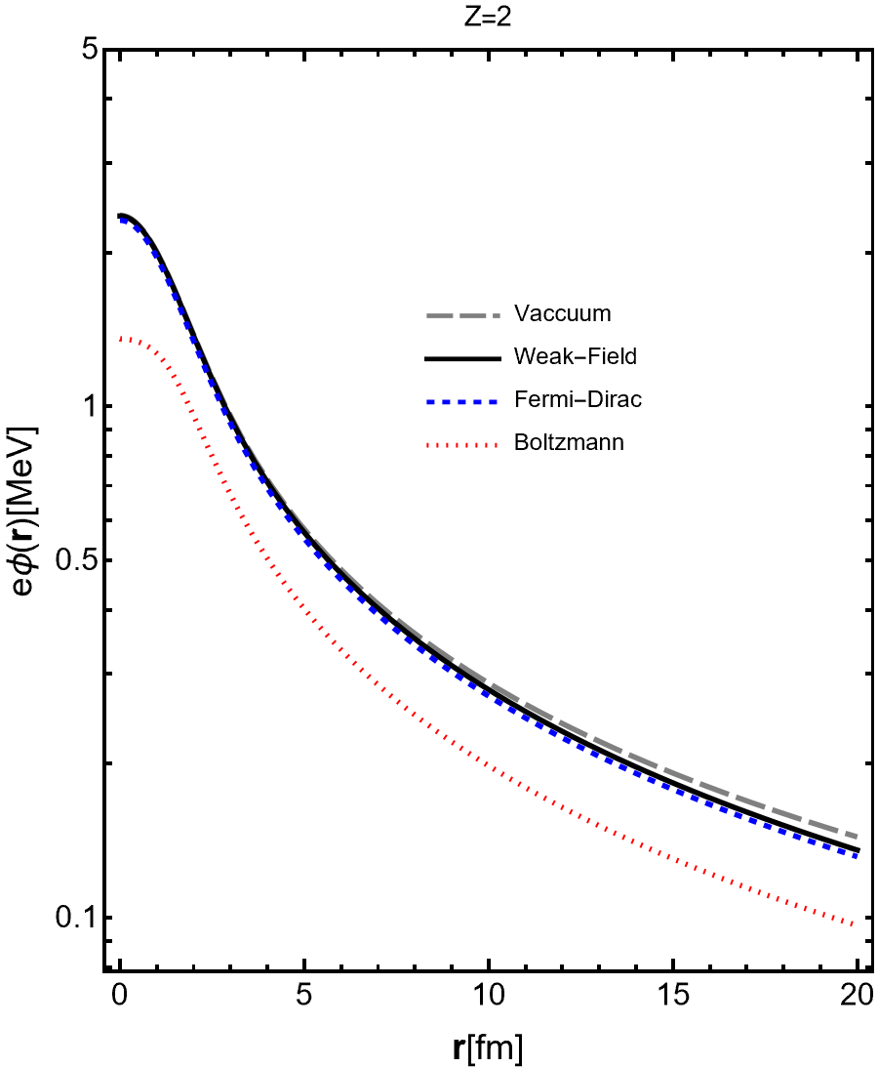
Strong field Screening
$$T=86 keV$$
Here, we show the decrease in Coulomb repulsion by showing the difference between the vacuum field and the screened potential.
$∆φ=φ_{vac}−φ_{ind}$
Strong screening predicts 6.35 times more screening than Debye-Hückel theory.
Could enhance stabilization of ⁸Be in a dense plasma environment.

Slide 68
Outlook
Find the screening modification to the potential as fitted to $α−α$ scattering [1].
Calculate ⁸Be bound state and/or strength and stability of resonance
Evaluate its properties as a function of temperature.
Study strong screening as a function of temperature.
As temperature increases, density increases but the strong field effect decreases.
Study strong screening for Z>2
Strong screen will increase nonlinearly with Z.
[1] L. Kumar, S. Awasthi, A. Khachi and O. S. K. S. Sastri, [arXiv:2209.00951 [nucl-th]].

Slide 69
Thank You!

Slide 70
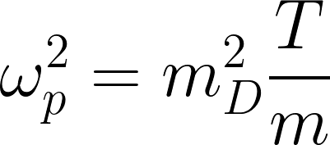
III) BBN $e^{+}e^{−}$Plasma: Damped-Dynamic Response
The polarization tensor is found by calculating the induced current due to small perturbations away from equilibrium in the Vlasov-Boltzmann equation
“Electron-Positrons”
“Photons” – does not couple directly to the EM field.
Solving for the polarization tensor in the non-relativistic limit $T_{BBN}≪m_{e}$ we find
$T_{BBN}=50−86$ keV
$$m_{D}=1/{λ_{D}}$$
The longitudinal polarization function corresponds to the movement of the charge
Now we quantify the damping rate $κ$ to calculate the fields
M. Formanek, C. Grayson, J. Rafelski and B. Müller, (2021)

Slide 71
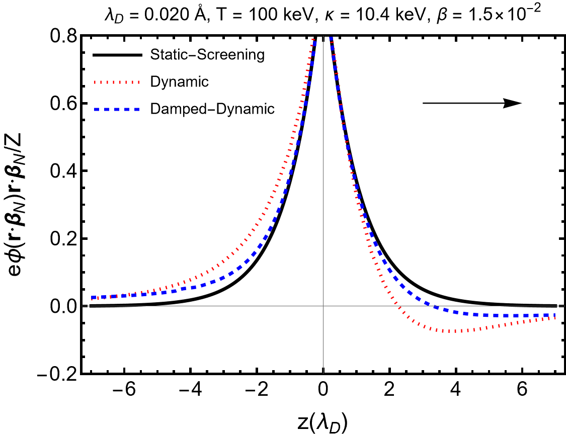
III) BBN $e^{+}e^{−}$Plasma: Model Comparisons
- numerical calculation predicts asymmetry in the potential leading to negative polarization charge in front and positive charge behind the moving nucleus.
- numerical calculation predicts a screening effect that is similar by smaller because of damping.
- numerical calculation predicts a screening effect that is similar but smaller because of damping.
C. Grayson, C. T. Yang, M. Formanek, and J. Rafelski (2023). Annals Phys., 458, p. 169453.
Dynamic screening result adapted from E. Hwang et al. “Dynamical screening effects on big bang nucleosynthesis,” JCAP 11 (2021)

Slide 72
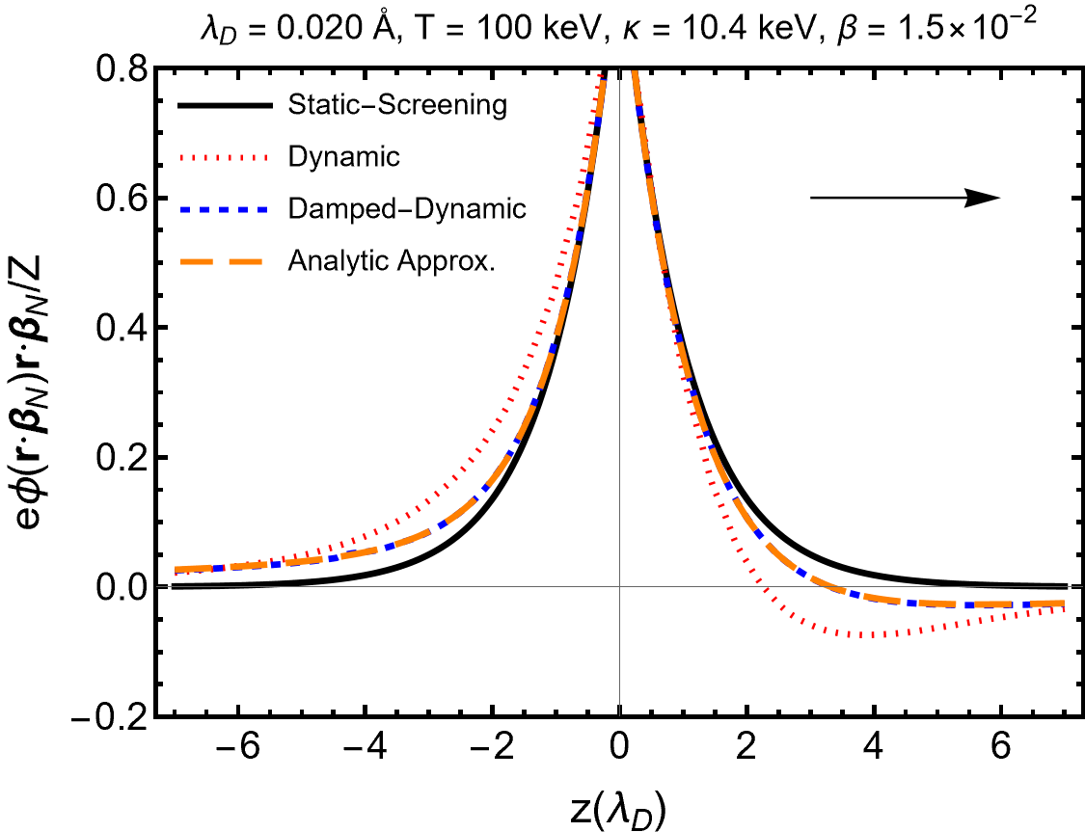
III) BBN $e^{+}e^{−}$Plasma: Model Comparisons
- predicts asymmetry in the potential leading to more screening in the direction of motion and less behind the moving nucleus.
- numerical calculation predicts asymmetry in the potential leading to negative polarization charge in front and positive charge behind the moving nucleus.
- numerical calculation predicts a screening effect that is similar by smaller because of damping.
- numerical calculation predicts a screening effect that is similar but smaller because of damping.
- our analytic approximation matches the numerical result for T=100 keV. (temperature used for comparison)
- our analytic approximation matches the numerical result for T=100 keV. Short distance behavior is relevant for quantum tunneling in fusion reactions.
C. Grayson, C. T. Yang, M. Formanek, and J. Rafelski (2023). Annals Phys., 458, p. 169453.
Dynamic screening result adapted from E. Hwang et al. “Dynamical screening effects on big bang nucleosynthesis,” JCAP 11 (2021)

Slide 73
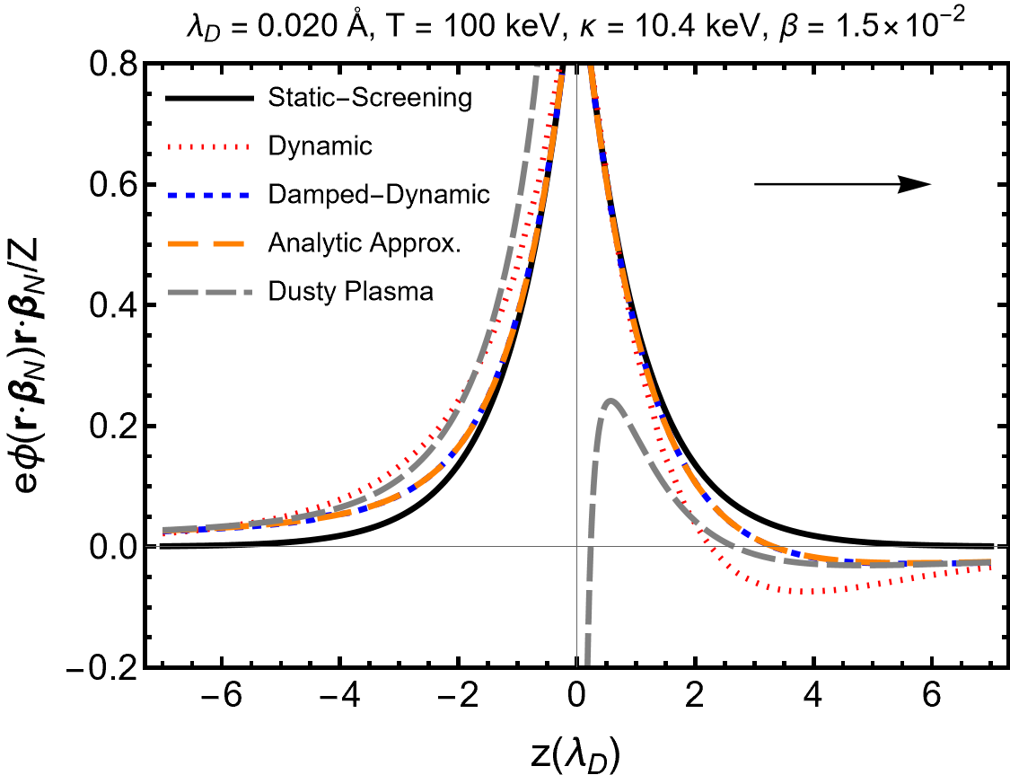
III) BBN $e^{+}e^{−}$Plasma: Model Comparisons
- numerical calculation predicts asymmetry in the potential leading to negative polarization charge in front and positive charge behind the moving nucleus.
- numerical calculation predicts a screening effect that is similar but smaller because of damping.
- our analytic approximation matches the numerical result for T=100 keV. Short distance behavior is relevant for quantum tunneling in fusion reactions.
- $1/{r^{2}}$ analytic result from Stenflo et al. (1973) matches the large distance behavior.
C. Grayson, C. T. Yang, M. Formanek, and J. Rafelski (2023). Annals Phys., 458, p. 169453.
Dynamic screening result adapted from E. Hwang et al. “Dynamical screening effects on big bang nucleosynthesis,” JCAP 11 (2021)

Slide 74
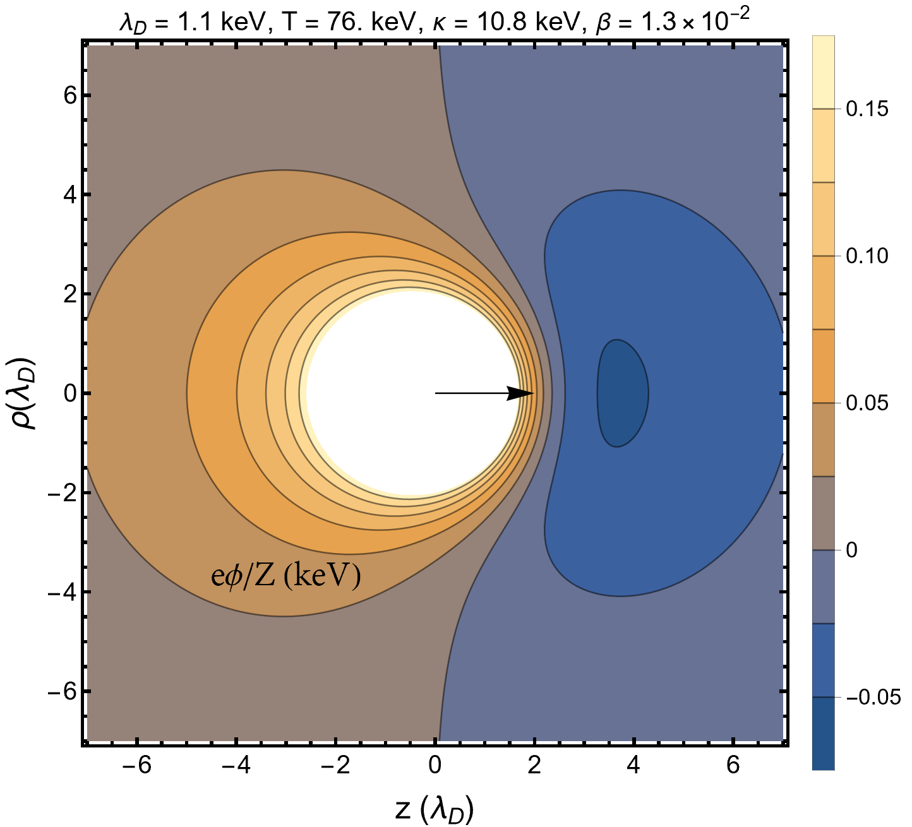
III) BBN $e^{+}e^{−}$Plasma: Screened Potential
Negative charge build up in front
Positive wake field

Slide 75
III) BBN $e^{+}e^{−}$Plasma: Summary
In summary, we derived an analytic expression for the damped-dynamic potential in the BBN epoch, a result which has previously been only calculated numerically and used it to find the nuclear reaction rate enhancement during BBN.
Our damped-dynamic potential predicts similar changes to reaction rates as found in Hwang et al. (2021). JCAP, 11, p. 017.
To calculate the short-range potential relevant for quantum tunneling we need to include strong screening.
When the electromagnetic energy is larger than the thermal energy $\frac{Zeφ}{T}≥1$.
Change in energy
due to field.
Being finalized
Nonlinear dependence on the field

Slide 76
Supplemental Slides

Slide 77
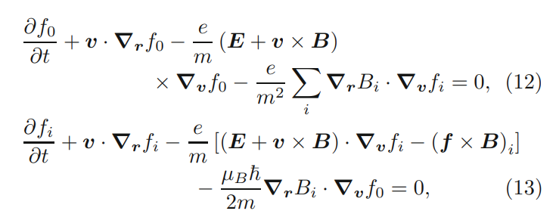
I) Electromagnetic Fields in a Plasma: Including spin
$f_{0}$ represents the probability to find an electron in phase space at a given time, while $f$ represents the probability to have a spin-polarization probability in the direction $i.$
Then taking the classical limit of the quantum evolution of the Wigner functions
1st order quantum spin corrections to Vlasov-Boltzmann motion
Hurst, J., Morandi, O., Manfredi, G. et al. Eur. Phys. J. D 68, 176 (2014).

Slide 78
I) BGK Collision Term: Current Conservation
Simplifications, such as the relaxation time approximation, are often used to reduce the Vlasov-Boltzmann equation to a differential equation.
“Bhatnagar, Gross, and Krook (BGK) Collision term – nonrelativistic”
Damping parameter
First term is zero since the Boltzmann equation conserves current
Formanek, M., C. Grayson, J. Rafelski, and B. Mueller (2021). Annals Phys., 434, p. 168605.
Additional terms can be added to ensure energy conservation, but for matter-antimatter plasmas this correction cancels. Rocha, G. S., G. S. Denicol, and J. Noronha (2021). Phys. Rev. Lett., 127(4), p. 042301.

Slide 79
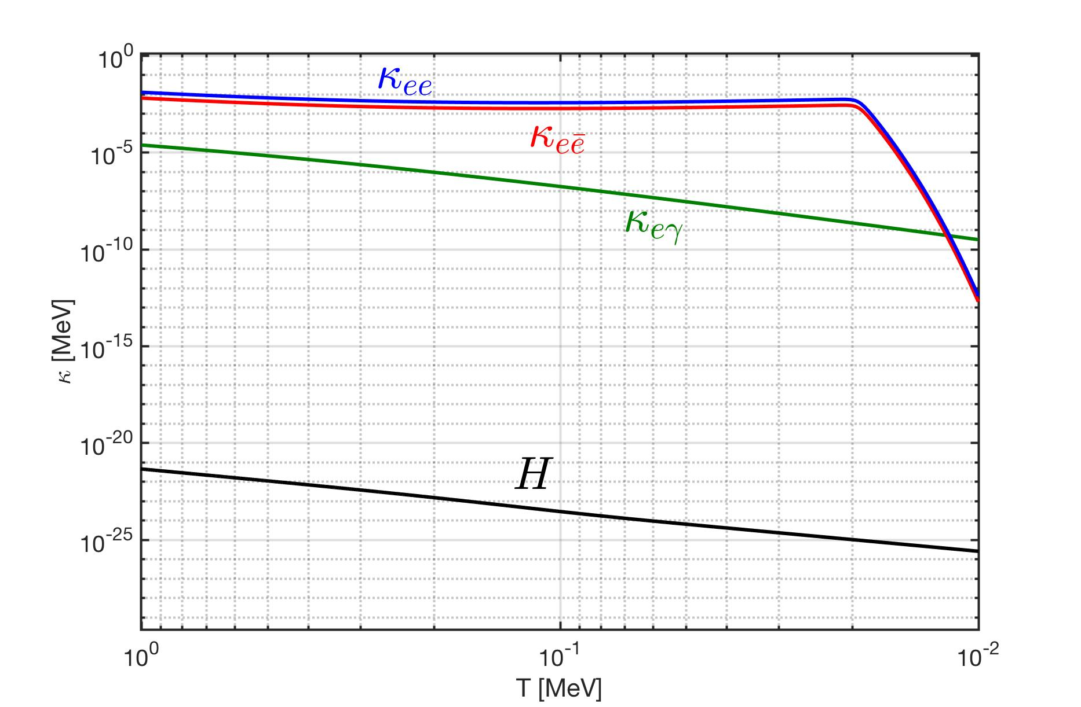
Plasma in the Early Universe: Hubble Constant
$1/H≫1/κ$ - as the universe expands the plasma has plenty of time to relax back to equilibrium. So is static with respect to the microscopic evolution.
Figure by Cheng Tao Yang, University of Arizona

Slide 80
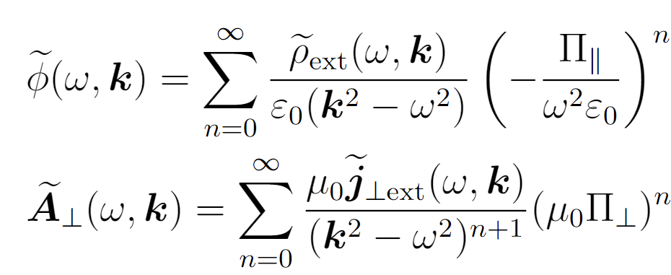
Polarization Response Expansion
Once the polarization tensor is found fields in the plasma can be found through the linear response relation.
If one iterative solves for the total field one finds the series expansion in of the self consistent field in $Π$
The first term n = 0 is the Coulomb field in empty space, and higher-order terms describe the back-reaction of the induced current on the external field.
“Linear response relation”
“Maxwell’s equations”

Slide 81
III) BBN $e^{+}e^{−}$Plasma: Screened Potential
The self-consistent potential is found by Fourier transforming its momentum space relation
where
For we prescribe a moving gaussian
$$β_{N}={v_{N}}/c≈ \sqrt{\frac{2T}{m_{N}}}$$
We perform the frequency integral using the delta function
We use contention $−β_{N}∙k$ from dusty plasma to get the correct causal behavior of the field.
M. Formanek, C. Grayson, J. Rafelski and B. Müller, (2021)

Slide 82
Classical kinetic treatment of QGP
Blaizot, J.-P. and E. Iancu (2002). 359, pp. 355–528.

Slide 83
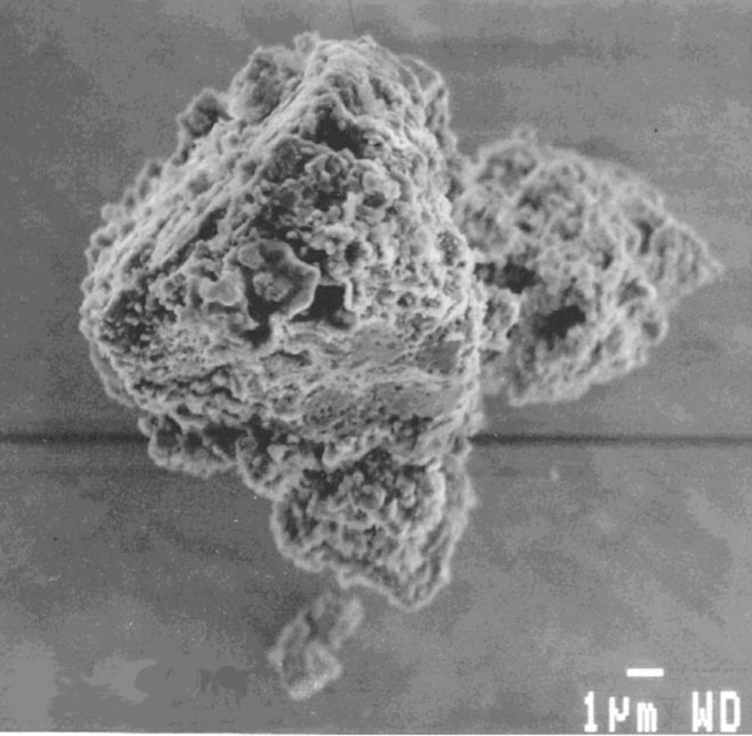
Plasma Screening Dusty (Complex) Plasmas
Current BBN screening models are analogous to models previously created to describe dusty (complex) plasmas.
focuses on plasma impurities (dust) on the order of $\sim 1$ $µ$m in size.
Areas of interest: Interplanetary space, Comets, Planetary rings, Earth’s atmosphere, fusion devices.
Both fields study larger, often spatially dispersed ‘impurities’ or dust with $Q/m$ different than standard plasma components.
We expect other results from this theoretical framework may be similar or directly applicable to BBN electron-positron plasma.
L. Stenflo, M. Y. Yu, and P. K. Shukla ”Shielding of a slow test charge in a collisional plasma” Phys. Fluids 16 (1973)
P. K. Shukla and A. A. Mamun ”Introduction to Dusty Plasma Physics” Plasma Phys. Control. Fusion 44 395 (2002)
P. K. Shukla and N. N. Rao ”Coulomb crystallization in colloidal plasmas with streaming ions and dust grains” Physics of Plasmas 3, 1770 (1996)
J. H. Chu and Lin I Phys. Rev. Lett. 72, 4009
Silicon dioxide dust in an Argon plasma

Slide 84
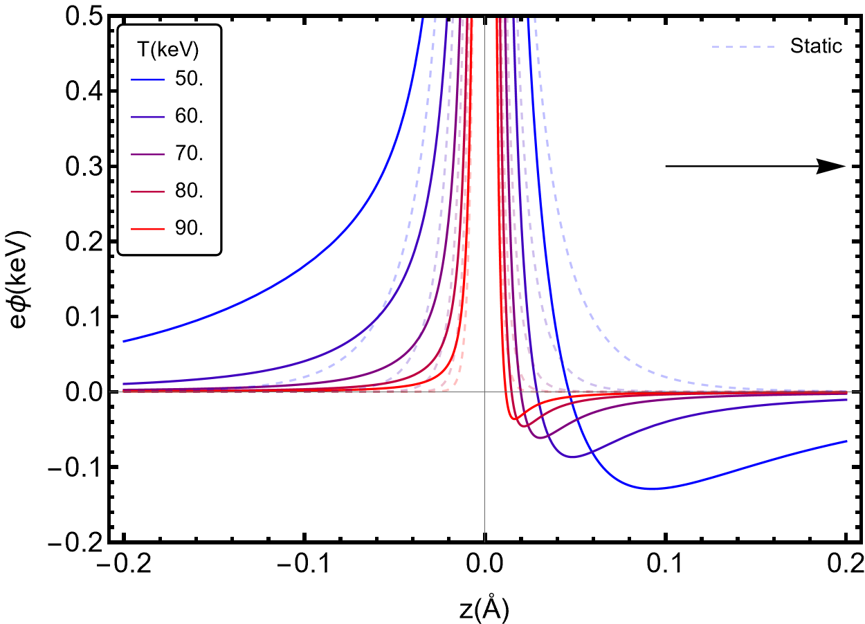
Damped-Dyanmic Screening – Temperature Variation
The size of screening polarization increases with decreasing temperature during BBN
³He
Small attractive portion of the potential

Slide 85
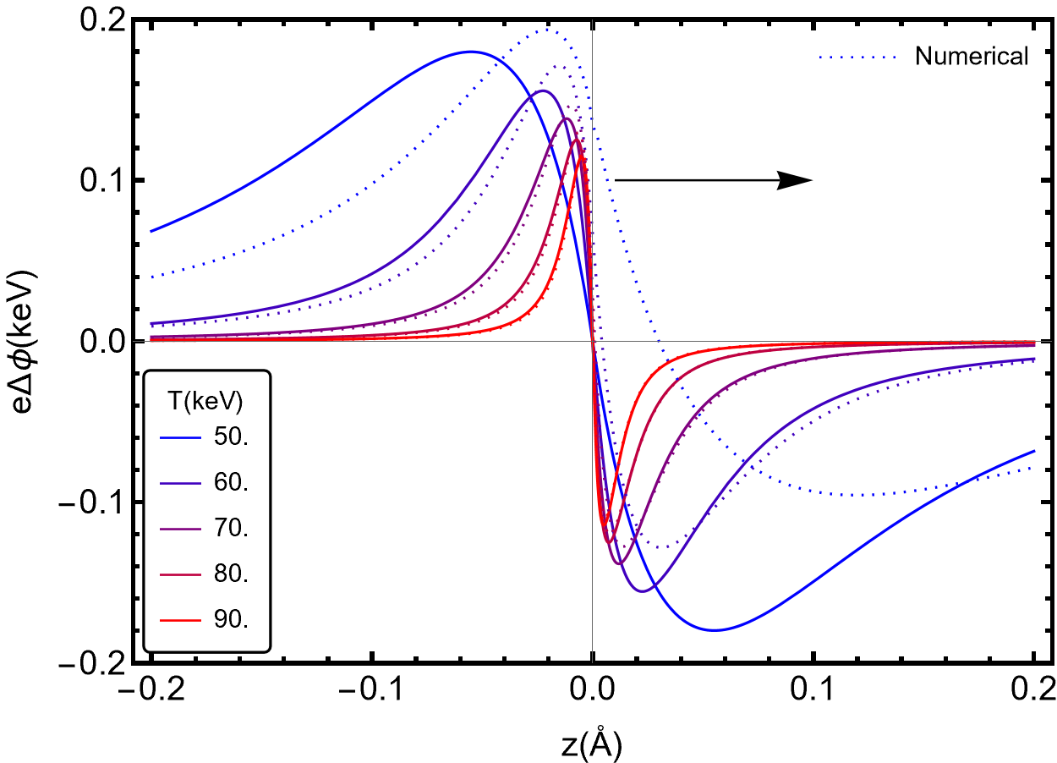
Damped-Dyanmic Screening – Temperature Variation
The size of screening polarization increases with decreasing temperature during BBN
³He
Small attractive portion of the potential
Analytic expression is valid late in BBN $T>70$keV.
As temperature decreases the dynamic contribution goes to zero.

Slide 86
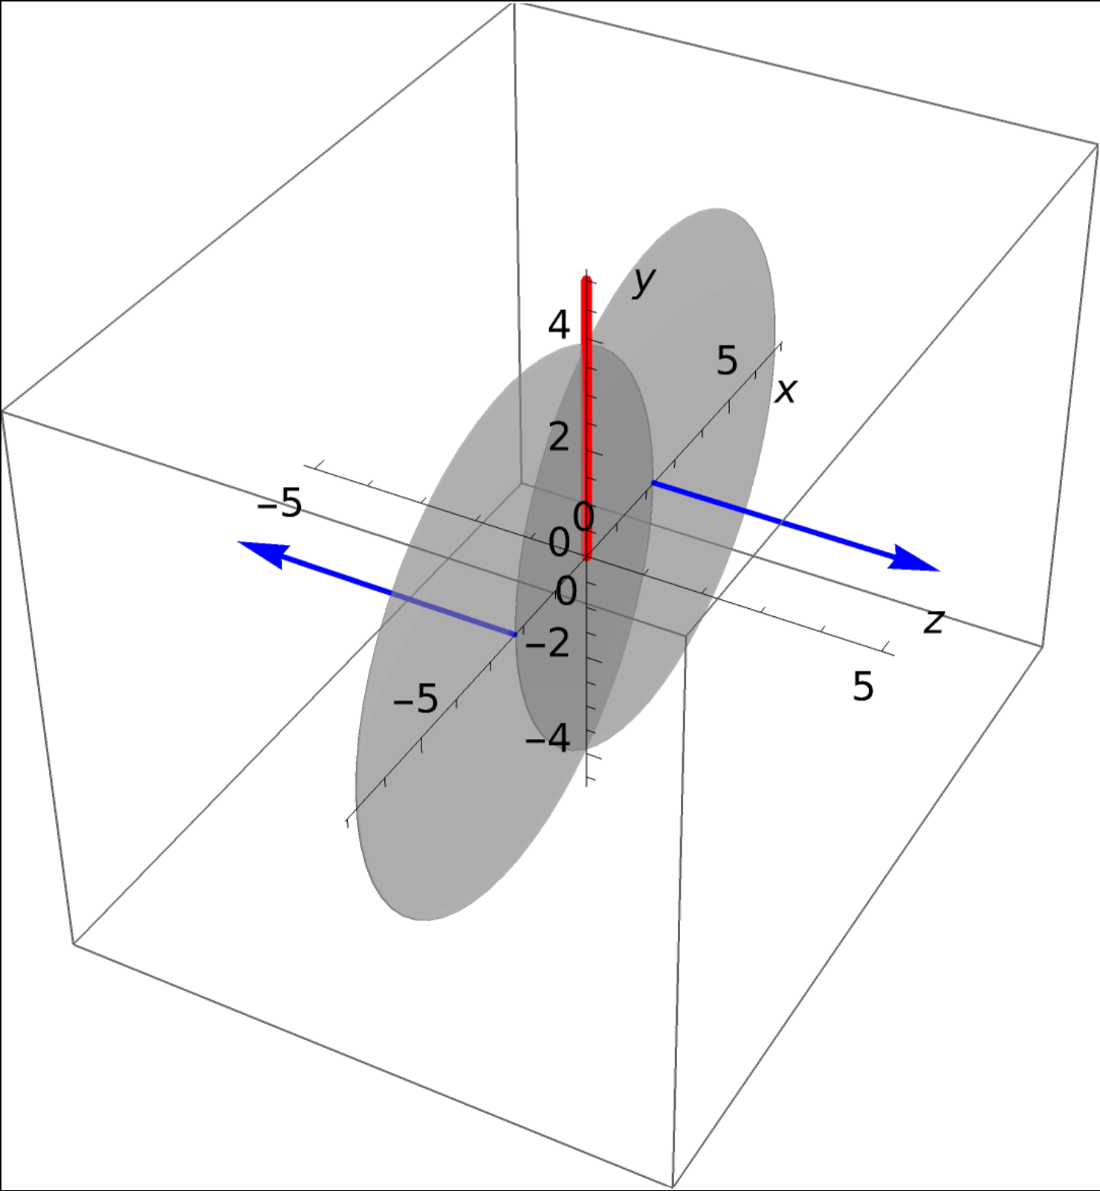
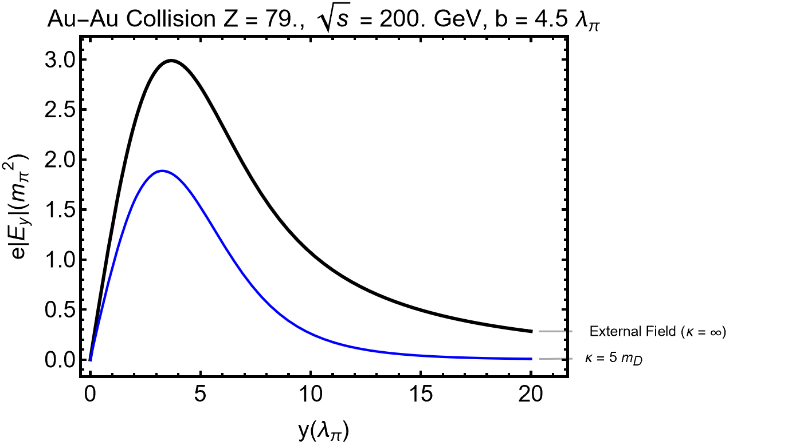
Electric Field
Transverse electric field is suppressed.

Slide 87
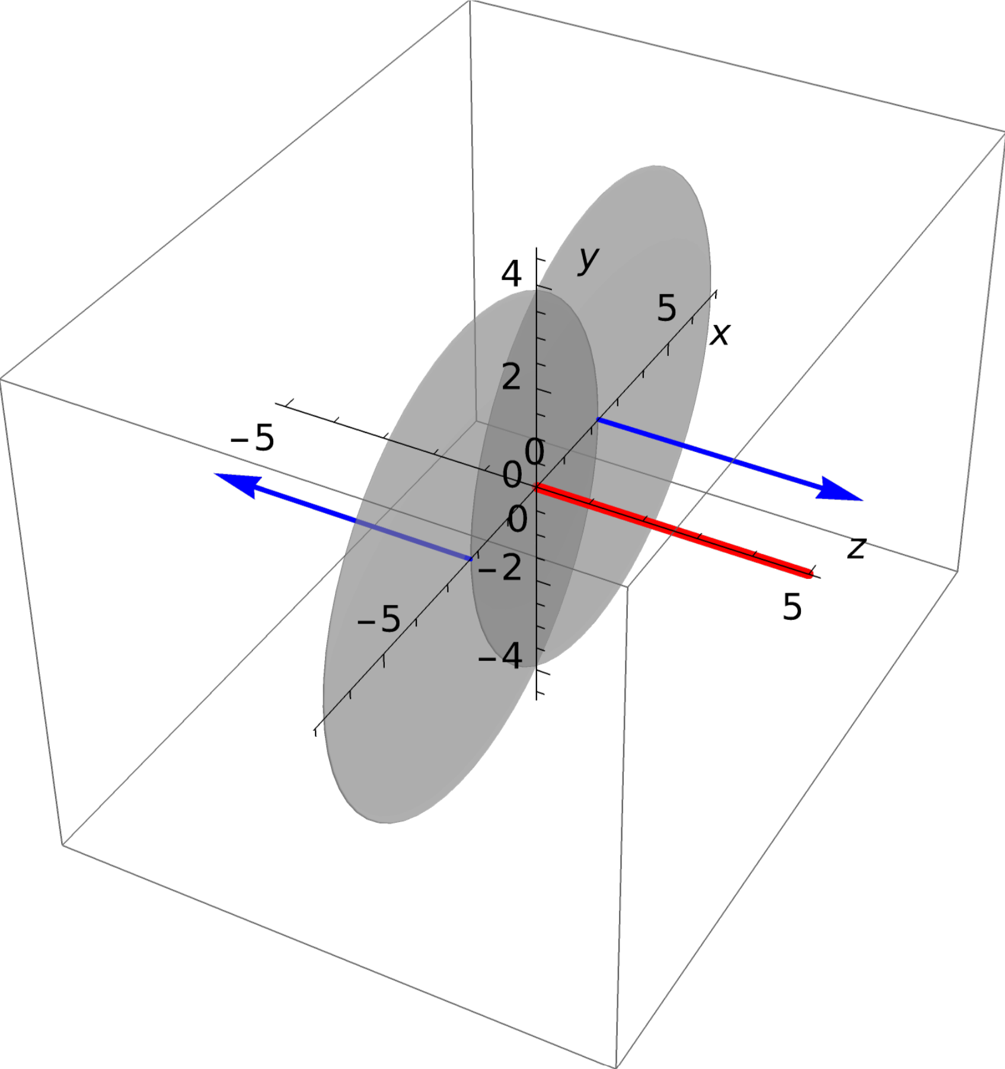
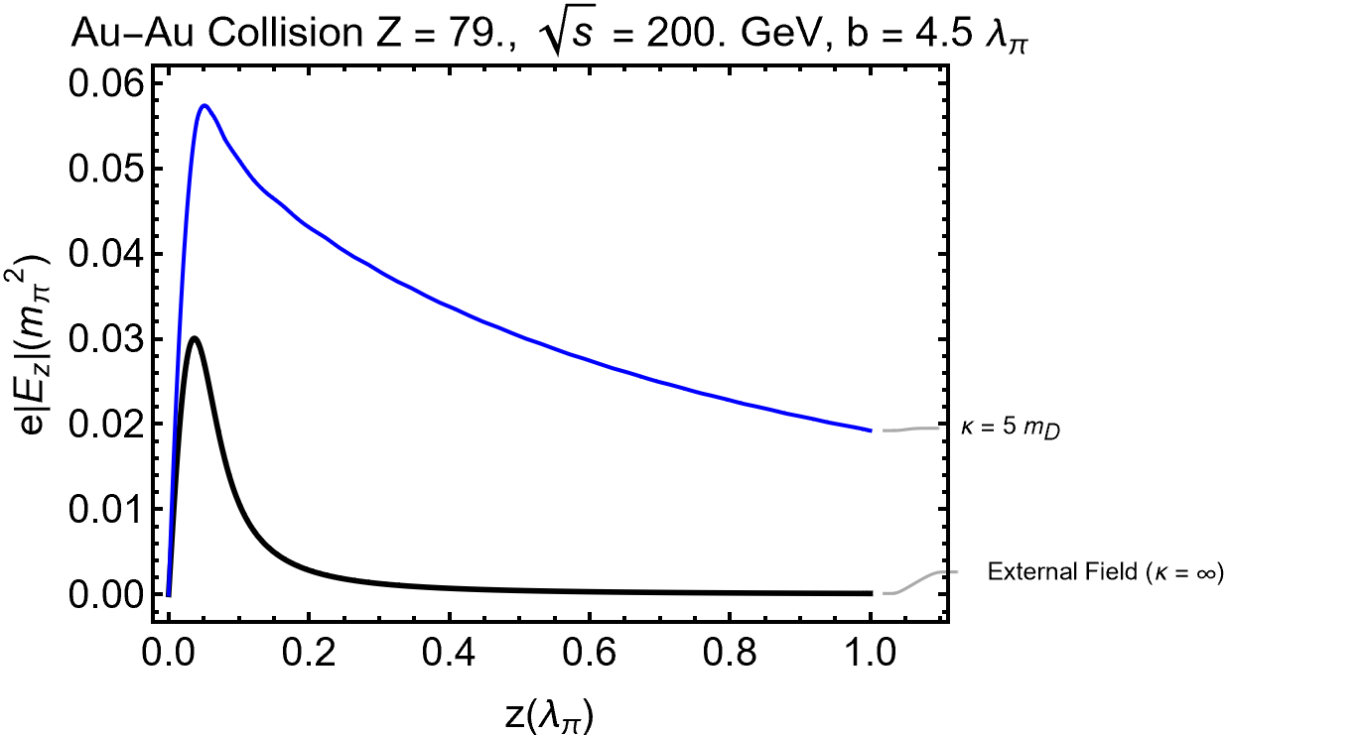
Electric Field
Longitudinal Electric field is enhanced

Slide 88
Switich-On
QGP Switch-On and Evolution: In order to accurately model in space and time QGP we would like to create a realistic spacetime picture of the plasma.
This can be done by adding a source to the neutral plasma in the boltzmann equation
The leads to a convolution integral in Ohm’s Law of the form,
where,
QGP

Slide 89
Free Charge Distribution
For simplicity we prescribe the external fields using a gaussian charge distribution normalized to the radius and charge of the nucleus.
Free Charge in Position Space
R_{rms} = 5.3 fm
Free Charge in Fourier Space
Notes:
Fix Z

Slide 90
Induced Charge
As 𝛾 increases the external charge density is contracted (grows large in magnitude but smaller in space).The functional dependence of the tail changes little so appears to be small and more smeared out at high gamma.
Notes:
The charge doesn't get enhance because to lorentz invariance, calculating the induced charge for a stationary charge in a moving medium should give the same results

Slide 91
Induced Charge
As 𝛾 increases the external charge density is contracted (grows large in magnitude but smaller in space).The functional dependence of the tail changes little so appears to be small and more smeared out at high gamma.
Notes:
The charge doesn't get enhance because to lorentz invariance, calculating the induced charge for a stationary charge in a moving medium should give the same results

Slide 92
Induced Charge - (Single Nuclei)
Plot below shows a single ion traveling through the plasma. A trailing negatively charged wake is shown trailing behind the positive Ion.

Slide 93
Charge Conservation in the Infinite Plasma
In the case of an infinite plasma in both space and time the induced charge balancing the induced screening charges has moves to infinity.

Slide 94
Plasma Frequency
We can use the dispersion relation to solve for the natural oscillations of the effective particles within the plasma i.e. plasmons, This is done by solving the dispersion relation in the limit k→0,
for both modes one finds,
For an oscillatory electric field, these modes are damped by the relaxation parameter
Where

Slide 95
Susceptibility
(Rukhadze and Silin, 1961)
Notes:
Find references for Polarization tensor

Slide 96
Fields of Colliding Ions
Surface indicates where potential reaches 2m𝜇
Velocity Field
Radiation Field
Blue arrows indicate direction of motion

Slide 97
Conductivity
Discontinuity at k = 0 comes from infinite extent of plasma (Baranger 1989)

Slide 98
Modes - Dispersion Relation
Negative imaginary part means modes are damped
Longitudinal Modes: Electric Charge Oscillations → Langmuir waves (density fluctuations), Debye screening (charge screening)
Transverse Modes: Current Oscillations → Electromagnetic waves in vacuum
Finte 𝜅
Longitudinal solution runs into the branch cut at -i𝜅

Slide 99
Modes - Dispersion Relation
Longitudinal Modes: Electric Charge Oscillations → Langmuir waves (density fluctuations), Debye screening (charge screening)
Transverse Modes: Current Oscillations → Electromagnetic waves in vacuum
-i𝜅
Longitudinal solution runs into the branch cut at -i𝜅
(Schenke et al. 2006)

Slide 101
Big Bang Nucleosynthesis (BBN)
$T_{BBN }=50−86$ keV
Why is the Early universe of interest?
During BBN, numerous nuclear reactions occur, producing primordial light element distributions.
Open questions and tensions between measurement and theory remain about light element distributions in the universe
Question: How does the universe’s composition affect the Big Bang Nucleosynthesis reaction network?
We acknowledge that these reactions do not occur in vacuum.
Notes:
use

Slide 102
Dispersion Relation of the Plasma
Solve for the poles of the propagator in fourier space
Focusing just on the longitudinal modes (related to potential screening)

Slide 103
Dispersion Relation of the Plasma
Solve for the poles of the propagator in fourier space
General solutions to a cubic equation are given by

Slide 104
Dispersion Relation of the Plasma
Dotted lines are imaginary parts and solid lines are the real parts

Slide 105
Dispersion Relation of the Plasma
The red mode gains a position imaginary part at finite k
This either indicates an acausality in the system or an instability in the plasma
The value of k here corresponds to waves of characteristic size

Slide 106
Baryon Separation vs Debye screening
Baryons are to dispersed in comparison to the size of the Debye sphere to play a role in screening

Slide 107
Light-cone Conductivity for Ultrarelativistic Ions
Width
Width
“Region of 2 sigma support”
The conductivity does not vary with and we can use its value at
“Lorentz contraction in direction of motion”
Notes:
This could be helpful for traverse size

Slide 108
Magnetic Field of Heavy Ion Collisions at the Origin,
Expansion of the light cone conductivity in 𝜔/𝜅:
“Late time solutions do not depend on 𝛾.”
“Drude conductivity”
Simplified form of the denominator allows for contour integration:
K. Tuchin, Phys. Rev. C 88 (2013)

Slide 109
Dark Energy and Dark Matter during BBN
PhD and Post-PhD research J. Birrell

Slide 110
Lithium problem

Slide 111
Damped Dynamic Screening: Plasma Parameters
“Photon mass” - Static screening length in the plasma
“Collision Rate” - (Mean free time in plasma)⁻¹
“Over Damped”
“Over Damped”
“Damped”
“Damped”

Slide 112
Multi component $e^{+}e^{−}$
In Matrix Form
Diagonalize
Approximate values of $κ$ are equal
with

