Slide 1


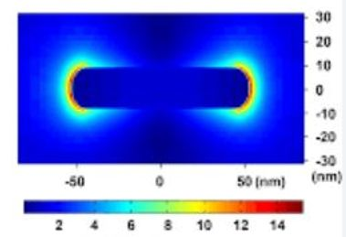
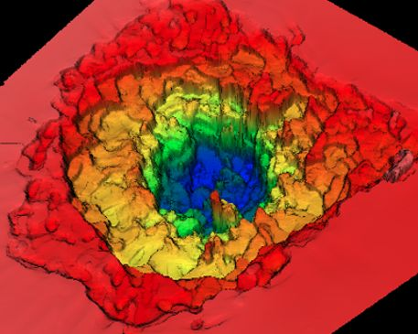
HIGH FIELD NANOPLASMONICS FOR NUCLEAR FUSION
NORBERT KROO
WIGNER RESEARCH CENTER OF PHYSICS
(on behalf of the NAPLIFE project)
PP2024: 11.06.2024

Slide 2
1.Material in extreme conditions
free
atom
I = 10¹⁶ W cm⁻²
+
Slope: 0.89+/-0.03
(tunnelling)
4.10¹⁰ W/cm²
Slope: 4.3+/-0.4
(perturbation)
Tunnelling
10¹⁴ - 10¹⁵ W cm⁻²

Slide 3

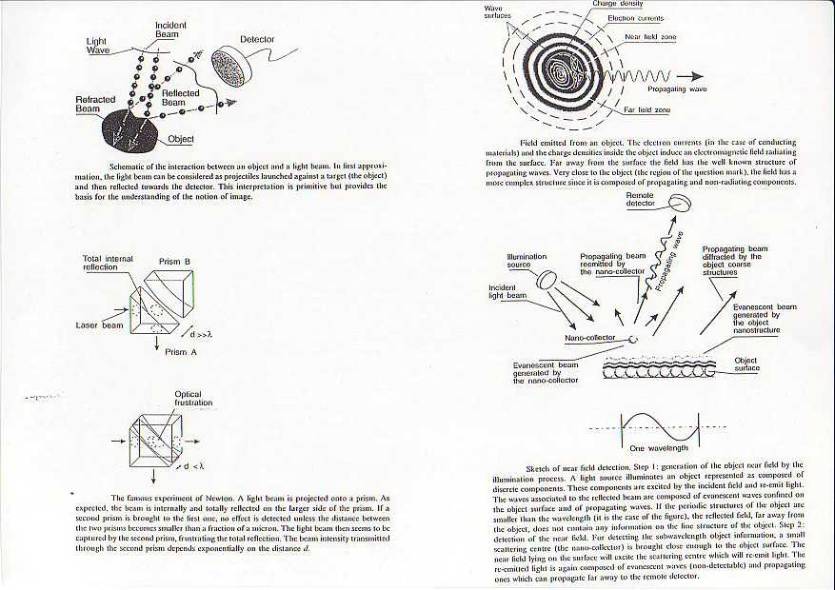
2.The optical near field

Slide 4
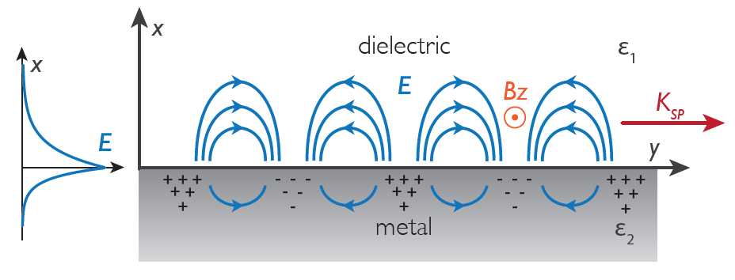
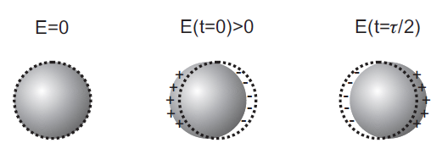
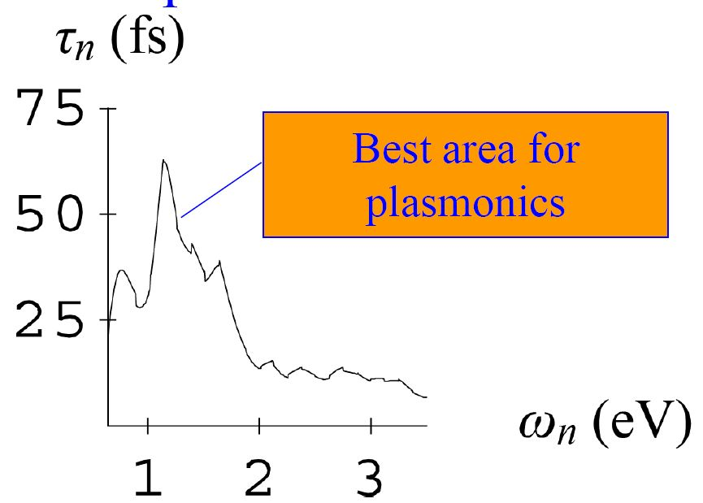
PLASMONICS AND HIGH FIELDS APPLICATIONS
Special type of the optical near field
SPP
LSPP
Ti:Sa laser: ʎ=800nm (~1.55eV) ; t(SPP)~30fs
ω(eV)

Slide 5


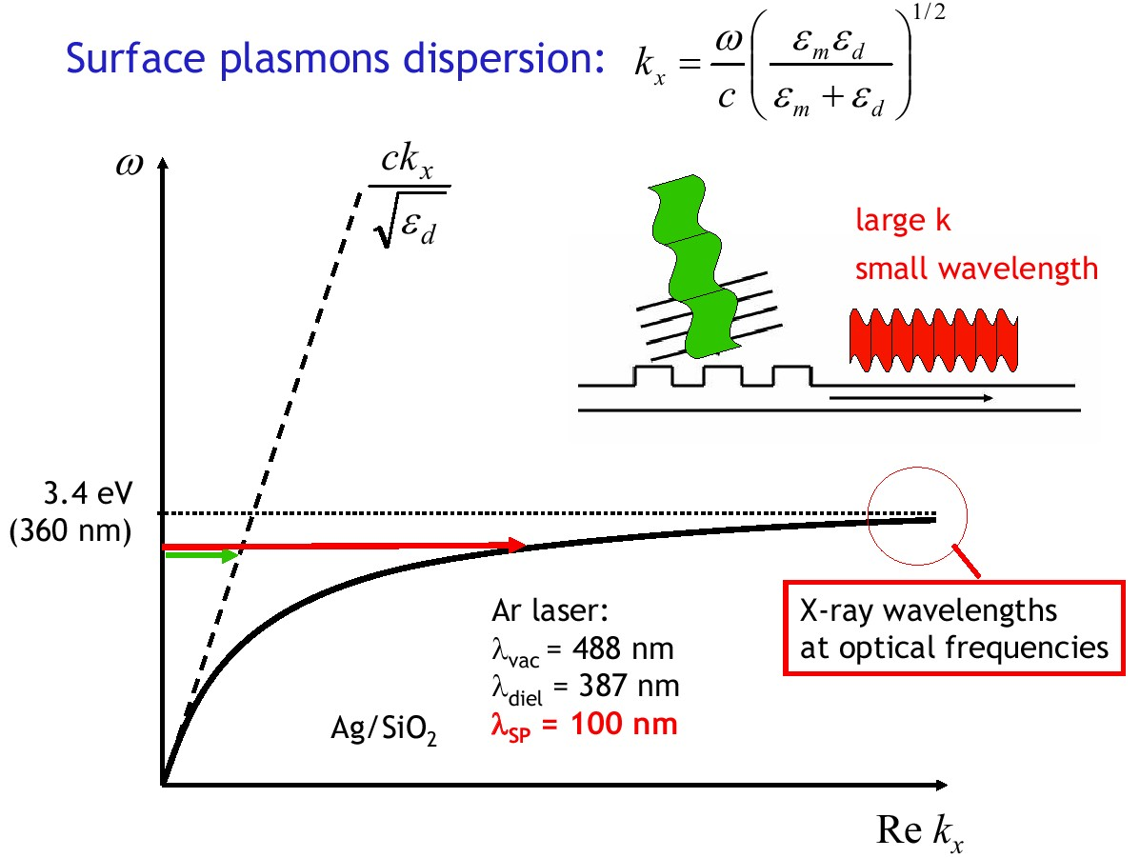
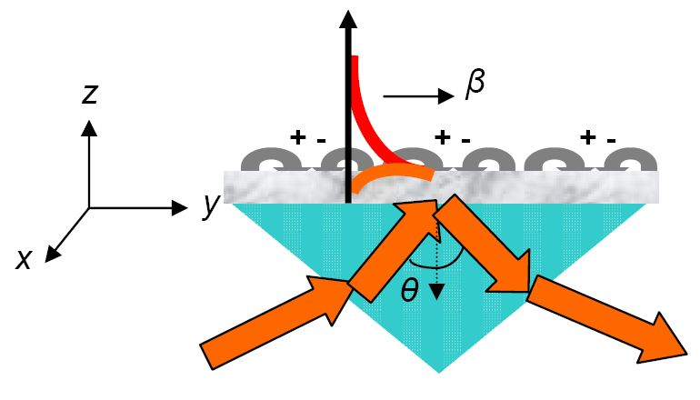
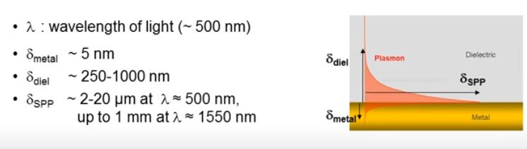
1.SURFACE PLASMON POLARITONS (SPP)

Slide 6
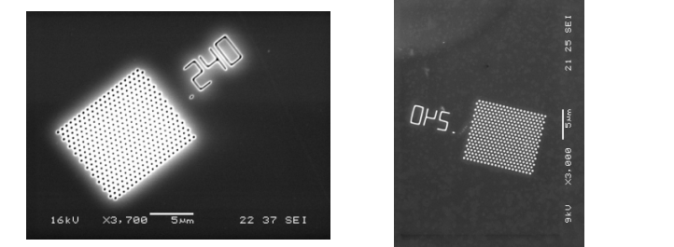
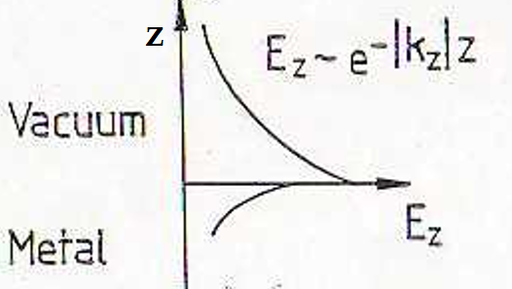
A fény hullámhossznál sokkal kisebb méretű lyukakon (réseken) is áthalad
VÁKUUM
AZ ENERGIA ZÖME A FELÜLETRE KONCENTRÁLÓDIK: ÓRIÁSI TÉR ERŐSÍTÉS
FÉM
NAGYSZÁMÚ POTENCIÁLIS ALKALMAZÁS.

Slide 7
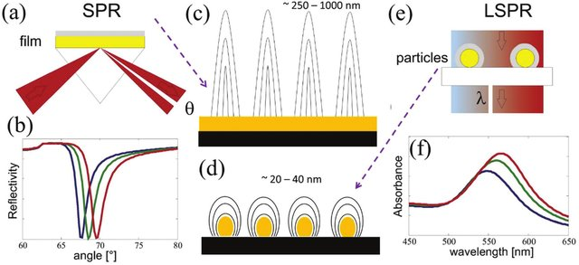
2.LOCALIZED PLASMONS (LSPP) UP TO 10²⁰ W/cm²)
(The basic difference between SPP-s and LSPP-s)
LSPP: -NO PENETRATION INTO THE PLASMONIC MATERIAL (e.g. metal)
- SMALLER PENETRATION INTO THE DIELECTRIC /VACUUM
-NO DISPERSION, RESONANCE DEPENDS ON SIZE, SHAPE, MATERIAL
-BROADER RESONANCE

Slide 8
PLASMON RESONANCE OF NANOPARTICLES SHAPE AND- ÉS SIZE DEPENDENT!
Nanoshell:
Bulk
a
Surface
b
Sphere
Nanoshell plasmon resonance depends on the x ratio .
Üreg

Slide 9
Spectral tuning range
nanoshell plasmon rezonance
1000
100
ε₂
Core/Shell Ratio r₁/(r₂-r₁)
ε₃
ε₁
10
r₁
r₂
1
0
2
4
6
8
10
Wavelength (microns)
1.24 electron volts 0.124
300 THz 30
10,000 cm⁻¹ 1,000

Slide 10
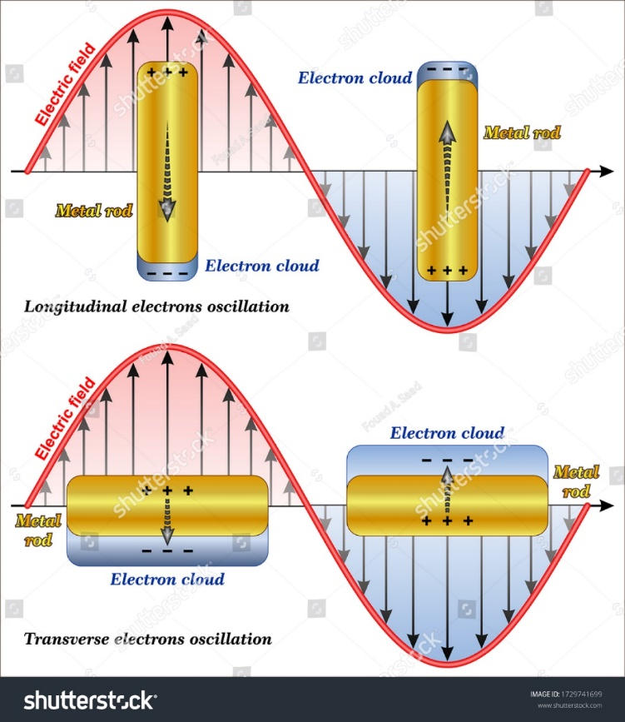
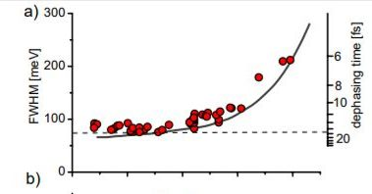
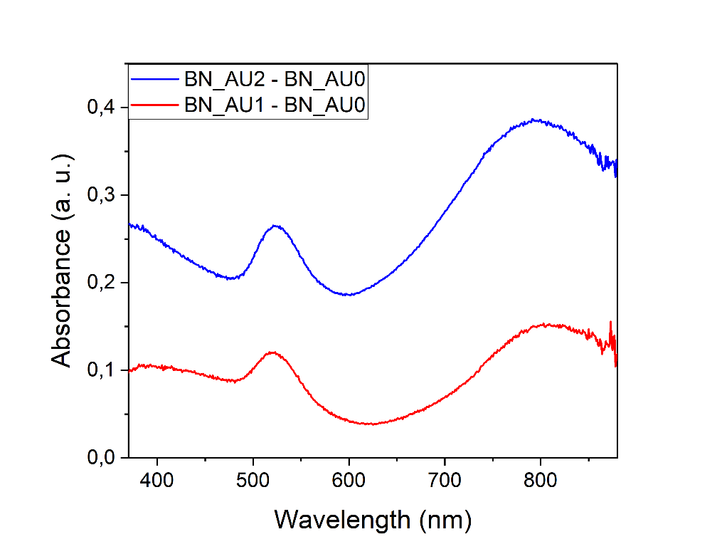
Nanorod:Transverse and longitudinal modes!
T
L

Slide 11
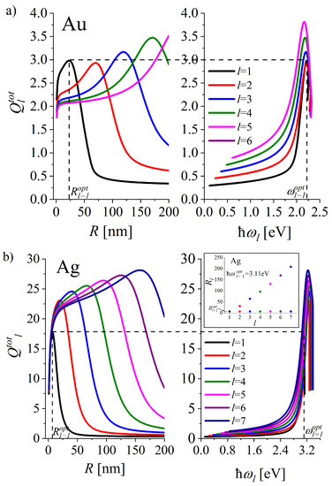
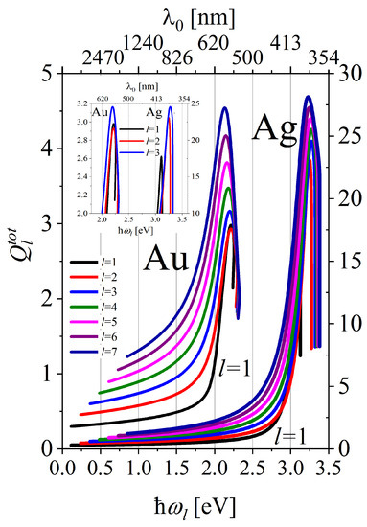
Krystina Kolwas: Materials 2023, 16,1801, pp1-15

Slide 12
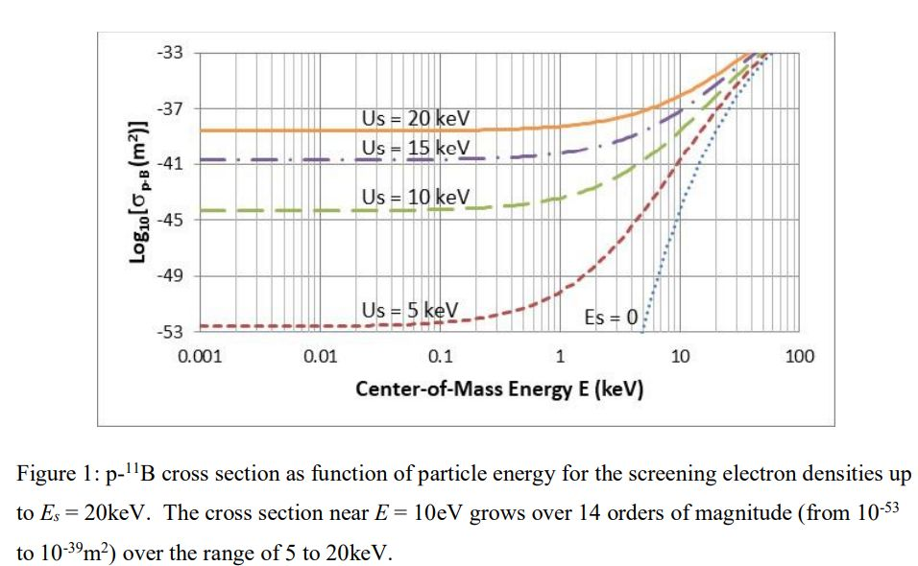
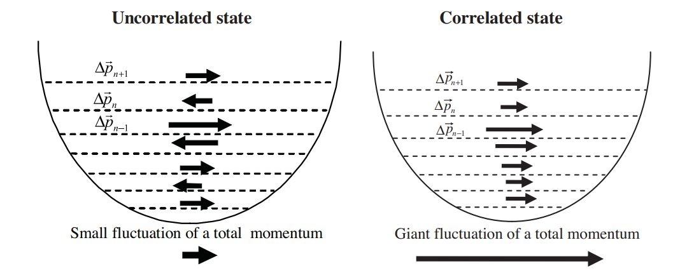
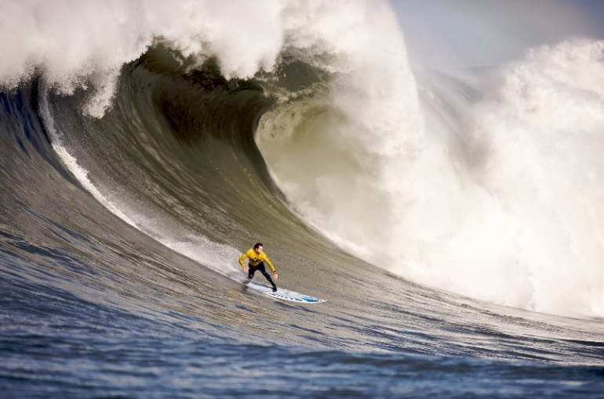
-HOT SPOT
-SCREENING
-PONDEROMOTORIC
ACCELERATION
-CORRELATED MOTION

Slide 13
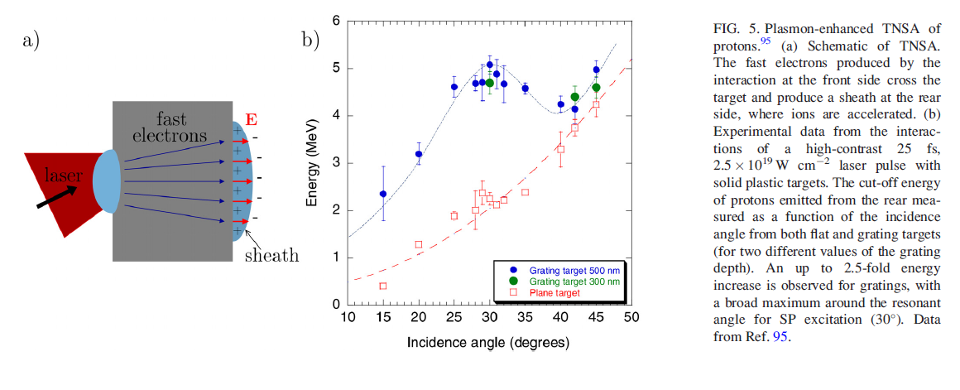
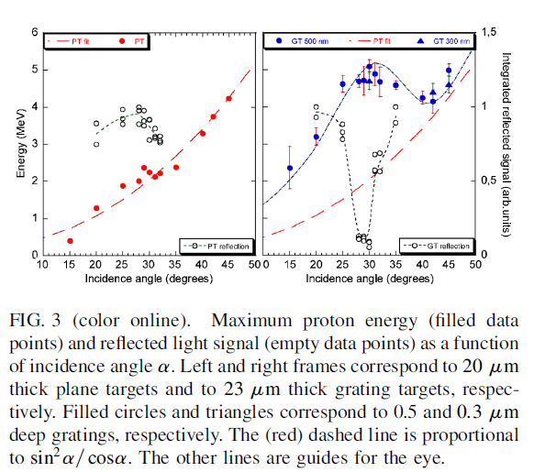
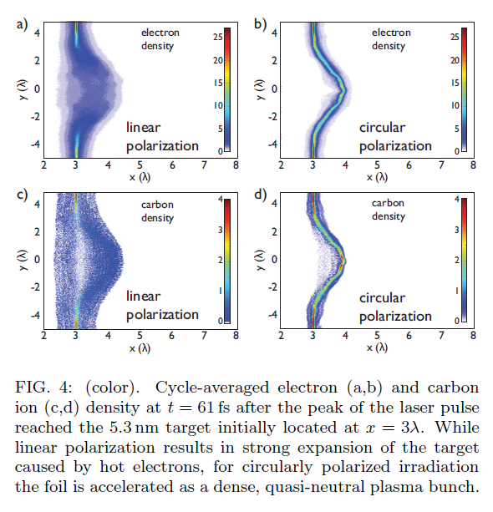
AND UP TO ~10²⁰ W/cm²

Slide 14
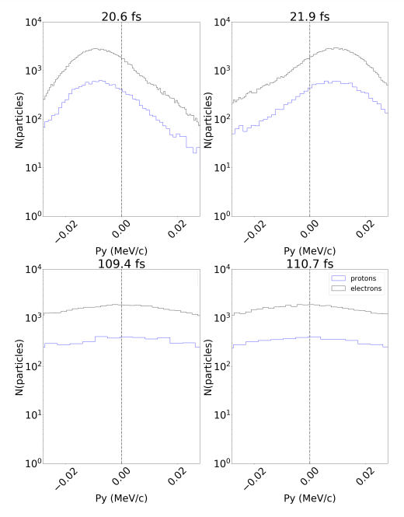
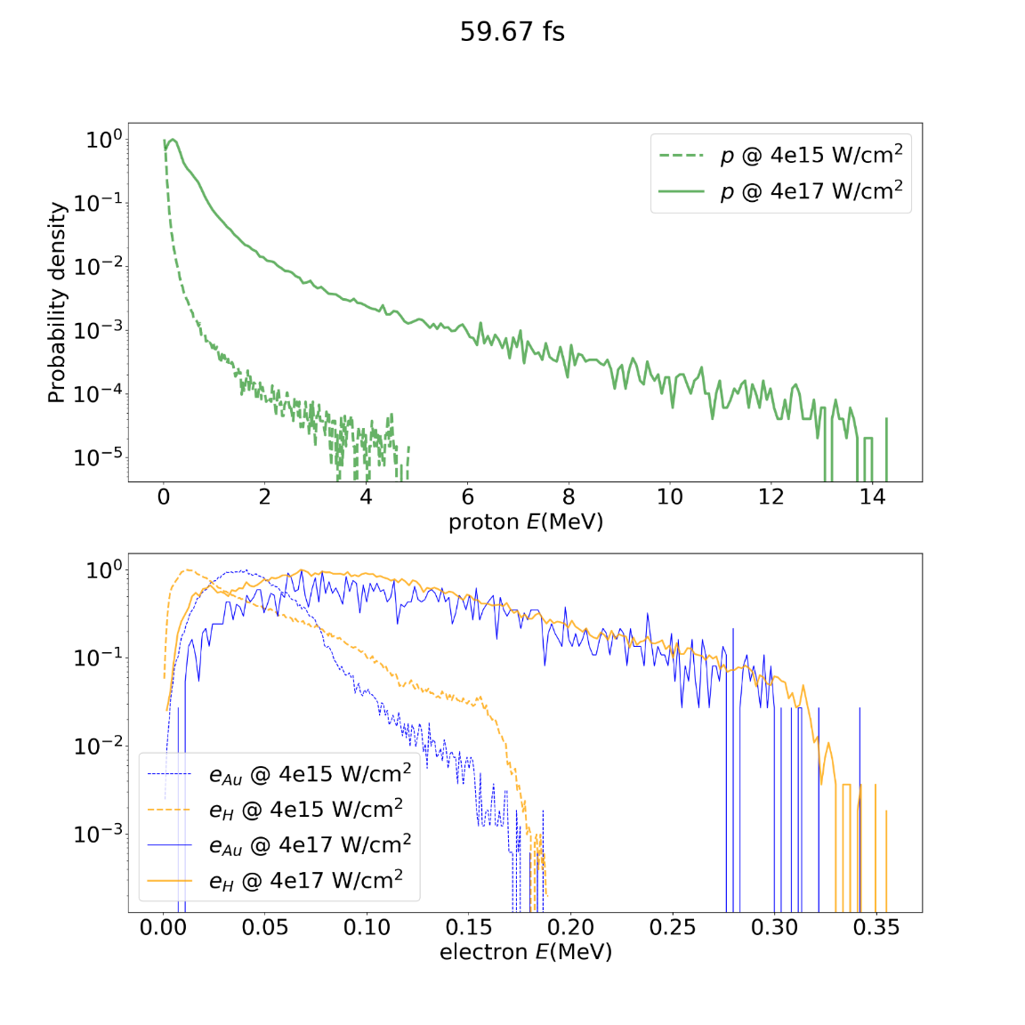
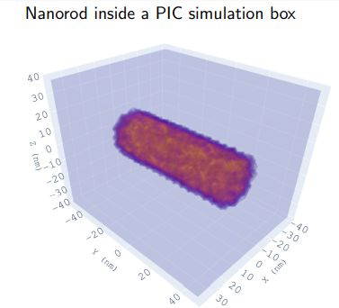
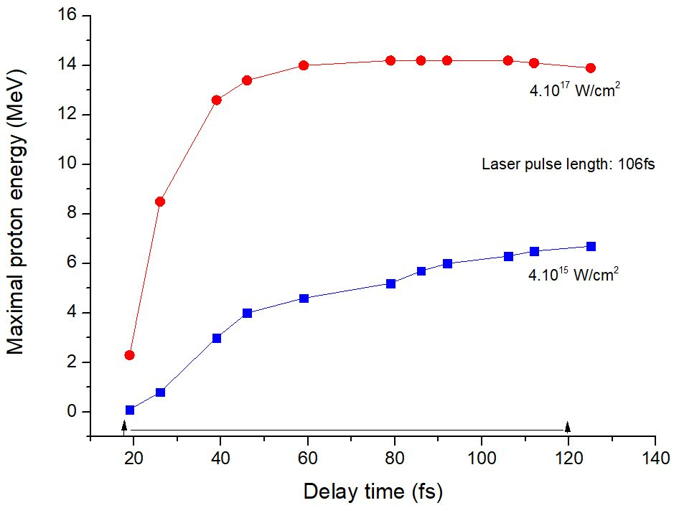
SIMULATION OF PROTON AND ELECTRON ENERGIES AT A SINGLE NANOROD

Slide 15
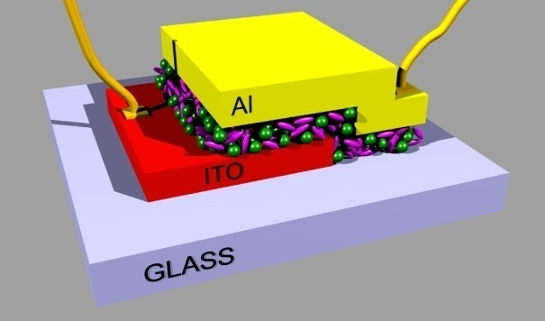
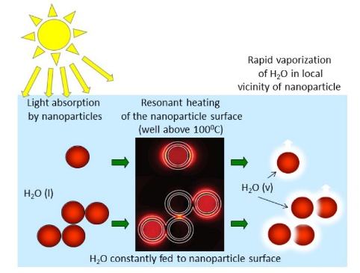
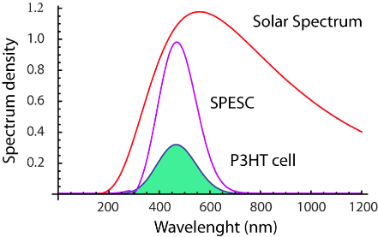
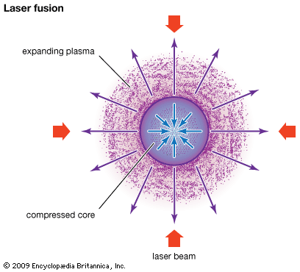
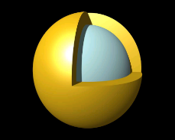
Some potential new energy technologies
(involving nanotechnologies)
P3HT Cell efficiency = 6%
SPESC (P3HT) efficiency = 17.5%
Toward our proposal

Slide 16
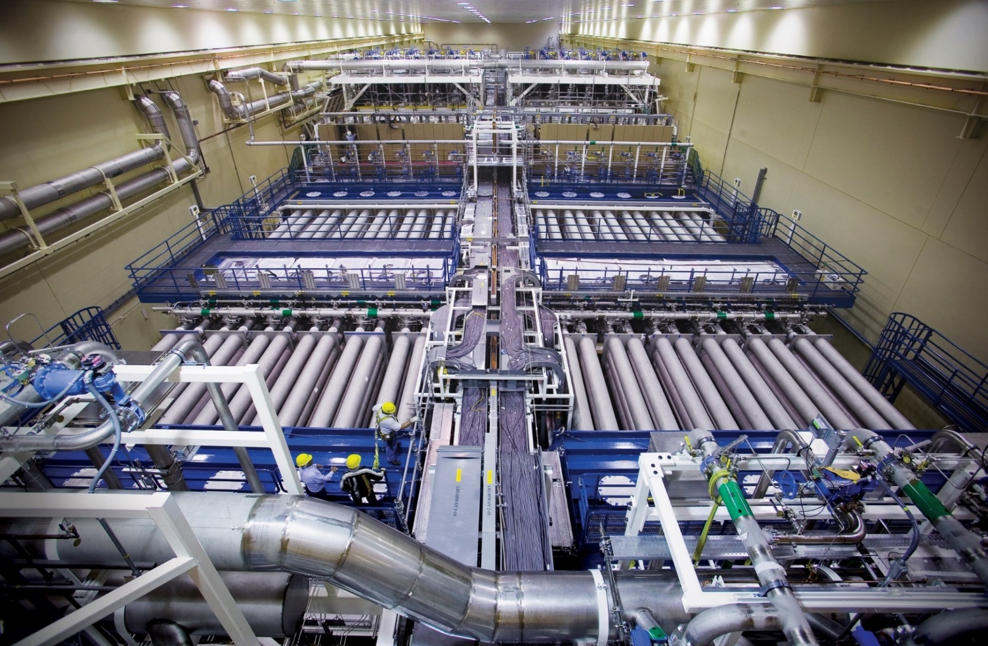
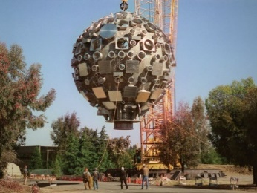
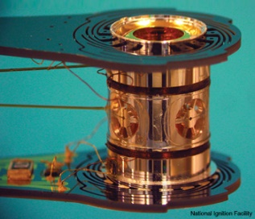
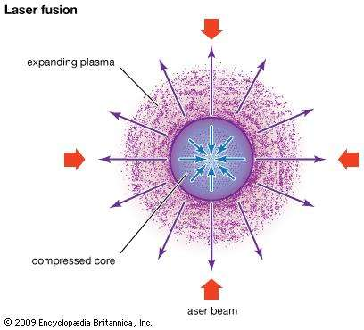
NIF (LÉZER INDUKÁLT FÚZIÓ)
10⁵USD
Target tartó
192 lézer, 400MJ, a targeten 2MJ. A generált nukleáris energia 3MJ. Egy target kapszula ára ~10⁵USD. A lézerimpulzus hossza : 10-50ns , 1 imp/nap. A berendezés ára: sokmilliárd USD.

Slide 17
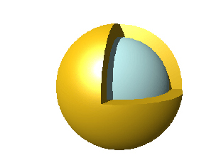
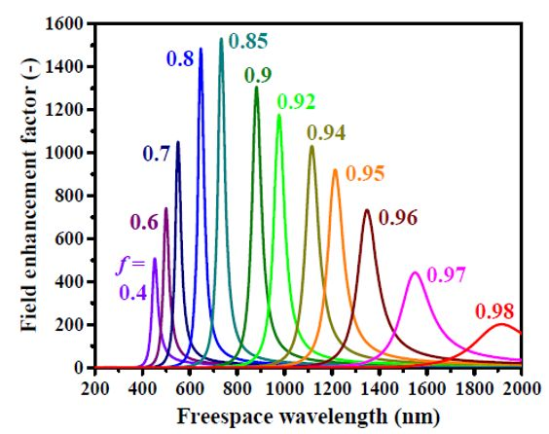
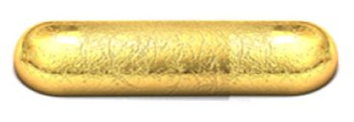

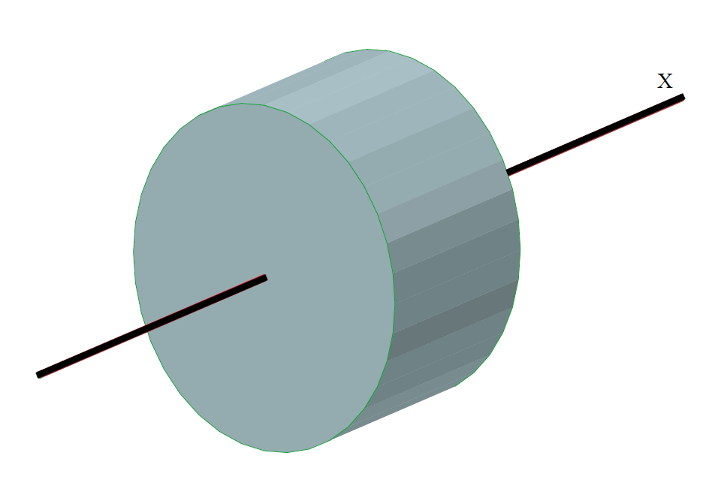
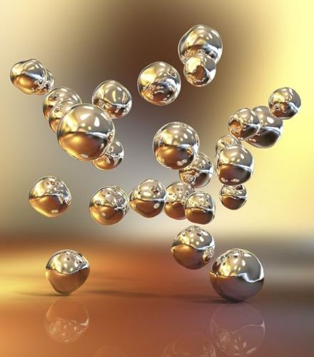
:
NANOPLASMONICS AND ENERGY CONCENTRATION
NANOSHELL
(nx10nm)
NANOROD (~85x25nm)
Λ=800nm
d ~ n.10μ
n.10μ
FEMTOSECOND LASER PULSES;
HIGH REPETITION FREQUENCY;
LIGHT SPEED: NO TIME FOR INSTABILITIES; ONLY TWO BEAMS; TIMELIKE VOLUME IGNITION
NANOPARTICLES IN THE FUSION MATERIAL

Slide 18
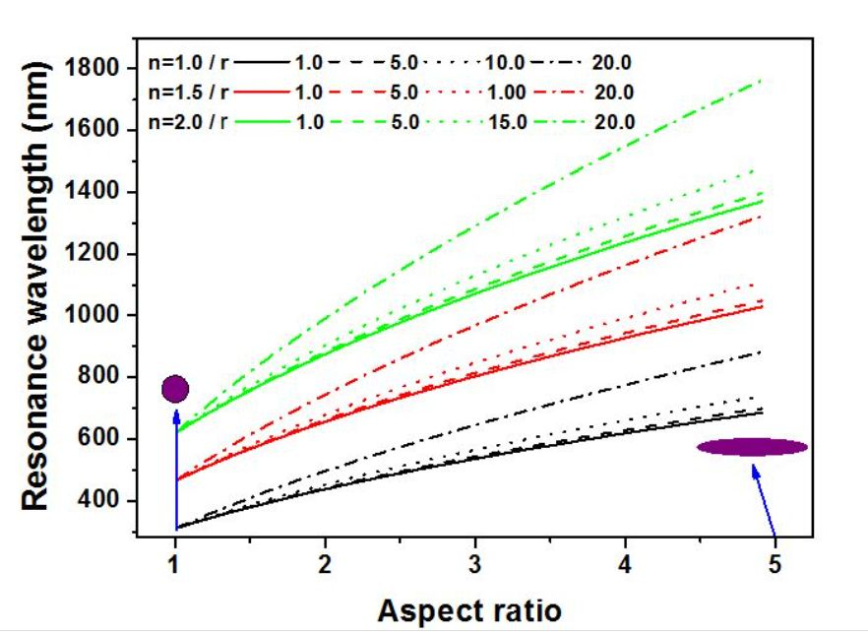
Ti:Sa laser

Slide 19
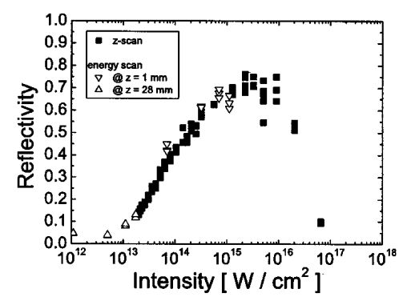
LIGHT-MATTER INTERACTION:
PLASMA-MIRROR REFLECTIVITY
(how can light enter into matter? )
PRESENT AND FUTURE
MY PAST EXPERIENCE
Ch.Ziener at al : J.Appl.Phys. 93,768 (2013)

Slide 20
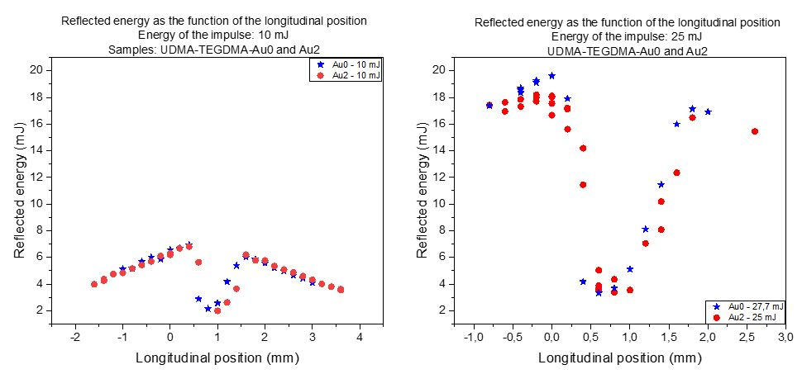
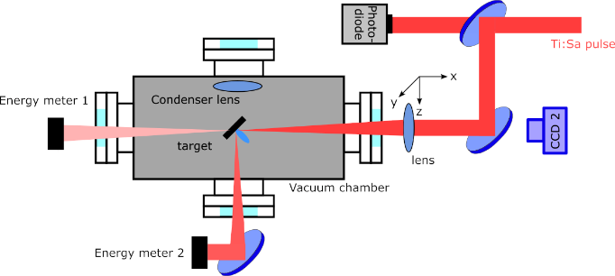
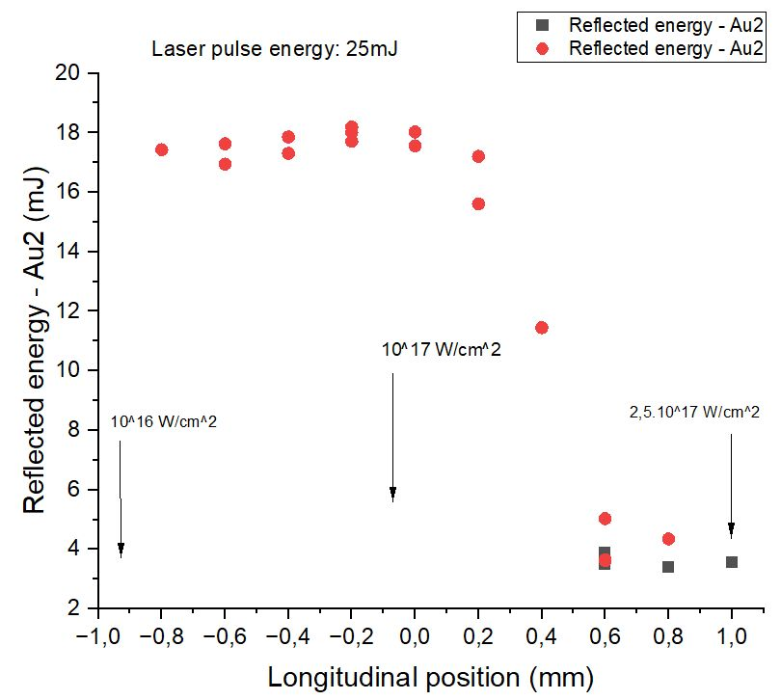
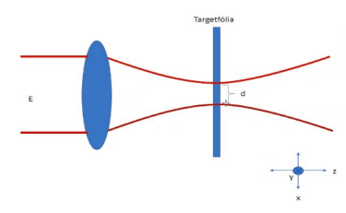
Minta: polimer (UDMA+ TEGDMA) Au2 (0.18m/m%) rezonáns nanorúd
és Au0 (nanorudak nélkül)

Slide 21
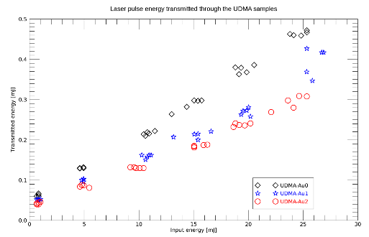
d = 160μ

Slide 22
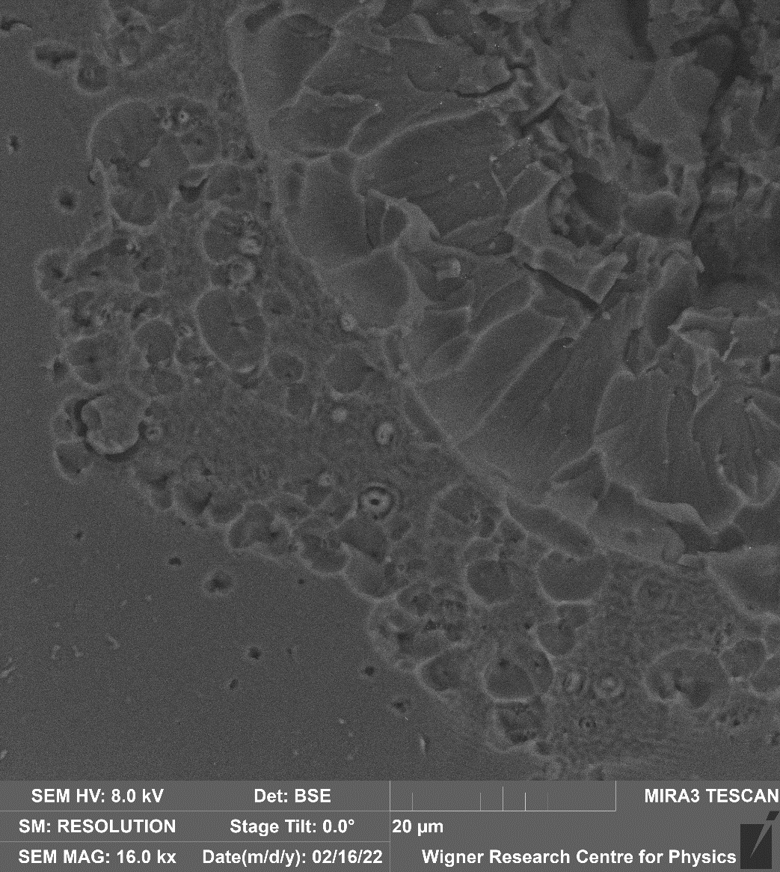
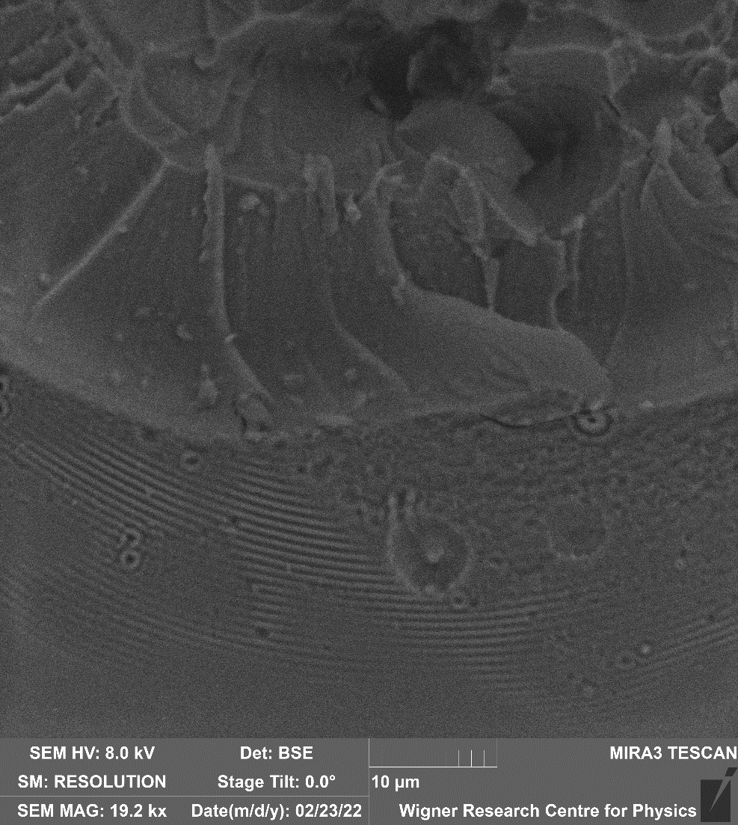



Slide 23

CRATER VOLUMES
2,5.10¹⁷W/cm²
2.10¹⁷W/cm²
1,2.10¹⁷W/cm²
0,46.10¹⁷W/cm²
0,5.10¹⁷W/cm²
HIGH FIELD PLASMONICS WORKS!

Slide 24


1,2.10¹⁷ W/cm²
Volume ~3,5 V₀

Slide 25


Crater volume: ~ Elaser imp.
Volume increase: ~ Ilaser imp
25mJ
27.5mJ

Slide 26






CRATER VOLUME IMAGES TAKEN AT WIGNER AND ELI (25mJ pulse energy)
WIGNER
Au0 42fs
WIGNER
Au2 42fs
ELI
ELI
Au0 12.3fs
Au0 12.3fs
ELI
Au2 12.3fs
ELI
ELI
Au0 42fs
Au0 43fs
ELI
Au2 43fs

Slide 27


2.Diagnozis :Raman scattering from the crater surface
arXiv2210.00619(2022),submitted to Advanced Optical Materials
Ilaser > 10¹⁶ W/cm²
a
Au2
Au1
b
Au0

Slide 28






3.SOME RESULTS OF THE Hᵅ AND Dᵅ SPECTRAL LINES
H
D
D
H
Deuterated (30%) sample
2D+H The total number of H atoms before the transmutation process
Number of D atoms in the case of 25mJ laser pulses : ~1.76x10¹⁵

Slide 29


Au0
Au2

Slide 30




798 Au2 12.3fs
102 Au0 12.3fs
1
4
12
12
6

Slide 31


HIGH INTENSITY PLASMONICS WORKS

Slide 32




With boron Au2 12.3fs
With boron Au0 12.3fs
6
4
3
1

Slide 33





Slide 34



LET
H?
D?
DIAMETER (micron)
LET (kev/micron)

Slide 35
α
DIAMETER (micron)

Slide 36

α
LET (KeV/micron)

Slide 37
CONCLUSIONS
1.Table-top lasers have been found to indicate the significant role of
high field nanoplasmonics in potential nuclear fusion processes.
2.Above ~ 10¹⁷W/cm² laser intensity the formation of reflective
plasma mirror is negligible, light penetrates into the sample.
3.Plasmonics works also at high laser intensities.
-Significant energy production has been detected, indicated by
the increase of the crater volume and Thomson parabola results
of BN seeded samples
-The source of this excess energy could be partly the deuterium
production, detected by optical spectroscopical methods.
-The particle energy of ions in the plume is always higher for
samples with resonant plasmonic nanoparticles than for those
without them.
-The Thomson parabola spectrometer spectra indicate also this
influence of the LSPP resonance effect on the basic processes.
4.Nuclear processes have also been indicated, but here further, more
convincing studies are needed.

Slide 38

THANKS FOR YOUR ATTENTION!

Slide 39


When the winds of changes are blowing some build shelters, but some others build wind turbines

