Slide 1
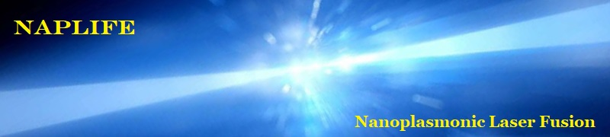

High-energy Non-thermal
Laser-induced Nano-fusion

Slide 2
















Csernai László
University of Bergen, Norway

Slide 3
Nour Jalal Abdulameer, Márk Aladi, L. Balázs, Balázs Bánhelyi, Tamás S. Biró, Attila Bonyár, Alexandra Borók, Larissa Bravina, István Csarnovics, László Pál Csernai, Mária Csete A. Csik, Gábor Galbács, Chris Grayson, Tamás Csörgő, Olivér Fekete, L. Himics, Román Holomb, L. Juhász, Gábor Kasza, Judit Kámán, Miklós Kedves, Rebeka Kovács, S. Kökényesi, Norbert Kroó, Archana Kumari, Tomás Lednický, Péter József Lévai, Igor N. Mishustin, Dénes Molnár, Anton Motornenko, Ágnes Nagyné Szokol, István Papp, Petra Pál, Béla Ráczkevi, Péter Rácz, Johann Rafelski, István Rigó, Leonid M. Satarov, Horst Stöcker, Daniel D. Strottman, G. Szabó, Melinda Szalóki, Géza Szántó, András Szenes, Karolis Tamosiunas, Nóra Tarpataki, Bálint Ferenc Tóth, Emese Tóth, Dávid Vass, Miklós Veres, Shereen Zangana, Konstantin Zhukovsky, (NAPLIFE Collaboration) ~ 50 participants
About half of participants supported in part by NKFIH, Budapest.

Slide 4
NAPLIFE: Three unique, new ideas
Simultaneous ignition by monochromatic, linearly polarized laser light to avoid instabilities. Short pulse length is needed ➔ Only ELI-ALPS ! (regular nonthermal) [Patented]
Using resonant nanorod antennas to increase and regulate light absorption (regular nonthermal) [Patented]
Accelerating protons via LWFA & LWFC mechanisms in one direction, orthogonal to the two colliding laser beams to start nuclear reactions (regular nonthermal)
Now: (i) Theory & ideas (ii) Validation status

Slide 5
Radiative electro-magnetic (EM) energy transfer
Thermal or mechanical ? Possible both ways:
- Thermal: Black body radiation → loss & Carnot efficiency → Entropy current. Most fusion energy schemes assume thermal processes ➔ loss!
- “Mechanical”: Monochromatic conductors, Coaxial or Rectangular Wave guides, Lasers, Monochromatic (~~~) broadcast, near to 100% efficiency!
(Directed radio (TV) broadcast possible to astronomical distances!)
Goal: Laser Induced Fusion Energy
– Transfer laser energy to nuclear reactions with minimal loss →
- Non-thermal processes are preferred
- E.g. convert laser energy to fusion target nuclei (p, d, t, He3, etc. ) with
least possible loss
Most other fusion initiatives are thermal !

Slide 6
(i) Theory & ideas

Slide 7
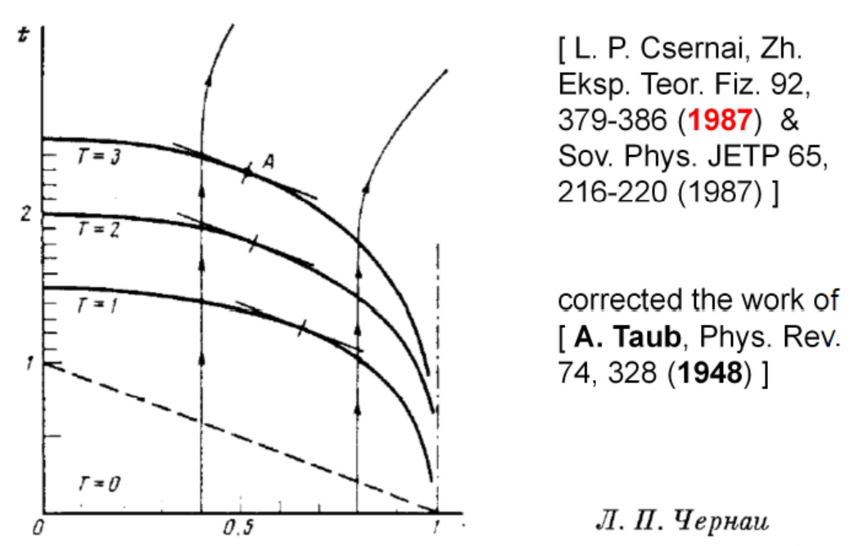
Simultaneous ignition – no instabilities
[ N. Kroo (2017) &
M. Csete et al., (2021) ]

Slide 9
Nuclear transmutation ➔ Deuterium
[ I. Papp et al. EPOCH PIC kinetic model ]

Slide 10
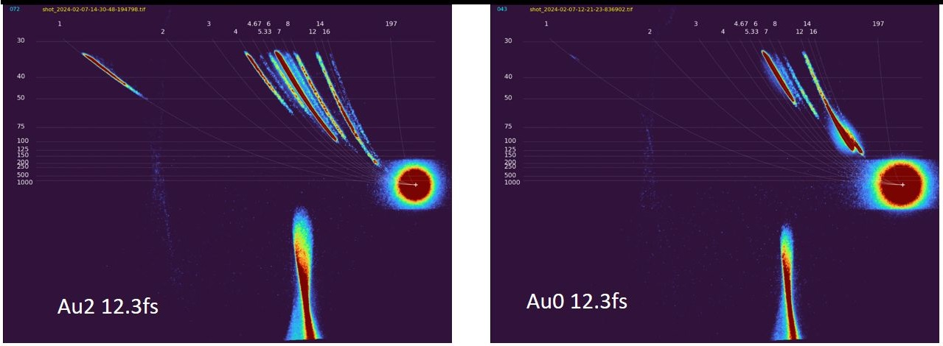
PROOF of Proton acceleration by nano-rod antennas (by Thompson Parabola)
With Au2 nano-antennas we observe accelerated, ~100 keV protons, while
without none! [M. Kedves, M. Aladi et al., ELI-ALPS preliminary]

Slide 11
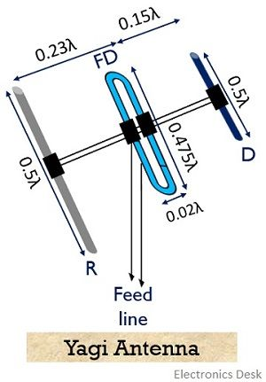
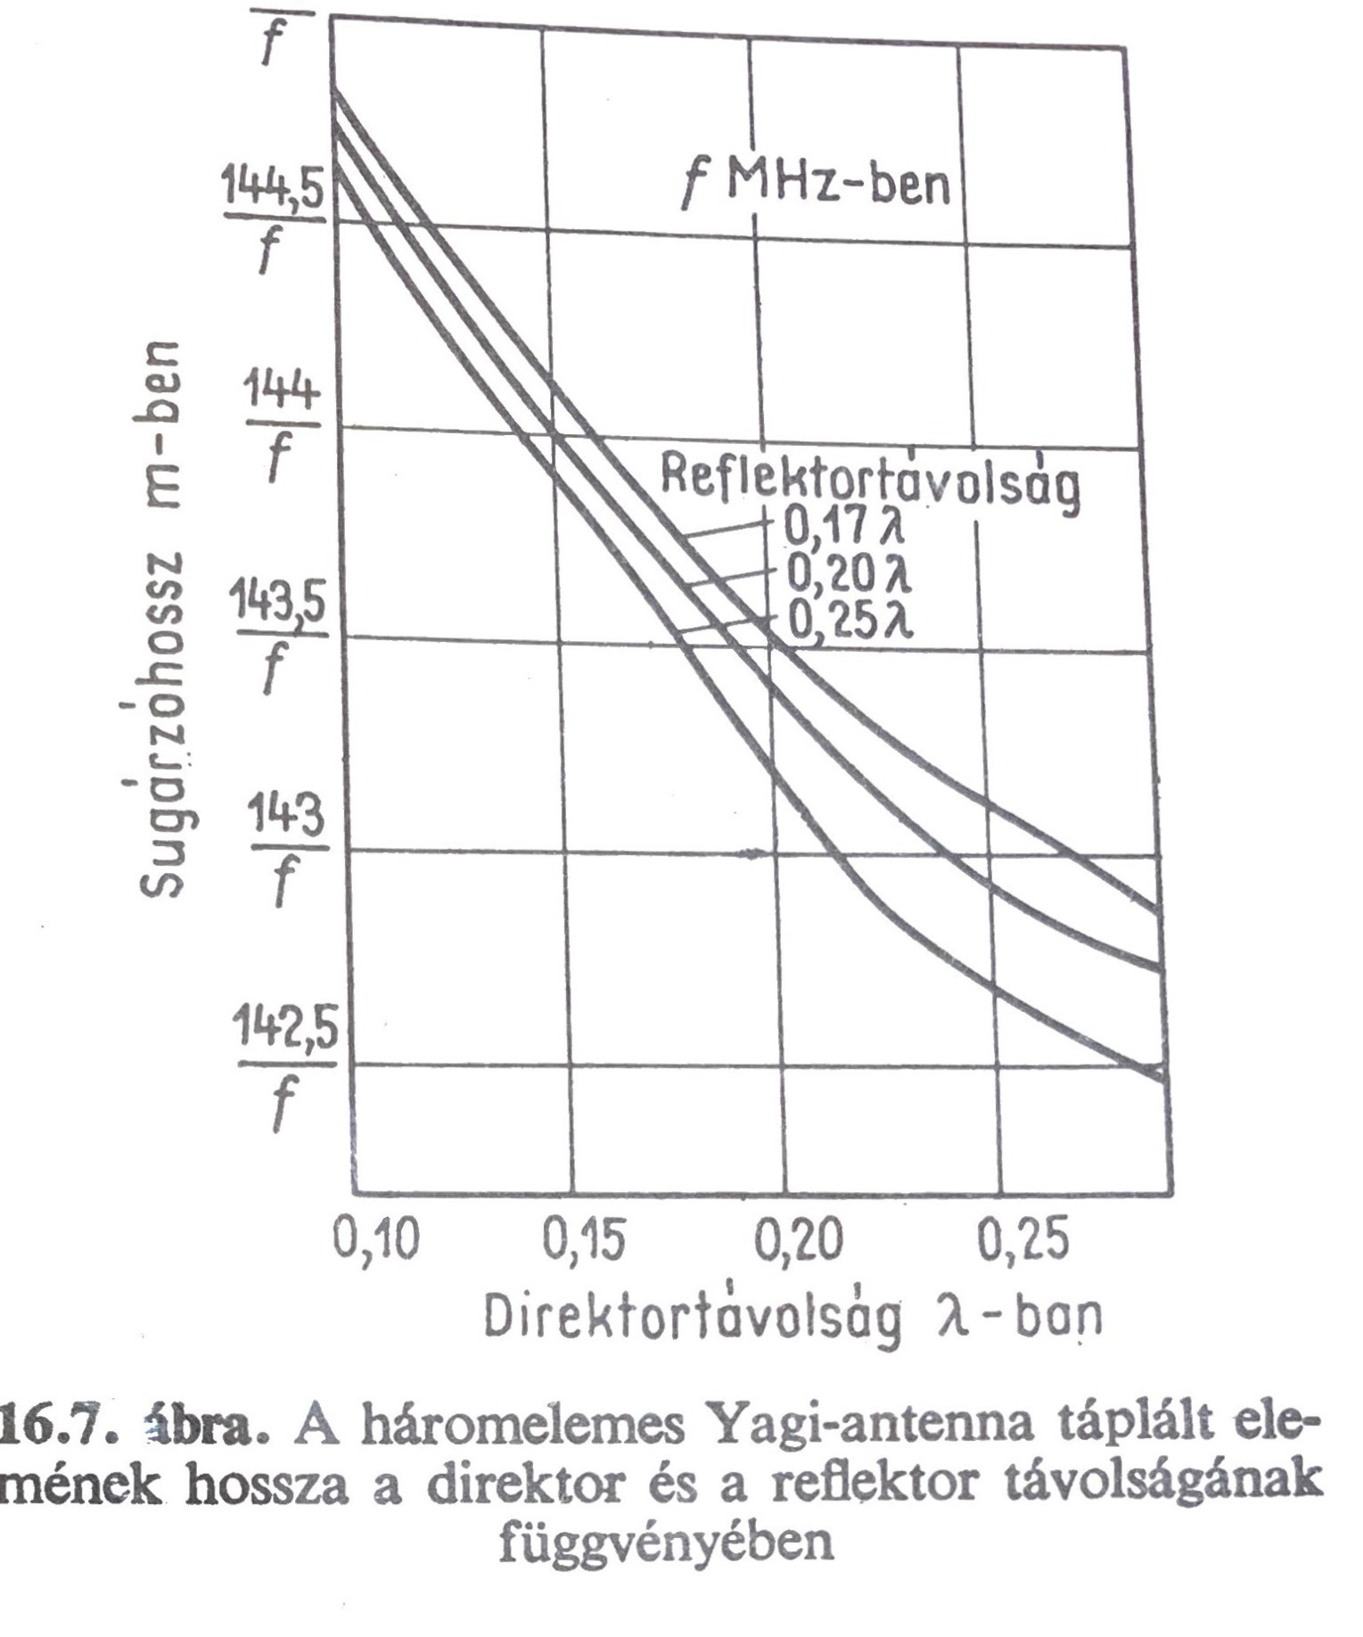
The Yagi-Uda antennas (in short Yagi-antennas) 1926
- The single thin wire resonant dipole antenna can receive EM broadcast even from weak signal and considerable noise. Then the received signal can be led to the receiver with a cable (e.g. coaxial or other type)
- Yagi H. and Uda S. increased the efficiency of these antennas in 1926 by adding director and reflector elements to the dipole.
[K. Rotamer: Antennenbuch, Deutscher Militärverlag, Berlin (2017)]
For us no feed line and no looped dipole are needed!

Slide 12
Laser-induced proton acceleration
by a resonant nanoantenna
[arXiv:2306.13445v2, István Papp, Larissa Bravina, Mária Csete, Archana Kumari, Igor N. Mishustin, Anton Motornenko, Péter Rácz, Leonid M. Satarov, Horst Stöcker, András Szenes, Dávid Vass, Tamás S. Biró, László P. Csernai, Norbert Kroó]
See tomorrow !

Slide 13
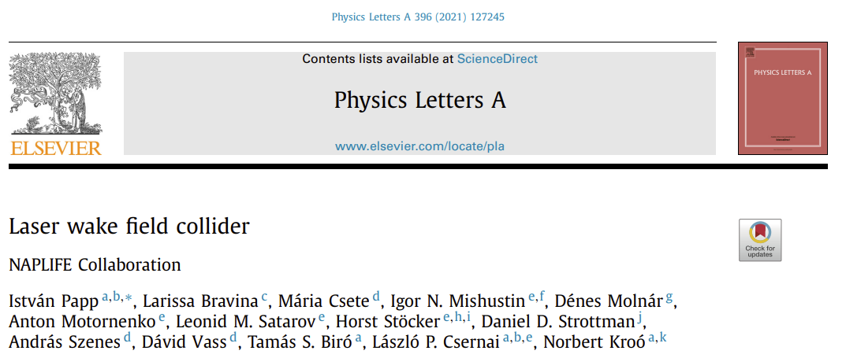
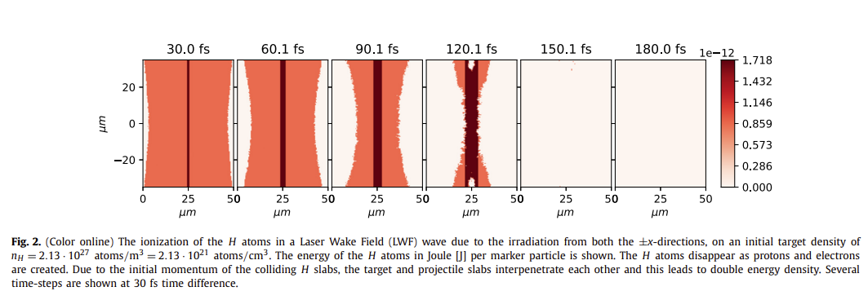
(2021)

Slide 14
Laser Wake Field Collider
non-spherical, non-thermal, not “NIF-TYPE”
Deuterons, (protons, 3He ions, … ) can be accelerated
in one direction (not thermalized !!!).
Two such colliding beams with full energy may lead to
higher energy nuclear fusion reactions, with higher reaction rate.
In the x (E-field) direction two slabs (/w evt gap) on top of each other
accelerated towards each other with non-thermal speed. The materials of the two slabs may be different,
e.g. Deuteron → ← He³ or d → ← t

Slide 15
Proton emission from resonant targets
arXiv:2309.05156v3
Nuclear physics method to detect size, timespan and flow in nanoplasmonic fusion
L.P. Csernai, T. Csörgő, I. Papp, M. Csete, András Szenes, Dávid Vass, T.S. Biró, N. Kroó

Slide 16
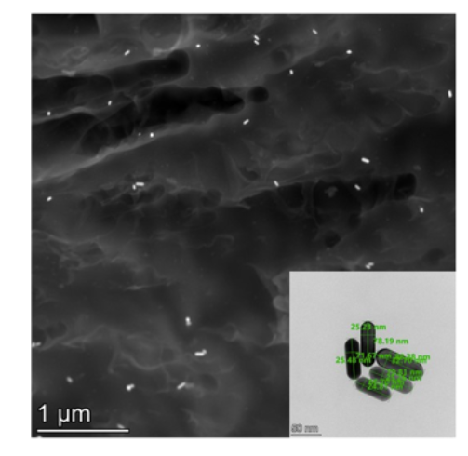
Resonant targets
Solid targets at room temperature → hard polymer: UDMA (470: H38, C23, O8, N2), TEGDMA, MMA - large hydrogen content (evt. deuterated) & 85x25 nm nanorod antennas (sort !)
1st random orientation, 85x25nm,
Au0,
Au1 (0.1m%),
Au2 (0.2m%)
[A. Bonyár et al., (BME)]
2nd directed & ordered [in progress]
[Zs. Márton, J. Budai, M. Csete et al.,
ELI-ALPS ]

Slide 17
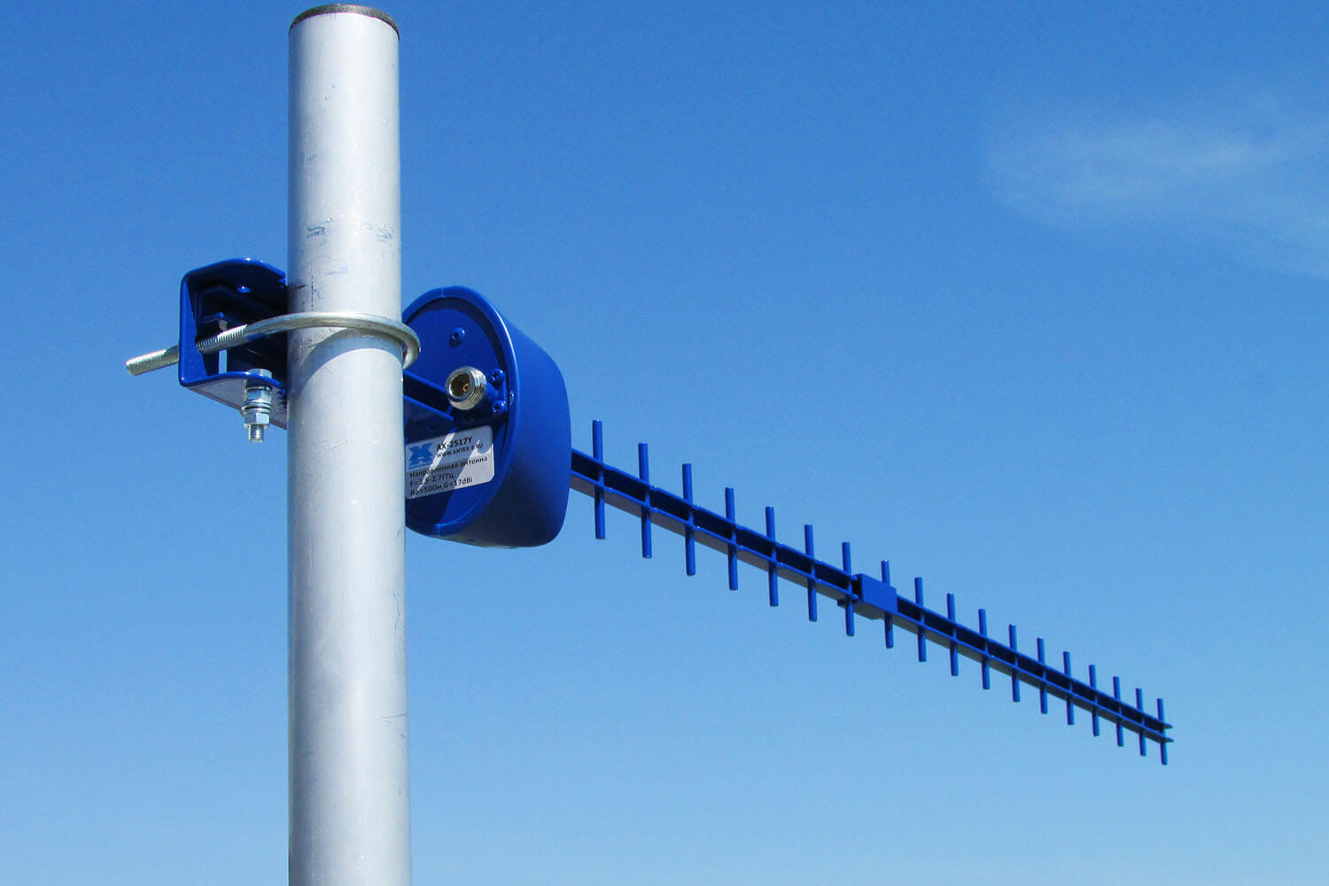
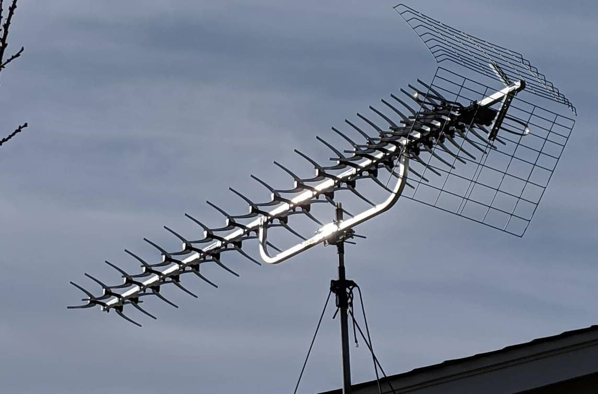
Long Yagi antennas with many directors
Nano-wire rods can also be used for good absorption
Length ≈ 10 λ = 5-6 μm
Transverse size
≈ 0.4-0.5 λ = 0.01 μm
Butterfly ⬄ increased Band width

Slide 18
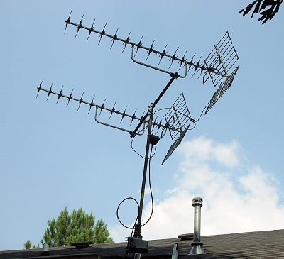
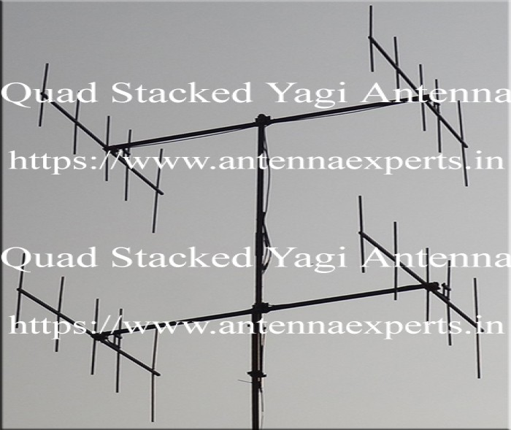
Stacked Yagi antennas ~ Nanowire arrays
z
We do not need “FEED Line”,
We want to accelerate protons or deuterons,
In the direction of the dipoles
With two-sided laser irradiation

Slide 19
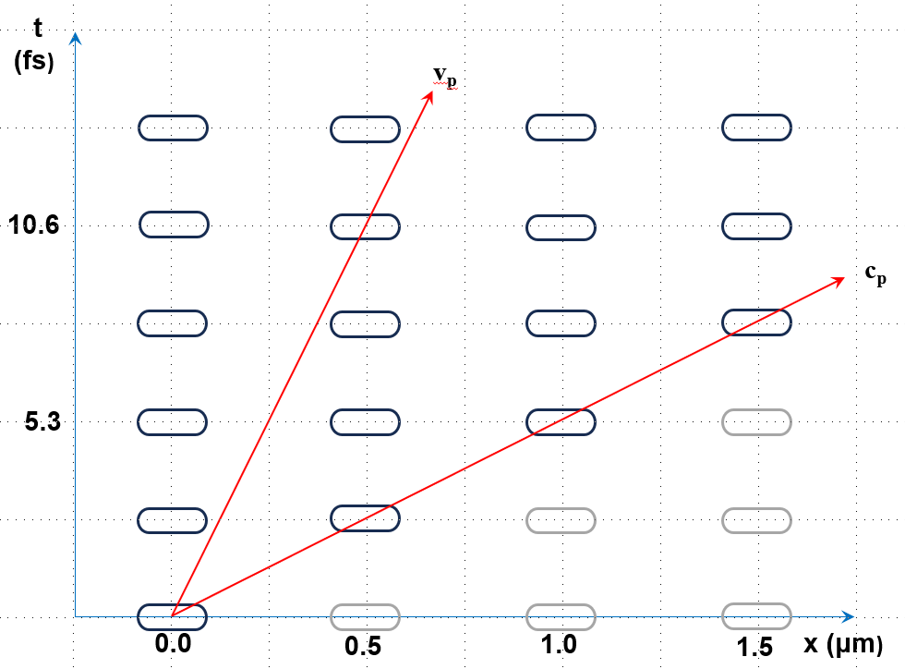
Distance between Yagi-type antenna array columns
Director distance should be such that the protons/deuterons are reaching the next array when that is in the phase, which accelerates it further.

Slide 20
Industrial setup

Slide 21
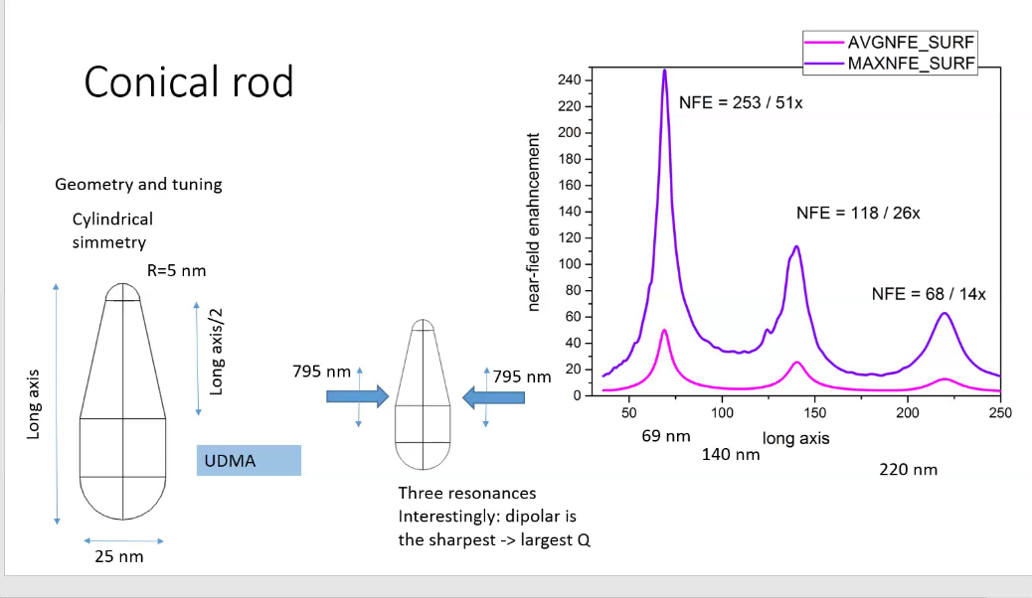
p acceleration in one direction
w/ sharp tip
Expectation: protons can leave the asymmetric nano-rod antenna more at the sharp edge (like in case of lightening rods).
This is similar to directed laser beam radiation where at one end of the resonating lasing body there is a half reflecting mirror, while at the other end there isa fully reflecting one.
[J. Budai, Zs. Márton, M. Csete et al., 2024]
The prime resonance of the asymmetric nanorod antenna is sharp, well separated from the much weaker higher harmonics.
This feature enables us to generate correlated and aligned, non-thermal proton beams!
Thus, in all steps of ignition process we can avoid losses arising from thermalization

Slide 22
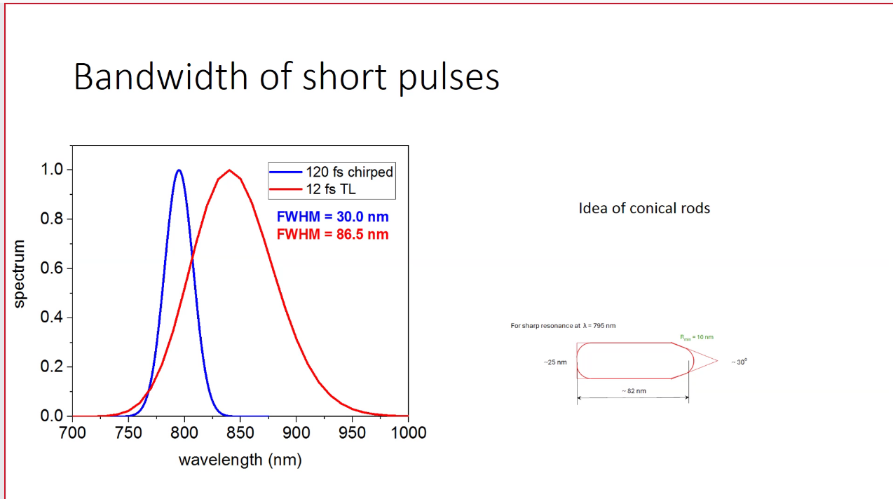
Resonance response bandwidth depends on the length of irradiation pulse
[M. Csete, A. Szenes, et al. 2024]

Slide 23
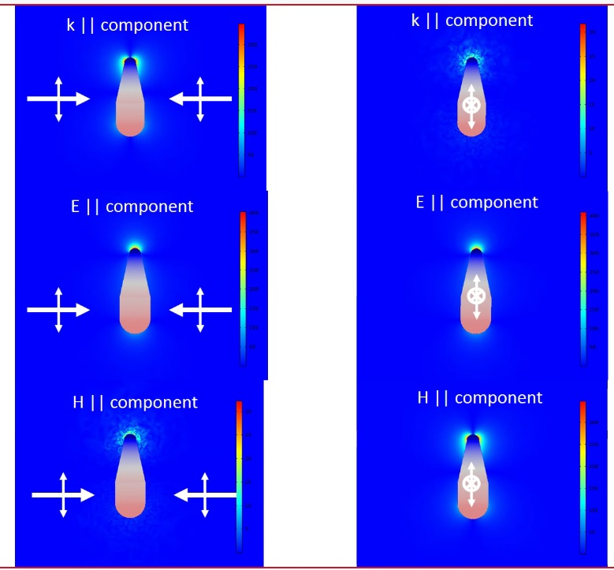
EM Fields around nano-antenna with sharp tip
Electric field (E) at
sharp tip is extreme high (COMSOL)
[A.Szenes, M.Csete et al.] ➔
Large proton flux is expected in EPOCH
PIC kinetic model with sharply directed and near monochromatic emission to one direction!
Non-thermal
Laser
Laser
Laser
Laser from
top & bottom

Slide 24
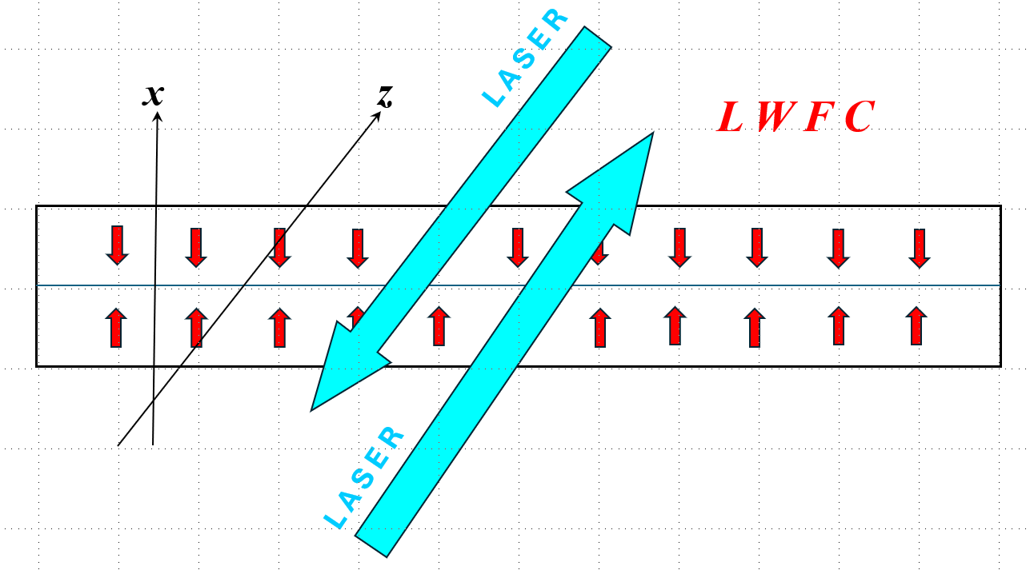
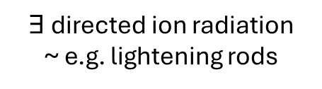
$∃$ directed ion radiation
~ e.g. lightening rods
Laser beam from ± z direction
Nanorod antennas pointing to ± x direction
Flat fusion fuel target is in the [ x –y ] plane

Slide 25
(ii) Validation status
Targets, Polymers, UDMA, TEGDMA, MMA, Deuterated MMA,
resonant nano-rods random oriented and placed [BME, U. Debrecen]
ordered & aligned nanorods [ELI – ALPS], directed nanorods […]
Laser irradiation
one sided irradiation up to now,
Wigner RCP Budapest, 30 mJ Ti:Sa Hydra I= ~ 2 10¹⁷ W/cm²
ELI-ALPS Szeged, 30 mJ SYLOS I= ~ 2 10¹⁹ W/cm²

Slide 26
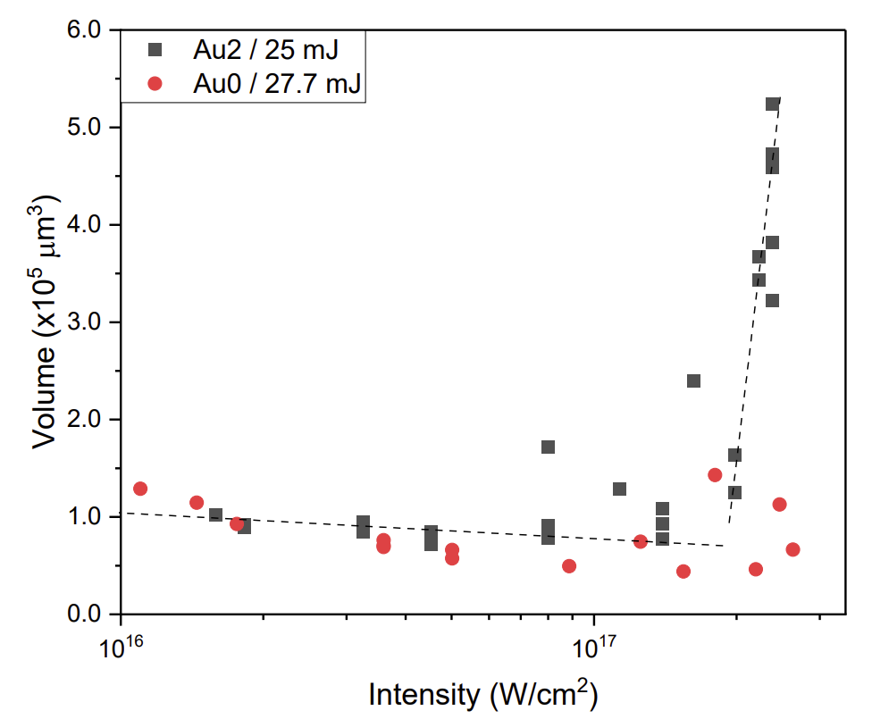
Crater Volume
[Ágnes Nagyné Szokol et al.,
arxiv.org/pdf/2402.18138]
See next talk in detail !!
Q = ~ 6
Change of the crater volume with the amount of laser light reflected by the target (plasma mirror) for the laser irradiations of the undoped (Au0) and gold nanorod containing (Au2) targets

Slide 27
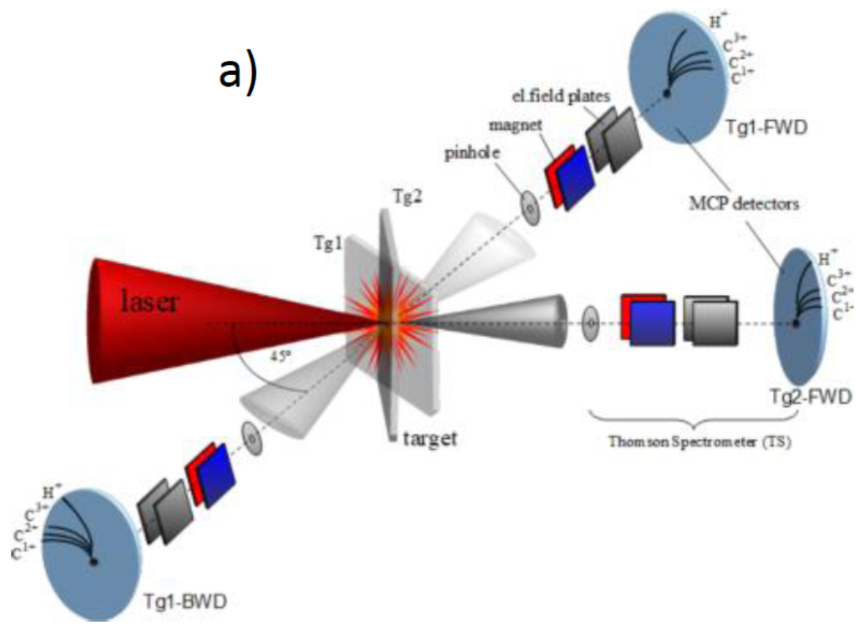
ELI-ALPS – High Intensity Tests 2024 –Thompson Parabola
[M. Kedves, M. Aladi et al., (2024) preliminary. ]

Slide 28
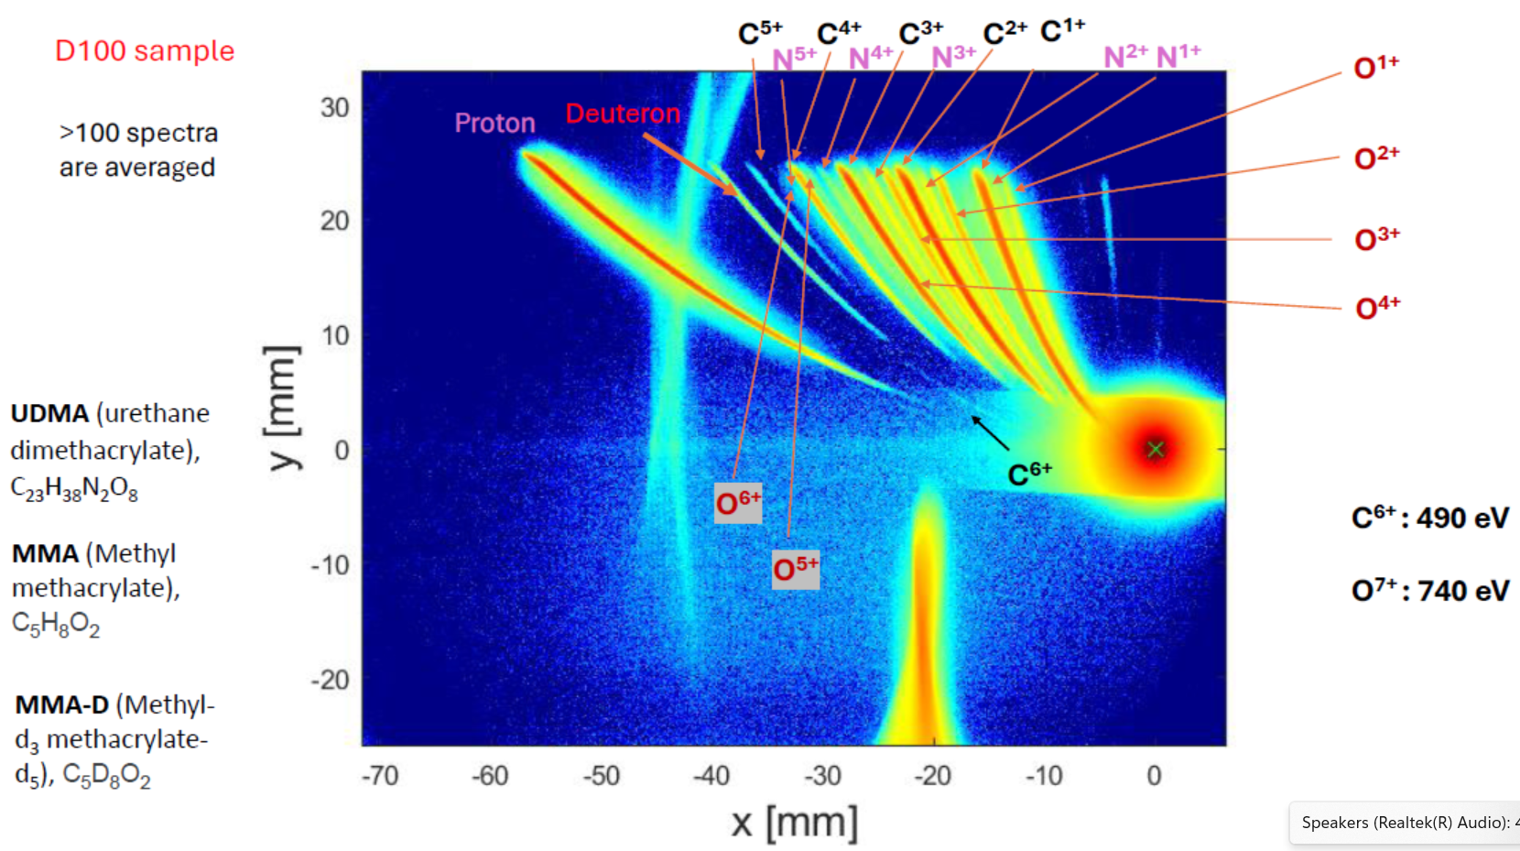
[NAPLIFE –ELI-ALPS 2024] preliminary
= D100
[M. Kedves, M. Aladi et al., (2024) preliminary. ]
See tomorrow !

Slide 29
CONCLUSIONS
Plasmonic amplification is verified
Proton acceleration is verified
Nuclear transmutation reactions are achieved
Formation of Deuteron nuclei is verified
contrary to the fact that
Only 30 mJ laser pulse energy was used
Only one-sided laser irradiation was available

Slide 30
Thanks for your attention

