Slide 1
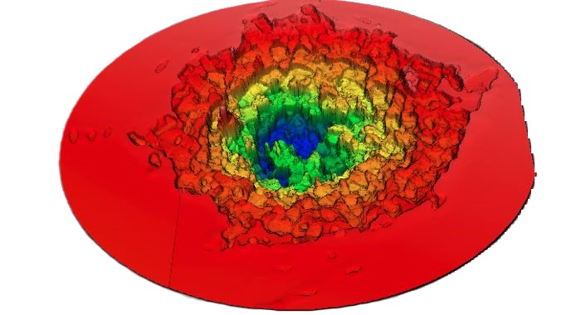
Morphology studies on craters created by femtosecond laser irradiation in UDMA polymer targets embedded with plasmonic gold nanorods
Particles & Plasmas Symposium 2024
Roman Holomb, István Rigó, Márk Aladi, Miklós Kedves, Béla Ráczkevi, Attila Bonyár, Melinda Szalóki, Alexandra Borók, László Csernai, Norbert Kroó, Tamás Biró, Miklós Veres
Former: Judit Kámán, Péter Rácz, Archana Kumari
Ágnes Nagyné Szokol
E-mail: szokol.agnes@wigner.hun-ren.hu

Slide 2
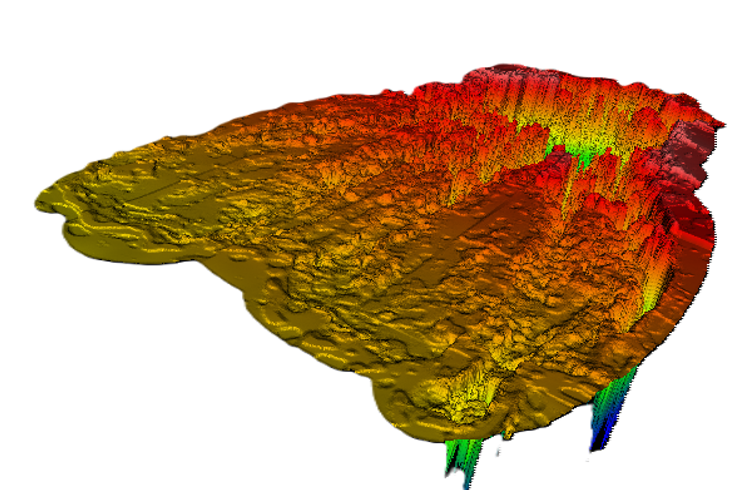
Overview
Sample preparation
Laser setup
Measurements
Data evaulation
Energy dependence of crater volume
Intensity dependence of crater morphology
Conclusions

Slide 3
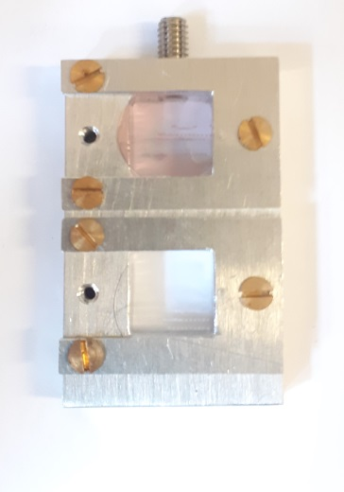
Sample preparation
Samples without and with gold nanorods
UDMA-TEGDMA monomer
C₂₃H₃₈N₂O₈ + C₁₄H₂₂O₆
+
Au nanorods (85 nm x 25 nm)
Polymerized
Thickness: 160-180 μm, 400 μm
Diameter: 1,5-2 cm
UDMA–Au0 – without gold
UDMA–Au1 – with gold (lower density)
UDMA–Au2 – with gold (higher density)
A.Bonyar at al. Int. J. Mol. Sci.
2022, 23, 13575. https://doi.org/
10.3390/ijms232113575
Notes:
Let we imagine a polymer-matrix – in our case urethan-dimetacrylate (UDMA) fool of Hydrogen (C₂₃H₃₈N₂O₈.) with + Triethylene Glycol Dimethacrylate TEGDMA dilution monomer in the ration of 3:1.
Let we add some gold nanoantennas with size tuned to be resonant for the laser wavelength.
The polymerization was carried out with a normal dental blue light cure lamp.
Urethan-dimetacrylate (UDMA )- Triethylene glycol dimethacrylate (TEGDMA)
As a result we got 160-200 um-thick discs.
In such way polimerized UDMA –TEGDMA without gold is transporent for the visible light.
The discs containing gold are redish.
In the next slides the samples without gold are signed by UDMA-Au0, samples containing less gold nanoantennas are signed by UDMA-Au1, ans the samples containing larger amount of the gold are signed by UDMA-Au2.
Let we place them in a sample holder and let we put in to a vacuum chamber.

Slide 4
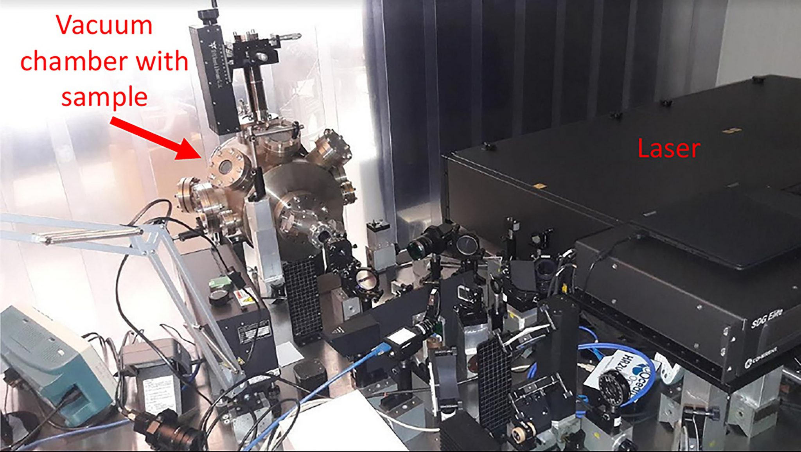
Laser setup
Vacuum chamber
Pressure: ~ 10⁻⁶ Pa
Illumination direction: 45°
Single laser shots with Ti:Sa laser
Wavelength: 795 nm
Pulse length: 42 fs
Intensity: 10¹⁶-10¹⁷ W/cm²
Pulse energy:
Pulse energy dependence experiment: 1 mJ, 5 mJ, 10 mJ, 15 mJ, 20 mJ, 25 mJ
Laser intensity dependence experiment: 10 mJ, 25-27.7 mJ
Illumination
direction
∼1.5 m
Coherent Hidra laser system in the Wigner RCP
Notes:
Put the samples in to a vacuum chamber. In the vaccuum chamber the pressure was arround 10⁻⁶ Pa. It was illuminated with a high intensity single laser pulse. Coherent Hidra Ti:Sapphire chirped-pulse two-stage amplifier-laser system having a central wavelength of 795 nm.
Two types of experiments were carried out.
At the first experiment we examinated the pulse energy dependence of the morphology: The irradiations were carried out at the same focal distance but with different energies: with 1 mj, 5 mJ, 10 mJ, 15 mJ, 20 mJ and 25 mJ on 3 different samples. One without gold nanopartoicles the other two conatining gold nanorods just in in two different concentrations.
2. At the other experiment we were investigating what happens if we chang the longitudinal focal distance from the surface of the target. The illuminations were carried out with 10 mJ and 25-27.7 mJ pulse energies both on undoped and doped polymer matrix.
The laser intensity on the target surface was varied by changing the target’s longitudinal displacement from the focal plane.
Motorized stage assured the changes of the position of the target. The changes were carried out in 0,2 mm long steps. After every shot tha sample was mooved on, so the new shot reached an untuched surface.

Slide 5
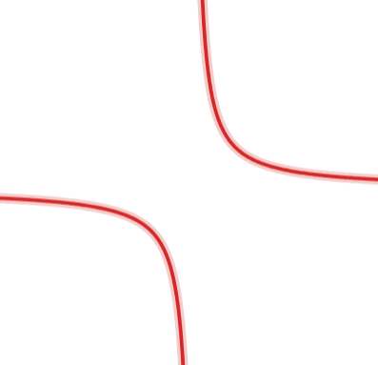
Target position
Target
Sample holder
Reflected
laser light
2w₀ = 20 µm
45°
Incoming
laser light
Steps of 0.2 mm
Notes:
Here you can see the position of the sample holder, so the incoming laser light reaches the sample surface under 45 degree. This way we could avoid the laser light’s back scattering toward the laser, from the other hand this placement insured the possibility to make in-situ measurements such as the reflected energy measurements.
At the second experiment the sampleholder was placed on motorized stage which mooved the sample in steps of 0.2 mm toward the laser beam focal point and removeing it from there. This way we could acheave the changes of the irradiation intensity.

Slide 6
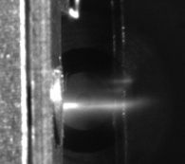
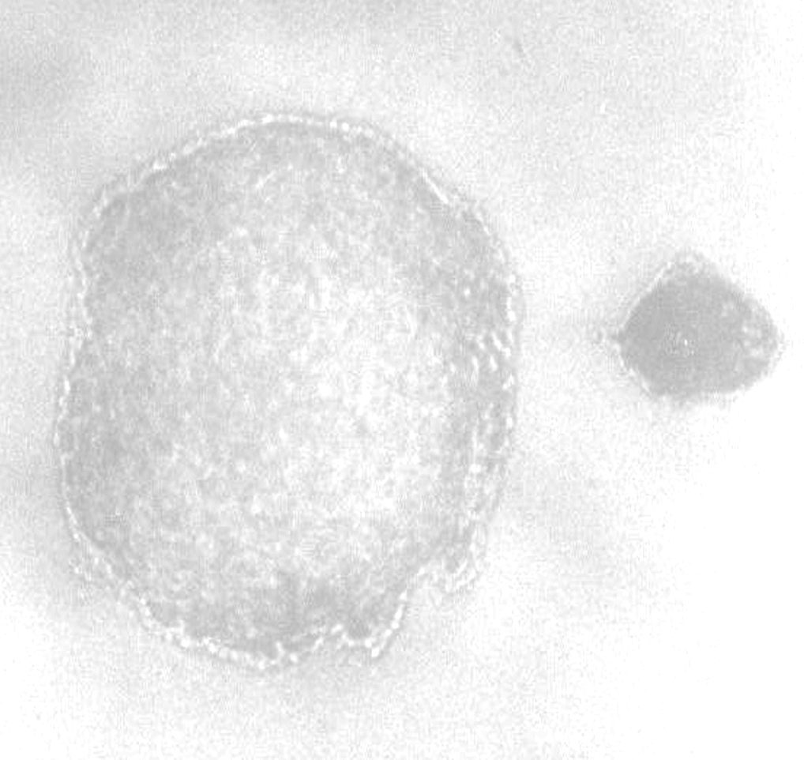
Observations
Target ablation
Plasma plume
Crater formation
Plume
Crater out of the focus
(4.2 mm distance)
Crater in the focus
Notes:
As the laser light reached the surface of the target, laser-matter interaction accured. Some of the material was ablated and appeared a plasma plume. In the target a crater was formated at every single shot.
As the target’s longitudinal displacement from the focal plane was changed the irradiation resulted different craters.
The crater a. was created, when the target distance was 4,2 mm from the minimum laser-focus spot, the crater b. when the surface of the foil was in the focal spot.

Slide 7
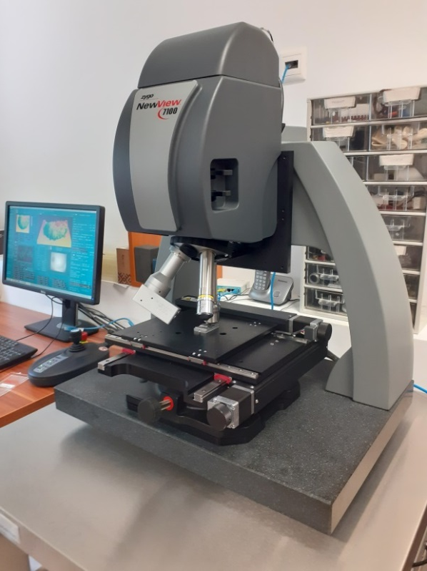
Measurements
Morphology of the craters – White light interferometry
Zygo NewViewTM 7100
Central wavelength: 580 nm (Δλ = 140 nm)
Vertical resolution: 0.1 nm
Optical resolution: 0.52 μm
Objective: Mirau 50x
Scanning length: 20-65 μm
Minimal modulation: 0.001%
Objective’s field of view: 0.19 mm x 0.14 mm
Stitching method
Notes:
From the measurements I will highlight the morphology mesurements. At both of the experiments the morphology of the craters were investigated by white light interferometry which is a non-contact and non-destructive 3D measuring method.
The measurements were carried out by a Zygo NewView 7100. White light is suitable for interferometric measurements as the white light is coherent only over a very short distance (< 3 μm) around the point where OPD = 0 (optical path difference). So the interference pattern of the white light occures only in this small vertical range.
Vertical resolution: 0,1 nm
Optical resolution: 0,52 μm
As the objective’s field of view (0.19 mm x 0.14 mm) in most of the case wasn’t enough big, stitching method was performed to extend the resolution for the reguired region.
The incomeing light partialy was absorbed, some of it trasmitted and a portion was reflected. The reflected energy was measured.

Slide 8
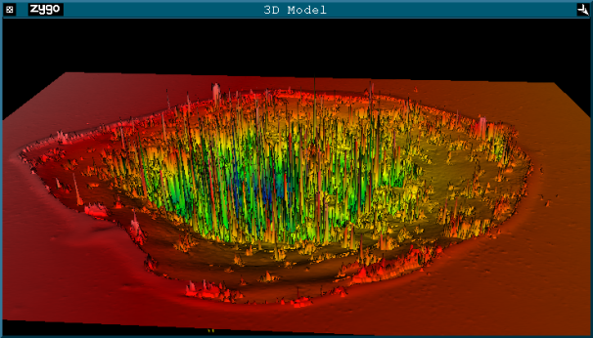
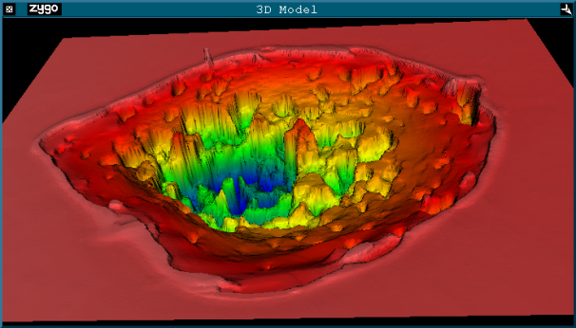
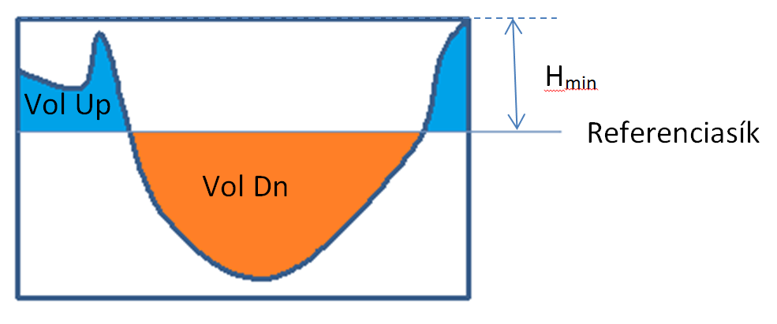
Data evaluation
1. Digital noise reduction
2. Selection of the range for measuring
3. Finding reference plane
4. Calculate the volume of the crater
Raw picture
Filtered picture
H
Reference plane
$V=VolDn+A_{pixel}∙N_{points}∙H−VolUp$
Notes:
Getting the raw data set it can be seen here that it contains artificial elements, so digital filtering was applied. After low pass filtering the median was taken from 11 data point for every filtered new data. The result can be seen here.
The irrelevant areas were masked.
In the next step a plane was removed, so the data was ready to measure the volume of the crater. (It allowed to calculate the volume….)
The software defines two volumes:
1. volume between the reference plane and the surface above it
2. Volume between the reference plane and the surface under the reference plane
But we need the whole craters inner volume so the ablated materials volume. Let we imagine a cylinder over the reference plane with the height Hmin measured in 4 different points and averaged. According the resolution of the camera the area of the pixels could be calculated.
The Zygo softvare gives the number of the pixels and this way can be already calculated the teritory for the base of cylinder.
In this way were performed all the crater measurements.

Slide 9
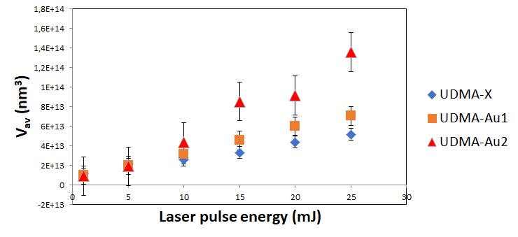
Crater volume vs. Pulse energy
Crater measurements in 5 different points for each energy and target
Notes:
Energy dippendens of the crater volumes – in 5 different points for every energy and target
For every energy in 5 diffrent point of the target was shot by a single laser pulse for every sample. The focal distance was the same.
The volume was measured and averaged at every single crater.
At the lower energies the craters volume do not shows difrences.
But from 10 mJ they seaparates. The craters in the sample with gold nanoantennas have larger volume then in sample without gold.
The result shows that the higher amount of gold nanoparticles coses bigger material loss.
It was found that the volume loss is growing as the energy is growing.
Error bars were placed according the minimum and maximum values – as we had only 5 shots for every sample and energy.

Slide 10
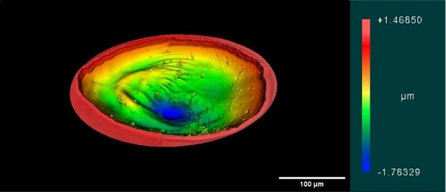
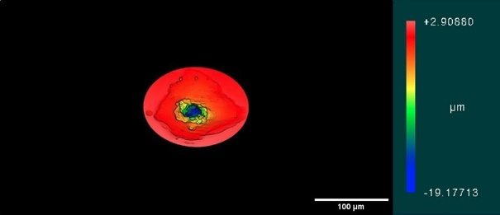
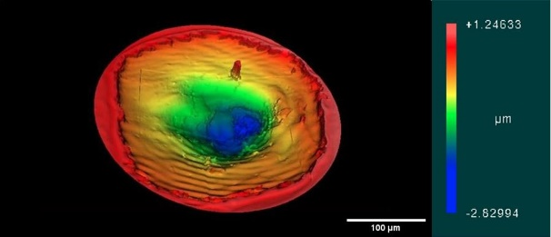
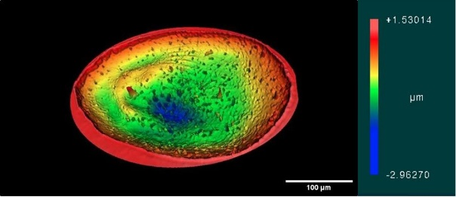
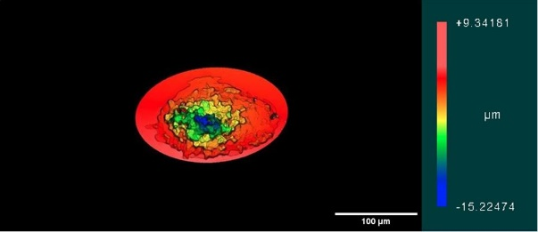
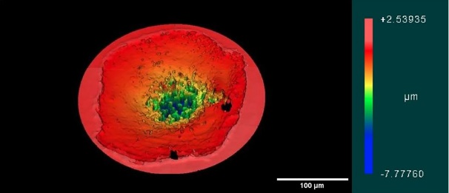
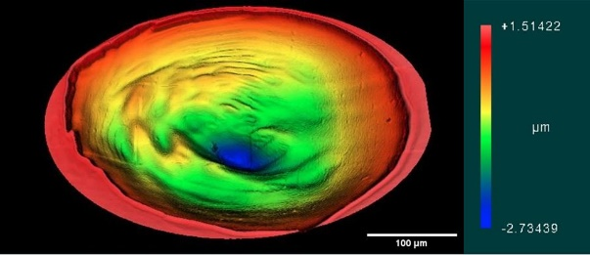
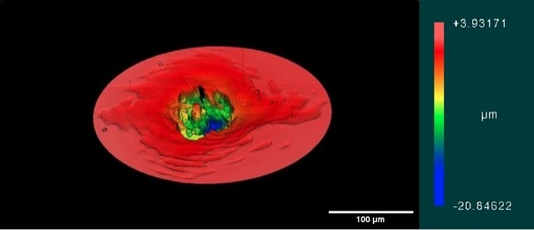
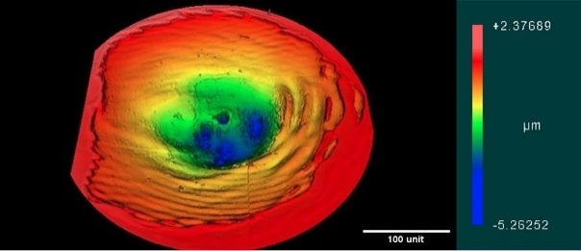
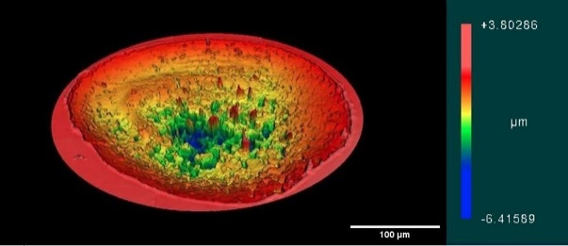
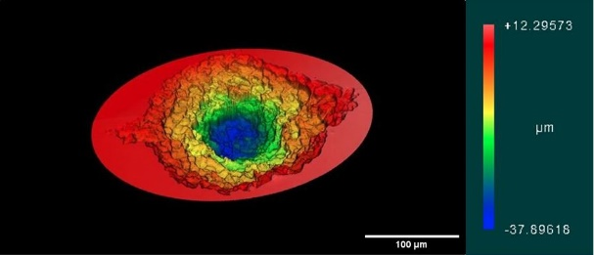
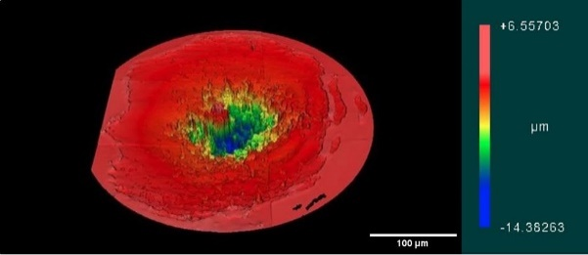
Crater morphology vs. Laser intensity
Laser energy / Target
Target position relative to the focal point/Laser intensity compared to the in-the-focus case
-1.8 mm
0.0 mm
+0.6 mm
10 mJ / Au0
10 mJ / Au2
27.7 mJ / Au0
25 mJ / Au2
Notes:
THESE ARE JUST EXAMPLES!!!!
White light interferometry images of the craters formed during the irradiation with low (top two) and high-energy (bottom two) laser pulse in undoped (Au0) and Au nanorod-doped (Au2t samples. The three columns represent conditions when the target is longitudinally after (left), in (center) and before (right) the focal point.
The scale is the same for al of the pictures. So we can compare the craters sizes.
At the midle colom the target surface was in the focal spot, so got the highest intensity. The towo other coloms shows the craters created out of the focus.
When the sample surface is in the focal point, the crater diameters are around 130-160 microns and 260-270 microns for the 10 mJ and high-energy irradiations, respectively. As expected, larger craters form in the out-of the-focus positions in both directions, having diameters above 200 microns and above 300 microns for the two cases, respectively.

Slide 11
Deepest profiles at 10 mJ for Au0
Notes:
Craters deepest profiles were taken at different focal distances and translated to be comparable.
Here we can observe the craters profiles for sample without gold after irradiation with 10 mJ pulse energy.
The craters out of the focus are wide and shallow. Approaching toward the focus the craters are deaper and deaper but relativly nerrow.

Slide 12
Deepest profiles at 10 mJ for Au2
Particles & Plasmas Symposium 2024 – 11 Jun 2024. Ágnes Nagyné Szokol
Notes:
Craters deepest profiles were taken at different focal distances and translated to be comparable.
In the case of the sample containing gold nanoparticles and irradiated by 10 mJ the results that the waist of the crater is larger.

Slide 13
Deepest profiles at 27.7 mJ for Au0
Notes:
Craters deepest profiles were taken at different focal distances and translated to be comparable.

Slide 14
Deepest profiles at 25 mJ for Au2
Notes:
Craters deepest profiles were taken at different focal distances and translated to be comparable.
________________________________
In the first line you can find the craters profiles produced by the lower energy, and under them the higher energies. In the first column are without gold, in the second with gold.
The black lines shows the crater profile in the case of 0 longitudinal distance from the focal point (where the waist of the beam is minimal.
At 10 mJ there are no big differences between the sample without and with gold, but the waist of the craters are thicker in the case if the sample containing gold. Mooving away the target from the focal spot, the diameter changes are similar. As well was found that as we are mooving away from the smallest beam waist, the crater diameter is bigger and bigger. In parallel the craters become shallower.
But at 25 mJ: we can observ, that the change of the depth is little bigger (36%) then at 10 mJ, but the diameter of the crater varies on the contrary. The waist of the crater is larger.
If we compare the depth intensity dependence we find that the depth of the craters is much bigger over 10¹⁷ W/cm² intensity, which can be reach at the higher energies.
It can be observed as well that the craters’ wall is much smoother in the case of the samples without gold then in the case of the samples with gold nanoparticles. So we calculated the roughnesses as well.

Slide 15
Comparison of the deepest profiles
Notes:
If we compare profiles for every sample and energy. We can conclude that the diameter of the craters decreased and the depth of the craters increased as the intesity of the laser was larger and larger.
It can be observed as well that the craters’ wall is much smoother in the case of the samples without gold then in the case of the samples with gold nanoparticles. So we calculated the roughnesses as well.

Slide 16
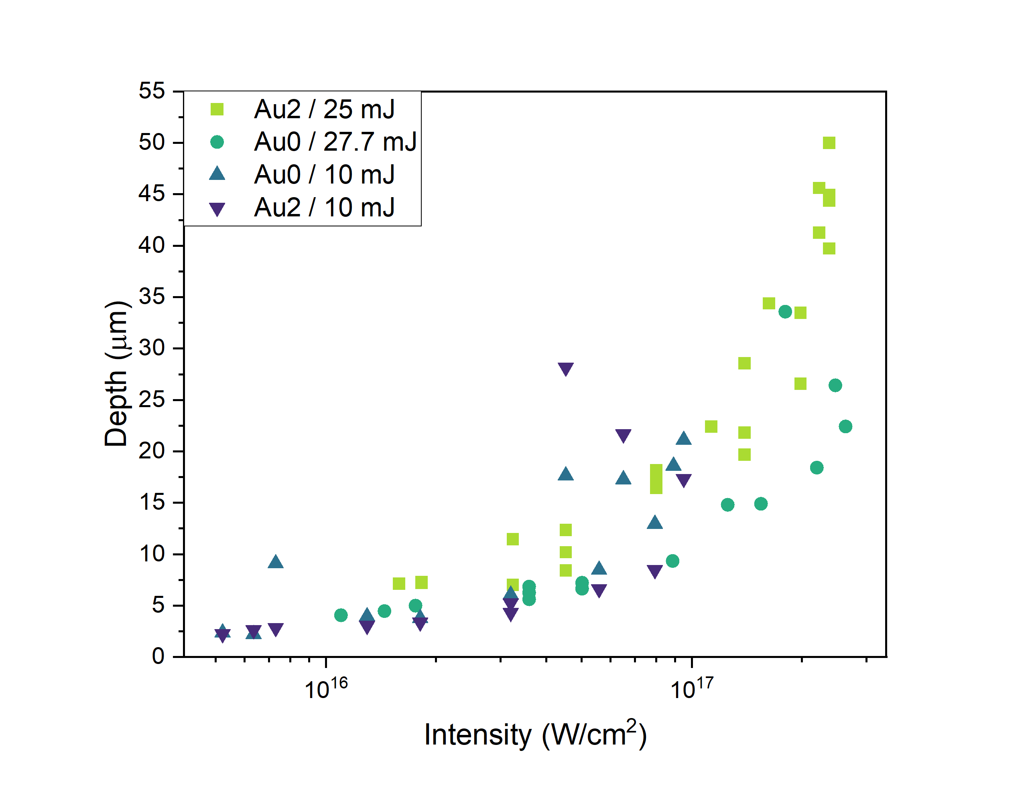
Single craters depth
Ratio of the maximum depth
 | 10 mJ | 25 mJ
$$\frac{D_{Au2}}{D_{Au0}}$$ | 1.25 | 1.36
Notes:
Craters deepest profiles were taken at different focal distances and translated to be comparable.
It was fount that the diameter of the craters decreased and the depth of the craters increased as the intesity of the laser was larger and larger.
It can be observed as well that the craters’ wall is much smoother in the case of the samples without gold then in the case of the samples with gold nanoparticles. So we calculated the roughnesses as well.
________________________________
In the first line you can find the craters profiles produced by the lower energy, and under them the higher energies. In the first column are without gold, in the second with gold.
The black lines shows the crater profile in the case of 0 longitudinal distance from the focal point (where the waist of the beam is minimal.
At 10 mJ there are no big differences between the sample without and with gold, but the waist of the craters are thicker in the case if the sample containing gold. Mooving away the target from the focal spot, the diameter changes are similar. As well was found that as we are mooving away from the smallest beam waist, the crater diameter is bigger and bigger. In parallel the craters become shallower.
But at 25 mJ: we can observ, that the change of the depth is little bigger (36%) then at 10 mJ, but the diameter of the crater varies on the contrary.
If we compare the depth intensity dependence we find that the depth of the craters is much bigger over 10¹⁷ W/cm² intensity, which can be reach at the higher energies.
It can be observed as well that the craters’ wall is much smoother in the case of the samples without gold then in the case of the samples with gold nanoparticles. So we calculated the roughnesses as well.

Slide 17
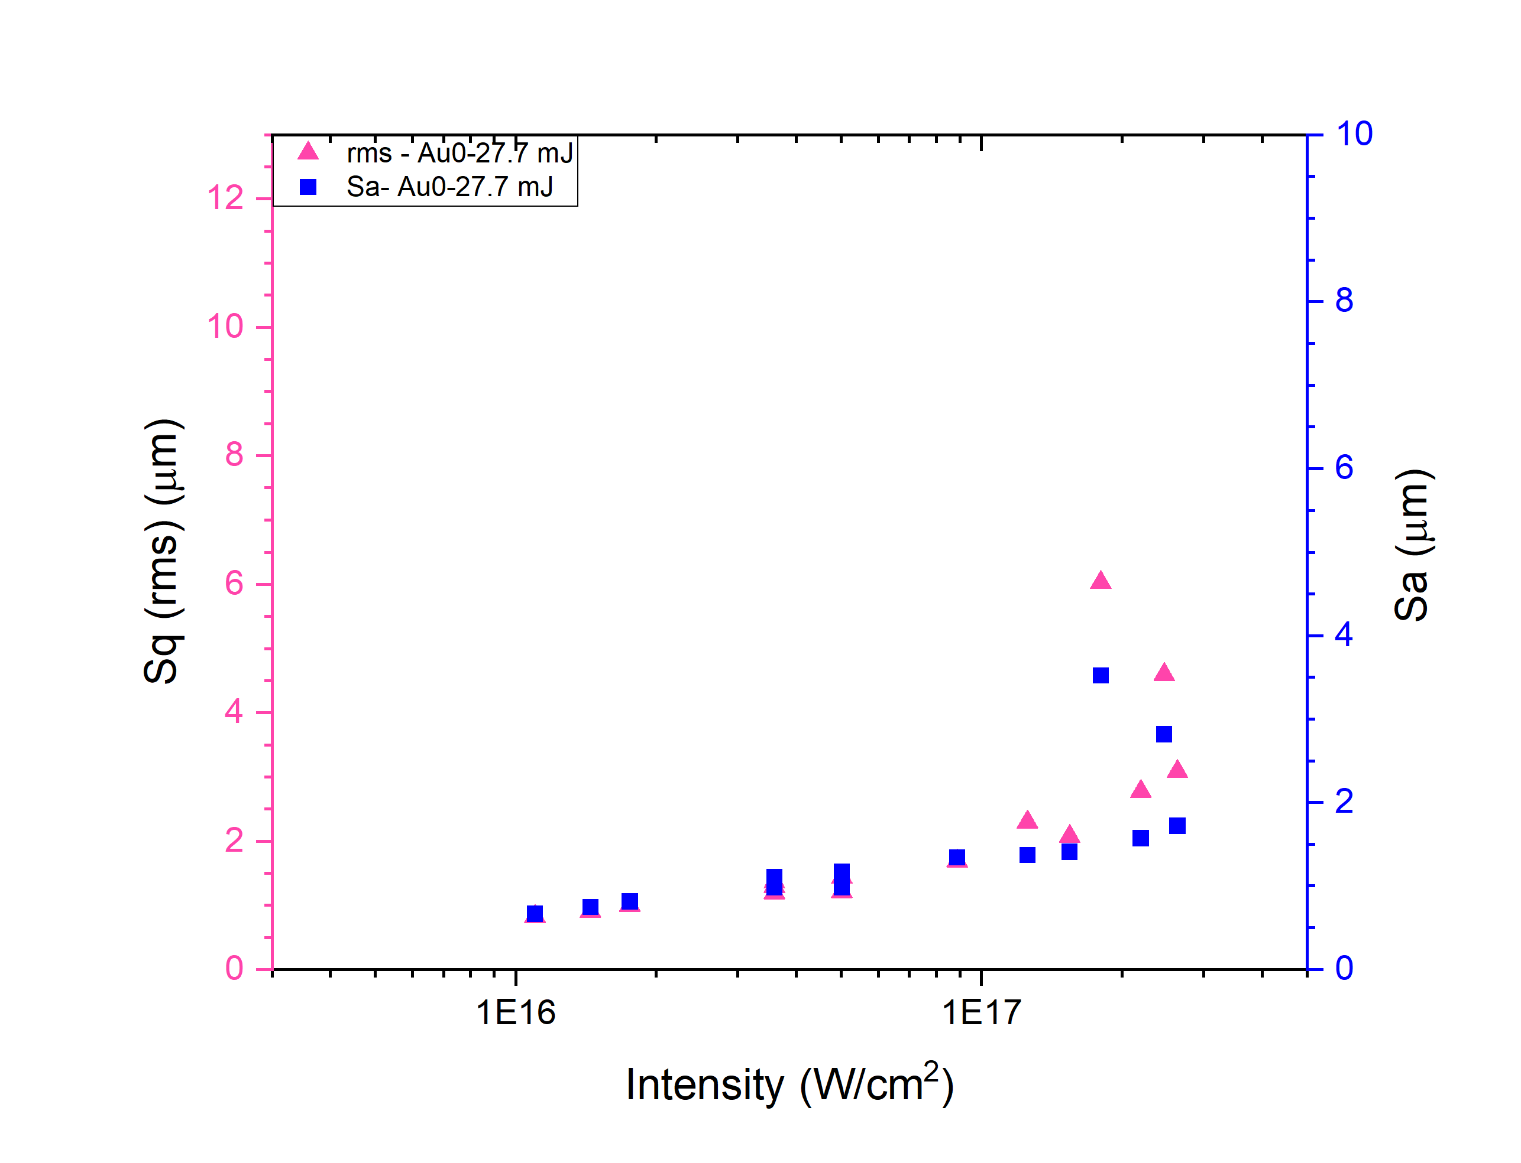
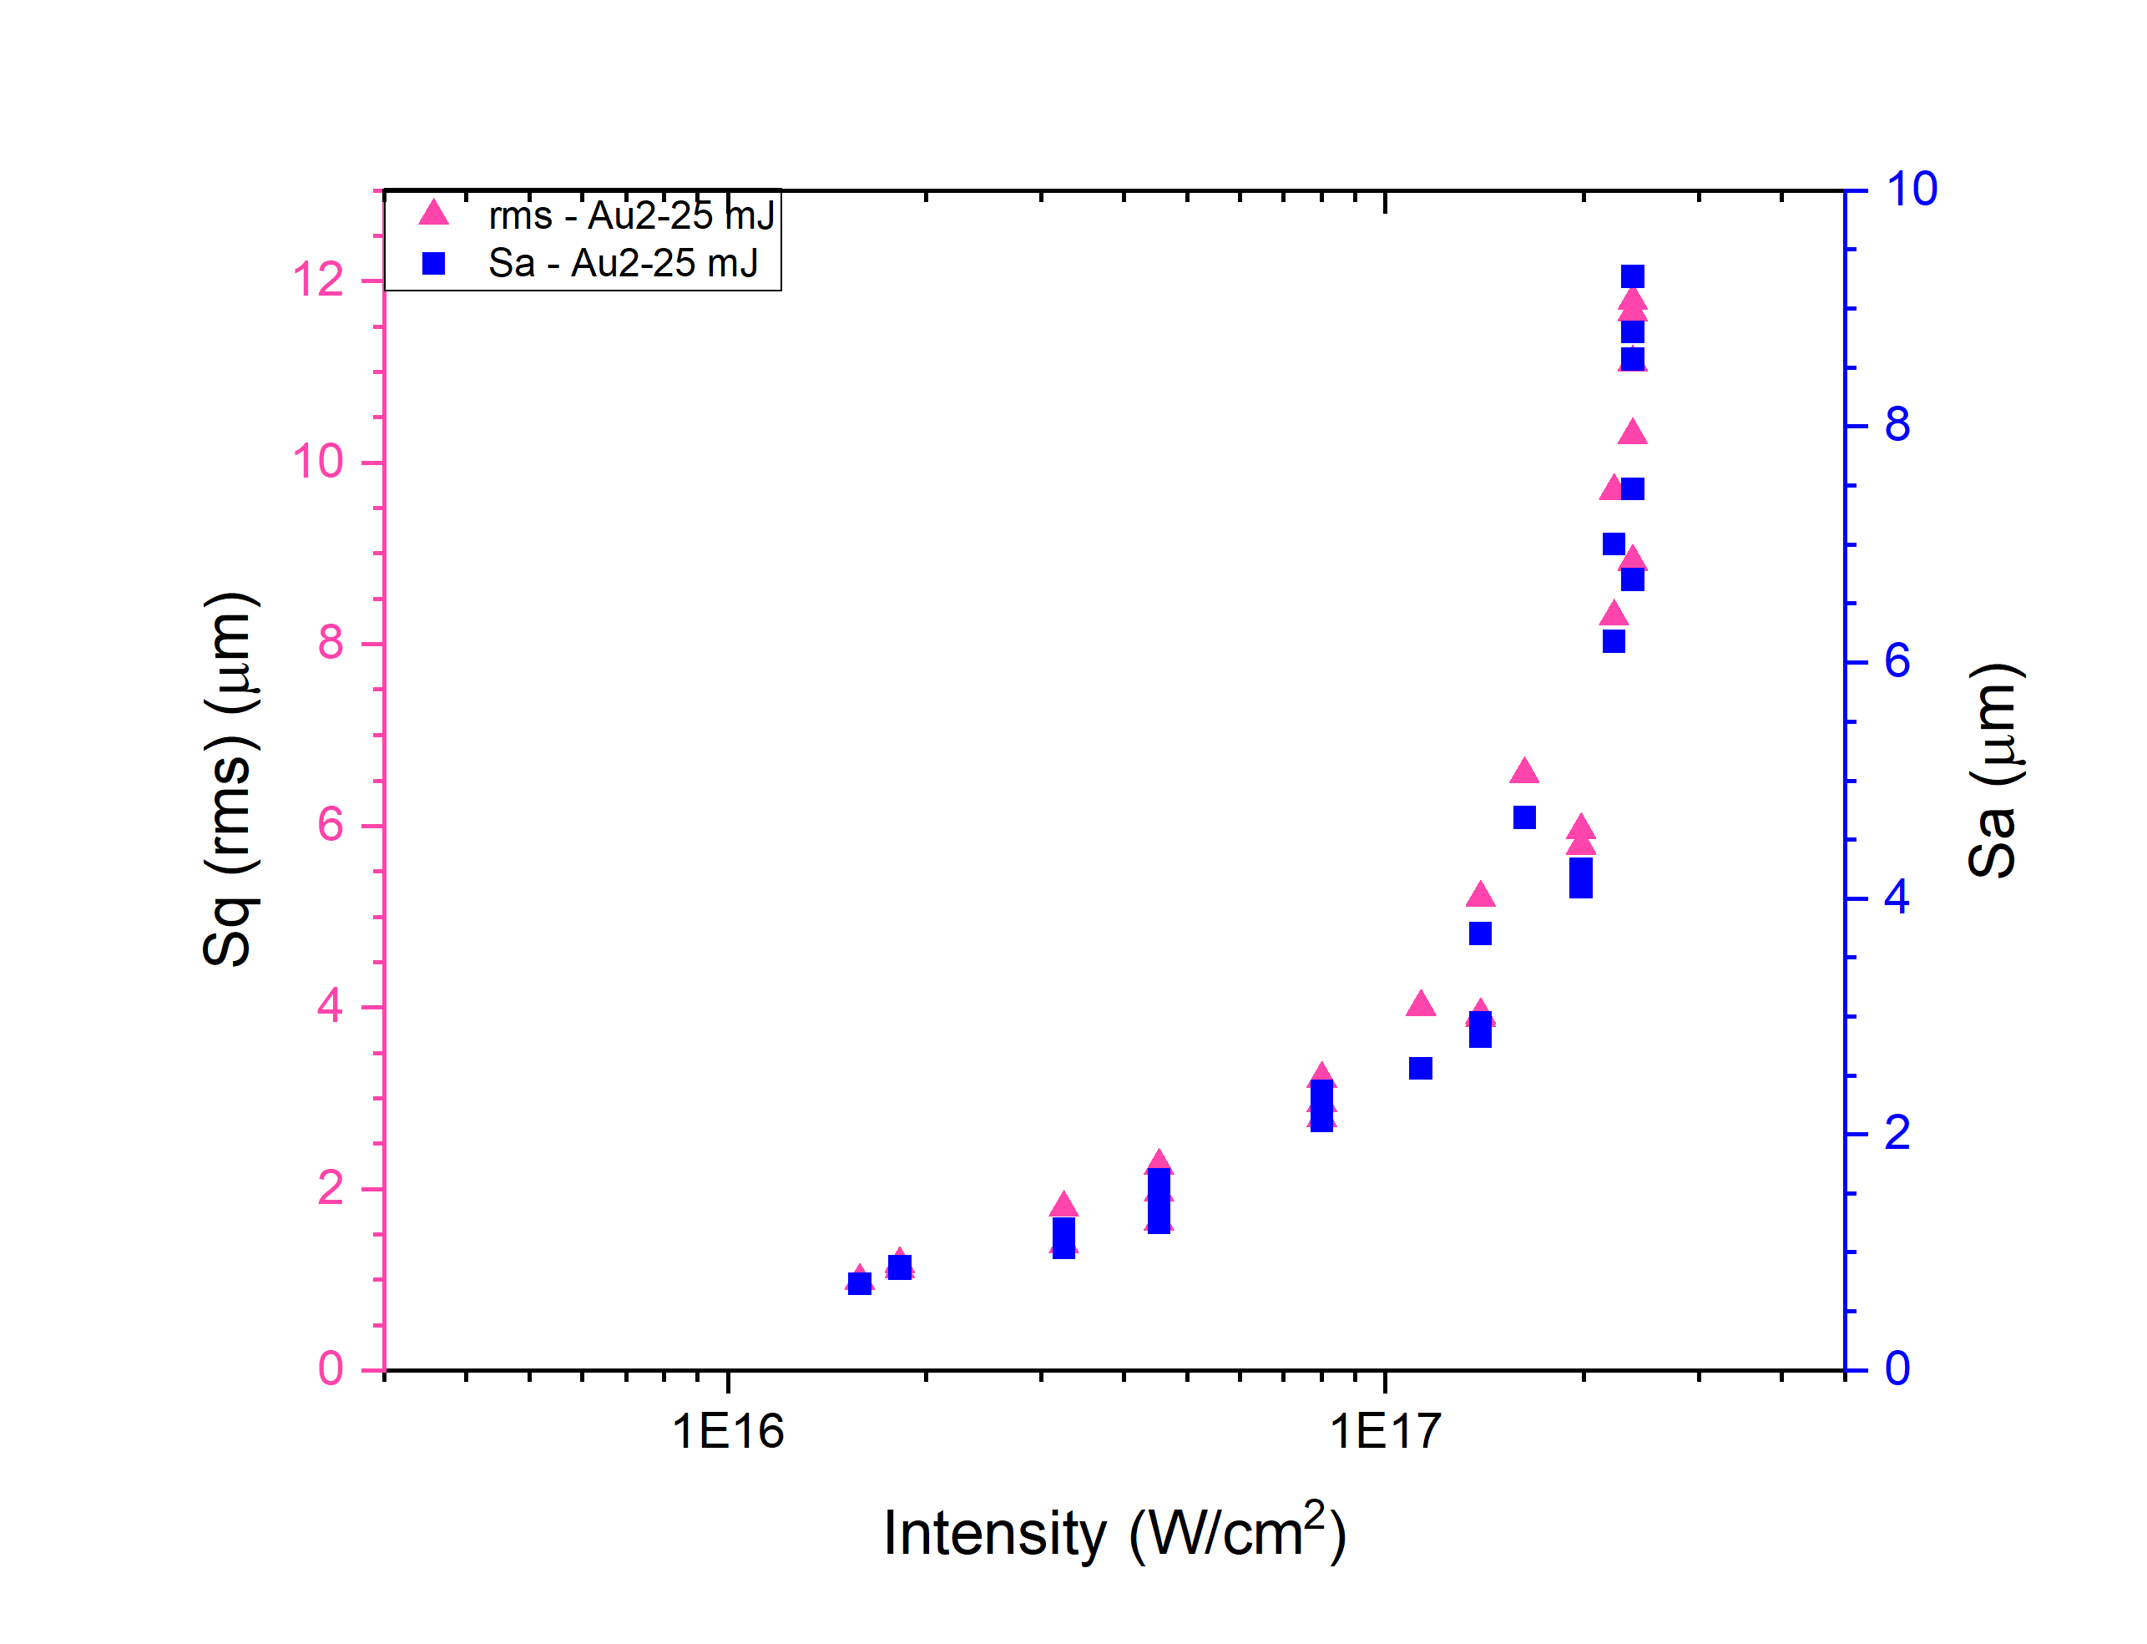
Roughness of the craters
$$S_{q}=rms=\sqrt{\frac{1}{L}\int_{0}^{L}{z^{2}\left(x\right)dx}}$$
$$S_{a}=\frac{1}{L}\int_{0}^{L}{\left|z(x)\right|dx}$$
27,7 mJ / Au0
25 mJ / Au2
Notes:
I already referred to the craters surface structure differences. We found that the roughness parameters could be adequate to describe these differences.
Sa – Arithmetical mean deviation.
Sq = Root-mean-square
The roughness changes were examinated as well in dependence of lasaer intensity changes. You can compare them for the higher energies (27,7 mJ in the case of Au0, and 25 mJ for Au2).
The quadratic (Sq) and averaged (Sa) surface roughness values were calculated from the white light interferometric images.
It was found that the increas of the laser intensity causes the rise of the surface roughness. It is much more obvious in the case of the sample containing gold.
The diffrence between the two craters is visible.

Slide 18
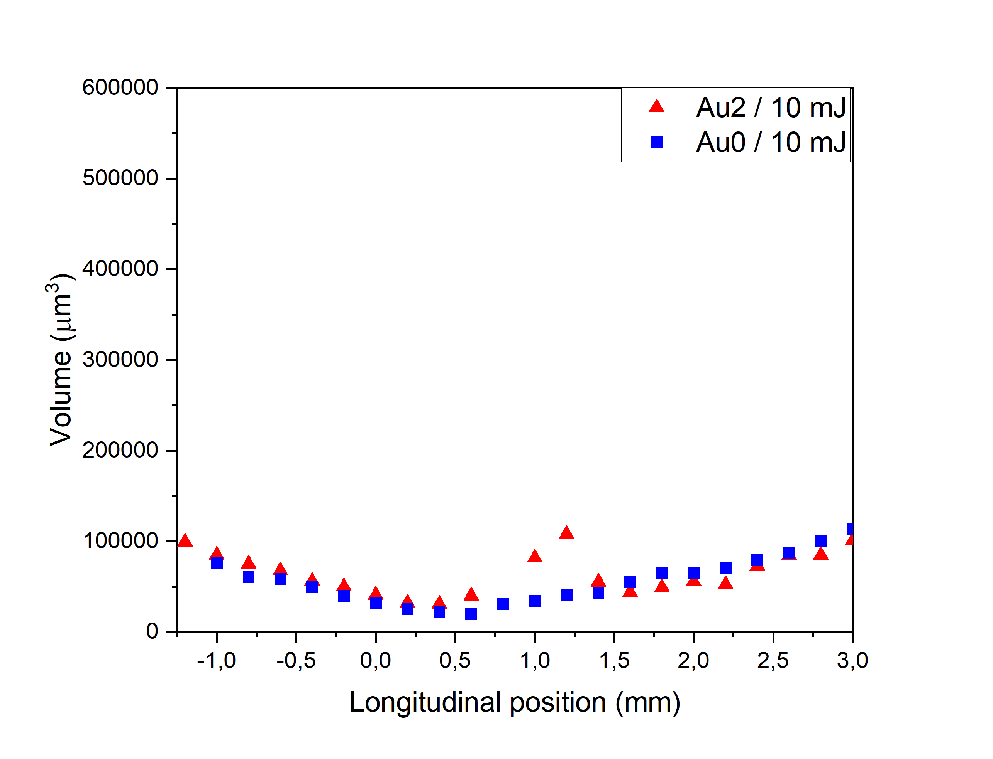
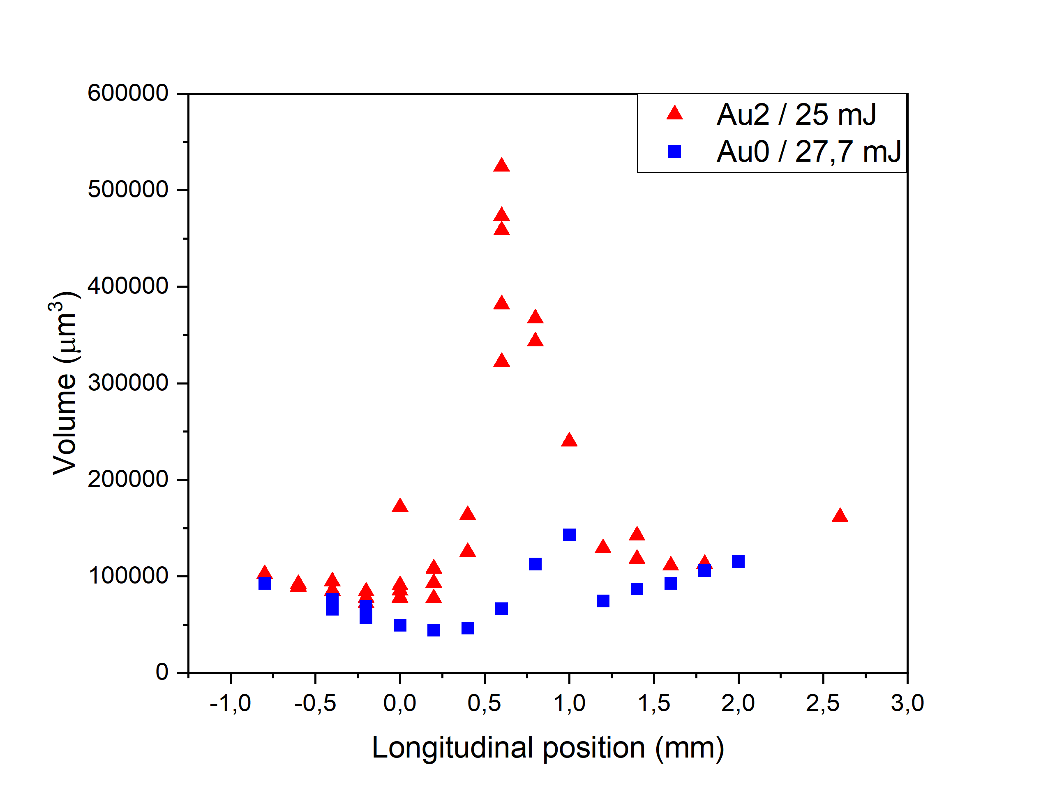
Crater volume vs. Focus position
Á. N. Szokol at al, arXiv:2402.18138. 2024
Notes:
At the first graph we can compare the volume values at the 10 mJ irradiation energy for the samples without and with gold at the function of longitudinal distance.
AT the second graph we can observ the comparison for higher illumination energy for these samples.
We can observe that arround the focal point at 25 mJ the volume of the crater extremly higher.

Slide 19
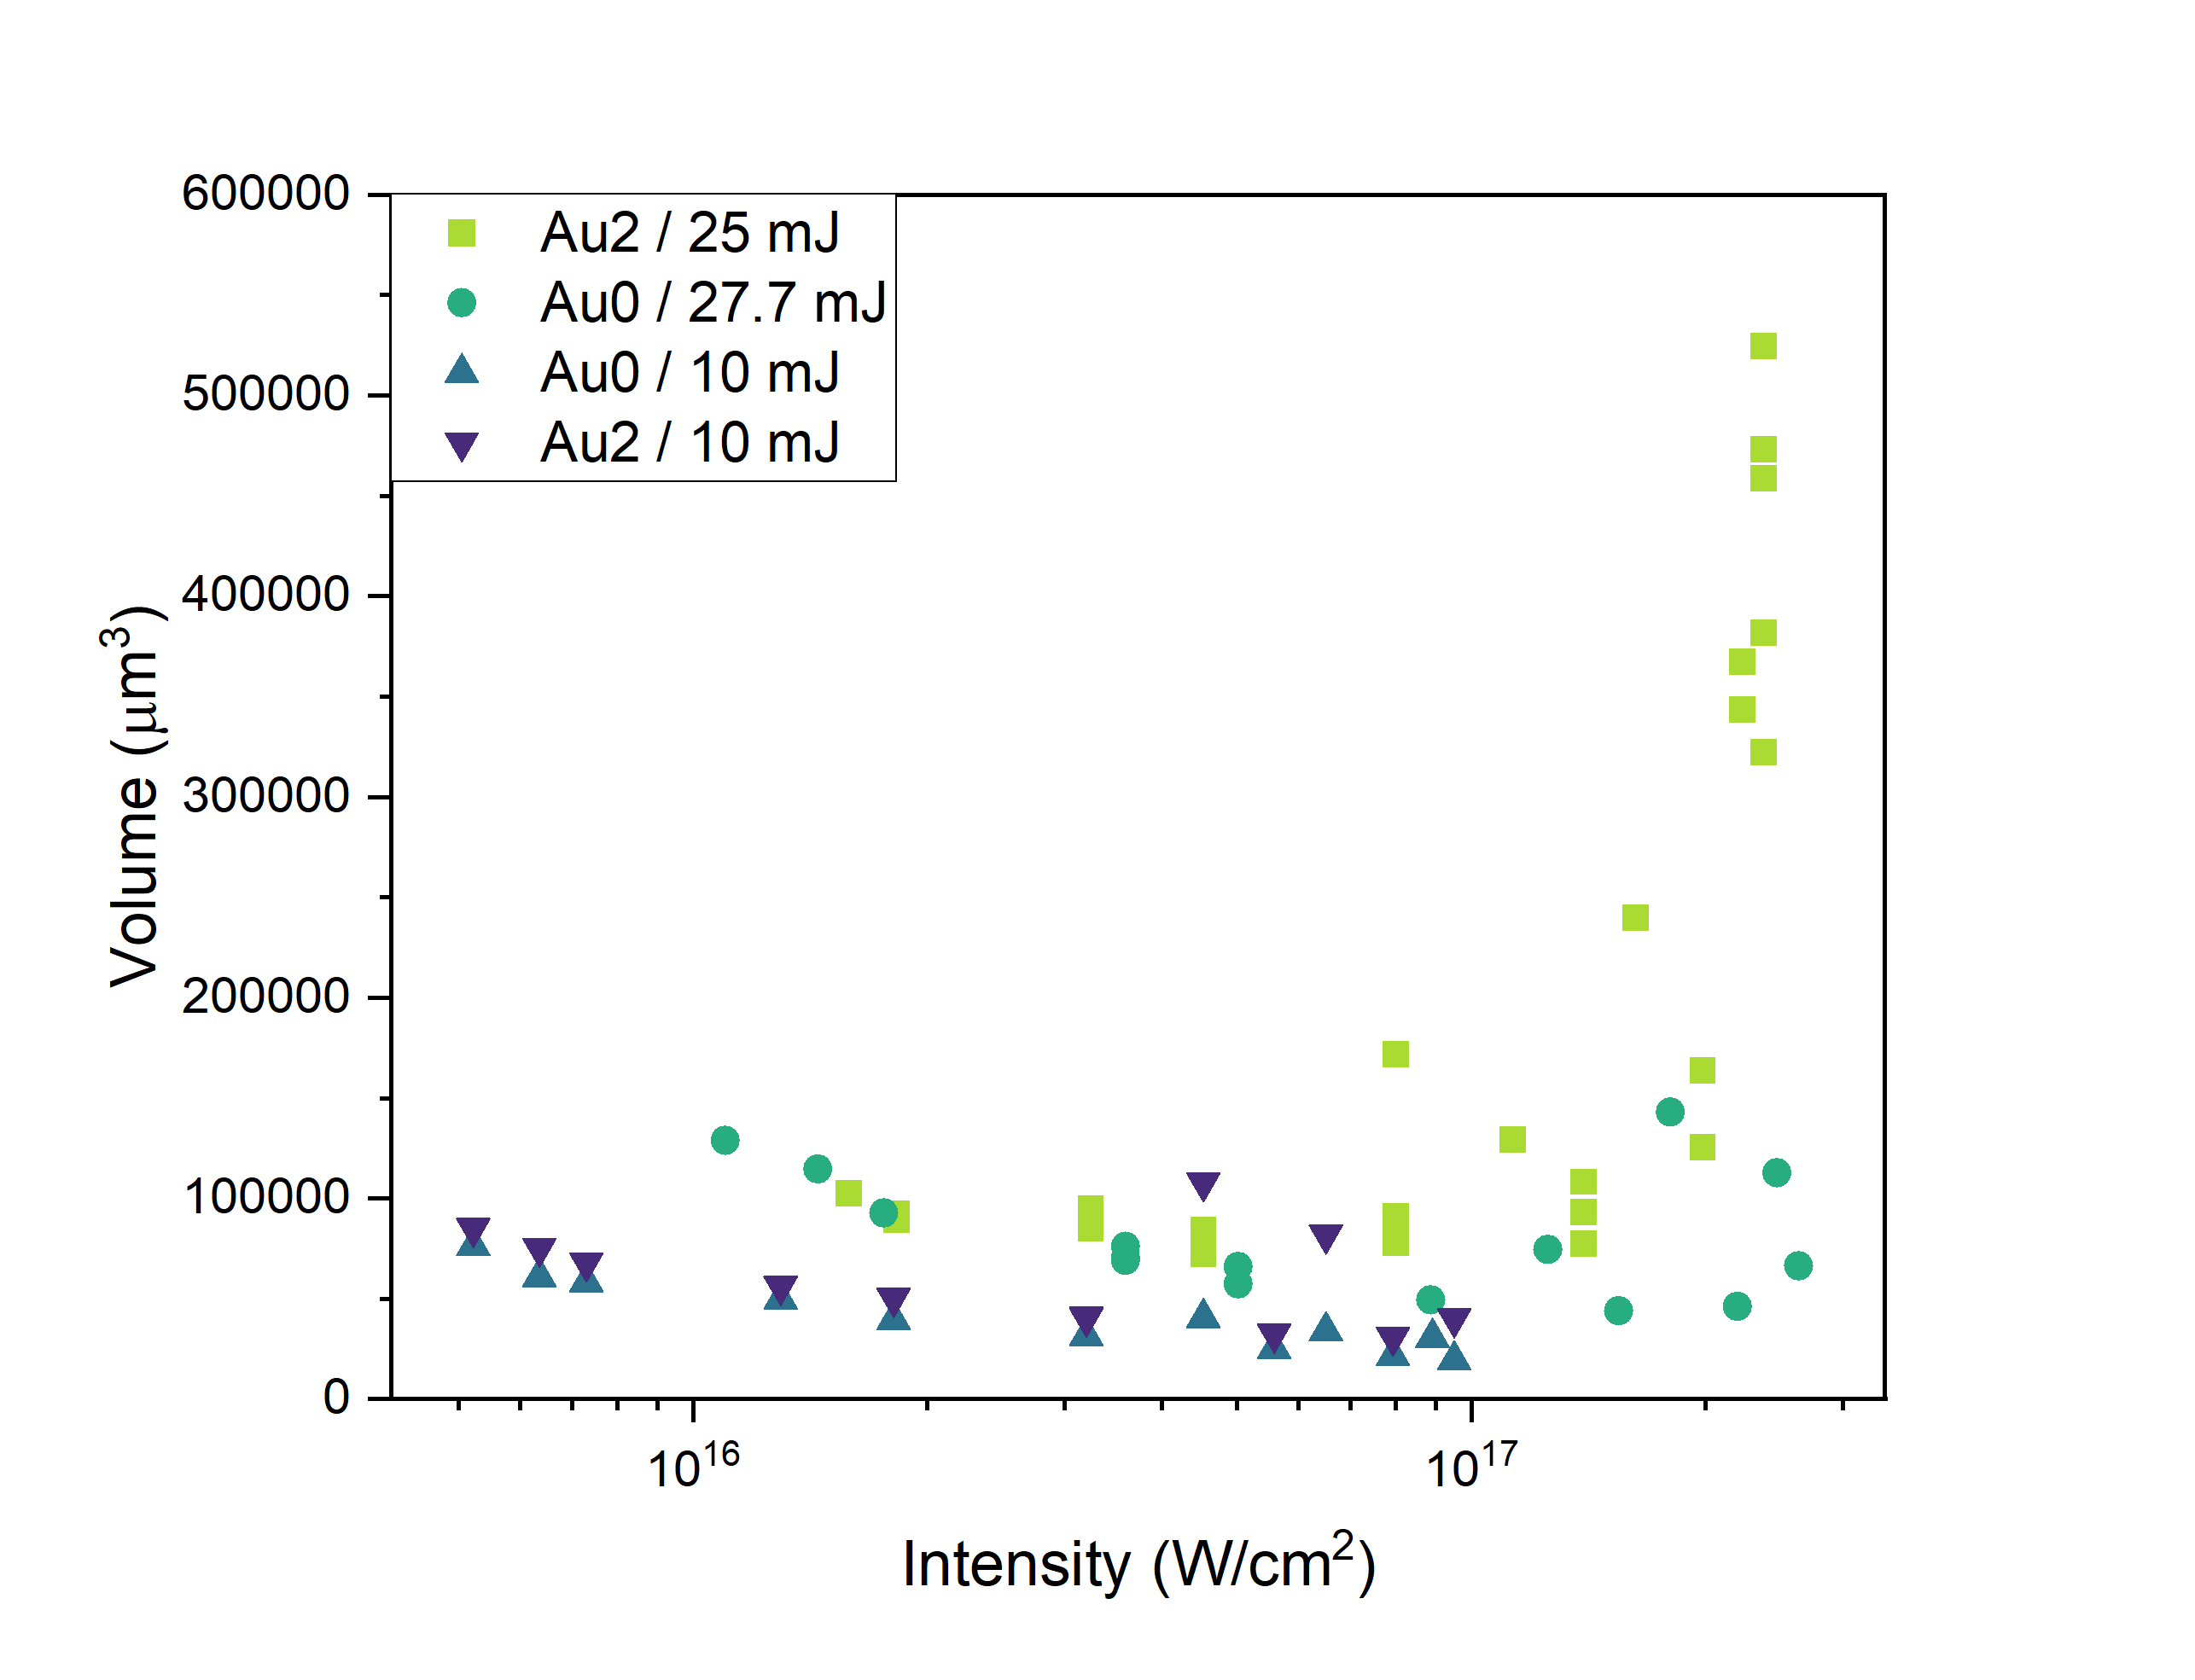
Intensity dependence - crater volume
For Au2 almost 7-fold increase of the volume.
Notes:
At the last graph we can compare all the volumes in dependence of the intensity.
It shows that at lower intesities the crater volumes are aproximately linearly decreasing, but over 1,25 x 10¹⁷ W/cm² the rapid, almost 7-fold increase of the volume can be obeserved.
It can can be attributed only to the presence of the gold nanoparticles, since those constituting the only difference between the two targets.

Slide 20
Conclusions
Crater morphology was studied in UDMA-TEGDMA polymer targets without and with gold nanorods irradiated with 42 fs long laser pulses.
It was observed, that the crater volume is higher:
in the presence of gold nanorods over 10 mJ irradiation energy;
at higher gold nanoparticle density.
With increasing intensity of irradiation
the diameter of the craters decreased;
the depth of the craters increased;
the craters depth was higher in the presence of gold nanorods.
Over 1.25·10¹⁷ W/cm² intensity in the presence of gold nanorods
the roughness values doubled;
the volume of the craters rapidly increased – almost 7 times.

Slide 21
Acknowledgements
Members of the NAPLIFE Structural Characterization Group
Miklós Veres
Gábor Galbács
Roman Holomb
Judit Kámán
István Rigó
Members of the NAPLIFE Laser Group
Miklós Kedves
Márk Aladi
Béla Ráczkevi
Péter Rácz
Archana Kumari
Nour Jalal Abdulameer
The NAPLIFE collaboration
This work was supported by Nanoplasmonic Laser Fusion Research Laboratory project financed by the National Research and Innovation Office of Hungary (NKFIH-468-3/2021), by the Eötvös Lóránd Research Network of Hungary (ELKH) and by the Hungarian Research Network (HUN-REN).
The research reported in this talk carried out at the HUN-REN Wigner Research Centre for Physics.

Slide 22
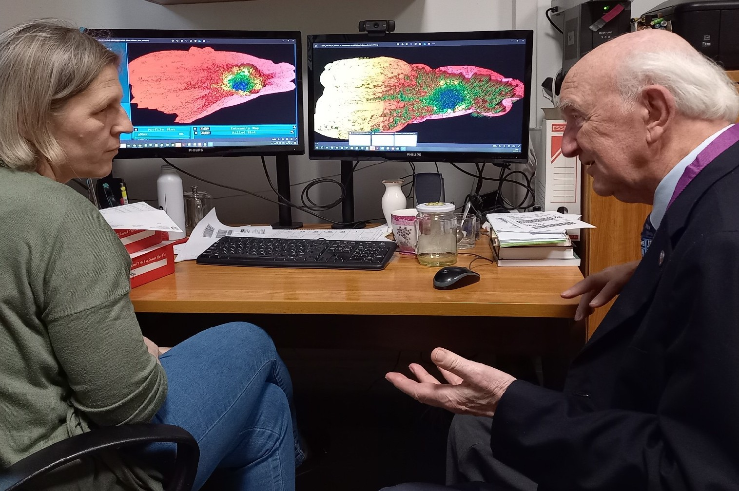
Thank you for your attention!
Particles & Plasmas Symposium 2024 – 11 Jun 2024 Ágnes Nagyné Szokol

