Slide 1
High-intensity femtosecond laser irradiation experiments on polymer targets doped with gold nanorods
Márk Aladi, Ádám Inger, Miklós Á. Kedves, B. Ráczkevi
Wigner Research Centre for Physics
NAPLIFE Collaboration

Slide 2
Introduction
Motivation, purpose
Detection of plasmonic amplification, e.g. higher energy protons, ions
Detection of fusion products, e.g. alpha particles, Deuterium
Experiments at Wigner
LIBS (laser induced breakdown spectroscopy), MS (mass spectrometry)
Reflection/transmission measurements
Study of the effect of the laser contrast
Measurements at the ELI-ALPS laser facility (in cooperation with NLTL group from the Univerity of Szeged)
Thomson Parabola Spectrometer
Nuclear trace detectors
Nuclear particle detectors (by colleagues from ATOMKI)
Preliminary results
Conclusions, further plans (Márk Aladi’s talk)

Slide 3
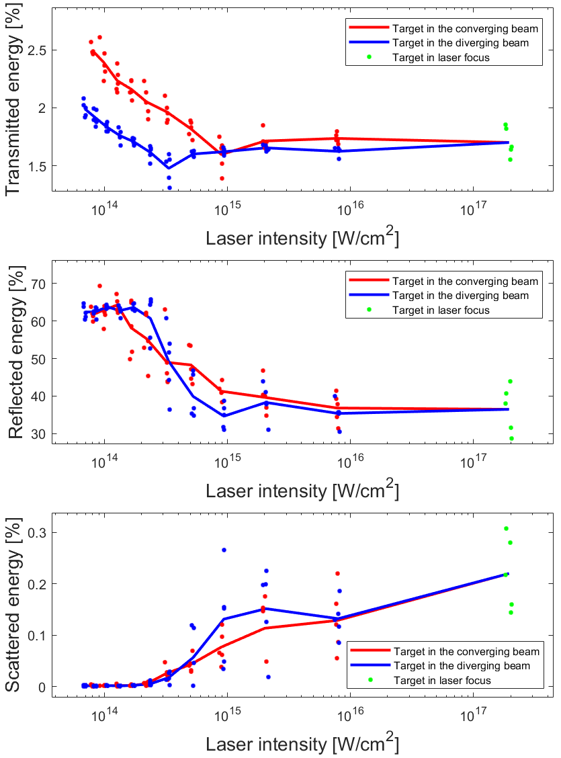
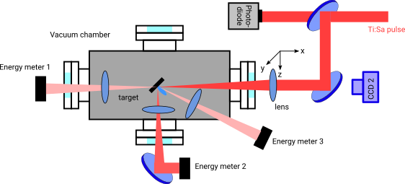
Reflection/transmission measurements at Wigner RCP
Arrangement Results

Slide 4
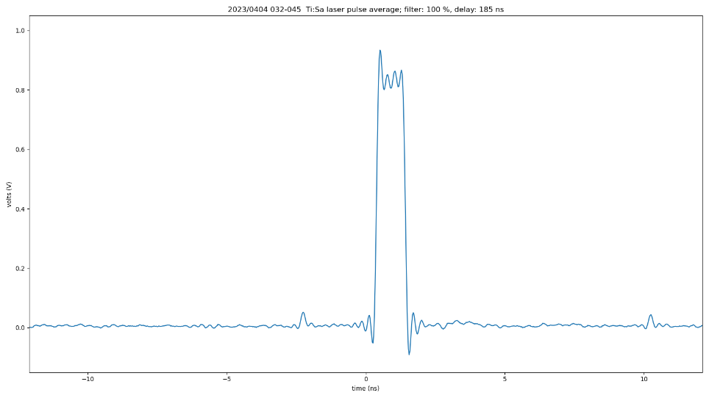
Laser contrast studies at Wigner RCP
Parameters of the Coherent Hidra laser at Wigner RCP laser plasma laboratory
Maximum pulse energy: 30 mJ
Minimum pulse duration: 40 fs
Central wavelength: ~800 nm
Repetition rate: 10 Hz
Beam diameter (1/e²): 15 mm
Contrast (ns): 10⁶ with pulse slicer (no specification for ps contrast)
Recent measurements with a photodiode:
prepulse at -2.8 ns

Slide 5
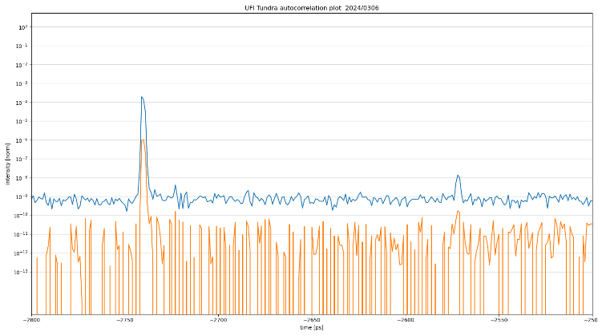
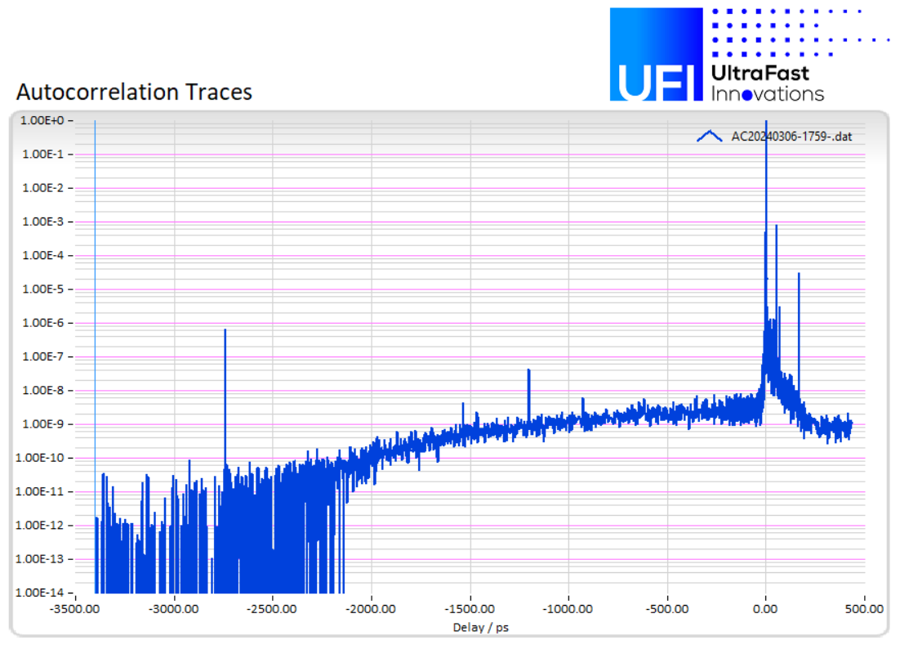
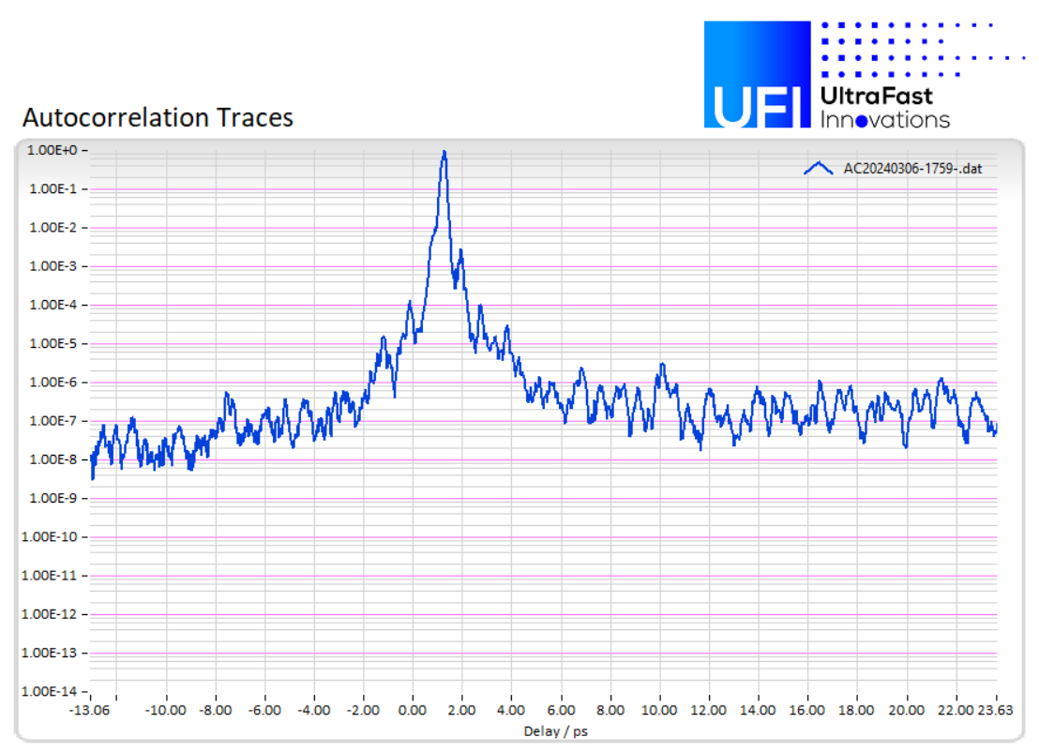
Contrast measurements with our new 3rd order autocorrelator
Prepulse at -2.8 ns with original setting and after the optimization of the pulse slicer delay
3rd order autocorrelation signals full and ps range

Slide 6
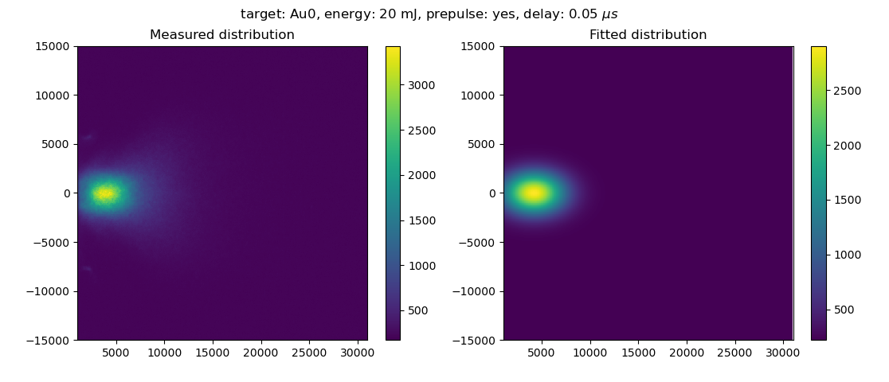
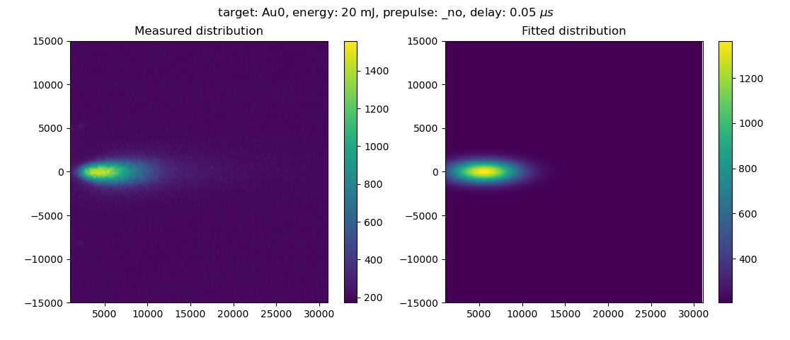
Plasma plume with prepulse
Maxwell-Boltzmann fit:
v = 9∙10⁴ m/s
and without prepulse
v = 1.1∙10⁵ m/s

Slide 7
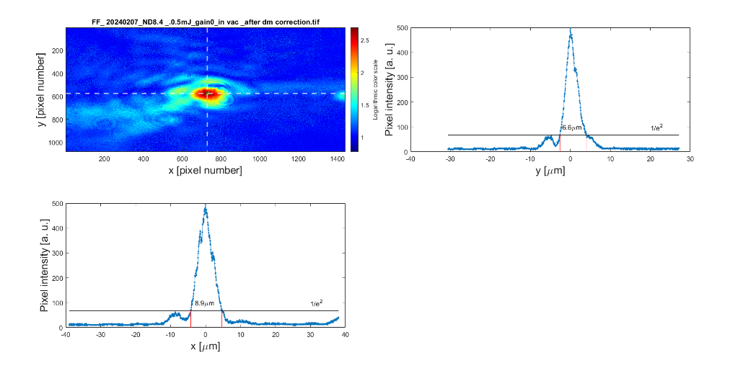
Measurements at the ELI-ALPS laser facility
Laser irradiation of the targets, detection of particles by:
- Thomson Parabola Spectrometer (TPS), in cooperation with Károly Osvay’s group of NLTL lab at the University of Szeged
- CR-39 trace detector plates
- scintillation detectors for neutron (and X-ray/gamma)
(by Barna Biró and László Stuhl from ATOMKI , Institute for Nuclear Research))
Laser: Sylos Experiment Alignment parameters:
- max energy ~ 40 mJ from the laser, 70-80% on the target surface
- wavelength centre 825 nm, typical spectrum 750 – 960 nm
- min pulse length 12 fs, longer pulses with negative chirp
focused beam size min ~ 3 μm
Contrast 10¹⁰

Slide 8
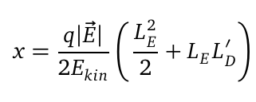
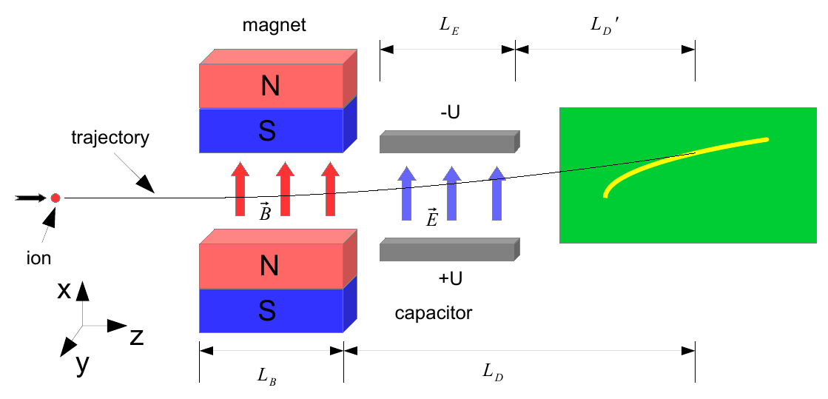
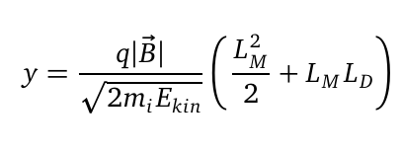
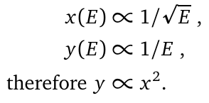
Thomson Parabola Spectrometer
(Master Thesis of Nils Schroeter, 2017)

Slide 9
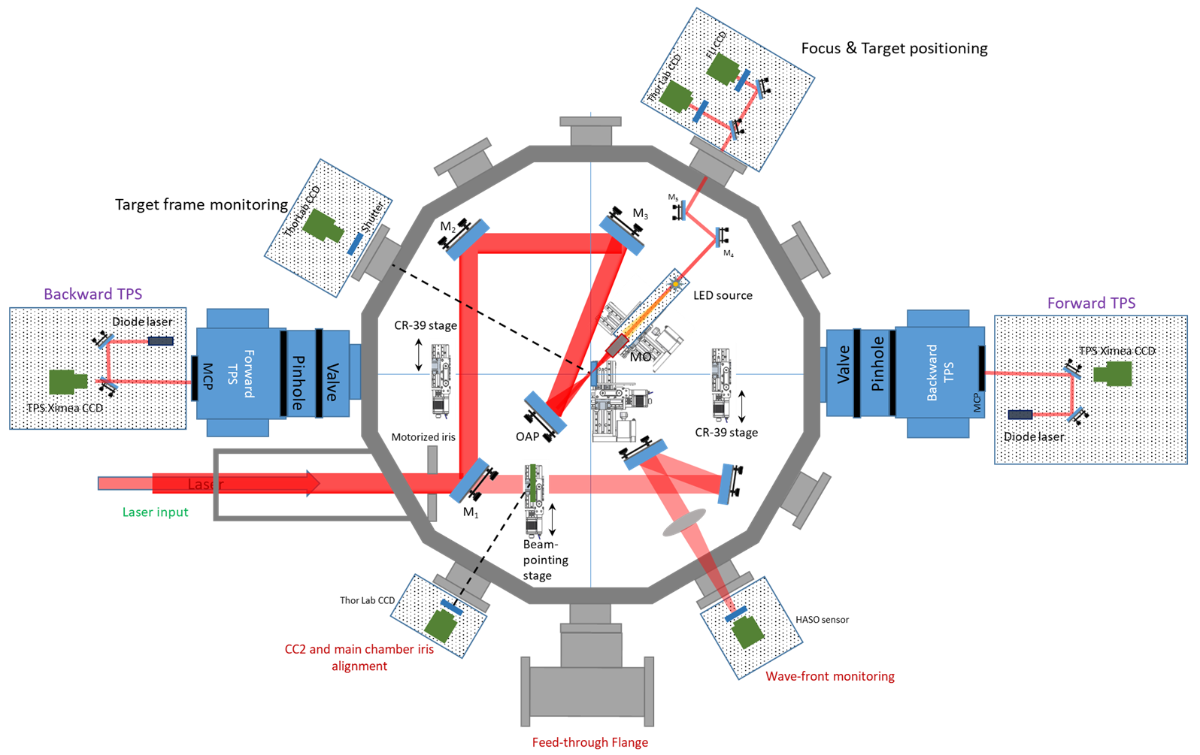
Experimental system of the NLTL Group of the University of Szeged
(K. Osvay and coworkers)

Slide 10
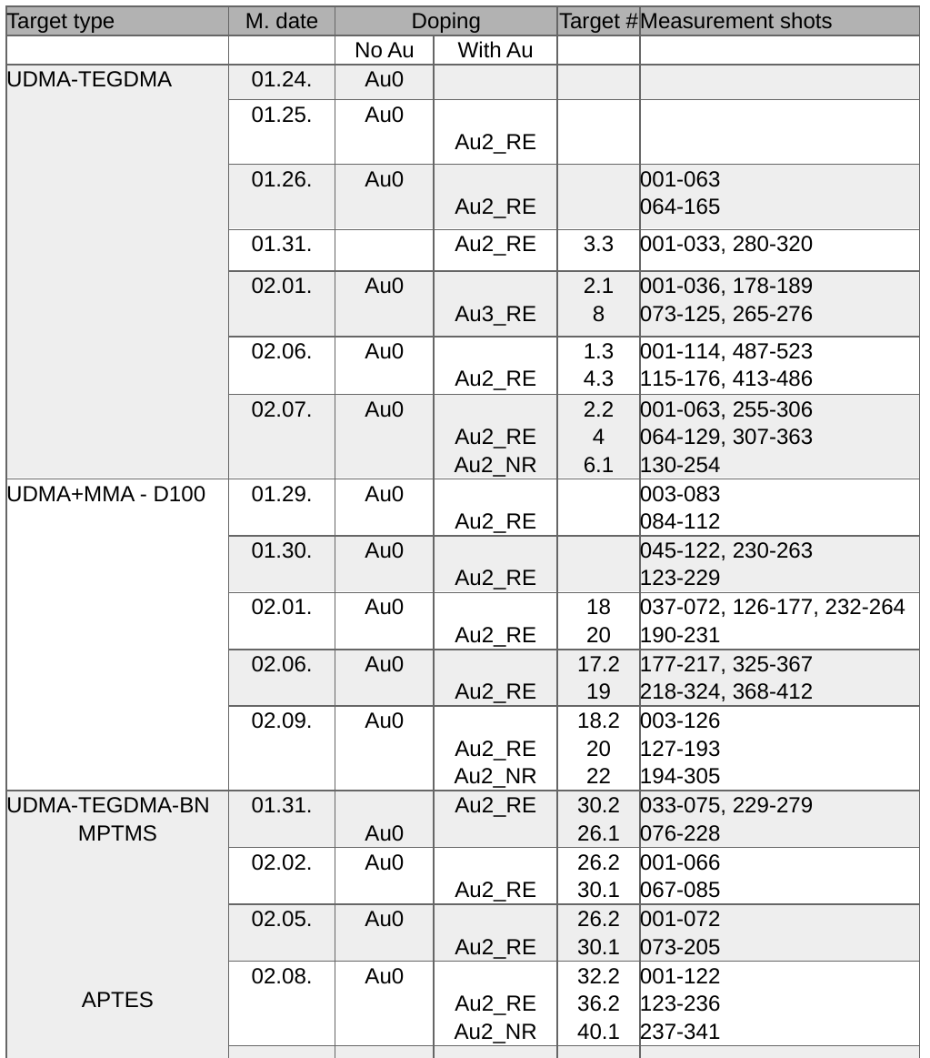
Targets
Target types used in the experiments:
UDMA-TEGDMA
UDMA-MMA, deuterated (D100)
UDMA-TEGDMA with BN
All 3 types:
Au0: without gold nanorods
Au2_RE: with gold nanorods of resonant size (25 x 85 nm)
Au2_NR: with gold nanorods of non-resonant size (25 x 34 nm)
Thicknesses: 150 or 400 μm

Slide 11
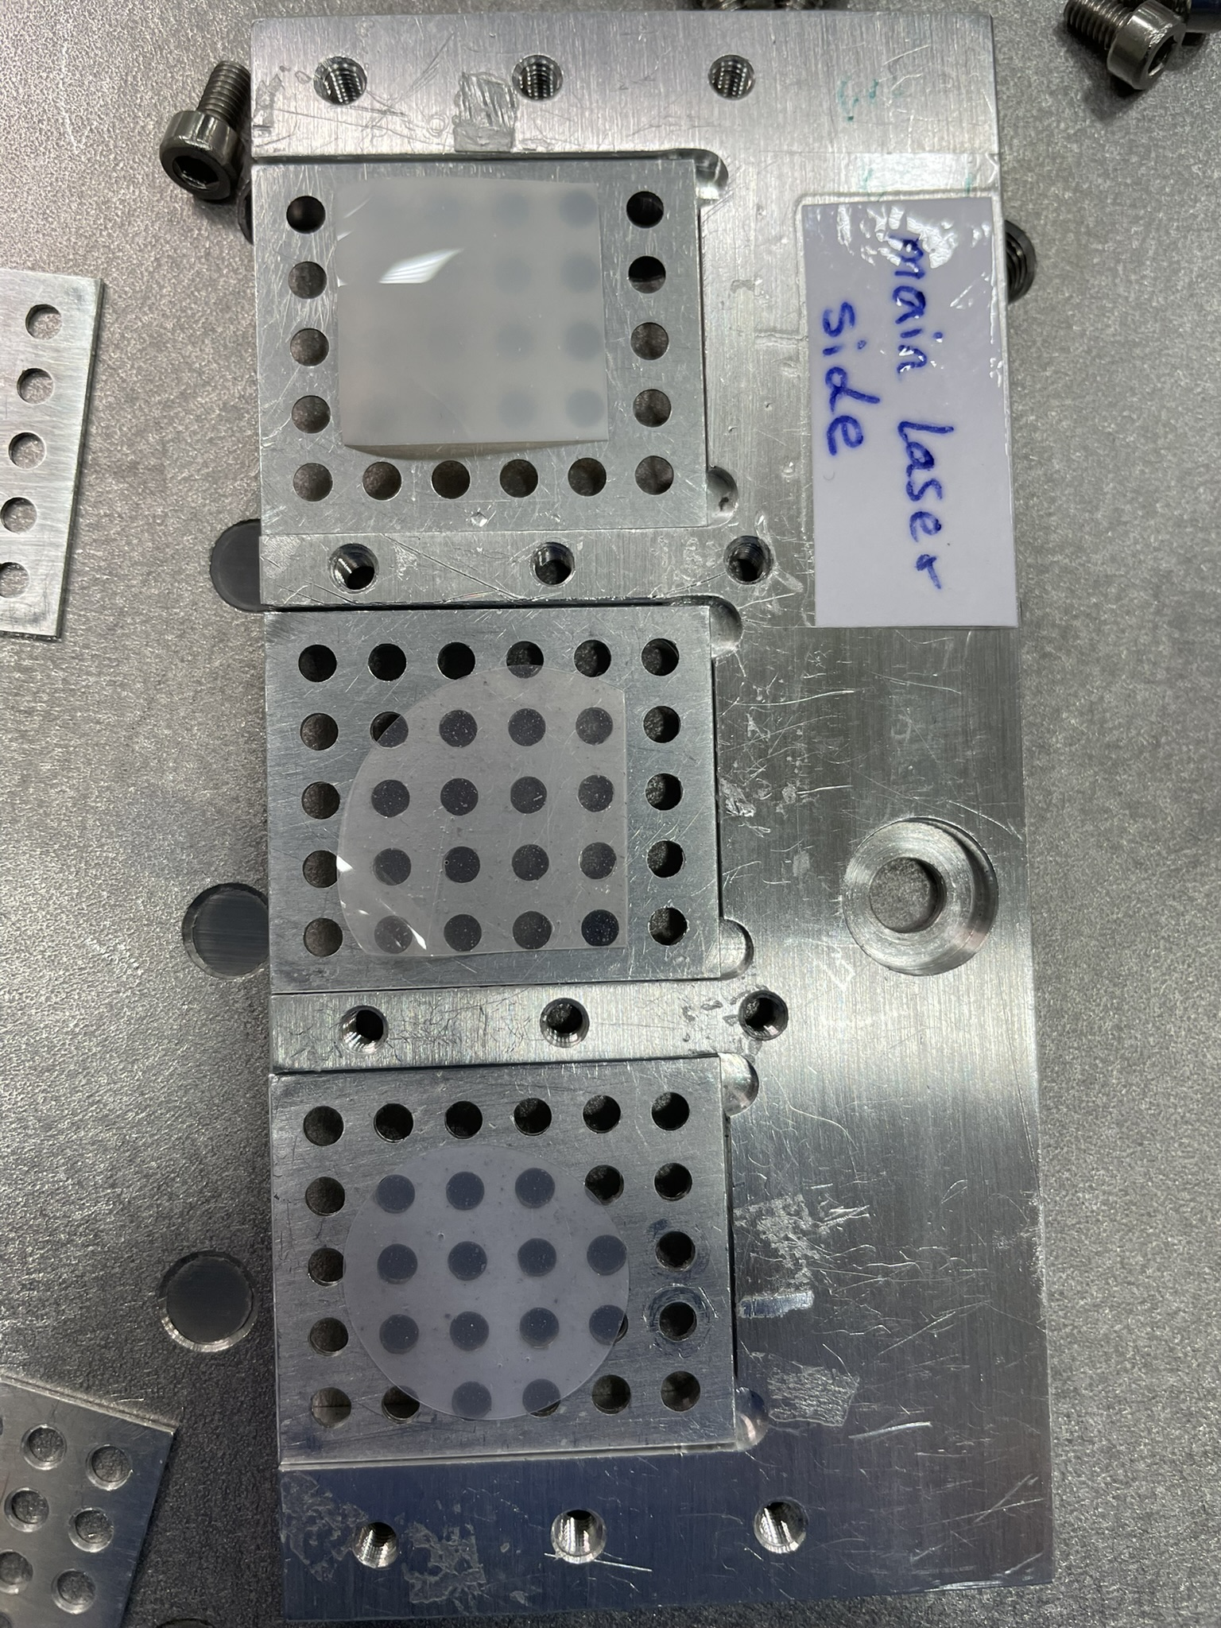
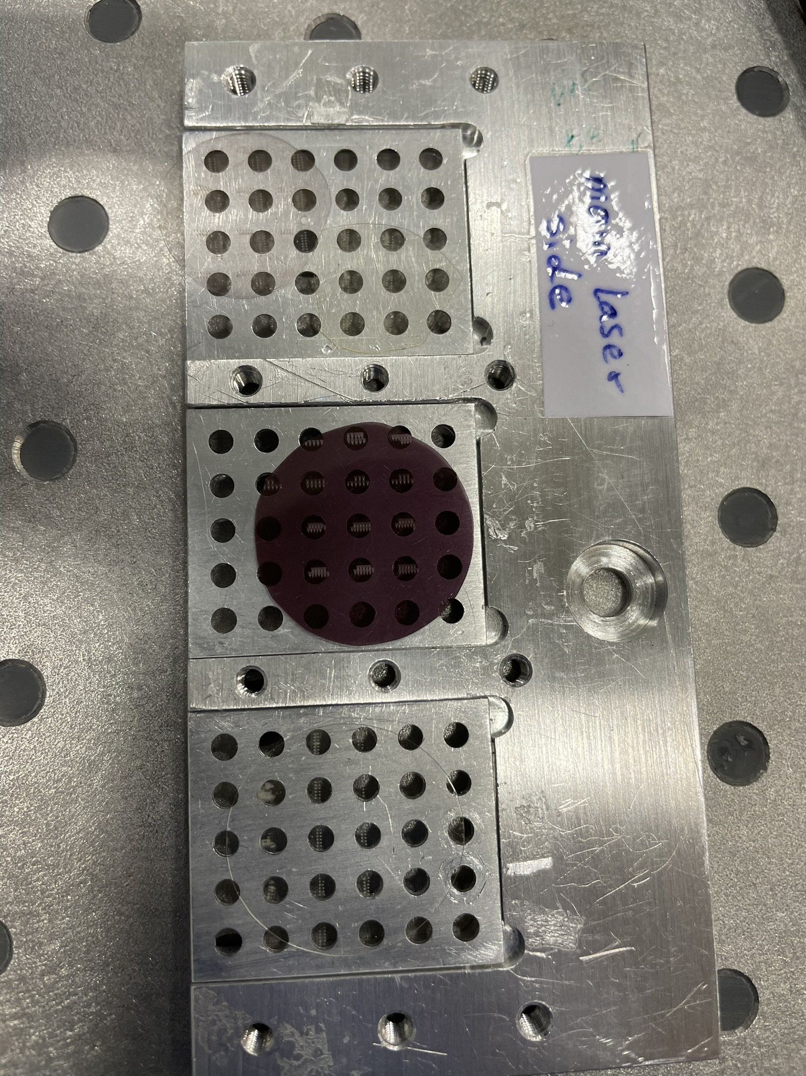
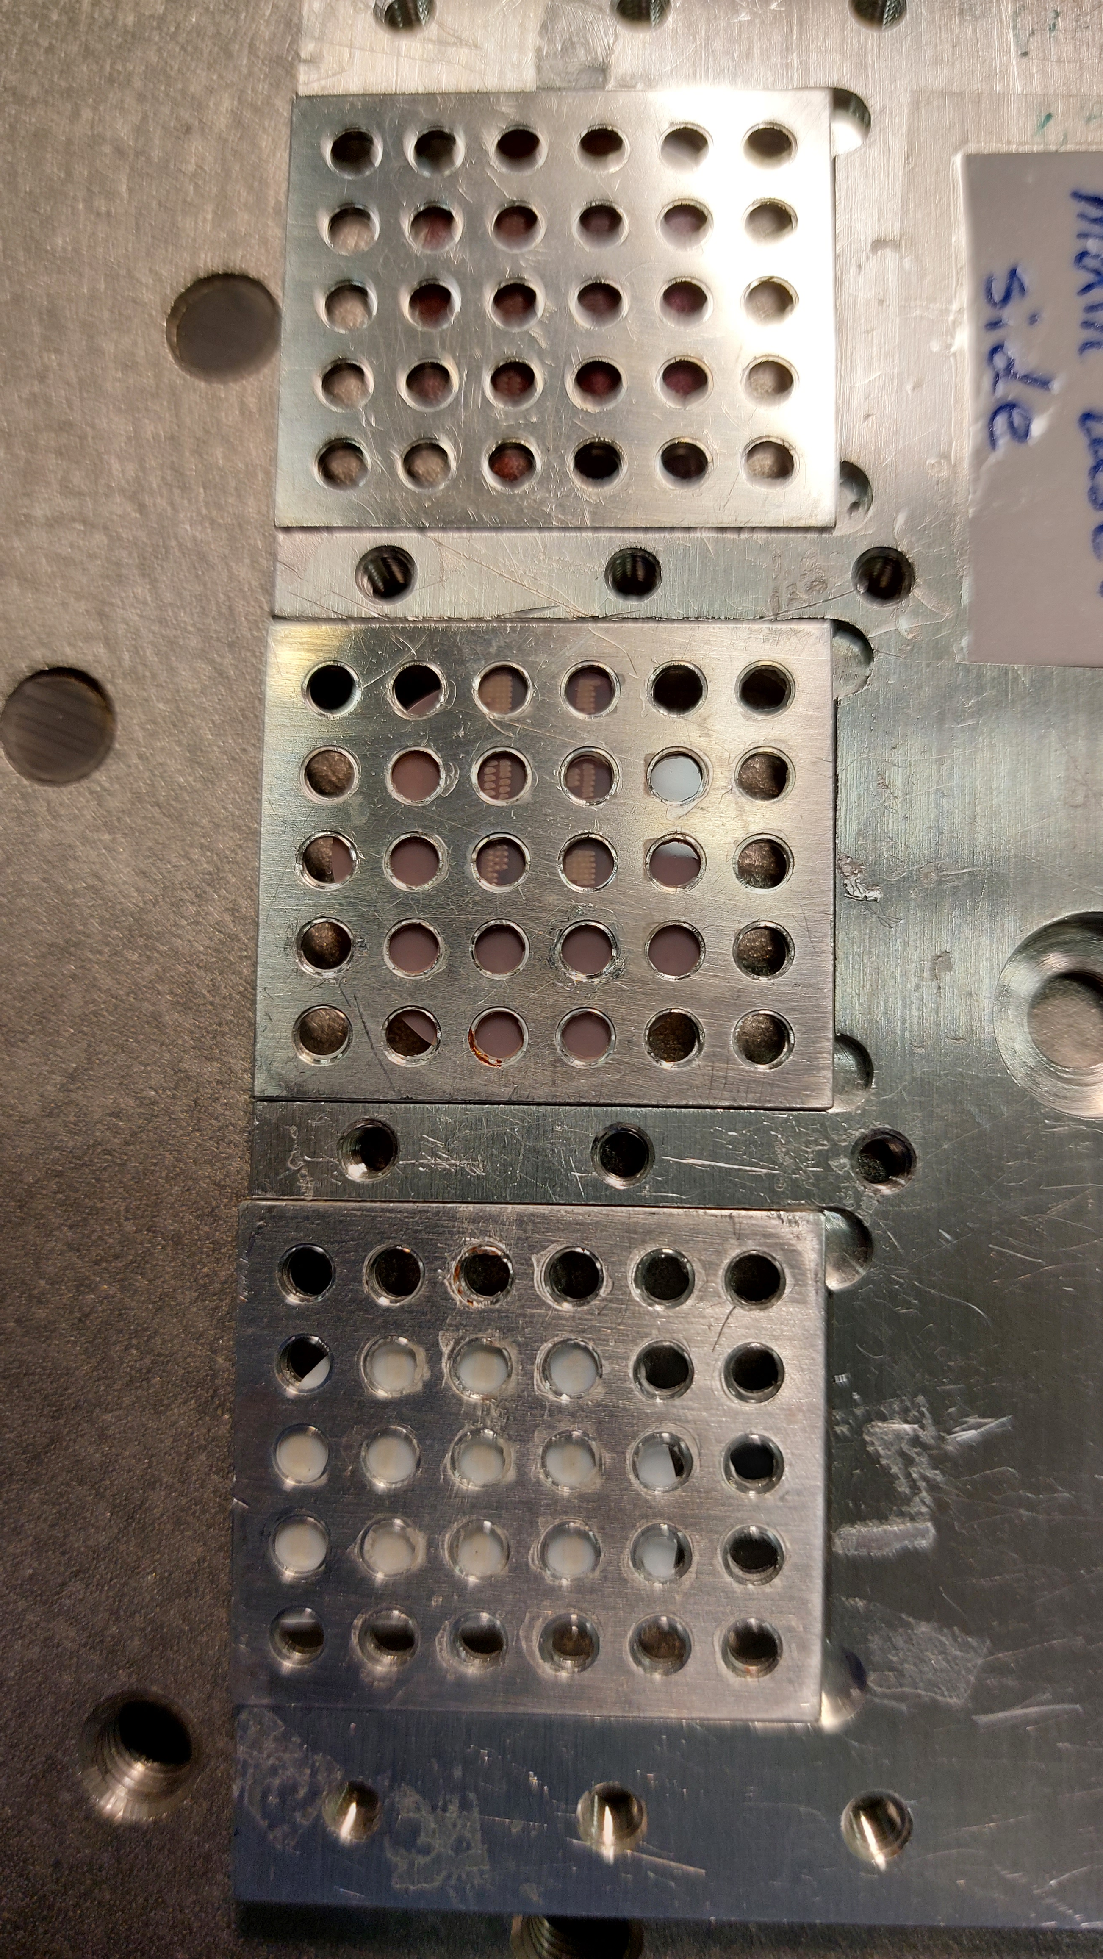
Pictures of the targets and holders

Slide 12
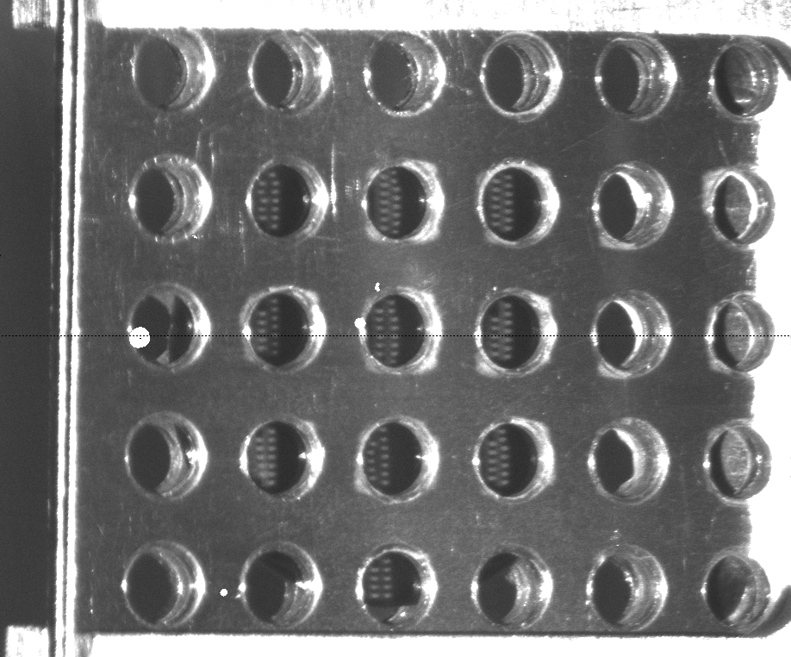
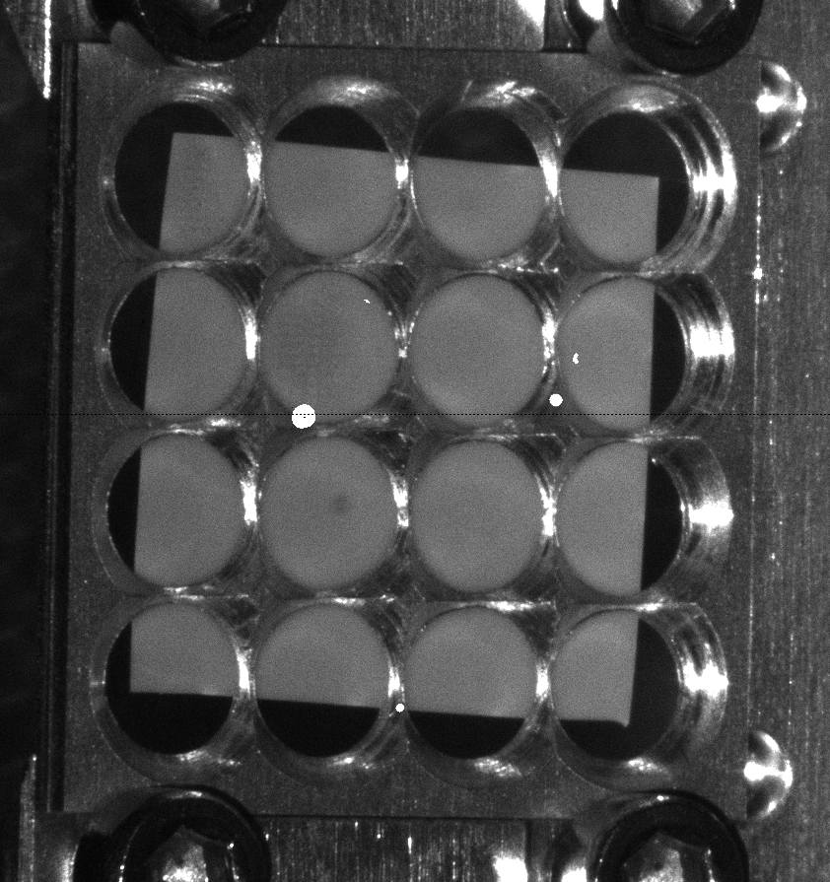
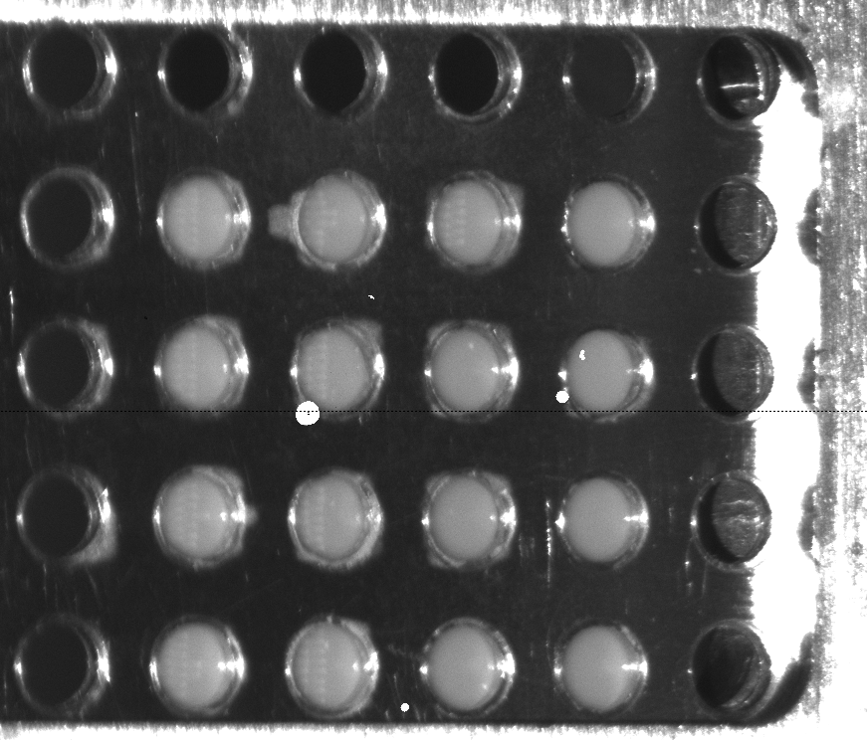
Target inspection during the irradiation
#4 Au2-400
BN-APTES-Au2_NR

Slide 13
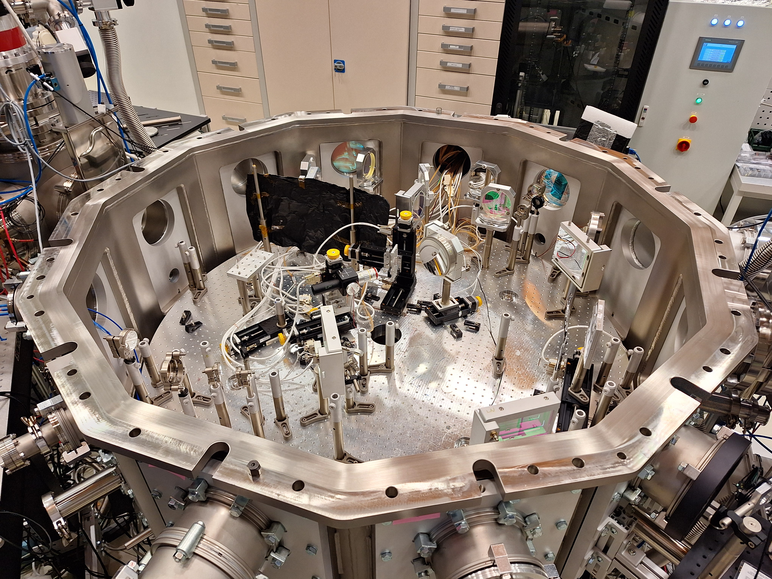
Photos of the experimental set-up

Slide 14
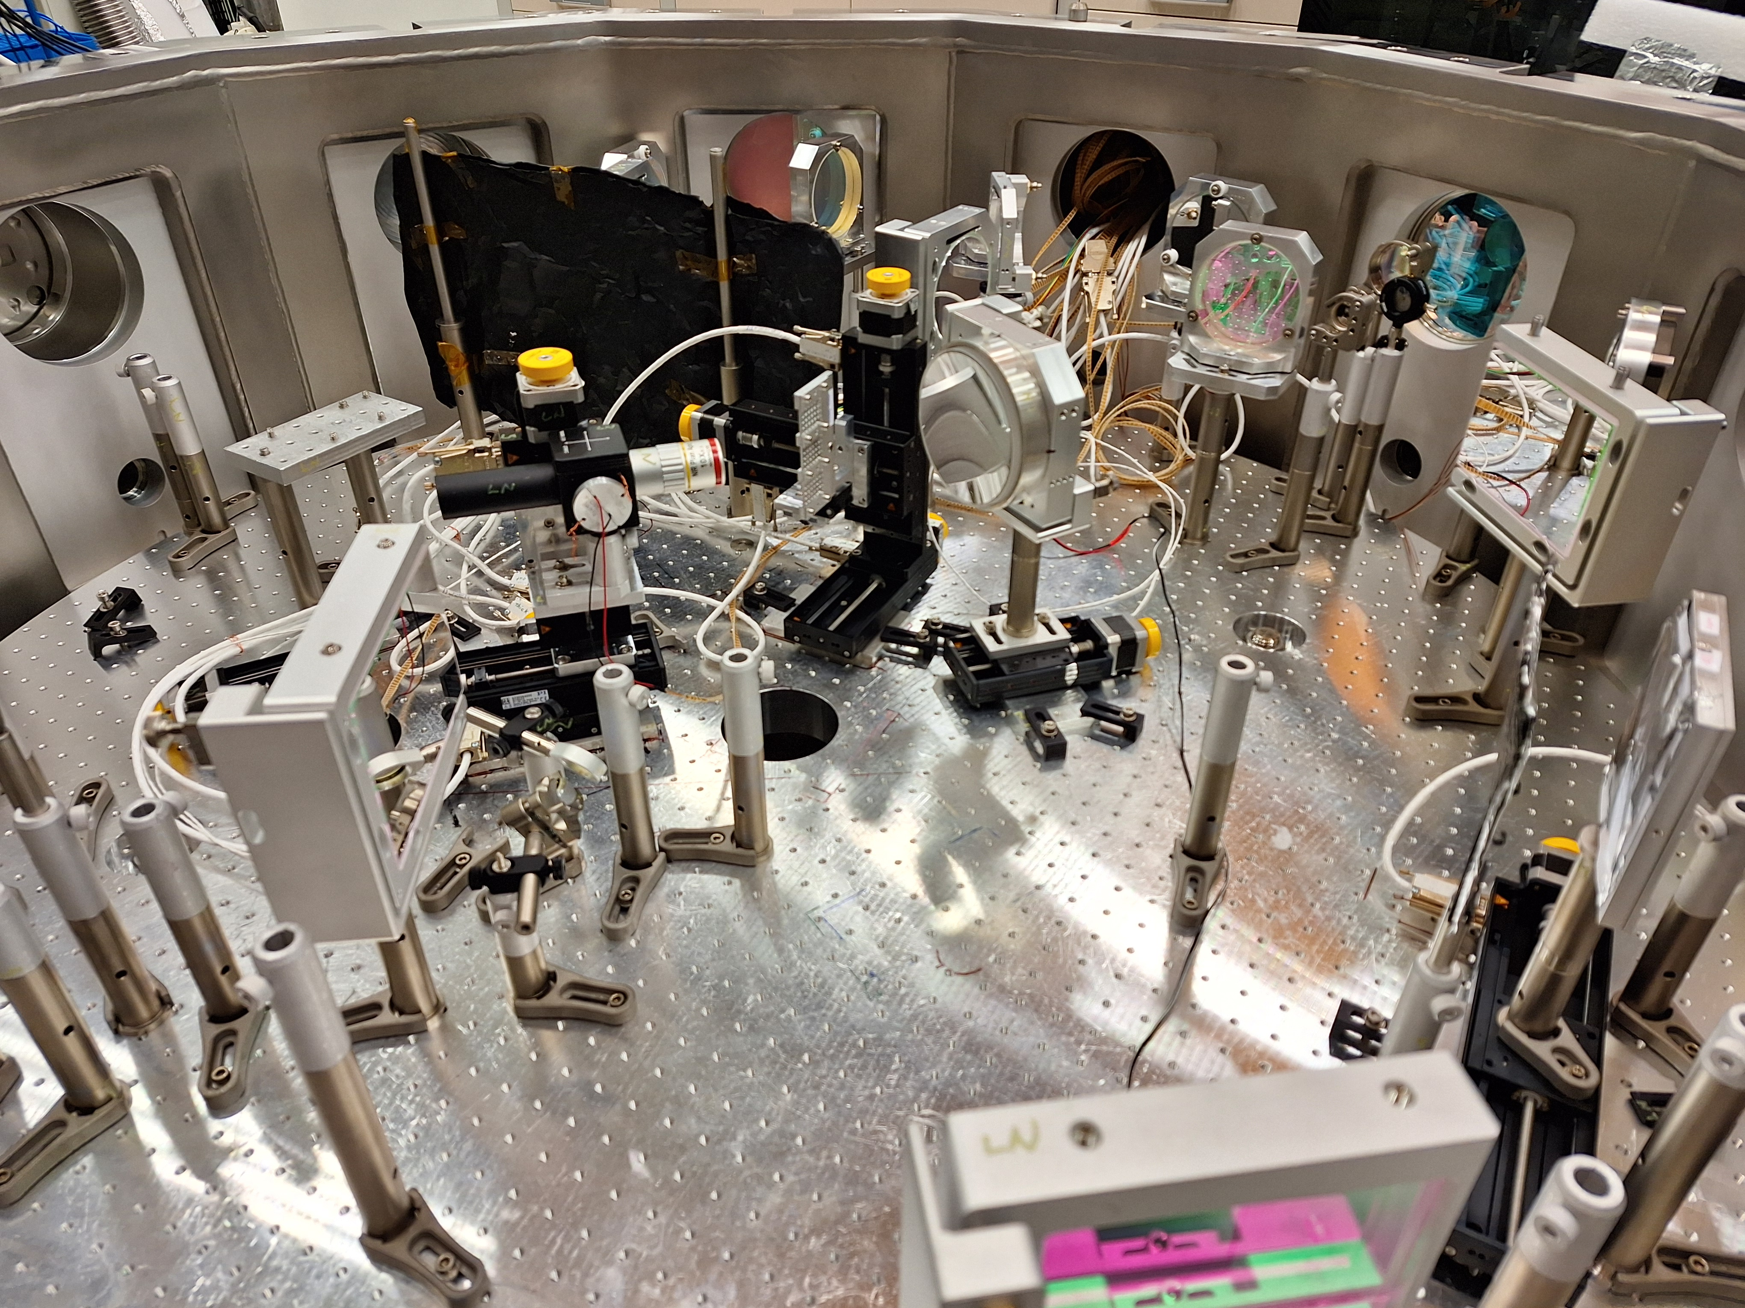

Slide 15
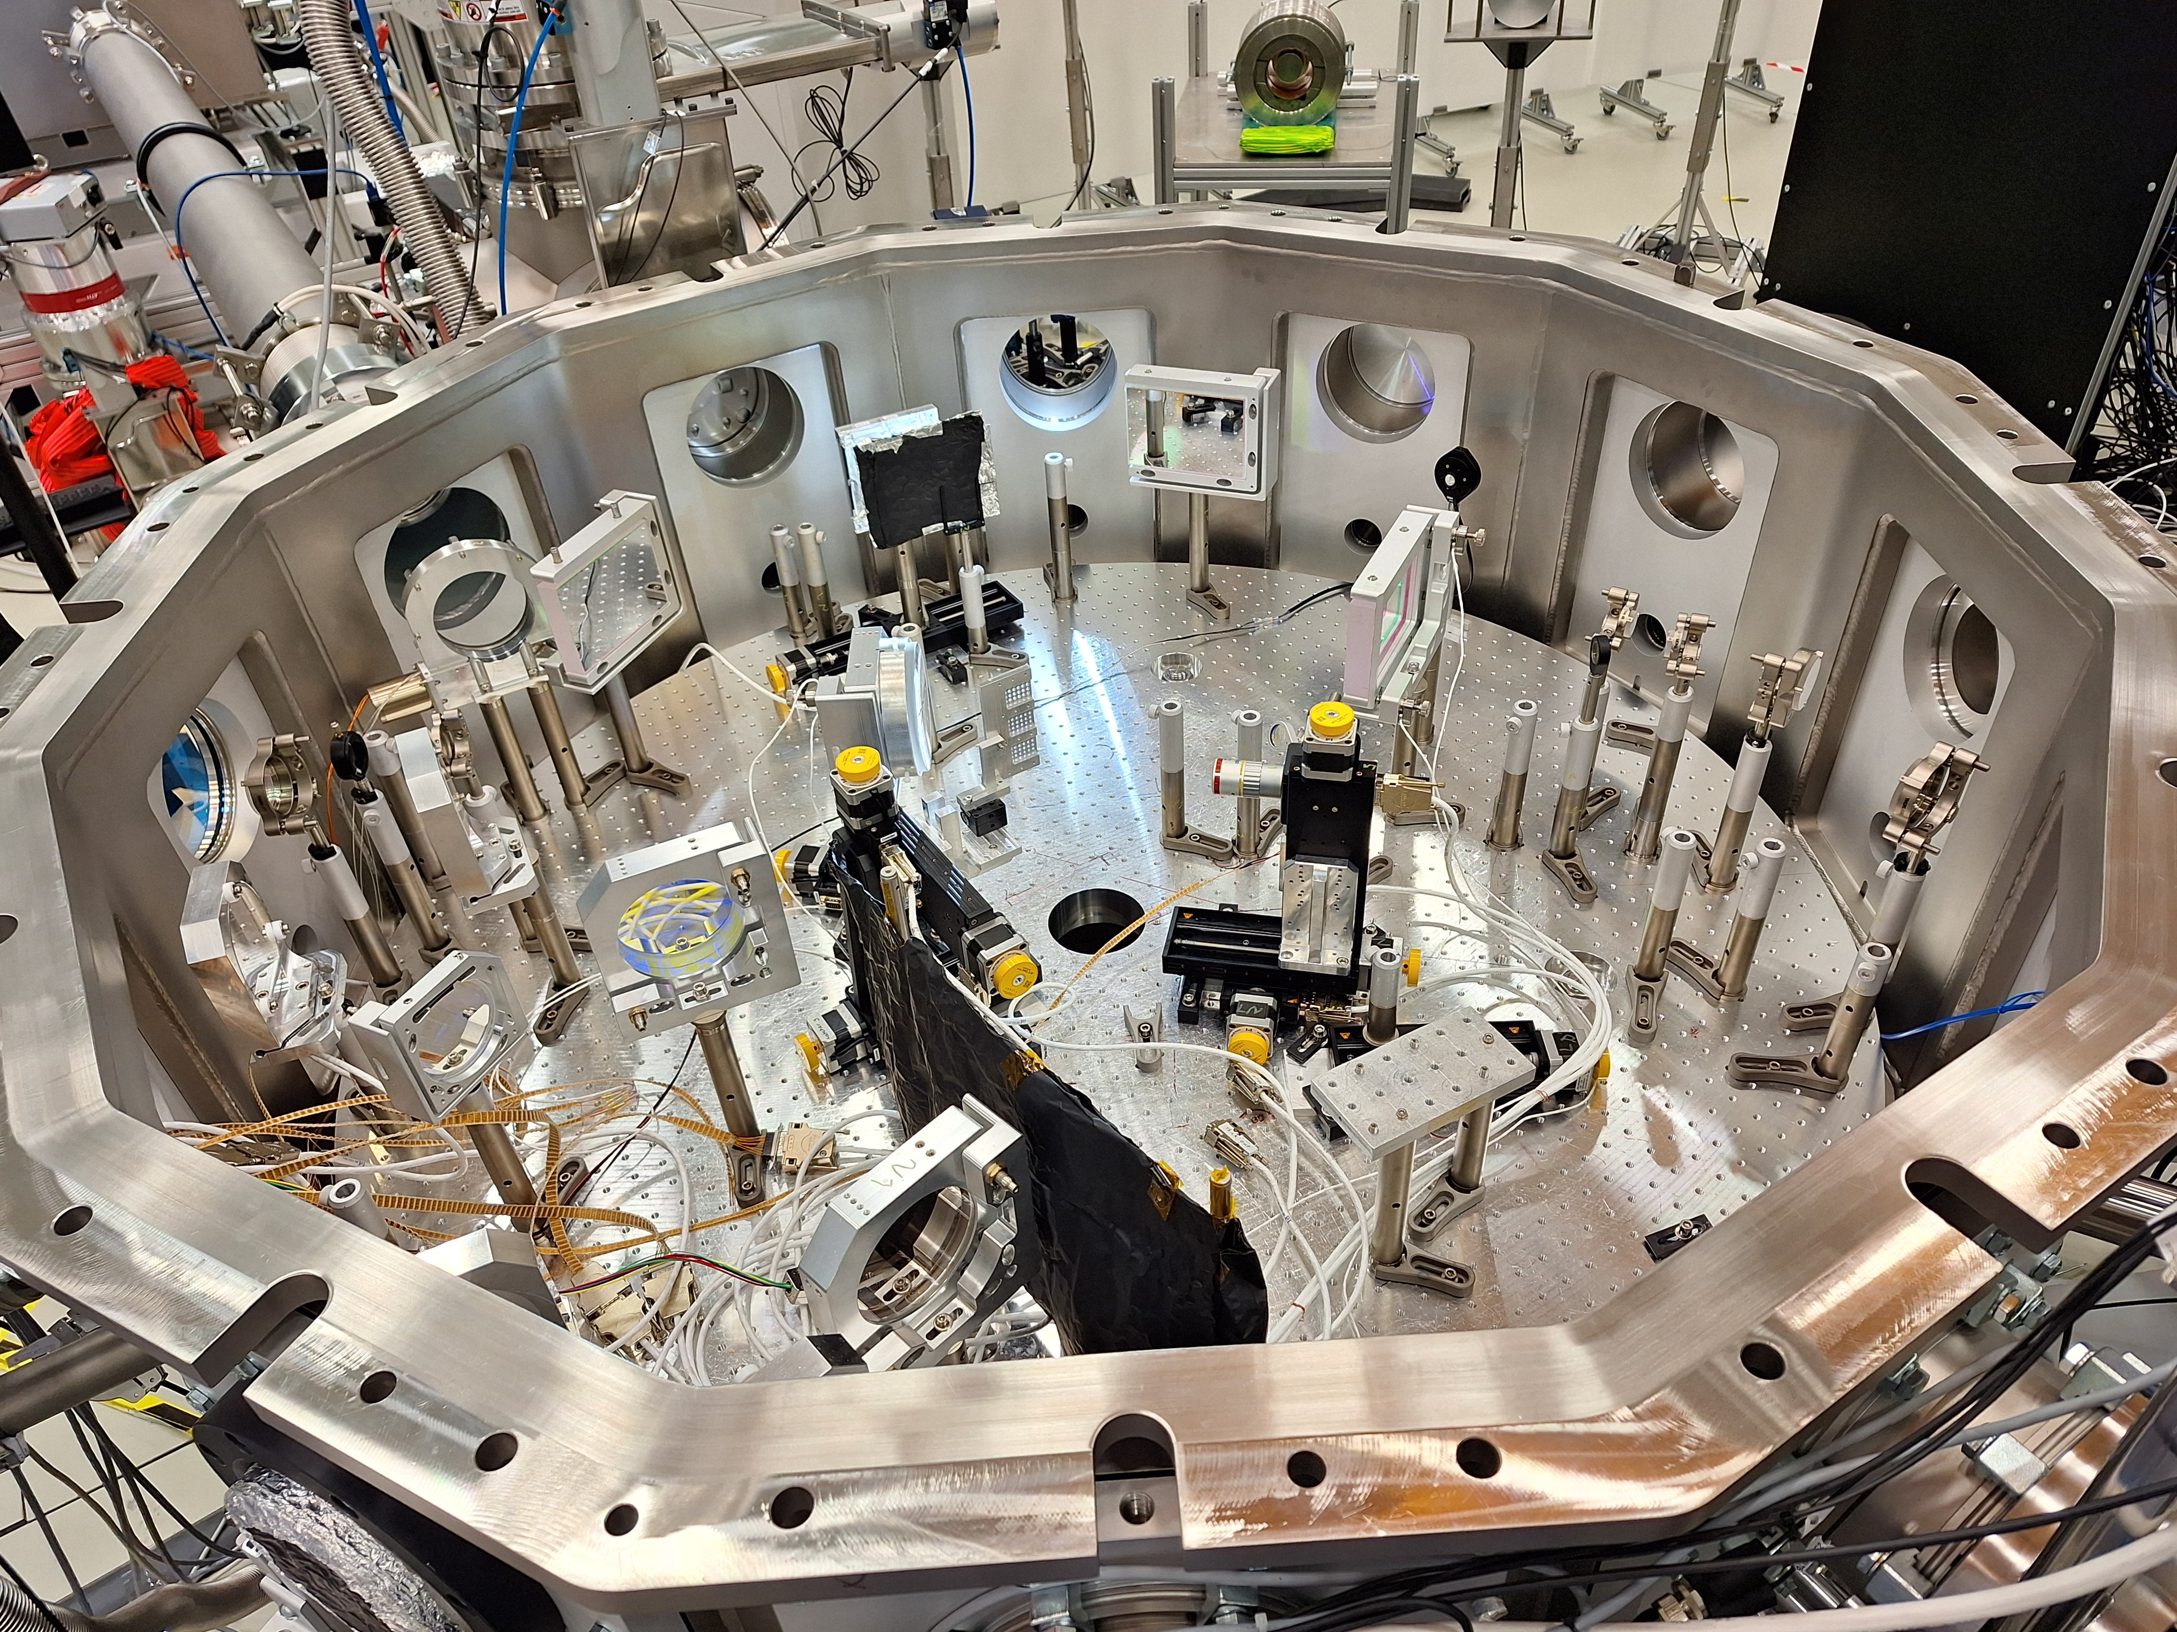

Slide 16
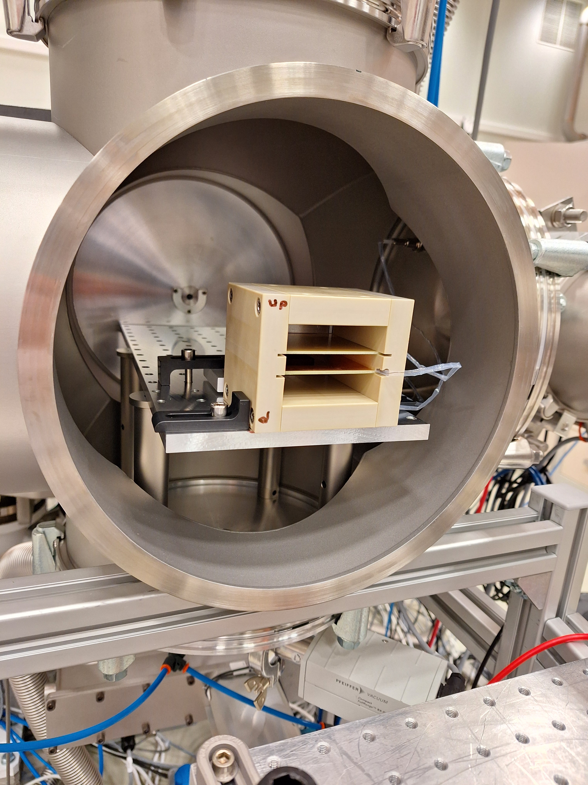
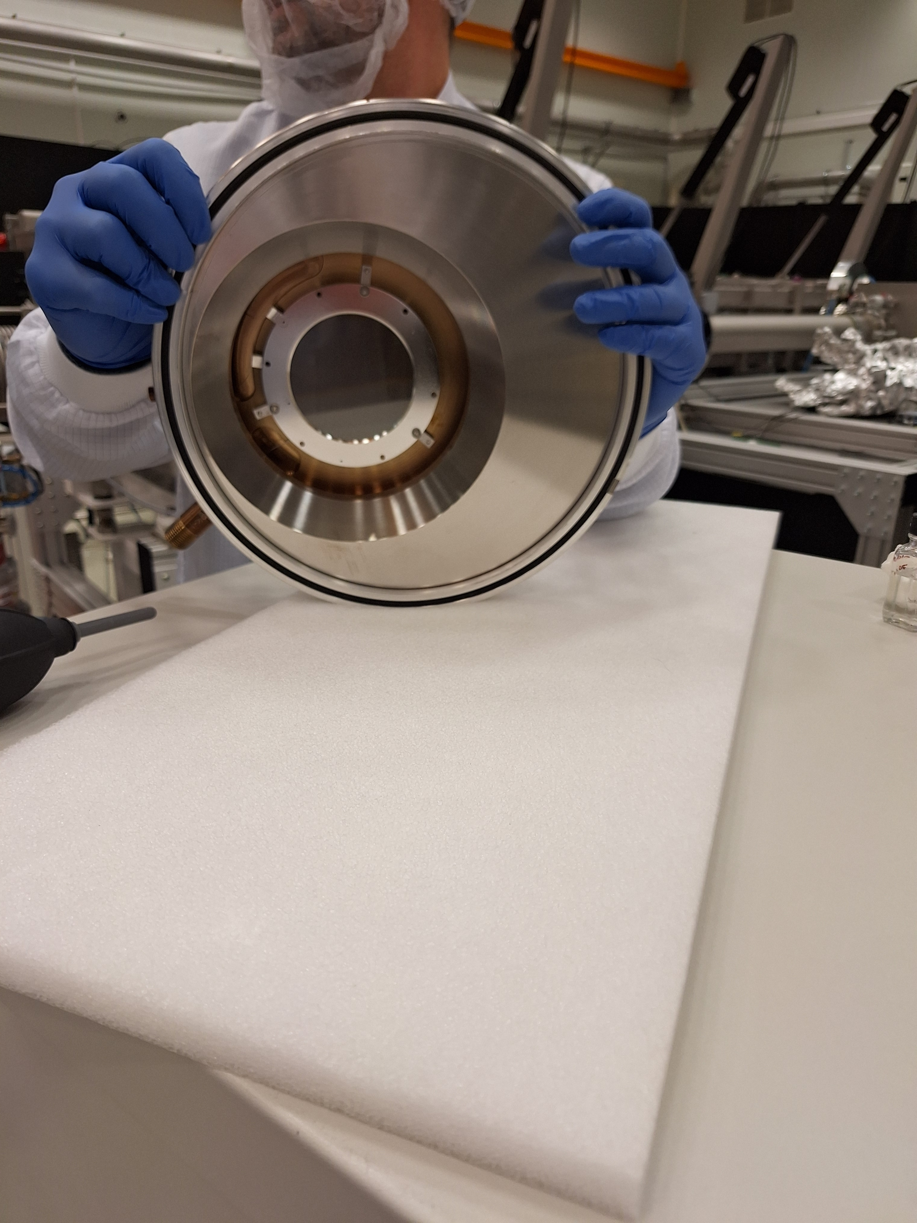
Thomson Parabola Spectrometer MCP

Slide 17
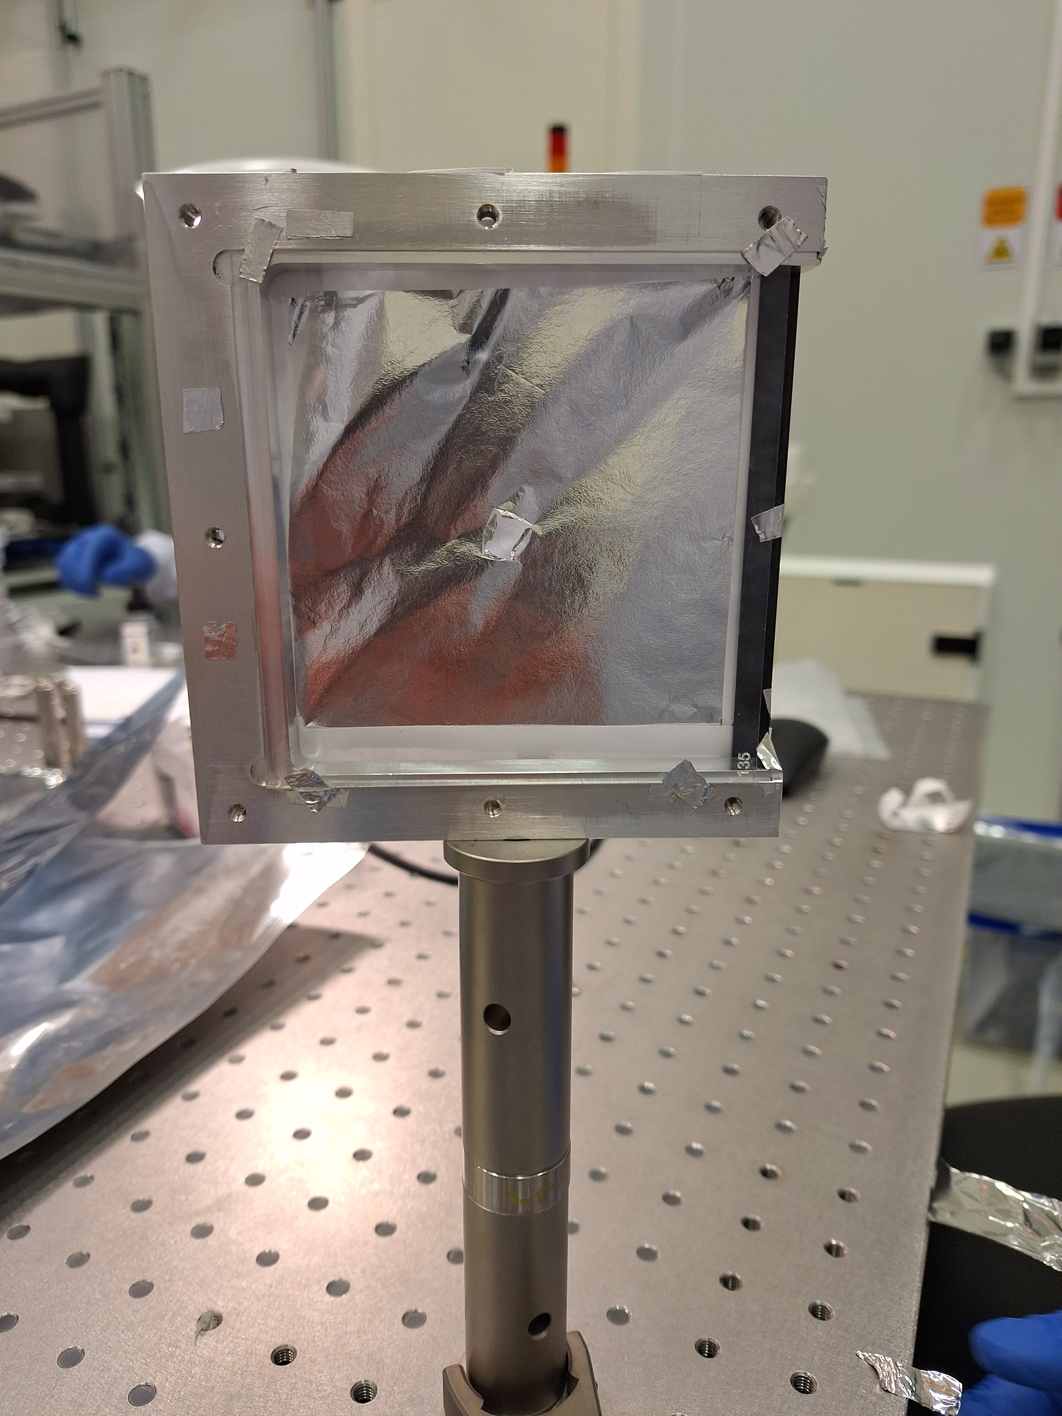
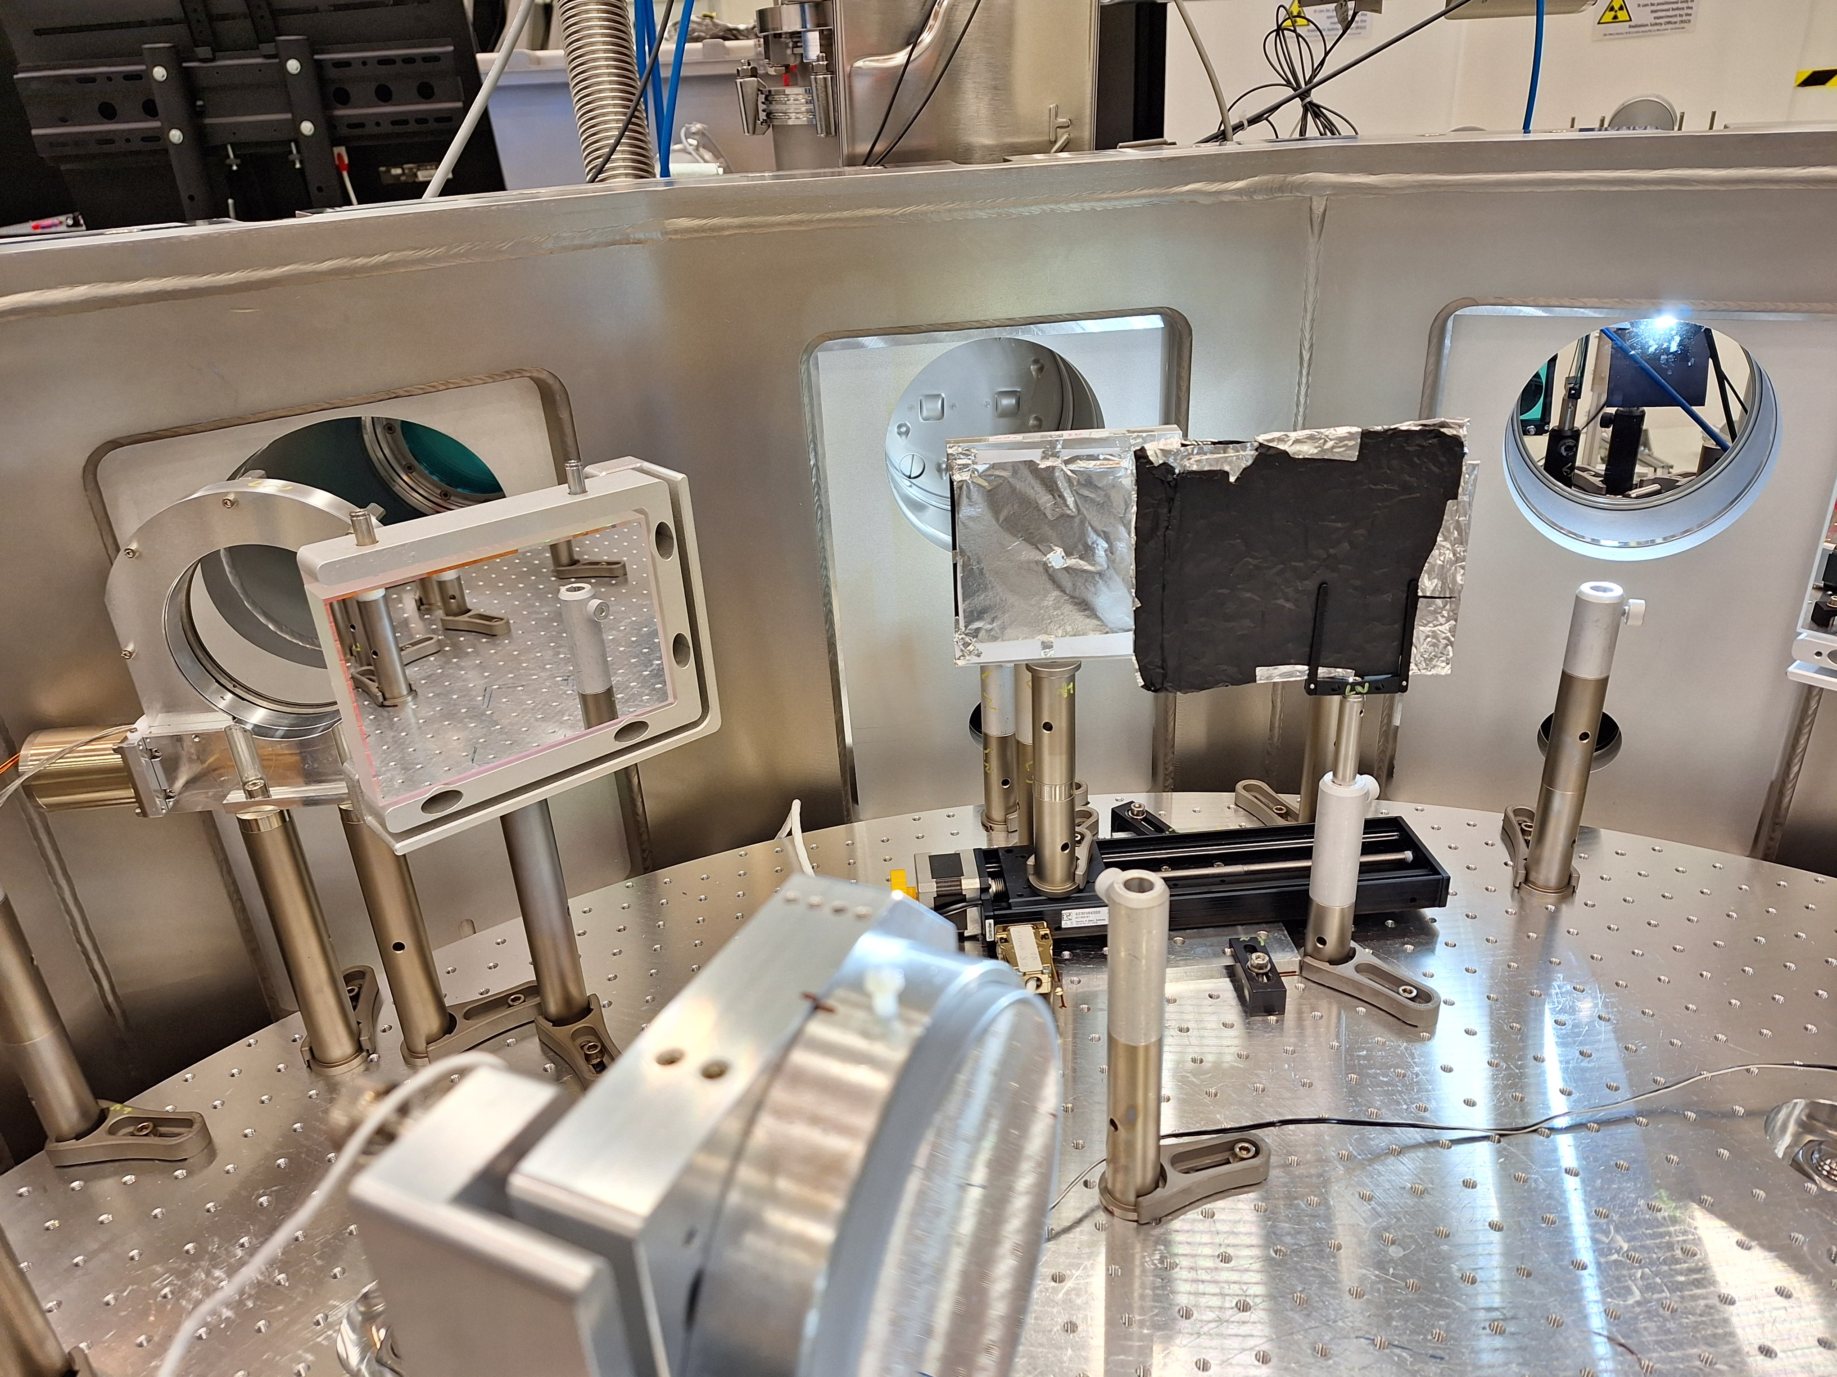
Exposure of CR-39 trace detector plates

Slide 18
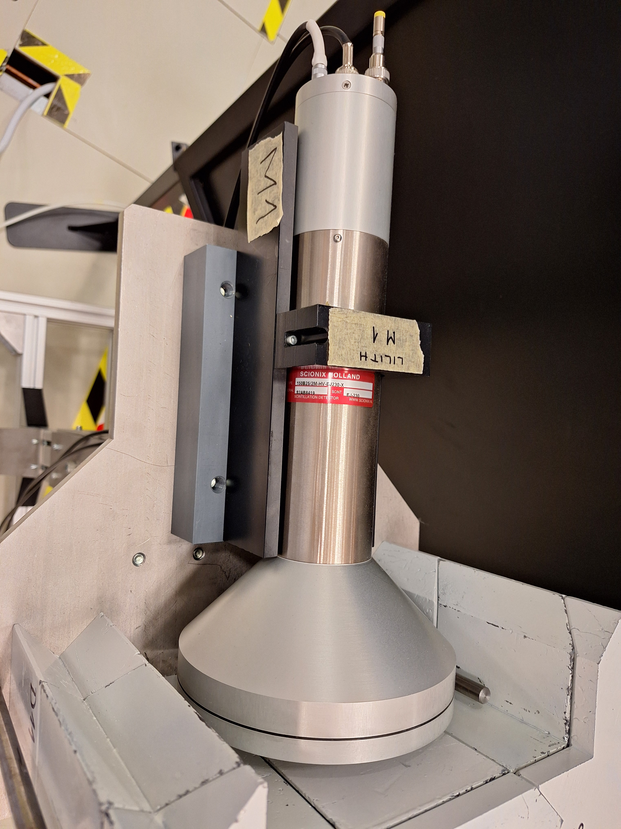
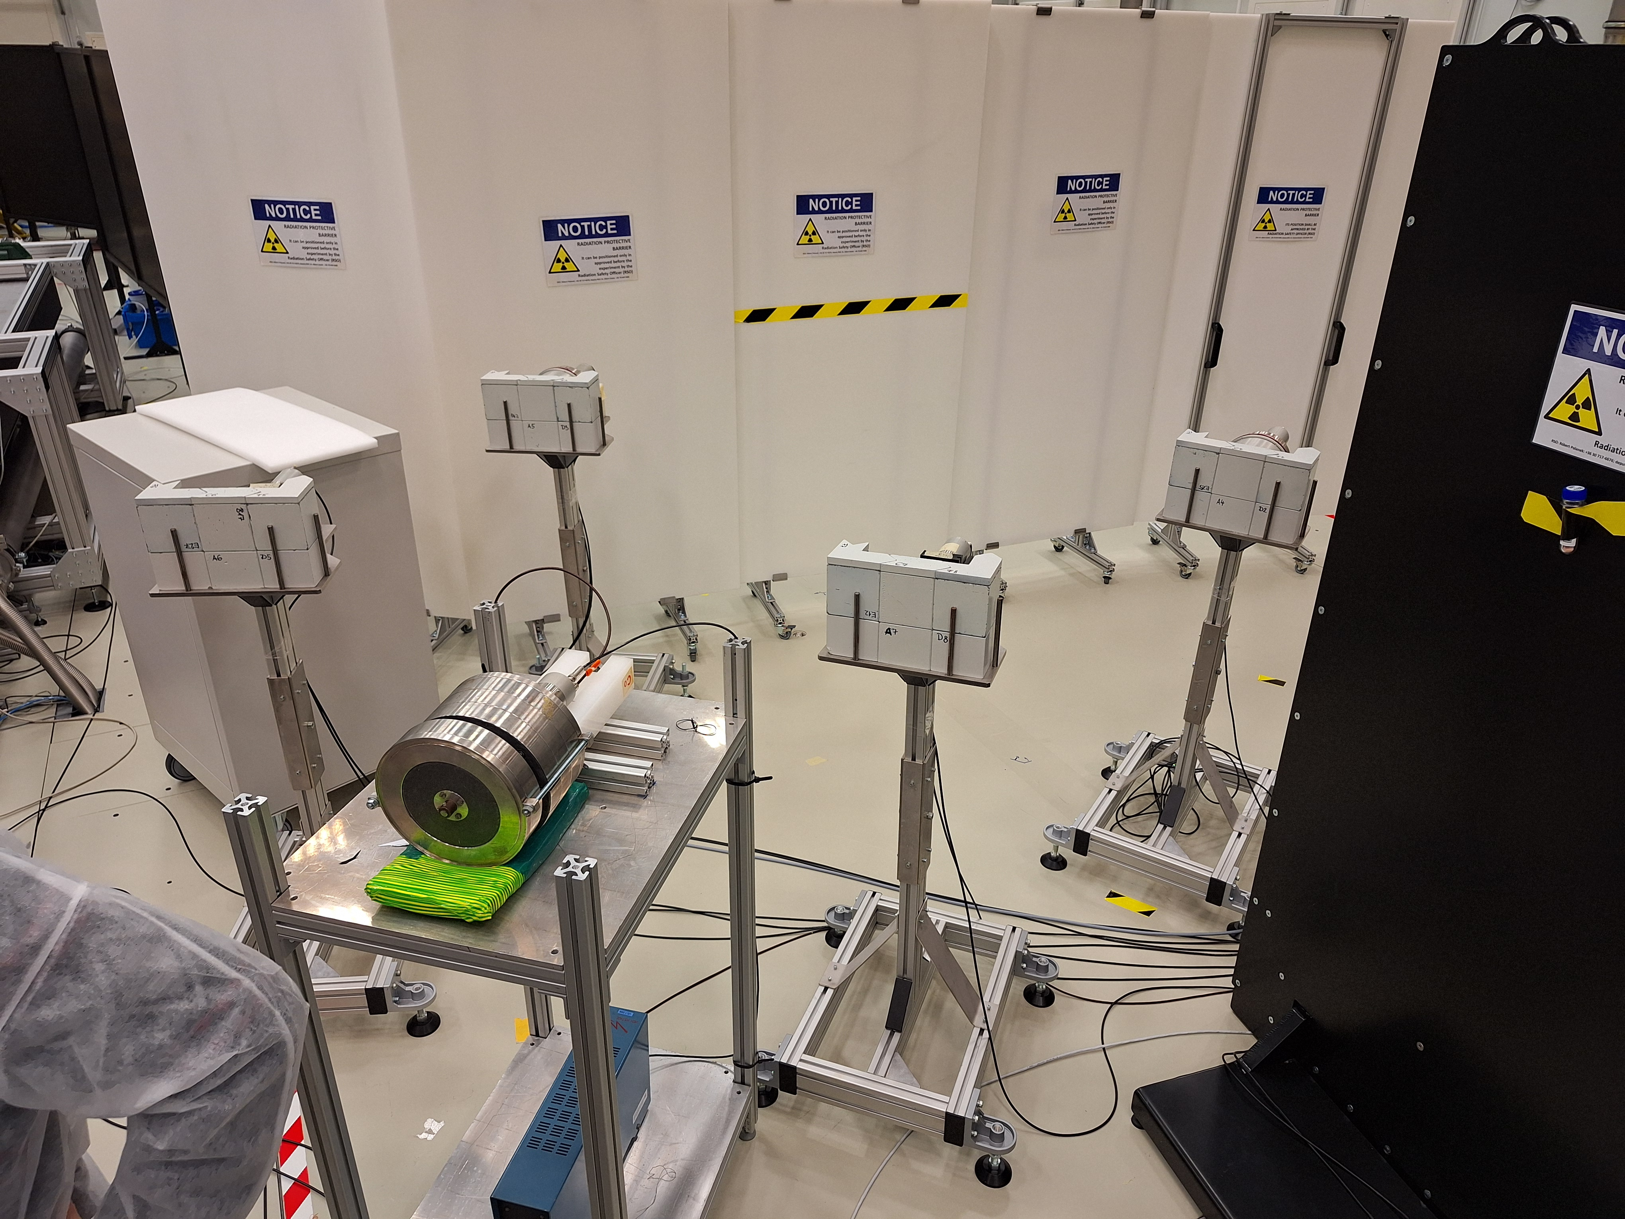
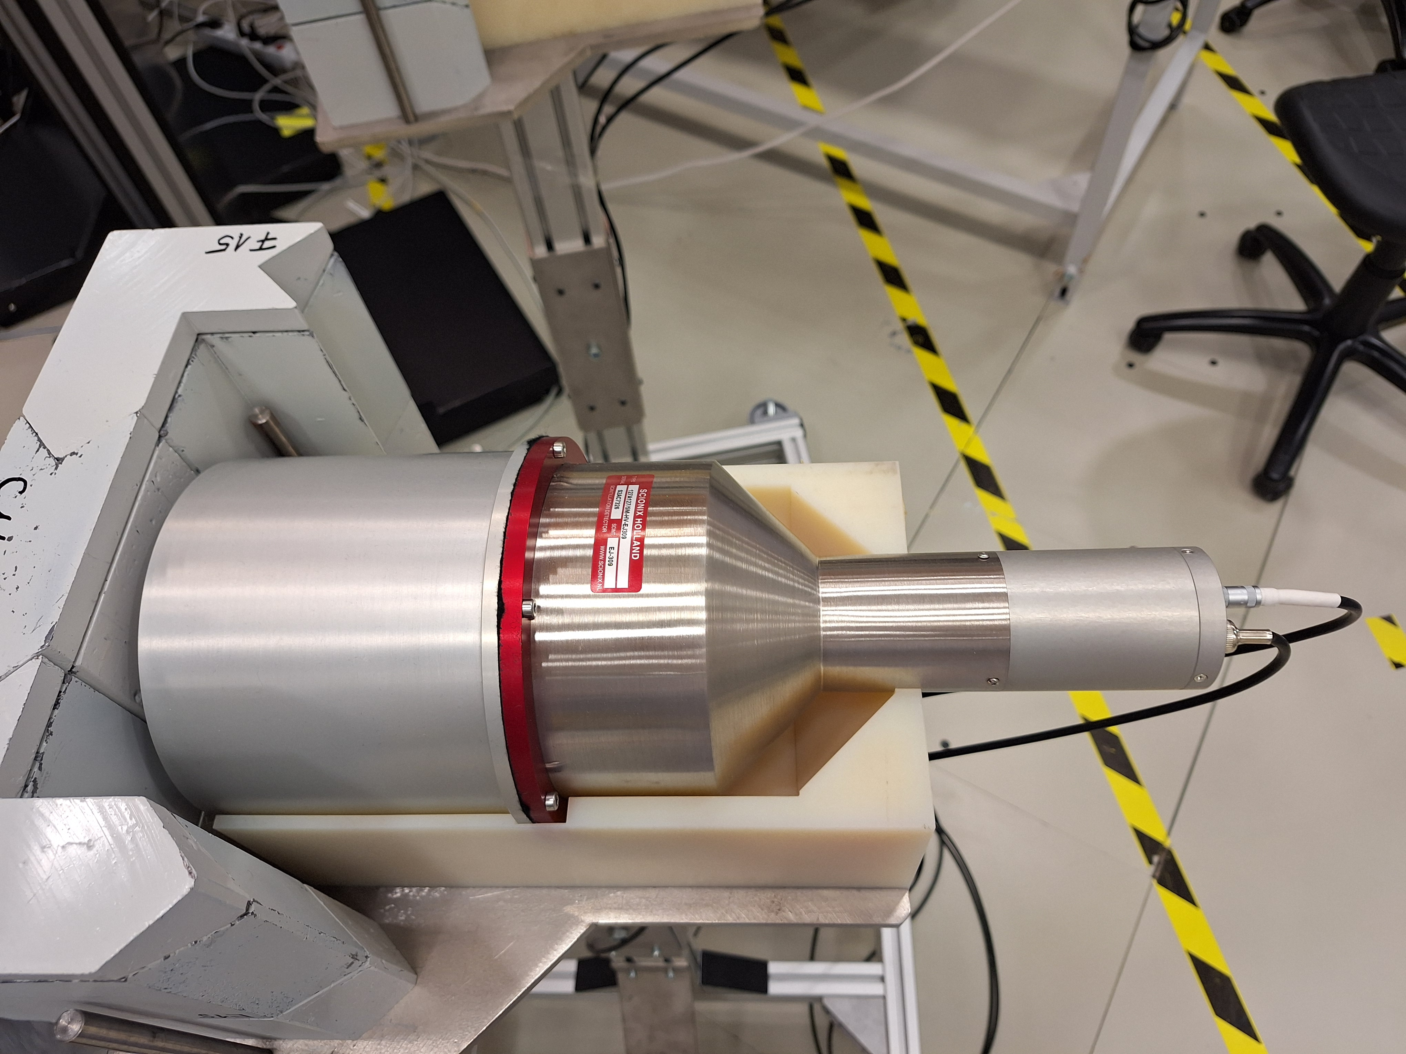
Scintillation detectors

Slide 19
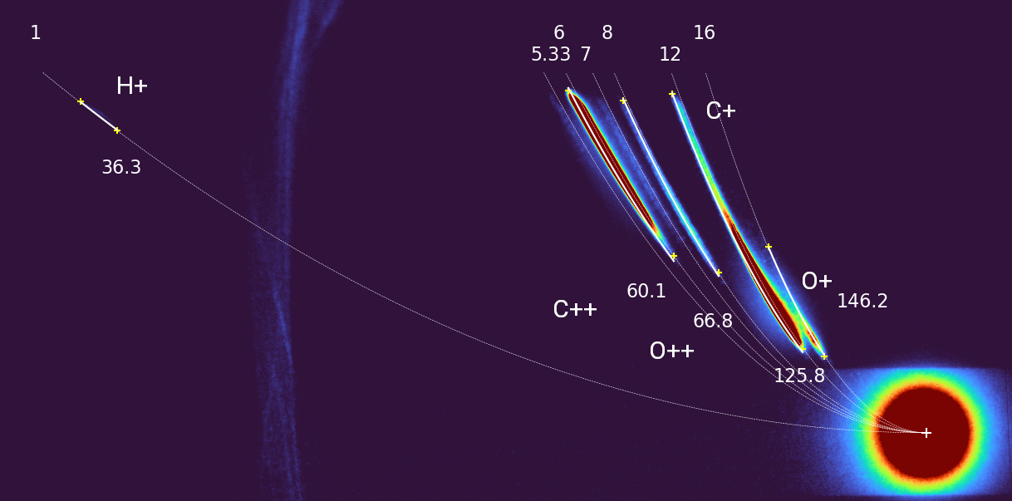
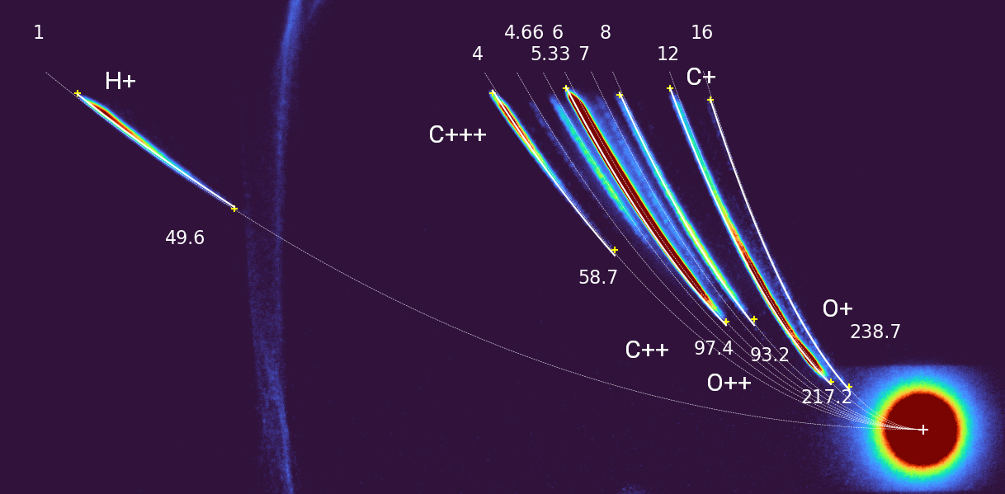
Results
Thomson parabola spectra
UDMA without gold with gold

Slide 20
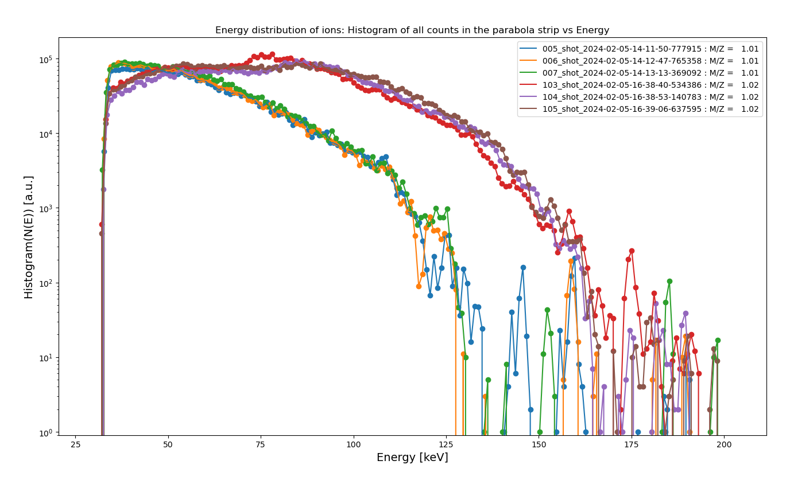
Energy distributions

Slide 21
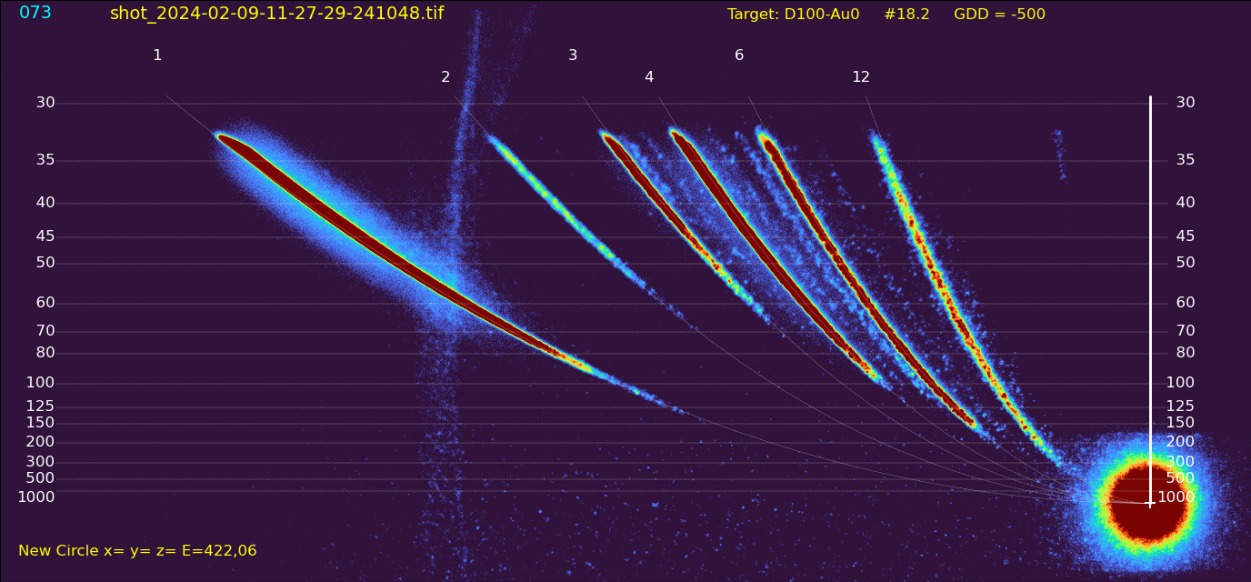
D+ ions obtained from deuterated samples

Slide 22
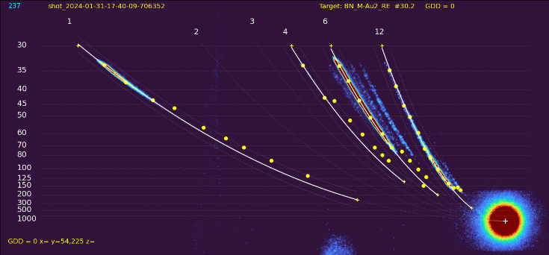
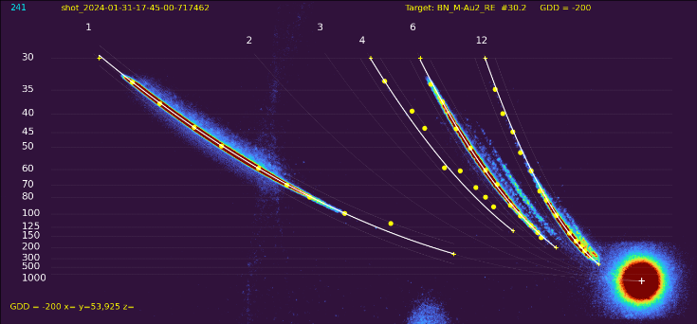
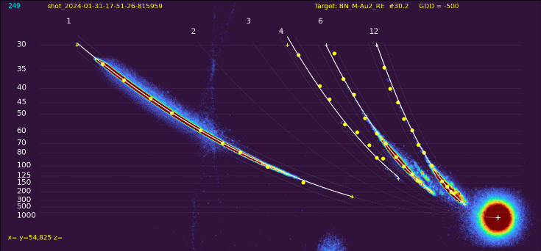
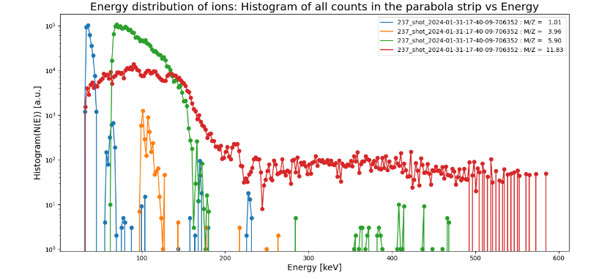
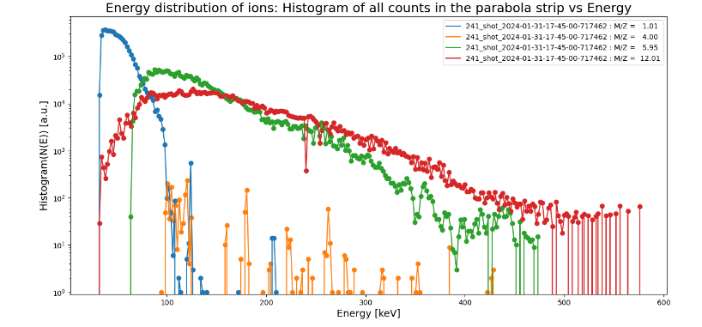
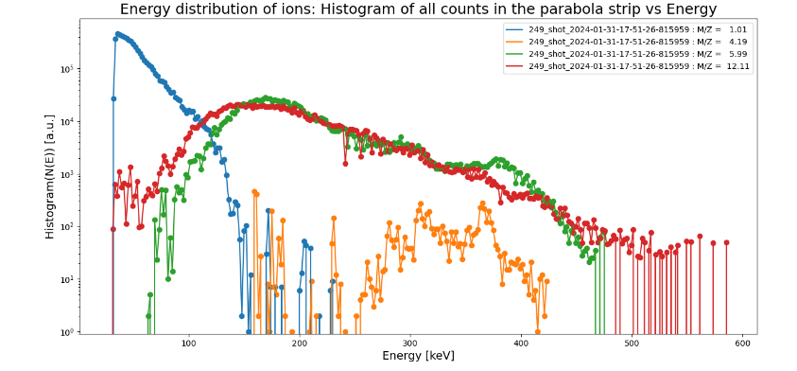
TPS signals at different pulse durations
12 fs 50 fs 120 fs

Slide 23
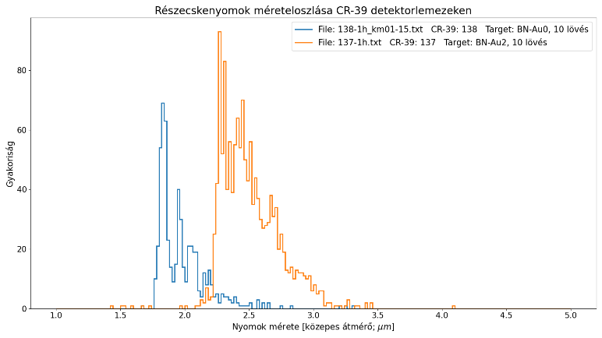
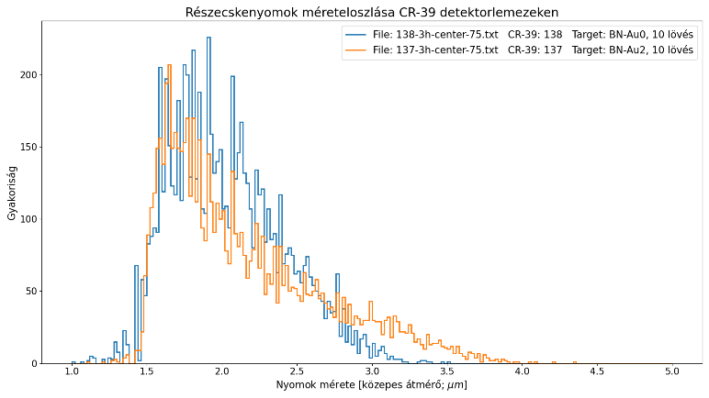
Some CR-39 trace detector results
Trace size distribution in the unshielded area
Target was UDMA-BN
No gold
1 h etching
3 h etching
With gold

Slide 24
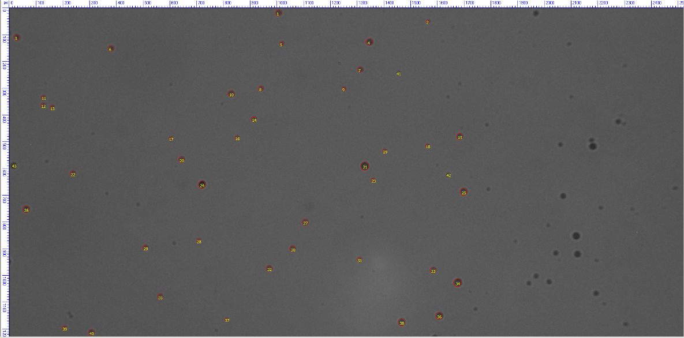
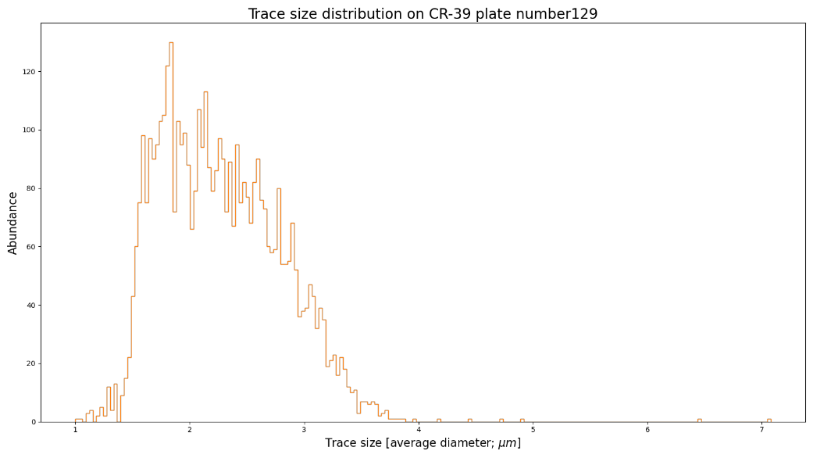
Traces in the shielded region, target: UDMA-D100 deuterated polymer
Exposed to 65 shots, including 12 fs and 120 fs pulses
CR-39 plates evaluation with the help of Julianna Szabó from EK (Energy Research Centre).

Slide 25
Conclusions
Laser contrast is important, working on improving it in the WRCP laser lab
TPS data analysis is ongoing, results are preliminary
Promising TPS results can be seen with higher energy ions detected with gold nanorods
Also promising CR-39 particle traces seen, but calibration is needed for all kinds of particles and energy ranges
Nuclear detector data still under evaluation, but photon signals were definitely larger for targets with gold nanorods
Sample surface positioning is critical
Future plans for experiments at ELI-ALPS
Find methods to manufacture targets with very good flatness
Find methods to position the sample surface exactly in the focus
Make sure the orientation is also correct and reproducible
Use thin targets (<~ 1 μm)
In the case of thick targets, leave it on the substrate

