Slide 1

Particle acceleration and fusion reactions driven by ultrafast laser pulses
Márk Aladi
Wigner Research Centre for Physics
NAPLIFe
Nanoplasmonic Laser Fusion

Slide 2
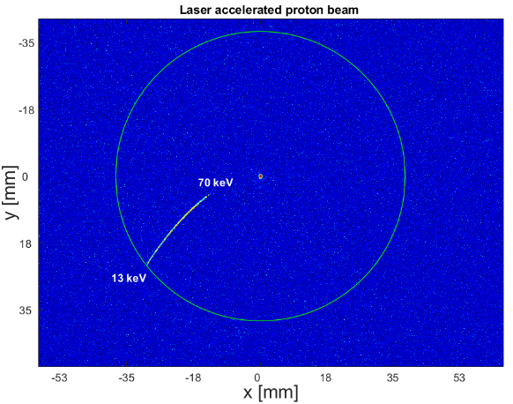
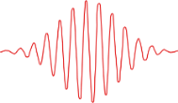
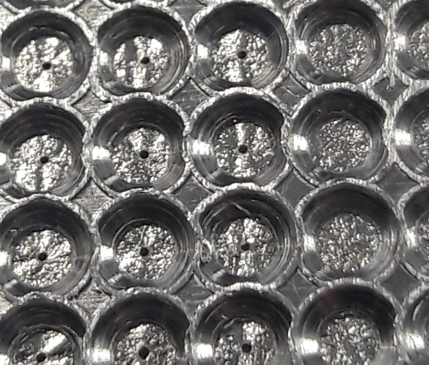
Outline: an experiment with high intensity laser pulses..
Detector 1
Target
Detector 2
Laser pulse
.
.
.
Detector n
particle acceleration
fusion reaction

Slide 3
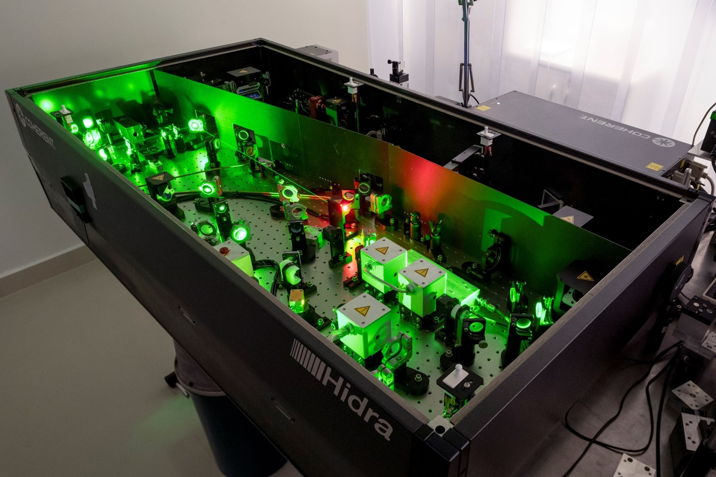

High intensity laser source in the Wigner RCP
Titanium-sapphire laser system
λ_{L} = 800 nm (central wavelength)
$τ_{p}$ = 40 fs (pulse duration, femto: ${10}^{−15}$)
$E_{p}$ = 30 mJ (pulse energy)
Ι_{L} $≈$10¹⁷ W/cm² (laser intensity)

Slide 4
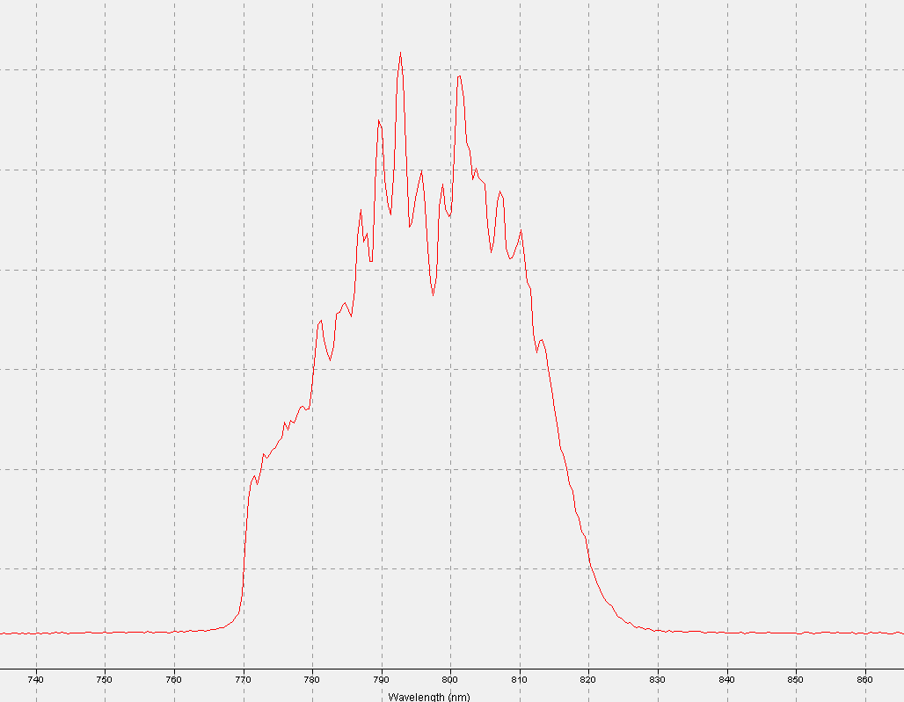
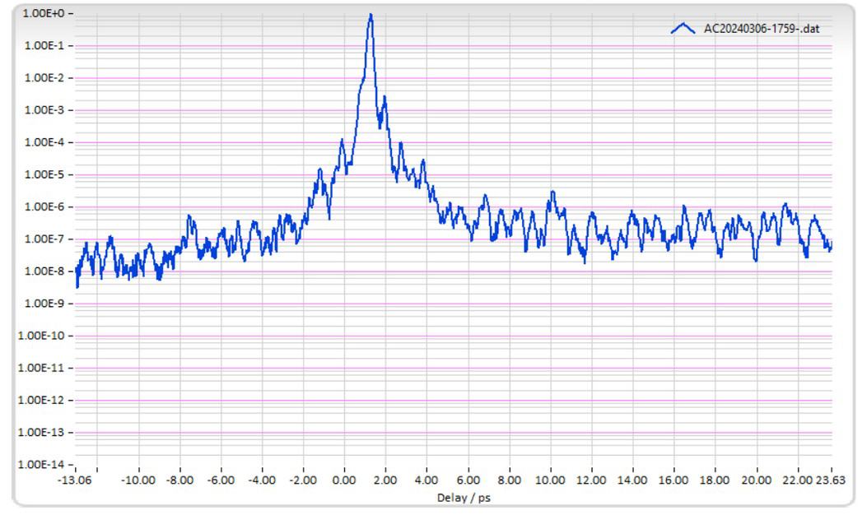
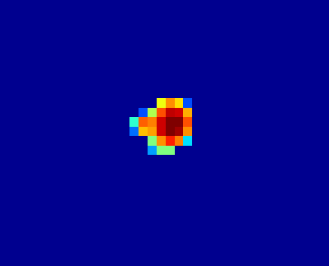
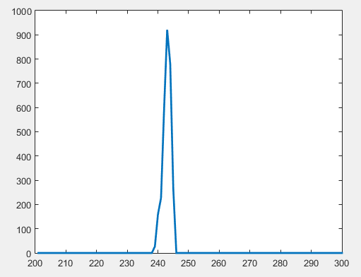

A laser pulse
Many parameters for the characterization of a laser pulse:
Repetition rate
Pulse duration
Pulse energy
Chirp
Polarization
Contrast ns
Spectrum and central wavelength
32 nm
Focused beam diameter
Beam size and tranverse distribution
$I_{L}≈$10¹⁷ W/cm²
Contrast ps

Slide 5
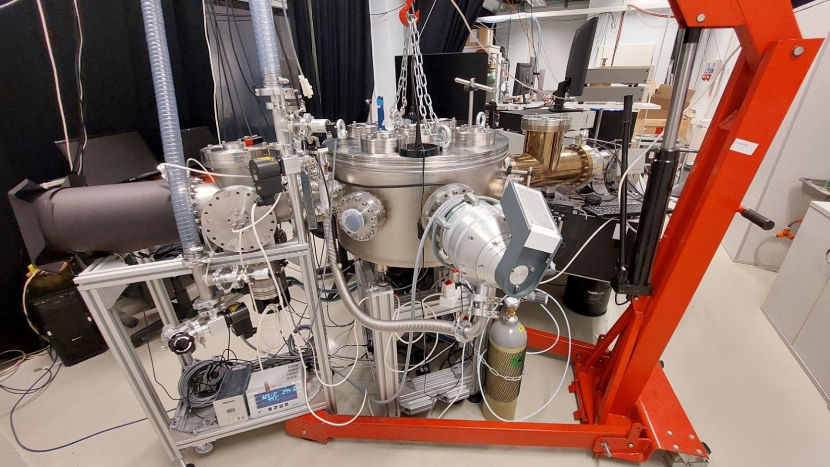
Experimental setup for acceleration and fusion in the Wigner RCP
Thomson parabola spectrometer
Target chamber

Slide 6
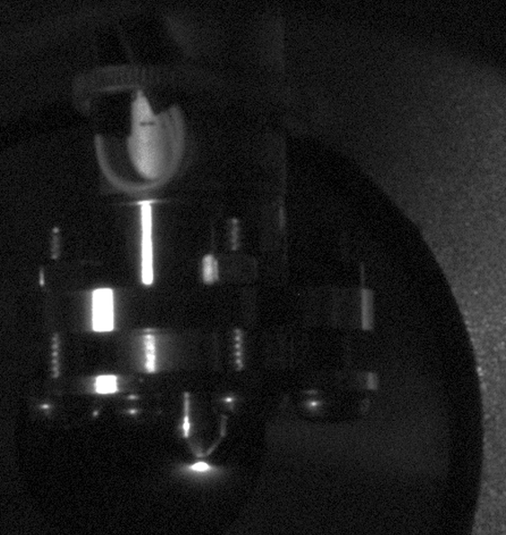
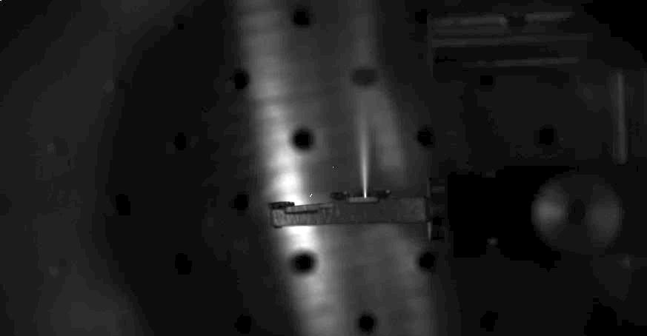
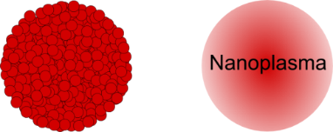
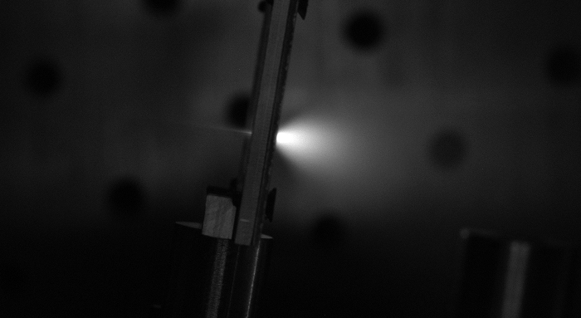
Target
Gas/fluid target
Solid target
If the gas is D₂:
ns pulse of neutrons with the yield of 10⁴ neutron/200 mJ laser energy
Laser pulse
Particle jet in the backward direction
THICK foil target
Laser pulse
Gas cluster target
Coulomb explosion, isotropic ion emission
Particle jet in the backward and forward direction, too
Laser pulse
THIN foil target
Notes:
laser heated D₂ cluster jet: exploding clusters

Slide 7
Particle acceleration: some of the possible acceleration mechanisms
Andrea Macchi et al. Rev. Mod. Phys., Vol. 85, No. 2, 2013.

Slide 8
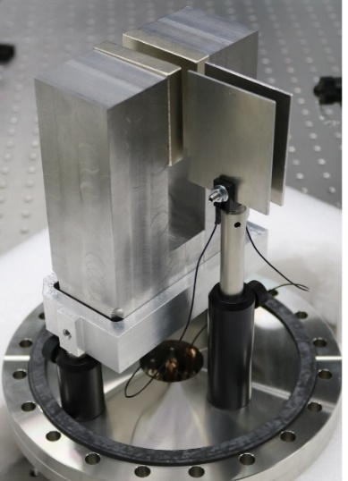
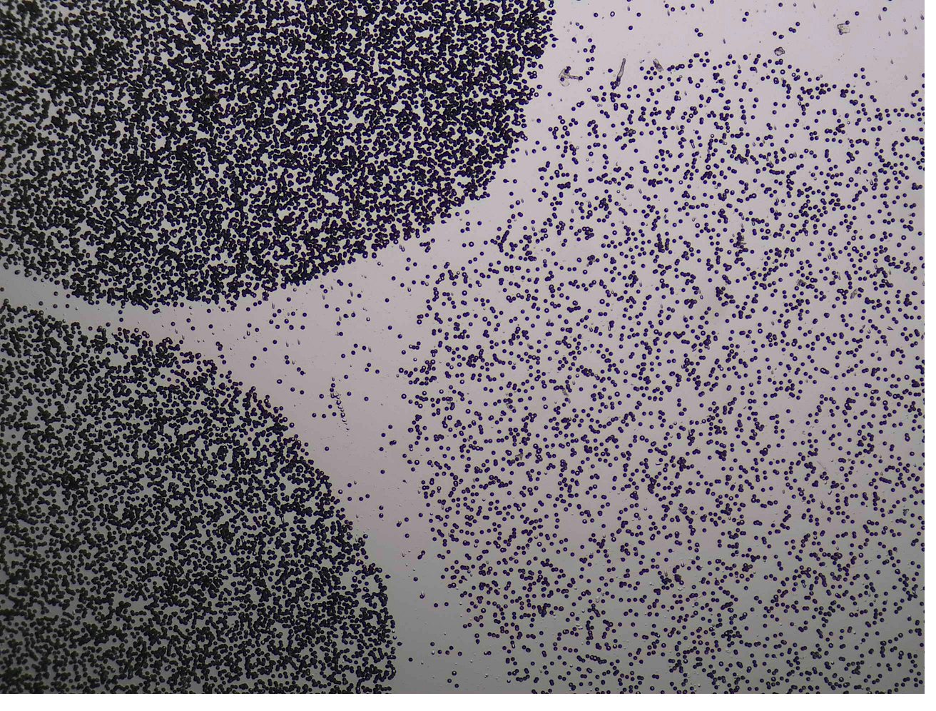
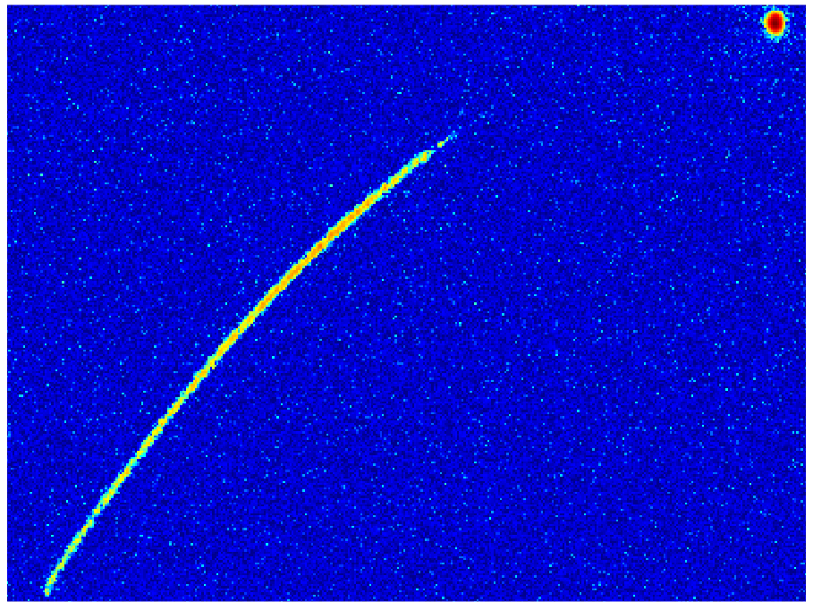
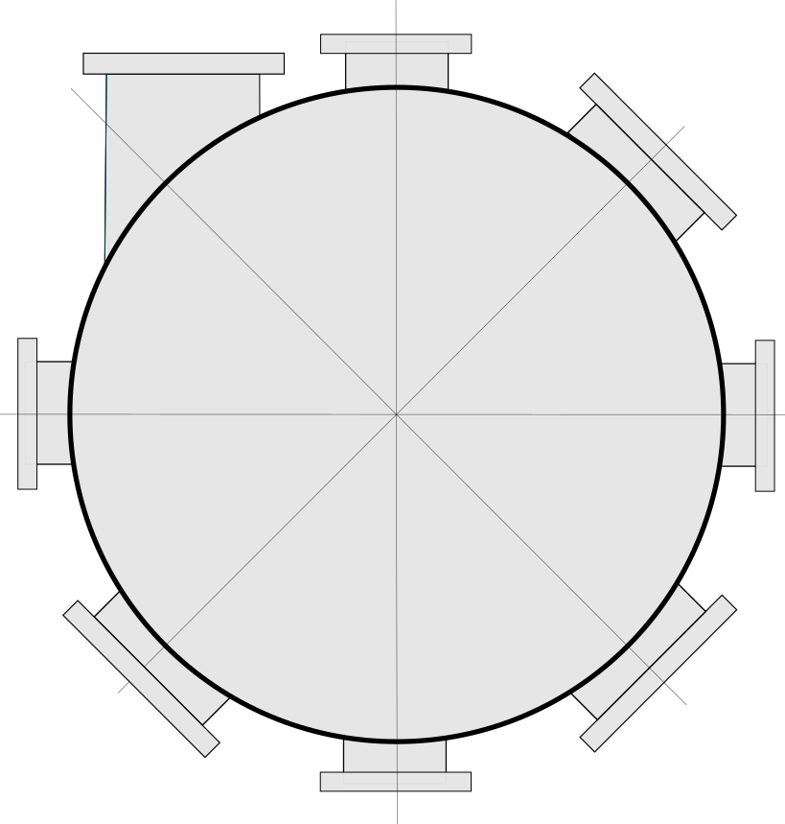
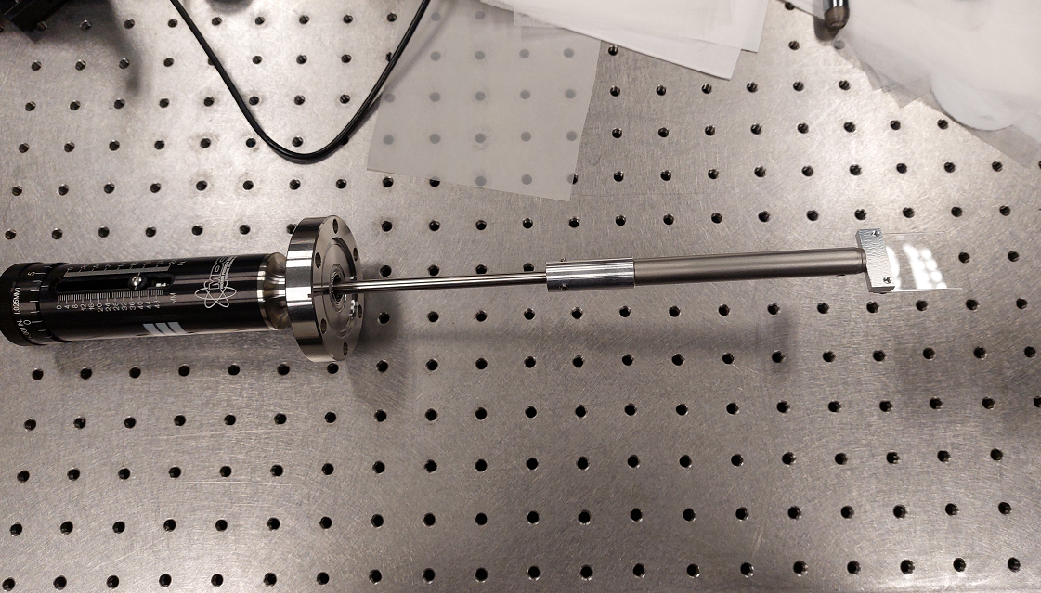
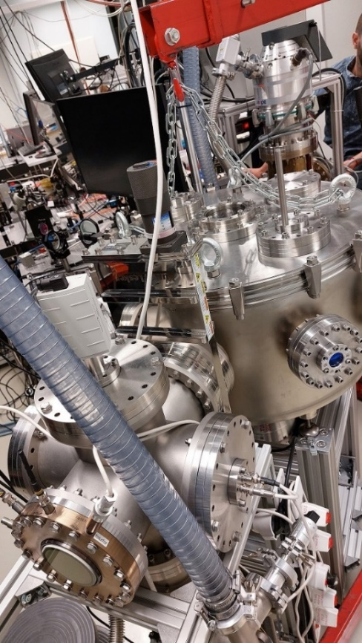
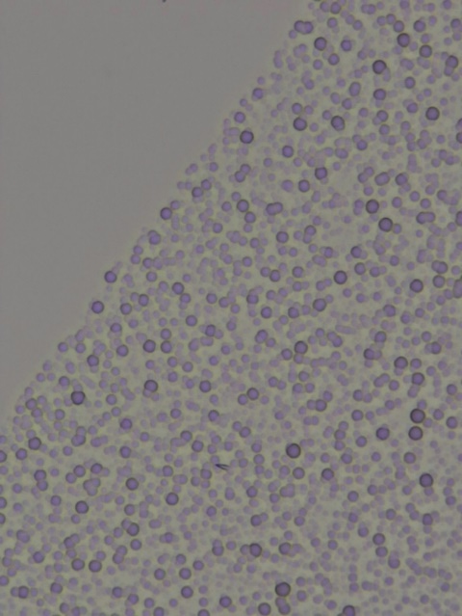
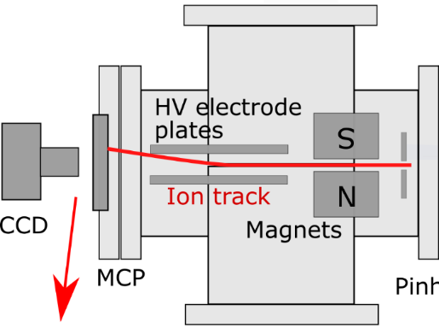
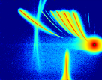
Detectors: Thomson parabola spectrometer and CR-39 track detector
Energy: 5,4 MeV
Electric plates
Laser beam
CR-39
plate
Magnets
Parabolic mirror
Tracks of α particles from ²¹⁰Po isotope for calibration
CR-39
target
CR-39 plate
CR-39
CR-39
Better way
XYZ stage
CR-39
From laser-target
interaction
CR-39
Shield
Mix of C, H, O, N ions
2 µm Al foil blocks the low energy plasma ions

Slide 9
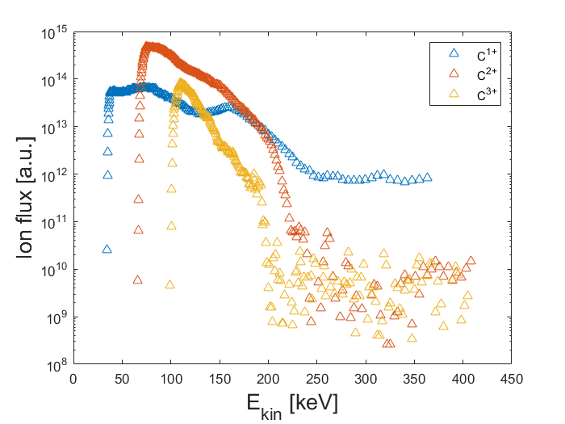
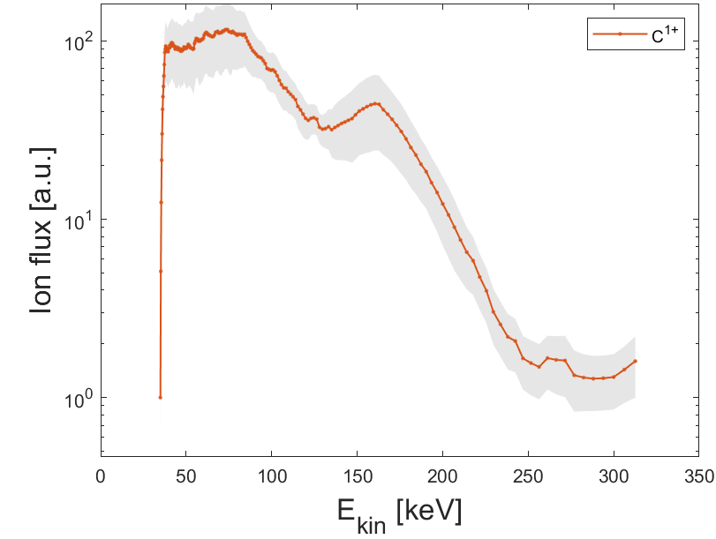
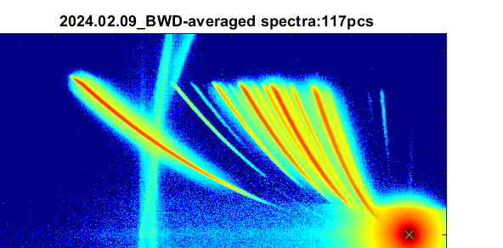
Experiment at ELI-ALPS with the setup of National Laser-Initiated Transmutation Laboratory
Cutoff energy
Polymer film with resonant gold nanorods
C⁴⁺
C¹⁺
C⁵⁺
C³⁺
C²⁺
N¹⁺
N³⁺
N²⁺
N⁴⁺
N⁵⁺
Deuteron
O¹⁺
Proton
O²⁺
O³⁺
C⁶⁺ : 490 eV
O⁷⁺ : 740 eV
O⁴⁺
Deuterated polymer target
O⁶⁺
O⁵⁺
C⁶⁺

Slide 10
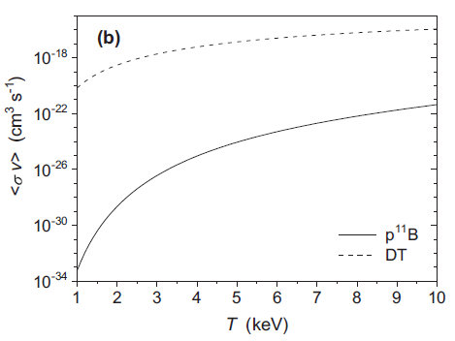


Fusion fuels as laser targets: DD and pB reaction
X. Ribeyre et al. Scientific Reports 12:4665 (2022).
Deuterium (not very rare: 0.0184–0.0026 %)
Tritium (radioactive and very rare!)
³Helium (rare, 0.0002 %)
⁶Lithium and ⁷Lithium (7.5/92.5 %)
¹¹Boron (80 %)
LORENZO GIUFFRIDA et al. PHYSICAL REVIEW E 101, 013204 (2020).
1.2 barn
0.1 barn
Low-temperature reactivity for pB and DT fusion.
Two experimental geometries:
D. Margarone et al. Appl. Sci. 2022, 12, 1444.
D. Margarone et al. Front. Phys. 8:343 (2020).
Progress in pB fusion:
Notes:
Fusion cross-sections of Deuterium–Tritium (DT), Deuterium–Deuterium (DD) and proton–Boron (pB) as a function of the center of mass kinetic energy. A main resonance peak occurring at 675 keV proton energy, with a maximum cross section of 1.2 barn. A second resonance at 160 keV has a maximum cross section of about 100 mbarn. An important quantity is reactivity rv, defined as the probability of reaction per unit time per unit density of target nuclei.
In a simplified view, on average one α particle is emitted with 4 MeV.
an energy of 1 MeV and the other two with the energy of 4 MeV
non-thermal reaction driven by laser pulses

Slide 11
Time-of-flight detector: alpha particle spectra in pB fusion
2.5-5.5 MeV
6-10 MeV
Section of the SiC detectors.
Ion TOF distribution for the Si-H-B target (orange curve) with the alpha-particle signal (α1 and α2) and plasma ions measured by the SiC detector covered by a 8-μm aluminum foil.
A. Picciotto et al. PHYSICAL REVIEW X 4, 031030 (2014).
Our TOF detector system is under construction.
Giuseppe Bertuccioa et al. Applied Surface Science 272 (2013) 128– 131
Notes:
Hydrogen-enriched and B-doped silicon target (Si-H-B).
The mean electric field of 35 kV/cm in the
depleted region allows a fast collection of the electron–hole pairs
generated by the radiation, so achieving fast detector response. Photo of the chip with three detectors
This channel generates alpha particles with an energy distribution ranging from 2.5 to 5.5 MeV and a maximum at around 4.3 MeV (α1).
A secondary channel generating alpha particles in the energy range 6–10 MeV can also be present (α2)

Slide 12
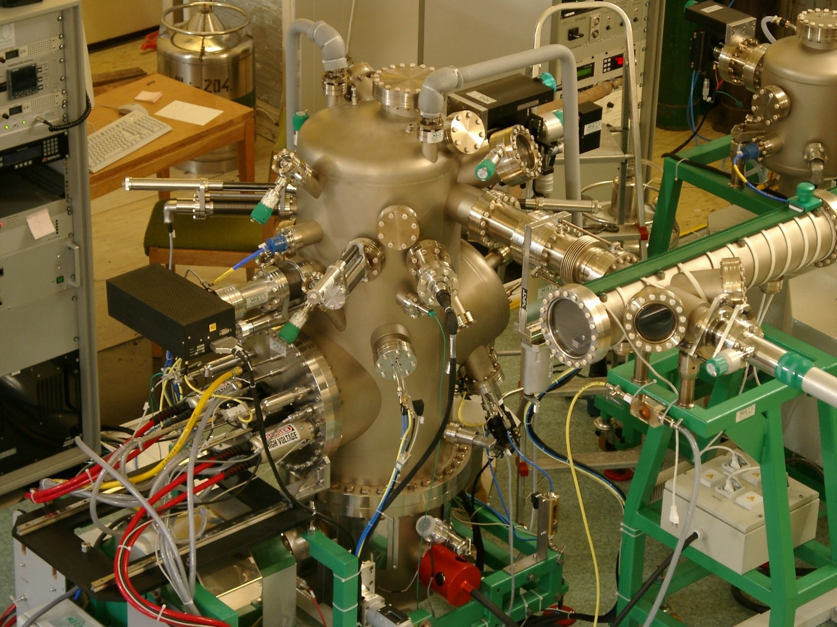
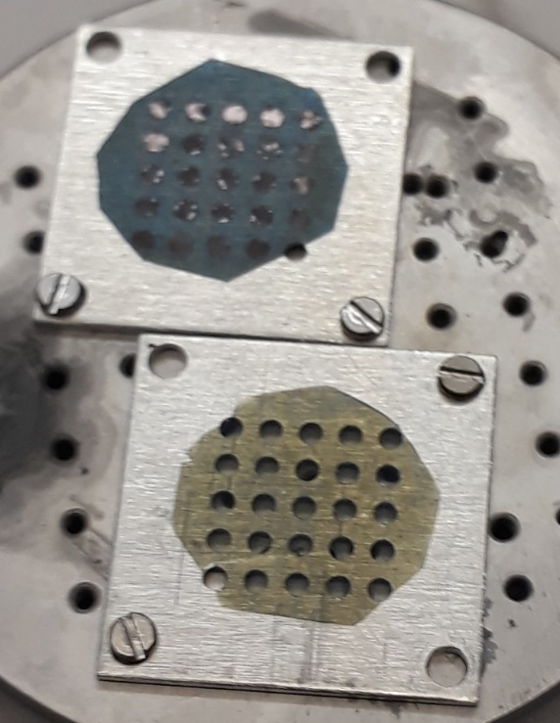
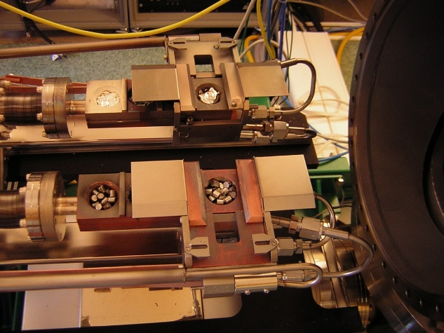
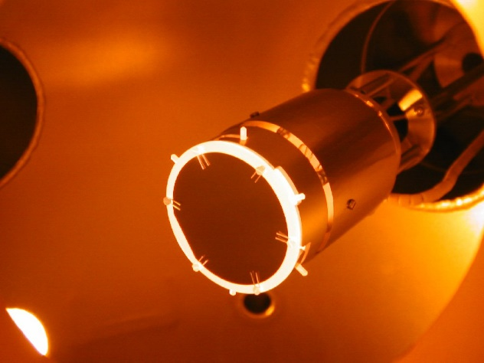
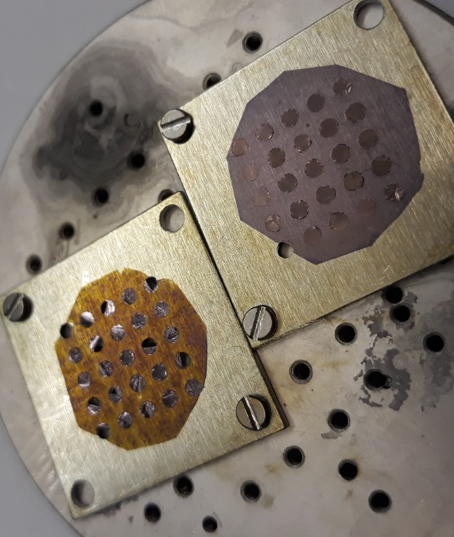

Metallic MBE (molecular beam epitaxy)
Carbon nanotube foil ($\sim$100 nm)
By Gergely Németh
By Gergő Hegedűs, Dániel Merkel
Evaporation Materials
Substrate annealing molybdenum block
Goals:
boron layer evaporation to polymer foil
Boron-polymer multilayers
Few 100 nm thickness of 1 layer
B
CH
B
CH
B
+ 10 nm gold layer

Slide 13
Thank you!

