Slide 1
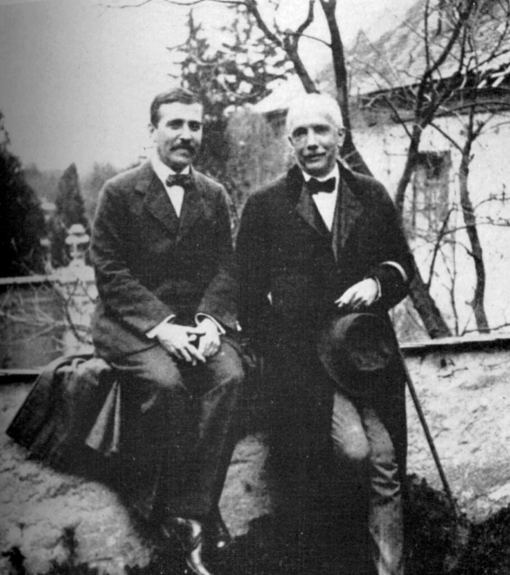
‘Time is a strange thing. When we live from day to day, time means nothing. But then, suddenly, all we feel is time: It's around us, it's inside us. Time shows in our faces, it shows in the mirror, and it throbs in my temples. And between you and me time flows again, soundlessly, like an hourglass.’
Hugo von Hofmannsthal, Der Rosenkavalier (1911)

Slide 2
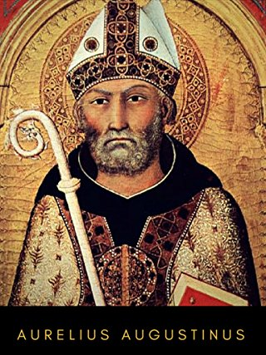
‘So what is time?
If nobody asks me about it, I know it;
but if I want to explain it to someone when they ask,
I don't know.
But this I can say with confidence: I know that there would be no past time if nothing passed,
no future time if nothing existed.
But what are these two times, the past and the future, since the past is no more and the future is not yet?’
Augustinus Aurelius (354 - 430)

Slide 3
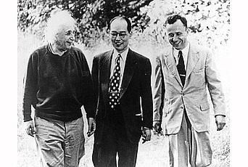
“Time is nature’s way of preventing everything from happening at once.”
John Archibald Wheeler

Slide 4
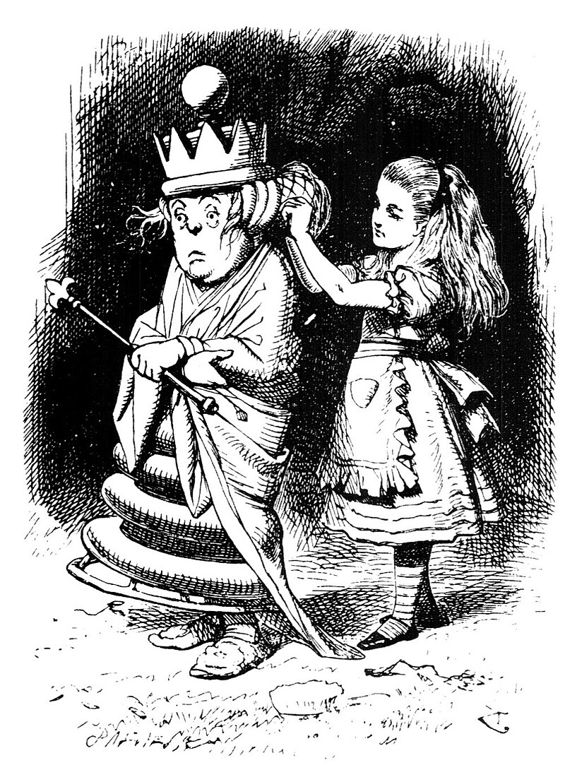
“It's a poor sort of memory that only works backwards.“
White Queen to Alice, Lewis Carroll: Through the looking glass

Slide 5

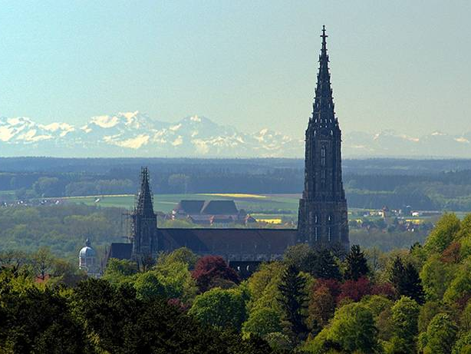
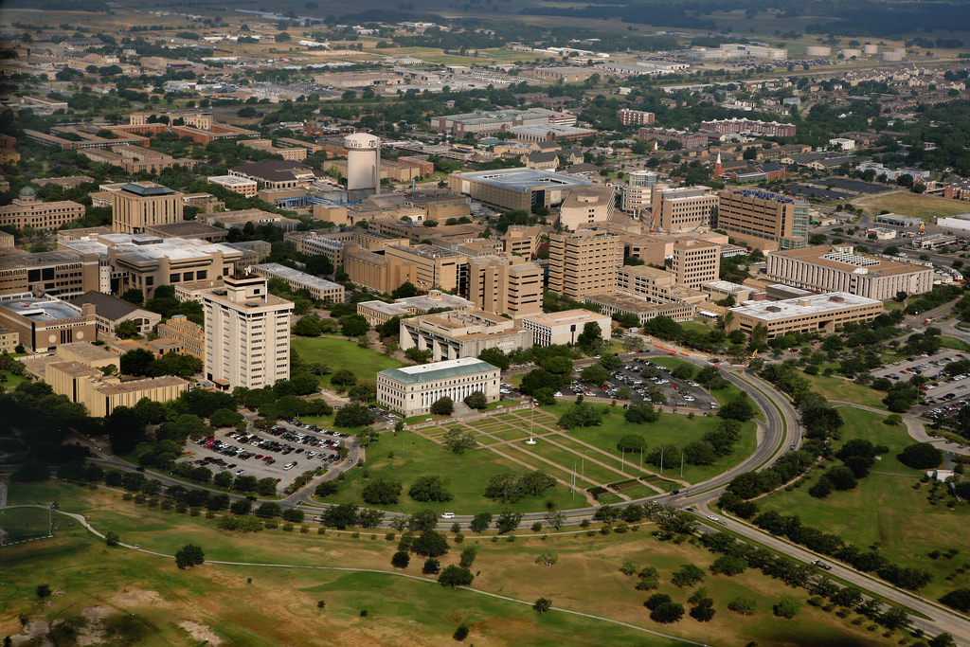

The Arrow of Time
W.P. Schleich
Institut für Quantenphysik
Center for Integrated Quantum Science and Technology IQ^{ST}
Universität Ulm
Hagler Institute for Advanced Study at Texas A&M University Texas A&M AgriLife Research
Institute for Quantum Science and Engineering (IQSE) and Department of Physics and Astronomy
Texas A&M University, College Station

Slide 6
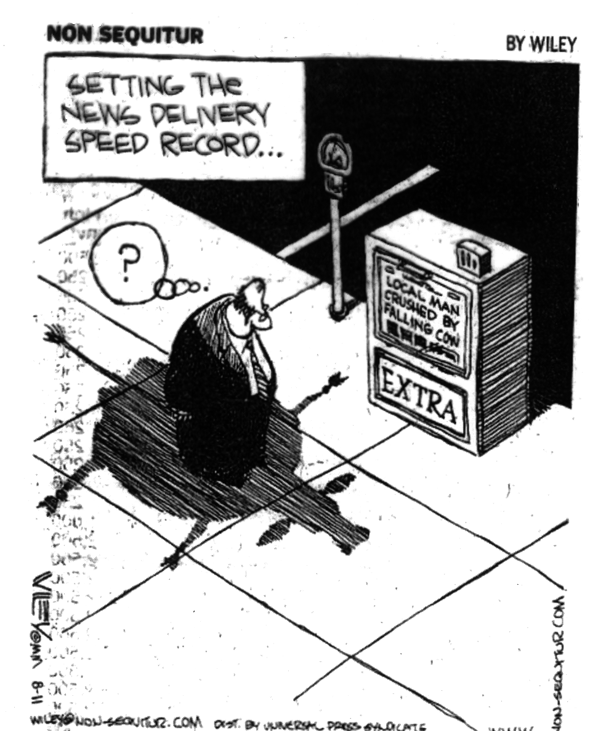

Slide 7
Overview
Time in physics
Light cone
A world without time
Propagation of light
Time travel

Slide 8
Newton mechanics
Force = mass x acceleration

Slide 9
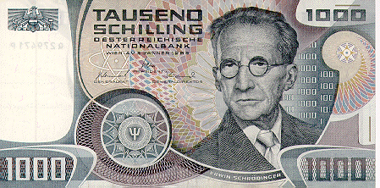
Quantum mechanics

Slide 10
Electrodynamics

Slide 11
H-Theorem

Slide 14
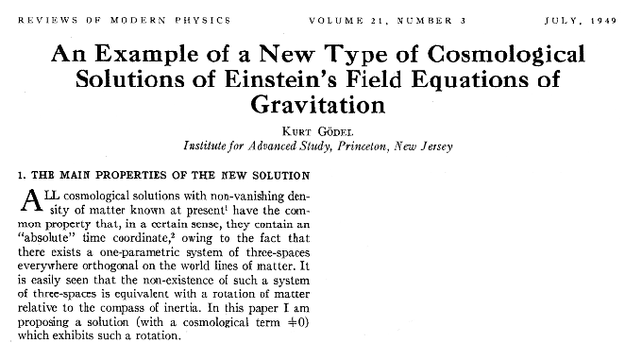
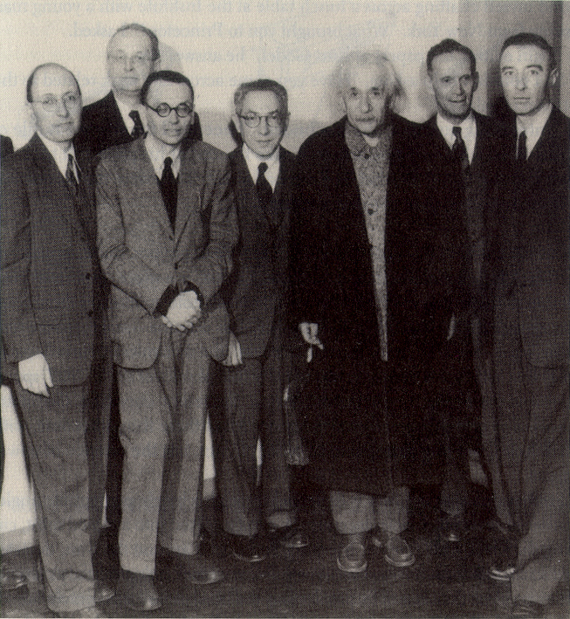

Slide 15
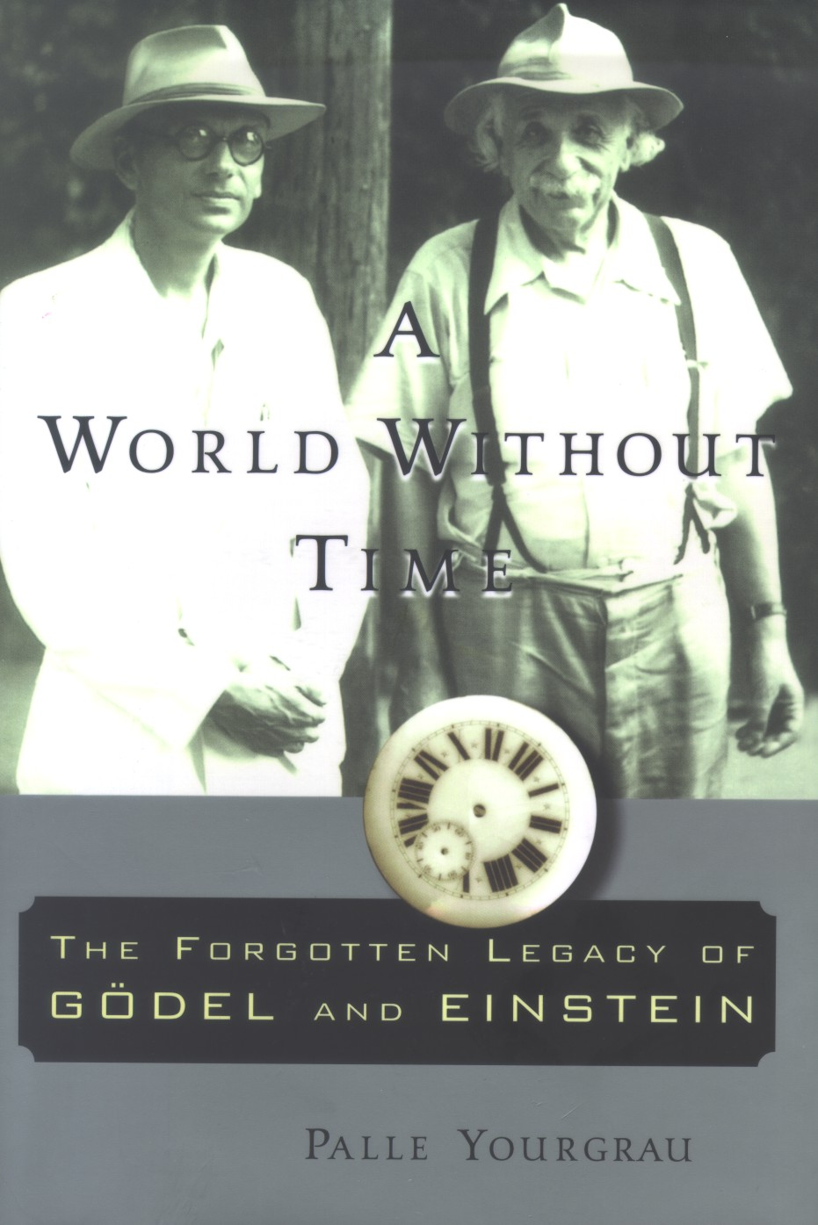

Slide 16
Kurt Gödel
Born 28. April 1906 (Brünn)
Died 14. January 1978 (Princeton)
Studied in Vienna 1923
Doctorate 1929
Incompleteness theorem 1931
Marriage to Adele Porkot 1938
Arrival in USA 1940
US Citizenship 1948
Institute of Advanced Studies

Slide 17
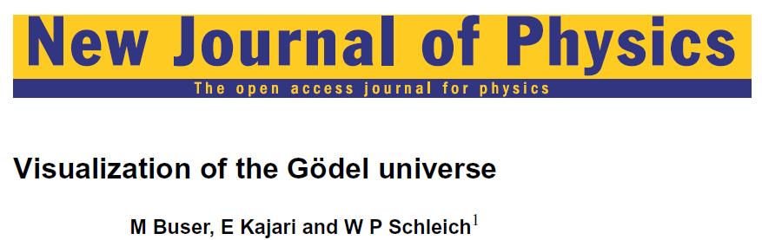
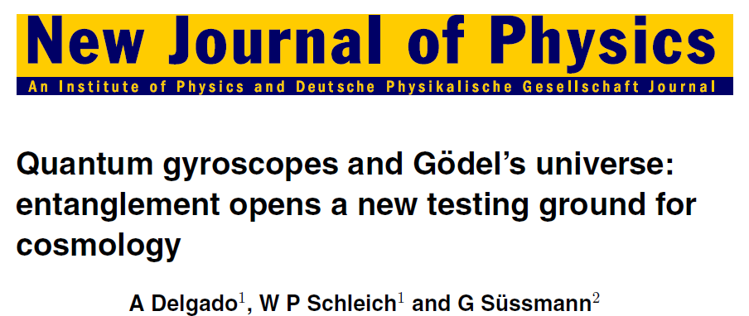





Slide 18
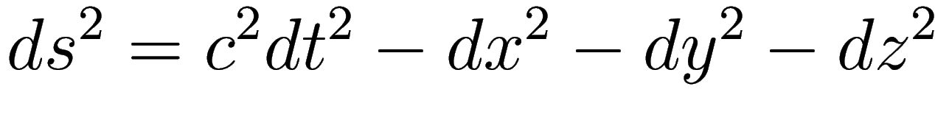
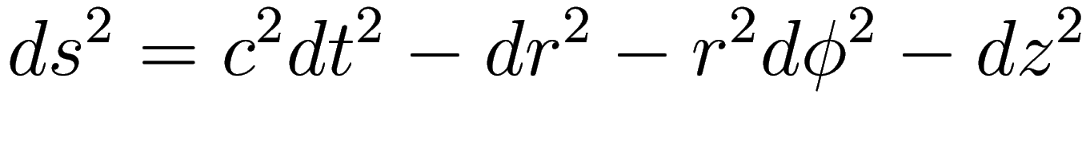
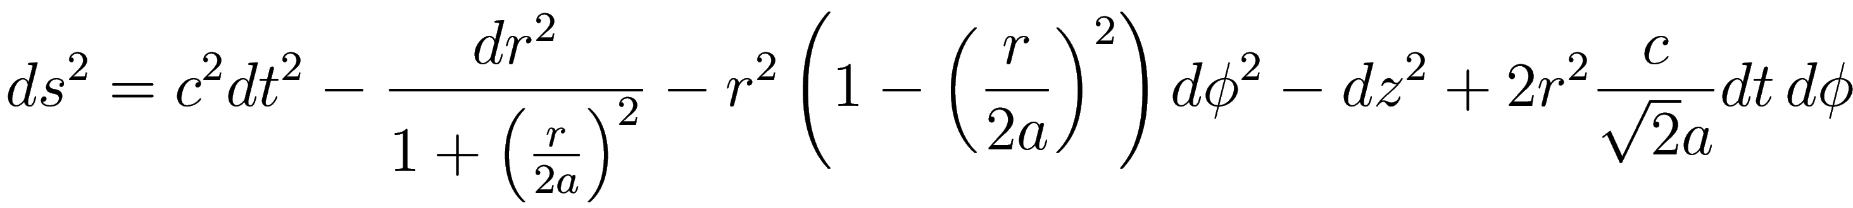
Gödel universe: line element

Slide 19
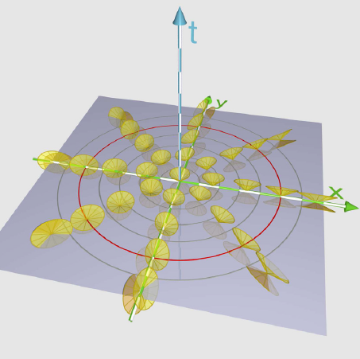
Light cones

Slide 20
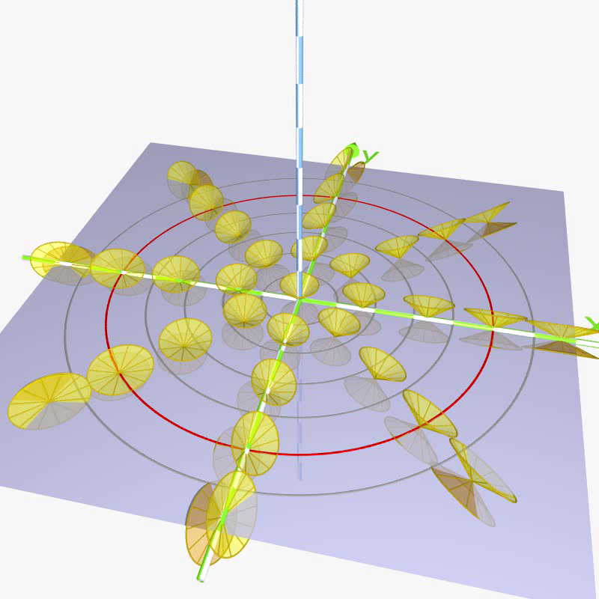
Light cones

Slide 21
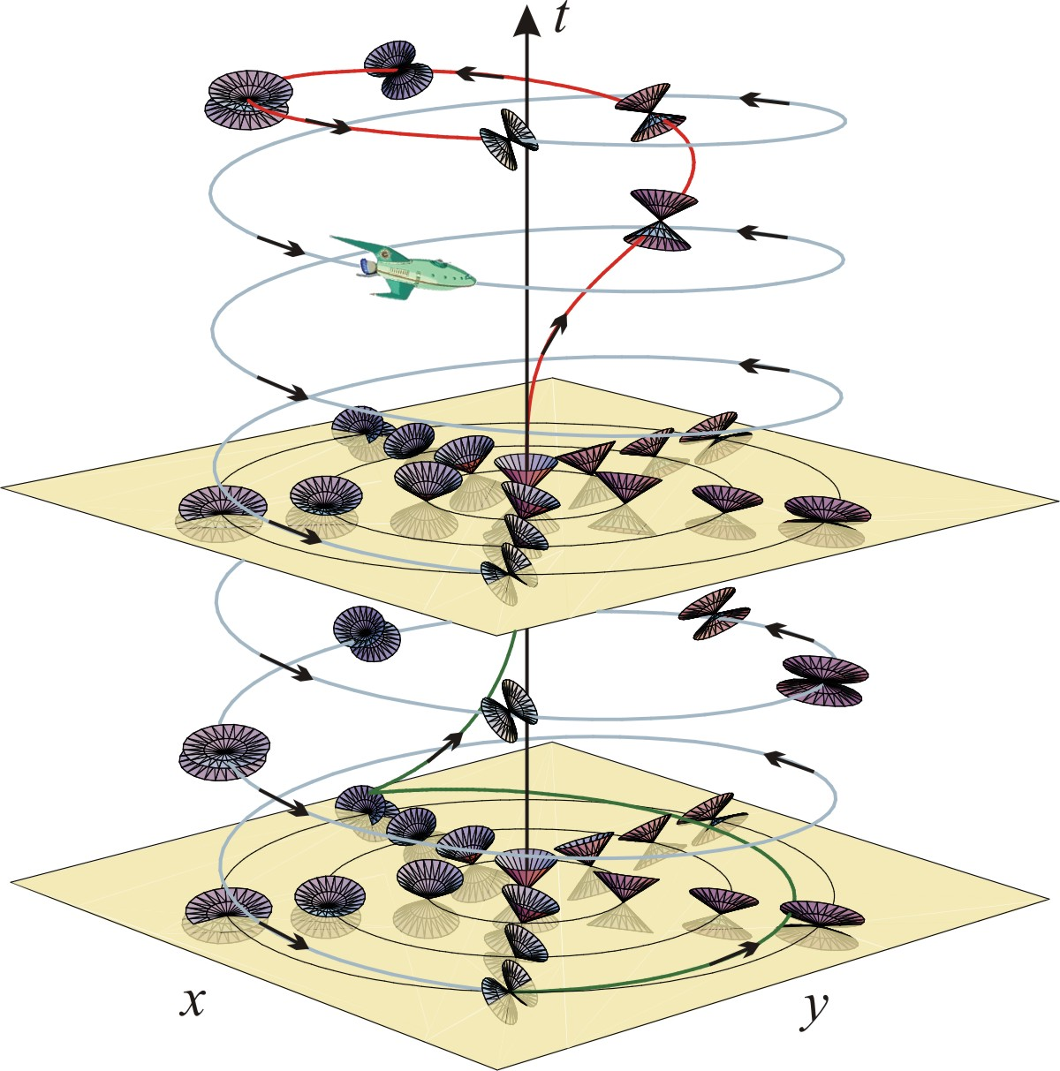
Example of closed world line
K. Gödel,
Rev. Mod. Phys. 21, 447 (1949)
„ ... i.e., it is theoretically
possible in these worlds
to travel into the past, or
otherwise influence the
past.“

Slide 22
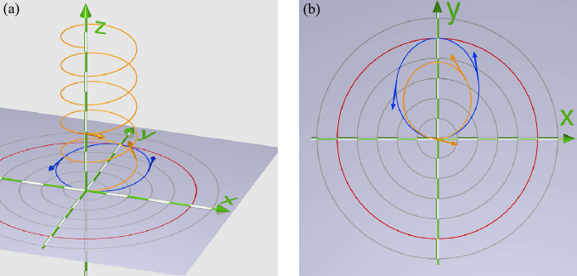
Null geodesics

Slide 23
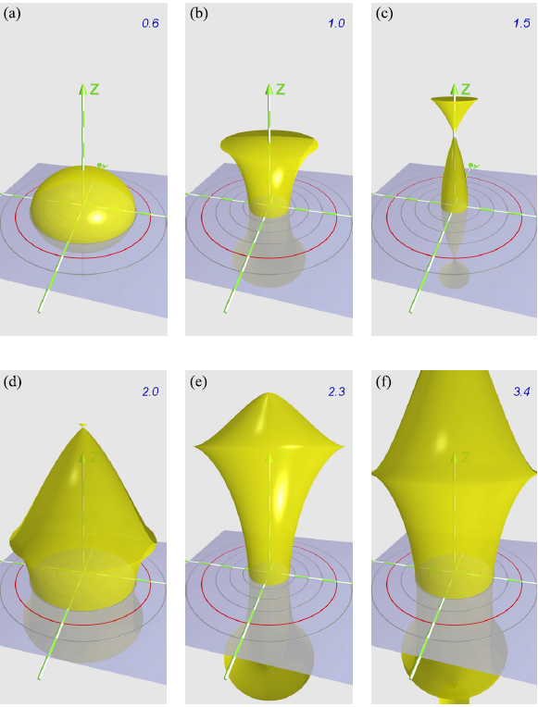
Wave front of a flash of light

Slide 24
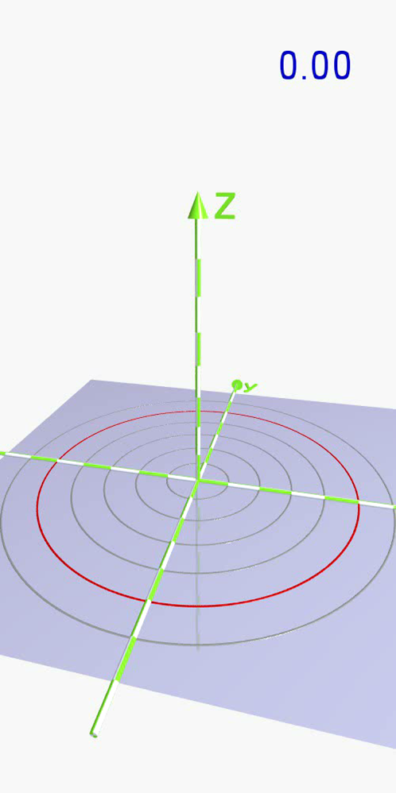

Slide 25
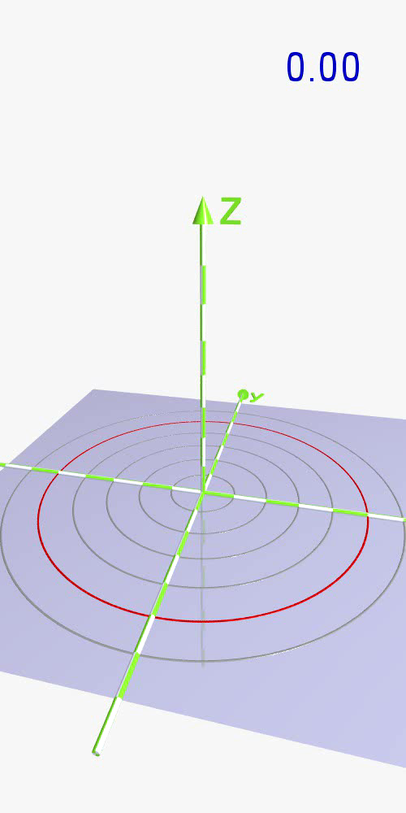

Slide 26
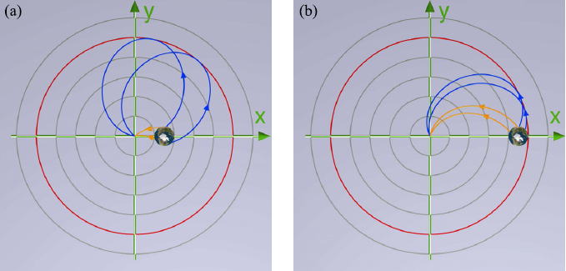
Two pictures of an object

Slide 27
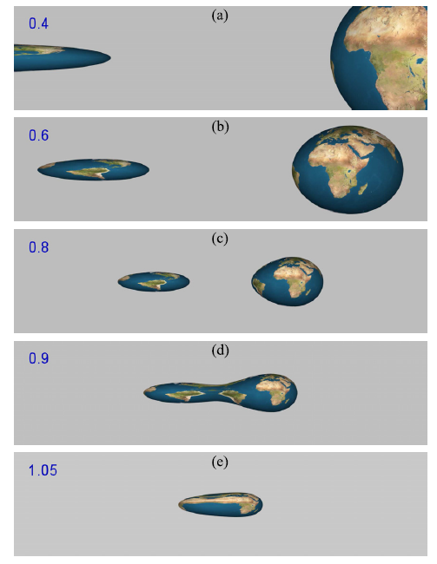

Slide 28
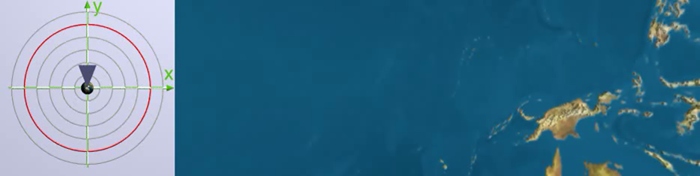

Slide 29


Slide 30
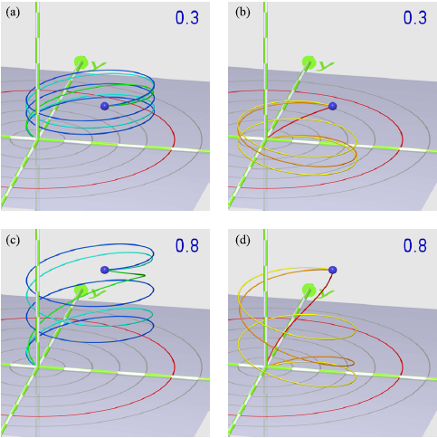
Multiple images

Slide 31
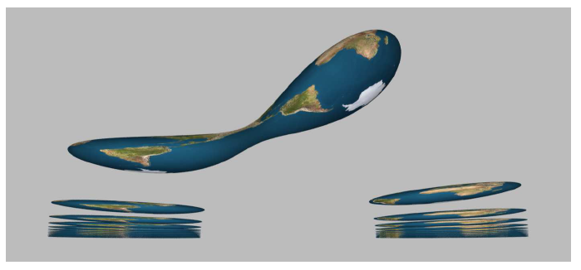

Slide 32
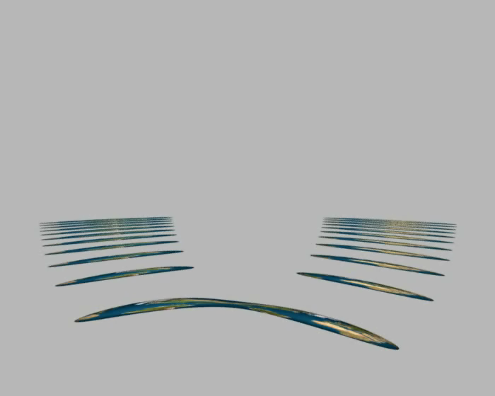

Slide 33


Slide 34
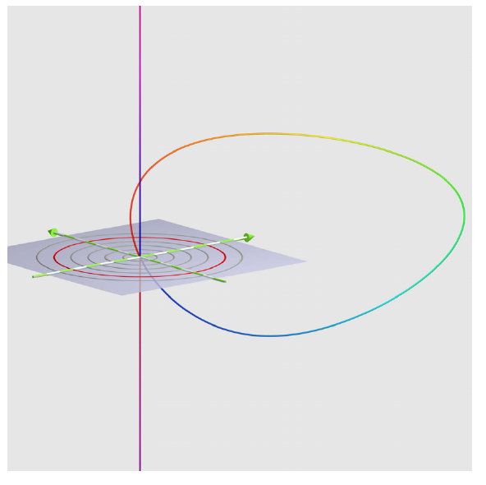
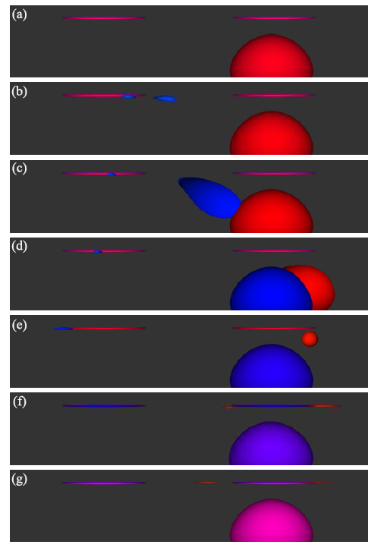
Closed world lines

Slide 35
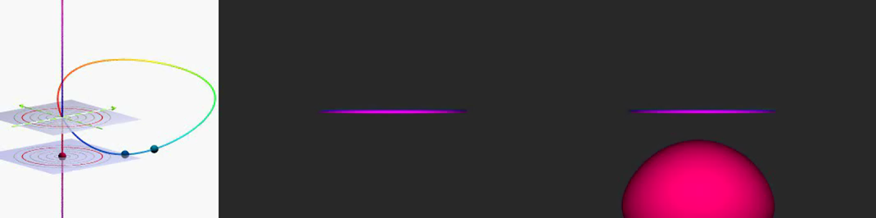

Slide 36


Slide 37
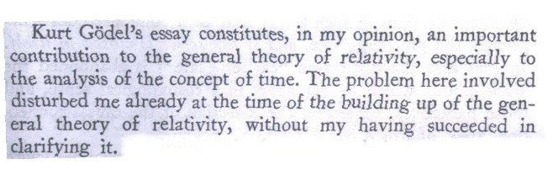
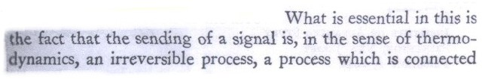
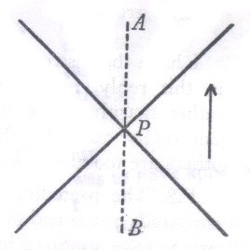


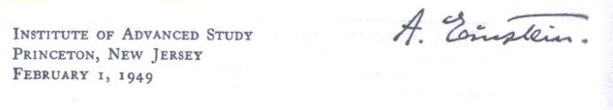

Slide 38
Summary
Time in physics
Light cone
A world without time
Propagation of light
Time travel

