Slide 1
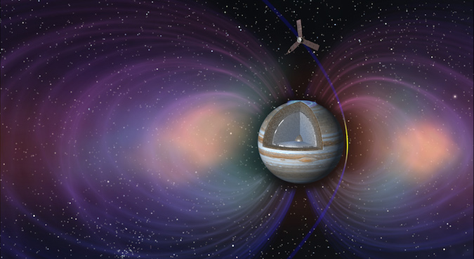
Exploration of Jupiter's Galilean satellites and their complex interactions with the Jovian magnetosphere Hungary's partcipation in ESA's Jupiter Icy Moons Explorer mission
Zsófia Bebesi, PhD
Senior Research Fellow
Wigner RCP
Department of Space Physics and Space Technology
Particles & Plasmas Symposium 2024 Budapest, 12 June 2024

Slide 2
Introduction
Jupiter has been visited by multiple space missions during the last decades, of which Galileo (NASA, Dec. 7th, 1995 - Sep 21th, 2003) and Juno (NASA, July 5th, 2016-) spent several years orbiting the gas giant and its plasma environment.
What makes us want to go back so soon?
These recent missions have made many fundamental discoveries that need to be investigated further. Also, it takes time to get there...
The core questions answered by previous missions were not specifically aimed at the huge icy satellites of Jupiter beyond their physical characteristics and interactions with the Jovian plasma environment - JUICE (ESA) will now target these objects and will explore the possibilities of potential habitability.

Slide 3
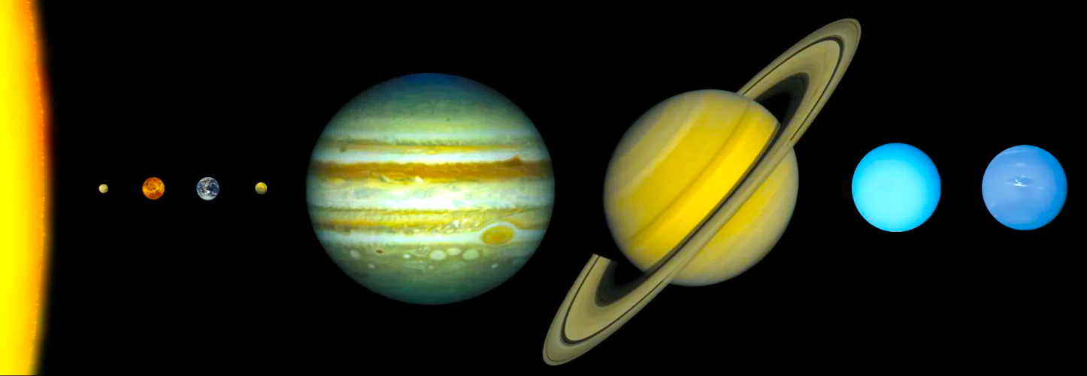
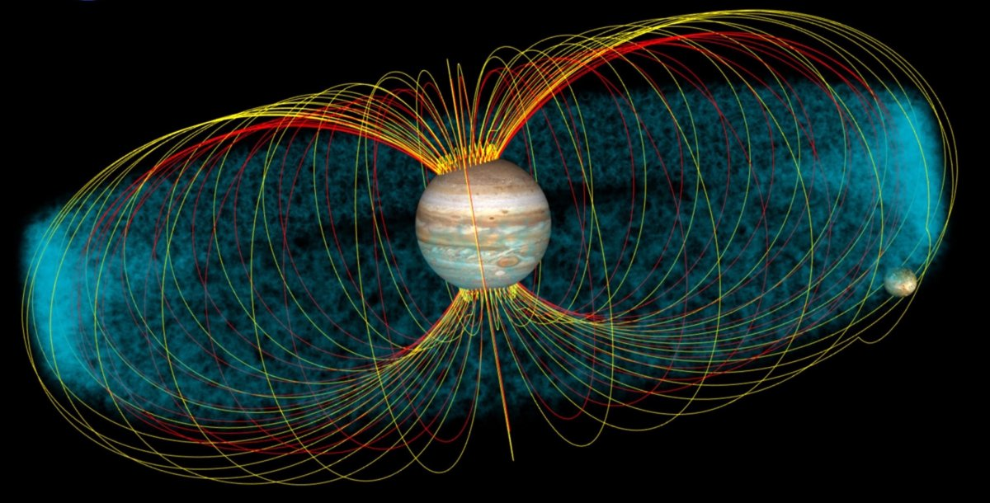
The Jovian plasma environment
Jupiter is the fifth planet from the Sun (5.20 AU), the largest, and more than twice as massive as all the other planets combined.
Jupiter - with a period of 9hr 55min - is fastest rotating planet in the Solar System.
It's composition is close to that of the primordial Solar Nebula (~90% hydrogen, ~10% helium, with traces of methane, water and ammonia.
The pressure in its centre is so great that (above its rock core) metallic hydrogen exists, capable of producing a self-sustaining dynamo (as in the Earth's iron core).
The combination of the huge mass and fast rotation produces a huge magnetic moment.

Slide 4
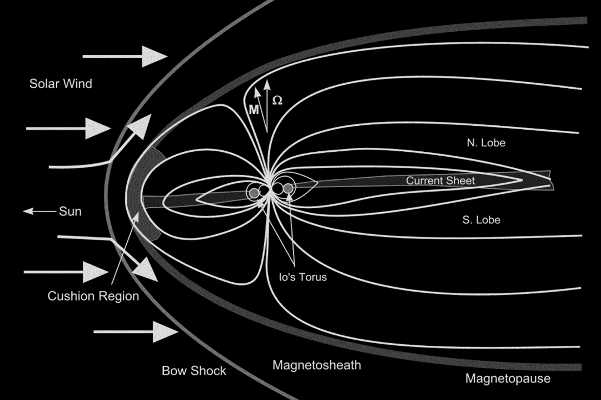
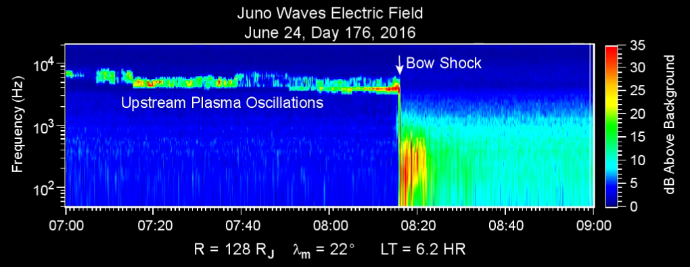
The Jovian plasma environment
The magnetic field of Jupiter has a dipolar strength 10,000 times as strong as the Earth's.
This deflects the solar wind around the planet, forming a huge cavity, the magnetosphere.
The average distance of Jupiter's bow shock at the sub-solar point is approximately 82 RJ (RJ = 69,911 km), and the magnetospheric boundary is generally located at a distance between 50-100 RJ from the planet.
The dynamic processes of Jupiter's magnetic field are primarily maintained by the planet's rotation, which is the the most important source of momentum in the magnetosphere.

Slide 5
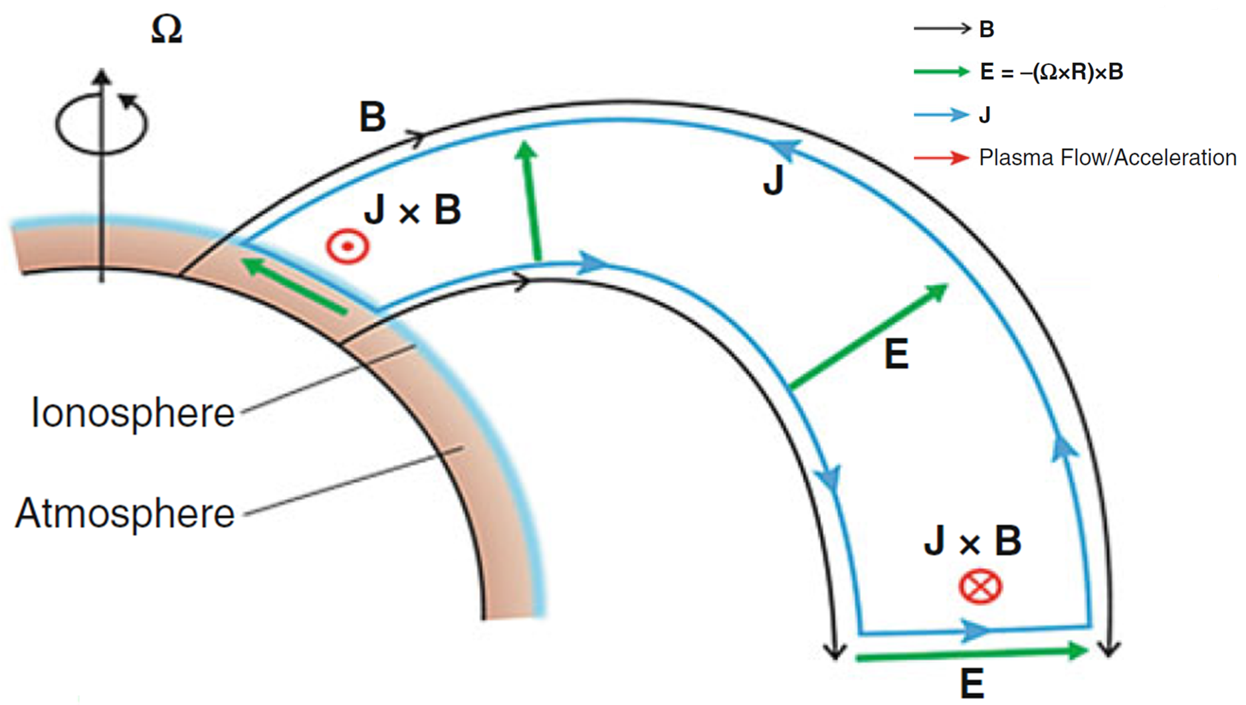
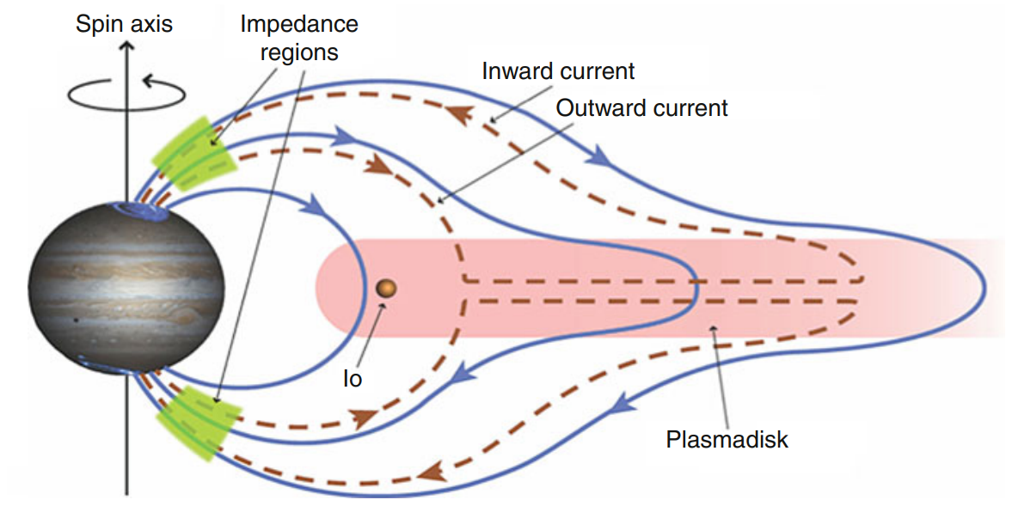
Jupiter's magnetospheric processes
Credit: Fran Bagenal
For the magnetospheric plasma to rotate with the planet, the upper region of the neutral atmosphere must corotate with the planet and be closely coupled to the (highly conductive) ionosphere by collisions.
The fast rotation stretches the corotating plasma into a disc by the centrifugal force, which (because it is frozen into the magnetic field) results in the deformation of the magnetic field lines in the equatorial plane; magnetodisc/plasmadisc.
The magnetodisc (or current sheet) contains plasma coming from internal sources, such as the moons.

Slide 6
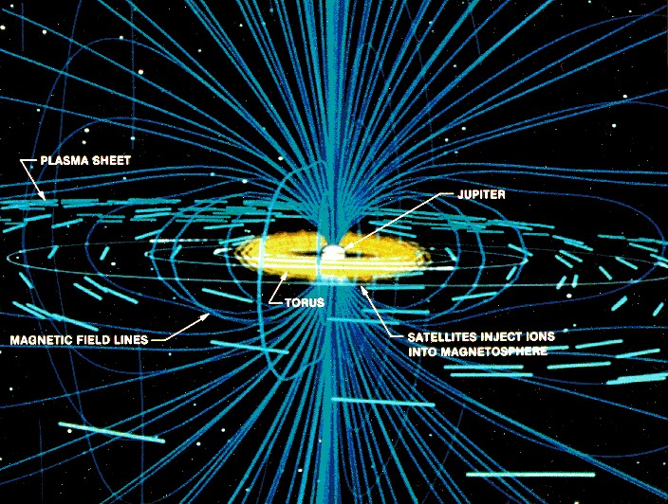
Jupiter's magnetospheric processes
The inner magnetospheric plasma sources (mainly the innermost Galilean satellite, the volcanic Io) throw out huge amounts of material that quickly becomes ionised, contributing to the current sheet material along the equatorial plane of the planet.
The charged particles gyrate around the magnetic field lines and bounce between the magnetic mirror points of the magnetosphere.
The corotation speed inside the magnetospheres of Jupiter and Saturn is subsonic - opposed to the solar wind plasma outside of the magnetosphere which is super-magnetosonic.

Slide 7
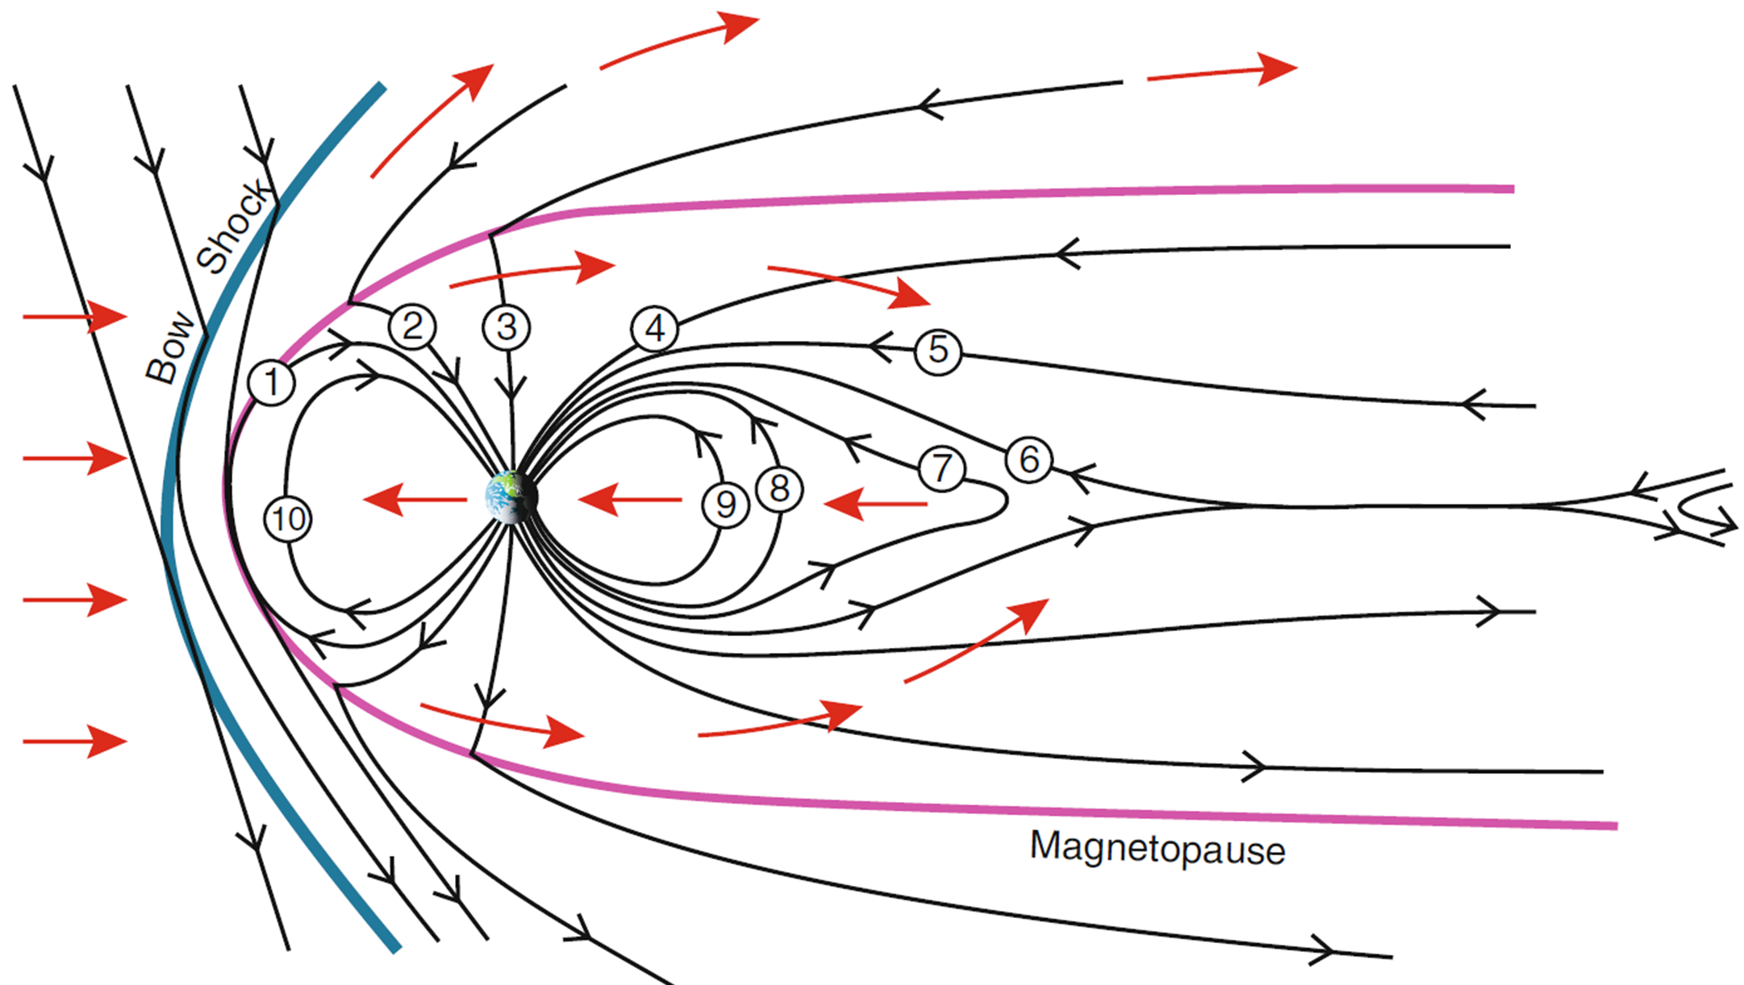
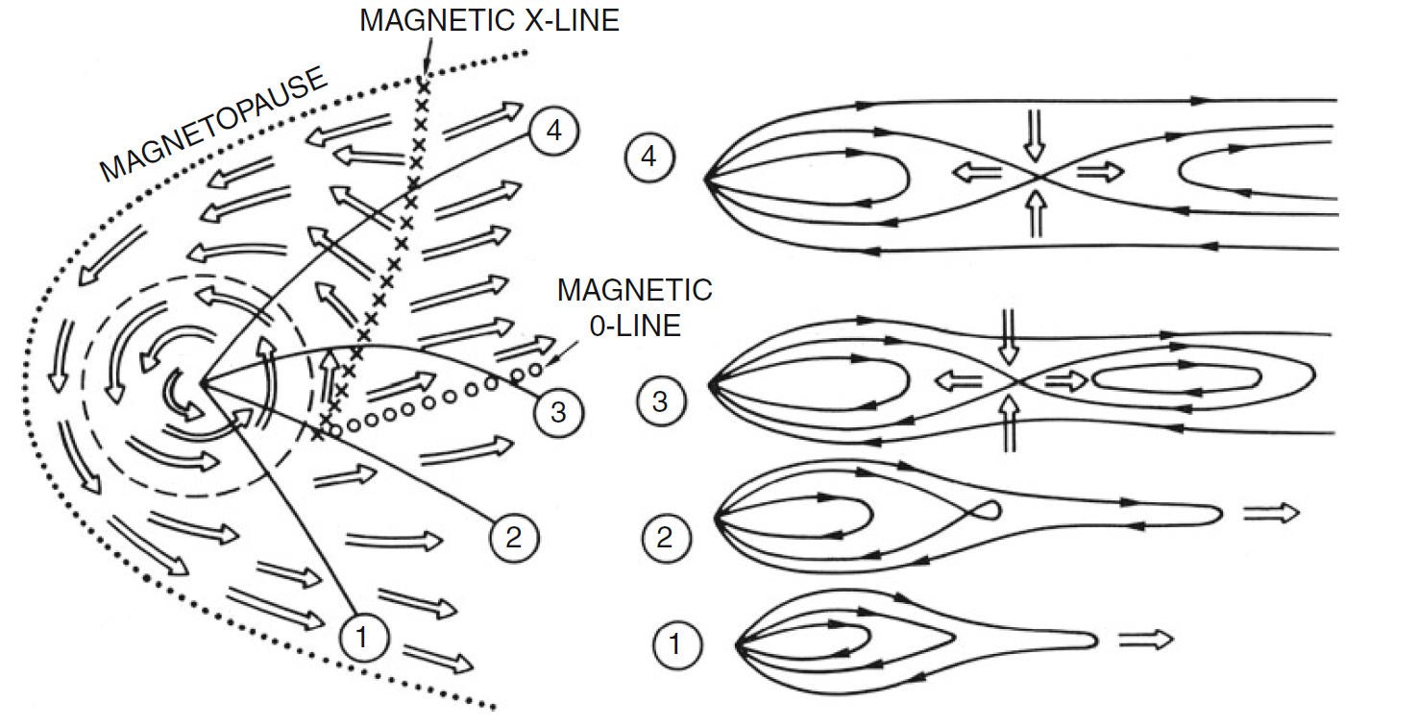
Space weather at Jupiter
Credit: Fran Bagenal
When the IMF and the magnetic field at the magnetopause is antiparallel magnetic reconnection can occur at the dayside magnetopause.
For a section of flux tube in the solar wind to move to the plane of the planet’s terminator, it takes only 10 seconds Mercury, 3 minutes at Earth, and 4 hours at Jupiter.
For a magnetosphere that is driven primarily by rotation, as the plasma moves around onto the nightside, it is no longer confined by magnetopause currents, transports farther from the planet, and stretches the magnetic field.
At some point, either the coupling to the planet breaks down completely or the field becomes so radially extended that a blob of plasma detaches and escapes down the magnetotail.

Slide 8
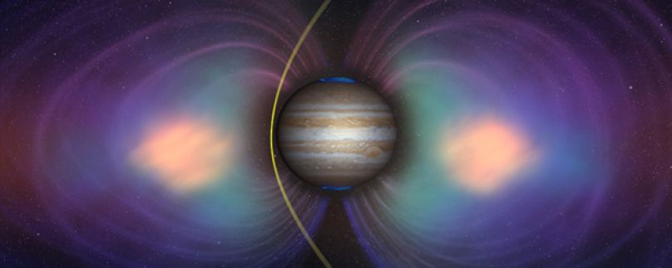
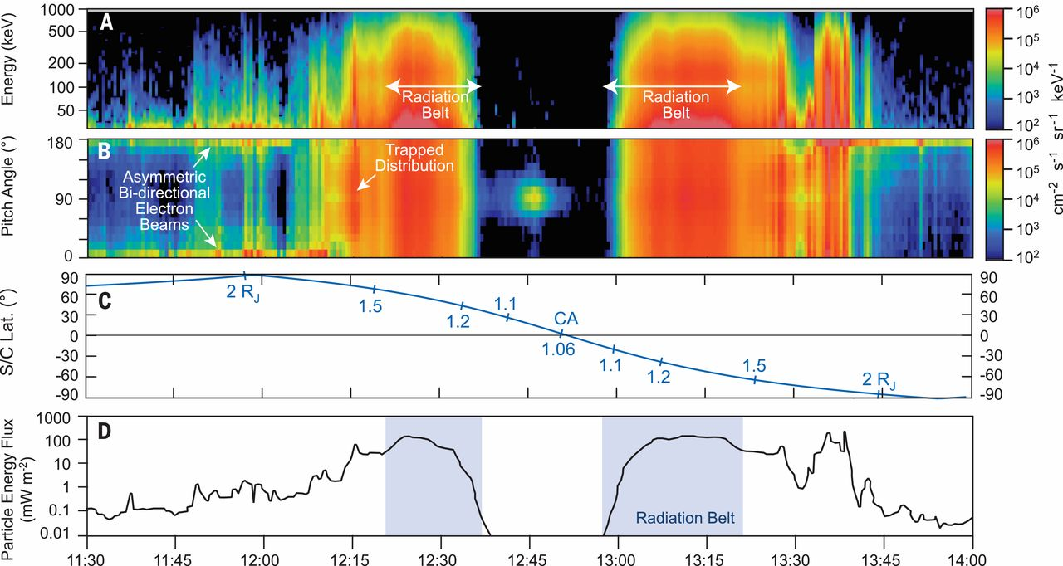
Jupiter's radiation belts
The highest fluxes of energetic particles in the magnetosphere are found closest to the planet, where they form a doughnut-shaped belt around the equator.
Jupiter’s magnetic field is so strong that even ∼100 GeV protons can be trapped by the closed field lines.
Jupiter’s radiation belts are among the most hazardous regions of our Solar System, trapping charged particles of extreme fluxes and energies that are typical for Galactic Cosmic Rays.
Energetic electrons leaking from Jupiter's magnetic field into the solar wind are so intense that they overwhelm the GCR electrons below 10 MeV, from inside the heliosphere to ∼10 AU from the Sun.
Connerney et al., 2017

Slide 9
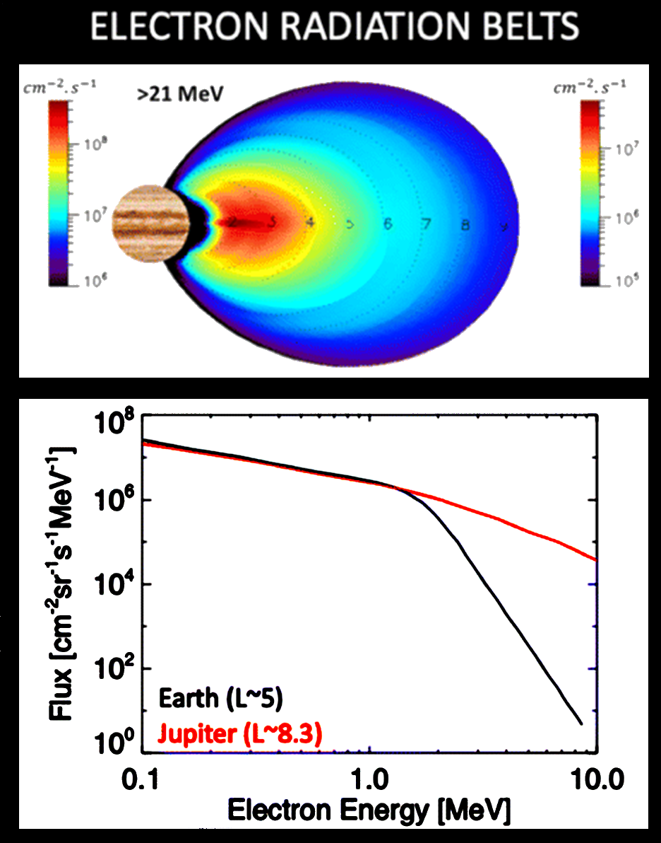
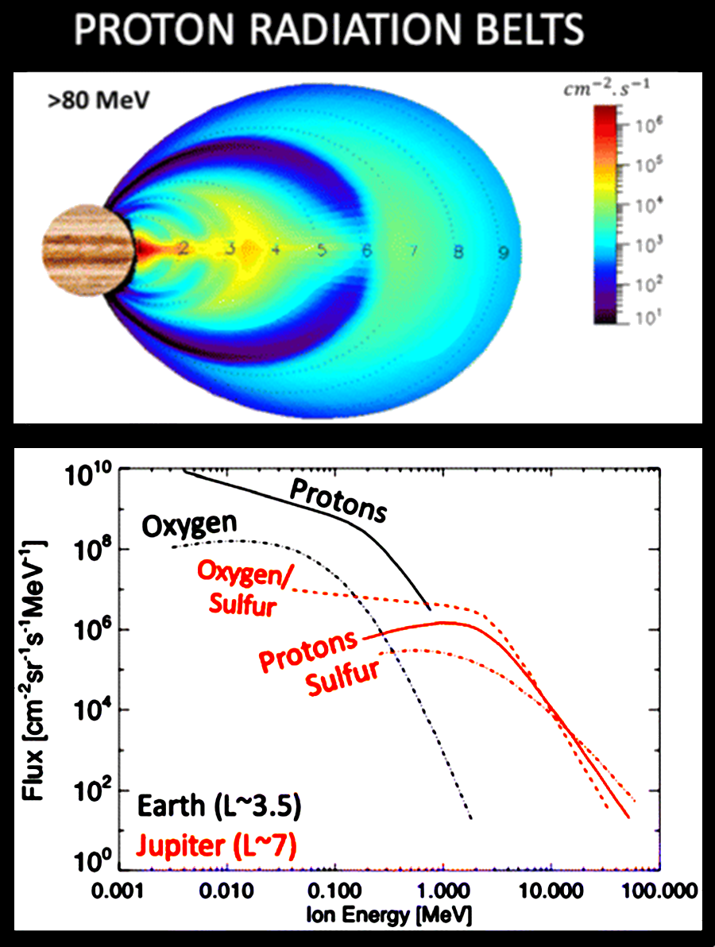
Jupiter's radiation belts
Jupiter’s inner radiation belts contain electrons with energies of 70 MeV, possibly even above 100 MeV. These electrons emit intense synchrotron radiation, which can be detected by radio telescopes.
The belts have a large variety of ions in comparable abundance to protons. At other planets, these are typically just trace elements.
At lower abundances, ions like helium, sodium, magnesium, carbon, and iron, have also been measured.
Furthermore, some of the ions have a range of ionization states.
Jupiter’s moons and tenuous rings shape the radiation belts by absorbing energetic particles, hence obstructing their transport and energization.
Jupiter’s magnetospheric region of the inner radiation belts with the Galilean Moons indicated (Credit: Quentin Nénon).
Roussos et al., 2022

Slide 10
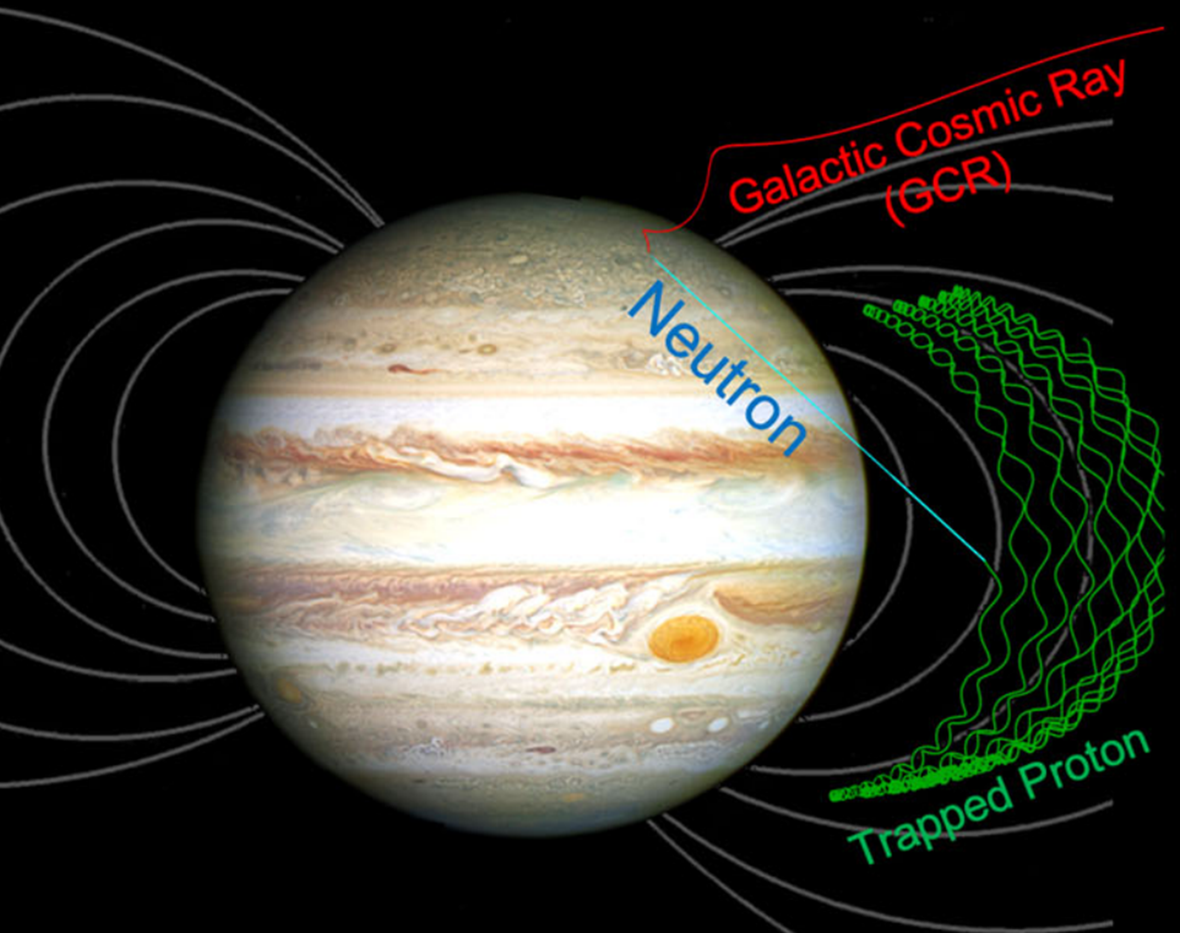
Jupiter's radiation belts - CRAND
Galactic Cosmic Rays (GCRs) with sufficient energy can penetrate the magnetic field and may collide with the atmosphere.
Secondary neutrons produced by these collisions can travel away from their generation site until they β-decay to protons and electrons: Cosmic Ray Albedo Neutron Decay (CRAND).
The decay products become trapped and add to the planet’s radiation belts.
At Earth and Saturn CRAND can result in protons of energies between several MeV and up to the proton trapping limit of each planet in the GeV range.
At Jupiter the magnetic field is much stronger and it has a H rich atmosphere that makes it less effective.

Slide 11
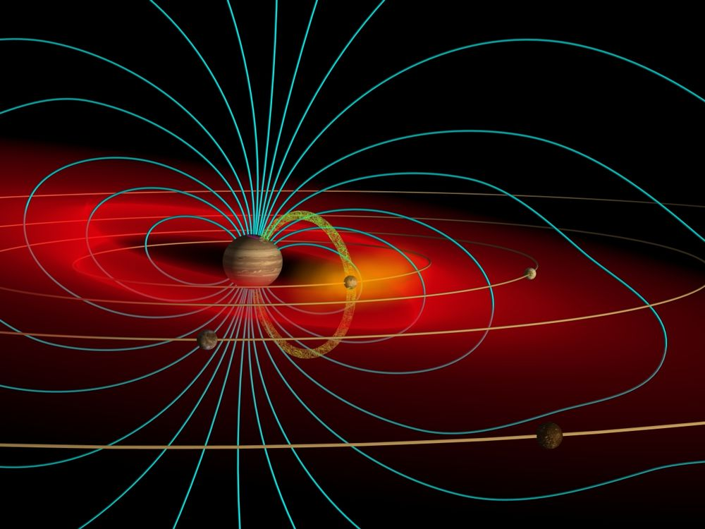
Magnetospheric plasma sources
Within the magnetosphere, there are multiple plasma sources that affect the distribution and dynamics of charged particles.
The charged particles (electrons, protons, oxygen and sulfur ions) within the magnetosphere will experience the planet’s strong magnetic field and get accelerated to high energies.
The protons partially come from Jupiter’s ionosphere but some also leak in from the solar wind.
The most important plasma sources in the inner Jovian magnetosphere are the four Galilean satellites.

Slide 12
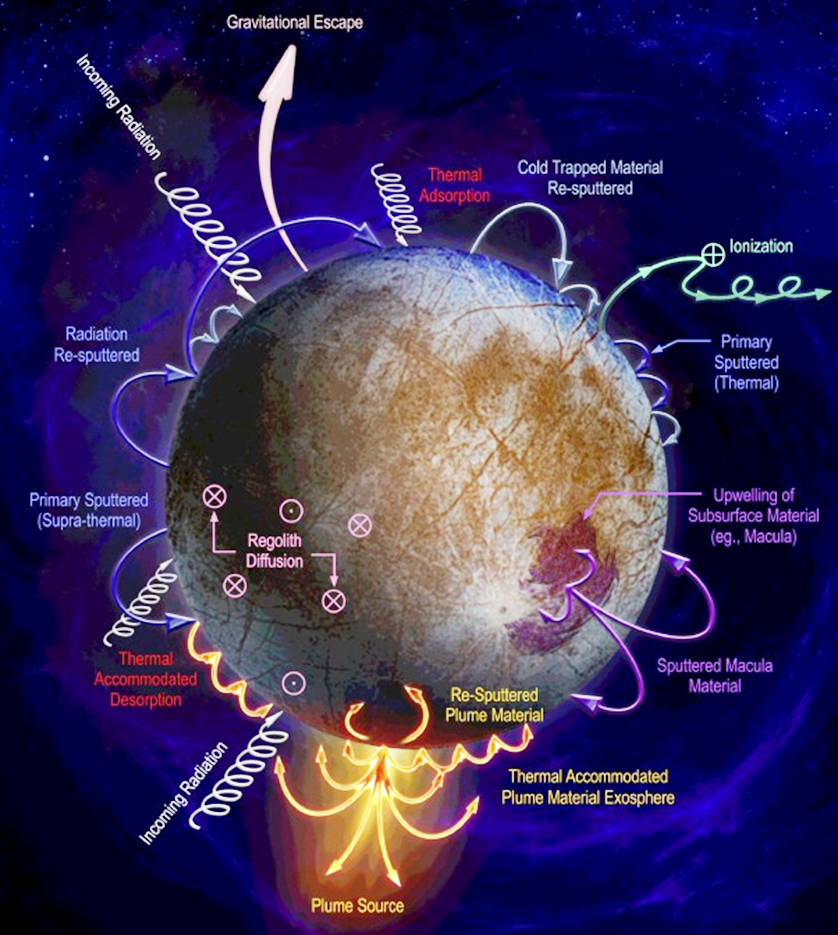
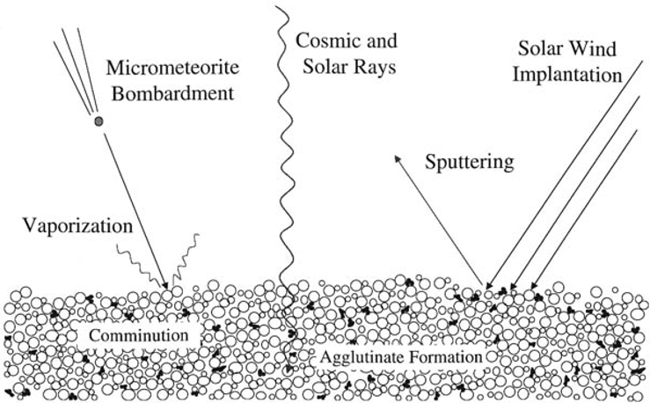
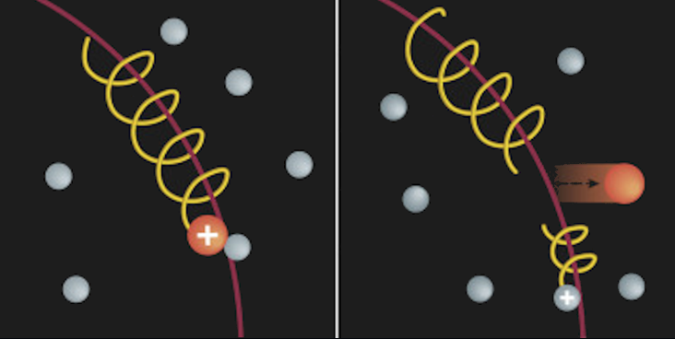
Magnetospheric plasma sources
The moon's surfaces and exospheres are continuously bombarded by the co-rotating energetic magnetospheric particles, solar EUV, meteoroids and dust.
Part of the material ejected from the surface would leave the vicinity of the moon (sputtering), the other part would fall back.
The exospheric neutrals can also get ionized (e.g. charge exchange) and transported away by the magnetic field lines of Jupiter (pick-up).
The material originating from a possible subsurface ocean would be ionized too, as soon as it gets ejected as geysers.
These processes result in complex interactions and have strong effects on the dynamics of the inner magnetosphere.

Slide 13
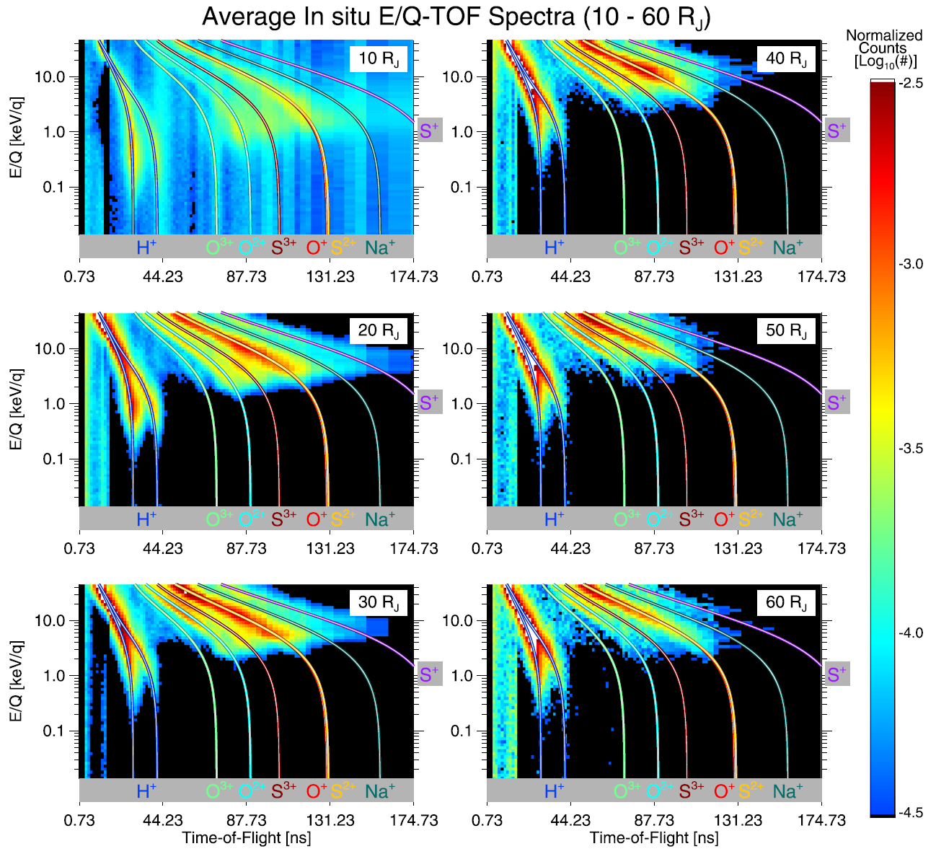
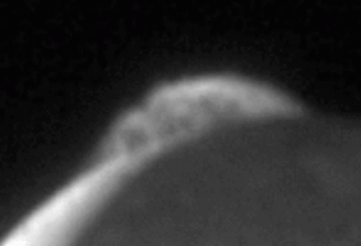
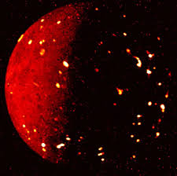
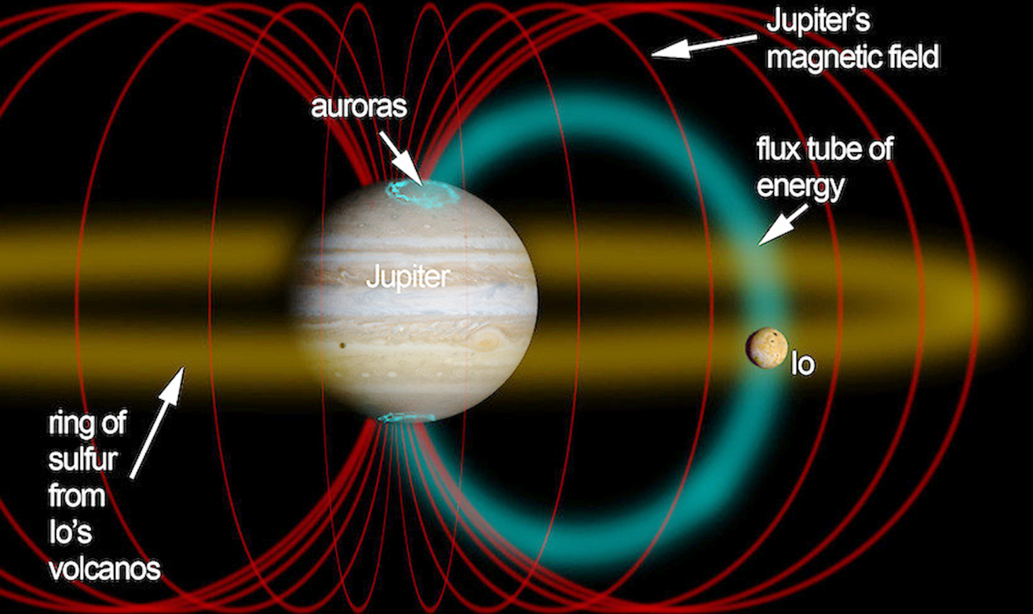
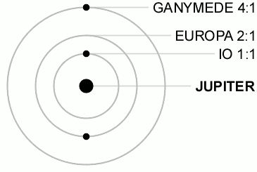
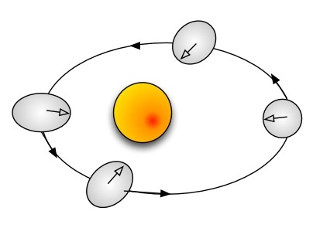
Magnetospheric plasma sources - Io
(Kim et al., 2019)
The dominant plasma source is the volcanic moon Io.
Due to tidal heating, a ton per second of sulfur dioxide gaseous volcanic material erupts from its interior.
This material gets ionized locally, and the resulting cold plasma composed of heavy particles forms a torus around Io's orbit at a distance of approximately 6 RJ from Jupiter.
Io's activity is sustained by tidal heating due to its orbital resonances with other Galilean satellites.
Averaged E/Q-TOF spectra measured by JADE-I at different radial distances from Jupiter, in the magnetic equator. The particle energy increases with radial distance due to an increase in corotation energy.

Slide 14
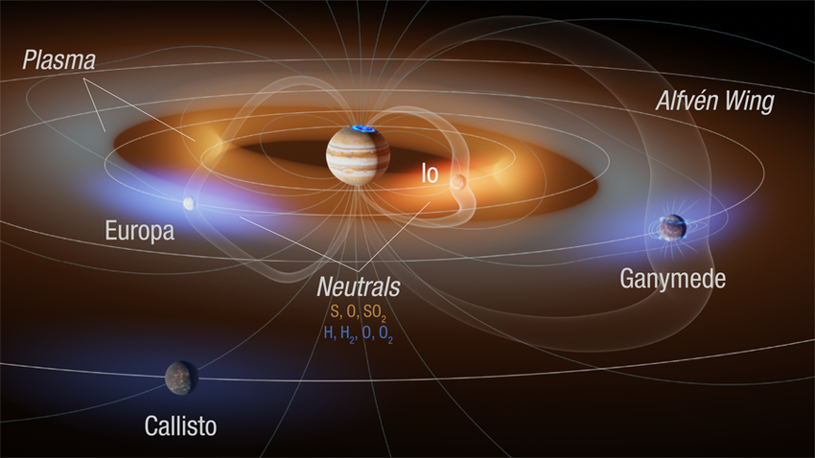
Magnetospheric plasma sources - Io
During the interaction between the plasma torus and Io, Alfvén waves are emitted along Jupiter's magnetic field lines in both directions.
In the case of the moons, an Alfvén wing is created as a result of the orbital motion, and it has been observed that at the footpoint of the wing connecting Io to Jupiter's atmosphere, strong auroral emissions can be detected (Connerney et al., 1993, Clarke et al., 1996, Prangé et al., 1996).

Slide 15
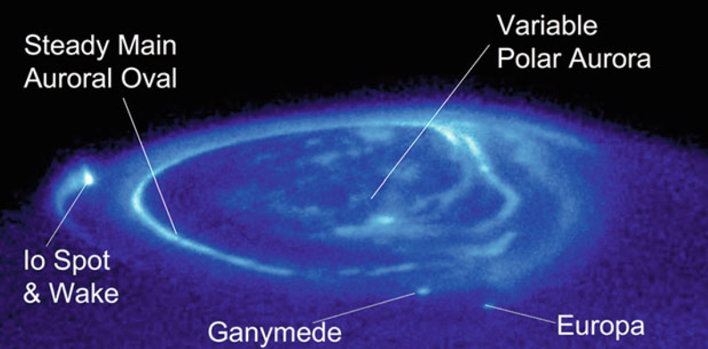
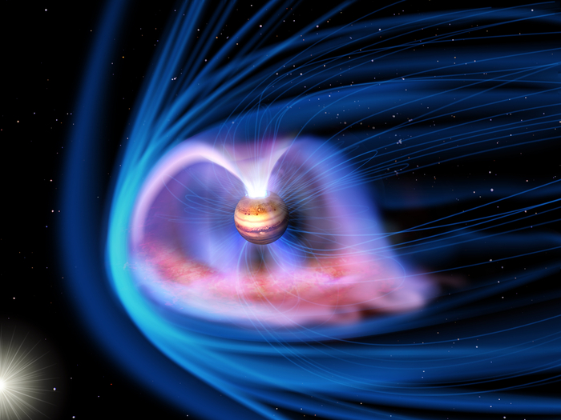
Magnetospheric plasma sources - Io
Jupiter’s magnetosphere accelerates electrons deep into the gas giant’s atmosphere. These electrons then collide with particles like hydrogen to produce Jupiter’s aurora.
Jupiter’s aurora is mostly driven by magnetospheric processes, doesn't depend on the intensity of the solar wind (like @Earth).
Much of Jupiter’s aurora-producing particles come from Io.
Jupiter’s aurorae also have been observed in X-ray, UV, IR, and visible light on the nightside.
The X-ray aurora, is thought to appear when oxygen and sulfur ions moving at relativistic speeds strike Jupiter's atmosphere.

Slide 16
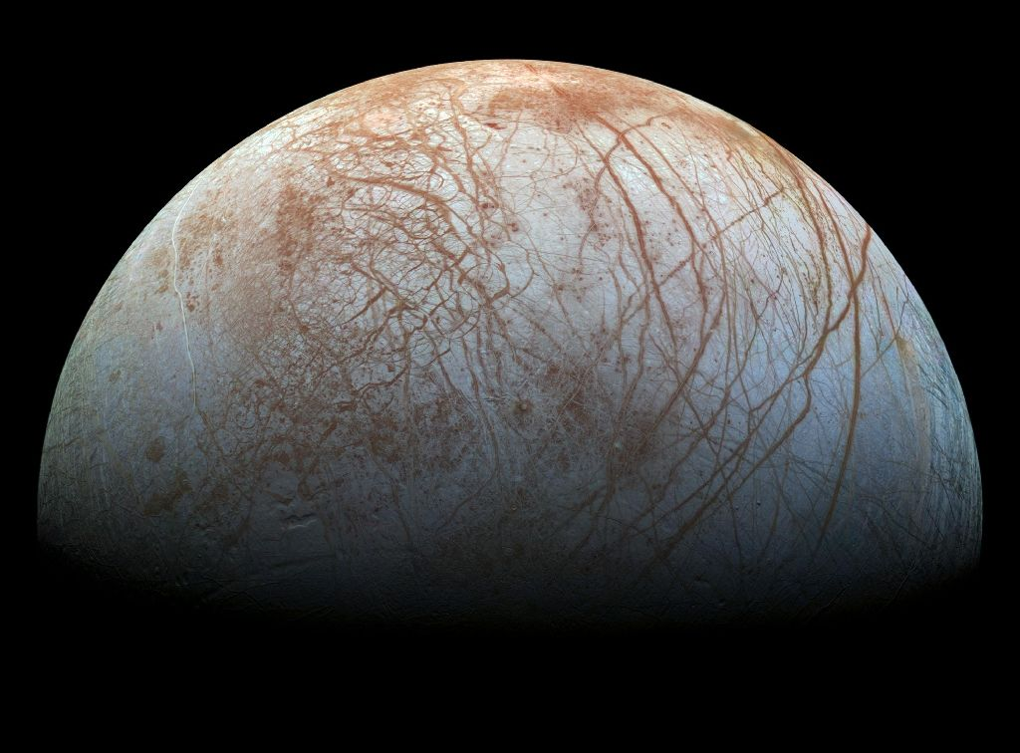
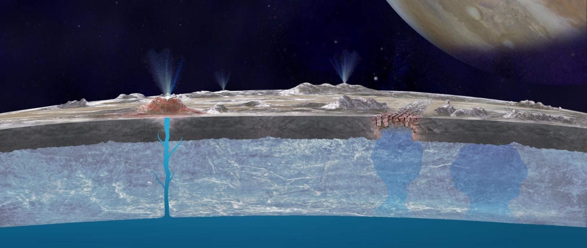
Magnetospheric plasma sources - Europa
The second Galilean moon Europa is also active, continuously spewing water ice and other organic compounds into the magnetosphere.
The "young", sparsely cratered surface, the observed fracture lines, and occasionally active geysers indicate the presence of a (probably global) subsurface ocean, that is maintained by tidal heating, and may even be suitable to sustain primitive life.
Tenuous exosphere consisting mostly of molecular oxygen (pressure is only 0,1 µPa) and water vapour, which probably originates from dissociation of water molecules through radiation.
Mineral deposits on the surface.

Slide 17
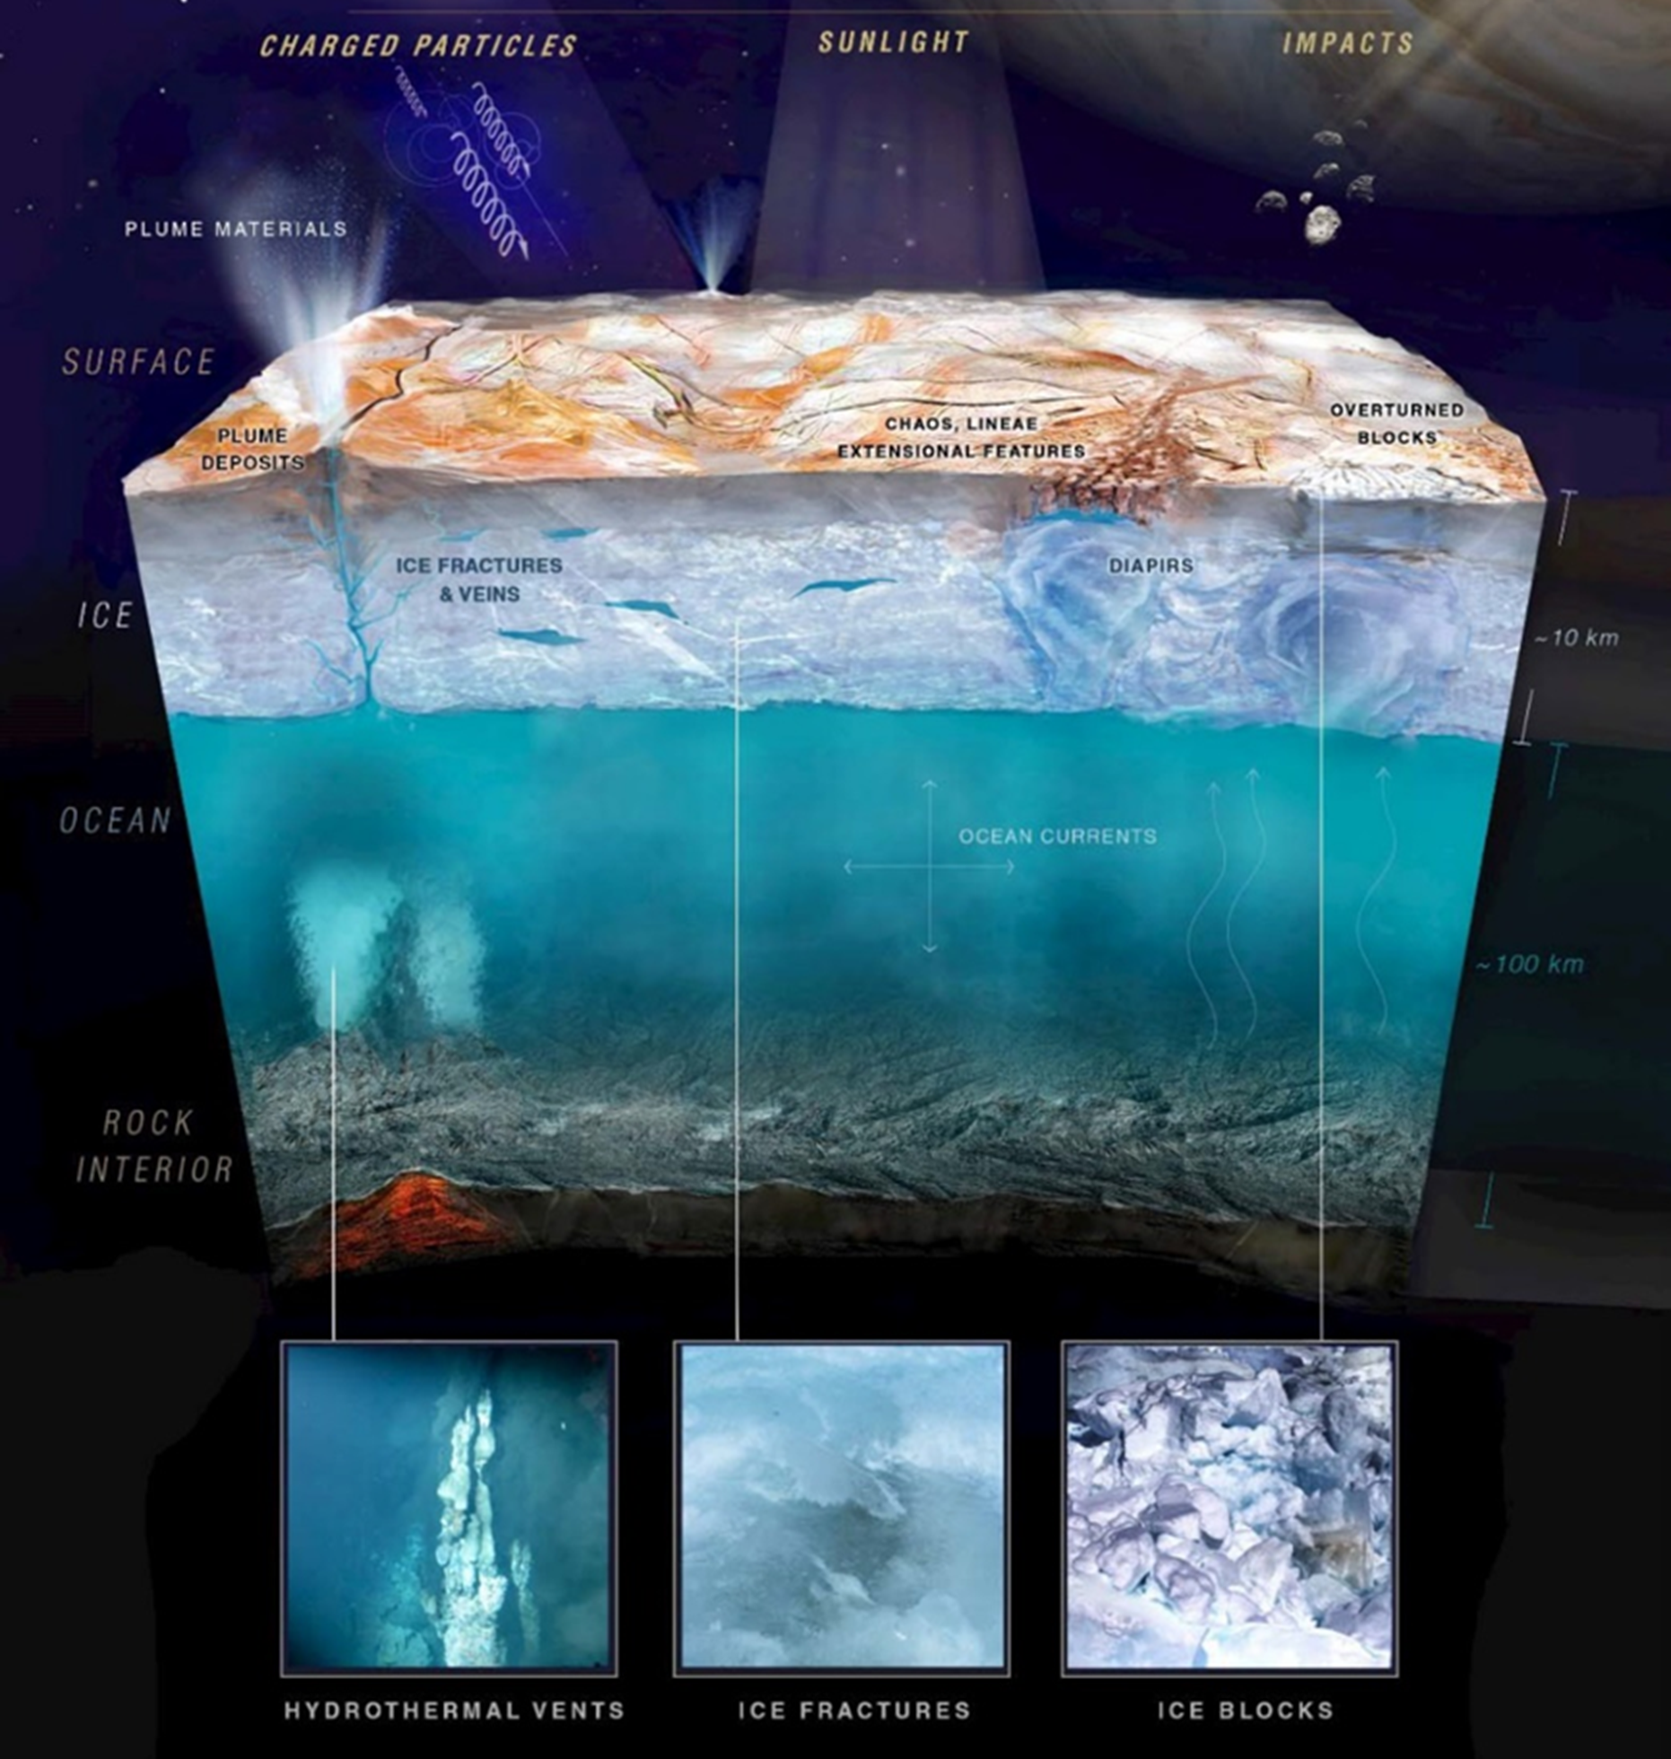
Magnetospheric plasma sources - Europa
The heat released through tidal friction maintains the liquid state of the subsurface ocean and also induces active geological processes.
Based on Galileo's measurements, Europa has an induced magnetic field, which arises from its interaction with Jupiter and involves a subsurface conductive layer.
It was already hypothesized that this layer could be an ocean of salty water.
The crust previously rotated (~80°), which could also have been influenced by the large extent of subsurface liquid.

Slide 18
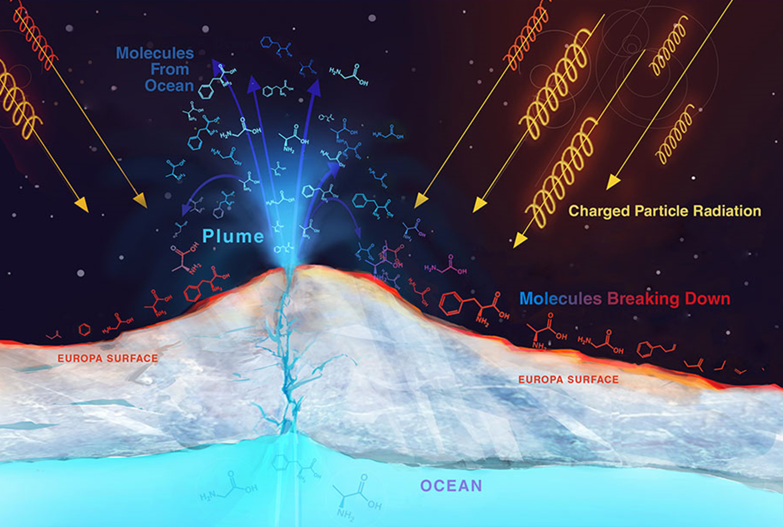
Magnetospheric plasma sources - Europa
Radiation emitted by Jupiter can destroy molecules that have surfaced from Europa's ocean, including those bio- and chemical signatures that might indicate the presence of potential primitive life.
Some important questions:
which part of the surface is exposed to the most intense radiation?
How deep do the high-energy particles penetrate?
In what ways does the radiation alter the freshly surfaced materials?
All these factors must be considered when planning upcoming space missions."
Innen még nézni anyagot!!!

Slide 19
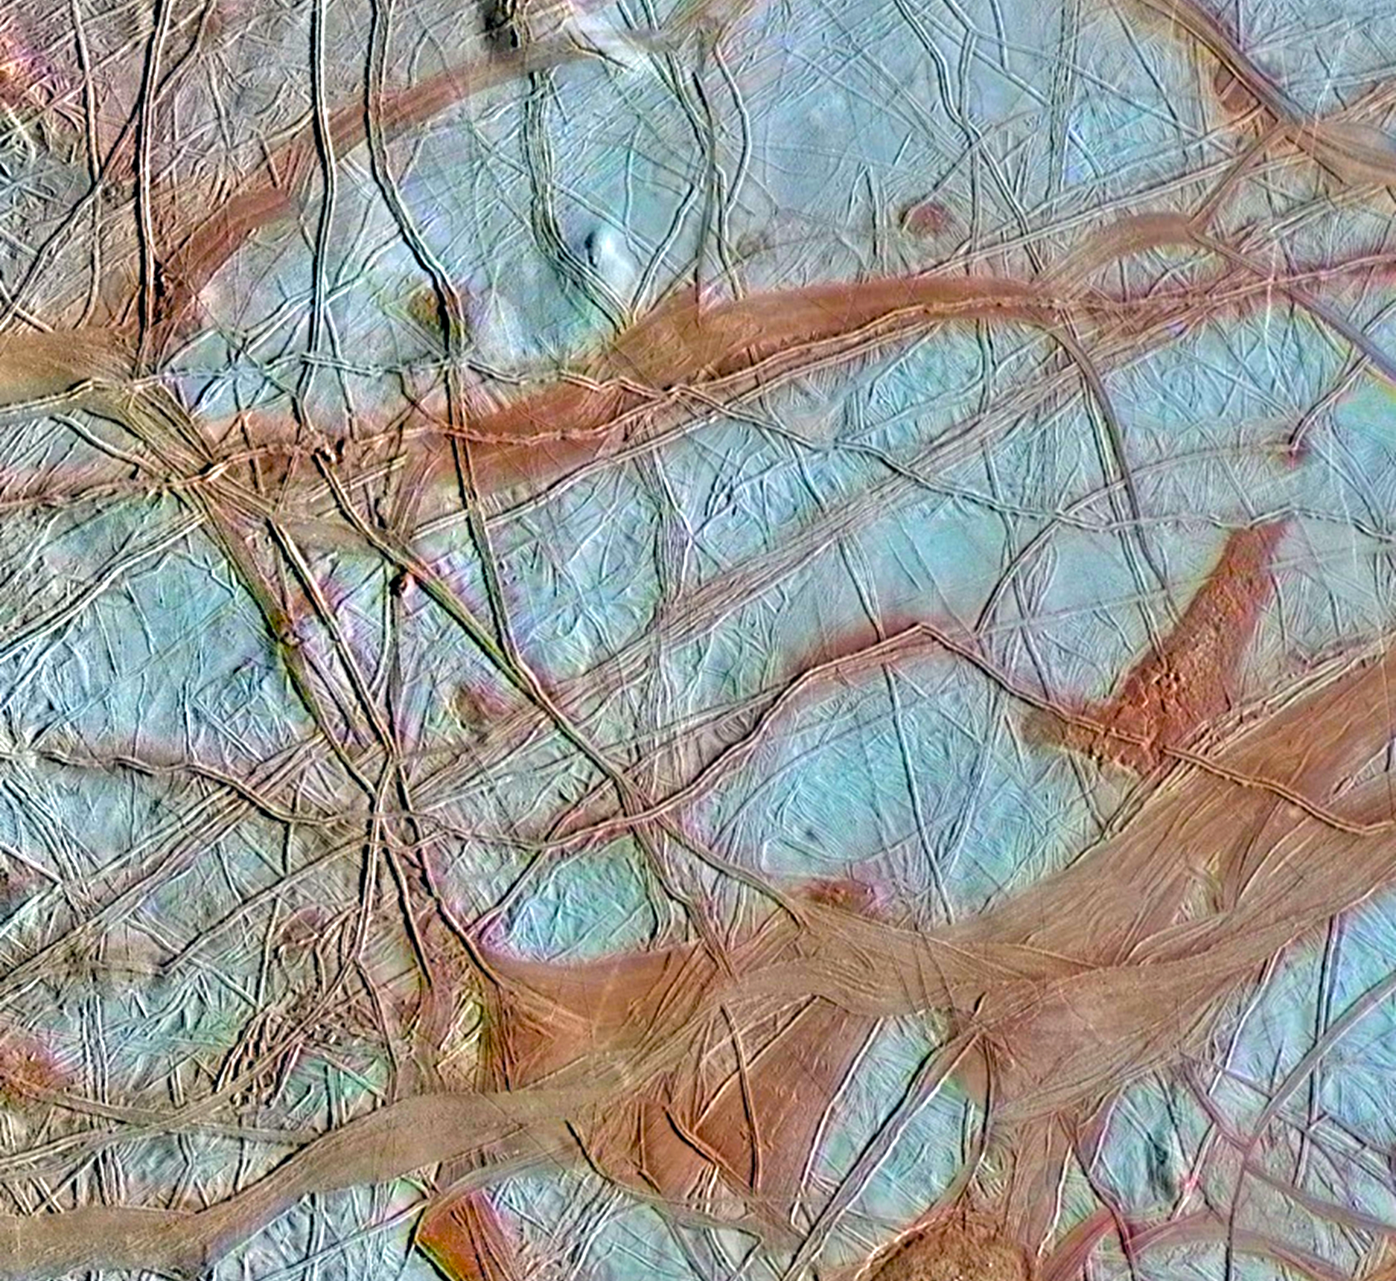
Magnetospheric plasma sources - Europa
According to spectrographic measurements, the reddish bands on Europa's surface are rich in various salts (mainly magnesium sulfate), which originate from the subsurface water.
Sulfur might also be responsible for the reddish color.
Another theory suggests that the discolored areas are covered by organic compounds, tholins. It is still unclear how these compounds are formed, but they could be very significant from an astrobiological perspective, as they may play a fundamental role in prebiotic chemistry and the eventual emergence of primitive life forms.
The presence of NaCl has also been previously detected based on HST measurements."

Slide 20
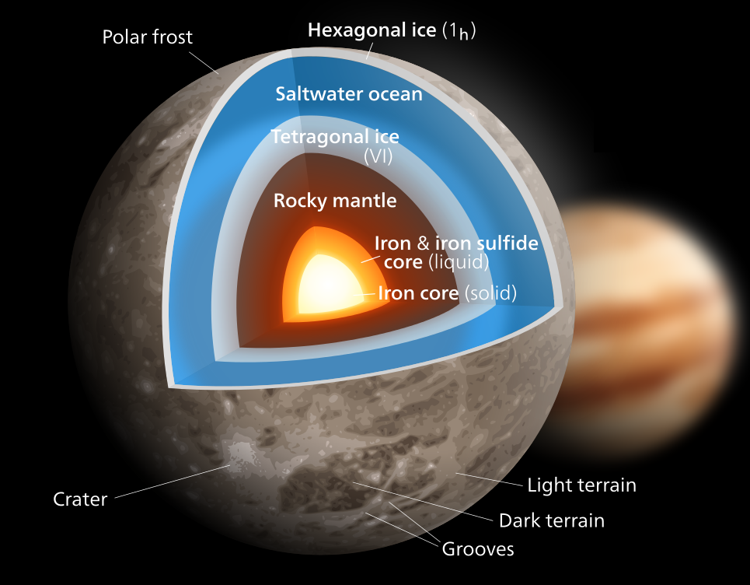
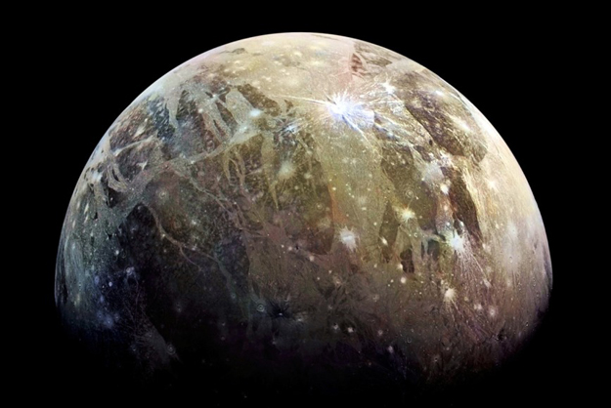
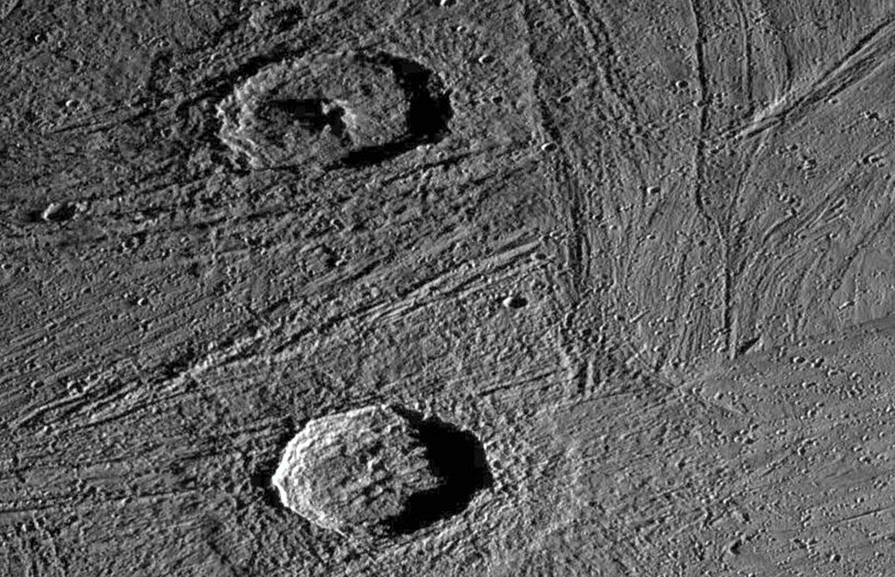
Magnetospheric plasma sources - Ganymede
Larger than Mercury, but less dense, Ganymede is the only known moon in the Solar System with its own magnetic field which is probably maintained by convection occurring in a liquid metallic layer above the iron core.
Globally, it contains approximately equal amounts of silicate and water ice. It may have a well-differentiated internal structure with an iron-rich, liquid core and an ocean beneath its crust.
On Ganymede, we can also see parallel cracks and rifts on the surface, but tidal friction here is not as significant as it is for the inner Galilean moons.

Slide 21
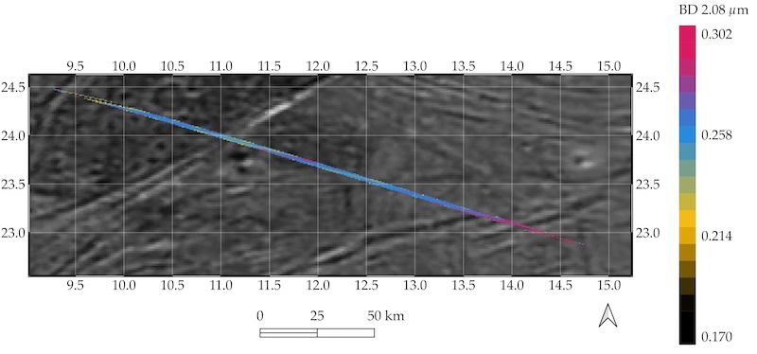
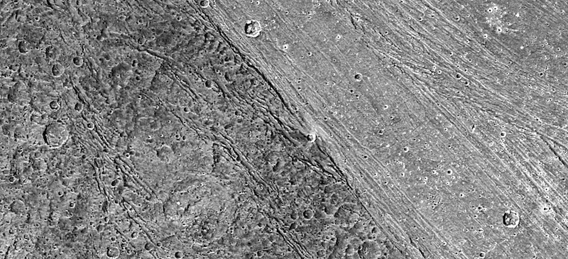
Magnetospheric plasma sources - Ganymede
The composition observed by JUNO/JIRAM (Jovian IR Auroral Mapper) on Ganymede could be a mixture of complex organic molecules, presumably the solid residue of the deep-ocean brine that reached the surface.
Higher-resolution data suggest the presence of the alkane methyl group, possibly associated with aldehydes.
Aldehydes play an important role as prebiotic precursor molecules, have been found in carbonaceous chondrites and potentially in the ice plume ice of Saturn's Enceladus and may result from liquid water activity.
The intrinsic magnetic field may shield the low-latitude/equatorial and the trailing hemisphere from impacting energetic (~50-100 MeV) charged particles.
(Tosi et al., 2022)
Shielded region where most of the salts and organic molecules are found (lat. 10-30° N). (NASA/ JPL/ DLR)

Slide 22
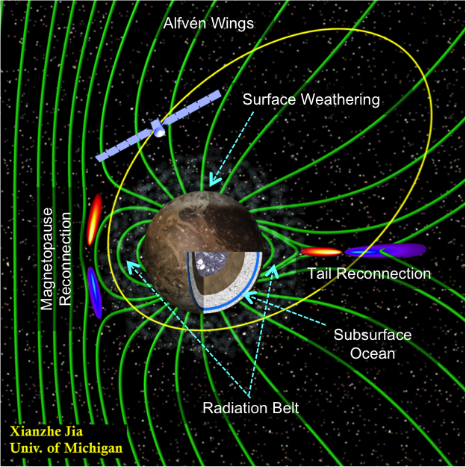
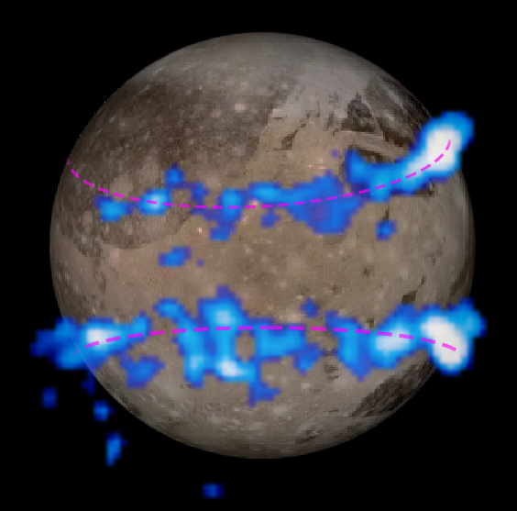
Magnetospheric plasma sources - Ganymede
The magnetic moment is ~3 times that of Mercury.
The magnetic dipole is tilted at an angle of 176° to the moon's rotation axis, so the north pole is below the orbital plane.
The dipole field strength at the equator is ~719 nT (1440 nT at the poles), much higher than the magnetic field strength of Jupiter's magnetosphere along Ganymede's orbit (~120 nT).
Along the equator, the field direction is opposite to Jupiter's magnetic field, so reconnection is possible.
The closed field lines are below 30° latitude, where charged particles are trapped, creating a kind of radiation belt.
Observations of aurora movements by Hubble also suggested the existence of an extensive, salt water layer.

Slide 23
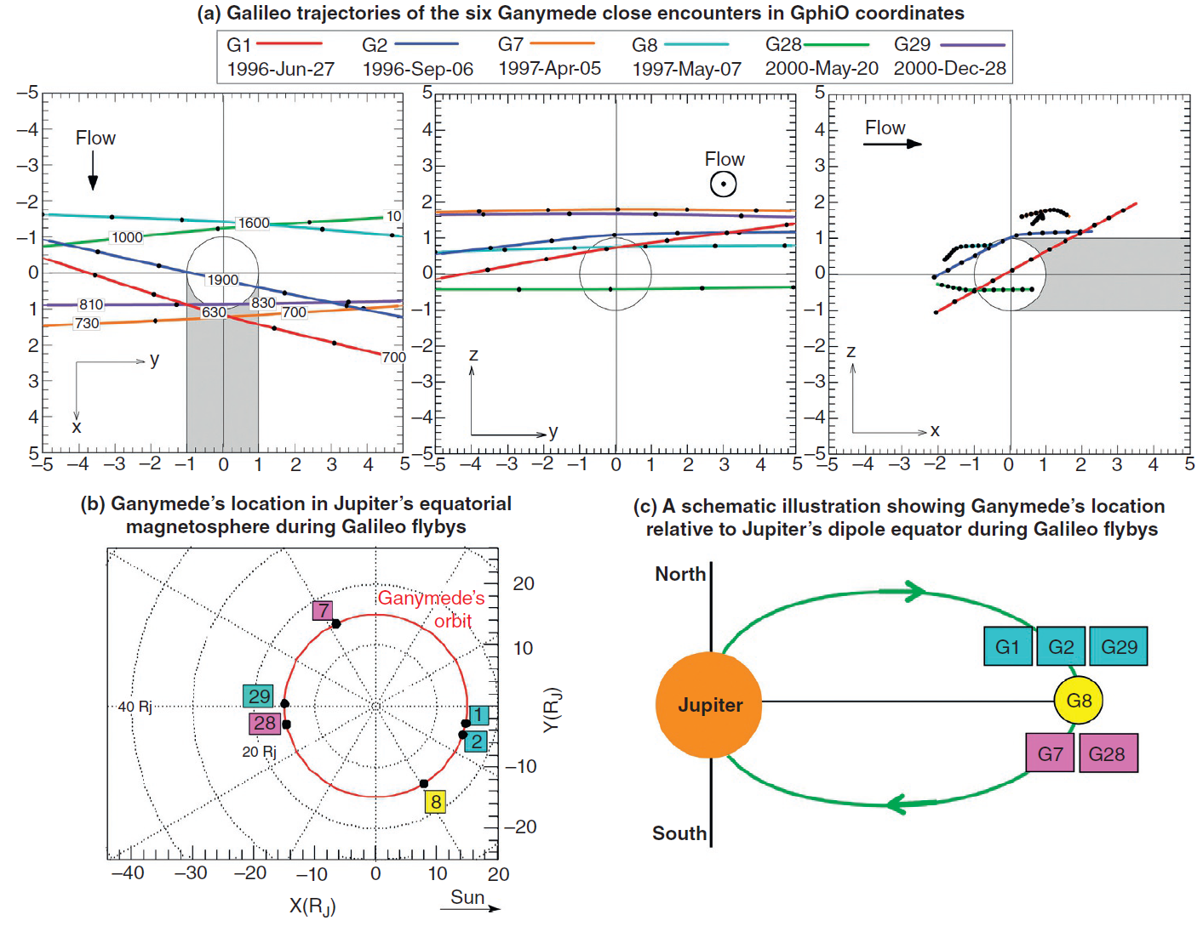
Magnetospheric plasma sources - Ganymede
The Galileo spacecraft made six close flybys of Ganymede from 1995 to 2000 (G1, G2, G7, G8, G28 and G29).
Discovered that Ganymede has a permanent (intrinsic) magnetic moment independent of the Jovian magnetic field.
CA of the Galileo flybys: 260-3100 km
Juno spacecraft performed two flybys in 2019 and 2021.
CA of the Juno flybys: ~1040 km
JUICE will enter into orbit around Ganymede in December 2034, periapsis will be ~500 km.
(NASA/JPL-Caltech/SwRI/Duling)
(Jia and Kivelson, 2021)

Slide 24
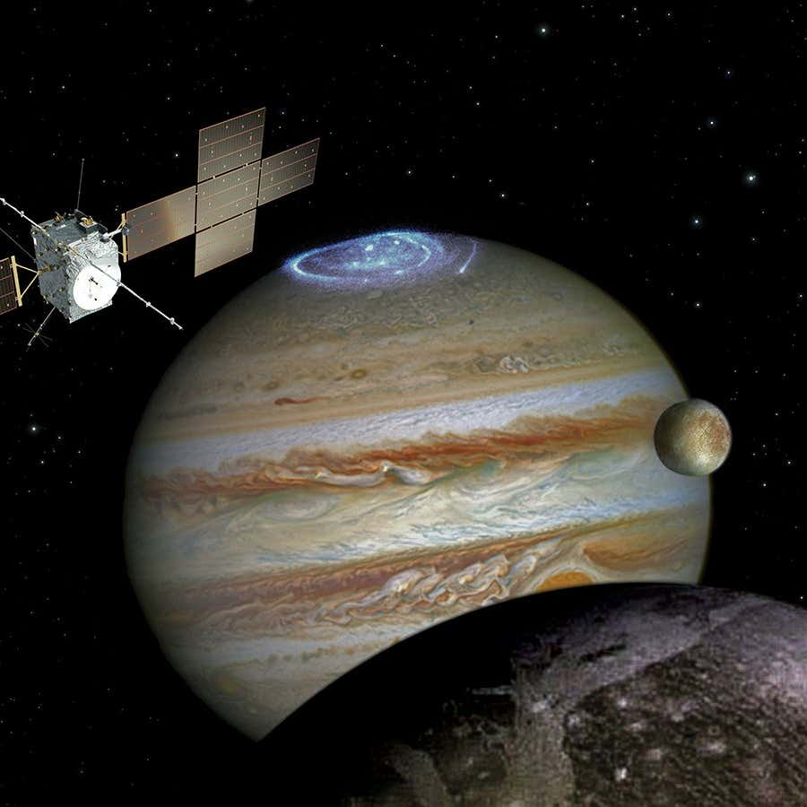
The JUICE mission to Jupiter
JUpiter ICy moons Explorer (JUICE)
Launch: April 14, 2023.
JUICE is the first large mission chosen in the framework of ESA's Cosmic Vision 2015-2025 program.
JUICE is designed to study 3 large Jovian satellites: Ganymede, Europa, and Callisto.
A three-year orbital survey of the Jupiter System (67 orbits).
Different periods and inclinations, alltogether 35 flybys of Europa (2), Ganymede (12) and Callisto (21).
Then, an additional 9 months in orbit around Ganymede.

Slide 25
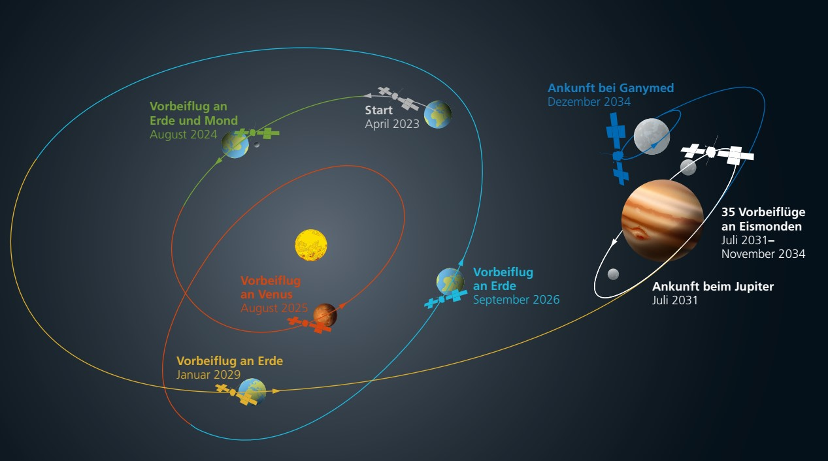
The JUICE mission on its way to Jupiter

Slide 26
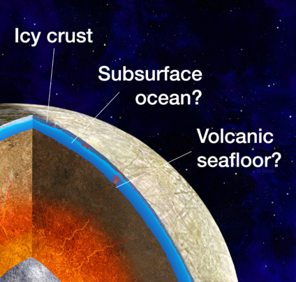
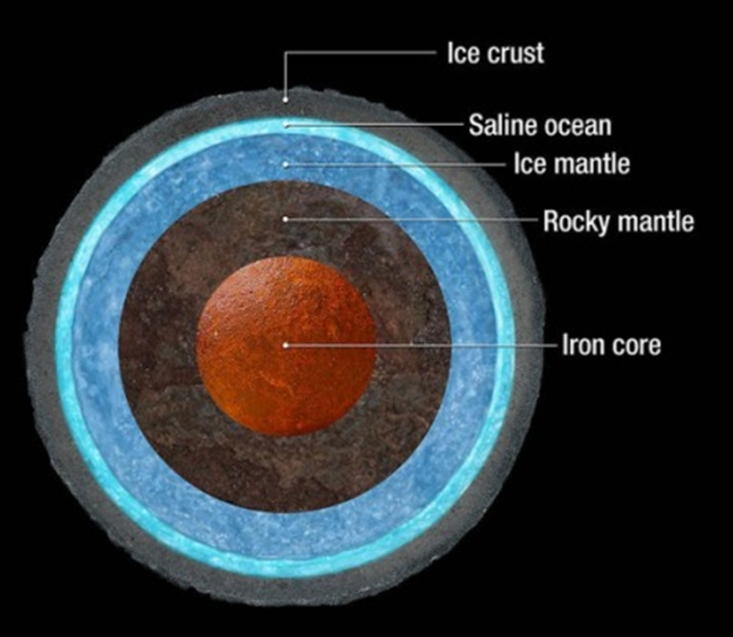
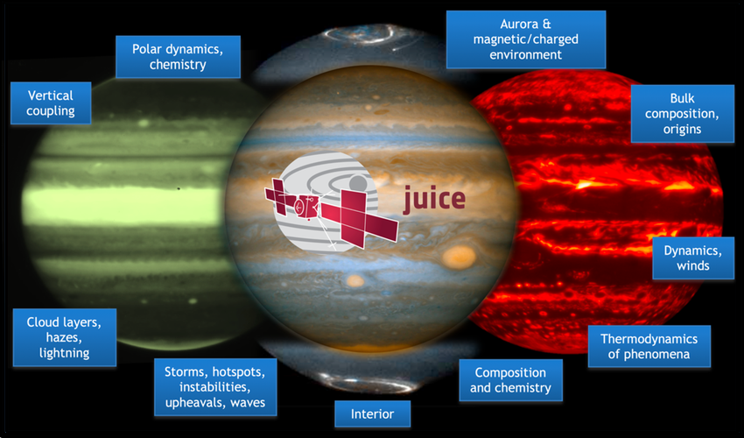
Scientific objectives of JUICE
To characterize the conditions that might have led to the emergence of habitable environments among the Jovian icy satellites.
Also, a multidisciplinary investigation of the Jupiter system as an archetype for gas giants.
With the onboard instruments of JUICE the international team of researchers will conduct in-situ measurements to find more indirect evidence for the existence of the moons' hypothesized subsurface oceans.
Furthermore to determine whether the conditions for primitive life (adequate heat source, liquid water, organic material) might be present in some form.
It is important to point out that JUICE itself will not look for direct signs of life.

Slide 27
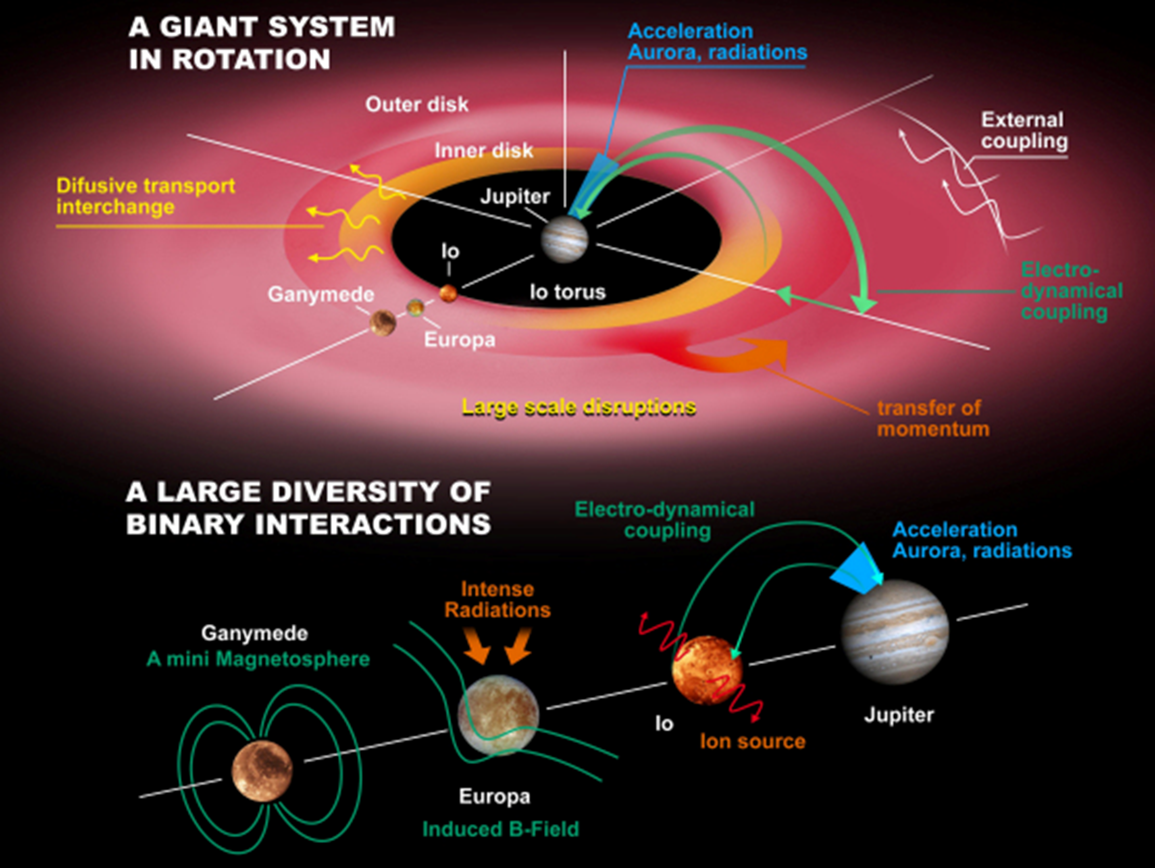
Fundamental objectives:
What are the conditions for planet formation and the emergence of life?
How does the Solar System work?
Major science themes:
The emergence of habitable worlds around gas giants.
The Jupiter system as an archetype for gas giants.
Coupled processes at Jupiter:
Gravitational - between Jupiter and its system of satellites
Electrodynamic - between the moons and the Jovian atmosphere and magnetosphere.

Slide 28
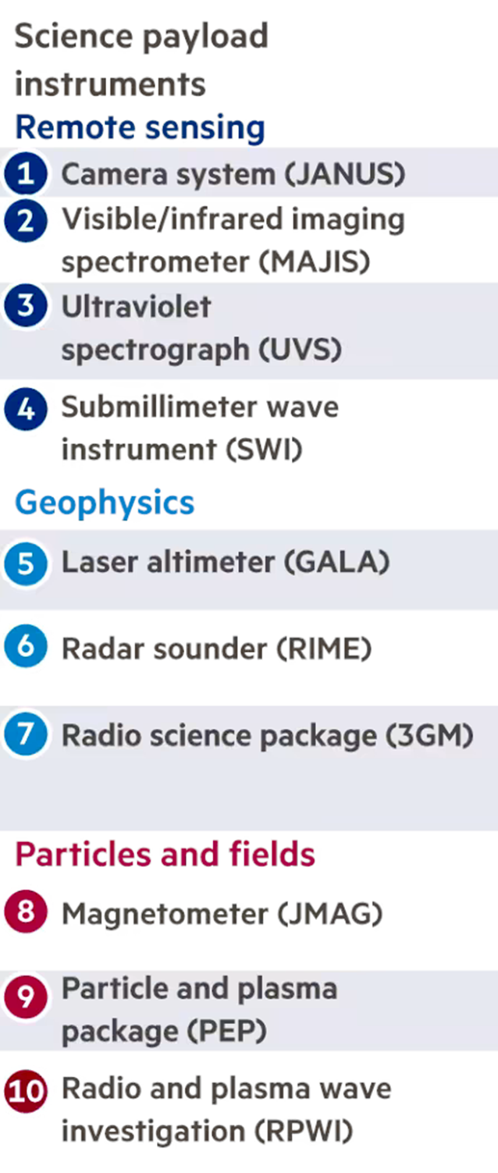
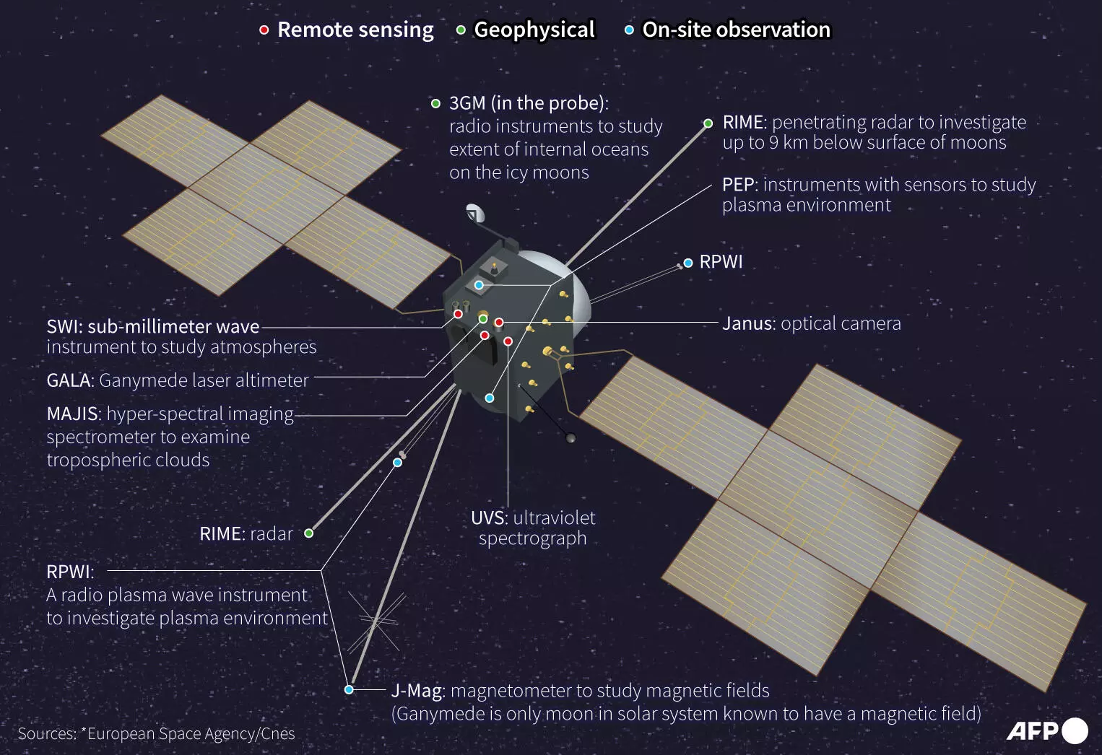
Data Volume ~1.4 Gb per day

Slide 29
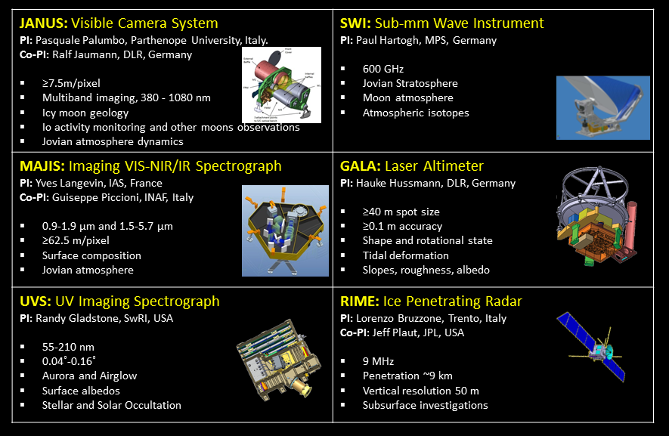
Onboard instruments
Highlights:
JANUS: Resolutions better than 400 m/pixel, best is 2.4 m.
MAJIS: Jovian atmosphere, ices and minerals on moons.
UVS: outermost atmospheres of the moons, Jupiter’s aurorae and upper atmosphere.
SWI: Jupiter’s rings and atmosphere, moons.
GALA: topography, vertical resolution of 10 cm at low altitudes.
RIME: subsurface structures of the moons.

Slide 30
Onboard instruments
Highlights:
3GM: radio waves to trace the strength of Ganymede’s gravitational field, measure the extent of any subsurface ocean in the three icy moons.
PEP, RPWI and J-MAG will study the magnetic and plasma environment in the jovian system, investigate the interaction between the magnetic fields of Jupiter and Ganymede.
PRIDE: communication with Earth-based radio telescopes to precisely map the spacecraft’s location in space.

Slide 31
Participation of the Wigner RCP and the SGF Ltd. in JUICE
PEP (Particle Environment Package) will detect electrons, ions, high-energy neutral atoms, and neutral gas in the environment of Jupiter within the energy range of 0.001-1 MeV and above.
It consists of two measuring units and six sensors.
The Space Technology team developed the power supply unit DCC (Direct Current Converter) for the sensors of PEP (Nagy et al., 2022).
It was a challenging task, because of the required high reliability in extreme operational circumstances.
For the testing a special equipment, EGSE (Electronic Ground Support Equipment) was developed by the SGF Ltd. and supported the testing of DCC.

Slide 32
Participation of Wigner RCP and the SGF Ltd. in JUICE
Our legacy in giant planet exploration by our participation in the Cassini mission to Saturn.
We will have the opportunity to:
study the velocity distribution of magnetospheric particles in the environment of the icy moons,
determine the composition of the magnetospheric plasma,
study the interaction between the magnetospheric plasma and particles originating from the surfaces of the moons,
investigate the physical processes related to the auroras of Jupiter and Ganymede,
analyze the erosion of the moons' surfaces caused by external impacts, including the neutral and charged particles escaping from the surface,
and examine the composition of the moons' exospheres.

Slide 33
The challenges of a harsh environment
Most spacecraft avoid the radiation belts and the damage they cause to sensitive electronics.
The energetic protons in Jupiter’s radiation belts can reach energies over 50 times higher than at Earth.
The synchrotron radiation emitted by energetic electrons is would not damage spacecraft, but it provides information about the high-energy electrons emitting it, which are the potential hazards.
Earth-based radio telescopes have mapped some wavelengths of synchrotron emissions from Jupiter's radiation belts.
Scientists and engineers use that information and the scientific data collected by previous space missions to model the belts and estimate their potential to damage spacecraft.

Slide 34
Protecting spacecraft from radiation - Juno
NASA’s Juno spacecraft crossed the radiation belts, and received a dose of ~500 mSv (human tolerance: ~50 mSv/year).
A special radiation vault was installed on the propulsion module; titanium with walls or nearly 1 m², about 1 cm thick. The whole vault weighs about 200 kg.
This titanium box encloses Juno's command and data handling units, power and data distribution unit and about 20 other electronic assemblies.
The vault doesn't completely prevent every Jovian electron, ion or proton from hitting the system, but it will dramatically slow down the aging effect radiation has on electronics for the duration of the mission.
Source: NASA/JPL-Caltech/LMSS

Slide 35
Protecting spacecraft from radiation - JUICE
For JUICE a detailed radiation model (JOvian Specification Environment; JOSE) was developed to serve as reference for engineers to build and test the instruments.
The model is based on data from all previous missions to Jupiter (Pioneer, Voyager, Cassini, Galileo).
JOSE is allowing mission planners to generate candidate spacecraft trajectories and assess their resulting radiation exposure.
Therefore JUICE will not visit Io and will only have 2 flybys at Europa (21 at the outermost Callisto) before entering into orbit around Ganymede - its magnetic field will contribute to shielding the spacecraft for the rest of the mission.
Sealing one of JUICE's lead vaults. Source: ESA
@Io B~2000 nT, 3600 rem/day (5x the lethal limit).
@Europa B~400 nT, lethal radiation in a few hours.
@Ganymede 50–80 mSv (5–8 rem) per day.

Slide 36
Thank you!

