Slide 1
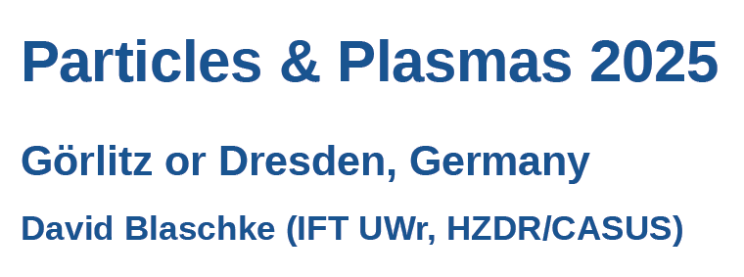
Density functional approach to neutron star astrophysics
David Blaschke (HZDR/CASUS & IFT UWr)

Slide 2
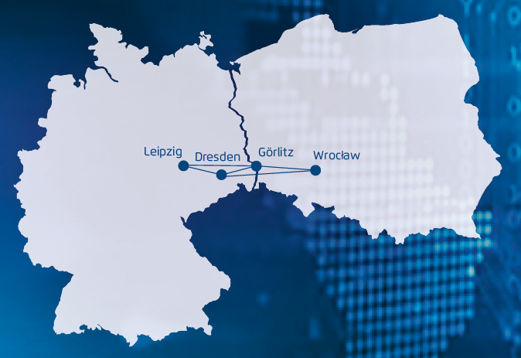
A NEW RESEARCH TRIANGLE
POLAND
Berlin
Warsaw
GERMANY

Slide 3
A NEW RESEARCH TRIANGLE
POLAND
Berlin
Warsaw
GERMANY

Slide 4
A NEW RESEARCH TRIANGLE
POLAND
Berlin
Warsaw
GERMANY

Slide 5
A NEW RESEARCH TRIANGLE
POLAND
Berlin
Warsaw
GERMANY

Slide 6
A NEW RESEARCH TRIANGLE
POLAND
Berlin
Warsaw
GERMANY

Slide 11
Polish-German WE-Heraeus Seminar &
Max Born Symposium:
https://events.hifis.net/event/1076
David Blaschke - Towards a unified approach to quark-hadron matter |
<number>

