Slide 1
The GPU partition of the Komondor supercomputer
Zoltan Juhasz
HPC Competence Centre KIFÜ
University of Pannonia

Slide 2
HPC Competence Centre – hpc.kifu.hu
Key roles
HPC user support
HPC knowledge transfer
HPC outreach and education, user training
International cooperation with other EU HPC Competence Centres
Target groups
academic research community
government
industry
international partners
Domain Software porting and/or development support
Advanced
Technical consulting
User technical support
Standard
Infrastructure access
Basic
User and project management

Slide 3
The Komondor Supercomputer
HPE CRAY EX System
Compute performance: 6.13 Pflop/s
# 300 on the TOP500 List
4 partitions: CPU, GPU, AI, BigData (EX425 and EX235n Compute Blades, HPE Apollo 6500 Gen10+, HPE Superdome Flex
State-of-the-art technology powering Frontier [#1], Aurora [#2], LUMI [#5], Perlmutter [#12], etc) supercomputers

Slide 4
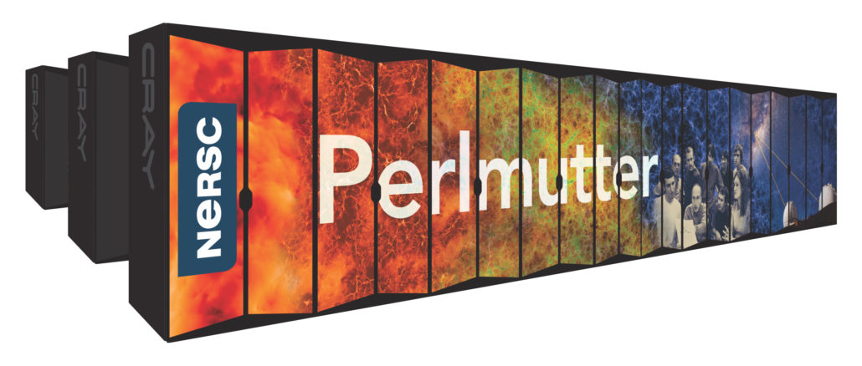
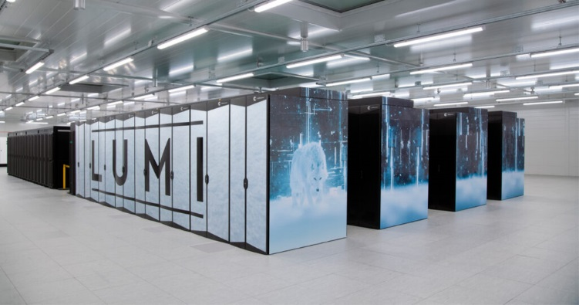
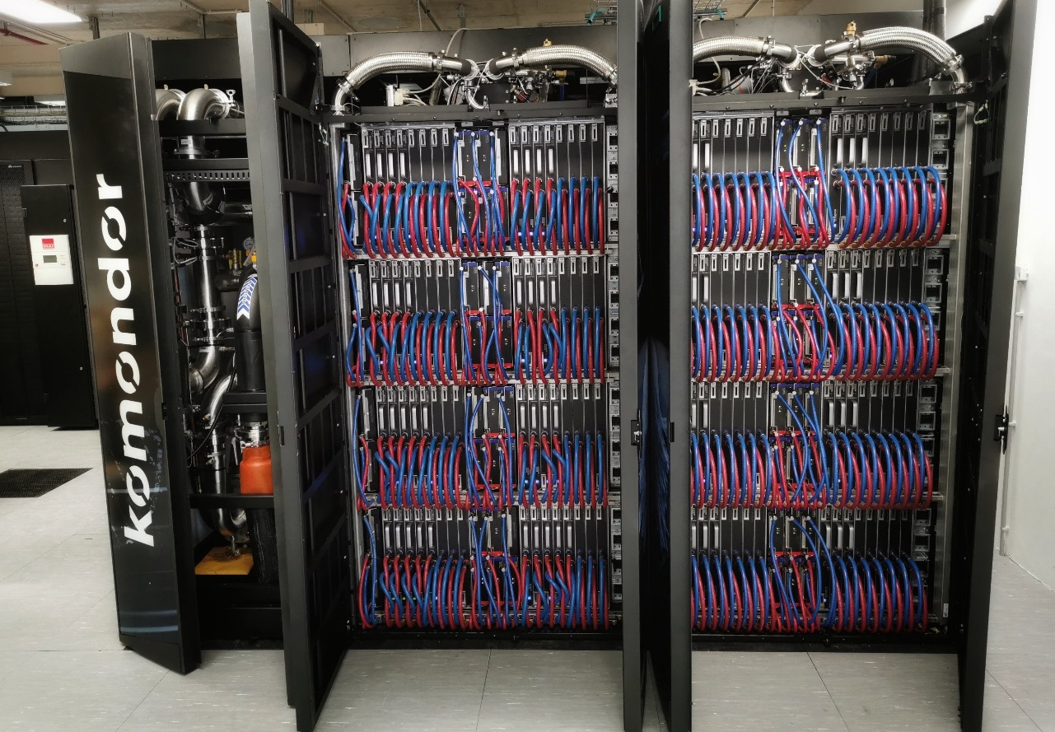
The CRAY EX family

Slide 5
Basic statistics (as of 15 May 2024)
System operational since August 2023
223 active projects, 1000 active users
Number of submitted jobs: 2,672,064
Increasing system utilisation: from 40-50 % (last year) to 80-90 % (current)
partition | # jobs | share
cpu | 1,182,945 | 44.27%
gpu | 1,483,271 | 55.51%
bigdata | 3,193 | 0.12%
ai | 2,655 | 0.10%
ai, gpu (hybrid job) | 2 | 0.00%

Slide 6
Project statistics – traditional projects

Slide 7
Project statistics – pilot projects

Slide 8
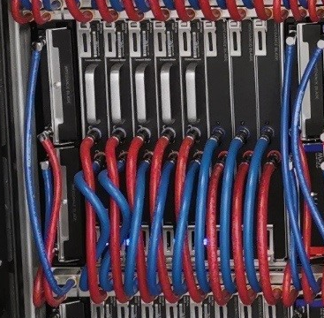
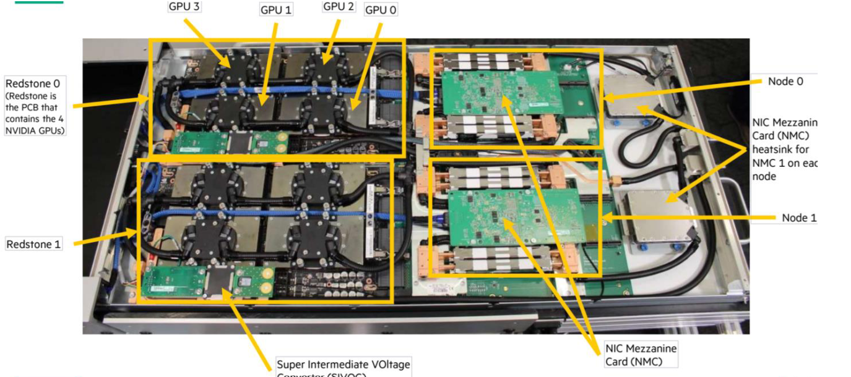
System Architecture
System
Cabinet
Chassis (8 per cabinet)
Blade (8 per chassis)
Node (2 per blade)
1 CPU, 4 GPUs per node

Slide 9
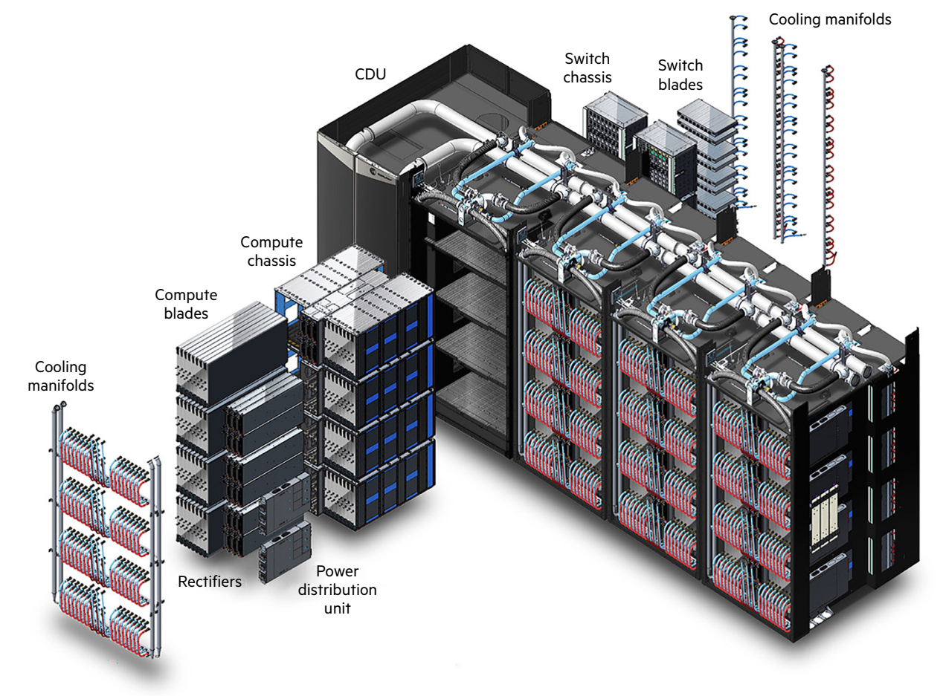
GPU partition
1 cabinet if fully loaded
8 x 8 = 64 blades
64 x 2 x 4 = 512 GPU cards
Komondor GPU part.
29 blades
58 nodes
232 GPUs

Slide 10
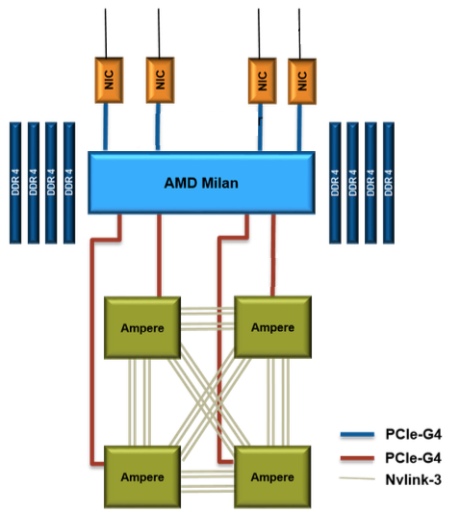
Node architecture (EX235n blade)
Two nodes per blade
Each node has:
1 AMD EPYC Milan 7763 CPU (64 cores)
4 Nvidia A100 (Ampere) GPUs
8 DIMMs per CPU socket (1DPC)
PCIe 4.0 (32 GB/s) GPU-CPU and NIC-CPU connection
2 HPE Slingshot 11 NICs (200 Gb/s)
256 GB of DDR4 DRAM: 204.8 GB/s CPU bw
40 GB of HBM per GPU with: 1555.2 GB/s GPU bw
4 third generation NVLink connections between each pair of GPUs, 25 GB/s/direction per link, 200 GB/s total BW point-to-point

Slide 11
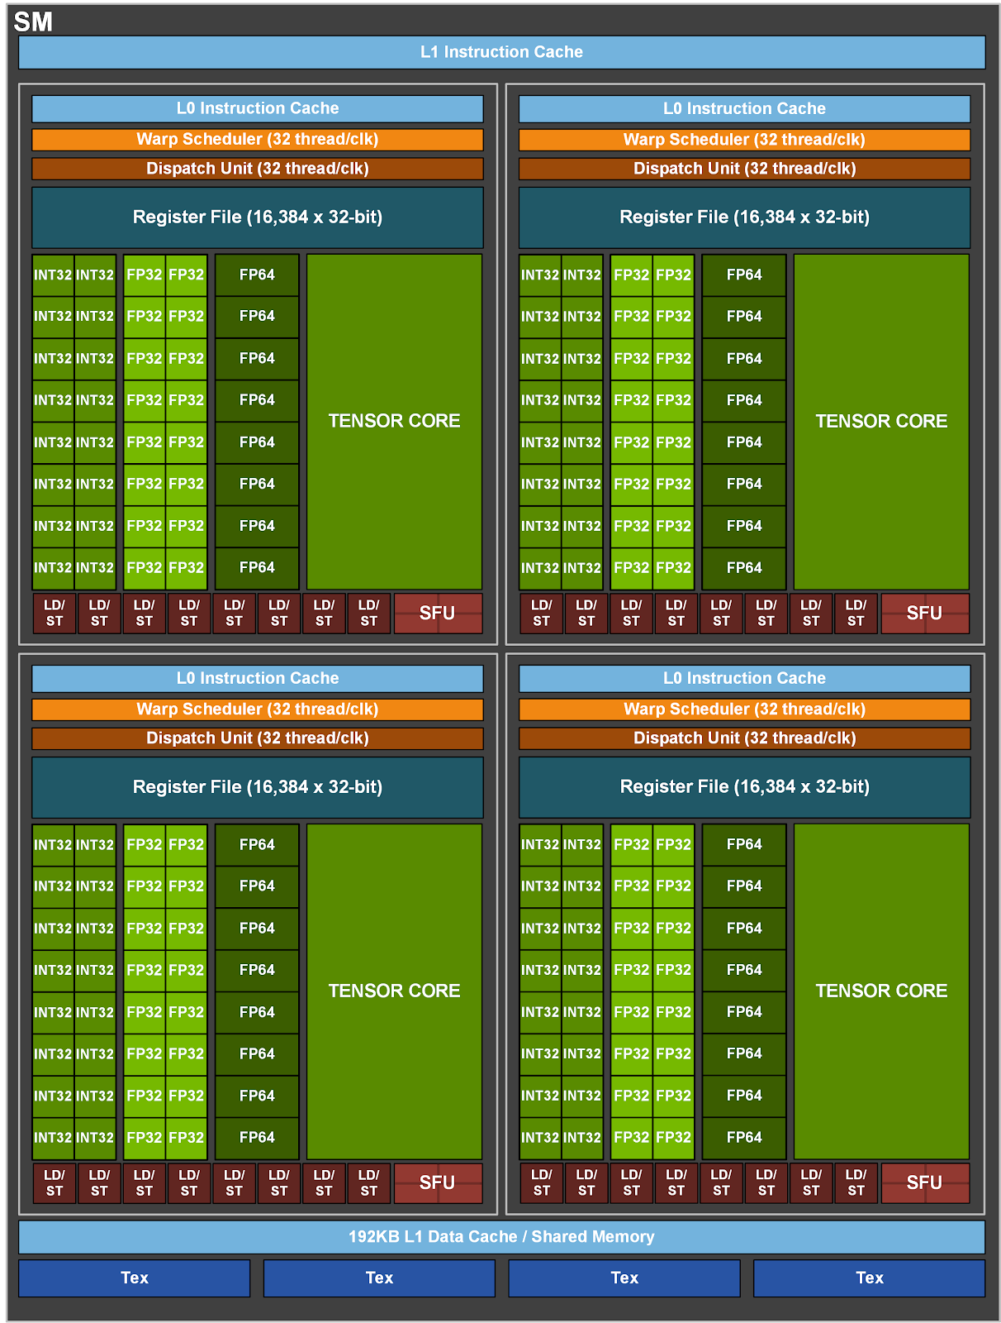
A100 GPU architecture
6912 FP32 CUDA cores (64/SM)
6912 INT32 CUDA cores
3456 FP64 CUDA cores
432 3rd gen Tensor Cores
SM: Streaming
Multiprocessor
108 SMs in total
Performance
Peak FP64 | 9.7 TFLOPS
Peak FP64 Tensor Core | 19.5 TFLOPS
Peak FP32 | 19.5 TFLOPS
Peak FP16 | 78 TFLOPS
Peak BF16 | 39 TFLOPS
Peak TF32 Tensor Core | 156 TFLOPS
Peak FP16 Tensor Core | 312 TFLOPS

Slide 12
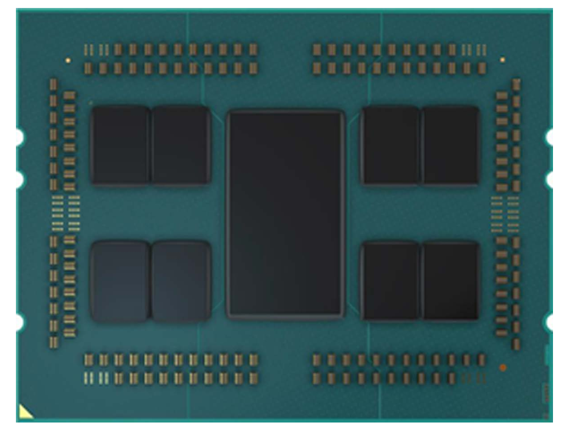
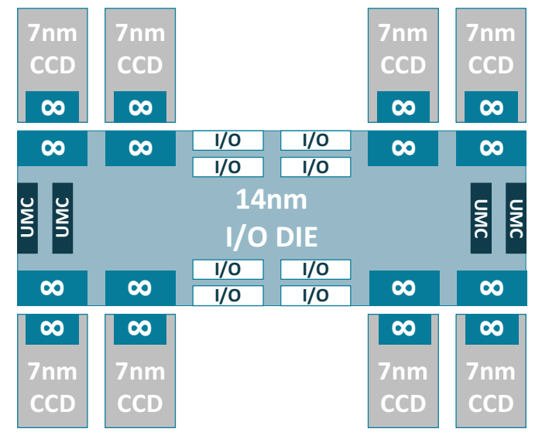
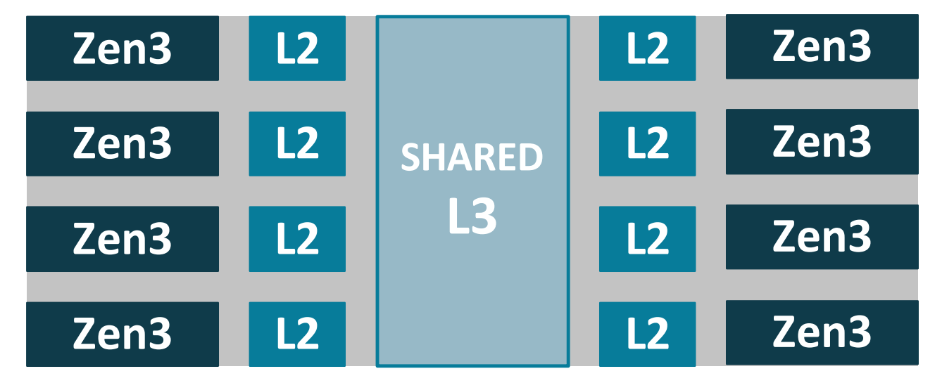
CPU architecture (AMD EPYC Milan 7763 )
Core Complex Die (CCD)

Slide 13
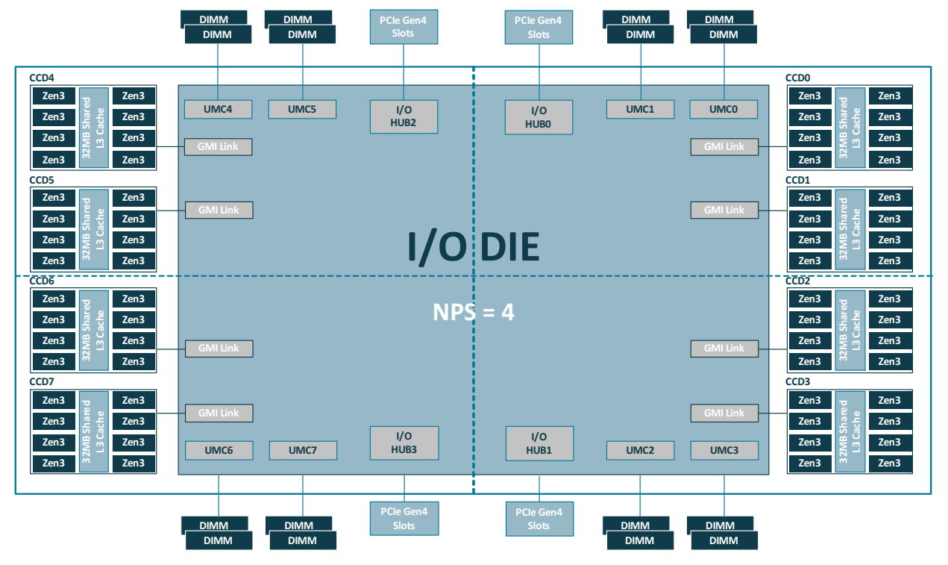
8 x16 PCI-e I/O ports per CPU

Slide 14
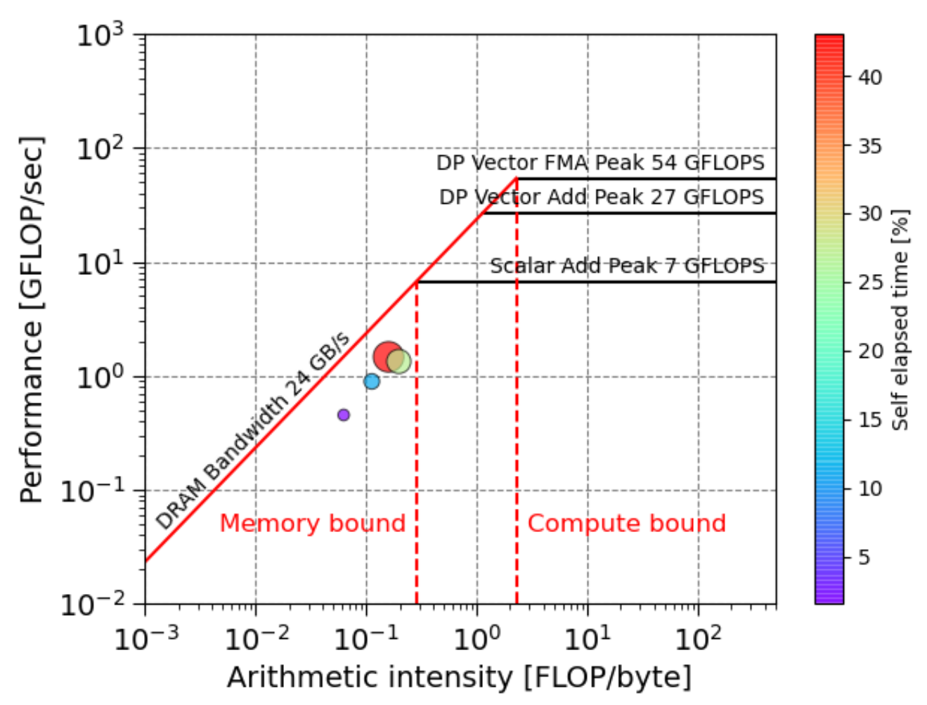
Roofline performance model
CPU theoretical peak performance :
39.2 GFlops per core
2.51 TFlops per socket
Instruction-to-bytes ratio:
$$\frac{\text{peak} \text{performance}\text{ (}\text{G}\text{F}\text{lop}\text{/}\text{s}\text{) } }{\text{peak} \text{memory} \text{bandwidth}\text{ (}\text{GB}\text{/}\text{s}\text{)}}$$

Slide 15
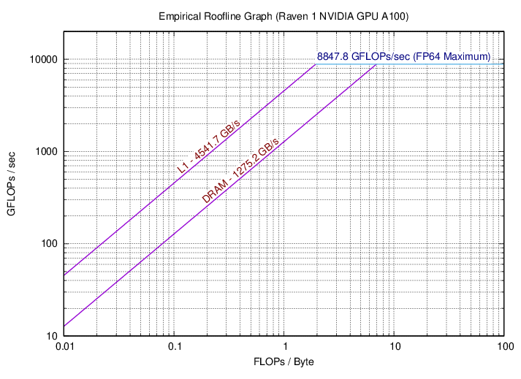
CPU theoretical peak performance :
39.2 GFlops per core
2.51 TFlops per socket
Instruction-to-bytes ratio:
$$\frac{\text{peak} \text{performance}\text{ (}\text{G}\text{F}\text{lop}\text{/}\text{s}\text{) } }{\text{peak} \text{memory} \text{bandwidth}\text{ (}\text{GB}\text{/}\text{s}\text{)}}$$
A100: 12.54 (FP32)
6.24 (FP64)

Slide 16
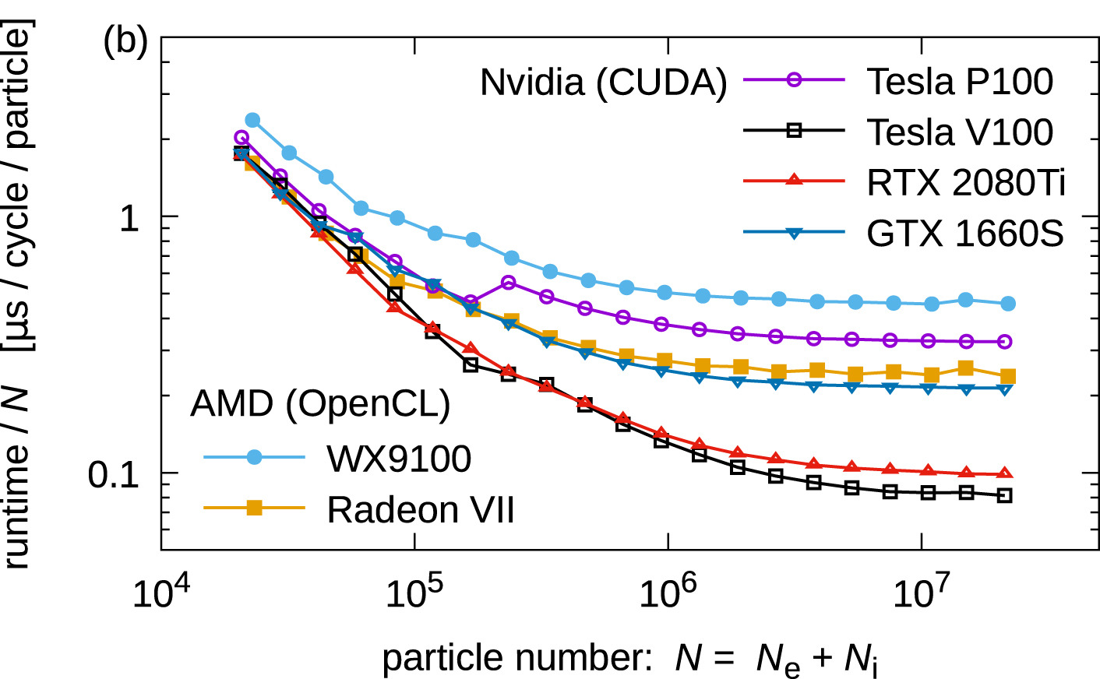
Why and when to use multiple GPUs?
Sufficient work
Saturation effect

Slide 17
GPU partition, chassis internal architecture

Slide 18
Slingshot 11 interconnect
Ethernet-based switch interconnect, scalable to nearly 300k endpoints
max. 3-hop distance to any node
Dragonfly topology
Rosetta switch (adaptive routing, congestion control, multicast, reduction)
2-3 μs internode point-to-point latency
200 Gb/s bandwidth
Hardware support for MPI operations (one-sided communication, collectives)

Slide 19
Programming multi-GPUs
Many programming models, configurations and options
1. How to use GPUs?
Using pre-compiled libraries only
OpenMP/OpenACC offloading
CUDA programming
2. How to communicate among nodes and GPUs?
MPI versions: MPICH vs OpenMPI (host-based or CUDA-Aware)
NVLink
NCCL, etc

Slide 20
Komondor software environment
Module system
CRAY programming environment
MPI versions
GPU specific considerations
CUDA compilation

Slide 21
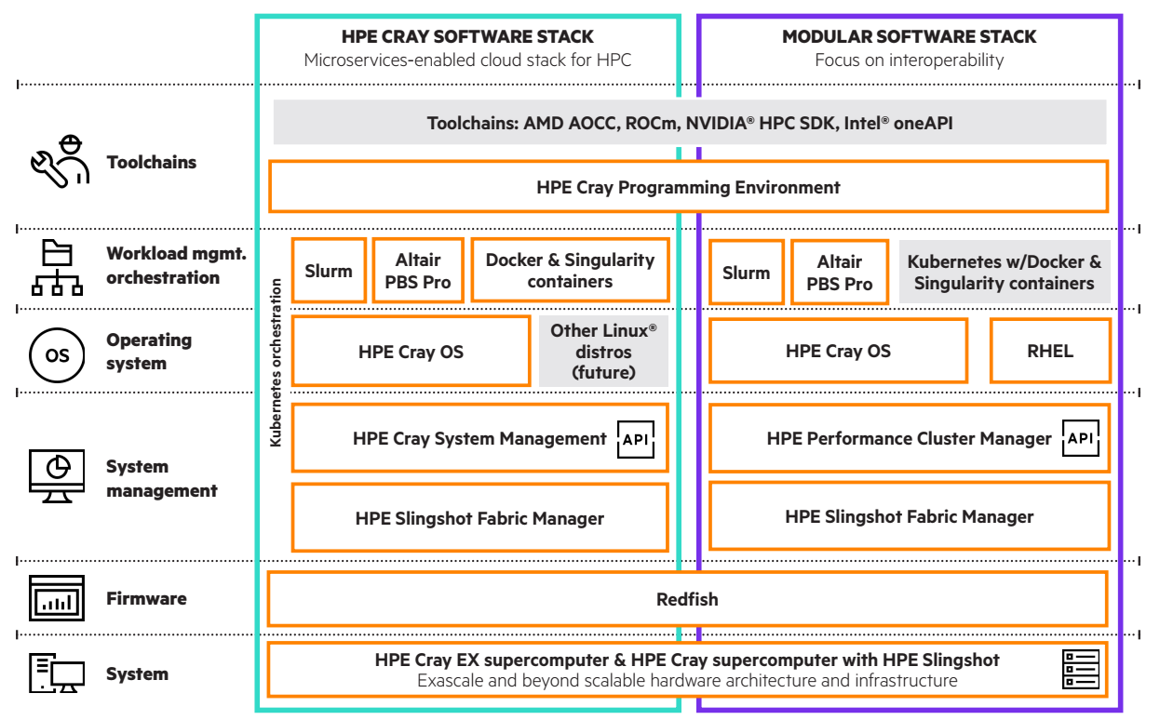

Slide 22
Default modules on Komondor
Currently Loaded Modulefiles/prog. environements:
1) craype-x86-rome 5) cce/16.0.1 9) cray-libsci/23.09.1.1
2) libfabric/1.15.2.0 6) craype/2.7.23 10) PrgEnv-cray/8.4.0
3) craype-network-ofi 7) cray-dsmml/0.2.2 11) sbank
4) perftools-base/23.09.0 8) cray-mpich/8.1.27
Other notable modules:
PrgEnv-nvhpc/8.4.0, PrgEnv-nvidia, cudatoolkit/12.3, nvhpc-hpcx-cuda12/23.11, openmpi/5.0.2

Slide 23
Compiler configuration with modules
Vendor | PrgEnv | Module | Language | Wrapper | Compiler
GNU | PrgEnv-gnu | gcc | C | cc | ${GCC_PATH}/bin/gcc
GNU | PrgEnv-gnu | gcc | C++ | CC | ${GCC_PATH}/bin/g++
GNU | PrgEnv-gnu | gcc | Fortran | ftn | ${GCC_PATH}/bin/gfortran
NVIDIA | PrgEnv-nvidia | nvidia | C | cc | nvc
NVIDIA | PrgEnv-nvidia | nvidia | C++ | CC | nvc++
NVIDIA | PrgEnv-nvidia | nvidia | Fortran | ftn | nvfortran
HPE | PrgEnv-cray | cce | C | cc | craycc
HPE | PrgEnv-cray | cce | C++ | CC | crayCC
HPE | PrgEnv-cray | cce | Fortran | ftn | crayftn

Slide 24
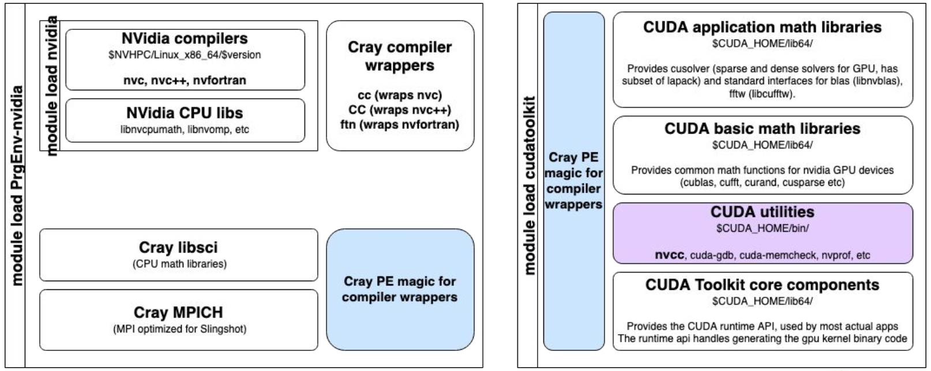
Example modules

Slide 25
GPU code compilation
CASE 1: 1-4 GPUs
cudatoolkit module, nvcc compiler
CASE 2: multinode programs with MPI
Cray-MPICH: works with separate C/C++ and CUDA source files
OpenMPI 5.0: can be used with single combined C/CUDA source files

Slide 26
GPU job execution with SLURM
Use the #SBATCH --gres=gpu:[1-4] option, no jobs will run without this option
Other options
--gpus-per-task: GPUs required per task. Requires the job to specify a task count.
--exclusive
--gpu-bind
--tasks-per-node
Multi Instance GPU (MIG) is disabled, no hardware partitioning of GPUs

Slide 27
Scheduling scenarios
Full node: 1 node and 4 GPUs
Multiple full nodes: exactly N x 4 GPUs
Fractions: 1 node, 1 to 3 GPUs
Many GPUs < Nx4 GPUs
Interactive jobs
User 1
GPU 0
GPU 1
User 2
GPU 2
GPU 3
User 1
GPU 0
GPU 1
User 2
GPU 2
GPU 3

Slide 28
Execution profiling, performance analysis
NSight Systems for program execution information
includes CUDA kernel, CPU execution info + communication information
NSight Compute for kernel analysis
Command line interface only (nsys, ncu)
Save output report into file, download to local workstation for visualisation

Slide 29
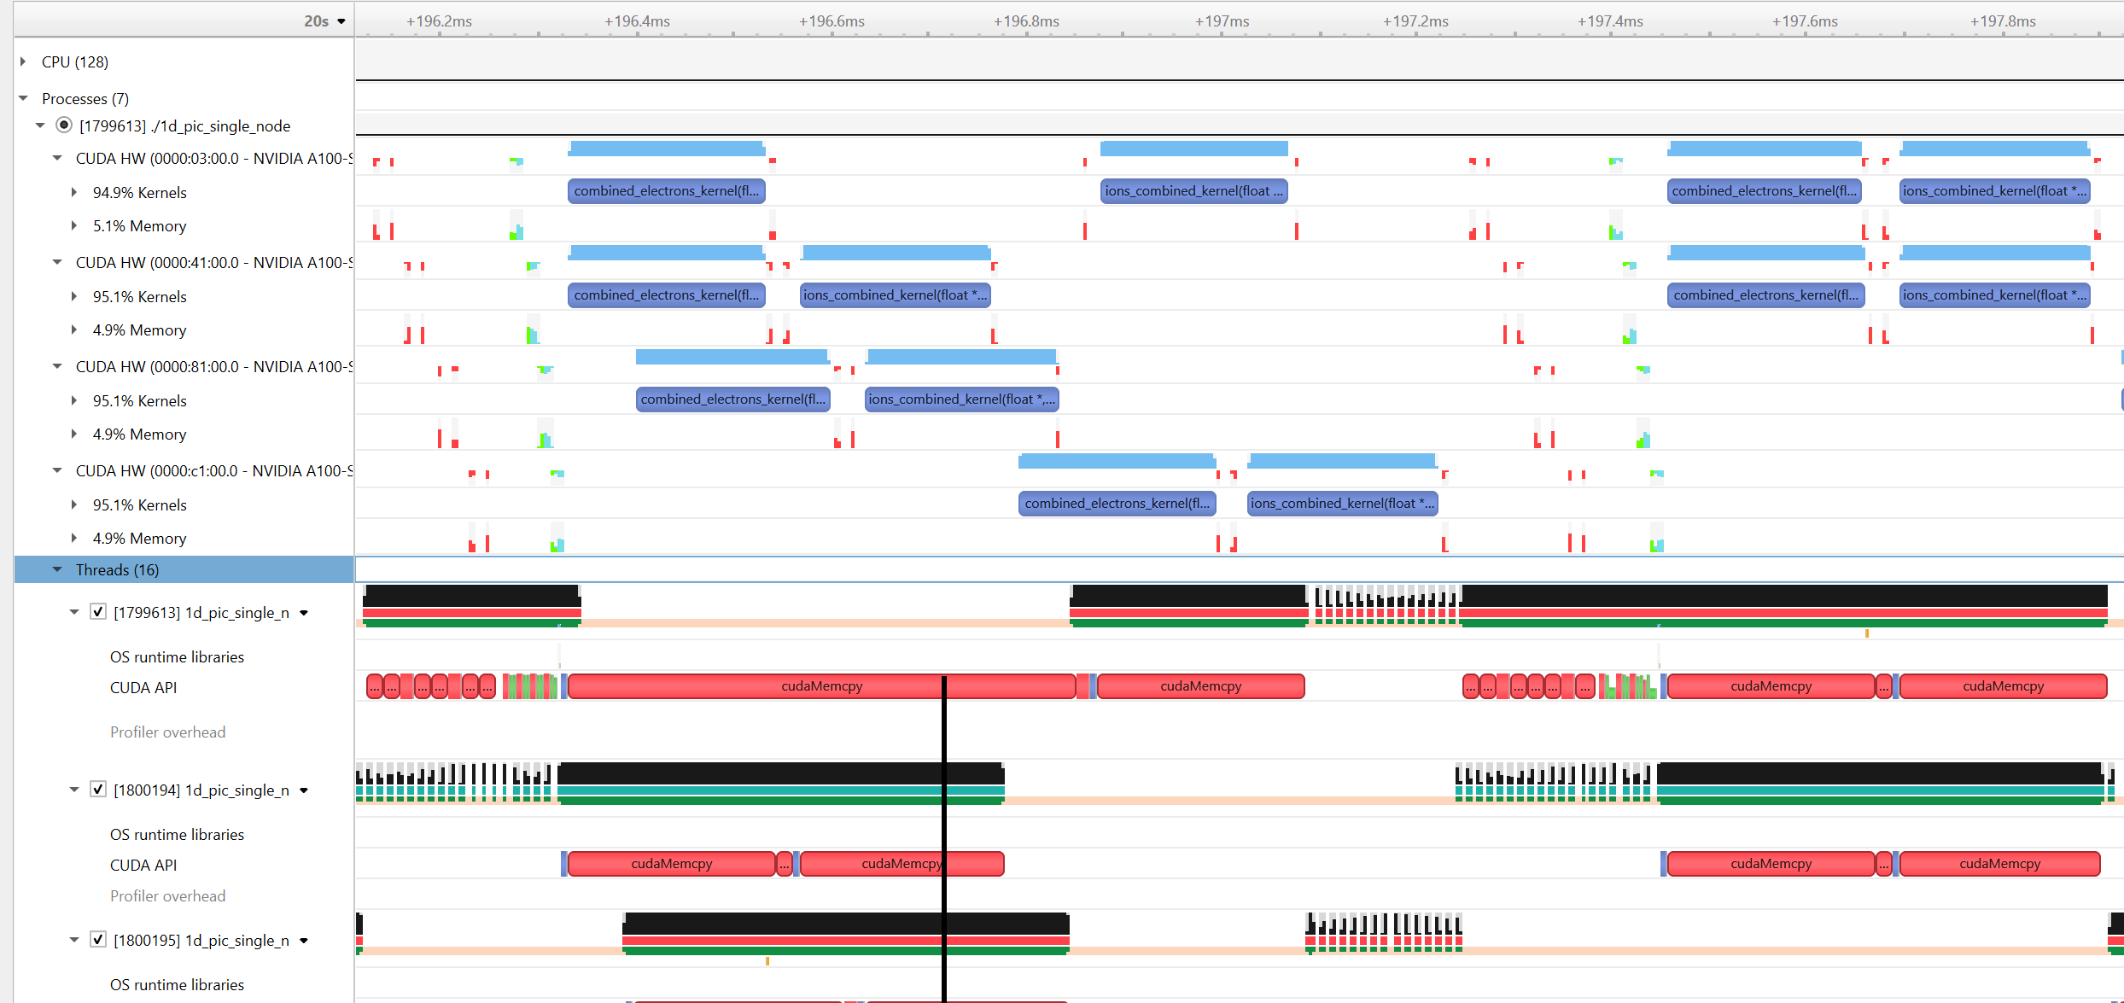
Example, v.1: 4 OpenMP threads, 4 GPUs, blocking CUDA function calls

Slide 30
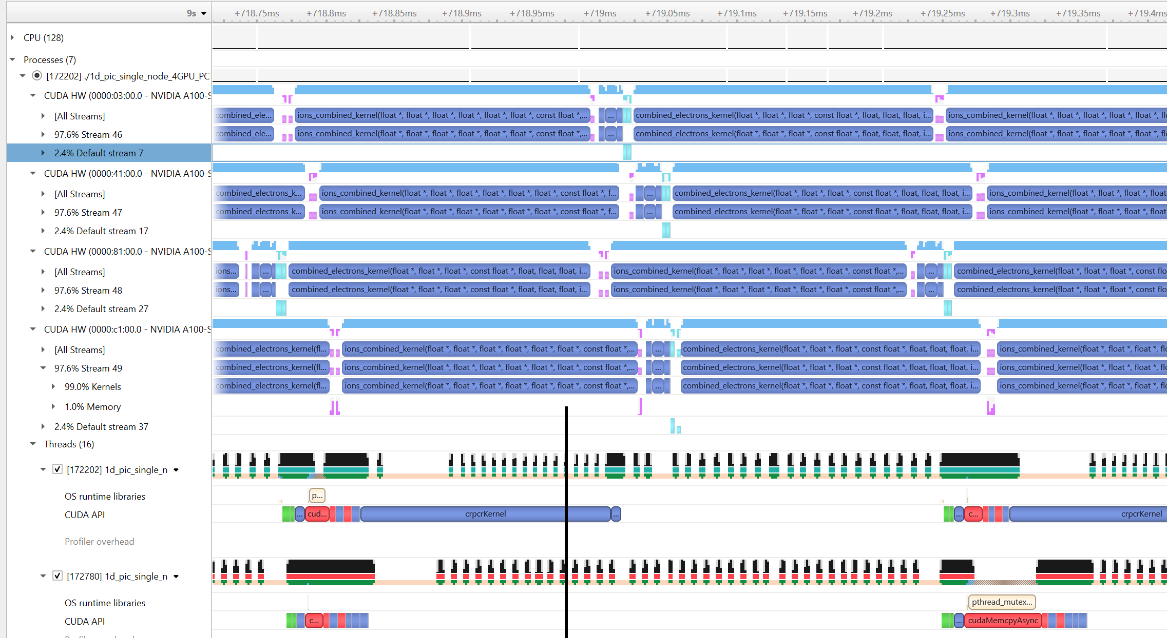
Example v.2: 4 OpenMP threads, 4 GPUs, 4 CUDA streams, async CUDA functions

Slide 31
GPU partition usage and statistics

Slide 32
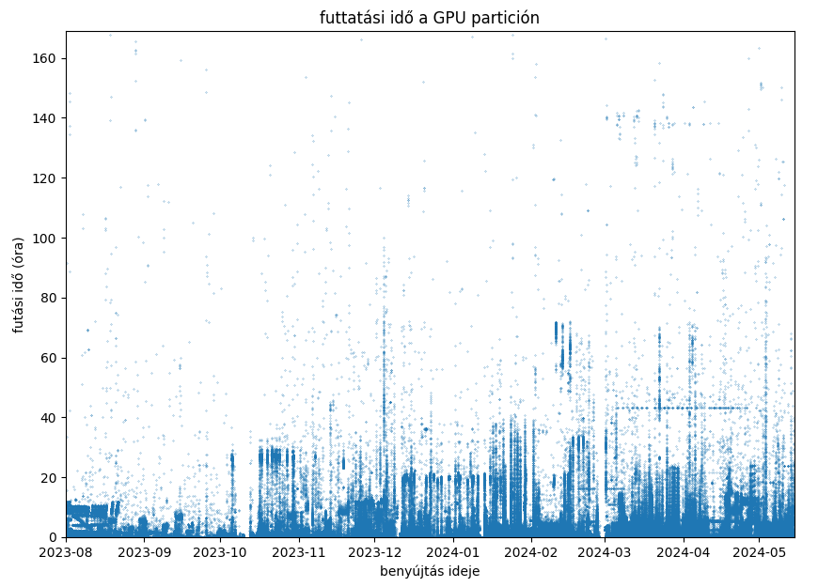
Job runtimes on the GPU partition
runtime (hours)
avg queue time:
< 1 hour
2 days
1 day
submission time

Slide 33
Allocated nodes per jobs (1,483,271 jobs) on the GPU partition
Less than 20 projects use more than 2 nodes!
Largest job uses 32 nodes
!
Job submission time

Slide 34
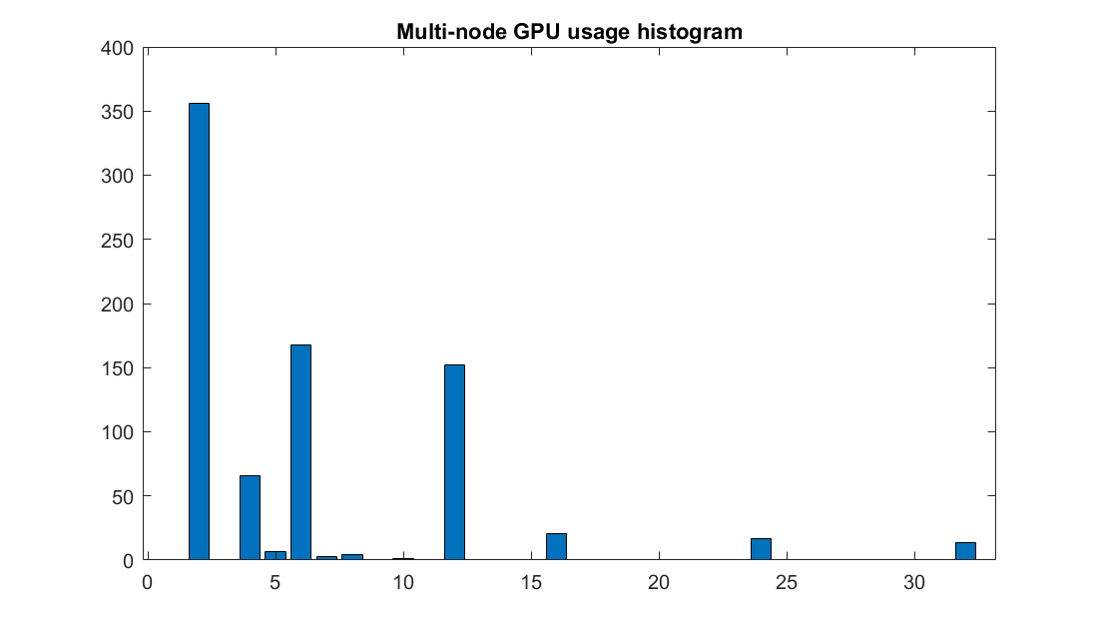
allocated nodes

Slide 35
Summary
The Komondor system is embraced by the research community
Most former supercomputer projects/users migrated
System utilisation is already around 90%
State-of-the-art system, most of the performance in GPU partition
Effective use is not trivial, requires system, hardware and software knowledge/expertise

Slide 36
Summary
Most current jobs are not true HPC jobs (yet) – very few GPUs per jobs, short execution times
Many programs will require performance analysis, optimisation and tuning
Great opportunity to learn, educate community, build up national HPC expertise
The HPC Competence Centre is here to help
Please send your suggestions, feedback or questions to us at hpc@kifu.gov.hu

