Slide 1

On European and hungarian STI ECOSYSTEM
Eurohpc JU partnership and national hpc policy
Ministry for National Economy
István Erényi, PhD
HUN-REN WIGNER RC for PHYSICS, 30-31 May 2024

Slide 2
Part 1. On the EuroHPC
Joint Undertaking (JU)

Slide 3

SCIENCE AND TECHNOLOGY DEVELOPMENT - TODAY
New requirements of modern economies and technologies
Accelerating global economic and societal progress
New and more mutual interdependence between science and technology
Science and technology becoming much more than ever multidisciplinary
Global competition is more apparent and increasing, especially between the US, Europe and Asia
Data „economy” and IT becoming as a cross sectoral general tools in science and economy
AI with new prospects both for developers and users
More collaboration

Slide 4
European partnerships programmes
Types of Partnerships
Partnership of the
Union (Commission)
Member States and/or
Private sector representatives
Partnership for tackling the most challenging areas, tasks,
i. 11 Institutionalised partnerships,
ii. 9 EIT-Knowledge and Innovation Communities,
iii. 12 co-programmed partnerships, based on a Memorandum of Understanding,
iv. 16 co-funded partnerships, based on programme co-fund actions
EuroHPC Joint Undertaking on supercomputing infrastructure and ecosystems - the first one, since 2018, renewed in 2021.
KDT (Key Digital Technologies (the Chip JU) on Chip developing and manufacturing
1500+ KKV digitális érettség mérése
Institutionalised partnerships
Co-programmed
partnerships
EIT
Knowledge and
Innovation
partnerships
3000 fő számára technológiai képzés
Co-funded
partnerships

Slide 5
What does the EU expect from the partnership programmes?
Collaboration brings together scientists, experts, exchanging ideas
  Joint actions, joint development tasks has its multiplying effect on getting result faster, better, more efficiently
  Attracts more active partners
  Better, more interesting environment has its effect to keep home European professionals
More effective participation in joint developments
  Partners become much more motivated toward joint actions
  Participants consider the partnership collaboration and the actions to be done in order to achive the goals for their own tasks
  Multidisciplinarity tightens cooperation of various fields and experts
Joint financing for more results
  The partners financial and/or „in kind” contributions
  Tighter control on spending and achieved results
In general
  Faster progress is offered for the European Science, Innovation and Technology
  Keeping pace with the strongest global competitors

Slide 6
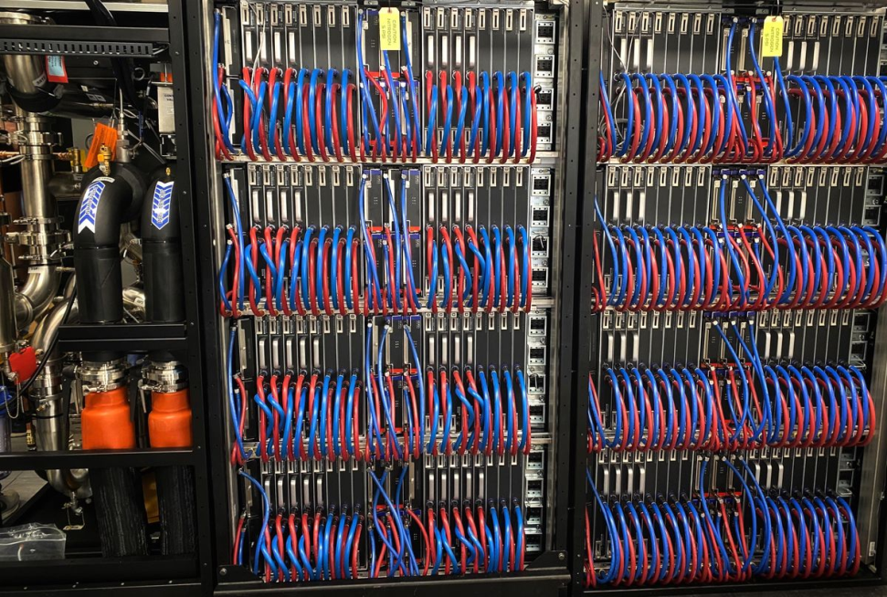
EuroHPC Joint Undertaking – the first European partnership
It is an Institutional partnership
Its main objective to develop and maintain globally competitive supercomputing infrastructure, competences and eco-system in Europe
Funding programs for HPC, AI, Quantum related R&D actions
Established in September 2018, renewed in 2021,
modification in progress
Participants:
  European Union
  35 Participating States: 27 EU MS-s,
  Iceland, Israel, Montenegro, N-Macedonia,
  Norway, Serbia, Türkiye, United Kingdom
  3 organisations of private companies:
  ETP4HPC, BDVA, QUiCK

Slide 7
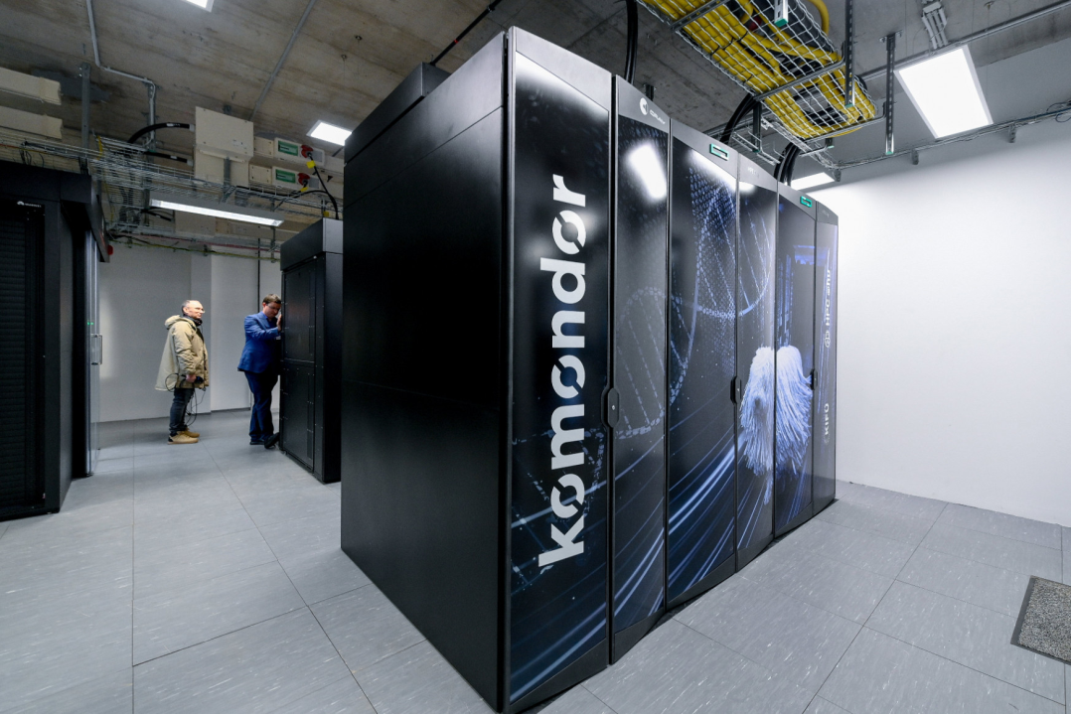
Hungary as a participating state in the EuroHPC JU
  Hungary is a funding member of the EuroHPC Joint Understanding
  No membership fee for participation
  However it is well expected that participating states (PS) take active contribution for projects
  50 % of funding is provided by the EU – Commission (Horizon, DEP, CEF –
  7 billion Euro for 2021-2027)
  50% comes from project activities,
  such as HPC development, Competition
  Centre operation, other projects
  900 M Euro – private members
  PS contribution: financial and „in-kind”
  EuroHPC operative control: office
  General control: Governing Board from
  all PS representatives

Slide 8
Hungary’s activities in the EuroHPC JU programs
  All PS-s operate at least one Competence Centre (CC) –
  one national CC’s operation is 50% (max 0,5 M Euro) financed by EuroHPC, and 50% by the PS
  A European Network is organised by all of the national CC-s
  Hungary is a Consortium Member of the Leonardo HPC (250 PF)
  Hungary’s contribution is in-kind (5 full time researcher-years)
  KIFÜ operates an HPC EDIH program
  Active participation in the EuroHPC
  Governing Board and its work on
  annual work-program, regulatory
  actions, proposals, reports, etc.)
  „Levente” mid-range HPC (20 PF)
  – proposal – in progress

Slide 9
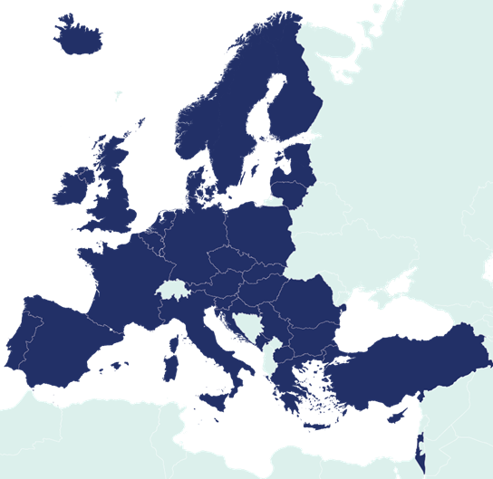
EuroHPC – a success strory – moving with tech development
  EuroHPC JU was established in 2018 to become globally competitive in HPC-s and their applications
  TOP500 list in June 2018 – no EU HPC in first 10:
  6 US, 2 China, 1 Switzerland 1 Japan – (13th Italy, 14th France)
  Now: 3 EU HPC-s in first 10: LUMI (390 PF Finland), Leonardo (250 PF Italy), Mare Nostrum V (210 PF Spain) – 5 US, 1 Japan, 1 Switzerland
  Following tech development:
  present modification new tenders
  for AI modules, quantum developments,
  chip developments, etc.
  Programs for HPC developments,
  education, trainings, EDIH programs, etc.

Slide 10
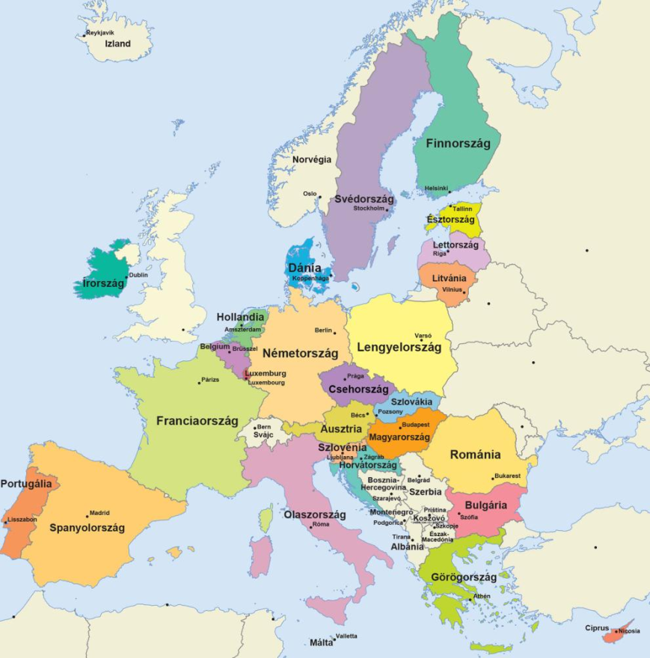
EuroHPC – opportunities to widen Hungarian STI projects
  Access to the EuroHPC JU HPC infrastructure:
  3 „PreExa” – LUMI (440 PF, Leonardo (250 PF), Mare Nostrum V (210 PF);
  5 „PF – range” (5 – 15 PF) – LU, SI, CZ, BG, PT;
  Access to Leonardo HPC, as consortium member (IT, AT, EL, HU, SI, SK);
  Application to EuroHPC funding programmes
    Infrastructure pillar (HPC developments)
    Connected and Federated HPC pillar
    Technology pillar
    Application pillar
    Competences and skills pillar
    International pillar
  Being part of wide all-European collaboration
  Opportunities in future R&D programmes

Slide 11
Part 2. On the Hungarian
„Levente” HPC program

Slide 12
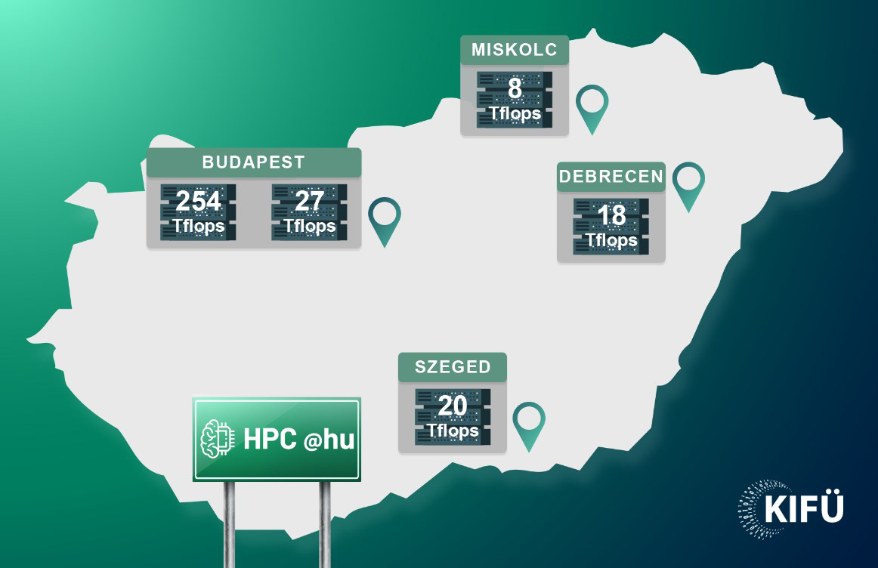
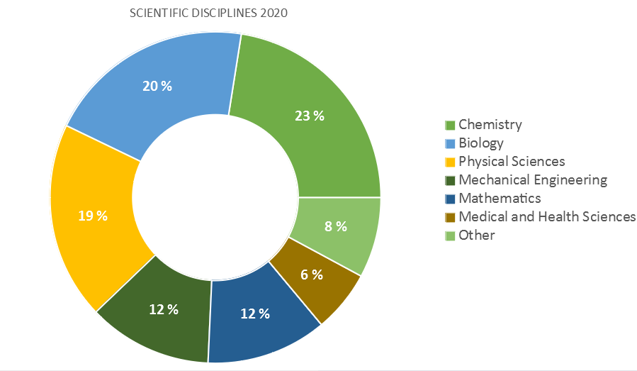
What was the urgent need to national HPC development?
  HPC-s in Hungary, before 2020:
  Total capacity: less than 0,45 PF
  in 5 different centers,
  biggest HPC was „Leo” of 0.28 PF,
  With more than 300 users and
  1000 projects
Users from all STI areas:
Chemistry, Biology,
Mathematics, Engineering,
Physics, Medical and Health Services

Slide 13
Hungarian HPC development programme
Governmental Decision 1422/2020 (VII. 23) on Hungarian HPC infrastructure development in two phases:
1st phase: „Komondor” 5 PF HPC by 2022, with GINOP 3.1 funding
2nd phase: „Levente” HPC 20 PF with direct EU funding support
EuroHPC tender call in for Hosting Entities for „Mid-Range” HPC, December 2021
KIFÜ’s application submitted 11/02/2022, positive decision of JU 14/06/2022
We are in delay in the phase of „Hosting agreement” negotiations
Recently – the Government, all ministries support the „Levente” project – however, financial issues not solved, yet
KIFÜ: Governmental ICT Development Agency is responsible for the Hungarian HPC infrastructure operation and services
KIFÜ was under the supervision of the Ministry of Innovation and Technology (legal successors: Prime Minister’s Cabinet Office - CO - and Ministry for National Economy)
KIFÜ now under the supervision of Digital Hungary Agency of the Cabinet Office
Two suitable HPC sites
Data Centre at the Debrecen University – for „Komondor” and
The Wigner RC for Physics (with some reconstructions) a candidate for „Levente”

Slide 14
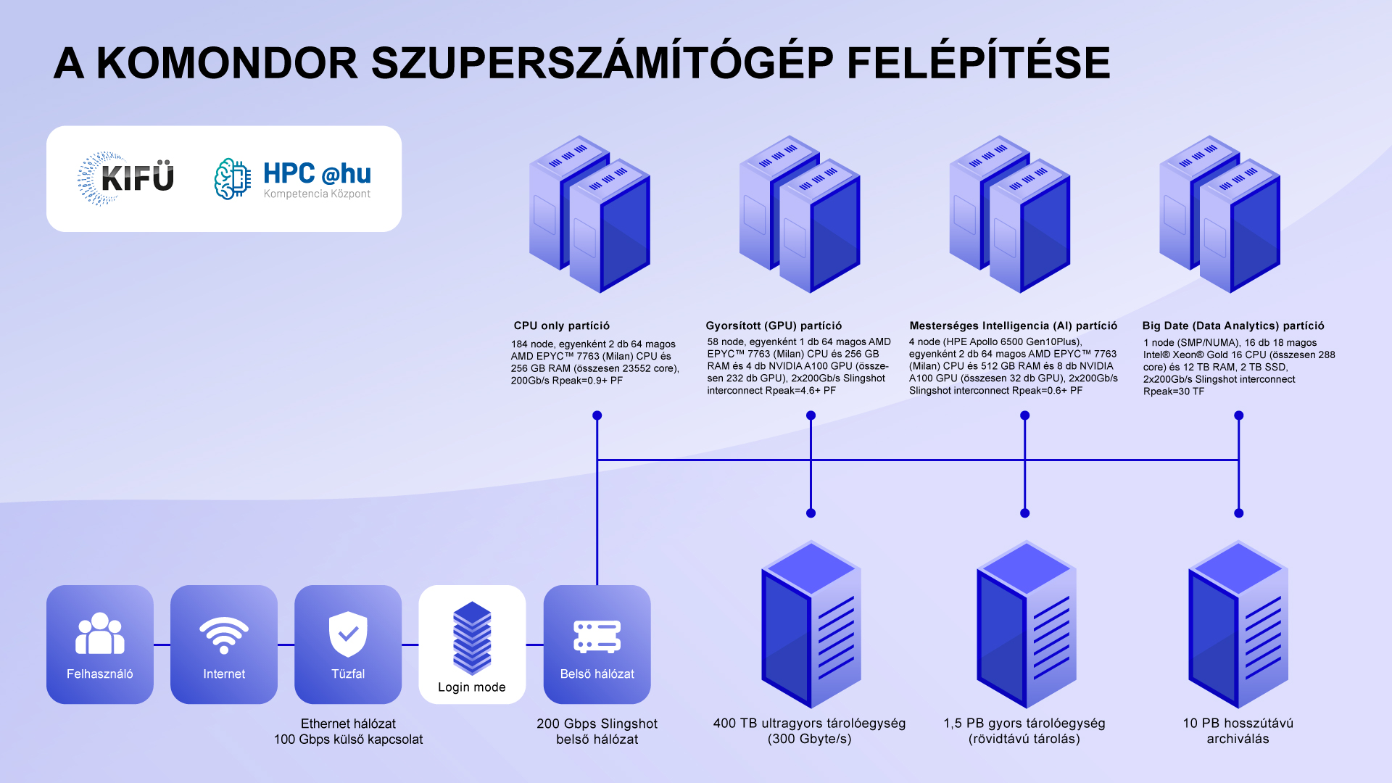
On Komondor HPC very briefly
CPU only partition:
184 nodes, Rpeak: 0,9 PF
Accelerator partition:
54 nodes, Rpeak: 4,6 PF
AI partition: 4 nodes,
Rpeak: 0,6 PF
Big Data partition:
Rpeak 30 TF
Slingshot internal interconnect: 200 Gbps
Scratch storage 400 TB
Work memory 1,5 PB
Archive memory: 10 PB

Slide 15

The „Levente” application – 2nd phase developments
Basic points of the application
2nd phase: „Levente” HPC 20 PF with direct EU funding support
EuroHPC tender call in for Hosting Entities for „Mid-Range” HPC, December 2021
KIFÜ’s application submitted 11/02/2022, positive decision of JU 14/06/2022
We are in delay in the implementation of the phase of „Hosting agreement” negotiations
Recently – the Government, all ministries support the „Levente” project – however, financial issues are not solved, yet
Applicant
Call Ref: EuroHPC-2021-CEI-MR-01
KIFÜ: Governmental ICT Development Agency with the support of the Ministry of Innovation and Technology (legal successors: Prime Minister’s Cabinet Office and Ministry for National Economy),
Hosting a Mid-range supercomputer „Levente” of 20 PF capacity
with Modular Architecture
The hosting site
Ownership and use of the „Levente”
First five years: 35% EurohPC JU,
65% Hungary (KIFÜ) – after 5 years: 100% Hungary
Data Centre of the Wigner RC for Physics
after some reconstructions

Slide 16
On the „Levente” application evaluation criteria
The following basic important chapters, parameters and features have been assessed during the evaluation process:
System specification in general
  Overall goal, hosting site, targeted system
Total cost of ownership
  preparation of site
  acquisition costs
  operating costs
Experience of the hosting entity
  of operating team
  organisational structure
  continuity procedures
  access to the HPC
Quality of the hosting facility
  Connection to power grid
  HPC center availability
  Connectivity to GEANT
Quality of services
  Access time model
  Availability policy
  Help desk availability
  Training courses

Slide 17
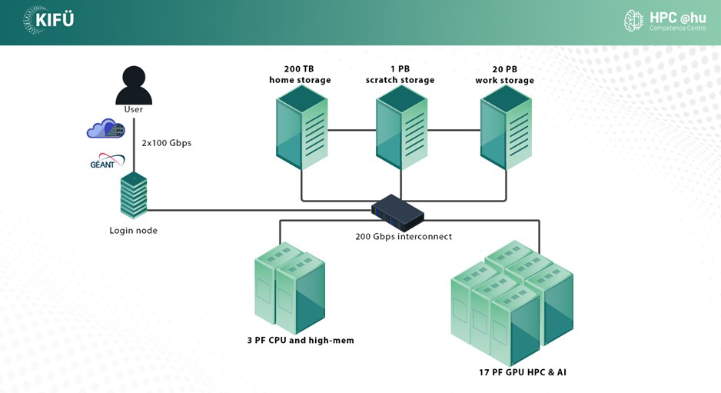
On the basic parameters of „Levente” HPC
Cooling system: water cooling
CPU partition with high-speed memory:
Rpeak: at least 3 PF
GPU (accelerator partition) + AI Partition:
Rpeak: at least 17 PF
Low latency internal interconnect:
200 Gbps
Fast user home area memory: 200 TB
Ultra fast scratch memory: 1 PB
Fast work storage: 20 PB
User (cloud) connection: at least
2 x 100 Gbps
Not a detailed specification - allowing some freedom for later adjustments to new and recent hardware developments

Slide 18
On the proporsed modular achitecture of „Levente” HPC
Desing principle – Modular Supercomputer Architecture (MSA)
MSA: developed for Jülich Supercomputer Centre
Integration of heterogeneity at system level
Results combination of different module to a
single supercomputer
Each module is a parallel computer composed of homogeneous set of nodes for the needs of specific applications – s.a. AI, Quantum, Neuromorphic, etc.
MSA principle results in system design tailored to
the concrete demands
Each code is executed on the most suitable platform
General purpose components to be used only where
absolutely necessary
Highly scalable workflow
High througput codes
The principle has been tested and are in operation
in JURECA HPC

Slide 19


Targeted application domains
A few examples for the Hungarian sectors
which are regarded as major contributors
for GDP growth in the coming years
European regulation (Horizon):
at least 80 % R&D, max 20 % for businesses
The Hungarian R&D community under the supervision of
Ministry of Culture and Innovation (MCI) (and HUN-REN), while the economic area under the supervision of Ministry for National Economy (MNE)
Targeted research areas (disciplines) - examples:
* Physics, * Chemistry
* Biology * Health
* Mathematics * Economy
* Agricultue * Transport, vehicle industry
* Social sciences * Linguistics
* AI * Big Data, IoT
Interest of MNE – contribution to GDP growth and wellbeing
Tightening links between R + I;
Shortening time from research to businesses,
Support innovative SME-s, start-ups, scale-ups,
Promoting, supporting national economic progress at home and internationally
Accelerating digital and green transformation of businesses and economy
Faster technology development and
Faster adaptation to new and emerging technologies
Infocommunication
Vehicle industry
Materials’ industry
Food industry
Health industry
Creative industry

Slide 20
Thank you for your kind attention!
Ministry for National Economy

