Slide 1
Roland Jakab
CEO
AI ACTION PLAN
From identifying needs to delivering on a roadmap
GPU Day 2024 Budapest, 2024.05.30
Kutatás. Innováció. Hatás.

Slide 2
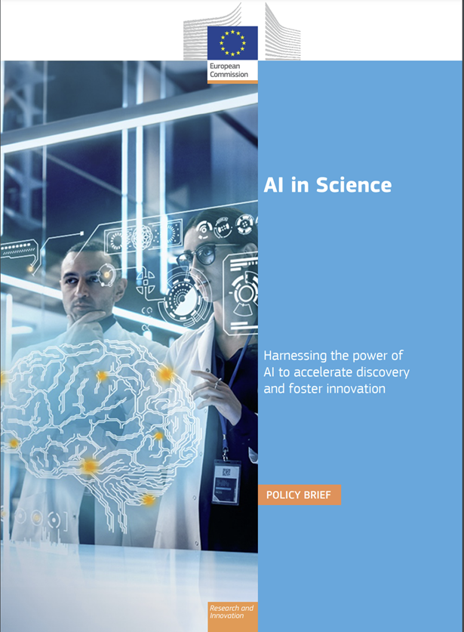
AI in Science - Policy brief - What we could achieve
“The power of collective AI-human intelligence could usher in a new era of problem-solving, accelerating discoveries and driving revolutionary advancements.”
“Integrating AI in scientific discovery is crucial for enhancing the EU’s competitive edge in the global scientific arena. Leadership in AI-powered science will translate into leadership in discovery and innovation, essential for economic and social prosperity and strategic autonomy.”
https://apre.it/wp-content/uploads/2023/12/ec_rtd_ai-in-science-pb.pdf

Slide 3
AI in Science - Policy brief - What we could achieve
AI in science: a tool for accelerated discovery
Research Assistant: Writing code, brainstorming, and manuscript preparation.
Literature Review: Summarizing papers, identifying relevant studies.
Making Predictions: Predicting protein structures with deep learning.
Data Transformation: Sharpening first black hole image.
Optimising Experiments: Configuring nuclear fusion tokamaks.
Mining Literature: Uncovering connections for new hypotheses.
Laboratory Automation: Running experiments with precision and speed.
Scientific Communication: Automating generation of scientific reports.
AI helping science solve global challenges
Climate Change: Enhancing climate models, predicting extreme weather
AMR: Discovering new antibiotics, fighting bacteria
Personalised Medicine: Analysing MRI, predicting cancer risks
Drug Development:
Tailoring treatments, understanding brains
Materials Science: Designing novel materials, predicting properties
Crisis Preparedness: Anticipating natural disasters, saving lives
Planetary Exploration: Autonomous robotic missions, exploring caves
Serendipitous Discoveries: Identifying patterns, discovering free-floating planets

Slide 4
HPC (GPU) is a key success factor for AI applications
(GPU)
[source: EC & EuroHPC]

Slide 5
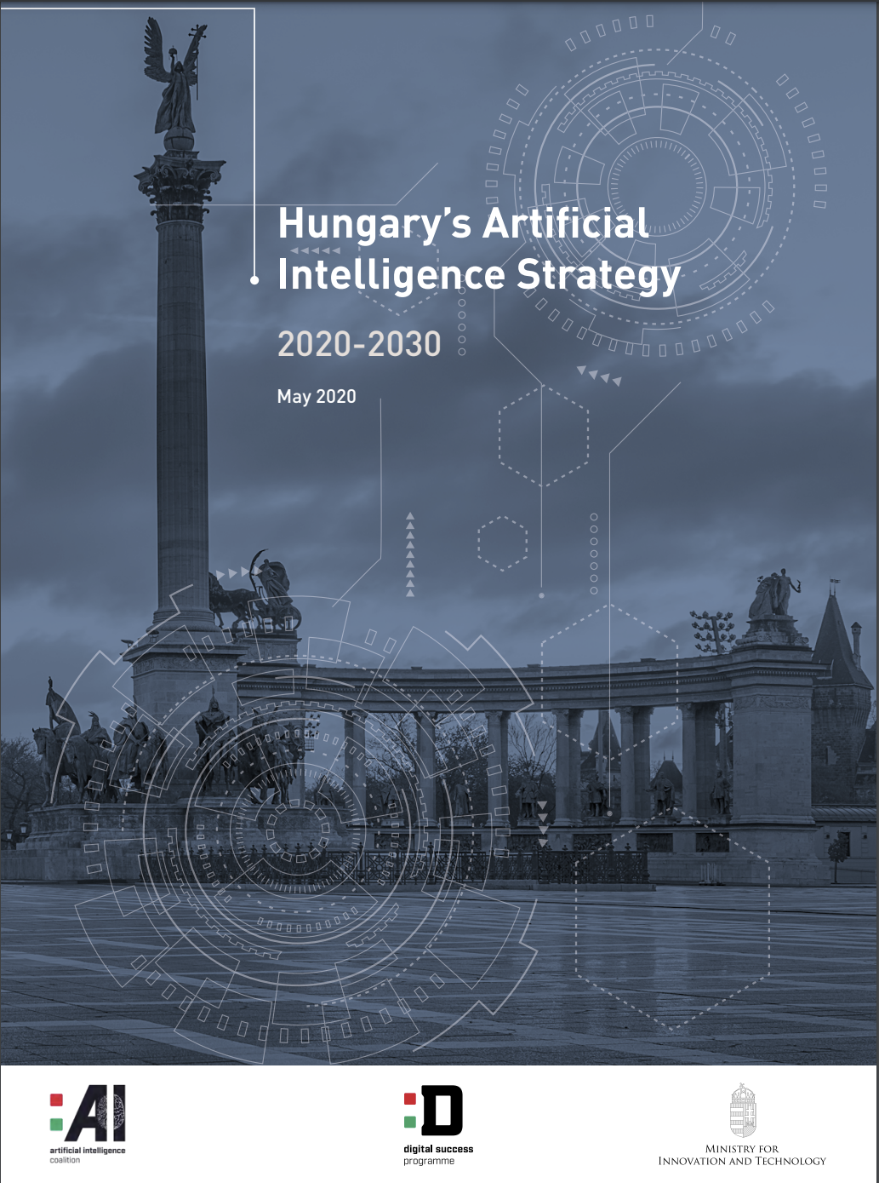
Infrastructure building is a key component of the Hungarian AI Strategy* as well
2023: Komondor release with significant GPU clusters
2025: Expected HUN-REN Cloud GPU extensions
2026: Expected release of with extended GPU capacity
*Currently being rewised
[source: ai-hungary.com]

Slide 6
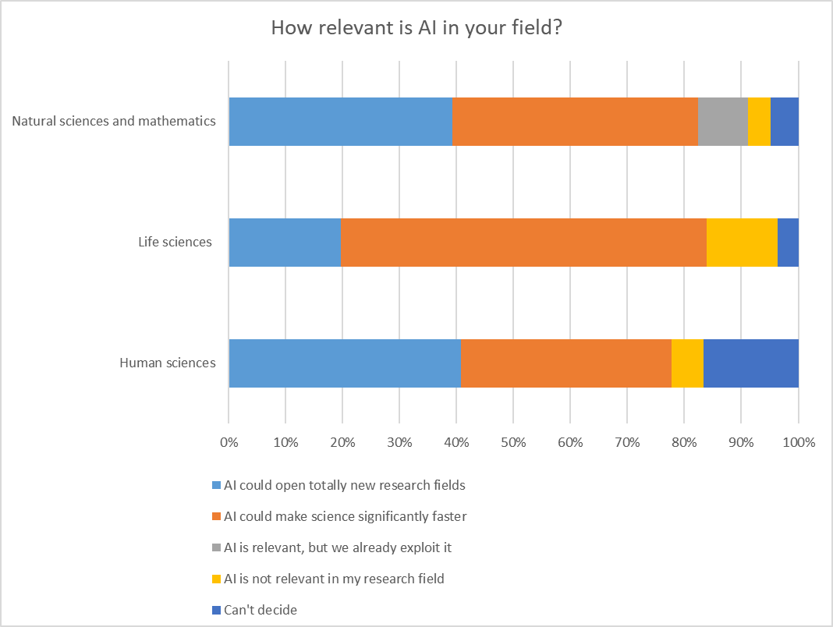
We asked our researchers as well
Most of our scientists agree, that AI will be very significant or transformative

Slide 7
Some clustered AI enabled breakout points from OUR researchers
1. Genomics and Proteomics
Genomic Imputation: Use in population genetics models.
Marker-Based Prediction: Genome analysis, 3D genome analysis.
Protein Modeling: Application in vaccine research, protein-ligand interaction prediction.
2. Image Processing and Remote Sensing
Autonomous Vehicles: Image processing for the development of self-driving vehicles.
Aerial Image Evaluation: Monitoring ecological processes.
Satellite Data Analysis: Processing meteorological and climate data.
3. Numerical Modeling and Simulations
Exoplanet Discovery: Use of numerical simulations in exoplanet discovery.
Dynamical Stability Examination: Analysis of the stability of exoplanetary systems.
Acceleration of Numerical Modeling: AI acceleration in applications such as fusion devices.
4. Healthcare and Biology
Clinical Prediction Models: Disease prediction, clinical decision support.
Vaccine Research: Protein modeling for mRNA development.
Electrophysiological Data Analysis: Cleaning and analyzing large volumes of raw medical data.
5. Environmental Science and Ecology
Modeling Ecological Processes: AI-based parameterization in numerical models.
Monitoring Invasive Species: Based on drone aerial images.
Bacterial Typing: Based on phenotypic properties, examination of antibiotic resistance.
6. Language Technologies and Text Mining
Text Mining: Exploration of interdisciplinary issues, analysis of multilingual content.
Questionnaire Content Analysis: Application of language technology to process open-ended questions.
Corpus Analysis: Analysis and database organization of digital and printed texts.
7. Social Sciences and Humanities
Analysis of Historical Data: 3D analysis and modeling of archaeological data.
Demographic Models: Modeling changes in prehistoric societies.
Analysis of Cultural and Social Impacts: AI-assisted social sciences, e.g., detection of manipulation and emotions.

Slide 8
How can HUN-REN contribute: The AI Action Plan
Inspired, capable, supported
Our goal is to support breakthrough research by empowering researchers with the capabilities of AI.
State of the art tooling
Scaled data access
Responsible and transparent

Slide 9
Inspired, capable, supported
Upskilling and inspiring:
From python AI library basics to GenAI usage
From general trainings to specialist workshops
From knowledge download to hackathons
AI Ambassador program
Representing needs and ideas
Supporting adaptation and spreading best practices
Specialist support
Hired generalists to discover
Contracted specialists to plan
Long term collaboration with fellow scientists through match-making
Researchers have to be comfortable with the technological capabilities and limitations of AI to find and pursue new ways to do research or new topics to research. They have to have access to quality upskilling and personal support in case of AI enabled research.

Slide 10
State of the art tooling
Provide useful AI software:
Have channels to support licensing of paid tools
Have funnels to provide open-source alternatives as applications
Have people who can help navigate the apps
On-demand flexible hardware
Map available hardware and access routes (Domestic, EU and global)
Improve usability and support
Improve local cloud booking flexibility and utilisation
Map demand growth with hardware development growth
Technology is advancing faster than ever. We have to be as close as possible to the frontier of support tools both in software and hardware while maintaining safety and sovereignty.

Slide 11
Scaled, professional data access
Streamlining data collaborations
Standardising legal frameworks
Giving legal support
Setting up data governance processes (skills&technology)
Accessing new data sources
Mapping available/potential data sources
Setting up grants for data access
Using centralised negotiation opportunities with big potential data partners
Setting the stage for technology enabled private data collaboration
Examining and designing privacy preserving data collaboration technologies
Accessing data redefines research opportunities, managing data indicates a new burden for researchers. We have to work together to support new data collaborations and eliminate friction in data management.

Slide 12
Responsible and transparent
Policy mapping:
Digest and circulate EU AI usage principles
Help find principles from specific publishers/journals
Policy development
Discuss policies on a country level
Develop and circulate guidelines for Hungarian researchers
Policy alignment
Set up provided technical frameworks (apps, compute) to be compliant by design
Spread responsible AI practice attitudes
More powerful AI and data management tools mean more responsibility. Researchers have to be clear on the “how”-s of ethical AI and data usage and be able to comply with them.

Slide 13
Grounded internationally
Aligning with the EU efforts:
Joining the AI usage measurement system
Participating in international best practicing
Engaging in cross-country collaborations
Professional grant management
Watching and disseminating information about grants
Supporting with international match-making
Easing the burdens of grant admission administration
Research does not happen in a country, still countries have to support their researchers to be able to collaborate internationally.

Slide 14
AI Action Plan in Practice – AI Ambassador program
AI Ambassadors support the Institute's researchers in
the use of AI
navigating the available resources
channelling emerging needs
disseminating good practices, providing inspiration
providing information on new updates or available
resources
AI Ambassadors are involved in
providing feedback on central efforts
testing new tools available, early access
discussions on good practices in use

Slide 15
AI in Focus – AI Ambassador Program
1. Collecting good practices, inspiration: from abroad?
How are we doing it at home, what good practices can we learn
Testing and deploying science supporting AI applications: What are the concrete AI tools, which of them
do we recommend to others? Which ones are worth installing and delivering in our own cloud?
Developing ethical and accepted AI usage guidelines: How should AI tools be used ethically so that they are best suited for publication?
Developing easily accessible computing infrastructure and user support: How can we make the available infrastructure easily accessible and usable, what support services are needed for good usage, how can European infrastructure elements be accessed?
AI user training and user consultation: Who should learn about what, in what form? How can we assess knowledge and needs? Who can be contacted for individual consultation?
Supporting data access: How can we easily contract with other organisations for data use? What data sources can be accessed with central lobbying power?
Monitoring and management of related EU applications: Where can funding for these activities be obtained? What efforts can be involved? What do we need to apply successfully?

Slide 16
We connect researchers with AI enabling resources
Researchers
Tailored AI inspirations
Tailored AI inspirations
Tailored AI inspirations
Tailored AI inspirations
Tailored AI inspirations
AI Ambassadors
Engaging researchers, collecting needs, organising inspiring workshops
First line support in using AI (research topics, application usage, hardware access and configuration)
HUN-REN
support
Coordination of on-demand resources
(AI advisor, legal, infrastructure, data usage, grant management)
HUN-REN
AI advisory service
Data management
Infrastructure management
Application development
Pool of experts
Legal services
Grant management
Benchmarking
AI tools
Data
Infrastructure
Training materials
Funds
Resources
Corporate cooperations
Legal templates
Good practices

Slide 17
Better AI infrastructure for every researcher!
How can we together…
…improve usability and support?
Ease of use
Reference architectures
Consulting resources
…improve utilization and access?
Easy access request
Utilization monitoring
Dynamic reallocation
…improve state of the art computing capacity?
Planning for technological change
Invest in what will be needed
Maintain and operate what we have built

