Slide 1
Tensor Core Computing: an example on Independent Component Analysis
May 2024
Zeyu Wang, Zoltan Juhasz
University of Pannonia
Veszprem, Hungary
Notes:
Parallel Implementation of Multivariate Empirical Mode Decomposition on GPU

Slide 2
Content outline
1. Tensor core
1.1 Abstract and hierarchy
1.2 Programming paradigm
2. Independent Component Analysis (ICA)
2.1 Algorithm flow
2.2 Parallel implementation
2.3 Variables analysis
3. Implementation strategy
3.1 Locating matrix multiplication
3.2 Numerical correctness
3.3 Performance preview
4. Future works

Slide 3
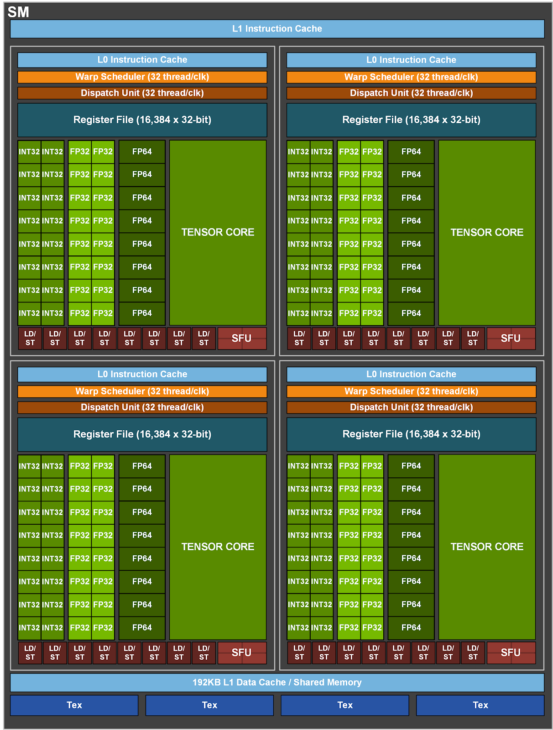
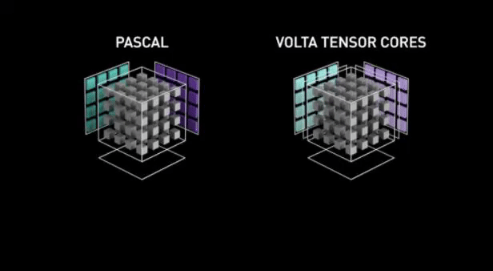
1.1 Abstract and hierarchy of the tensor core
4x4
4x4
4x4
$$A_{0,0}$$ | $$A_{0,1}$$ | $$A_{0,2}$$ | $$A_{0,3}$$
$$A_{1,0}$$ | $$A_{1,1}$$ | $$A_{1,2}$$ | $$A_{1,3}$$
$$A_{2,0}$$ | $$A_{2,1}$$ | $$A_{2,2}$$ | $$A_{2,3}$$
$$A_{3,0}$$ | $$A_{3,1}$$ | $$A_{3,2}$$ | $$A_{3,3}$$
$$B_{0,0}$$ | $$B_{0,1}$$ | $$B_{0,2}$$ | $$B_{0,3}$$
$$B_{1,0}$$ | $$B_{1,1}$$ | $$B_{1,2}$$ | $$B_{1,3}$$
$$B_{2,0}$$ | $$B_{2,1}$$ | $$B_{2,2}$$ | $$B_{2,3}$$
$$B_{3,0}$$ | $$B_{3,1}$$ | $$B_{3,2}$$ | $$B_{3,3}$$
$$C_{0,0}$$ | $$C_{0,1}$$ | $$C_{0,2}$$ | $$C_{0,3}$$
$$C_{1,0}$$ | $$C_{1,1}$$ | $$C_{1,2}$$ | $$C_{1,3}$$
$$C_{2,0}$$ | $$C_{2,1}$$ | $$C_{2,2}$$ | $$C_{2,3}$$
$$C_{3,0}$$ | $$C_{3,1}$$ | $$C_{3,2}$$ | $$C_{3,3}$$
D
=
*
=
A
B
C
The structure of GA100 SM

Slide 4
Some GPUs equipped with tensor cores
Model | Micro-architecture | Launch | CUDA cores | Memory size (GB) | Processing power (TFLOPS)
 |  |  |  |  | Tensor core FP32 | Single precision | Double precision
V100 | Volta | Jun 21, 2017 | 5120 | 16/32 | 112.2 | 14.0 | 7.0
T4 | Turing | Sept 12, 2018 | 2560 | 16 | 64.8 | 8.1 | 0.2
A100 | Ampere | May 14, 2020 | 6912 | 40/80 | 312.0 | 19.5 | 9.7
H100 | Hopper | Mar 22, 2022 | 14592 | 80 | 756.4 | 51.2 | 25.6

Slide 5
1.1 Abstract and hierarchy of the tensor core
warp
Multiple tensor cores
16x16
16x16
16x16
$$A_{0,0}$$ | $$A_{0,1}$$ | $$A_{0,…}$$ | $$A_{0,15}$$
$$A_{1,0}$$ | $$A_{1,1}$$ | $$A_{1,2}$$ | $$A_{1,3}$$
$$A_{…,0}$$ | $$A_{2,1}$$ | $$A_{2,2}$$ | $$A_{2,3}$$
$$A_{15,0}$$ | $$A_{3,1}$$ | $$A_{3,2}$$ | $$A_{3,3}$$
$$B_{0,0}$$ | $$B_{0,1}$$ | $$B_{0,2}$$ | $$B_{0,15}$$
$$B_{1,0}$$ | $$B_{1,1}$$ | $$B_{1,2}$$ | $$B_{1,3}$$
$$B_{2,0}$$ | $$B_{2,1}$$ | $$B_{2,2}$$ | $$B_{2,3}$$
$$B_{15,0}$$ | $$B_{3,1}$$ | $$B_{3,2}$$ | $$B_{3,3}$$
$$C_{0,0}$$ | $$C_{0,1}$$ | $$C_{0,2}$$ | $$C_{0,15}$$
$$C_{1,0}$$ | $$C_{1,1}$$ | $$C_{1,2}$$ | $$C_{1,3}$$
$$C_{2,0}$$ | $$C_{2,1}$$ | $$C_{2,2}$$ | $$C_{2,3}$$
$$C_{15,0}$$ | $$C_{3,1}$$ | $$C_{3,2}$$ | $$C_{3,3}$$
D
=
=
*
A
B
C
Software hierarchy
Hardware hierarchy
Notes:
The correspondence is: one warp is handled by multiple tensor cores, or multiple tensor cores are used by one warp, still dynamically/concurrently. And threads within a warp provide a larger 16x16x16 matrix operation to be processed by multiple tensor cores.

Slide 6
1.2 Tensor core programming paradigm
N
(1,1)
(1,2)
(1,3)
is a 16*16 submatrix / tile
K
N
N
(1,1)
(1,3)
(1,4)
(1,5)
(1,1)
(1,2)
(1,3)
(1,1)
(1,2)
(1,3)
wmma::fragment< >
wmma::load_matrix_sync< >
wmma::mma_sync< >
wmma::store_matrix_sync< >
M
(2,1)
*
K
+
M
=
M
(3,1)
(3,1)
(4,1)
column major
column major
column major
A
C
D
(5,1)
column major
B
Loop over K (accumulated by each warp)
A(1,1) * B(1,1) + A(1,2) * B(2,1) + A(1,3) * B(3,1) + A(1,4) * B(4,1) + A(1,5) * B(5,1) + C(1,1) = D(1,1)
A(1,1) * B(1,2) + A(1,2) * B(2,2) + A(1,3) * B(3,2) + A(1,4) * B(4,2) + A(1,5) * B(5,2) + C(1,2) = D(1,2)
A(1,1) * B(1,3) + A(1,2) * B(2,3) + A(1,3) * B(3,3) + A(1,4) * B(4,3) + A(1,5) * B(5,3) + C(1,3) = D(1,3)
A(2,1) * B(1,1) + A(2,2) * B(2,1) + A(2,3) * B(3,1) + A(2,4) * B(4,1) + A(2,5) * B(5,1) + C(2,1) = D(2,1)
A(2,1) * B(1,2) + A(2,2) * B(2,2) + A(2,3) * B(3,2) + A(2,4) * B(4,2) + A(2,5) * B(5,2) + C(2,2) = D(2,2)
A(2,1) * B(1,3) + A(2,2) * B(2,3) + A(2,3) * B(3,3) + A(2,4) * B(4,3) + A(2,5) * B(5,3) + C(2,3) = D(2,3)
A(3,1) * B(1,1) + A(3,2) * B(2,1) + A(3,3) * B(3,1) + A(3,4) * B(4,1) + A(3,5) * B(5,1) + C(3,1) = D(3,1)
A(3,1) * B(1,2) + A(3,2) * B(2,2) + A(3,3) * B(3,2) + A(3,4) * B(4,2) + A(3,5) * B(5,2) = C(3,2) = D(3,2)
thread grid
is a warp
A(3,1) * B(1,3) + A(3,2) * B(2,3) + A(3,3) * B(3,3) + A(3,4) * B(4,3) + A(3,5) * B(5,3) = C(3,3) = D(3,3)
2D thread grid
Notes:
1.2 Tensor core programming paradigm (with code demo together)
One warp is responsible to a set of 16*16*16 operation, also, one warp is in charge of one tile in the result matrix.
When designing the kernel function, we need to make sure all the threads in the same warp know which tile in A and B they should point to.
So, what is exposed to the users or what we need to be concerned about is the mapping between different warps and different 16*16 tiles in the D=A*B+C process. As for “which fragment in the tile is scheduled to which thread and handled by which tensor core” is opaque to us.
wmma::fragment
Codes shouldn’t be shown, just put the key lines in the kernel function code.

Slide 7
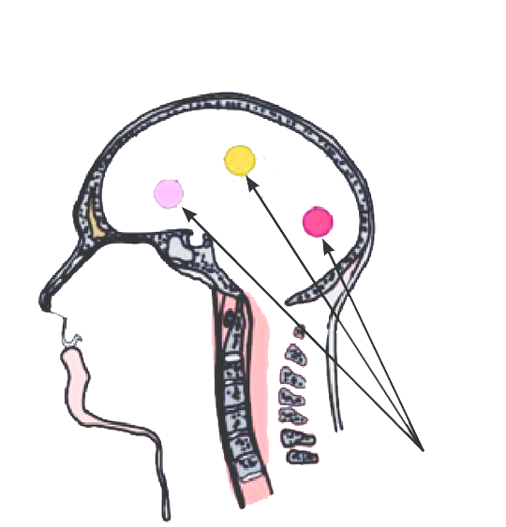
2.1 Independent Component Analysis (ICA)
Measured EEG signals
$$x(t)$$
Unknown
$$\left[\begin{matrix}x_{1(t)} \\ x_{2(t)} \\ x_{3(t)}\end{matrix}\right]=\left[\begin{matrix}a_{11} & a_{12} & a_{13} \\ a_{21} & a_{22} & a_{23} \\ a_{31} & a_{32} & a_{32}\end{matrix}\right]·\left[\begin{matrix}s_{1(t)} \\ s_{2(t)} \\ s_{3(t)}\end{matrix}\right]$$
Mixing
$$X$$
$$A$$
$$S$$
$$S=W·X$$
True brain signal
$$s(t)$$
$$X=A·S$$
$$W=A^{−1}$$

Slide 8
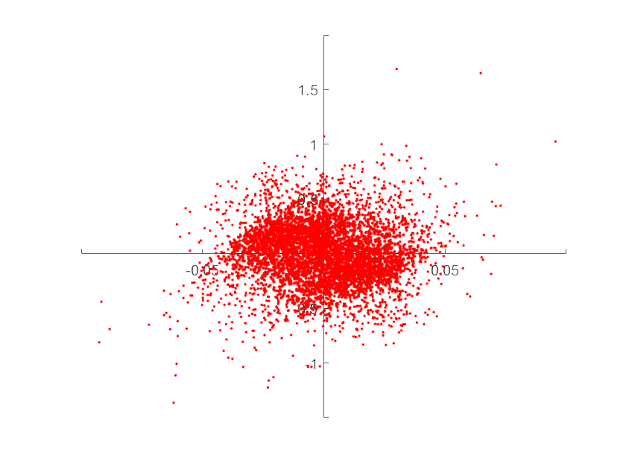
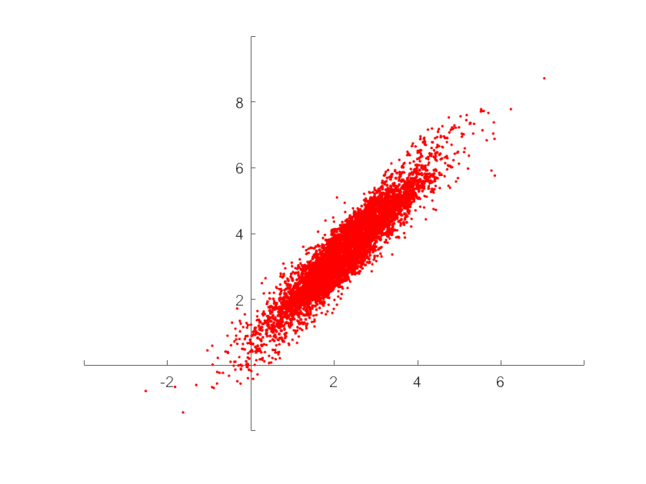
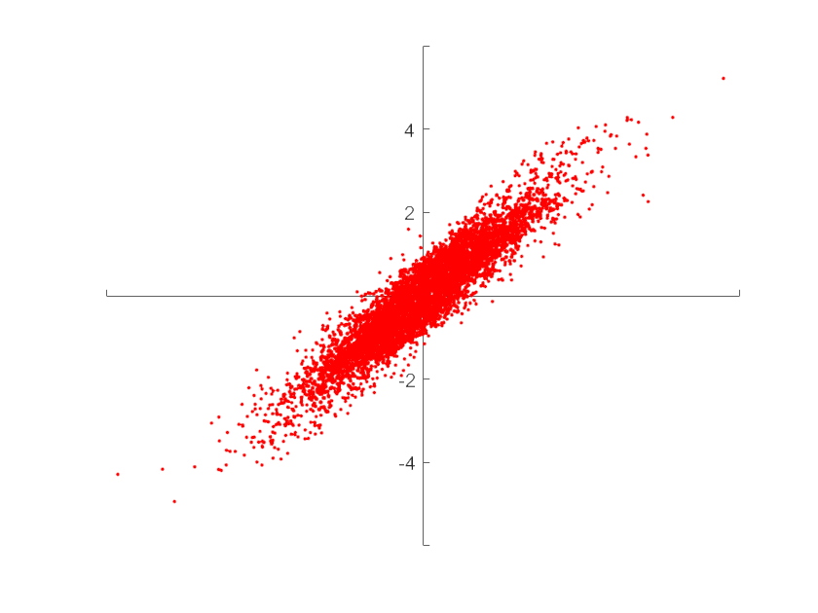
2.1 Algorithm flow
$$Cov=XX^{T}$$
$$\left[\begin{matrix}Var(CH1) & Cov(CH1,CH2) & Cov(CH1,CH3) \\ Cov(CH2,CH1) & Var(CH2) & Cov(CH2,CH3) \\ Cov(CH3,CH1) & Cov(CH3,CH2) & Var(CH3)\end{matrix}\right]$$
$$\left[\begin{matrix}1 & 0 & 0 \\ 0 & 1 & 0 \\ 0 & 0 & 1\end{matrix}\right]$$
Singular Value Decomposition
$$X=UΣV^{T}$$
$$Σ=diag(σ_{1},σ_{2},σ_{3},…)$$
Raw data
Centralized data
Whitened data
$$X_{deco}=\sqrt{U^{T}X }$$
Update
Whitened data
Unmixing matrix
$$W$$
$$g(·)$$
Independence criterion
$$x_{1}(t)$$
$$u_{1}(t)$$
$$y_{1}(t)$$
$$s_{1}(t)$$
$$x_{2}(t)$$
$$u_{2}(t)$$
$$y_{2}(t)$$
$$s_{2}(t)$$
…
…
…
…
$$x_{n}(t)$$
$$u_{n}(t)$$
$$y_{n}(t)$$
$$s_{n}(t)$$
The process of solving the unmixing matrix
Notes:
More equations about the matrix rotation and starching, SVD

Slide 9
2.2 Parallel implementation
1. Initialize $W(0)$
2. while (not converged and $t$ < limit)
2.1 Y = permutate(X)
2.2 for each block B in signal Y
2.2.1 $U = WY+bias$
2.2.2 $Y = tanh(U)$
2.2.3 $W^{∗}=$
$W+η(I−YU^{T}−UU^{T})W$
2.2.4 update bias
end for
end while
CUDA ICA
Notes:
There are a lot of matrix matrix multiplication operations in each iteration.

Slide 10
2.3 Variables analysis
weights (ch*ch)
data (ch*s)
u (ch*b)
y (ch*b)
bias (ch*1)
permute (s*1)
Step1
weights (ch*ch)
data (ch*s)
bias (ch*1)
u (ch*b)
y (ch*b)
bsum (ch*1)
sign (ch*1)
Step2
sign (ch*1)
y (ch*b)
bsum (ch*1)
yu (ch*ch)
Step3
u (ch*b)
y (ch*b)
yu (ch*ch)
Step4
weights (ch*ch)
bias (ch*1)
yu (ch*ch)
bsum (ch*1)
pdf
numChannels = ch : not modified
numSamples = s : modified
blockLength = b
sign (ch*1)

Slide 11
y
u
3.1 Locating matrix multiplication
y
weights
data
bias
yu = y * u’
u = weights * data
bsum = sum(y)
yu = yu + I
use bias?
yes
u = u + bias
u
no
Step 2
Step 3
y = -tanh(u/2)
bsum
yu
Step 1
y
1. Initialize $W(0)$
2. while (not converged and $t$ < limit)
2.1 Y = permutate(X)
2.2 for each block B in signal Y
2.2.1 $U = WY+bias$
2.2.2 $Y = tanh(U)$
2.2.3 $W^{∗}=$
$W+η(I−YU^{T}−UU^{T})W$
2.2.4 update bias
end for
end while
bsum
yu
weights = lrate * yu * weights + weights
weights
use bias?
no
Step 4
yes
bias = lrate * bsum + bias
: FMA operation
bias

Slide 12
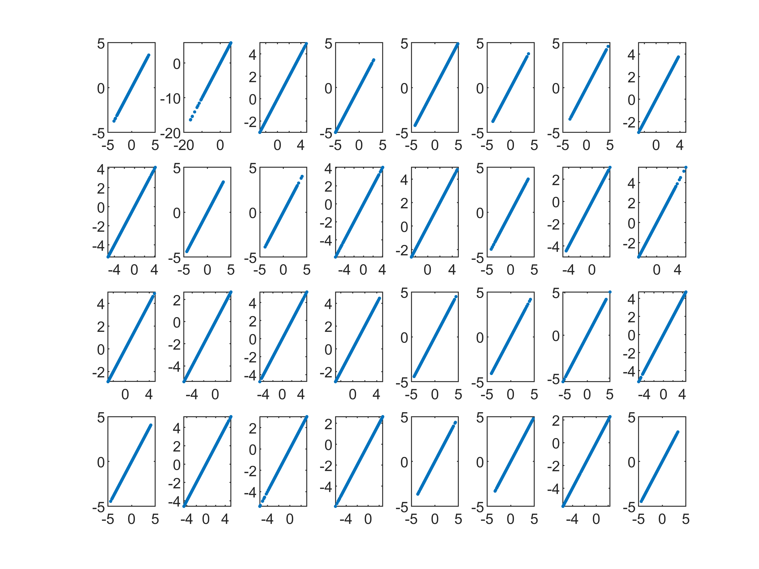
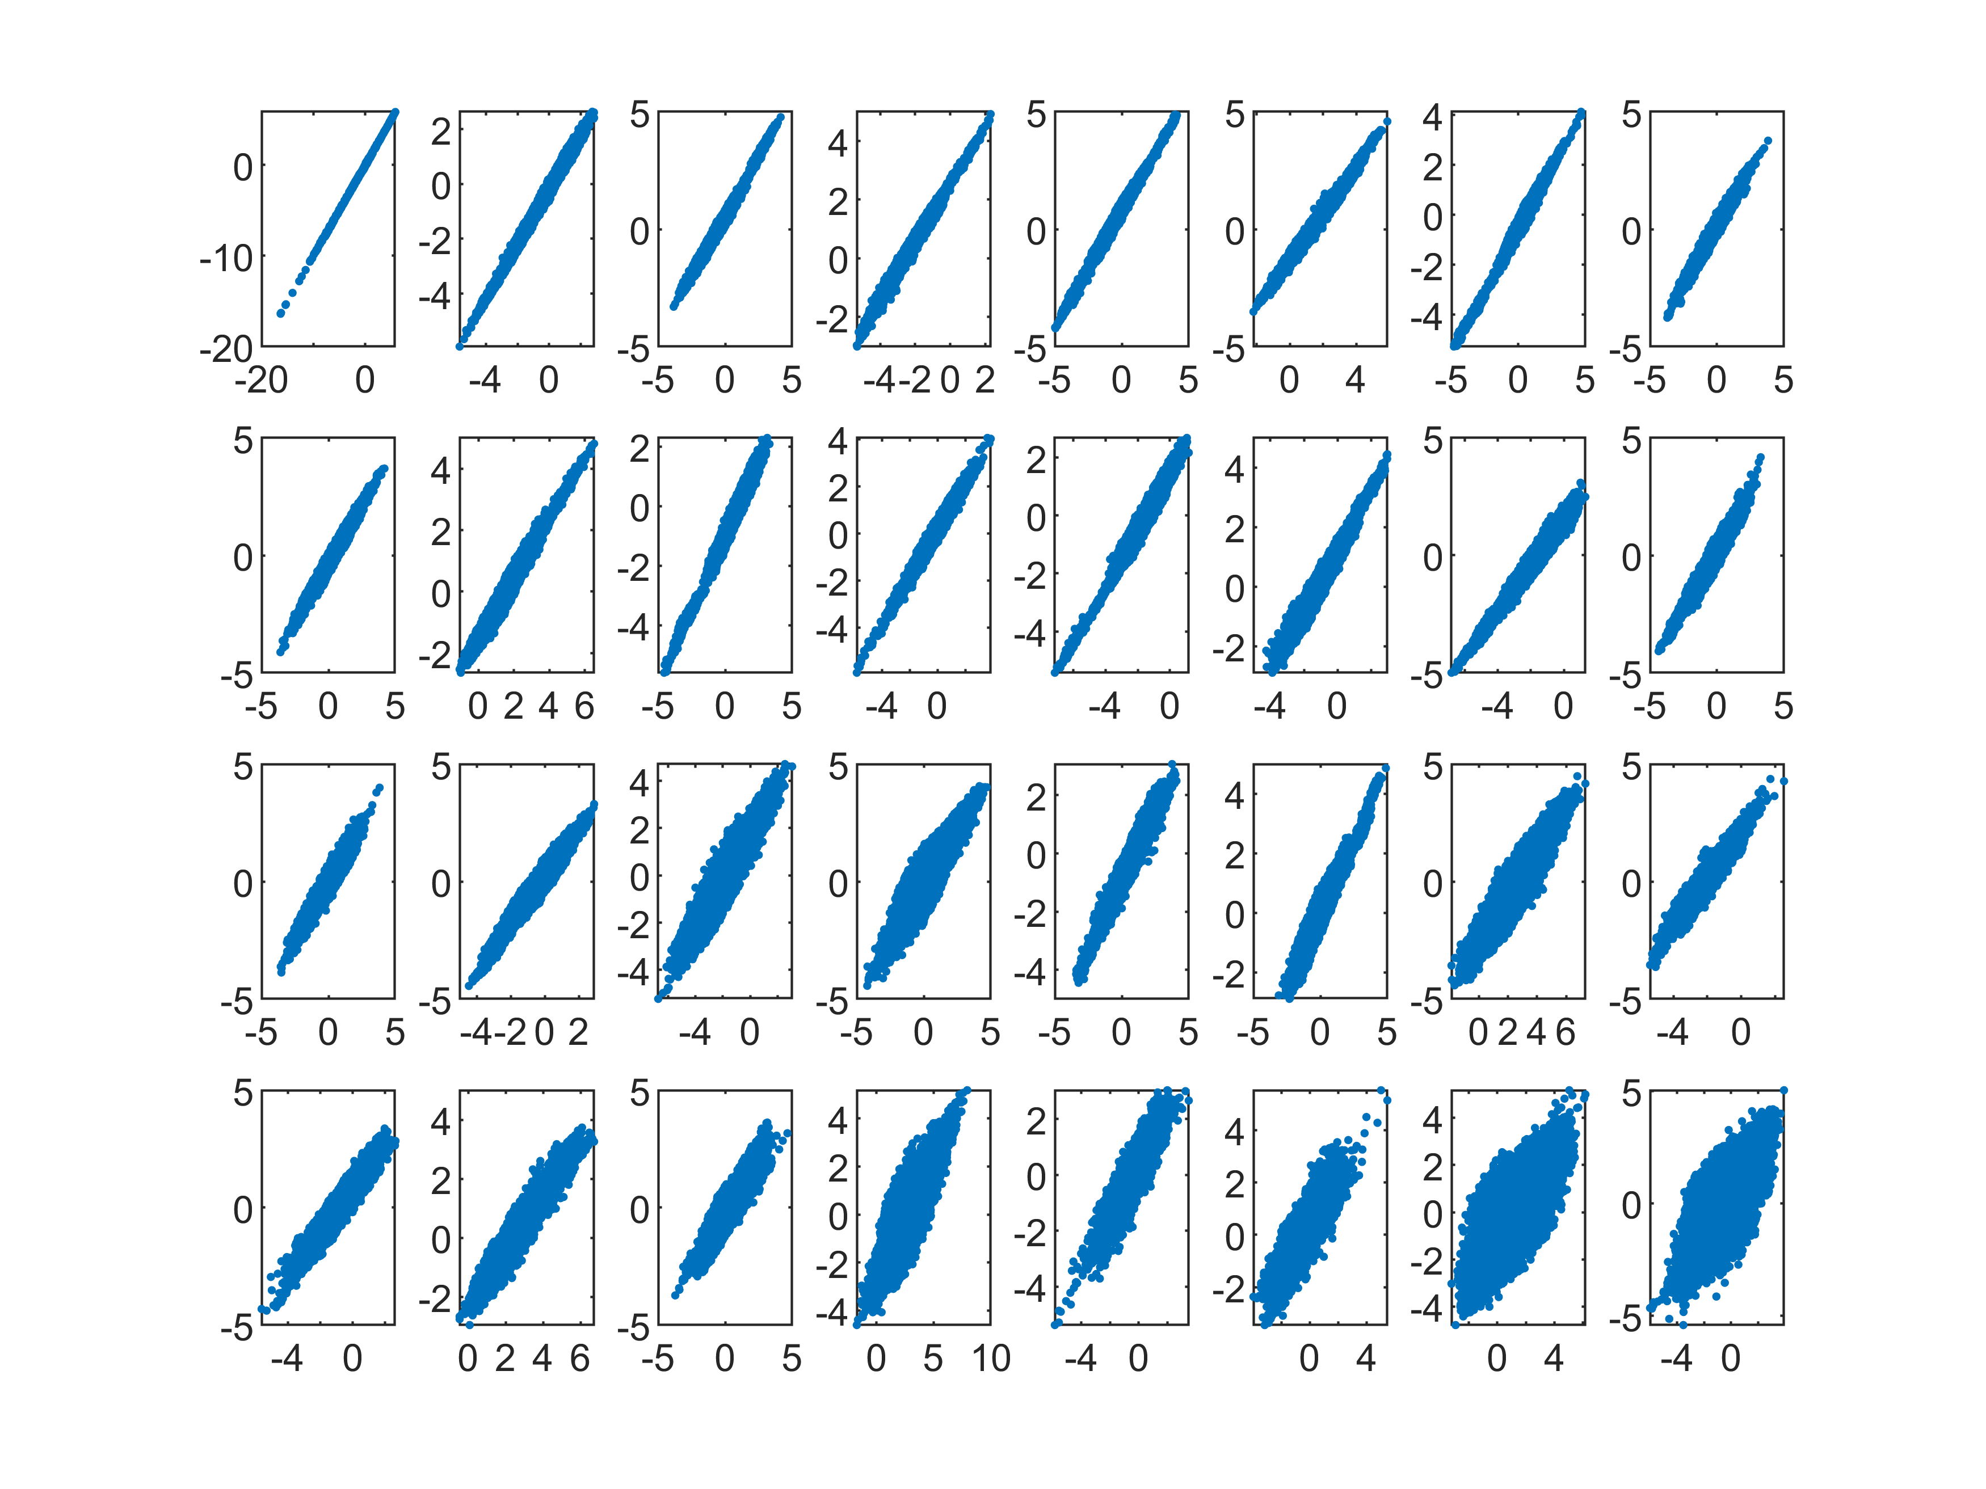
3.2 Numerical correctness
The diagonal lines produced by IC pairs from
MATLAB-ICA and CUDAICA
The diagonal lines produced by IC pairs from
tensor core ICA and CUDAICA
Notes:
There are 4 cased

Slide 13
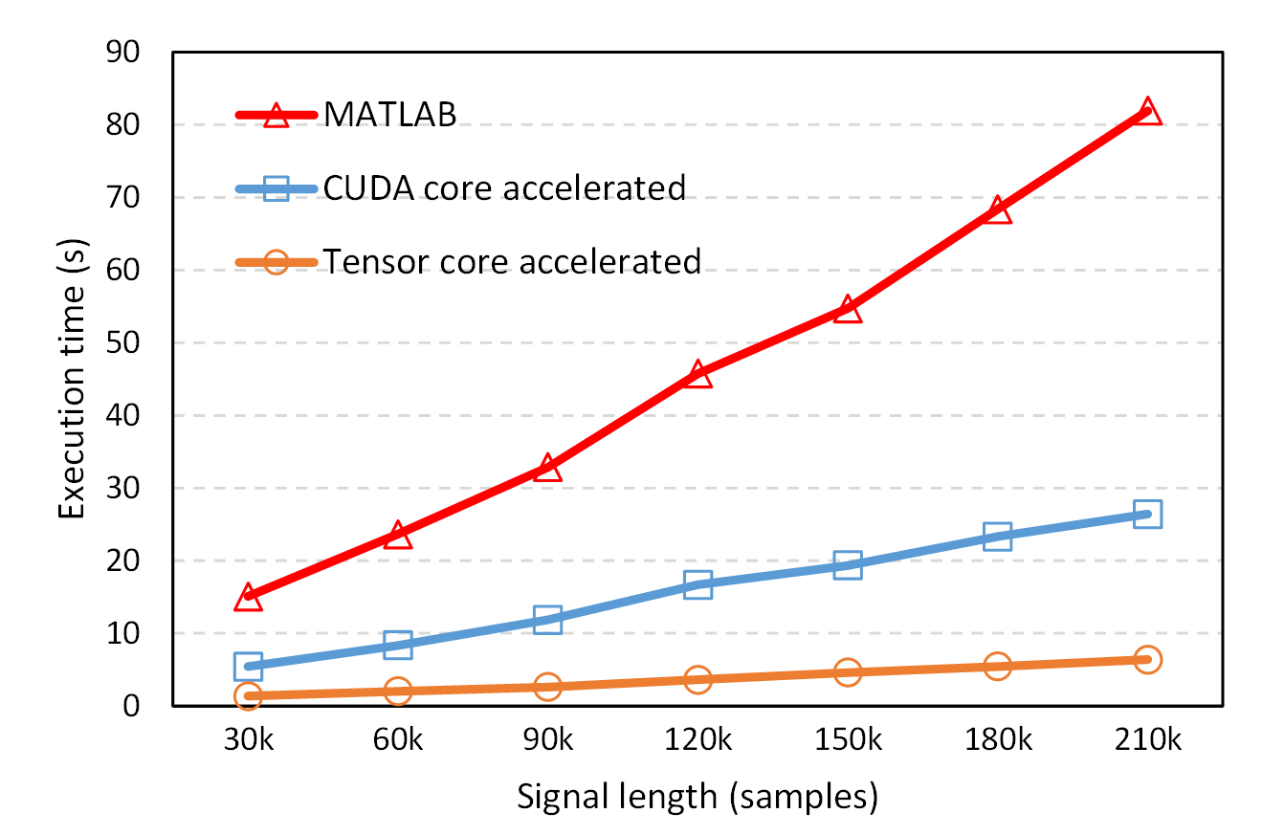
3.3 Performance preview
32-channel EEG data, up to 210k time points, CUDA core and tensor core execution time are produced by A100 GPU on Komondor supercomputer. The MATLAB execution time is produce by a 8-core CPU (i7-9700k)
3x speedup
4x speedup
Notes:
Regardless of correctness, ideal performance
Matlab version

Slide 14
4 Future works
Numerical correctness issue
Tensor core + shared memory strategy
Further performance testing
New strategy and larger dataset
EEG processing pipeline integration
Impact of mixed precision computing
FP32, TF32, FP16, BF16 ……
Other potential algorithms that tensor cores can optimize
Are there a lot of matrix multiplication operations in the algorithm? Why not consider using tensor cores to speed it up?

Slide 15
This research is supported by
Új Nemzeti Kiválóság Program (UNKP)

Slide 16
Decorrelation
Samples
$$\left[\begin{matrix}x_{11} & \begin{matrix}x_{12} & x_{13} & \end{matrix} & x_{1n} \\ x_{21} & \begin{matrix}x_{22} & x_{23} & \end{matrix} & x_{2n} \\ x_{31} & \begin{matrix}x_{32} & x_{33} & \end{matrix} & x_{3n}\end{matrix}\right]$$
$$⋯$$
$$Cov\left(X,Y\right)=\frac{1}{n}\sum_{i=n}^{n}{(x_{i}−E(x))(y_{i}−E(Y))}$$
Channels
$$⋯$$
$$⋯$$
Covariance
Data matrix
$$\left[\begin{matrix}1 & 0 & 0 \\ 0 & 1 & 0 \\ 0 & 0 & 1\end{matrix}\right]$$
Diagonalization
$$\left[\begin{matrix}Var(CH1) & Cov(CH1,CH2) & Cov(CH1,CH3) \\ Cov(CH2,CH1) & Var(CH2) & Cov(CH2,CH3) \\ Cov(CH3,CH1) & Cov(CH3,CH2) & Var(CH3)\end{matrix}\right]$$
Diagonal matrix
Covariance matrix
$$Cov\left(X,Y\right)\left\{\begin{aligned}>0: Positive correlation \\ <0: Negative correlation \\ =0: No correlation\end{aligned}\right.$$
Notes:
One of the measure of the correlation between two variables is the covariance, and we use the covariance matrix to measure the correlation between the channels of the EEG data, what we want finally is this kind of diagonal form covariance matrix, that means there is no correlation between each channel.

Slide 17
Decorrelation
Raw data
Centralized data
Whitened data
Centralization
Raw data
Eigenvalue matrix
^(-0.5)
Centralized data
Covariance
matrix
Eigenvalue decomposition
Decorrelated data
Whitened data
Eigenvector matrix
Notes:
The specific approach is the centralization and whitening, first we subtract the mean of the raw data and calculate its covariance matrix, next we get the eigenvector matrix to multiply the centralized data matrix to achieve the decorrelation.
From the graphic perspective, what we are doing is the rotation and stretching of the raw signal matrix.
The decorrelation process is also called sphering processing, because the distribution of the data is changed to a sphere.

Slide 18
$$UU^{T}=I$$
$$V^{T}V=I$$
$$X=UΣV^{T}$$
$$XX^{T}=UΣV^{T}∗{(UΣV^{T})}^{T}$$
$$XX^{T}=UΣV^{T}∗VΣU^{T}$$
$$XX^{T}=UΣU^{T}$$
$$XX^{T}U=UΣ^{2}$$
$$U^{T}XX^{T}U=U^{T}UΣ^{2}$$
Set ${Y=U}^{T}X$
$$YY^{T}=Σ^{2}$$

Slide 19
Remove dependency
Update
Whitened data
Unmixing matrix
$$W$$
$$g(·)$$
Independence criterion
$$x_{1}(t)$$
$$u_{1}(t)$$
$$y_{1}(t)$$
$$s_{1}(t)$$
$$x_{2}(t)$$
$$u_{2}(t)$$
$$y_{2}(t)$$
$$s_{2}(t)$$
…
…
…
…
$$x_{n}(t)$$
$$u_{n}(t)$$
$$y_{n}(t)$$
$$s_{n}(t)$$
The process of solving the unmixing matrix
Notes:
The next step is to remove the dependency,
The whitened data will be computed by the unmixing matrix and the non-linear function, and then we will assess the independence of the output signals, if it doesn’t meet the requirements, we will implement a back propagation to update the unmixing matrix, after some iterations, the independence of the output signals will be improved, and we will achieve our purpose of separating the signals.
So the key here is to figure out how to measure dependency, how to determine the loss function.

