Slide 1



Materials challenges in quantum sensing with diamond nitrogen-vacancy center
Adam Gali
HUN-REN Wigner Research Centre for Physics, Budapest, Hungary
Budapest University of Technology and Economics, Budapest, Hungary
ReAQCT 2024
Recent advances in quantum computing and technology (ReAQCT)
June 19-20, 2024, Bosch Budapest Innovation Campus, Hungary

Slide 2
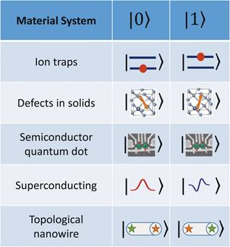
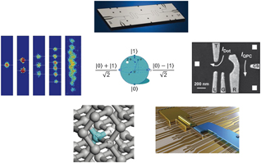
Introduction
Development of materials to single atom limit
Development of spectroscopy to single photon limit
James N. Eckstein and Jeremy Levy, MRS Bulletin 38, 783, (October 2013)

Slide 3
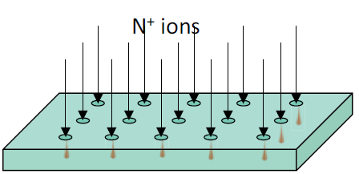
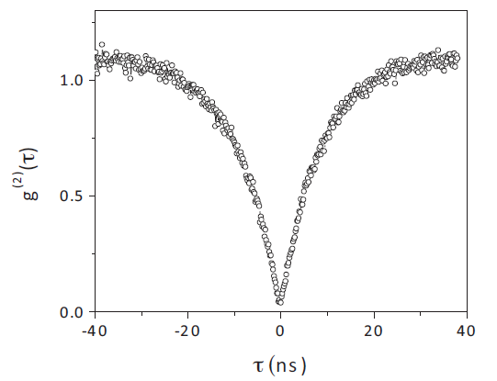
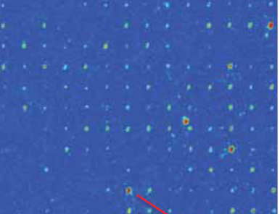
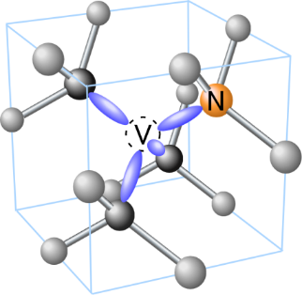
Introduction
implantion of N ions: create vacancies
annealing at T>700 °C: formation of NVs
acid cleaning of the damaged surface
J. Meijer et al., APL 87 261909 (2005)
J.R. Rabeau et al., APL 88 023113 (2006)
single photon emitter, single spin

Slide 4
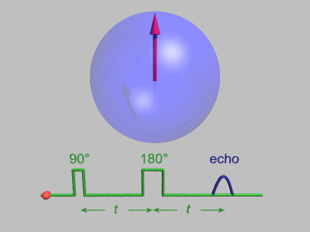
Introduction
Optically Detected Magnetic Resonance – ODMR
Long coherence time at room temperature
Maze et al., New Journal of Physics, 14, 103041 (2012)

Slide 5
NV center in diamond: one spin to sense them all
Magnetic field sensing
Electric field sensing
Thermometry
Strain and pressure sensing
Force sensing and gravitometry
measure temperature at the nanoscale: single (biological) molecule
Revolutionize chemistry, biology and medical diagnostics
gyroscopes on chip operating at harsh environments
Revolutionize (self-driven) automotive industry, navigation systems
portable gravitometry
Revolutionize geographical science and astronomy

Slide 6
NV center: magnetometer for solid state physics
Casola et al., Nature Reviews Materials, 3, 1 (2018)

Slide 7
Shallow nitrogen-vacancy centers in diamond
oxygen termination for nearly positive electron affinity
band bending (negative species at the surface)
nearby vacancies and divacancies are formed
Nano Letters 14, 4772 (2014)
Nat. Elec. 1, 502 (2018)
Nat. Comms. 8, 1549 (2017)

Slide 8
Charge transition levels of defects in diamond
Phys. Rev. B 89, 075203 (2014)
V
V₂
green illumination ionizes neutral single vacancies and divacancies with creating holes
NV⁻ has a giant hole capture cross section [Nat. Elec. 4, 717 (2021)]

Slide 9
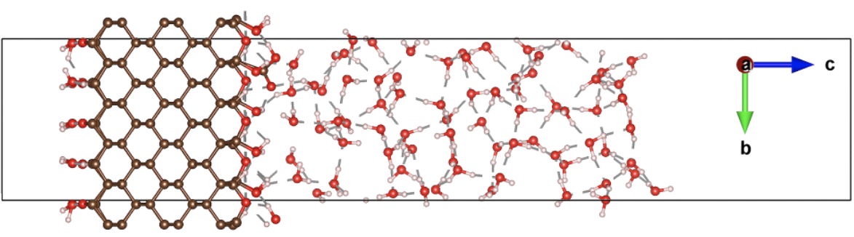
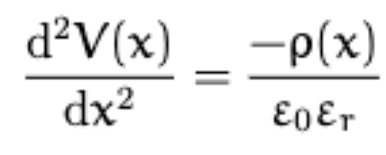
Modeling of diamond surface and band bending
Methodology: ab initio DFT and beyond
A. Gali, Nanophotonics, 8, 1907-1943 (2019)
A. Gali, Nanophotonics, 12, 359-397 (2023)
Ambient condition: absorbed water on top of diamond surface
ab initio molecular dynamics to cover diamond with water
carboxyl groups (COOH) represent acceptor defects at the surface
Electron affinities (vacuum level shifts and work functions) can be determined

Slide 10
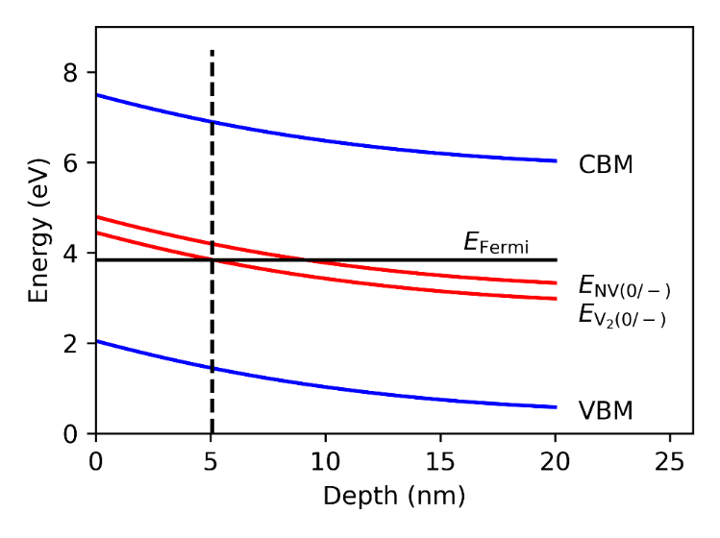
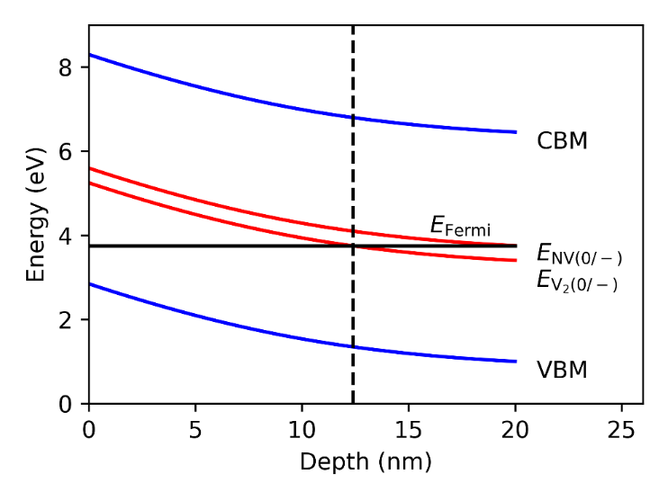
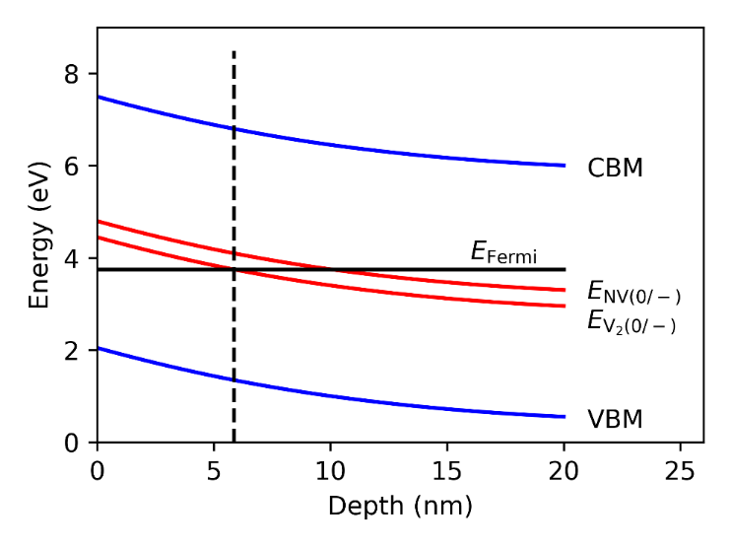
Results: low pressure is the problem
Large band bending causes the instability of deep defects’ charge state under illumination (V₂⁻ → V₂⁰)
V₂⁰ emmits a hole (V₂⁰ → V₂⁻ + h⁺), which is captured by the NV (NV⁻ + h⁺→ NV⁰)
Water, reducing the band bending, extends the stability region towards the surface
The effect originates from the low pressure applied in the cooling process rather than low temperature

Slide 11
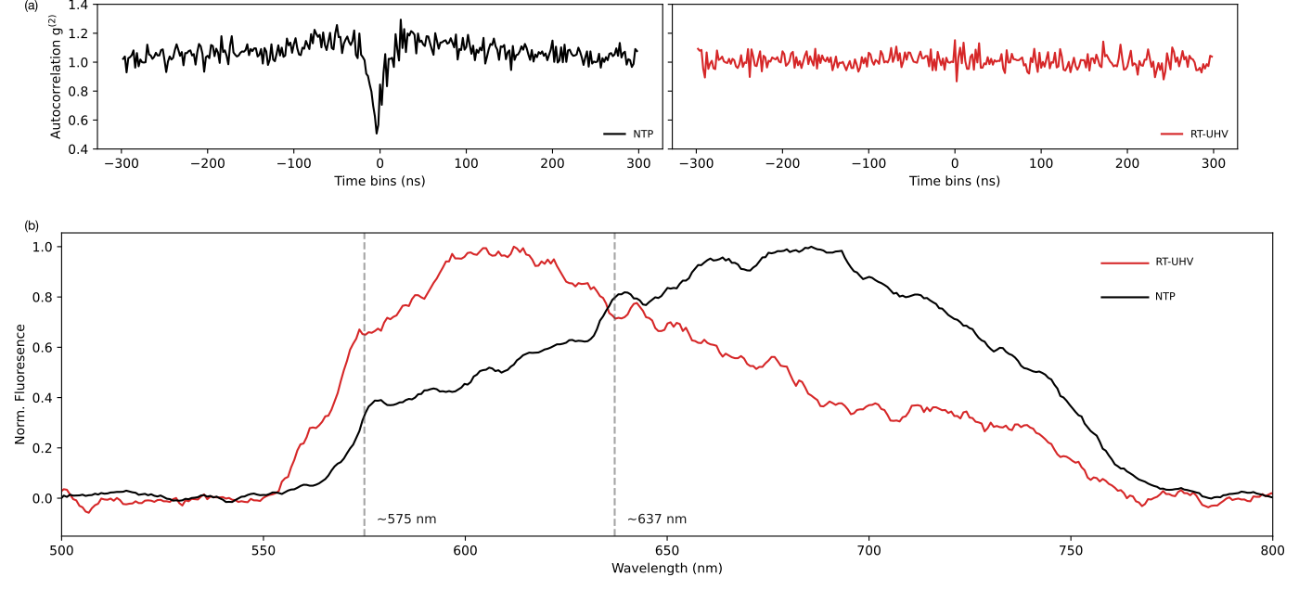
Results: experimental verification
single NV⁻ ODMR signal disappears at room temperature after applying low pressure

Slide 12
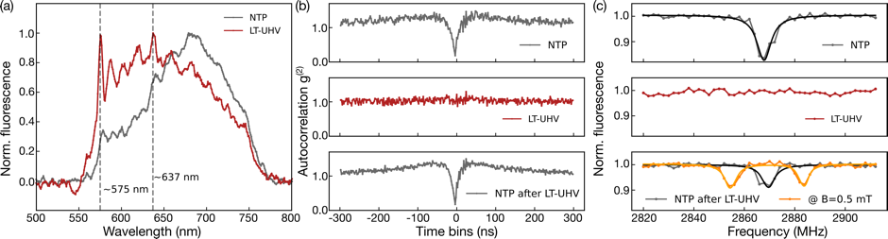
Results: experimental verification
ODMR signal disappears at ~4 K, so that the antibunching feature
PL implies that NV⁻ gets ionized to NV⁰
Spraying water (1-2 nm layer) leads to revival of the ODMR signal of single shallow NV centers
with A. Singha @ MPI in Stuttgart, Nano Letters, 23, 2563 (2023)

Slide 13
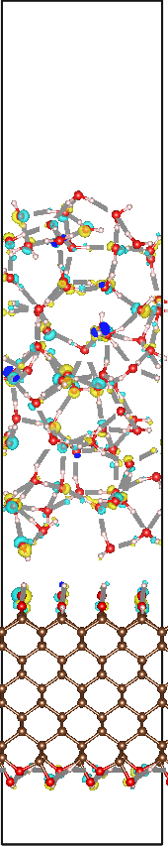

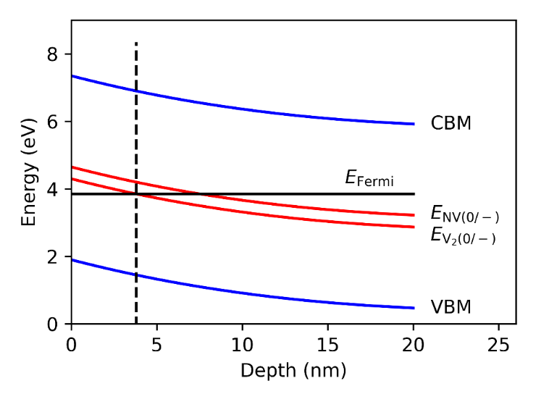
Results: electrolyte (NaCl) solution
−
water at room temperature electrolyte at room temperature
COO⁻H⁺
COO⁻Na⁺
+
experiments with D. Bucher @ TU München, ACS Nano, 17, 10474 (2023)
interfacial dipole moment is developed

Slide 14
Results: electrolyte (NaCl) solution
Marcus-theory for calculating the electron (charge and spin) hopping
slow for P1 center, 0.1 GHz for vacancies at a distance of 3 nm in contact with water
It slows down with an order of magnitude caused by interfacial dipole field in contact with electrolyte
T₁ times of NV and the dark spins increase
experiments with D. Bucher @ TU München, ACS Nano, 17, 10474 (2023)

Slide 15
Observed single photon sources and quantum bits
exp. confirmed qubits
Room temperature qubits
Diamond NV
Science 276, 2012 (1997)
SiC V_{Si}-center (low contrast)
Nat. Mat. 14, 164 (2015)
SiC divacancy (high contrast)
Nature 479, 84 (2011)
Nat. Comm. 4, 1819 (2014)
Nat. Sci. Rev. 9, nwab122 (2022)
A. Gali et al., Appalied Physics Reviews, 7, 031308 (2020)
Quantum guidelines for solid-state defect spins, Nature Reviews Materials 6, 906 (2021)

Slide 16
Quantum Technology Summer in Budapest
154 attendees, 28 countries from 5 continents

Slide 17


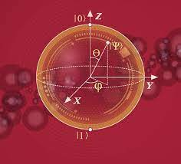


Summary
charge state of shallow vacancies should be controled
absence of water is the problem for the oxygen-terminated diamond NV quantum sensor in cryogenic temperature operation
this can be resolved by water dosing
biomedical sensor applications are viable (e.g., blood serum)
Nano Letters, 23, 2563 (2023)
ACS Nano, 17, 10474 (2023)
Anton Pershin
Acknowledgement
Horizon Europe

Slide 18
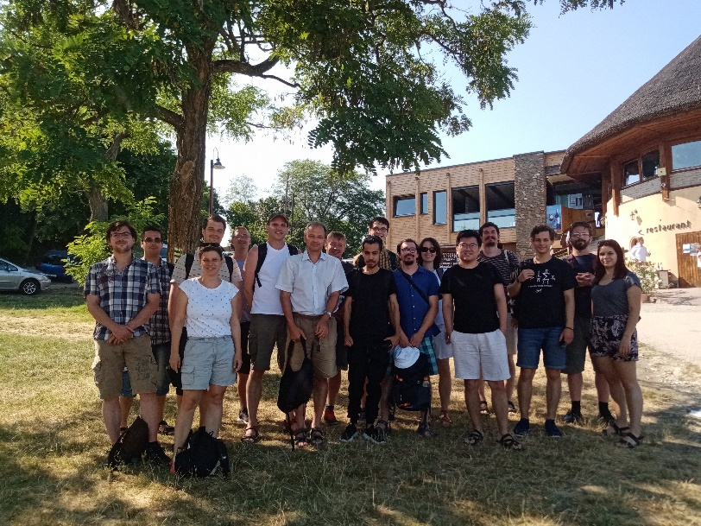
Magneto-optical spectroscopy research group

Slide 19
Supplementary Materials

Slide 20
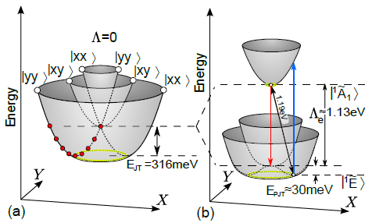
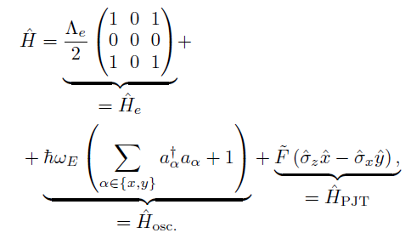


HUN-REN Wigner Research Centre for Physics, Adam Gali
Damped pseudo Jahn-Teller effect
KS DFT APES
Derived APES
electron-phonon Hamiltonian in (A₁ + E) x E el-ph space

Slide 21






HUN-REN Wigner Research Centre for Physics, Adam Gali
Damped dynamic Jahn-Teller effect combined with pseudo JT effect

Slide 22
HUN-REN Wigner Research Centre for Physics, Adam Gali
Damped dynamic Jahn-Teller effect combined with pseudo JT effect

Slide 23
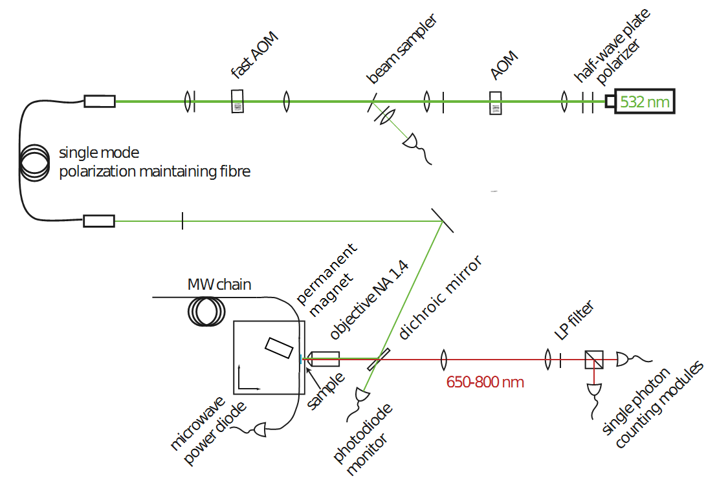
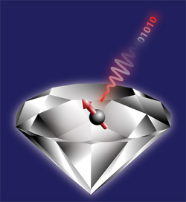
NV center: sketch of typical ODMR setup
optical path
Photoexcitation
optical readout of single spin
Science 276, 2012 (1997)
Microwave
Confocal microscope
Photodetectors

Slide 24
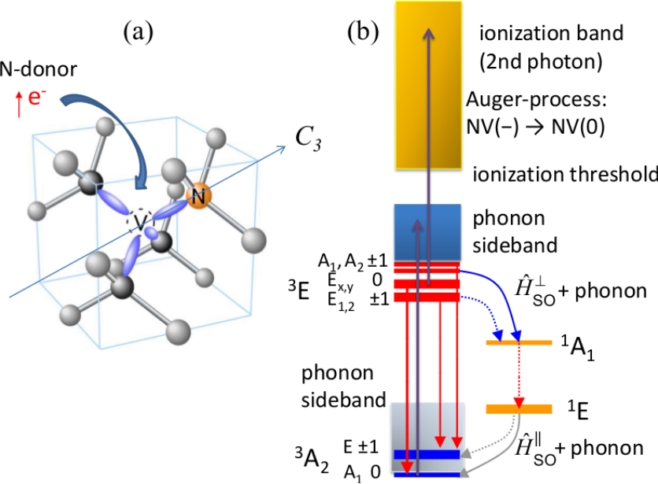
Important properties
Magnetic field,
electric field,
strain field and temperature dependence
(c)
E ±1
T₂≈1 ms @ RT
30% readout
contrast
D: zero-field splitting
A₁ 0
e spin – e (n) spin interaction

Slide 25
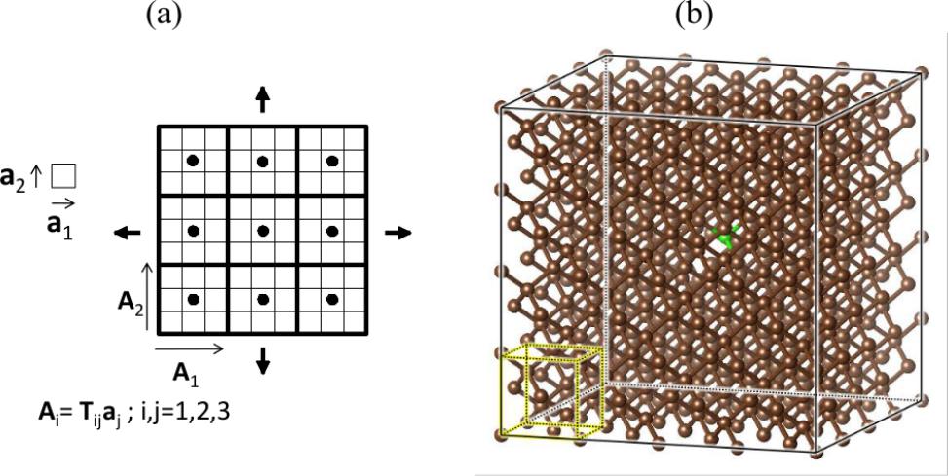

Methodology
Born-Oppenheimer approximation (adiabatic potential energy surface)
HSE06 hybrid Density Functional Theory functional (almost no band gap-error)
electronic structure and spin-density distribution
constrained occupation DFT for excited state calculation
[Gali et al., Physical Review Letters 103 186404 (2009)]
512-atom supercell with Γ-point sampling of BZ

Slide 26
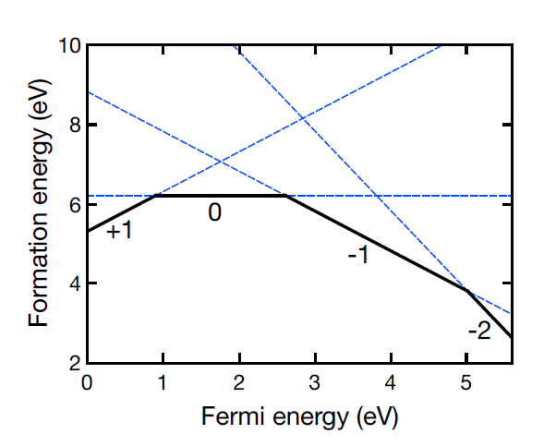
Typical characterization: thermodynamics
(0)
(½)
(1)
(½)

Slide 27
Developments and implementations
impact ionization and Auger-Meitner rates [PRL (2013); PRB 87 155402 (2013)]
hyperfine coupling [PRB 88 075202 (2013)]
electron spin – electron spin coupling (zero-field splitting) [JP:CM 26 015305 (2014); PRB 90 235205 (2014)]
treatment of highly localized d-electrons [PRB(2013); 90 035146 (2014)]
interaction of quantum wells (stacking faults) and point defects [Nanoscale 6 10027 (2014); Nature Communications 6 7783 (2015)]
comprehensive theory of optical nuclear spin polarization [PRB (2020)]
modeling of complex surfaces and quantum confinement effects [Nature Nanotechn. 9 54 (2014); Nano Letters 14 4772 (2014); JP:CM 26 143202 (2014)]
CI+cRPA method for excited state calculation [npj Quantum Materials 3, 31 (2018)]
intersystem crossing (ISC) rates [PRB 96, 081115(R) (2017); 98, 085207 (2018)]
Spin-orbit coupling and ISC: should go beyond Born-Oppenheimer approximation

Slide 28
General considerations: why Jahn-Teller systems
high spin ground state
degenerate orbitals
degenerate orbital
Jahn-Teller instability

Slide 29
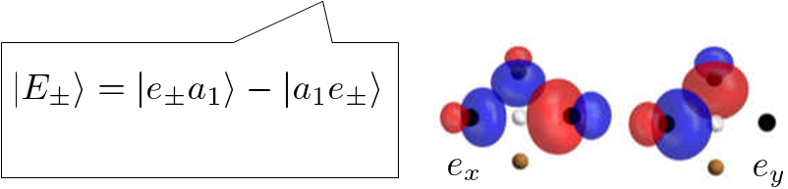
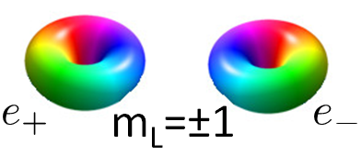
General considerations: spin-orbit coupling (SOC)
orbitally degenerate state with spin
non-zero spin-orbit coupling
λ_{z} L_{z} S_{z}
m_{J}=±3/2
m_{S}=±1/2
λ_{z}
m_{L}=±1
m_{J}=±1/2
like a p electron

Slide 30
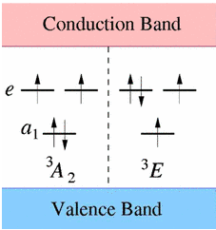
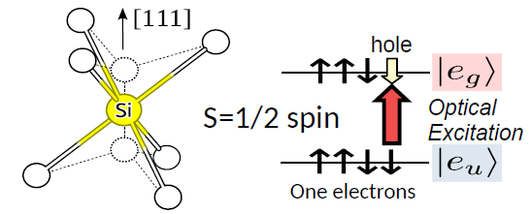
Jahn-Teller systems in defect qubits
NV center
SiV center
Thiering & Gali, PRB Rapid 96, 081115
Thiering & Gali, PRX 8, 021063

Slide 31
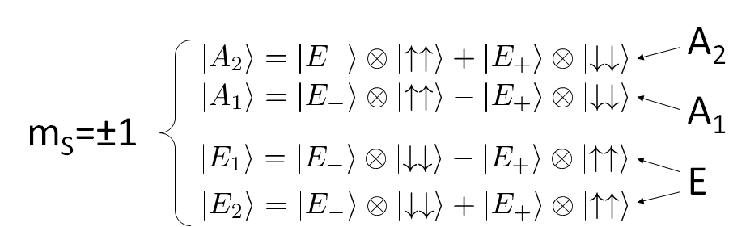
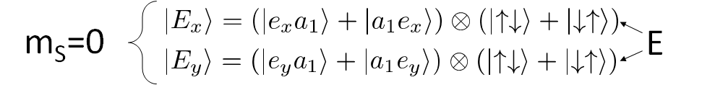
Jahn-Teller systems in defect qubits
³E excited state at a closer look
{A₁, A₂}
λ_{z}
E (0)
λ_{z}
E (±1)

Slide 32
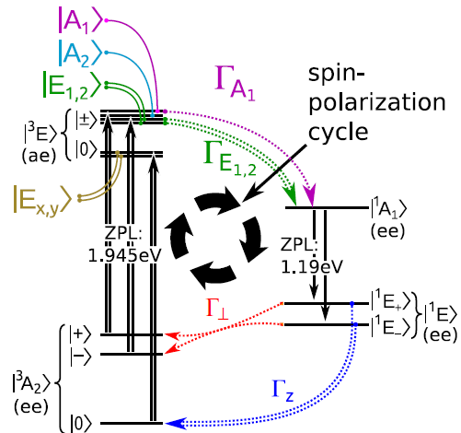
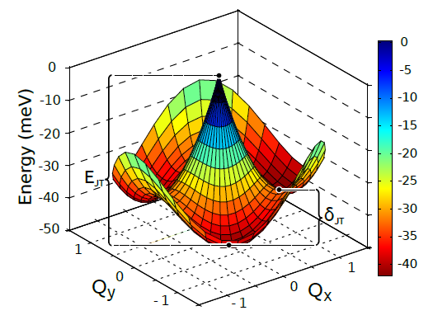
Understanding ISC and optical spinpolarization
³E excited state: Exe dynamic Jahn-Teller system
✘
Group Theory predicts no effective intersystem crossing (ISC)
pseudo Jahn-Teller interaction: (A₁ + E) x e system

Slide 33


Understanding the effective spin-orbit coupling
³E excited state: Exe dynamic Jahn-Teller system*
n, m quanta of e_{X}, e_{Y} phonons
I. Bersuker, The Jahn-Teller effect (Cambridge University Press, 2006).
Frank S. Ham, Phys. Rev. 138, A1727 (1965)
λ_{z}^{eff} = p λ_{z}
Ham reduction factor p
*K.-M. C. Fu et al., PRL 103 256404 (2009)
T. A. Abtew et al., PRL 107 146403 (2011)

Slide 34
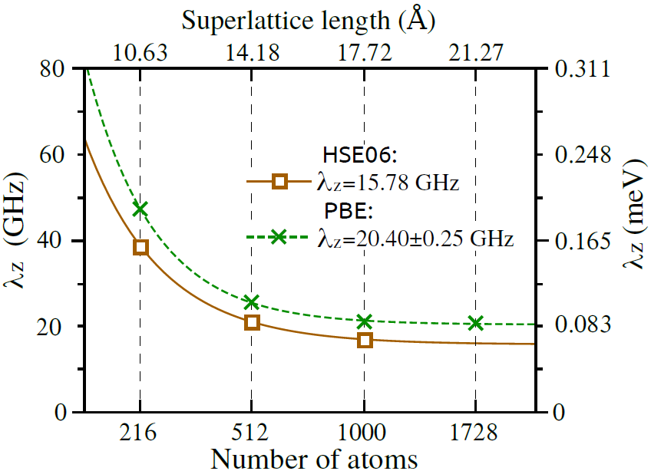
Understanding ISC and optical spinpolarization
³E excited state: Exe dynamic Jahn-Teller system
p = 0.307
λ_{Z}(eff) = p λ_{Z} =
0.307 × 15.78 GHz =
4.86 GHz
λ_{Z}(exp) ≈ 5.0 GHz

Slide 35




Understanding ISC and optical spinpolarization
³E excited state: Exe dynamic Jahn-Teller system
n, m quanta of e_{X}, e_{Y} phonons
vibronic wavefunctions
≈ 0.5
Thiering & Gali, PRB Rapid 96, 081115

Slide 36
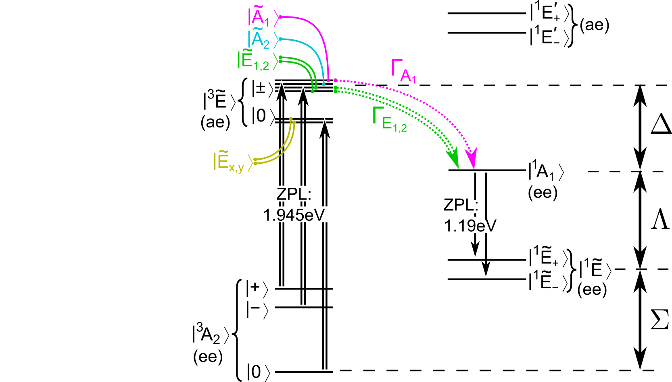
ISC at lower branch: spin-orbit coupling with singlets
λ
λ_{z}

Slide 37
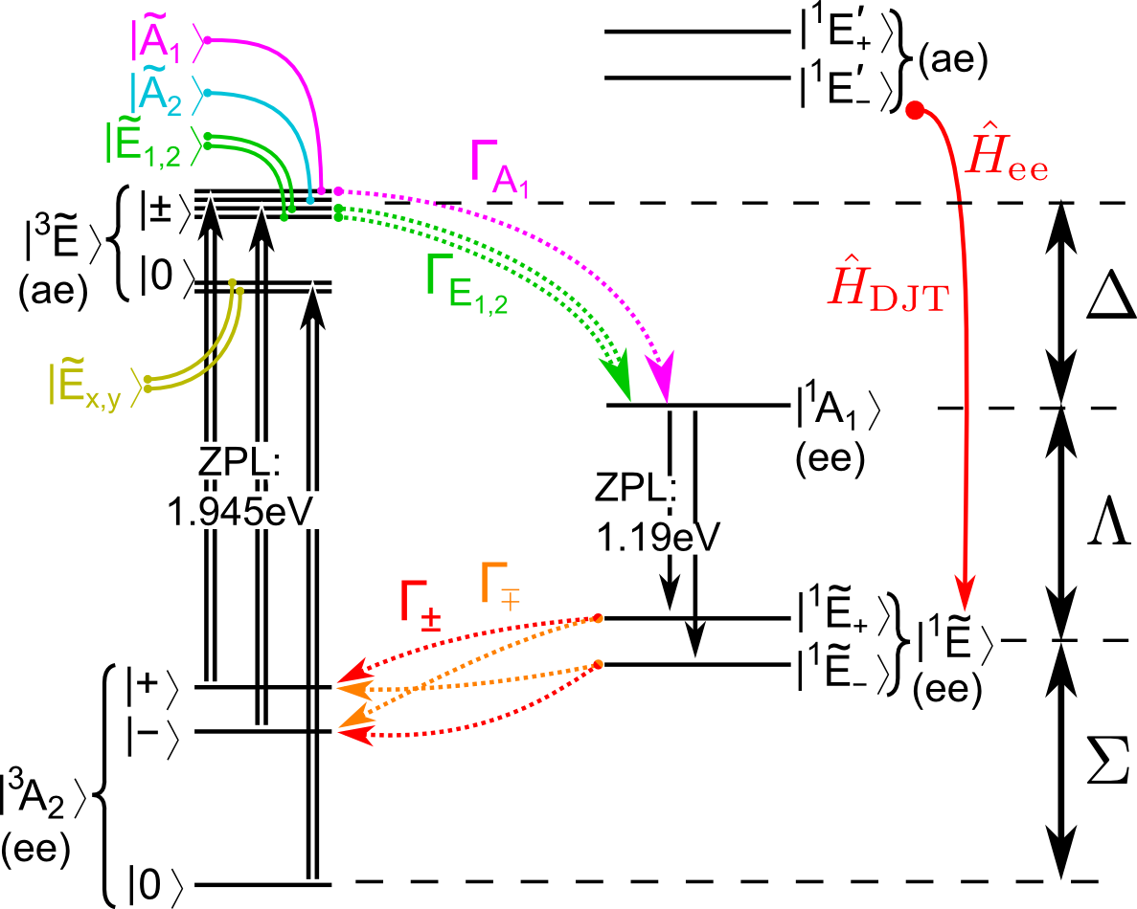
ISC at lower branch: spin-orbit coupling with singlets
Electron-electron interaction
brings (damped) dynamic Jahn-Teller interaction

Slide 38
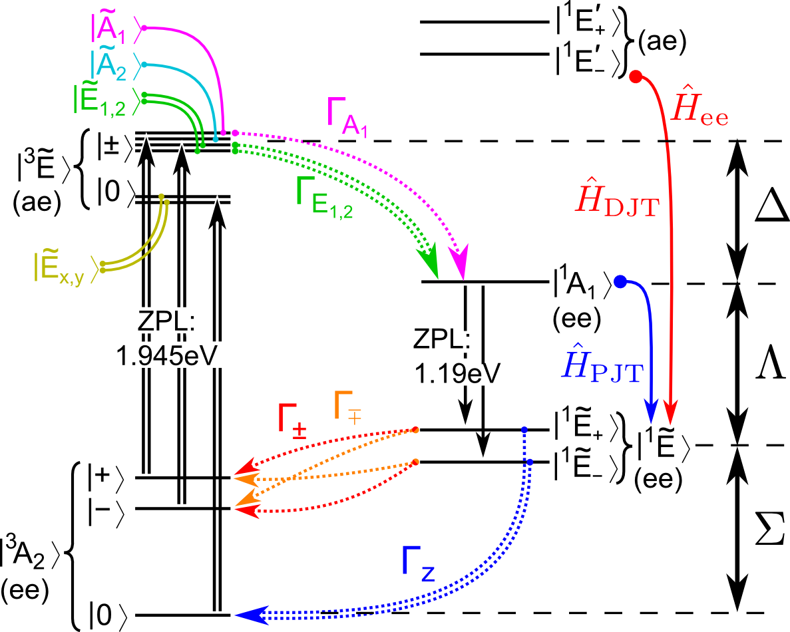
ISC at lower branch: spin-orbit coupling with singlets
Electron-electron interaction:
brings (damped) dynamic Jahn-Teller interaction
Electron – phonon coupling:
damped pseudo Jahn-Teller interaction
Quantum guidelines for solid-state defect spins, Nature Reviews Materials 6, 906 (2021)

Slide 39
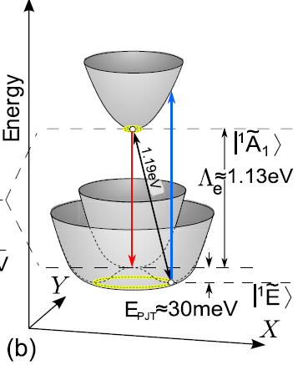
Understanding ISC and optical spinpolarization
Damped pseudo Jahn-Teller interaction: (A₁ + E) x e system

Slide 40
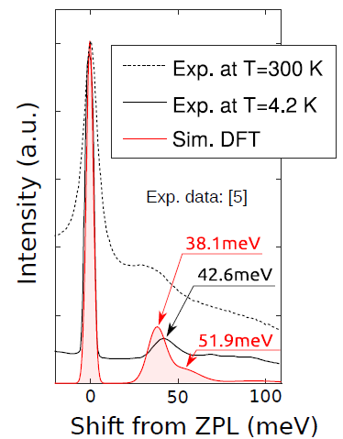
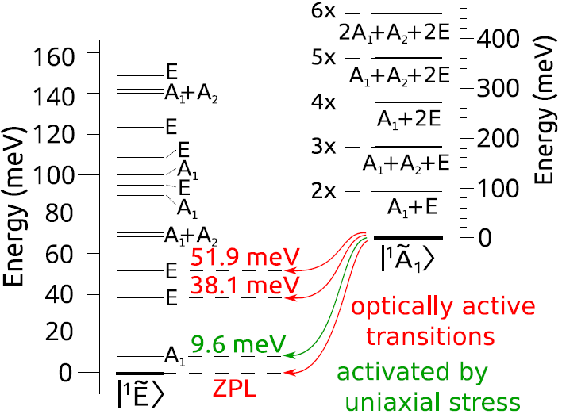
Understanding ISC and optical spinpolarization
Damped pseudo Jahn-Teller interaction: (A₁ + E) x e system
✓
broad feature in phonon sideband
forbidden phonon peak in between
✓

Slide 41
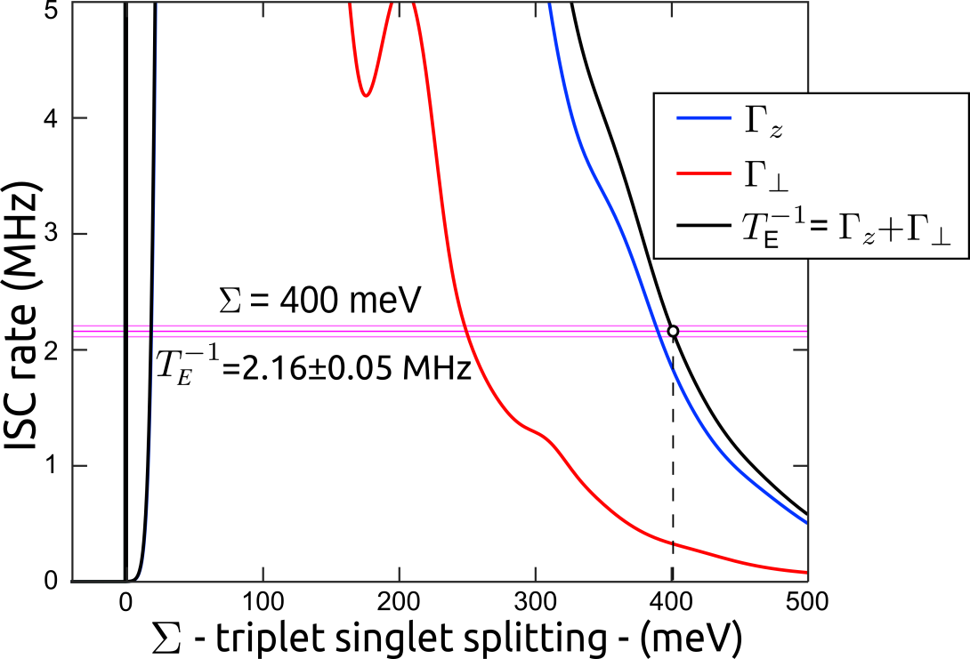
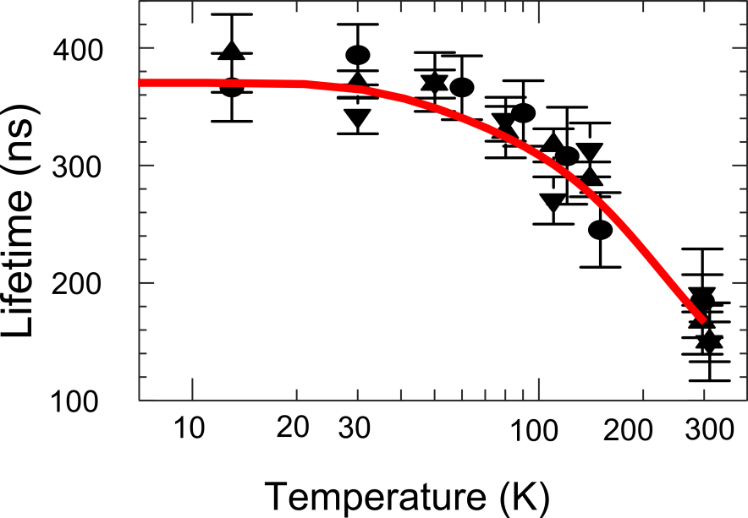

Understanding ISC and optical spinpolarization
Damped pseudo Jahn-Teller interaction: (A₁ + E) x e system
✓
temperature dependence
≈ 6
NJP 13, 025013 (2011)
Thiering & Gali, PRB 98, 085207

Slide 42
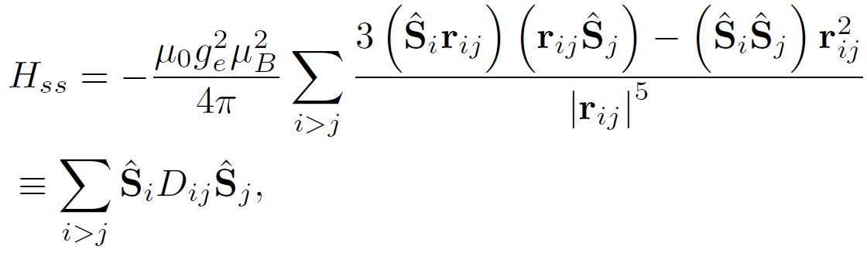
NV center in diamond: T1 time with temperature
RT operation: large triplet-singlet gap and large phonon energies w.r.t. zero-field-splitting energy
quasi-local vibration modes
double exponential (Orbach-like) decay with 65-meV and 165-meV effective modes activated by temperature
T1 time ≈ 1 ms at room temperature
PRL 130, 256903 (2023)

