Slide 1
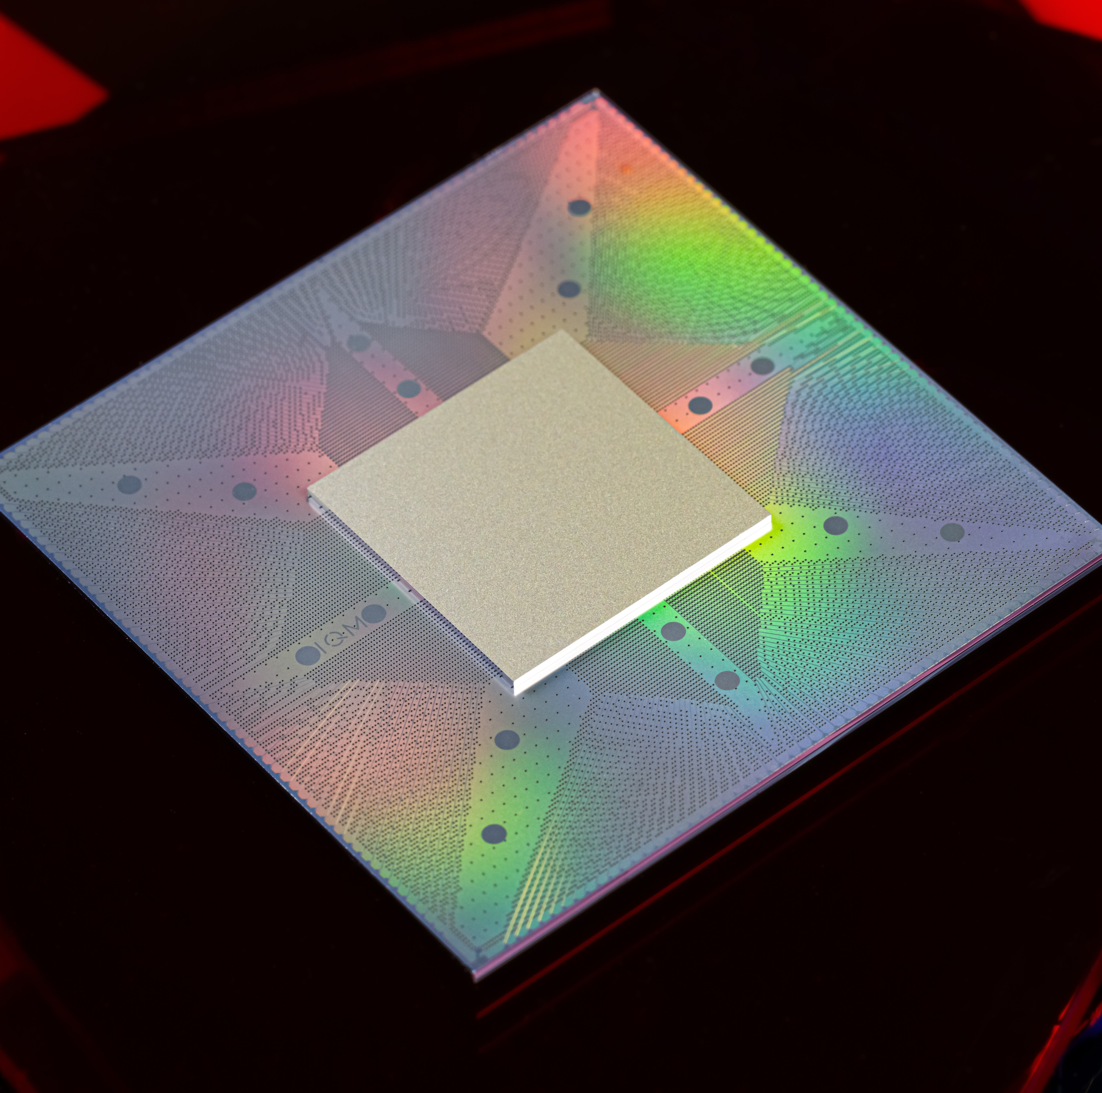
Recent developments in open-source design tools and QPUs
WE BUILD QUANTUM COMPUTERS
E. Takala¹, T. Mylläri¹, J. Räbinä¹, P. Smirnov¹
M. Malinen², P. Råback², J. Ruokolainen², J. Kataja²
¹ IQM Quantum Computers ltd, Finland
² CSC – It Center for Science ltd, Finland
www.meetiqm.com

Slide 2
KQCircuits by IQM – global leader in building quantum computers
https://github.com/iqm-finland/KQCircuits

Slide 3
[1] Z. K. Minev et al., ‘Energy-participation quantization of Josephson circuits’, npj Quantum Inf, vol. 7, no. 1, Art. no. 1, Aug. 2021
[2] P. Råback et al., ‘Elmer’. CSC – IT Center for Science, Available: github.com/ElmerCSC/elmerfem
Simulations
Ansys
Q3D – capacitance extraction using method of moments
HFSS – S matrix extraction
HFSS Eigenmode with ideal inductors modelling junctions/SQUIDs
pyEPR support [1]
Elmer (Open-source FEM solver by CSC Finland) [2]
2D cross-section and 3D Simulations (capacitance, inductance, s-matrix)
Waveguide media properties for arbitrary cross-sections (impedance and capacitance)
Kinetic inductance for some penetration depth
Energy participation ratio (EPR)
FEM component in KQC workflow quite replaceable with other third-party simulator software as we learn about them (e.g. Sonnet, AWS Palace https://awslabs.github.io/palace/stable/)
https://www.ansys.com/
https://www.csc.fi/fi/web/elmer
https://www.sonnetsoftware.com/

Slide 4
There is MUCH more – go and see KQCircuits presentation at FSIC2023!
For more information about KQCircuits capabilities available online, detailed presentation by P. Smirnov (video available):
https://wiki.f-si.org/index.php?title=KQCircuits_%E2%80%93_open-source_EDA_software_for_designing_chips_with_super_conducting_qubits

Slide 5
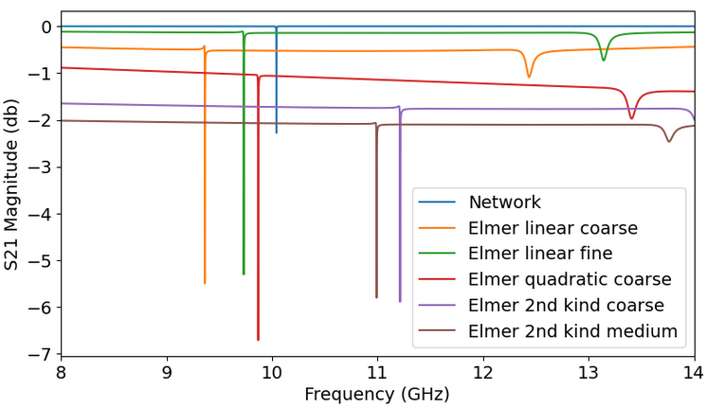
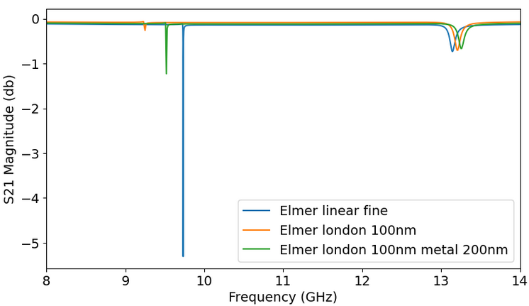
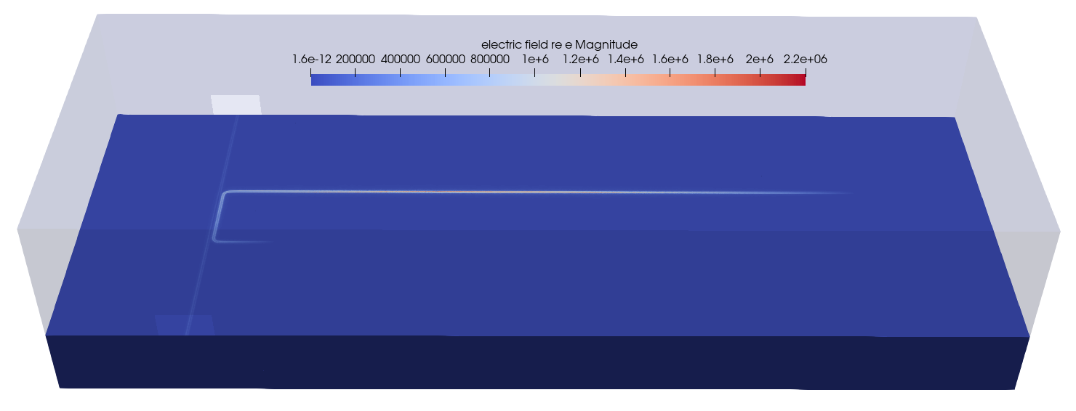
Case study: Hanger resonator
lambda/2 resonator s-parameters
computed using a network model
Also with KQC-Elmer (peak ﬁnding algorithm)
Nedelec linear and quadratic elements underestimate resonance and 2nd kind overestimates it
Penetration depth (100 nm) decreases resonance frequency
Metal thickness (200 nm) increases resonance frequency
https://github.com/iqm-finland/KQCircuits/blob/main/klayout_package/python/scripts/simulations/hanger_resonator_sim.py

Slide 6
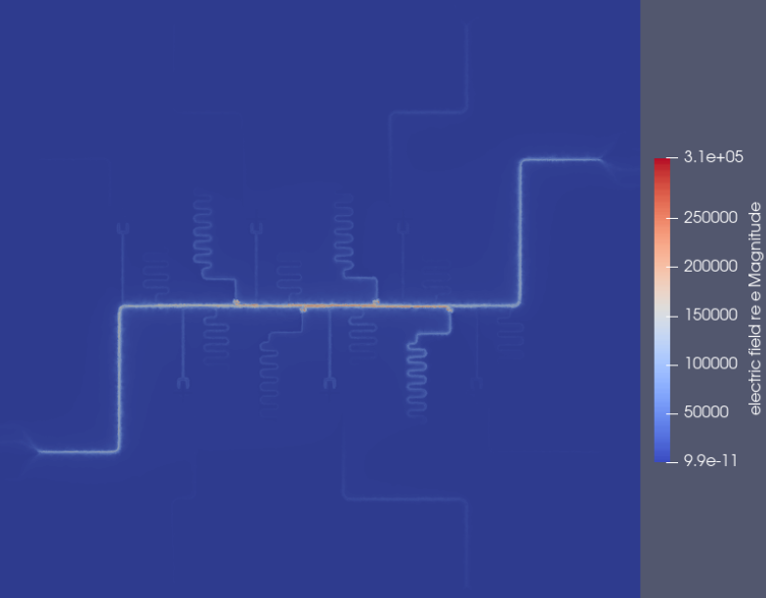
Elmer full wave simulation - chip example

Slide 7
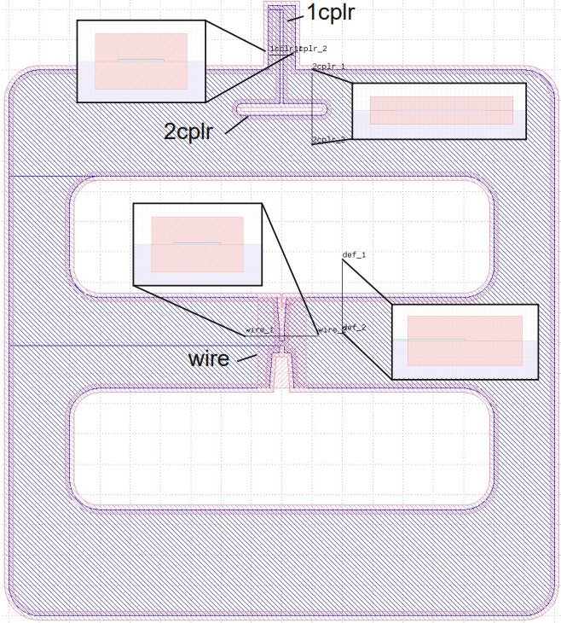
Case study: EPR with MER – Double pads
Metal Edge Regions (MER)
Automatically generated
Divided into regions (user specified)
Each region can be associated with a 2D cross-section
2D cross-section
Automatically generated
User gives coordinates on chip (two points define a cross-section location)
In the example we have four regions:
1cplr, 2cplr, wire and default
Four loss groups: ma, sa, ms, substrate
MERs
Default is the region that is not explicitly defined

Slide 8
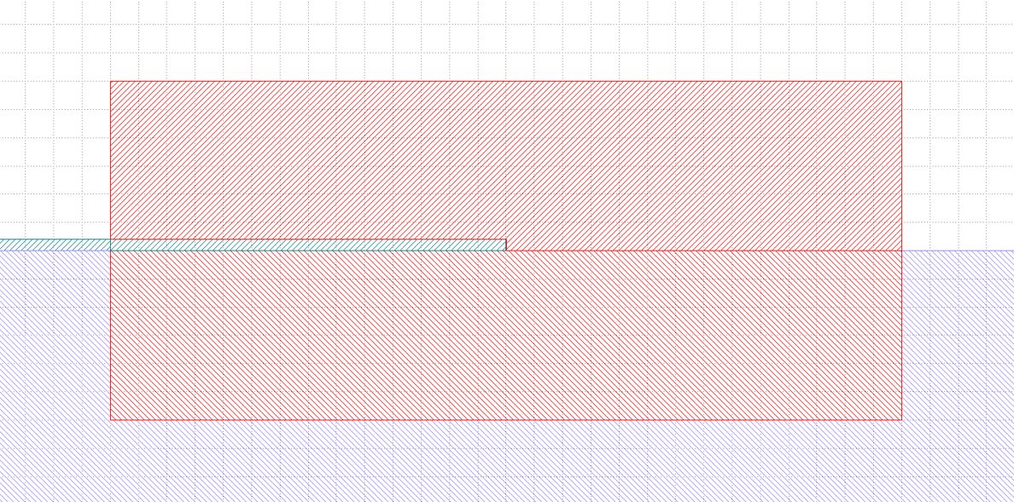
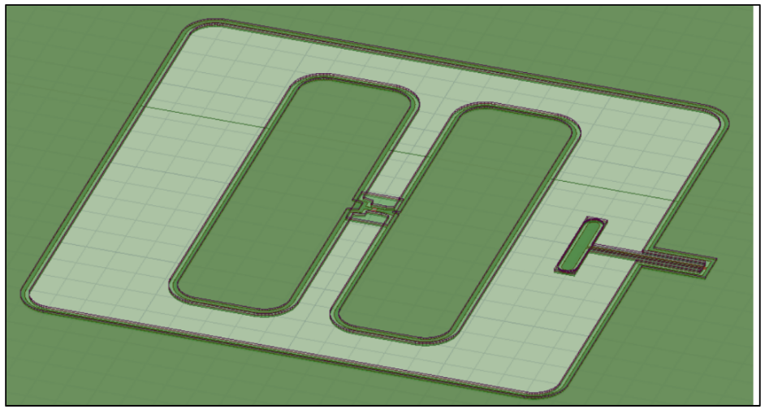
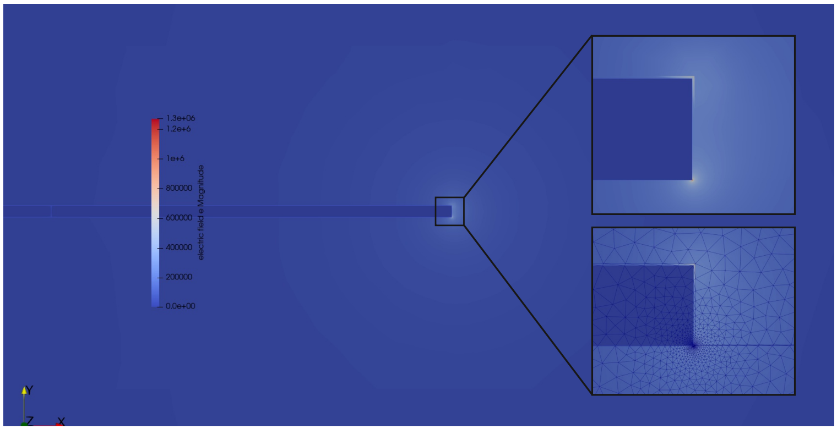
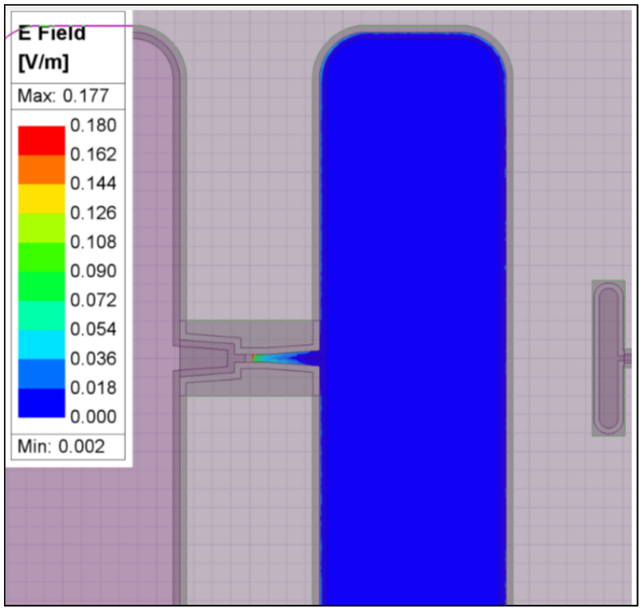
Corrected EPR
Only total energy is computed in 3D metal edge regions
2D simulation models implement interfaces in detail
3D total energy is corrected using 2D cross-section simulation
MER box in 2D corresponds to that in 3D
Vacuum
MA
SA
MS
Substrate
Only total energy computed in MERs
Interfaces are modeled in 2D
wire
2cplr
1cplr

Slide 9
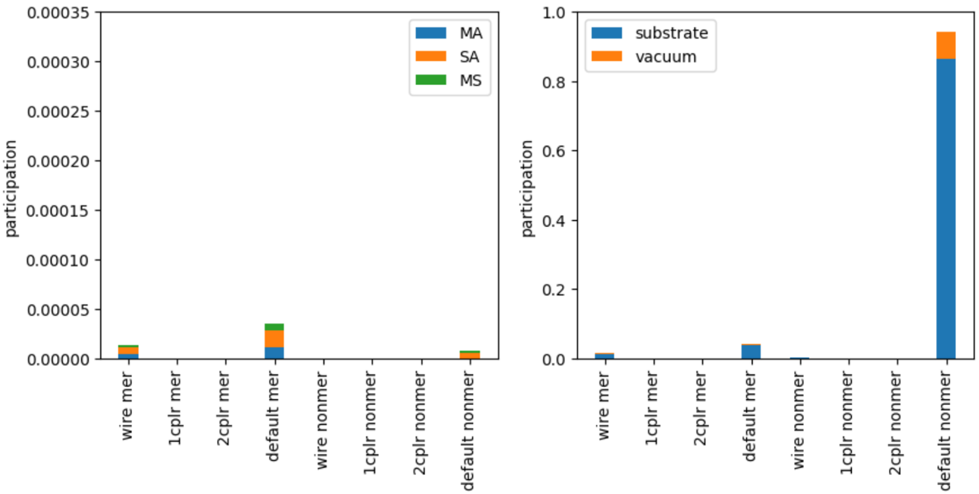
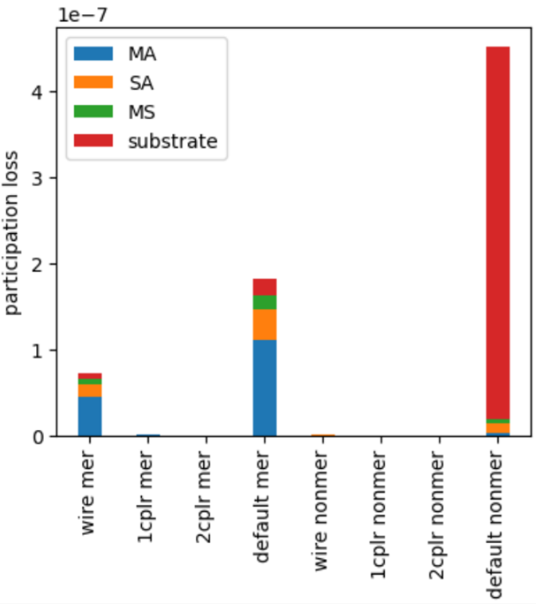
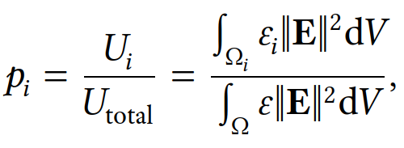
EPR – participation and loss
wire
2cplr
1cplr
Energy participation and loss can be grouped by a cross product of region (wire, 1cplr, 2cplr, default), loss group (MA, SA, MS, Substrate, Vacuum) and MER/non-MER
Default contains everything else

Slide 10
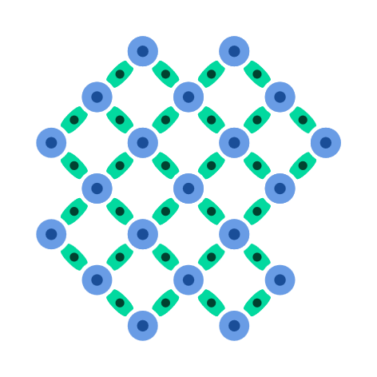
Crystals and Stars
Qubit Crystal
Qubits and tunable couplers
Fast parallel gates
Resonator Star
Qubits, tunable couplers and computational resonators
One-to-all connectivity

Slide 11
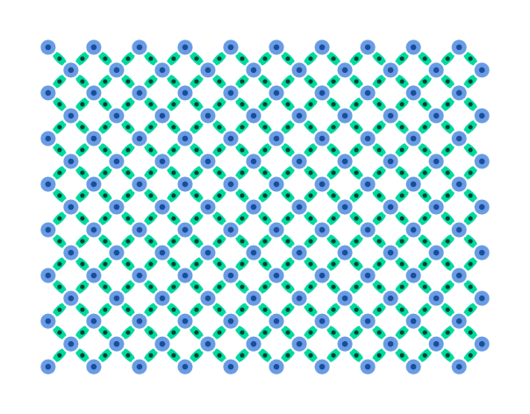
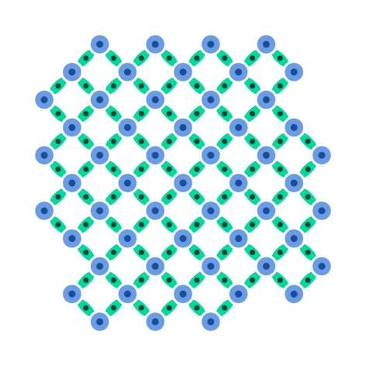
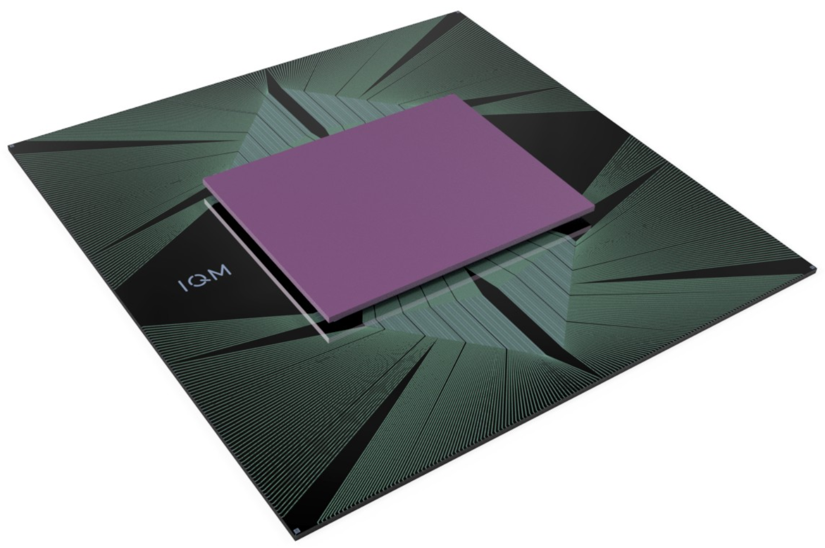
Qubit Crystals
IQM-5
5 qubits
4 couplers
Air-bridges or flip-chip
Produced at scale
IQM Garnet
20 qubits
30 couplers
Flip-chip
Produced at scale
IQM-54
54 qubits
70 couplers
Through Silicon Via
Acceptance testing
IQM-150
150 qubits
266 couplers
Through Silicon Via
First cooldown during 2024
W48.2

Slide 12
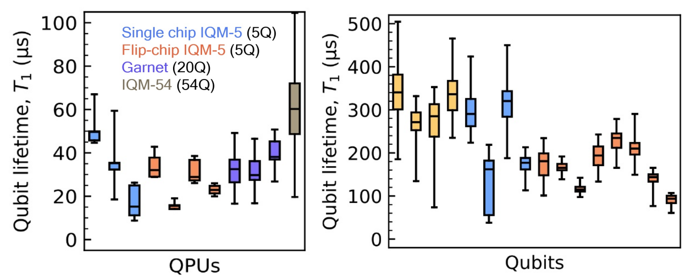
Qubit lifetime [1]
QPU qubits
Test device qubits
[1] Heinsoo et al., am. phys. soc. W48.2 (2024)

Slide 13
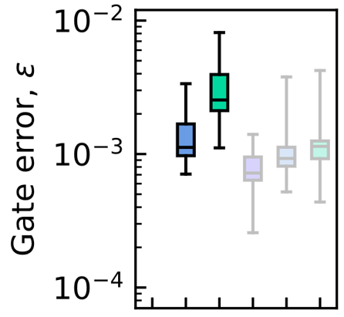
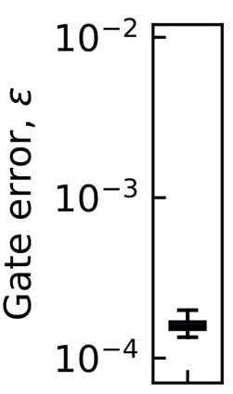
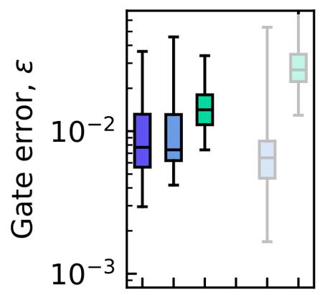
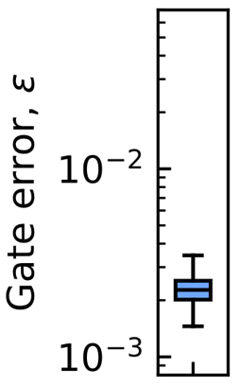
Benchmarks [1]
IQM Garnet™ A
QPU
Test device
Qubit count
20
Largest GHZ genuinely entangled state
20
Single qubit gate
Quantum volume
32
(Classical simulation complexity)
CLOPS
2600
(Computation rate)
Q-score
11
(Max-cut task size)
Two qubit gate
1Q fidelity
median 99.91 %
best 99.944 ± 0.003 %
2Q fidelity
median 99.51 %
best 99.8 ± 0.5 %

Slide 14
Conclusions
IQM QPUs designed using KQCircuits
Fully open-source simulator available
Semi-automatic EPR MER method available
Median single-qubit gate error below ${10}^{−3}$
Median two-qubit gate error below ${10}^{−2}$
Competitive 20 qubit machine produced at scale
More than 50 contributors from IQM
Collaboration with VTT
Acknowledgements
eelis@meetiqm.com

Slide 15
Appendix

Slide 16
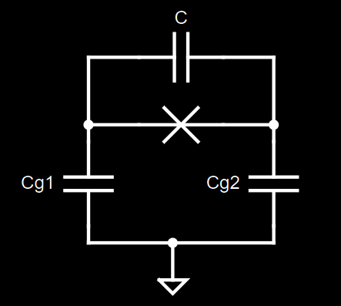
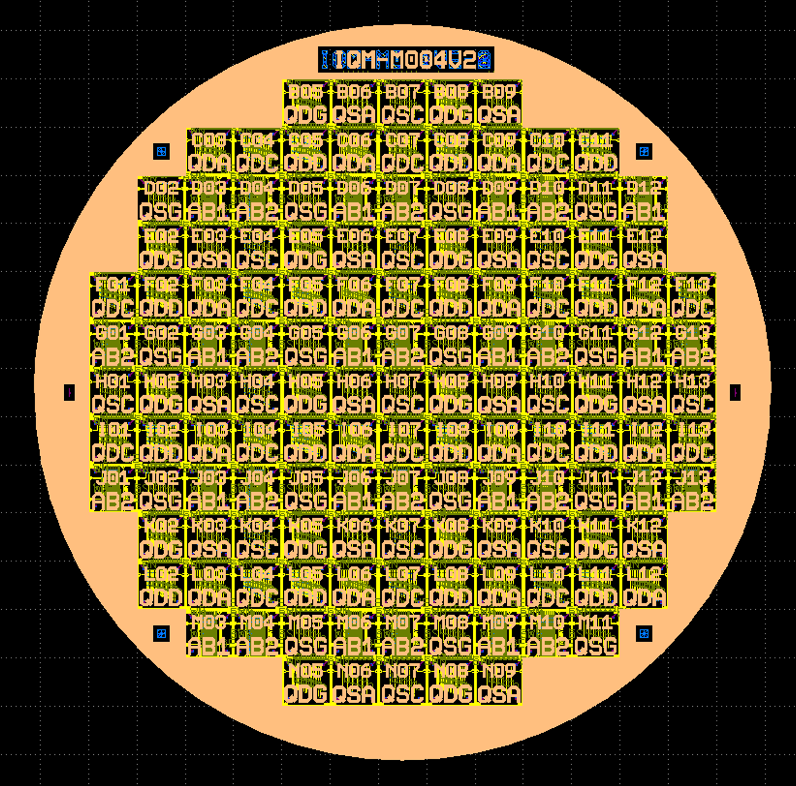
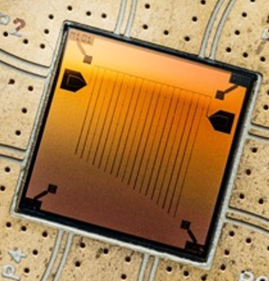
QPU design process
$$H(ω, g)$$
Hamiltonian
Circuit
Geometry
KQC
Mask Layout
KQC
Fabrication
Element library
Components FEM
(enabled by KQC)
Validation
Netlist, DRC, Full FEM
(enabled by KQC)

Slide 17
Interface loss references
[28] W. Woods et al., ‘Determining Interface Dielectric Losses in Superconducting Coplanar-Waveguide Resonators’, Phys. Rev. Applied, vol. 12, no. 1, p. 014012, Jul. 2019. [30] M. V. P. Altoé et al., ‘Localization and Mitigation of Loss in Niobium Superconducting Circuits’, PRX Quantum, vol. 3, no. 2, p. 020312, Apr. 2022. [95] C. Wang et al., ‘Surface participation and dielectric loss in superconducting qubits’, Appl. Phys. Lett., vol. 107, no. 16, p. 162601, Oct. 2015. [143] M. P. F. Graça et al., ‘Electrical analysis of niobium oxide thin films’, Thin Solid Films, vol. 585, pp. 95–99, Jun. 2015. [144] J. Verjauw et al., ‘Investigation of Microwave Loss Induced by Oxide Regrowth in High-Q Niobium Resonators’, Phys. Rev. Applied, vol. 16, no. 1, p. 014018, Jul. 2021. [145] J. Krupka et al., ‘Measurements of Permittivity and Dielectric Loss Tangent of High Resistivity Float Zone Silicon at Microwave Frequencies’, in 2006 International Conference on Microwaves, Radar & Wireless Communications, Krakow, Poland, May 2006, pp. 1097–1100.

