Slide 1

Hybrid Tree Tensor Networks for Quantum Simulation
Julian Schuhmacher
PhD student

Slide 2
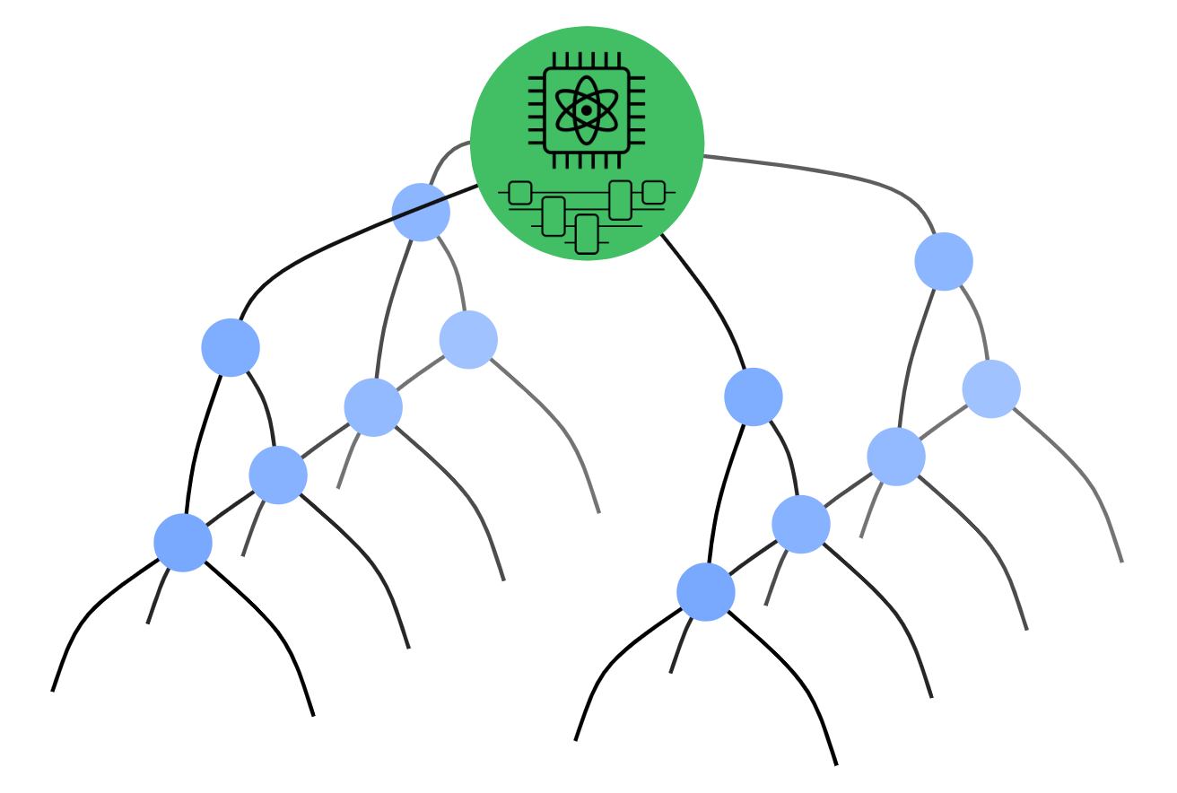
Combining quantum states with tensor networks
Hybrid quantum-classical approach:
  Assist quantum computations with tensor networks.
  Use quantum computers to prepare quantum states which are hard to prepare for tensor networks.
Questions to answer:
  Can classical tensor network methods be used to enhance quantum computations?
  Can quantum states prepared on quantum computers be used to enhance classical tensor network methods?

Slide 3
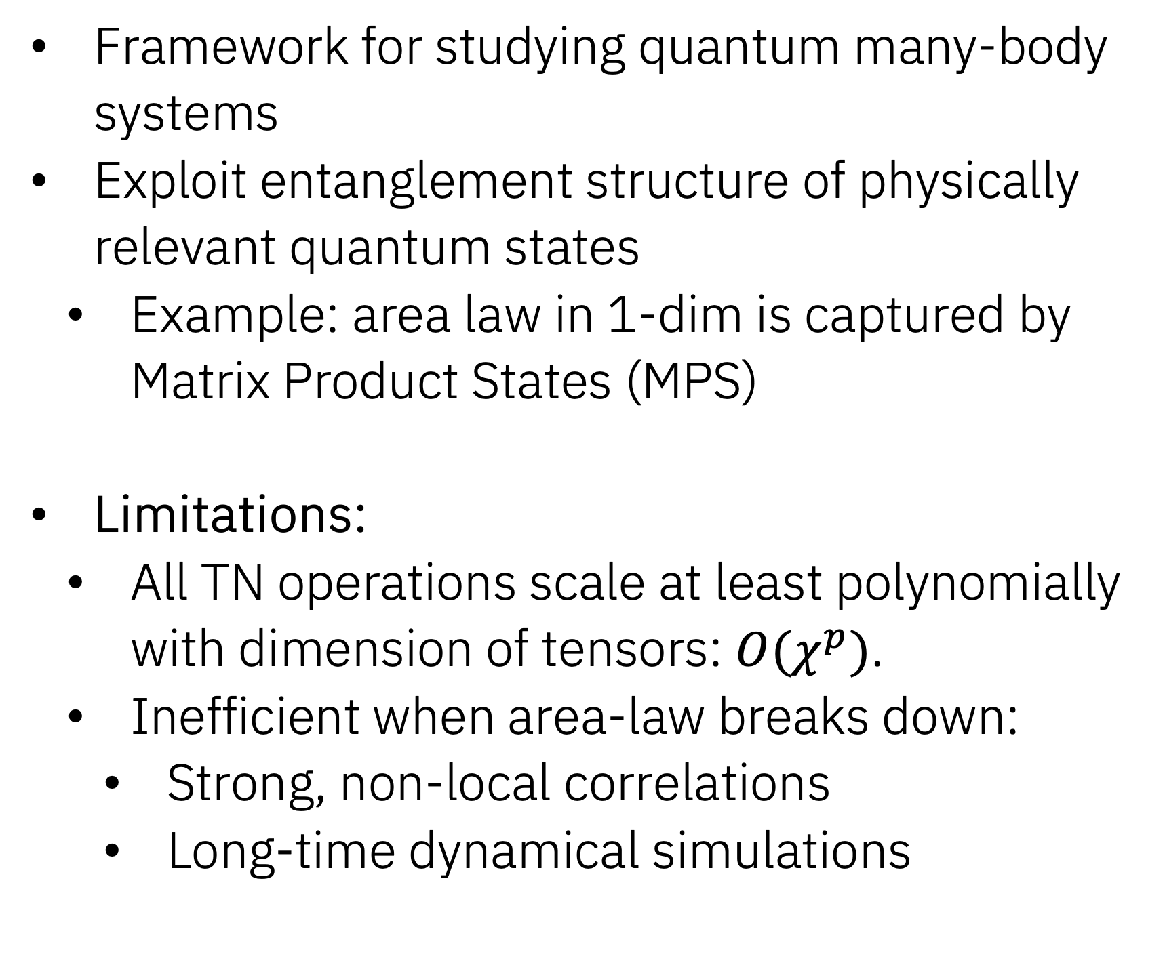
Tensor Network Methods
General rank-n tensor
Framework for studying quantum many-body systems
Exploit entanglement structure of physically relevant quantum states
  Example: area law in 1-dim is captured by Matrix Product States (MPS)
Limitations:
  All TN operations scale at least polynomially with dimension of tensors: $O(χ^{p})$.
  Inefficient when area-law breaks down:
    Strong, non-local correlations
    Long-time dynamical simulations
MPS decomposition

Slide 4
Hybrid Tensor Networks (hTNs)
Interpret quantum states as quantum tensors
Hybrid TN framework with contraction rules for combining classical and quantum tensors [1]
Advantage:
Allows to effectively integrate quantum states into classical TNs.
Defines a new family of variational hybrid wave functions.
Ultimate goal: Use efficient classical TN algorithms until classically unfeasible, and use quantum tensors to represent the parts of a system which are hard to describe classically.
[1] X. Yuan et al., Phys. Rev. Lett. 127, 040501 (2021)

Slide 5
Hybrid Tree Tensor Networks (hTTNs)
Binary TTN
Our studied hybrid TN approach: hybrid tree tensor network with a quantum tensor at the top
Motivation: Hierachical structure of TTN results in increased bond dim. towards the top.
  Ideal application of quantum tensors
Main contributions:
  Develop local, iterative optimization algorithm for hTTNs
  Implicit isometrization of quantum tensors
  Complexity analysis for a specific hTTN architecture
Binary hTTN

Slide 6
Classical optimization algorithm
Normalization condition:
Isometrization condition:
Steps of the algorithm:
  Select a single tensor as the canonical center of the TTN
  Determine the local effective Hamiltonian around the center tensor
  Solve local optimization:
  Shift canonical center to a neighbouring tensor: QR-decomposition
  Repeat steps 2.-4. until convergence

Slide 7

Hybrid optimization algorithm
Optimization workflow for hTTNs:
  Optimize corresponding classical TTN (at affordable bond dim.)
  Initialize tensors in hTTN from classical guess
  Continue with optimization of hTTN
Identical steps for hybrid optimization algorithm
Practical differences:
  Local optimization of quantum tensor
  Quantum tensors have a fixed canonical form
$→$ implicit isometrization

Slide 8
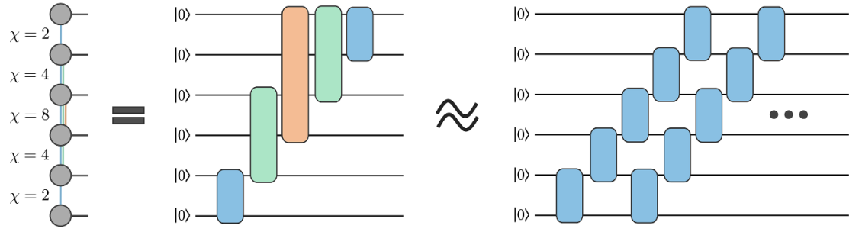
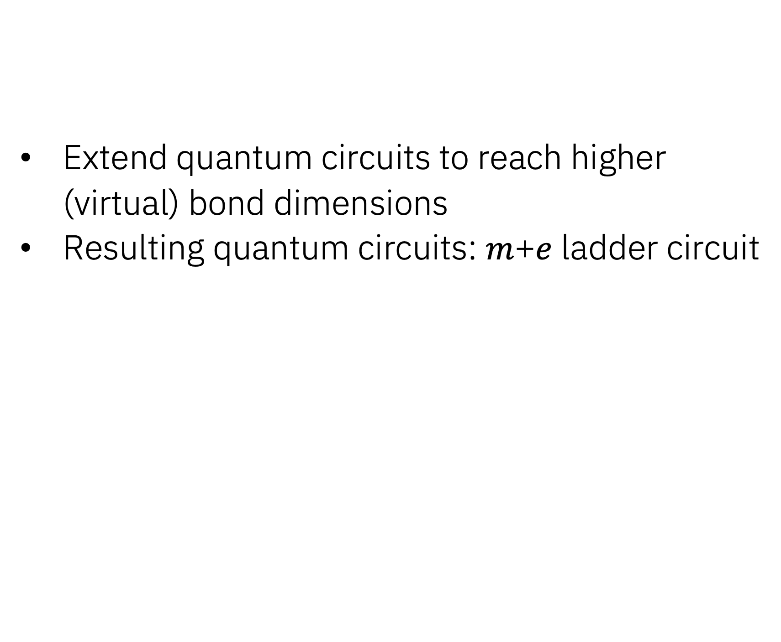
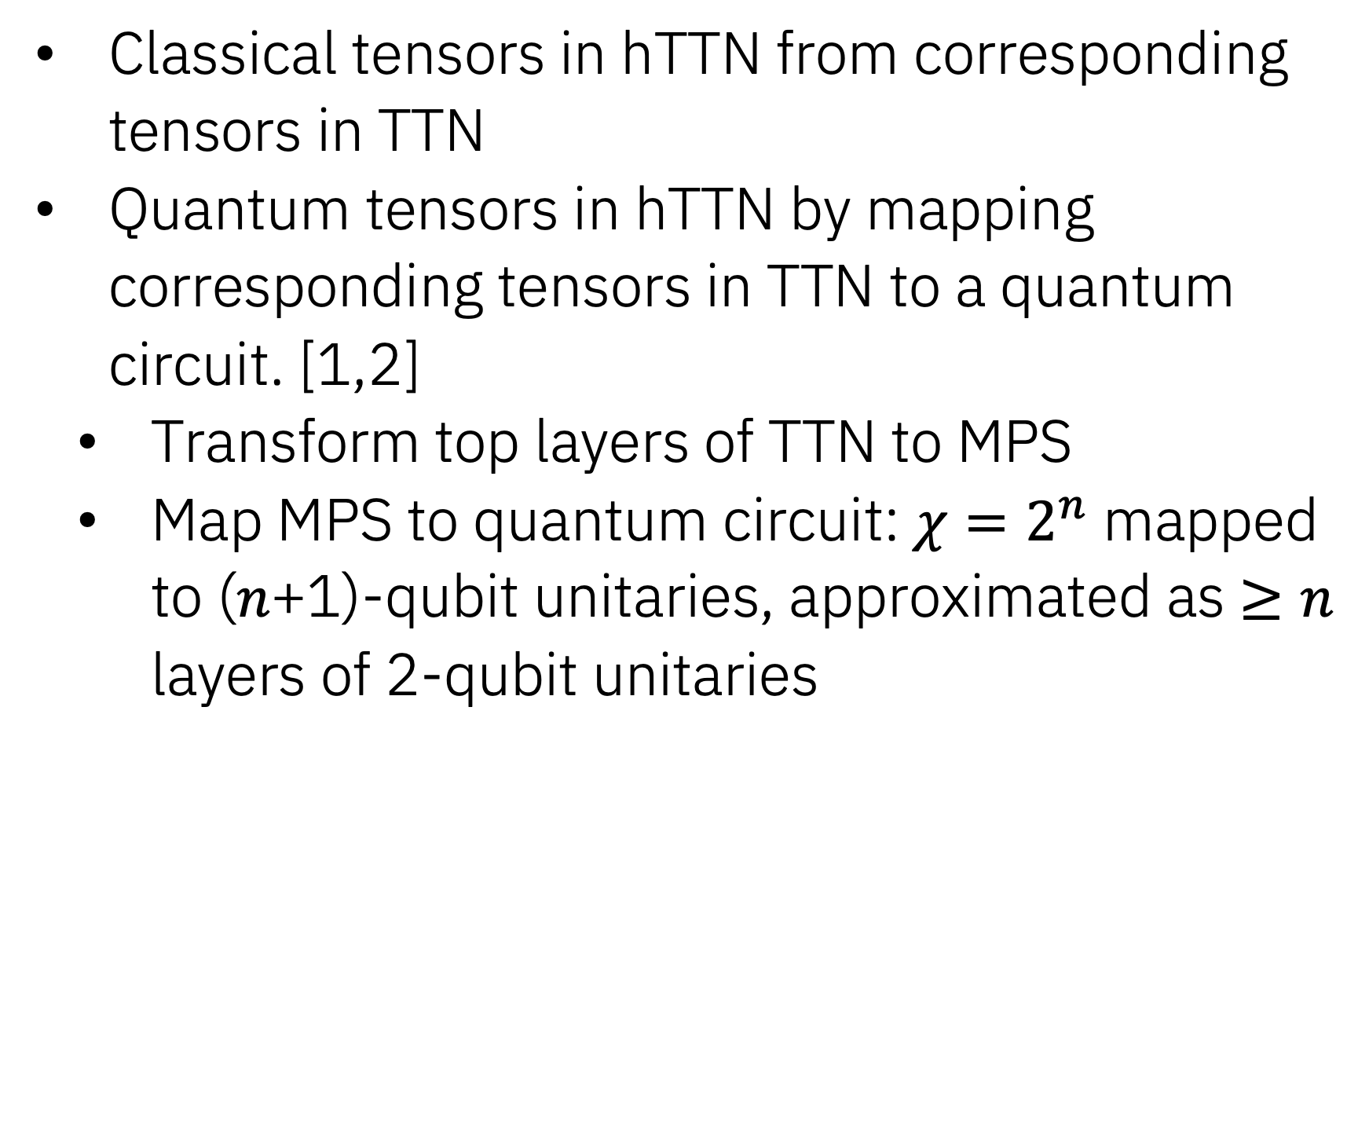
Initialize tensors in hTTN
Classical tensors in hTTN from corresponding tensors in TTN
Quantum tensors in hTTN by mapping corresponding tensors in TTN to a quantum circuit. [1,2]
  Transform top layers of TTN to MPS
  Map MPS to quantum circuit: $χ=2^{n}$ mapped to ($n$+1)-qubit unitaries, approximated as $≥n$ layers of 2-qubit unitaries
Extend quantum circuits to reach higher (virtual) bond dimensions
Resulting quantum circuits: $m$+$e$ ladder circuit
Initialized from classical TTN
Extension to increase bond dim.
Figure taken from [2]
[1] S.-J. Ran, Phys. Rev. A 101, 032310 (2020)
[2] M. S. Rudolph et al., Quantum Sci. Technol. 9 015012 (2023)

Slide 9
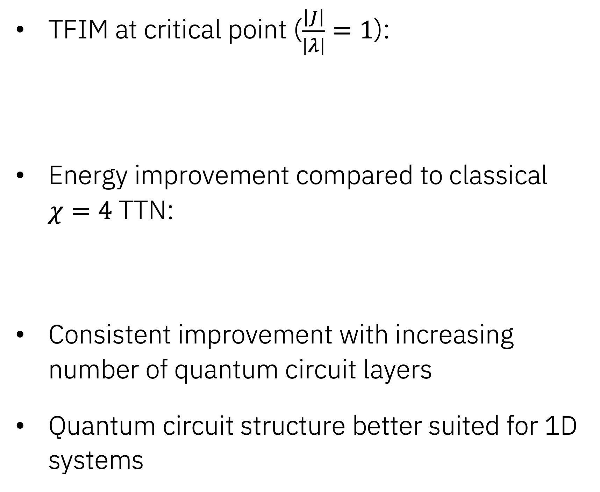
Transverse Field Ising Model
1D: 16 sites
TFIM at critical point ($\frac{\left|J\right|}{\left|λ\right|}=1$):
Energy improvement compared to classical $χ=4$ TTN:
Consistent improvement with increasing number of quantum circuit layers
Quantum circuit structure better suited for 1D systems
2D: 4x4 sites
Energy improvement =

Slide 10
Circuit Design
Ladder circuit
Brick-wall circuit
Adapting structure of quantum circuit to studied sytems can improve performance
Example: periodic boundary conditions
  8-site TFIM
  Initial quantum circuit does not have a periodic structure
  Adding additional gates connecting first and last qubits in each layer significantly improves energy for lower depths circuits

Slide 11
Summary/Outlook
Established general workflow to optimize arbitrary loop-less hTNs.
Demonstrate that we can enhance purely classical TTNs by replacing upper layer(s) with quantum tensor(s).
Limitations:
  Variational optimization of quantum tensors
  Number of measurements when calculating expectation values
Open points/Outlook:
  Model-inspired circuit design
  Effect of hardware noise
  Time-evolution via TDVP or TEBD

Slide 12
Summary/Outlook
Established general workflow to optimize arbitrary loop-less hTNs.
Demonstrate that we can enhance purely classical TTNs by replacing upper layer(s) with quantum tensor(s).
Limitations:
  Variational optimization of quantum tensors
  Number of measurements when calculating expectation values
Open points/Outlook:
  Model-inspired circuit design
  Effect of hardware noise
  Time-evolution via TDVP or TEBD

Slide 13
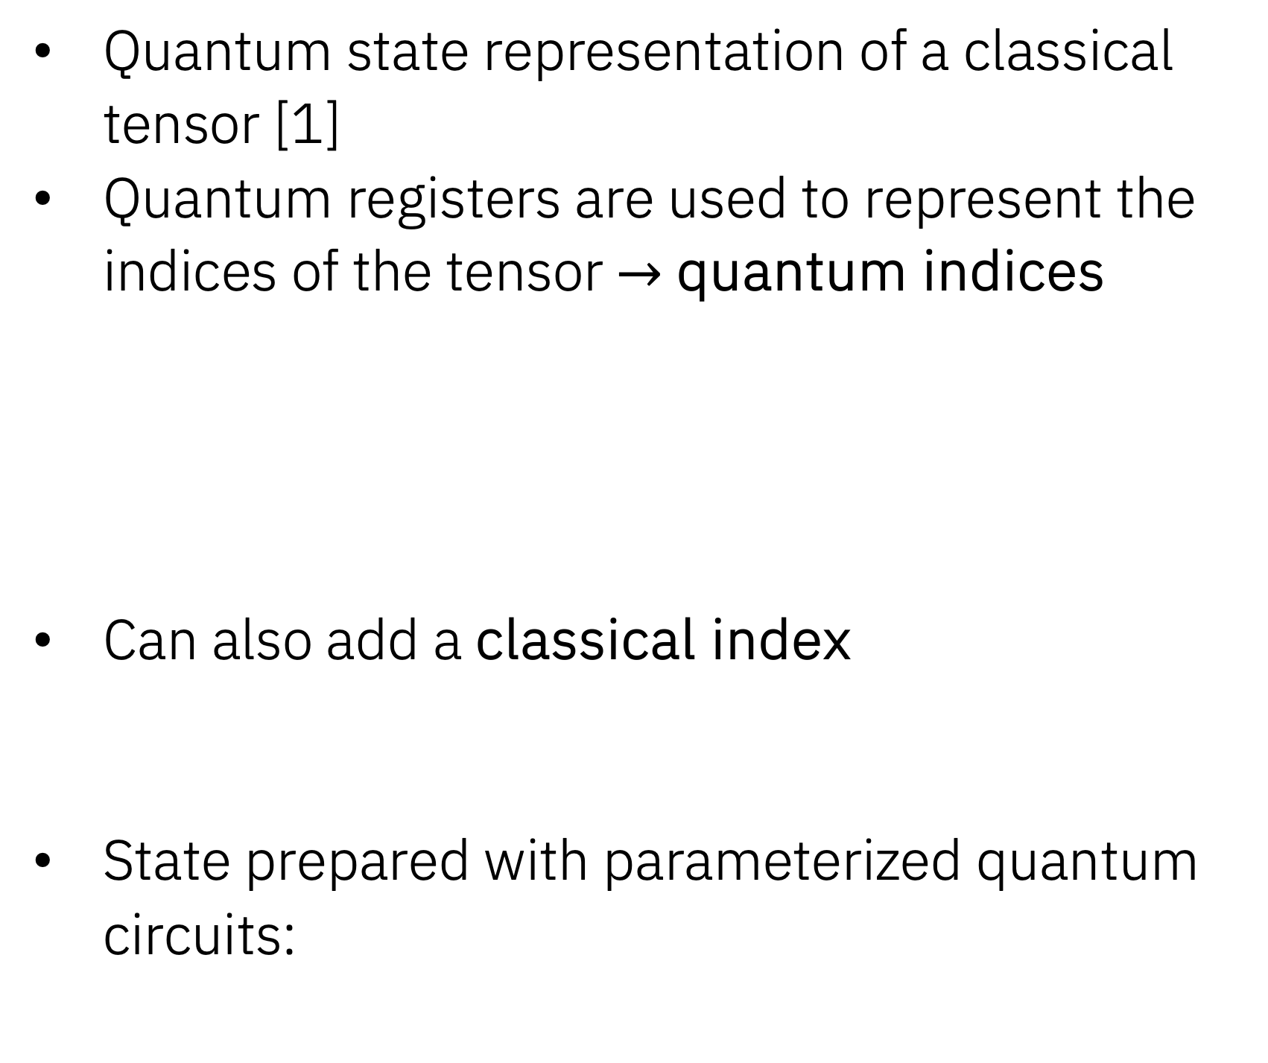
Quantum Tensors
Quantum state representation of a classical tensor [1]
Quantum registers are used to represent the indices of the tensor $→$ quantum indices
Can also add a classical index
State prepared with parameterized quantum circuits:
[1] X. Yuan et al., Phys. Rev. Lett. 127, 040501 (2021)

Slide 14
Quantum tensor contractions
Hybrid contractions: generalization of conventional contraction rules to combinations of classical and quantum tensors [1]
Contraction procedure depends on the nature of the tensors and the type of link connecting them.
Example: Quantum tensor (classical index) with classical tensor:
Expectation values (open-link contraction):
Open classical link:
Open quantum link:
[1] X. Yuan et al., Phys. Rev. Lett. 127, 040501 (2021)

Slide 15
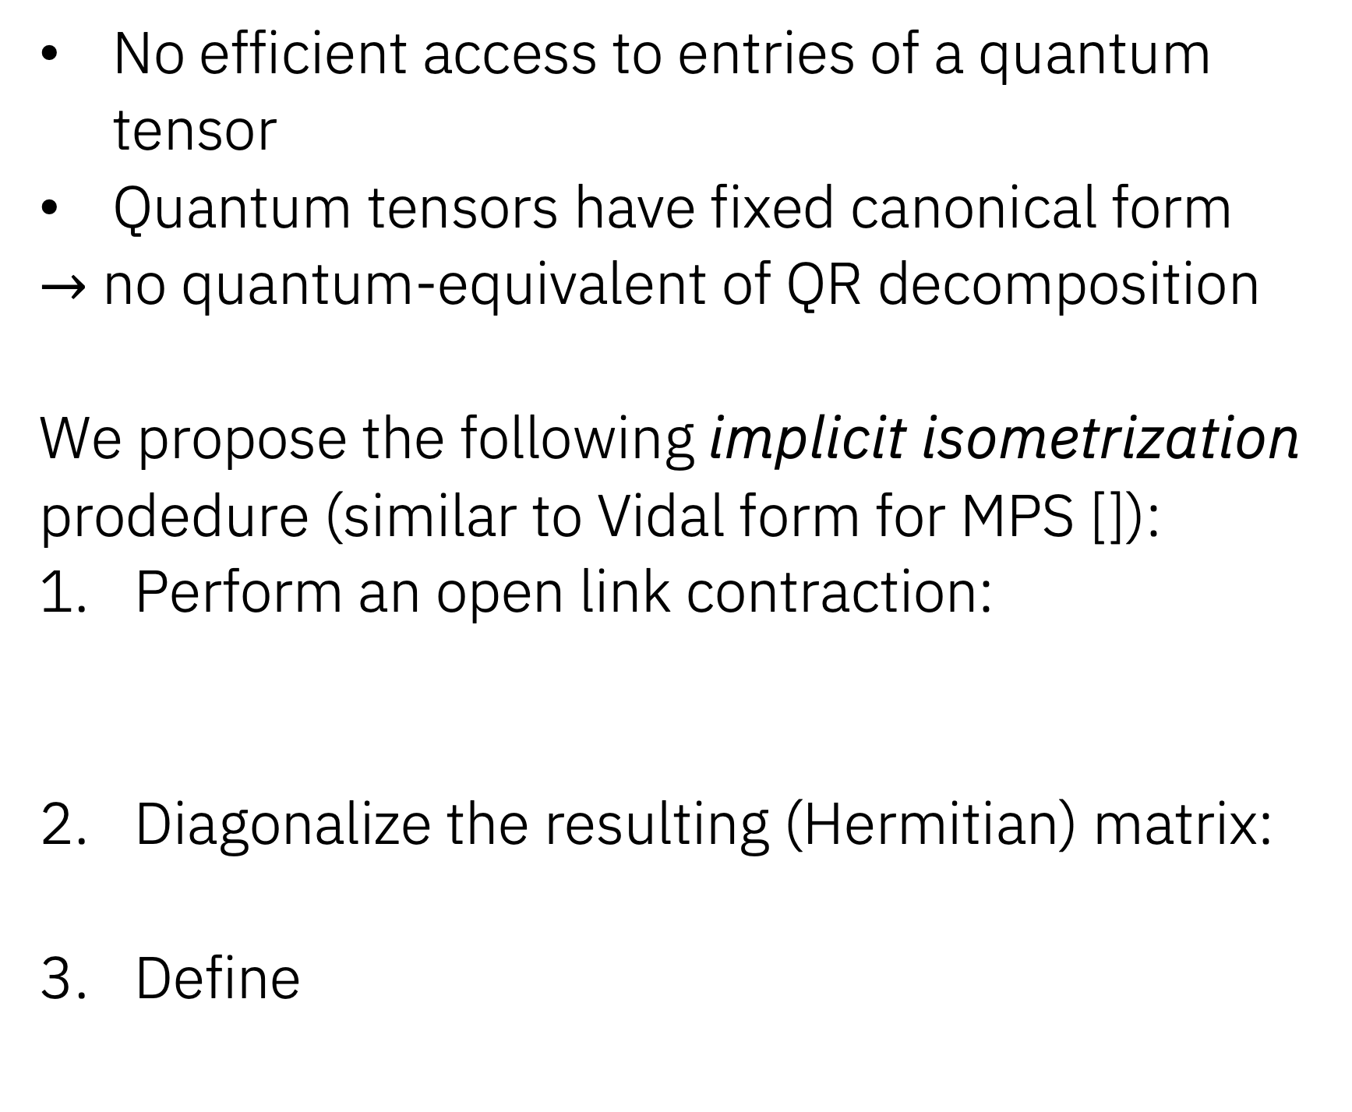
Implicit isometrization
1.
2.
No efficient access to entries of a quantum tensor
Quantum tensors have fixed canonical form
$→$ no quantum-equivalent of QR decomposition
We propose the following implicit isometrization prodedure (similar to Vidal form for MPS []):
Perform an open link contraction:
Diagonalize the resulting (Hermitian) matrix:
Define
Implicit since quantum tensor together with classical tensor acts as an isometry:
3.

Slide 16
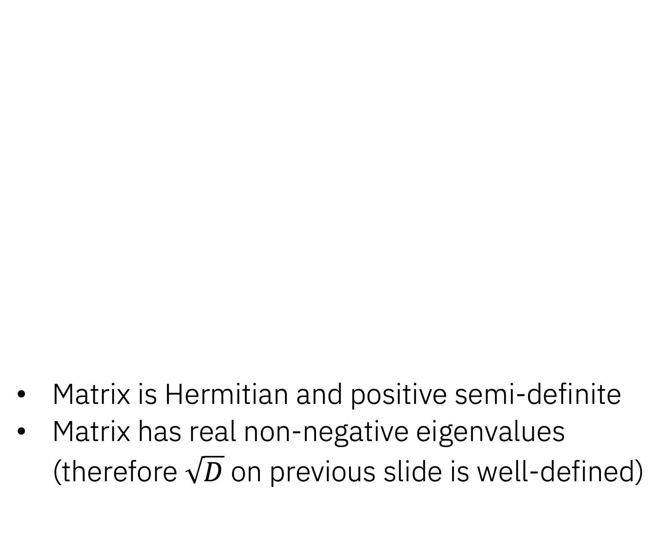
Positive semi-definite measurement matrix
Matrix is Hermitian and positive semi-definite
Matrix has real non-negative eigenvalues (therefore $\sqrt{D}$ on previous slide is well-defined)

Slide 17
Local optimization of quantum tensor
Without classical tensors associated with the quantum tensor
Including classical tensors associtated with the quantum tensor
In order to reduce the complexity of the optimization, we project the classical tensors to the closest unitary. The penalty term is then trivially fulfulled and the loss function reduces to:
Loss function optimized with Variational Quantum Eigensolver:

Slide 18
Toric Code
Ground state energy known
Optimization is challenging
Test hTTN with multiple quantum
tensors
4x4-lattice
8x8-lattice

Slide 19
Local diagonalization of effective Hamiltonian
To measure the expectation value of the local effective Hamiltonian, each term in the tensor product has to be expanded in the Pauli basis
In the worst case, the number of term in this expansion is
Number of measurements therefore grows exponentially with the number of legs
However, we can locally diagonalize each term in the tensor product with an unitary transformation:
The unitaries can be added to the circuit, and the diagonal matrices are decomposed as
All observables then commute, and can be estimated in a single measurement.

