Slide 1
Statistical phase estimation and error mitigation on a superconducting processor
Nick Blunt
ReAQCT conference, Budapest 2024
NSB, Laura Caune, Róbert Izsák, Earl T. Campbell, Nicole Holzmann PRX Quantum 4, 040341 (2023)

Slide 2
Statistical phase estimation
Hadamard test:
Measuring in the $x$ or $y$ basis allows us to estimate the real and imaginary parts of:
Expanding $\left|ψ\right\rangle$ in the eigenbasis of $H$, (denoted $\{|Ψ_{i}〉\}$):
(where )
$⇒$The energies of $H$ can be extracted from the frequencies present in $g_{k}$

Slide 3
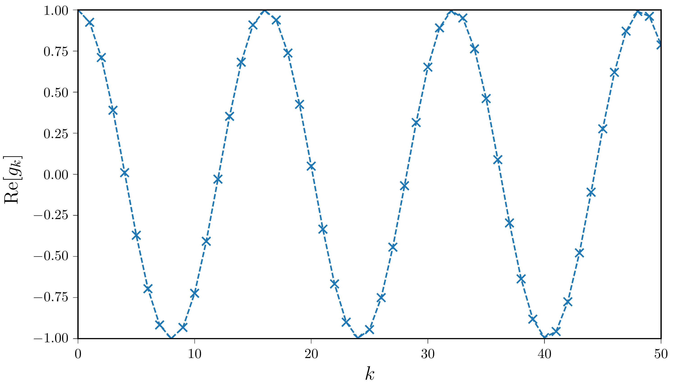
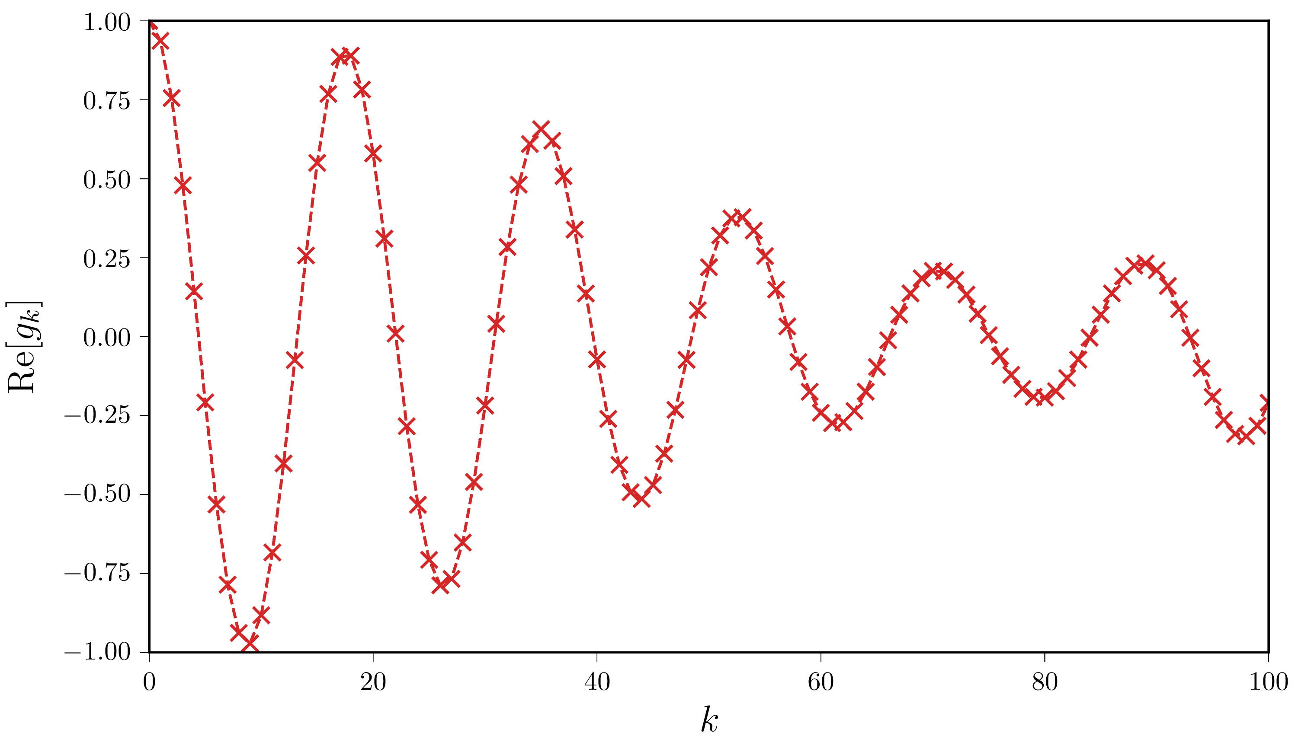
Statistical phase estimation
Hadamard test:
If $|ψ⟩$ is an exact eigenstate:
If $|ψ⟩$ is an approximate state:
$⇒$The energies of $H$ can be extracted from the frequencies present in $g_{k}$

Slide 4
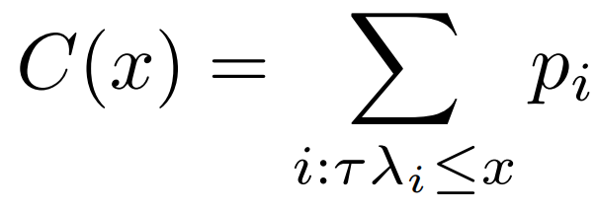
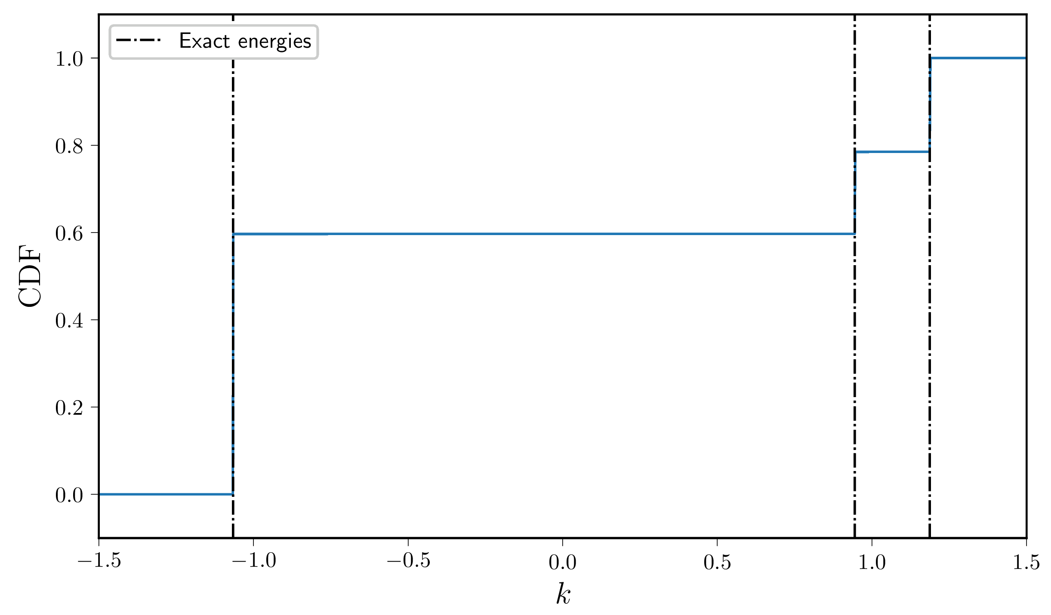
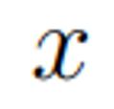
CDF-based approach to statistical QPE
Define a CDF:
(where )
Lin and Tong, PRX Quantum 3, 010318 (2022)
Wan, Berta and Campbell, Phys. Rev. Lett. 129, 030503 (2022)

Slide 5
CDF-based approach to statistical QPE
Define a CDF:
(where )
Probability distribution:
Redefine as 2$π$-periodic:
Fourier approximation to $Θ\left(x\right)$:
After some algebra:
The $F_{k}$’s decay as 1/k
Lin and Tong, PRX Quantum 3, 010318 (2022)
Wan, Berta and Campbell, Phys. Rev. Lett. 129, 030503 (2022)

Slide 6
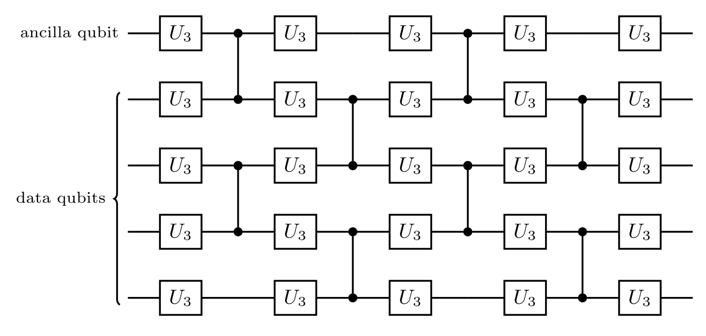
Variational circuit compilation
Define a circuit ansatz to approximately perform the desired unitary
Optimize the parameters by minimizing an appropriate loss function:
The optimization is performed using BFGS, which seems robust in practice
Only uses linear topology, and native gates
Tazhigulov et al. PRX Quantum 3, 040318 (2022)
Keever and Lubasch, Phys. Rev. Research 5, 023146 (2023)

Slide 7
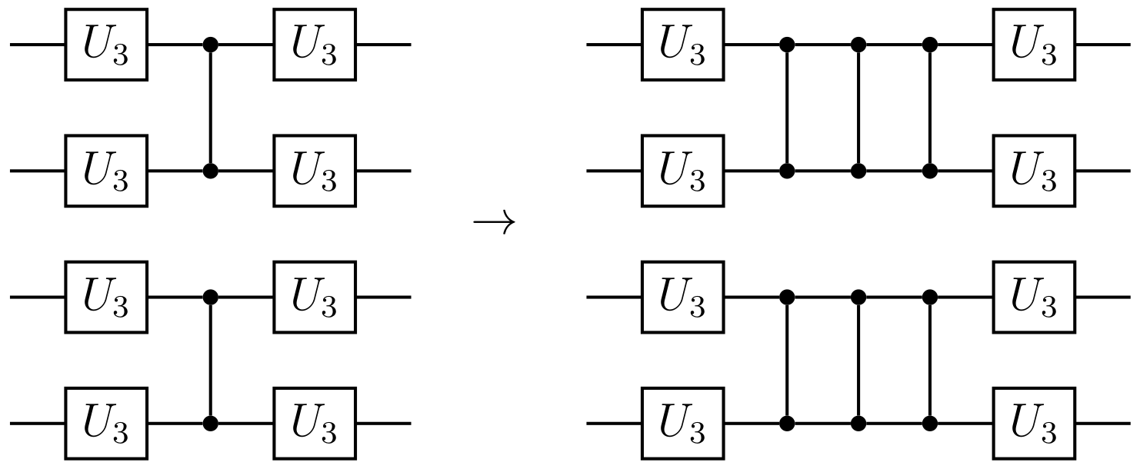
Zero-noise extrapolation (ZNE)
Basic idea:
Parameterize the expectation as $E(λ)$, where $λ$ specifies the amount of noise in the circuit. Then extrapolate to $λ=0$.
Define the initial circuit as 𝜆=1 (“error rate” = 1)
Define circuits with increased noise through “identity insertion”:
We only fold the two-qubit gate layers, which have the highest error rate
1. K. Temme, S. Bravyi, and J. M. Gambetta, Phys. Rev. Lett. 119, 180509, 11 (2017)
2. Y. Li and S. C. Benjamin, PRX 7, 6 (2017)

Slide 8
Randomized compiling
We perform Pauli twirling around the CZ gate layers, to convert coherent errors into Pauli errors
The twirling gates are absorbed into the surrounding U₃ layers $⟹$ the circuit depth is unchanged
The twirls can be incorporated into the circuits that must be performed anyway
1. Wallman and Emerson, PRA 94, 052325 (2016)

Slide 9
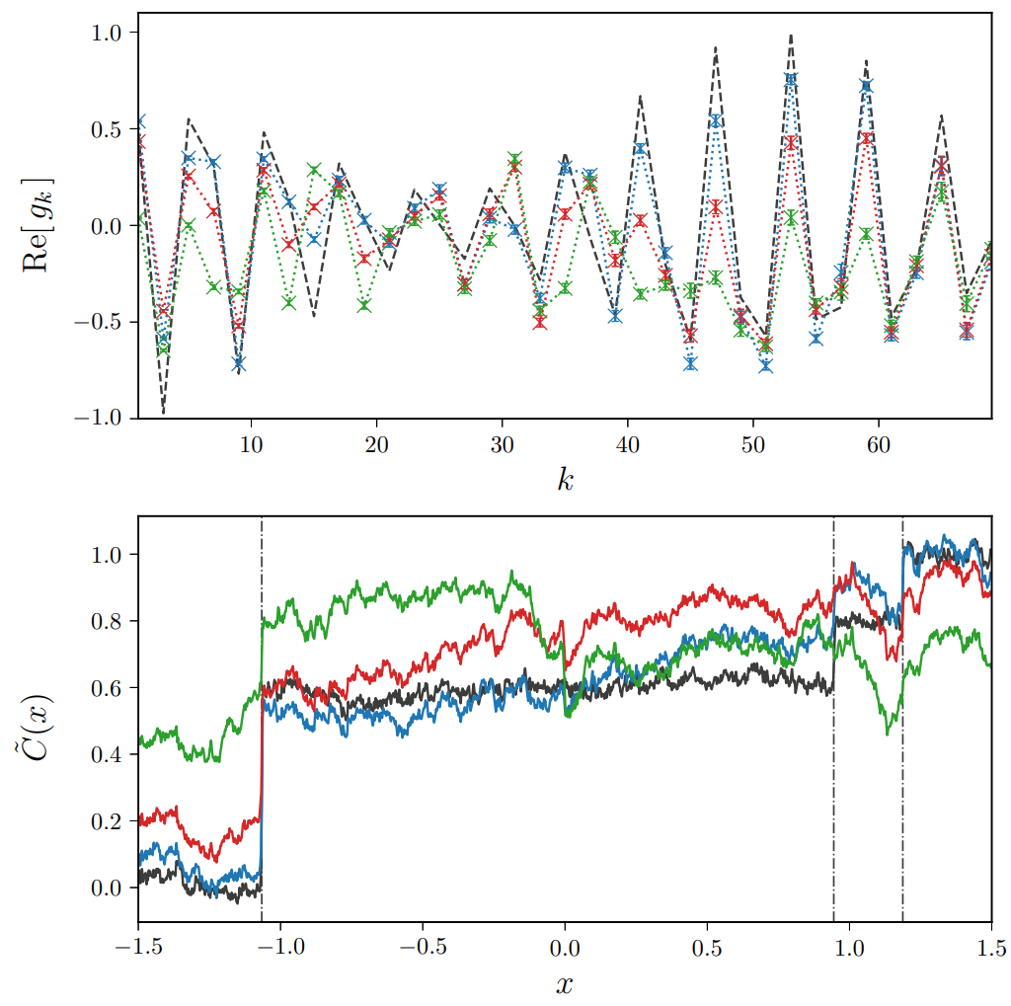
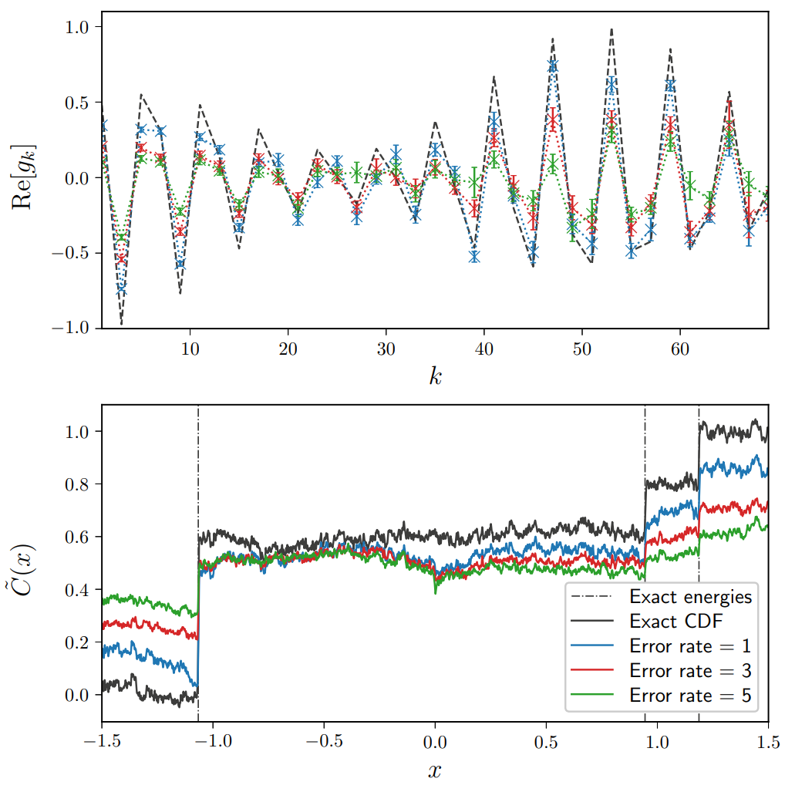
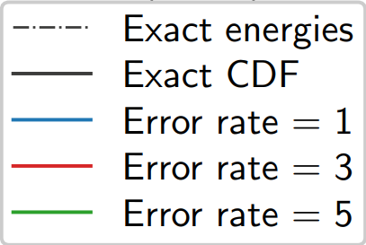
Example results: methanethiol (2e,2o)
System: methanethiol molecule in a small active space (2 electrons, 2 orbitals), 3 qubits total
Without randomized compiling:
With randomized compiling:

Slide 10
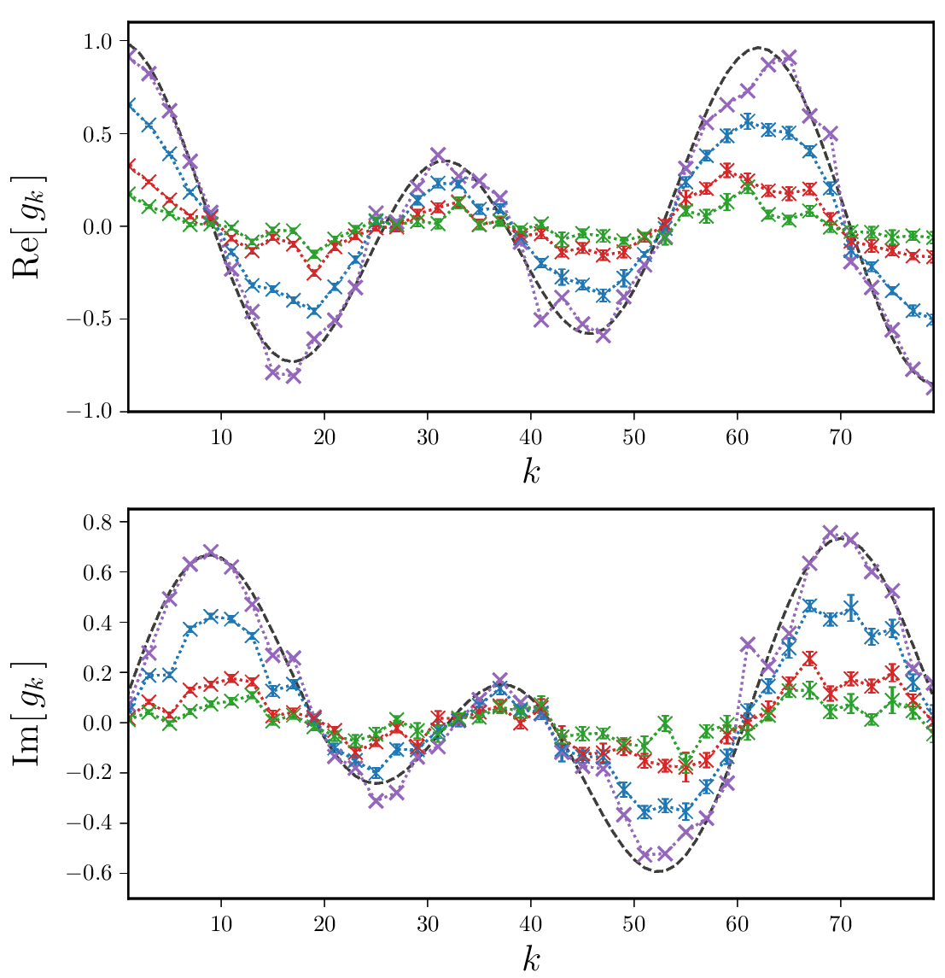
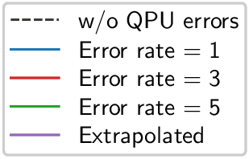
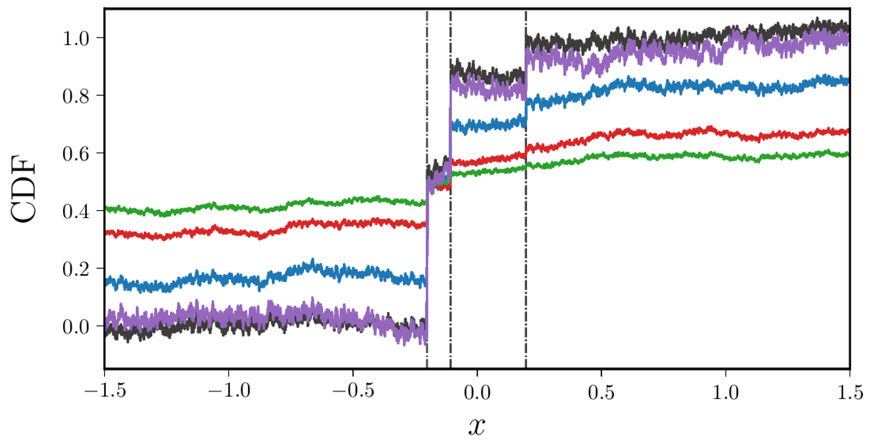
Results: H₃⁻ molecule
System: H₃⁻ molecule in a STO-3G basis (4 electrons, 3 orbitals), 5 qubits total
CDF ($\tilde{C}(x)$)
Time evolution vector ($g_{k}$)

Slide 11
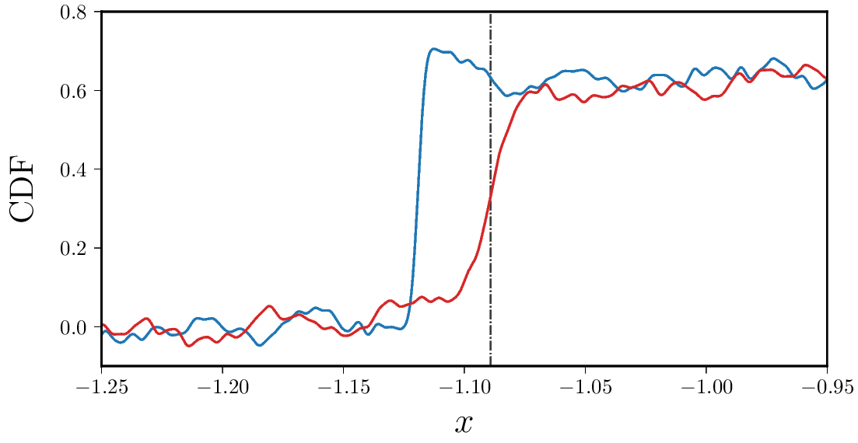
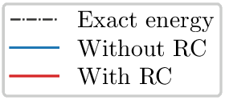
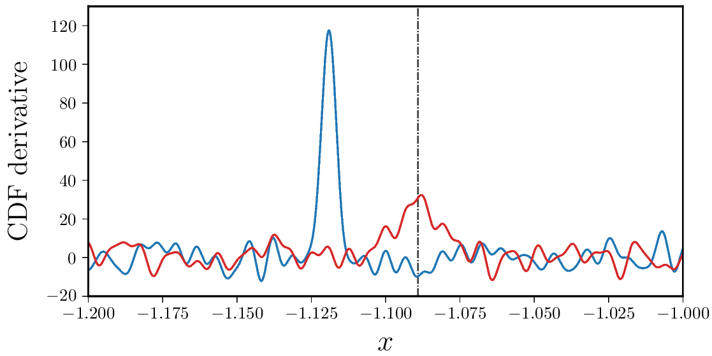
Simulated results: Trotterization (H₂)
Simulated results for H₂ molecule in a minimal basis:
Circuit for a single Trotter step:
We apply a large $R_{ZZ}$ error to each CZ gate
This leads to a large error in the energy, which is fixed by randomized compiling (RC)

Slide 12
Thanks
nick.blunt@riverlane.com
Laura Caune Róbert Izsák Earl Campbell Nicole Holzmann
Andy Patterson (Rigetti) Marco Paini (Rigetti) Andrew Arrasmith (Rigetti) Bram Evert (Rigetti)

Slide 13
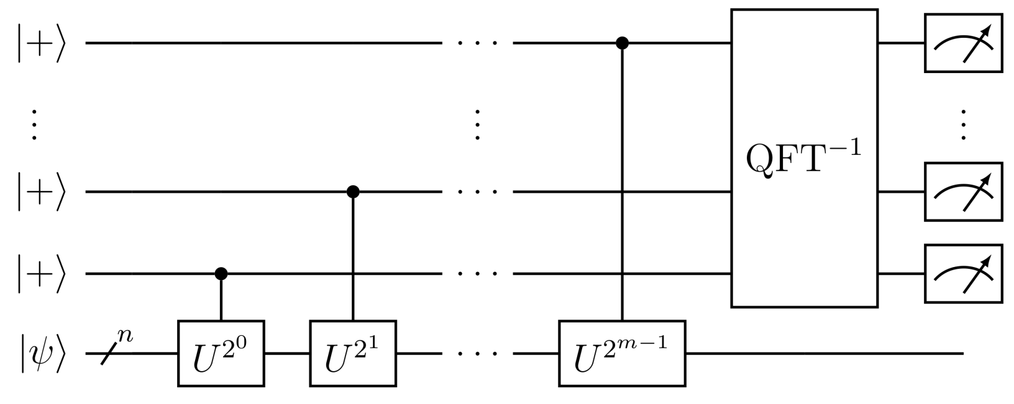
Textbook quantum phase estimation
Total running time for precision $ε$ is $O\left(ε^{−1}\right)$ ✓
Typically, each application of U is very expensive $⇒$ very high total circuit depth ✗
The output is a discrete distribution of measurements results – not ideal for error mitigation ✗
There are iterative version of QPE that require only a single ancilla, but above points remain

Slide 14
Comparison with textbook QPE
Total running time for precision $ε$ is $O\left(ε^{−1}\right)$ (up to log factors) ✓
Hadamard test with a single ancilla qubit ✓
Circuit depths can be up to 100 times lower than textbook QPE [1, 2] ✓
Expected to have a higher total runtime (a higher prefactor) than textbook QPE ✗
Ding and Lin, PRX Quantum 4, 020331 (2023)
Wang et al., Quantum 7, 1167 (2023)

Slide 15
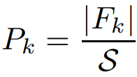
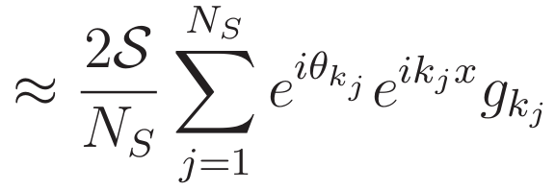
Importance sampling in statistical QPE
The $F_{k}$’s decay as 1/k
Normalization:
Take $N_{S}$ samples of $k$:
Total run time for precision $ϵ$:
$O(ε^{−2})$ -> $O(ε^{−1} log⁡(ε^{−1}))$
Lin and Tong, PRX Quantum 3, 010318 (2022)

Slide 16
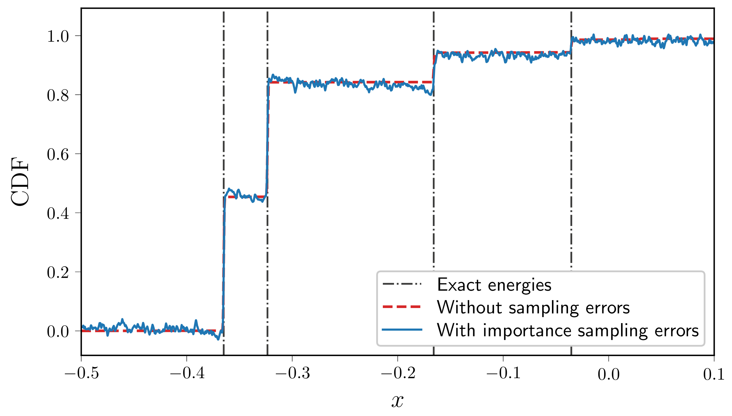
A simulated example: H₄
CDF for square H₄ in a STO-3G basis, Hartree-Fock initial state

Slide 17
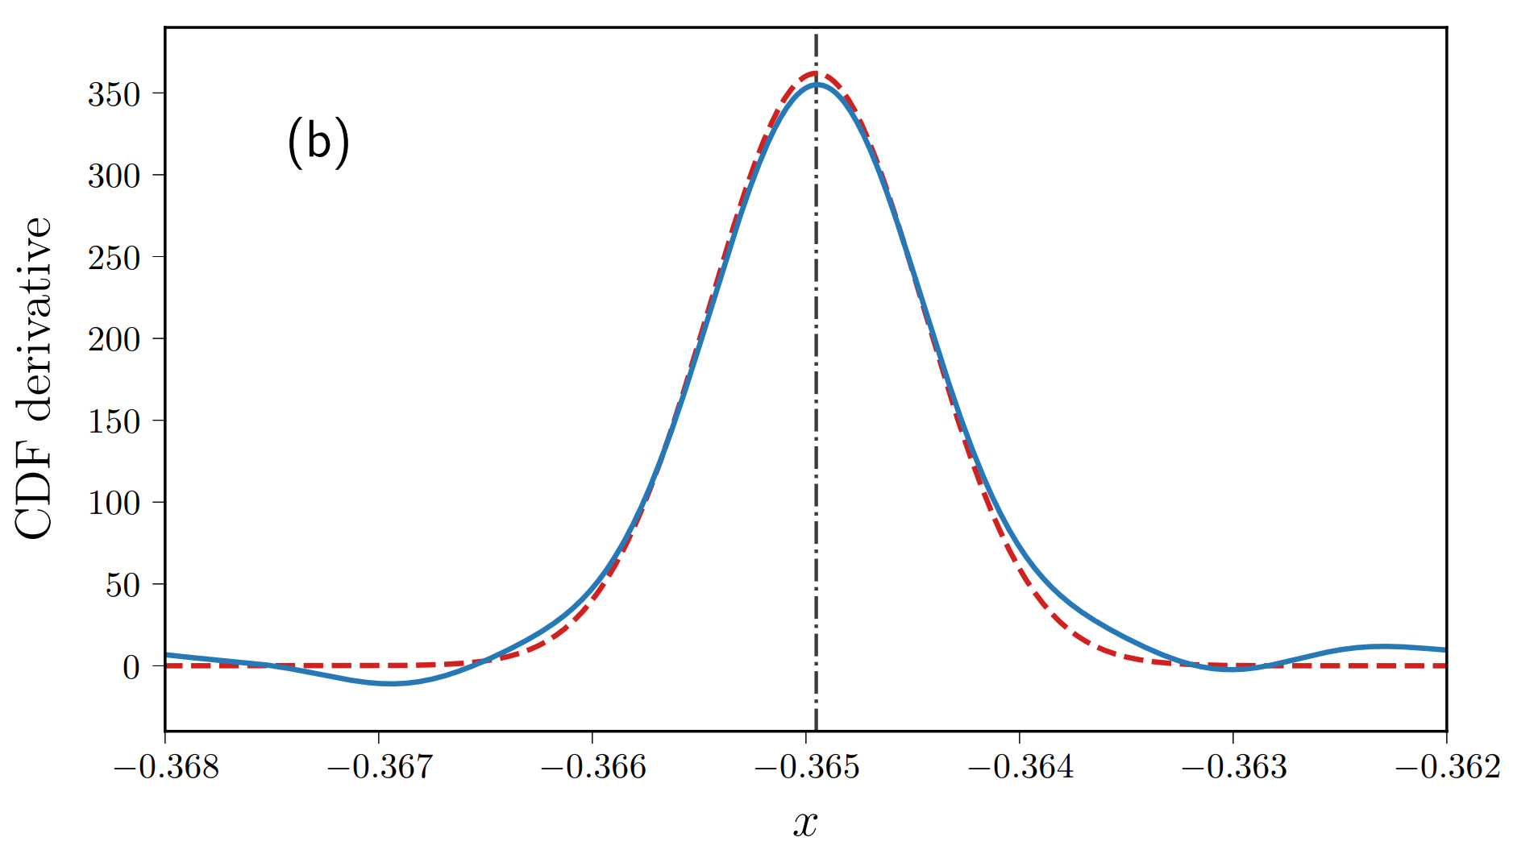
A simulated example: H₄
CDF derivative for square H₄ in a STO-3G basis, Hartree-Fock initial state

Slide 18
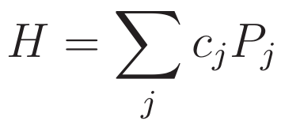
Compilation for time evolution
First-order Trotterisation:
Using Trotterisation is not realistic for large k and large active spaces on current QPUs
Example: H3⁺ using 2 electrons in 3 orbitals, the Hamiltonian has 44 Pauli operators (L=44)
Consider a single multi-qubit Pauli appearing in the Hamiltonian, $P_{j}=ZXZX$:

Slide 19
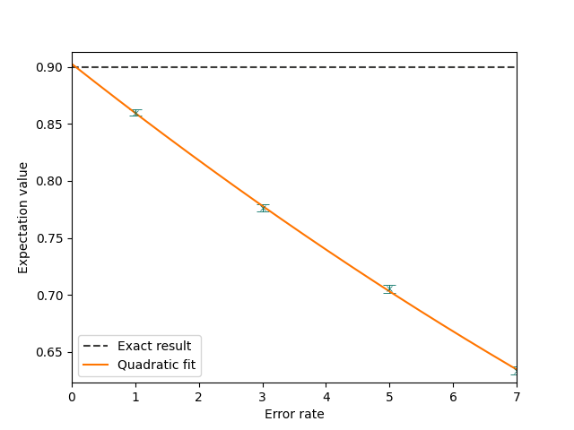
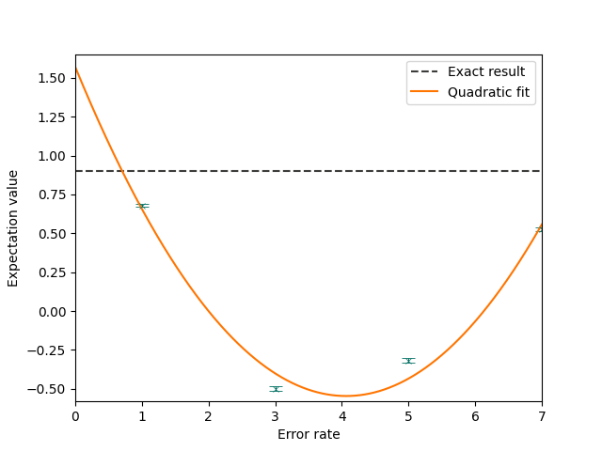
Zero-noise extrapolation (ZNE)
System: H₂ STO-3G basis
System: H₂ STO-3G basis
Simulation run on a QVM with depolarizing noise applied to the 2q gate (p=0.05)
Run on Rigetti’s Aspen-M-1 QPU, folding two-qubit gates

Slide 20
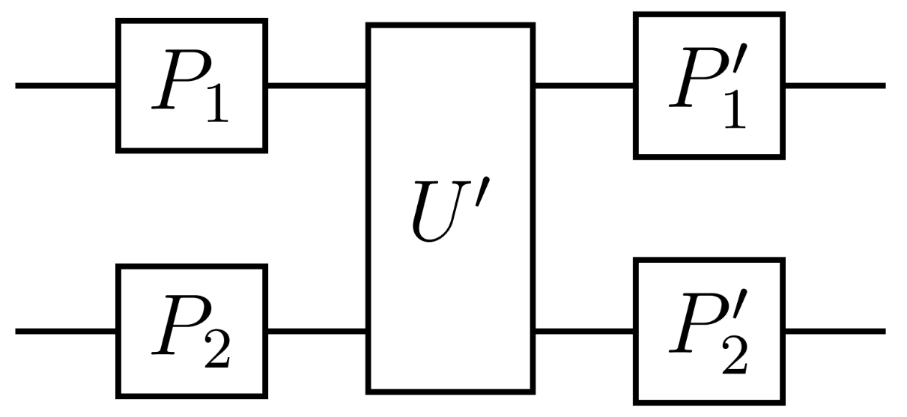
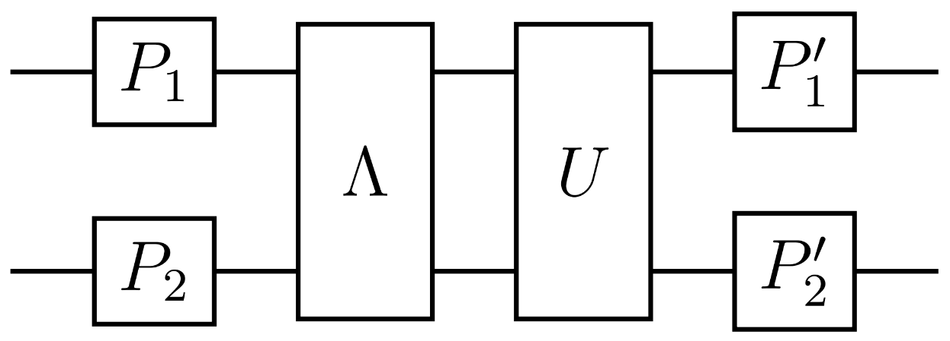
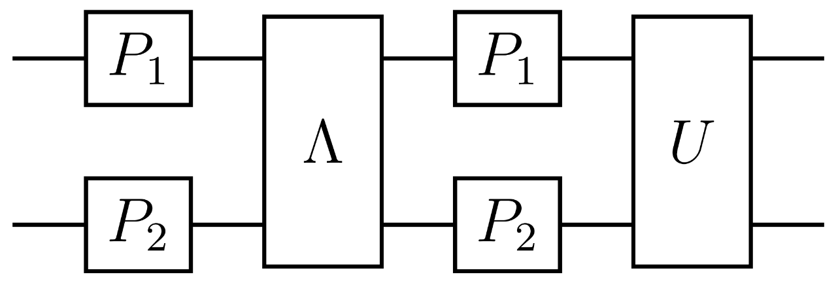
Randomized compiling
Consider some noisy gate:
where $U$ is a Clifford gate, $Λ$ is an error channel
Consider applying random Paulis before $U′$ and the conjugate (cancelling) Paulis afterwards:
$$=$$
$$=$$
Twirling the error channel:
Results in a Pauli channel:
1. Wallman and Emerson, PRA 94, 052325 (2016)

Slide 21
Experimental setup
Quantum circuits were performed on Rigetti’s Aspen devices (Aspen 11, M-2 and M-3)
Performed using Rigetti’s software stack (pyQuil) and quantum cloud service (QCS)
A key requirement is to perform a large number of different circuits – made use of multithreading and parametric compilation features to reduce this overhead
For the largest examples, results are averaged over ~58,000 different circuits, with 50 shots performed for each, and up to 7 qubits
For ZNE, we made efforts to make gate layers as consistent as possible, i.e. using consistent timings for the folded layers

Slide 22
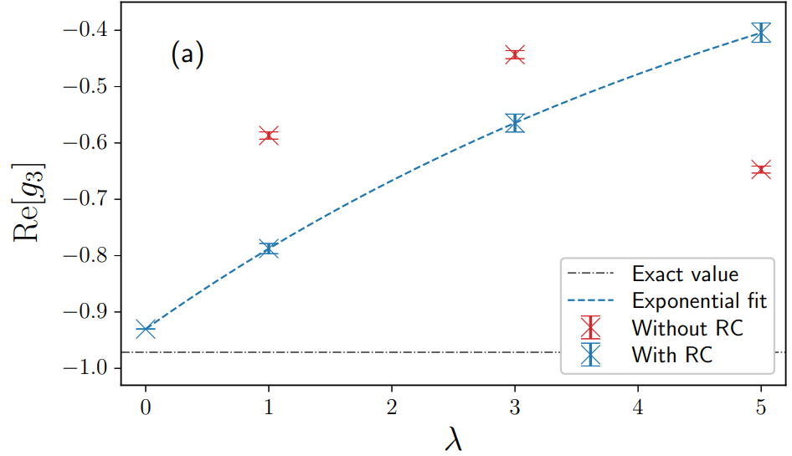
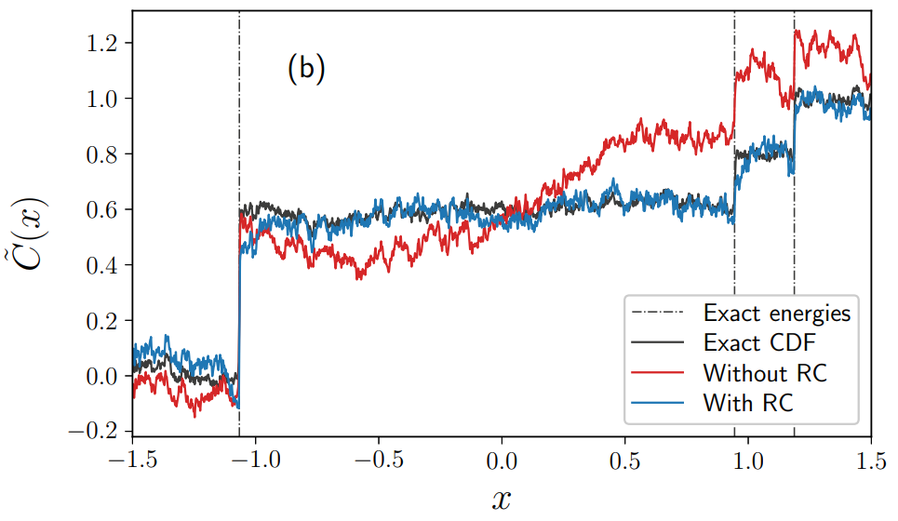
Example results: methanethiol (2e,2o)
System: methanethiol molecule in a small active space (2 electrons, 2 orbitals), 3 qubits total
Comparison of ZNE extrapolation with and without randomized compiling
ZNE extrapolation for $g_{k}$ at $k=3$
CDF using extrapolated $g_{k}$ values

