Slide 1

Architecture considerations for superconducting quantum processors
Anton Frisk Kockum
Associate Professor, Chalmers University of Technology
REACQT, Budapest, 19 June 2024

Slide 2
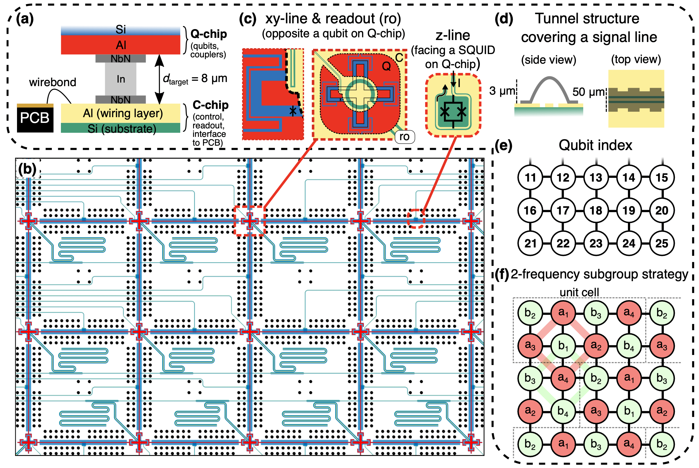
Kosen et al., arXiv:2403.00285

Slide 3
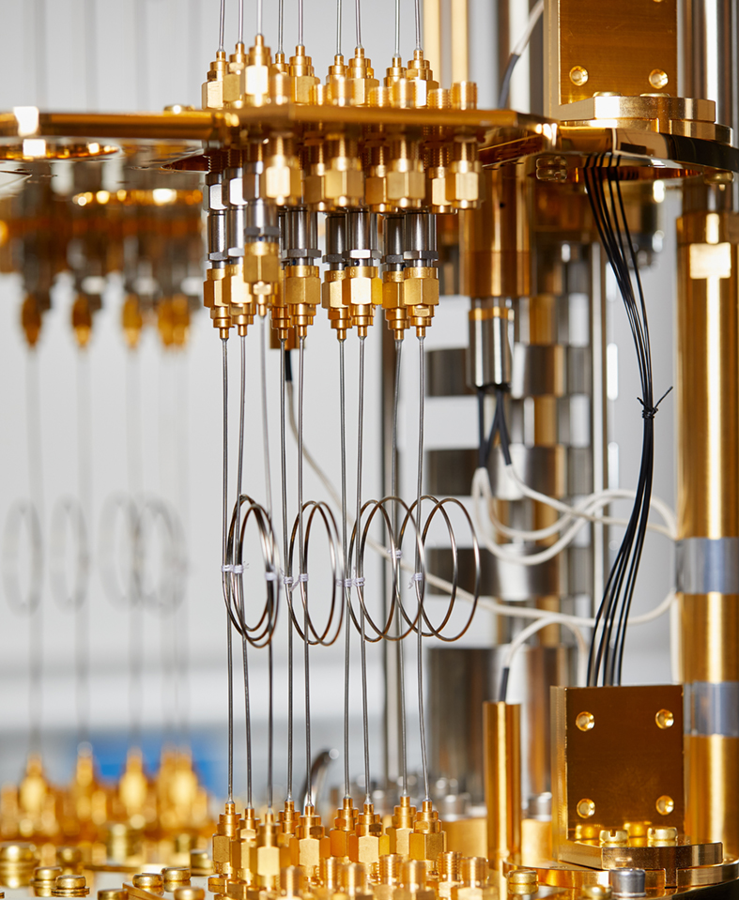
Overview
Introduction – building a Swedish quantum computer
Two-qubit gates with tunable couplers
Quantifying the impact of decoherence
Three-qubit gates
ZZ coupling – challenge and opportunity
Crosstalk and frequency crowding
Summary
Kosen et al., Quantum Sci. Technol. 7, 035018 (2022)
Abad et al., Phys. Rev. Lett. 129, 150504 (2022)
Abad et al., arXiv:2302.13885v2
Pettersson Fors et al., in preparation (2024)
Osman et al., Phys. Rev. Res. 5, 043001 (2023)
Kosen et al., arXiv:2403.00285
Gu et al., PRX Quantum 2, 040348 (2021)
Warren et al., npj Quantum Inf. 9, 44 (2023)

Slide 4
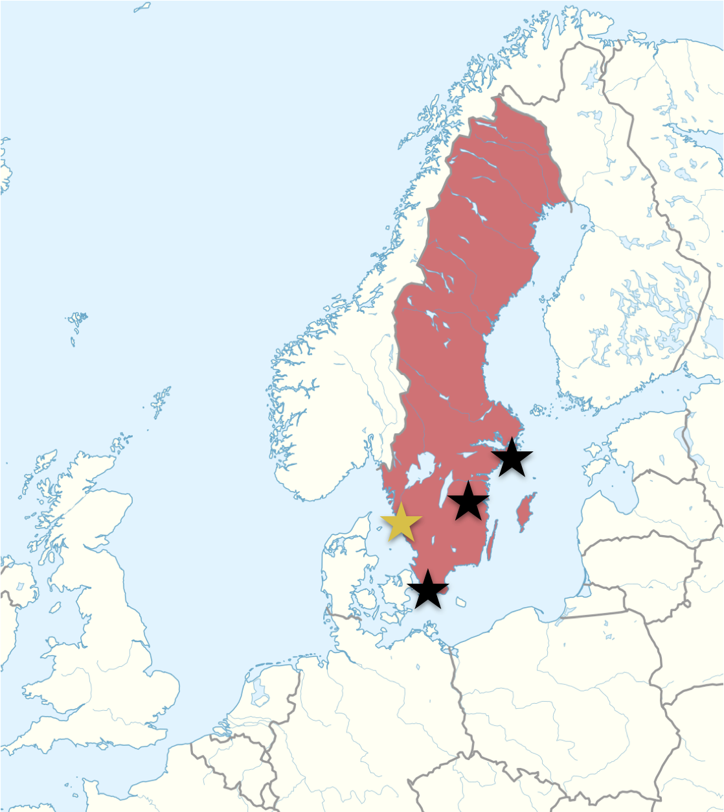


WACQT in brief
wacqt.se
@wacqt_sweden
Main goals
Two parts
Locations
To build a broad competence base in Sweden for Quantum Technology
To build a quantum computer based on superconducting circuits
Core project on quantum computing
Excellence program including all of Quantum Technology
Chalmers, Gothenburg U
KTH, Stockholm U
Lund
Linköping U
Duration
Involving industry
Funding
12 years, (3+4+3+2 years)
Started 2018-01-01
SME for enabling technology
Big industry for applications
KAW: 1400 MSEK
Universities: 200 MSEK
Industry partners: ~150 MSEK

Slide 5
Core project
A full-stack approach at Chalmers along two tracks: discrete and continuous variables implemented with superconducting circuits
Now scaling up after having demonstrated the basic building blocks
25 qubits being tested now; 100 qubits 2027
Theory comes in at all levels of the stack
This talk will focus on the qubits themselves, their layout, the gates between them, and what it takes
to scale up

Slide 6
Two-qubit gates with a tunable coupler
Fixed-frequency qubits (for better coherence) connected through a coupler qubit whose frequency can be tuned by the magnetic flux through a SQUID
Parametric modulation of the coupler frequency, with modulation frequency matching the transition we want to activate – access to several two-qubit gates
On a flip-chip:
Single-qubit gates in 20 ns with 99.97% fidelity
Two-qubit CZ gates in 295 ns with 98.66% fidelity
Mostly coherence-limited fidelities
Kosen et al., Quantum Sci. Technol. 7, 035018 (2022)

Slide 7
The impact of decoherence
Actual noisy process
Perfect gate unitary
Average gate fidelity
Expanding to first order in the small parameter – decoherence rates times gate time
Dimension
Number of qubits
Pure dephasing rate
Gate time
Relaxation rate
Abad et al., Phys. Rev. Lett. 129, 150504 (2022)
For gates leaving the computational subspace: Abad et al., arXiv:2302.13885v2

Slide 8
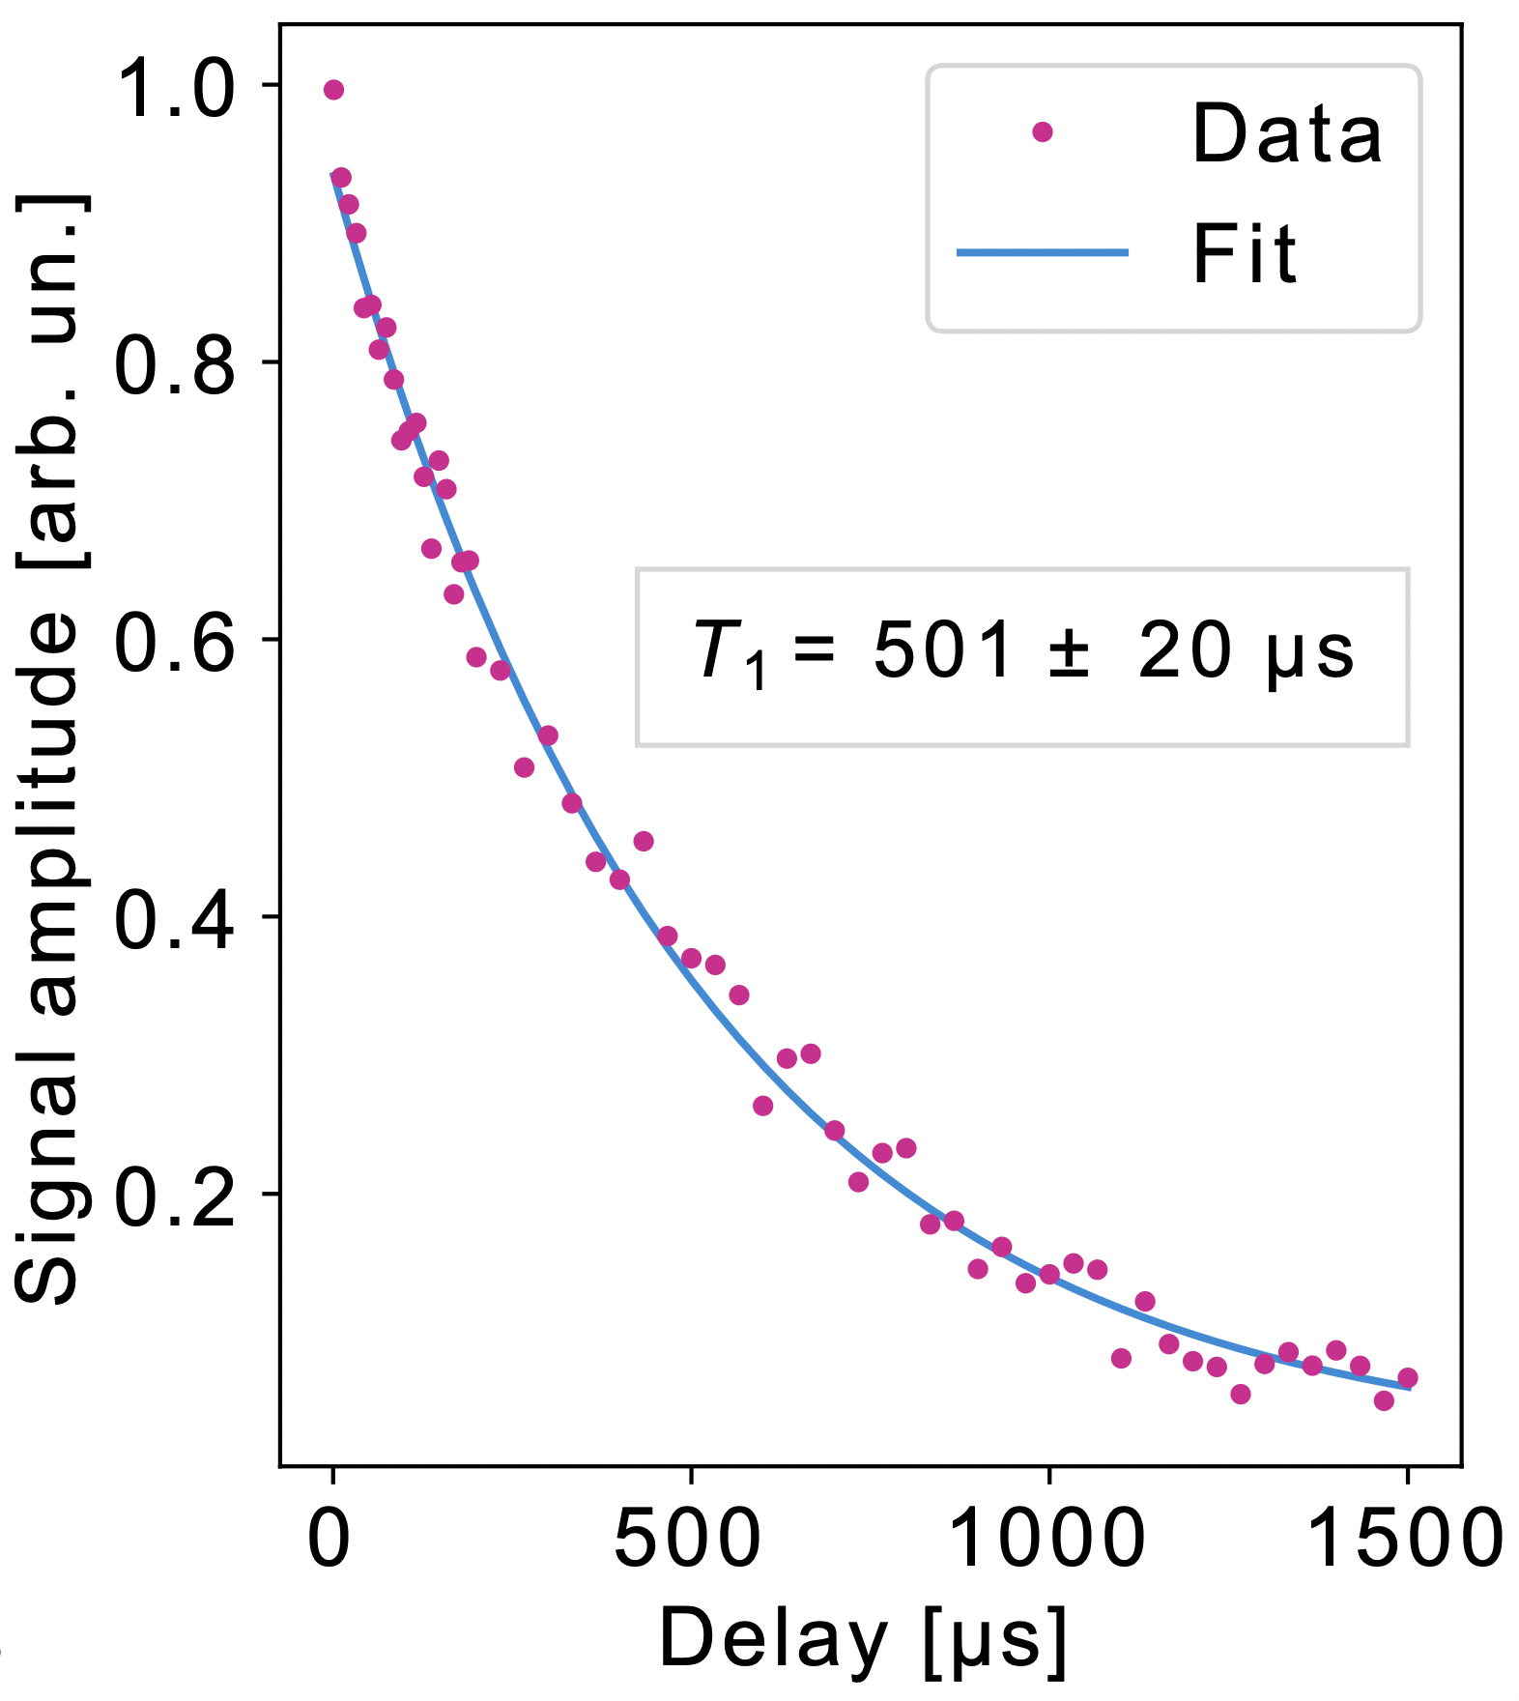
Fighting the impact of decoherence
Longer coherence times
Faster gates
Single-qubits gate are already close to their speed limit at 10-20 ns, set by anharmonicity
Current two-qubit gates at 100s of ns are the bottleneck – room for improvement
Exploring both parametric modulation and adiabatic tuning of the coupler frequency
Searching parameter space by numerical modelling in CSQR – Chalmers Superconducting Qubit Repository
Biznarova et al., arXiv:2310.06797

Slide 9
A three-qubit gate from two-qubit gates
CZ gates based on population transfer from 11 to 02 and back
Gu et al., PRX Quantum 2, 040348 (2021)

Slide 10
A three-qubit gate from two-qubit gates
CZ gates based on population transfer from 11 to 02 and back
Gu et al., PRX Quantum 2, 040348 (2021)

Slide 11
A three-qubit gate from two-qubit gates
CZ gates based on population transfer from 11 to 02 and back
Three-qubit gate with population transfer between 110 and 101, and phase on 111
The middle qubit controls population transfer between the outer qubits
Gu et al., PRX Quantum 2, 040348 (2021)

Slide 12
A three-qubit gate from two-qubit gates
CZ gates based on population transfer from 11 to 02 and back
Three-qubit gate with population transfer between 110 and 101, and phase on 111
The middle qubit controls population transfer between the outer qubits
Faster than a two-qubit gate!
Gu et al., PRX Quantum 2, 040348 (2021)

Slide 13
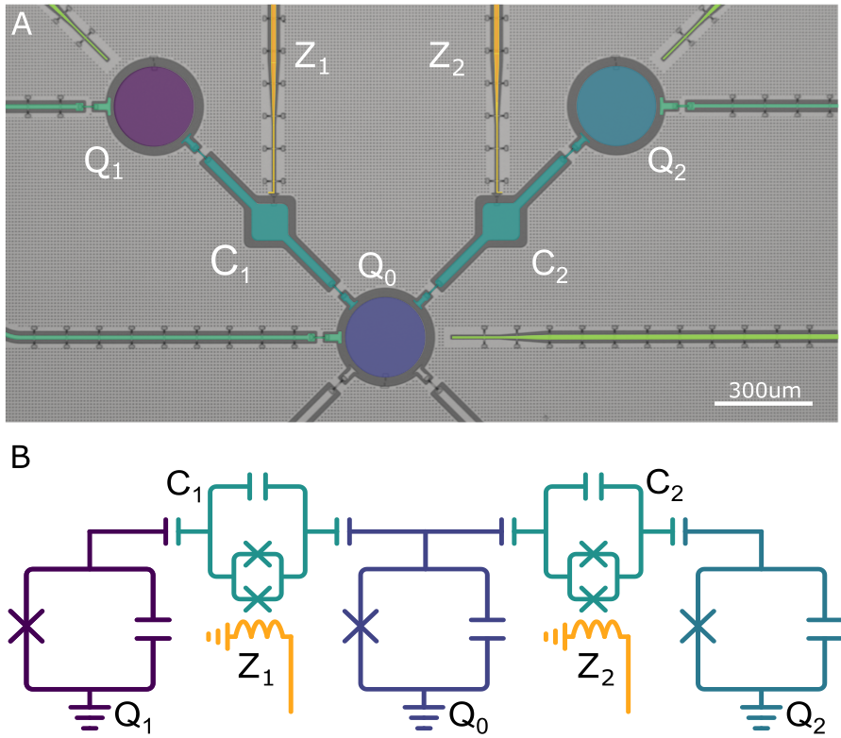
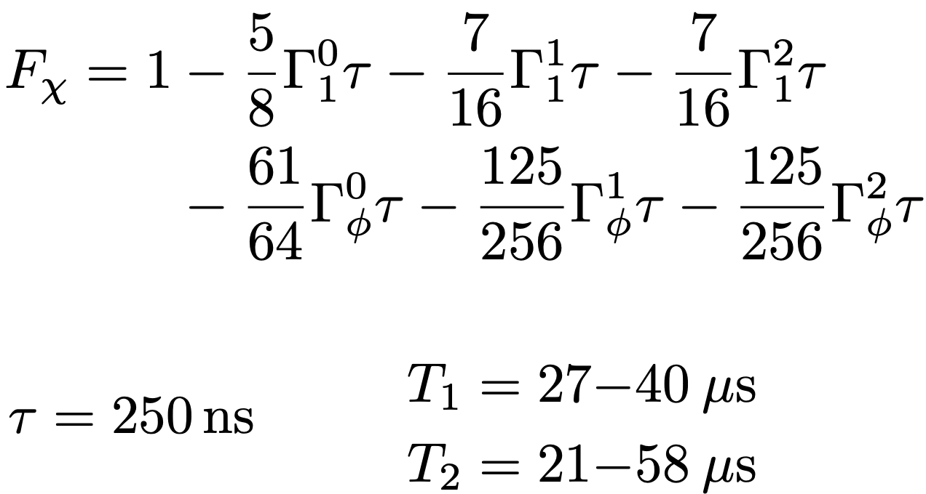
Experimental results for the three-qubit CCZS gate
We can implement a whole family of 3-qubit gates (tuning by tuning the relative phase between the tones modulating the couplers)
Fidelity very close to the coherence limit
Warren et al., npj Quantum Inf. 9, 44 (2023)

Slide 14
Experimental results for the three-qubit CCZS gate
We generated the maximally entangled 3-qubit GHZ and W states almost 3 times faster than possible with 2-qubit gates; state fidelities were 95.6% and 94.7%, respectively
Warren et al., npj Quantum Inf. 9, 44 (2023)

Slide 15
ZZ coupling: motivation and methods
Coupling added,
diagonalization
Gives a CPHASE gate
If unintended, problematic once the ZZ coupling ~100 kHz
If intended, we want a ZZ coupling of several MHz
Analytical treatment for understanding – approximating the Hamiltonian, diagrammatic treatment in perturbation theory revealing key mechanisms
Numerics in CSQR for precision
Pettersson Fors et al., in preparation (2024)

Slide 16
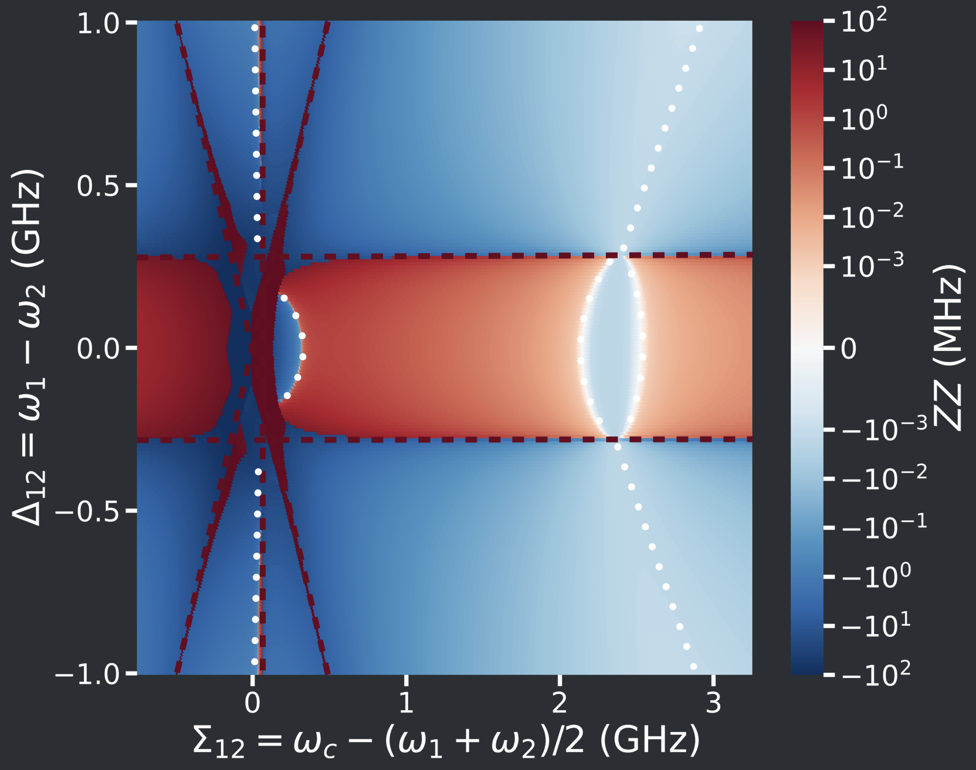
ZZ coupling: results
Six regions of weak ZZ coupling
(white dotted lines)
Can be explained by a few mechanisms
Some regions predicted and observed before, but some are new and we have a general method to understand where they appear
In some places, weak ZZ coupling is close to strong ZZ coupling, which can be used for a two-qubit gate
Pettersson Fors et al., in preparation (2024)

Slide 17
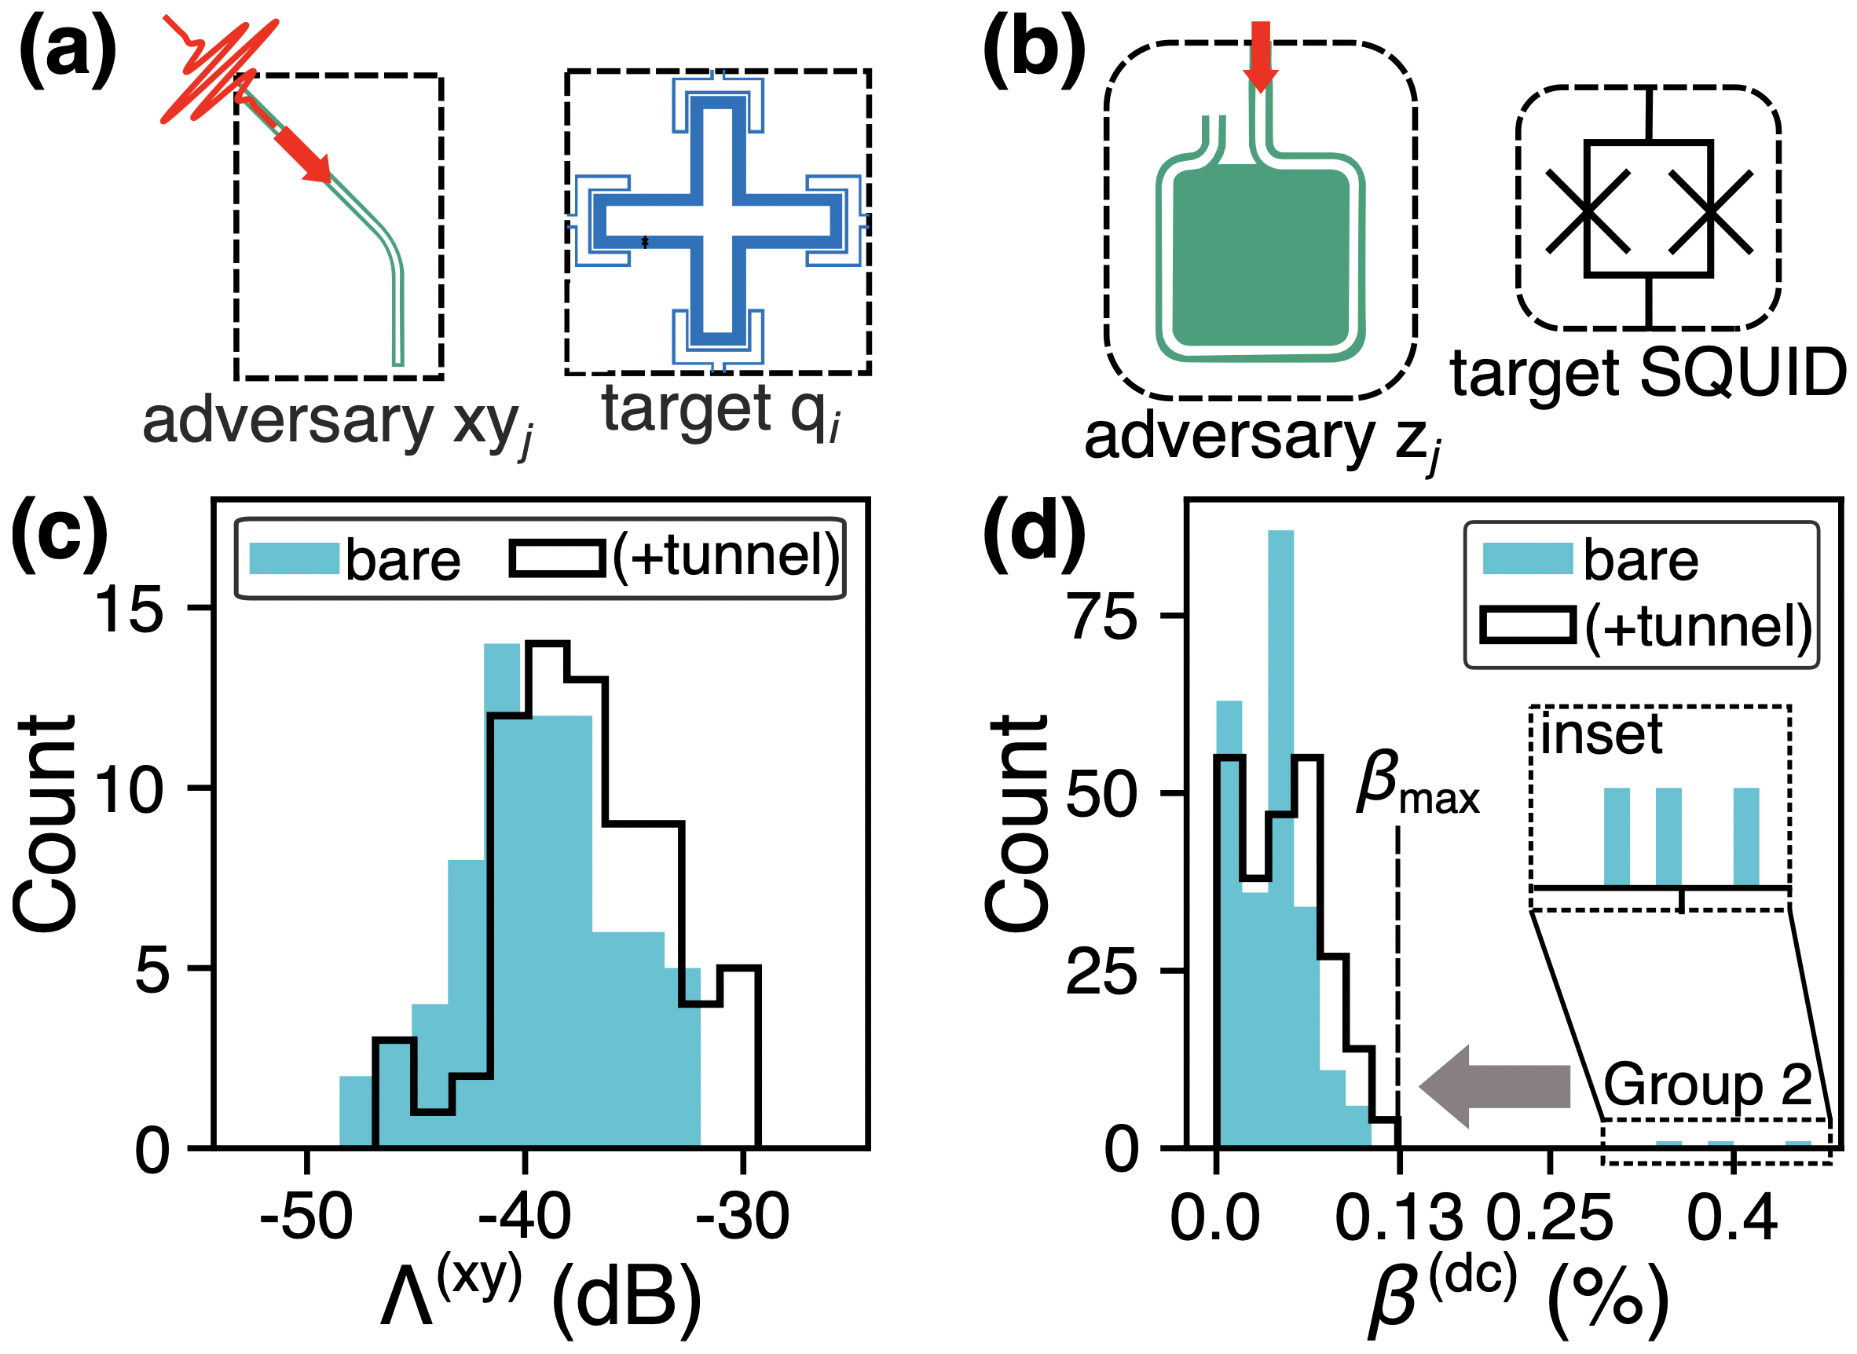
Crosstalk and frequency crowding
Transition frequencies can collide for single-qubit gates
Three modulation frequencies that can collide for two-qubit gates
Osman et al., Phys. Rev. Res. 5, 043001 (2023)
Kosen et al., arXiv:2403.00285

Slide 18
Choosing a layout
A tileable unit cell of eight qubits, arranged in two subgroups of four qubits each that are closer in frequencies and anharmonicities
Osman et al., Phys. Rev. Res. 5, 043001 (2023)

Slide 19
Estimating the impact of crosstalk and frequency variations
Two- and three-level models with detuned Rabi oscillations
Varying crosstalk
Varying fidelity threshold
Varying frequency variations
Collisions for two-qubit gates
Osman et al., Phys. Rev. Res. 5, 043001 (2023)
Kosen et al., arXiv:2403.00285

Slide 20




Summary
We are building the Swedish quantum computer with superconducting qubits in a square-grid architecture with tunable couplers mediating two-qubit gates between fixed-frequency qubits
Many things need to be considered when designing two-qubit gates; we show how that can be done
We have developed theoretical methods to quantify the impact of decoherence on gate fidelities
To fight the impact of decoherence, we are both making longer-lived qubits and faster gates; we have developed and implemented a three-qubit gate that is both more powerful and faster than our two-qubit gates, without needing any change to the hardware
ZZ coupling can be both a blessing and a curse; we have developed analytical and numerical methods to understand and engineer it
Crosstalk and frequency crowding are problems that need to be mitigated; we have designed a qubit layout that works well for the measured parameters in experiments
Kosen et al., Quantum Sci. Technol. 7, 035018 (2022)
Abad et al., Phys. Rev. Lett. 129, 150504 (2022)
Abad et al., arXiv:2302.13885v2
Pettersson Fors et al., in preparation (2024)
Osman et al., Phys. Rev. Res. 5, 043001 (2023)
Kosen et al., arXiv:2403.00285
Gu et al., PRX Quantum 2, 040348 (2021)
Warren et al., npj Quantum Inf. 9, 44 (2023)
wacqt.se
@wacqt_sweden
Notes:
Mall för forskningsinfrastruktur

