Slide 1
Bayesian Quantum Amplitude Estimation
ReaQCT 2024
Alexandra Ramôa
This work is financed by National Funds through the Portuguese funding agency, FCT - Fundação para a Ciência e a Tecnologia, within project UIDB/50014/2020.
DOI 10.54499/UIDB/50014/2020 | https://doi.org/10.54499/uidb/50014/2020

Slide 2
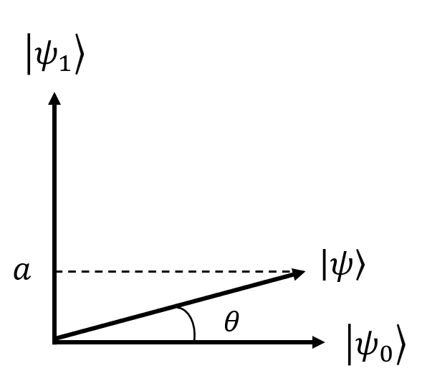
Quantum Amplitude Estimation (QAE)
We can prepare the quantum state
$\left.\left|ψ\right.\right\rangle =\sqrt{a}\left.\left|ψ_{1}\right.\right\rangle +\sqrt{1−a}\left.\left|ψ_{0}\right.\right\rangle$.
Find a.

Slide 3
Quantum Amplitude Estimation
$$\left.\left|ψ\right.\right\rangle =\sqrt{a}\left.\left|ψ_{1}\right.\right\rangle +\sqrt{1−a}\left.\left|ψ_{0}\right.\right\rangle$$
Classical solution
Quantum solution
Sample from $Binomial (a)$ and take averages over N samples.
Apply phase estimation to the Grover quantum amplitude amplification operator.
G
Quantum Phase Estimation

Slide 4
Quantum Amplitude Estimation
There is a quadratic quantum speed-up for this task.
$$ε∈O(N^{−0.5})$$
■ classical
■ quantum
estimation error
$$ε∈O(N^{−1})$$
cost

Slide 5
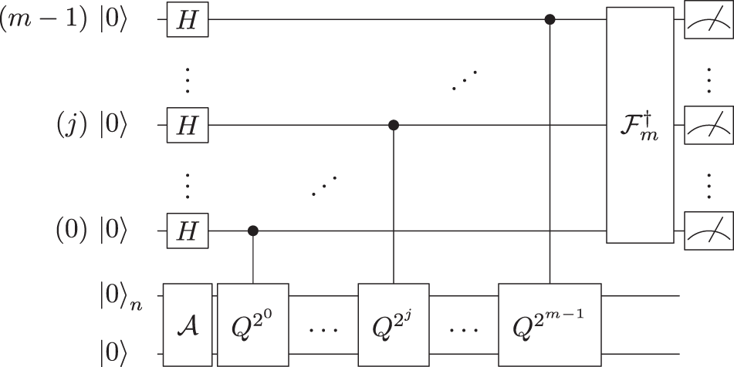
QAE with Noisy Quantum Devices
The circuit is not viable for today’s quantum devices.
Alternative strategies have been proposed.
in: Grinko, D., Gacon, J., Zoufal, C. et al. Iterative quantum amplitude estimation. npj Quantum Inf 7, 52 (2021).

Slide 6
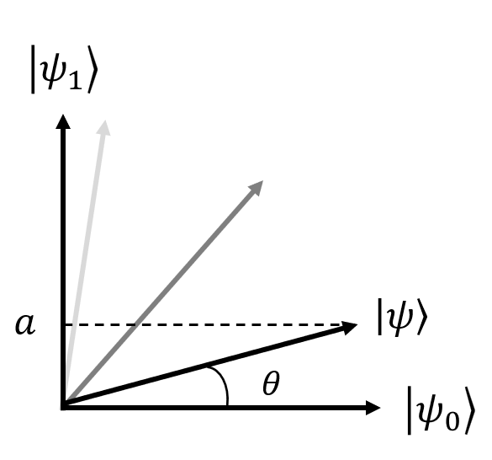
QAE with Noisy Quantum Devices
We can sample from
$p\left(θ|k\right)≡\left\langle \left.ψ_{1}\right|\right.G^{k}\left.\left|ψ\right.\right\rangle =\sin^{2}\left(r_{k}θ\right)$
with cost in $𝒪(r_{k})$.
Use this extra freedom to unlock otherwise unachievable learning rates.

Slide 7
QAE with Noisy Quantum Devices
Learn the hidden parameter of an observable probability distribution $Binomial (p\left(θ\right),N_{shots})$.
Classical samples:
$$p\left(θ\right)=\sin^{2}{θ}$$
Quantum-enhanced samples:
$$p\left(θ|r\right)=\sin^{2}\left(rθ\right)$$
for $r$ any odd integer
$$ε∈O(N^{−0.5})$$
?
$$ε∈O(N^{−1})$$

Slide 8
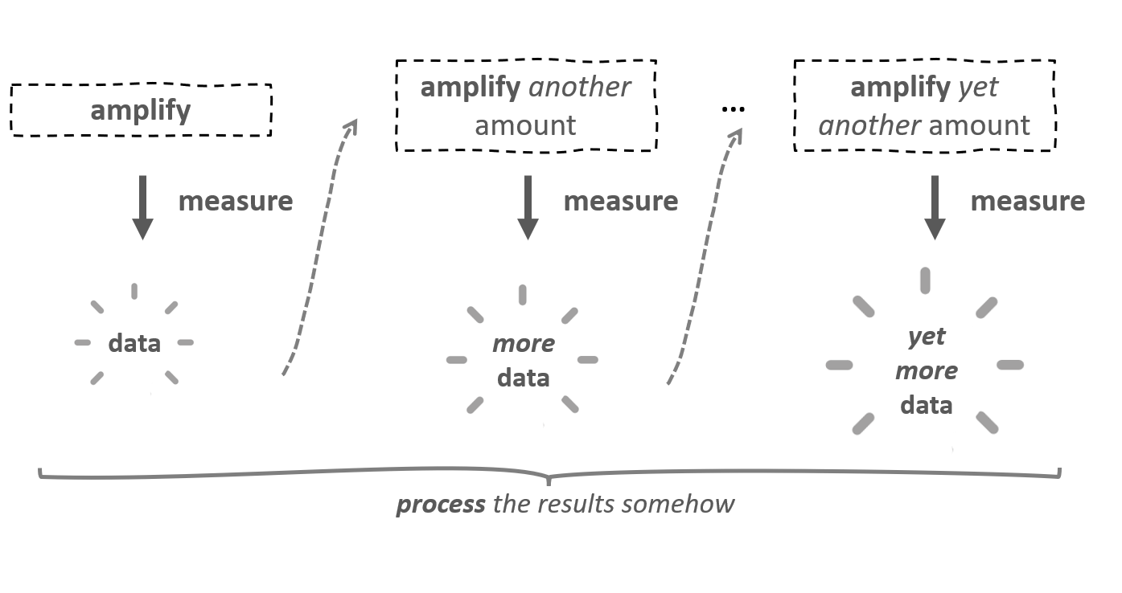
QAE with Noisy Quantum Devices
We can look at this as a data science problem.

Slide 9
QAE with Noisy Quantum Devices
quantum processing
$$n$$
$$A$$
$$G$$
$$…$$
$$G$$
$$…$$
$k$ applications of G
(i+1)-th
experimental control
$$k_{i+1}$$
i-th experimental
outcome
classical processing

Slide 10
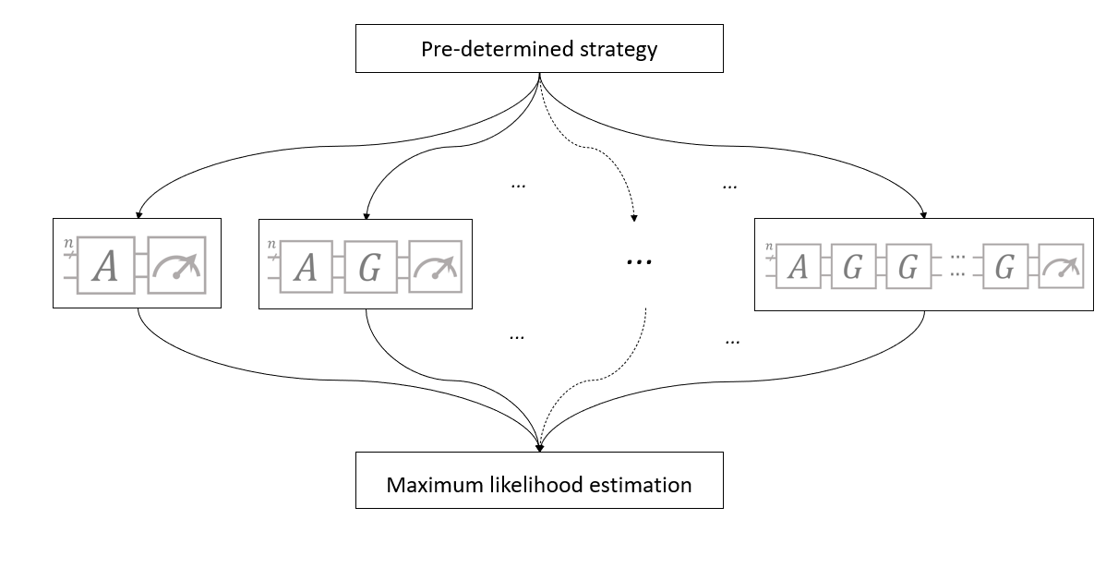
Maximum Likelihood QAE

Slide 11
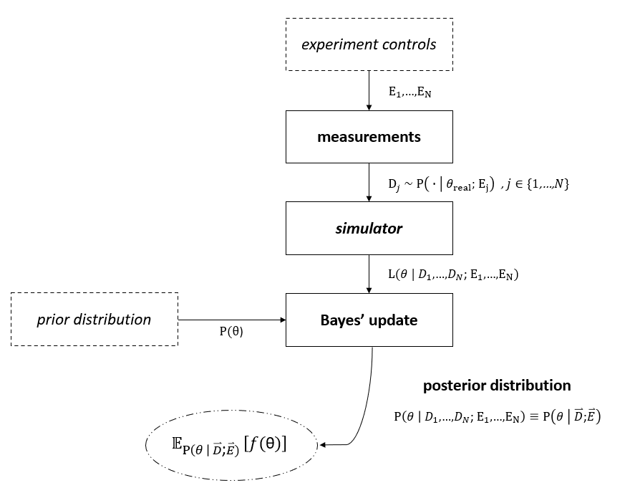
Bayesian Amplitude Estimation
Bayesian statistics offers a natural paradigm for QAE.
$$P\left(θ | D\right)=\frac{L\left(θ | D;E\right)P(θ)}{P(D;E)}$$

Slide 12
Bayesian Amplitude Estimation

Slide 13
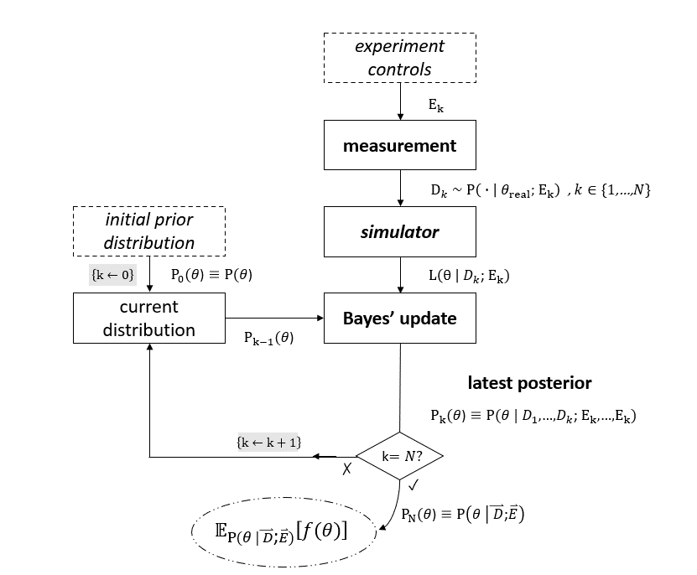
Bayesian Amplitude Estimation

Slide 14
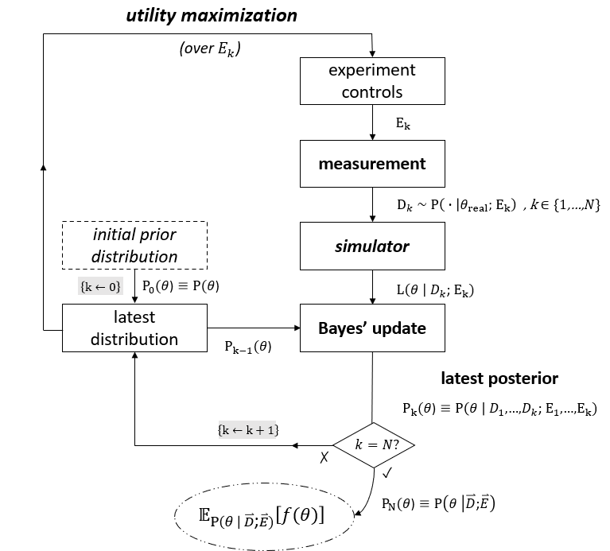
Bayesian Amplitude Estimation

Slide 15
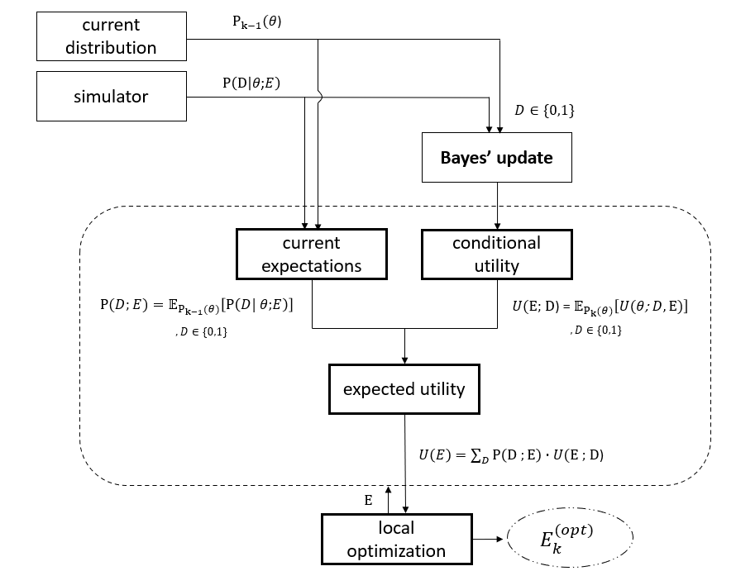
Bayesian Amplitude Estimation

Slide 16
Bayesian Amplitude Estimation
$$P\left(θ | D\right)=\frac{L\left(θ | D;E\right)P(θ)}{P(D;E)}$$
The use of Bayesian inference does not fully determine the protocol; the optimization and representation methods employed are determinant for performance.

Slide 17
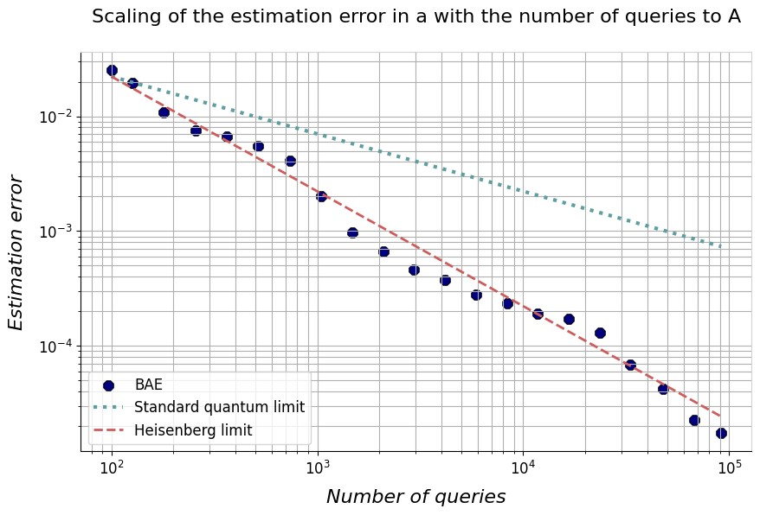
Bayesian Amplitude Estimation
We combine general, scalable and adaptive-compatible statistical methods with problem-tailored heuristics to keep the problem tractable while retaining the quantum advantage.

Slide 18
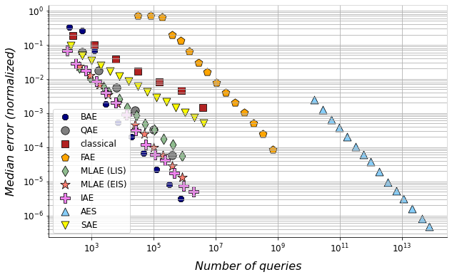
Comparative Results
- ideal case

Slide 19
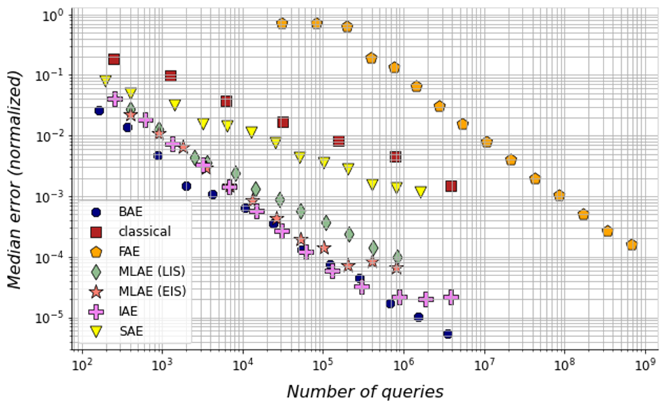
Comparative Results
- noisy case

Slide 20
Key Takeaways
Our Bayesian amplitude estimation algorithm:
Achieves the Heisenberg limit;
Is highly adaptable, parallelizable and scalable;
Is capable of dealing with noise.

Slide 21
Thank you for your attention!
Reach me at:
alexandra.ramoa@inl.int

